Slide 1
Properties of the SNO+ Detector From Optical Calibration Data
Sara Bergevin (She/Her)
Supervisors – Dr. Christine Kraus, Dr. Alexander Wright
CASST 2026

Slide 2
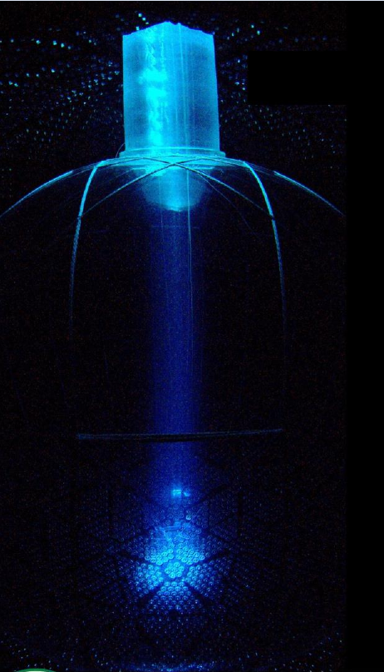
Table of Content
Intro on the SNO+ detector
Refractive index
Occupancy
Summary and future paths of inquiry

Slide 3
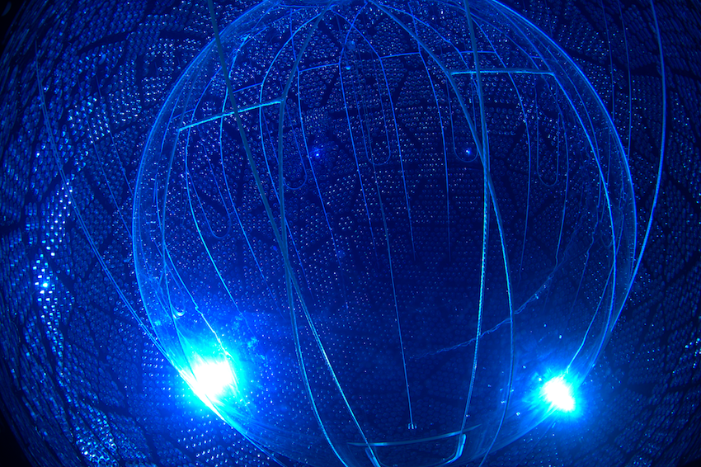
The SNO+ Detector
Located in Sudbury.
Continuation of the SNO experiment; uses preexisting infrastructure
Liquid scintillator neutrino detector
To be loaded with tellurium for double beta decay
Calibrations took place
Currently under maintenance

Slide 4
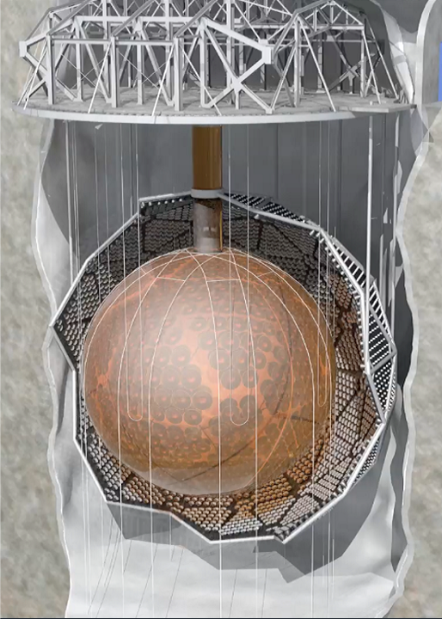
Geometry of the Detector
Deck
Hold up ropes
Geodesic sphere support structure
Acrylic sphere within support structure (AV)
Acrylic sphere is filled with scintillator cocktail
Entire detector is in a cavity filled with ultra-pure water (roughly 10 stories)
Z points upward, X points toward north and Y points towards the control room
Hold up and hold down ropes
PSUP
Acrylic vessel
Hold down ropes

Slide 5
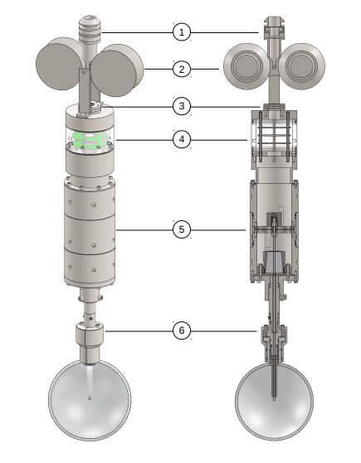
Calibration
AmBe (Americium Beryllium source) -> neutron source
ELLIE ( Embedded Led Light Injection Entity) system -> built in calibration system
Laserball-> light source

Slide 6
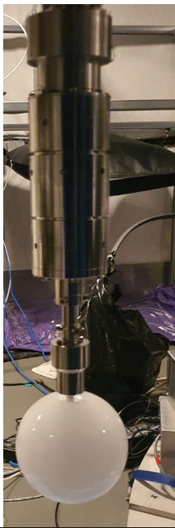
Optical Calibration Data
Part of calibration runs
Laserball runs within AV
Dated to Oct 6 and Oct 22-23 2025
500nm wavelength
1 hour run
40Hz

Slide 7
Hit Time Residuals
When an event is registered, signal is saved
Event signal is fit
Residuals from this signal are the hit time residuals

Slide 8
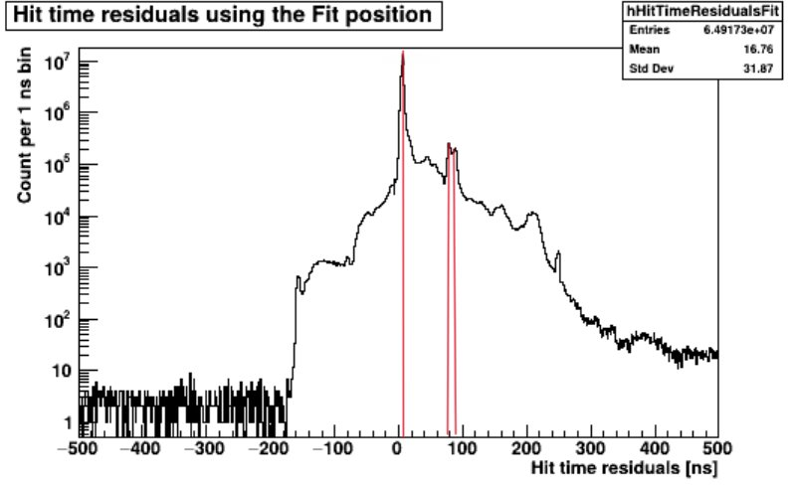
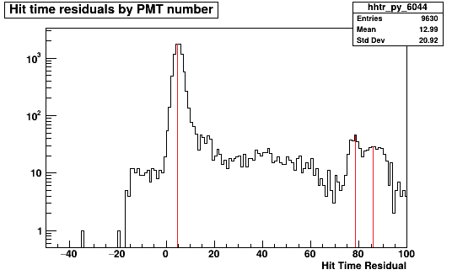
Refractive Index
Liquid scintillator is a mixture of components added in-situ
Index of refraction important for optical models
Found from time of flight of reflections

Slide 9
How?
Direct path: 6m scintillator+2.35m water
reflection path: 6m scintillator + 4.7m water + 12m scintillator + 2.35m water
Path difference: 12m scintillator + 4.7m water
The laserball emits its light pulse
The light hits the PMTs and either gets detected or reflects
The reflected light gets detected on the other side of the detector
3
1
2
2

Slide 10
First Method
Specular reflections
Using summed hit time residuals, we find the first, second and third peaks
Time interval between first and third peak
Remove time from water travel
Neighboring reflections
Direct light

Slide 11
Second Method
In order to decrease uncertainty more statistics necessary
Using individual PMT Data
Similar method
Plot refractive indices from individual PMTs
Fit gaussian to peak

Slide 12
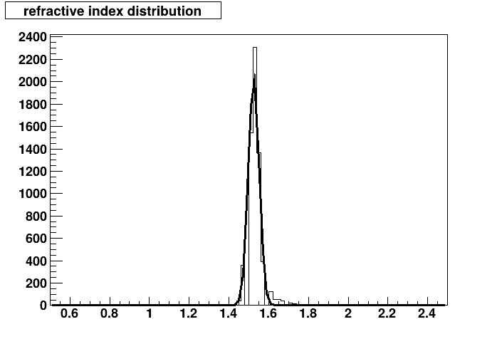
Results of Refractive Index
Summed PMT data gives a value of 1.550±0.050
This analysis gives a value of 1.524±0.027
Compared to LAB with a value of roughly 1.482

Slide 13
Detector Occupancy
Is there any variation in the responsiveness in any specific direction
Is there any variation of relative efficiency
Are structures visible from PMT layout
Are there "holes" in the detector

Slide 14
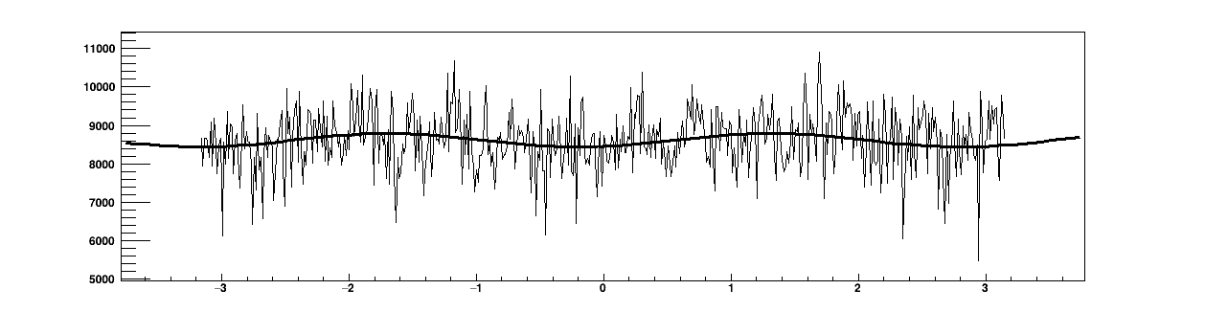
Responsiveness of Detector in Theta/Phi
Find the average hits as a function of theta and phi
Gives info on the laserball runs and how isotropic the light might be

Slide 15
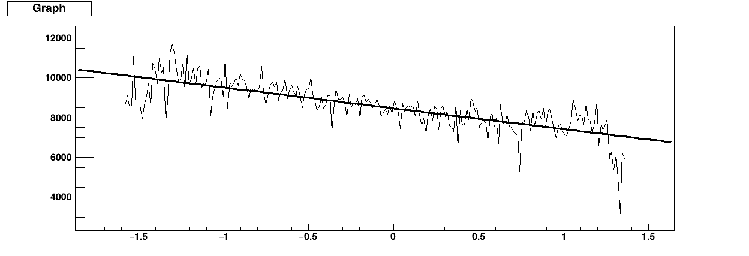
Responsiveness of Detector in Theta/Phi
Relatively isotropic in phi
Skewed towards lower theta values
  Expected due to design of Laserball

Slide 16
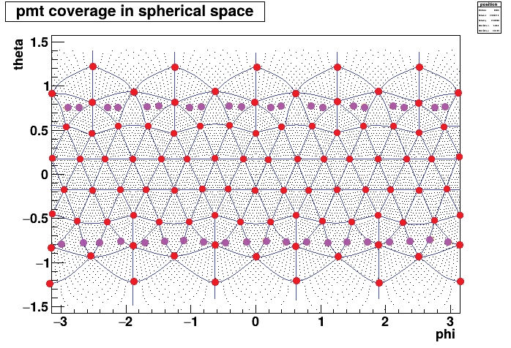
Visible Structures in the Detector Map
From position information we can figure out the underlying structures within the detector
Underlying structure | Colour marking
PSUP | Blue lines
Connection points | Red
Hold up/ hold down ropes | Purple

Slide 17
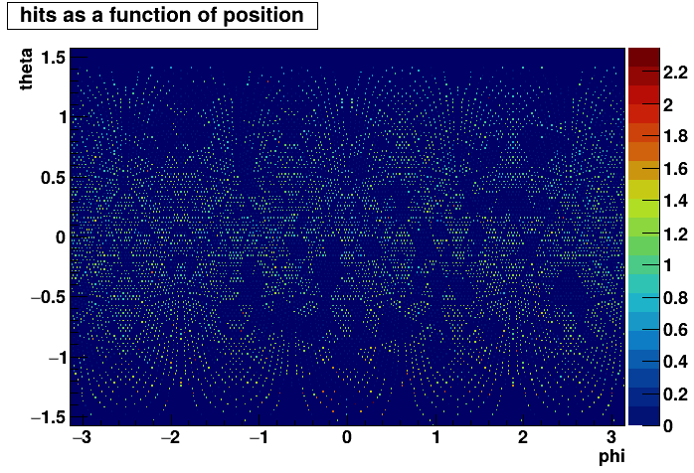
Holes in the Detector
Knowing if the detector has any holes in its detecting range is important
We can observe where there are higher and lower than average readings

Slide 18
Summary & Future Paths of Inquiry
Summary:
Refractive index: 1.524±0.027
Anisotropy of laserball
Hits by PMT
Future paths of inquiry
Using hit time residuals to validate position reconstruction

Slide 19
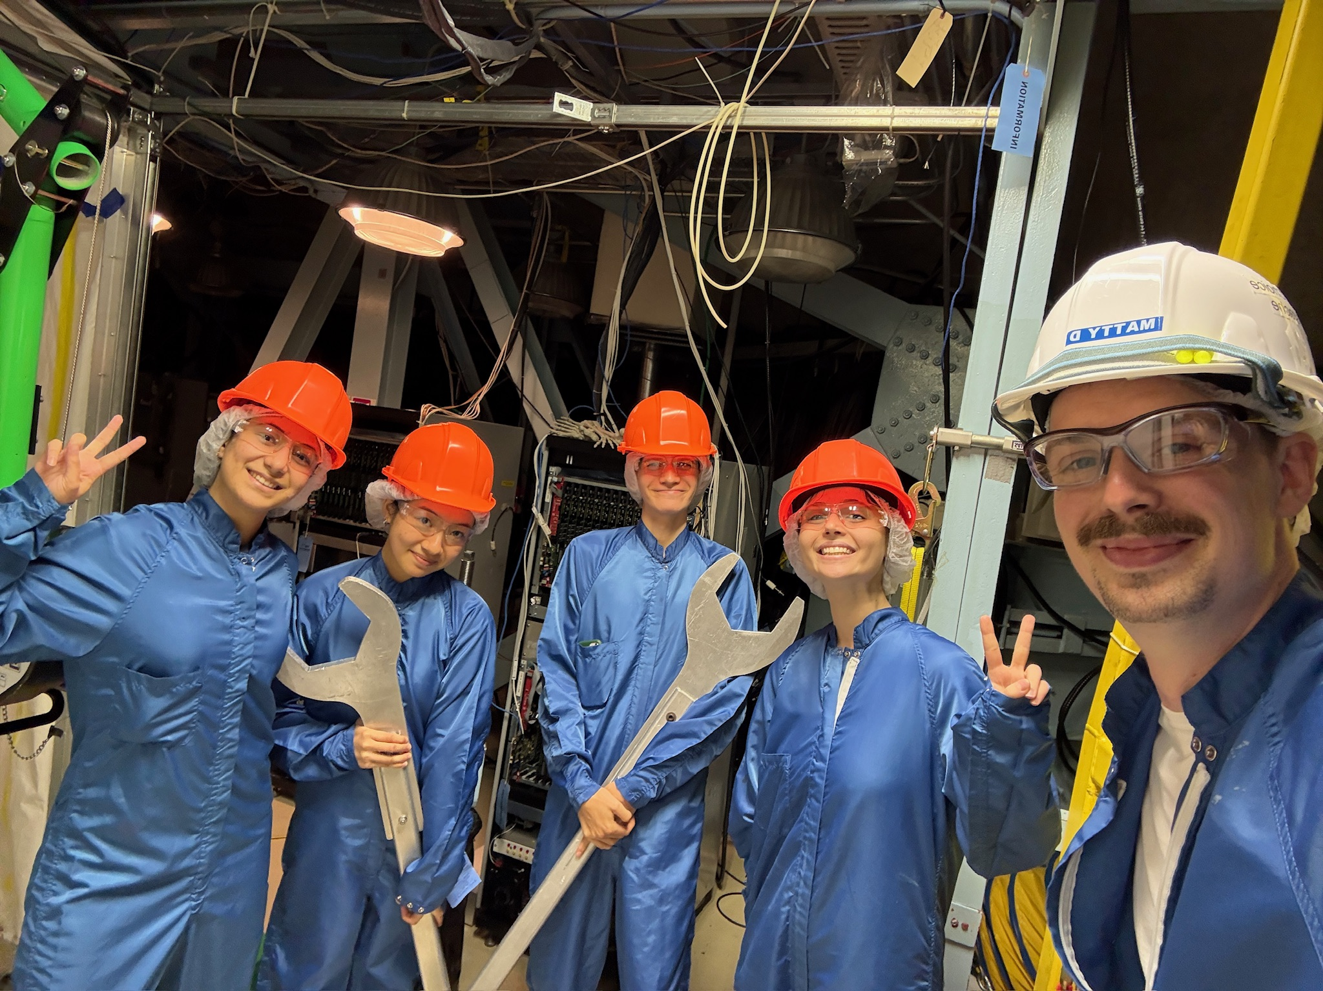
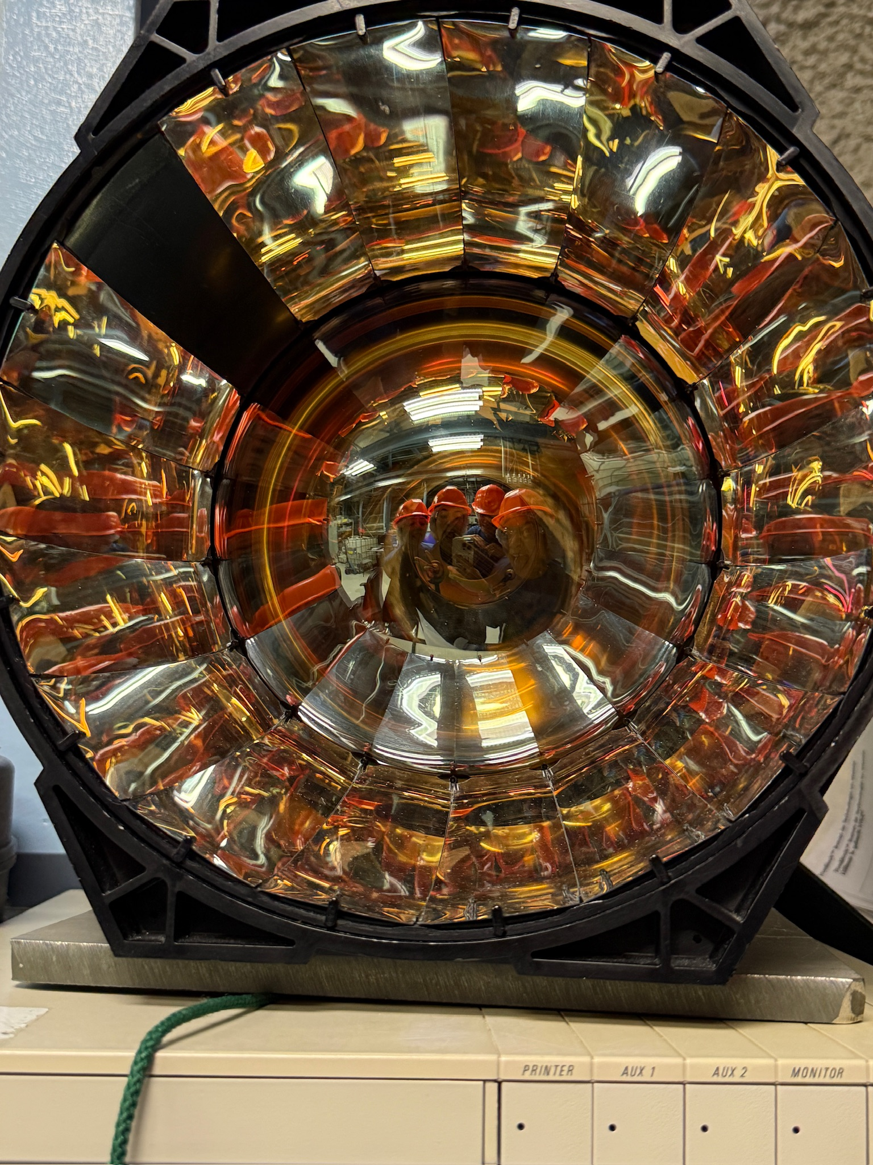
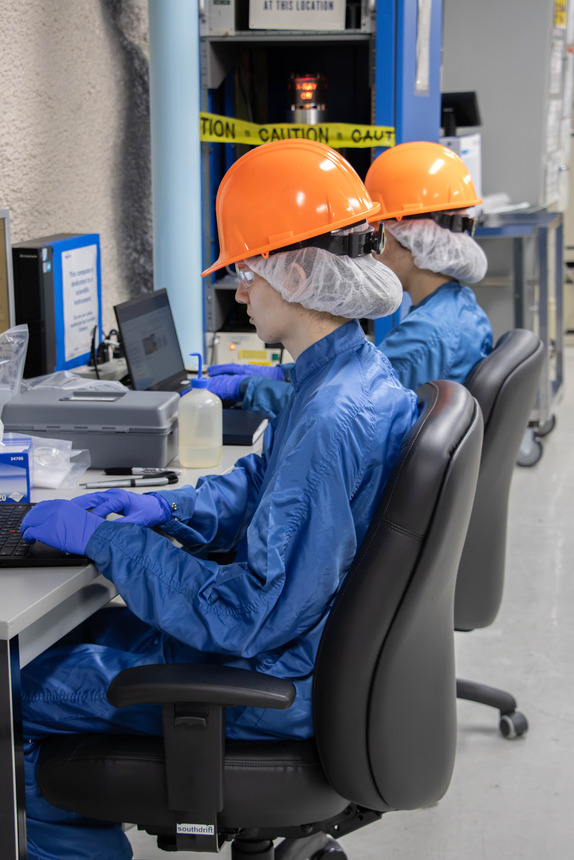
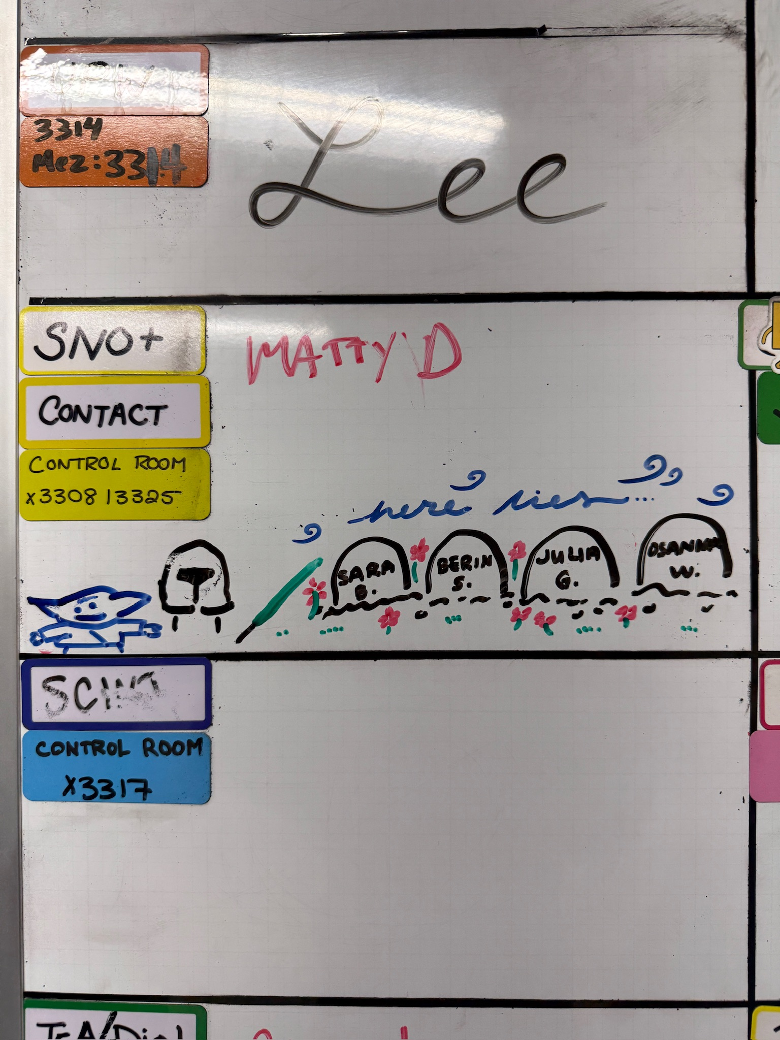
Notable Data Points
Total amount of tapelifts done ~150
Total amount of tapelifts analyzed ~200
Fastest XRF switch time: 9s
12 crates analyzed
13 shifts underground

Slide 20
Acknowledgements
Special thanks to:
  Christine Kraus
  Ryan Bayes
  Matt Depatie
  Stefan Kaluzienski
  Mark Ward
  The SNO+ local group
  Alex Wright
The SNO+ undergrad team:
  Berin Sancakdar
  Julia Gorovitz
  Osanna Wong
  Martin Courchesne
The SNOLAB undergrad students

Slide 21
Questions?

Slide 22
Backup and Extra Info

Slide 23
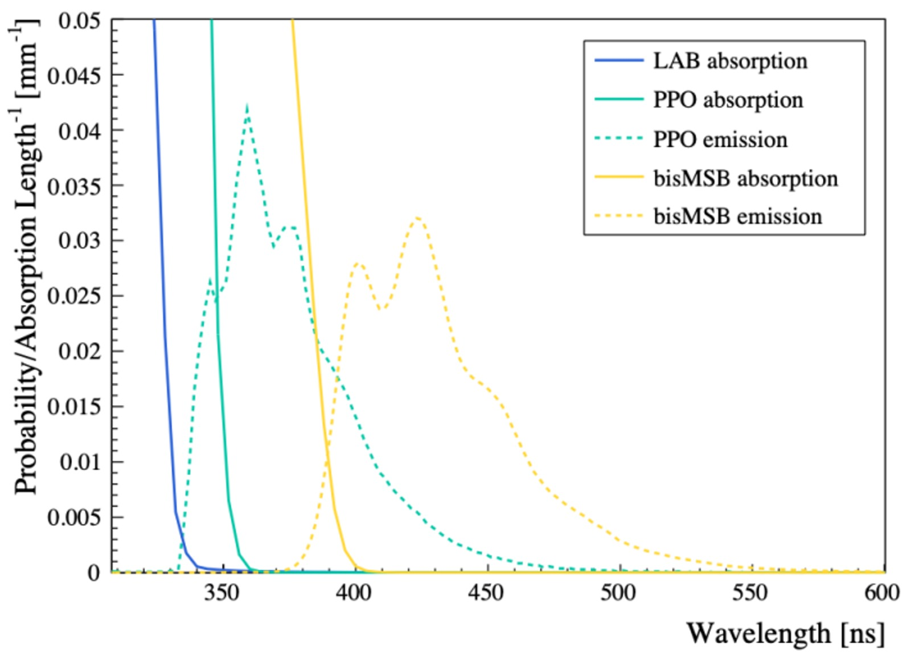
Why 500nm Wavelength
Mostly above bis-MSB emission range
Close enough to targeted frequencies that PMTs are still sensitive enough

