Slide 1
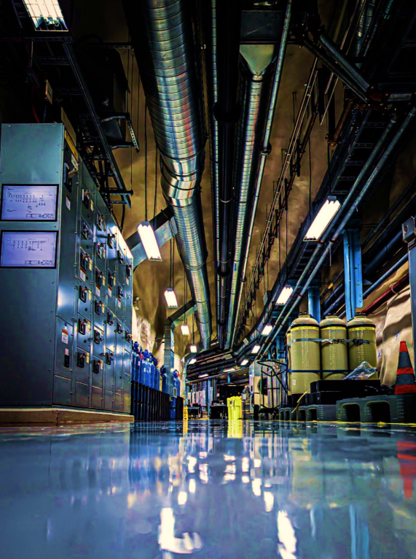

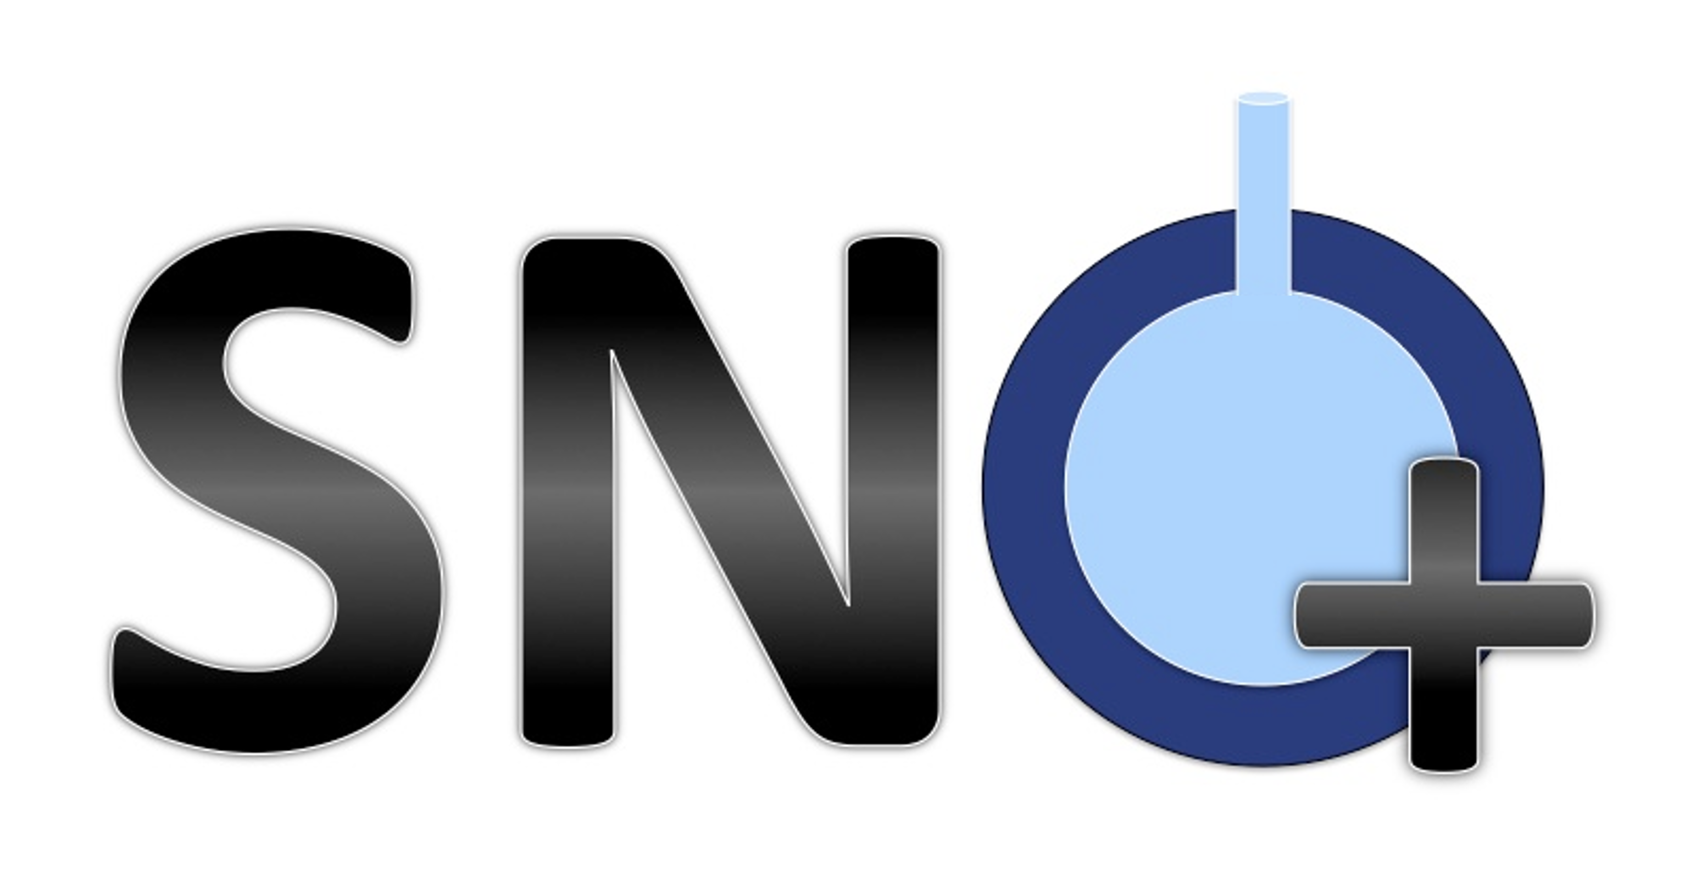

CASST 2026
The Systems Behind SNO+: Scintillator Process Control
Martin Courchesne

Slide 2
Work Term Goals
Gain experience in quality assurance (QA)
Support the development of operating procedures (SOP)
Contribute to process improvement
Gain familiarity with piping and instrumentation diagrams (P&ID)
Assist with process monitoring and analysis
1
Notes:
Some goals I wanted to accomplish during my term at snolab as an engineering student were:… Throughout this talk I will go over how I was able to achieve each of these goals.

Slide 3
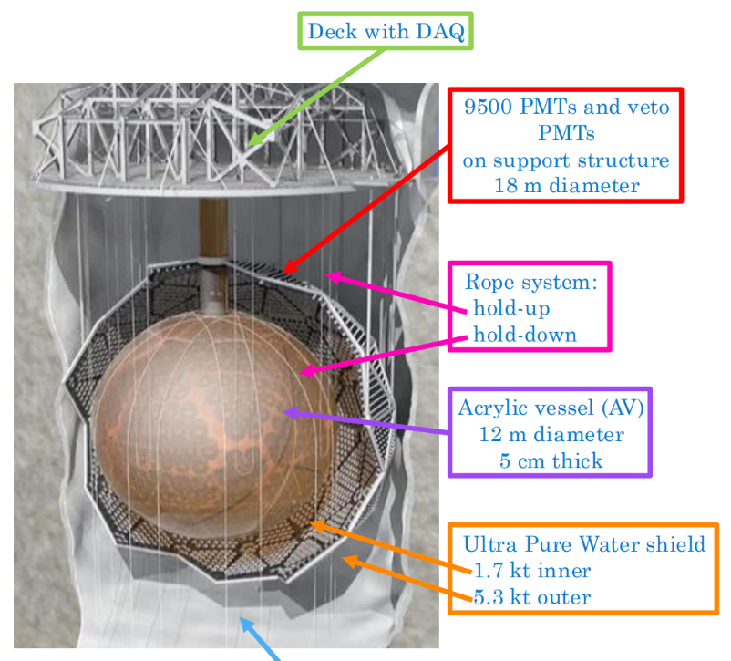

SNO+
2
Notes:
The SNO+ experiment is located 2km underground at SNOLAB in Sudbury, Canada. A low background search for neutrinoless double beta (0𝜈𝛽𝛽) decay will be conducted using 780 tonnes of liquid scintillator. Explain diagram.

Slide 4
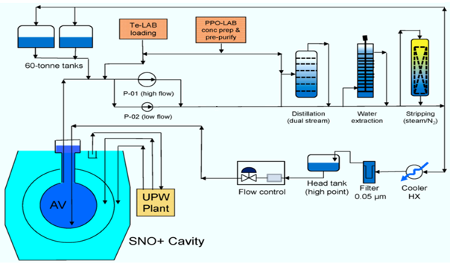
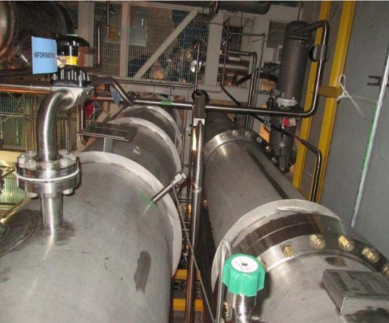

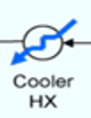
Scintillator Plant
Purifies, stores, and transfers the liquid scintillator used inside the SNO+ detector
The plant's primary processes include distilling, stripping, and filtering
Cooler
HX
3
Notes:
Here is a very simplified flow path diagram of the scintillator plant (similar to a compact oil refinery). In my presentation, I will be focusing on the scintillator plant which is used to purify, store and transfer the liquid scintillator used inside of the SNO+ detector. It is important to note that the liquid scintillator is a mixture containing LAB, PPO, bisMSB, BHT.
**Talk about orientation of the columns**

Slide 5
Cooler
HX
4
Notes:
The current process that is being executed at this moment aims to drain the AV and pass the scintillator through the stripping column and then transfer it to the 60 tonne tanks for a maintenance phase. The AV is also in a cavity filled with UPW (as mentioned earlier). In order to ensure that the AV does not encounter any unwanted stress, both the liquid scintillator and UPW need to be maintained at **specific conditions** during the draining activities .

Slide 6
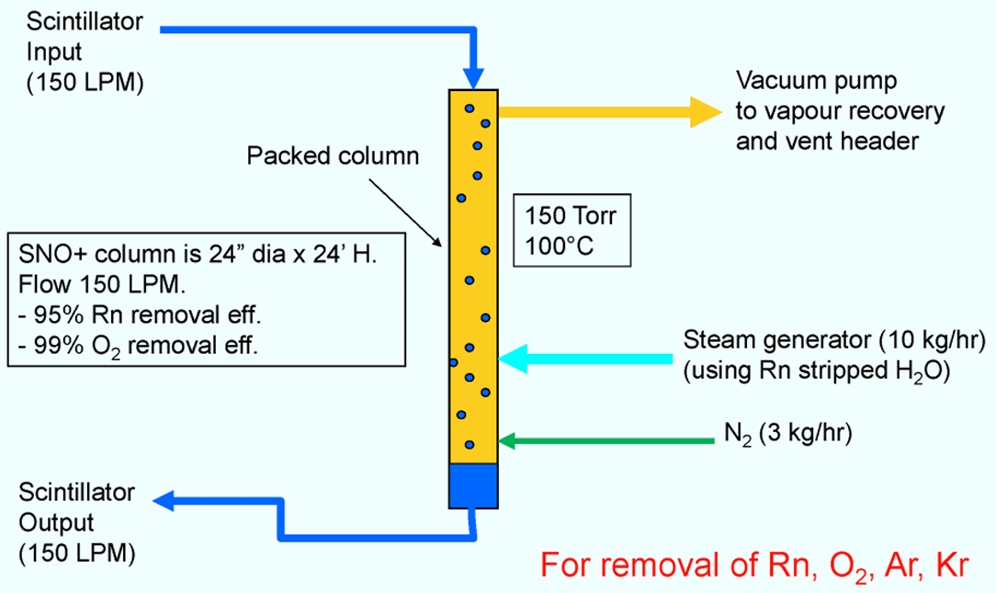


Stripping Column
Mass transfer process used to remove dissolved gases in the scintillator to reduce background
Removes Oxygen, Radon, Argon, and Krypton
Steam commissioning
Process
Not commissioned
5
5
Notes:
Here is the stripping column in the scintillator plant (describe diagram). The is a Mass transfer process due to differences in partial pressures. The SNO+ stripping column operates under vacuum to enhance the separation efficiency. Also, it is important to heat the scintillator to 100°C because water vaporizes at this temperature. Nitrogen is used for stripping because it is chemically inert so it does not react with the scintillator and it contains no oxygen or moisture therefore it will not contaminate the scintillator. Steam stripping is not commissioned yet but....

Slide 7
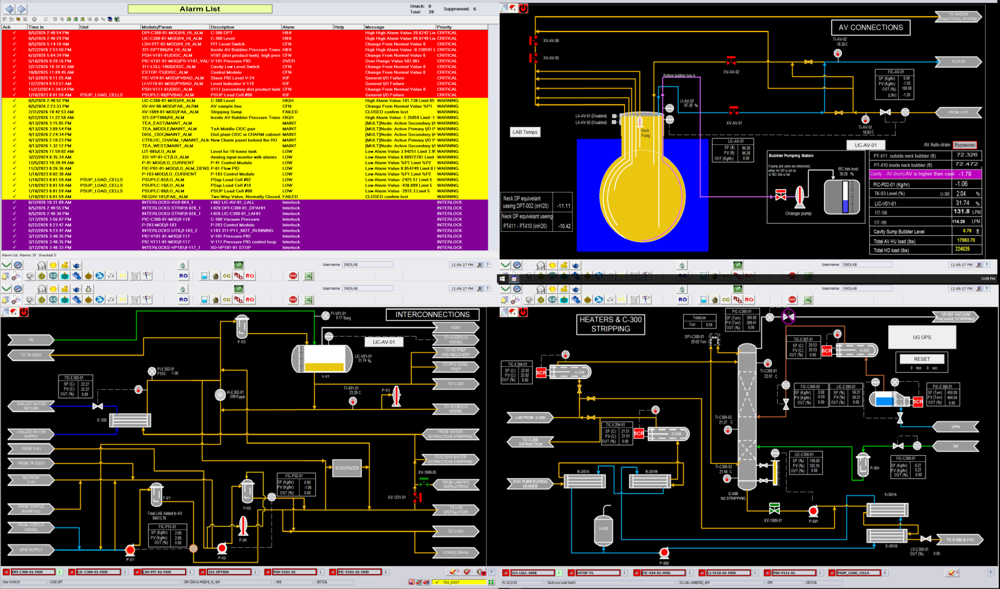
Notes:
Now that I’ve mentioned important equipment utilized in the current phase. The next step is to talk about how the operators of the plant control this equipment. DeltaV is an industrial automation platform engineered to provide real-time decision-making in order to control the parameters of the plant. Explain pages. And talk about lo, lolo alarms and hi, hihi alarms (example of P301 and level in sump). And how good operators notice these deviations before alarm is reached. Also mention how deltaV was programmed in order to ensure that all the safety mechanisms for the plant are in place.
DeltaV is an industrial automation platform engineered to provide real-time decision-making, improved operational performance, and enhanced safety

Slide 8
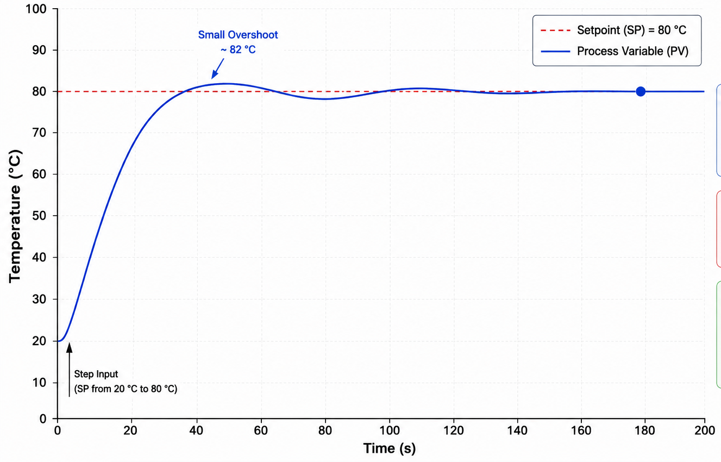

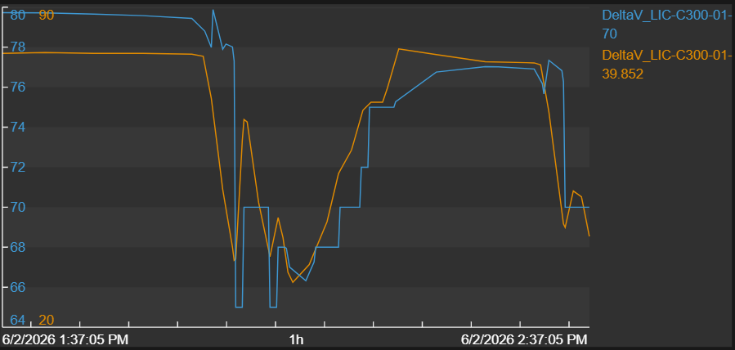

Process Control System
Process variable: the actual, real-time value of the parameter being controlled
Steady state: the condition where the system’s properties do not change over time
Setpoint
Pump Power (%)
Level in
Column (%)
Steady state
Temperature (°C)
Process variable
Time (s)
Time (h)
7
Notes:
**Mention examples for stripping** Another important factor that I’ve learned while operating the scintillator plant is the behavior of PID controllers. During the operation of the plant I used two operation modes for controllers, either automatic or manual. When the controller is set to auto and a set point is given (target value for a process variable) the equipment connected to the controller will reach this value and maintain it with some deviations. In manual mode the operator is needs to adjust the target value every so often in order to keep the system in a safe state. (when filling the column)

Slide 9
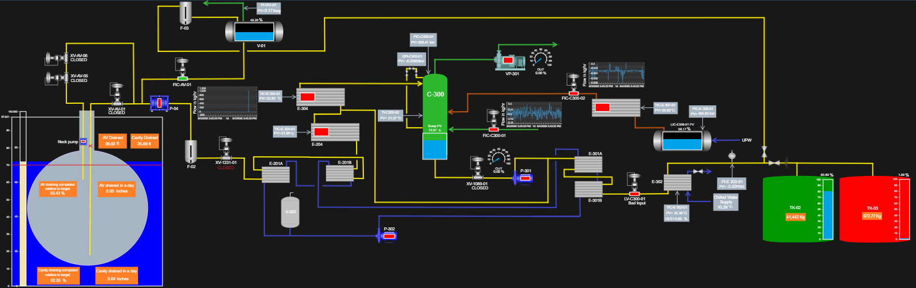
Monitoring Display
8
Notes:
Throughout my term I have contributed to the draining activities by working many afternoon shifts. During this time, I used Pi Vision which is a web-based display and dashboard building tool that allows users to configurate and utilize the real time operations data in order to realize specific calculations. I used Pi Vision to recreate a very simplified version of the current operation that is being done. I was able to calculate the amount of kg’s of scintillator in each of the 60 tone tanks and I also calculated the % of the AV draining according to the relative target. Finally, the whole goal of this operation is to get the scintillator from the AV to the 60 tone tanks.
Pi Vision is a web-based display and dashboard building tool that allows users to create configurable visualizations of real-time operations data

Slide 10
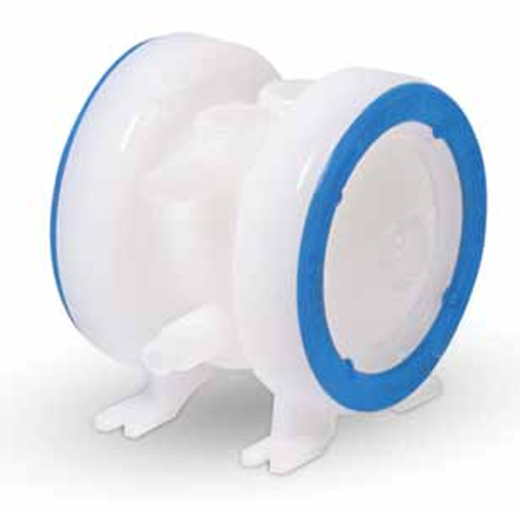
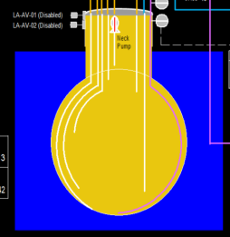

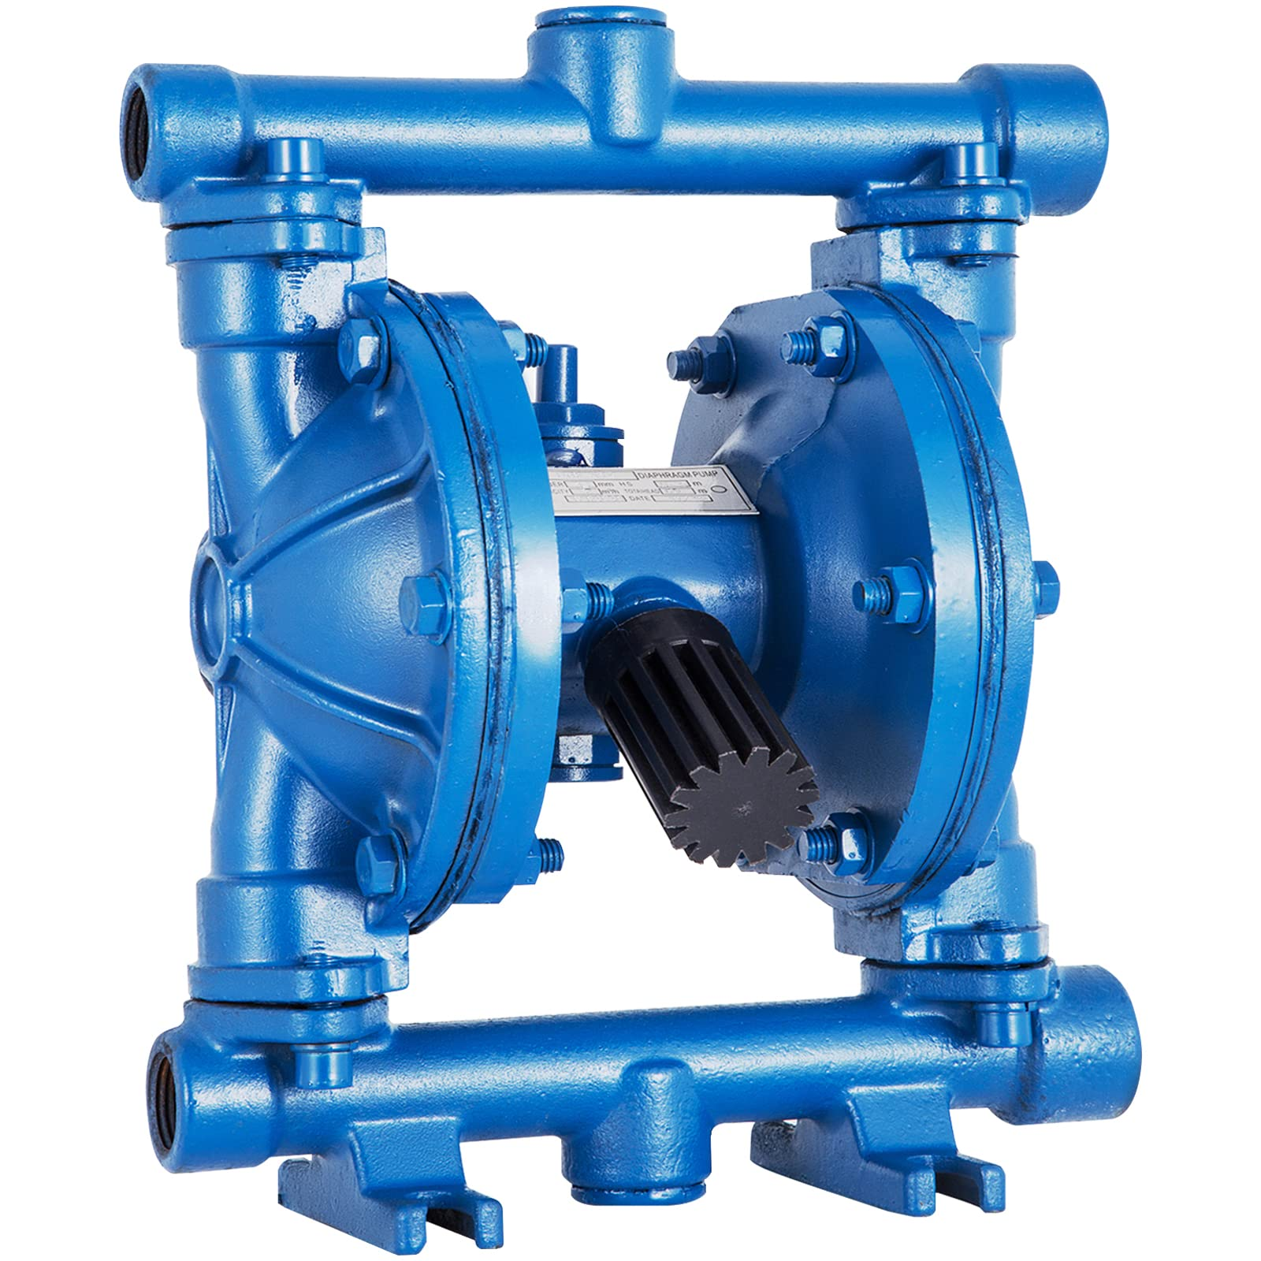
Challenges
Installation of a small diaphragm pump inside the neck of the AV
Neck pump
Neck pump
X
X
X
X
X
X
X
X
AV
P-04
9
Notes:
Some challenges that were encountered during the draining phase of the AV are that all of the lines going inside the AV that could be used to drain it using P-04 (bigger neck pump / 700 kg/hr) have leaks in them. For this reason a smaller pump had to be installed inside of the neck of the AV (130kg/hr). In order to limit the impurities entering inside the AV N2 was initially used as the compressed gas for pump actuation fed by a surface LN2 dewar. This would cause the fittings and outside of the dewar to frost up so it could only be ran for 1 hour and then it would need to be shut down for 30 minutes to let all the frost thaw out. So, compressed air was installed to the neck pump instead of the nitrogen. It first passes through filters in order to limit impurities and the compressed air outlet is directed back to the outside of the AV. This seemed to obtain the most consistent flow even with a big suction lift. (pumps are not good for suction they are mostly good at pushing fluid).

Slide 11
Work Term Goals
Gain experience in quality assurance
Support the development of operating procedures
Contribute to process improvement
Gain familiarity with P&ID’s
Assist with process monitoring and analysis
10

Slide 12
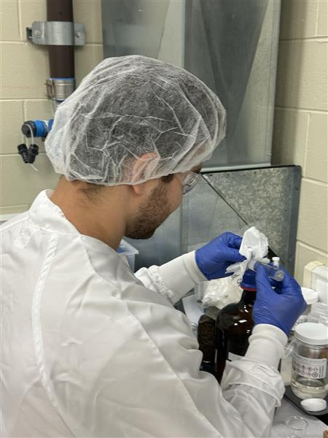
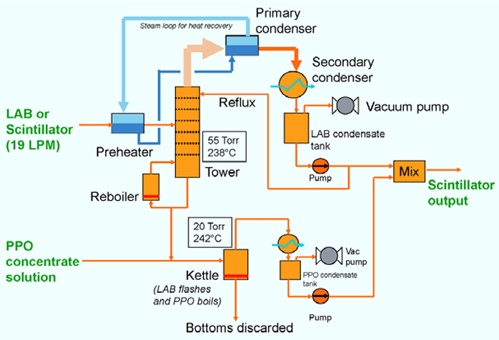

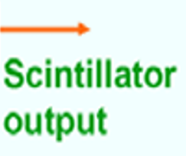

Next Steps
Term extension
Quality Assurance of sampling
Distillation when refilling the AV
Steam stripping commissioning
11
Notes:
I’ve been approved to stay at SNOLAB for a 16 month coop. this means I will restart my 4th year at laurentian in September 2027. This means I will keep helping out with QA for samples. Participate in the distillation process when refilling the AV as well as hopefully commissioning steam stripping because this would help lower the consumption of nitrogen from the underground plant as well as remove even more radon and other impurities from the liquid scintillator.

Slide 13
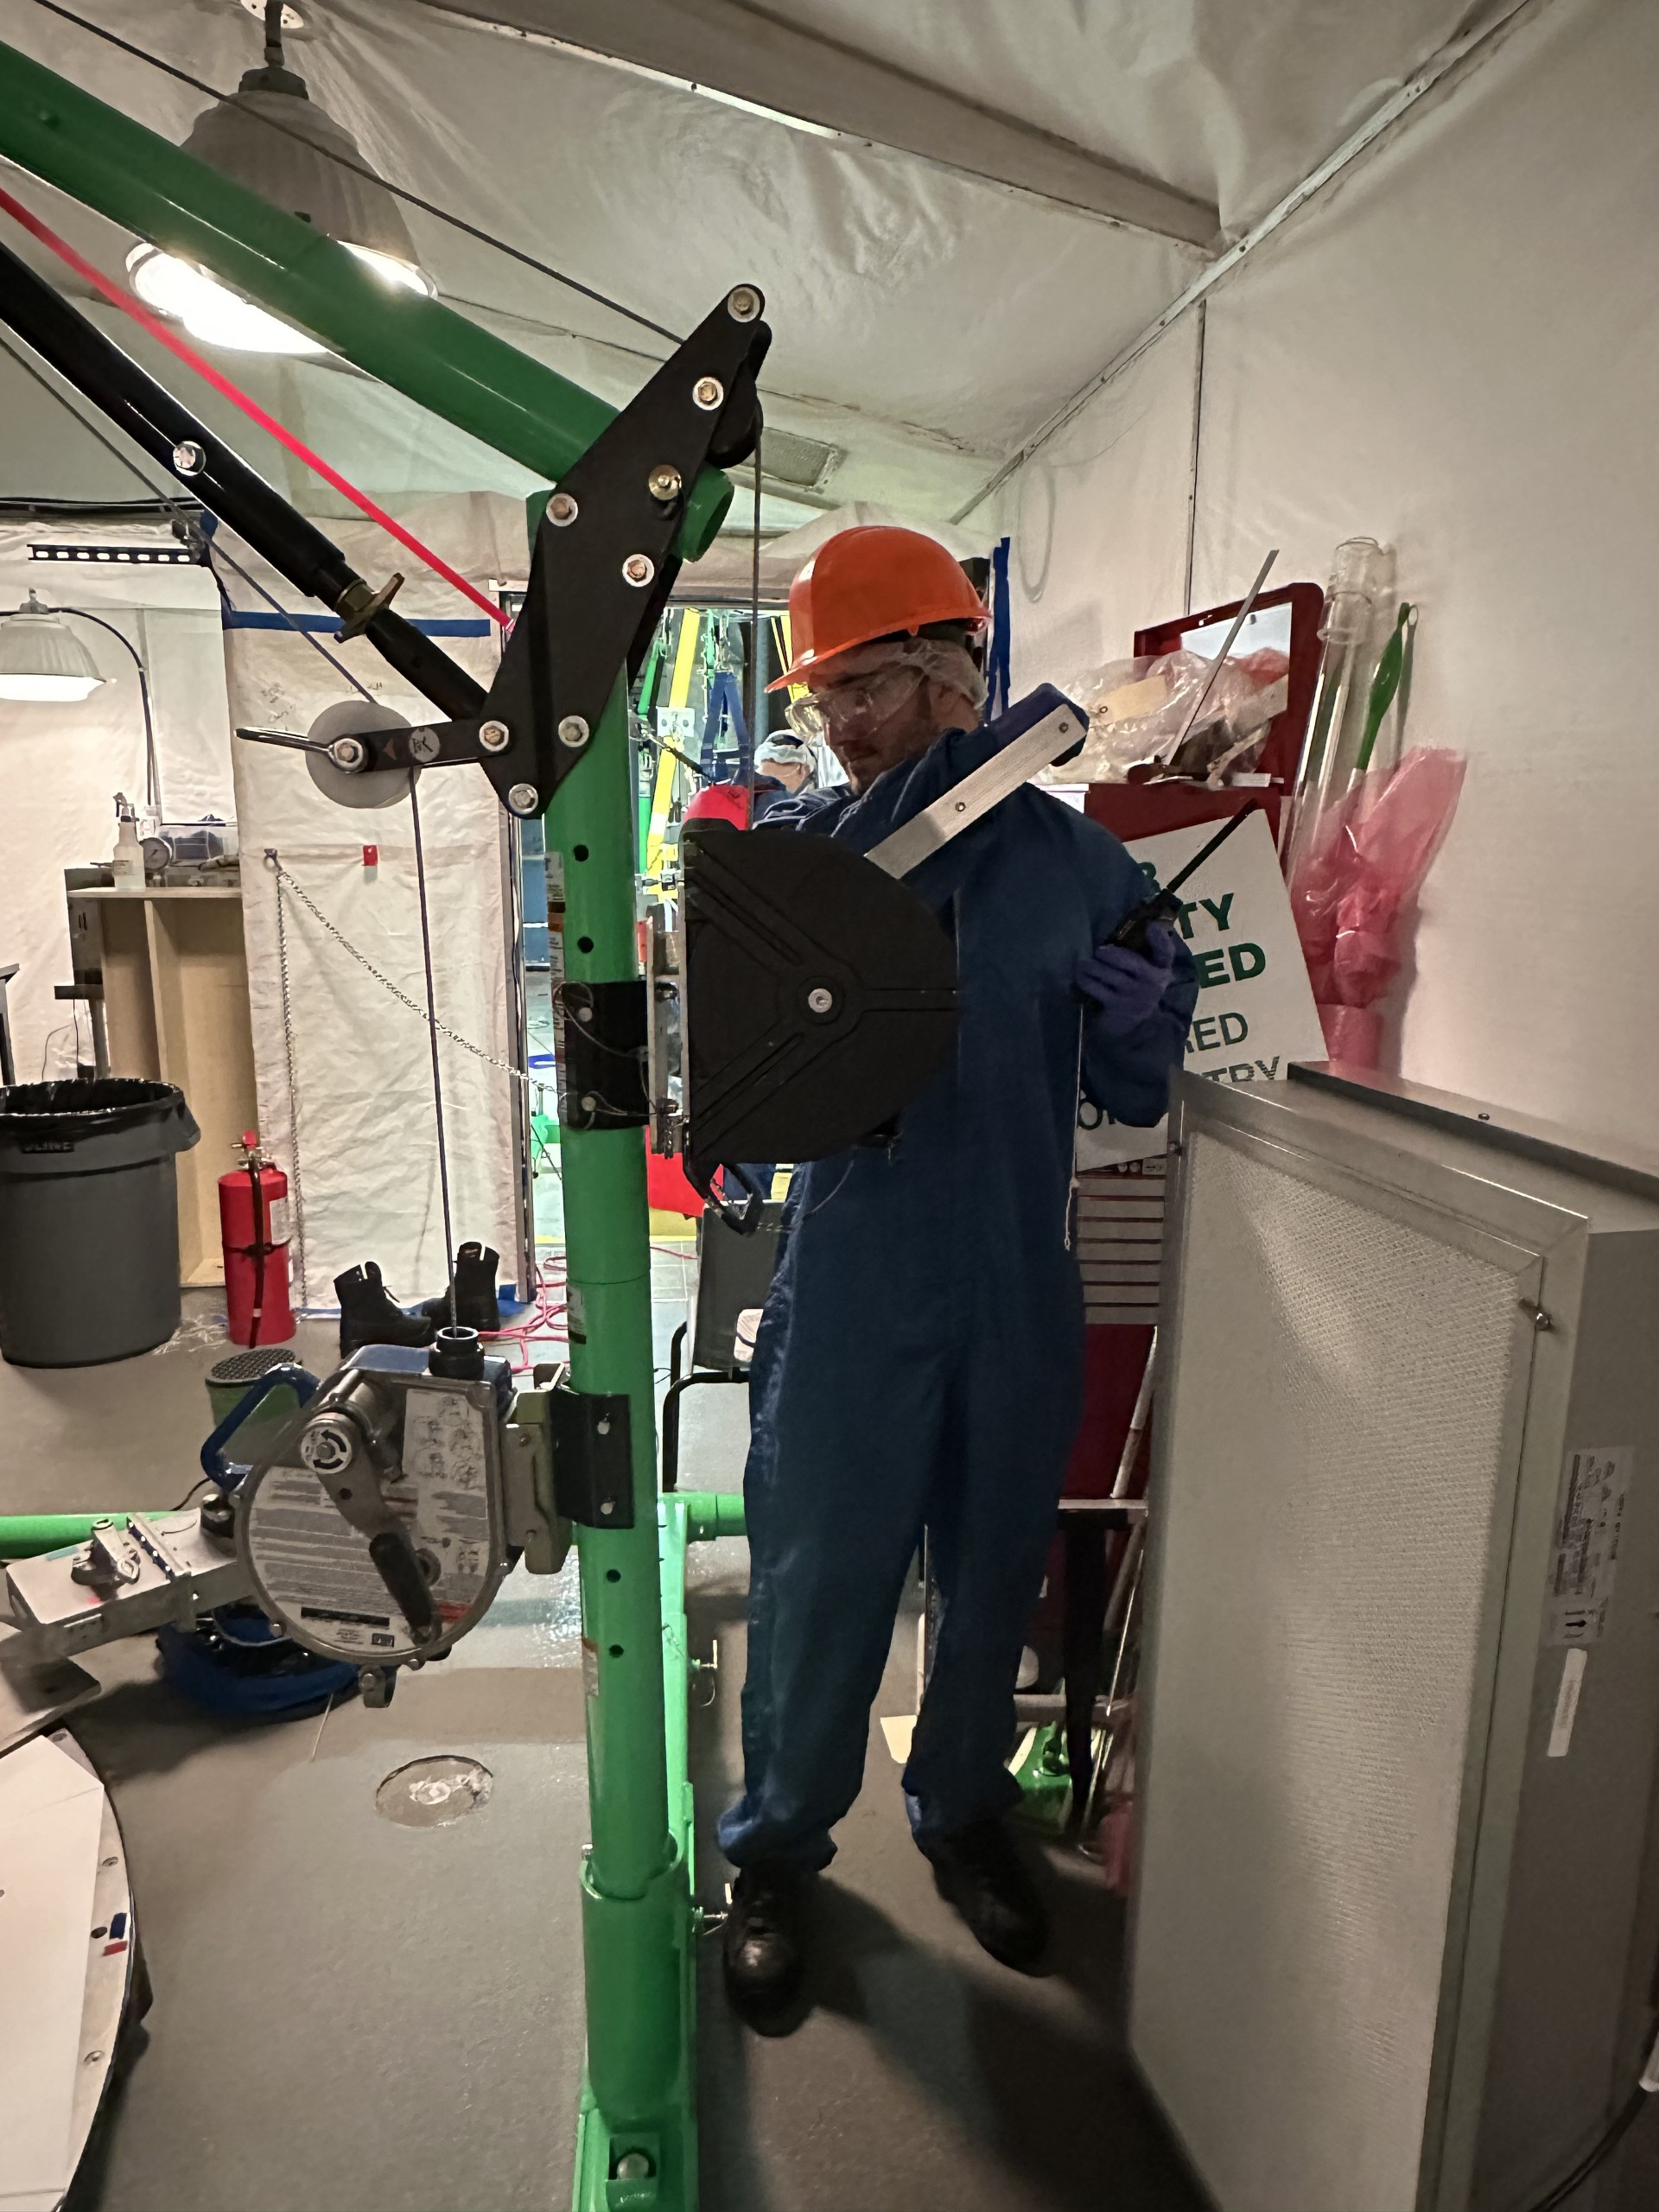
Questions?
Other Work Completed:
Cavity crew
TeA plant team
Solving calculations
Special Thanks To:
Aleksandra Bialek
Jazmine Gauthier
Christine Kraus
Marty St-Amant
Samuel Caron
SNO+ team
12

Slide 14
Back up

Slide 15
Scintillator
Linear Alkyl Benzene: 780 tones
PPO: 2.2 g/L
BHT: 5.5 mg/L
bisMSB: 2.2 mg/L
Notes:
LAB: Low cost, high optical transparency, chemically inert (does not react with any materials)
PPO: Converts excitation energy into detectable blue light
BHT: antioxidant
bisMSB: wavelength shifter to longer wave lengths (PMT’s can easily detect the light)

Slide 16
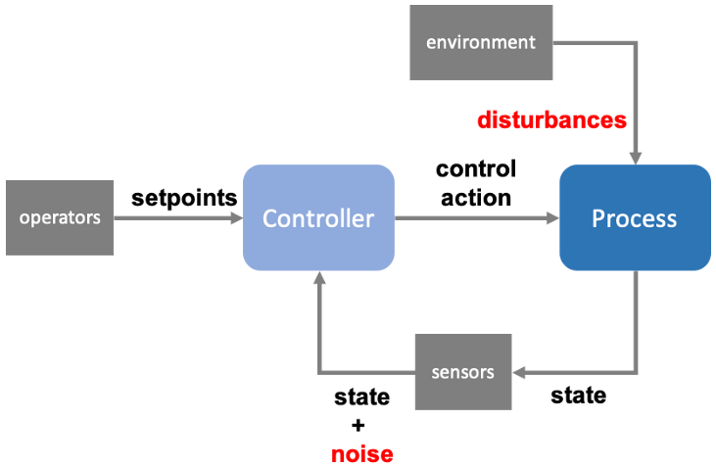
Process Control System
Manage industrial processes in real time by keeping key process variables within predefined setpoints
Notes:
Quick break down of the figure.

