Slide 1
2026/08/13
Developing a Quantitative ZnS(Ag) Test System
Connor Stubbs
Radon Assay Student

Slide 2
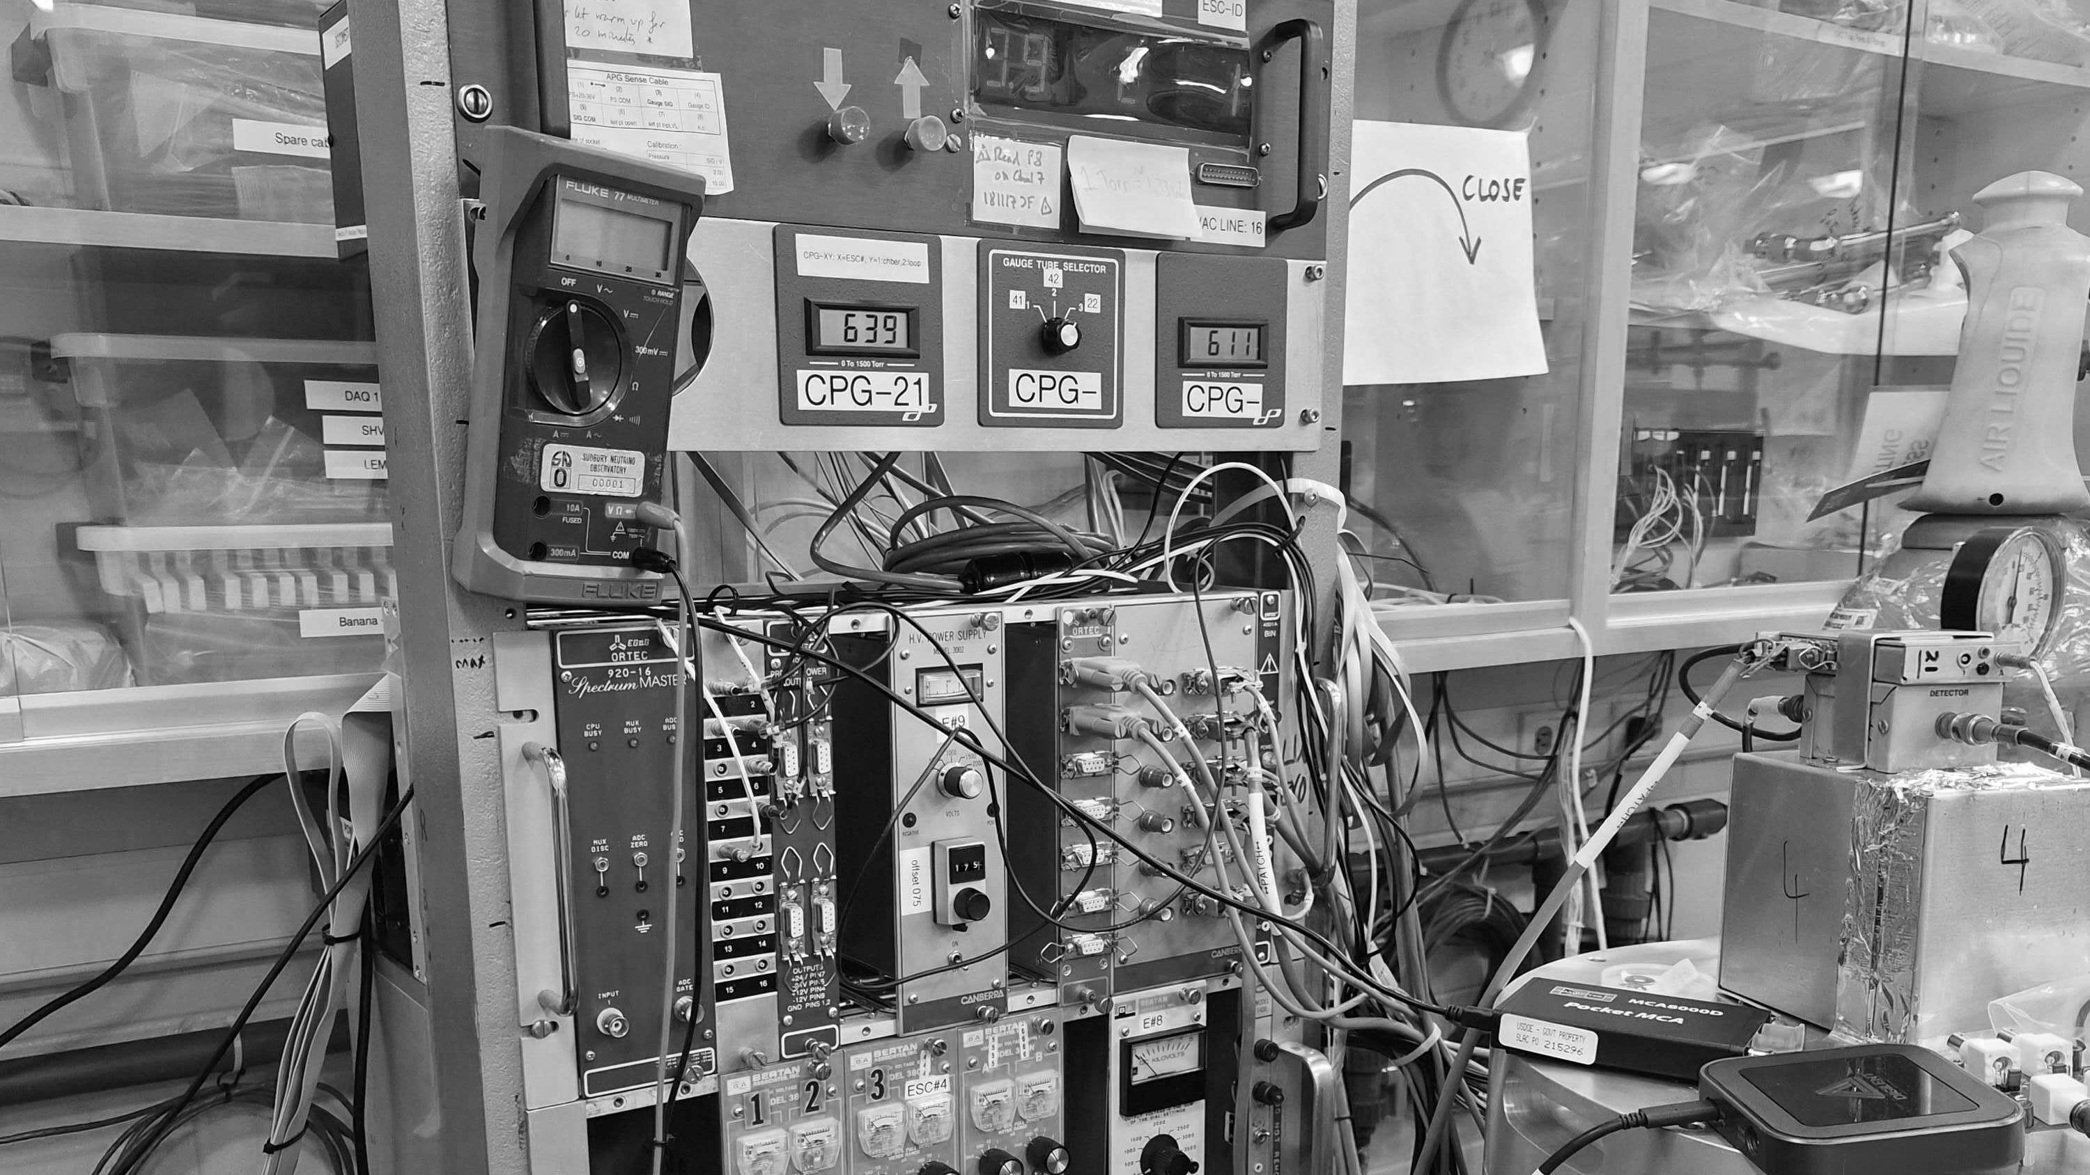

Background
Notes:
Lets start with some background information that motivates this project

Slide 3
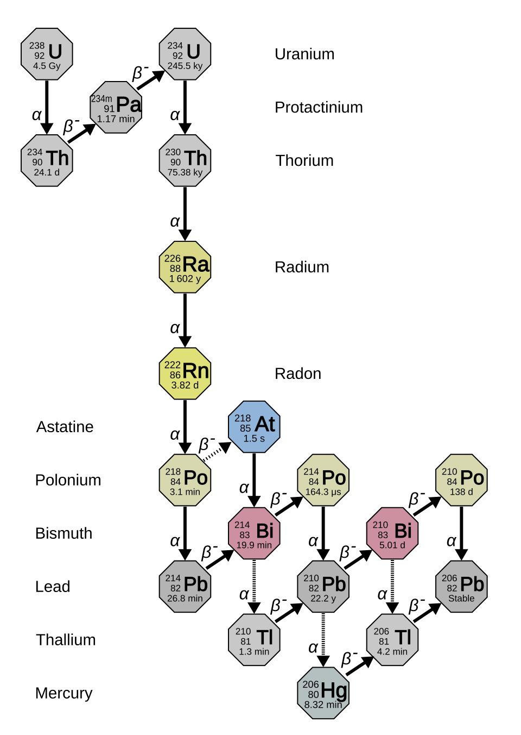
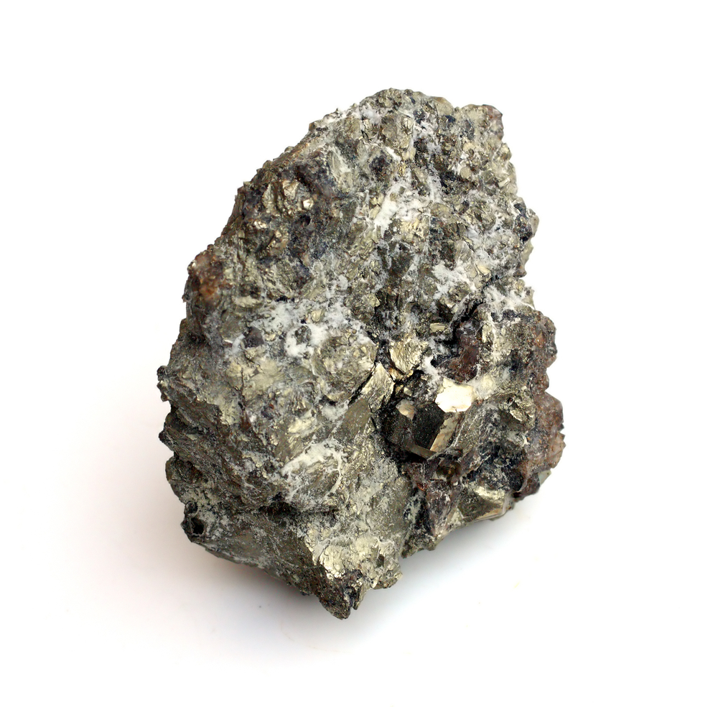
Radon Decay
Odorless, colourless, inert, radioactive gas
Able to travel far from emission source
Notes:
Im sure most of you know the struggles we have with radon, but to give a refresher: radon is an odorless, tasteless, colourless, inert, and radioactive gas that is released from the uranium 238 decay chain. Being surrounded by rock, which contains traces of these long half life elements at the top of the decay chain, radon is a major background for both our dark matter and neutrinoless double beta decay experiments.
Stress why the radon is so detrimental.

Slide 4
Background
Assays
Notes:
That is where the assay team comes in. We trap radon from experiment volumes or items and count the decays to determine the amount of radon that is entering the volme or emanating from the item. We specifically look for these 3 alpha decays that occur in quick succession. One slight issue with this process is that these decays leave behind lead 210 with a 22 year half life, that eventually alpha decays again. This polonium 210 decay is our background.

Slide 5
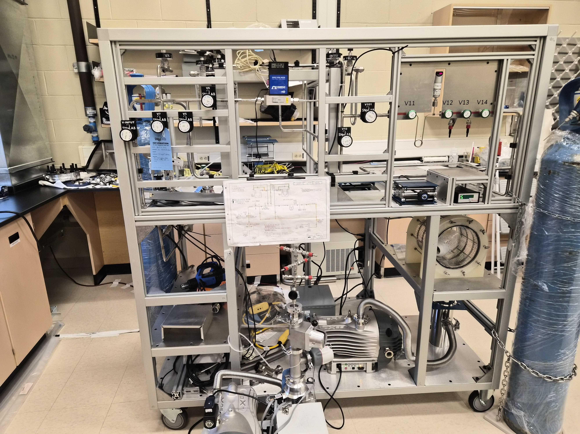
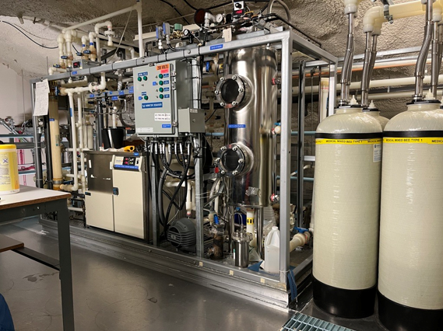
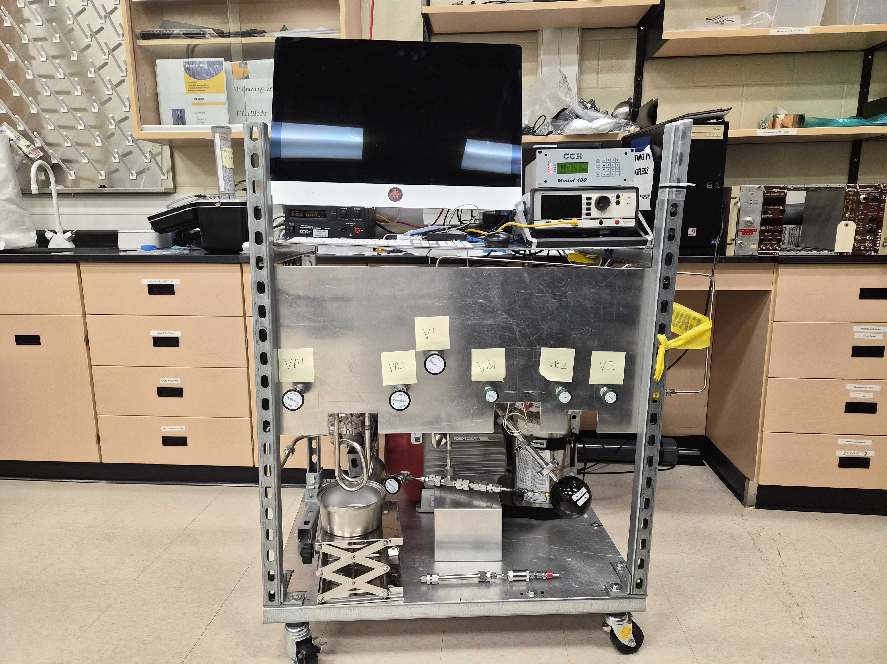
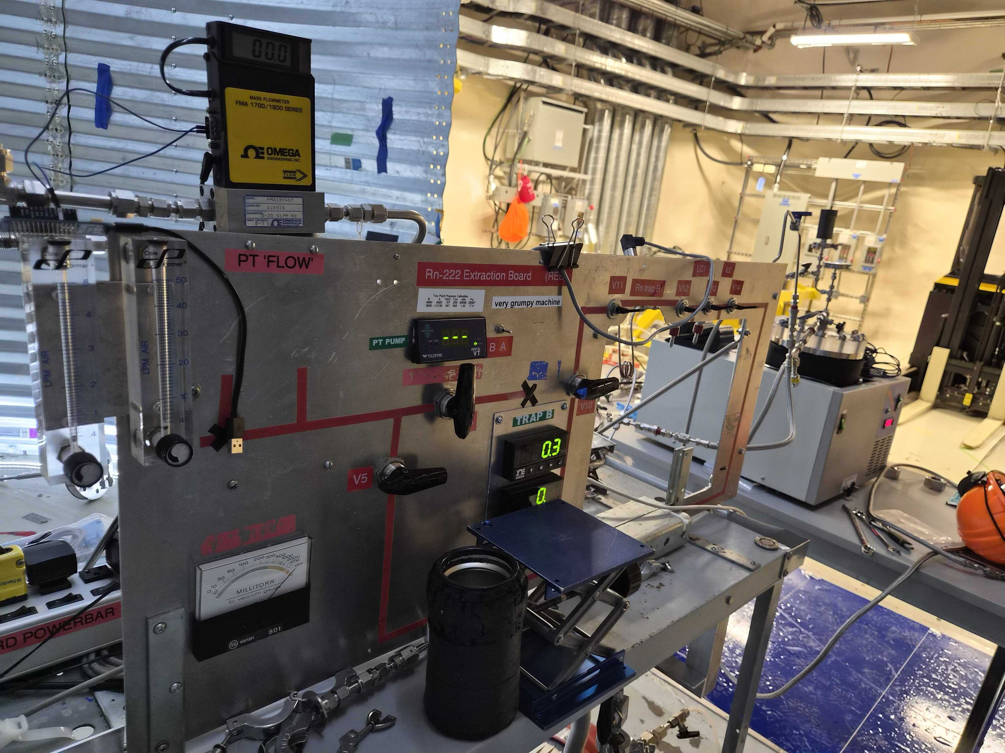
Assays
Surface
Emanation
Underground
UPW
Surface
Sphere
Underground
Mobile Board
Notes:
Replace with old assay animation slide, maybe just leave an image of the board up on that slide

Slide 6
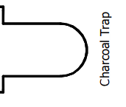
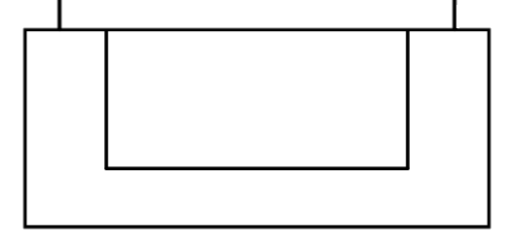
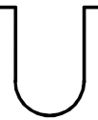


Assays
Cryopump Charcoal Trap to Trap A
Remove water and freeze radon in charcoal trap
Cryopump from Trap A to Trap B
Volume Share to Lucas Cell
Notes:
And to do these assays, a typical process consists of removing water and freezing radon in the first trap by pulling the gas through while it is submerged in liquid nitrogen. The inlet of the first trap is closed, and the gas is pulled into trap A, which is again in ln2, while the first trap is heated. This is repeated into trap B, the concentrator trap, then the gas is volume shared from trap b to the lucas cell
Focus on lucas cell

Slide 7
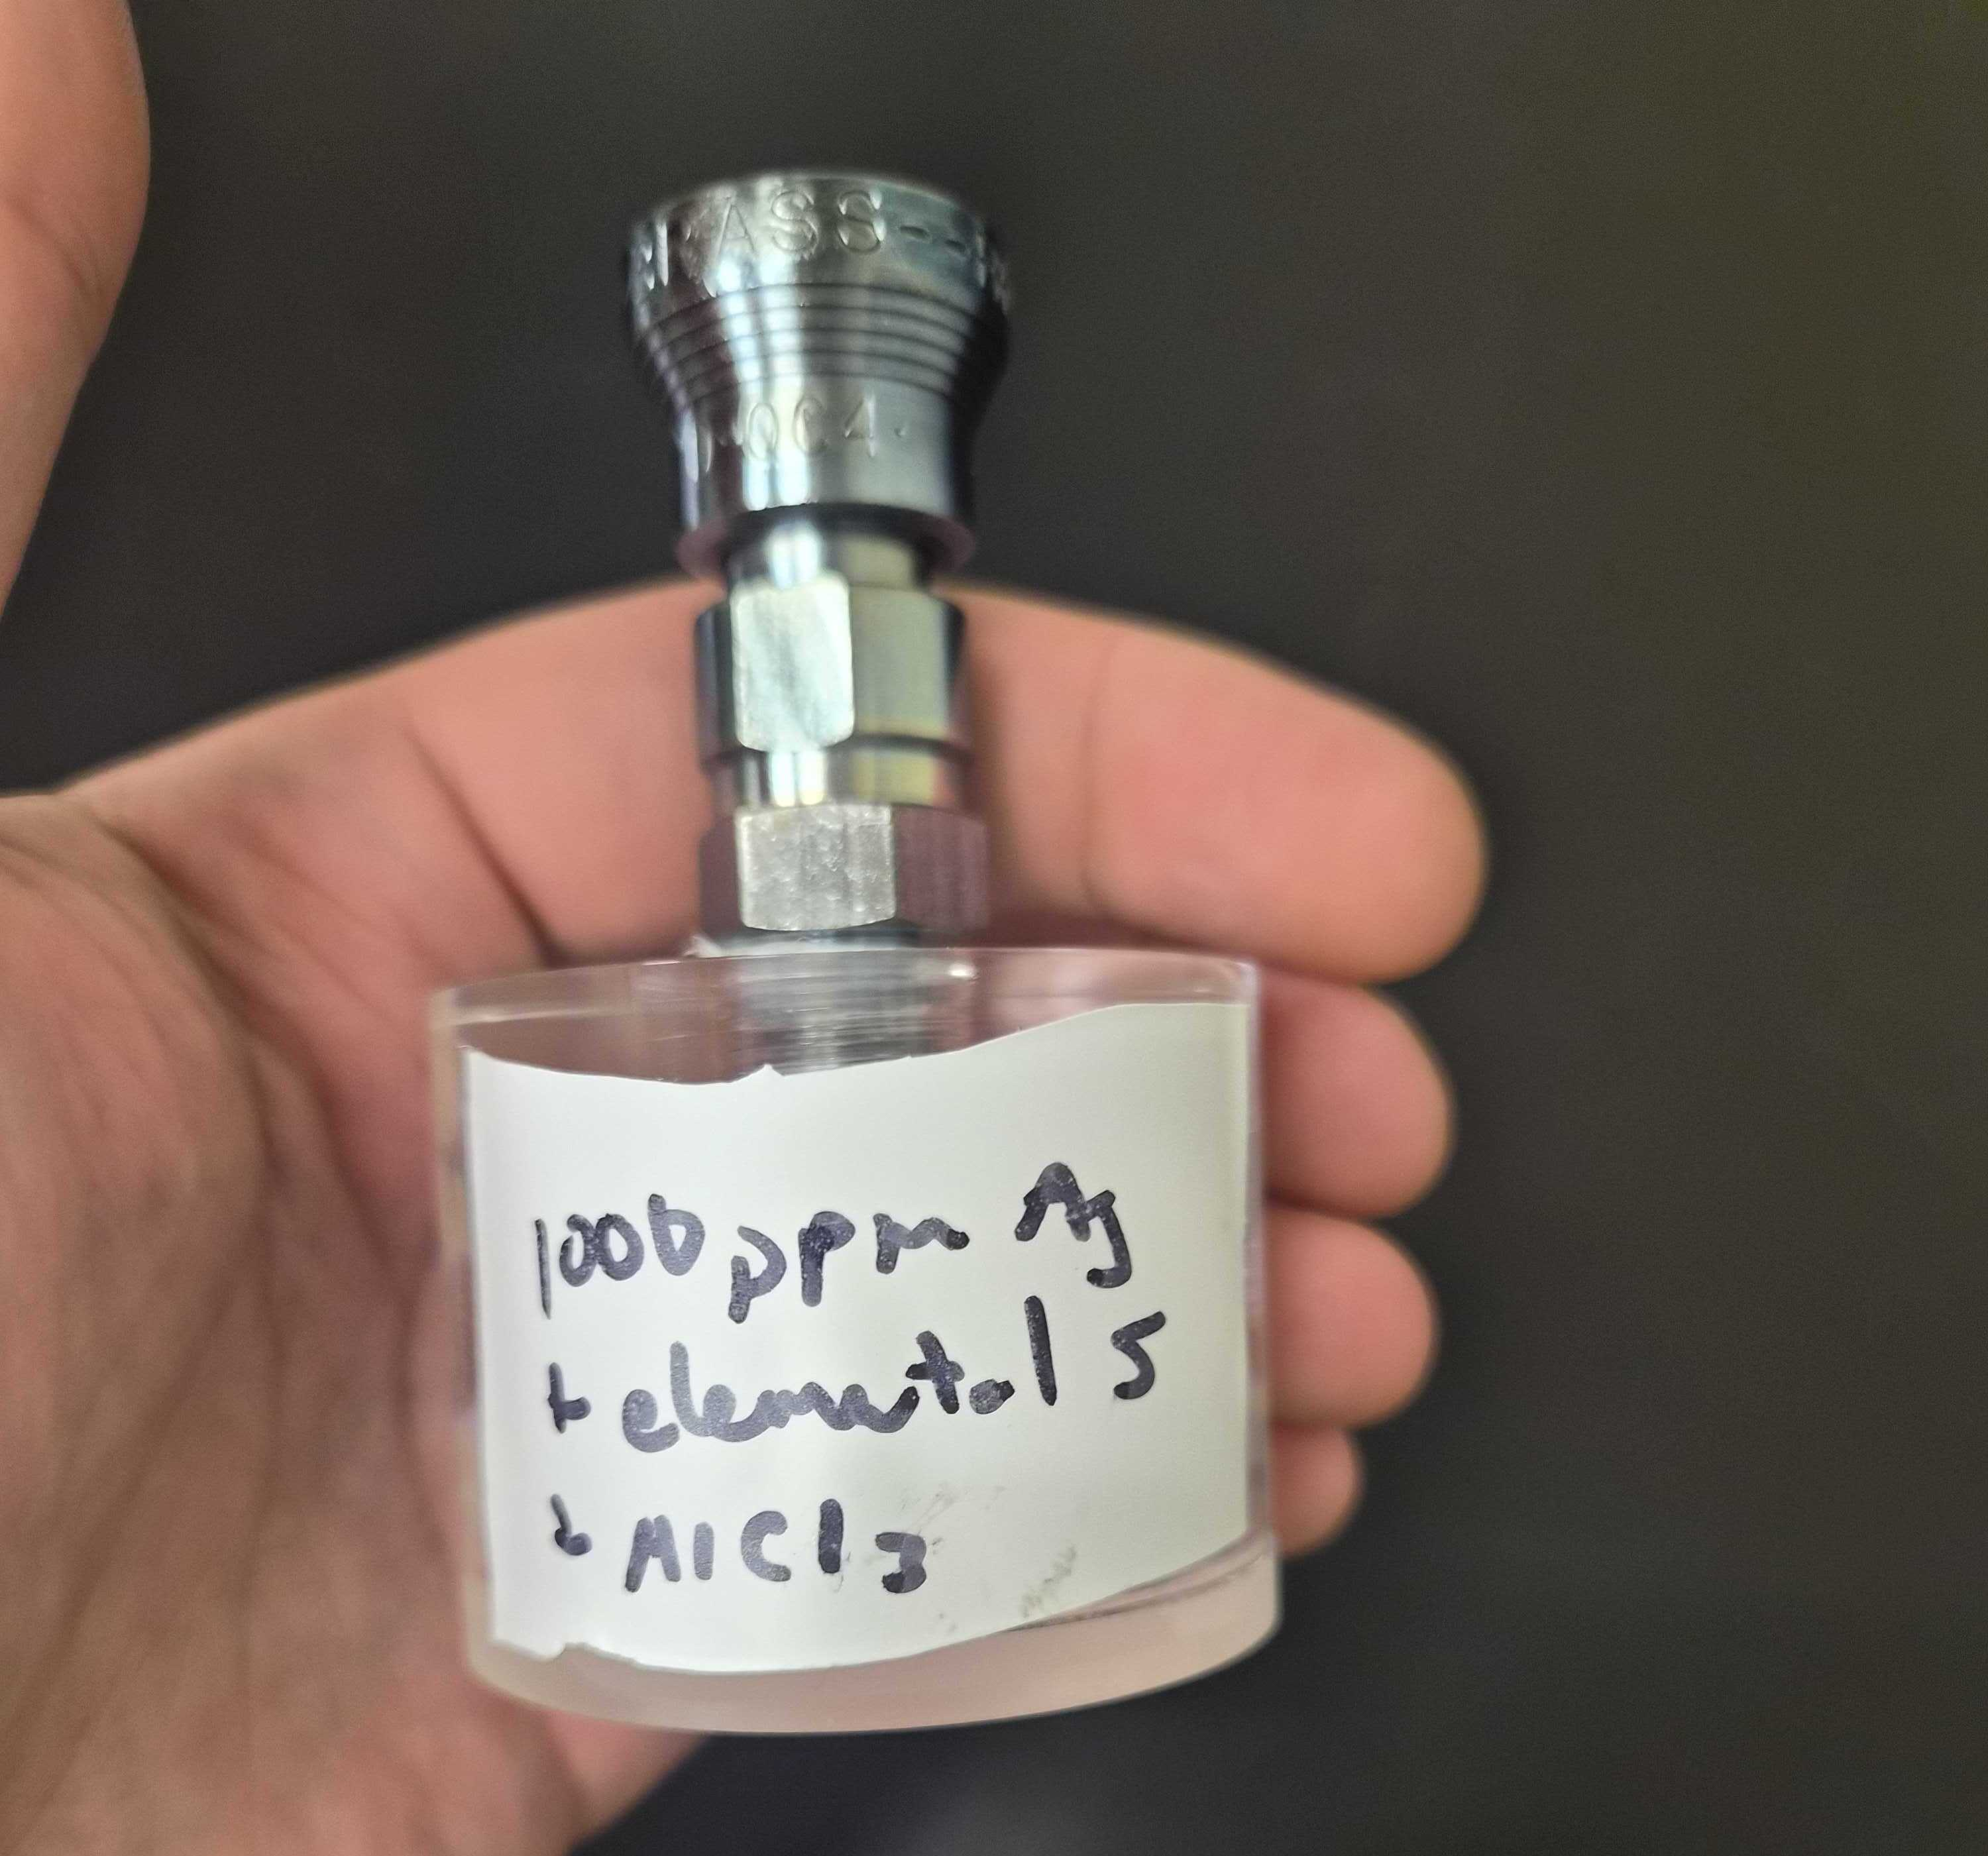
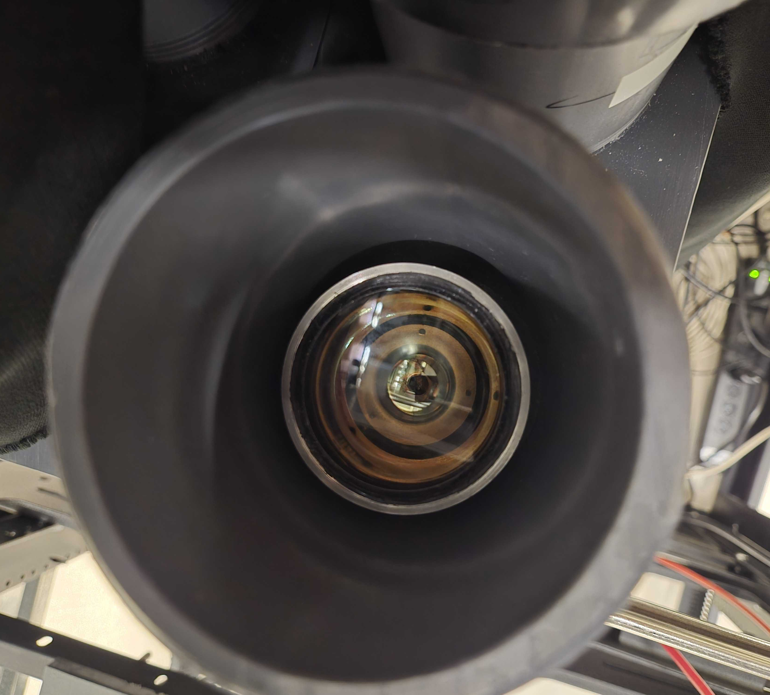
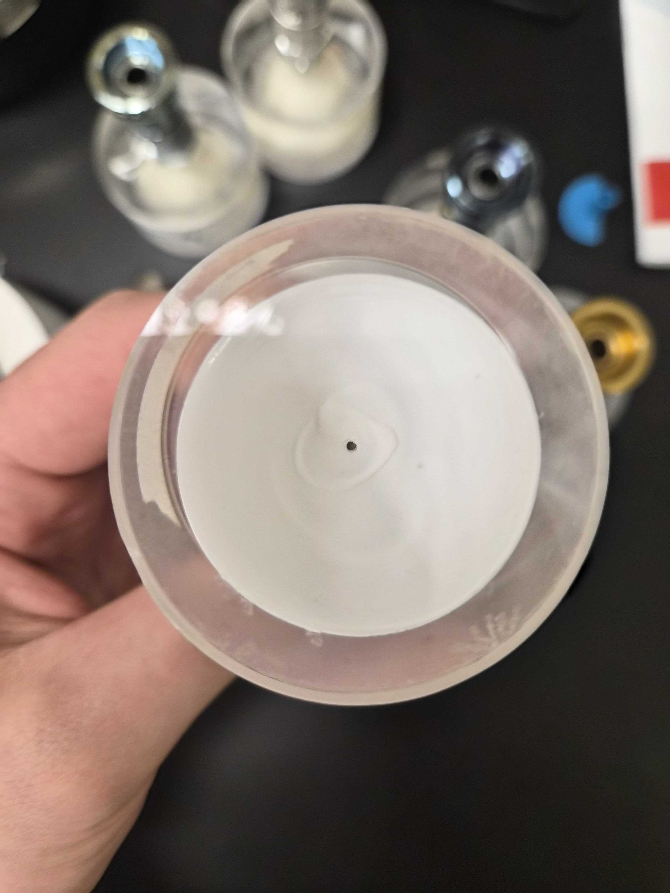
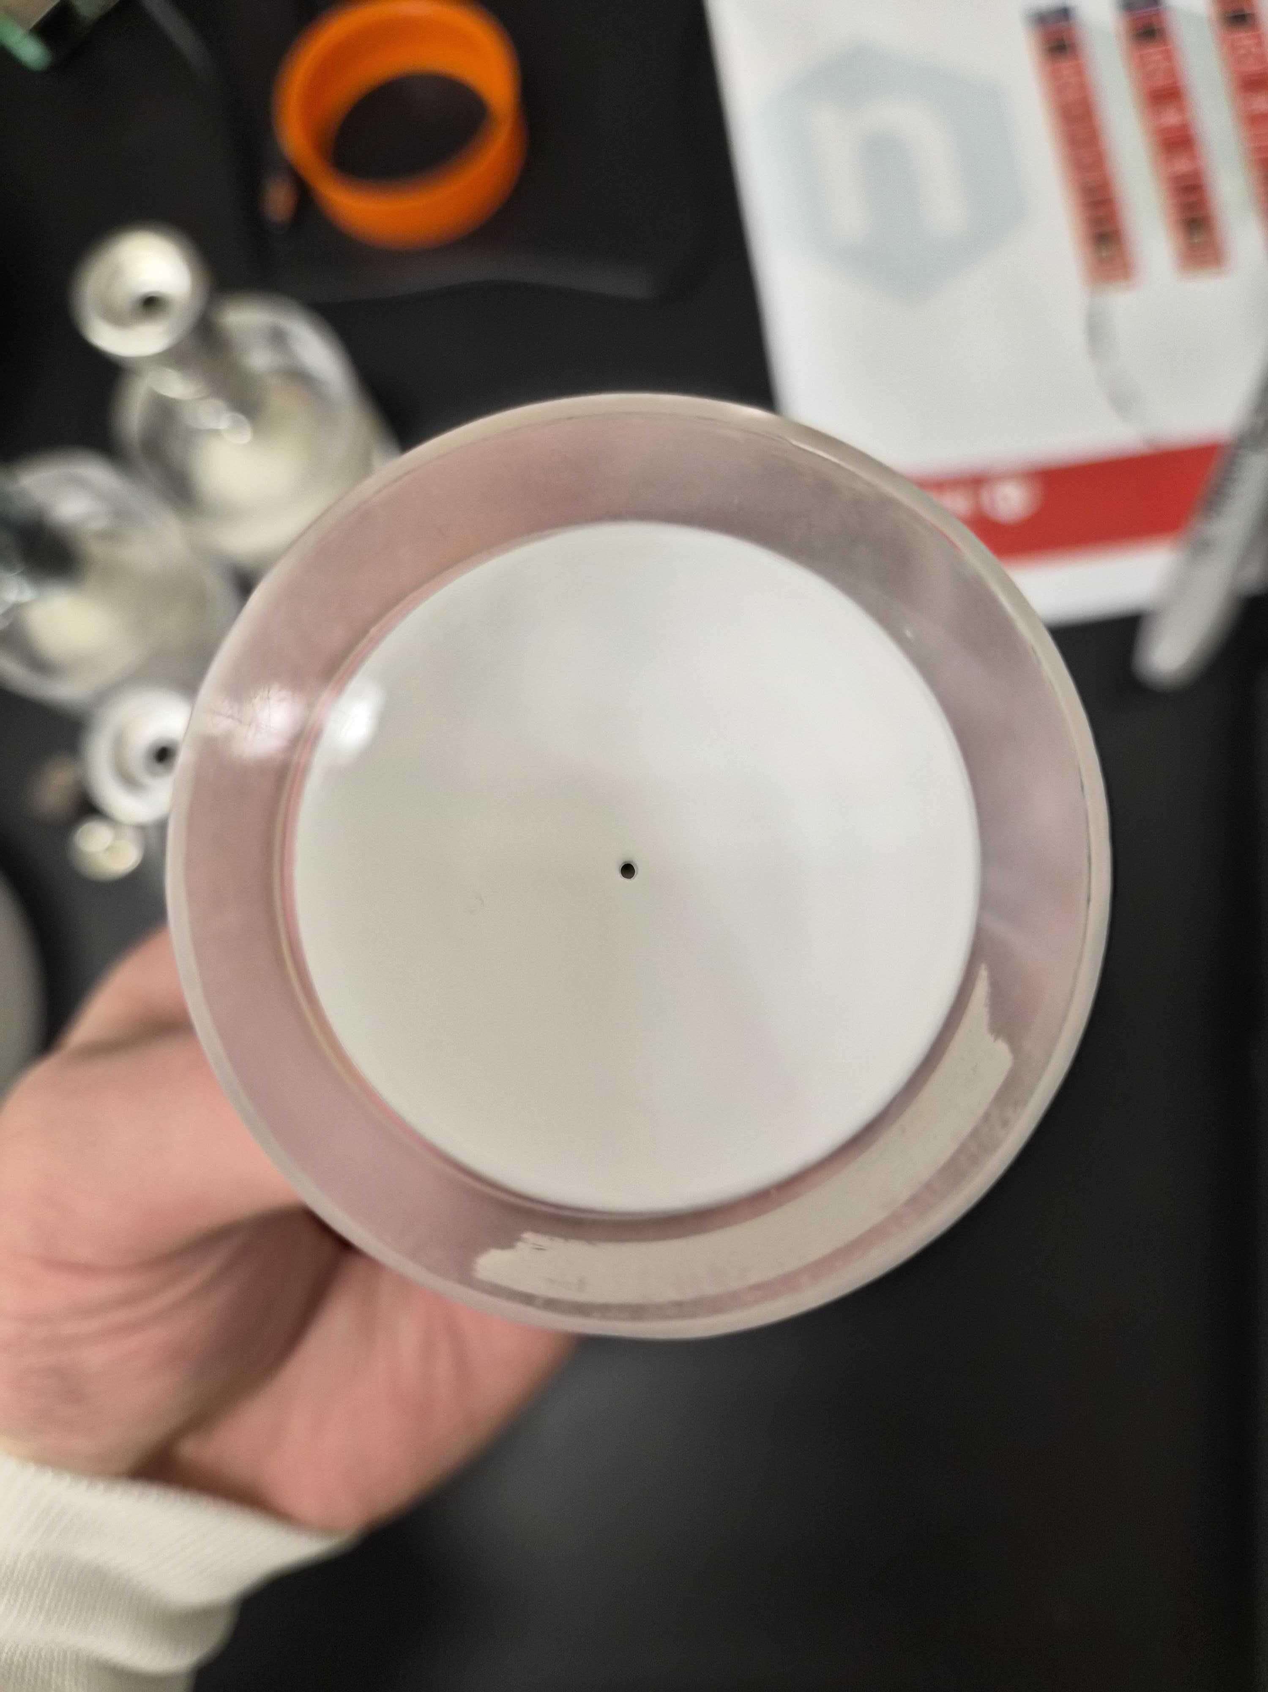
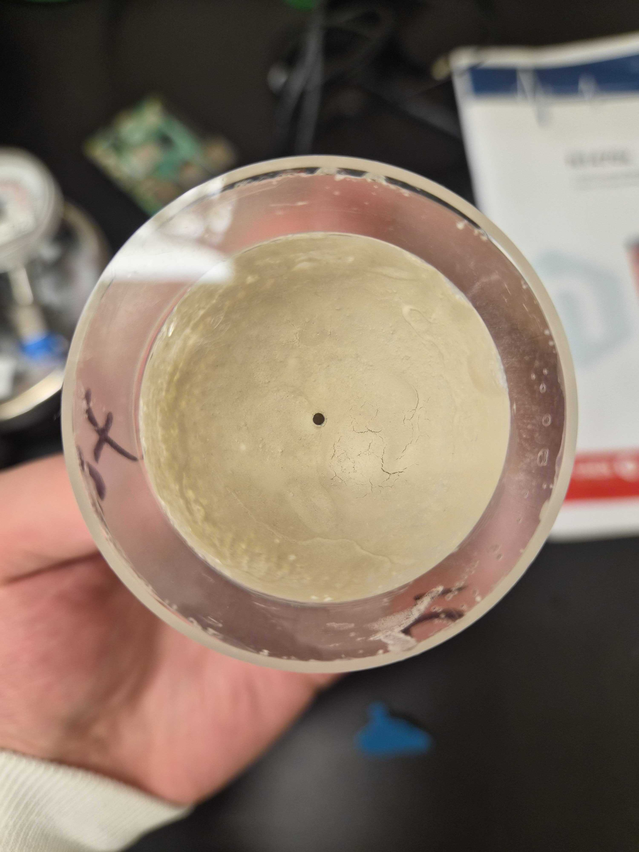
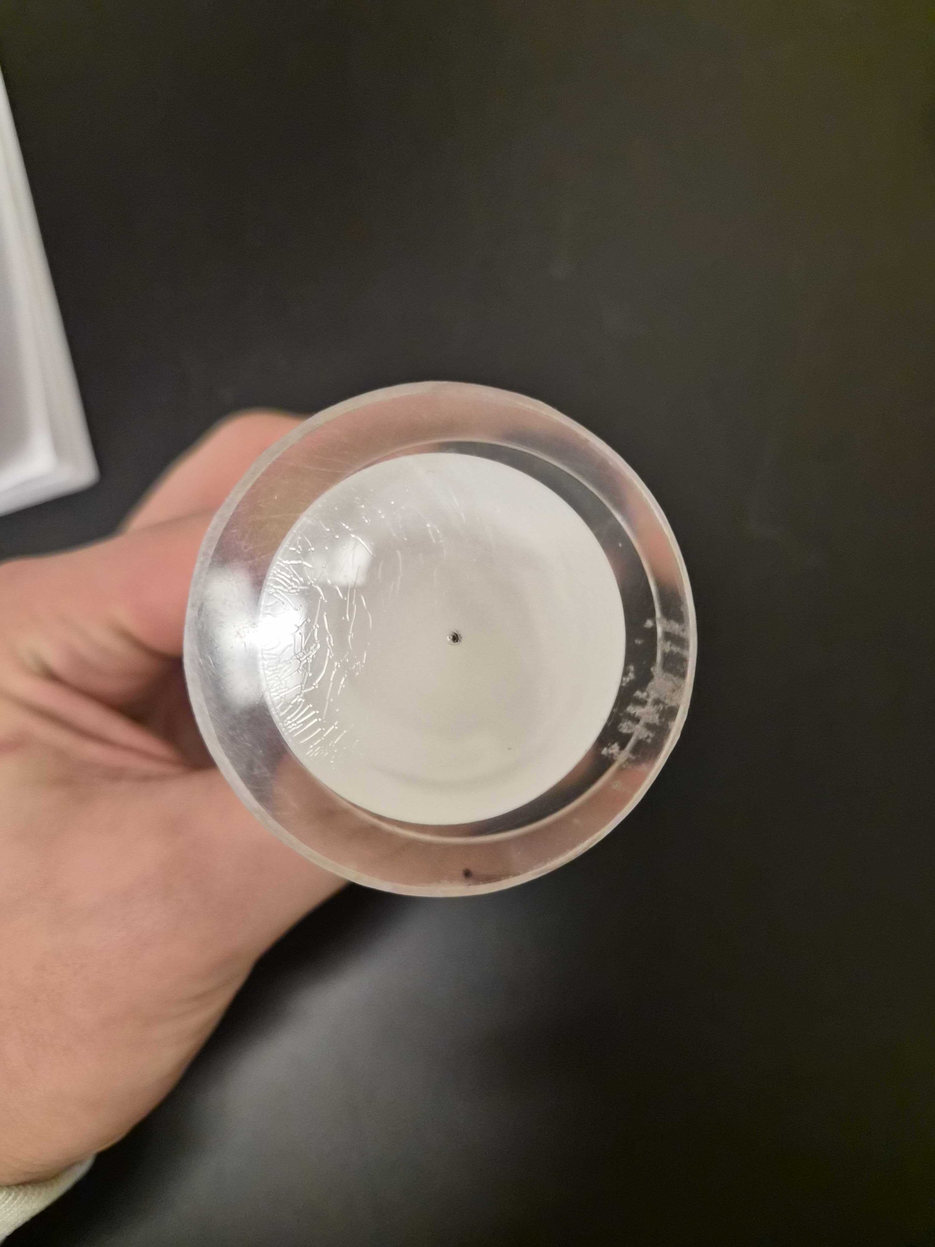
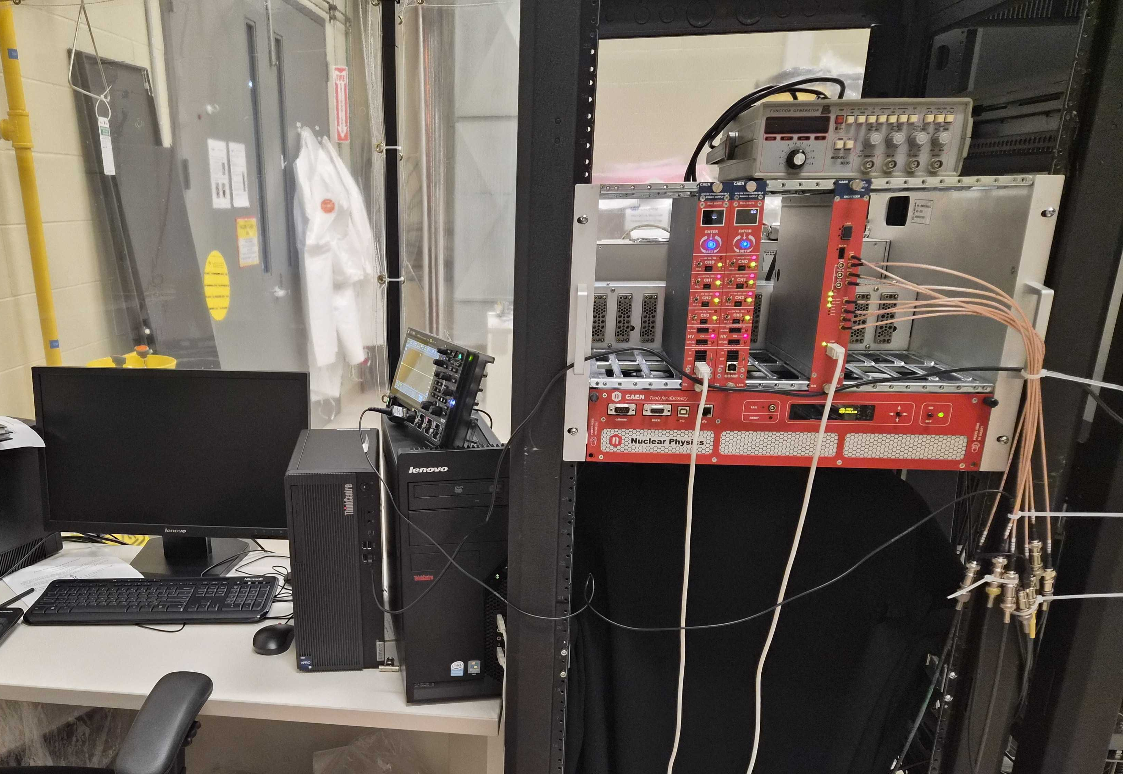
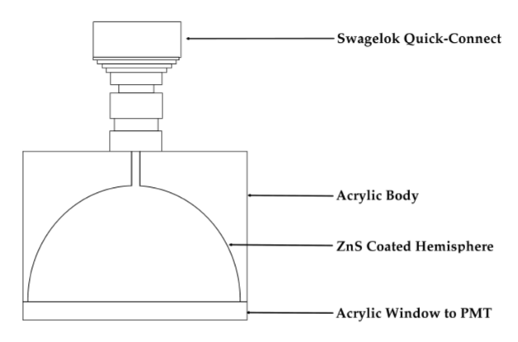
Johnson
Rexon
Lucas Cells
Acrylics hemispheres with alpha scintillator painted on and a quick-connect for gas to come in
Put onto photomultiplier tubes to count alpha decays and relate that to radon atoms
Made at SNOLAB with many different variations of ZnS(Ag)
SNOLAB
Eljen
Notes:
So that brings up another question, what is a lucas cell? These are 2 inch diameter acrylic hemispheres with ZnS, a sensitive alpha scintillator, painted on the inside. This means that when an alpha particle strikes the sides, it emits light. To capture this light, the windows of the lucas cells are placed on photomultiplier tubes like that of the top picture and our data acquisition or daq system below it counts the scintillations. We have many lucas cells here at snolab and continue to make more. Nowadays, we are also attempting to manufacture our own very radiopure ZnS
Bit too much text on this slide

Slide 8
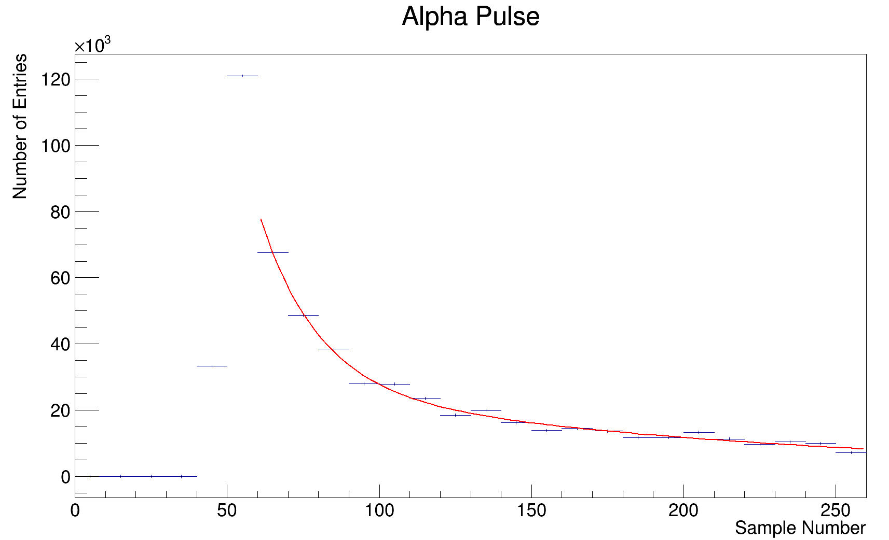
Purpose
Quantify the background and alpha detection efficiency of ZnS(Ag) scintillators that we use for radon assays.
  Use a radon source to put in a number of atoms and monitor detections
  Need to be able to do this several times a week
  Ensure background is lower than commercial alternatives
Notes:
This finally leads us back to the ZnS test system. As we manufacture our own ZnS, we need a way to compare with the commercial products we already have. There are three main criteria that our test system needs, one being a way to compare light yield, another being a way to compare detection efficiency, and lastly it needs to be a process that takes only a few hours.
Might be too much text

Slide 9
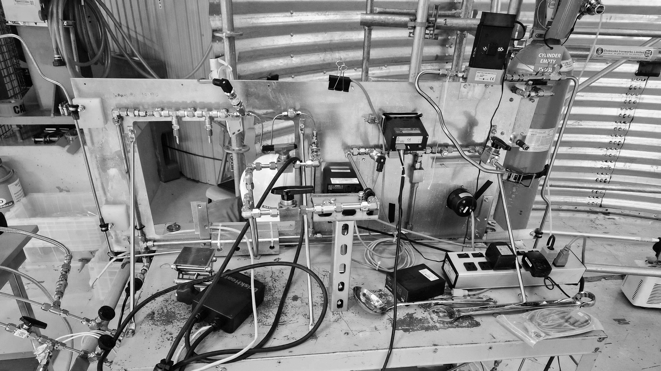
Scintillator Testing

Slide 10
Test Conditions
We want to inject a controlled amount of radon into the Lucas cells, this allows us to achieve our two goals
To minimize variation, the same Lucas cell and PMT are used
Radon Source
0.5µm Filter
Lucas Cell
2 Bq radium source
4-hour emanation
Notes:
To test the scintillator, we inject a known amount of radon into a lucas cell and count it. We use the same lucas cell and pmt for all trials, and filter the input to avoid contaminating the lucas cell. Mention that it is volume sharing
Could get rid of second point

Slide 11
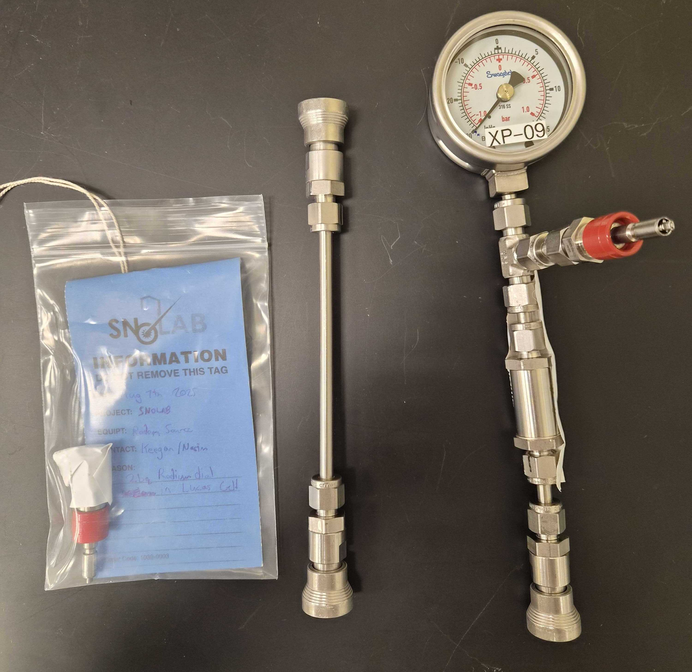
Radon Source
Currently using radium-painted watch dials as a radon source
Allow it to emanate while connected to a Lucas cell
To test efficiency, we need a consistent number of atoms
Before using, we need to characterize the source
Notes:
Currently, we use a 2bq radium watch dial as a radon source that were bought by keegan paleshi. The watch dial is the left most item in this picture, it is inside a quick connect fitting, the filter to lucas cell setup is the right most, and the center item is used to connect the plumbing to a vacuum pump
Add image of raw dial

Slide 12
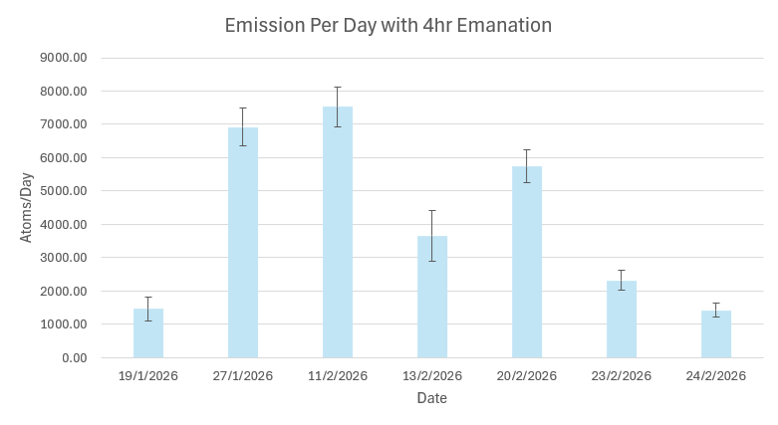
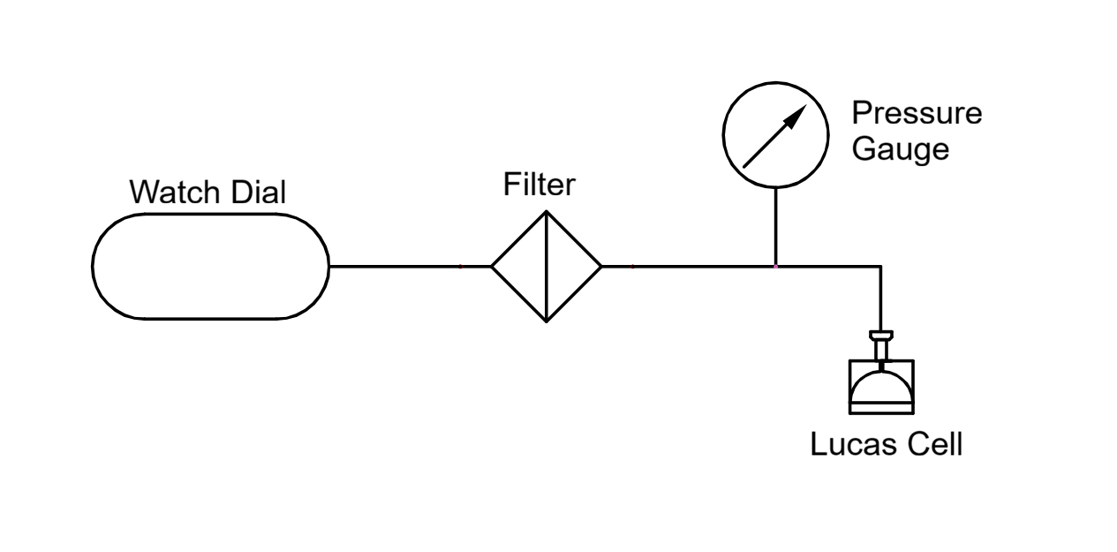
Emanation Procedure
Pumped slightly
less
Thoroughly
pumped
Neglects emanation between trials
Notes:
Our first procedure consists of pumping the Lucas cell thoroughly and pumping the plumbing stack slightly less to maintain a pressure variation pushing gas towards the lucas cell. This data does not look great, and seems to show that there may be a relationship between difference in time between trials corresponds to the emission rate
Maybe make like later procedures with animation, explain plot axes

Slide 13
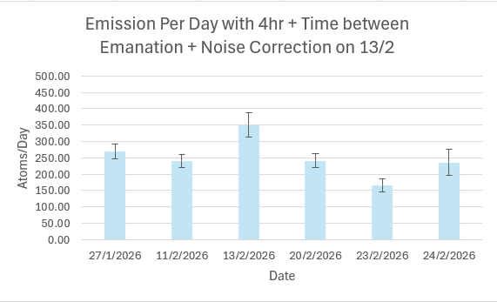
Emanation Procedure
Emanation = 4hr + time between tests
Notes:
Correcting that, it immediately looks more statistically sound but still not perfect
The emanation time is now too long again and not as useful to us, so we must try a new procedure

Slide 14
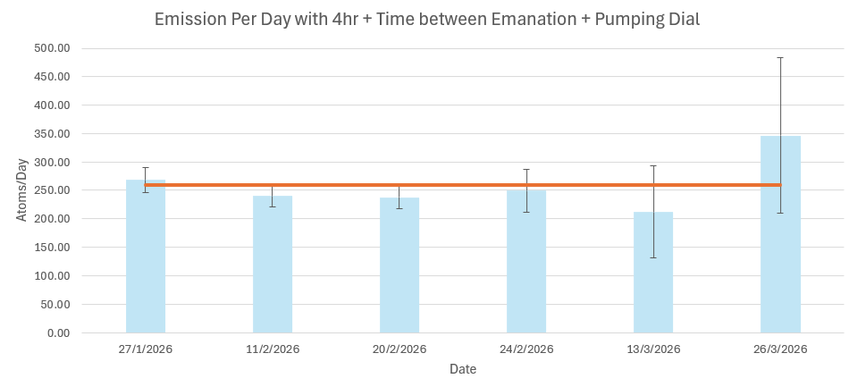
Emanation Procedure
Pumped slightly
less
Thoroughly
pumped
Remove outliers, compare new samples
Notes:
Temporarily, we remove the outliers to get a baseline to compare the new procedure to. We see agreement, but because the uncertainty is proportional to the square root of the number of counts and we are now reducing the counts by 1 or 2 orders of magnitude, the uncertainty is too high for this to be useful. This leads to one final attempt at a new procedure, where the 200bq watch dial is used instead.

Slide 15
Emanation Procedure
Up the counts with a 1hr emanation of a 200 Bq watch dial
Notes:
This data is even more sporadic. What could be the cause of this and the outliers we saw in the 2bq samples
replace with 200 Bq

Slide 16
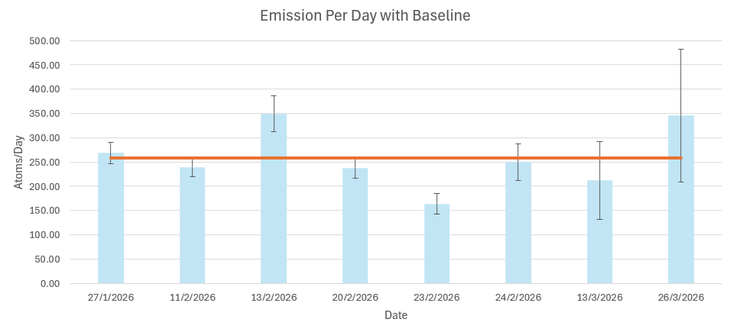
Identifying Systematic Errors
Why are there inconsistencies?
  Pressure variation
  DAQ stability
Notes:
Pressure – We are volume sharing so that can be very sensitive to difference in pressure between trials and between components
DAQ Stability – changes in bias voltage or electronic noise could cause inconsistent results. We cant really verify the pressure theory now, so we investigate stability more in depth
Get rid of first point

Slide 17
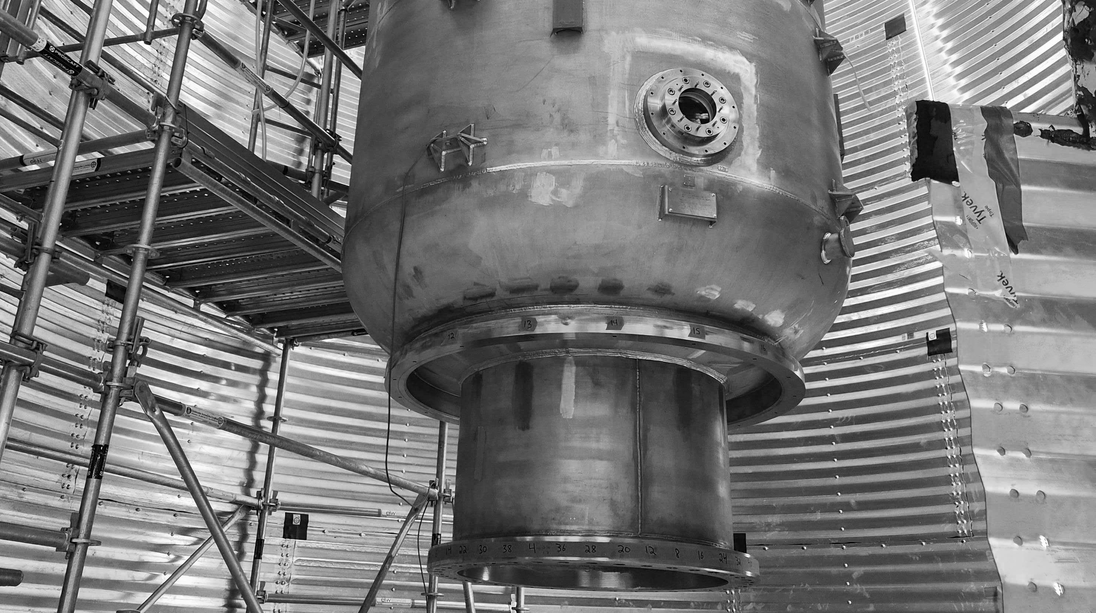
Reducing Systematic Errors

Slide 18
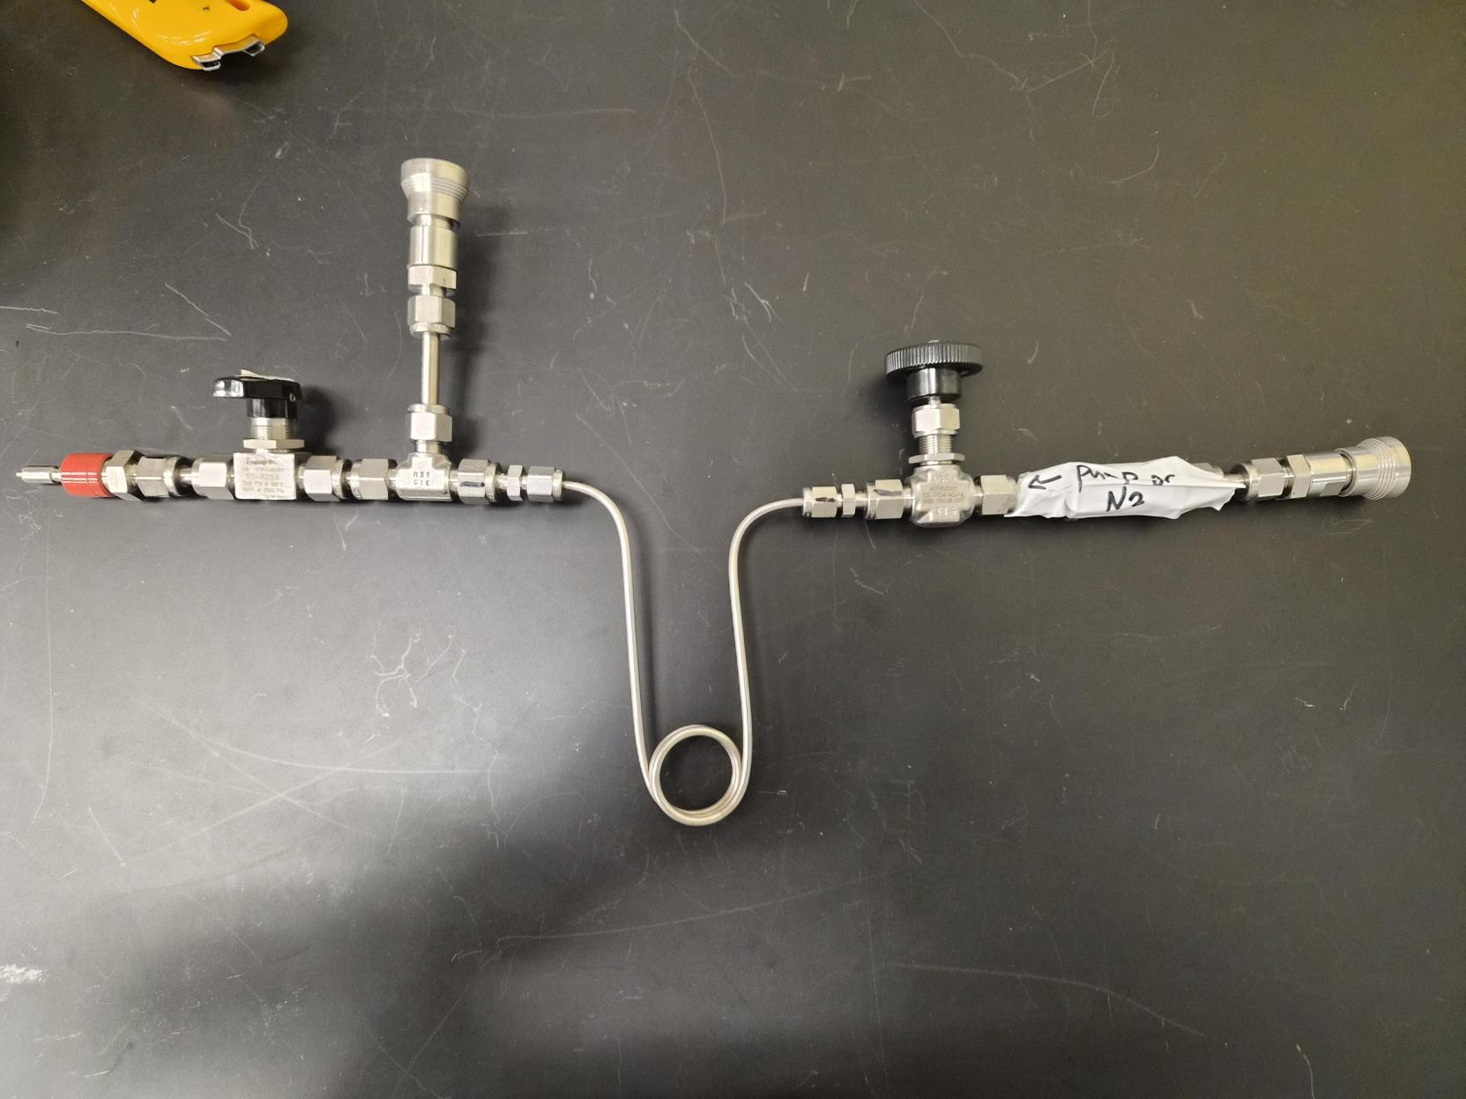
Pressure Variation
Allows LN2 application to trap
Allows easy, uniform pumping
Using cryopumping to eliminate pressure variation
  Cool trap to lower pressure, heat trap to raise pressure
Notes:
Too much text,

Slide 19
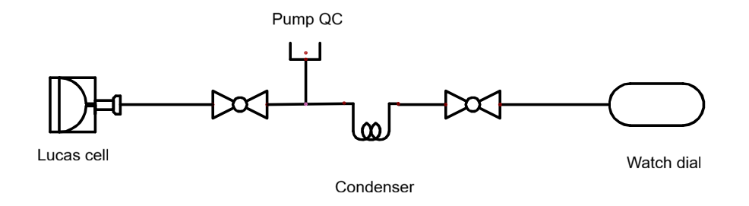
Emanation Procedure
Thoroughly pumped
LN2 bath -> Heat gun
Notes:
This data is even more sporadic. What could be the cause of this and the outliers we saw in the 2bq samples
Change uncertainty colours, mention axis change as well

Slide 20
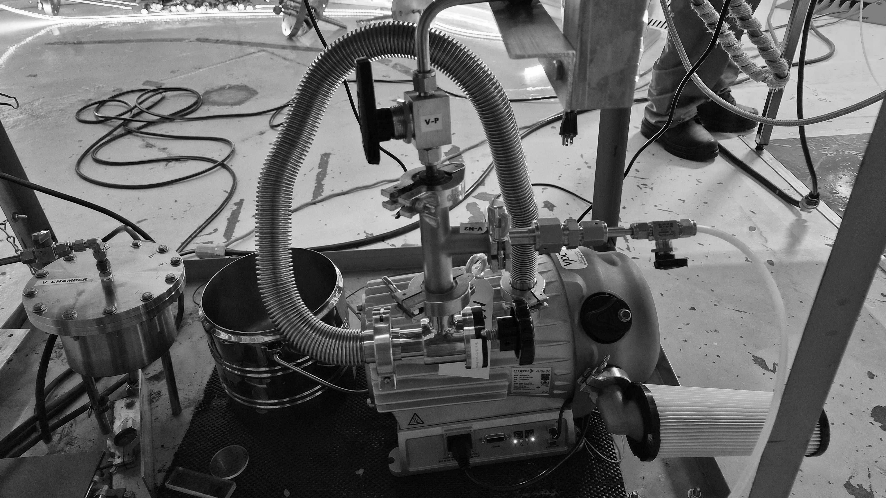
Shape Comparison
Notes:
What we can do with this procedure though, is compare light yield across manufacturers.

Slide 21
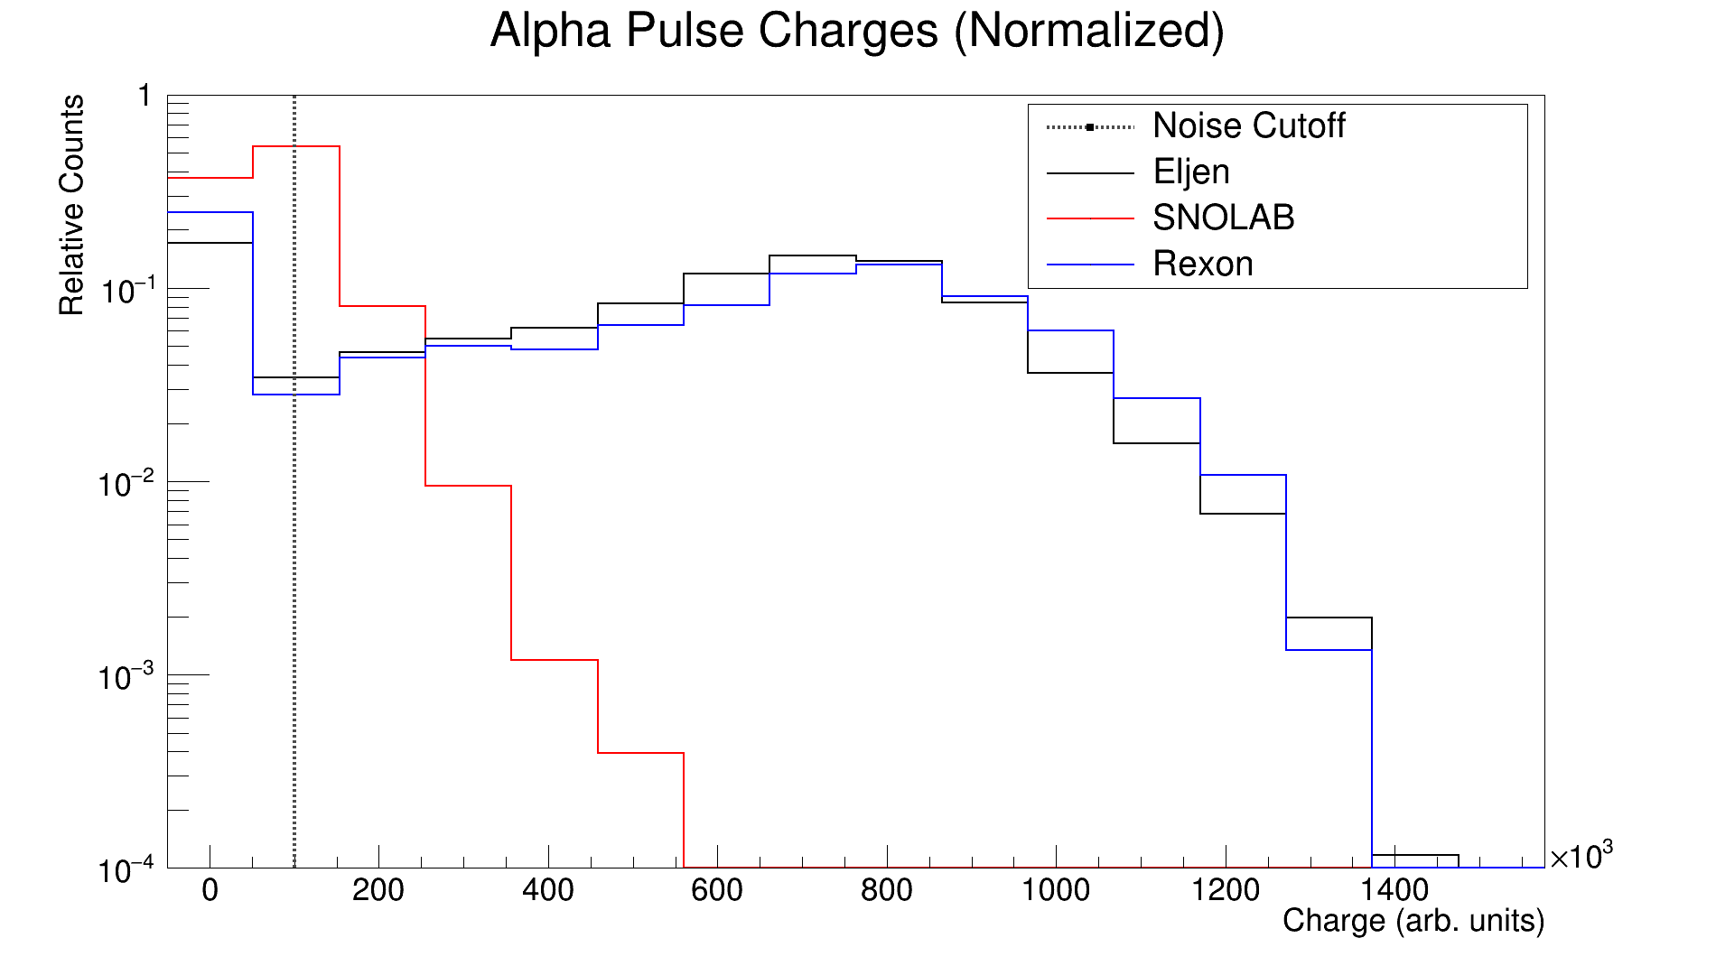
Notes:
This is a normalized view of 3 different manufacturers after a 10 minute, 200 bq emanation. The similarity between the Eijean and Rexon lucas cells gives a good indication that high purity ZnS must have a light yield spectrum similar in shape to this response. This highlights the faults of our current manufacturing capabilities quite clearly, the shift to the left is indicative of a reduced efficiency the oxidization that gives our scintillator its brown colour.
Replace eijean with eljen

Slide 22
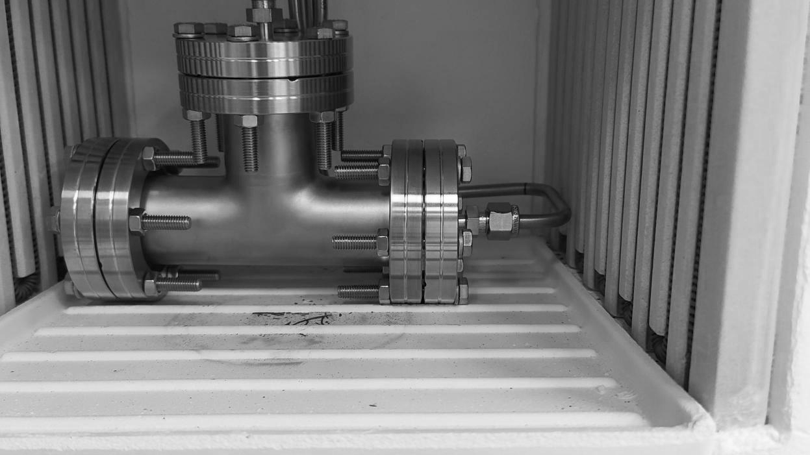
Background Counting

Slide 23
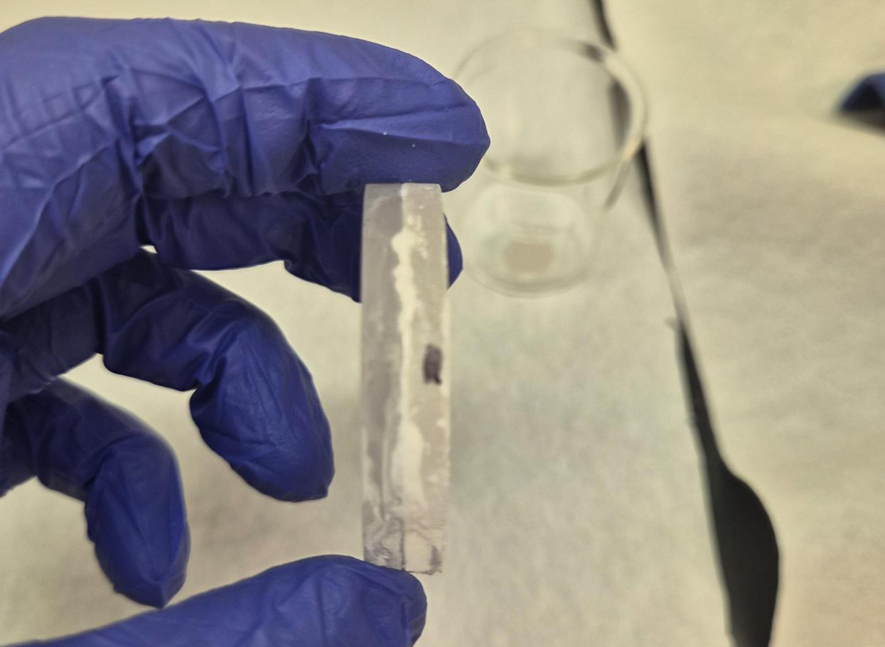
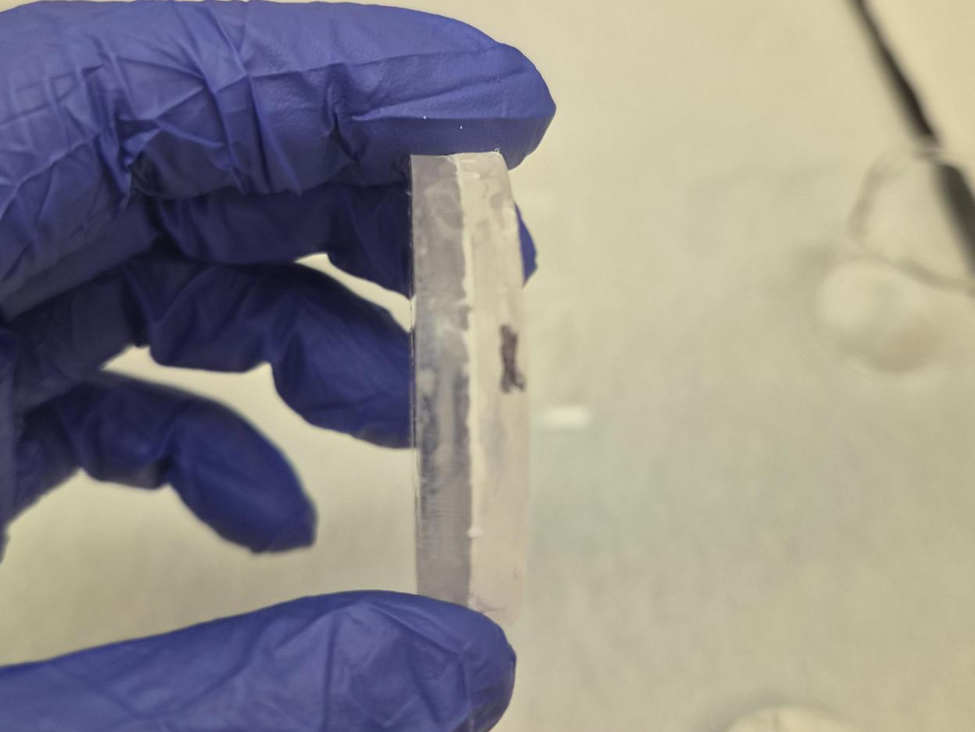
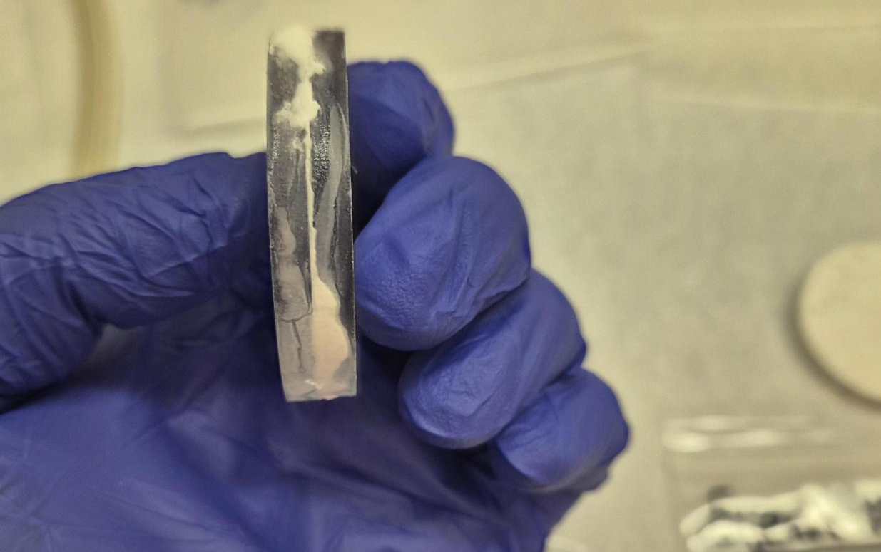
Current Samples
Lucas cells can count in PMTs easily, but for small batches and tests it is not worth making a whole Lucas cell
Using sandwiched windows to count background

Slide 24
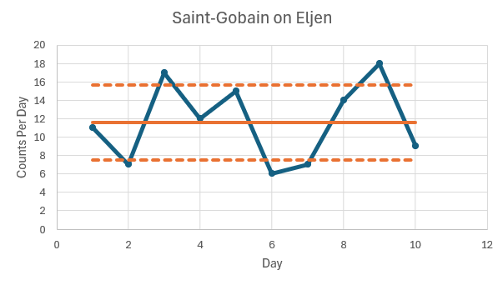
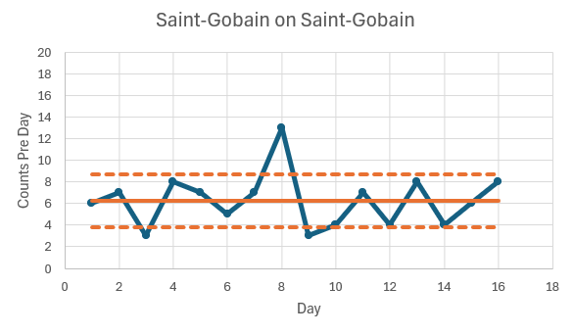

Commercial Samples
11.6 +/- 4.1 counts per day
6.25 +/- 2.4 counts per day
Notes:
Remove initial decay on sp plot, rename commercial to the company name, consistent background location, better conclusion -> first test of selective precipitation procedure to reduce bg worked, at least factor of 2 reduction on commercial. Also shows that lucas cell system is good for testing zns. Cut daq stability spend more time on this. Power outage on the selective precipitate. Think about how to deal with double scintillation
Put on the same y axis or at least make axis scale the same

Slide 25
In-House Samples
3.23 +/- 1.42 counts per day
(Days 11-14 were affected by a power outage)
18.33 +/- 4.5 counts per day
Notes:
Remove initial decay on sp plot, rename commercial to the company name, consistent background location, better conclusion -> first test of selective precipitation procedure to reduce bg worked, at least factor of 2 reduction on commercial. Also shows that lucas cell system is good for testing zns. Cut daq stability spend more time on this. Power outage on the selective precipitate
Same thing here with same y axis to make things look better also

Slide 26
Background Results
Commercial samples scintillate on both sides, in-house only scintillates on the bottom
Efficiency of the disk setup should be calculated
Shows promise, factor of ~6 reduction comparing selective to bulk precipitate
Commercial Sample
In-house Sample
Scintillator
Undoped ZnS
Scintillator
Notes:
Remove initial decay on sp plot, rename commercial to the company name, consistent background location, better conclusion -> first test of selective precipitation procedure to reduce bg worked, at least factor of 2 reduction on commercial. Also shows that lucas cell system is good for testing zns. Cut daq stability spend more time on this. Power outage on the selective precipitate
Explain diagram better,

Slide 27
Acknowledgements and Next Steps
Understand disk efficiency
Investigate other DAQ channels uncertainty
Use calibrated Pylon source with current procedure
Create less oxidized ZnS(Ag) in-house
Thanks to
Nasim Fatemighomi
Steve Maguire
Peter Qin
Keegan Paleshi
Kacper Rogut
Notes:
Next steps on left and thanks on the right

