Slide 1
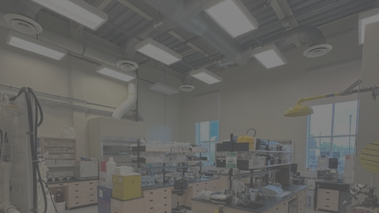

Developing Silver Doped Zinc Sulfide Scintillator for Lucas Cell ²²²Radon Counting
Kacper Rogut (He/Him)
Undergraduate Chemistry Assistant

Slide 2
Background: Radon at SNOLAB

Slide 3
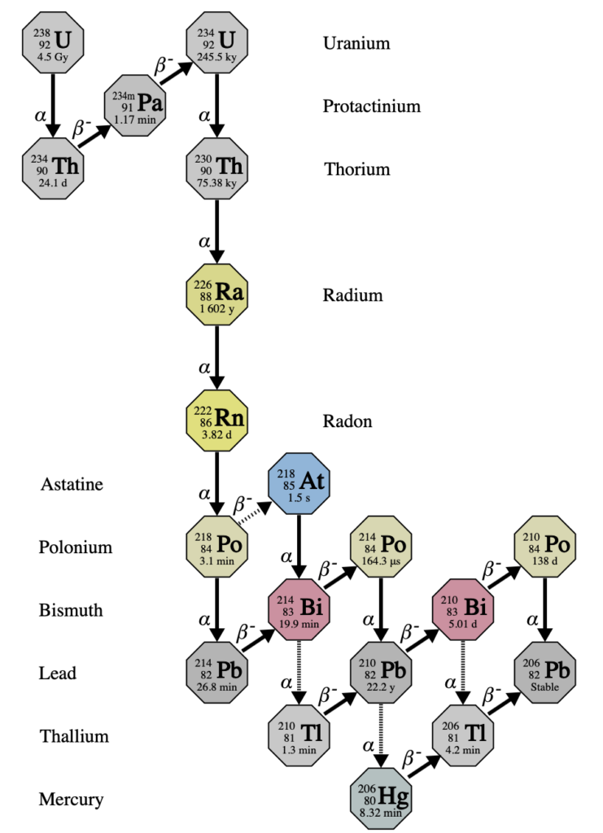
Intro to the project
First thing to understand is Radon
  Noble Gas
  α-particle decay
  ²²²Rn half-life ~4 days
Emanates from materials and from underground
A significant background source in low background experiments

Slide 4
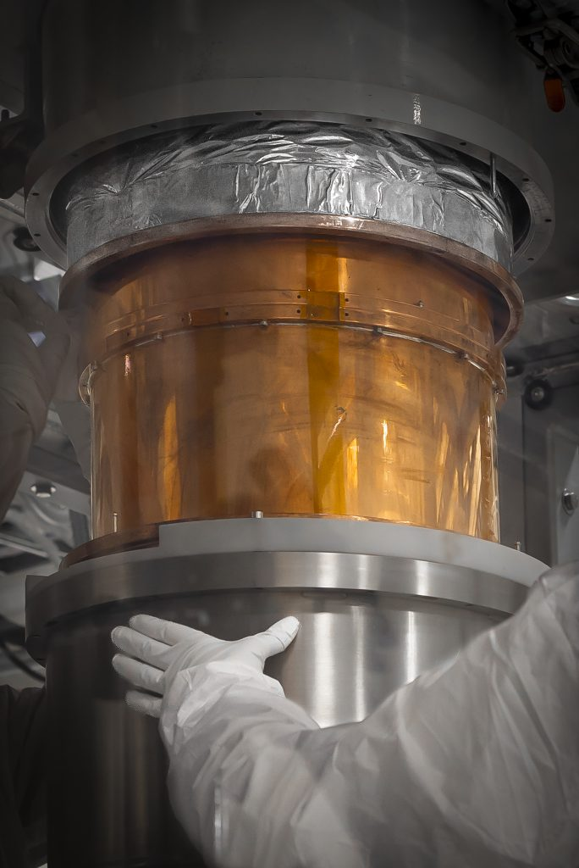
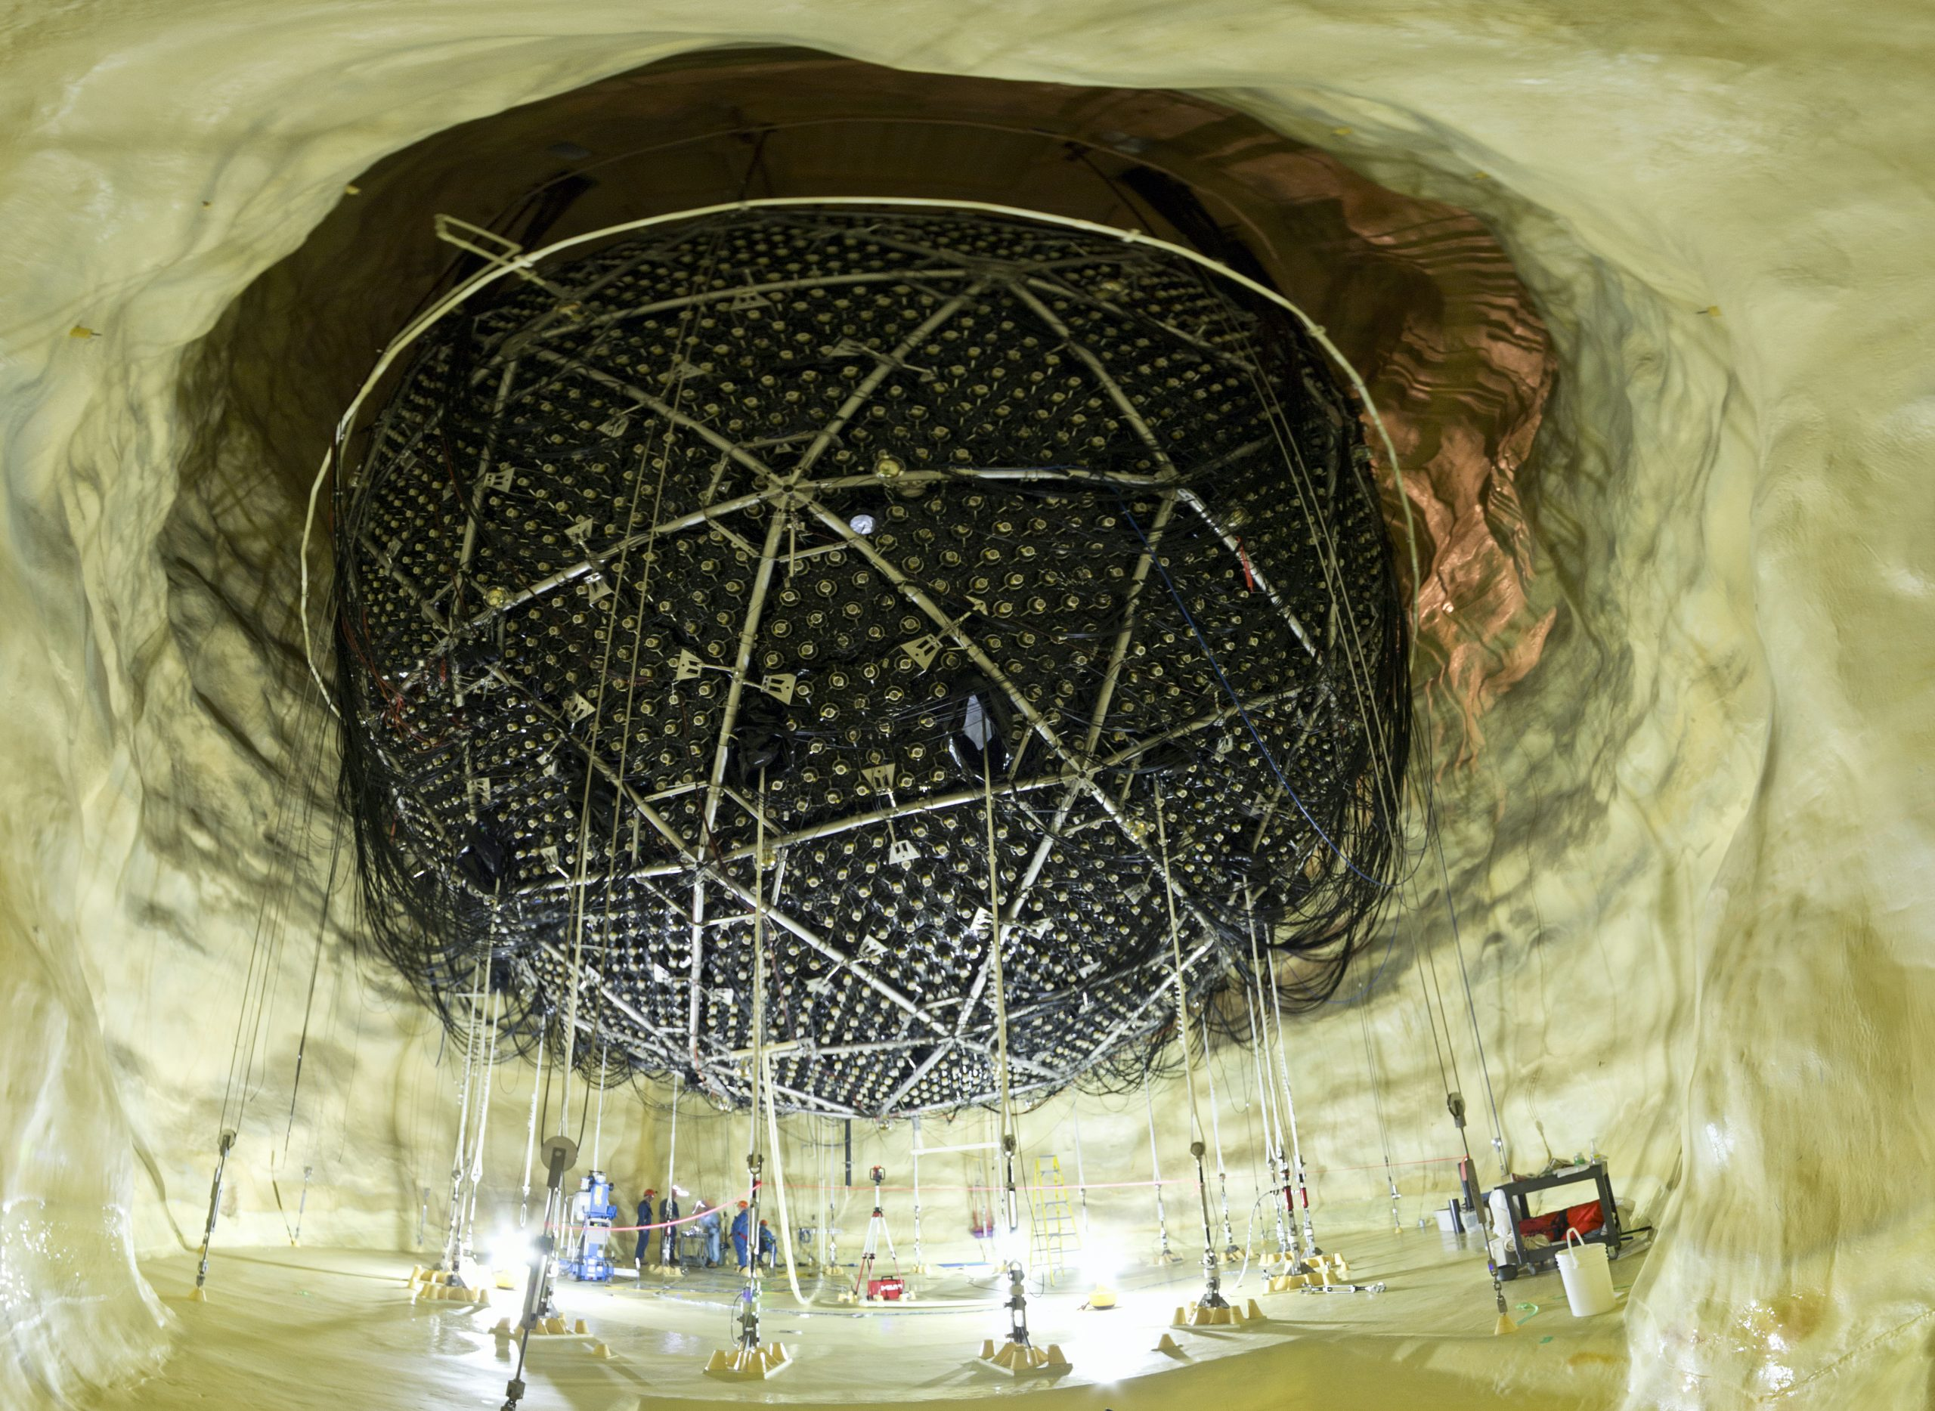
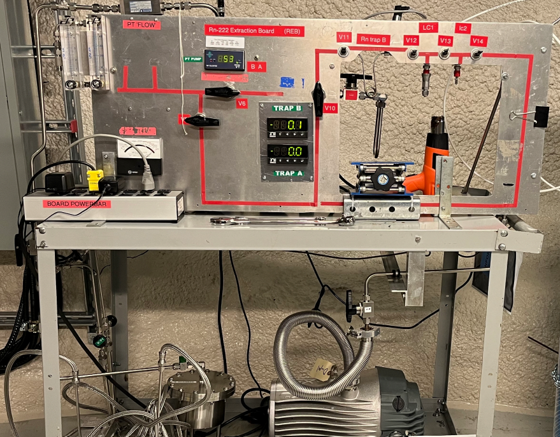
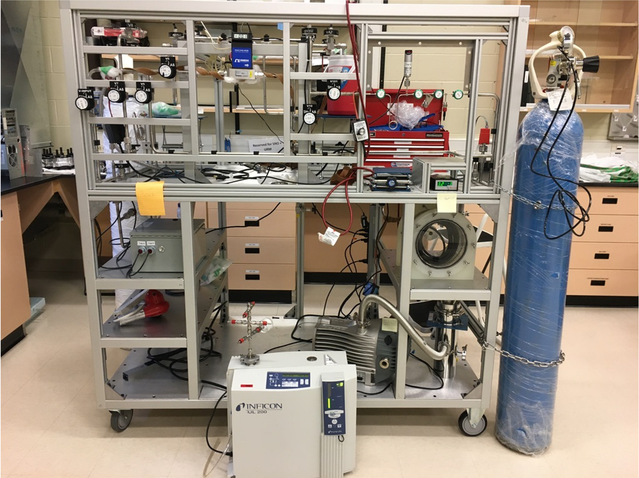
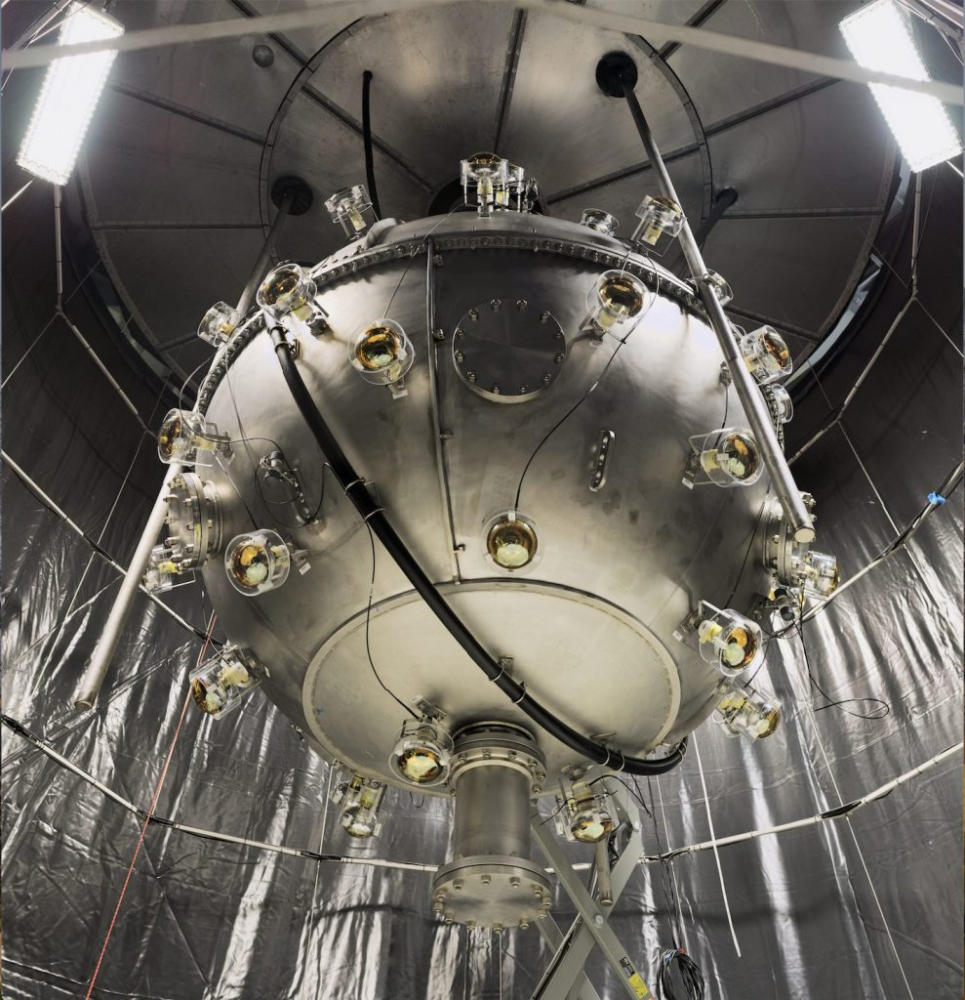
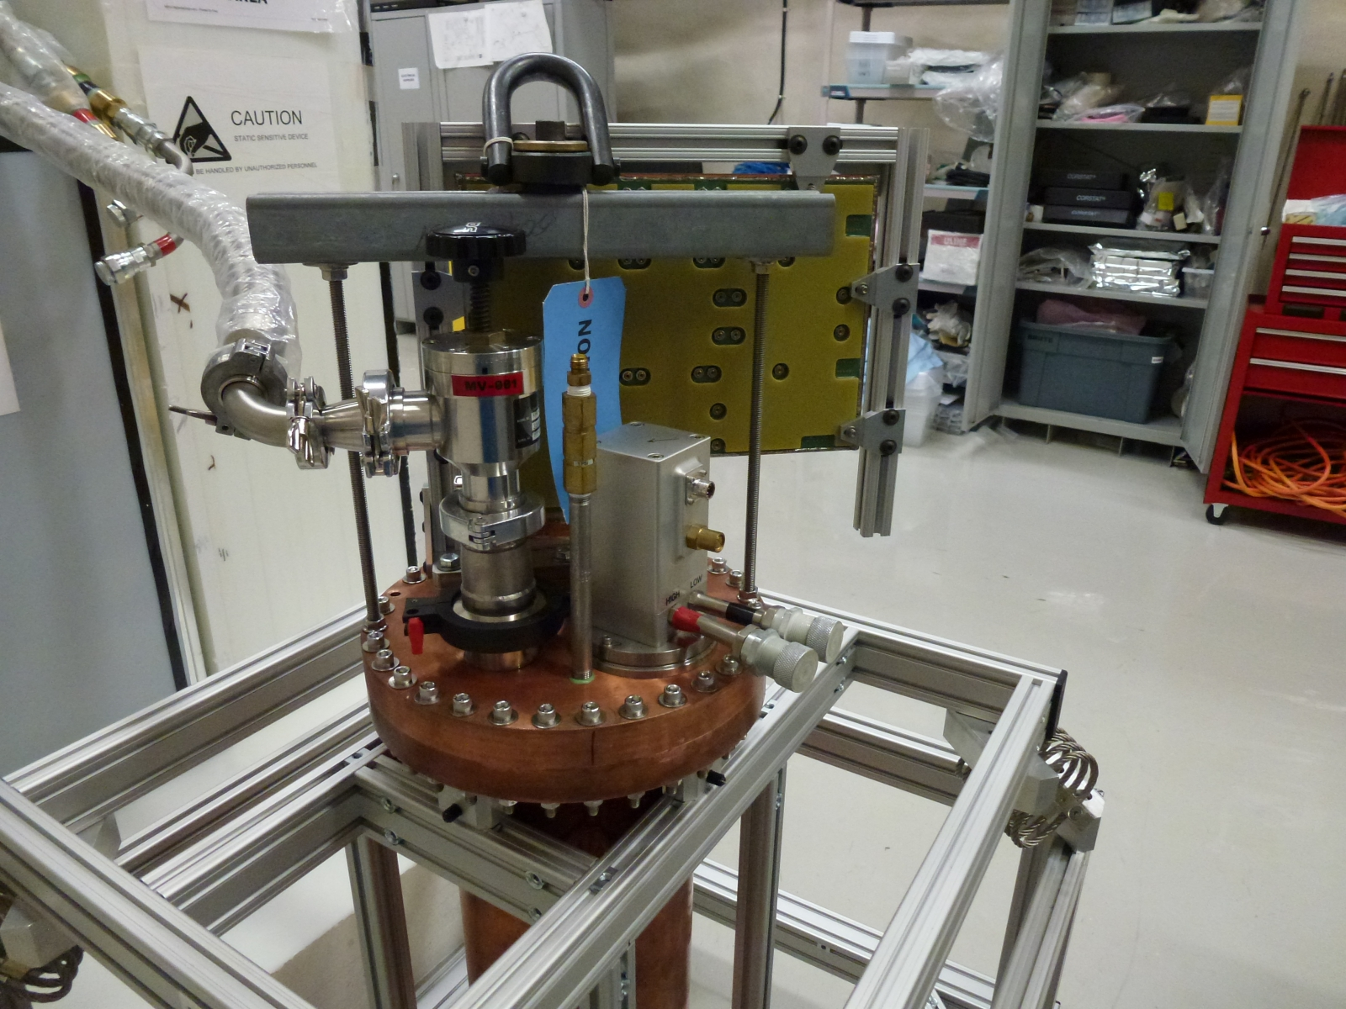
Intro to the project
- Radon assay boards used for​
  High sensitivity radon emanation measurement​
SNOLAB experiments that use Rn measurements
  SNO+
  CUTE
  DAMIC
  DEAP-3600
  XLZD

Slide 5
Improving radon assay
capabilities is a priority at SNOLAB

Slide 6
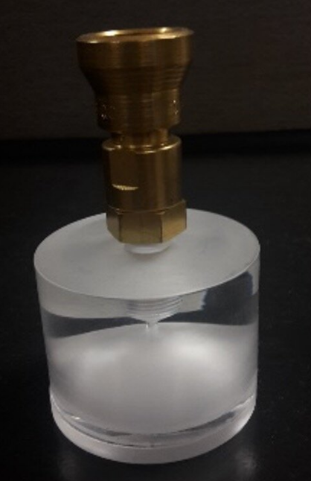
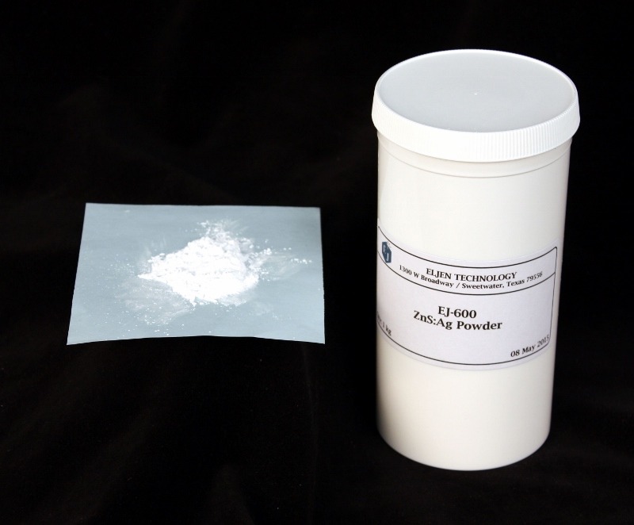
Background
Your new favourite words: Lucas Cell and ZnS:Ag
ZnS:Ag
Lucas Cell (LC)

Slide 7
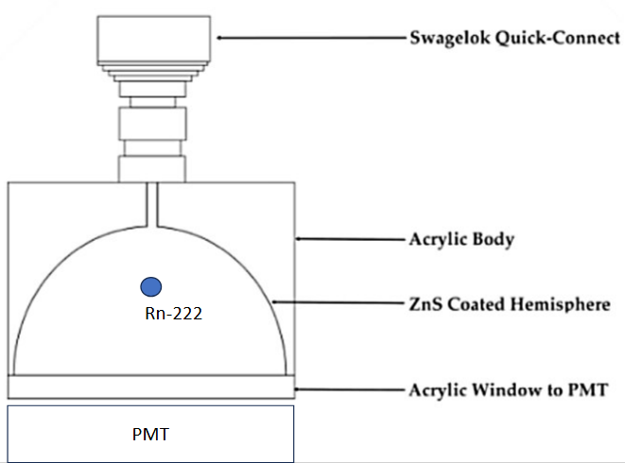
Questions
Lucas Cell (LC)​
​
- Who is Lucas?
- What is a Lucas Cell?
  Measures Radon decay using α-particle scintillator, ZnS:Ag
Light
α-particle
- Photomultiplier tube (PMT) collects and amplifies light so it can be analyzed​
^{222Rn}
--> 218Po

Slide 8
Background- Scintillation
Excitation Band
  ZnS scintillation requires an activator.
    Silver provides a bright blue light and is ideal for alpha
  Band gap is forbidden
  Excitation of electron
  Energy transfer to an activator (Ag)
  De-excites and emits photon
Ag excitation band
α
UV Light
Visible Light
Ag Ground state
Valence Band

Slide 9


Background
LC is coated with ZnS:Ag​​
Should we buy commercial?
NO
ZnS:Ag
Lucas Cell (LC)
  Too much background for our low-background experiments!​​
  This is my role... synthesizing low-background ZnS:Ag​

Slide 10
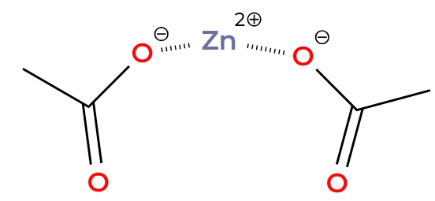
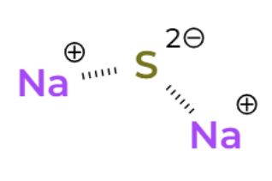
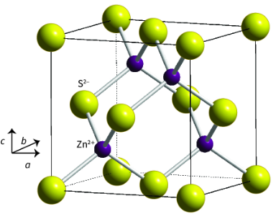
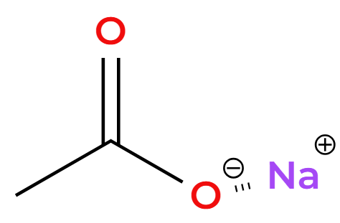


Experiment - Synthesis
Synthesize zinc sulfide
2. Silver doping
Zinc Acetate and Sodium sulfide as initial reagents​

Slide 11
Experiment - Synthesis
Zinc Sulfide is formed as a precipitate.
    Everything else stays in solution.​
  Product is filtered and collected as a wet solid​
=> Bulk ZnS​

Slide 12
How do you remove background?

Slide 13
Selective Precipitate

Slide 14


Experiment - Selective Precipitate
  This method takes advantage of Ksp, product solubility
          Smaller Ksp = first to precipitate
  The impurities uranium, thorium, and lead have extremally small Ksp in this reaction​

Slide 15
Experiment - Selective Precipitate
Add a few drops
95% mol equivalent
Sodium sulfide
Zinc Acetate Solution
ZnS + unprecipitated impurities
Filtrate​
Liquid Waste
Filter Precipitated ZnS
SP ZnS
Solid Waste
Precipitated Pb Impurities

Slide 16
ZnS Background Testing

Slide 17
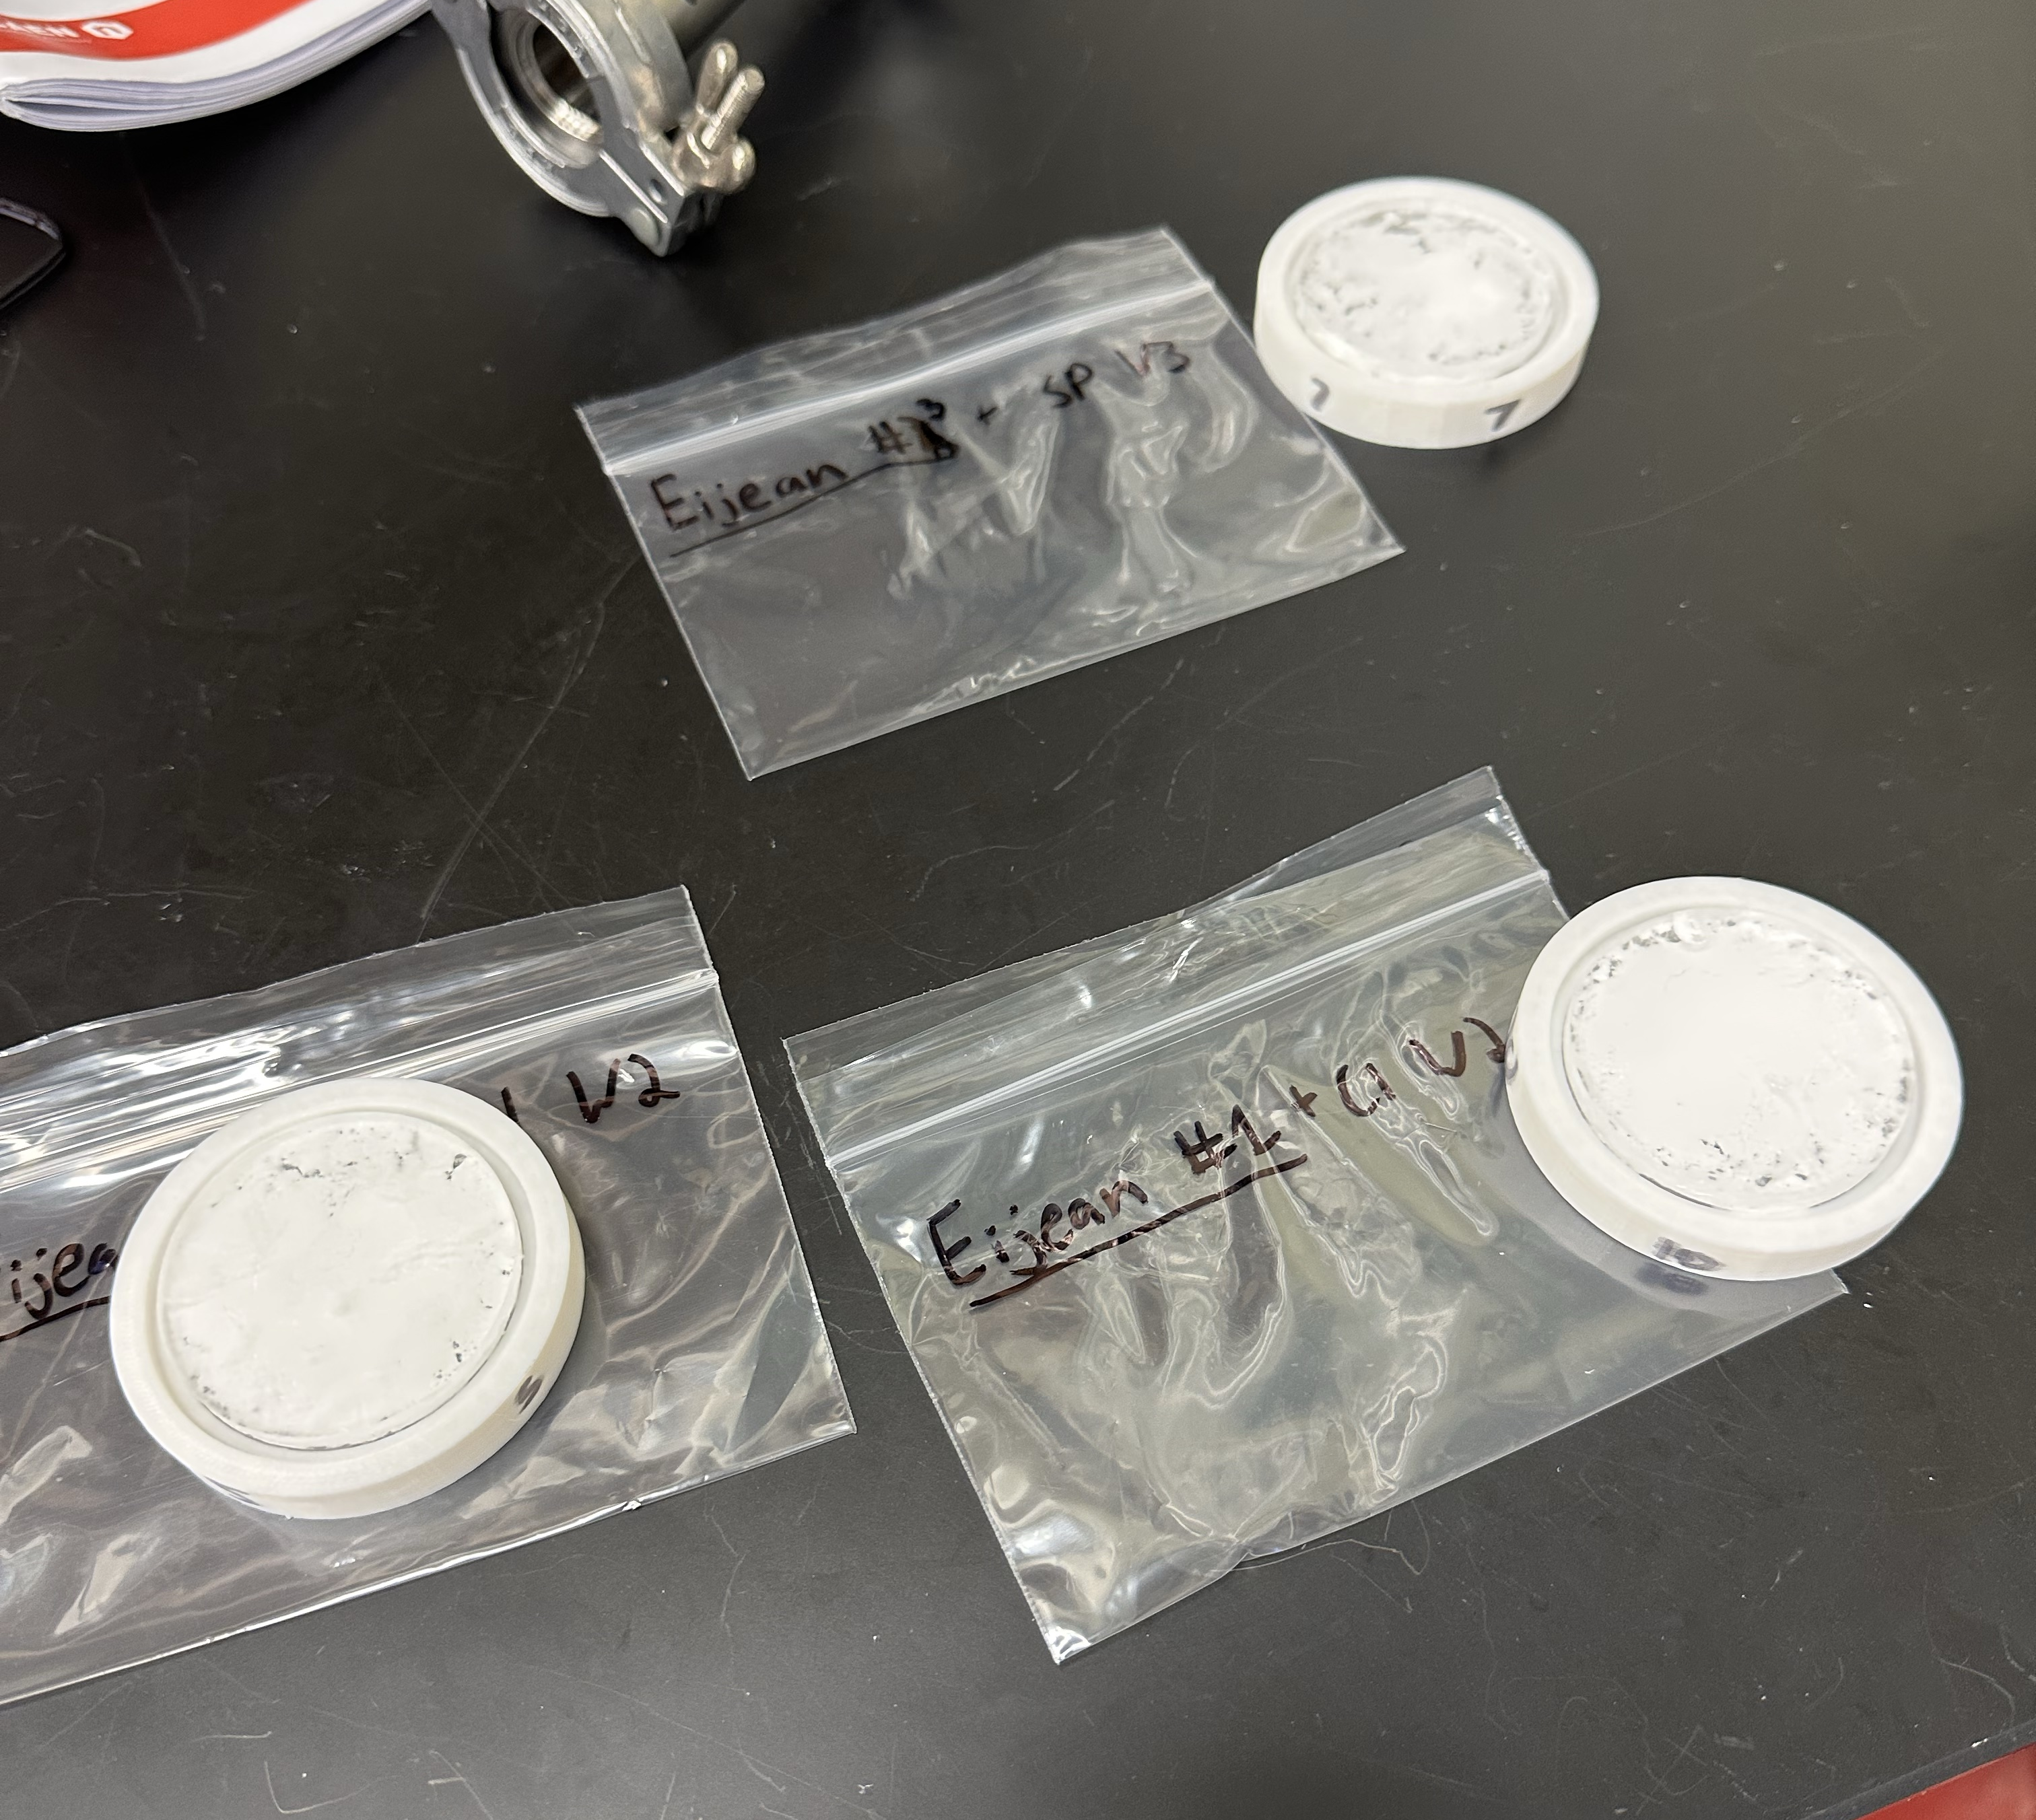
Experiment - Radon Counting
Initial background testing:​
Three samples we tested:
  In-house SP ZnS
  In-house bulk ZnS
  Commercial ZnS:Ag

Slide 18
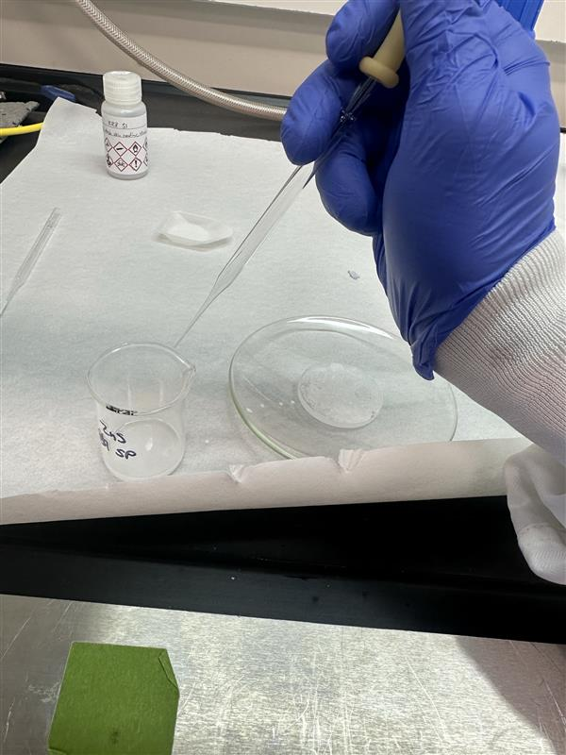
Experiment - Radon Counting
  Developed new procedure for Radon counting
    Acrylic windows, same material as LC
    Sandwich with a scintillating commercial ZnS:Ag

Slide 19
Experiment - Radon Counting
Visible Light​
Commercial ZnS:Ag
ZnS Coating
SP, Bulk, or Commercial ZnS

Slide 20
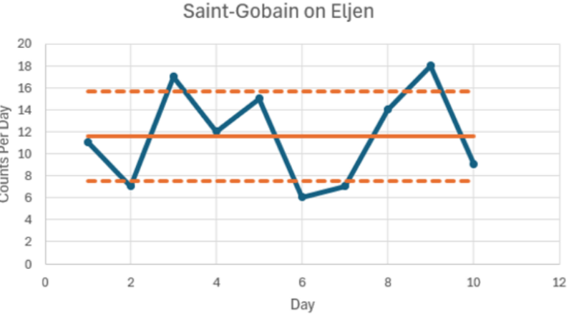
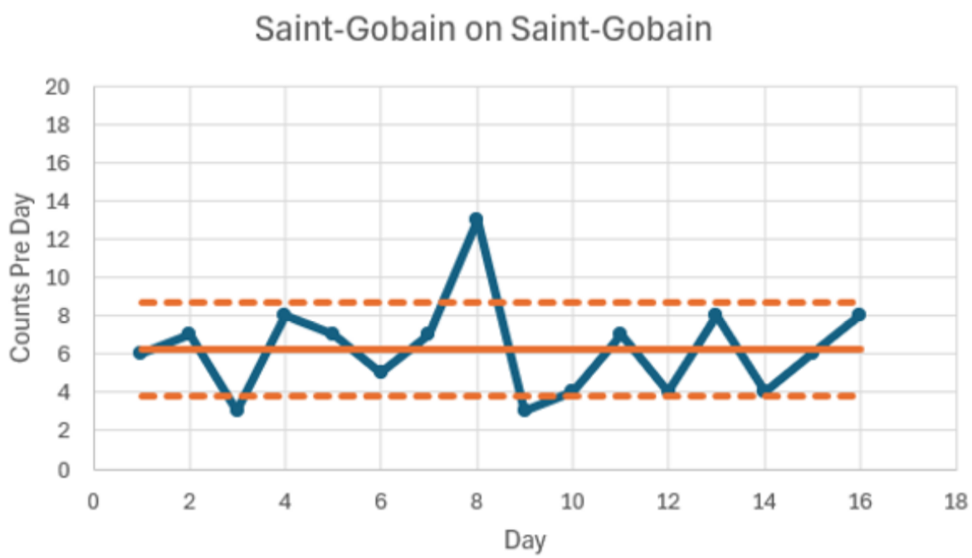
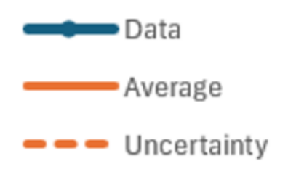
Experiment - Window Radon Counting
Sandwich:
Commercial on commercial ZnS:Ag
~12 Radon counts/day
~6 Radon counts/day​

Slide 21
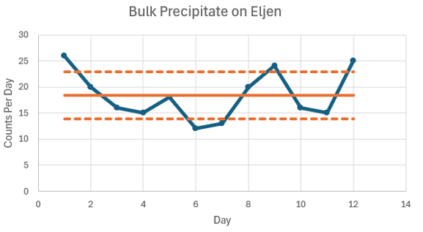
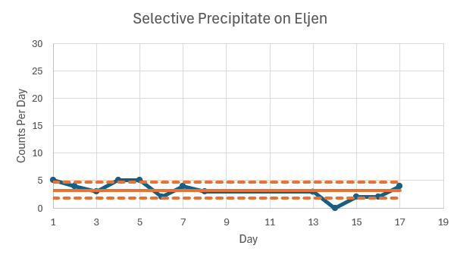
Experiment - Window Radon Counting
Sandwich:
In-House ZnS on commercial ZnS:Ag​
~18 Radon counts/day
~3 Radon counts/day​

Slide 22

Experiment - Window Radon Counting
Bottom Window | Top Window | Radon Count / Day
In-house ZnS SP | Commercial Eljean | 3
Commercial St.G | Commercial St.G | 6
Commercial St.G | Commercial Eljean | 12
In-house ZnS Bulk | Commercial Eljean | 18
Two coatings, therefore SP may be as low as 0 counts / day
  This demonstrates our new Rn assay system is working and lowering ZnS:Ag background

Slide 23
Silver Doping

Slide 24
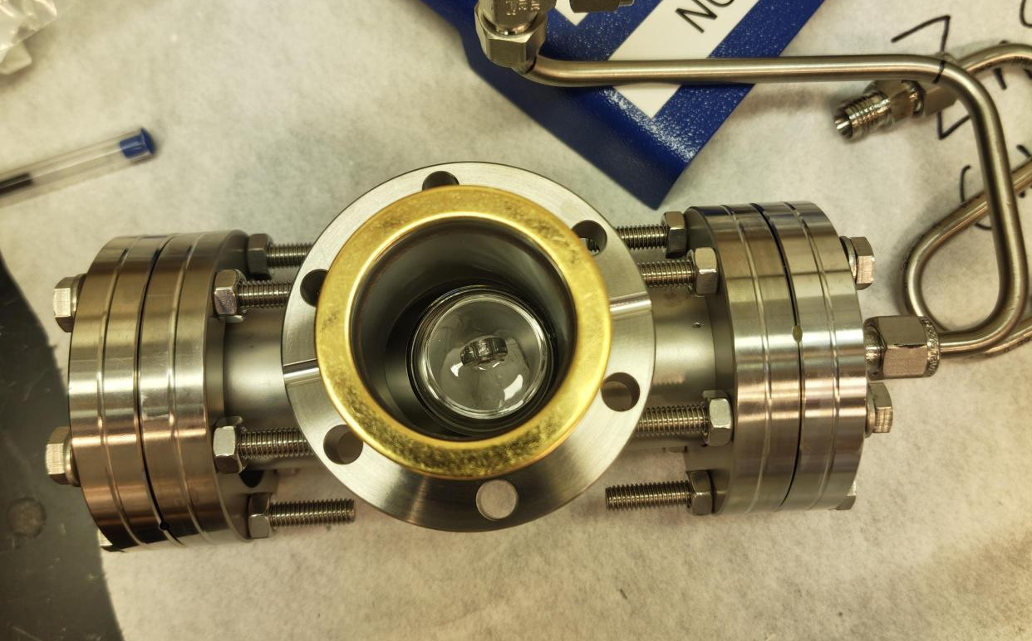
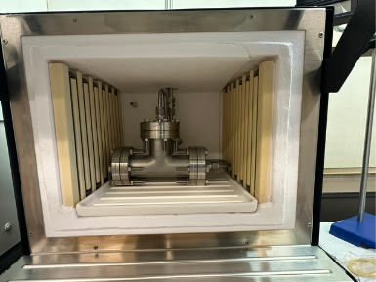
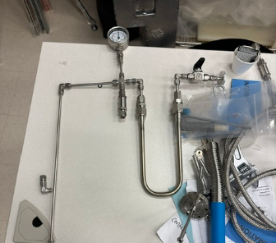
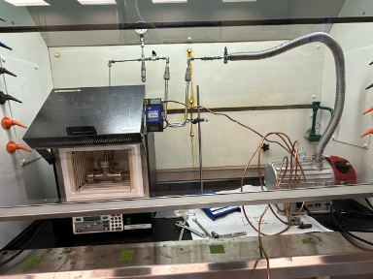
Experiment - Silver Doping Oven
Silver is baked into the ZnS
Air causes oxidation
=> ZnO
Makeshift inert oven

Slide 25
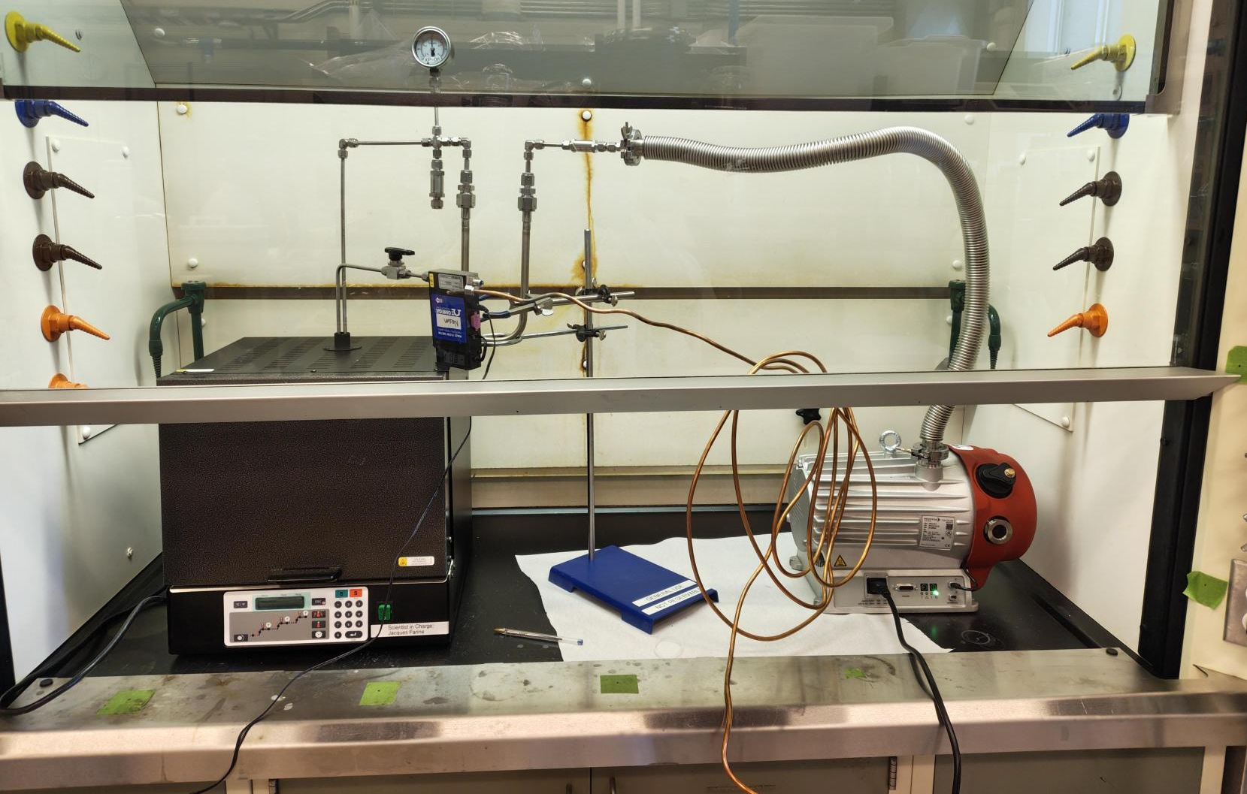
Experiment - Silver Doping Oven Set Up
Charcoal Trap
Oven
Vacuum
Argon Tank

Slide 26
Experiment - Silver Doping Procedure
The sample mixture:
ZnS
Silver acetate
Salt (flux)
Elemental sulfur (O₂ scavenger) ​
Synthesis of Silver-Activated Zinc Sulfide (Zns:Ag) Powder by Thermal Diffusion Method for Production of Thin Film Alpha Scintillators by Mehdi Sohrabi, Fereshteh Saheli and Kheirollah Mohammadi

Slide 27
Experiment - Silver Doping Procedure
Create vacuum, fill with Ar x5
Bake moisture off at 120°C
Synthesis of Silver-Activated Zinc Sulfide (Zns:Ag) Powder by Thermal Diffusion Method for Production of Thin Film Alpha Scintillators by Mehdi Sohrabi, Fereshteh Saheli and Kheirollah Mohammadi

Slide 28
Experiment - Silver Doping Procedure
3. Heat to 350°C
Sulfur melts
Displaces air in pores
4. Heat slowly to 950°C
Sulfur boils, reacts with O₂ and leaves as gas
ZnS and Ag melts at 900°C ​
5. Cool to room temp
Wash with UPW to remove salt
Synthesis of Silver-Activated Zinc Sulfide (Zns:Ag) Powder by Thermal Diffusion Method for Production of Thin Film Alpha Scintillators by Mehdi Sohrabi, Fereshteh Saheli and Kheirollah Mohammadi

Slide 29
Silver Doping Results

Slide 30
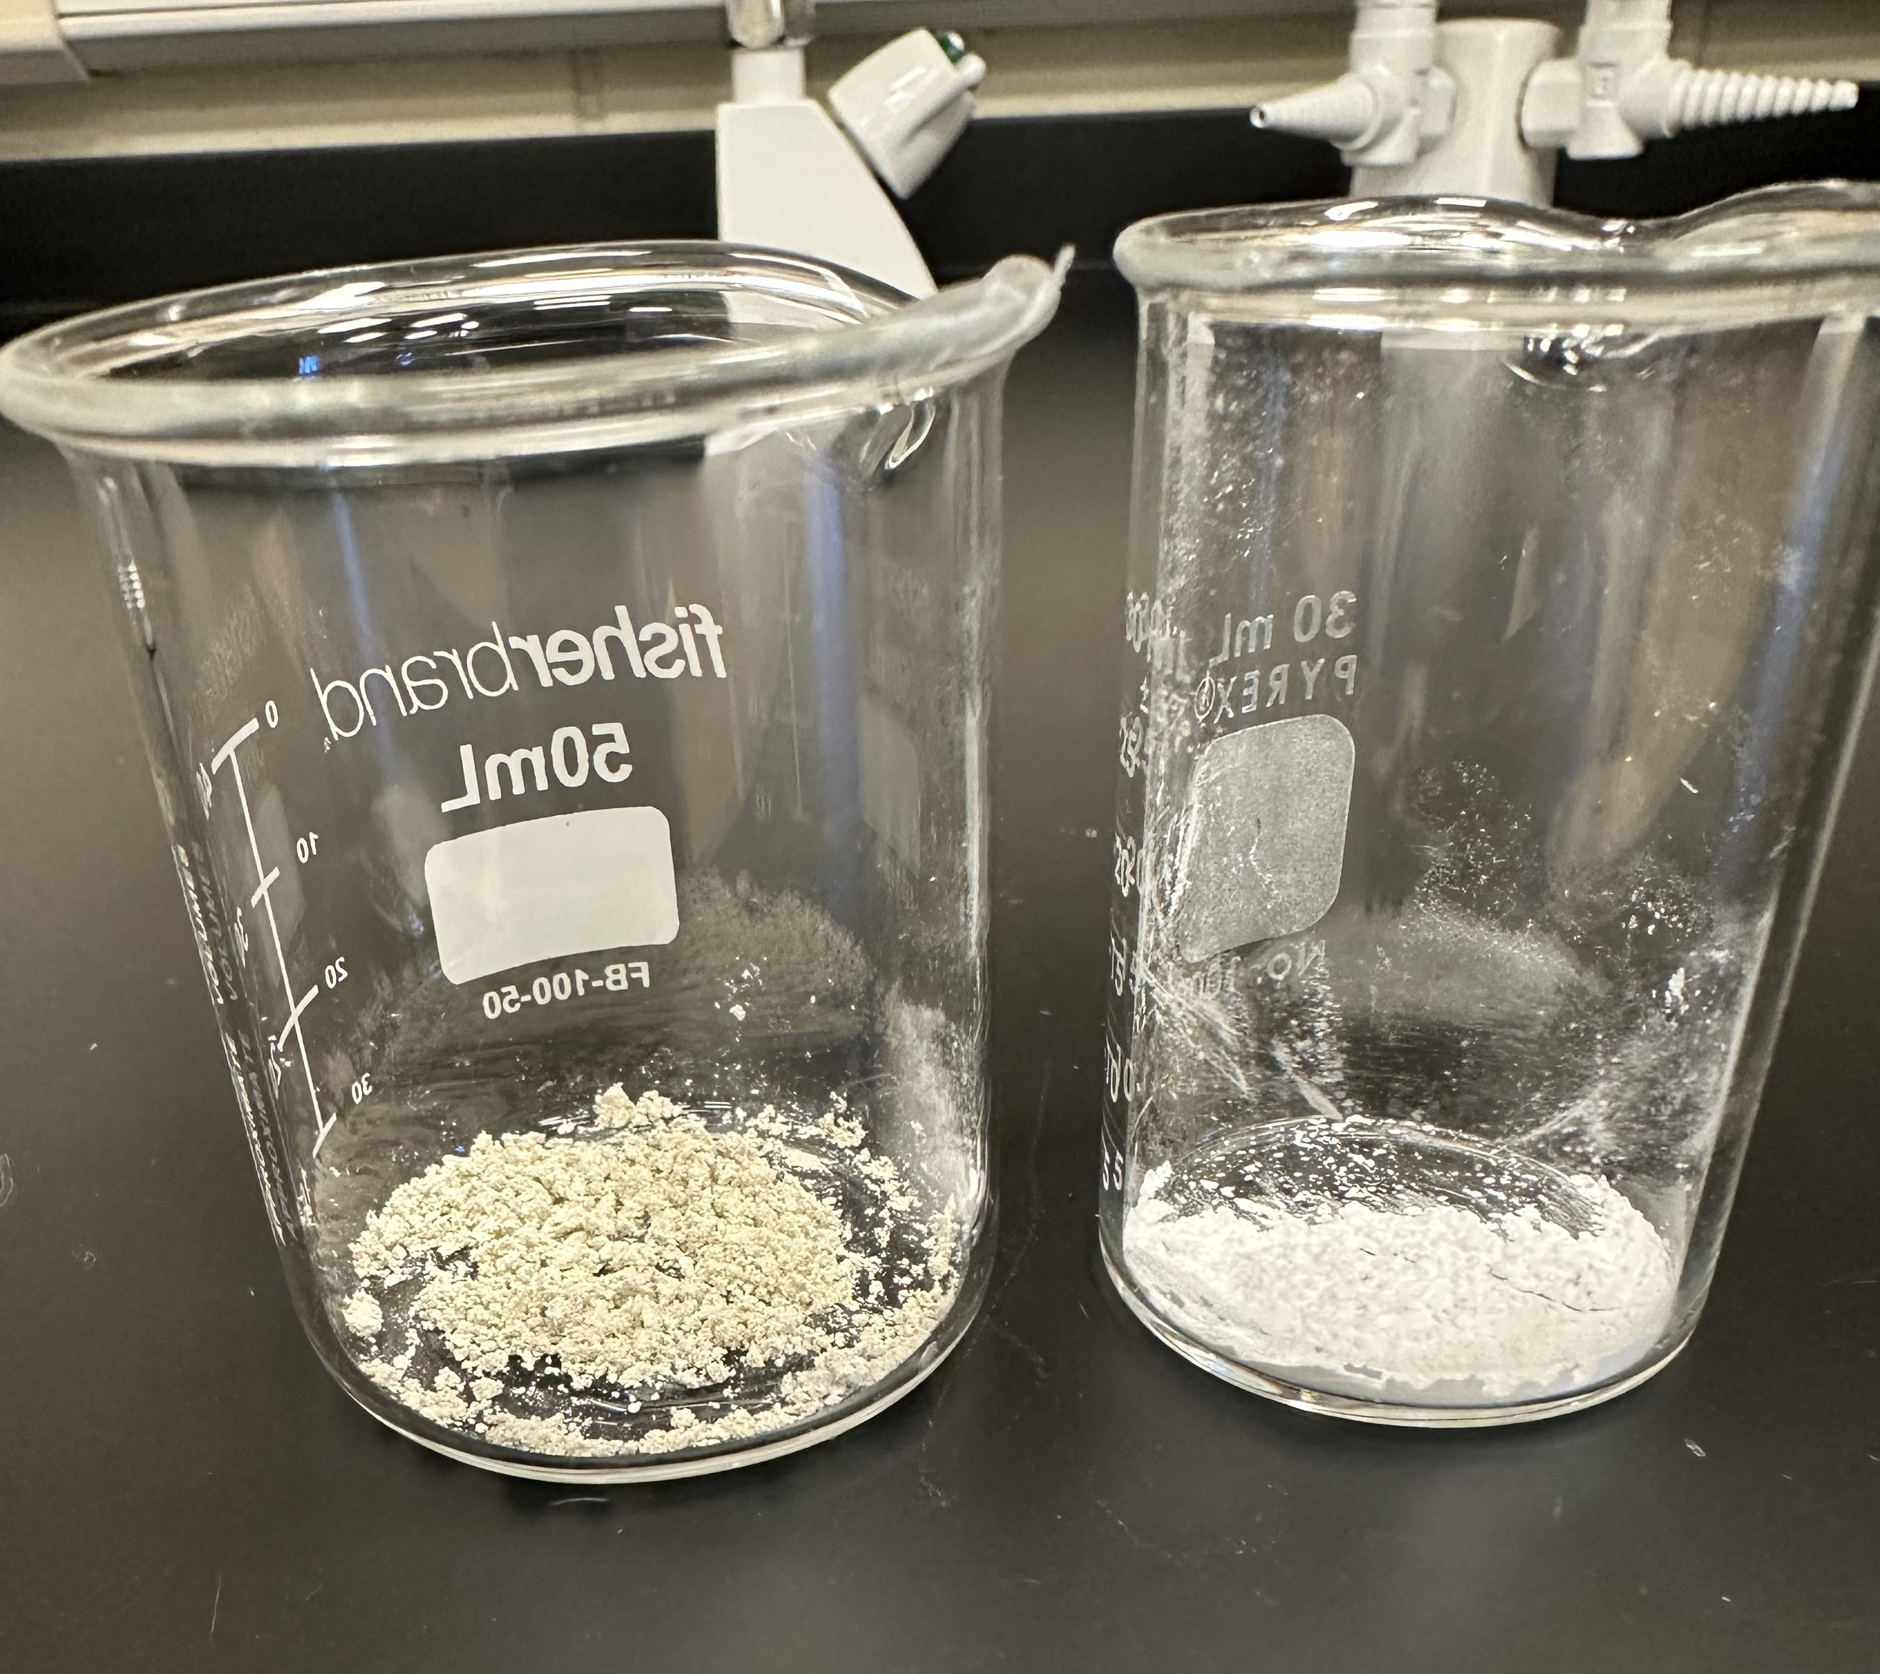
In-House Zns:Ag
Commercial Zns:Ag

Slide 31
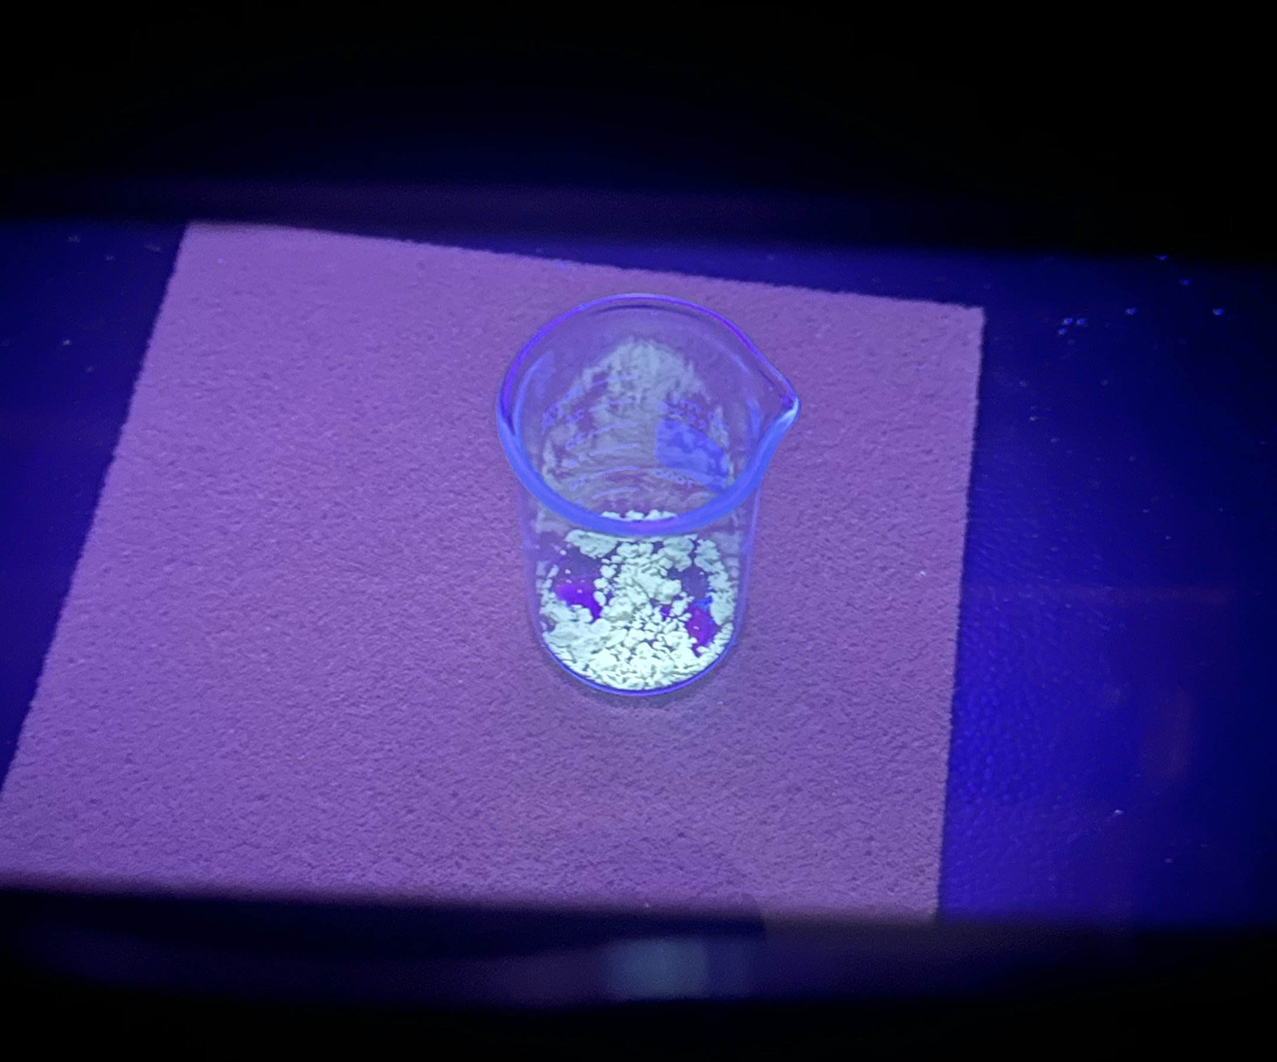
Experiment - Silver Doping Results
Doping worked
There is light
    Green / Blue

Slide 32
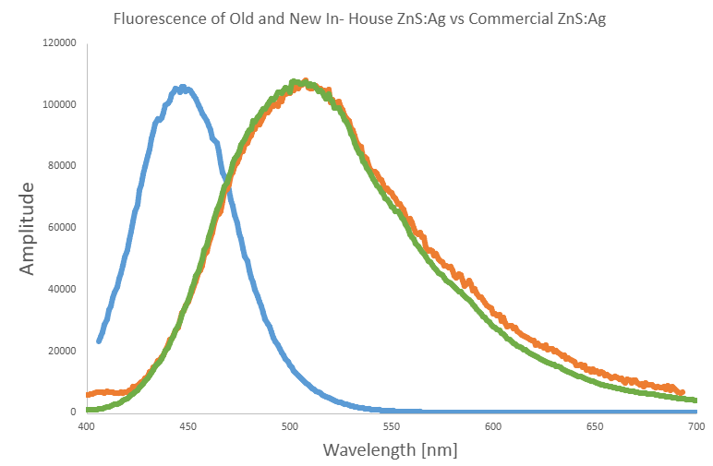
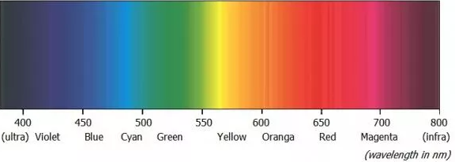
Thank you to
Prof. Stefan Siemann
School of Natural Sciences Laurentian University
*Amplitudes are normalized
https://www.gigahertz-optik.com/en-us/service-and-support/knowledge-base/basics-light-measurement/light-color/

Slide 33
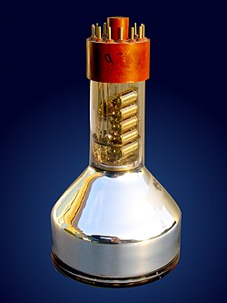


PMT
Light
Light
Thank you to
Prof. Stefan Siemann
School of Natural Sciences Laurentian University
https://www.gigahertz-optik.com/en-us/service-and-support/knowledge-base/basics-light-measurement/light-color/

Slide 34
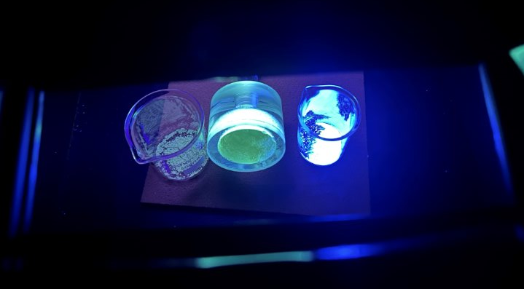
In-House Zns:Ag
Commercial Zns:Ag
Old In-House Zns:Ag

Slide 35
What Went Wrong?
Paper's procedure found ~80% efficiency compared to commercial ​
Too much silver
    Measured ~1500ppm compared to ~600ppm Ag
    This quenches light efficiency
OR​
Too little silver​
      Acetate group calcined off​
      Silver couldn't be doped in easily​

Slide 36
Next Steps
  PXRD (Powdered X-ray diffraction)
    to analyze chemical structure
  XIA α-particle counter tests in progress
  Future procedure must adjust to match commercial results​
    Different Ag concentrations and reagents​
    Different O₂ scavenging methods​

Slide 37
Selective precipitate has promising results for lowering background

Slide 38
Acknowledgements
Steve Maguire
Nasim Fatemighomi
Scientific Support Team
Peter Qin
Connor Stubbs
Martin Blanco

Slide 39
Thank You for Listening

Slide 40
Extra Slides

Slide 41
WHO IS LUCAS??
Henry F. Lucas
May 3, 1926 — Nov 12, 2020
September 1957
Improved Low-Level Alpha-Scintillation Counter for Radon https://pubs.aip.org/aip/rsi/article-abstract/28/9/680/299355/Improved-Low-Level-Alpha-Scintillation-Counter-for?redirectedFrom=fulltext
"he focused his research on the health effects of Radon Gas and went on to invent the Lucas Cell, which is recognized as a sensitive, reliable method for measuring Radon"
https://www.trimblefuneralhomes.com/obituaries/henry-f-lucas

Slide 42
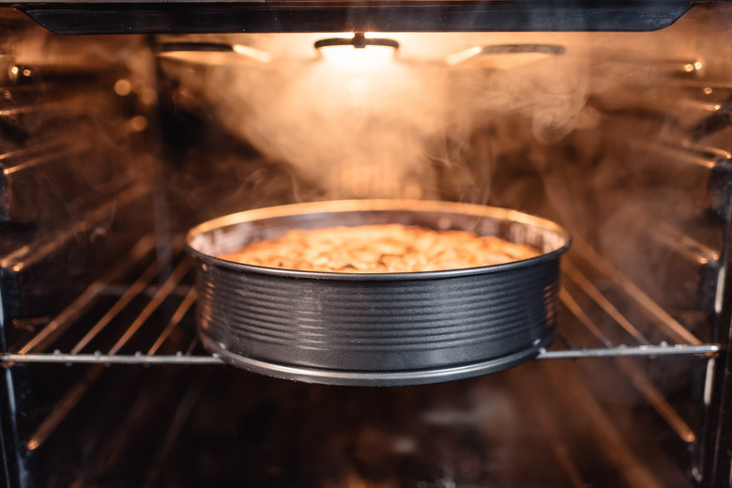
Experiment - Selective Precipitate
  Wet solid
  Baked at 40-45C
  46g: ~97% yield
https://www.sciencing.com/chemical-reactions-involved-baking-cake-7173041/

