Slide 1
Cracking the Crate:
Tracking the SNO+ Suspects with X-Rays
Julia Gorovitz
Supervisors: Christine Kraus, Matt Depatie, Mark Ward, Ryan Bayes, Stefan Kaluzienski
CASST 2026
1

Slide 2
Contents
Introduction
Copper Creep Corrosion
XRF Spectroscopy Analysis
Data Findings and Discussion
Conclusion and Future Directions
Acknowledgements
2
Notes:
Outline it better

Slide 3
Introduction
01
The SNO+ Experiment
3

Slide 4
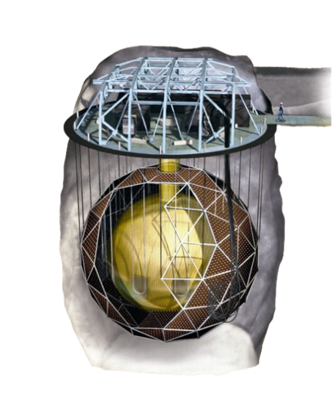
SNO+:
9000+ PMTs
  Infrastructure inherited from SNO
Acrylic vessel
  780 tonnes of LAB
Surrounded by 7 kt of UPW, with a 2 km rock overburden
4
Diagram credits: https://snoplus.phy.queensu.ca/about.html
Notes:
Point out age of electroncs, don’t talk about nickel mine stop getting distracted

Slide 5
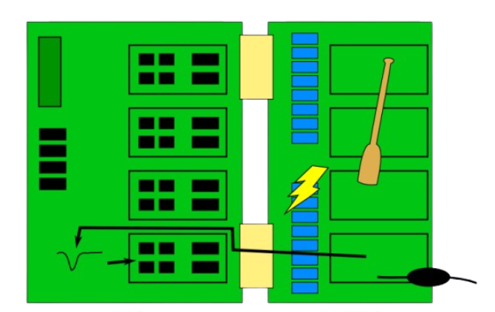
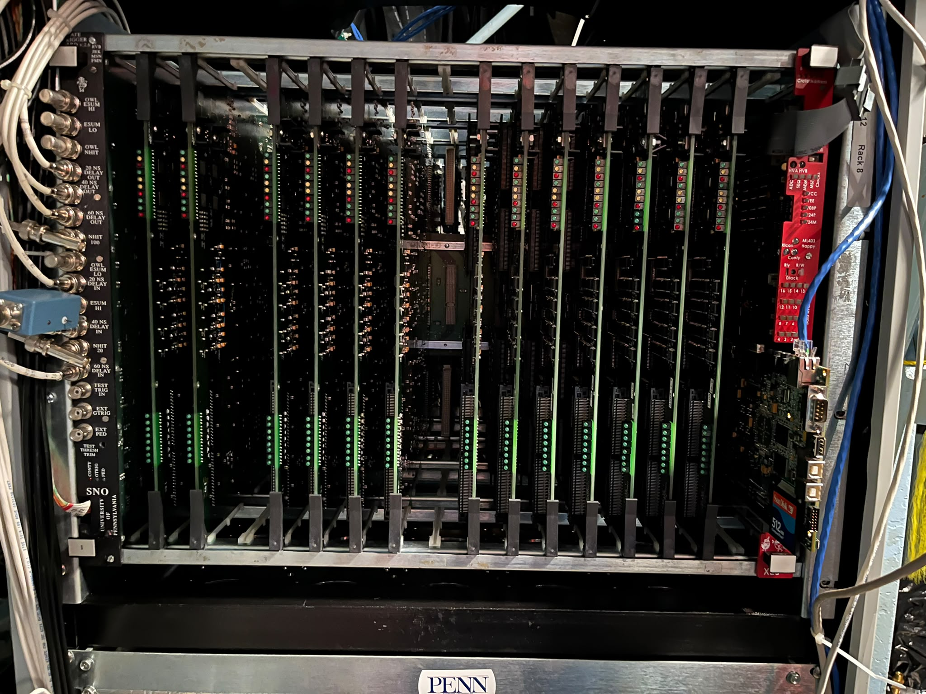
HV Cables connected to PMT Interface Cards
5
Diagram credits: Andy Mastbaum (2014)
Notes:
Lead soldering, circuits made of copper

Slide 6

electronics
Well said, Uncle Ben!
What challenges come with so much (old) hardware to maintain?
6

Slide 7
Copper Creep Corrosion
02
“Dark matter”
7
Notes:
Mention dark matter joke

Slide 8
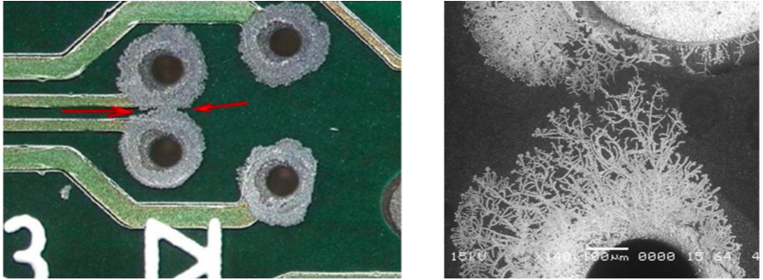
What is it?
Mine air contains H₂S and moisture
Circuit boards made of copper -> oxidation!
2Cu + H₂S + ½ O₂ → Cu₂S + H₂O
8
Photo credits: https://knowledge.ni.com/KnowledgeArticleDetails?id=kA00Z000000kIpsSAE
Notes:
Maybe talk about mine here instead, don’t talk so much about oxidation here

Slide 9
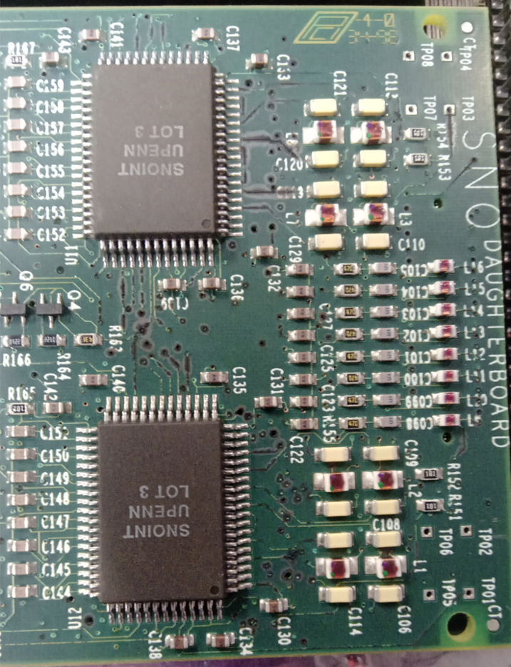
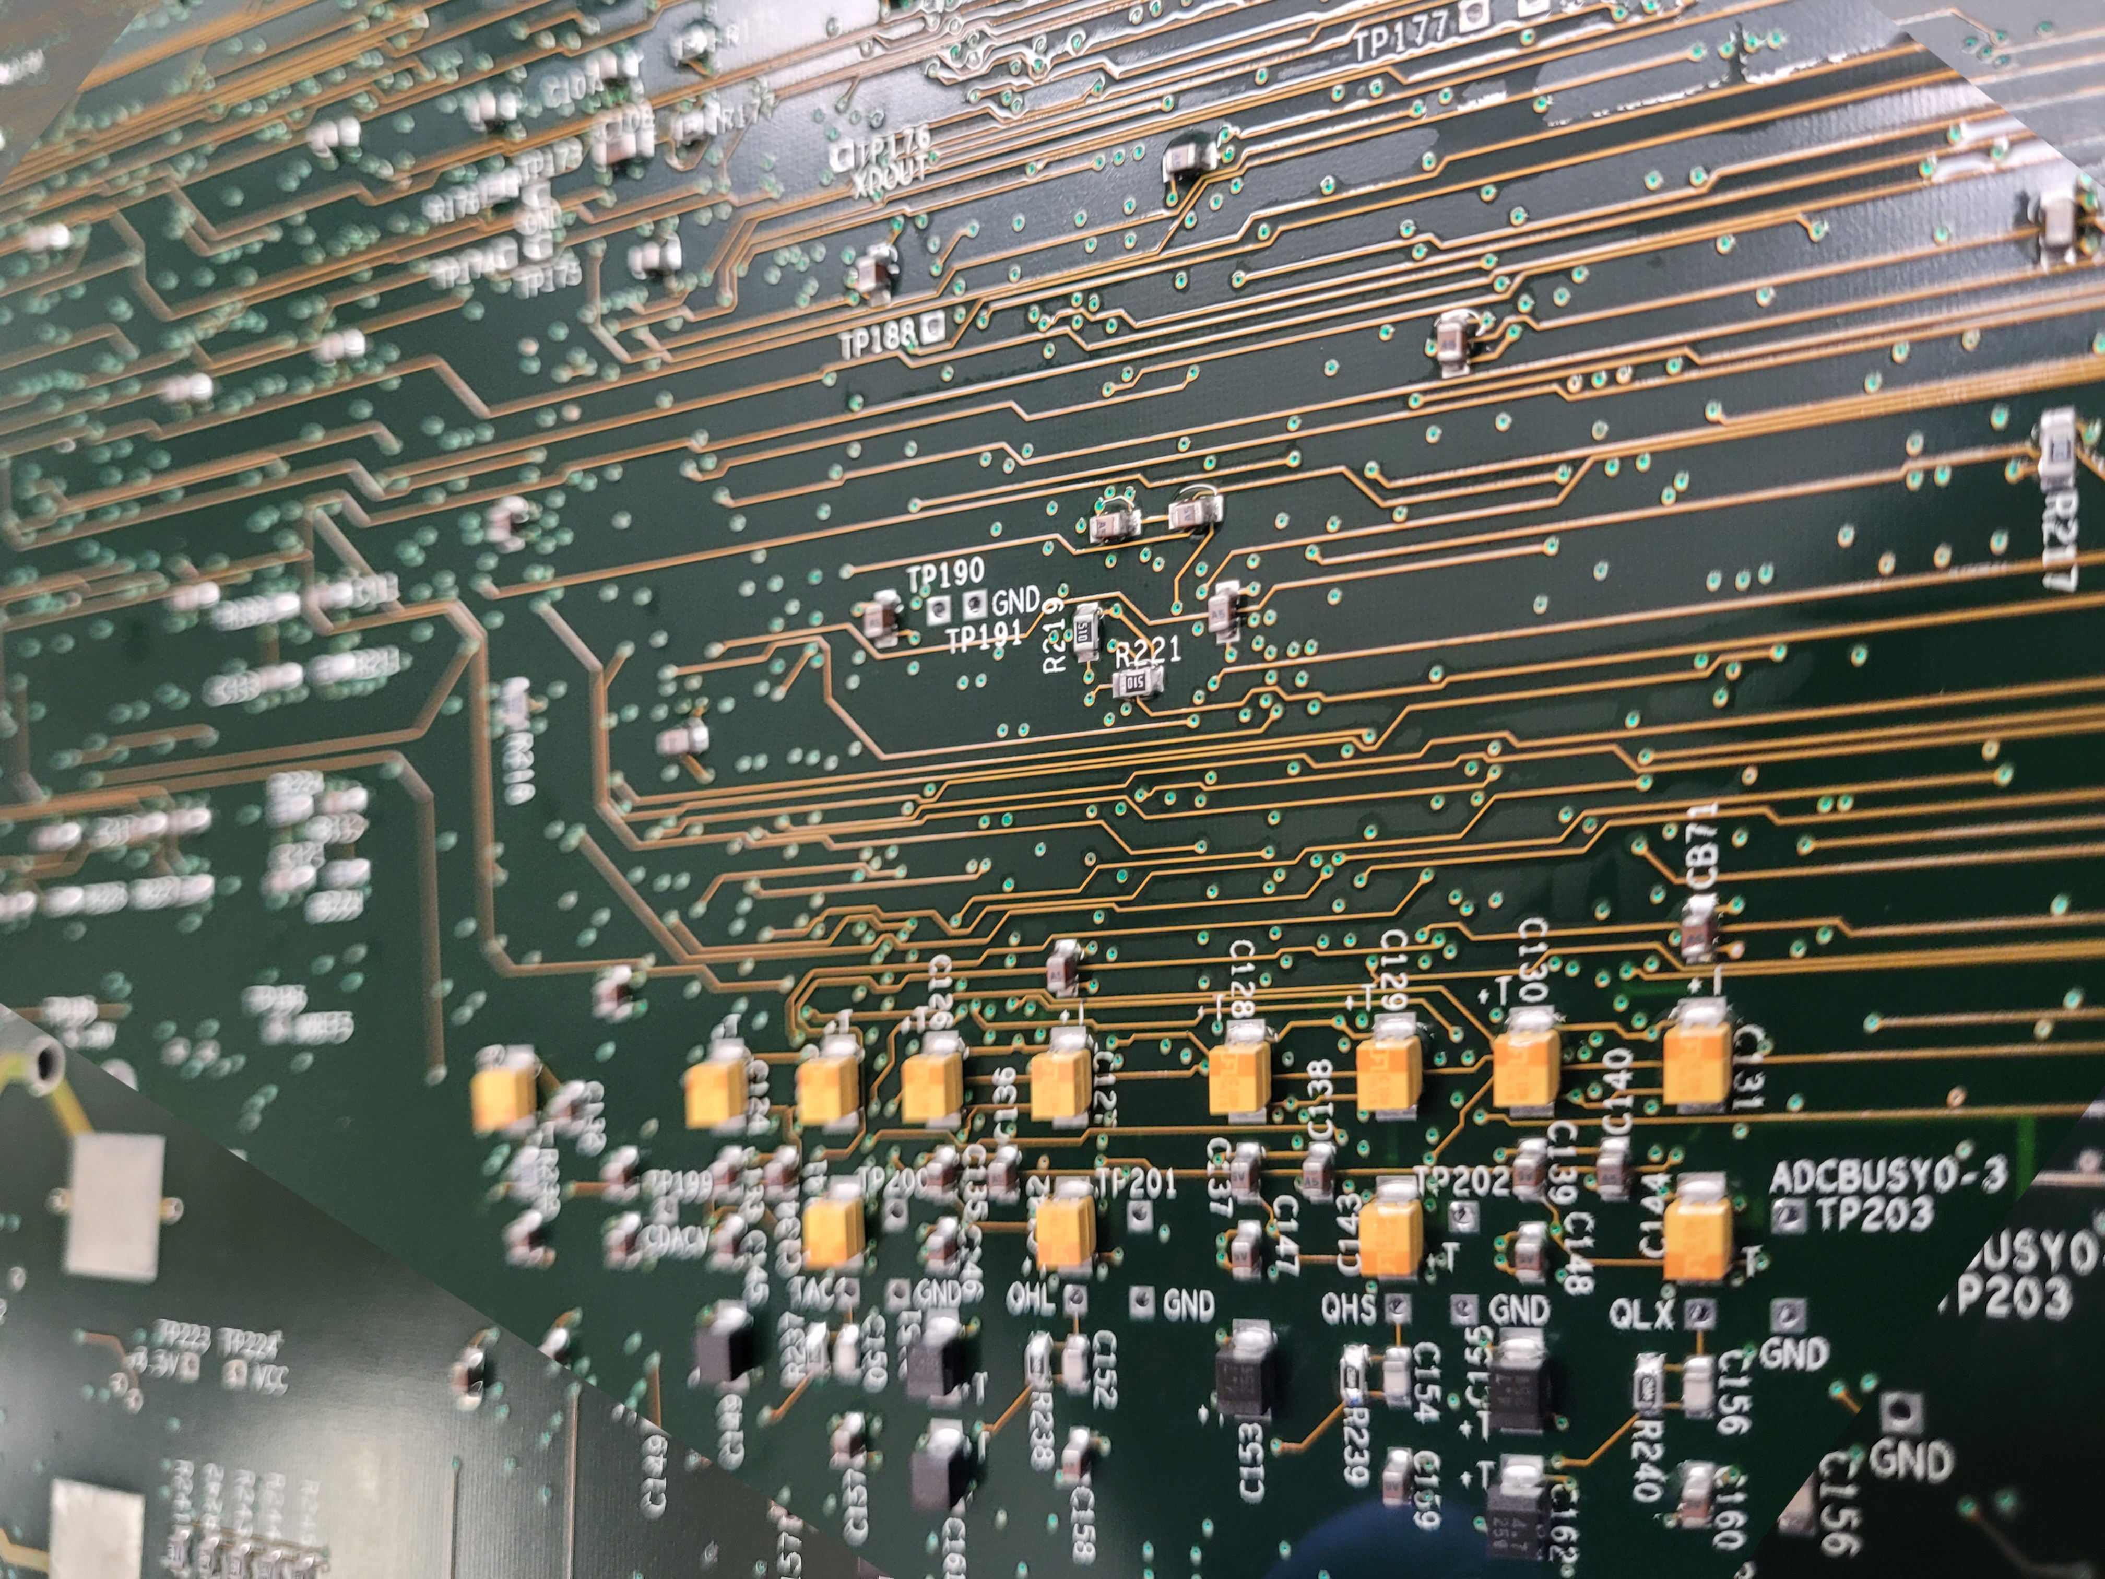
In our boards
Causes short circuits and creates unwanted connections because of the copper sulfide
How do we quantify it?
Photo credits: Oluwasemoore Tijani and Mark Ward
9
Notes:
Mention lead, really really point out this problem

Slide 10
X-Ray Fluorescence
03
Using spectroscopy to find the culprit
10

Slide 11
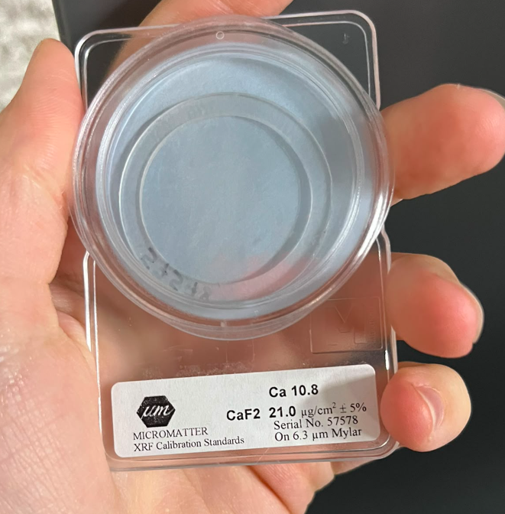
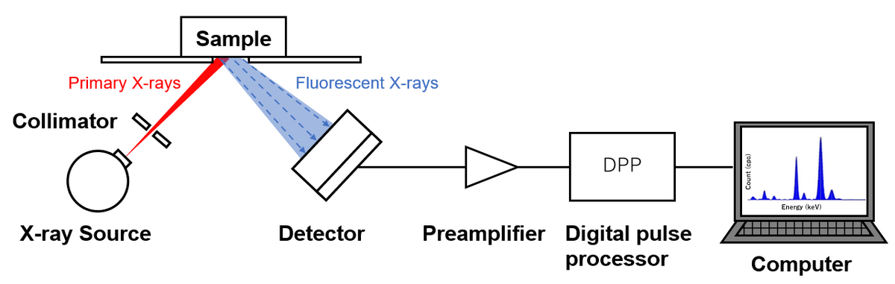
Methods
Tapelifts are taken
Tapelifts pick up corroded copper
Diagram reference: https://www.horiba.com/int/scientific/technologies/energy-dispersive-x-ray-fluorescence-ed-xrf/xrf-key-components/
12
Notes:
Focus more!!! Don’t be boring

Slide 12
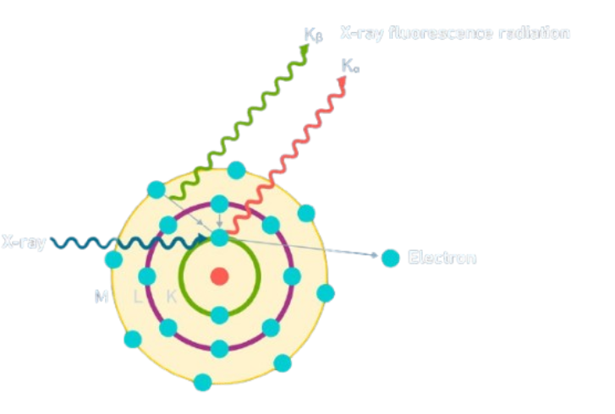
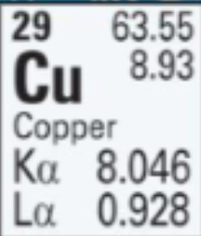
The theory
Non-destructive technique based on X-Ray emissions of electrons “jumping down”
11
Diagram reference: https://ywcmatsci.yale.edu/gallery/xrf/principle
Notes:
https://www.technologynetworks.com/analysis/articles/x-ray-fluorescence-xrf-theory-practice-and-applications-396212

Slide 13
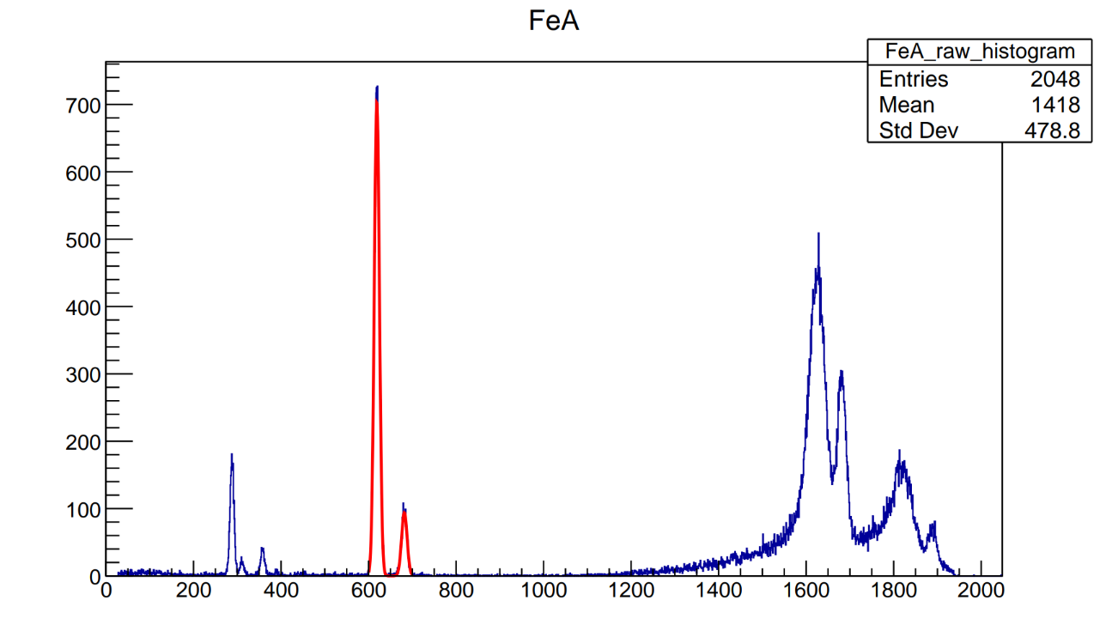
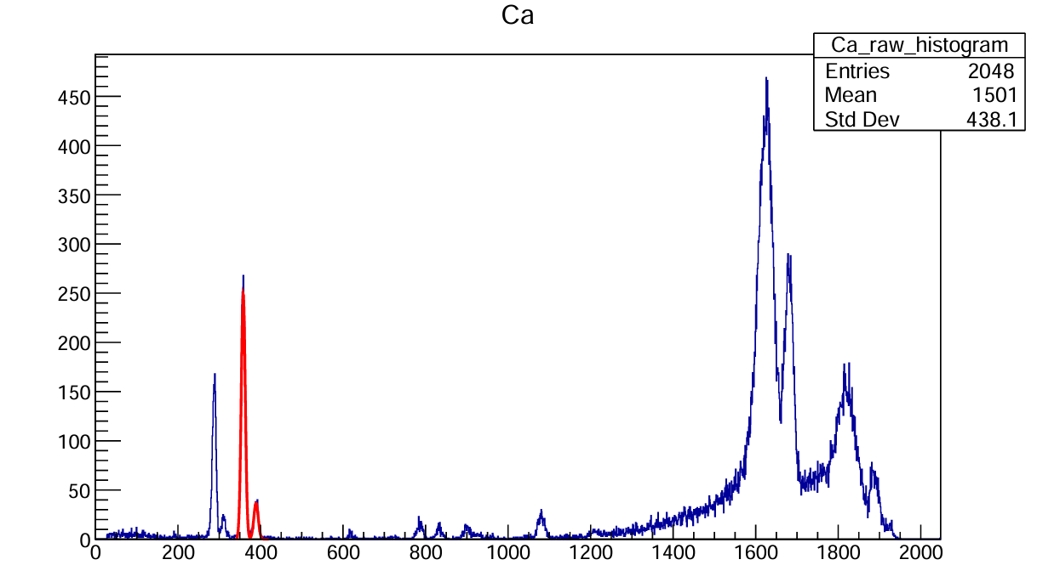
Data processing
Fe and Ca standards
  Used to calibrate the energy
13
Notes:
Be concise here please, just say the energy hets calibration

Slide 14
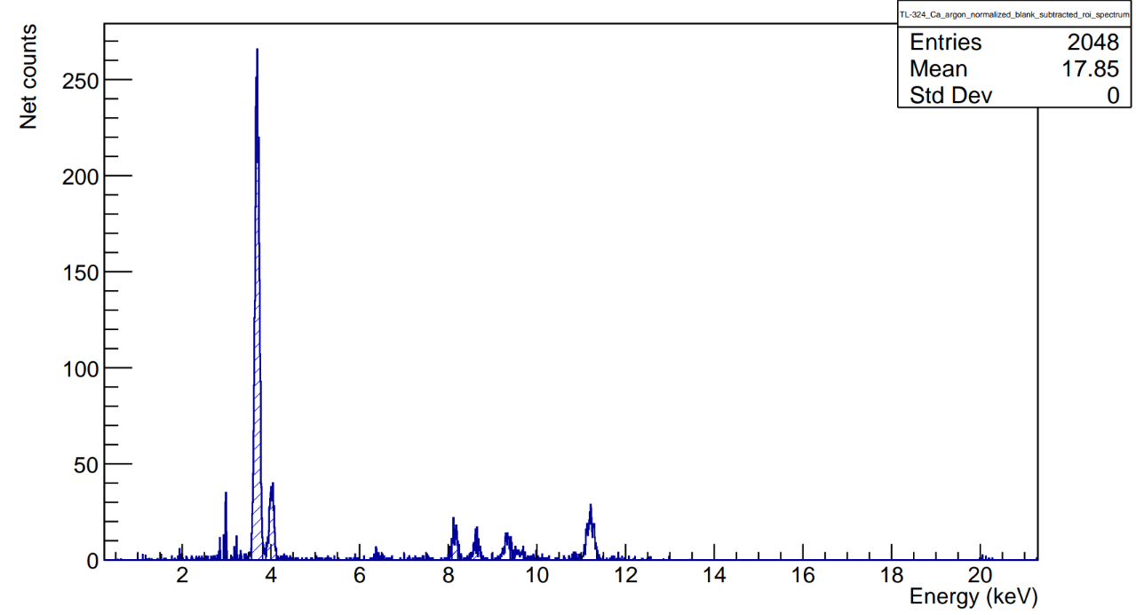
Data processing
Calibration: Fe and Ca
  Known standards are used to correct the spectra
Blank subtraction
  Remove backgrounds from the machine/ tapelifts
14
Notes:
Molybdenum xrf source if anyone asks :D
correct the blank part

Slide 15
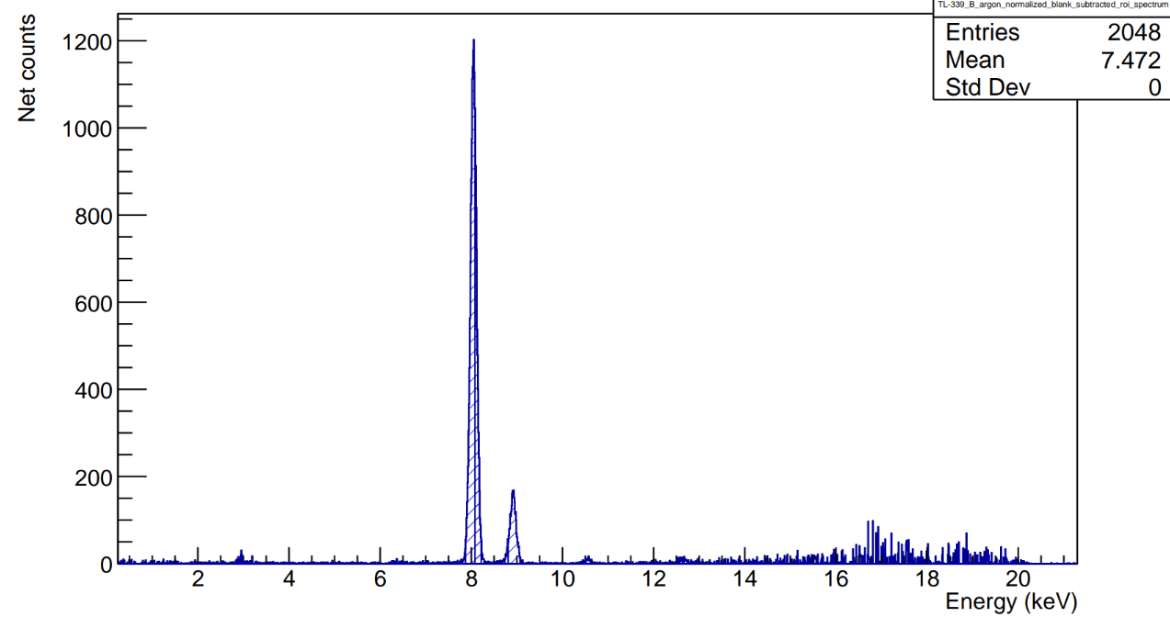
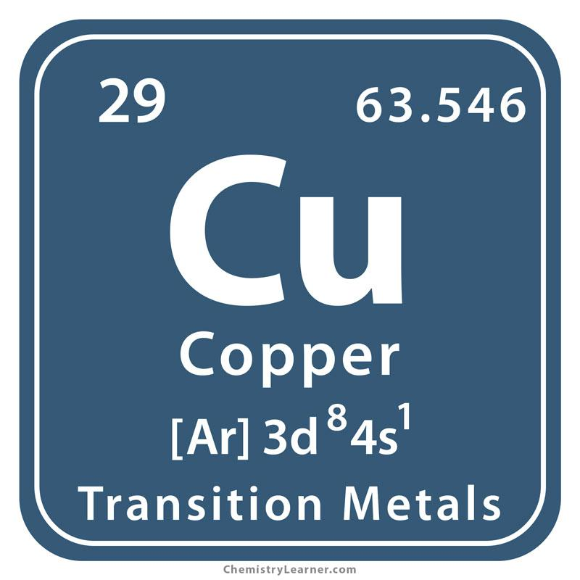
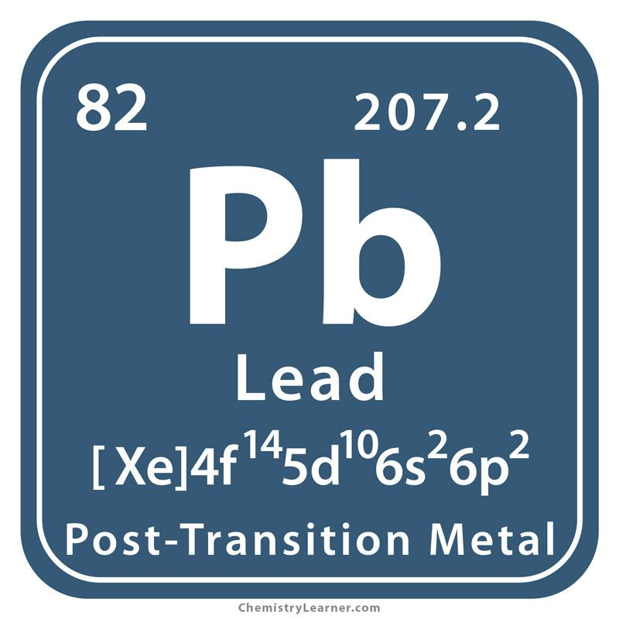
Daughterboard example
Kα
Kβ
Very tiny Pb Lα
15
Notes:
Ask mark about the lead vs copper

Slide 16
Data Findings & Discussion
04
16

Slide 17
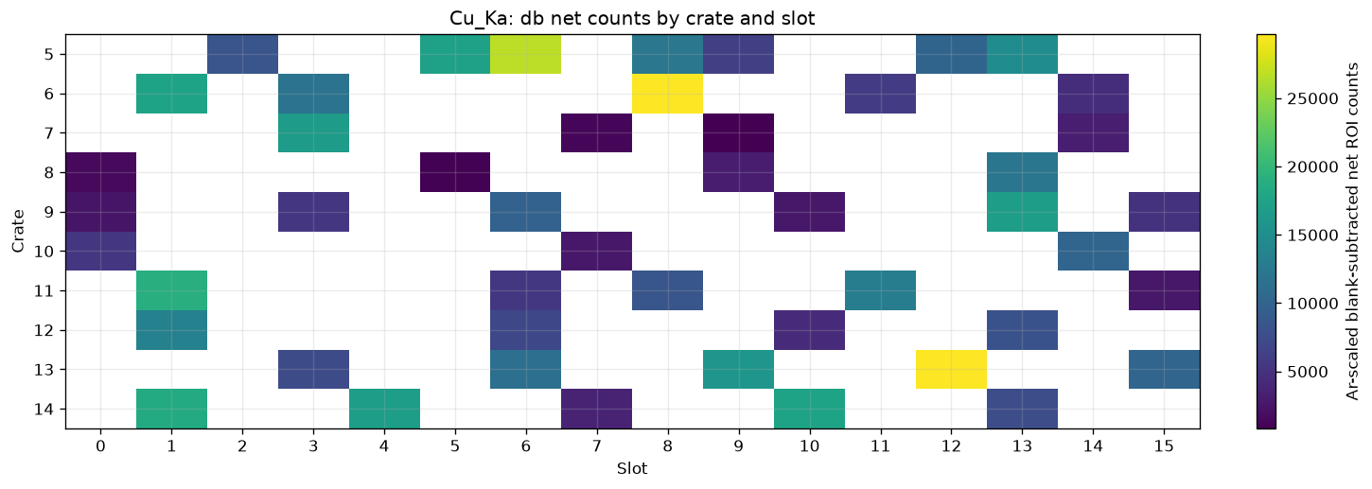
Element distributions by crate
Crate
Slot
Counts
17
Notes:
Redo this one compressing the separate days into one same crate, be moreobjective!!!!! Say that its fairly coherent

Slide 18
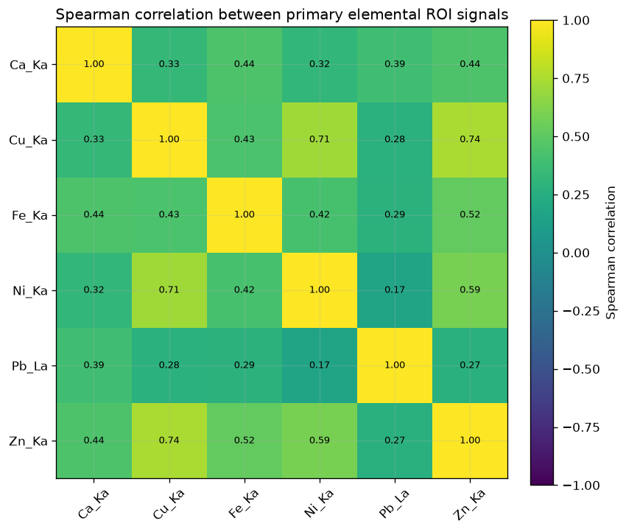

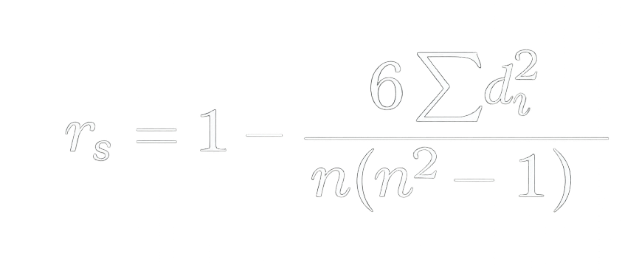
Correlation between elements
Rank difference
18
Notes:
*investigate zinc more*mPandas, don’t spend too much time explaing this!! Just say it’s a correlation matrix and we’re good, nickel was used in smal amounts for corrosion prevention (in case someone asks)

Slide 19
Conclusions and Future Directions
05
Ideas for the next detectives on the case
19

Slide 20
Conclusions
Several recurring Cu and Pb hotspots were identified
Cu, Ni, and Zn frequently rank high at the same locations
Large variations between crates! Additional measurements are needed before identifying a definitive corrosion pattern, but, the FEC’s were already cleaned :(
20

Slide 21
Future Directions
More tapelifts per location for improved statistical accuracy
Conclude tapelifting the remaining crates
Re-do tapelifts in newly clean FECs
Tapelift with time: week after, month after, semester after, etc… to keep track of the culprit’s action
Compare elements statistics to failure statistics
21

Slide 22
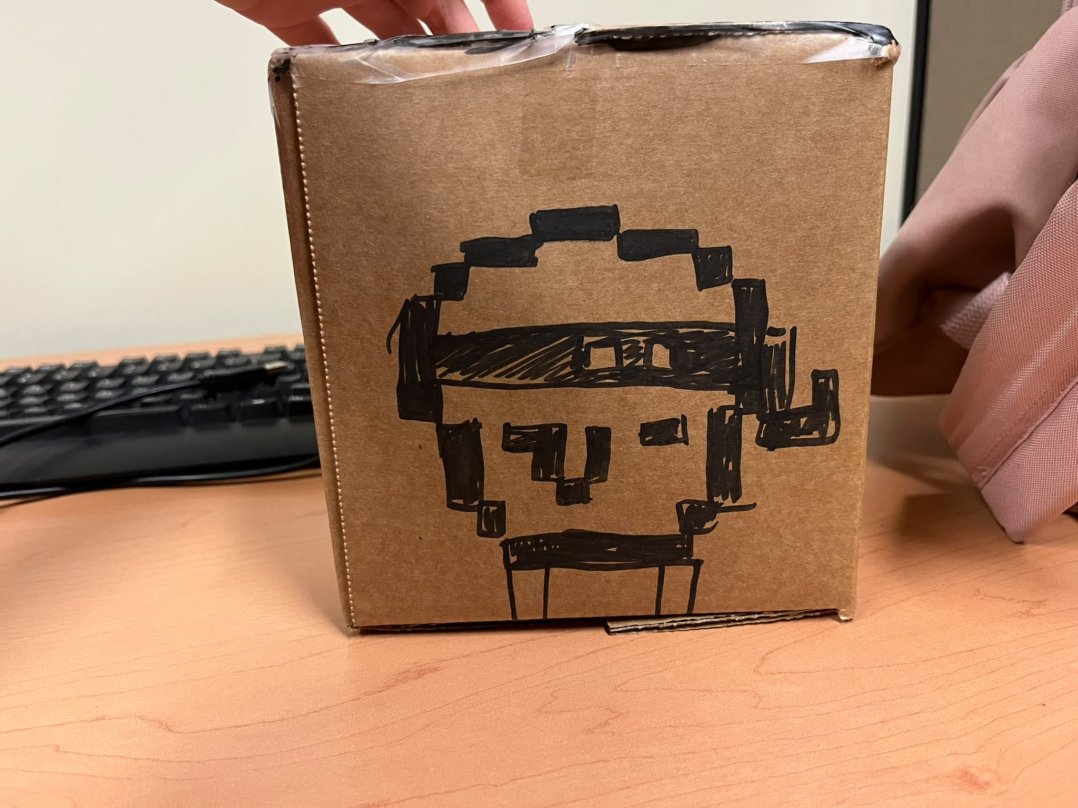
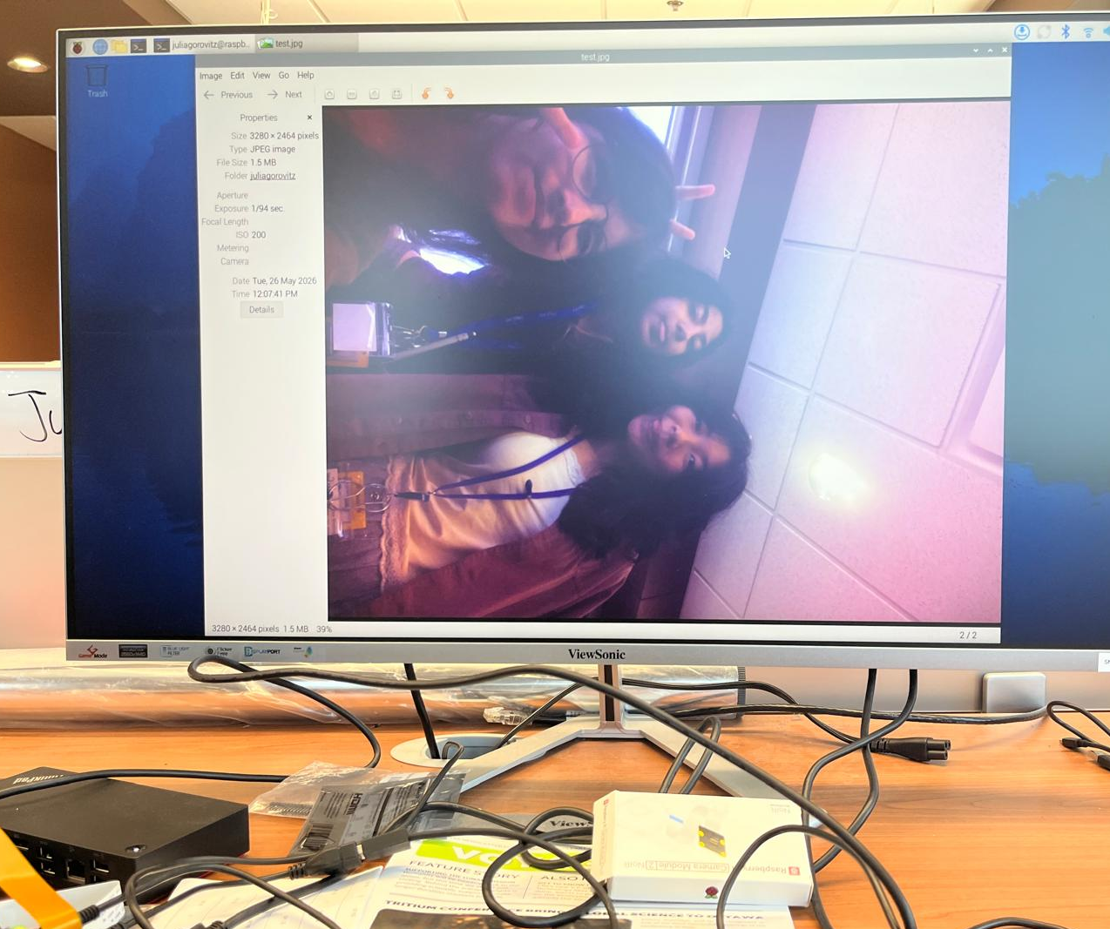
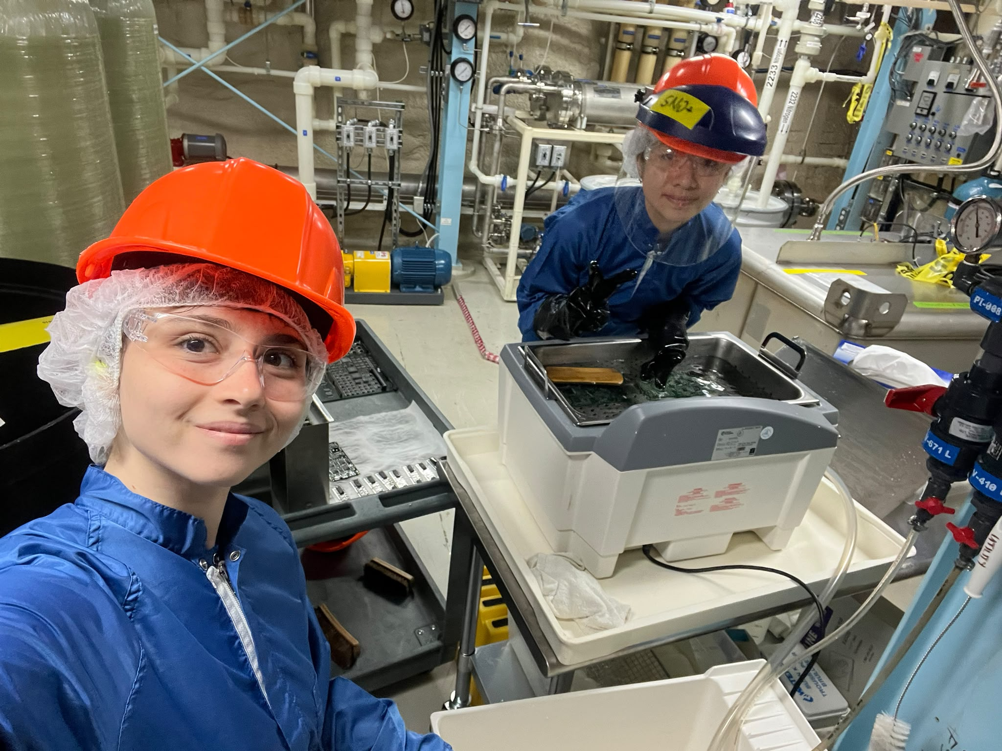
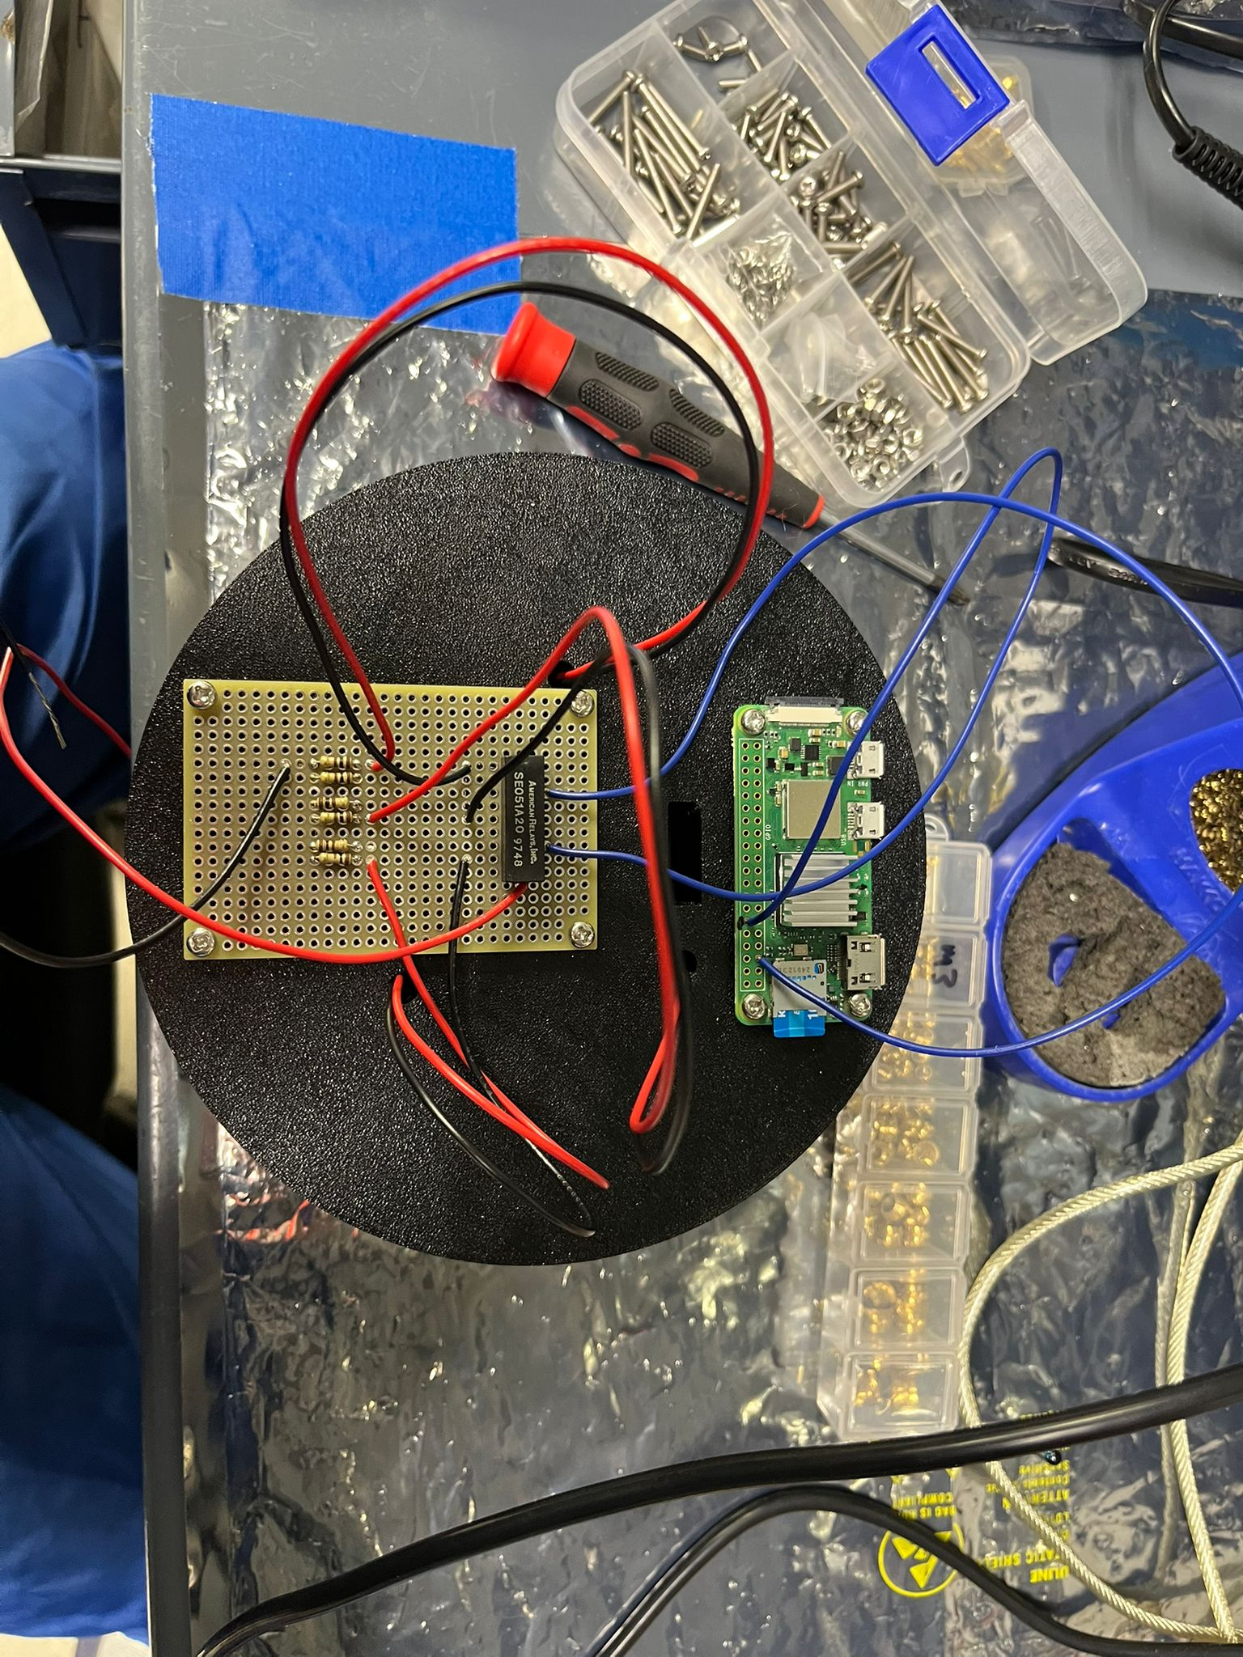
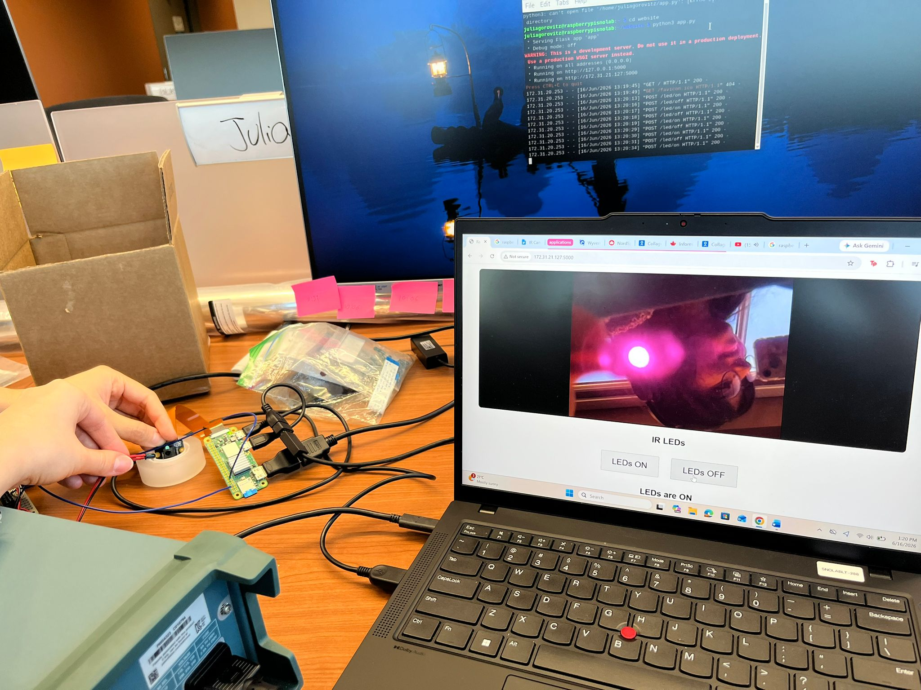
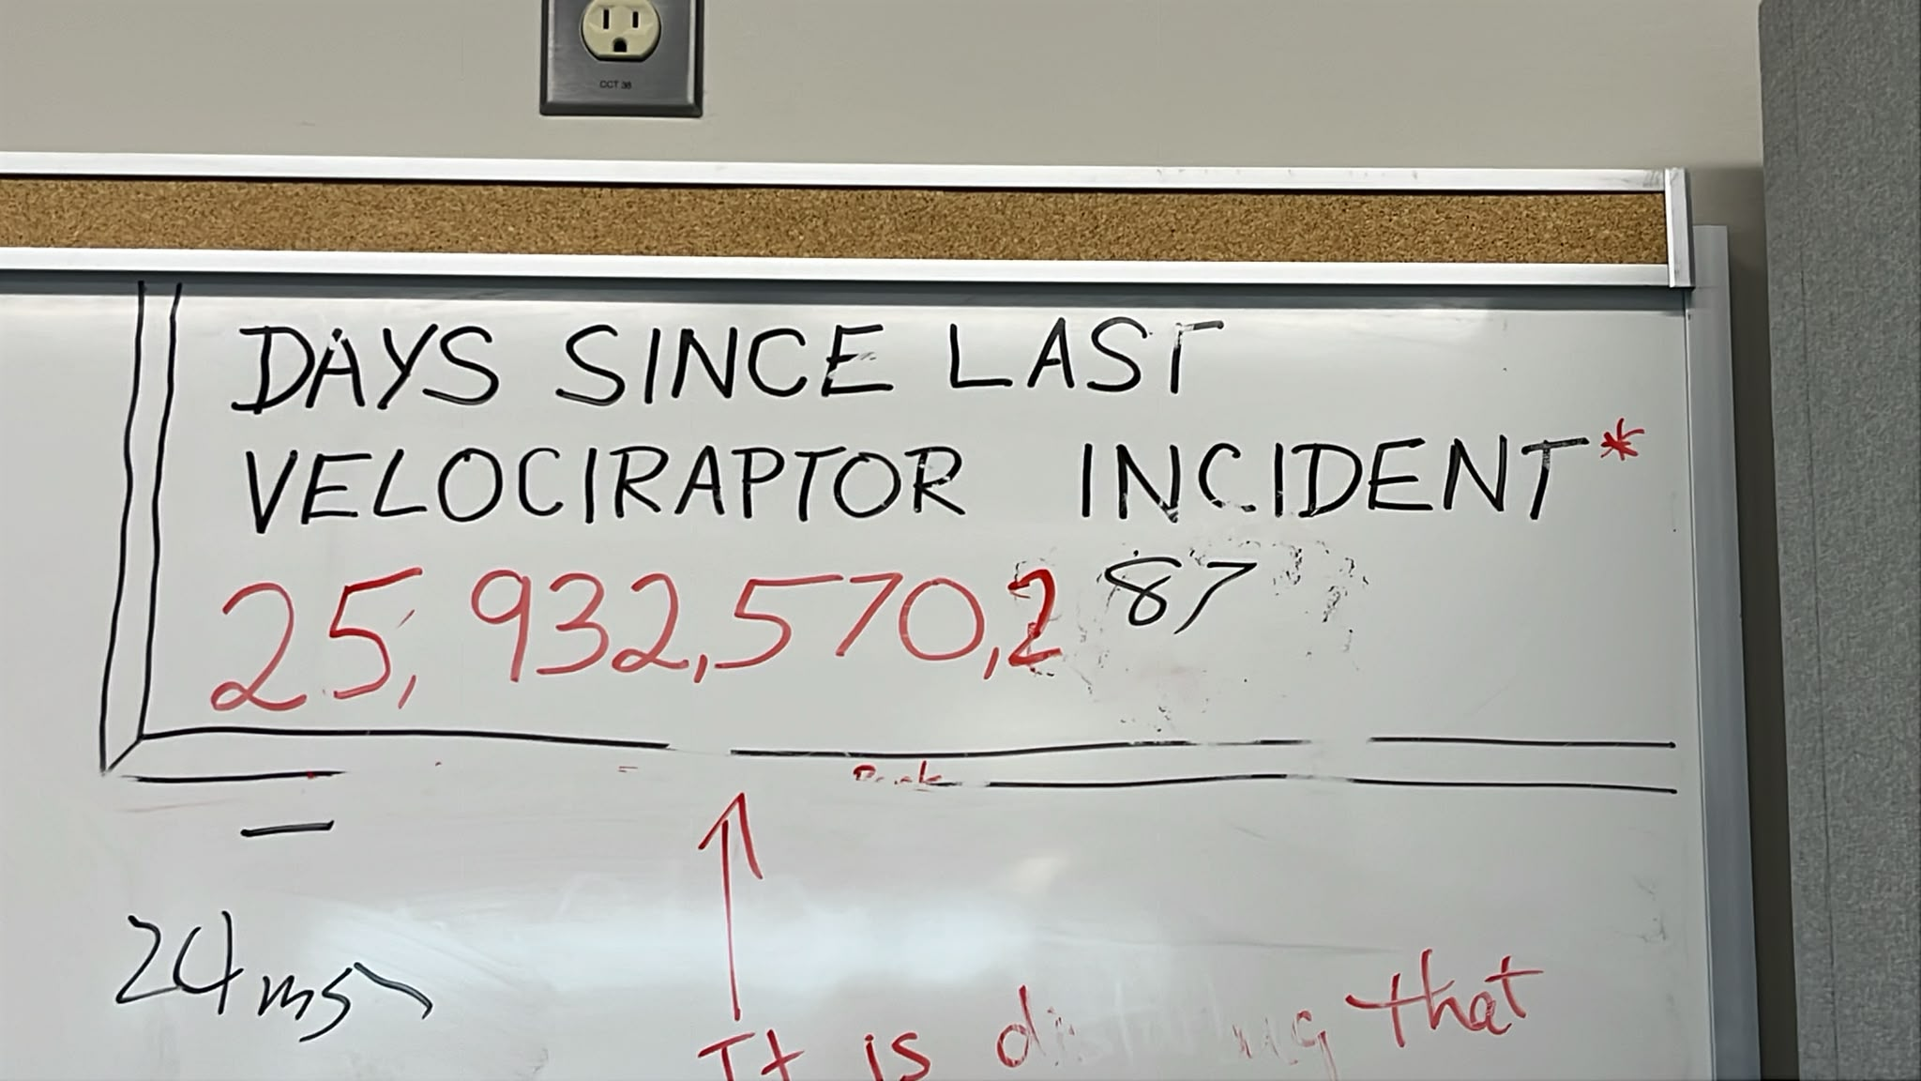
Special Thanks!
Dr. Christine Kraus, Juliette Deloye, Dr. Nasim Fatemi-Ghomi, Dr. Lorna Nolan, Dr. Mark Ward, Matt Depatie, Dr. Ryan Bayes, Stefan Kaluzienski

Slide 23
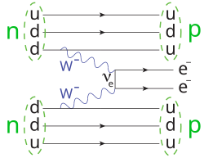
Goals of the experiment:
Neutrinoless double beta decay (0νββ)
Solar neutrinos
Geo antineutrinos
Reactor antineutrinos

Slide 24
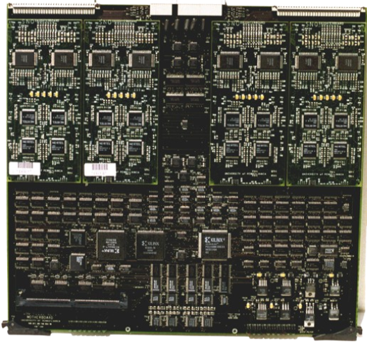
This is a real front-end card!
In SNO+ we have 300+ of these, each with four daughterboards
Distributed in 19 crates in the deck:
Notes:
Picture of a rack!

Slide 25
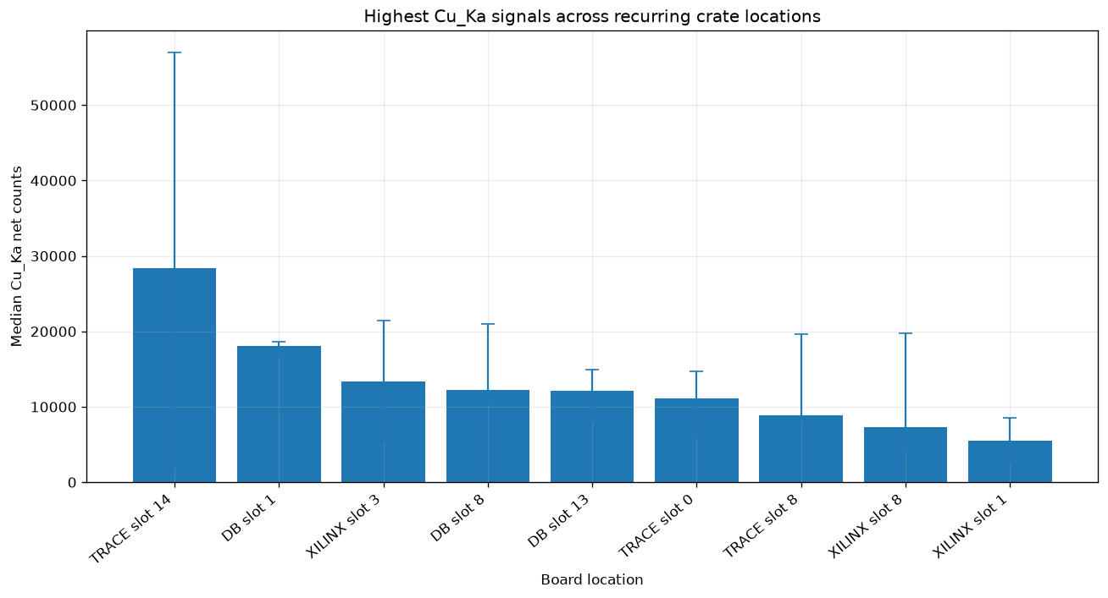
Element distributions by crate
20

Slide 26
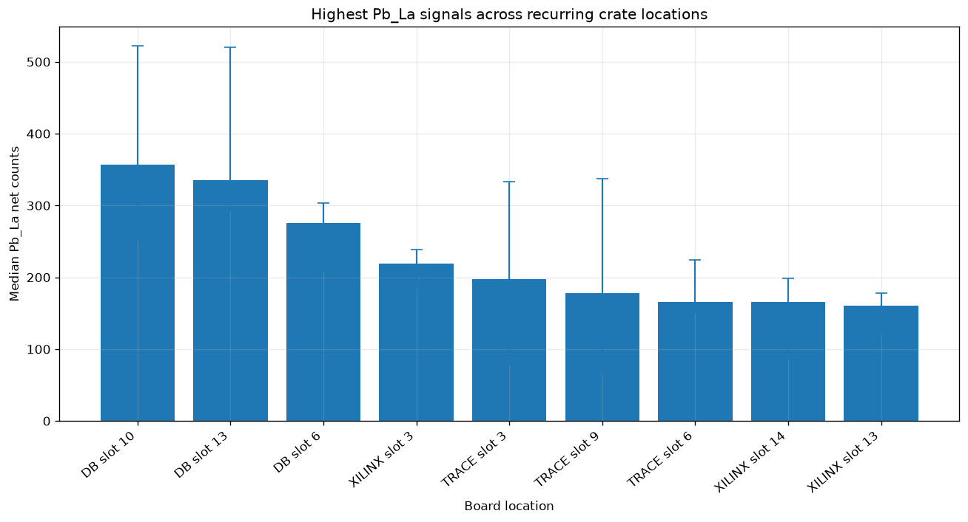
Element distributions by crate
19

Slide 27
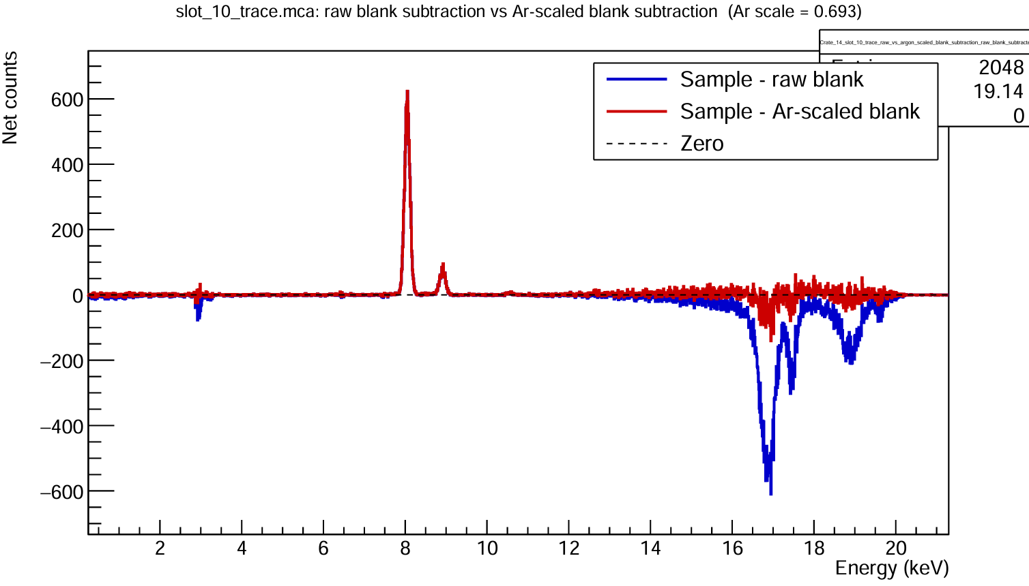
Data processing
Calibration: Fe and Ca
  Known standards are used to “correct” the spectra
Calibration: Fe and Ca
  Known standards are used to “c
Blank subtraction
  Remove backgrounds from the machine/ tapelifts
Argon normalization
  Correct for inflation in peaks from more and more radiation
15

