Slide 1
2026/8/11
Project Management
Frederick Aguirre-Levesque
Project Management Student

Slide 2
Outline
Initial expectation
The Beginning
Projects Worked
Underground
  Super CDMS
  SNO+
  Pico-500
Surface
  Procurement
  IT Support
  Document Management
  Transformer
  Foundation Chemical Shed
  XLZD
Observation
Key takeaways and Next steps
Thanks YOU
1
Notes:
Two separe boxes and number them by page number

Slide 3

Initial Expectations
      Goal: Gain experience in engineering project management in a globally know institute
      Expectation: Administrative paperwork
      Reality: A complex, hands-on discipline
2
Notes:
1.Hook: After spending a few intense years surviving thermodynamics and juggling differential equations to find the perfect theoretical design, I had an epiphany: a flawless 3d model is absolutely useless if the machinery gets stuck in a cage of a mine shaft! That’s when you realize that project management isn’t just an administrative chore, but an essential survival skill for bringing a future engineer’s ideas into the real world.
2.Initial expectation :
My goal in applying to the PMO was to gain experience in engineering project management in a globally know institute.
Additionally, my initial assumption was that project management would be an administrative environment focused mostly on paperwork. The reality, however, is that the PMO is a highly complex, hands-on department. This realization really took shape as I engaged with the following projects

Slide 4

The Beginning
The first few week consisted of:
  ReQlogic training
  Shadowing PM on surface and underground
  Reading documentation to learn how Lifecycles and projects operate
3
Notes:
Just like everyone else I also had training for the first 2 weeks. However, unlike the rest who are more on the science side of things I was also trained on reqlogic for procurement and had been placed with different PM in order to see how they proceed with there work. Additionally, I would also read a lot of documentation in order to learn how project life cycles work from start to finish at every step.

Slide 5
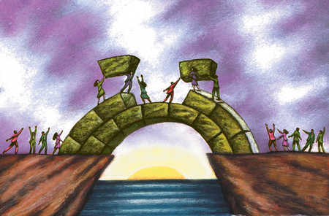
Projects worked
Underground
Surface
Notes:
Throughout my four-month placement I worked with countless people on different projects both underground and on surface:

Slide 6
Underground Operations
2km deep in the Creighton Mine
5
Notes:
The things I did underground consist of:

Slide 7
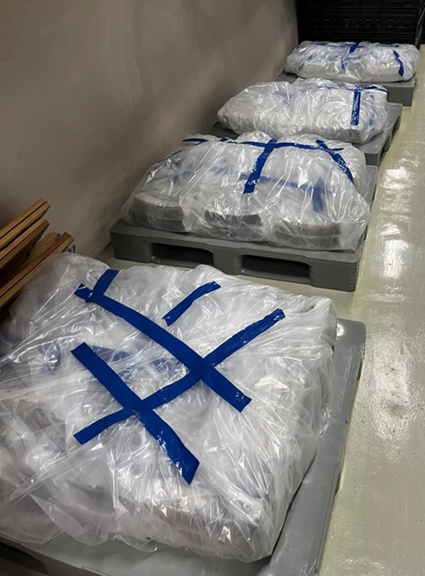
SBC (Lead Work)
Duration: 3 days
Precautions:
Tyvek suit
Double layered gloves
Decontaminations
Well ventilated work zone
Disposal Bags
Barriers
Daily weight limitation
Required training:
Attended lead safety training
Lead SDS/ Emergency response
6
Notes:
Doing Lead work for SBC also know as (Scintillating Bubble chamber). The reason for this was that we had to move the lead bricks out of the lab and onto the surface to ship it away to get melted and turned into plating for future projects.
This took about 3days to completes. Additionally, due to the leads toxicity we had to take precaution as well as having to complete the lead safety handling training. For the precautions we had to wear a Tyvek suit, double layered gloves, work in a well-ventilated area, and had to take a decontamination shower every time we changed clothing due to the lead being dangerous if we inhaled it or if it came into contact with our skin. On top of that we had to keep a purple disposal bag with us at all time for anything that came into contact with the lead including out gear and the saran rap.
Talk about weight limitation this was a colaboration

Slide 8
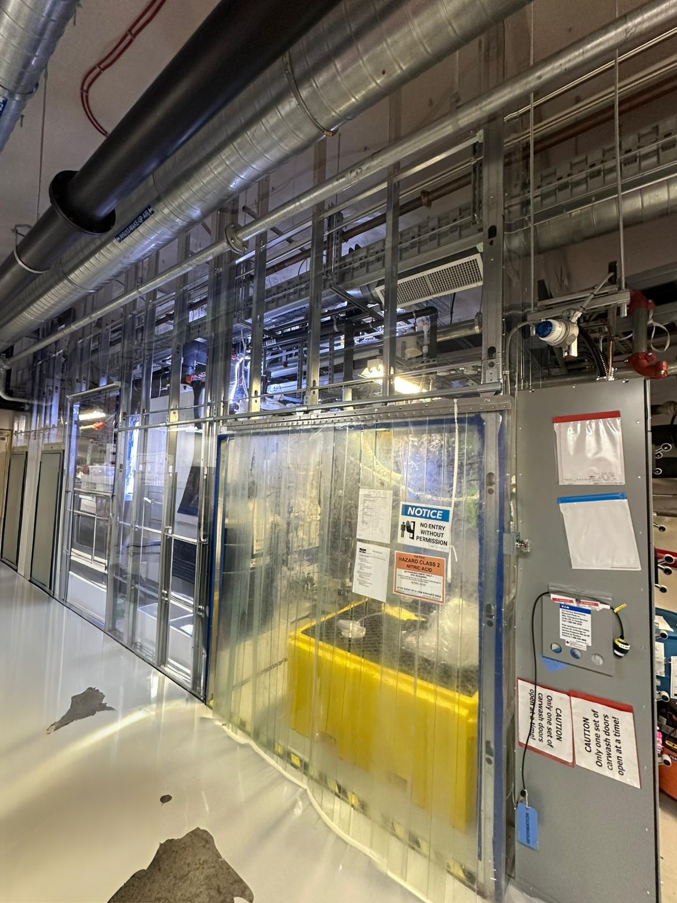



SNO+ (Experiment Support)
Delta V System
Plant Checklist
Collaborated with Samuel, Marty, and crew to help design new system button within the Delta V control system.
Learned and executed pre-operation checklist for the TeA and TeDiol plants under Marty and his team
Inventory Management
Plant Maintenance
Worked alongside Samuel to meticulously record, inventory, and label the old sample cabinet contents.
Assisted in the crucial task of cleaning TeA plant pipes that were experiencing rust clogging issues.
7
Notes:
I also assisted with the SNO+ experiment for TeA(Tellurium Acide) plant and TeDiol(Tellurium Diol) plant. While working with Marty and his crew I would assist with the delta v system. This software permits the user to run both plants from there computer. When using this software, we could monitor various parts of the plant, such as pressures, volume percentage, flow rate. Also, we were able to control the pumps and valves from the system. Furthermore, I would also assist by doing the pre-operation checklist. I have even assisted with the aid of Samuel in record counting of inventory and labeling of old sample in our cabinet. I also assisted Samuel with cleaning the TeA plants pipes when they filled with rust.

Slide 9
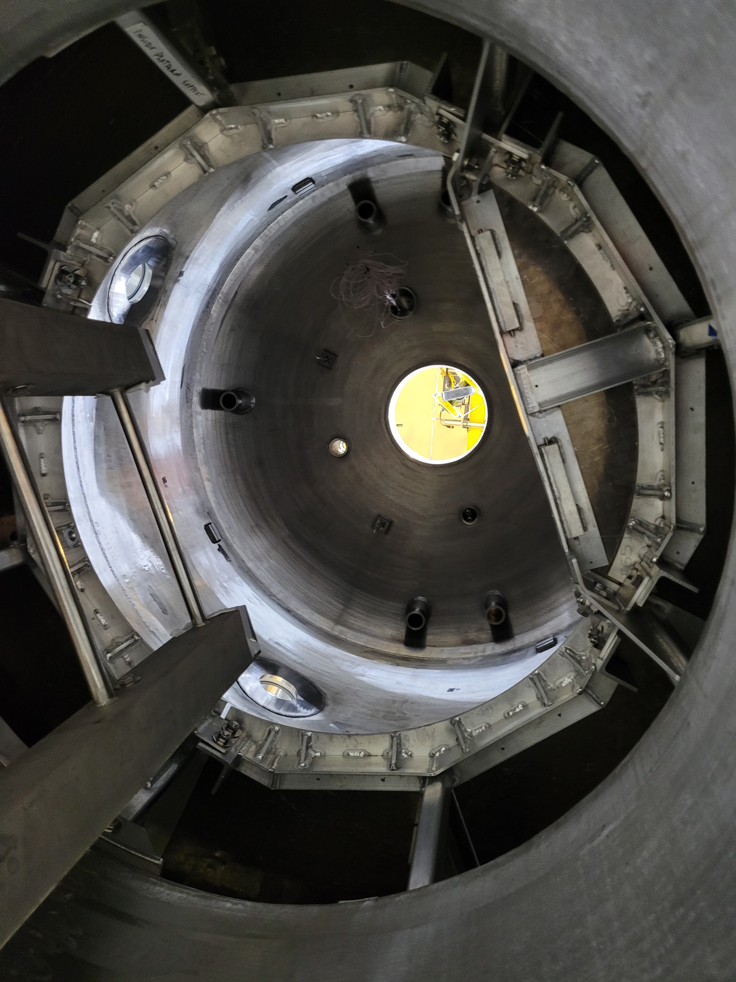
PICO-500
Key Contributions:
•
Aided the PICO-500 crew with safe winch crane operations during equipment movement/installation.
•
Assisted in applying specialized reflective film onto plates intended for the interior of the PICO-500 detector.
8
Notes:
Another project I assisted with underground was by Providing hands-on support for Pico-500. During my few time with the PICO crew I would as sit them by operating the winch in order to lift them and the material safely into the pressure vessel. Additionally, I assisted in applying reflective film onto plates that would go in the interior of the pressure vesel.

Slide 10
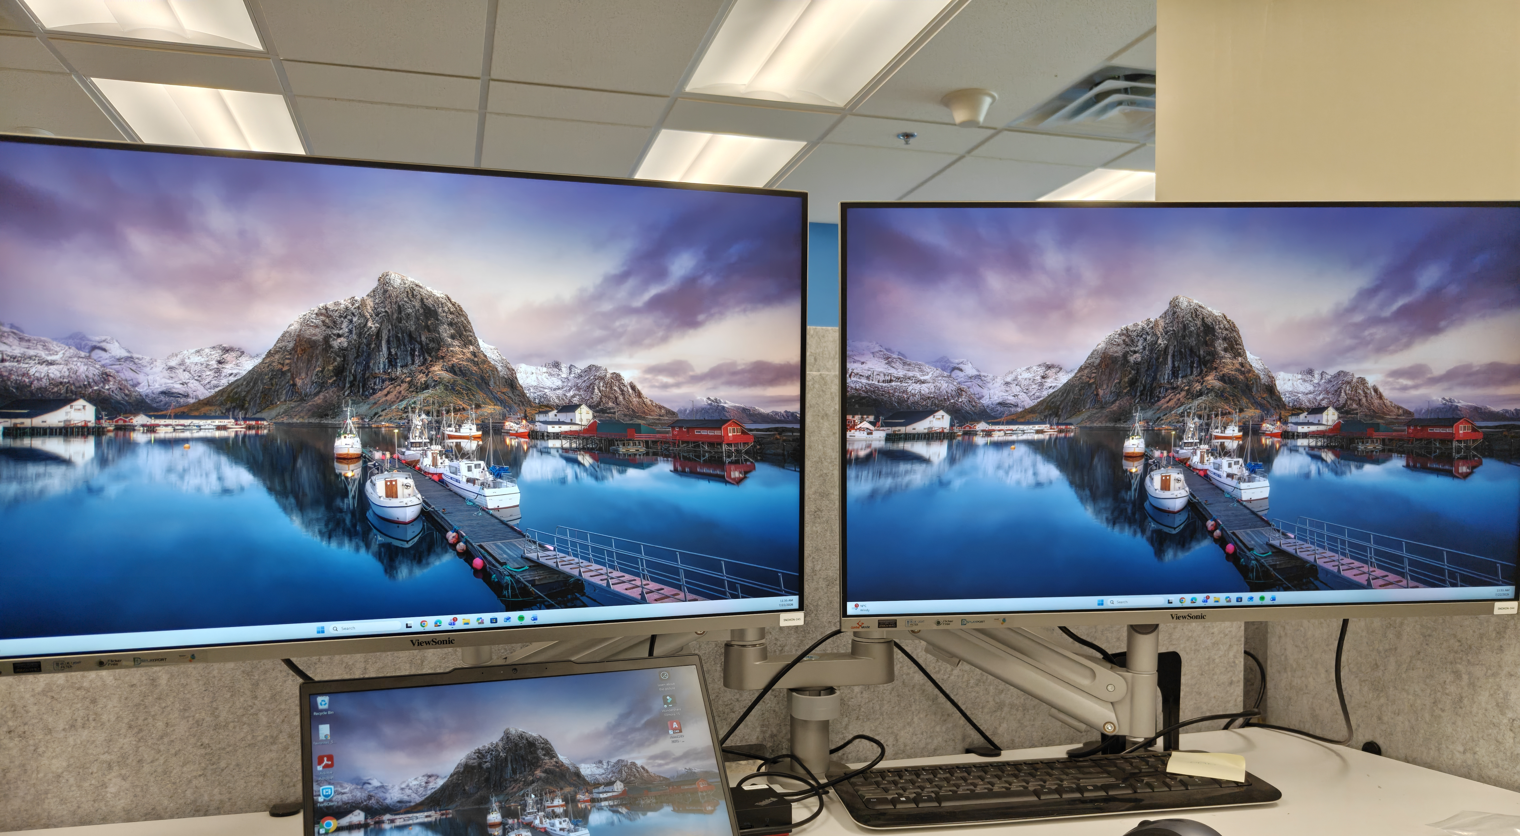
Surface Work
Project Planning & Administration
9
Notes:
Now the things I have done on surface consist logistical support as well as projects for example:

Slide 11
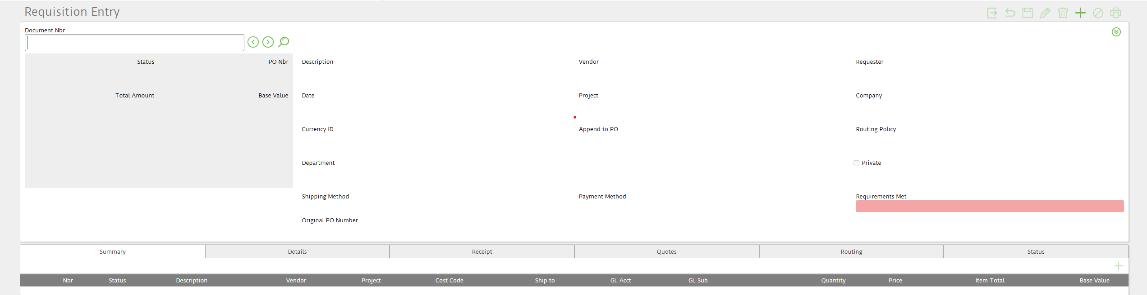
Procurement (ReQlogic)
Communicated directly with vendors to request and compile quotes for necessary equipment. Utilize Req-Logic to create order requisitions.
10
Notes:
For logistical support I assist with procurement. During this procedure I use the ReQlogic software to place requests. As you can see in the lower picture this was taken from ReQlogic. However, just filling the information boxes isn’t all that there is to it. As for every project there is a cost code and a different hierarchy. What I mean by this is that whenever I want to move onto the next step of the requisition slip, I need to get approval from someone and depending on the project this person will differ. Additionally, when working on a requisition form its always ideal to have a quote, and for this reason I also have to reach out to vendors in order to obtain these quotes.
For Logistical support I would assist with procurement. During procurement I use the ReQlogic website. As seen on the picture down below when filling out a request it is necessary to fill out the following boxes. After the request gets filled, it is sent for review, where a higher up will review it. And once its been accepted the order can be placed. Furthermore, it is always beneficial to have a quote to add to the request before submitting it for review, and for this reason I also reach out to suppliers in order to get these quotes. Another thing I assist the PMO with
Talk about how training I know what this thing stuff, but I thought it was just filling it out, but it was actually more complex as each project has a different cost codes. A mean of Communication from finance to the vendor

Slide 12

IT Support
Created IT tickets to create, manage, and close workspaces and folder structures for internal and external projects. Helped troubleshoot issues that arose for the Project Management Office (PMO) team.
11
Notes:
, is creating IT tickets. this is so I can manage, create , and close workspaces and folder in external and internal projects of our docushare repository. In doing so, if any question or problems were to arise I would fix these problems for the PM’s. AlsoI assisted with

Slide 13
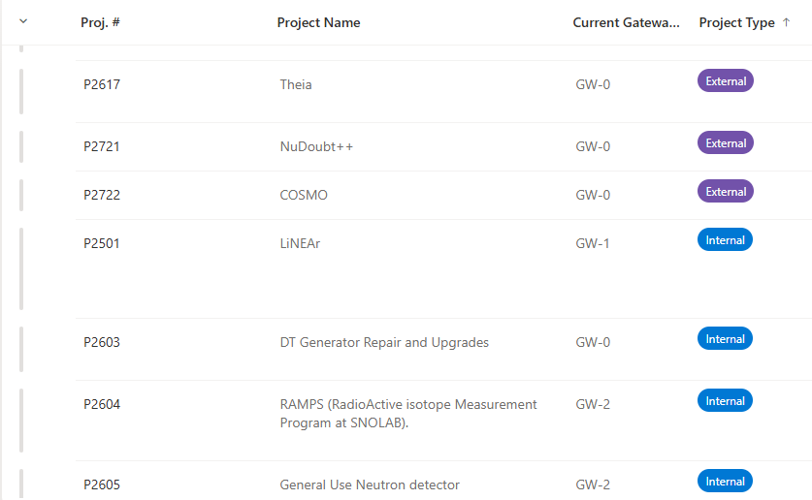
Document Management
Worked with Mehwish on updating SharePoint documents information and DocuShare repositories.
12
Notes:
managing and updating the projects SharePoint and docushare. This consisted of adding missing project into the SharePoint as well as updating their project information. When updating the projects information I would update, emergency contacts, project date and location, the names of the PMs, supervisors, supporting peoples and others. While in docushare I would update all project folders once there was any new material to organize.
Means of communication for snolab and for this it essential to keep updated

Slide 14
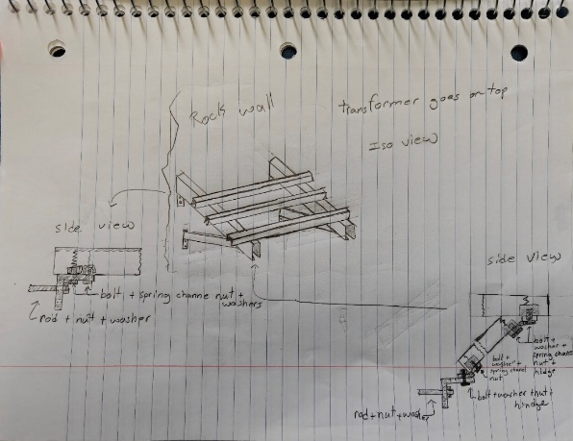
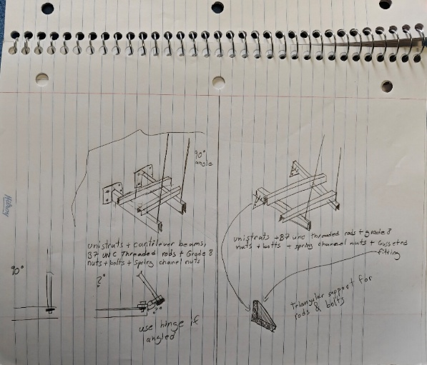
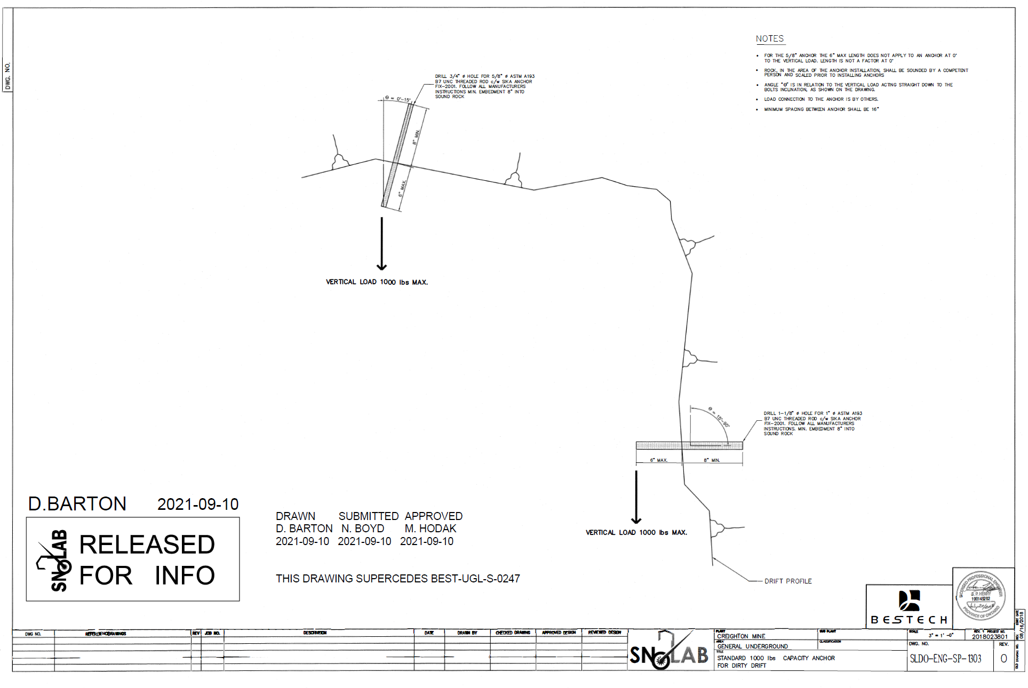
Chiller Drift Remediation
Researched designs and requirements
Designed 3 models
Created a BOM
13
Notes:
Now for project that I have worked on. The first project that I assisted with was for the Chiller Drift Remediation (underground transformer wall mount). During this projects some of the difficulties that arose where the mine constraint of the uneven walls. This made it akwards to mount things properly on the wall. For this reason, I had to do a lot of research on how to mount this and to take the terrain into consideration for my calculations. Once that was I done I would create 3 separate concept sketch that were structurally sound as well as a Bill of Material with all the necessary parts and with their appropriate supplier. On the top 2 pictures you can the hand drawn sketch.

Slide 15
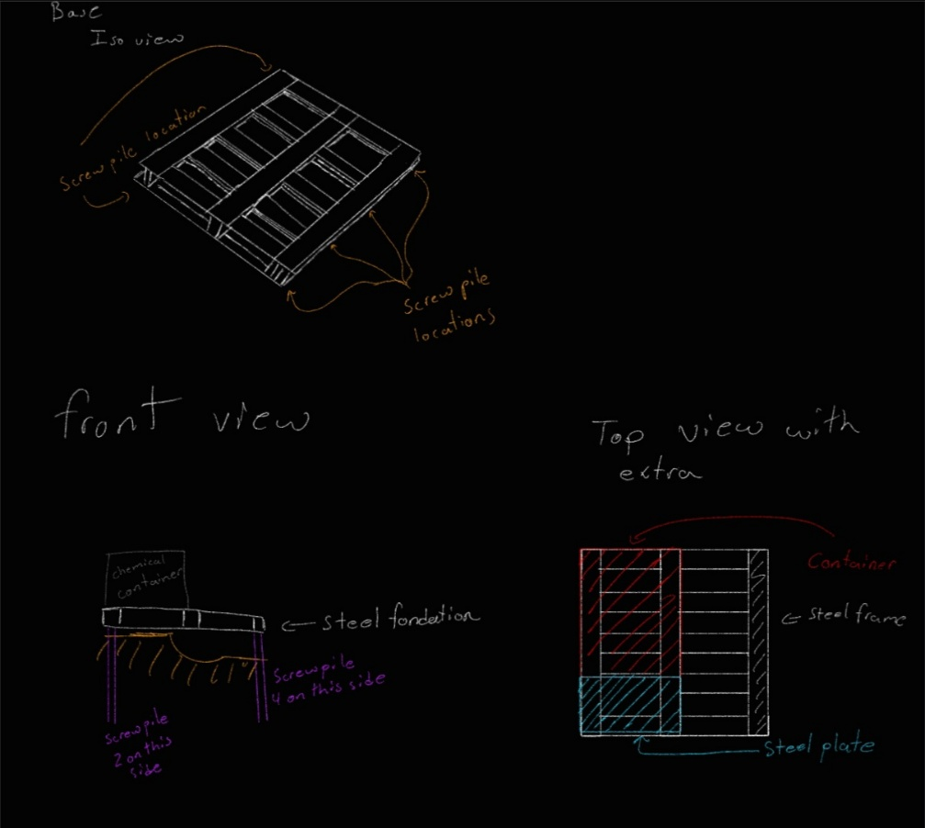
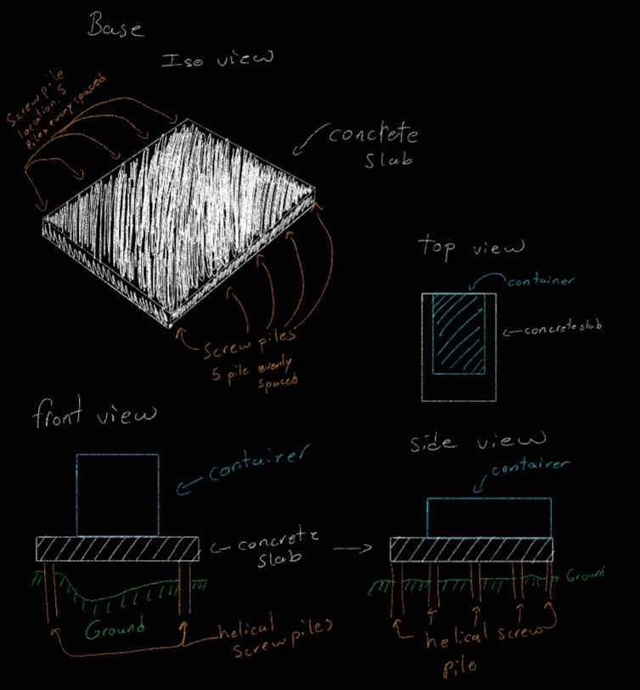
Surface Chemical Storage Shed
Researched soil test methods and necessary equipment
Designed foundation concept designs
Developed procedures for soil tests and step by step guide to make the foundation
14
Notes:
The next project that I worked on was the surface chemical storage shed. For this task I was requested to also create 3 separate concept designs, 2 separate procedure document for the necessary soil tests needed and the step-by-step guide on how to build the decided foundation with a list of necessary machines. During this task there was a lot of research to be done in order to find what would be the best option and material to use. Not only that the reson for the soil test and the coluvert was for water drainage and to test the soil for corrosivity. -----------------------------------------------------
Explain the problems why the coluvert why the soil test, why etc

Slide 16
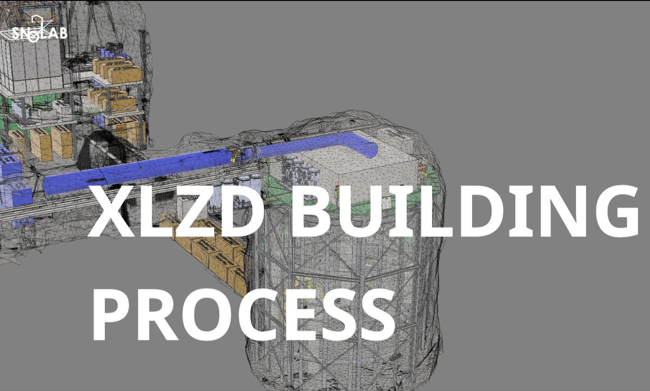
XLZD
Reworked/updated original XLZD building video
Reworked/updated XLZD underground map
15
Notes:
And the most recent project that I am still working on is the XLZD (Xenon lux zeplin Darwin)project.

Slide 17

Observation
High Activity Levels: Immediately noticed the constant, high volume of activity happening at all times.
Busy Department: Realized how incredibly busy the PMO department is daily.
Project Management: Observed the team constantly juggling multiple projects from start to finish.
16
Notes:
Going into this COOP, I knew that working in this unique environment would add its unique set of challenges. But honestly the first thing that stood out to me was just how much there was going on at all time. From my perspective this showed me how incredibly busy the PMO is as they are constantly juggling multiple project from start to finish.
IDEA: PMO IS NECESSARY FOR ALL DEPARTMENT AS THEY PROVIDE A SERVICE TO ALL DEPARTMENT

Slide 18
Key takeaway and Next Steps
Bridged the gap between academic theory and real-world application
Gained practical insight into the operation of complex systems and large-scale projects
Recognized the PMO as a critical driver of project success and smooth execution far beyond a simple administrative or paperwork-focused role
17
Notes:
In conclusion, my time here was well spent, as it allowed me to bridge the gap between academic theory and real-world application. Furthermore, it provided me with the opportunity to see how complex systems and large-scale projects operate(such as pico-500, the chemical storage shed, and the XLZD which is currently on going and many others). Most importantly, I learned that the project management office is not just an administrative department focused on paperwork but rather, it is a vital part of the machine that permits projects to proceed smoothly and efficiently.
The next students will continue the project that I have done
Rework by recapping what I did and learn from working on this

Slide 19
Thank YOU!
Thank you for these valuable four months! I am incredibly grateful for the opportunity to:
Learn from the best: Thank you for your patience, guidance and sharing your expertise
Contribute: I appreciate being trusted with hands-on projects that permitted me to gain real experience
Professional Growth: Your guidance has been invaluable in building the project management skills I will need for the future.
18
Notes:
I would like to give my thanks to the PMO for this in valvulae four months.
Update and shorten

Slide 20
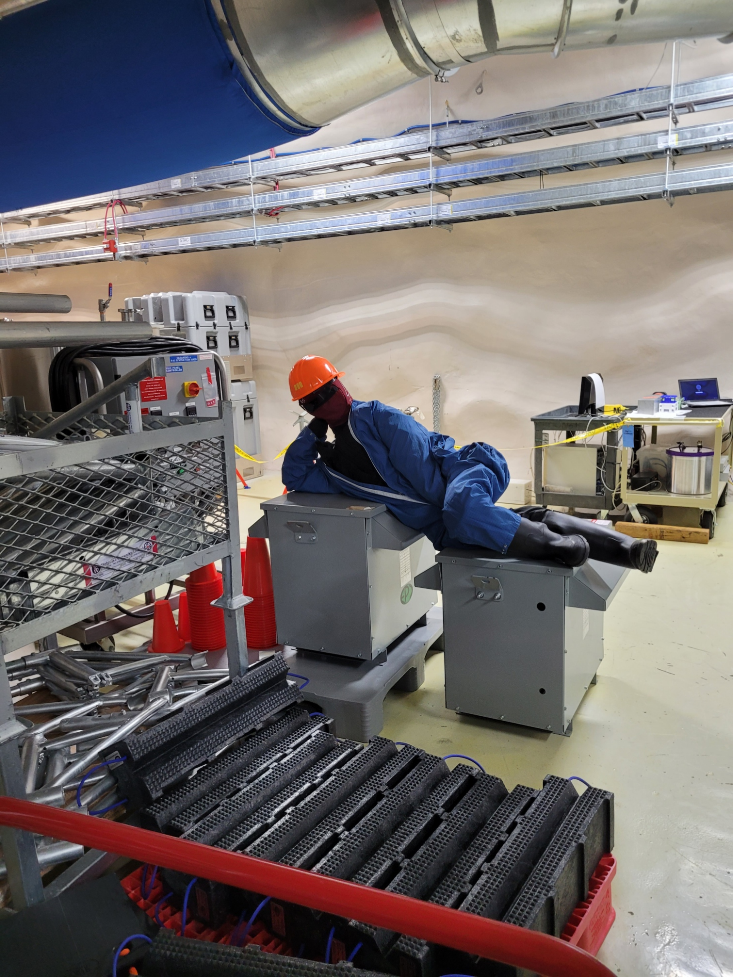
Questions?
Thank you for Listening.
19

Slide 21
Image sources
https://www.istockphoto.com/photo/big-journeys-begin-with-small-steps-sign-with-sky-background-gm687814130-126550243
https://www.illustrationsource.com/stock/image/14620/people-building-bridge-over-river/?&results_per_page=1&detail=TRUE&page=7
https://www.dreamstime.com/stock-illustration-cartoon-man-carrying-large-magnifying-glass-vector-image65676657
20

