Slide 1
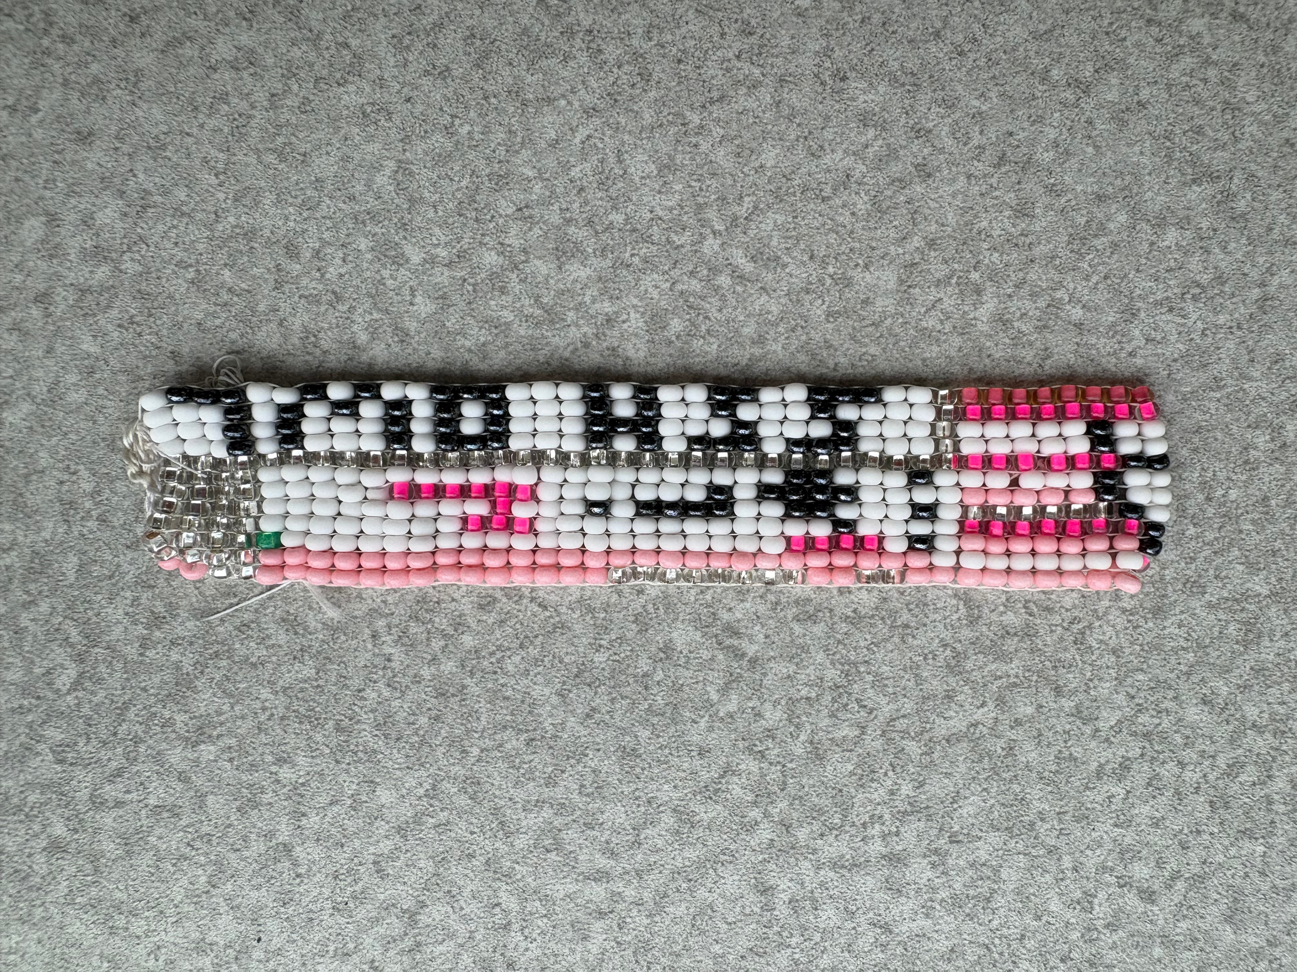
1

Slide 2
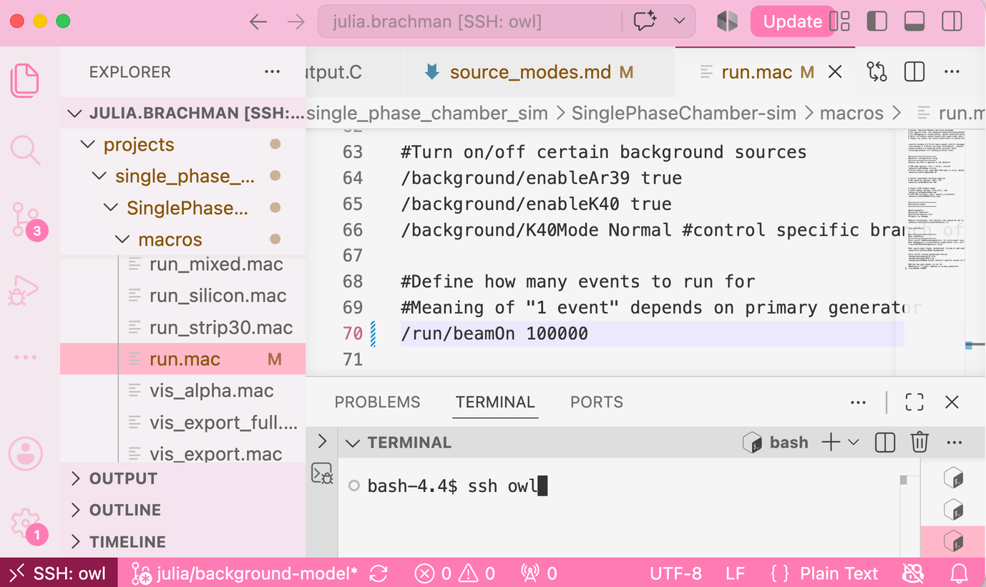

  Photo credit: McDonald Institute
MI beading workshop with Matt, Ty, and myself
Code is a tool to build simulations
2

Slide 3


FROM
CODE CRYOSTAT
TO
BUILDING A SINGLE-PHASE LIQUID ARGON CHAMBER
JULIA BRACHMAN (she/her)
SCALAR @ QUEEN’S UNIVERSITY
CASST 2026
3

Slide 4
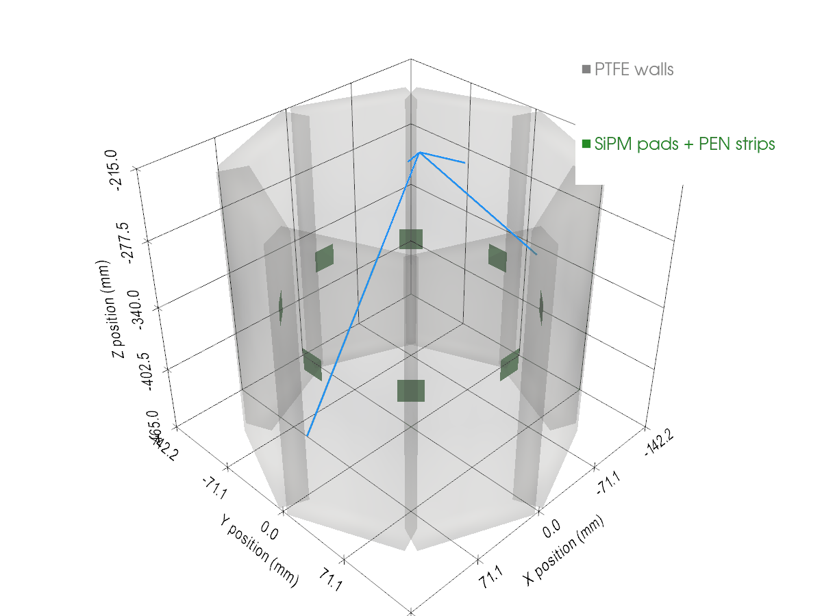
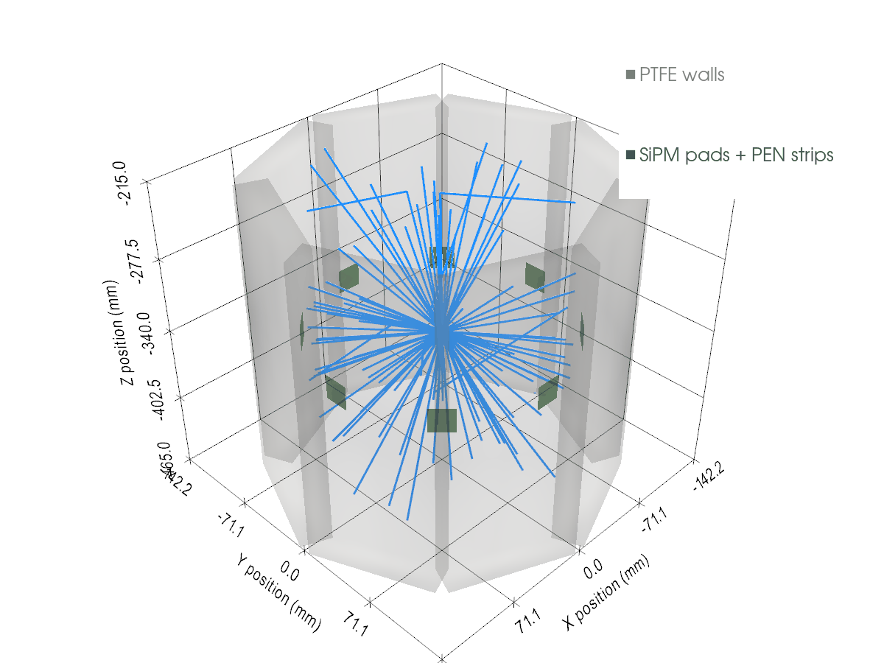
DO
HOW DO WE PHYSICS
with simulations?
Animation of our detector: scintillation photon tracks (blue) produced from…
1 Ar-39 beta decay
1 Am-241 alpha decay
4

Slide 5
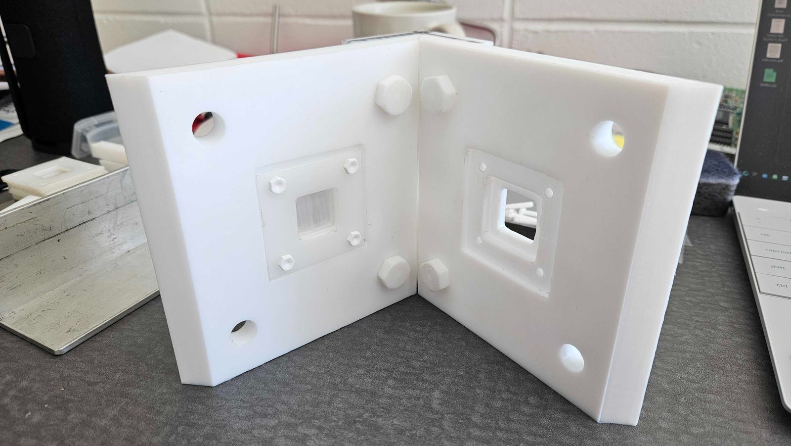
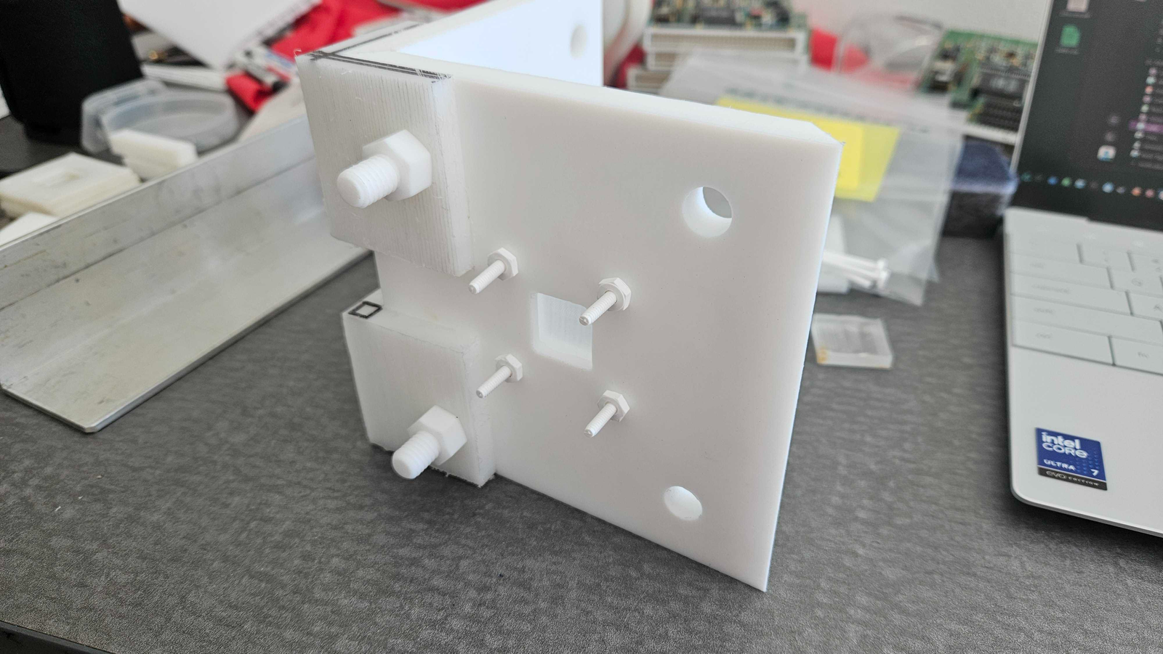
SINGLE-PHASE LAR CHAMBER
  Study technology for future liquid argon (LAr) detectors
Prototype
2-wall assembly
Photo credit to P. Taylor
5

Slide 6
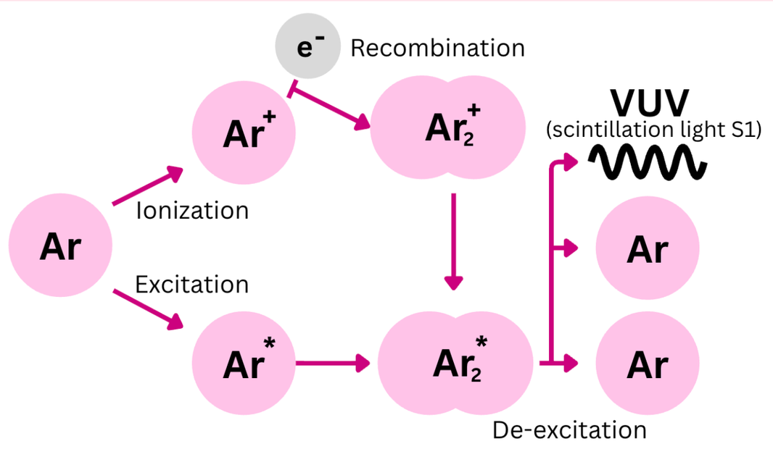
SINGLE-PHASE LAR CHAMBER
SCINTILLATION = flash of light when material absorbs energy
  Study technology for future liquid argon (LAr) detectors
    Ar-40 scintillates when particles interact
Nuclear recoils excite or ionize Ar-40, producing prompt scintillation light (S1) at 128nm.
6

Slide 7
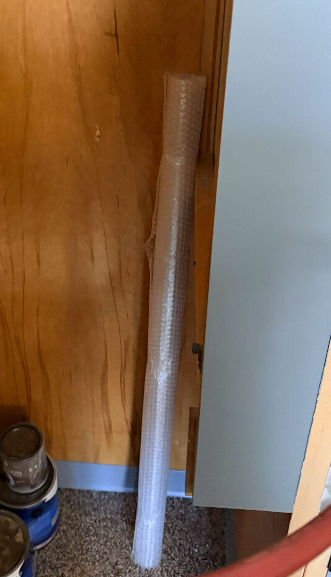
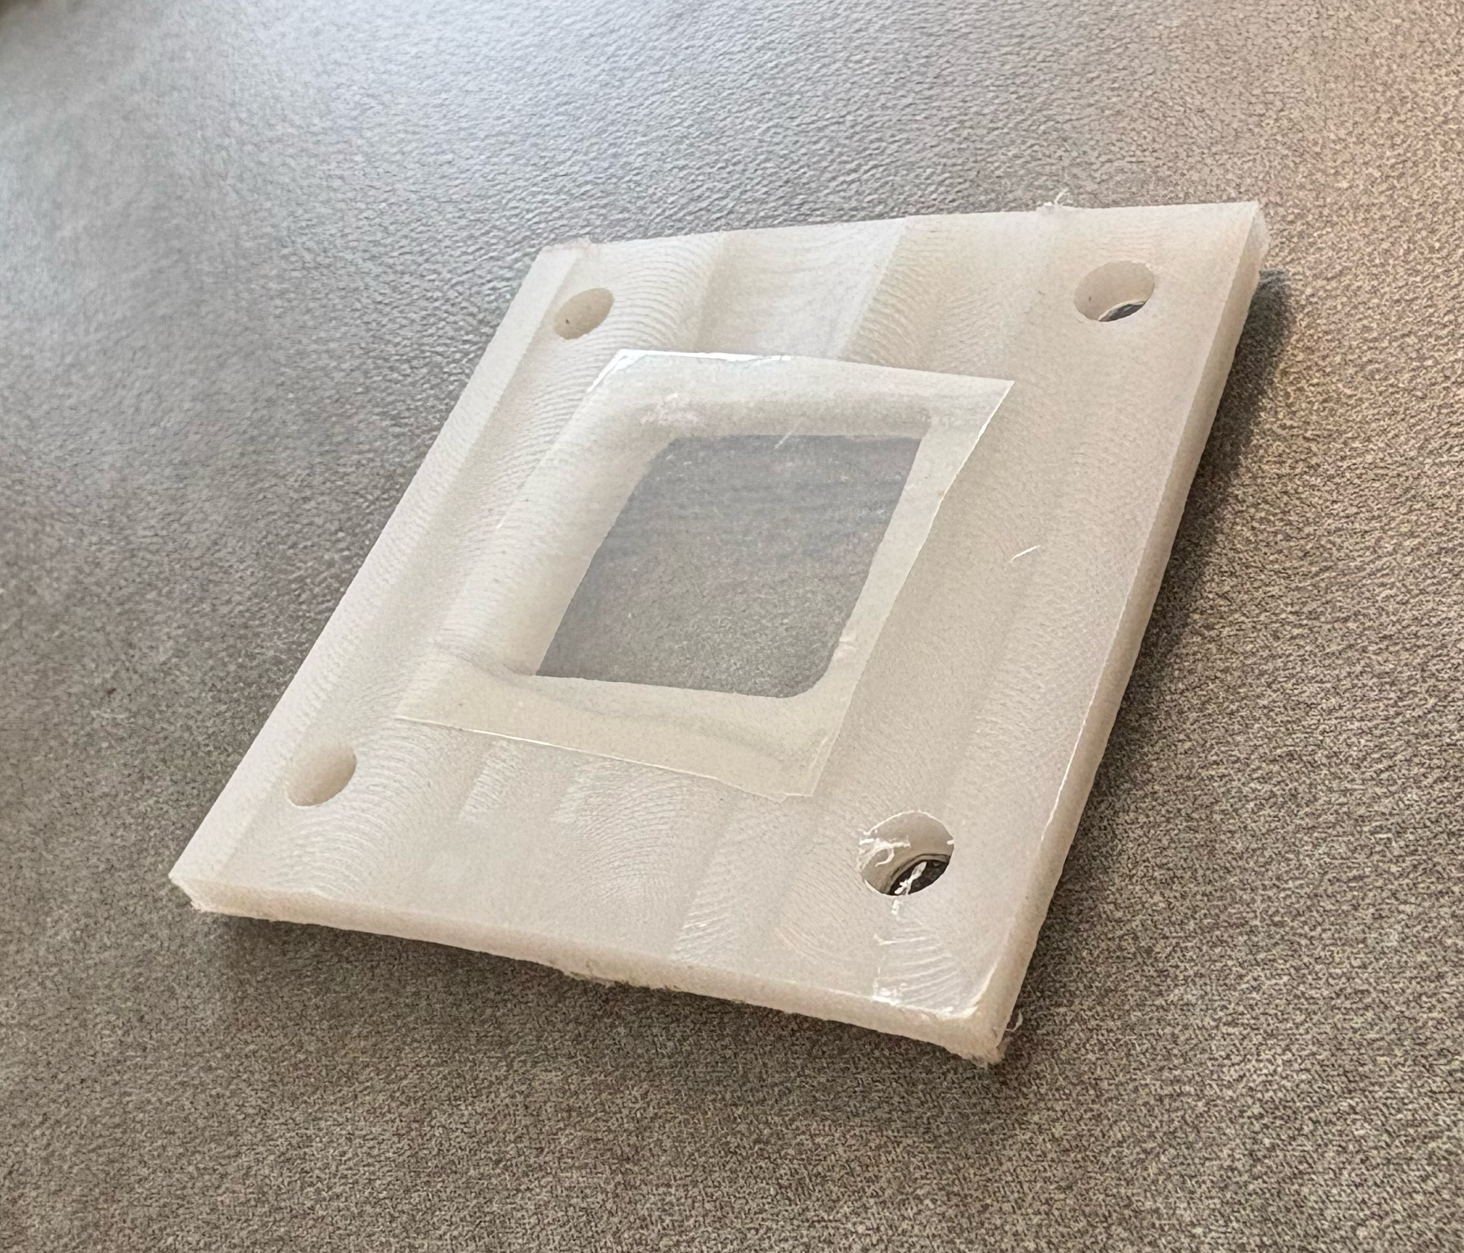
SINGLE-PHASE LAR CHAMBER
  Study technology for future liquid argon (LAr) detectors
    LAr scintillates when particles interact
    PEN shifts the
      light wavelength
    (128nm → 420nm)
Roll of PEN in our lab.
Photo credit Dr. Michela Lai.
Sheet of PEN (25 µm thick).
7

Slide 8
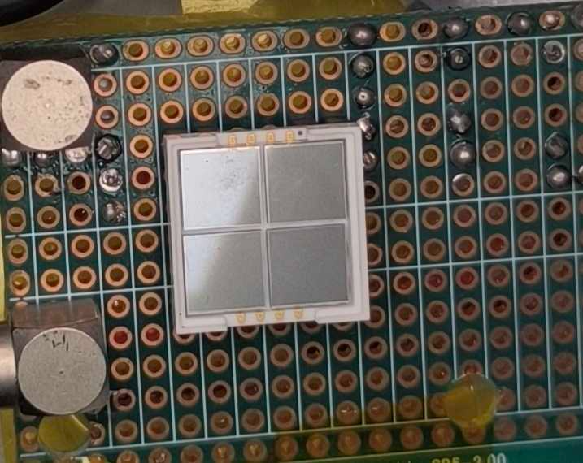
SINGLE-PHASE LAR CHAMBER
  Study technology for future liquid argon (LAr) detectors
    LAr scintillates when particles interact
    PEN wavelength shifts light
    SiPMs observe light
Analog SiPM from our lab.
Photo credit Maxence Rault
8

Slide 9
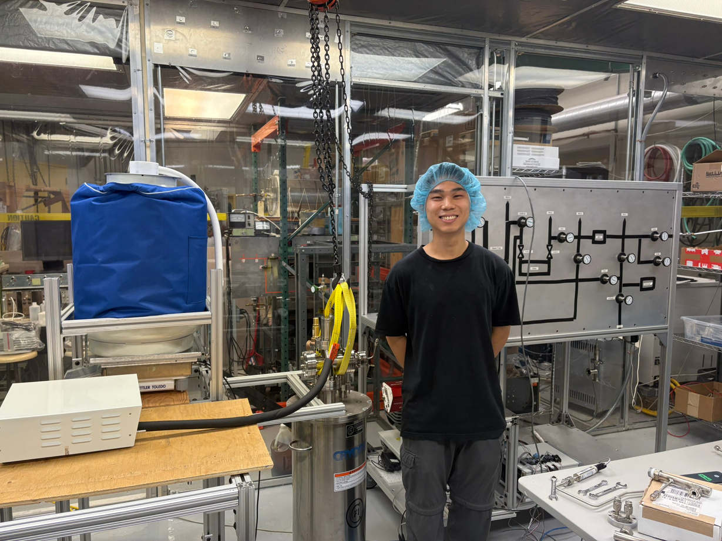
“CLEAN” CRYOGENIC ENVIRONMENT
  Backgrounds mitigated as much as possible
  Chamber to be operated at cryogenic temperatures (∼87 K)
  The SCALAR group has a cryostat locally
See another talk: H. Wen “Slow-Control Infrastructure for Noble Liquid Detector R&D”
9

Slide 10
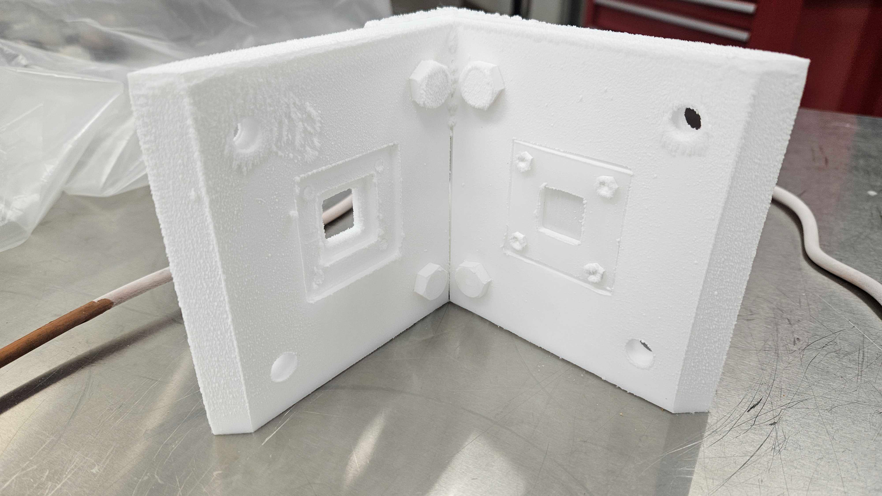
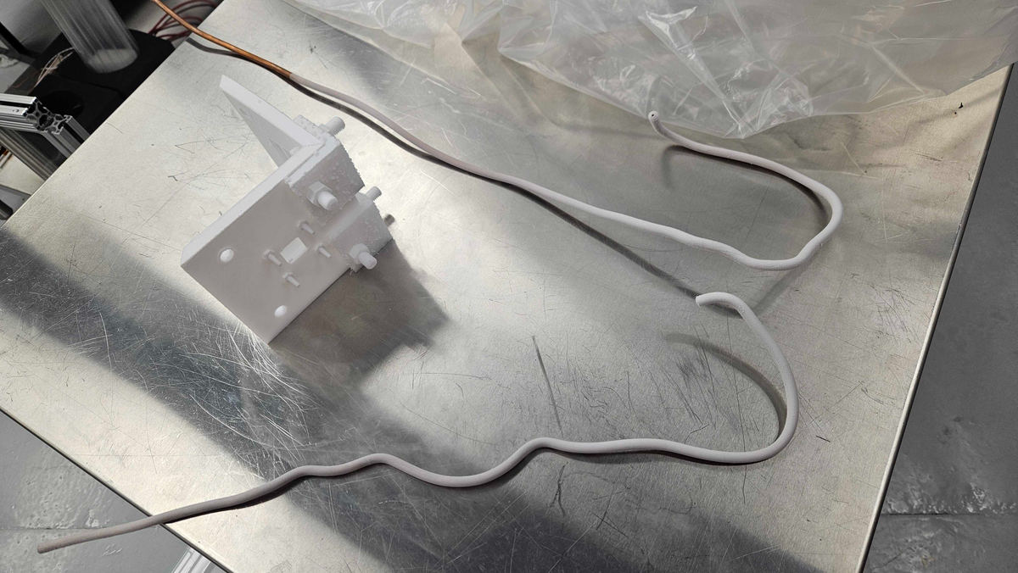

CONSTRUCTION
  Constructed of polytetrafluoroethylene (PTFE, Teflon)
  Initial prototype with high density polyethylene tested in liquid nitrogen
2-wall assembly after cryogenic test.
Photo credit to Peter Taylor
10

Slide 11
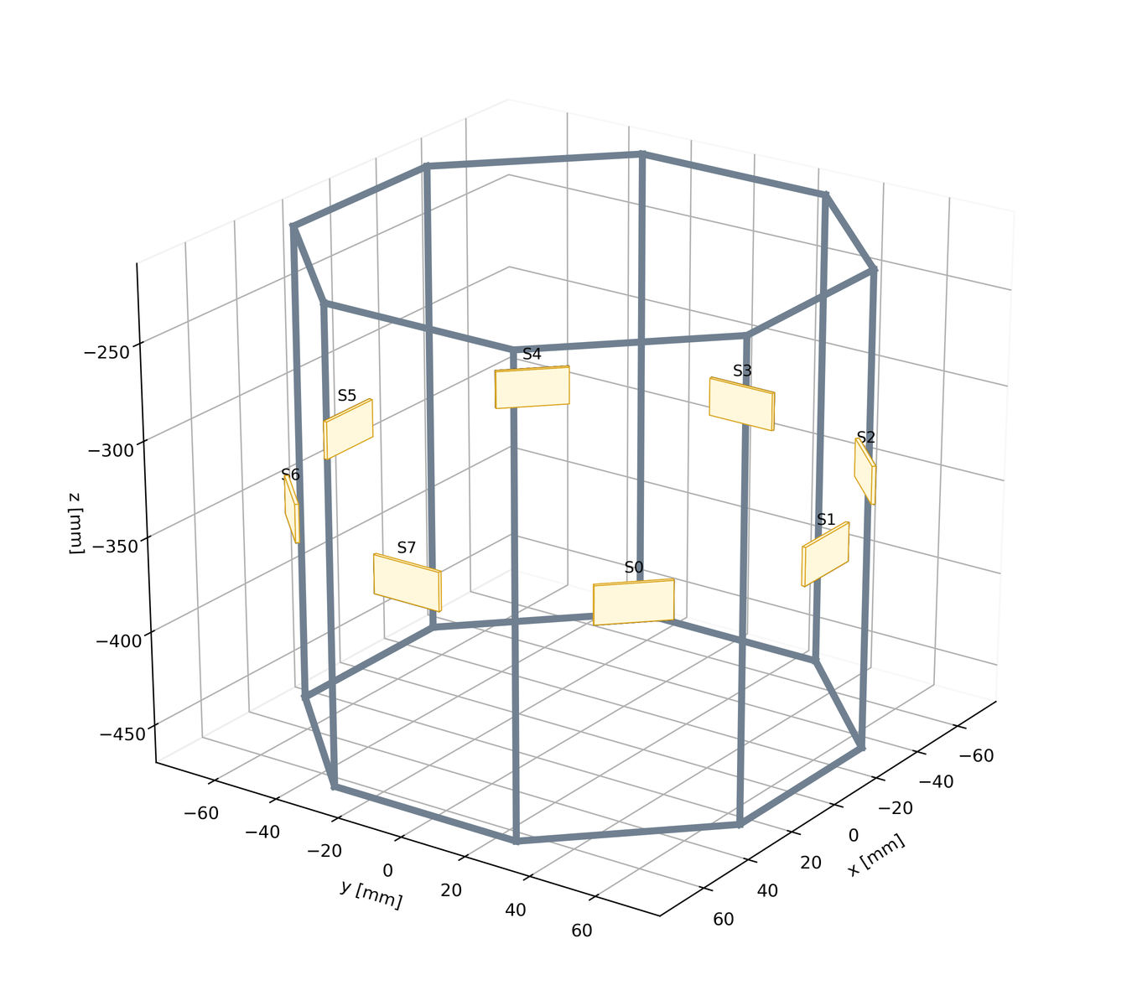
CONSTRUCTION
  Constructed of polytetrafluoroethylene (PTFE, Teflon)
  Initial prototype tested
in liquid nitrogen
Final prototype will be octogonal chamber
PTFE geometry with SiPMs and PEN, as used in simulations.
11

Slide 12
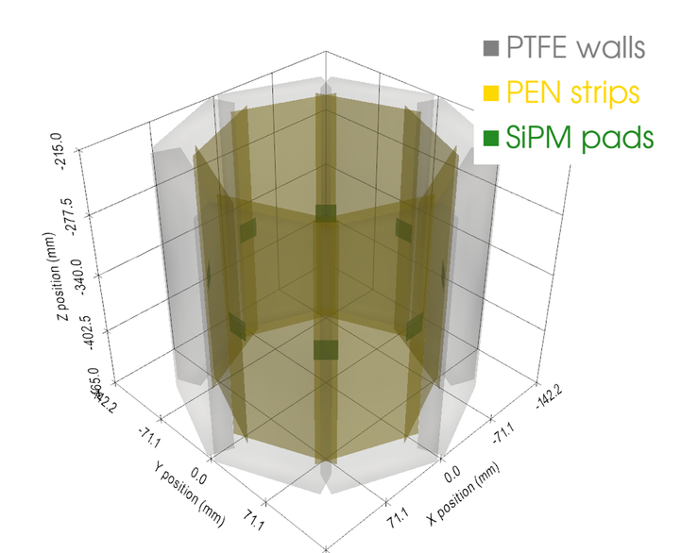
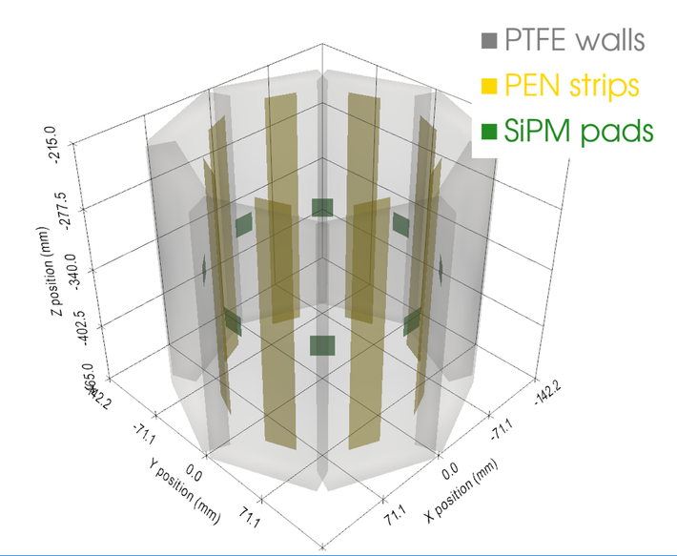
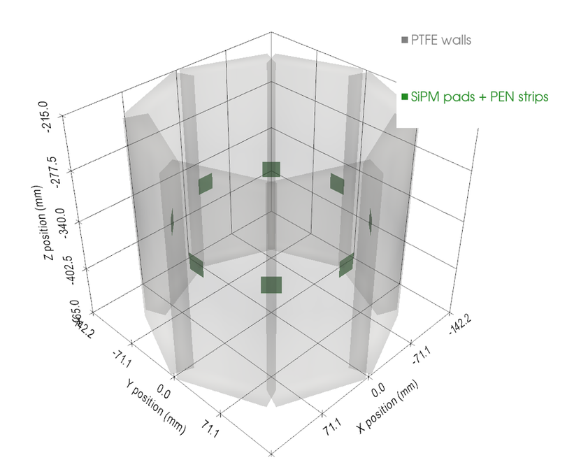
WLS = wavelength shifter
COMPLEMENTING HARDWARE...
  Placement of PEN WLS changes efficiency
  Optimized using simulation
Full PEN WLS mode
Strip PEN WLS mode
PEN on SiPMs WLS mode
12

Slide 13
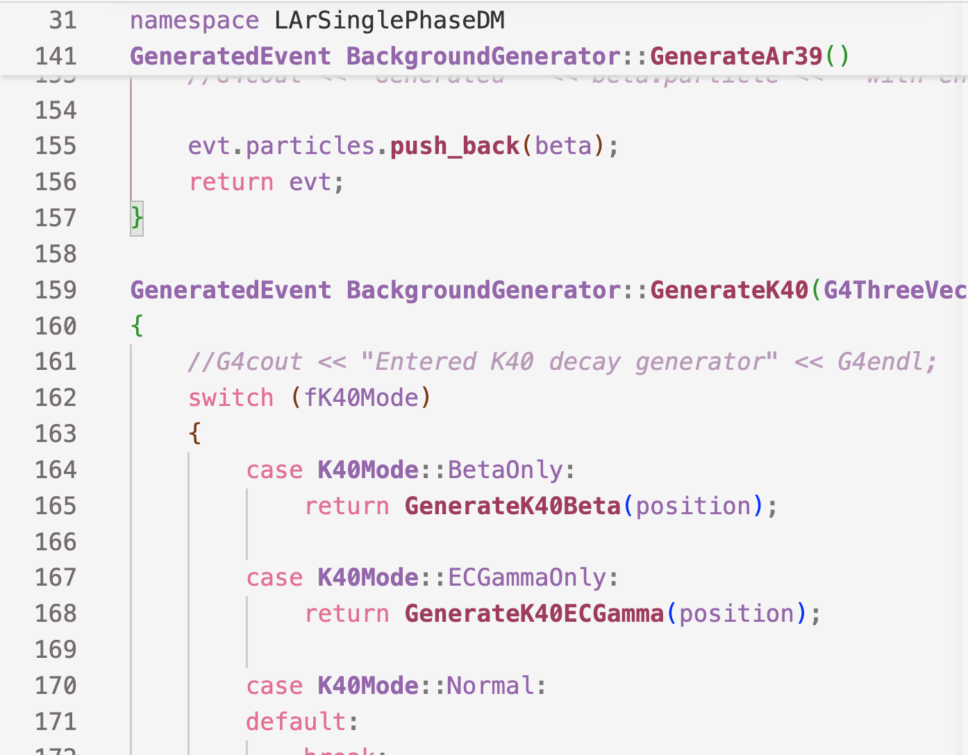
  UNDERSTAND YOUR DETECTOR
Octogonal PFTE chamber filled with liquid argon using PEN wavelength shifter (WLS) and silicion photomultiplers (SiPMs) to detect scintillation from elastic scatters.
  DOWNLOAD GEANT4
Open-source toolkit developed by CERN and used by (frustrated) physicists all over the world. C++ and object-oriented, it allows users to track particle paths using Monte-Carlo methods in user-defined geometries.
SIMULATION
  BUILD YOUR SIMULATION
...
13

Slide 14
How can we predict what happens when radiation interacts with our detector?
14

Slide 15
How can we predict what happens when radiation interacts with our detector?
Build a digital model of the single-phase chamber
15

Slide 16
How can we predict what happens when radiation interacts with our detector?
Build a digital model of the single-phase chamber
Define detector materials and geometry
16

Slide 17
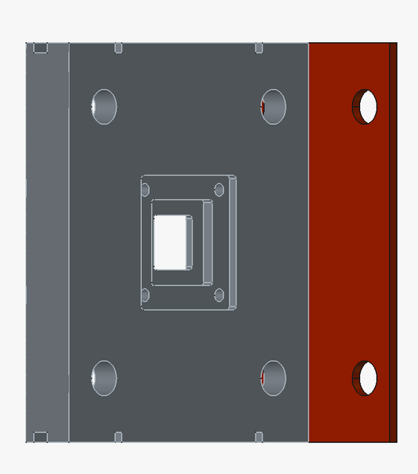
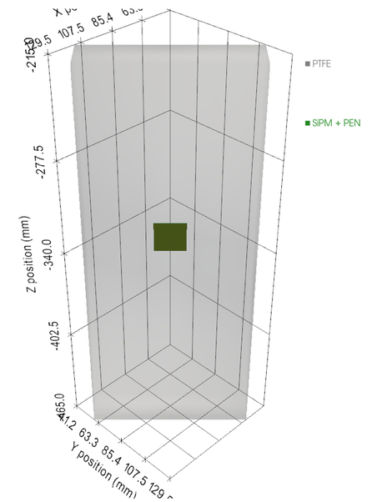
How can we predict what happens when radiation interacts with our detector?
Build a digital model of the single-phase chamber
LAr
Define detector materials and geometry
PTFE
Cryostat
SiPMs
WLS
Geant4 model
CAD model
17

Slide 18
How can we predict what happens when radiation interacts with our detector?
Build a digital model of the single-phase chamber
LAr
Define detector materials and geometry
Define radioactive sources
PTFE
Cryostat
SiPMs
WLS
18

Slide 19
How can we predict what happens when radiation interacts with our detector?
Build a digital model of the single-phase chamber
LAr
Energy
Define detector materials and geometry
Define radioactive sources
PTFE
Ar-39
Position
Cryostat
SiPMs
WLS
K-40
Alphas
19

Slide 20
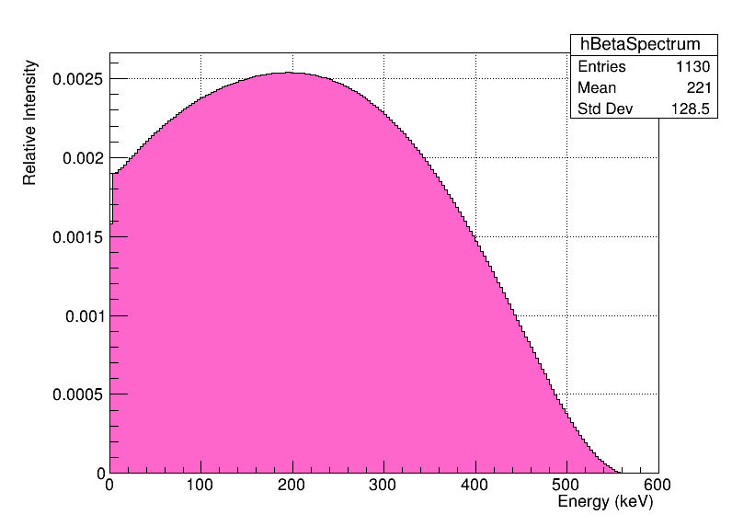

Ar-39
Define radioactive sources e.g.
Density | 1.396 g/cm³ at 84K
Optical properties | Refractive index, Rayleigh scattering length, optical range 2.0–10.6 eV (620–117 nm)
Scintillation yield | 40 photons/keV
Absorption length | 20m
Energy
Position
Distributed through bulk volume
20

Slide 21
How can we predict what happens when radiation interacts with our detector?
Build a digital model of the single-phase chamber
Select physical processes
21

Slide 22
How can we predict what happens when radiation interacts with our detector?
Build a digital model of the single-phase chamber
Select physical processes
Electromagnetic interactions
Optical photons
Scintillation
Absorption
WLS
22

Slide 23
How can we predict what happens when radiation interacts with our detector?
Build a digital model of the single-phase chamber
Select physical processes
Generate Monte Carlo events
Sample particle type
Sample energy
Sample location
23

Slide 24
How can we predict what happens when radiation interacts with our detector?
Build a digital model of the single-phase chamber
Select physical processes
Generate Monte Carlo events
Track every particle through the detector
and simulate all interactions
24

Slide 25
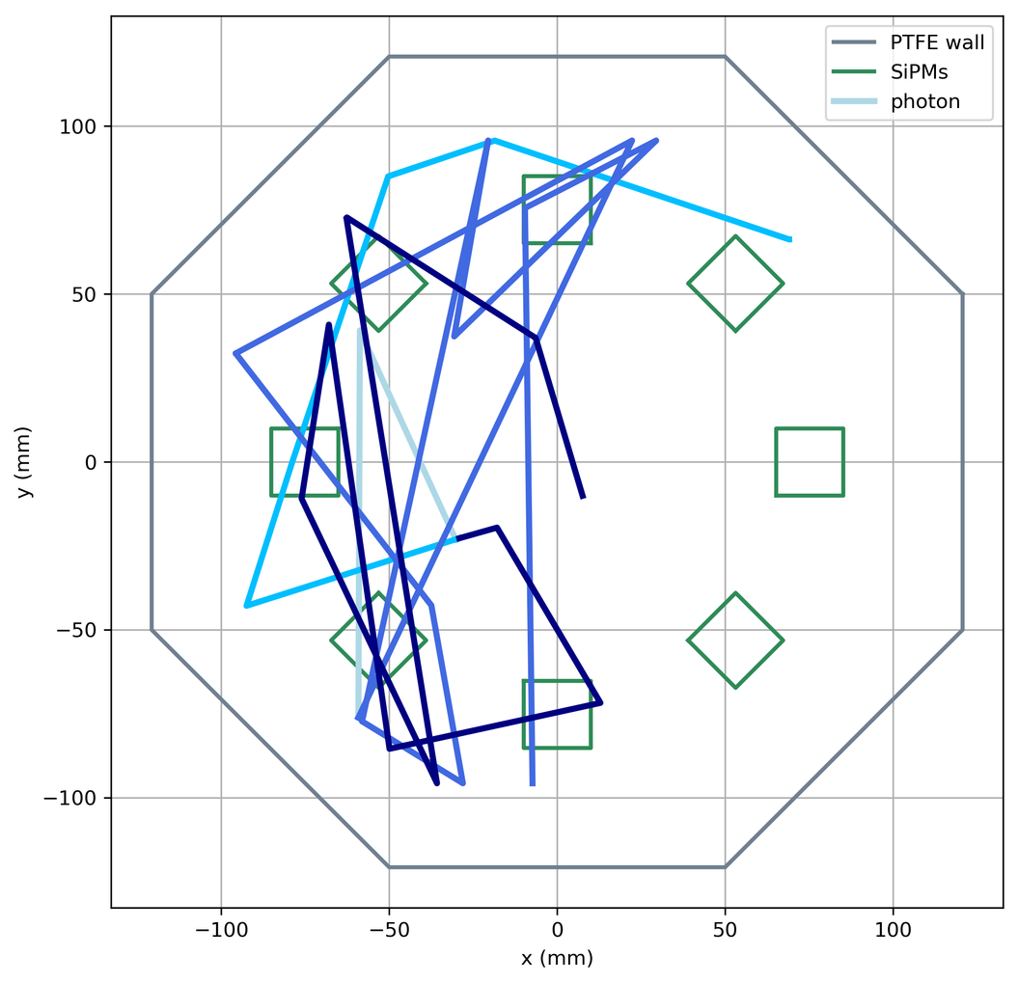
Ar-39
Generate events e.g.
Electron deposits energy in LAr, producing scintillation (VUV) photons.
Visualizer shows 4 particle tracks from 1 event.
25

Slide 26
How can we predict what happens when radiation interacts with our detector?
Build a digital model of the single-phase chamber
Select physical processes
Generate Monte Carlo events
Track every particle through the detector
and simulate all interactions
Record detector observables
Energy deposited
Photons produced
SiPM hits
26

Slide 27
How can we predict what happens when radiation interacts with our detector?
Build a digital model of the single-phase chamber
Select physical processes
Generate Monte Carlo events
Track every particle through the detector
and simulate all interactions
Record detector observables
Spectra
Backgrounds
Analyze and validate results
Light yield
Efficiencies
27

Slide 28
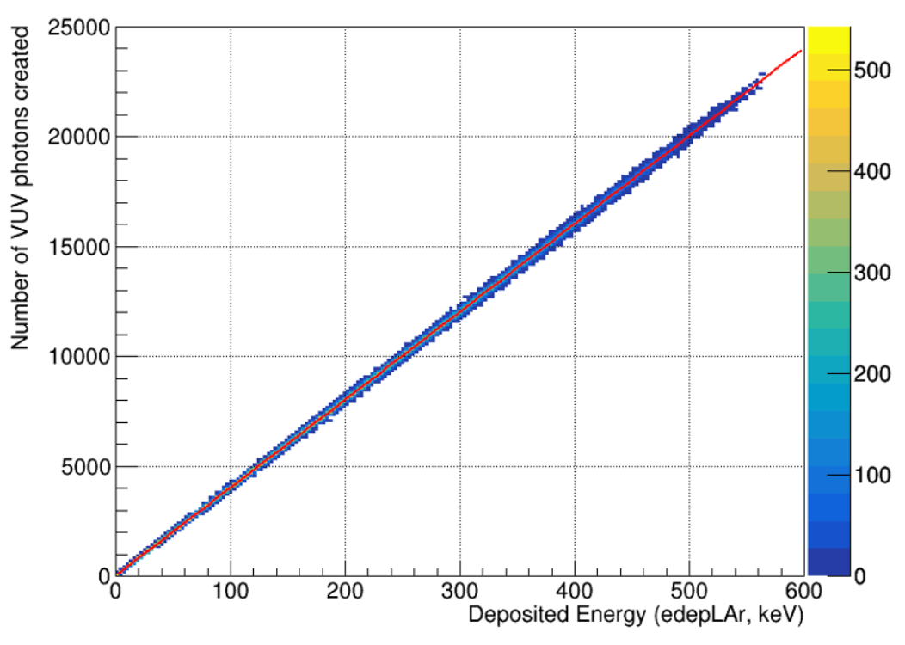
Ar-39
Results e.g. Amount of scintillation produced
Yield = 39.999±0.025 photons/keV
  Excited molecular states of Ar (“excimers”) release light when they decay
  Deposited energy in LAr vs amount of light produced is linear
Slope = Scintillation yield
28

Slide 29
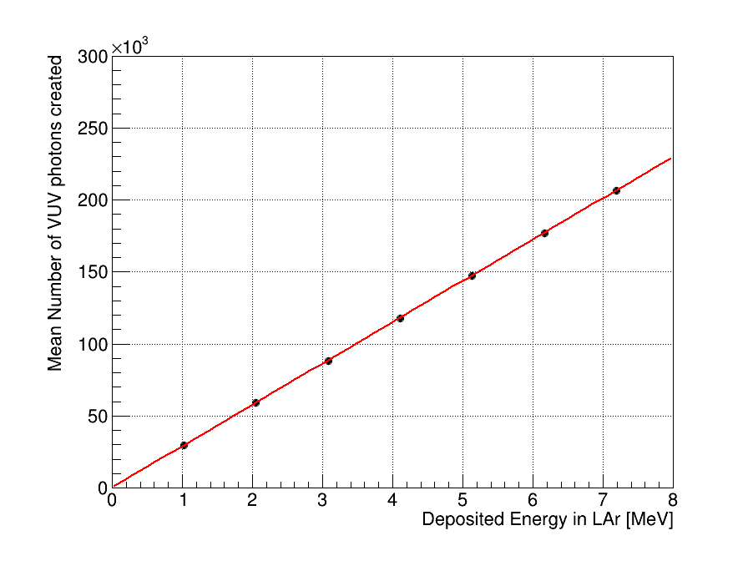
Alpha gun
Results e.g. Amount of scintillation produced
  Quenching : processes that divert deposited energy away from scintillation, e.g. into heat, reducing the detectable light yield.
  Alphas experience strong quenching
  Scintillation yield is reduced to
  70% of full yield
  Matches theoretical Q value (~0.7)
Yield: 28.708±0.0174 photons/keV
29

Slide 30
4 photon tracks
from 1 Ar-39 event
104 photon tracks
from 1 alpha-gun event
30

Slide 31


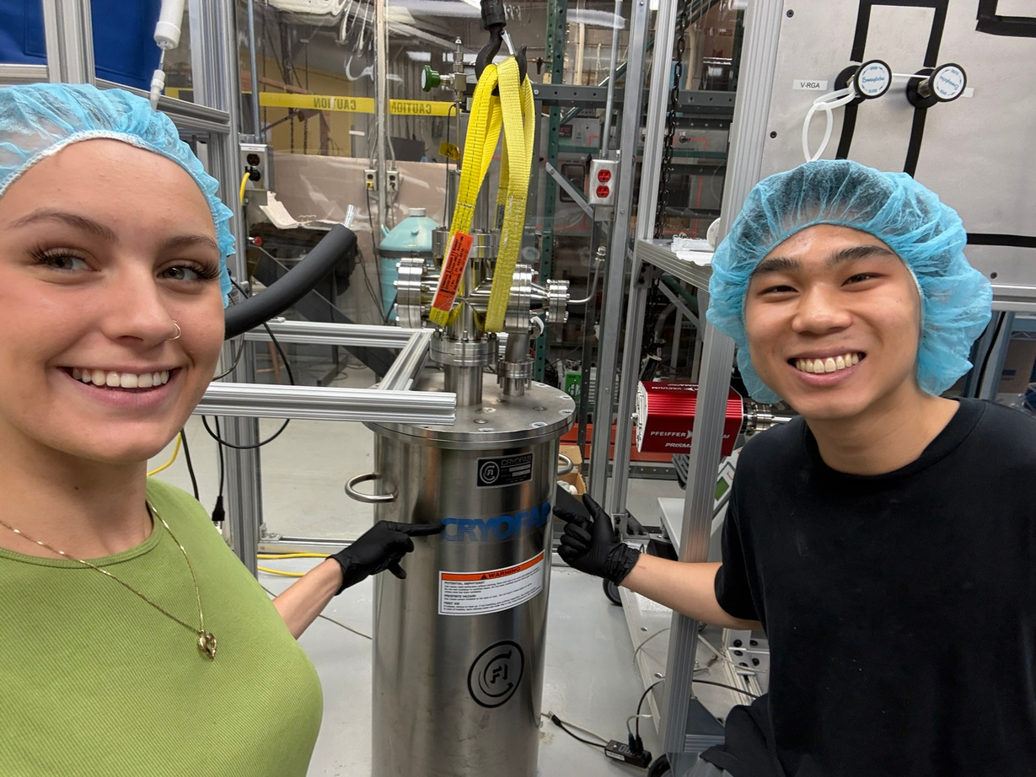


THANK YOU
Scan to connect with me on Linkedin!
Julia Brachman
22gn16@queensu.ca
Queen’s University
31

Slide 32
BACKUP SLIDES
32

Slide 33
EXTRA SLIDES
DIRECT DETECTION WITH LIQUID ARGON
  Nuclear recoils excite or ionize Ar-40, producing prompt scintillation light (S1, 128nm).
  Non-recombined ionization electrons can produce secondary scintillation (S2) through electroluminescence.
Single-phase chambers only collect S1
Dual-phase chambers can collect S1 & S2
33

Slide 34
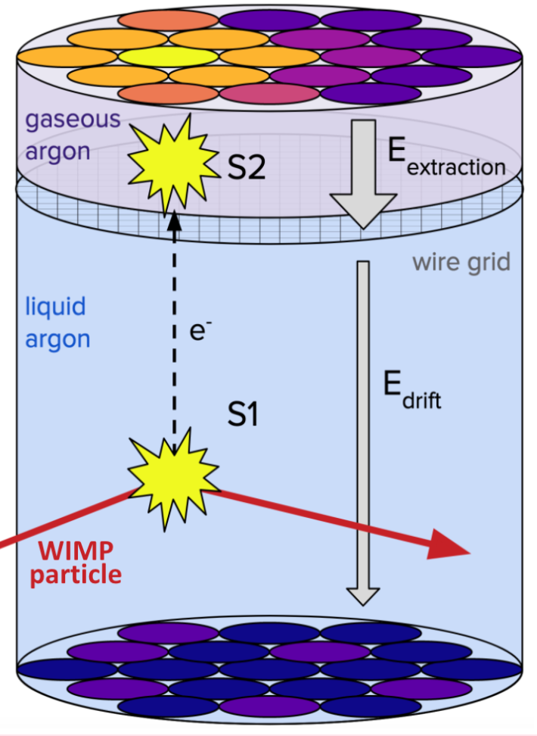
EXTRA SLIDES
DUAL-PHASE (TPC) CHAMBERS
  “Time projection chambers”
  Drift ionization electrons are directed from a liquid to a gaseous layer
  Requires complex high-voltage and fine-tuned electric fields within a cryogenic system
Figure from “Direct Dark Matter Detection with Darkside-20k experiment” [slides], by Manthos, I., 2022, University of Birmingham
34

Slide 35
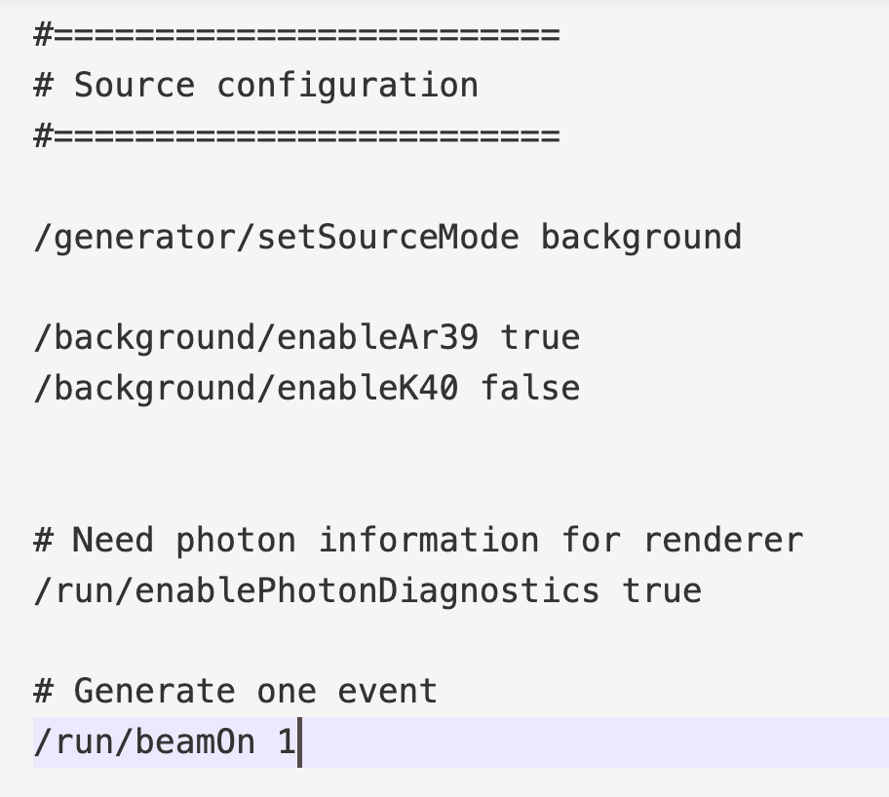
EXTRA SLIDES
COMPONENTS OF THE GEANT4 CODE
  Macros are plain text files with built-in user interface (UI) commands
  Used to customize simulation runs, called with the executable
Example screenshot from a macro
35

Slide 36
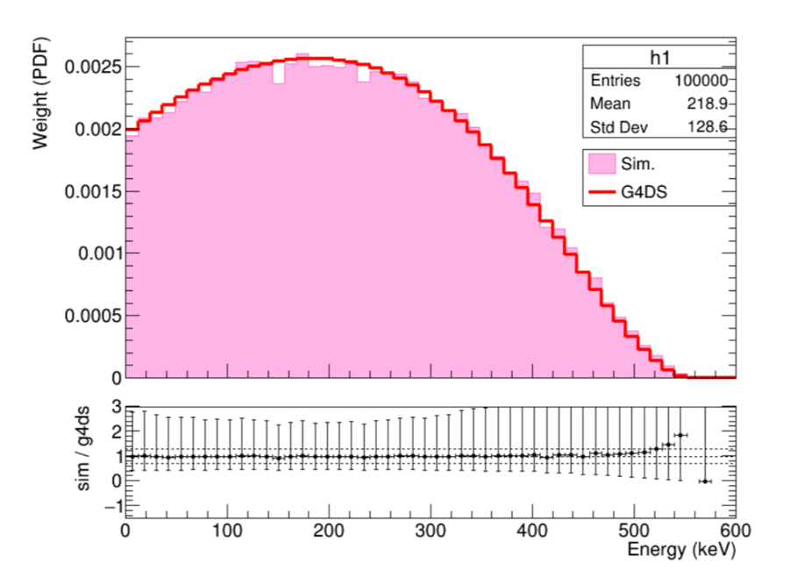
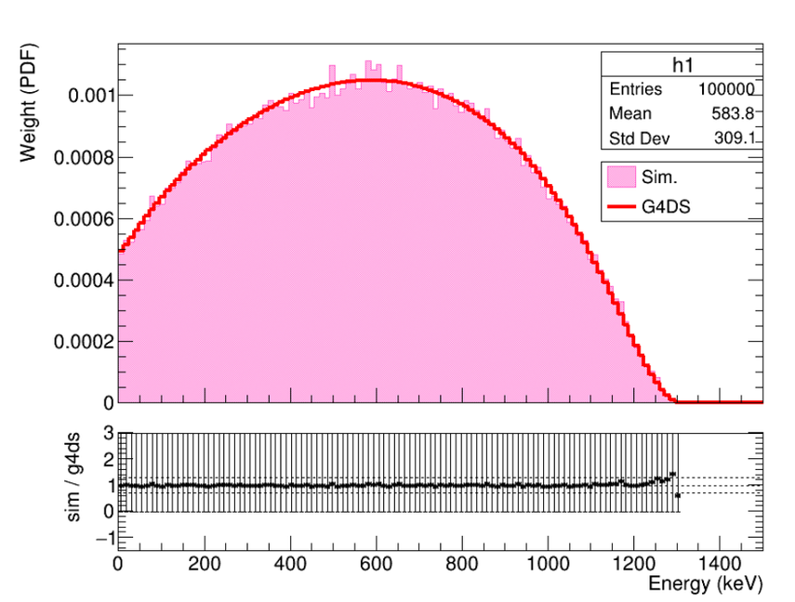
EXTRA SLIDES
HOW DO WE VALIDATE BACKGROUND GENERATOR?
  Compare sampled energy to expectation
K-40 beta sampled energy spectrum
36
Ar-39 beta sampled energy spectrum

Slide 37
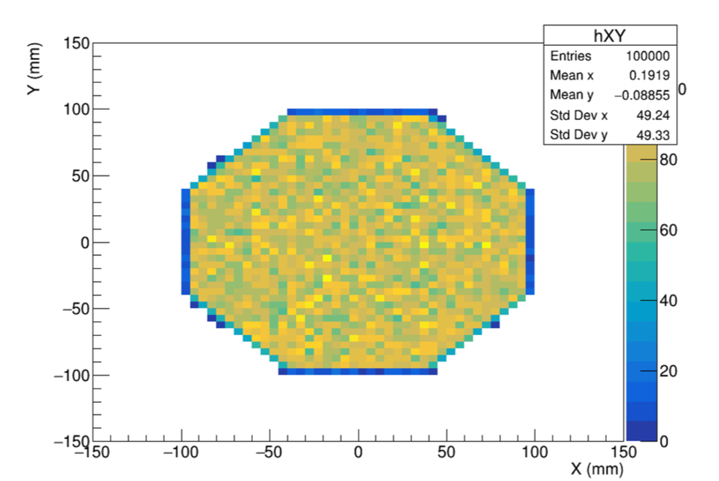
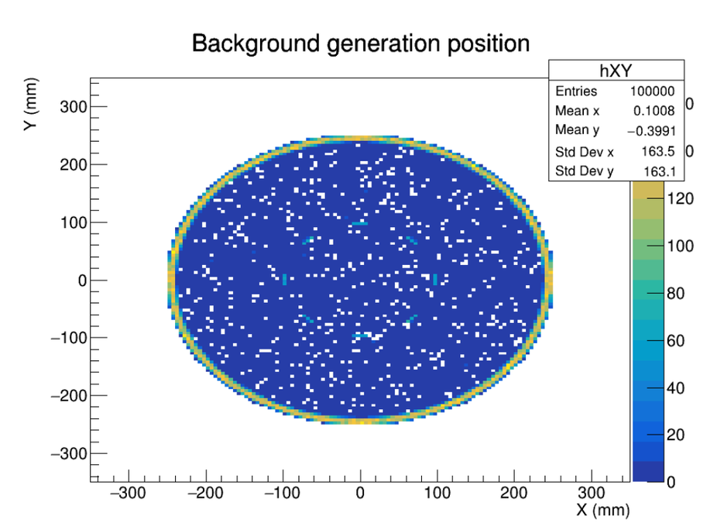
EXTRA SLIDES
HOW DO WE VALIDATE BACKGROUND GENERATOR?
  Compare sampled position to expectation
Ar-39 beta sampled position
K-40 EC gamma sampled position
37

Slide 38

EXTRA SLIDES
HOW DO WE PREDICT ACTIVITY?
  Determined from active volume, density, and specific activity
  Specific activity is taken from literature
  Volume is determined by our detector
38

Slide 39
EXTRA SLIDES
SCINTILLATION YIELD
  Scintillation: The flash of light after a material absorbs energy
  Yield depends on type of radiation and dE/dx
    Higher ionization density increases non-radiative recombination, thus reducing light yield
Excited Ar (“excimers”) release light when they decay
  Quenching: any process that reduces interupts the excimer from producing VUV scintillation
39

Slide 40
EXTRA SLIDES
TYPES OF SIGNALS IN LIQUID ARGON
Electron recoil
Energy deposited by electrons.
Relatively low ionization density.
E.g. betas from
Ar-39 → K-39 decay
Nuclear recoil
Energy deposited by recoiling argon nucleus.
E.g. WIMP signal on Ar-40
Alpha events
Energy deposited by alphas.
More densely ionizing tracks.
E.g. Rn-222, Po-210 decay chains
40

Slide 41
EXTRA SLIDES
TYPES OF SIGNALS IN LIQUID ARGON
Electron recoil
Energy deposited by electrons.
Relatively low ionization density.
E.g. betas from
Ar-39 → K-39 decay
Nuclear recoil
Energy deposited by recoiling argon nucleus.
E.g. WIMP signal on Ar-40
Alpha events
Energy deposited by alphas.
More densely ionizing tracks.
E.g. Rn-222, Po-210 decay chains
More quenching!
41

Slide 42
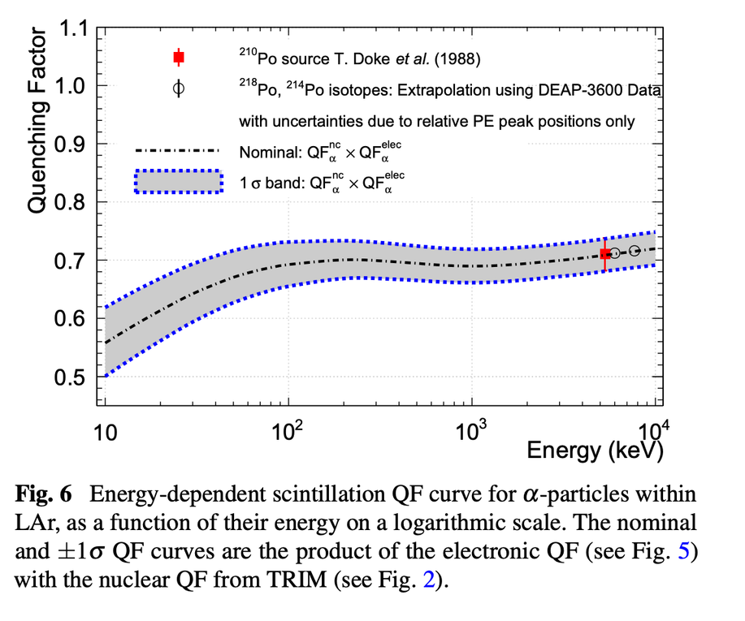
EXTRA SLIDES
ALPHA QUENCHING
  DEAP-3600 calculated the quenching factor of alpha particles as function of energy
  For 1 Mev, Q ~ 0.7
Adhikari, P et al. DEAP Collaboration. (2025). Relative measurement and extrapolation of the scintillation quenching factor of alpha-particles in liquid argon using DEAP-3600 data. Eur. Phys. J. C, 85, 87. 10.1140/epjc/s10052-024-13518-7 / arXiv:2406.1859
42

Slide 43
EXTRA SLIDES
What is PEN?
  Polyethylene naphthalate
  Industrial-grade thermoplastic polyester
  Solid thin sheets (~25 µm)
  Absorbs vacuum ultraviolet (VUV) scintillation light and re-emits it as visible blue light
  Boosts photosensor efficiency
  Another common wavelength-shifter is TPB, which is evaporated on surfaces instead of being a sheet.
43

