Slide 1
An Alternate Approach to High Energy Event Simulation in DEAP3600
Matt Poser, Queen’s University
Supervisors: Dr. Philippe DiStefano, Dr. Theo Hugues
CASST 2026, August 12/13

Slide 2
Key Concepts & Acronyms
“See” the light
Photoelectric effect [1]
Electrical signal
PhotoMultiplier Tubes (PMTs)
‘Volumetric Pixel’
3-D cube, arbitrary size
Used to discretize the detector
Voxel
Pre-generated data, stored in memory
Used to bypass computation
Reused data
LUT (Lookup Table)
1

Slide 3
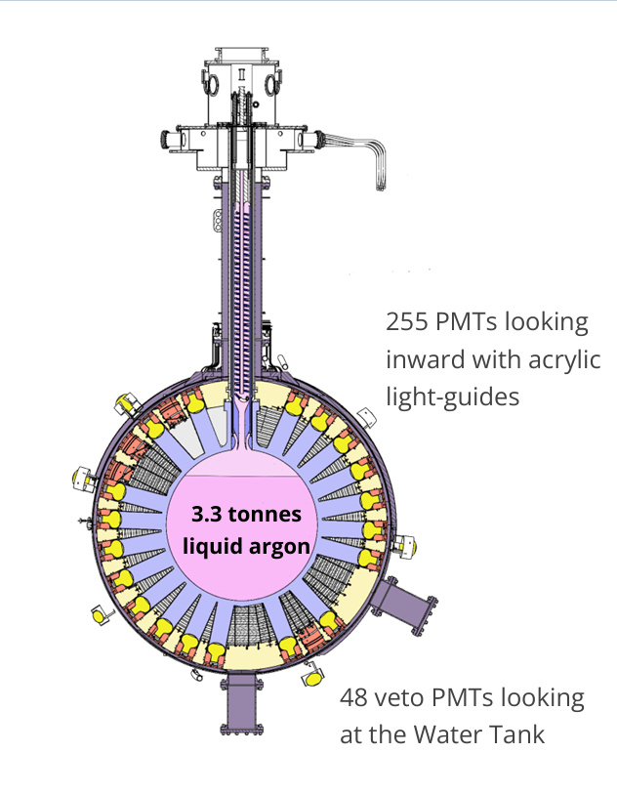
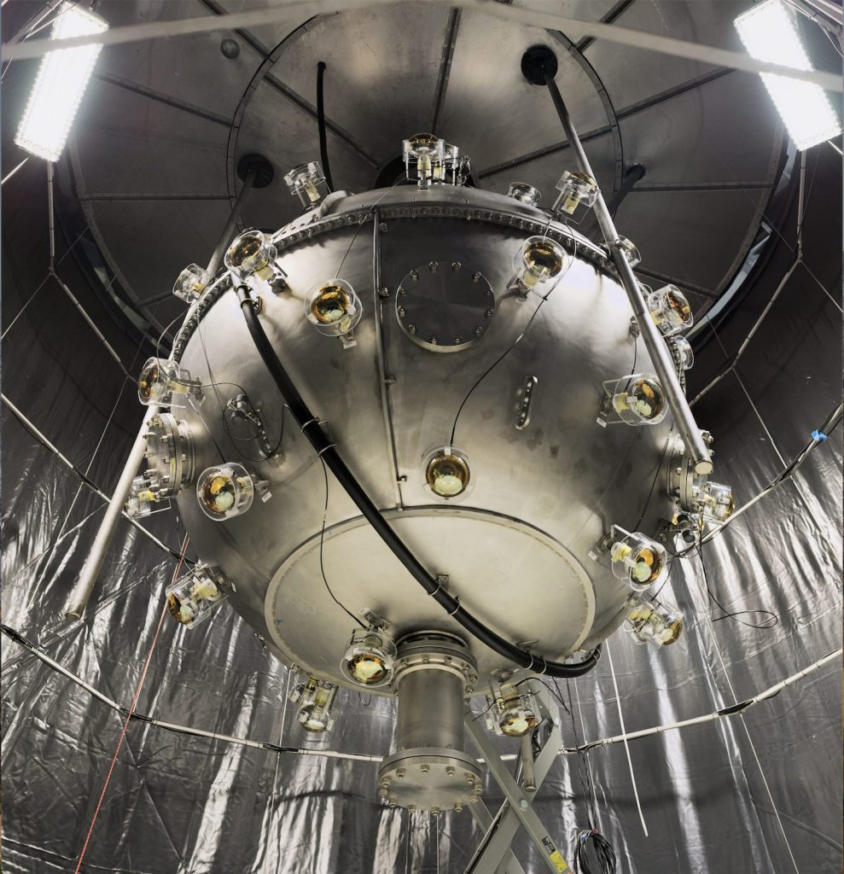
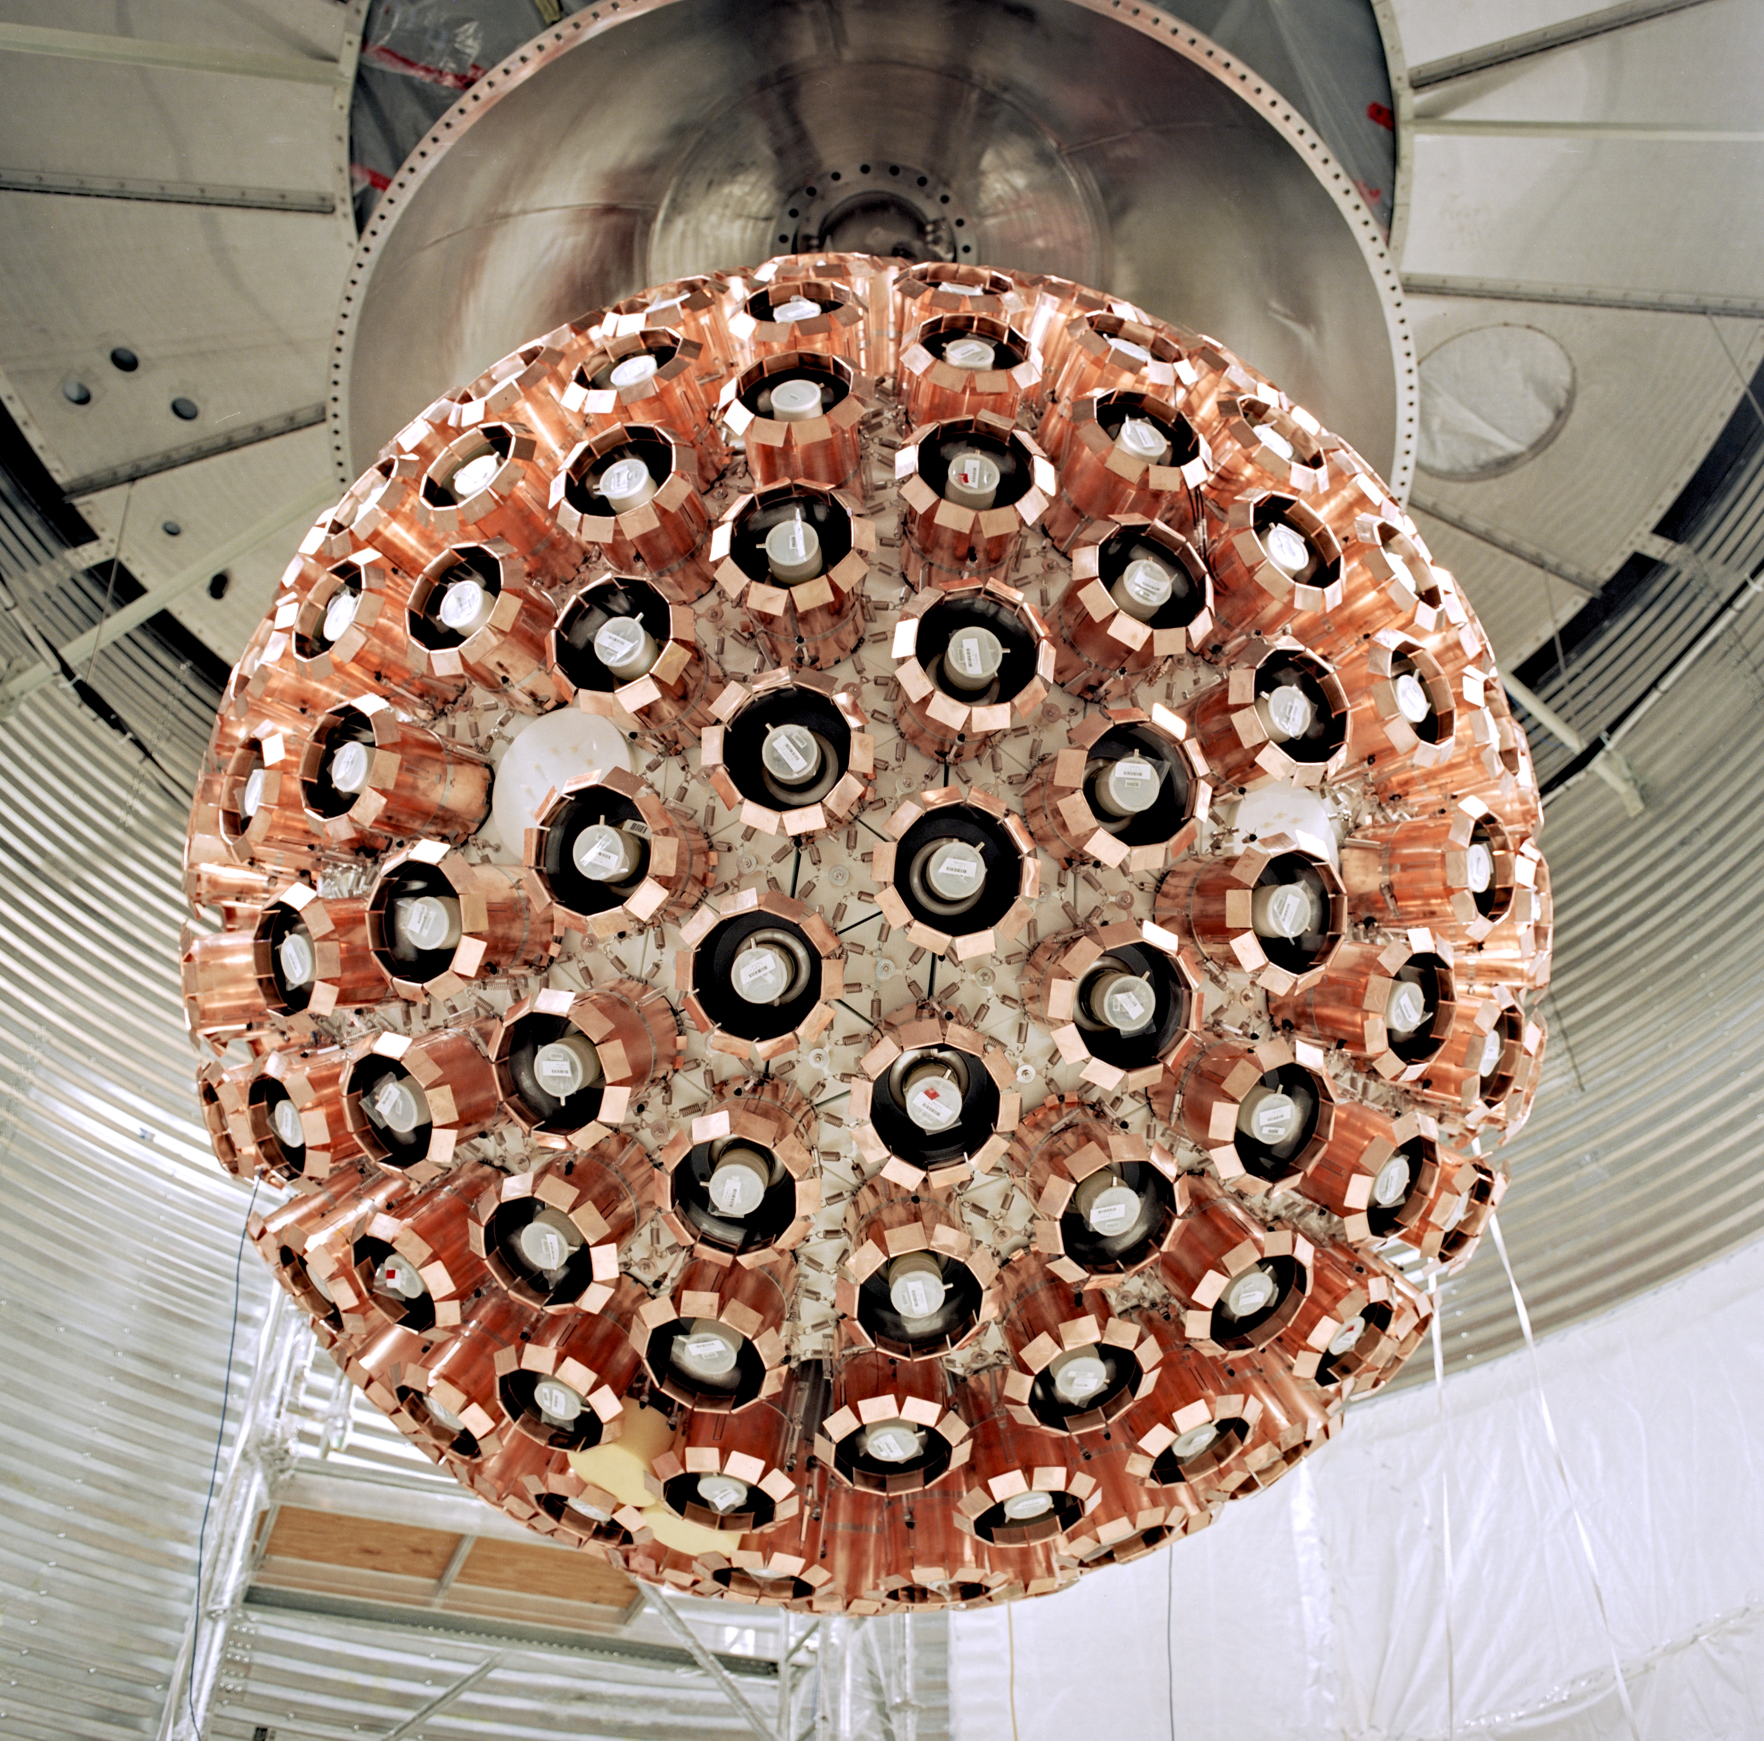
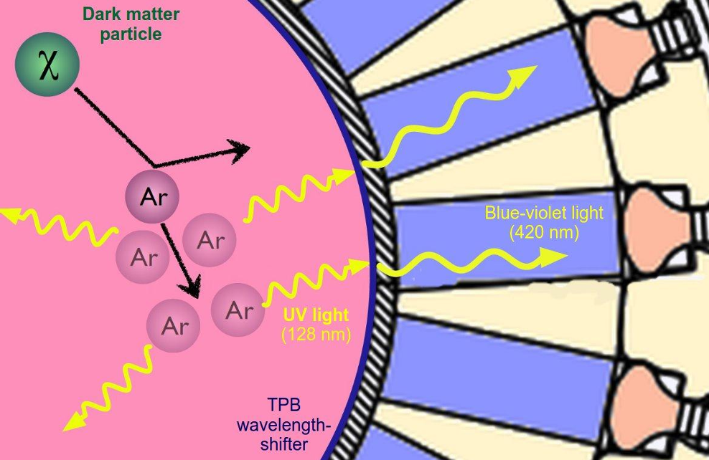
The DEAP3600 Experiment
Direct detection DM Search
    10 years at SNOLAB this fall!
    LAr target, scintillation
Probing for many candidates
    WIMPs
    Planck Scale, multiple scattering [2]
Constraints on ‘parameter space’
Ongoing analysis for heavy, higher energy DM candidates
2

Slide 4
As events go up in energy
(more E deposited in recoil)
Or, have multiple scatters
The number of scintillation photons increases greatly
3

Slide 5

Simulation
Important for checking results
Making predictions & models
Different tools
    Digital clone
    Objects, stepping
LAr releases ~40,000 photons per MeV of energy deposited
What happens as we go to very high energies?
Object A,
State n
Object A,
State n+1
Solve ODE, PDE
Number of photons slows down simulation!
4

Slide 6
Make a simulation tool which:
Skips photon stepping
Accurately models where photons end up
5

Slide 7

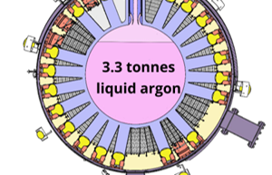
Voxelization, Lookup Tables
How do skip simulating photons?
We know:
    Event location
    Number emitted
Jump to:
    Where they end up
    What PMTs see them
Compute ahead of time, call at runtime (LUTs)
51
1
Event
49
37
20
5
2
5
2
2. For each voxel, how many hits does a PMT see?
3. Reconstruct event using LUT-sampled hit counts
1. Divide detector into voxels
6

Slide 8
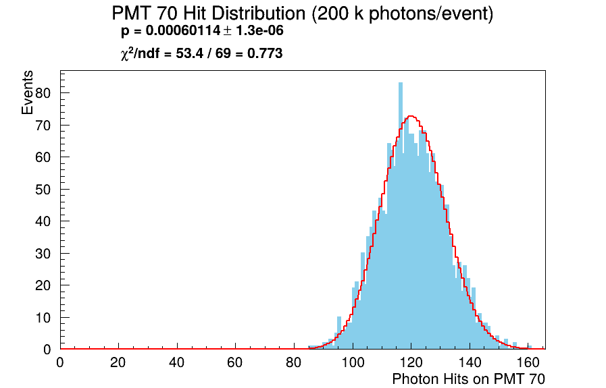
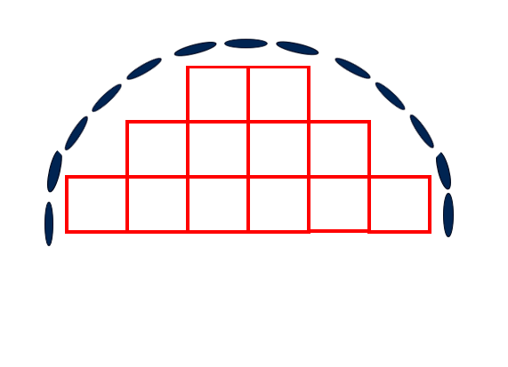
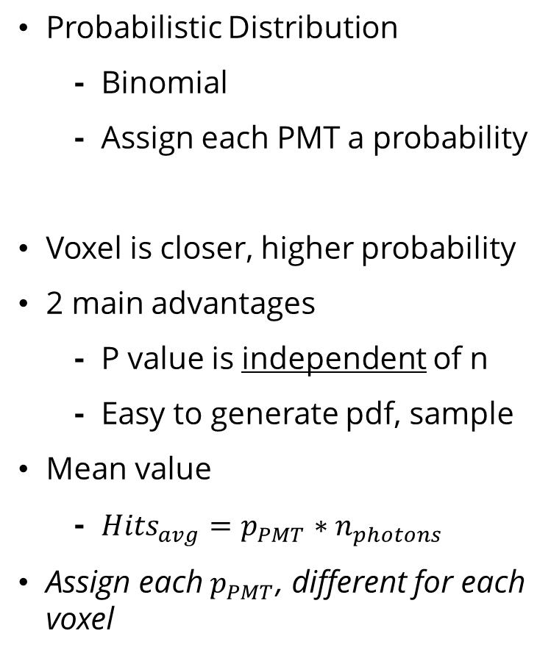
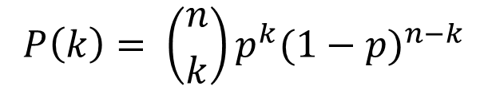
Modeling Photons in the Detector
Probabilistic Distribution
    Binomial
    Assign each PMT a probability
Voxel is closer, higher probability
2 main advantages
    P value is independent of n
    Easy to generate pdf, sample
Mean value
    ${Hits}_{avg}=p_{PMT}∗n_{photons}$
Assign each $p_{PMT}$, different for each voxel
“On average”
p=0.1
p=0.2
Event
p=0.2
p=0.1
p=0.1
p=0.09
$$P\left(k\right)= \left({n \atop k}\right)p^{k}{(1−p)}^{n−k}$$
p=0.05
7

Slide 9
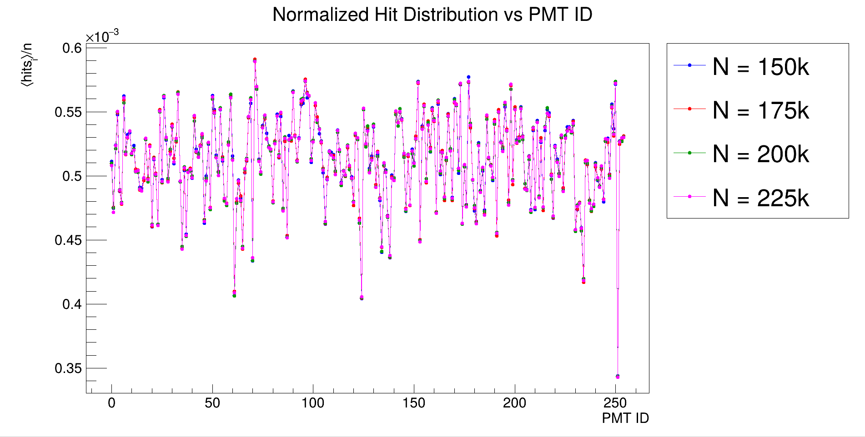
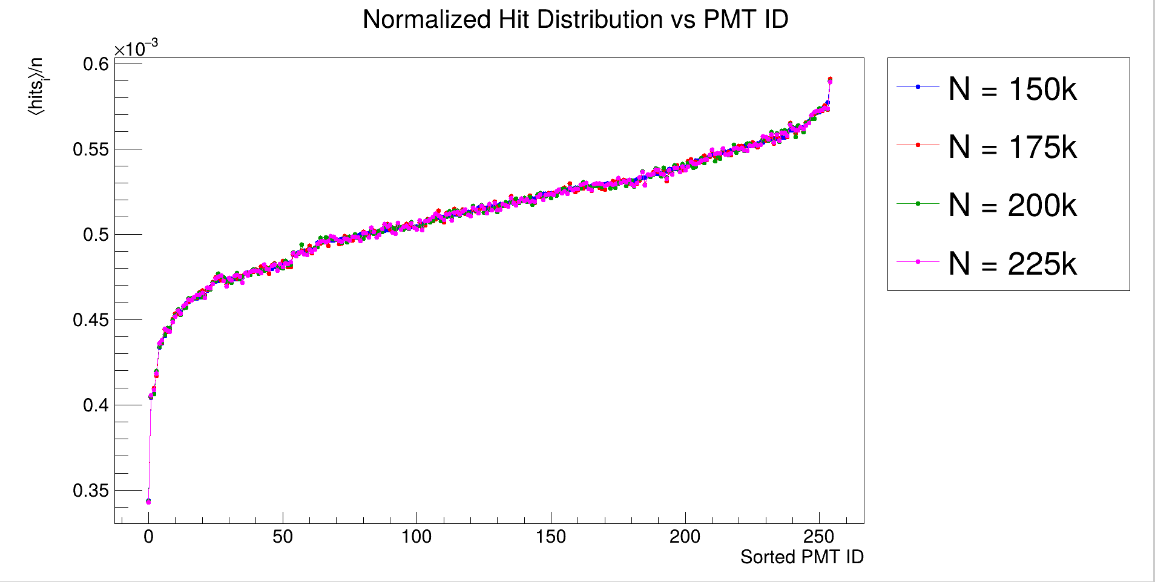
Project Status
Probabilities generated for 1 voxel!
Can begin moving our ‘photon source’ around
Generate probabilities for all voxels
Develop full tool & structure for RAT
8

Slide 10
References
[1] Shimazdu North America, “How does a photomultiplier tube work?” Shimadzu North America, Analytical and Measuring Instruments. Accessed: Aug. 5th, 2026. [Online]. Available: https://www.ssi.shimadzu.com/service-support/faq/uv-vis/instrument-design/9/index.html
[2] P. Adhikari et al. (DEAP Collaboration), "First direct detection constraints on Planck-scale mass dark matter with multiple-scatter signatures using the DEAP-3600 detector," Phys. Rev. Lett., vol. 128, no. 1, Art. no. 011801, Jan. 2022, doi: 10.1103/PhysRevLett.128.011801. [Online]. Available: https://arxiv.org/pdf/2108.09405
[3] Primer, "Overexplaining the binomial distribution," YouTube, Jun. 17, 2023. [Video]. Available: https://www.youtube.com/watch?v=6YzrVUVO9M0
9

