Slide 1
Slow-Control Infrastructure for Noble Liquid Detector R&D
Howard Wen
August 12-13, 2026
CASST 2026

Slide 2
Slow-Control Infrastructure for Noble Liquid Detector R&D
Howard Wen
August 12-13, 2026
CASST 2026

Slide 3
Noble Liquid Detectors
Leading technology for direct dark matter searches
Notes:
CASST 2026

Slide 4
Noble Liquid Detectors
Leading technology for direct dark matter searches
?
Ncl
Notes:
CASST 2026

Slide 5
Noble Liquid Detectors
Leading technology for direct dark matter searches
?
?
Ncl*
Notes:
CASST 2026

Slide 6
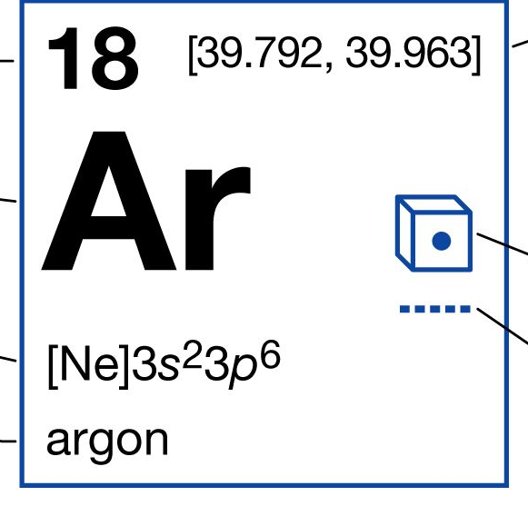
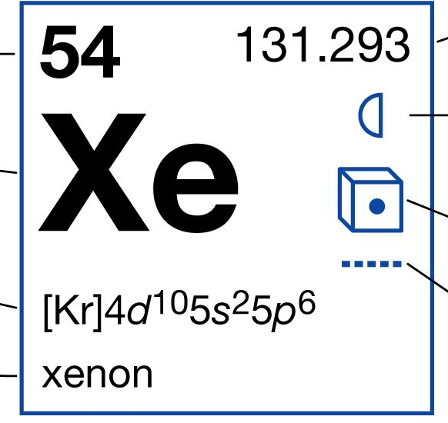
Noble Liquid Detectors
Leading technology for direct dark matter searches
?
?
Ncl*
Notes:
CASST 2026

Slide 7
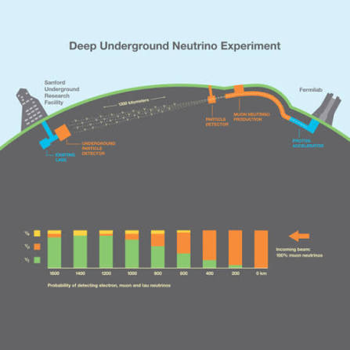
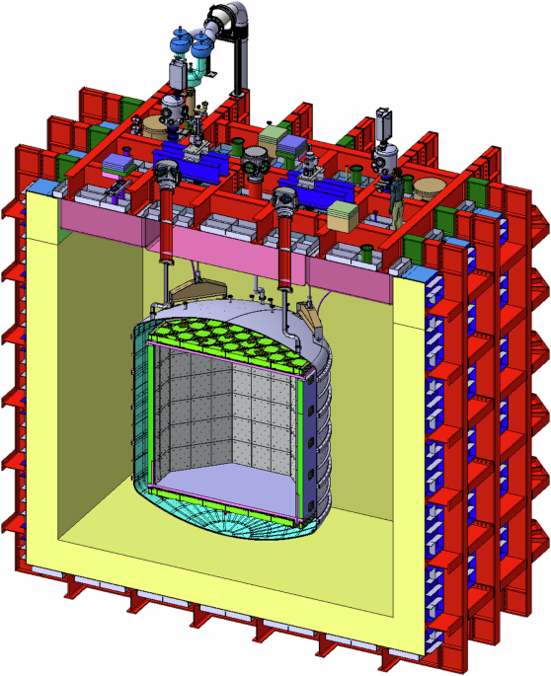
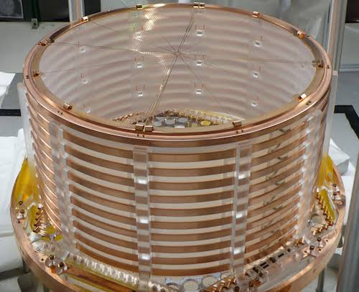
Examples
DUNE, from IPP website
DarkSide-20k, from Nature journal
EXO-200, from Moore Lab @ Yale

Slide 8
Slow-Control Infrastructure for Noble Liquid Detector R&D
Howard Wen
August 12-13, 2026
CASST 2026

Slide 9
We are always finding improvements for future detector designs
At Queen’s, it’s the Scintillation Characterization And Liquid Argon Research (SCALAR) program

Slide 10
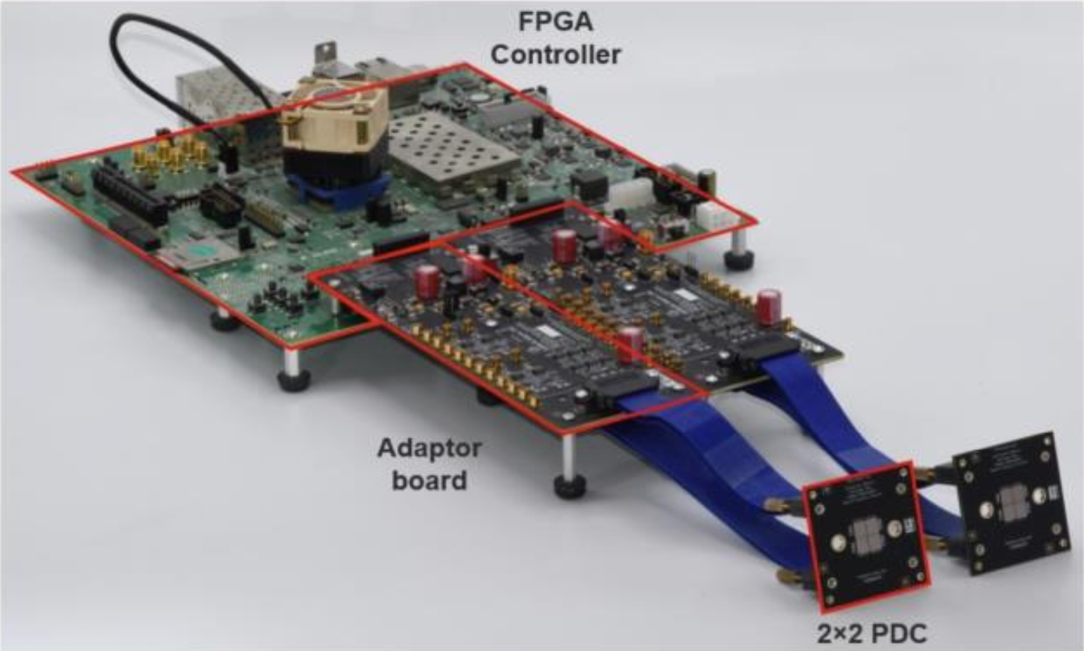
We are always finding improvements for future detector designs
At Queen’s, it’s the Scintillation Characterization And Liquid Argon Research (SCALAR) program
Characterizing new photosensors

Slide 11
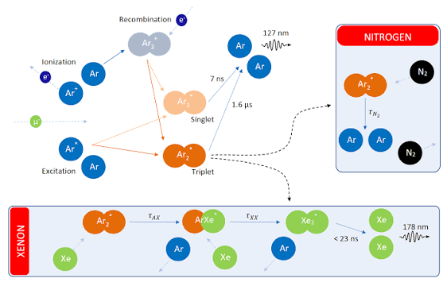
We are always finding improvements for future detector designs
At Queen’s, it’s the Scintillation Characterization And Liquid Argon Research (SCALAR) program
Characterizing new photosensors
Understanding behaviour of doped liquid argon
Doping liquid argon with xenon in ProtoDUNE Single-Phase: effects on scintillation light, from CERN

Slide 12
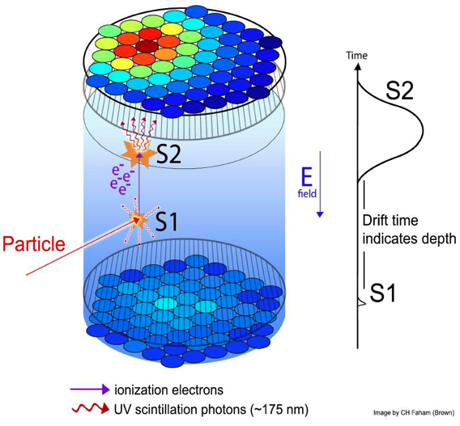
We are always finding improvements for future detector designs
At Queen’s, it’s the Scintillation Characterization And Liquid Argon Research (SCALAR) program
Characterizing new photosensors
Understanding behaviour of doped liquid argon
Testing new detector designs
Doping liquid argon with xenon in ProtoDUNE Single-Phase: effects on scintillation light, from CERN

Slide 13
Slow-Control Infrastructure for Noble Liquid Detector R&D
Howard Wen
August 12-13, 2026
CASST 2026

Slide 14
How do we conduct R&D here at Queen’s?
Creating our own noble liquid detector environment

Slide 15
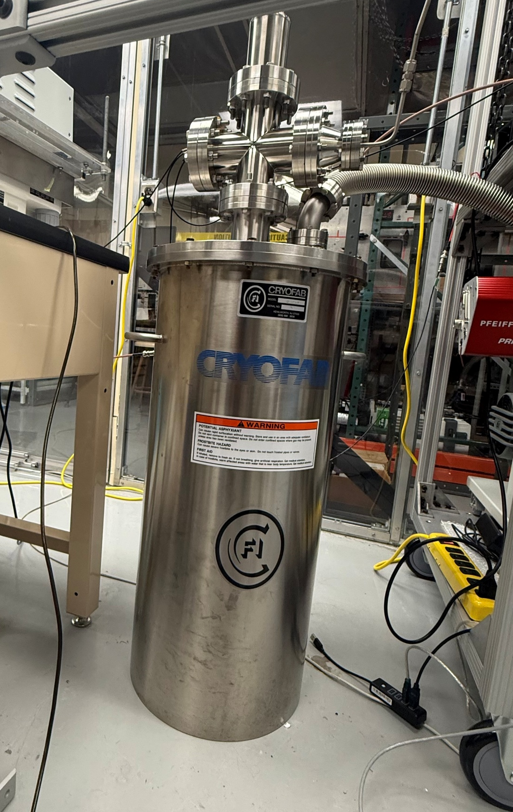
How do we conduct R&D here at Queen’s?
Creating our own noble liquid detector environment

Slide 16
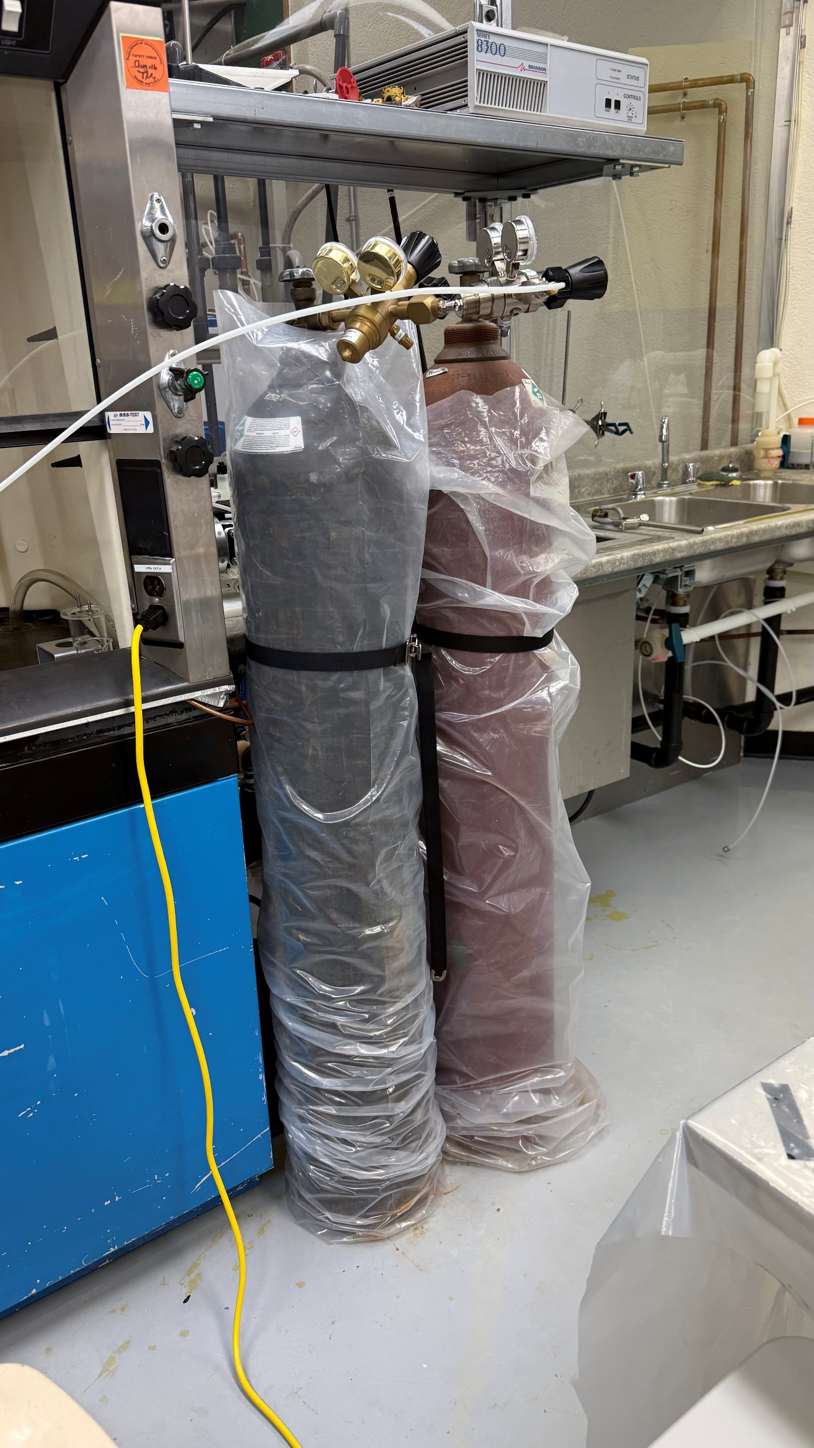
How do we conduct R&D here at Queen’s?
Creating our own noble liquid detector environment

Slide 17
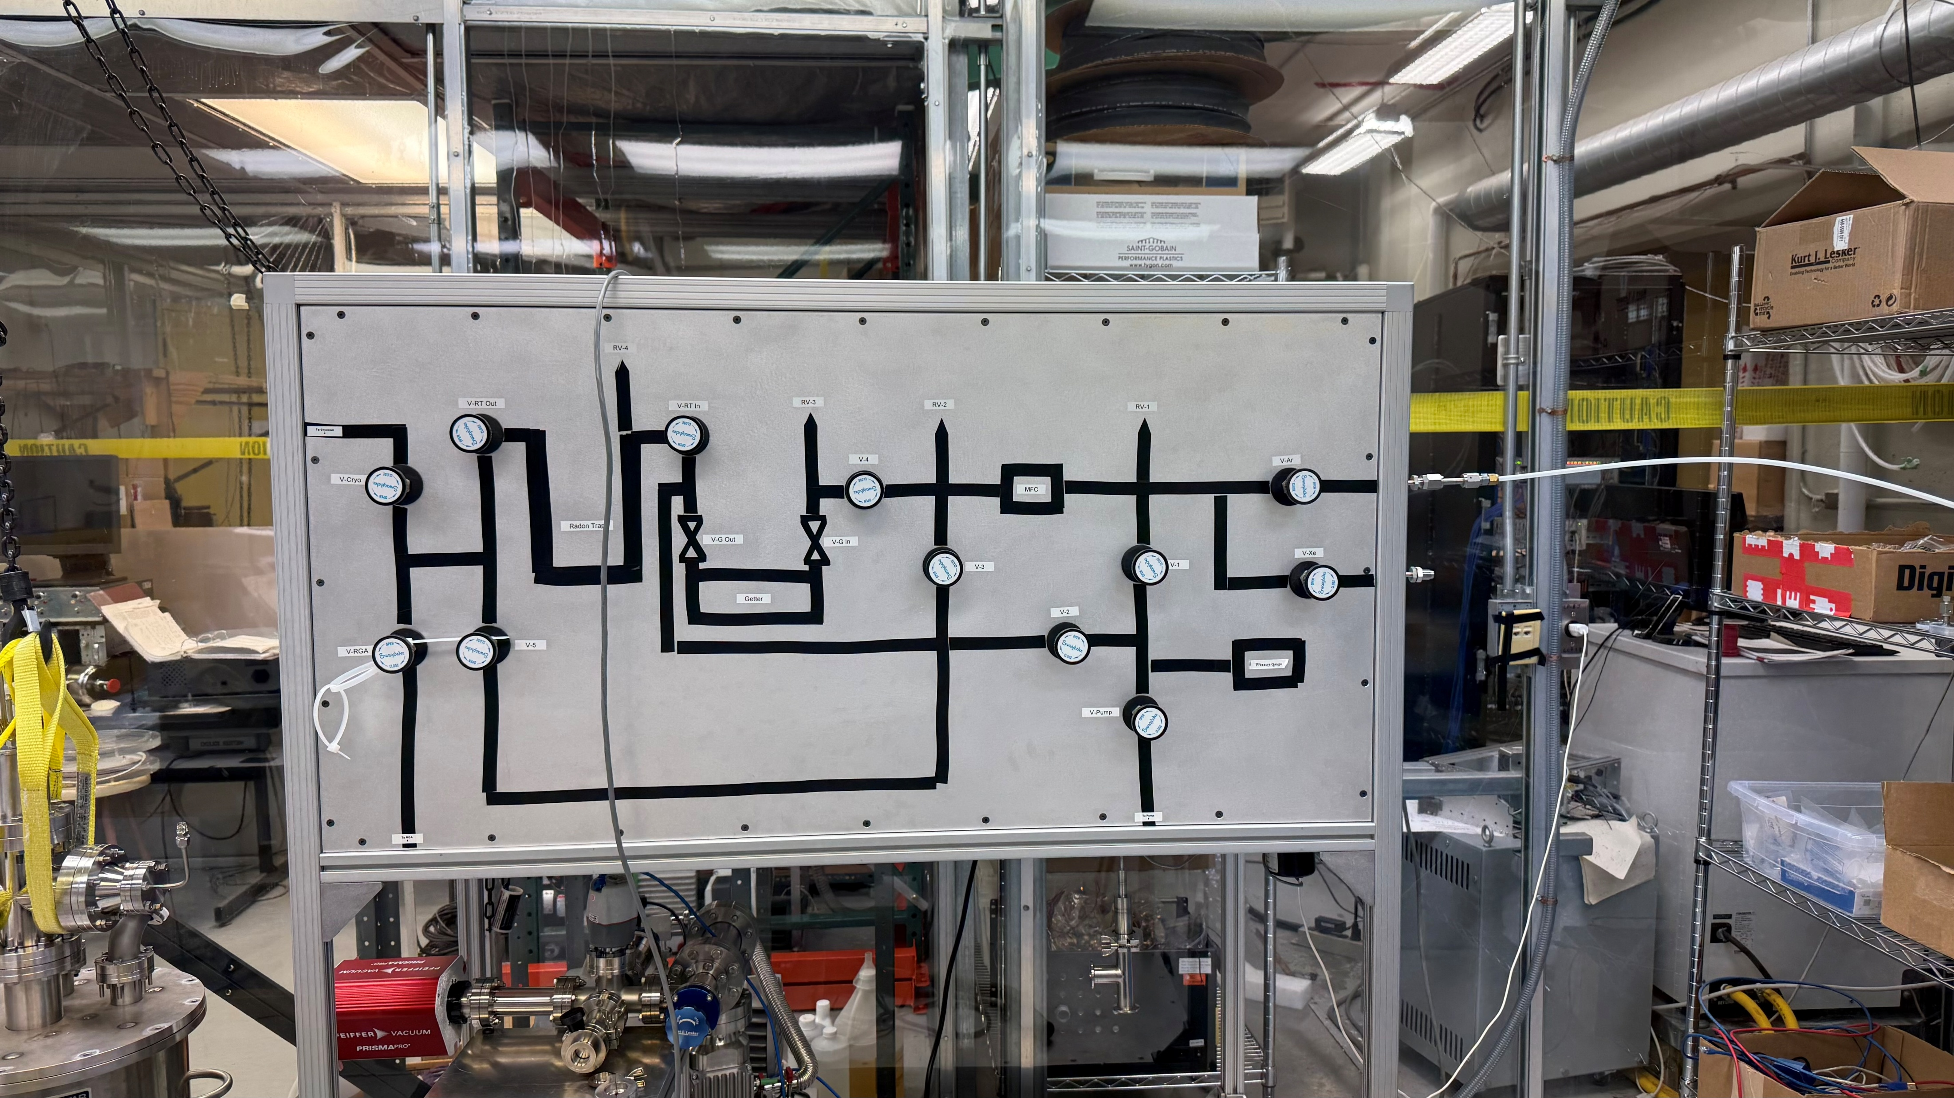

Slide 18
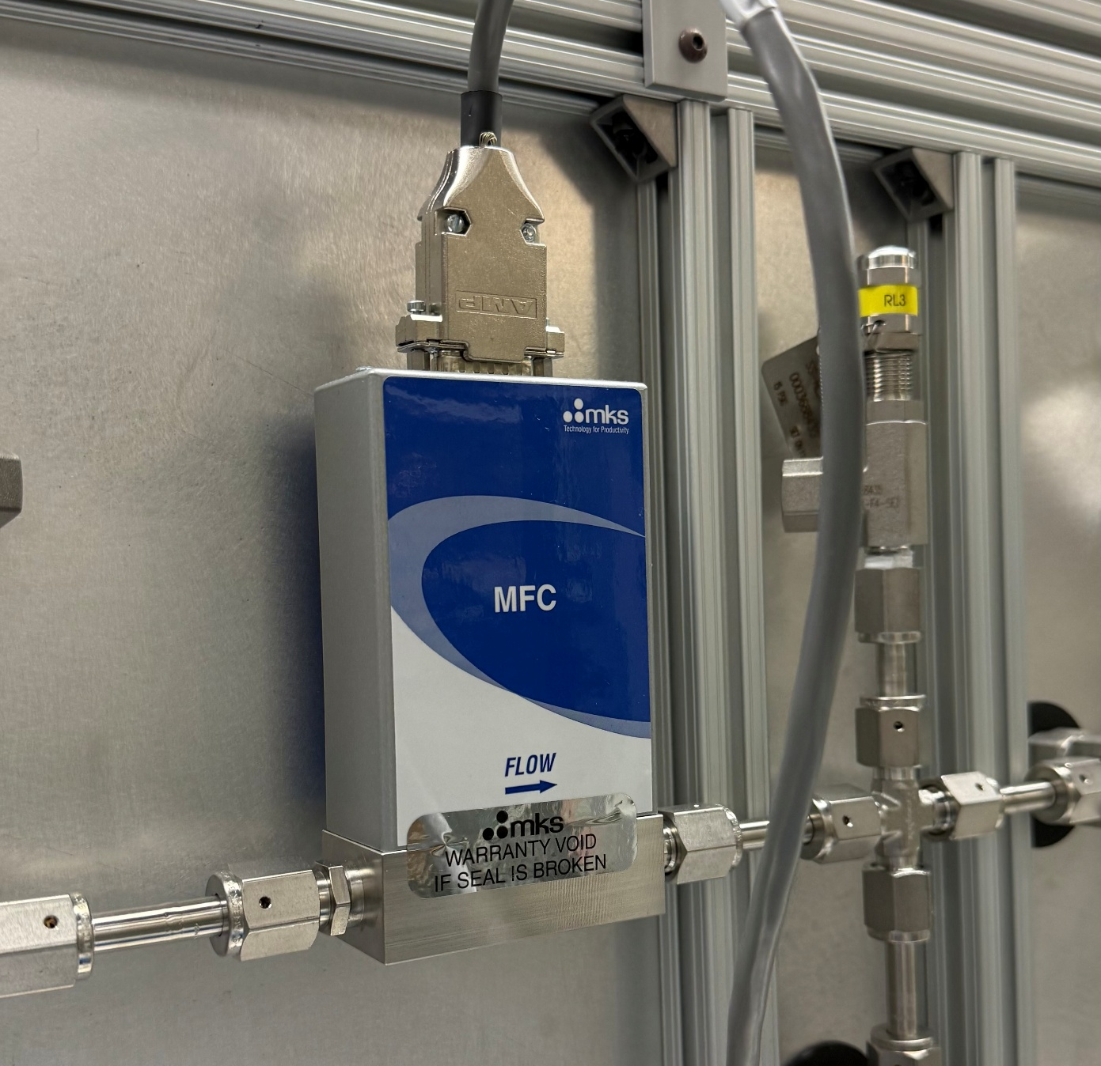

Slide 19
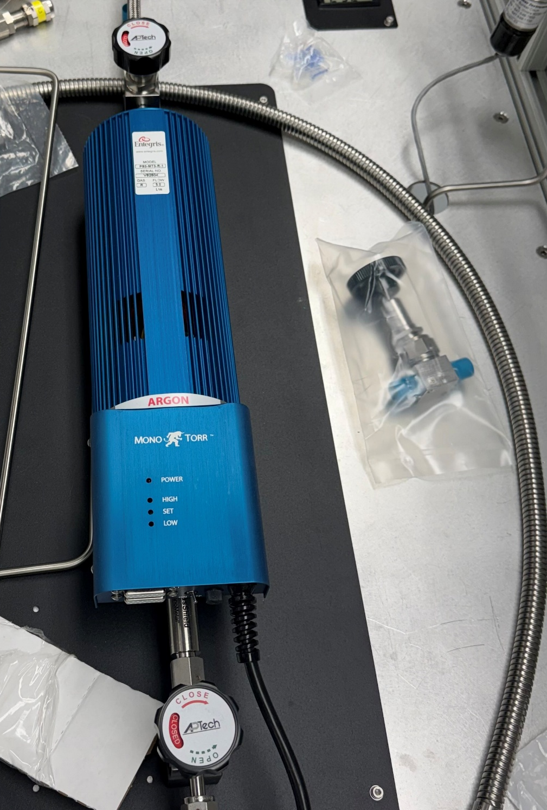
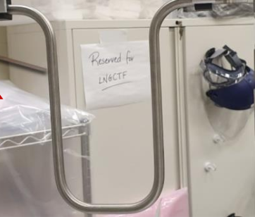

Slide 20
How do we conduct R&D here at Queen’s?
Creating our own noble liquid detector environment

Slide 21
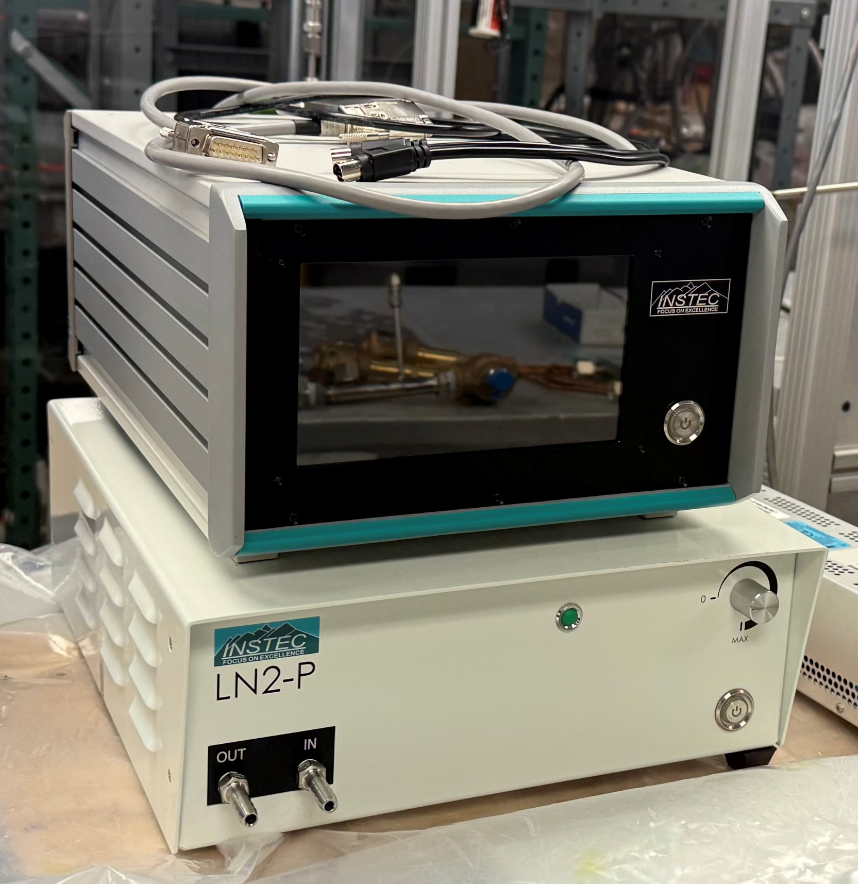
How do we conduct R&D here at Queen’s?
Creating our own noble liquid detector environment

Slide 22
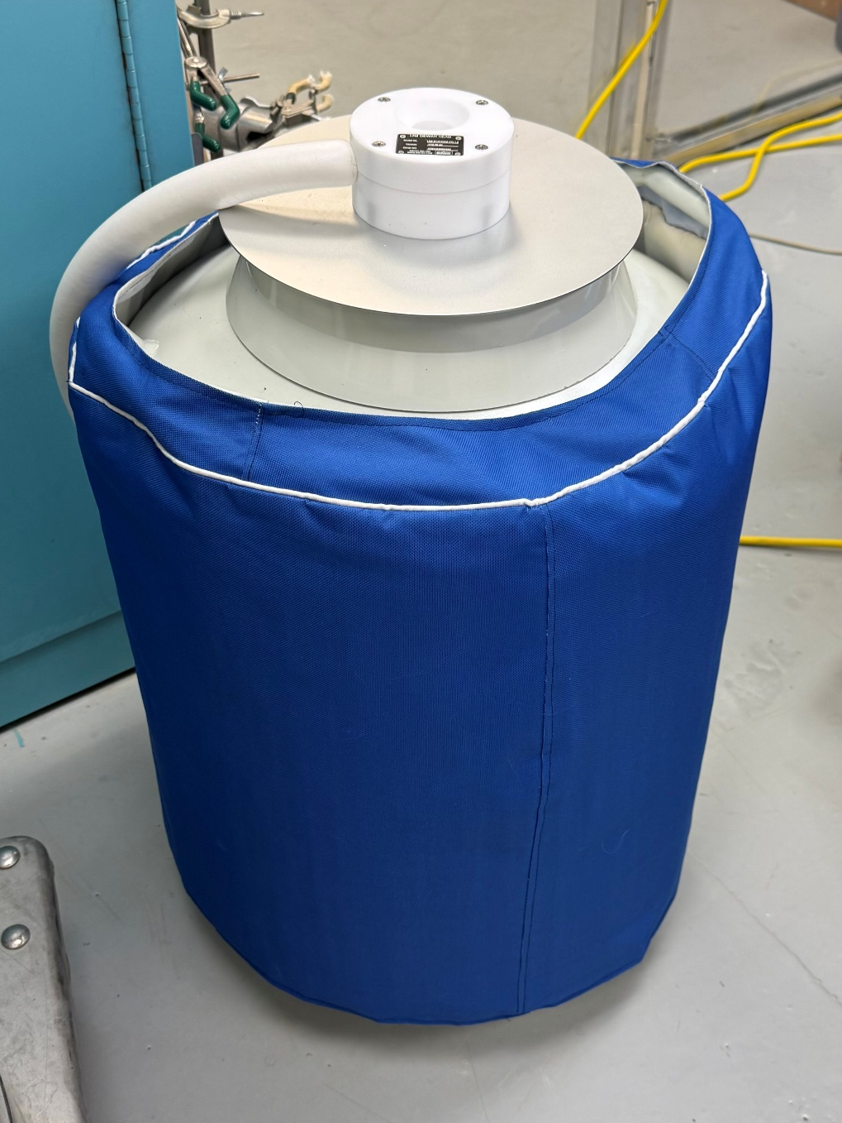
How do we conduct R&D here at Queen’s?
Creating our own noble liquid detector environment

Slide 23
How do we conduct R&D here at Queen’s?
Creating our own noble liquid detector environment
Liquid nitrogen
Gaseous argon
Liquid argon

Slide 24

How do we conduct R&D here at Queen’s?
Creating our own noble liquid detector environment
Liquid nitrogen
Gaseous argon
Liquid argon

Slide 25
Liquid argon is delicate – temperature band is very small!
-185.85°C
-189.34°C
*at standard atm. pressure
Gaseous argon
Liquid argon
Solid argon

Slide 26
How do we conduct R&D here at Queen’s?
Creating our own noble liquid detector environment
Liquid nitrogen
Gaseous argon
Liquid argon

Slide 27
How do we conduct R&D here at Queen’s?
Creating our own noble liquid detector environment
Liquid nitrogen
Gaseous argon
Liquid argon

Slide 28
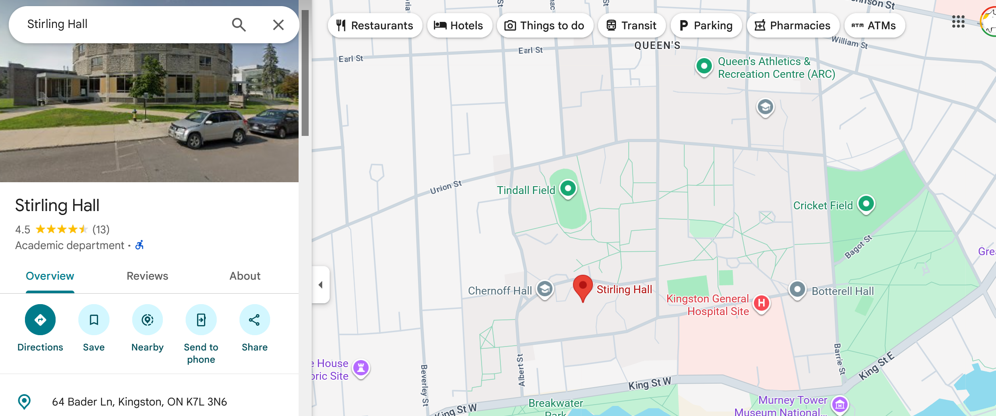
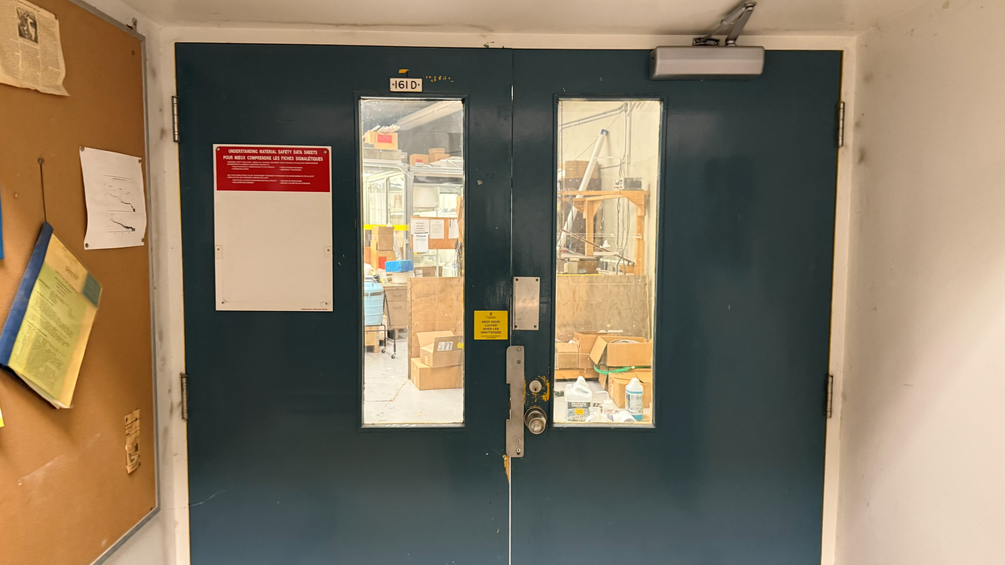
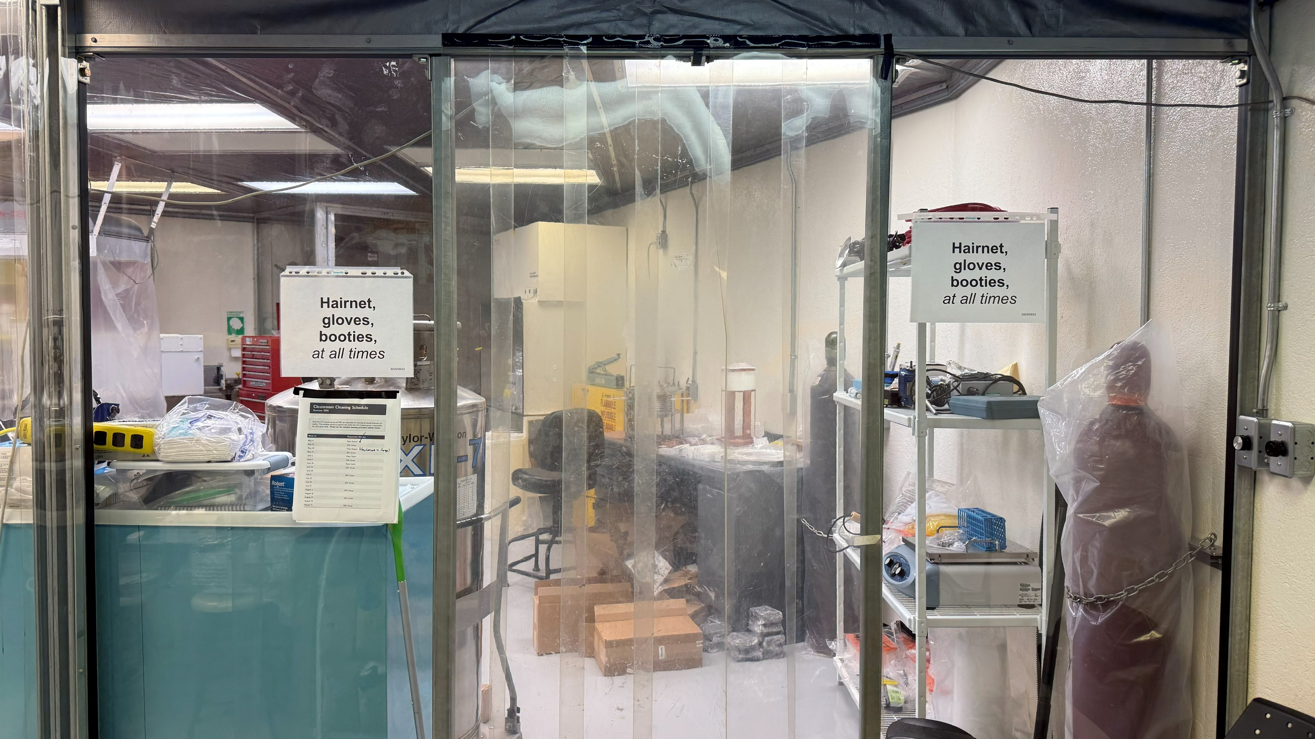
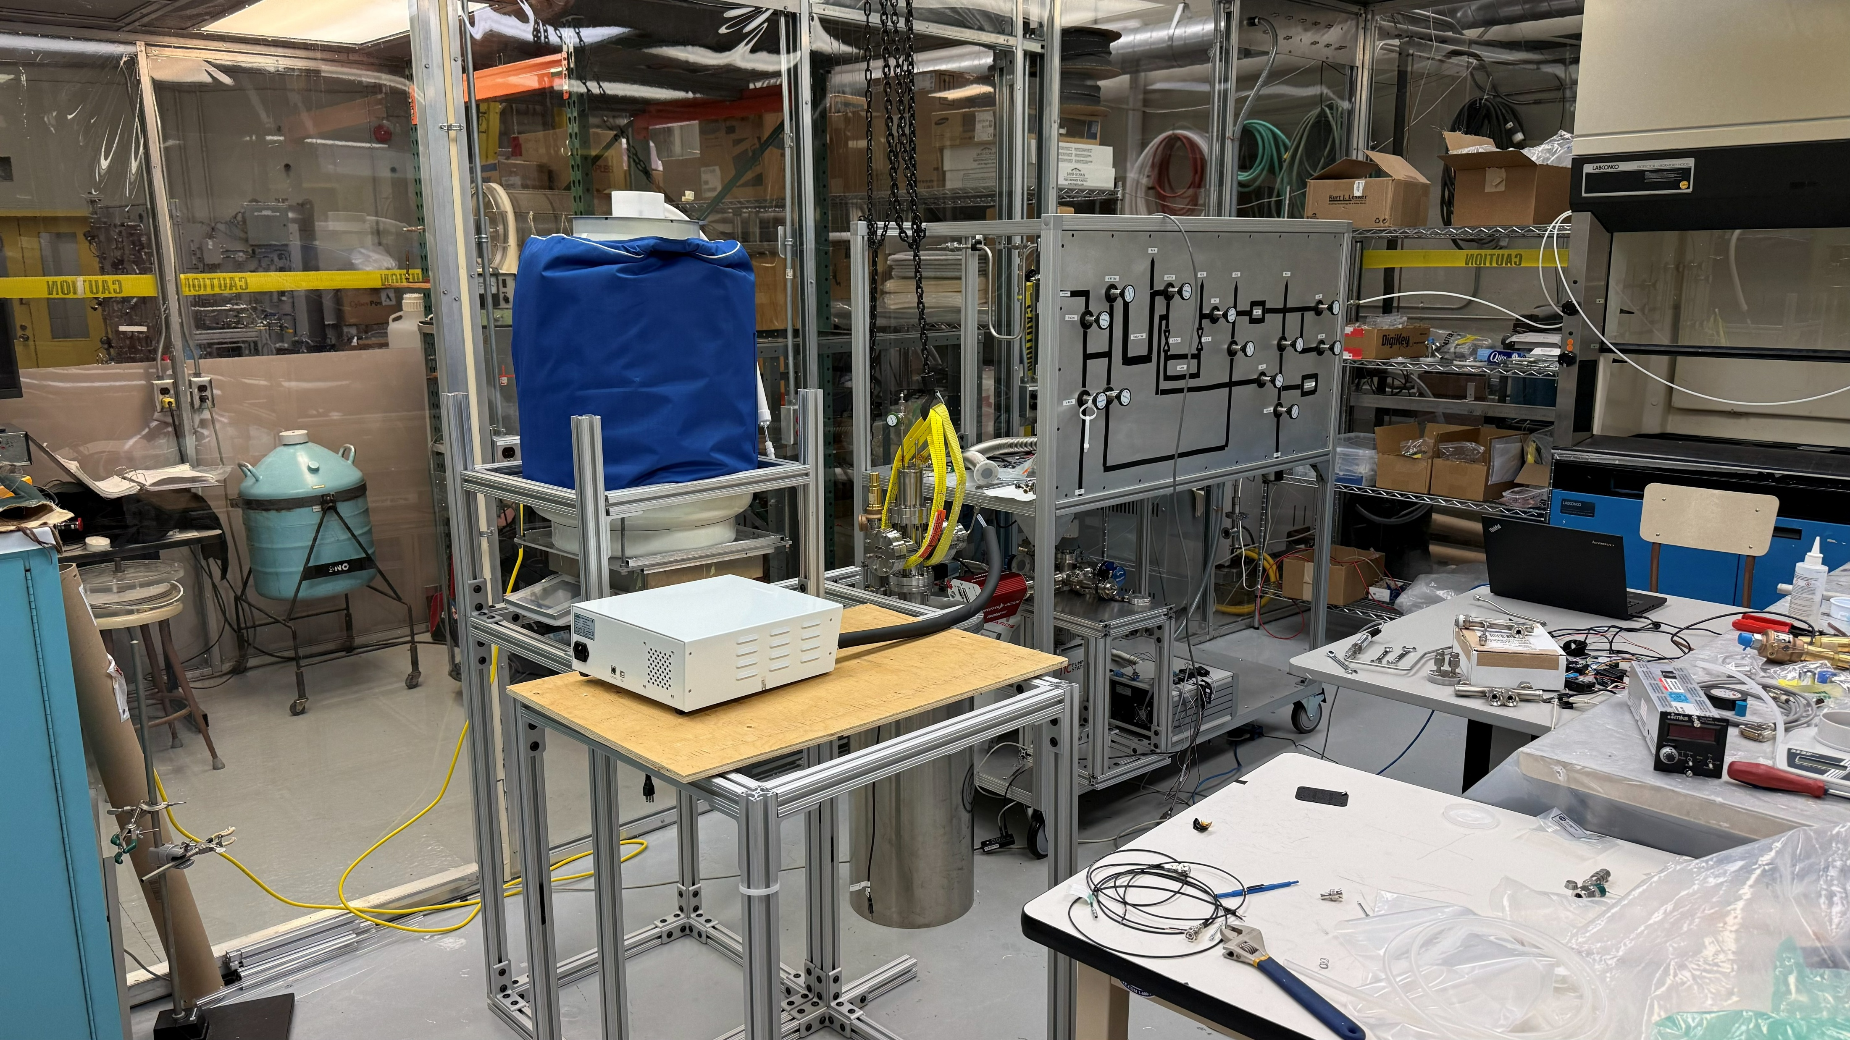
Duration and location

Slide 29
SCALAR slow control
Monitoring, controlling, and maintaining the state of the cryostat
?
?
?

Slide 30
SCALAR slow control
Monitoring, controlling, and maintaining the state of the cryostat
Temperature sensors
Pressure Transducer
?
?
Mass flow controller
?
LN2 pump
Dewar scale
RGA
Pump vacuum
MIDAS

Slide 31
SCALAR slow control
Monitoring, controlling, and maintaining the state of the cryostat
Temperature sensors
Find documentation and learn how to use
Control via software
Characterization & calibration & validation
Test reliability
User interfacing
Inter-sensor logic
Pressure Transducer
?
?
Mass flow controller
?
LN2 pump
Dewar scale
RGA
Pump vacuum
MIDAS

Slide 32
SCALAR slow control
Monitoring, controlling, and maintaining the state of the cryostat
Temperature sensors
Find documentation and learn how to use
Control via software
Characterization & calibration & validation
Test reliability
User interfacing
Inter-sensor logic
Pressure Transducer
?
?
Mass flow controller
?
LN2 pump
Dewar scale
RGA
Pump vacuum
MIDAS

Slide 33
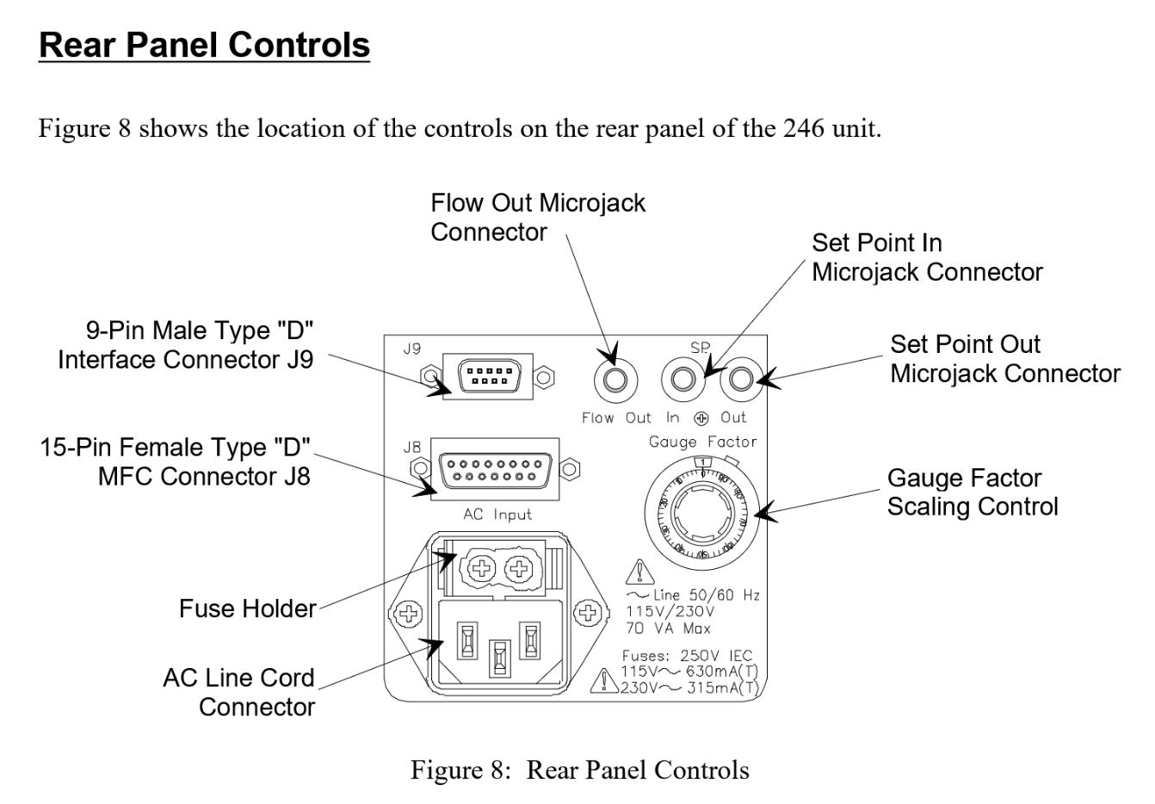
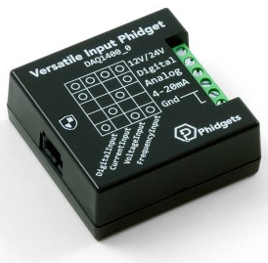
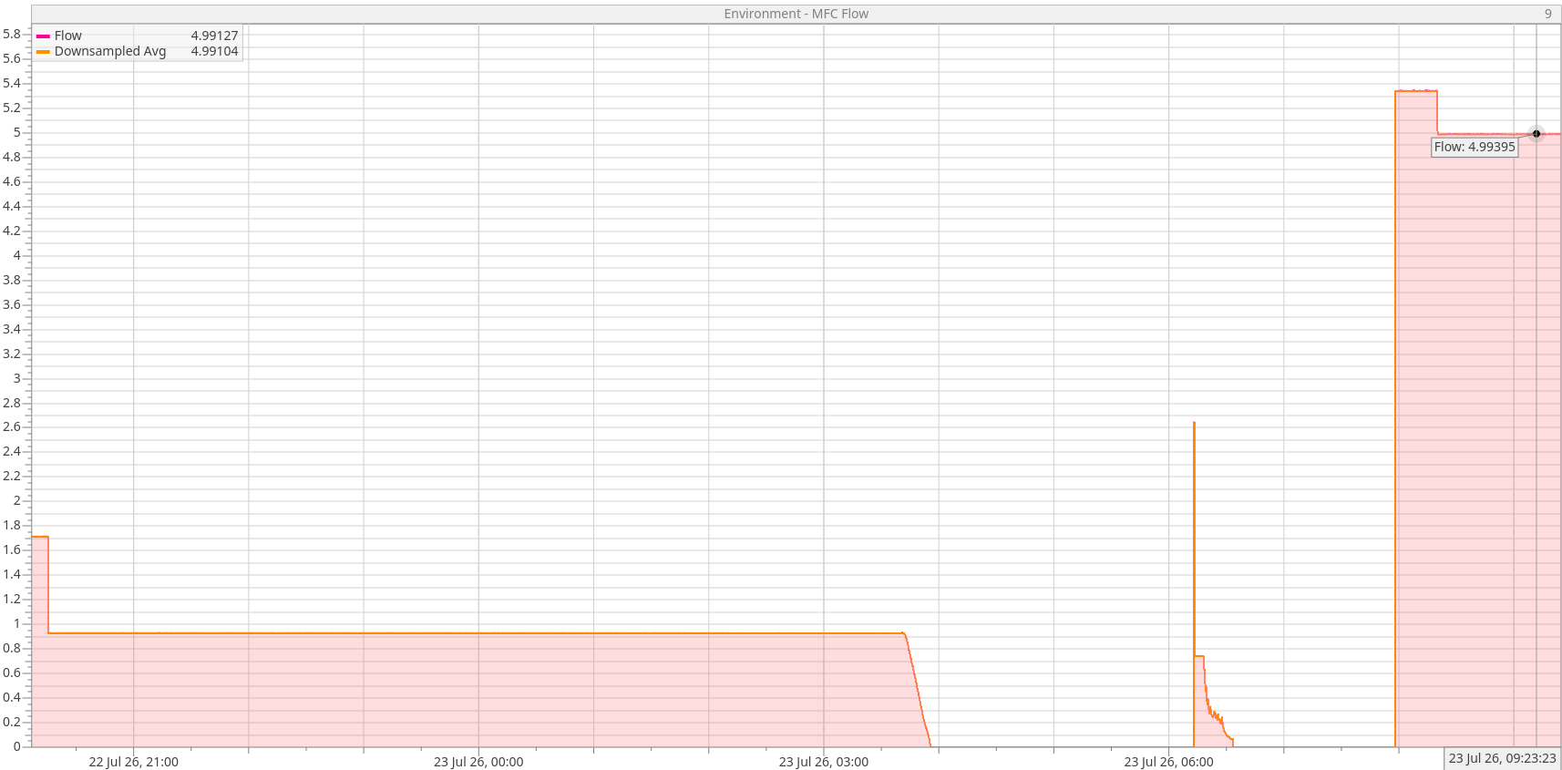
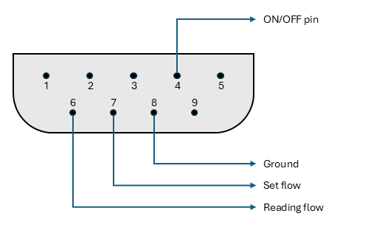
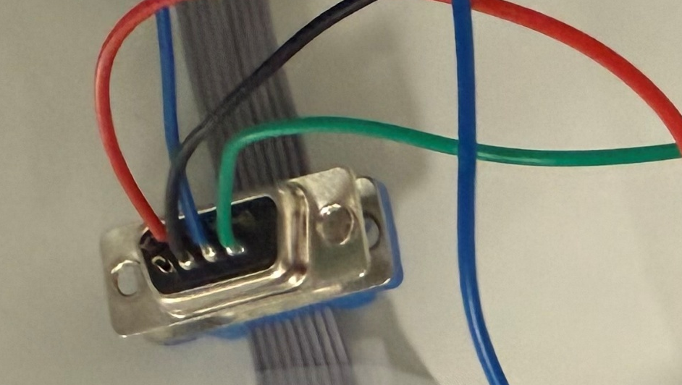
Integrating into software
Mass flow controller and 246C power supply

Slide 34
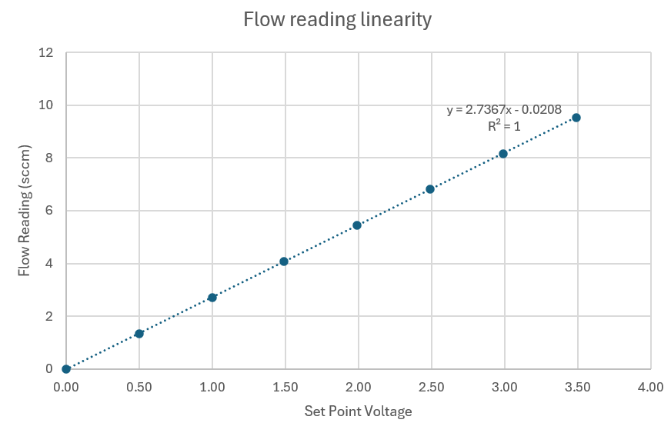
Validation

Slide 35
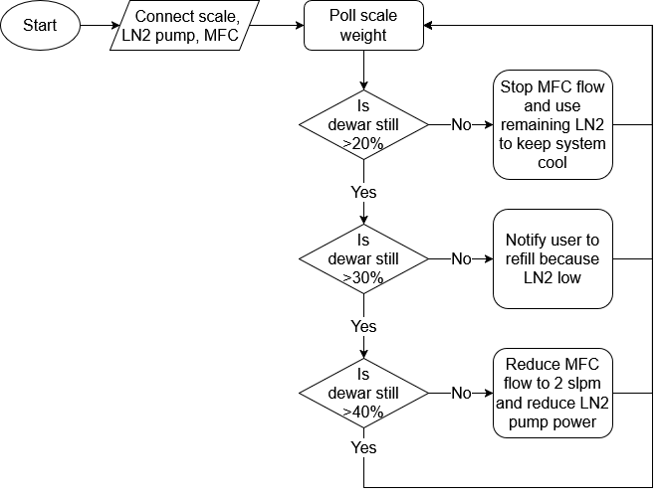
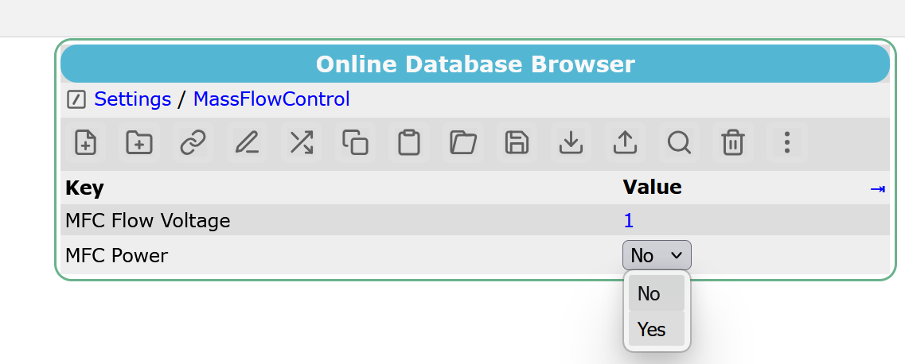
User interface and inter-sensor logic

Slide 36
MIDAS basic system architecture (https://triumf.ca/)
Host computer
Web user interface (status, plots)
(https://raven.phy.queensu.ca)
Data logger
Online Data Base (ODB)
Temperature frontend
Pressure frontend
Scale frontend
Etc…
Temperature sensors
Pressure transducer
Scale
Etc…

Slide 37
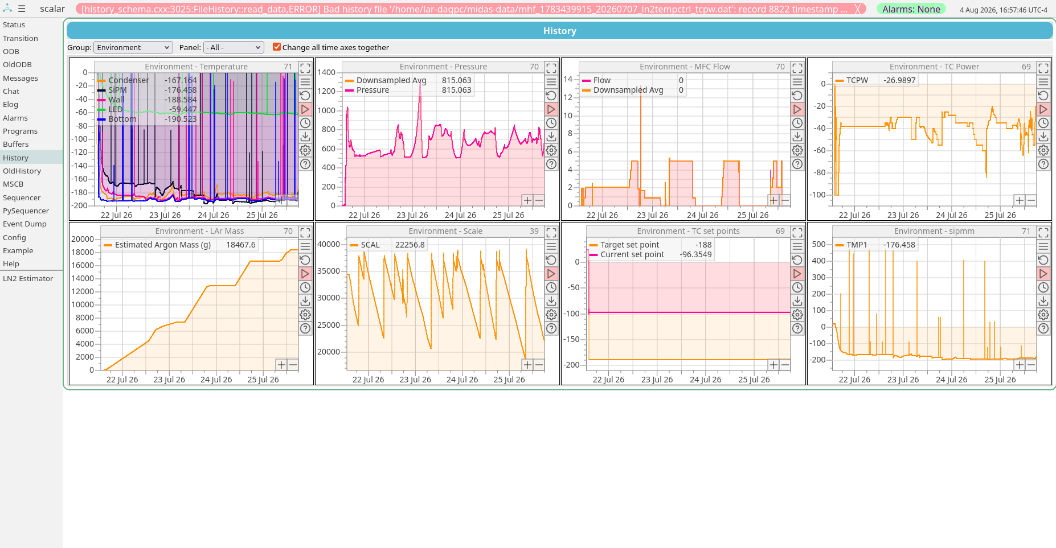
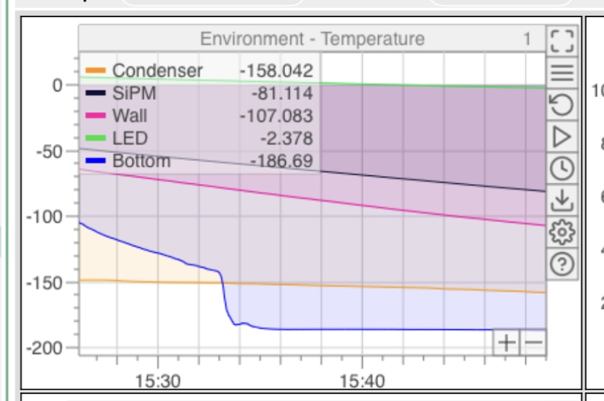
What has all of this cumulated into?
(°C)
(torr)
(slpm)
(%)
(g)
SCALAR MIDAS slow control history plots, https://triumf.ca/

Slide 38
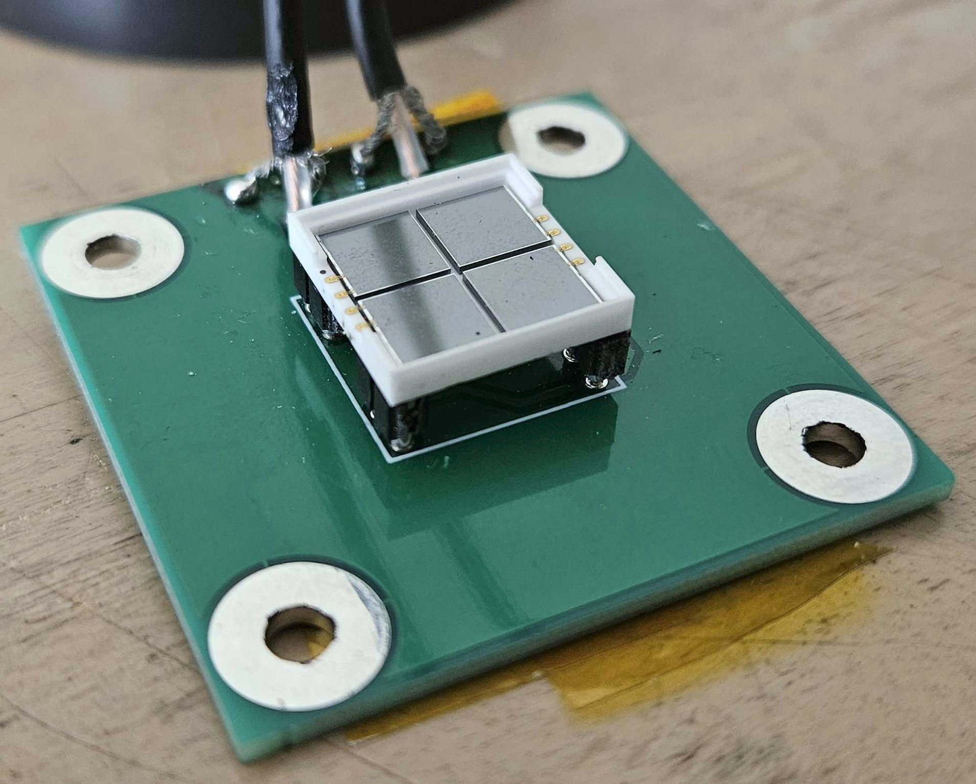
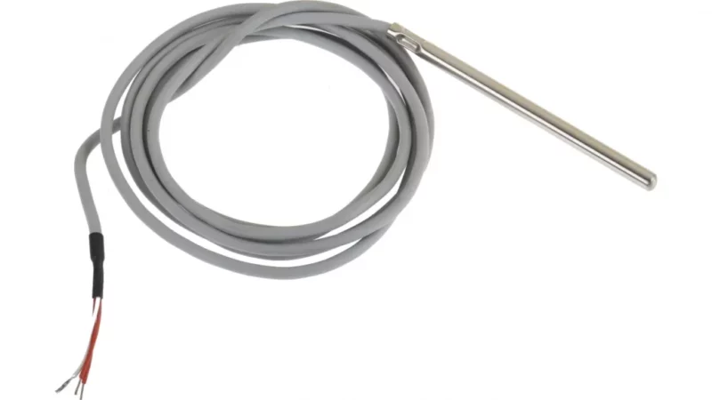
What has all of this cumulated into?
(°C)
-185.85°C
-189.34°C
x5

Slide 39
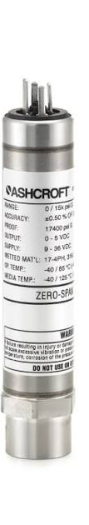
What has all of this cumulated into?
(torr)

Slide 40
What has all of this cumulated into?
(%)

Slide 41
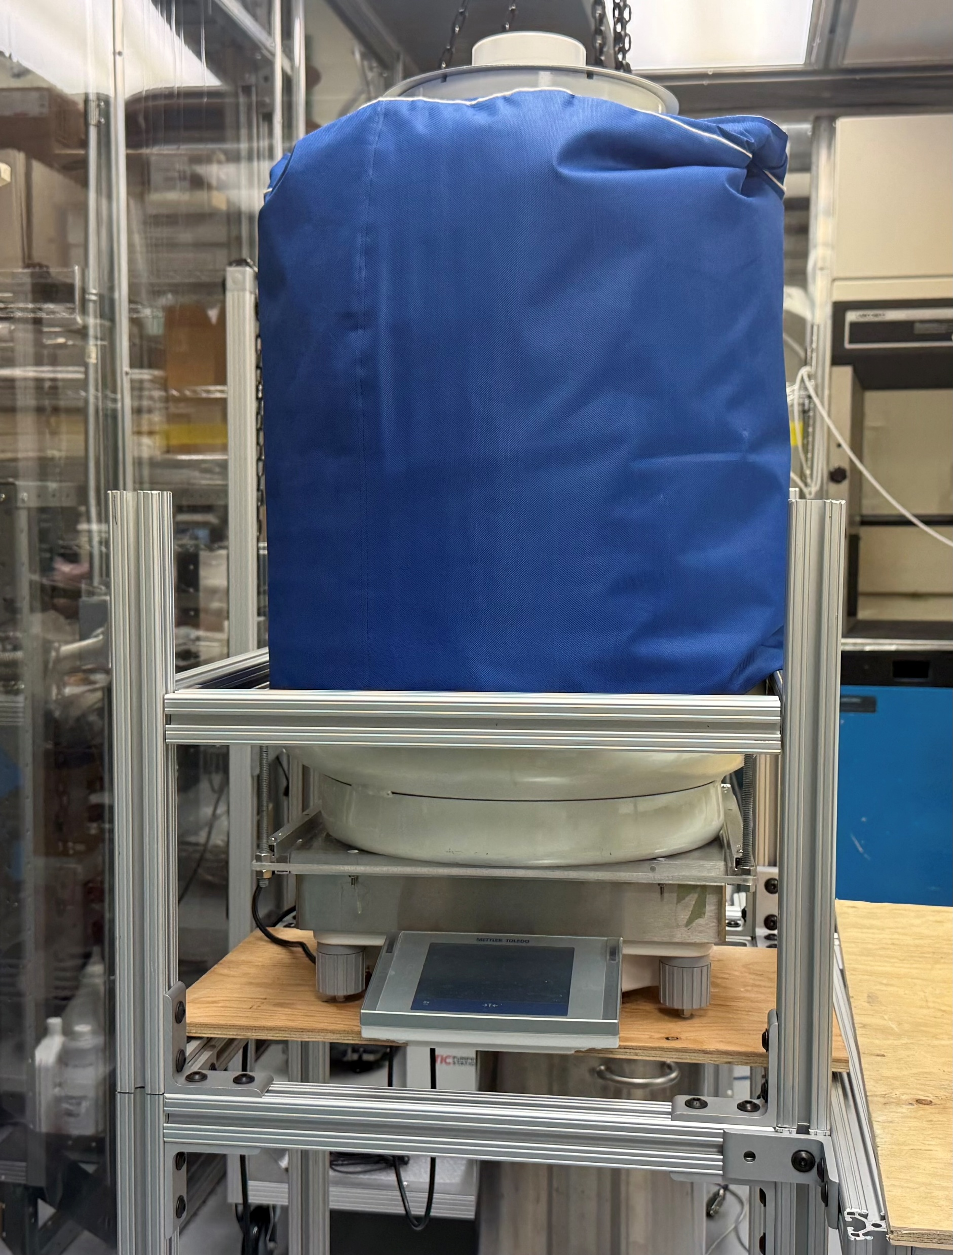
What has all of this cumulated into?
(g)

Slide 42
What has all of this cumulated into?
(slpm)

Slide 43
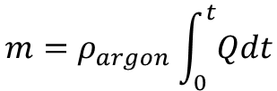
What has all of this cumulated into?
$$m=ρ_{argon}\int_{0}^{t}{Qdt}$$

Slide 44
What has all of this cumulated into?
Testing and conclusions:
  Successful run to fill with ~18.5 kg of LAr
  Run cryogenic tests on our photosensors (SiPM)
  Demonstrated reliable infrastructure and standard operating procedure for LAr fills
Notes:
Busy slides

Slide 45
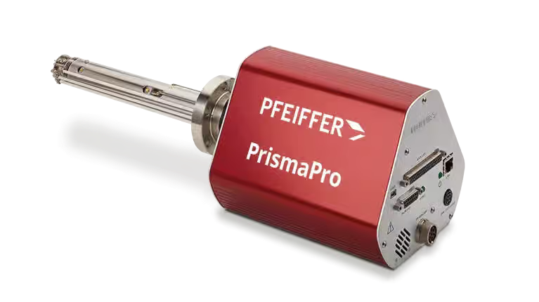
Next steps
Add system to test purity of LAr periodically
How to dope argon
Add single and dual phase detectors into the cryostat

Slide 46
Slow-Control Infrastructure for Noble Liquid Detector R&D
Howard Wen
August 12-13, 2026
CASST 2026

Slide 47
Feedback
Cut generalities in the middle
Trim intro
Some later slides too busy with text
What did I specifically do, what’s next
More time explaining what things are
Either introduce and elaborate or don’t mention at all
MIDAS DAQ first, slow control secondary
  Slide on flow diagram/architecture
Intro too long
Scale elaboration
MIDAS history maybe?
Plot + device
Intro: Try to focus the introduction on specific aspects of LAr that are important. Mention Darkside-20K an SiPMs
Main body: focus more on highlighting what you have done for these projects. It was a good overview, but I think presentation are stronger when you can focus more on the work that you have done specifically.

Slide 48
Michela
9-11: you do spend a lot of time on this
getter and radon trap are both part of the system. We regulate how much argon is flowing with the mass flow meter (measure) and controller (regulate), the getter removes the electronegative impurities (oxygen, nitrogen, CO2, H2O...) , and the radon trap (the U tube in the back) removes radon by adsorption on activated charcoal powder. And then this purged argon goes into the cryostat, where it gets heat transferred from the LN2 line
26 these times are with our current setup, just specify that
39 MIDAS is generally developed at TRIUMF. You named your software developed in MIDAS, as RAVEN, right? Cool name, keep it
40 you should spend way more time here. Teach your colleagues how to read these plots.
did you ever mention that SiPM are photosensors?

