Slide 1

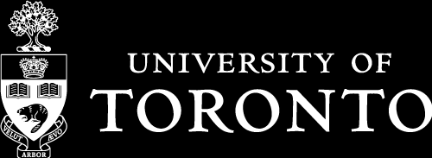
Radon Shielding in the SuperCDMS Experiment
Presented by Jonathan Finer
Department of Physics, University of Toronto
Supervisors: Ziqing Hong (UofT), Matt Stukel (SNOLAB)
CASST
12 August 2026

Slide 2
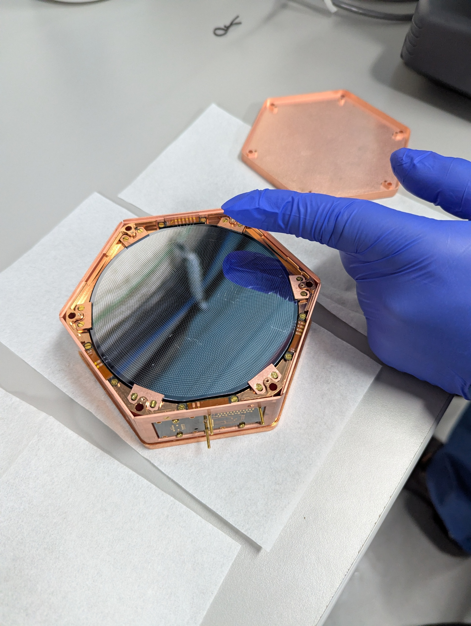
SuperCDMS Introduction
Cryogenic silicon and germanium detectors
HV and iZIP
Phonon and ionization sensors
NR vs ER

Slide 3
Background on Backgrounds

Slide 4
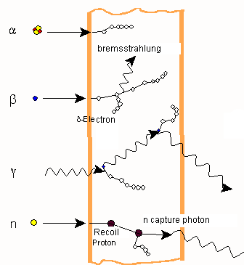
4
Background Interactions
Neutrons:
  NR
  Blocked by hydrogenous materials
Gamma rays and X-rays:
  ER
  Blocked by high-Z materials
Alpha particles:
  Produce neutrons through (α, n)
Beta particles:
  Produce X-rays through bremsstrahlung
Image Attribution: https://commons.wikimedia.org/wiki/File:Strahlenarten_en.png

Slide 5
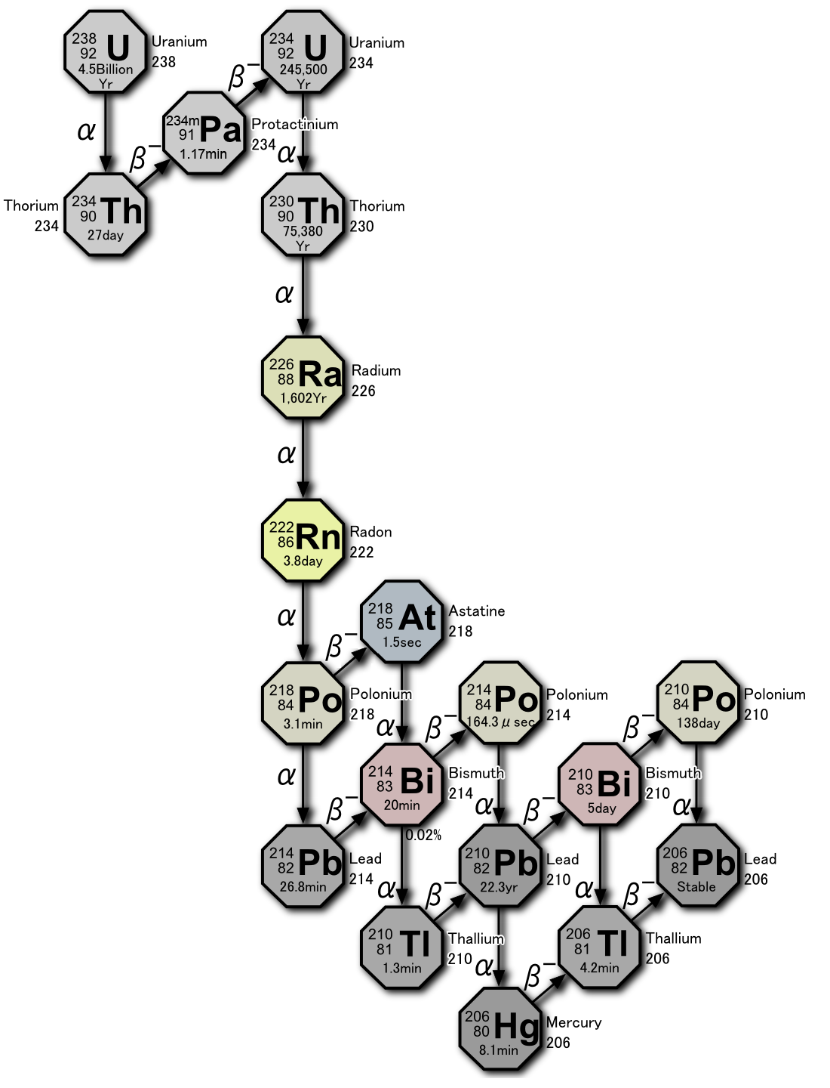
5
Radon Background Sources
Rn-222 in U-238 decay chain
~130 Bq/m^3 in SNOLAB
Pb-214 and Bi-214 gamma rays
Pb-210 plate-out
  X-rays
Po-210 (α, n) with C-13 in HDPE
Pb-206 NR
Overall event rate x6
Image Attribution: https://commons.wikimedia.org/wiki/File:Decay_chain(4n%2B2,_Uranium_series).PNG

Slide 6
6
Radon Shield

Slide 7
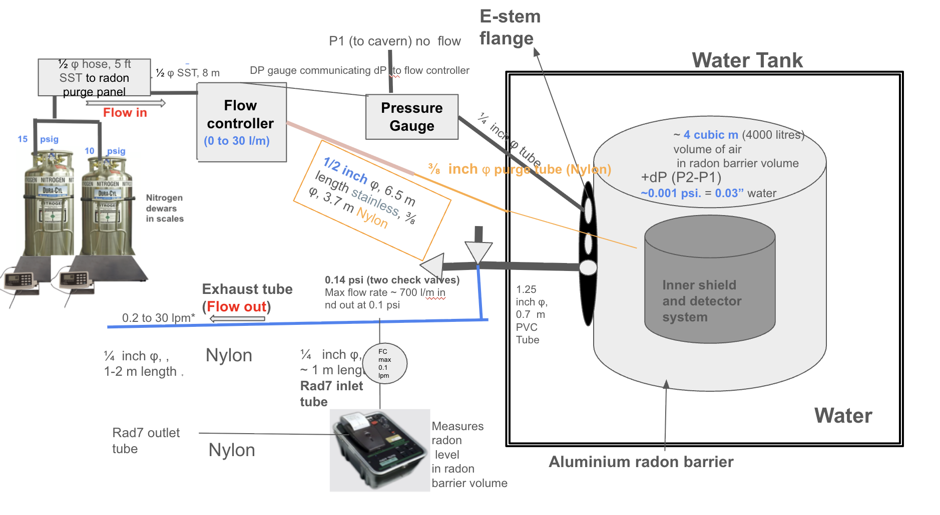
7
Overview

Slide 8
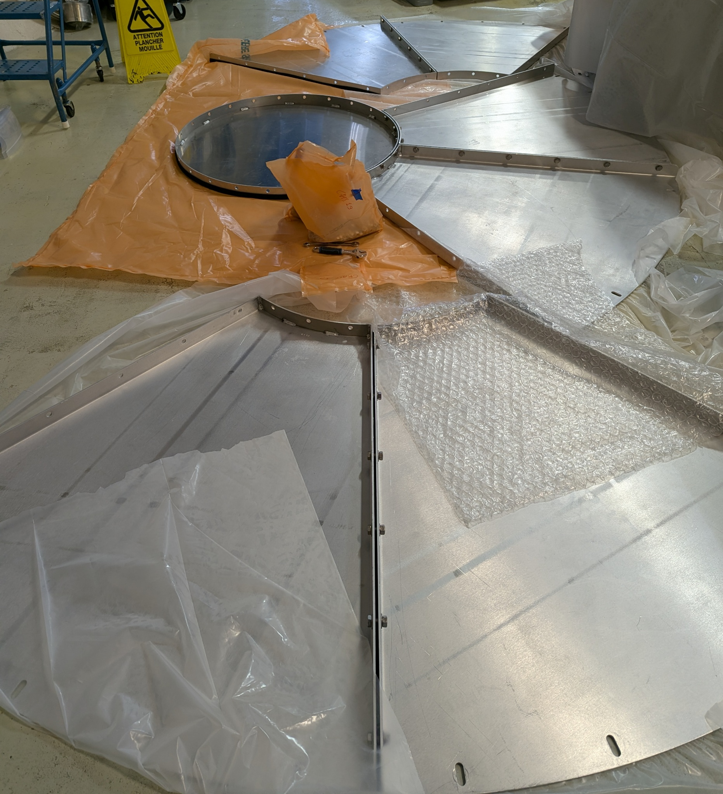
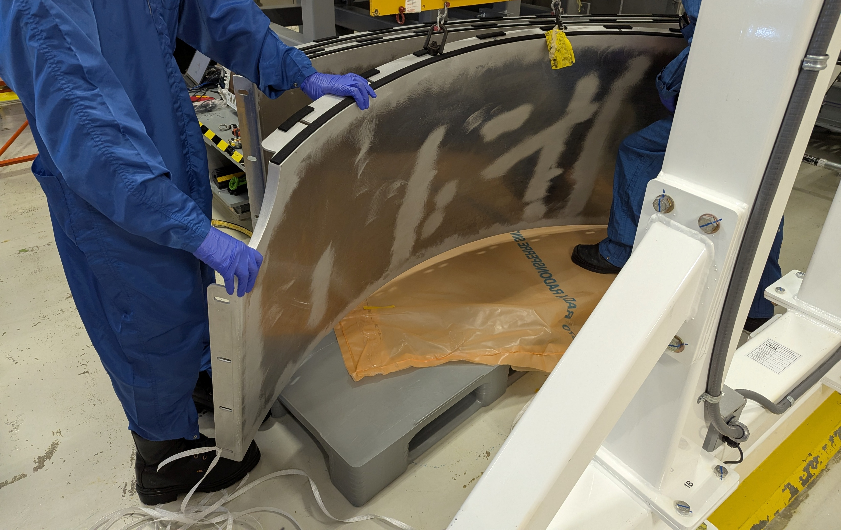
8
Radon Barrier

Slide 9
9
Overview

Slide 10
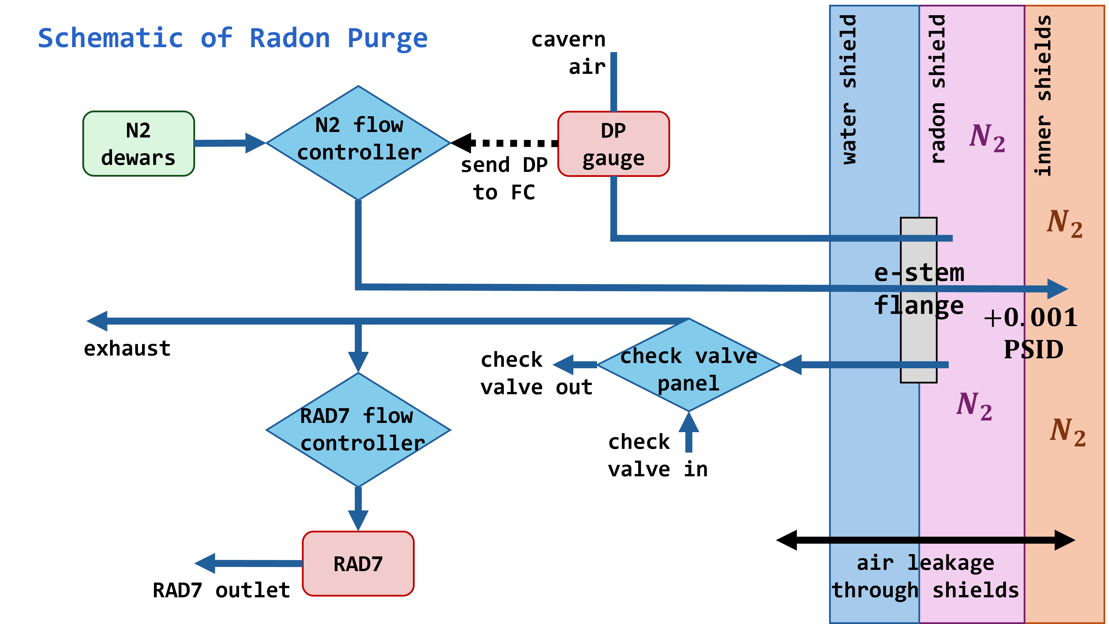
10
Radon Purge System
01. Radon Purge Panel
02. Flow Controller
03. Check Valve Assembly
04. Radon Sensor

Slide 11
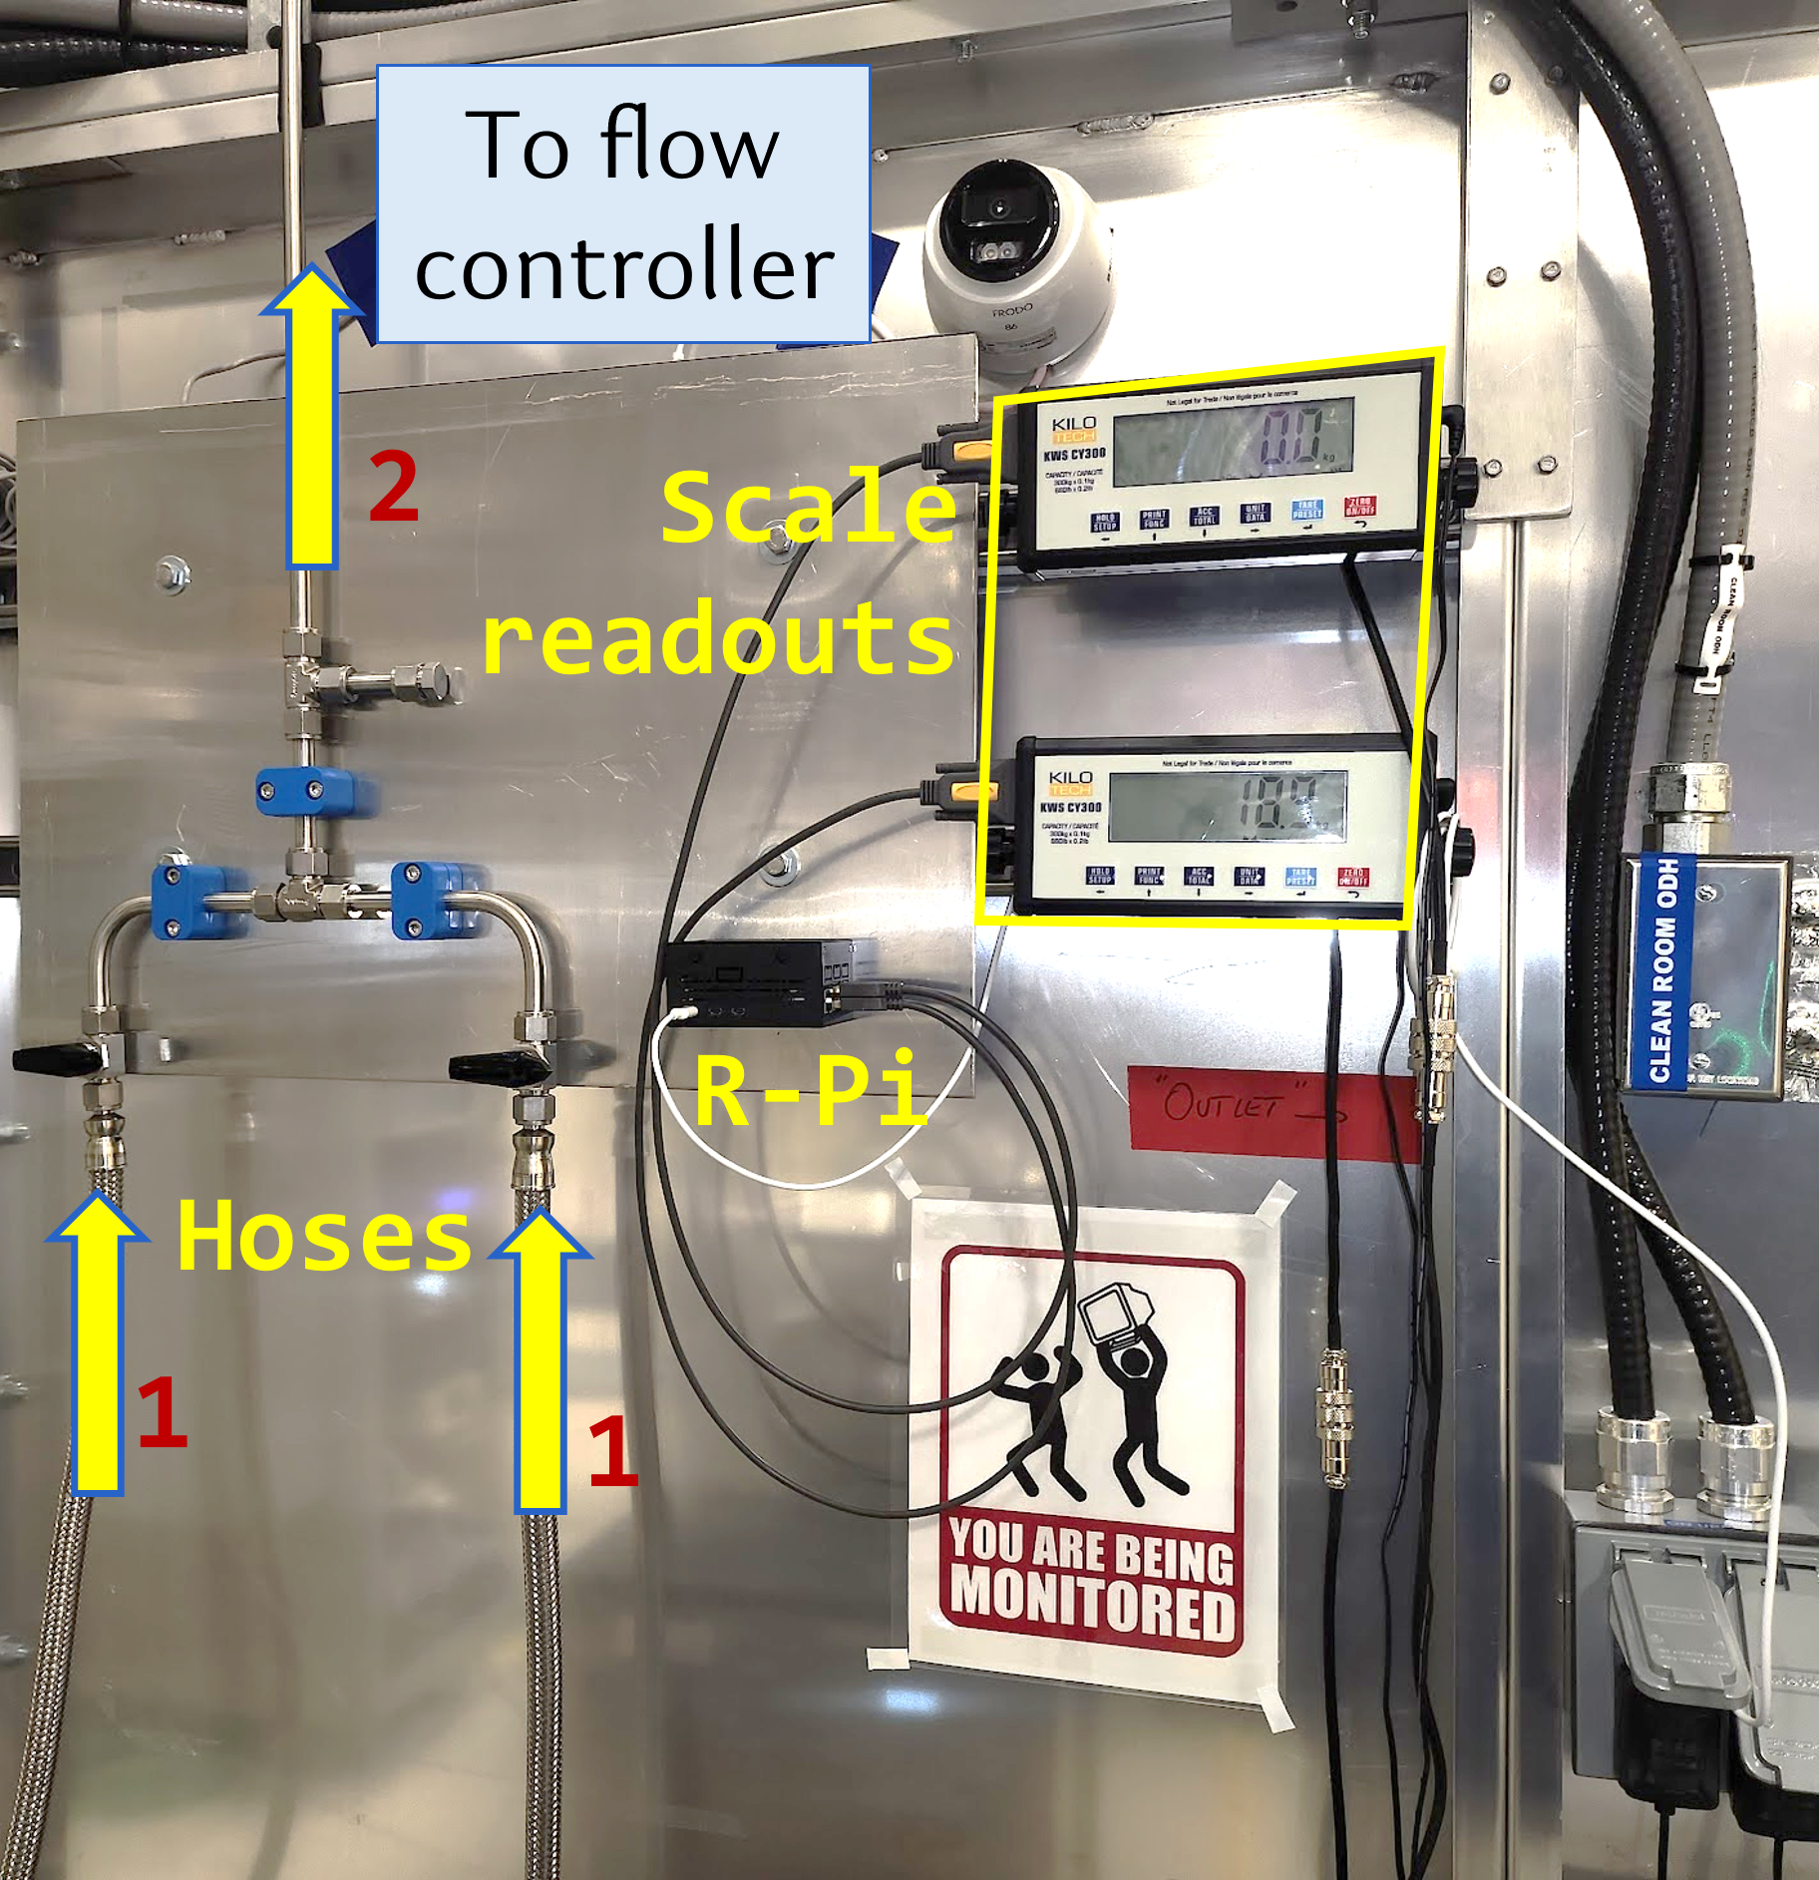
11
Radon Purge Panel
Liquid nitrogen with negligible radon concentration (~50 μBq/m^3, goal is <1 Bq/m^3)
Constant flow
Dewars replaced periodically

Slide 12
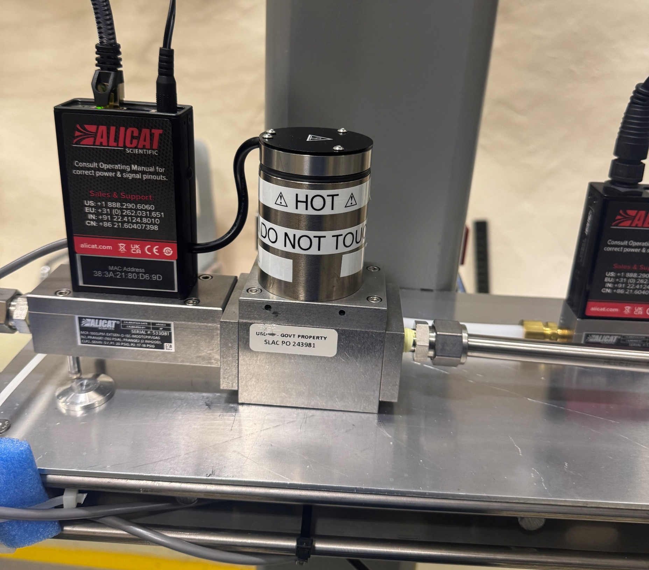
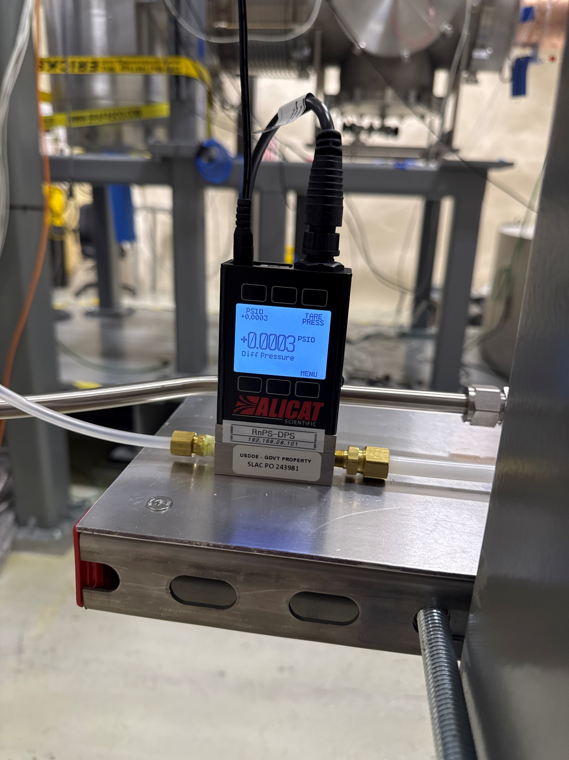
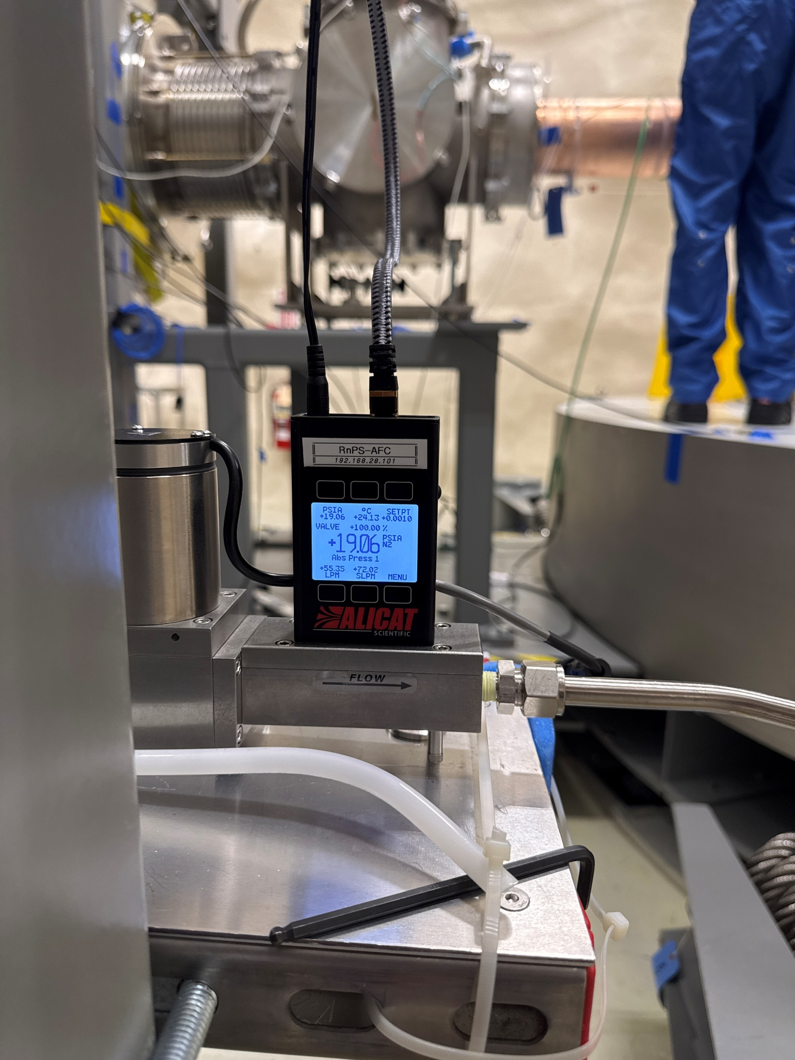
12
Flow Controller and Pressure Gauge
Pressure Gauge
Pressure Gauge
Flow Controller
To Controller
Flow Controller
N2 from Dewar
From Barrier
To Inner Shields

Slide 13
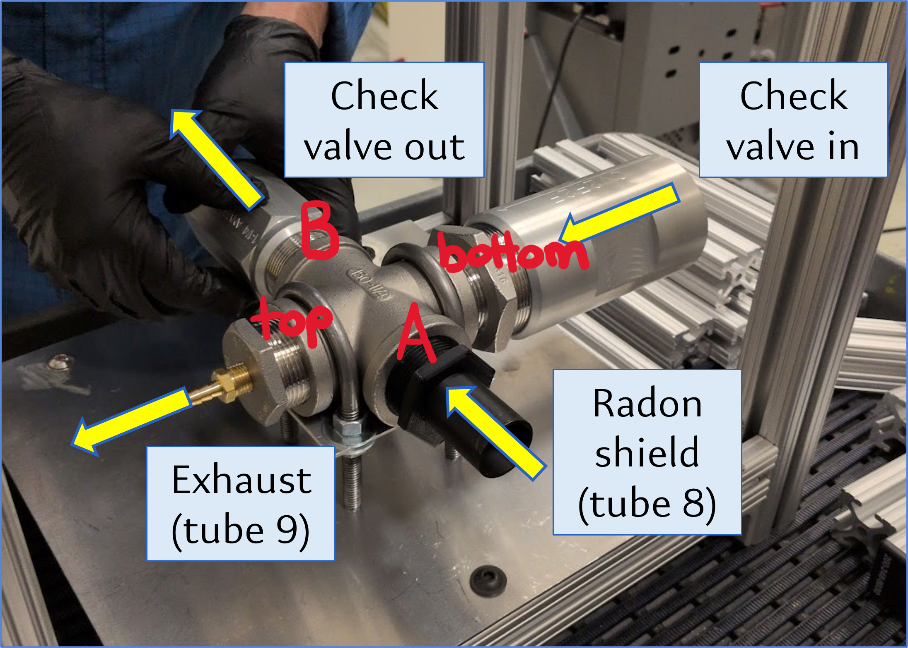
13
Check Valve Assembly
Allows cavern air in during underpressure
Allows interstitial air out during overpressure

Slide 14
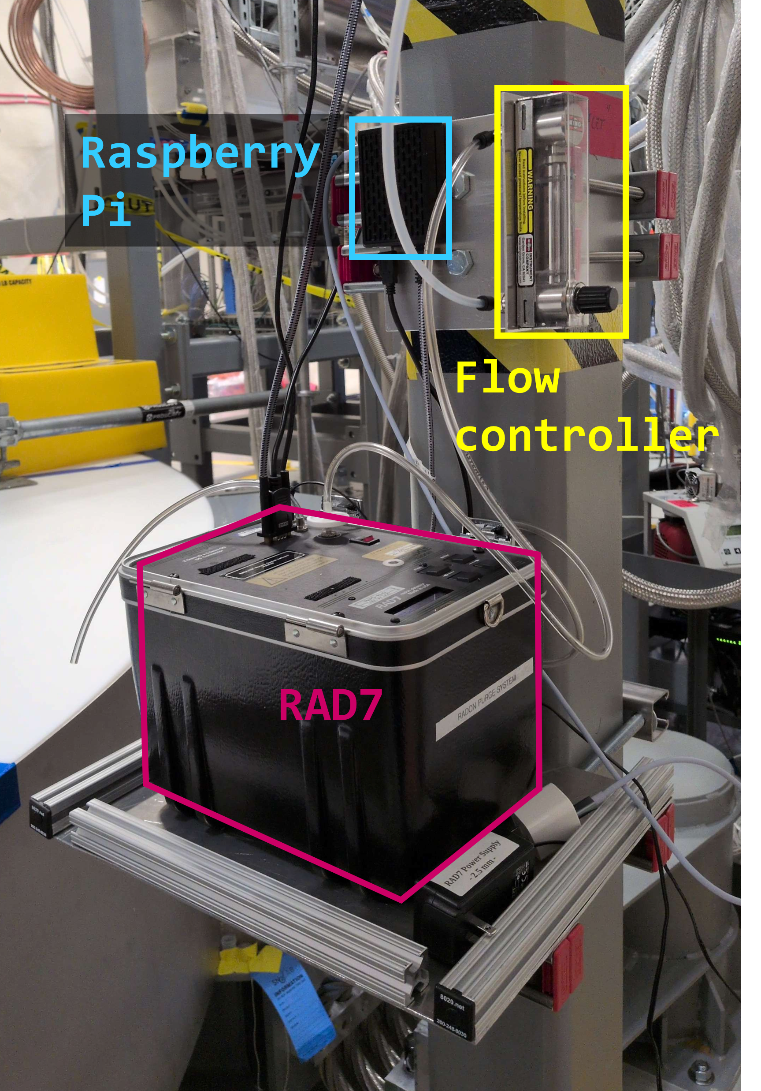
14
Radon Concentration Sensor
Detects radon activity in air
Tracks average concentration

Slide 15
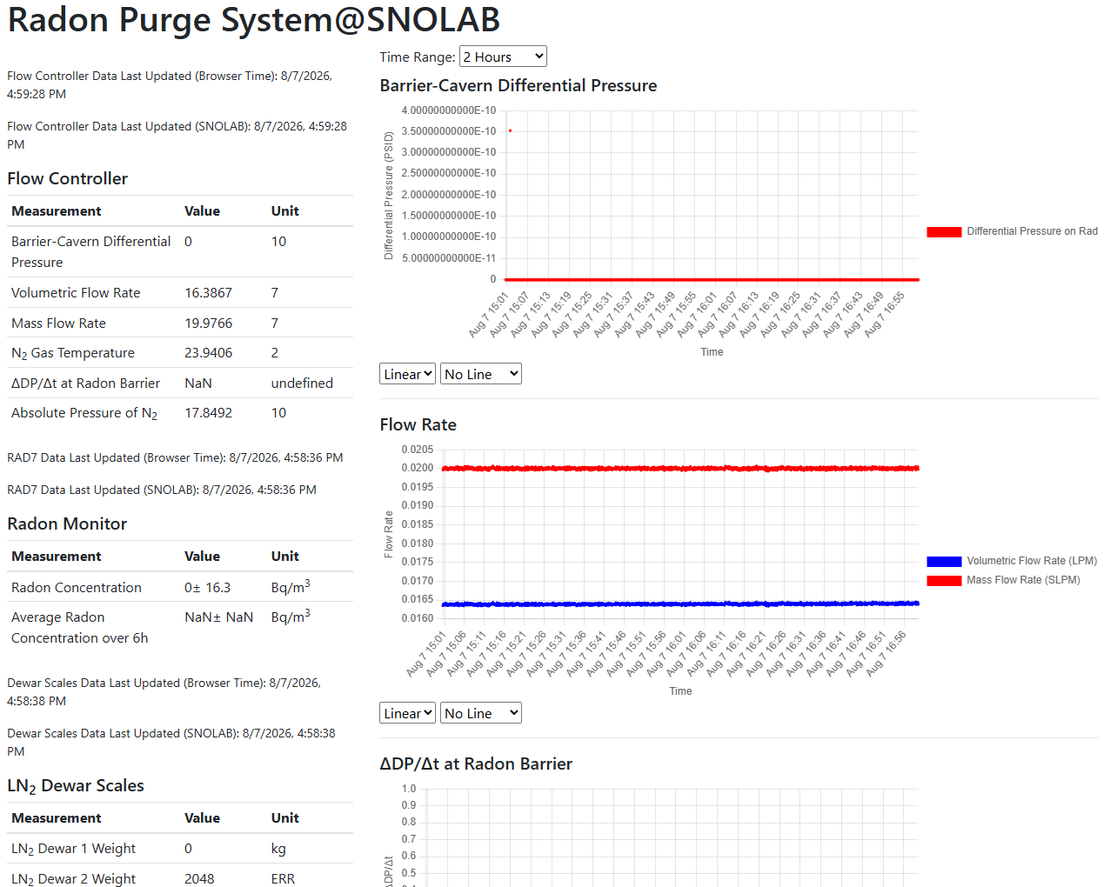
15
Monitoring
Instruments send data to IPC
Webpage hosted at UofT displays data in tables, plots charts
Shifters stare at values

Slide 16
16
Leak Testing

Slide 17
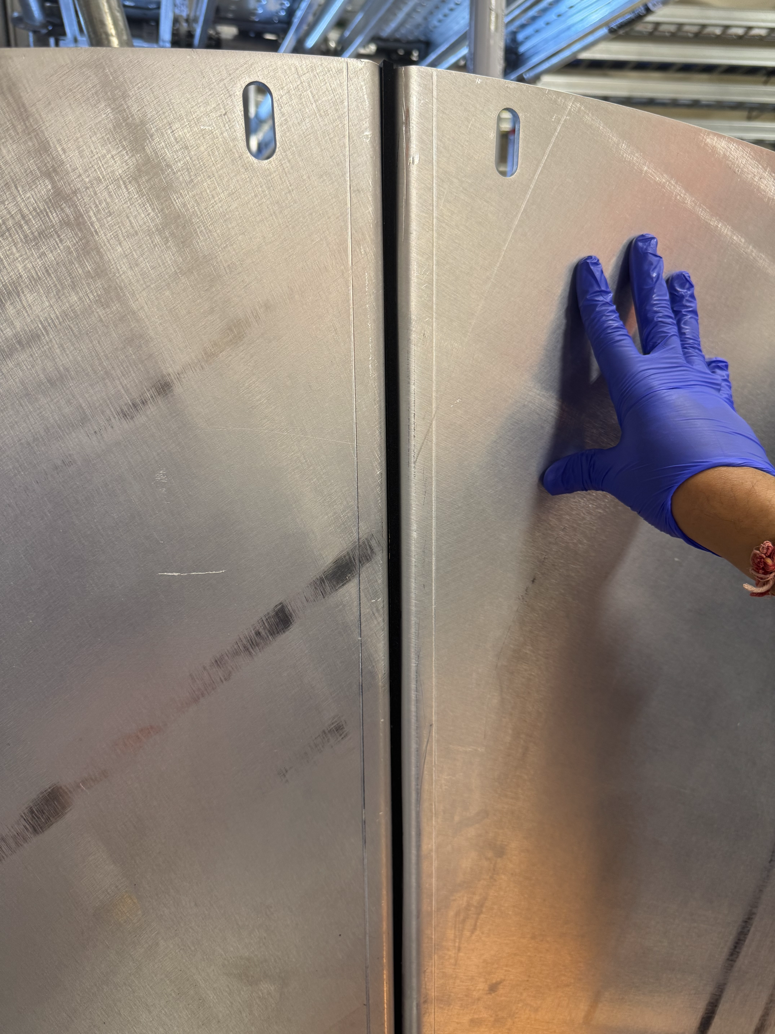


17
Pre-installation

Slide 18
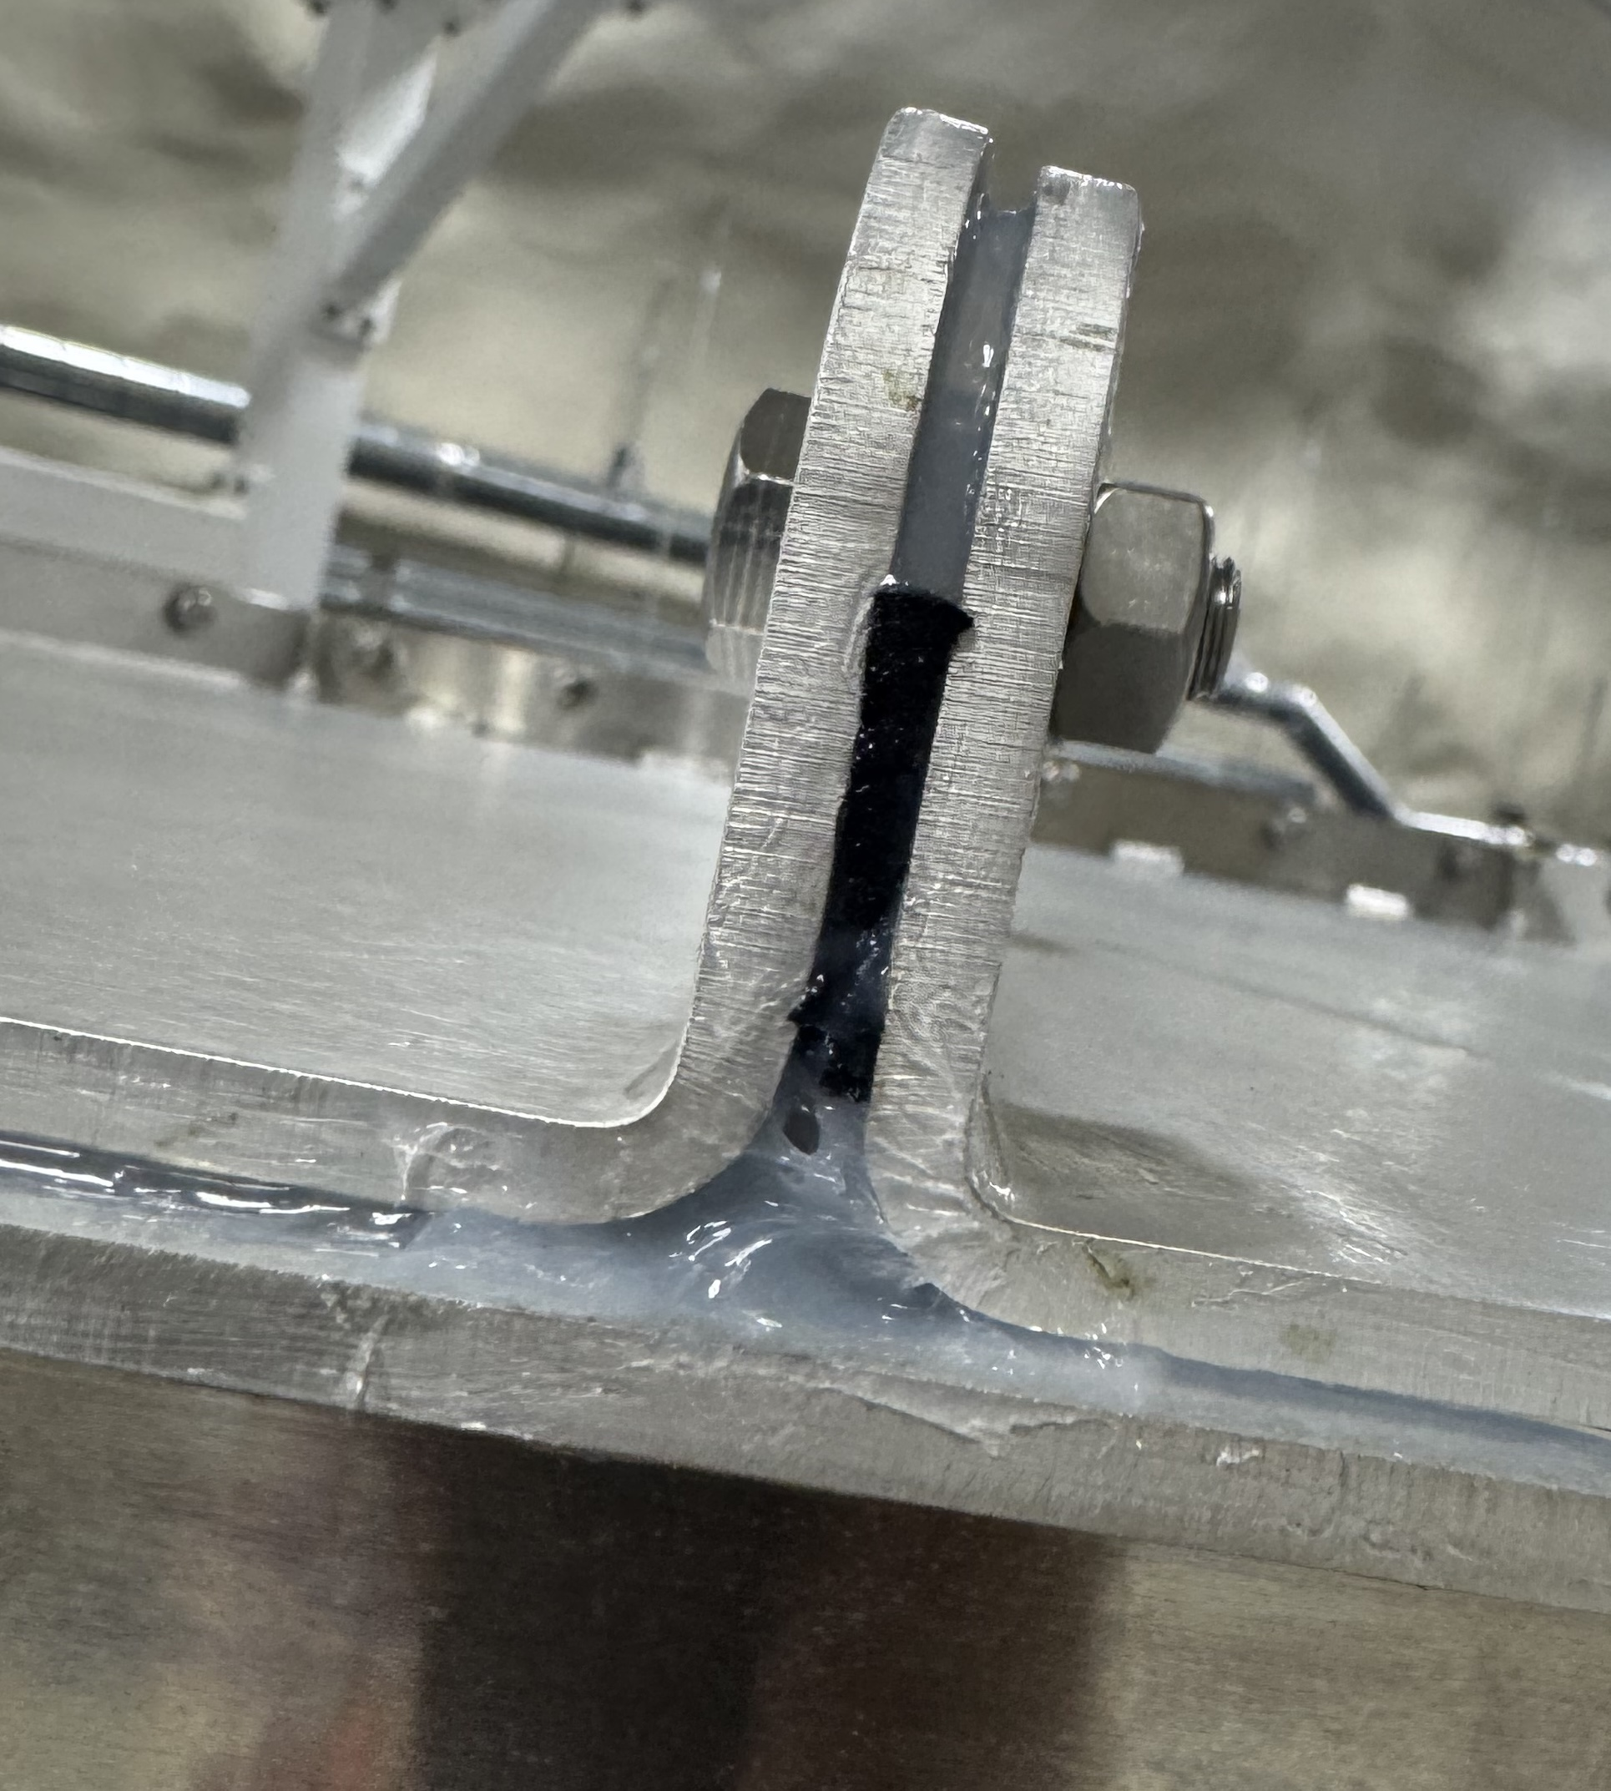
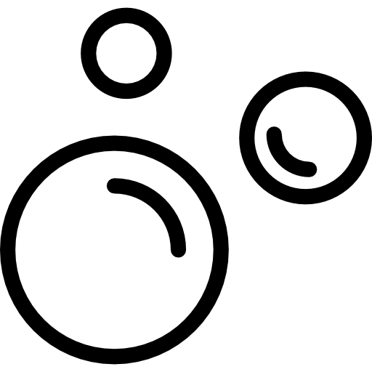
18
Post-installation

Slide 19
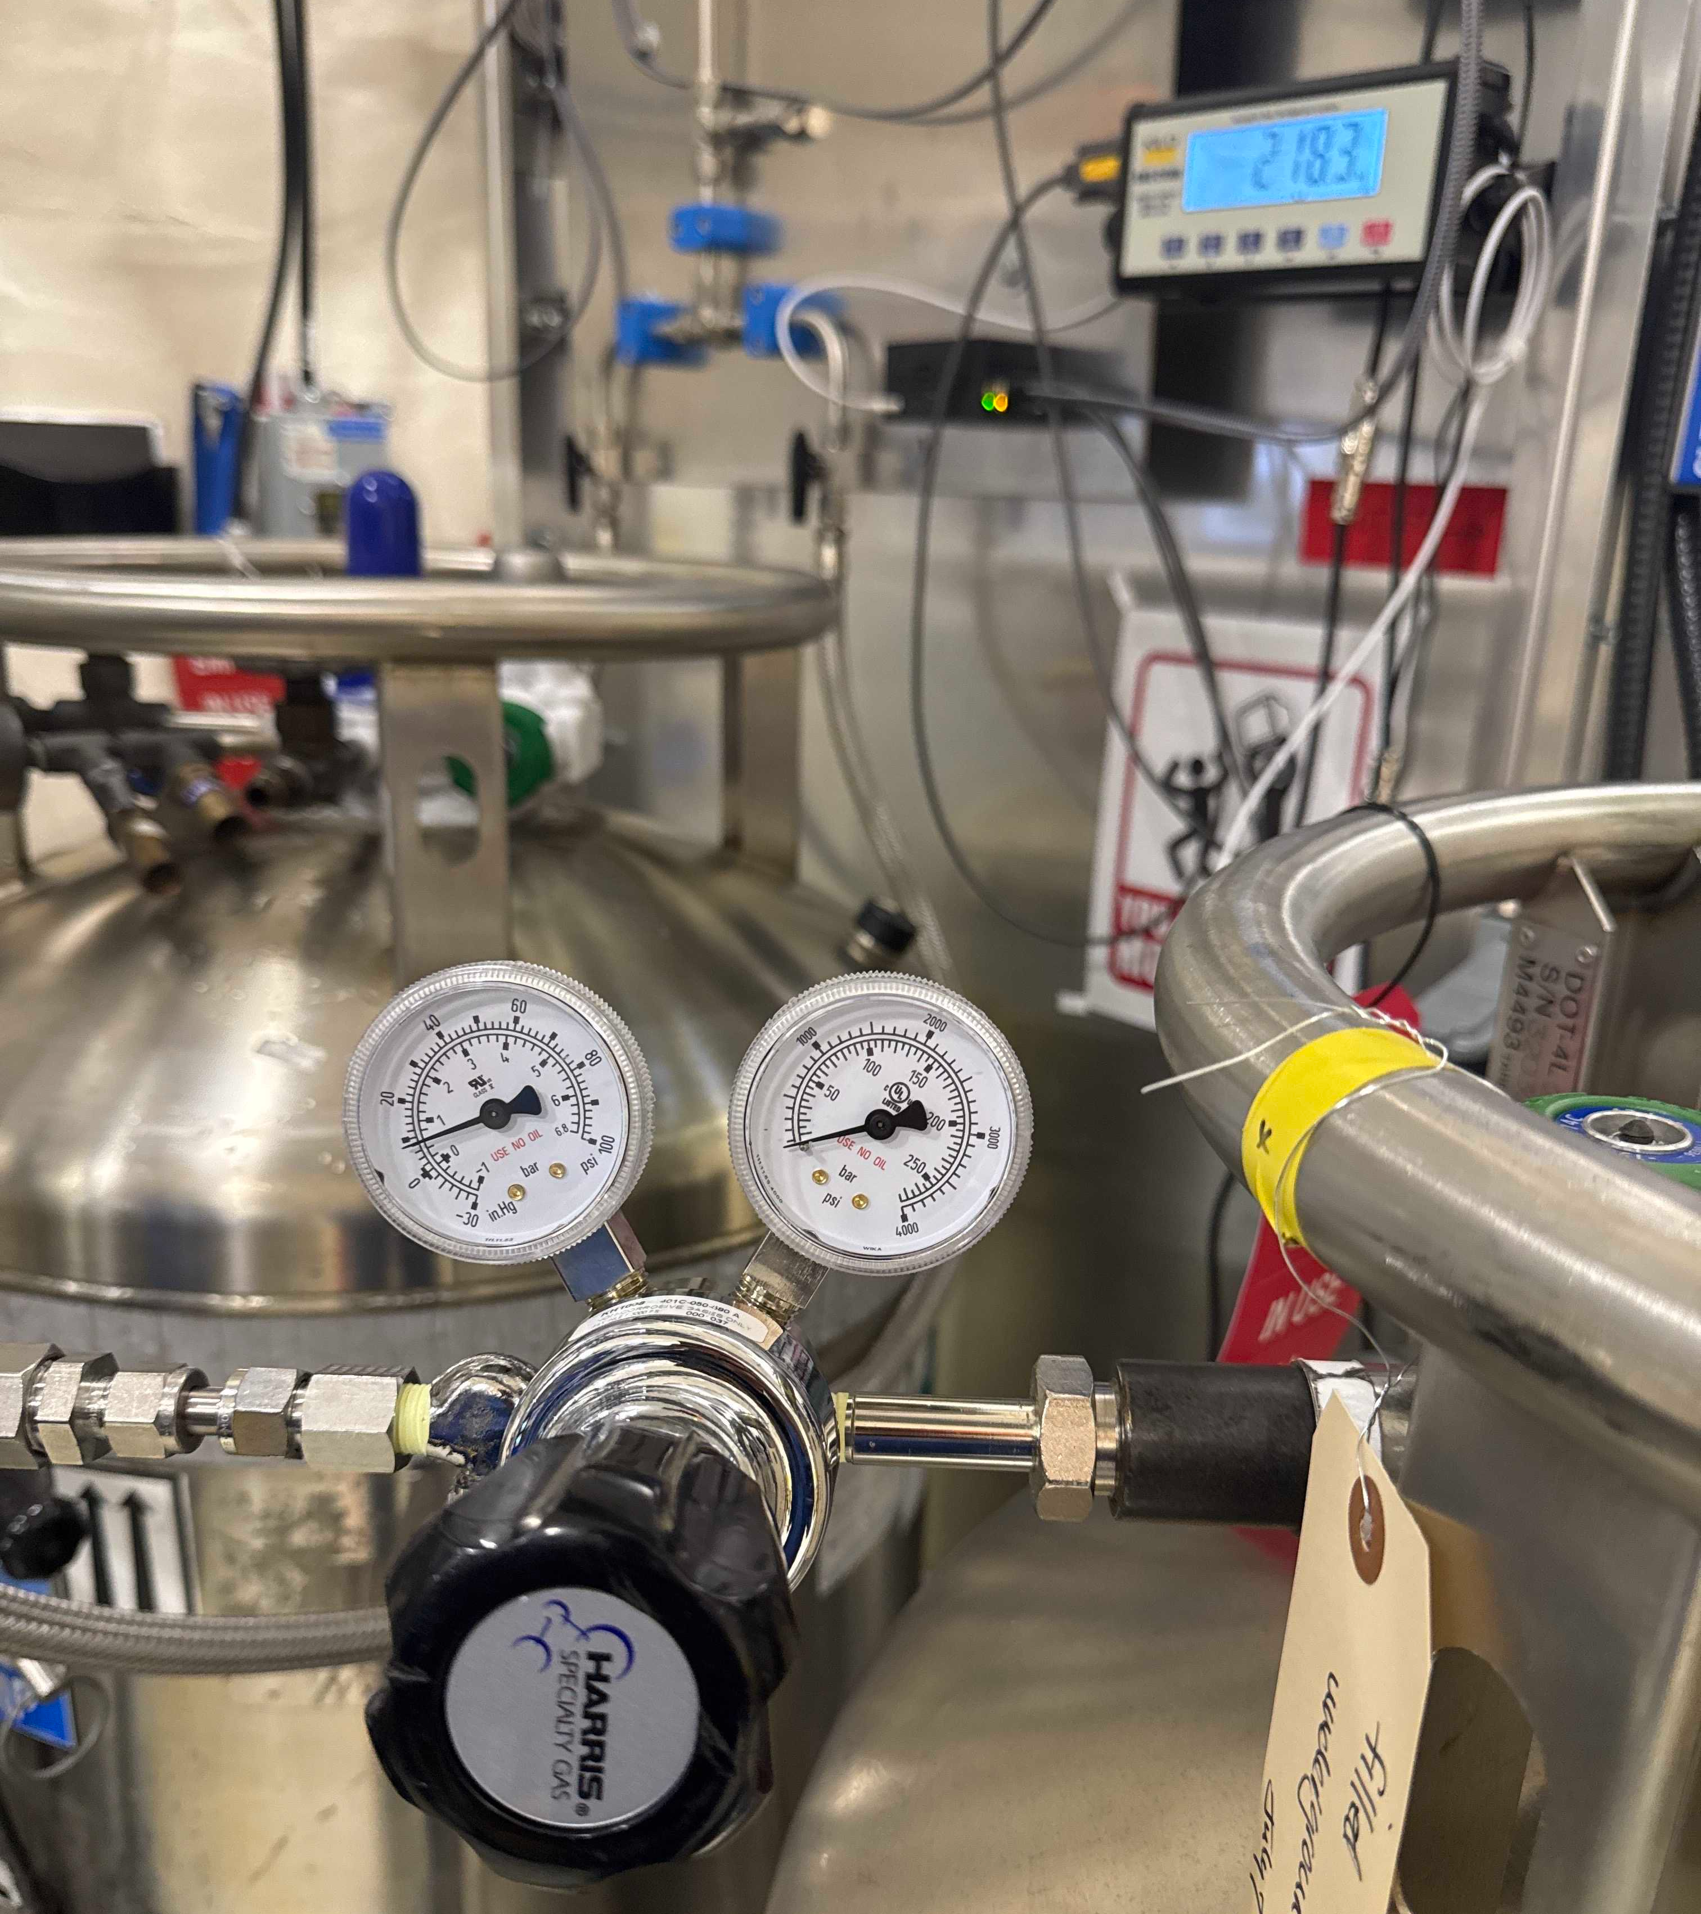
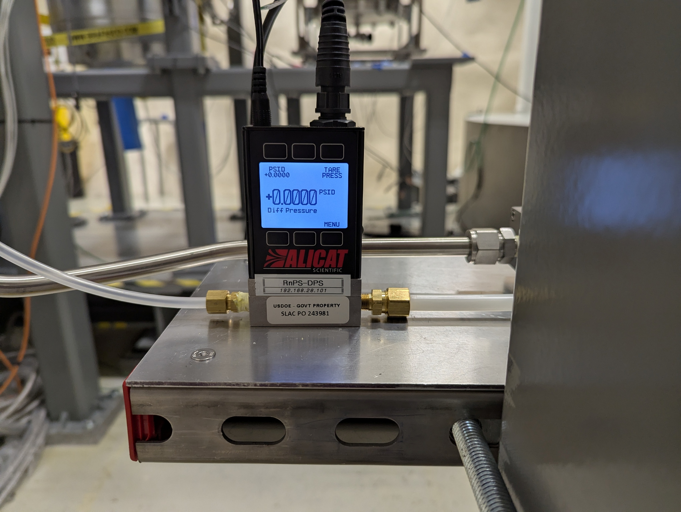
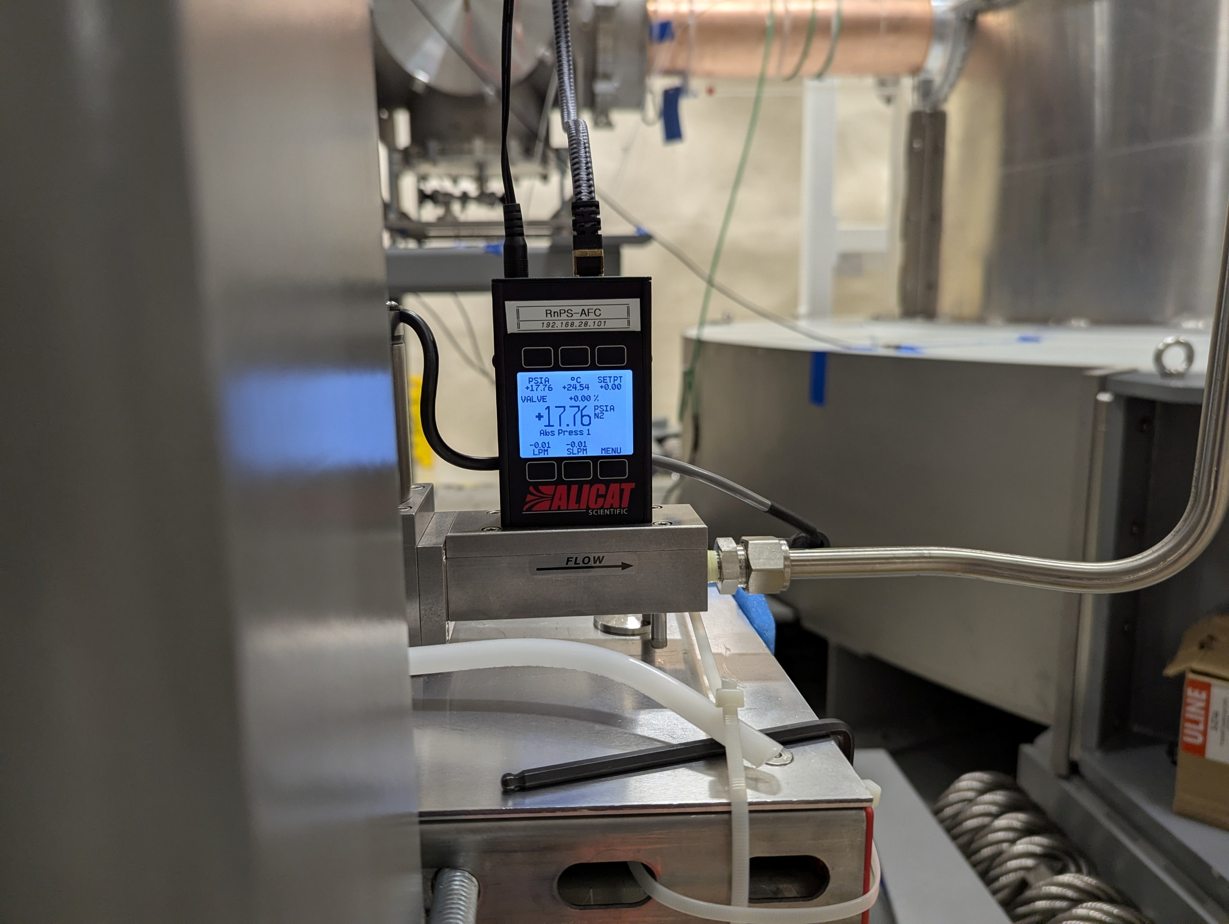
19
Post-sealing
17.76 PSI
0.00 PSI
Absolute Pressure
Setpoint
8 PSI
Flow Rate
Tared DP
0.00 SLPM

Slide 20
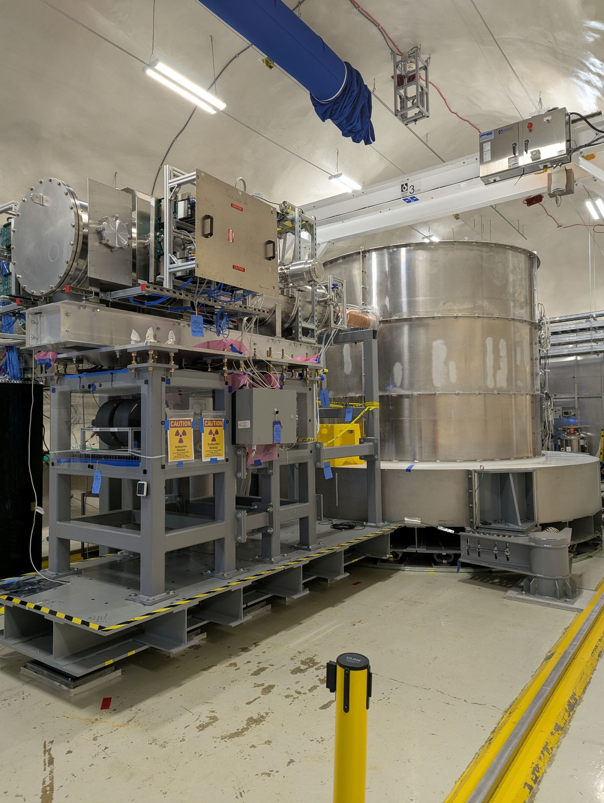
20
Summary
Radon is problematic
  Produces neutrons, gamma rays, X-rays, Pb-206
To shield experiment:
  Seal detectors
  Flow pure nitrogen in
Operation:
  Monitor Rn concentration (and many other parameters)
  Refill liquid nitrogen

Slide 21



21
Acknowledgements
Principal Investigators:
Professor Ziqing Hong, University of Toronto
Dr. Matt Stukel, SNOLAB
Professor Prisca Cushman, University of Minnesota
Postdoctoral Fellows:
Dr. Xuan Chen, University of Toronto
PhD Candidates:
Joseph Mammo, University of South Dakota
Manish Jha, University of South Dakota
Undergraduates:
Sam Jia, University of Toronto

Slide 22
22
Thank
You

Slide 23
23
References
The SuperCDMS Collaboration, SuperCDMS ELOG, 2026.
The SuperCDMS Collaboration, SuperCDMS SNOLAB Technical Design Report, 2018.

