Slide 1


Time
Servers and Simulations:
Building Critical Infrastructure for the NEWS-G Experiment
Andrew Gault
Summer Student Researcher
Queen’s University, NEWS-G

Slide 2
Simulations
2
Initial goal: Replicate our current NEWS-G sphere setup given a 3D modeling software, CADQuery, that uses programming to make objects, and COMSOL Multiphysics to setup the electrostatics and run simulations to answer questions like what is the best 19-anode sensor design.

Slide 3
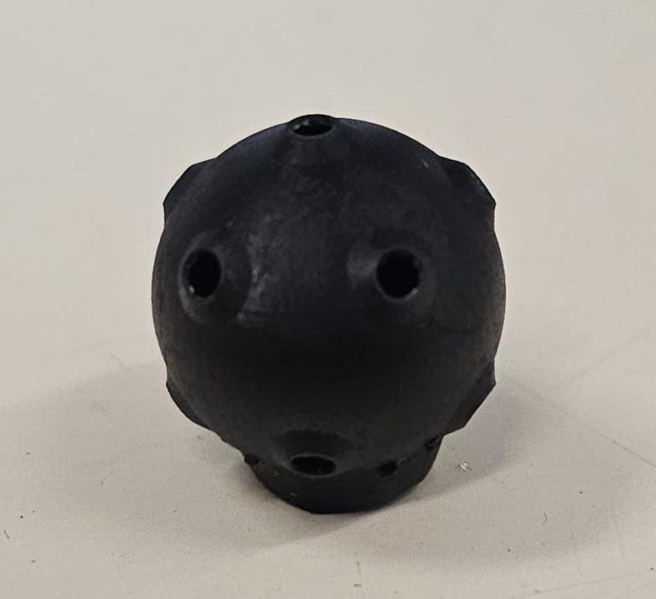
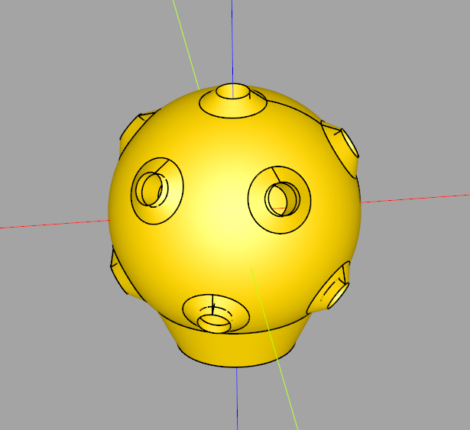
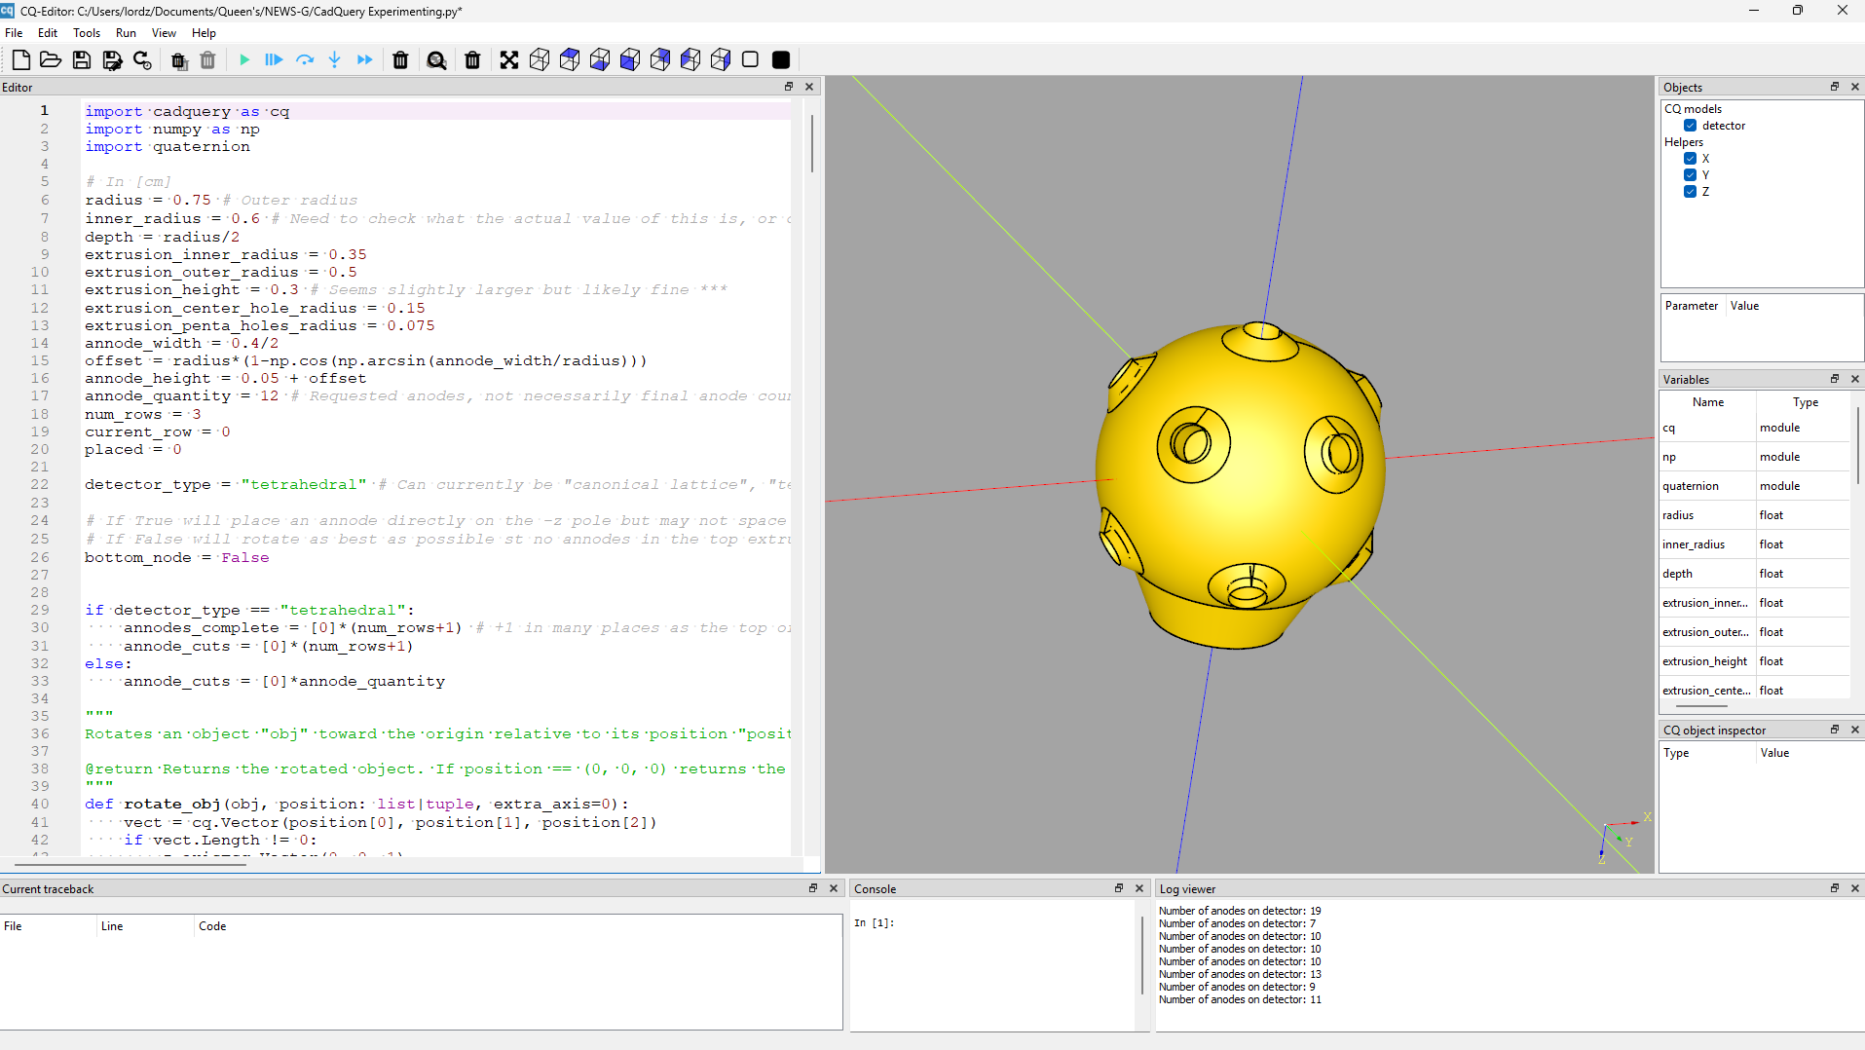
CADQuery -- Start
3
Software that uses Python code to procedurally create 3D objects.
Used a printed model I found of an 11 Anode Tetrahedral Achinos sensor as reference to recreate in the software.
I then automated customizing three different designs.

Slide 4
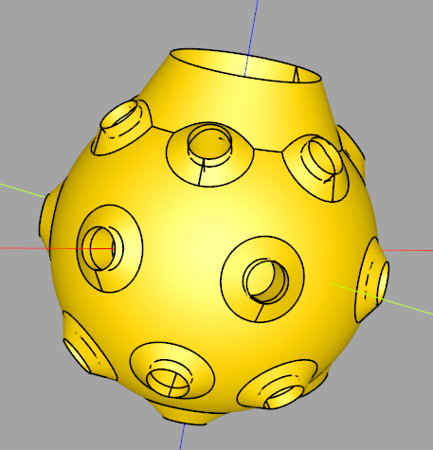
CADQuery -- Tetrahedral
4
WHAT?
Evenly spaced rows filled with nodes with one node on the bottom. Each row is offset to make a triangular configuration.
HOW?
Uses a set of polar arrays, one for the rows and one for
each node within their respective rows.
Automatically determines how many nodes to put on each row based
on the number of nodes and rows requested.
CONFIG?
Number of rows and total number of nodes can be customized.

Slide 5
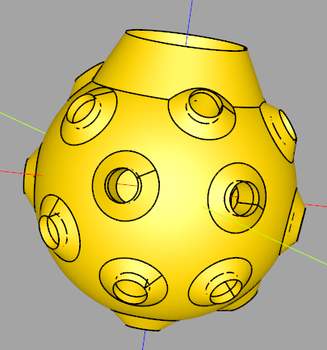
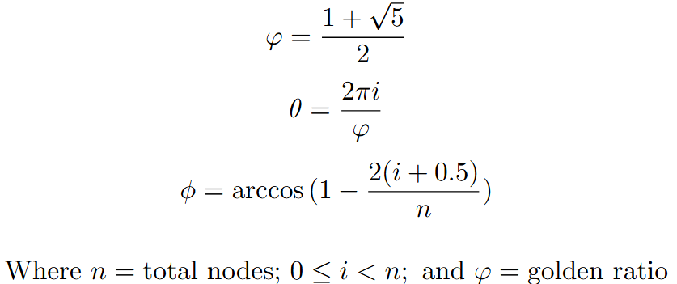
CADQuery -- Canonical Fibonacci Lattice
5
WHAT?
A modified Fibonacci Lattice to improve packing (maximize the minimum distance between any two neighbouring nodes).
HOW?
Uses the following formulas to calculate the angles:
Uses quaternions and the vector V₁ × V₂ | V₁ =
origin to node and V₂ = origin to -Z pole to rotate
all nodes so there is one at the -Z pole when the config does not already put one there.
CONFIG?
Number of nodes, force bottom node (True/False).

Slide 6
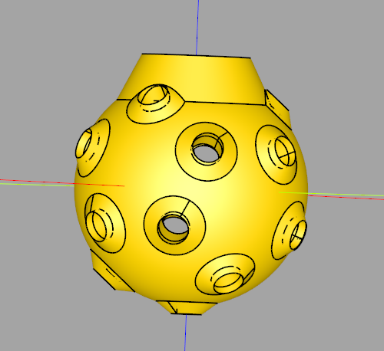
CADQuery -- Regular Dodecahedron
6
WHAT?
Largest platonic solid (identical faces with equal-length edges) in terms of vertices. Not as well packed as canonical lattice, but due to the uniform spread, likely to be better for us.
HOW?
Manually inputted x, y, z coordinates for each node position as it is a unique polyhedron.
Notes:
Much quicker and simpler to manually set each node position.

Slide 7
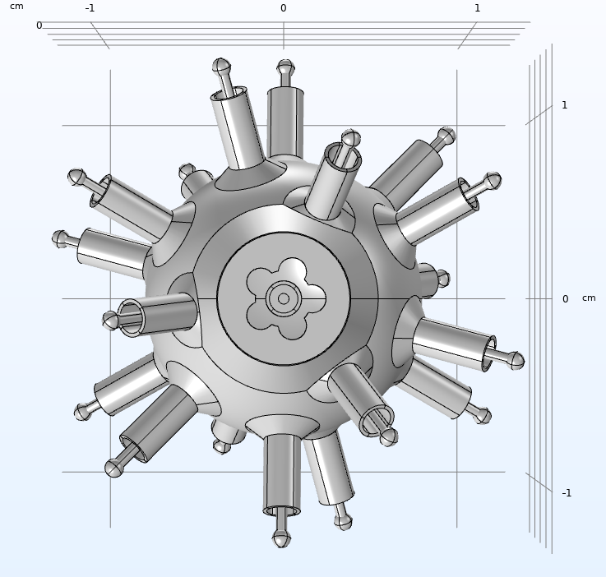
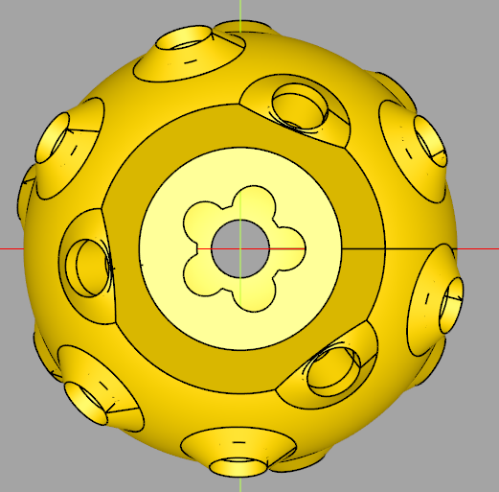
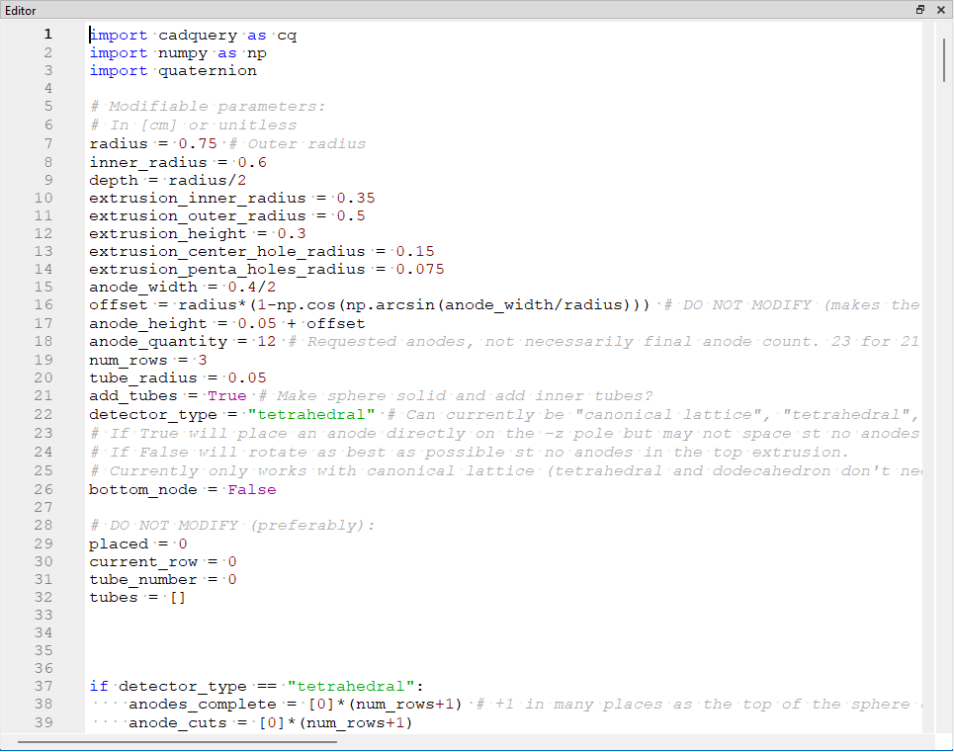
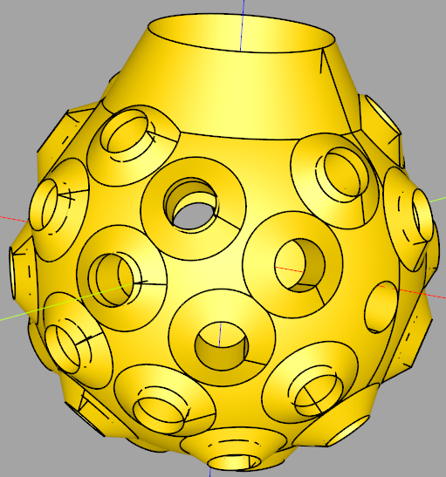
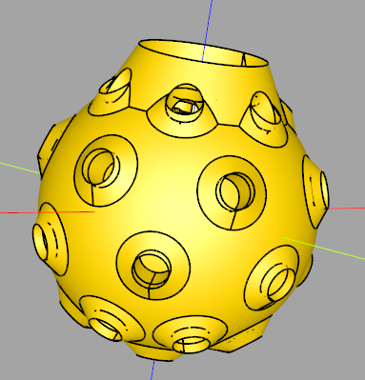
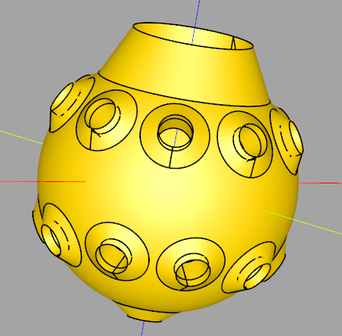
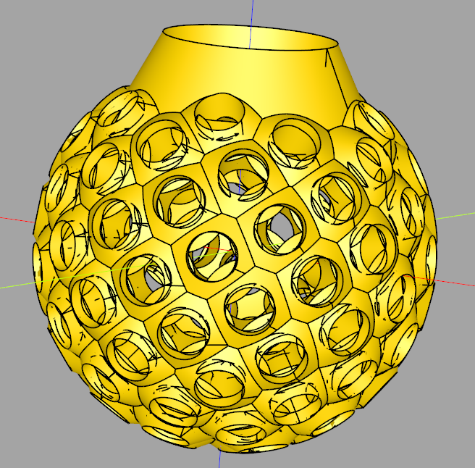
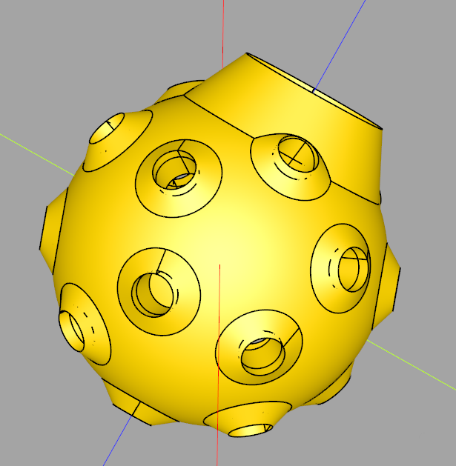
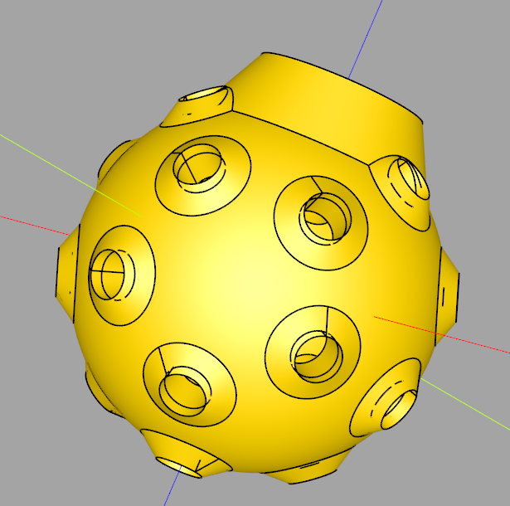
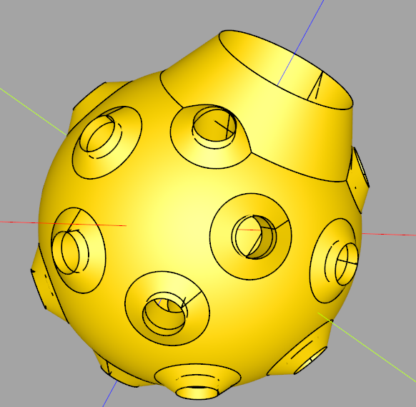
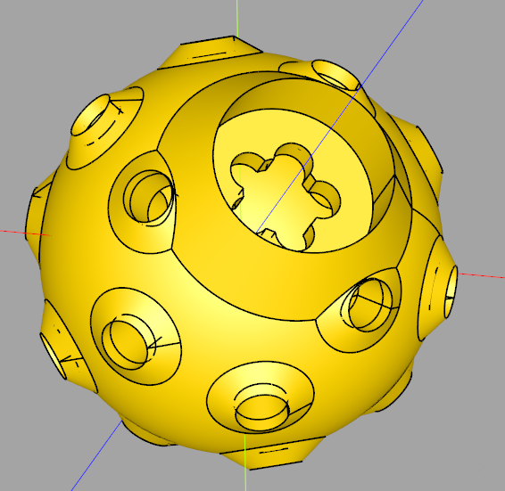
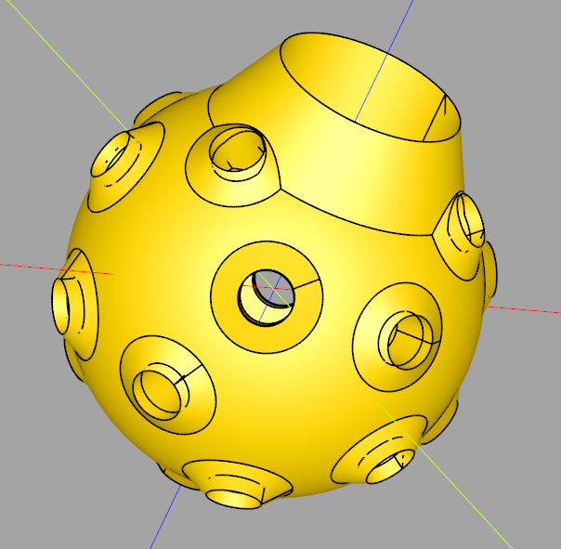
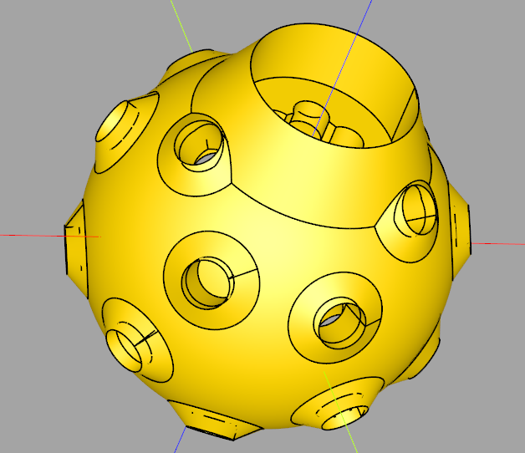
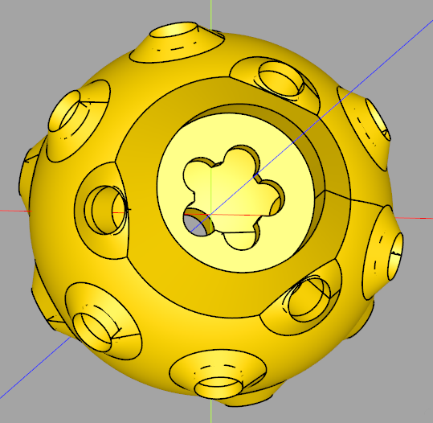
CADQuery -- Config
Time
7
Regular Dodecahedron:
Tetrahedral:
Canonical Lattice:
Contains easy-to-modify parameters at the top to quickly tweak previous designs.
If a person wants to make an entirely new design, objects like the node and useful code are held within utility functions and, along with the rest of the code, are well documented.
19 anodes 4 rows
19 anodes 3 rows
25 anodes 5 rows
36 anodes
90 anodes
19 anodes

Slide 8
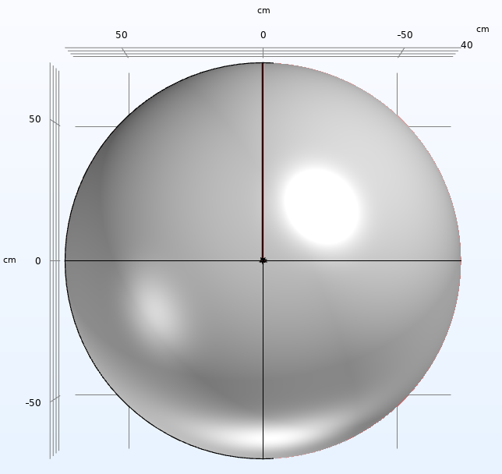
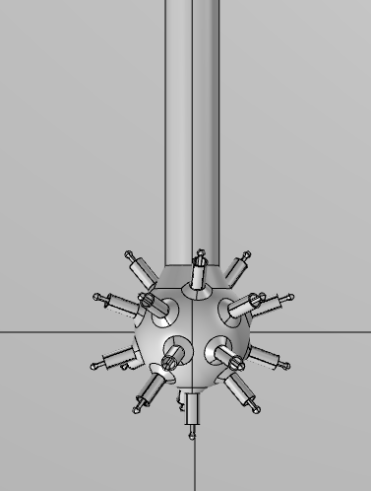
COMSOL Multiphysics
8
Glass
Copper Pipe
Detector /Sphere
Umbrella
Anodes

Slide 9
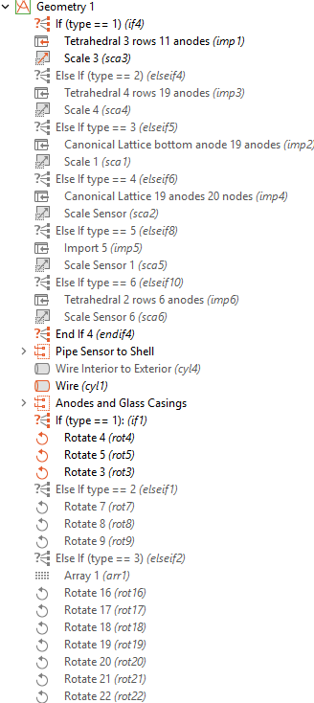
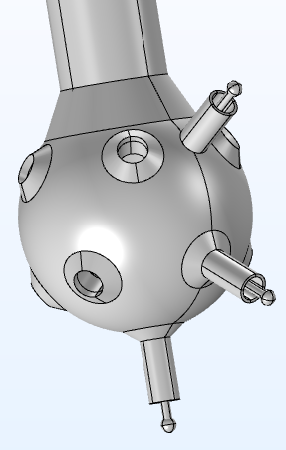
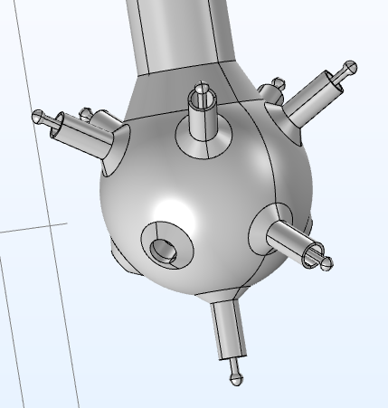
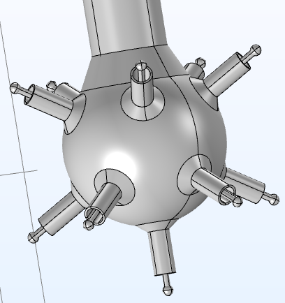
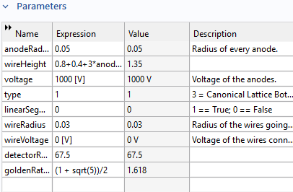
COMSOL Multiphysics
9
Designed a single COMSOL file that contains all the infrastructure needed to switch between and build off of sensor types imported from CADQuery.
Various other easily modifiable parameters to change the sensor and detector as a whole.

Slide 10
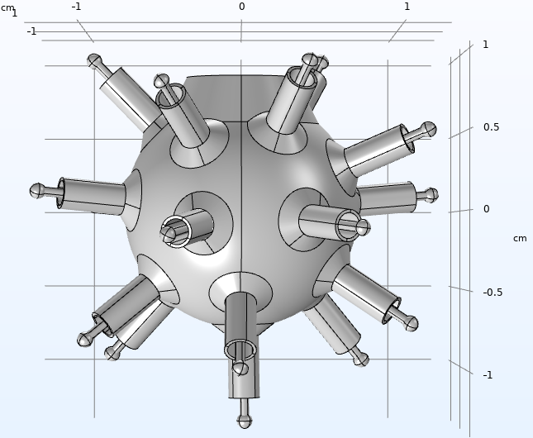
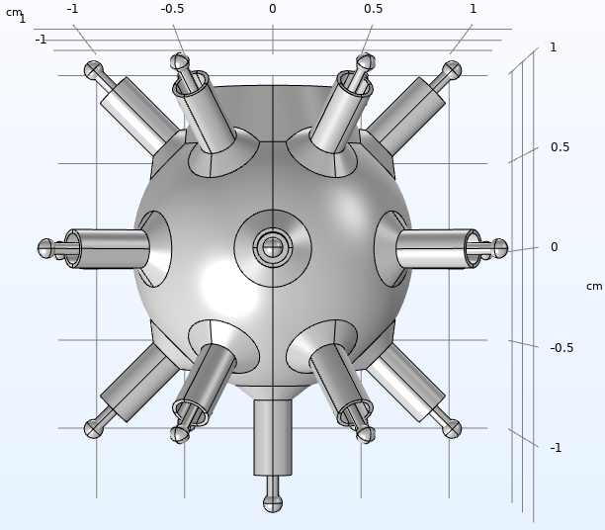
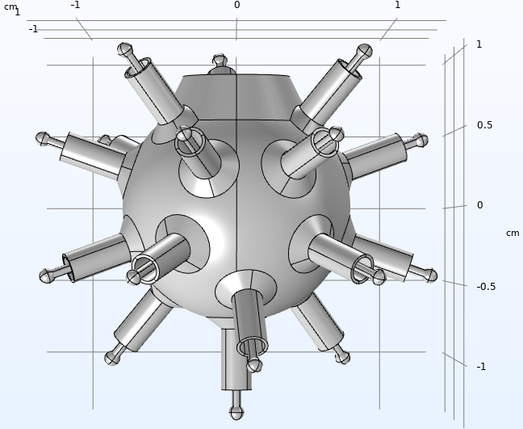
COMSOL Multiphysics
Final 19-anode sensor designs
10
Canonical Fibonacci Lattice
4 Row Tetrahedral
Regular Dodecahedron
Notes:
Test for uniformity. Looking for high, even gain/number of electrons per anode.

Slide 11
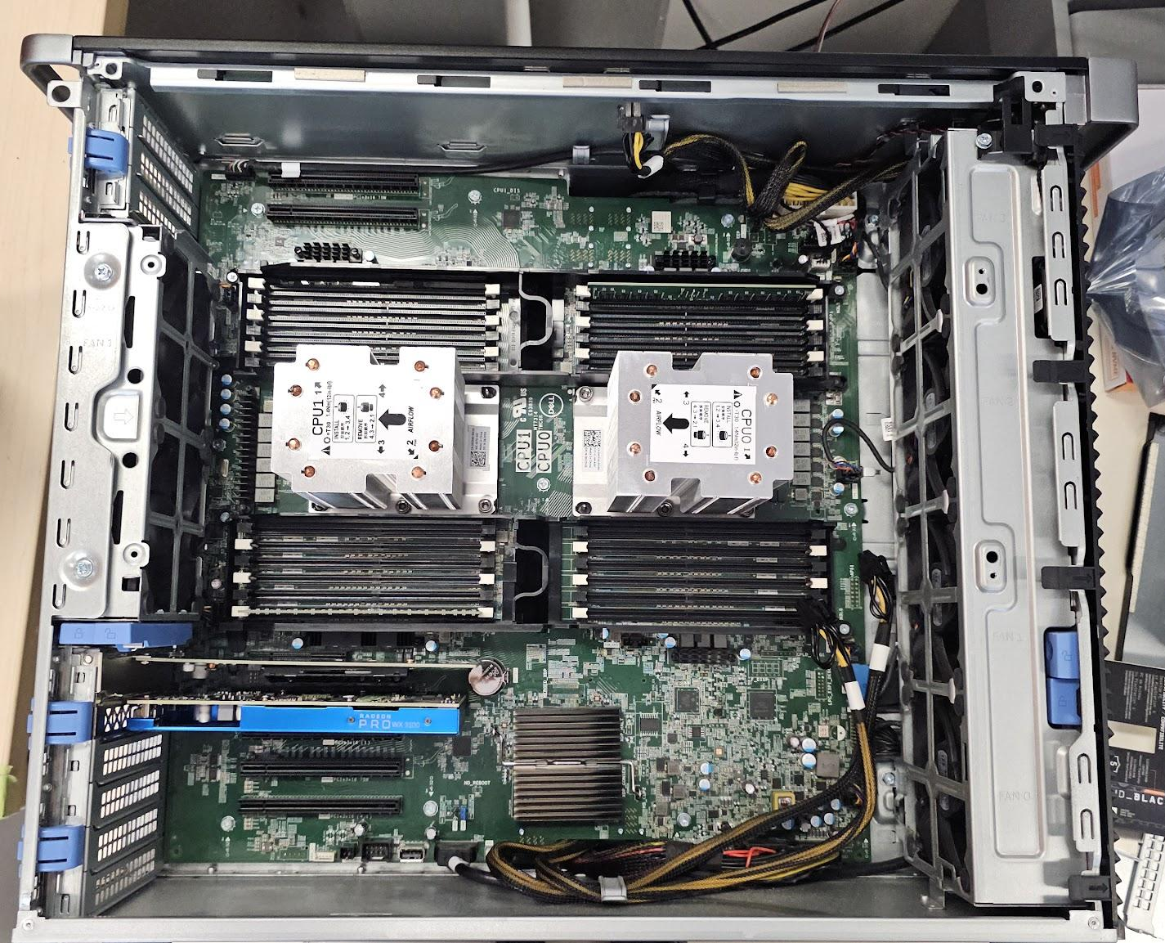
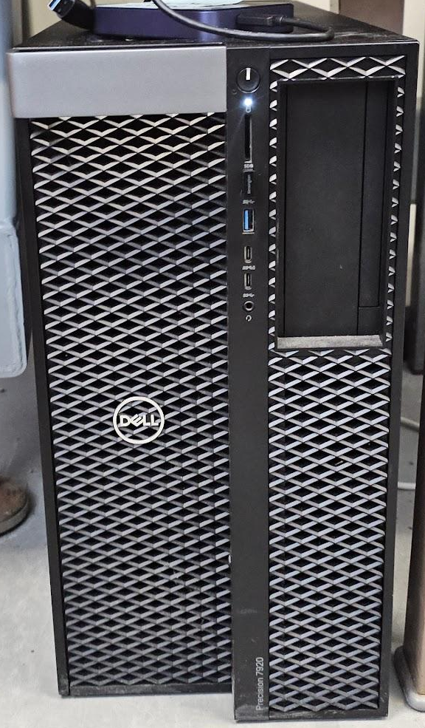
COMSOL Multiphysics
11
I completely refurbished the dedicated COMSOL computer with a new SSD, put the hard drive array into RAID 10 (faster with data loss redundancy), and a fresh install of all necessary software with several other optimizations implemented.

Slide 12
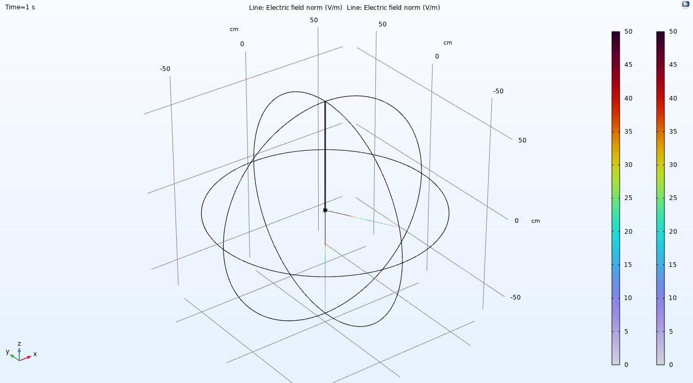
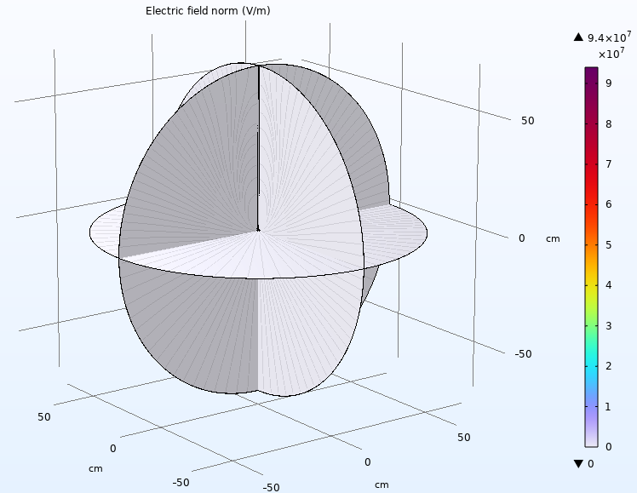
COMSOL Multiphysics
12
Ran a batch simulation to find where the electric field’s E_{norm} in a multi-anode sensor looks like a single anode sensor. Has 120 combinations of parameters.
Wrote a program to analyze the data. Finds
distance from center that E_{norm} ~ A/r² where
A is a real number. Found at R² of 0.9, 0.95,
0.98, and 0.99. By comparing the calculated
distances given each parameter combination
a law can be formed to give us an approximate
answer.
Notes:
With a new PC set up I was able to run a batch simulation over 120 parametric combinations to try and find the distance from the center of the detector where a multi-anode looks like a single anode in terms of its electric field. The simulations finished successfully and I wrote a program to help the next person analyze the data and come to a useful conclusion.

Slide 13
Servers
13

Slide 14
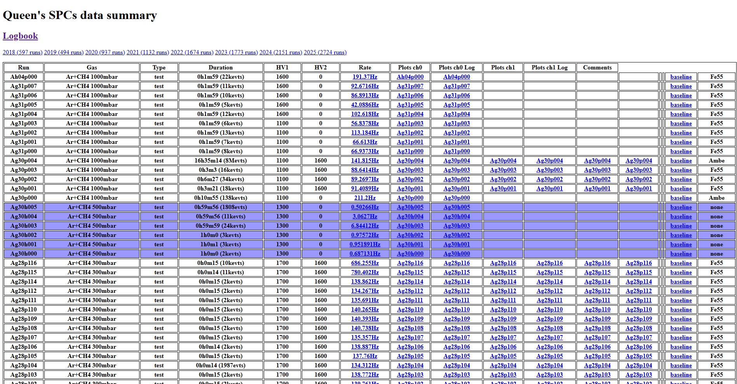
Background
14
What was
Used HTTP (all network traffic visible to malicious actors.)
Comments not functional.
Plots open in new tabs one at a time.
Rigid headers (what you see is what you get.)
No filtering or searching (aside from using CTRL-F to search for terms that are loaded in the page.)
Can only view one sphere’s runs at a time.
Etc.

Slide 15
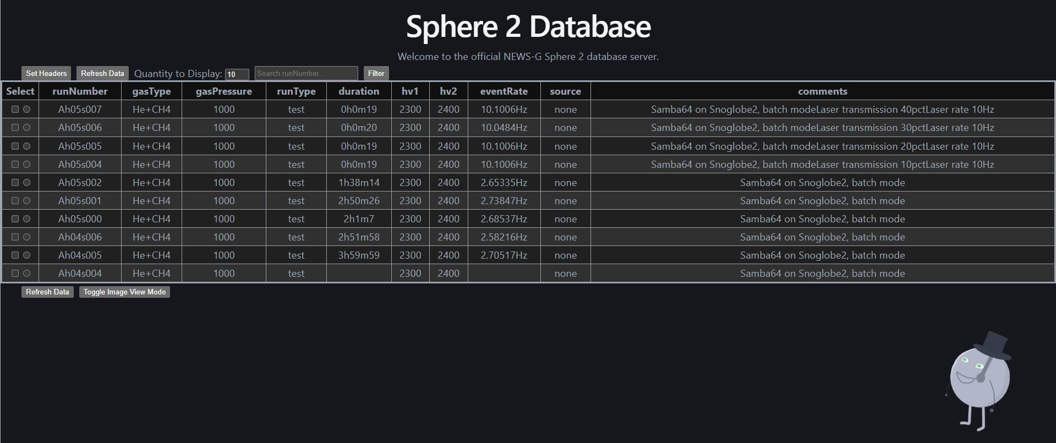
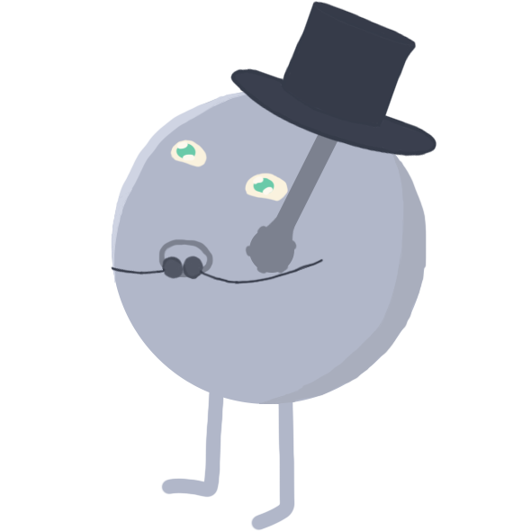
Background
Time
15
Old design:
Comparison
New design:

Slide 16
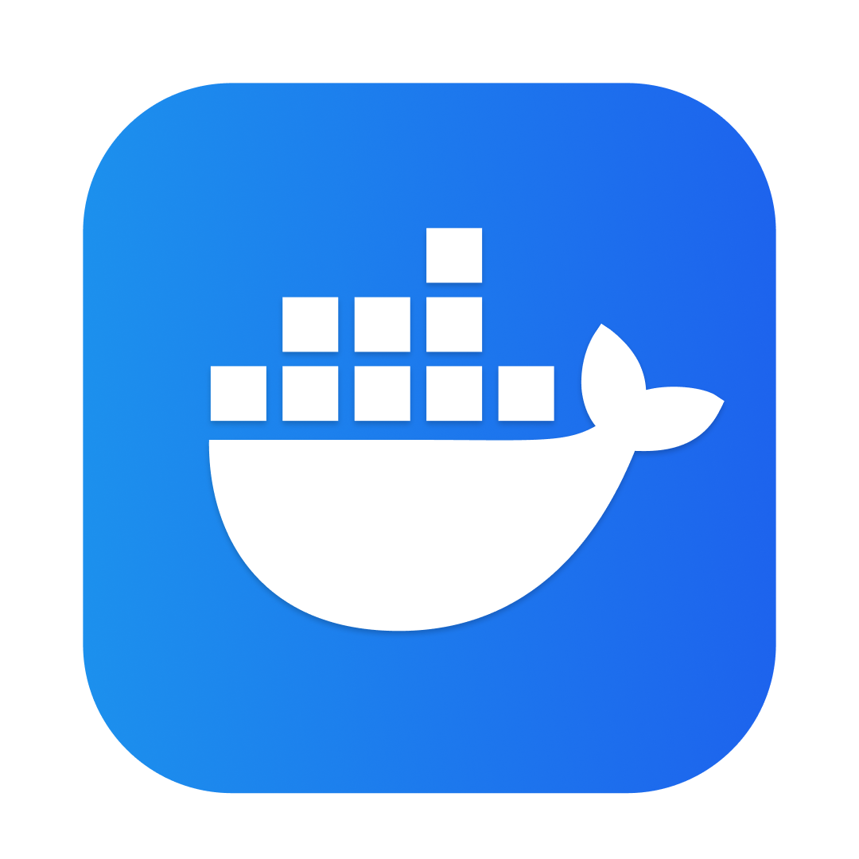
Structure
New design
16
Docker - Lets groups of functions run inside containers, which are separate simplified virtual machines for enhanced security and faster updates.
Front-end (what the user sees/the website)
(Abstracted interface
between front-end and database)
Back-end
Database (Holds run data)

Slide 17





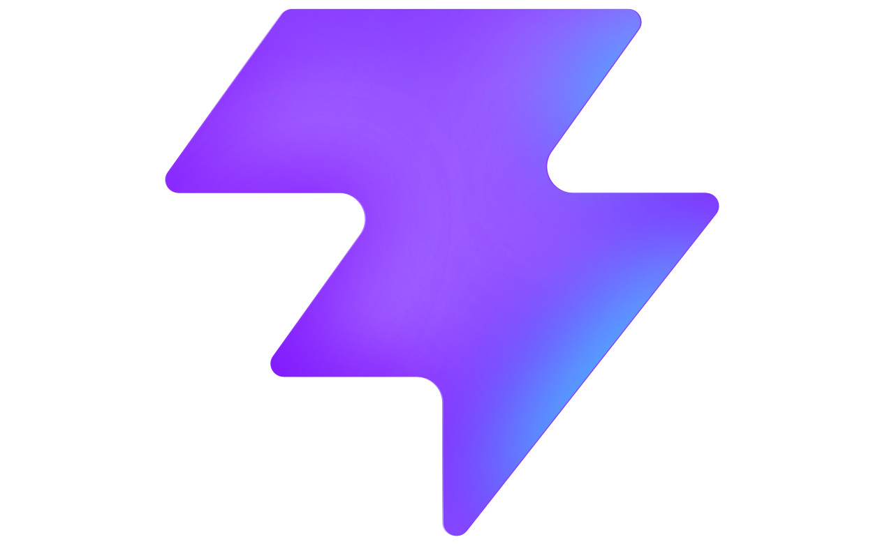
Structure
Time
17
NGINX (Engine X)
Exposes website to internet and manages
web traffic (sending and receiving data.)
Front-end (what the user sees/the website)
(Abstracted interface
between front-end and database)
Back-end
Database (Holds run data)
React
Vite
To create interactive websites that load and change elements without the page reloading/changing.
Bundles, optimizes, and quickly builds/deploys javascript and css files.
Enables fast routing and prevents malicious injection into the database.
Uses JSON files for each data point/run. Allows for different fields in future if they change.

Slide 18
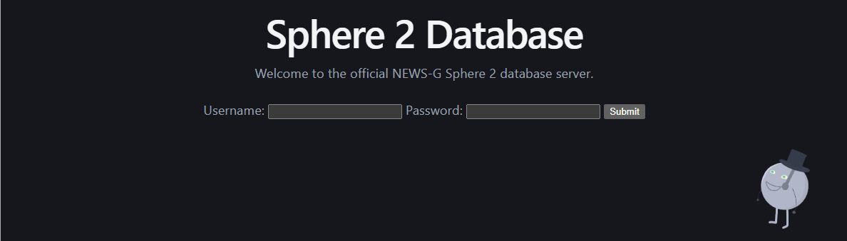
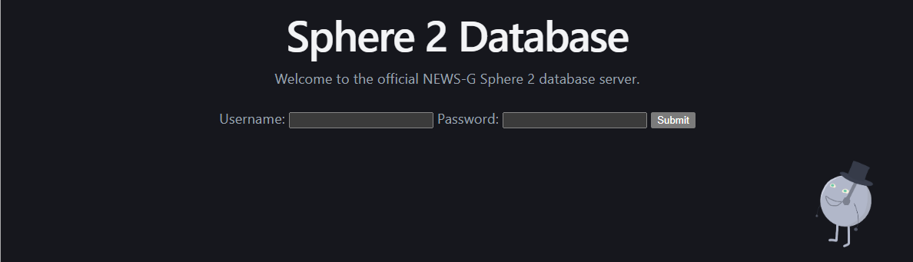
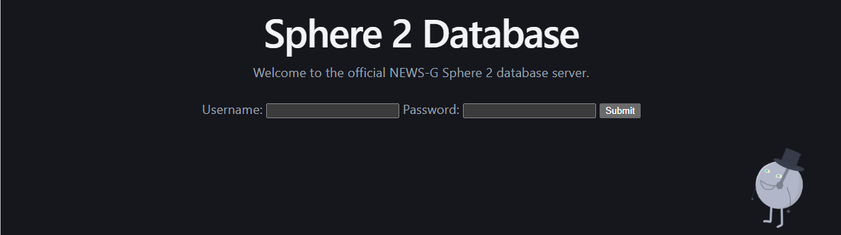
End Result
Time
18
Login Page for basic security:
·
·
·
·
·
·
·
·
·
·
·
·
·
·
·
·
·
·
·
·
·
·
·
·
·
·
·
Notes:
Login to Sphere 2 Database before presenting to avoid giving out username and password.

Slide 19
End Result
19
Live Demo!

Slide 20
Thank you!
20
Questions?

Slide 21
Extra Slides
21

Slide 22
CADQuery -- Diagram/Legend
22
Anode
Wire
Node
Sensor Head/Umbrella
Extrusion
Notes:
For context

