Slide 1


Slide 2
When Signals Go Dark
_
Recovering Information From a Broken Detector
Simon Cao
Supervised by Dr. Pekka Sinervo

Slide 3
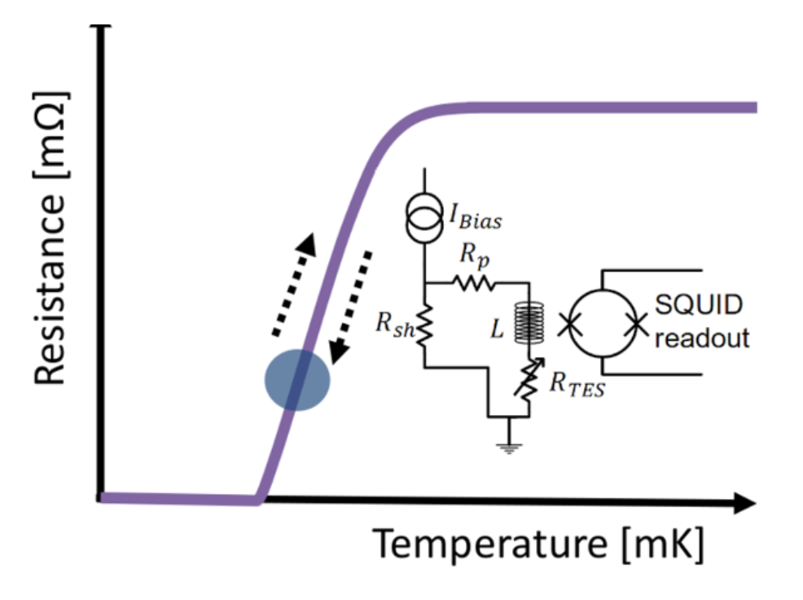


Phonon propagation
Nuclear recoil
Heats up
Normal
C1
F1
E1
A1
B1
D1
HV
Here
C2
A2
B2
E2
F2
D2
Superconducting
Figure 1. SuperCDMS HV detector

Slide 4

Small amplitude
Large amplitude
Delay
Figure 1. SuperCDMS HV detector

Slide 5


Figure 2a. Top-down view of water ripples after something was thrown inside

Slide 6
Figure 2b. Top-down view of water ripples after something was thrown inside. Covered

Slide 7





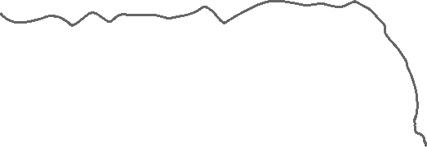





Figure 2c. Person throwing rock in water

Slide 8
Figure 3. Prediction pipeline
Amplitude
ML
& delay
Position and Energy

Slide 9
Detector Monte Carlo
Figure 4. Detector Monte Carlo simulations

Slide 10
Gamma ray
Pb
Figure 5. Background events

Slide 11


Figure 6a. Broken detector

Slide 12
Broken connection
Struggles transitioning
Won’t go SC or normal
Figure 6b. Reasons for broken detector

Slide 13
Broken Channels
Can we still recover position and energy from a broken detector?

Slide 14
Figure 7a. Prediction pipeline. One sensor missing
Detector Monte Carlo
ML
Amplitude
Position and Energy?

Slide 15
Baseline
F1 Missing
ML
VS
ML
Figure 7b. Process of analysis

Slide 16
Radius prediction
Let’s try to recover the radial position of an event recorded by a broken detector

Slide 17
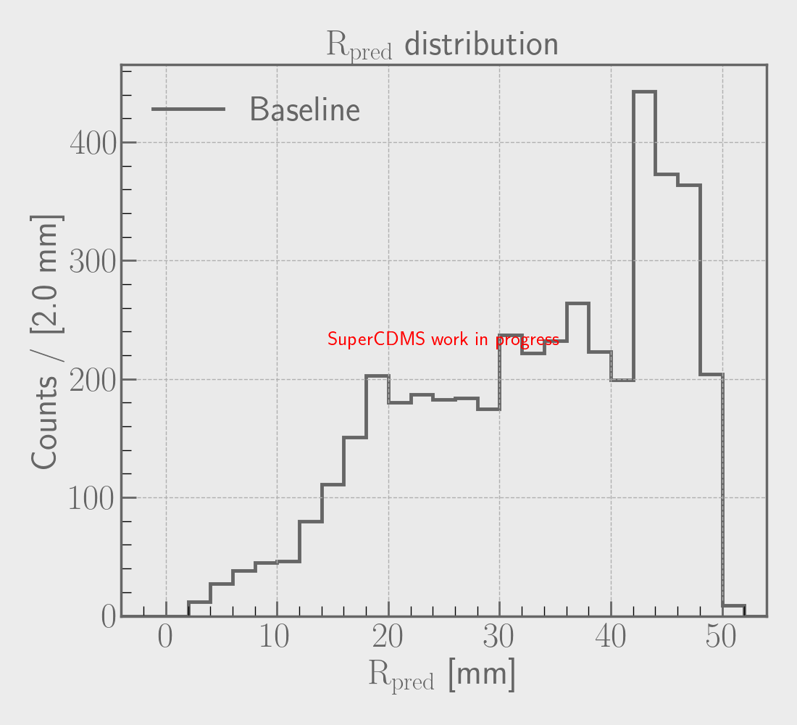
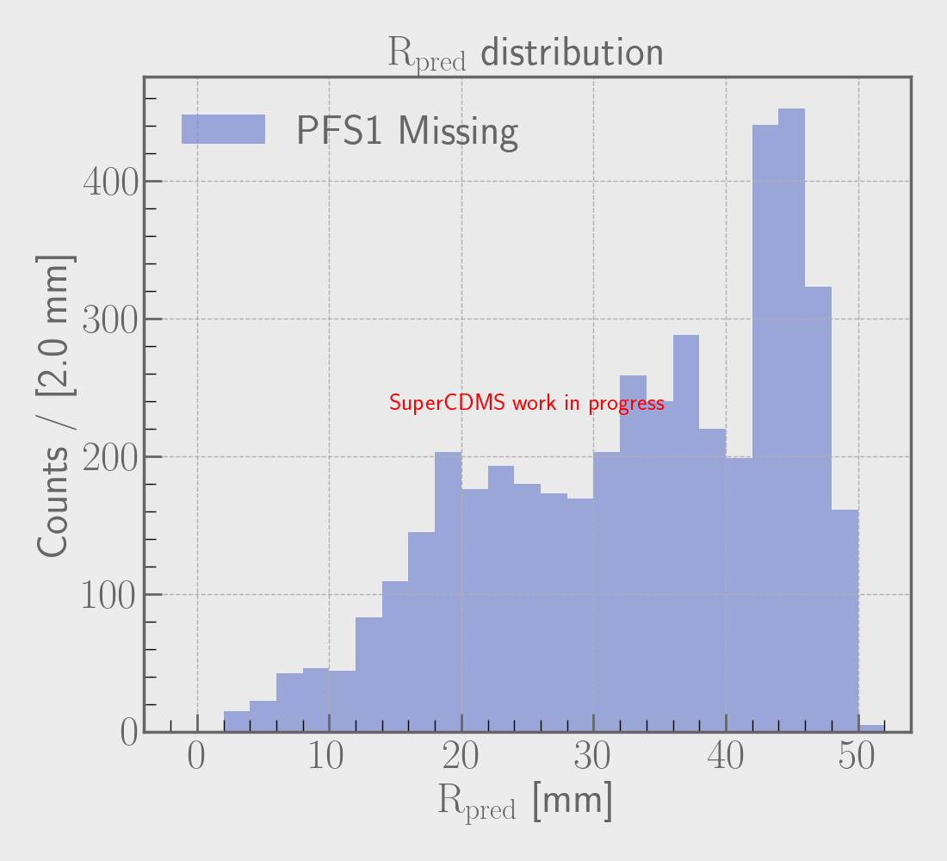
Baseline
F1 Missing
VS
Figure 8. Process of analysis. Radius prediction

Slide 18
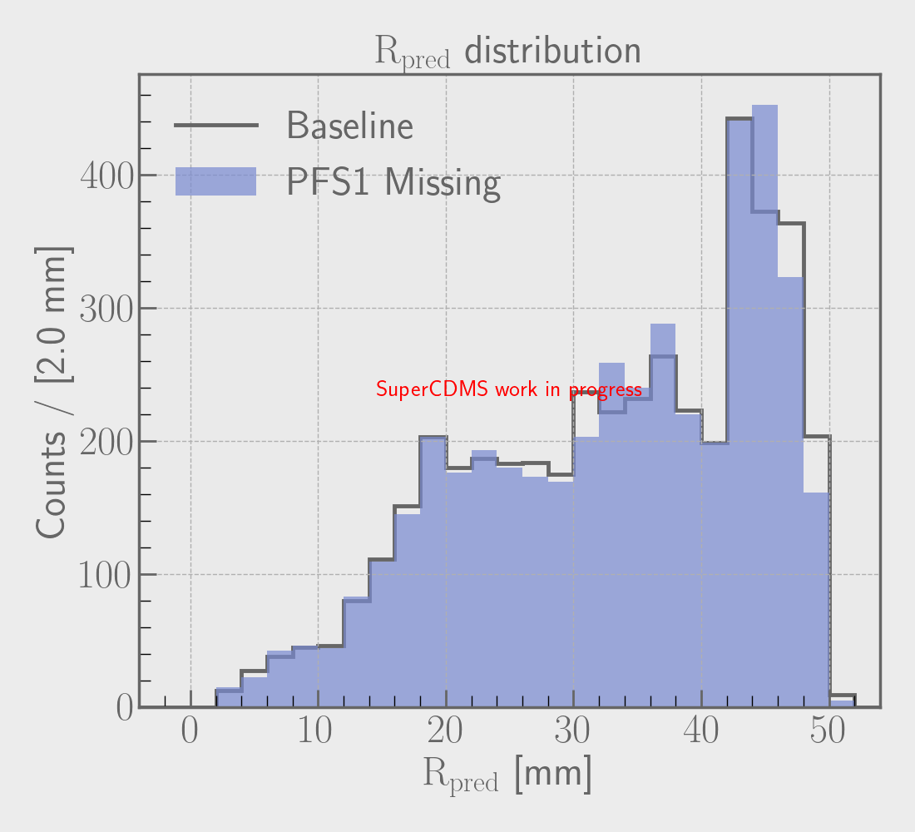


Both peaks match well
At low R, it matches almost exactly
Figure 9. Comparing radius predictions

Slide 19
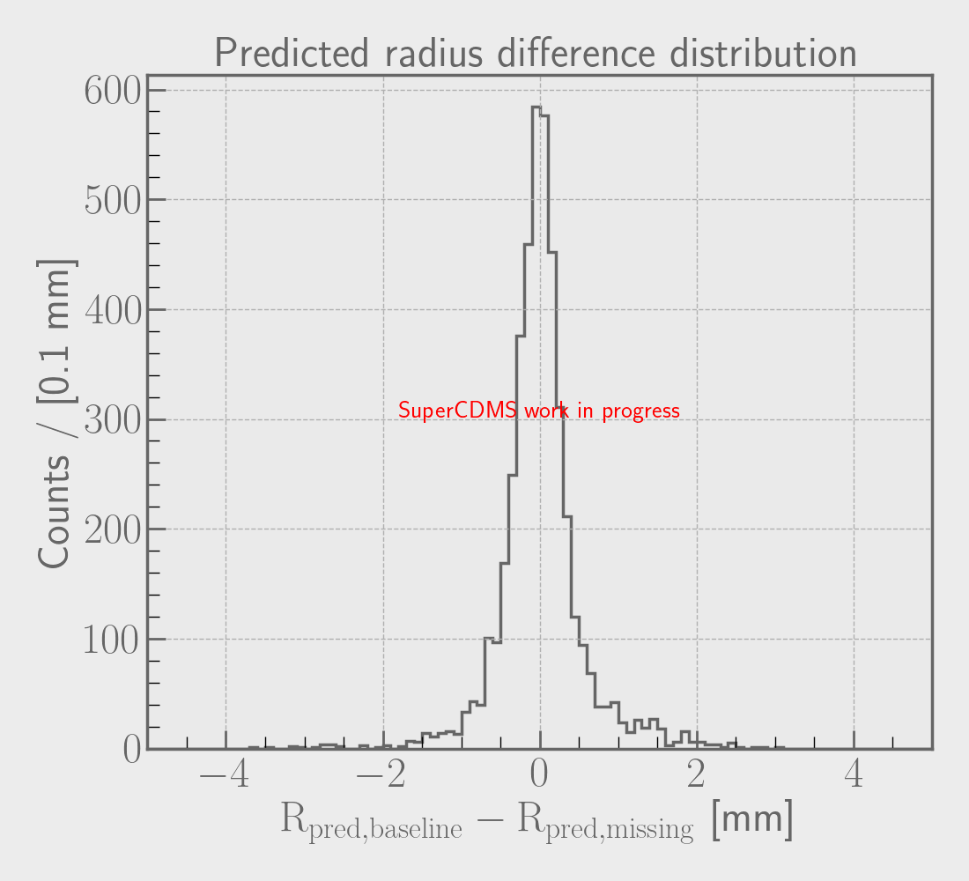
2 mm
Figure 10. Radius difference distribution
Figure 9. Comparing radius predictions

Slide 20
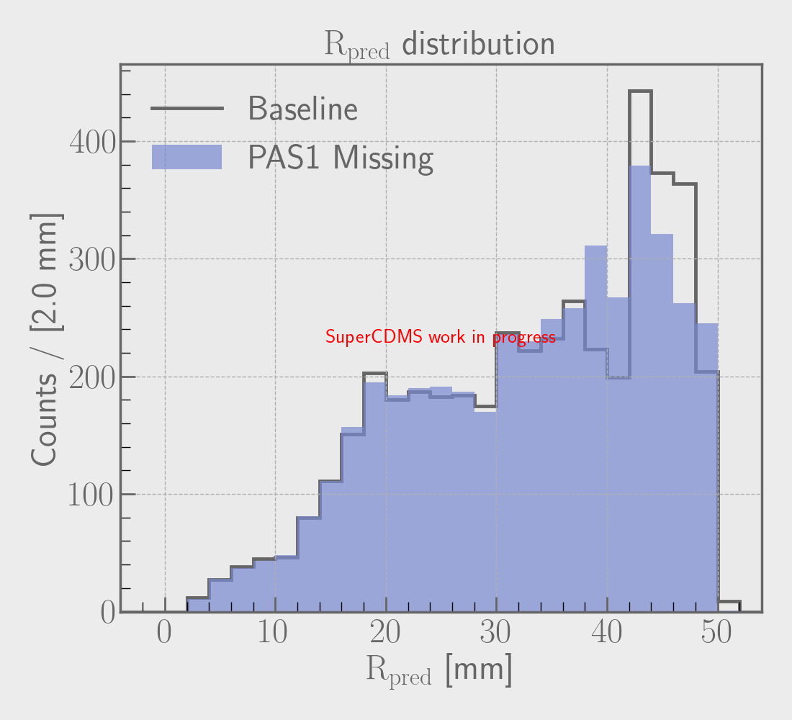
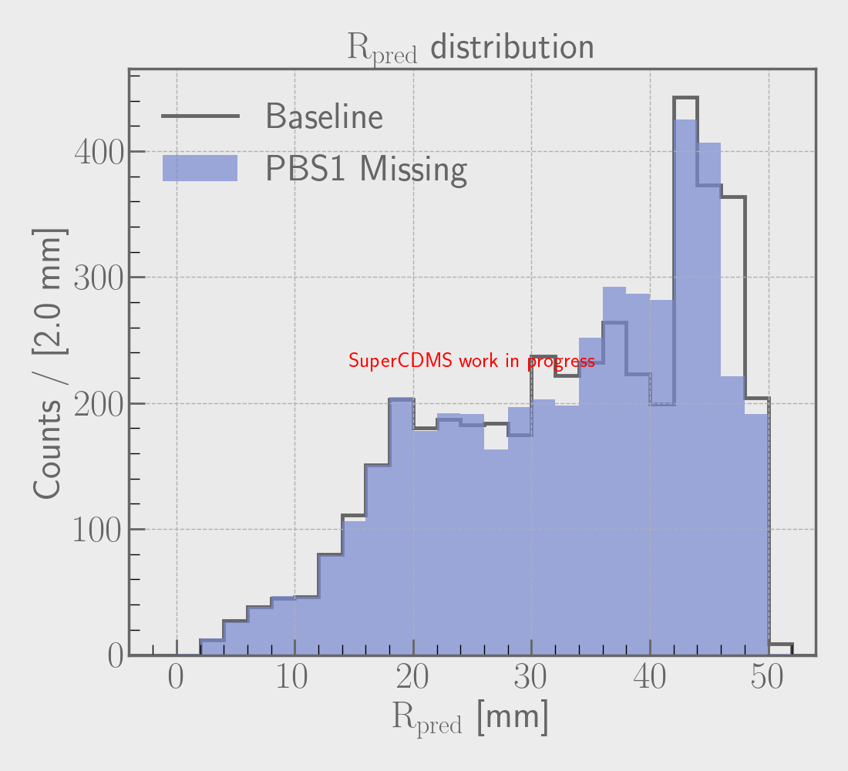
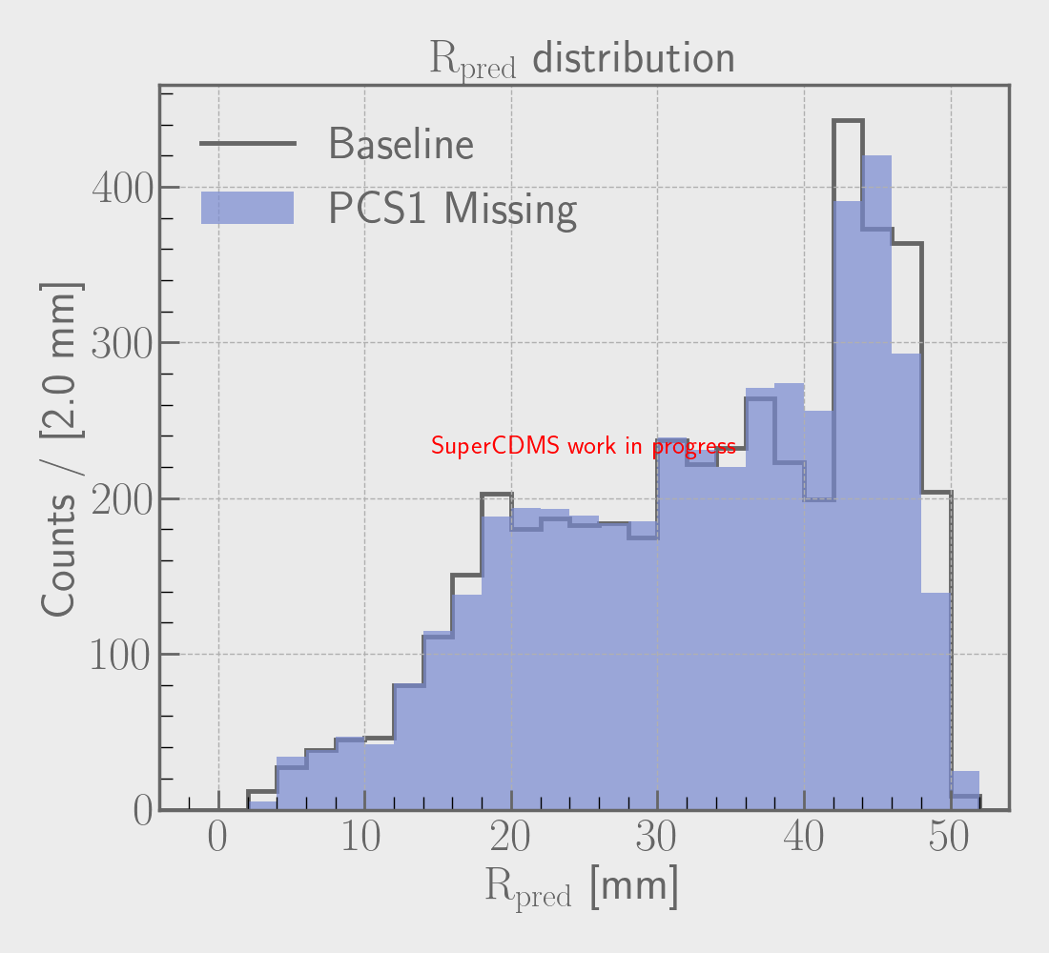
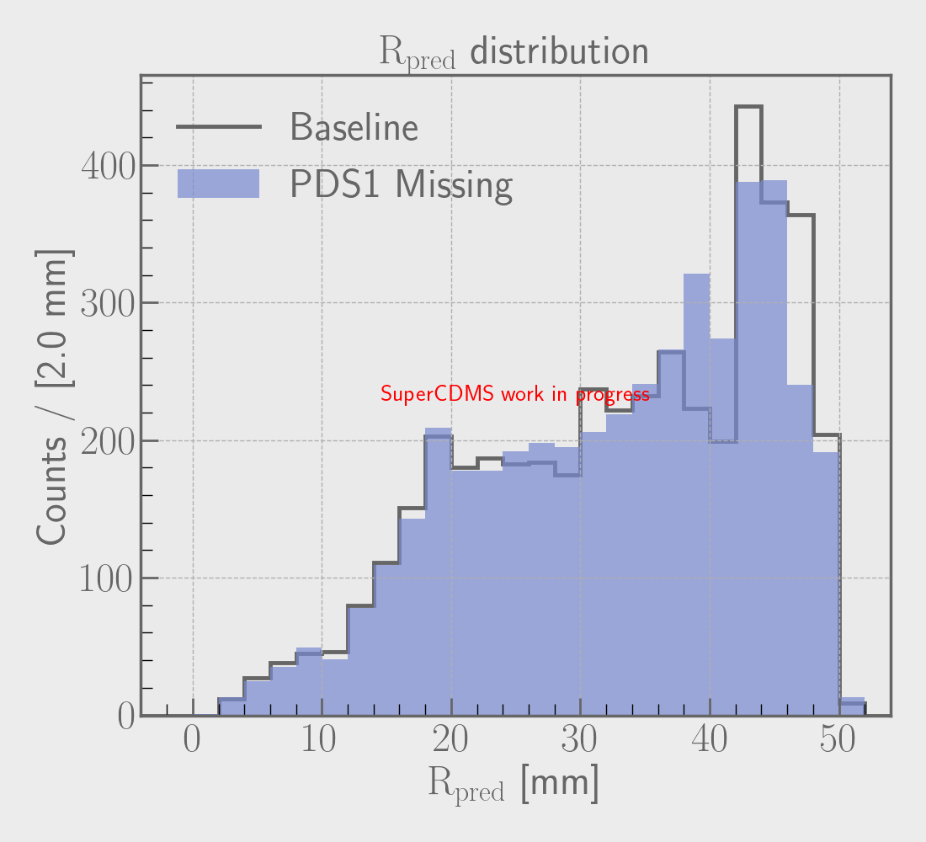
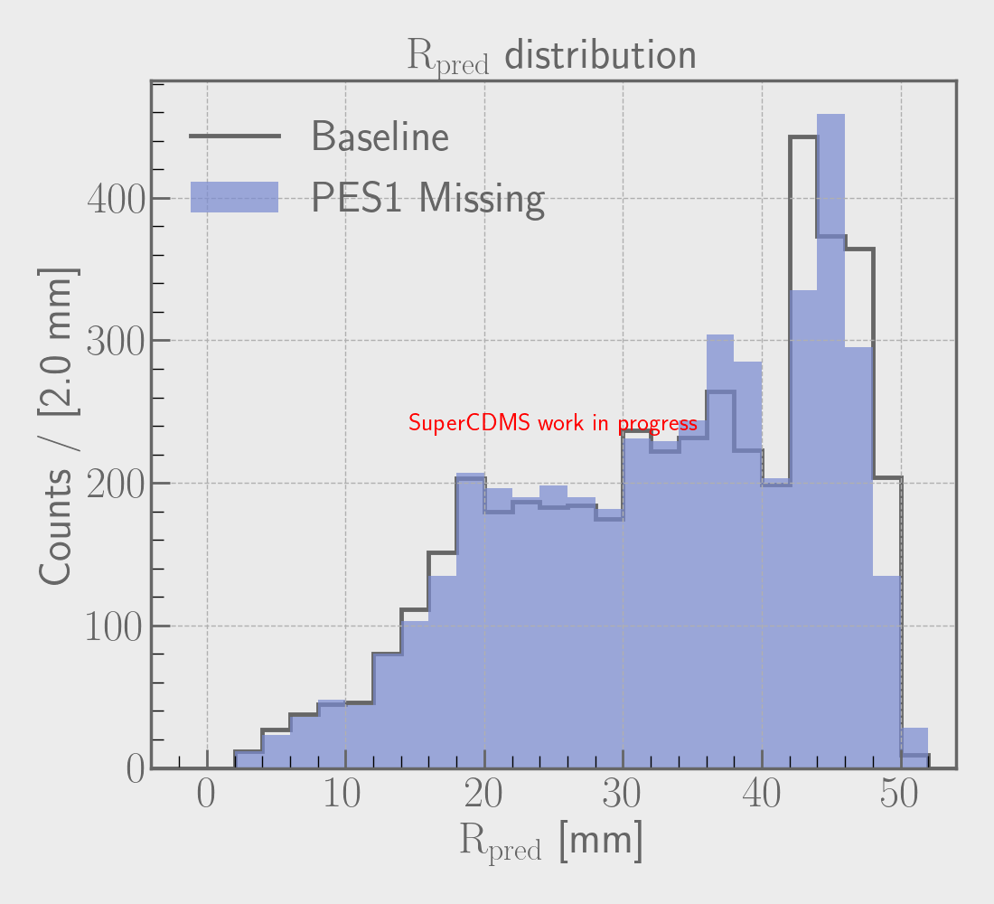




Figures 11 (a)-(f)

Slide 21
Energy prediction
Let’s try to recover the energy of an event recorded by a broken detector

Slide 22
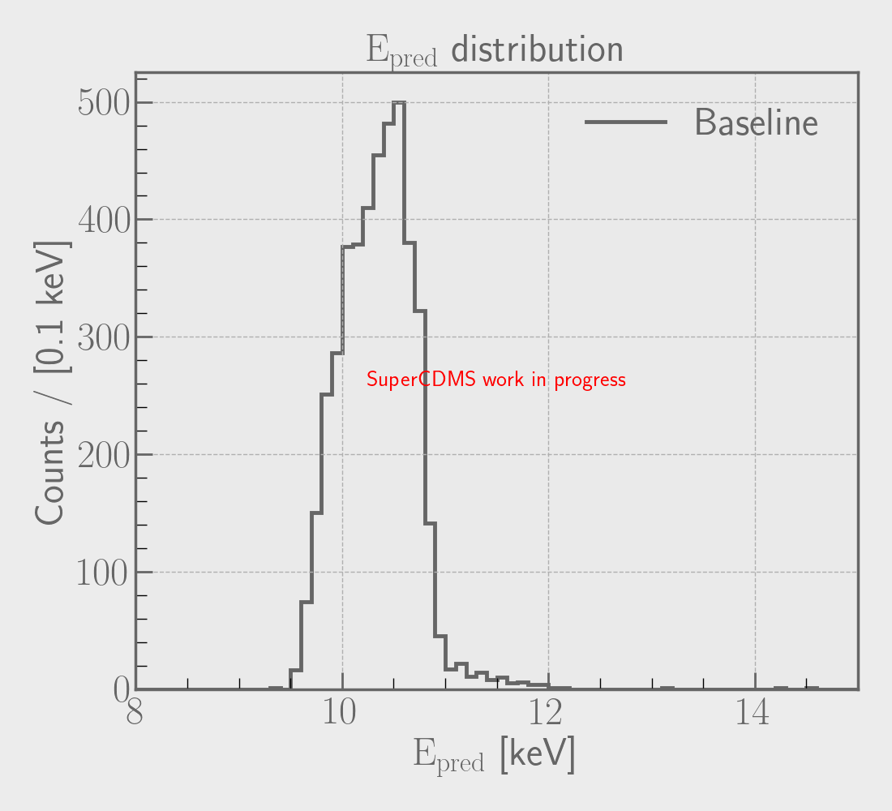
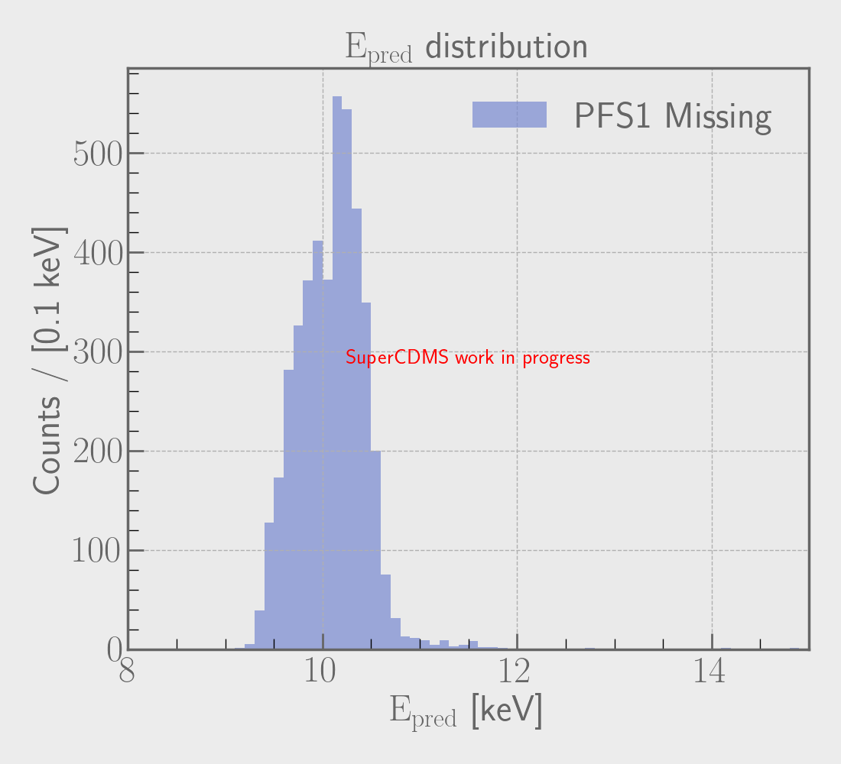
Baseline
F1 Missing
VS
Figure 12. Process of analysis. Energy prediction

Slide 23
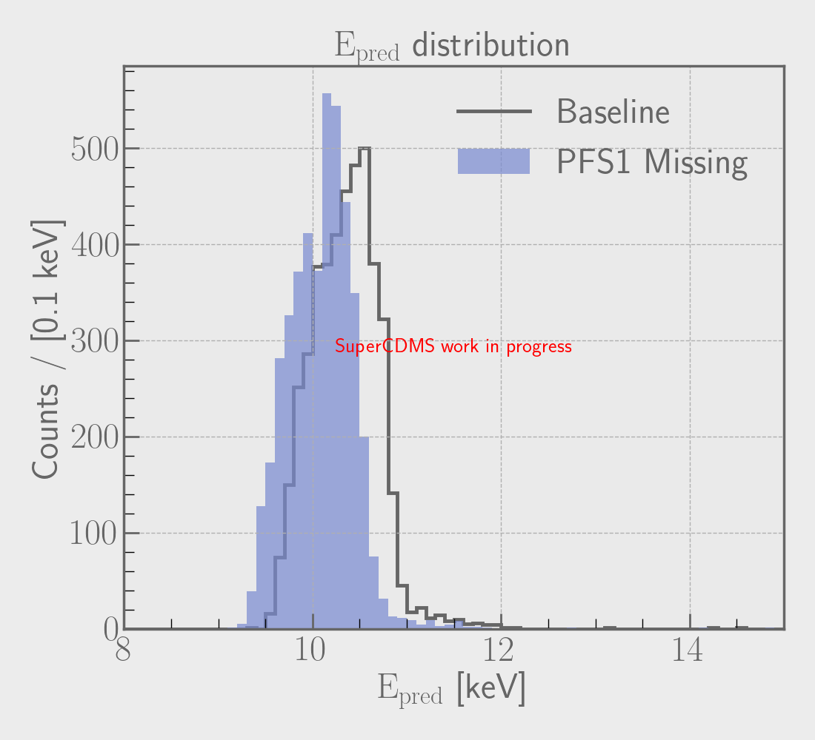
It’s shifted!
Figure 13. Comparing energy predictions

Slide 24
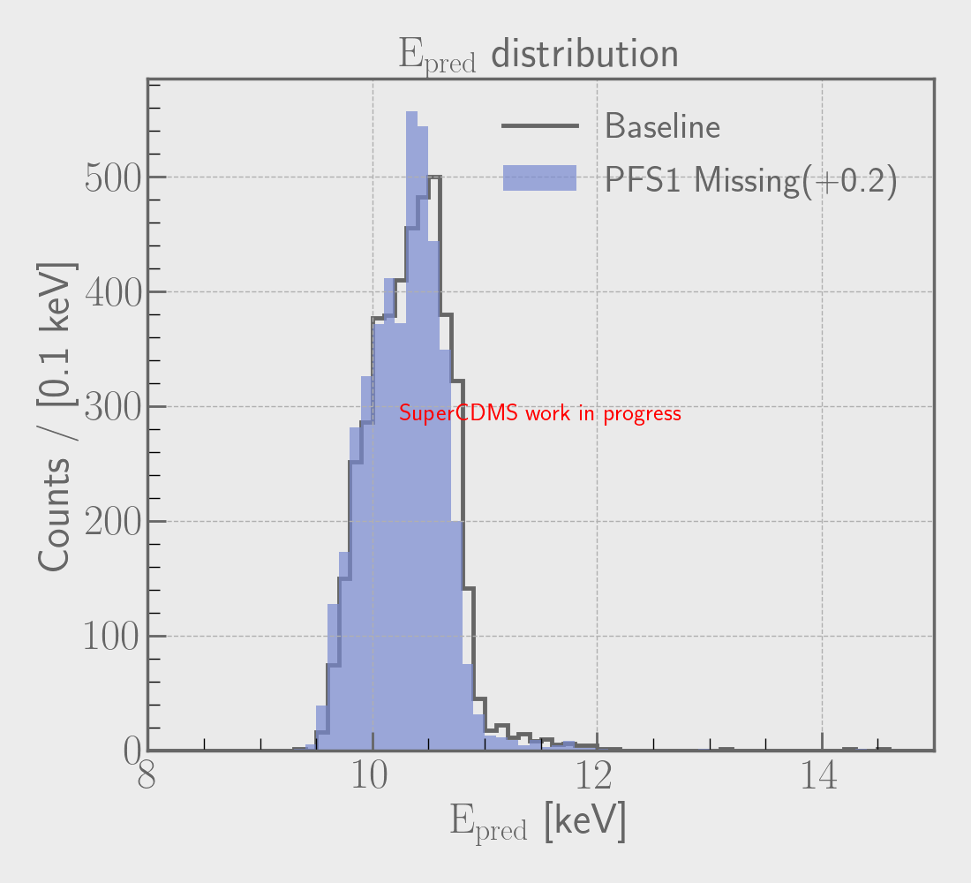
The peaks match
The widths match
The tails match
Figure 14. Comparing energy predictions. Offset

Slide 25
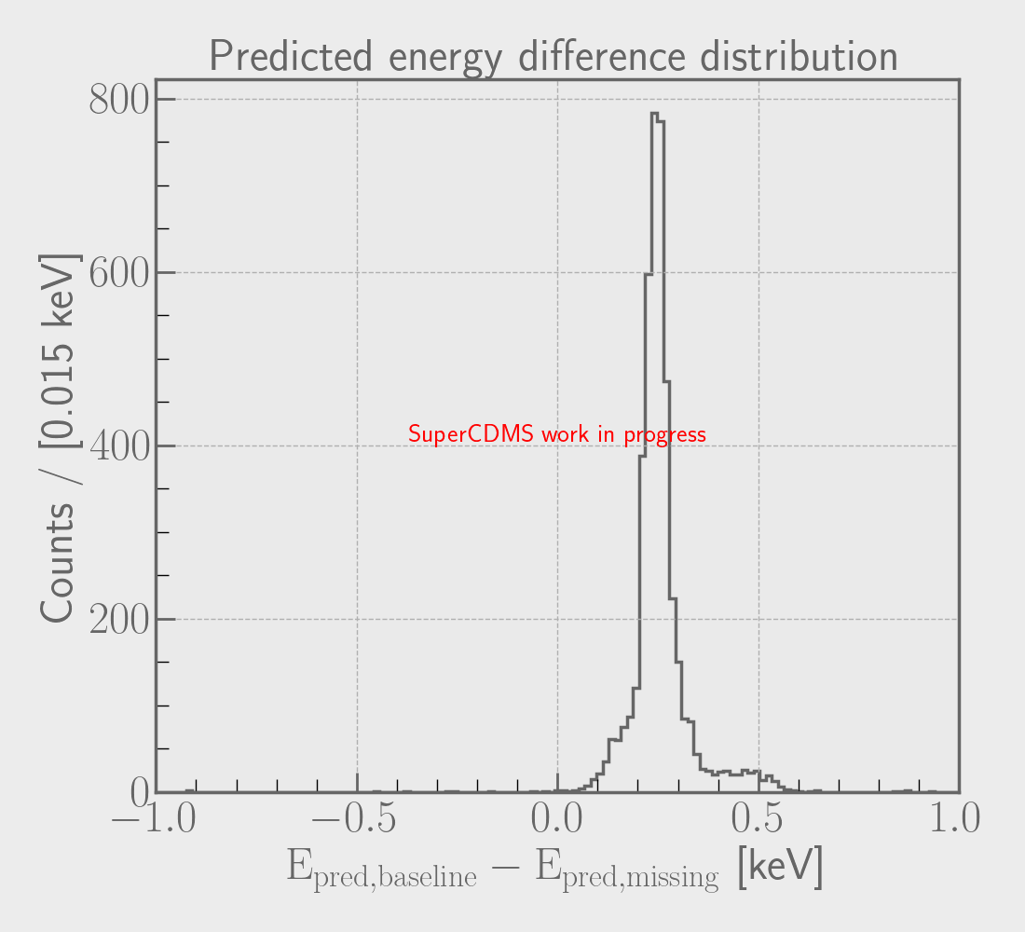
Figure 15. Energy difference distribution
Figure 13. Comparing energy predictions

Slide 26
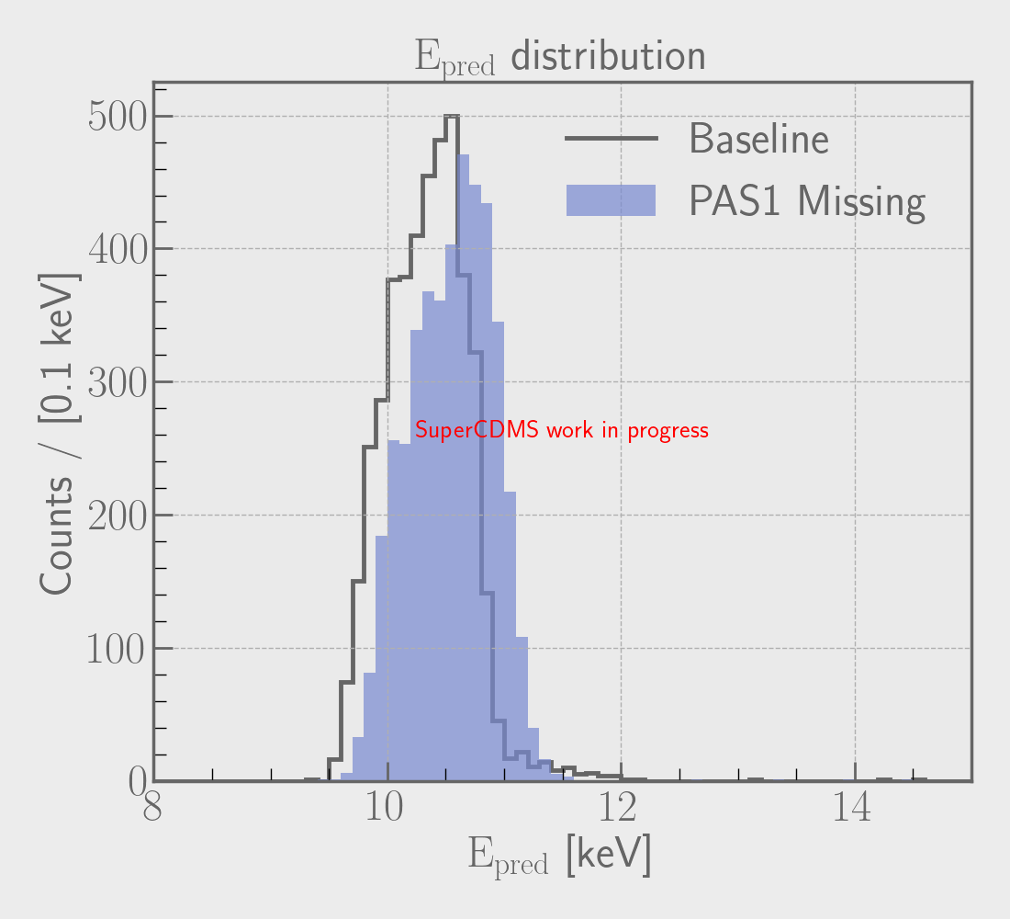
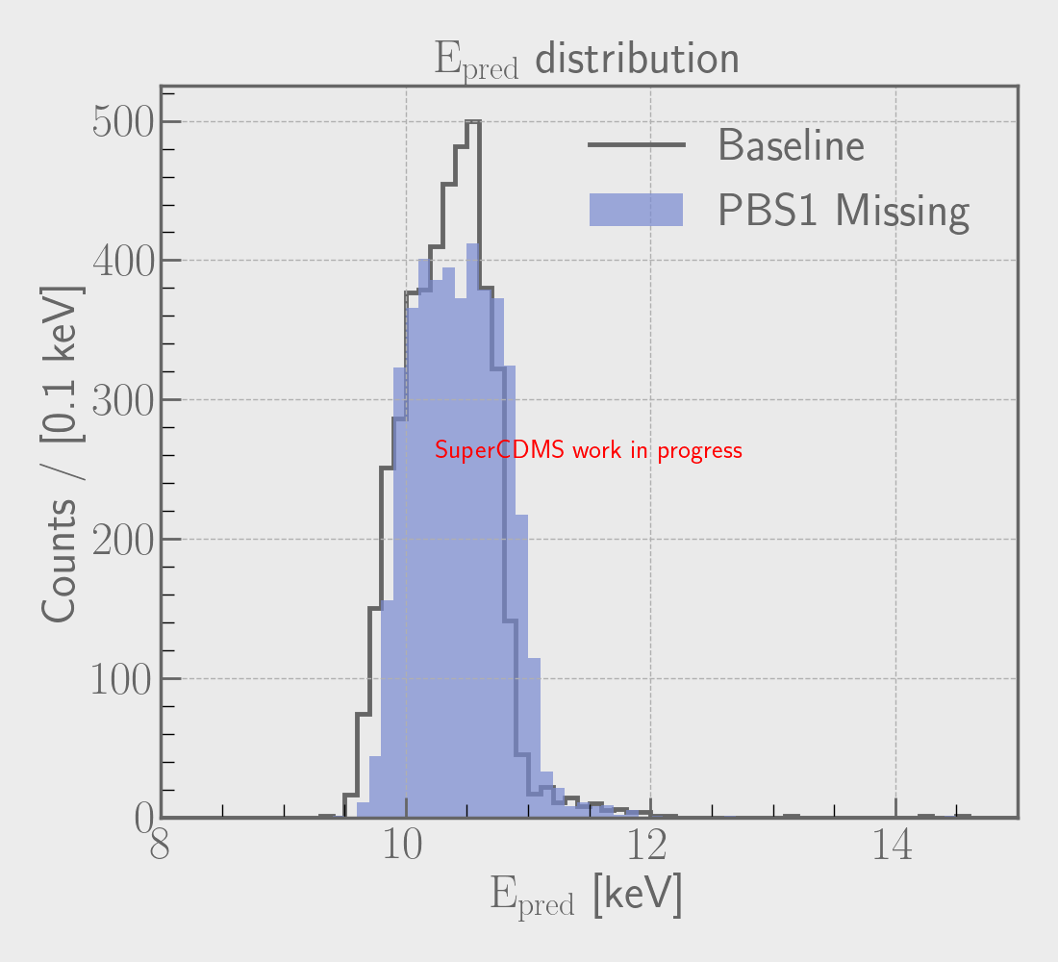
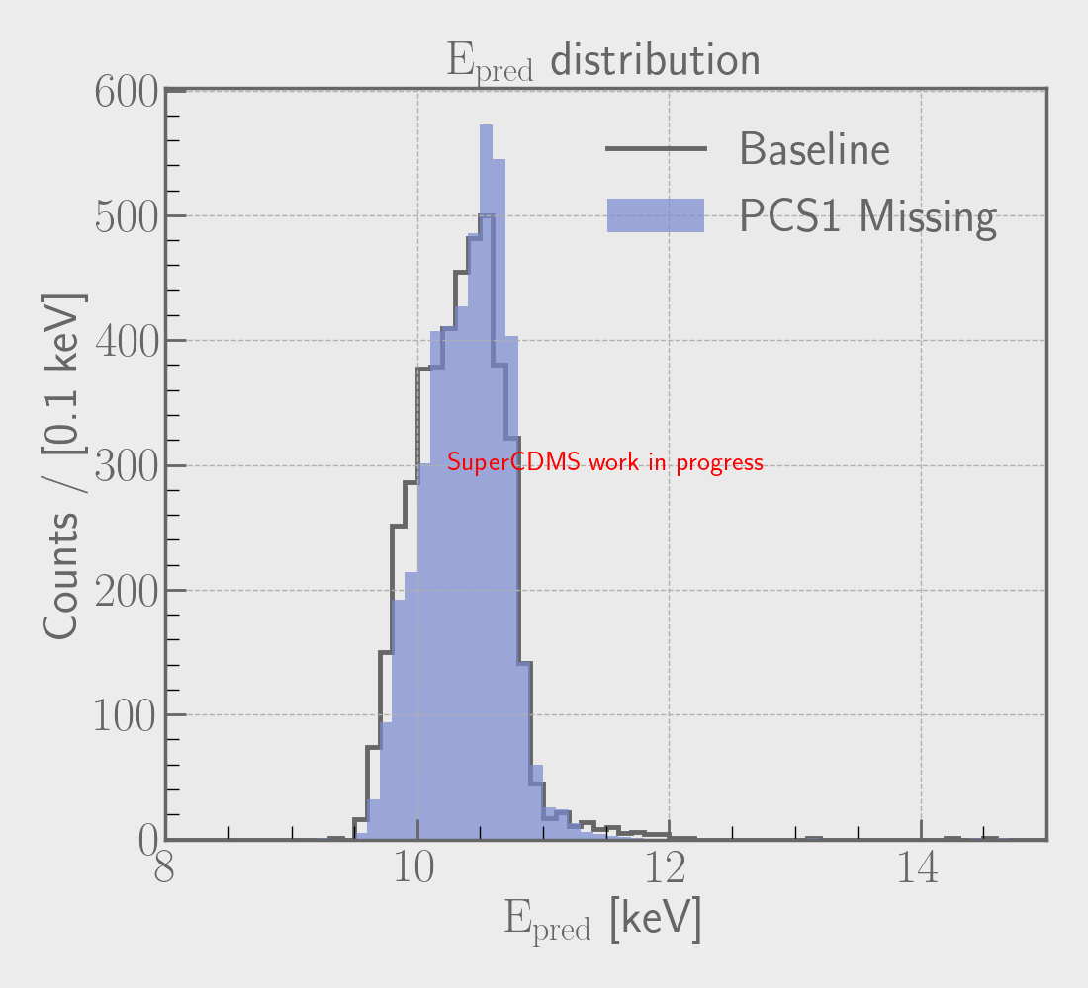
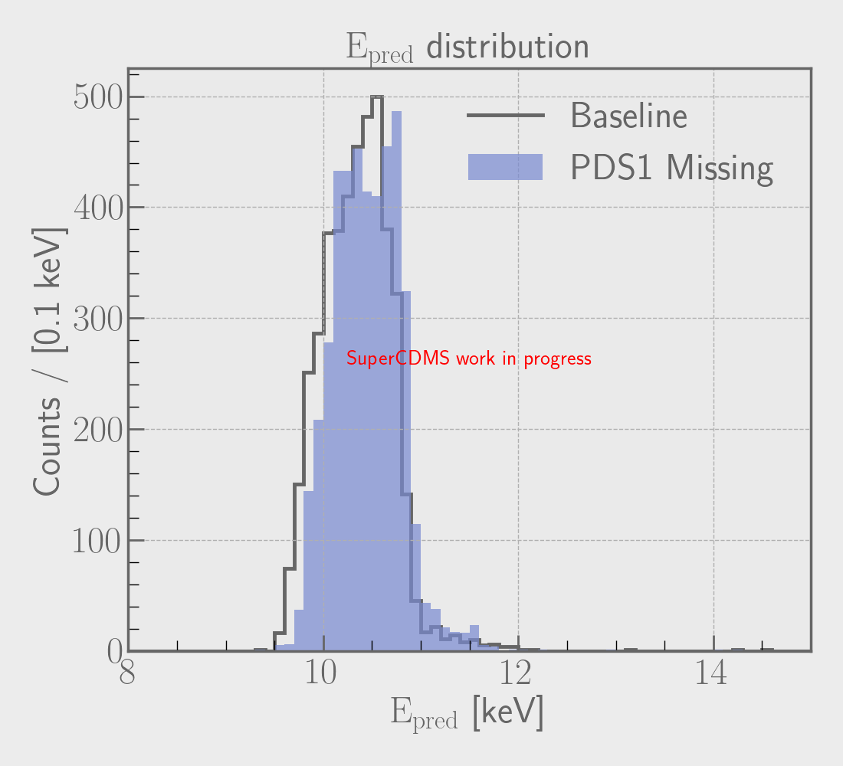






Figures 16 (a)-(f)

Slide 27


Conclusion
Acknowledgements
We present a method to recover information from dark matter detectors with broken sensors.
d
We successfully predict the radius to around the same quality as when the detector is fully working. The energy prediction behaves a bit differently.
Research Supervisor: Dr. Pekka Sinervo
Professor: Dr. Miriam Diamond
Post Doctoral Fellow: Dr. Madeleine Zurowski
Graduate Student: Warren Perry
We acknowledge the support of the Natural Sciences and Engineering Research Council of Canada (NSERC).
Nous remercions le Conseil de recherches en sciences naturelles et en génie du Canada (CRSNG) de son soutien.

Slide 28
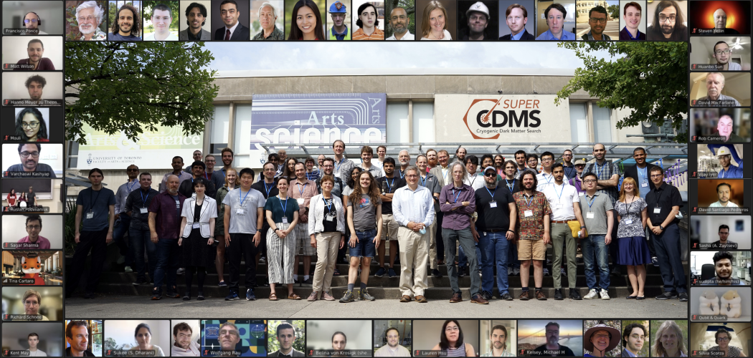

Slide 29
Conclusion
Acknowledgements
We present a method to recover information from dark matter detectors with broken sensors.
d
We successfully predict the radius to around the same quality as when the detector is fully working. The energy prediction behaves a bit differently.
Research Supervisor: Dr. Pekka Sinervo
Professor: Dr. Miriam Diamond
Post Doctoral Fellow: Dr. Madeleine Zurowski
Graduate Student: Warren Perry
We acknowledge the support of the Natural Sciences and Engineering Research Council of Canada (NSERC).
Nous remercions le Conseil de recherches en sciences naturelles et en génie du Canada (CRSNG) de son soutien.

Slide 30
Backup Slides

Slide 31
TES
When it heats up
We keep the TES here
Figure 17. TES resistance vs. temperature curve. Image courtesy of Madeleine Zurowski.

Slide 32
Model Architecture - HGBR
Hyperparameter | Value
Max iterations | 425
Max depth | 10
Learning rate | 0.25
n_iter_no_change | 25 (early stopping = True)
All else default

Slide 33
Model Architecture - NN
Hyperparameter | Value
Hidden layers | (256,256,128) (~100k params)
Activation | ReLU hidden, linear final
Loss | Relative MSE
Learning rate | 3e-4
Epochs | 250
Validation split | 0.1
Batch size | 512
Optimizer | Adam

Slide 34
Position and Energy
Amp
Detector Monte Carlo
ML
Figure 4b. Detector Monte Carlo simulations. Training

Slide 35


True Position and Energy
Error
Pred Position and Energy
Amp
Detector Monte Carlo
ML
Figure 4b. Detector Monte Carlo simulations. Training

Slide 36
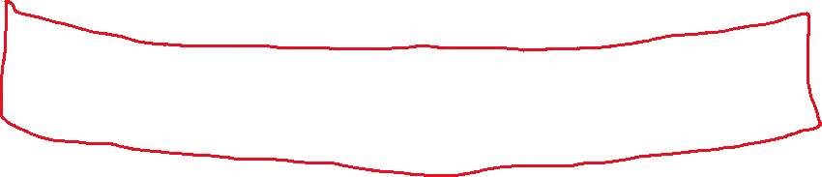

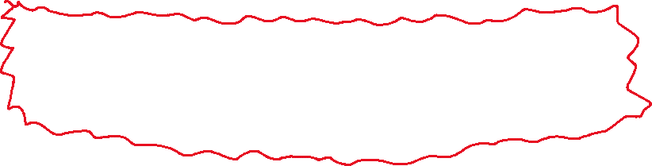
More background
Fiducial volume
Less background
Figure 4b. Fiducial volume

Slide 37
Electron recoil
Figure 4c. Electron recoil

