Slide 1


SECURE. CONTAIN. PROTECT.
Infrastructure Anomalies at SNOLAB
Qusai Almasri
IT Student
12/08/2026

Slide 2
Core Skills
Linux & Bash workflows
An actual brain (negotiable at times)
Service orchestration
Debugging production systems
Data migration & Infrastructure setup
Why I was hired

Slide 3
Overview
Bored so leaving this here
Tickets of Doom
  Server Script Management
(S) How an IT Auditor/Seeker works (Mr. “Anomaly Detector”)
(C) Mitigating Anomalies
(P) VM-Host Cyber Security Project

Slide 4


Tickets of Doom
Categorizations of Anomalies: Straight Chilling – Doesn’t Seem Right – Get the Big Shots – Uh Oh
Case 1 – DarkSide DocDB
Case 2 – The Accursed OneDrive
This one explains itself.
All the hate to Bill Gates
Problem: Research website returned 502 Bad Gateway.
Analysis: Docker containers had restarted; the application received a new internal IP, but nginx was still forwarding to the old one.
Solution: Corrected the nginx upstream address and restored the service.
Found me again

Slide 5
Server Script Management (Closest to programming)
Case 3: Shift Report Automation
Case 4: Server SSL Renewal
Problem: After a VM crash, automated shift-report jobs stopped producing the expected results.
Analysis: Check Cron, Apache, Postfix.
  Scheduled scripts and logs.
Solution: Verify complete workflow, not just whether a script returned 0, then document schedules and dependencies.
Problem: Several SSL certificates expired on VM Cluster were not renewing correctly.
Analysis: Identified the affected certificates and services requiring renewal.
Solution
Renewed, restarted, and verified the new certificates were active.

Slide 6

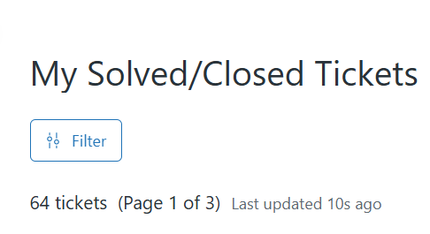
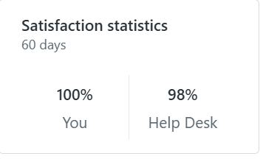
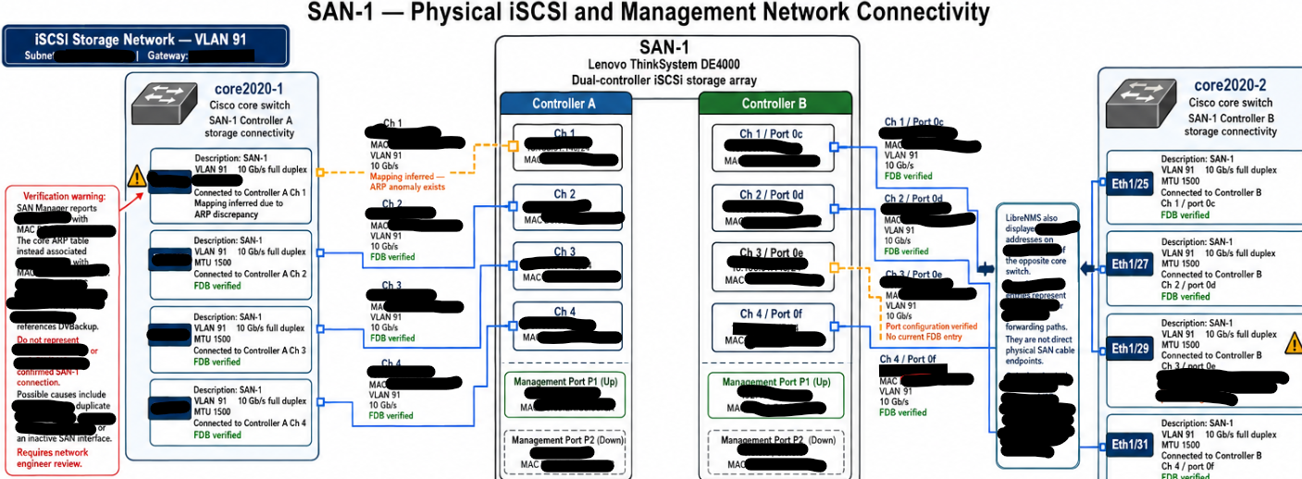









Why are you still looking? Everything is redacted lil bro

Slide 7



(S) How an IT Seeker Works
Many VMs and manual checking to be done cannot be scaled (via correct configuration).
What to Seek:
  services;
  ports;
  users/admins;
  software and patches;
  firewall state;
  certificates;
  authentication and event logs.
What actually happens:
  Misery (Not really)
  Lots of lines to read that cannot be given to ChatGPT (Privacy & Confidentiality Clause)
  Debugging/Documenting is where all attention is usually at (Occasional line skipping can happen)
Compare systems against an expected baseline and flag meaningful differences for investigation.

Slide 8
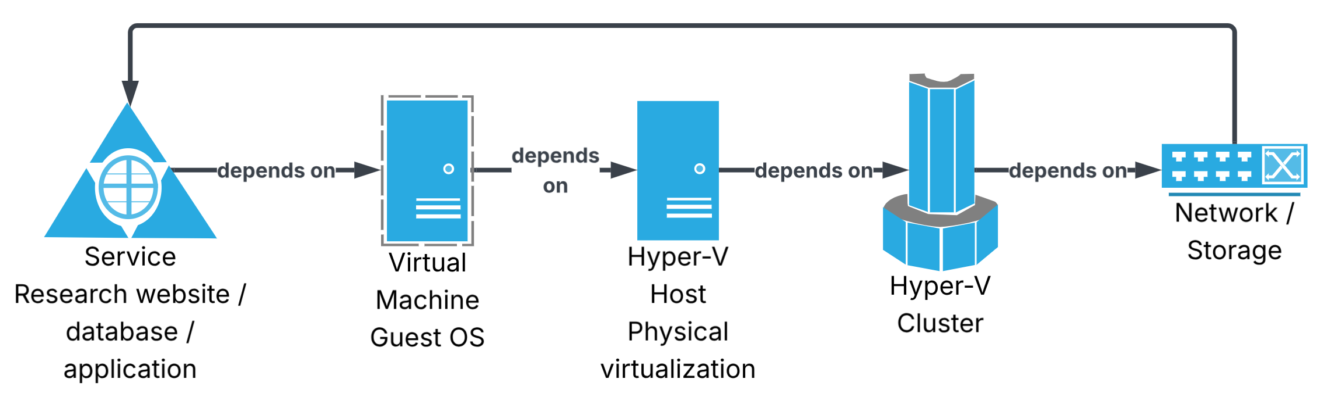
(C) – Contain: VM Host Migration
Problem: Existing virtual workloads needed to be migrated onto the newly configured Hyper-V cluster without breaking the research services running on them.
Analysis: Moving a VM isn't just moving a file. Must understand the dependency chain:
Solution: Migrate workloads in a controlled way, verify services after moving them, and understand dependencies before changing the infrastructure underneath them.

Slide 9
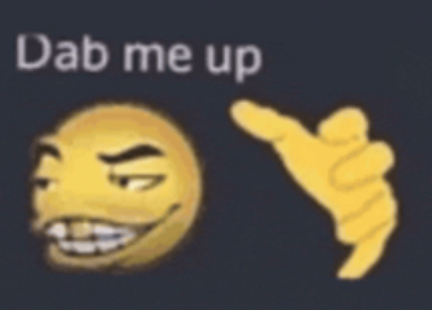
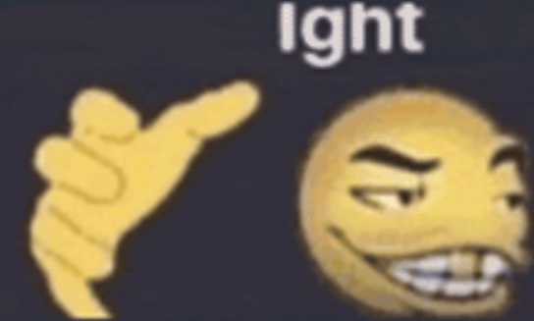
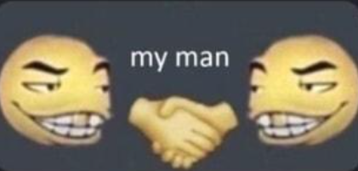
Prerequisite: How does a Syn-Ack Handshake work?
Client sends SYN to start a TCP connection
Server replies SYN-ACK to acknowledge and synchronize
Client sends ACK back, completing the three-way handshake and establishing the connection.

Slide 10
(P) – Protect: The Ballad of VM Crashes
Imagine this: Misconfiguration of a host is larger in impact than one individual VM.
On July 14th 2026, we had the system migrated and (with thoughts and prayers) configured to some degree.
Now Imagine This
Both.Hosts.Crashed.
And the results came as a harsh ordeal for us…

Slide 11
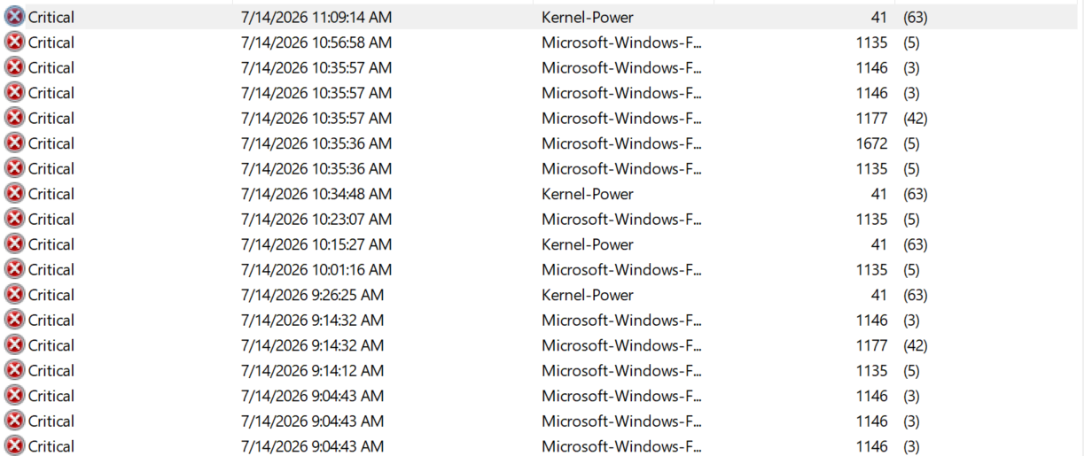

Slide 12

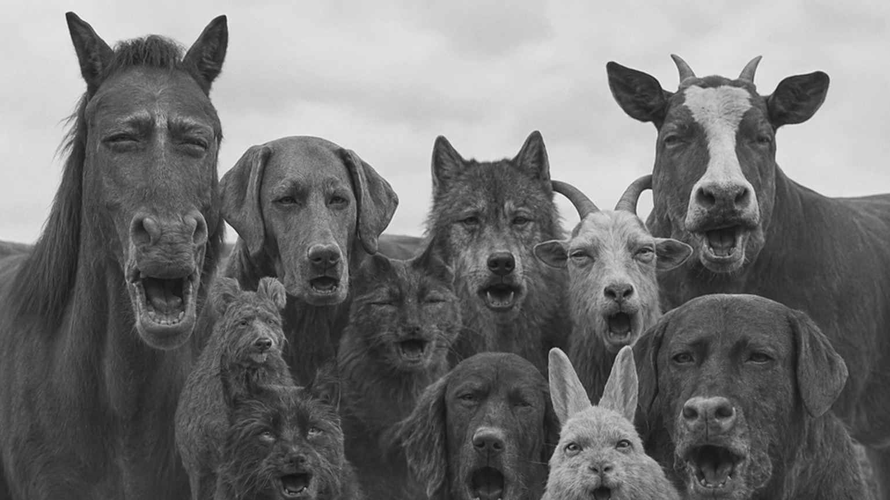
Notes:
https://tenor.com/view/animals-what-gif-380703429183677770

Slide 13
(P) – Protect: The Ballad of VM Crashes Part 2
Problem: Hyper-V hosts sit underneath numerous virtual services, so compromising or misconfiguring a host has a much larger impact than compromising one individual VM.
Analysis: Use what you learned from the migration to examine the host from several security angles:
  What services and ports are exposed?
  Who has administrative access?
  Are systems patched?
  Are firewall and authentication settings appropriate?
  Is management traffic properly separated?
  Are logs sufficient to understand an incident?
  Can abnormal configurations be detected automatically?
You seriously reading all this? Focus!

Slide 14
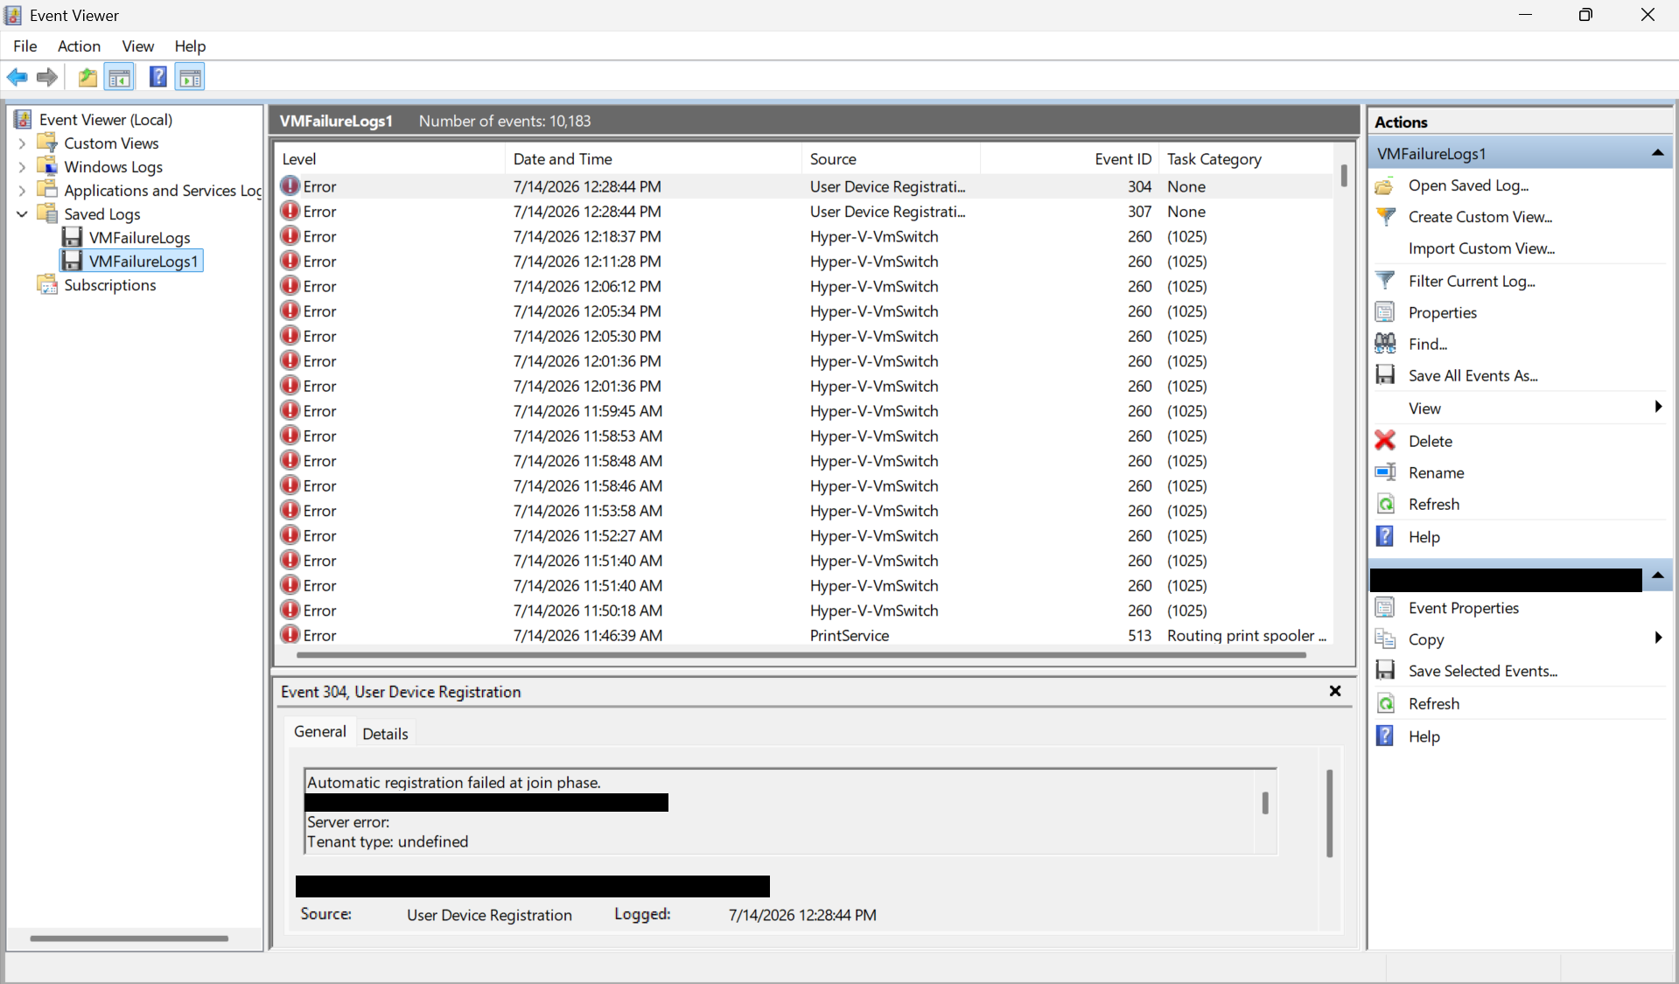
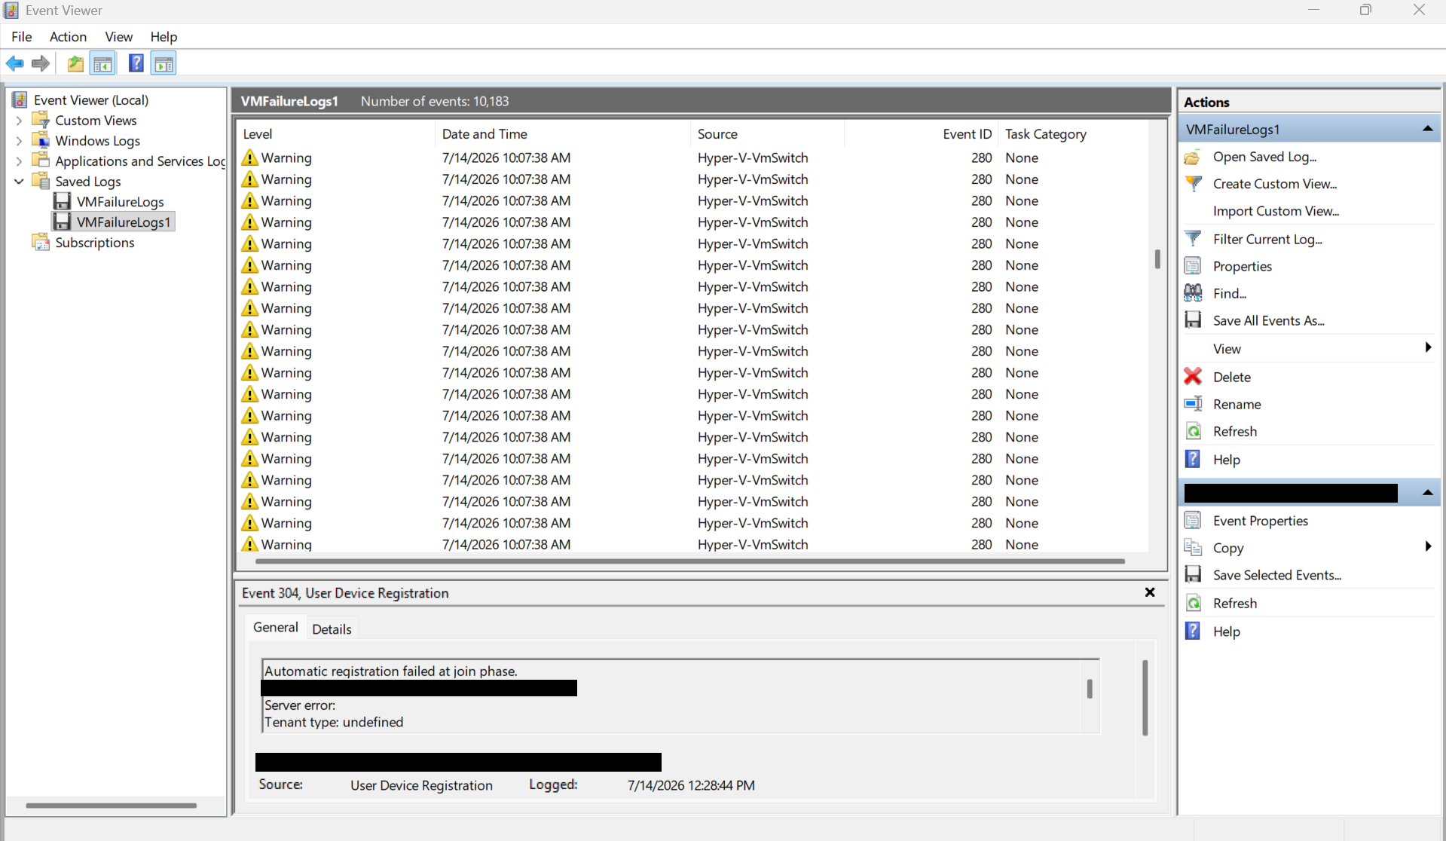
Solution After Examination
Each controller was mapped to a respective host (ex. Host – 1 Connected to Controller A)

Slide 15
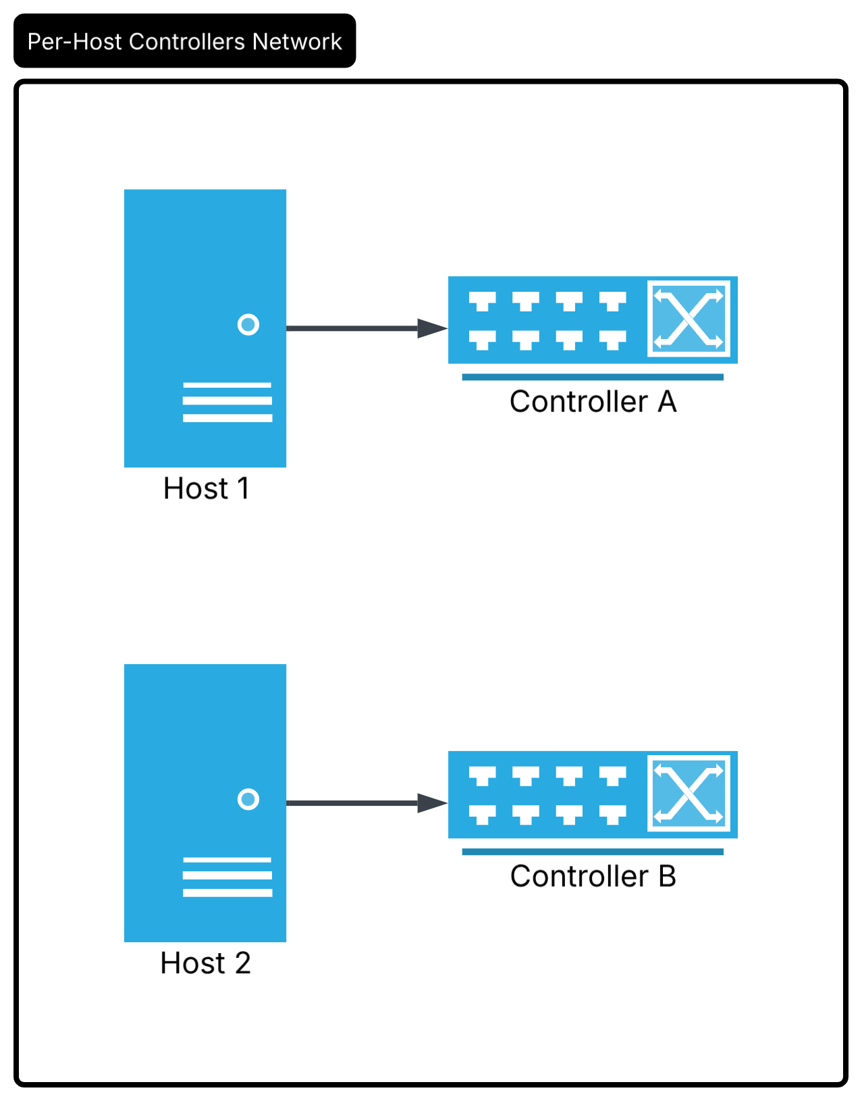
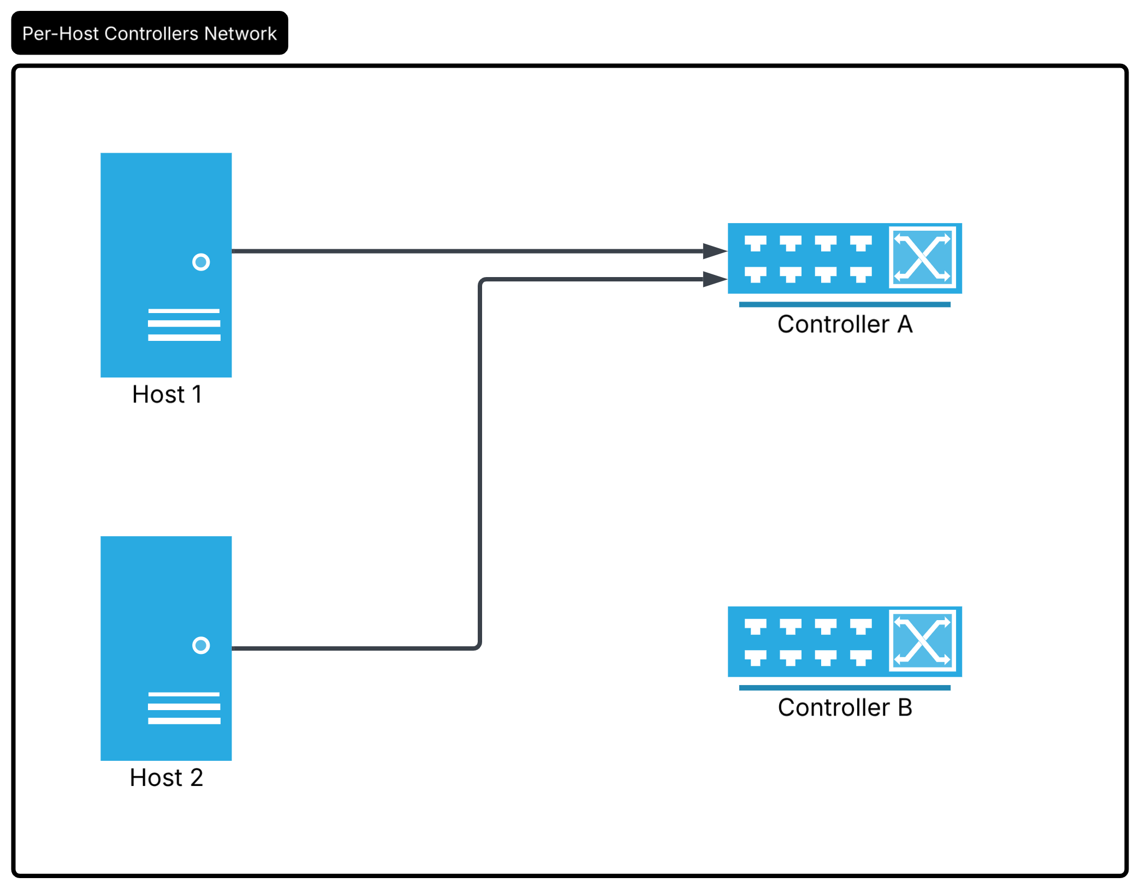
*Dies off
Hello?

Slide 16
IT Appreciation
Kipp Grose
James Hawkins
Peter Luczak
Krina Patel
Diane Lessard
Ahmed AbdelDayem (Mac Fan Boy)

Slide 17
Questions?
He's Lying

