Slide 1



Searching for Galaxies Without Stars: HI Follow-up of FASHI Dark Galaxy Candidates
Supervisor: Kristine Spekkens
Qwin Goodwin
CASST 2026
Notes:
Group and supervisor/CASST 2026

Slide 2
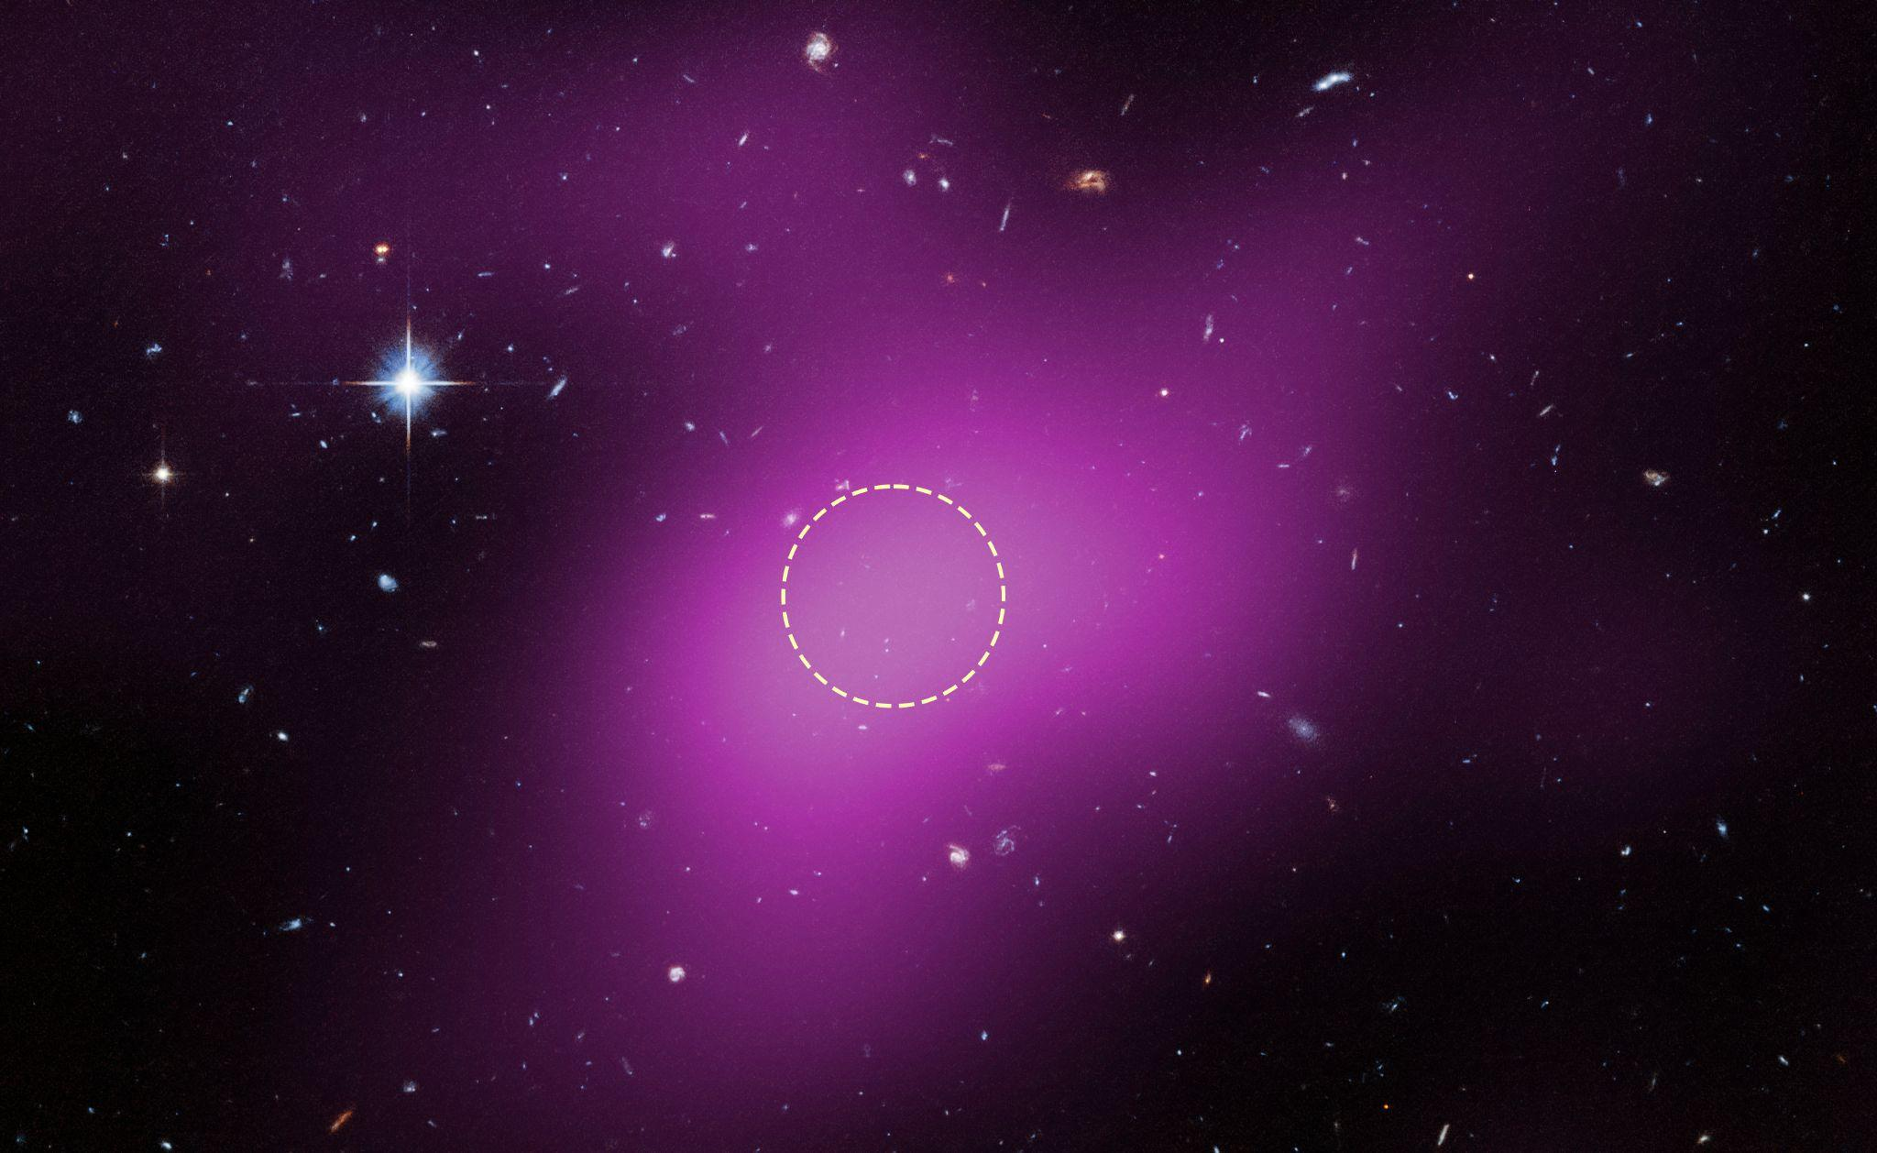
Dark Galaxies
Photo Credit: European Space Agency
Dark galaxies are large isolated clouds of atomic hydrogen (HI) and dark matter, with no optical counterpart.
According to the Lambda CDM paradigm, a galaxy’s stellar mass scales with that of its halo.
Below a critical halo mass, star formation no longer occurs.
Photo of Cloud-9, currently our best dark galaxy candidate
Notes:
Source photo

Slide 3
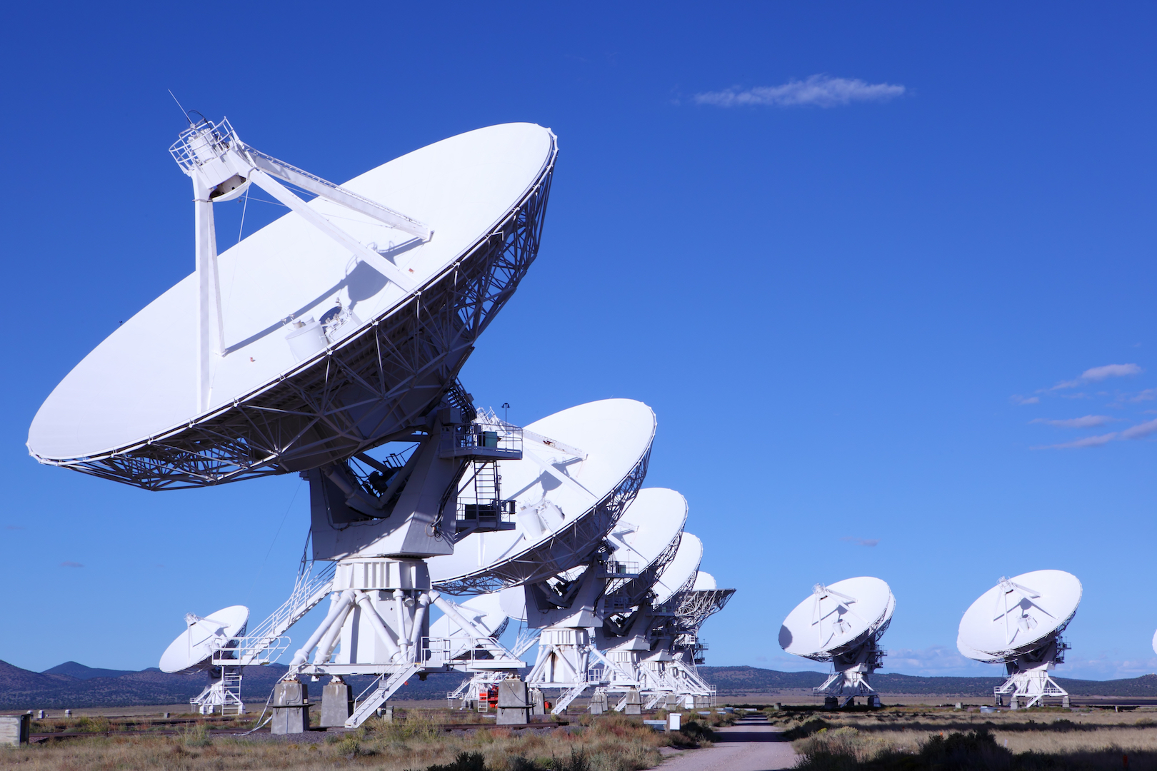
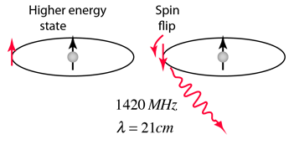
The 21 cm HI Spectral Line
Photo Credit: Space.com
The 21 cm radio wave is emitted when an electron in HI spontaneously flips its spin.
When the proton and electron have the same spin, the system is in a high energy state.
For one atom, it takes roughly 10 million years for the spin flip to occur.
Photo Credit: HyperPhysics

Slide 4
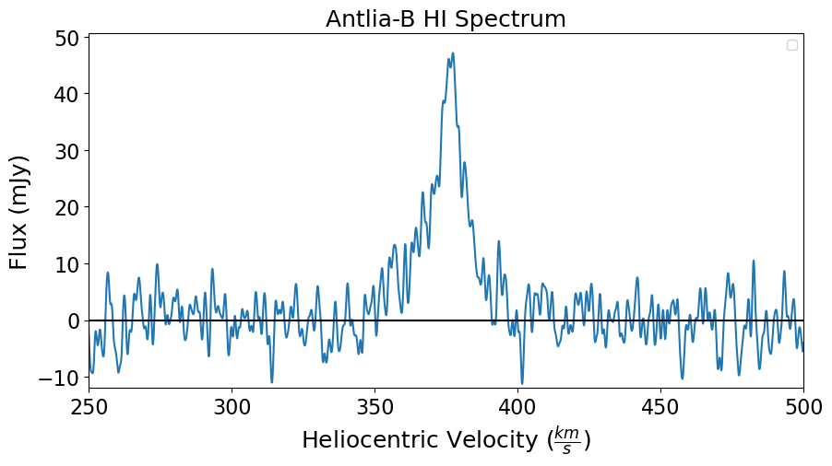
High-Quality Spectrum

Slide 5
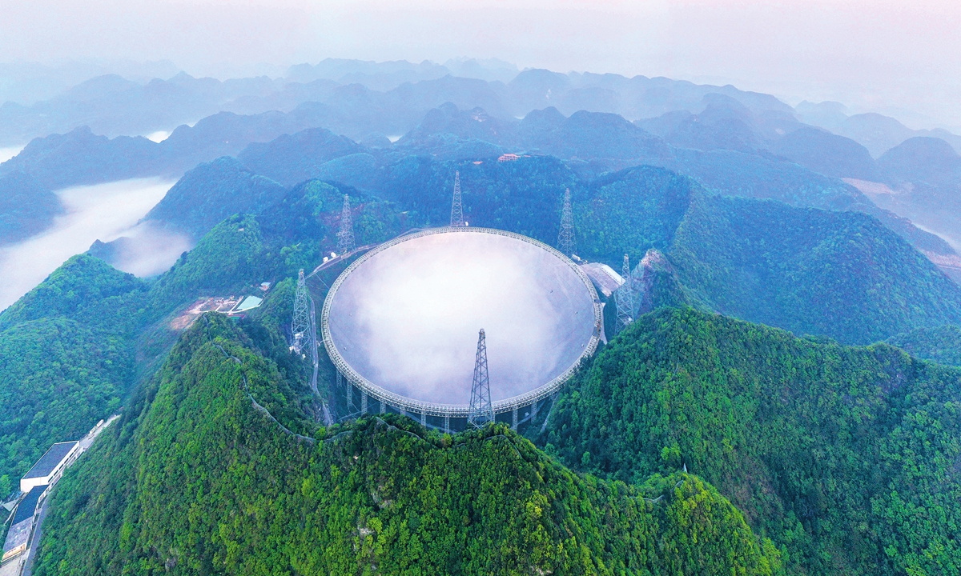
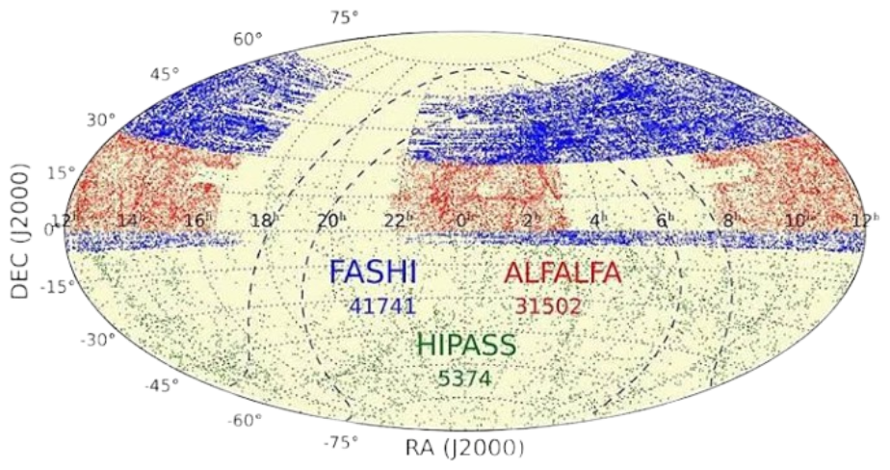
FAST and FASHI
Photo Credit: Global Times
Five-hundred meter Aperture Spherical radio Telescope (FAST) is the largest single dish radio telescope.
FAST has a diameter of 500 meters; it is located in Guizhou, China.
The FAST All-Sky HI survey (FASHI) is a drift scan survey.
The first data release of FASHI contains nearly 42,000 galaxies.
Photo Credit: Zhang et al. 2026

Slide 6
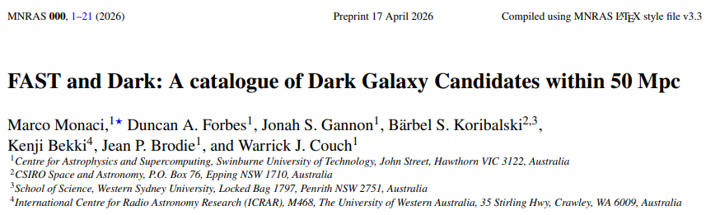
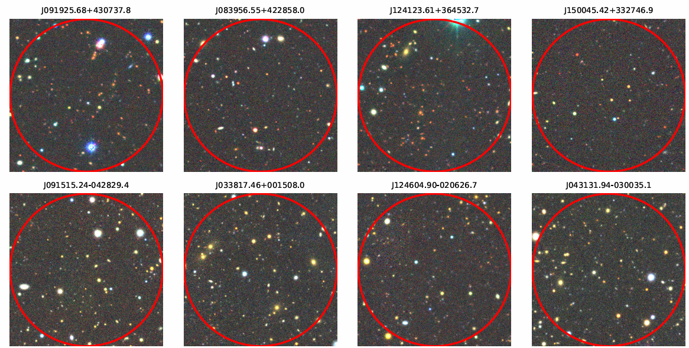
The 70 Dark Galaxy Candidates
Photo Credit: Monaci et al. 2026

Slide 7
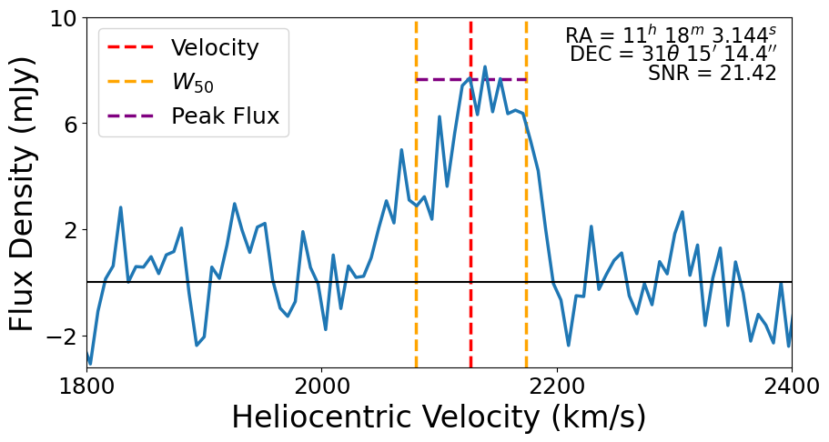
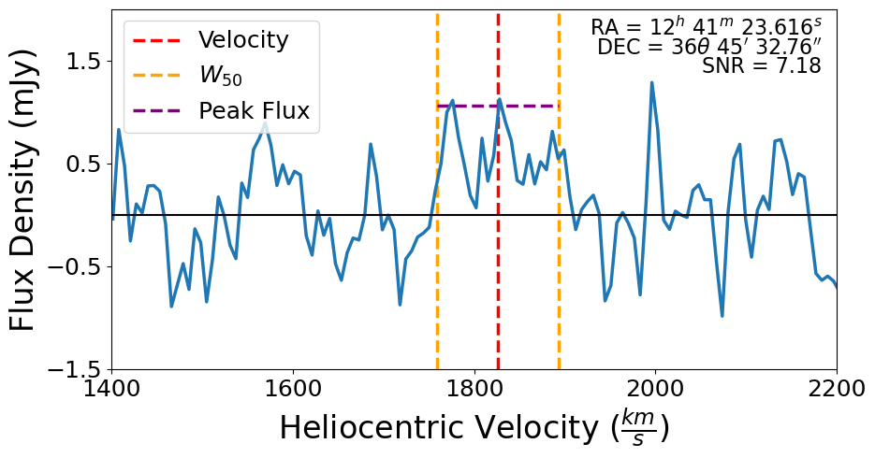
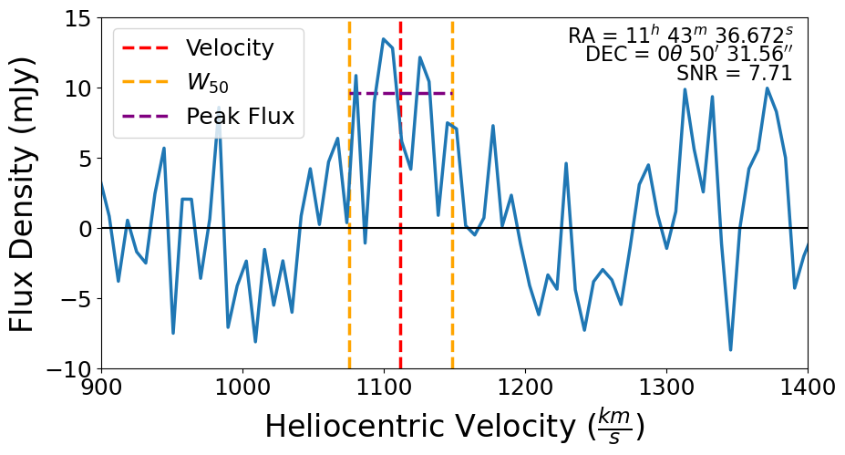
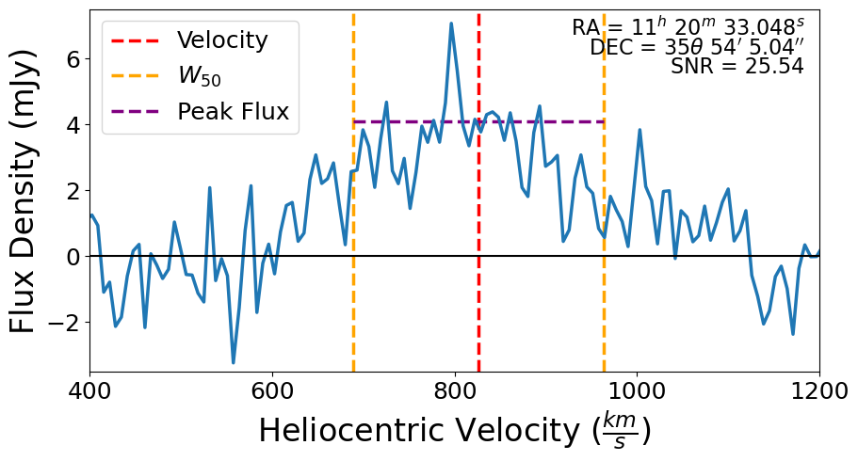
Sample Dark Galaxy Candidate Spectra

Slide 8
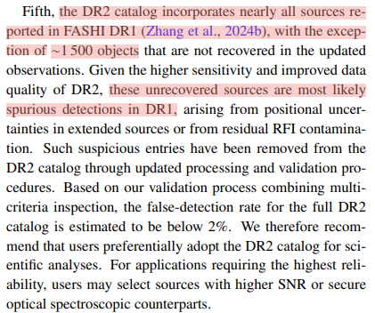
FASHI’s Second Data Release
Photo Credit: Zhang et al. 2026
In early July, FASHI came out with DR2, claiming to have observed over 150,000 galaxies.
After cross checking, we found that 60 of the 70 dark candidates were not in DR2, indicating they were spurious.
This left us with 10 galaxies in our catalogue.
Notes:
Add angry meme/define spurious

Slide 9
Sample Spectra After Cuts

Slide 10


Slide 11
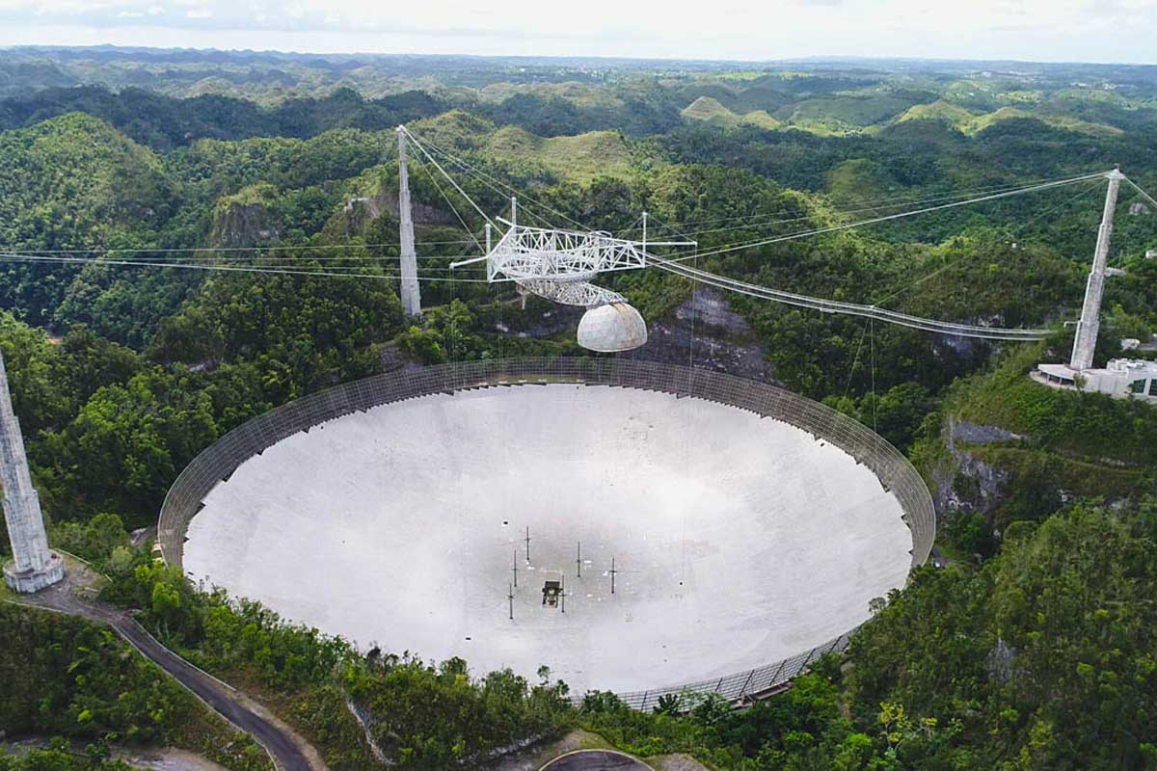
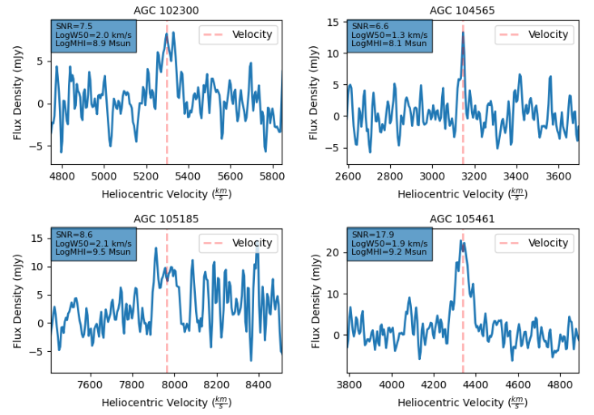
The ALFALFA Catalogue
Photo Credit: Universe Today
In concept, the ALFALFA survey is almost identical to FASHI.
Using the Arecibo telescope, the ALFALFA survey contains over 31,000 galaxies.
One group of researchers identified over 100 dark galaxy candidates from ALFALFA.
After checking for optical counterparts and cross-checking with FASHI DR2, there were 73 galaxies we wanted to follow up.

Slide 12
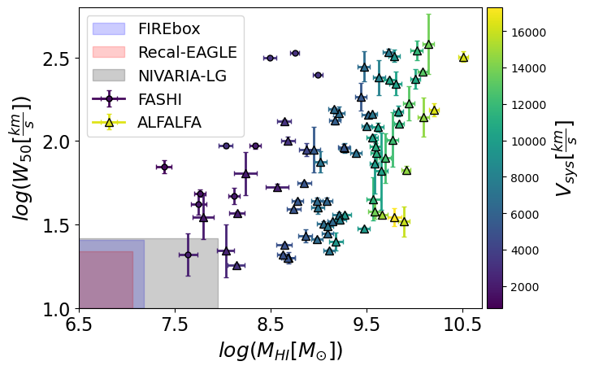
Comparing Dark Candidates to Theory

Slide 13
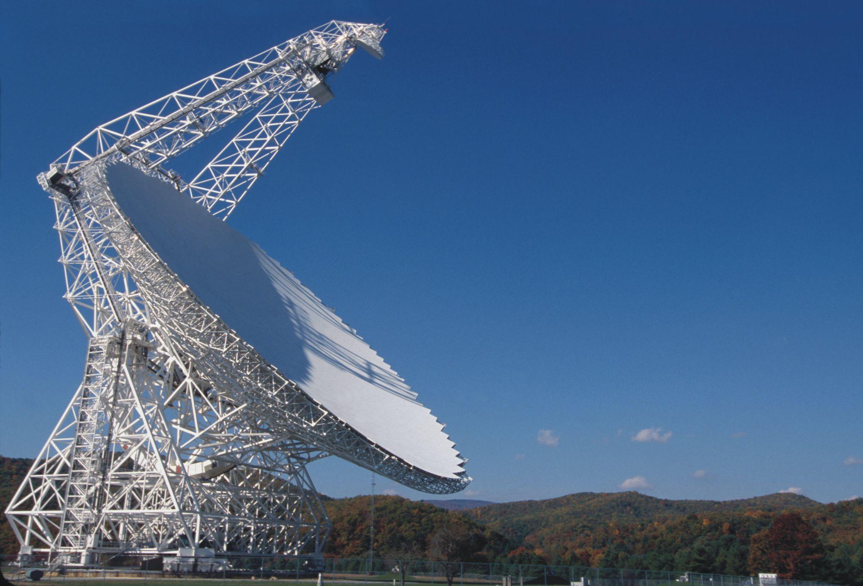
Green Bank Telescope Proposal
Photo Credit: NRAO
We plan to follow-up using the Green Bank Telescope (GBT).
This is a 100 meter diameter radio telescope in Green Bank, West Virginia.
The GBT would focus on one galaxy at a time, yielding a much higher spectral resolution.
This decrease in noise would let us know whether or not there is a galaxy.

Slide 14

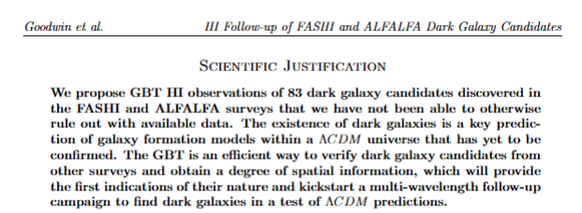
Conclusion
We successfully submitted a proposal to the GBT to follow up the 73 ALFALFA and 10 FASHI dark galaxy candidates.
If these galaxies prove to be dark galaxies, it would redefine the way we understand galaxy formation and evolution.
We hope to hear back about our proposal sometime in the fall.
I am more than happy to take questions!

Slide 15
Thank You!

