Slide 1
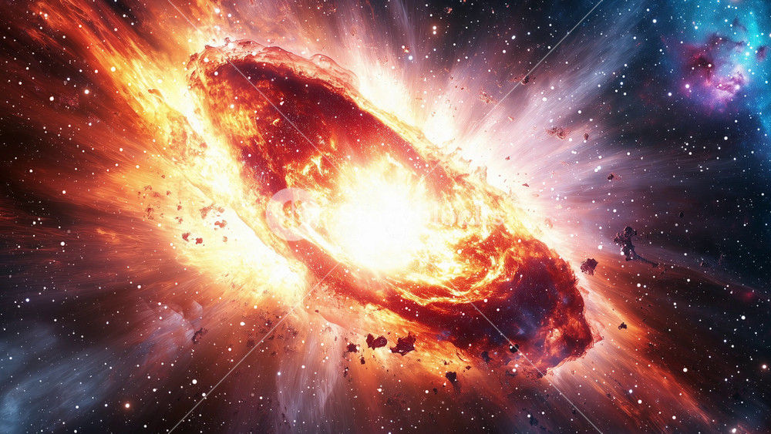
Seeing Seismicity Through a Supernova Detector
Katie Fosten – Research Assistant with SNOLAB
Thank you, Steve Sekula and Steffon Luoma.
1
Notes:
Intro you
Thank peeps
Intro topic + correlation

Slide 2
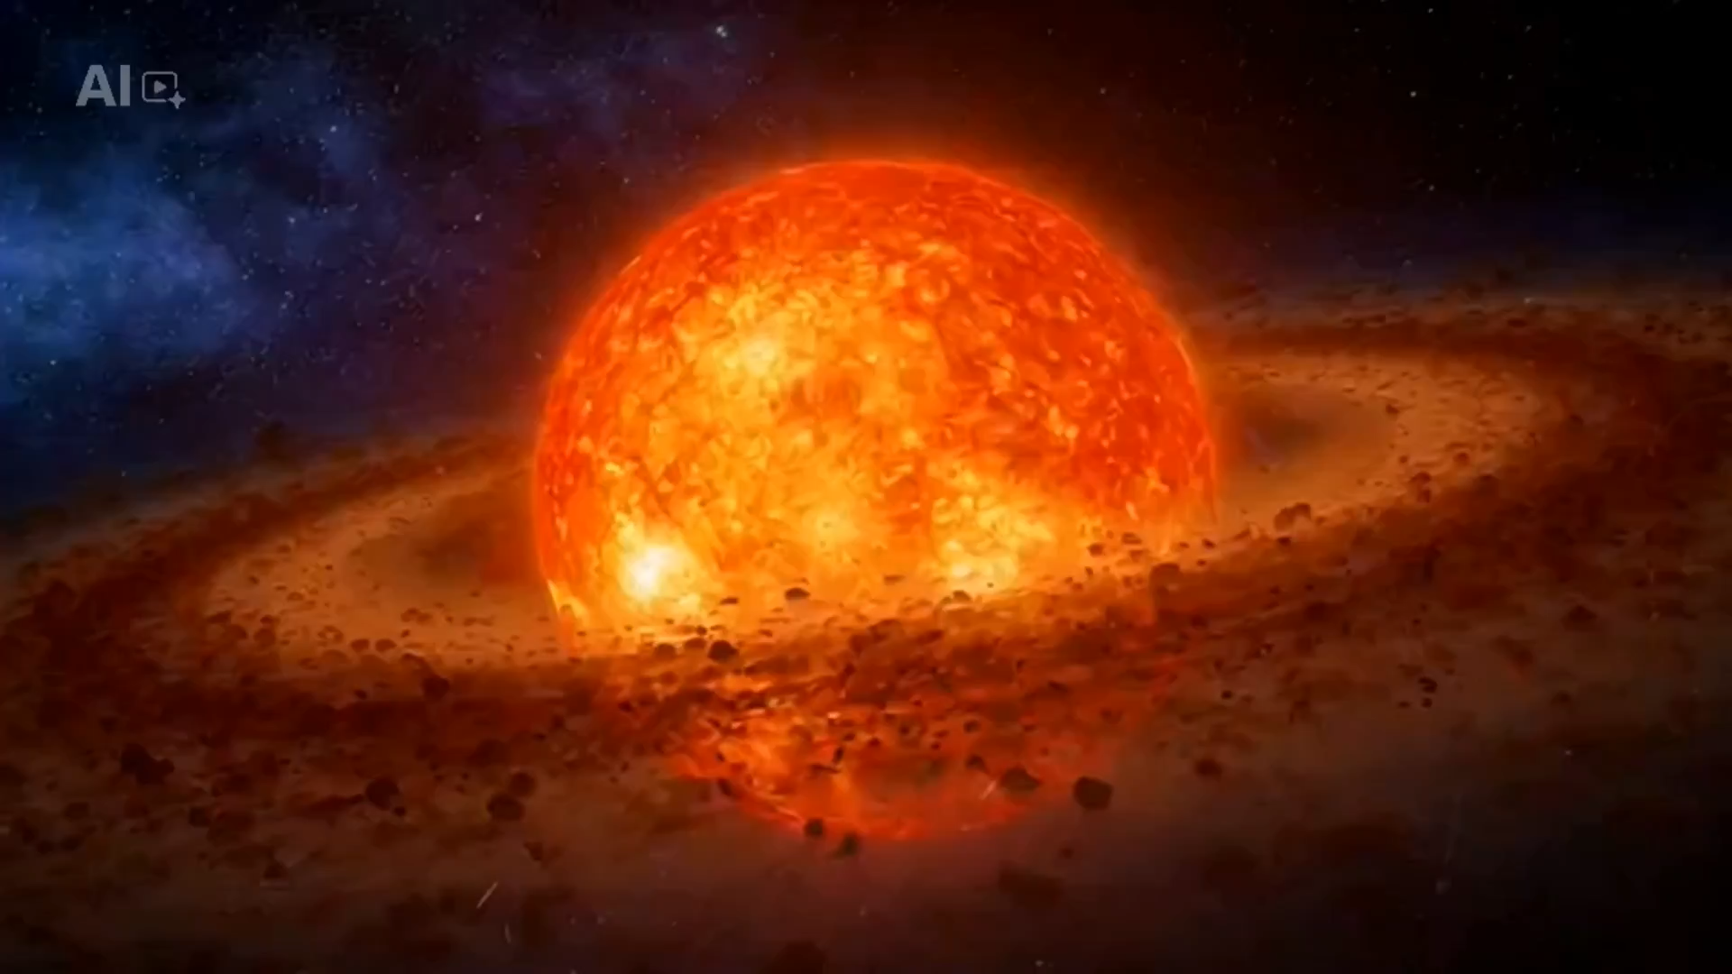
2

Slide 3
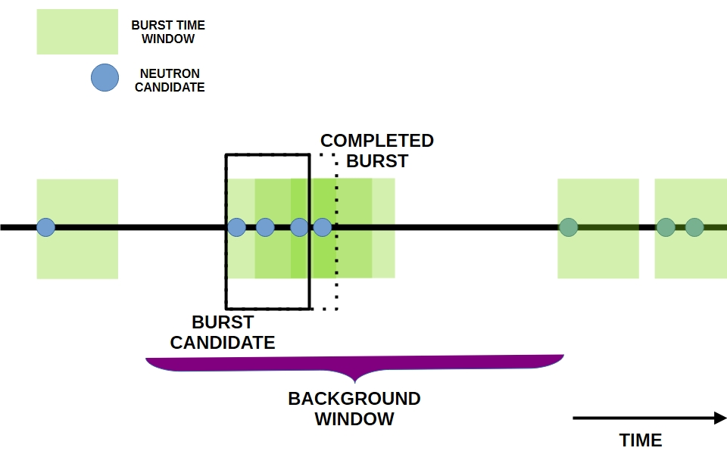
HALO (Helium and Lead Observatory)
Comprised of 79 tons of lead and 128 He-3 NCD
Key terms
  Ionization
  Event
  Neutron Candidate
  Burst
  Unknown Burst
3
Notes:
NCD neutron counting detector
When electrons are captured by the helium they ionize and create an electrical signal
When the electricity from an ionization is between 480-1600 ADC
When a neutron candidate appears
When three of more neutrons are found within a 2 second time frame
When a burst does not meet the criteria for any other type of burst

Slide 4
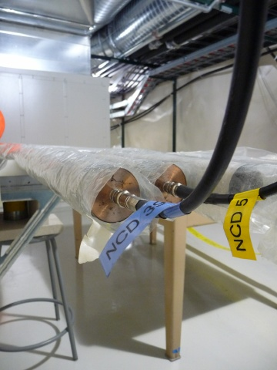
Ionization
When electrons are captured in the He-3 tubes they ionize and send out an electrical signal
4

Slide 5
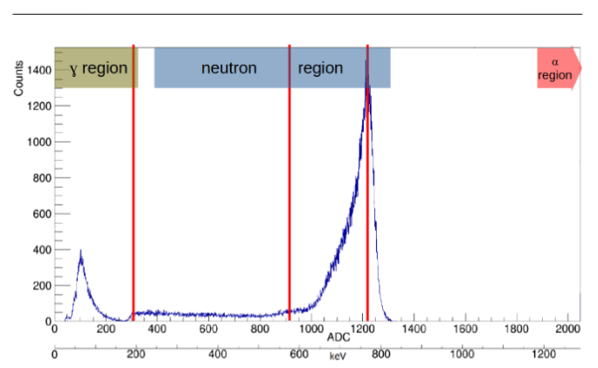
Event
Anytime our electronics receive an electrical signal
5

Slide 6
Neutron Candidate
An electrical signal between 380-1300 ADC (Analog-to-digital converters)
6

Slide 7
Burst
At least 3 neutron candidates in the span of 2 seconds
7

Slide 8
Unknown Burst
A burst that does not meet the criteria for any other type of burst and has no known cause
8

Slide 9
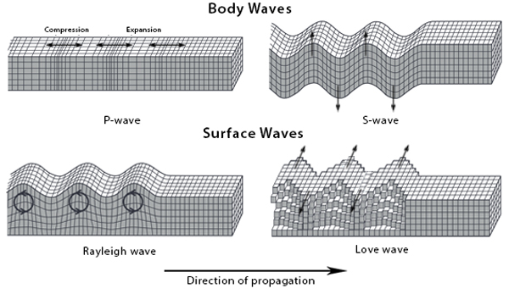
Seismic Events
Seismic Waves
Caused when stress is suddenly released in the earth
Creates four types of seismic waves
Key terms
  Distance
  Magnitude
  Intensity
9
Notes:
The two body waves are important because they are the ones that mainly affect us underground
The difference between the two arrival times can be used to calculate the distance away
Distance is from a specific location to the hypocenter of the event which is the origin point
Magnitude is the number that represents the total energy released and using commonly the richter scale increases by a power of ten
Intensity is the force or impact of the seismicity at a specific location

Slide 10
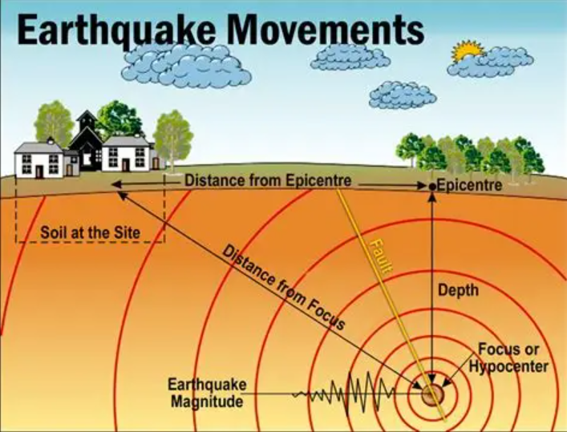
Distance
The distance from a specified location to the hypocenter or the origin point of the seismic event
10

Slide 11
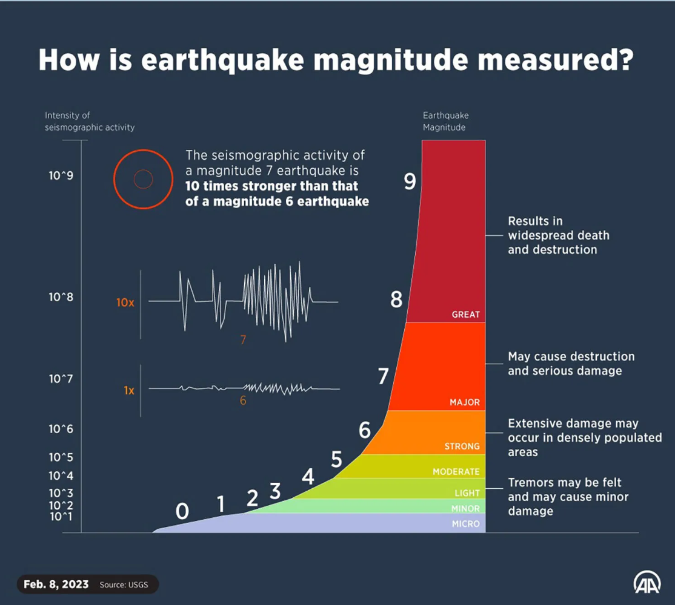
Magnitude
The total amount of energy released by the seismic event
11

Slide 12
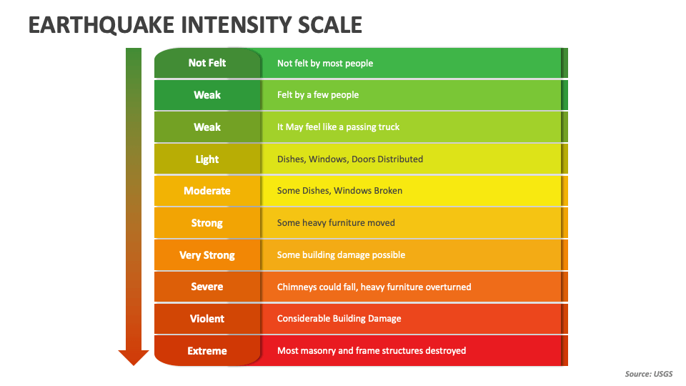
Intensity
The force or impact of the seismic event on a specific location
12

Slide 13
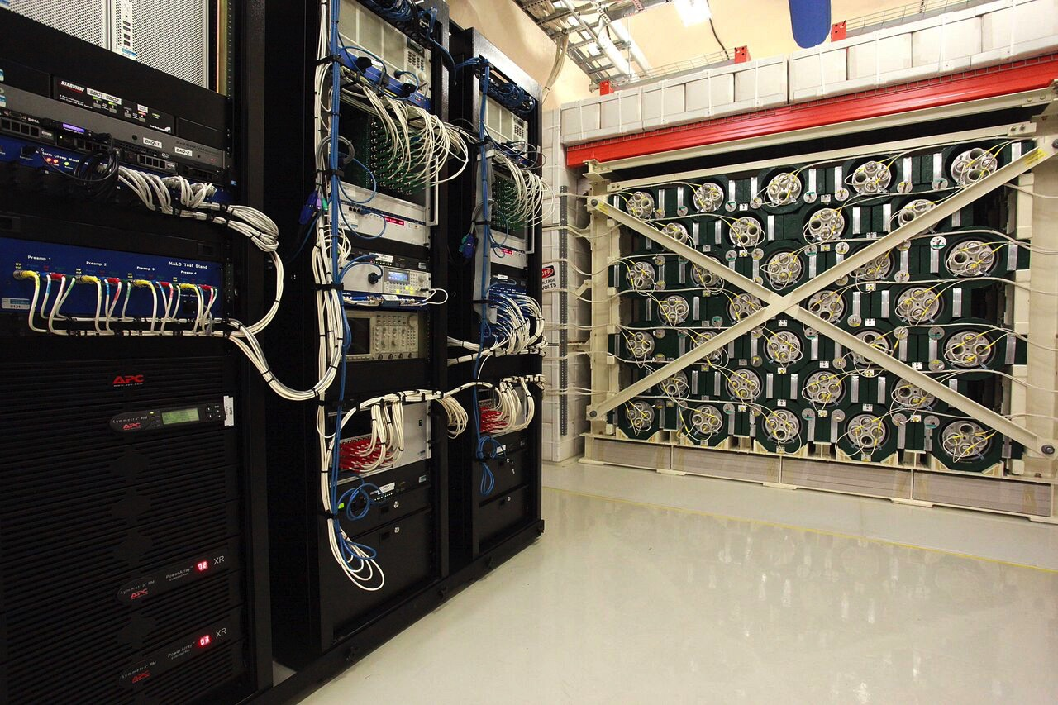
HALO (Helium and Lead Observatory)
Located underground at SNOLAB
High-quality shielded data since 2016
13
Notes:
Located in the stub at halo

Slide 14
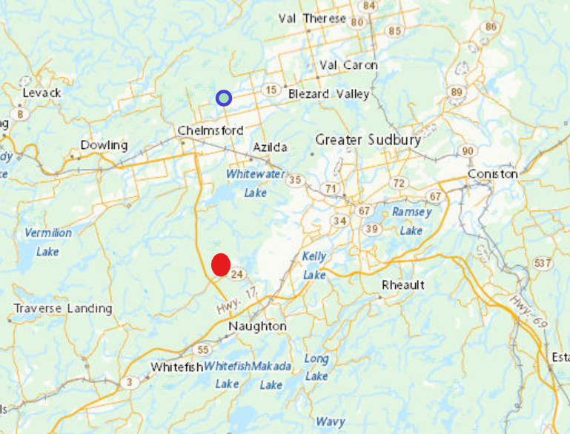
Earthquakes
Canada
  Two locations since 2016
    One in Onaping
    closed in 2019
    One in Sudbury
    opened in 2017
14

Slide 15
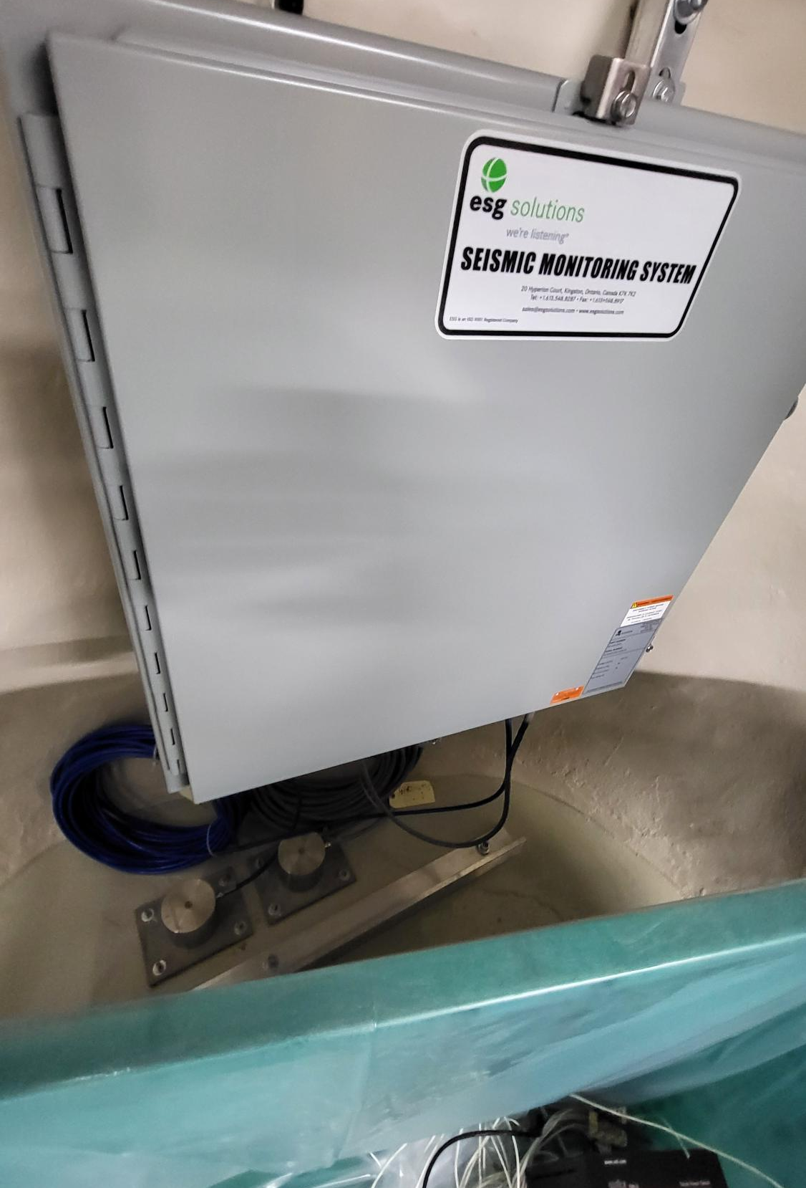
Seismic Detectors
  Located underground at SNOLAB active since 2023
15
Notes:
One in the low background lab and one in the halo area the one photographed is in the HALO area

Slide 16
Don't Shake Detectors
It is possible that the shaking from seismic events can cause something to happen in the detector to send out electrical signals
HALO is located in a mine in a city where the leading cause of seismicity is mining events
16
Notes:
Whether is be loose connections something not being properly secured
Seismicity is a concern for many experiments as no one wants seismicity to mess up their data

Slide 17
Process
Used Earthquakes Canada to filter events 10 Km away above 2 Magnitude and within 10 years
Compared the data with unknown caused bursts from HALO
Discovered 8 overlaps within a second between the two sets of data
Confirmed high levels of seismicity using our underground seismic detectors for events after 2023
17
Notes:
Needed events in a 10km radius within the last 10 years and with a magnitude above 2

Slide 18
Results
Seismic events |  |  |  | Halo
Date | Time | Magnitude | Depth (km) | Date and Time | Neutrons
2/7/2026 | 6:41:30 | 2.7 | 2.6 | 2026-02-07 06:41:30.607396+00:00 | 17
10/24/2025 | 15:20:14 | 3.4 | 2.2 | 2025-10-24 15:20:14.377048+00:00 | 443
10/20/2025 | 0:46:54 | 2.9 | 2.2 | 2025-10-20 00:46:54.795229+00:00 | 152
8/10/2024 | 7:32:56 | 2.8 | 2.9 | 2024-08-10 07:32:56.497569+00:00 | 63
1/3/2024 | 9:14:34 | 2.6 | 2.5 | 2024-01-03 09:14:34.762175+00:00 | 5
9/18/2020 | 9:53:52 | 2 | 2.4 | 2020-09-18 09:53:52.433697+00:00 | 8
4/23/2020 | 7:10:22 | 3 | 2.4 | 2020-04-23 07:10:22.327784+00:00 | 9
3/2/2018 | 7:09:47 | 2.7 | 2.5 | 2018-03-02 07:09:46.614368+00:00 | 6
18

Slide 19
Results
Using ONLY data from Earthquakes Canada
19

Slide 20
Results
Using Earthquakes Canada as well as our own Seismic Detectors
20

Slide 21
Probabilities
1% chance of an event meeting the seismic criteria on a given day
6% chance of an unknown event every day
4% of unknown events are correlated to seismicity
21

Slide 22
Next Steps
Improve SNOLAB seismic data usability
Determine the force from the seismicity on the detector
Experiment with other types of bursts
22

Slide 23
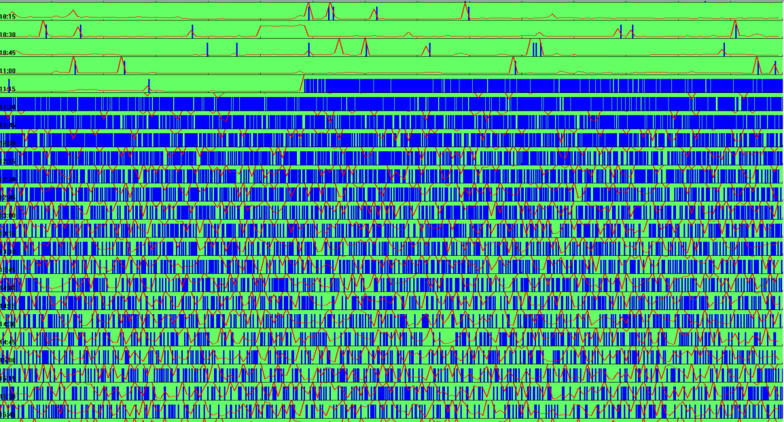
Recap
Unknown bursts can be caused by electrical signals from the shaking of seismicity
The magnitude of the earthquake is related to the number of neutrons that appear
There are many more projects that could be made on the actual impact of seismicity on projects
October 24, 2025
23

Slide 24
Questions?
24

Slide 25
Earthquakes (general)
Richter scale is the most common however we use Nuttli for our area
Richter was made for calculating magnitude for the California area and the rock shape and type the Nuttli calculation better reflects the area in eastern Canada
Even with Nuttli calculation magnitude follows the same scale as you go up an integer the amplitude increases by a power of ten and energy increases 31.6 times
You can estimate the distance by calculated the time difference between the arrival of the P and S waves and if you know the rock type you can estimate the velocity of the seismic waves and calculate distance from that
25

Slide 26
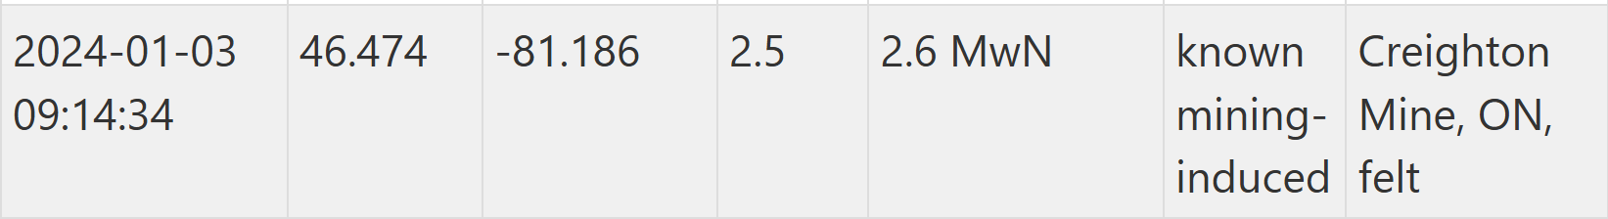
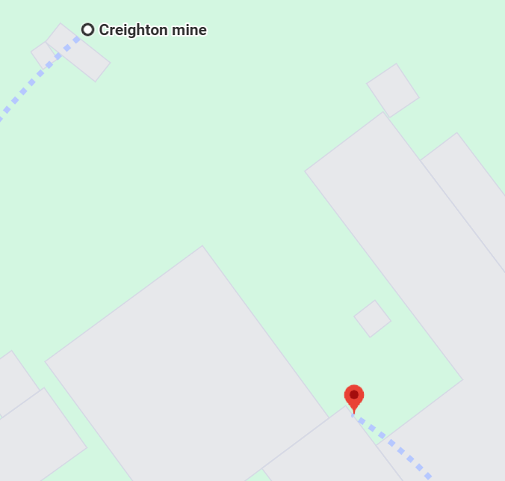
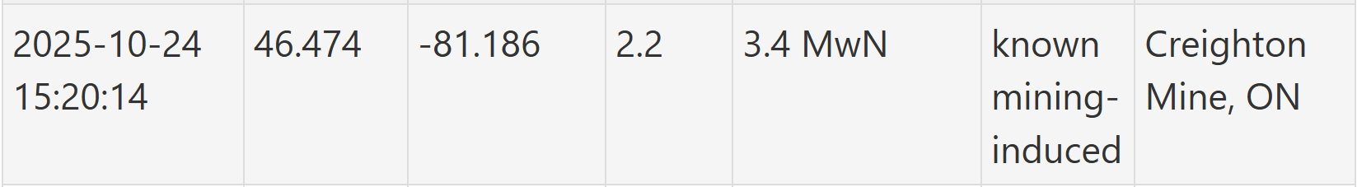
Earthquakes Canada
Provides date and time, coordinates, depth, magnitude, probable cause and location
Coordinates are just general coordinates for Creigton mine
26

Slide 27
Seismic Detector Machine
Two locations underground one near HALO and one in the Low Background Lab
Each has a Geophone for wave velocity
Each has a Accelerometer for wave acceleration
Each Geophone and Accelerometer has three triaxle channels to measure in 3D
Possibly GPS possibly PTP
In EST/EDT
One surface detector that does not belong to SNOLAB
27

Slide 28
Seismic Detector Technology
Provides daily general files with triggers which are times when the amplitude was above a certain number (timing may be off)
Provides wave forms showing the wave amplitude (waveforms are only 1.25s long timing may be off, may have a max amplitude that can be detected) allows for selection of P and S waves (don't know when the event starts)
Provides instantaneous average peak particle velocity measured every 5 seconds (timing may be off, cannot calculate distance, may miss actual peaks of events)
Possibly able to create map of seismic events (currently does not)
28

Slide 29
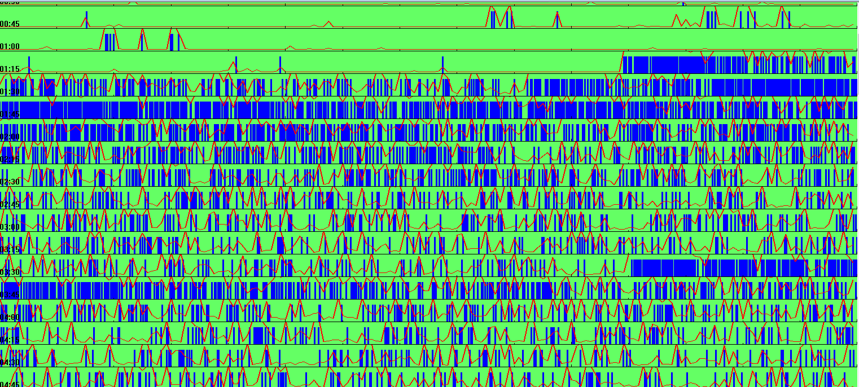
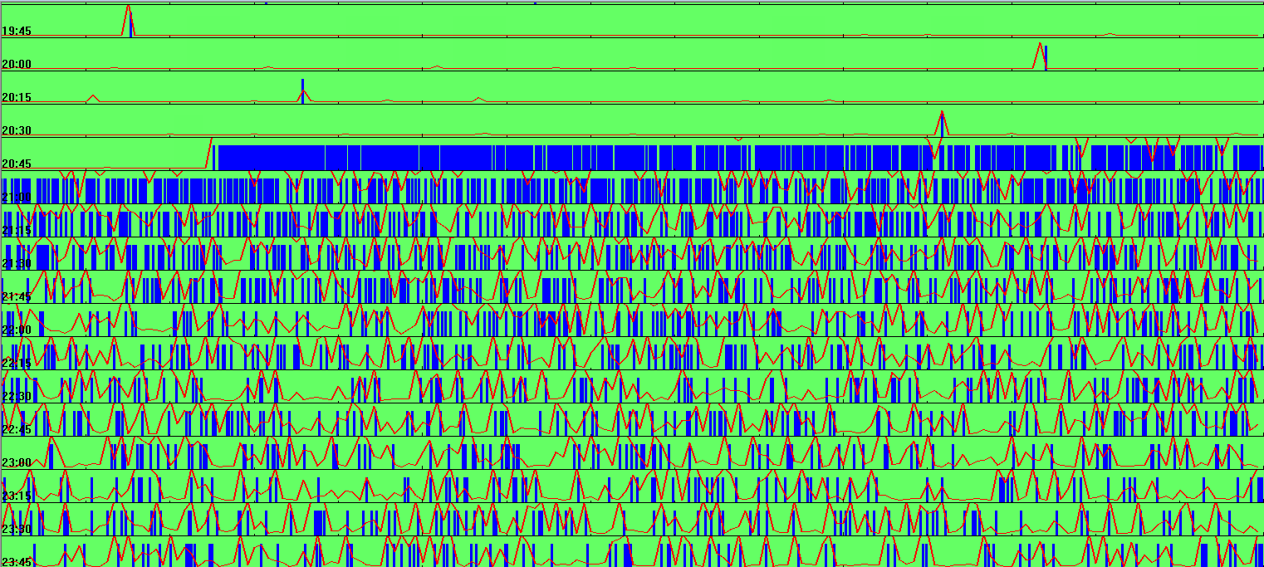
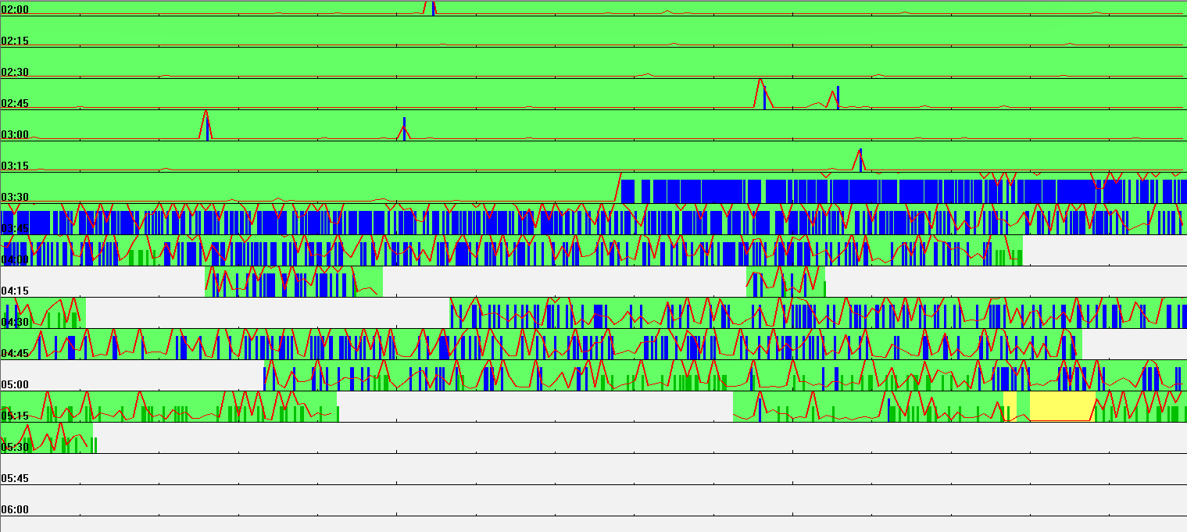
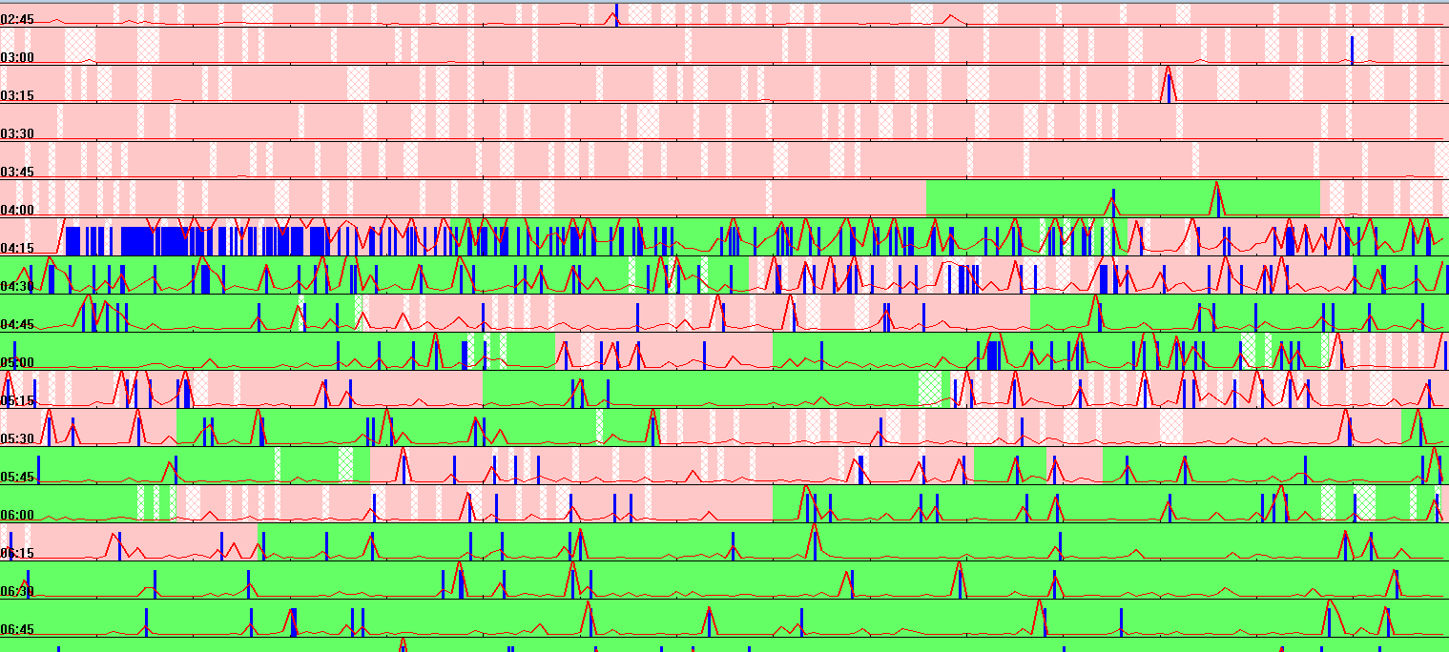
Seismic Detector (triggers)
2/7/2026
10/24/2025
10/19/2025
Triggers
Blue – automatic by detector
Green – manual by person
Daily View
Green – all good
Pink – one station is off time
White – no data
Yellow – data not fully processed
Hatched – one sensor down colour is the state of the other sensor
8/10/2024
1/3/2024
29

Slide 30
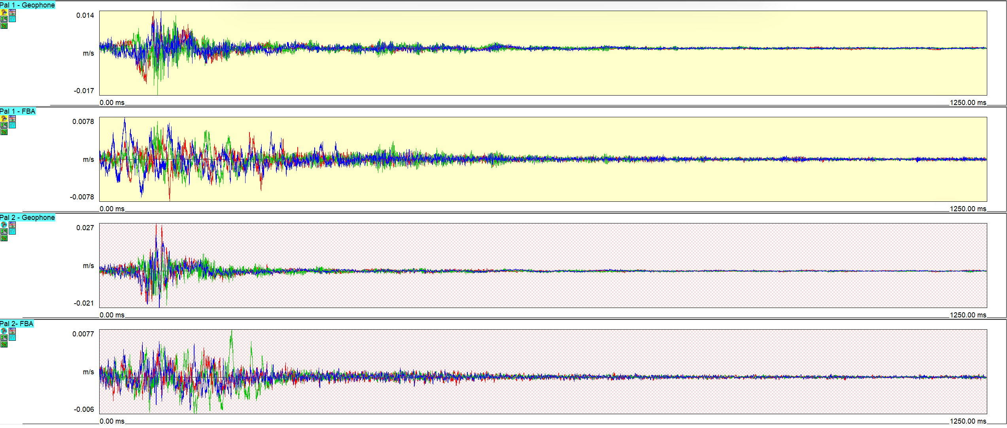
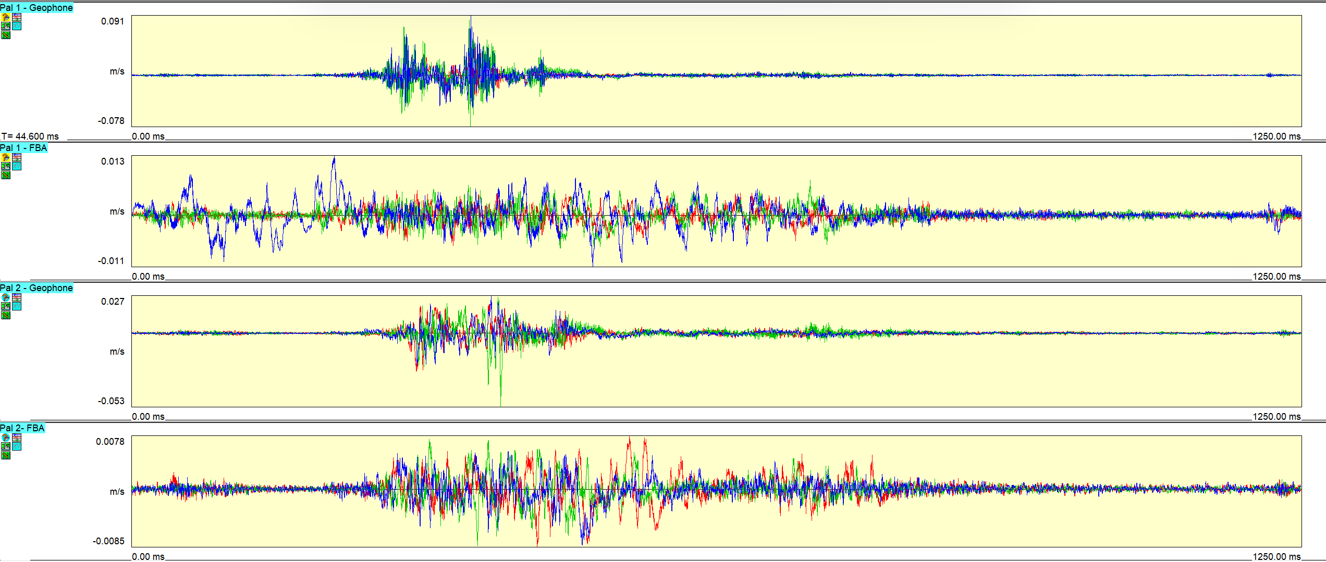
Seismic Detector (waveforms) 1
1/3/2024
8/10/2024
HALO area geophone total amplitude: 0.031 m/s
HALO area geophone total amplitude: 0.169 m/s
30

Slide 31
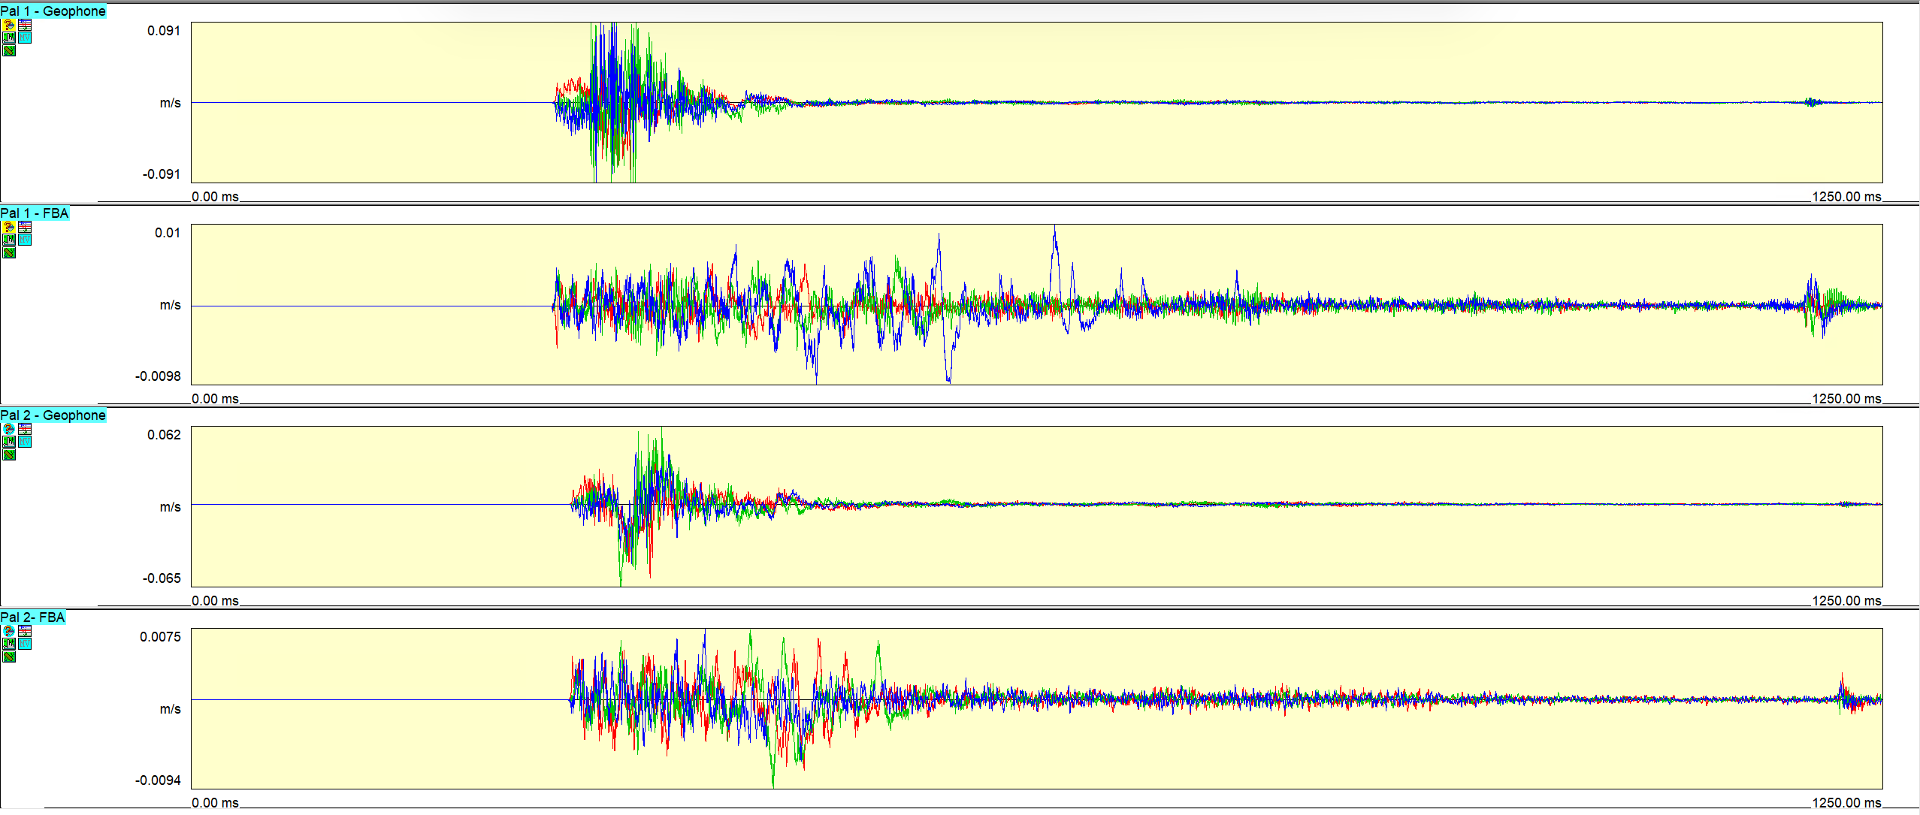
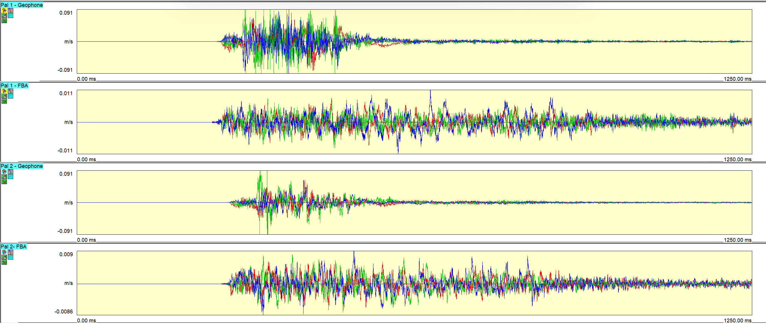
Seismic Detector (waveforms) 2
10/19/2025
10/24/2025
HALO area geophone total amplitude: 0.182 m/s
HALO area geophone total amplitude: 0.182 m/s
31

Slide 32
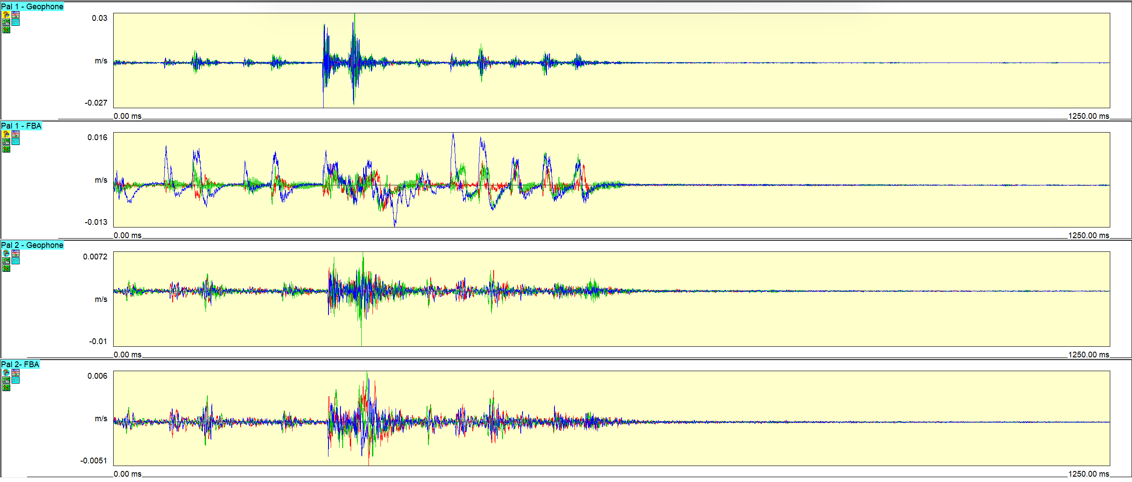
Seismic Detector (waveforms) 3
2/7/2026
HALO area geophone total amplitude: 0.057 m/s
32

