Slide 1
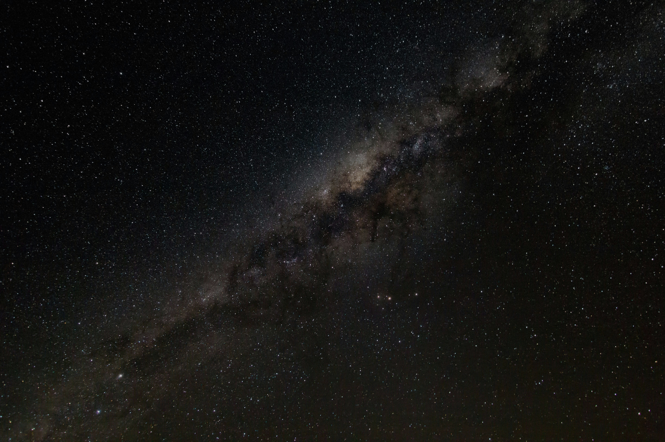
Seeing Dark Matter: Reconstruction of Energy, Position, and Timing
Cary Kan
CASST 2026
08/12/2026

Slide 2

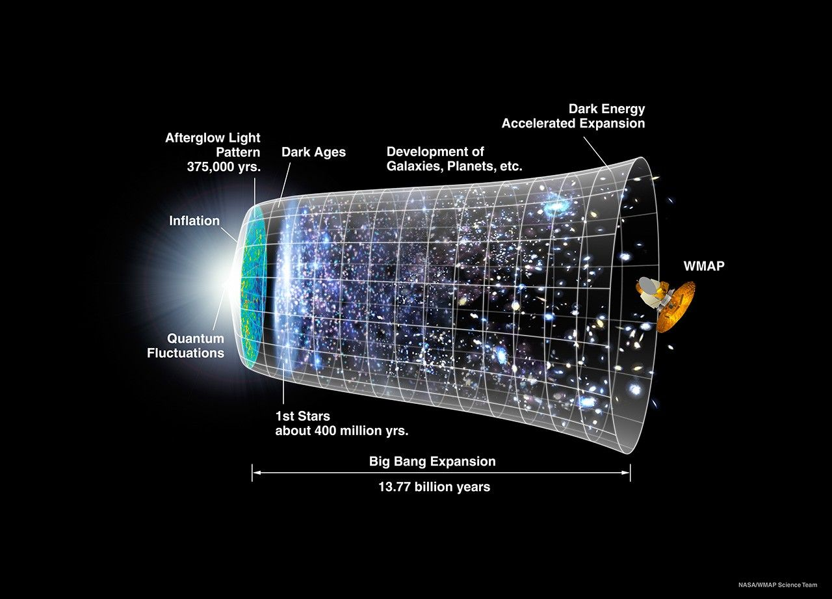
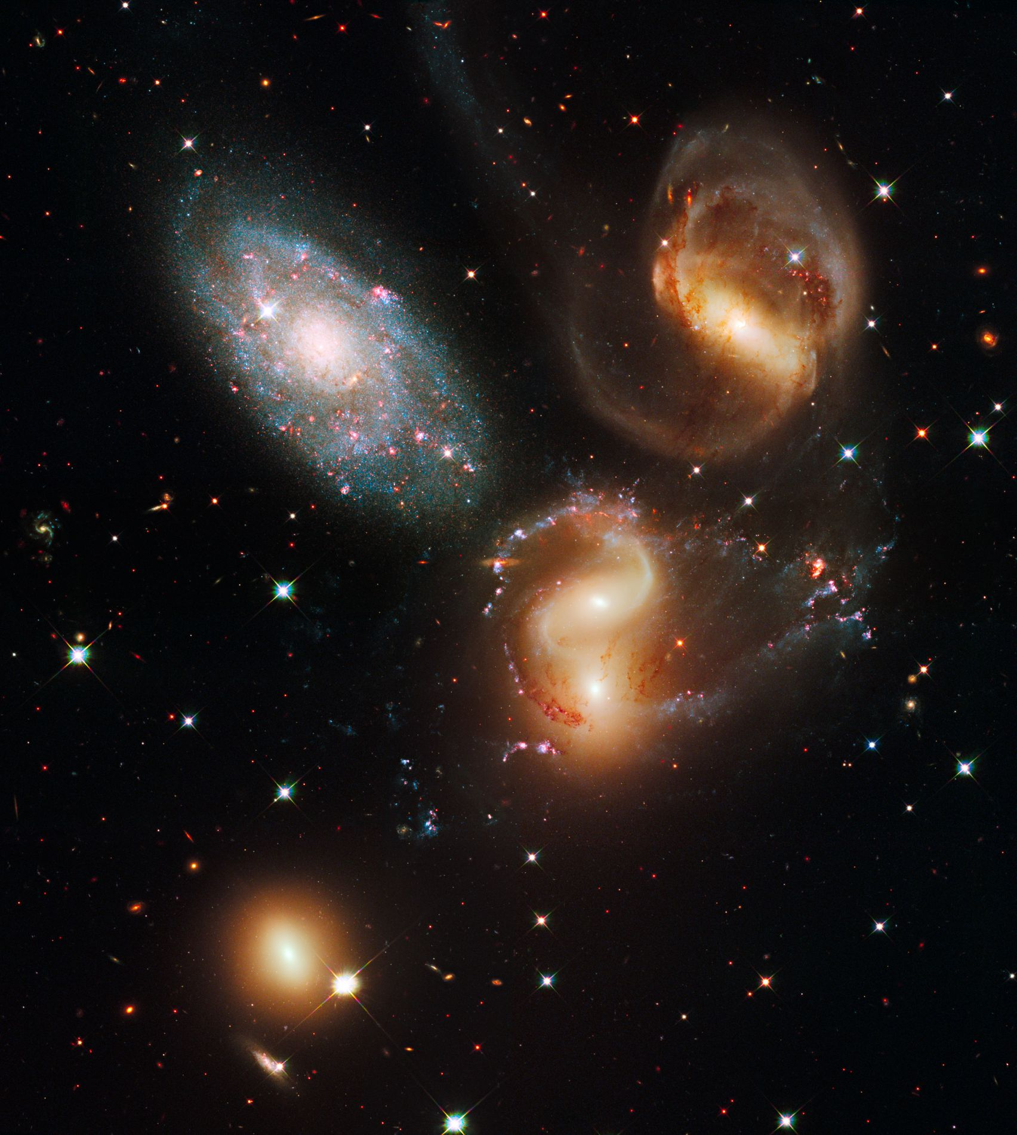
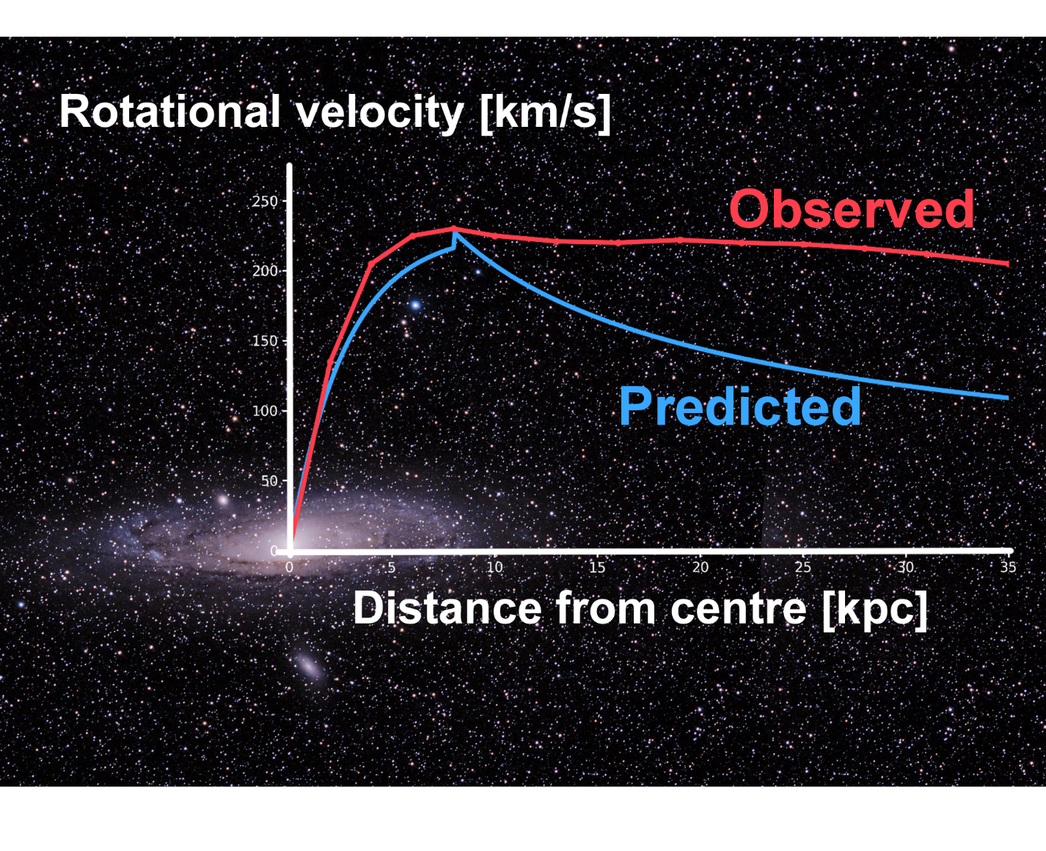

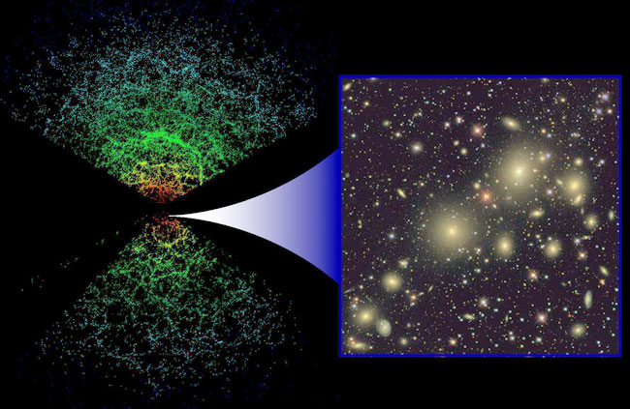
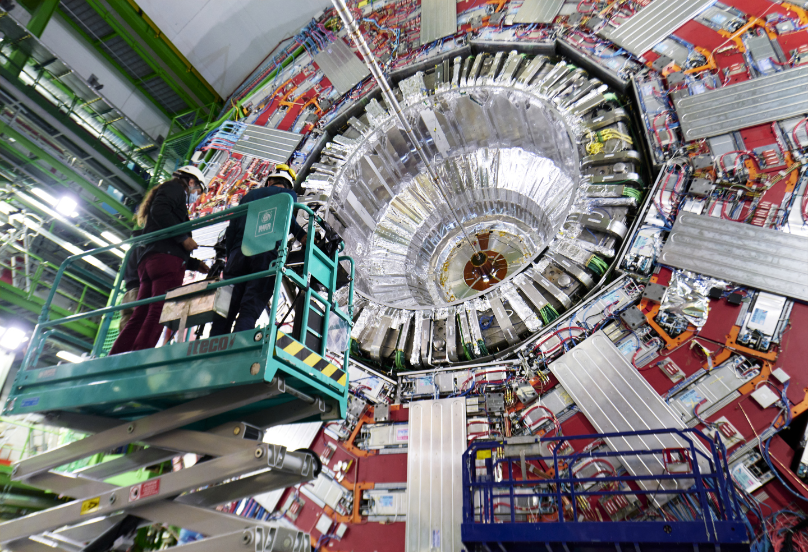




Dark Matter
Annihilation
$$\overline{χ}$$
$$f$$
Scattering
$$χ$$
$$\overline{f}$$
84% of the Universe’s total matter, 26% of its total energy
Three main ways of searching for dark matter
  Indirect detection
  Direct detection
  Collider Experiments
Production

Slide 3
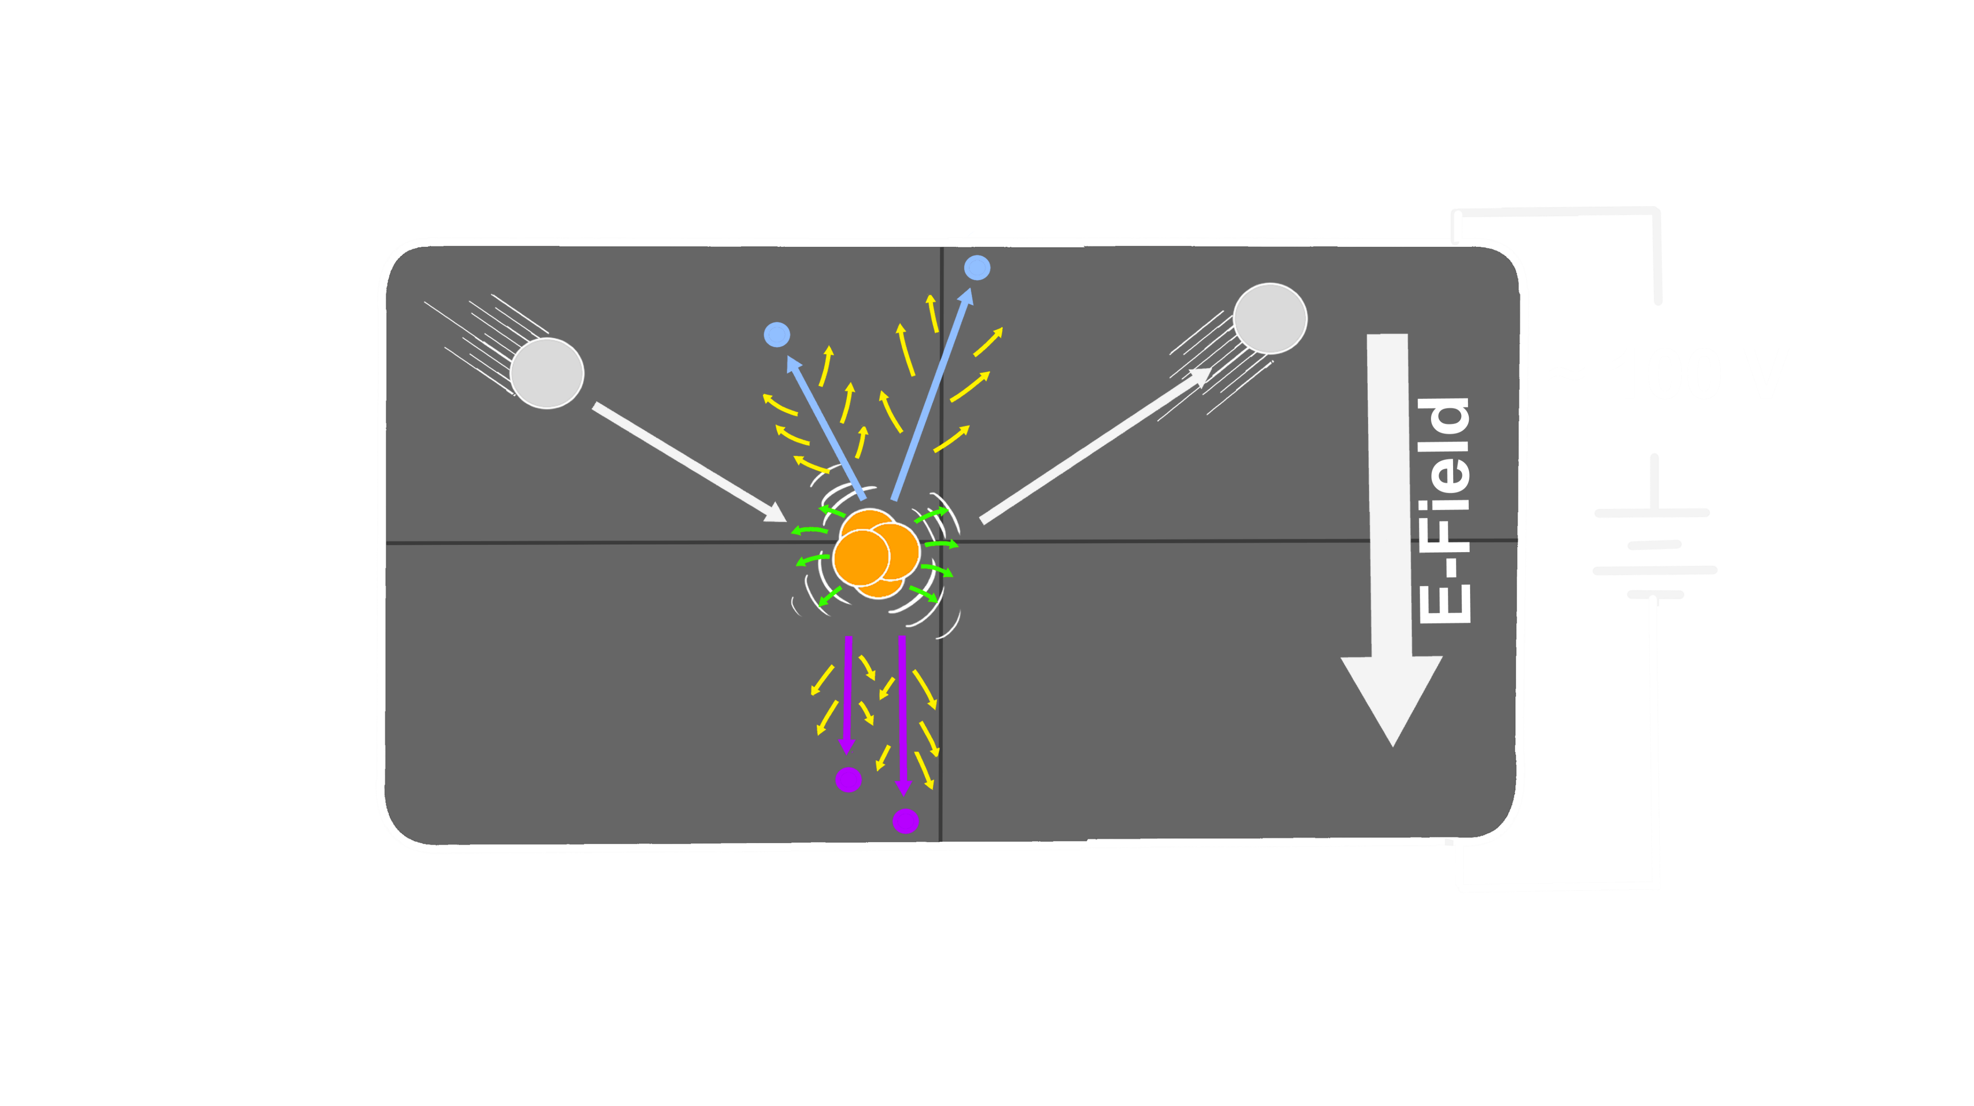








Direct Detection
$$χ$$
Dark matter particle
$$e^{−}$$
$$χ$$
Electrons
$$χ$$
$${\sim 100 V}_{b}$$
Electron holes
Prompt phonons
NTL phonons
$$n$$
$$h^{+}$$
Voltage bias
$$E_{t}=E_{R}+n_{eh}eV$$
Total phonon energy
Initial recoil energy
Number of eh pairs
Notes:
Add axis to the detector

Slide 4
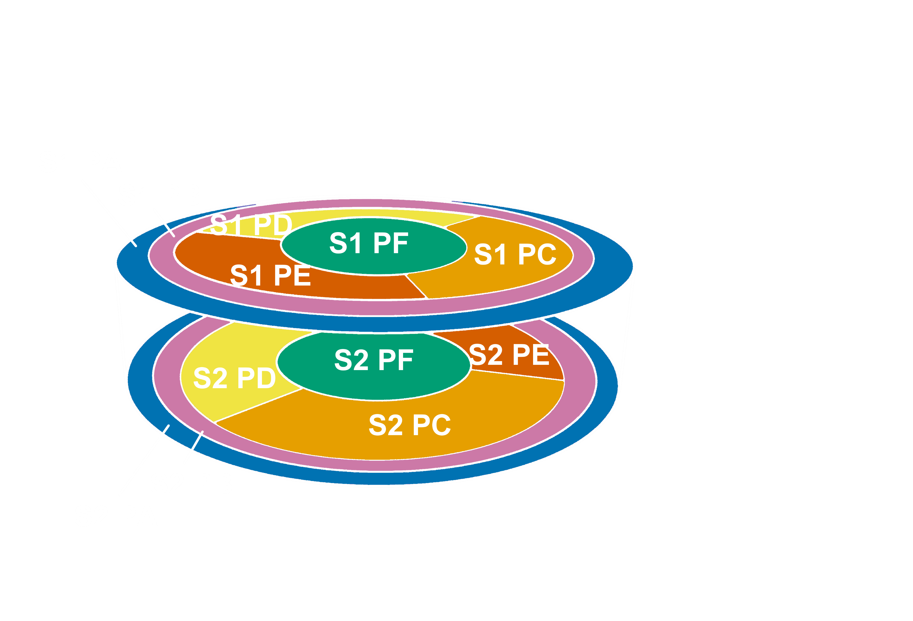







The SuperCDMS HV Detector
16.5
100mm wide, 33mm tall,12 sensors
100 V across the detector for NTL effect
  Secondary phonons produced by drifting e/h
$$e^{−}$$
$$χ$$
$$χ$$
$${\sim 100 V}_{b}$$
-50
$$n$$
50
$$h^{+}$$
-16.5
$$χ$$
Dark matter particle
Electrons
Electron holes
Prompt phonons
NTL phonons
Notes:
Add axis to the detector

Slide 5
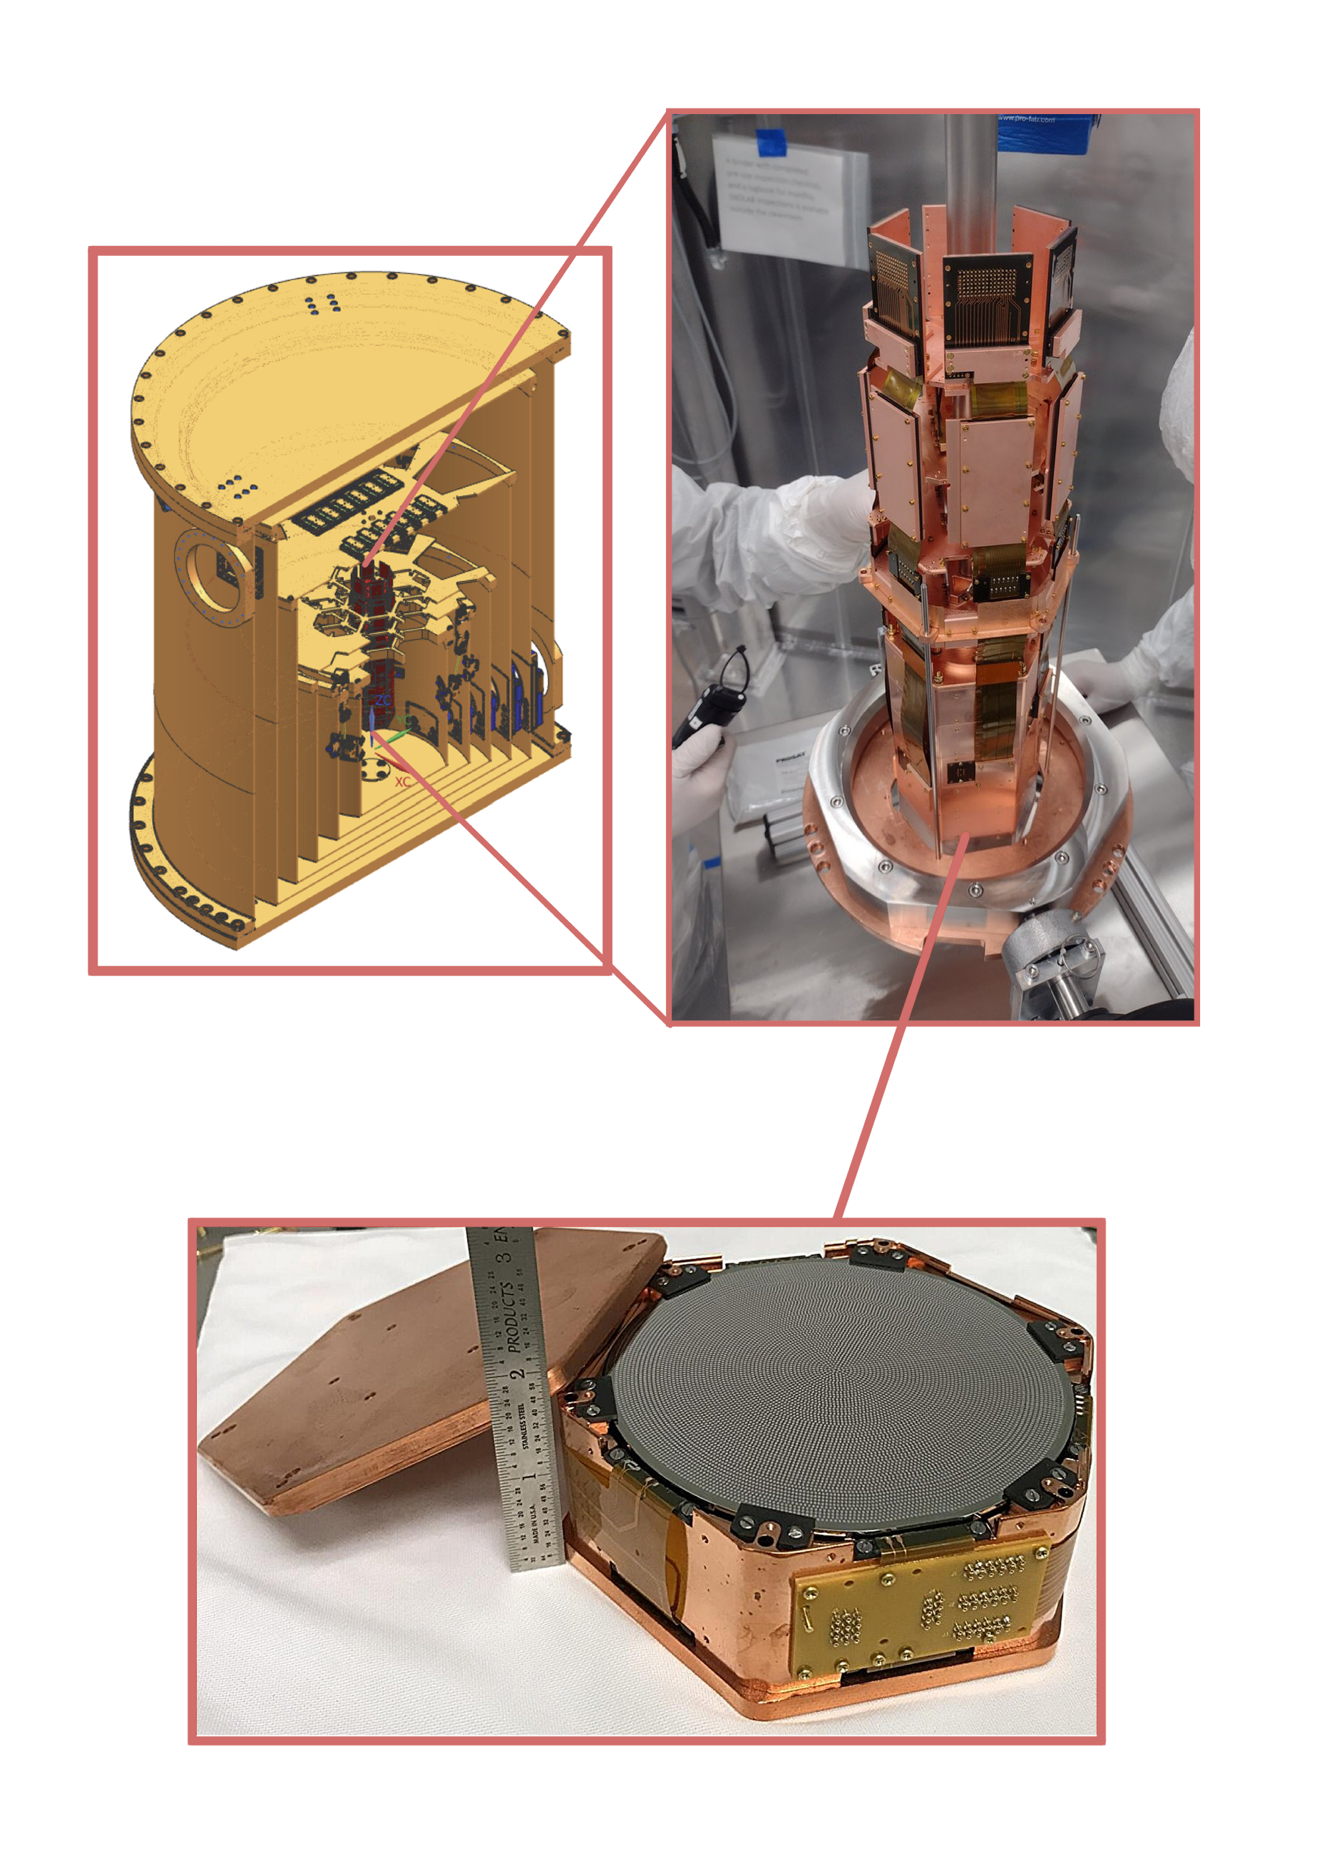
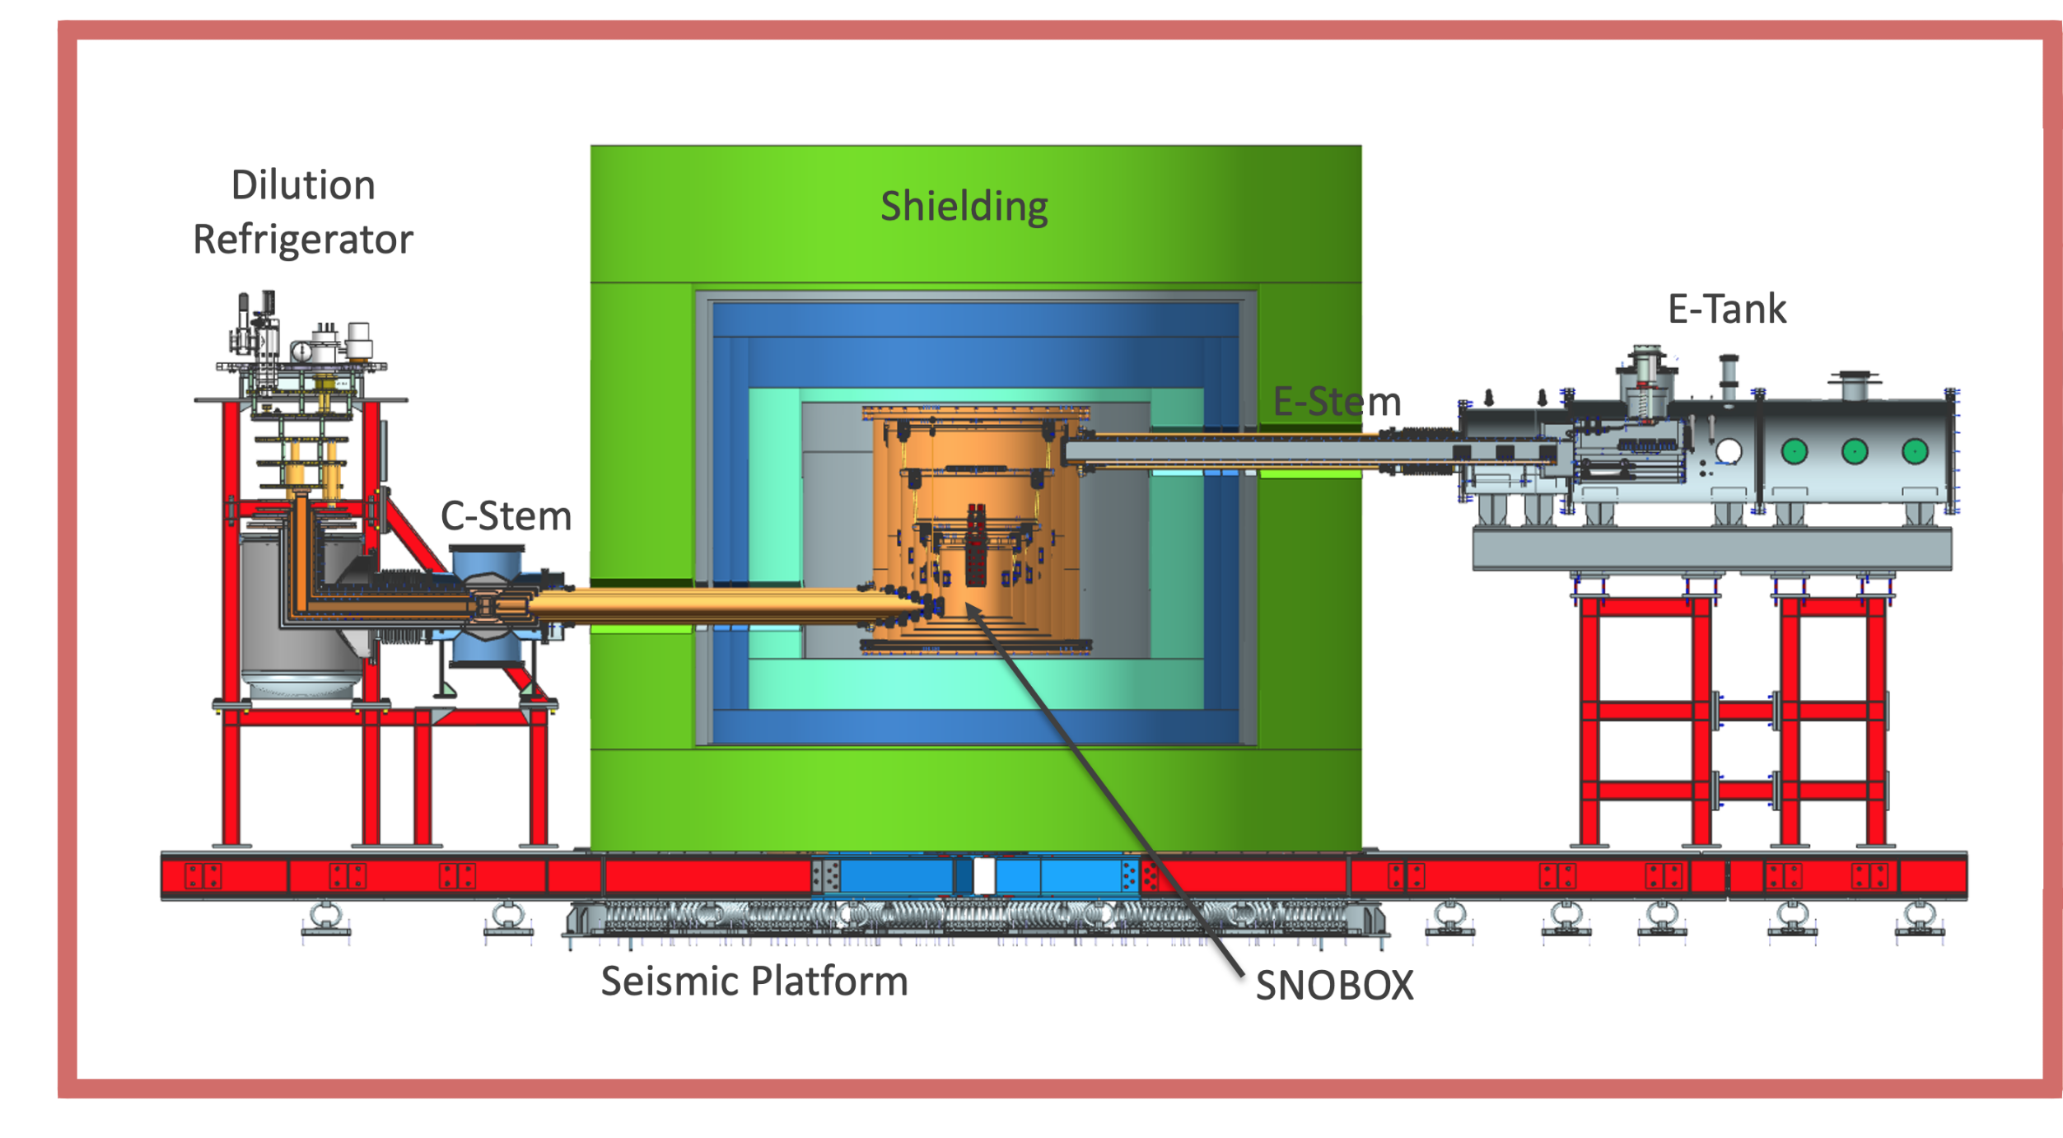

SuperCDMS at SNOLAB
Detector tower
Cryostat
Ultra-pure lead
Water tank
Polyethylene
  SuperCDMS SNOLAB focuses on WIMP candidates with masses below 10 $GeV$/$c^{2}$
  Cryogenic temperatures ~ 10-13 mK
HV detector

Slide 6
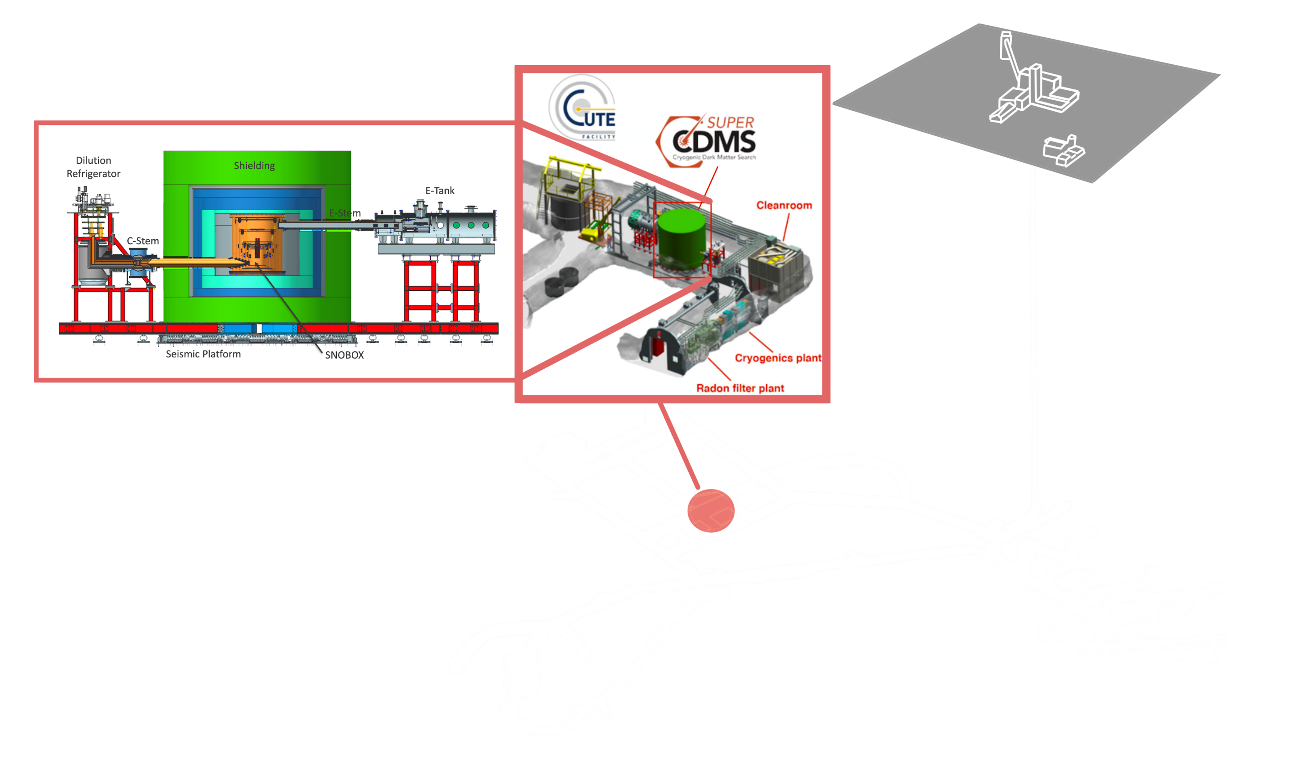
SuperCDMS at SNOLAB
2km
Common backgrounds:
  Gamma rays, X-rays, beta particles, neutrons, neutrinos…etc
Currently working with data from Cryrogenic Underground Tower Test facility CUTE

Slide 7
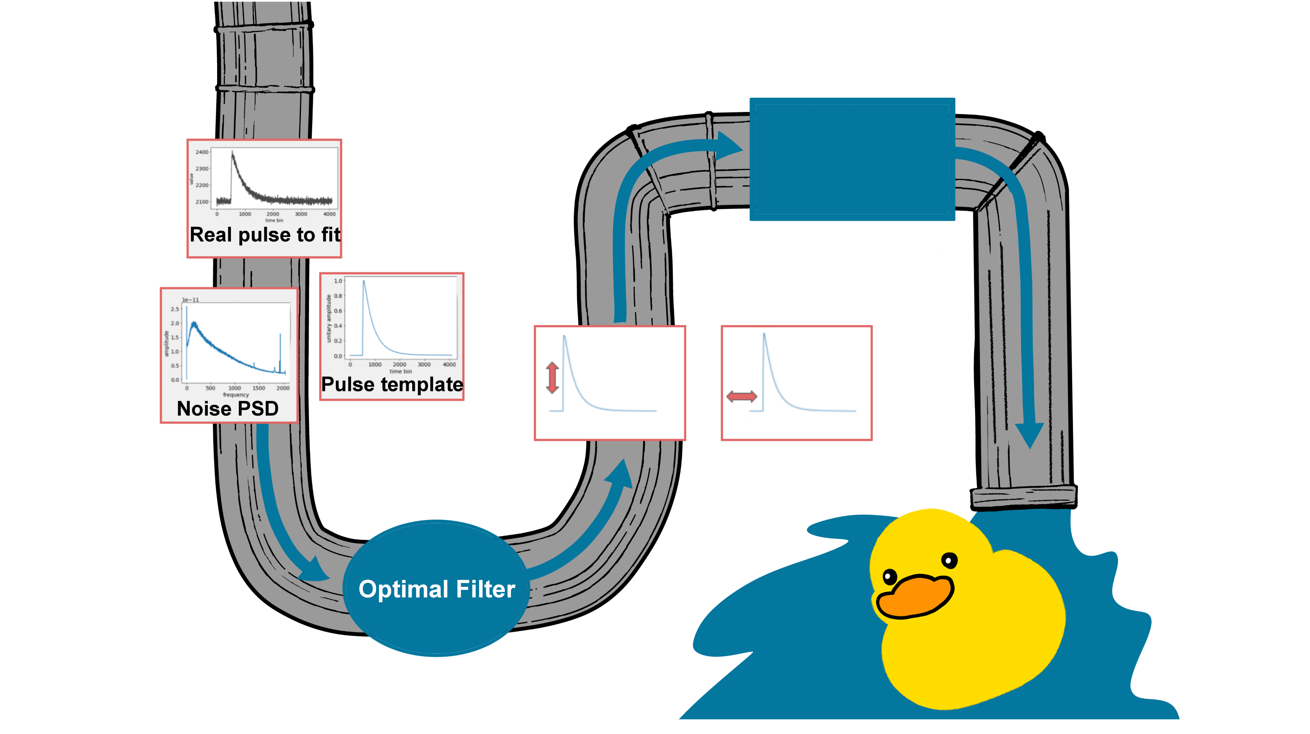
The Training ‘Pipeline’
Training
DMC data
‘DMC’
Amplitude
Time delay
Trained Model

Slide 8






Predictions using ML Models
Real data
  Does the event have an energy compatible with the search region?
  Is the event happening in the detector bulk?
  Is it like known background control populations?
Trained Model
$$E$$
$$R$$
$$X$$
Predictions
$$Y$$
$$Z$$

Slide 9
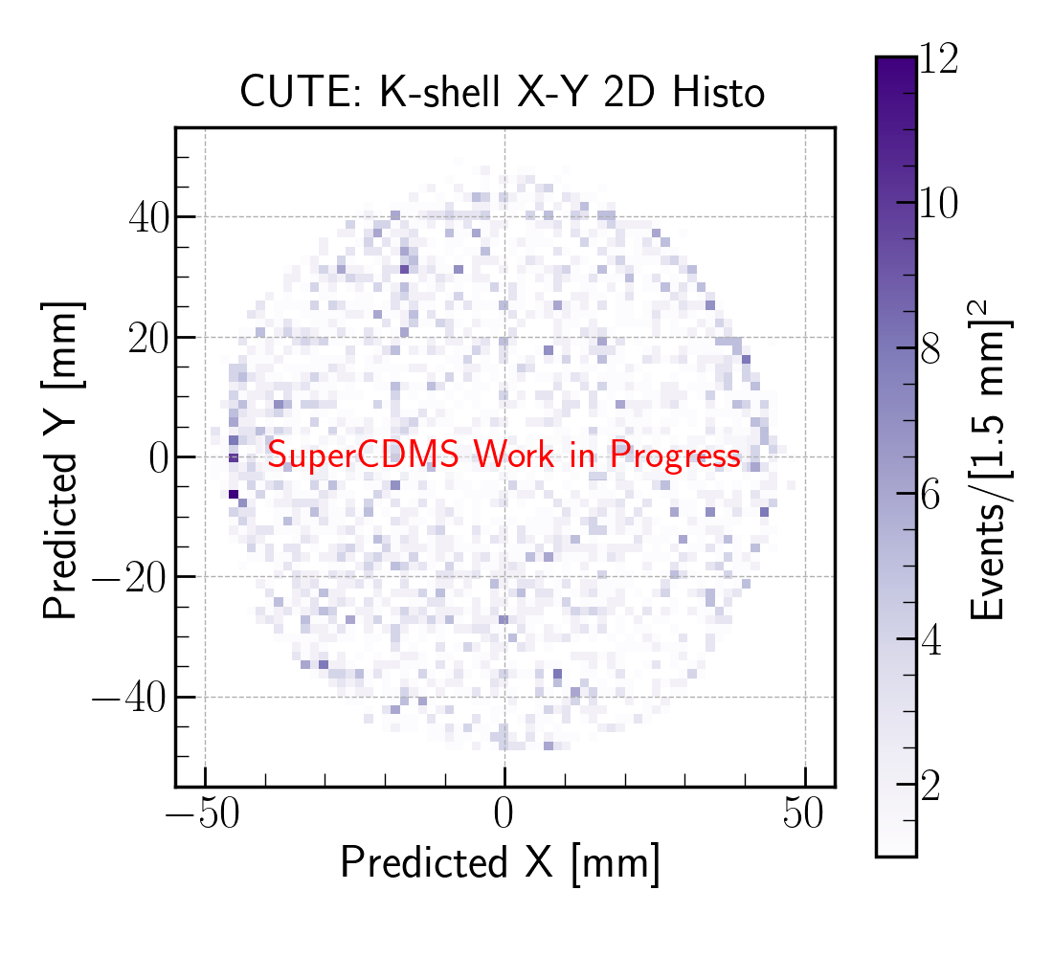
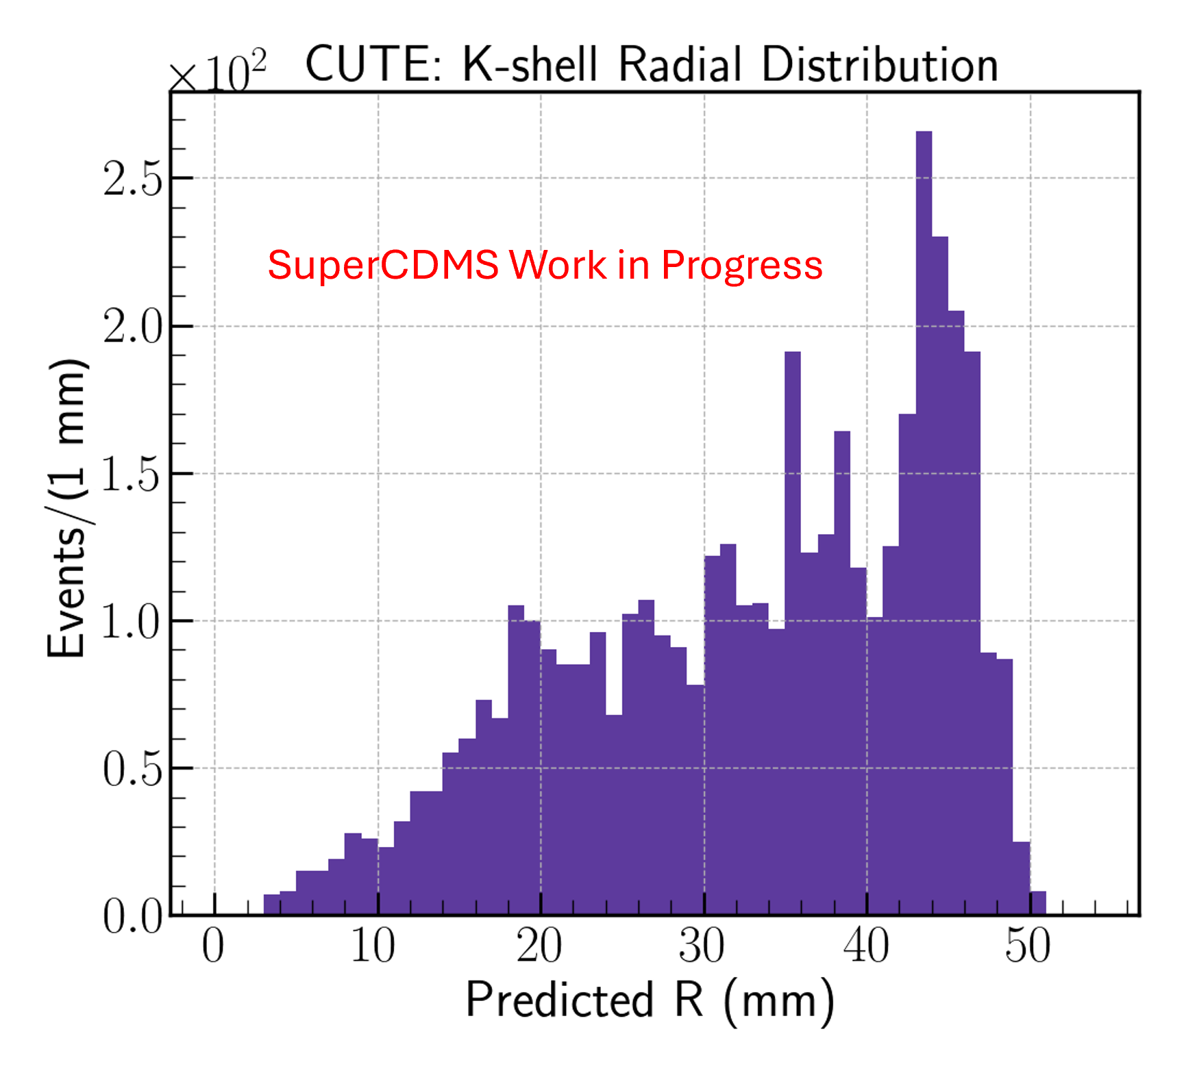
Radial Position Prediction
  K-shell radius distribution indicates uniformly distributed events, which is what we expect
  Backgrounds are expected at surfaces (large R)
    Use this to our advantage for background discrimination

Slide 10
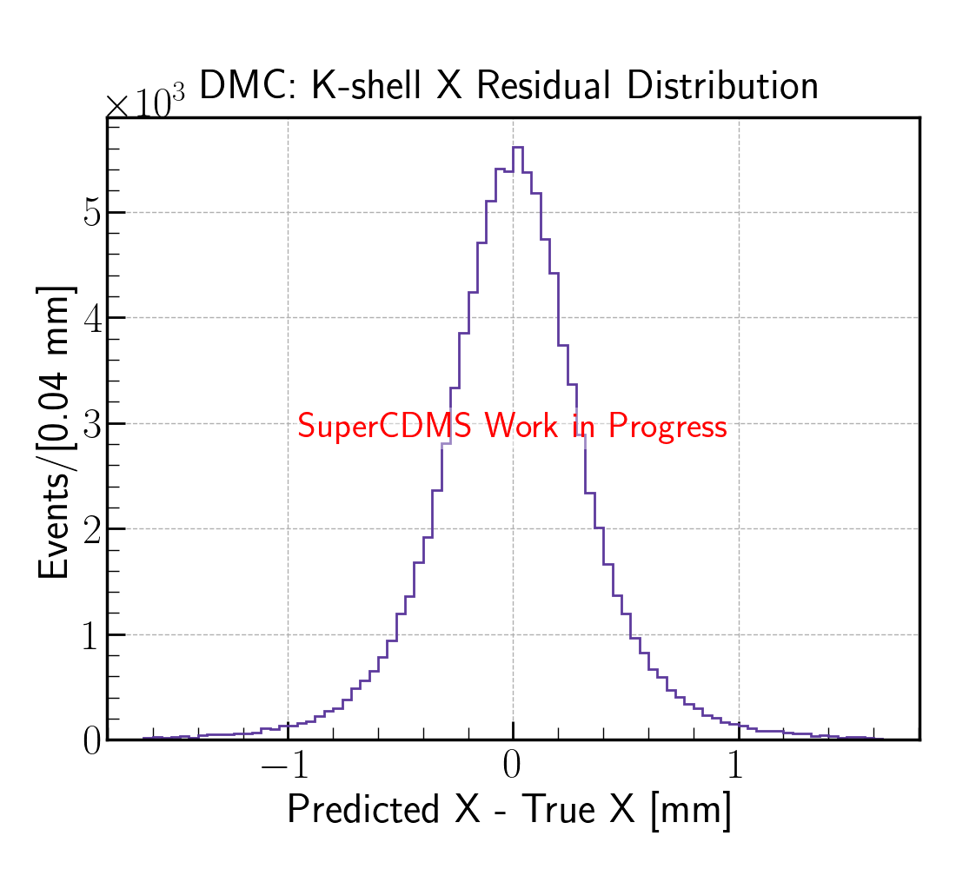
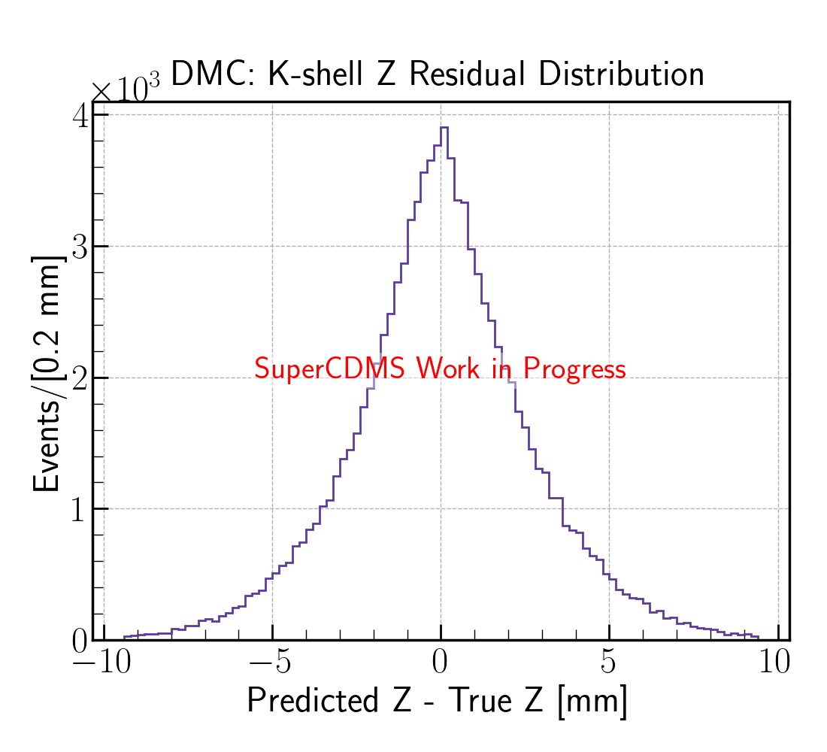
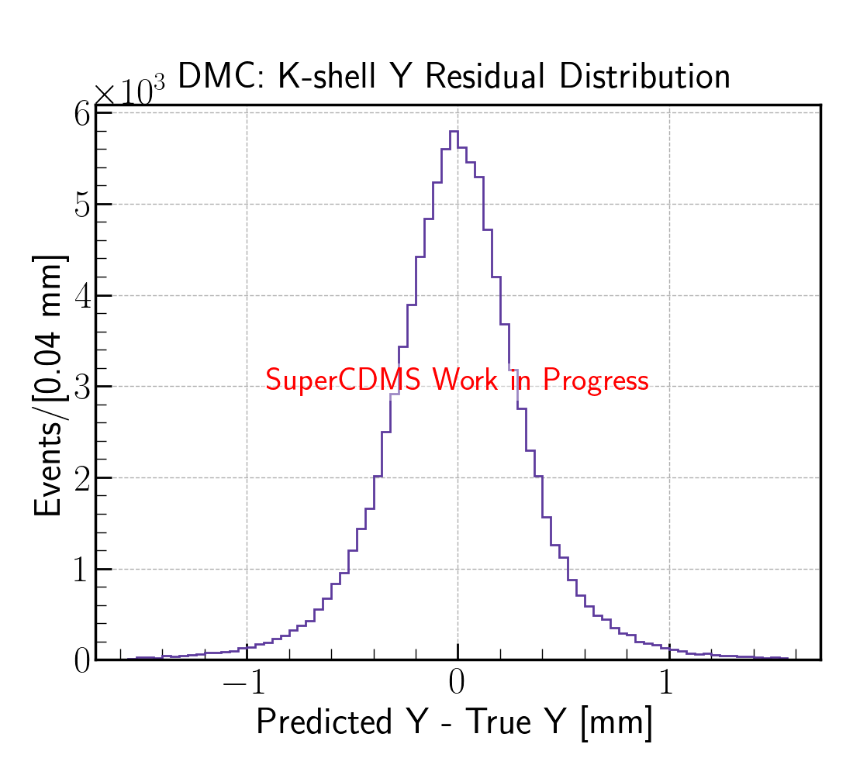
Z Prediction
Z resolution is much worse than that of X and Y
Z is predicted through detector side differences
  Time delay would add more information to the learning

Slide 11
Conclusion
Machine Learning is a viable analysis tool for SuperCDMS data
Demonstrated that this can predict position of dark matter collisions in SuperCDMS detectors
Future work on improving training and prediction through time delay

Slide 12
Back-up slides

Slide 13
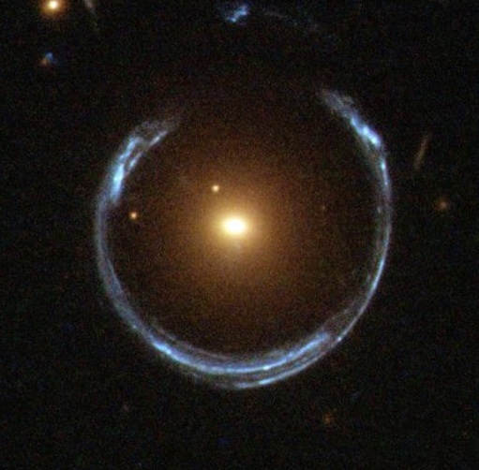
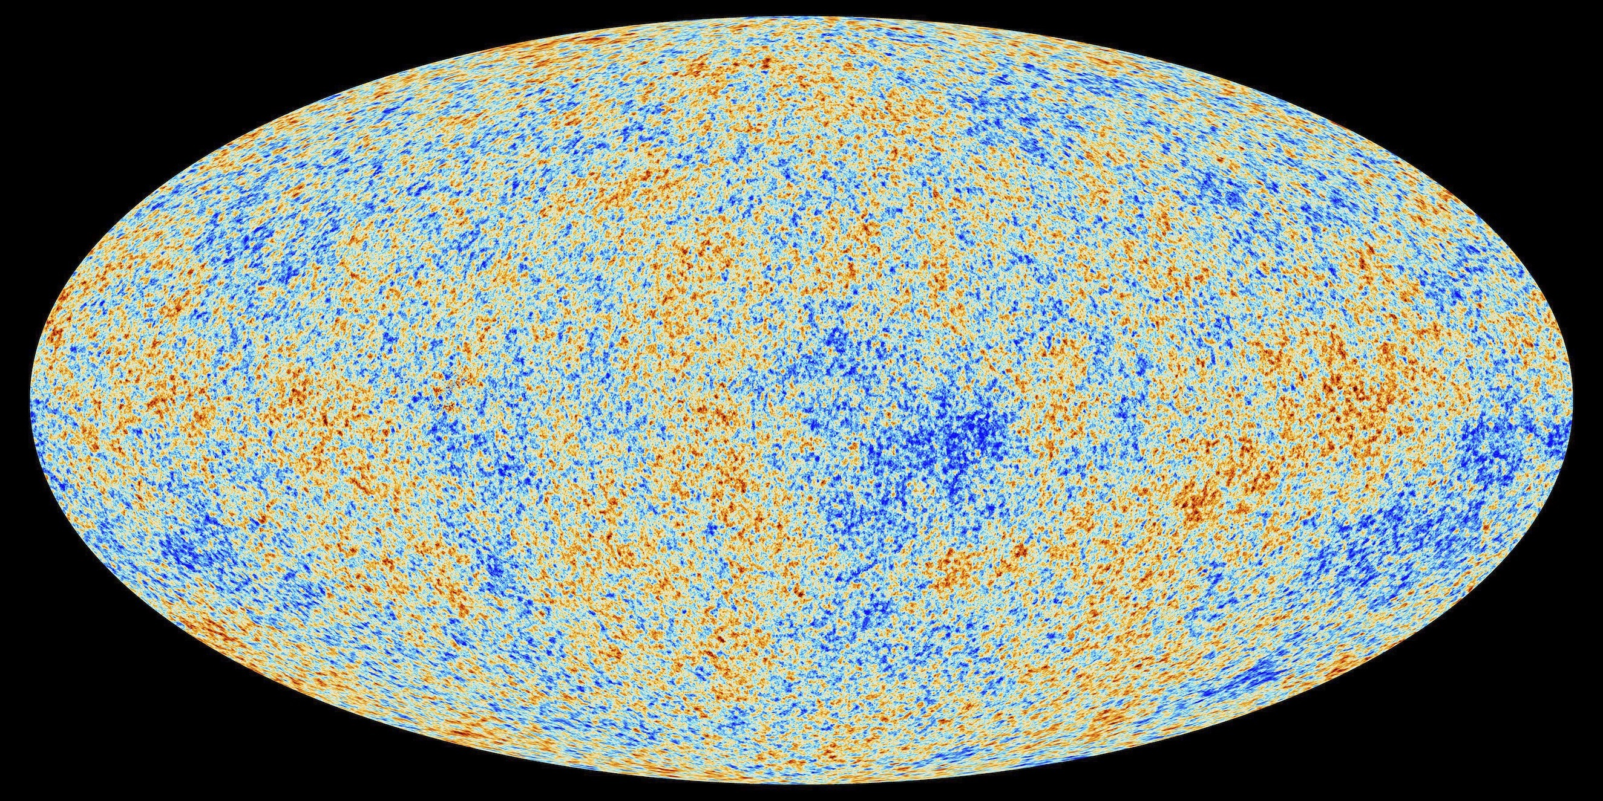
Dark Matter History
1970
1970s-1980s
2013-2018

Slide 14




The WIMP
Annihilation
$$\overline{χ}$$
$$f$$
Scattering
$$χ$$
$$\overline{f}$$
Production

Slide 15
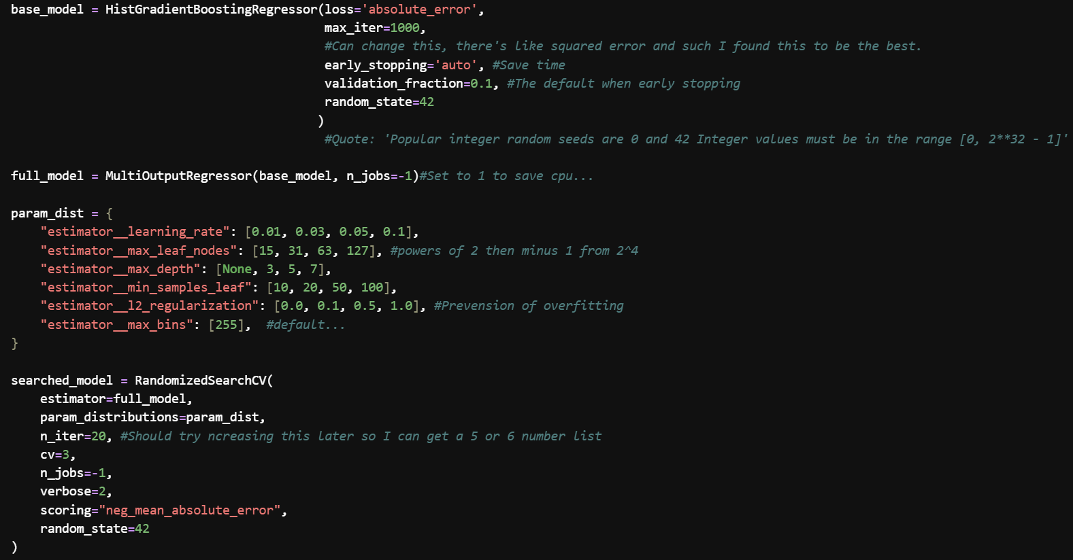
Model Specifications

Slide 16
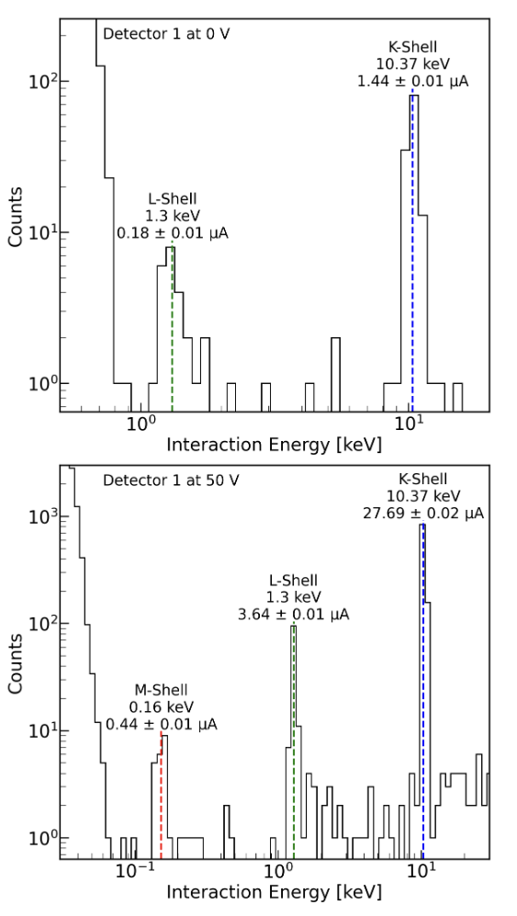
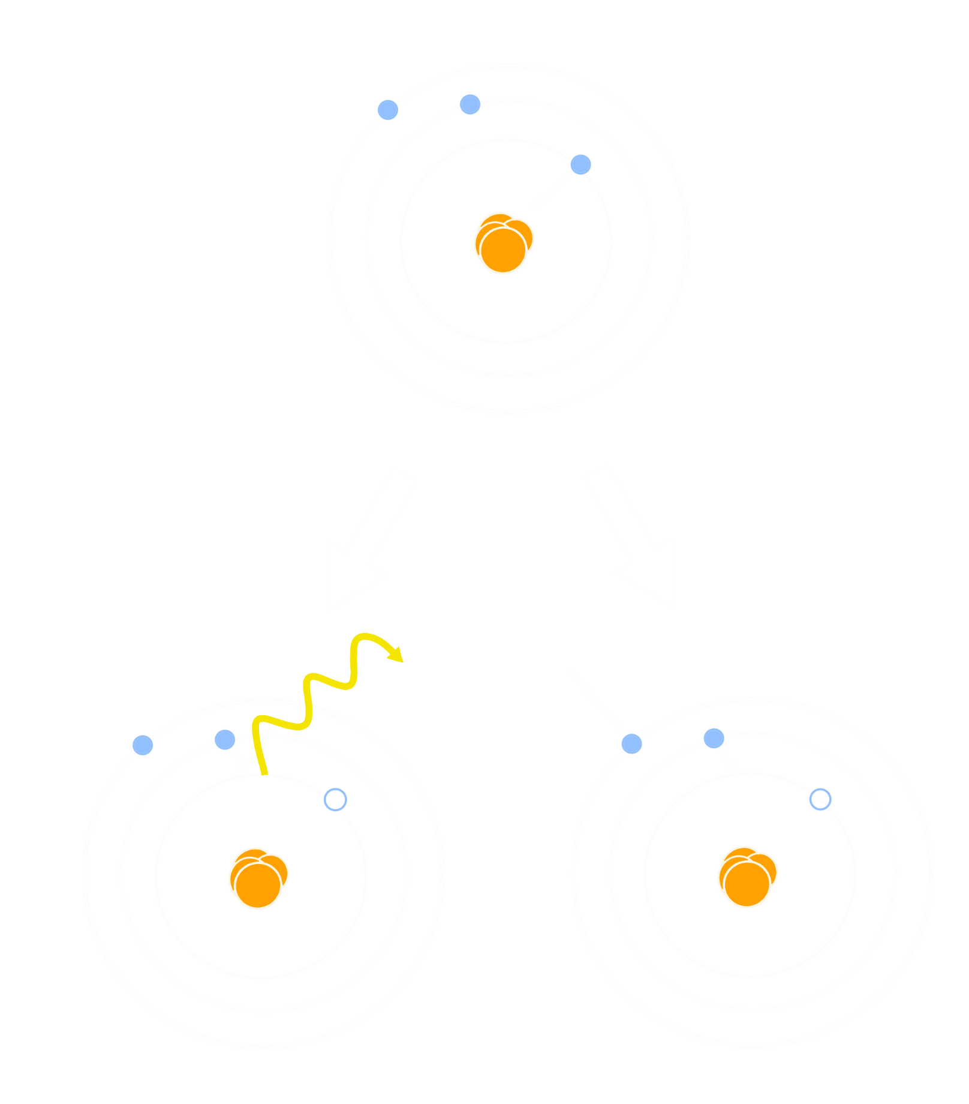

Detector Calibration
K, L, and M peaks are an invaluable calibration tool
  Ge detectors irradiated with neutrons decays into $71Ge$
The known $71Ge$ peaks establishes a conversion
  an unknown event amplitude can be translated into a physically meaningful interaction energy
Auger electron
X-ray
Notes:
‘Au-jay’

Slide 17
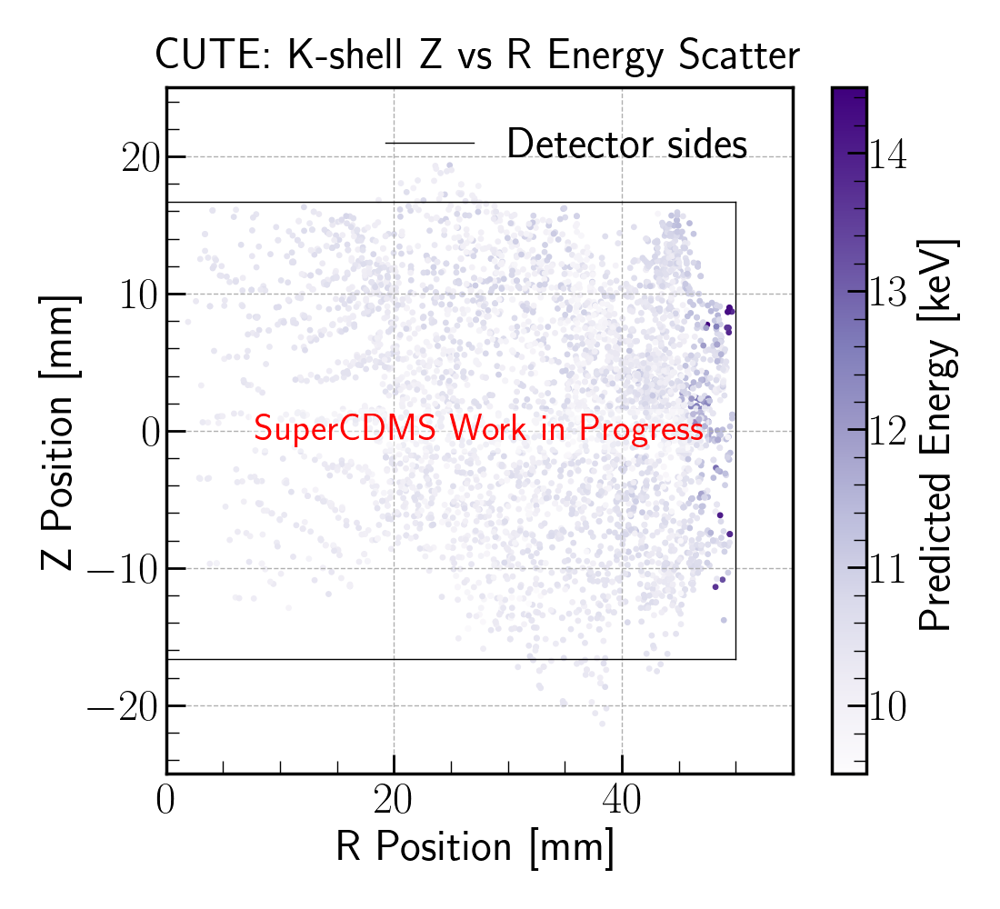
Z Resolution

