Slide 1

Charge Calibrations of the HELIX Time-of-Flight System
Kaitlyn Broad* under the supervision of Dr. Nahee Park*
August 12th, 2026 – CASST 2026
*The Department of Physics, Engineering Physics, and Astronomy at Queen's University

Slide 2
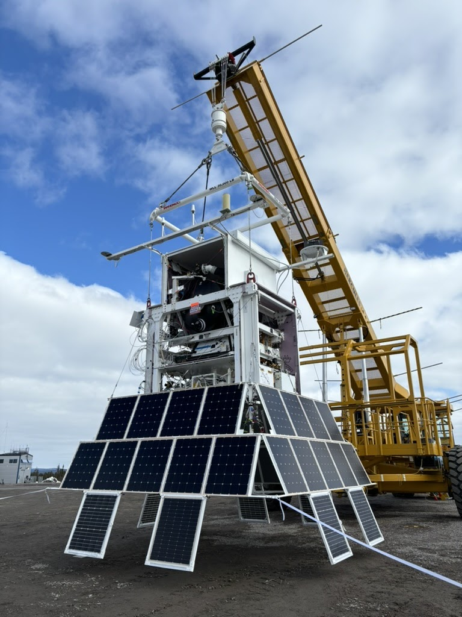
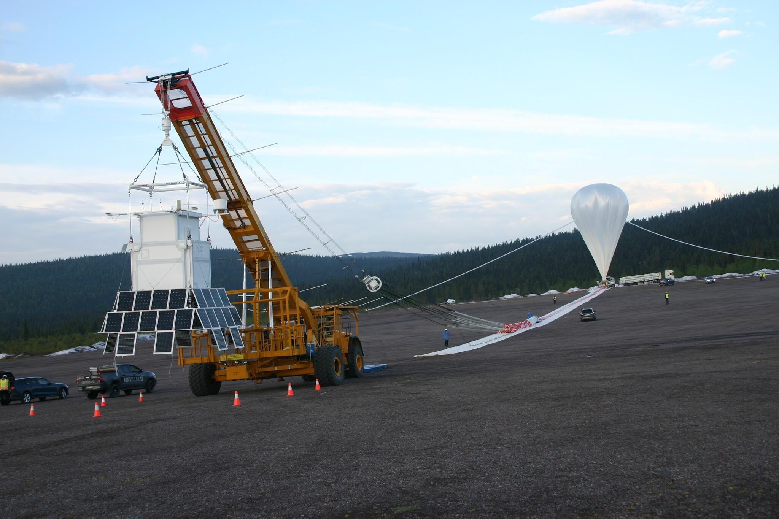
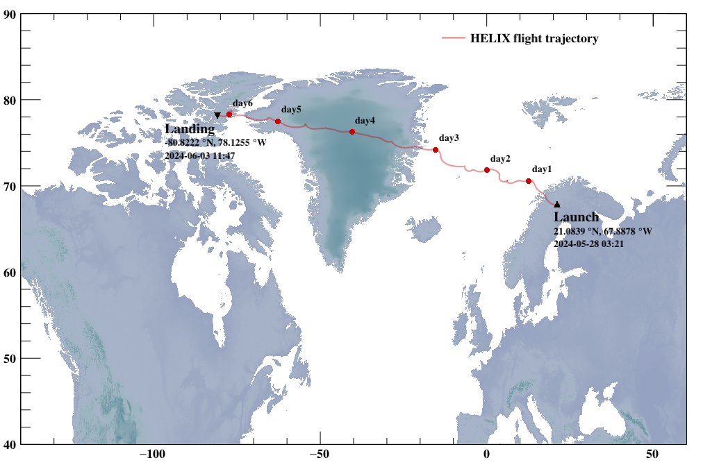
High Energy Light Isotope eXperiment (HELIX)
Multi-phase balloon-borne experiment
Measure isotopic abundance of cosmic rays of 0.2-10 GeV/n
≈6.3 day flight in 2024
Photo credit: HELIX Collaboration
Notes:
What is /n unit?: per nucleon

Slide 3
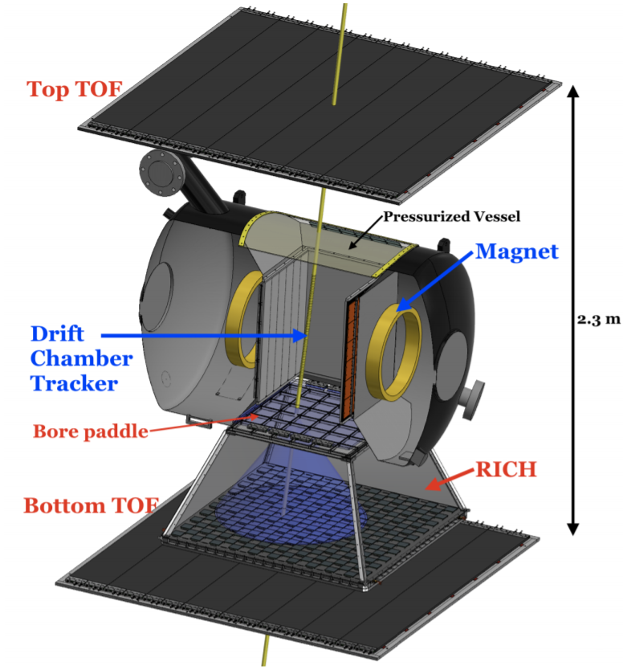
HELIX Subdetectors
Drift Chamber Tracker (DCT)
Time-of-Flight (TOF)
Ring Imaging Cherenkov (RICH) detector
Photo credit: HELIX Collaboration
Notes:
Drift Chamber Tracker
Time of Flight detector
Ring Imaging Cherenkov detector

Slide 4
Time-of-Flight System (TOF)
TOF paddles allow us to detect the charge and velocity of particles passing through
3 paddles from the detector: top, bottom, bore
The particle must pass through all 3 paddles to form the system trigger
Photo credit: HELIX Collaboration

Slide 5
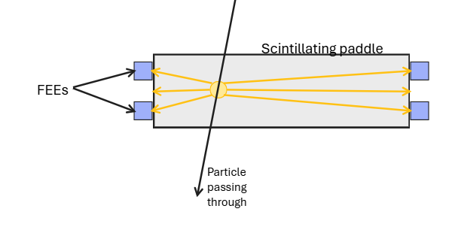
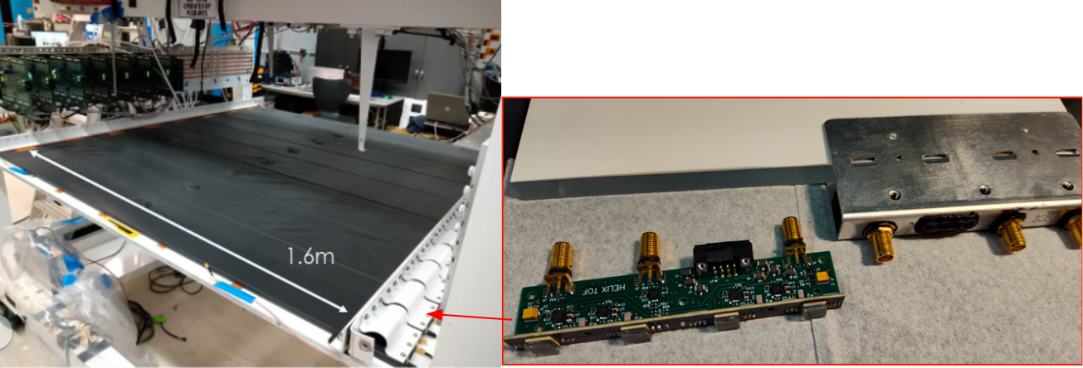
Top and bottom TOF Paddles
8 scintillating paddles per layer
Top and bottom are 2.3m apart
1.6m long, 40cm wide, 1cm thick
8 silicon photomultipliers (SiPM) and 2 front end electronics (FEE) at each end
Light scatters isotropically
64 FEEs in total
Photo credit: HELIX Collaboration

Slide 6
Motivation
Top and bottom TOF paddle will uniformly detect each cosmic ray
Read the same charge throughout the detector
Obtain more accurate charge measurements

Slide 7
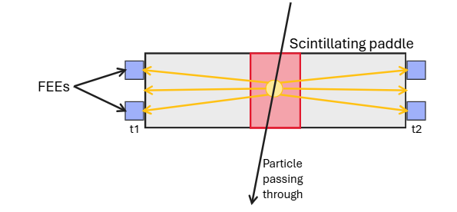
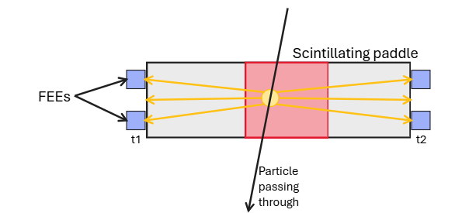
Tof paddle time cuts
Determine the time it takes for the light to reach the FEEs
Apply time cut
  |t₁ – t₂| ≤ 1ns or 2ns
t₁ and t₂ must be roughly equal for the particle to be roughly centered to properly perform the calibration
1 nanosecond
time cut
2 nanosecond
time cut

Slide 8
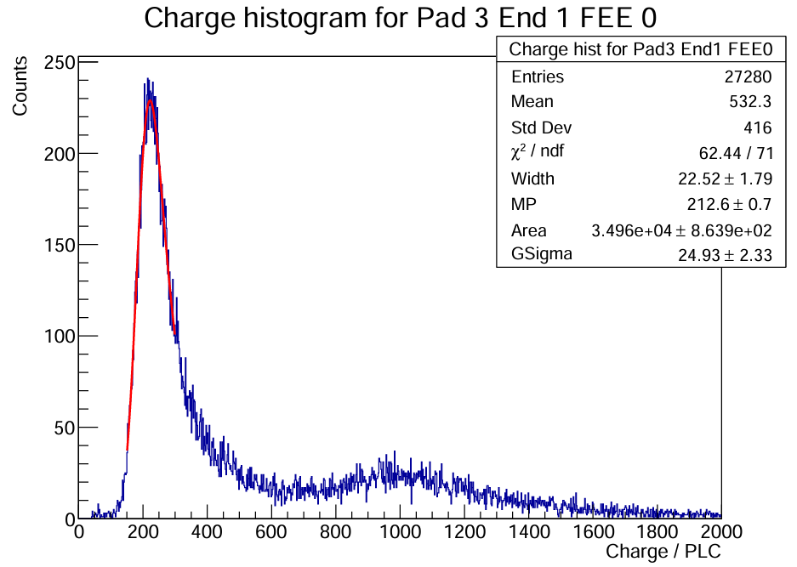
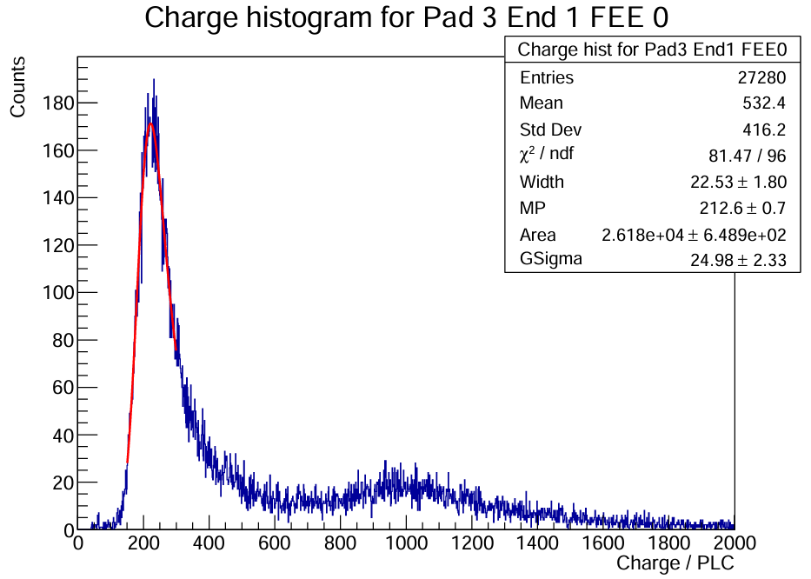
Charge Histograms
1 nanosecond
x-axis: Charge/PLC
Fit a langau function
Determine the most probable value (MPV)
2 nanoseconds

Slide 9
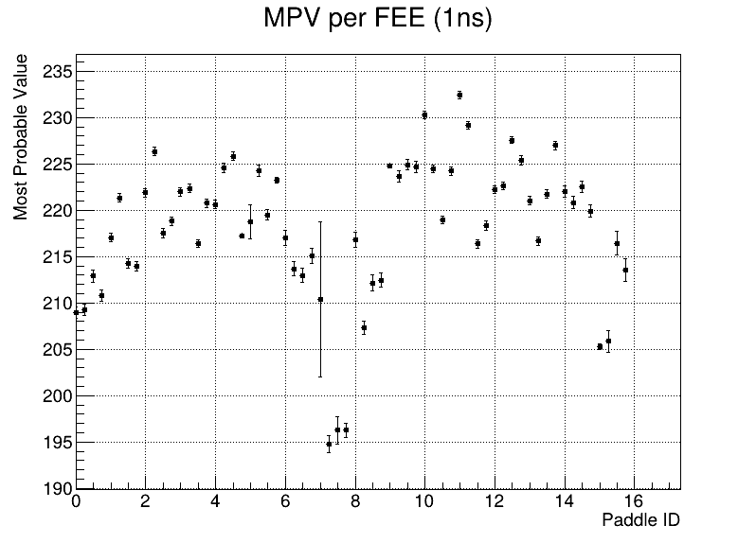
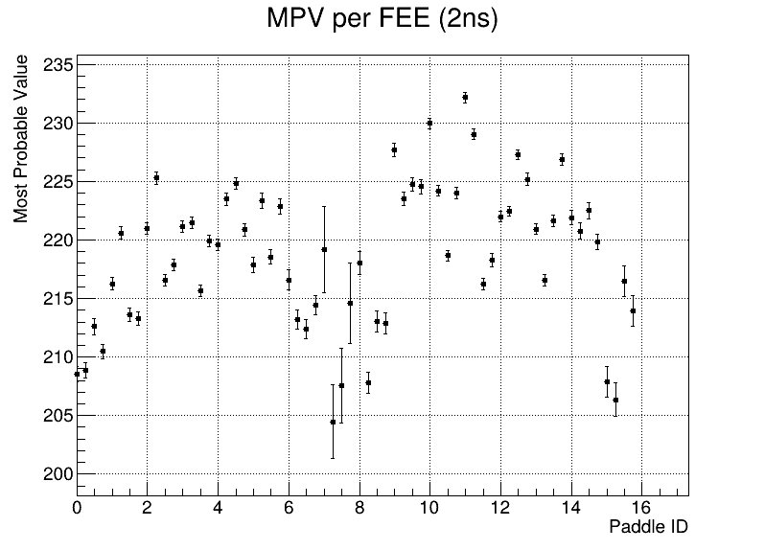
Calibrations
MPV ÷ 220 = Correction value

Slide 10
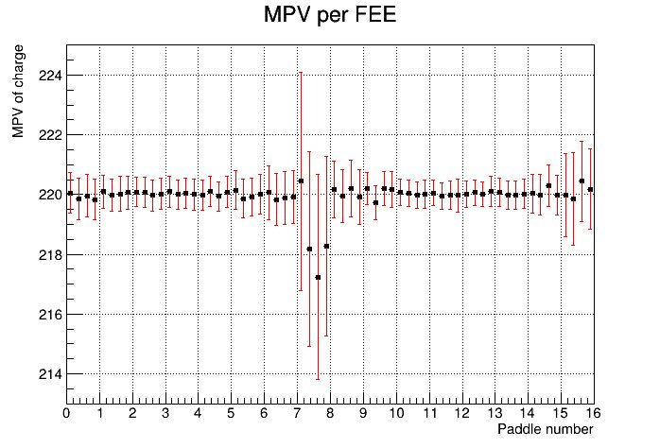
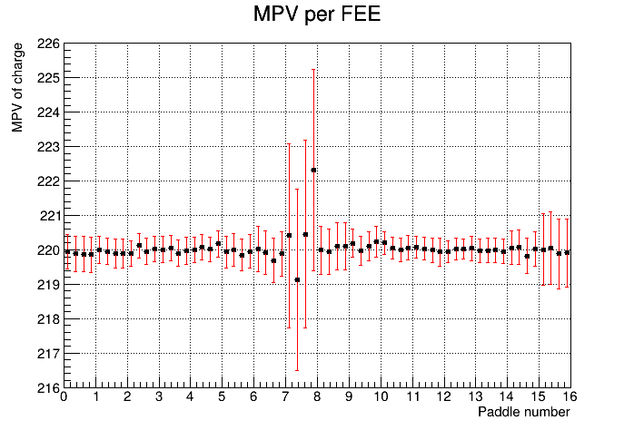
Results
1 nanosecond
2 nanoseconds

Slide 11
Results – Correction values
1 nanosecond
2 nanoseconds
Min: 0.947507, Max: 1.07225
Avg correction value: 1.00570
Pad 3 End 1 FEE 0: 1.01988
Min: 0.951829, Max: 1.05912
Avg correction value: 1.00342
Pad 3 End 1 FEE 0: 1.01967

Slide 12
summary
Apply time cuts
Create FEE histograms and fit langau function
Determine MPV
Calculate correction values
Apply correction values

Slide 13
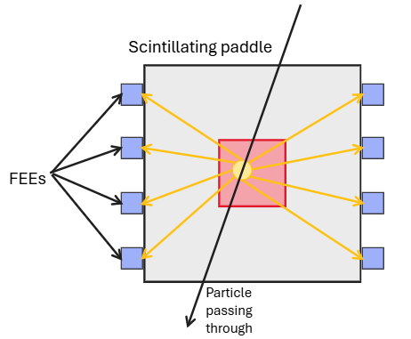
Next steps: Bore Paddle Calibrations
Area cut instead of time cut
4 FEEs on 2 opposing sides
61cm x 61cm, 1cm thick
1.5m below top paddles

Slide 14
Thank you!
Questions?

Slide 15
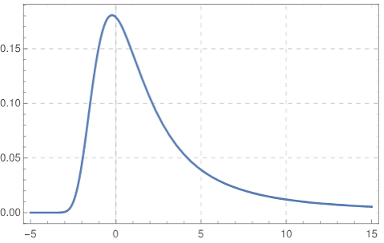
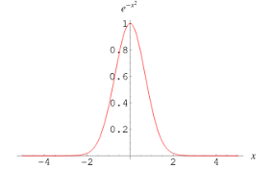
What is a langau function?
Convolution between landau and gaussian functions
+
=

