Slide 1


CITIROC BASED SIPM READOUT FOR HELIX RICH DETECTOR
Lily Moss
Queen’s University
Supervised by Dr. Nahee Park

Slide 2


Project Background
High Energy Light Isotope eXperiment
(HELIX)
  Cosmic ray balloon experiment
  Studying propagation of cosmic rays
  Optimized to measure 9-Be and 10-Be isotopes
  Clock isotopes provide insight into propagation times
  First flight in May 2024, studied 0.2 - 3 GeV / n
  Further flights up to 10 GeV / n
01

Slide 3
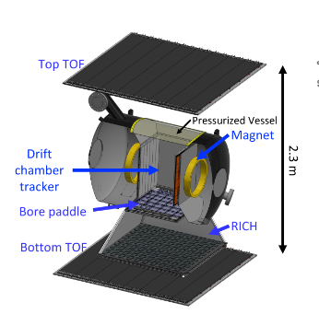
HELIX Instrument
  TOF: scintillating paddles, measures timing, velocity and charge
  DCT: multi-wire gas detector, tracks position to measure rigidity
    Housed within 1 T superconducting magnet
  RICH: Ring Imaging CHerenkov detector
    Radiator plane: aerogel tiles produce Cherenkov light
    Focal plane: array of 12800 Silicon Photomultipliers (SiPMs)
    Measures velocity of higher energies
02
Notes:
kaitlyn talking about TOF

Slide 4
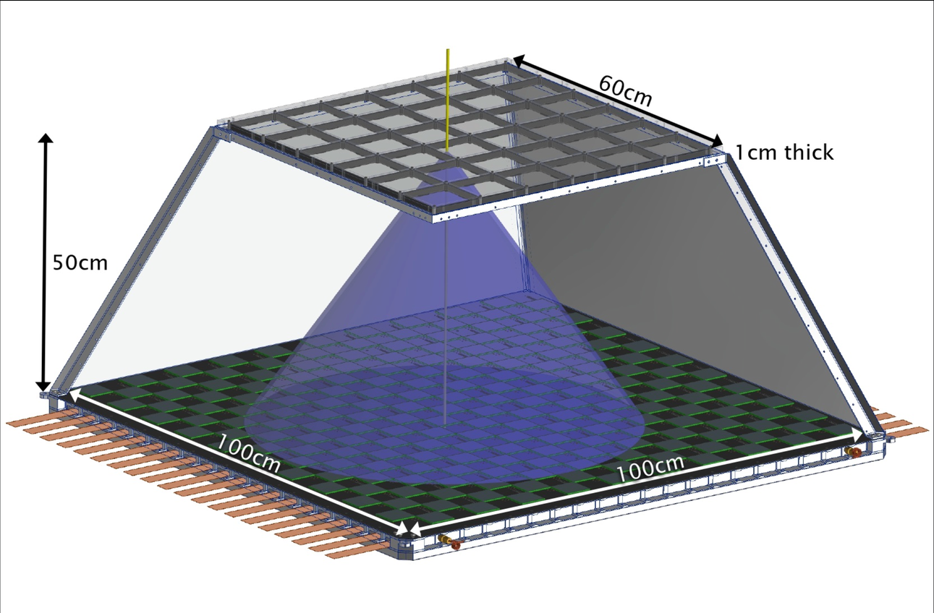
The RICH
Radiator Plane:
  Aerogel properties:
    Tuneable refractive index
    Low density
  NaF: for cross calibration measurements with TOF
Focal Plane:
  1 square meter
  12800 SiPMs each 6mm x 6mm
Requirements
  Low power consumption
  Trigger 12800 SiPMs at 1 PE (Photoelectron)
03

Slide 5
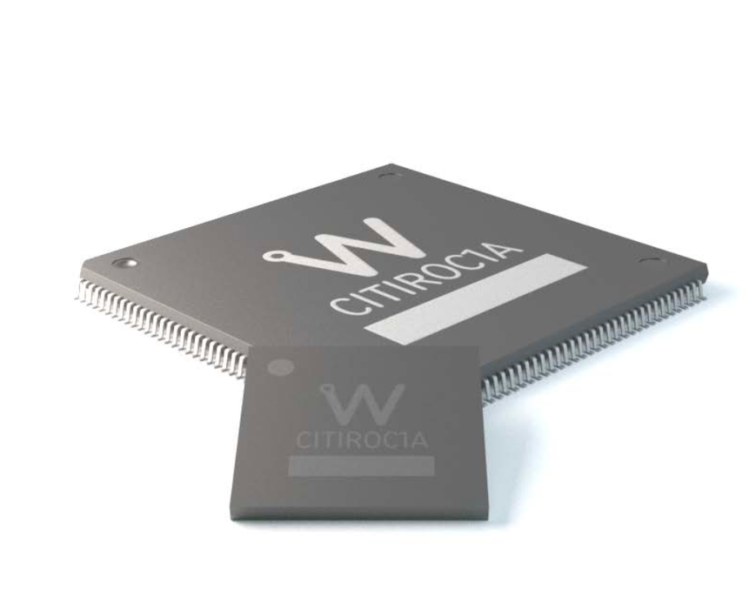
The CITIROC
Cherenkov Imaging Telescope Integrated Read Out Chip (CITIROC)
  32 channel ASIC (Application-Specific Integrated Circuit)
  Triggers on > ⅓ PE
  Charge measurements through positive signal integration
  Power consumption 225 mW (low)
04

Slide 6




Upgrade to the RICH
Dual-Layered Aerogel
  Aerogel tiles with two different refractive indices
  Benefits:
    Multiple cherenkov cones
    Improved energy threshold (maintaining mass resolution)
  Upcoming beam test to quantify how much this will improve our resolution
  Beam test will involve a model set-up with CITIROCs and SiPMs
  My work: characterize SiPMs and CITIROC DT5202 to be used in beam test
05

Slide 7
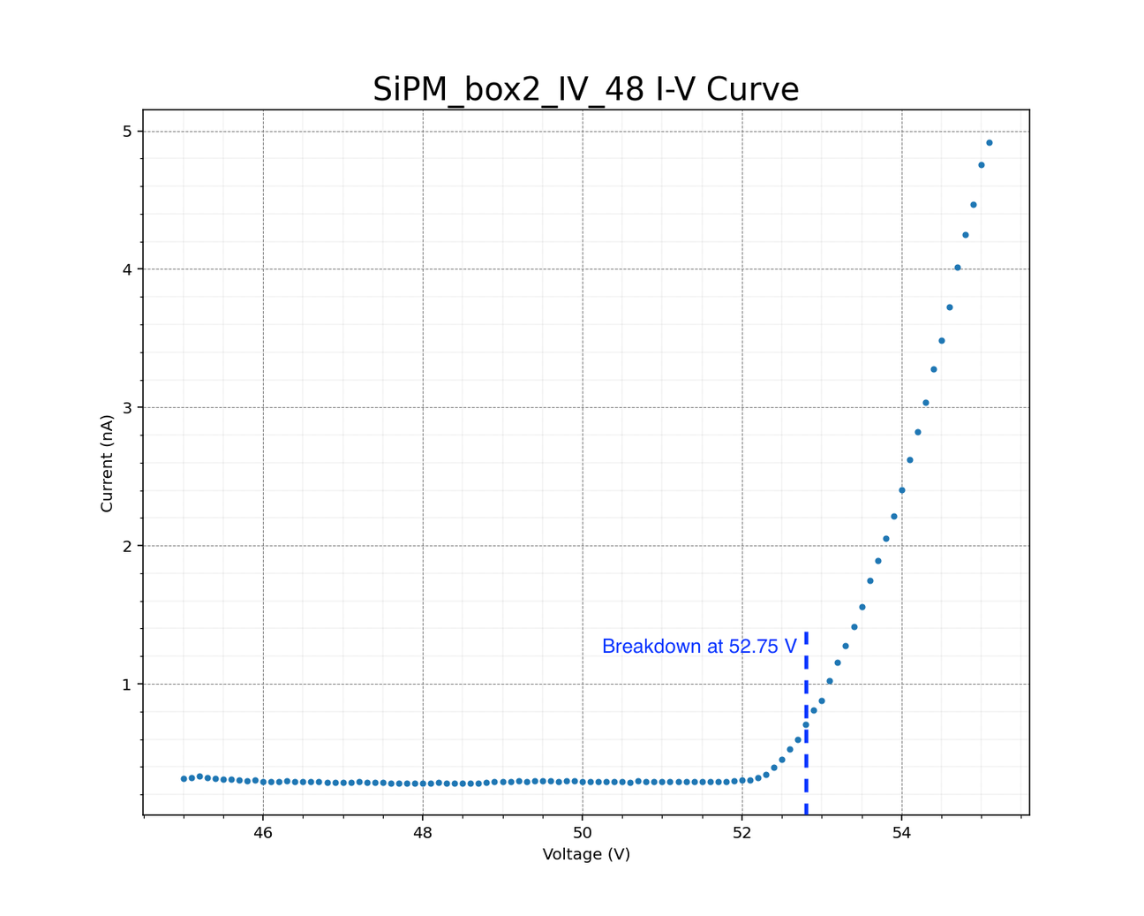
Characterizing SiPM
Current vs Voltage (IV) curves:
  Goal: measure breakdown voltage for gain calculation
  Breakdown voltage is a property of the SiPM
    It’s the point when the SiPM starts being conductive and able to measure light
  It is calculated using an approximation of the local second derivative
  Measured breakdown at 52.65 +/- 0.08 V
  Manufacturer breakdown at 52.2 V
IV curve
Breakdown at 52.65 +/- 0.08 V
06

Slide 8
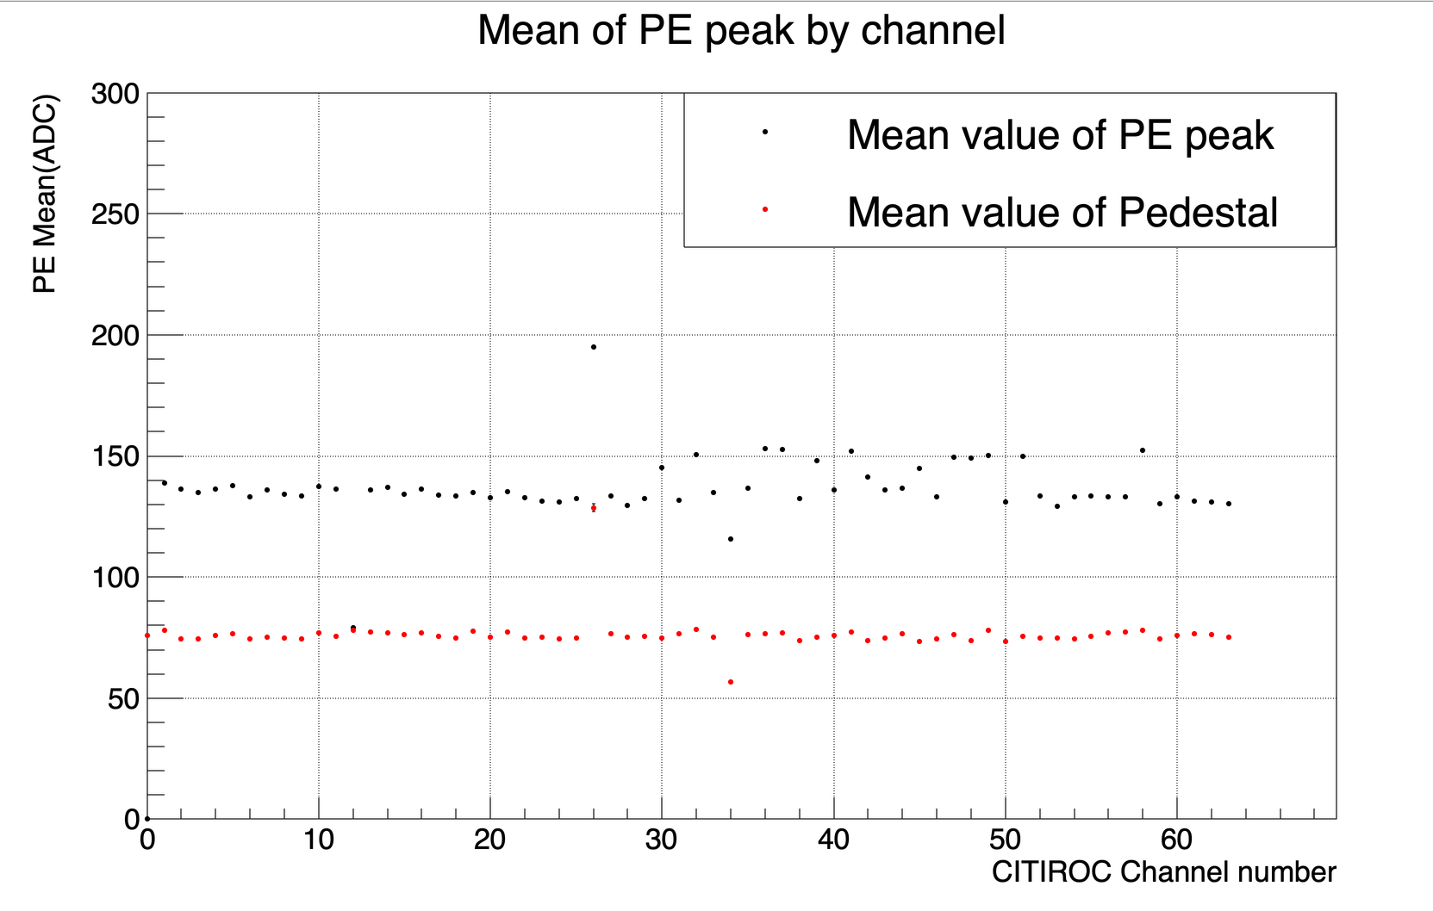
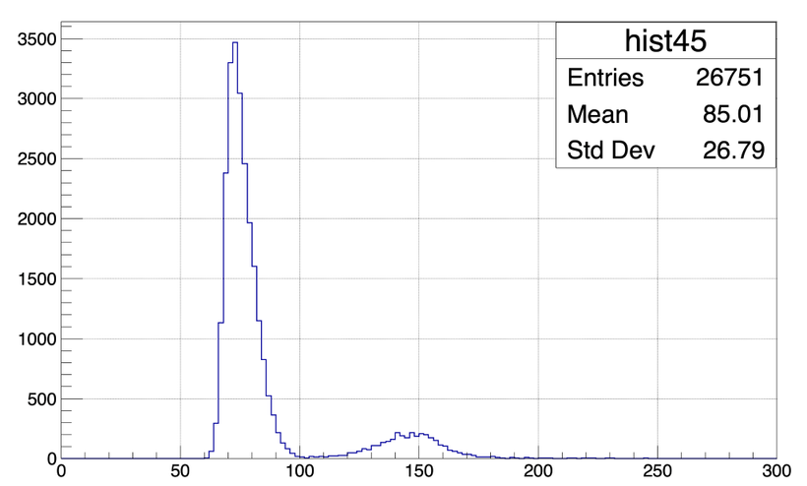
CITIROC DT5202
Mean of Pedestal and PE
  CITIROC DT5202 is the model planned for use during RICH upgrade beam test
  Goal: check uniformity of all 64 channels
    Pedestals: 3.5% variation
    Photoelectron (PE) peaks: 7.4% variation
Example of Charge histogram from one channel
Counts
Pedestal
1 PE
ADC Channels
07

Slide 9
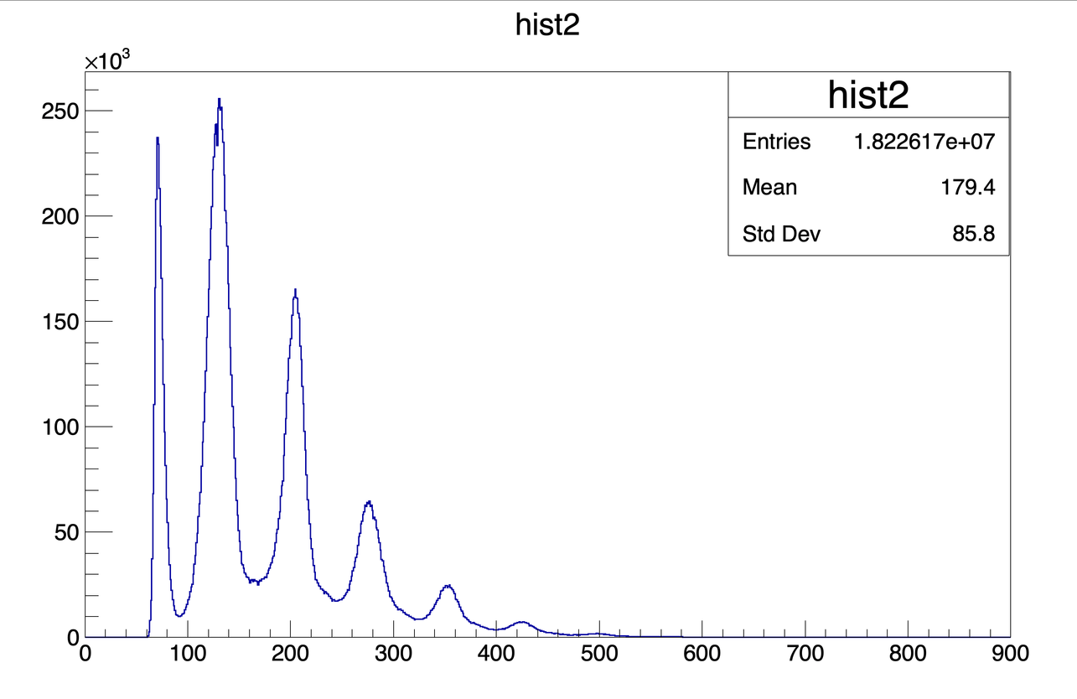
PE spectrum
SiPM
PE spectrum
Signal
CITIROC
1 PE
Light
Pedestal
LED
Trigger
2 PE
Counts
  Testing with LED driver
  Results
    CITIROC parameters have been optimized
    CITIROC board output has linearity
3 PE
4 PE
5 PE
ADC Channels
08

Slide 10
Summary
  Dual-refractive index aerogel upgrade to RICH, needs to be tested to make sure performance will improve
  CITIROCs for SiPM readout in the RICH
  SiPM characterized by the breakdown voltage
  CITIROC channel validation
  Tested CITIROC paramters and linearity
09

Slide 11
THANK YOU

Slide 12
RICH Specs
  32 hydrophobic aerogel tiles (n=1.16)
  4 tiles of NaF (n=1.33), one in each corner
  All tiles are 10 cm x 10 cm x 1 cm
  Focal plane has 200 SiPM arrays
    Each has 64 SiPMs
  β resolution of 0.1% for Z>3
  Hamatsu SiPMs with 75 um pitch
  Checkered pattern to maximize area and reduced cost
10

Slide 13
The CITIROC (cont’d)
CITIROC specs
  Power consumption of 225 mW
  Supply voltage 3.3 V
  Positive Signal Polarity
  Timing resolution better than 100 ps (RMS of one PE)
  Dynamic range 0-400 pC (or 2500 PE with SiPM gain of 10e6)
11

Slide 14
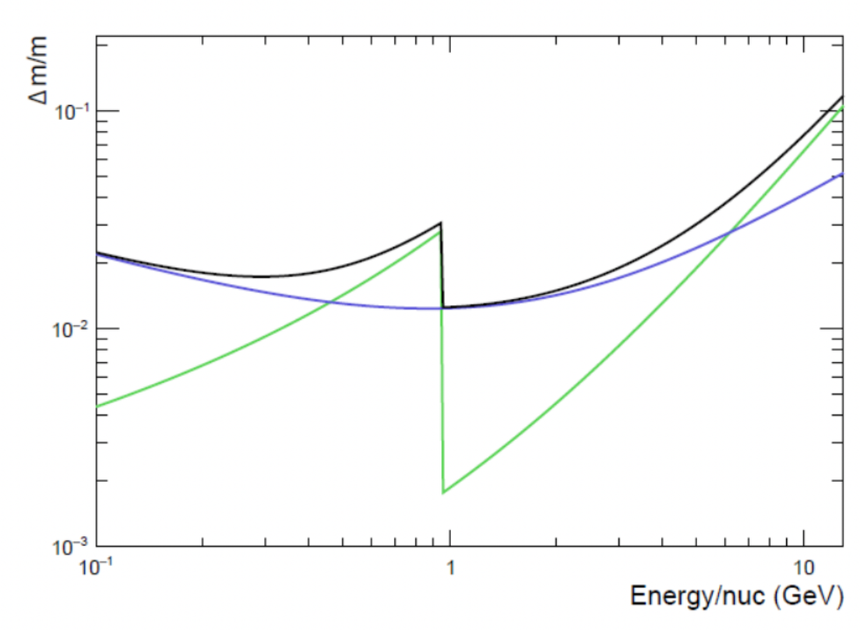
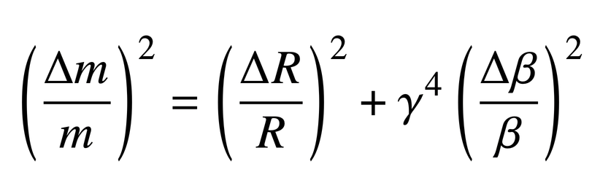

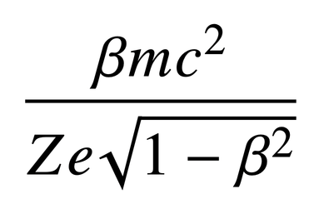
HELIX Resolution
  HELIX measures rigidity, velocity and charge
  Calculates mass to determine which isotope of Beryllium
  Requires high mass resolution to distinguish between isotopes (designed for 3%)
Mass Resolution
Velocity resolution
Overall resolution
The High Energy Light Isotope eXperiment program of direct cosmic-ray studies (2024)
Cosmic-ray isotope measurements with HELIX (2019)
12

Slide 15
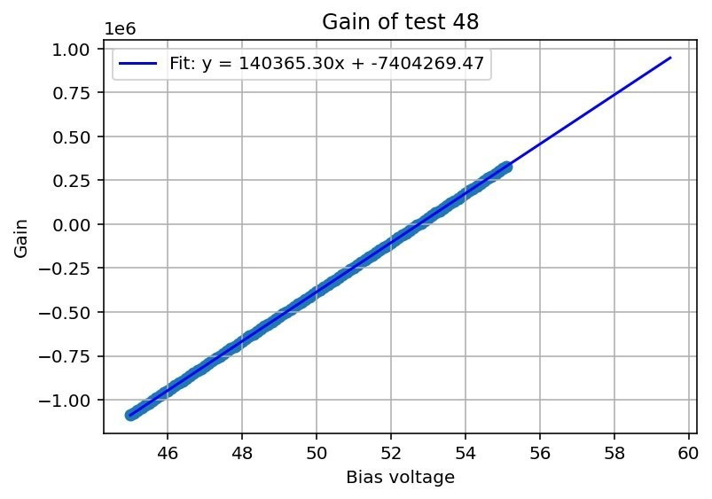

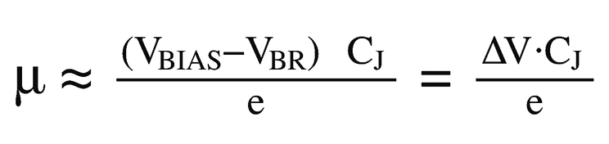
Characterizing SiPM
Gain from IV curve:
  Goal: calculate gain using breakdown voltage
  Results: gain = 687789.96​ (at 22.6ºC)
  Matches expectations of 7e5 at 25ºC
  So this SiPM is functional and we can use it with the CITIROC!
02.
Gain is 687789.96
Operational voltage at 57.2 V
13

Slide 16
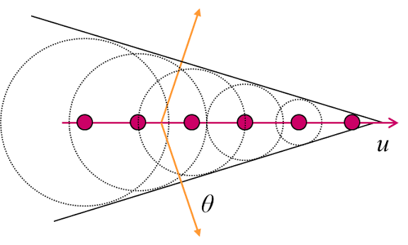
The RICH
Cherenkov Light
  A particle travels faster than light in a medium
  Medium is excited, and as it returns to ground state, emits photons
  Wave fronts interefere constructively, creating a cone shape
14

