Slide 1
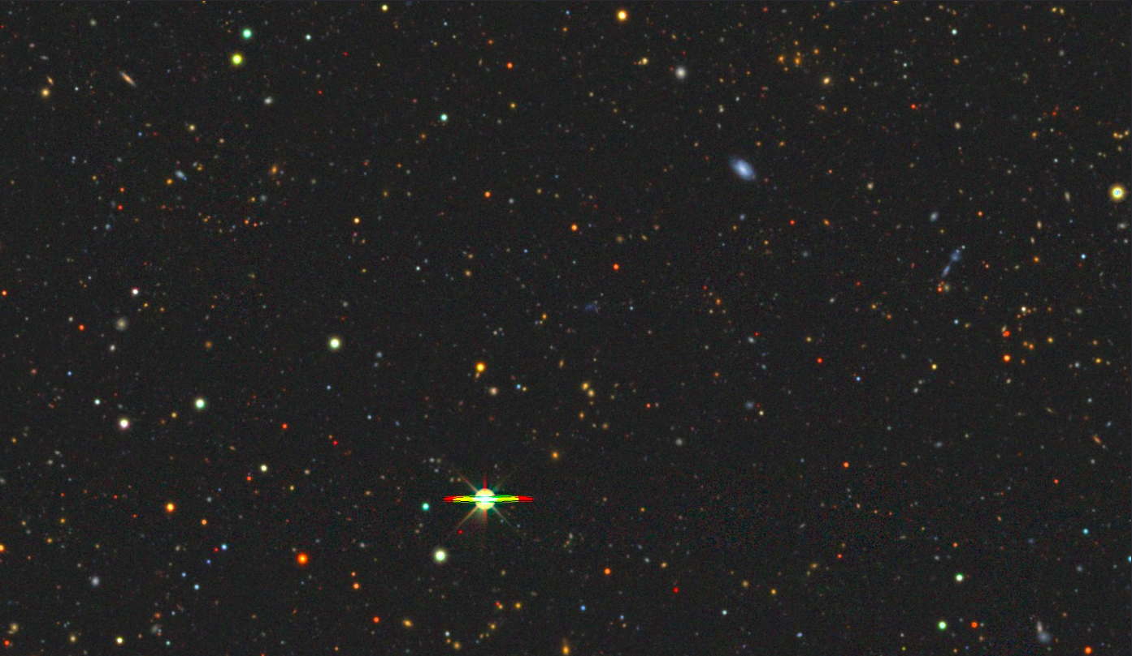
A Shot in the Dark:
Searching for Dark Galaxies in the ALFALFA Catalog
Patrick Wang, Haverford College
Dr. Kristine Spekkens, Queen’s University
© Legacy Surveys / D.Lang (Perimeter Institute)

Slide 2

Dark Galaxies
2
Reservoirs of starless gas (neutral hydrogen; HI)
  Hosted by low-mass dark matter haloes
Predicted by $Λ$CDM and various cosmological simulations
The absence of stars makes them difficult to detect
  Theoretically detectable by the HI gas itself (as radio data)
Notes:
Put simply, dark galaxies are reservoirs of starless gas, surrounded by dark matter haloes that are too small to collapse that gas to form stars
They’re predicted by the lambda cdm model of the universe, and produced by various cosmological simulation. Finding them would thus clarify our cosmological theories and understanding of galaxy evolution. But, that’s if we could find them
A big part of the reason we haven’t officially found any yet is because they are starless and therefore optically invisible. So, astronomers look for the gas itself—in the form of neutral hydrogen or HI. There’s a lot to say here about how we specifically detect HI, but for the sake of time, just know that HI is detectable at radio frequencies

Slide 3
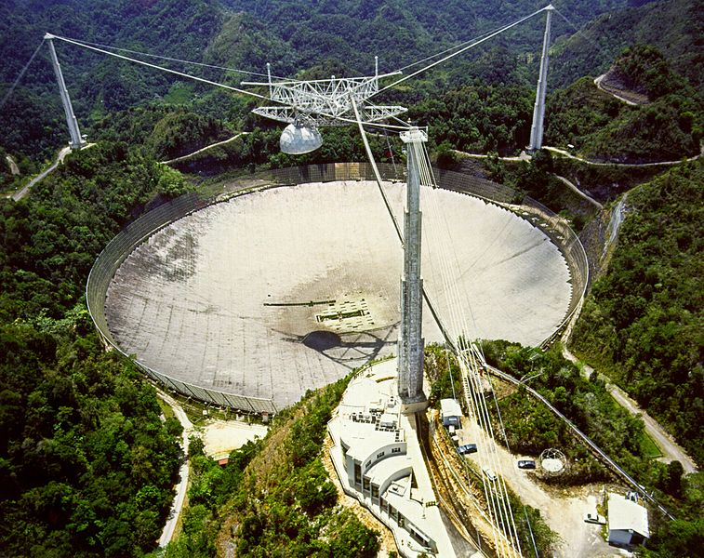
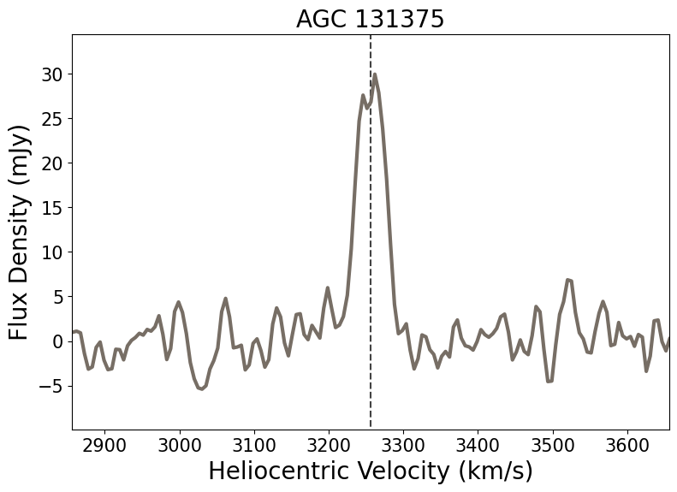
The Arecibo Legacy Fast ALFA Survey (ALFALFA)
3
Arecibo observed from 1963 to 2020, making over 30,000 detections
  Especially sensitive at HI sources (1420 MHz)
Observations in the form of spectra
Notes:
Arecibo was a leading-edge radio telescope that collected data for over 50 years, compiling its detections into the massive ALFALFA catalog, complete with their coordinates and other such properties
Being a radio telescope, it was specialized to detect HI source frequencies,
Observing them in the form of spectra like this
This example depicts an HI source (which could be a galaxy or just a cloud). Its energy is expressed on the y-axis as the flux captured by Arecibo’s beam (another way to think of them is brightness), and the x-axis is a measure of VHELIO, how fast this source is moving away from us, which is a proxy for its redshift

Slide 4
Our Dark Galaxy Candidates
4
Obtained from two sources:
  Kwon et al. 2025 (K25)
    142 galaxies
  Luke Leisman’s 2017 PhD Thesis (L17)
    243 galaxies + 47 confirmed spurious detections
The goal: cross-match these and obtain a new sample of high-confidence dark galaxy candidates for potential follow-up by the Green Bank Telescope
Notes:
Our data is composed of two catalogs of HI sources, one being a paper from last year by Kwon et al., which I’ll call K25, and another being Luke Leisman’s 2017 PhD Thesis, which I’ll call L17.
Both of these sources contain lists of ALFALFA galaxies classified as lacking an optical counterpart
In other words, they’re HI sources that Kwon et al. and Leisman thought were good dark galaxy candidates, because when they looked at the sources’ optical imaging, they found nothing obvious there
Because these come from two separate eras of optical imaging and HI detections, my goal is to cross-match these independent catalogs to get a refined sample of even higher-confidence dark galaxy candidates, that we can potentially follow up with the Green Bank Telescope—a modern radio telescope that’s even more sensitive than Arecibo was, all in the hopes of narrowing our search for dark galaxies

Slide 5
5
Notes:
This is the result of our cross-matching between K25 and L17, showing the distribution of data within the K25 subsample specifically
Wanna work with it cause its recent
45 galaxies were independently deemed DGCs by K25, 56 were agreed upon by K25 and L17, and 41 were deemed by L17 to be spurious, or unreal detections
(in case of questions; spurious from follow-up with Arecibo L-band wide)

Slide 6
5
Notes:
My work involves taking these 101 DGCs and seeing how we can refine the sample

Slide 7
6
Spectral analysis – Plotting the original ALFALFA spectra will give us insight into the quality of the detections and properties of the alleged galaxies
Interpreting our new dataset
Checking for optical counterparts – Examining K25 and L17’s methodology and reconfirming their findings with different techniques will allow us to refine our final sample
Notes:
This will involve two main tasks: The first one involves analzying the original ALFALFA spectra, and the second involves double checking for the absence of optical counterparts, which is especially relevant to L17, as deeper and higher-resolution optical imaging surveys have emerged since 2017
In the next few slides, you’ll see how these steps built off each other to paint a fuller picture of each detection
In case of questions: compared to K25, I was more liberal with my OC classification—they had stricter definitions for what was considered a

Slide 8
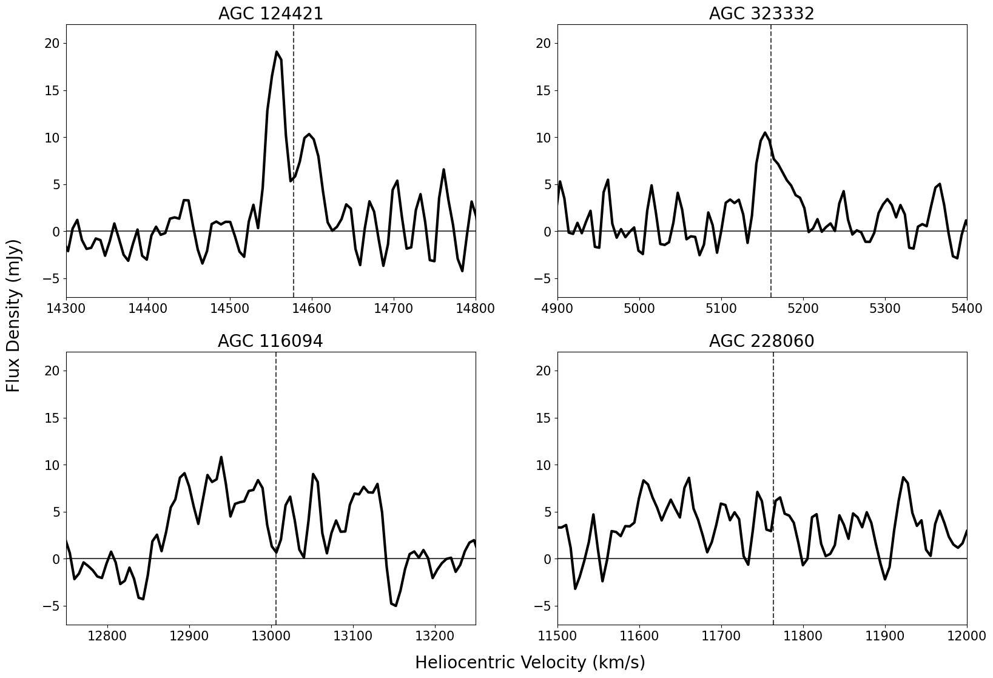
7
Spectral Shape Classification Scheme
Notes:
For the first step, I looked at the spectra of each of the 101 detections, classifying and color coding them based on their shape, quality, and perceived legitimacy

Slide 9
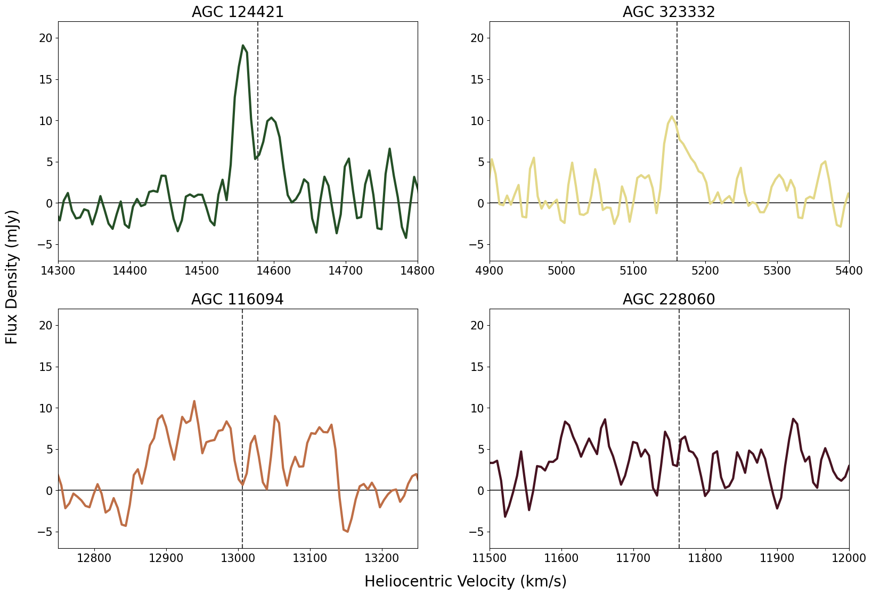
7
Double
horn
Single peak/
ramp shape
Wide / multiple peaks
Bad baseline / interference
Notes:
Here’s the general scheme: green indicates the highest confidence of a galaxy detection, usually characterized by a double horn profile in which both ends of a galaxy—one rotating away from us and one rotating toward us—are visible. Yellows were usually single peak-detections, indicating that something was there, but maybe not necessarily a galaxy. Orange and red were detections with bad and badder quality, respectively.

Slide 10
8
Checking for
Optical Counterparts
Using DESI Legacy Survey Sky Viewer & SIMBAD
Notes:
Next, to check for optical counterparts, we use DESI’s optical survey and simbad, an extensive resource used to search for properties of known and cataloged stars, galaxies, and everything in between

Slide 11
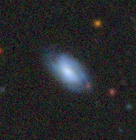
DESI Image of AGC 219555 (V_{hel} = 3391 km/s)
9
LEDA 1532003: 17282 km/s (Ahumada et al. 2020)
100 arcsec
© Legacy Surveys / D.Lang (Perimeter Institute)
Notes:
These are the coordinates of agc219555, recorded as having a vhelio of 3391 km/s
Clearly, there many things in this picture we could say are optical counterparts, but the most obvious that would make sense for this vhelio value is this blue galaxy here
But, when we search in simbad, we see that its vhelio is way off, so maybe agc219555 doesn’t have an optical counterpart
There are two facts that complicate this: one is that HI gas can and often extends far beyond its host galaxy. The other is that the Arecibo beam has a nominal width of 3.5’, but it is uniquely shaped, and can often detect beyond this

Slide 12
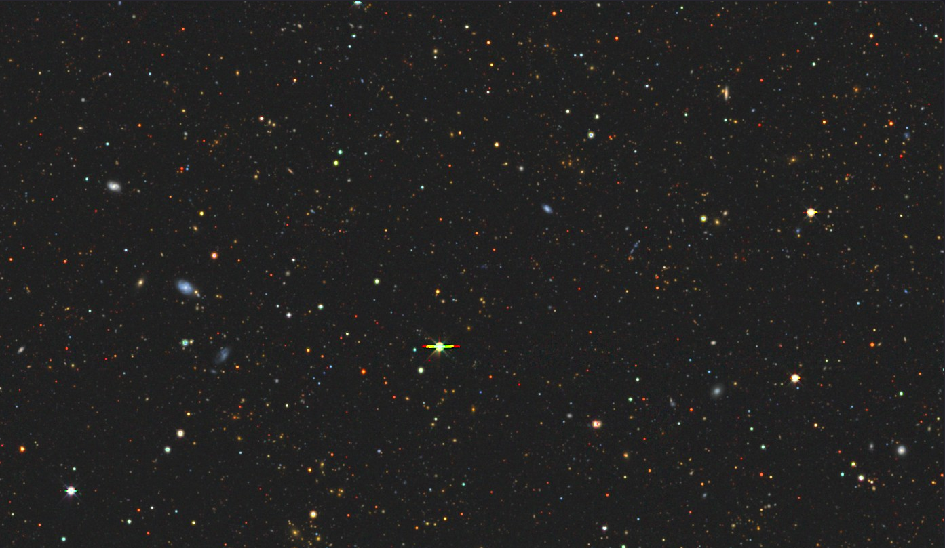
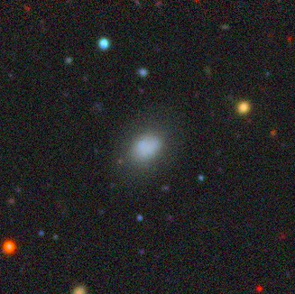
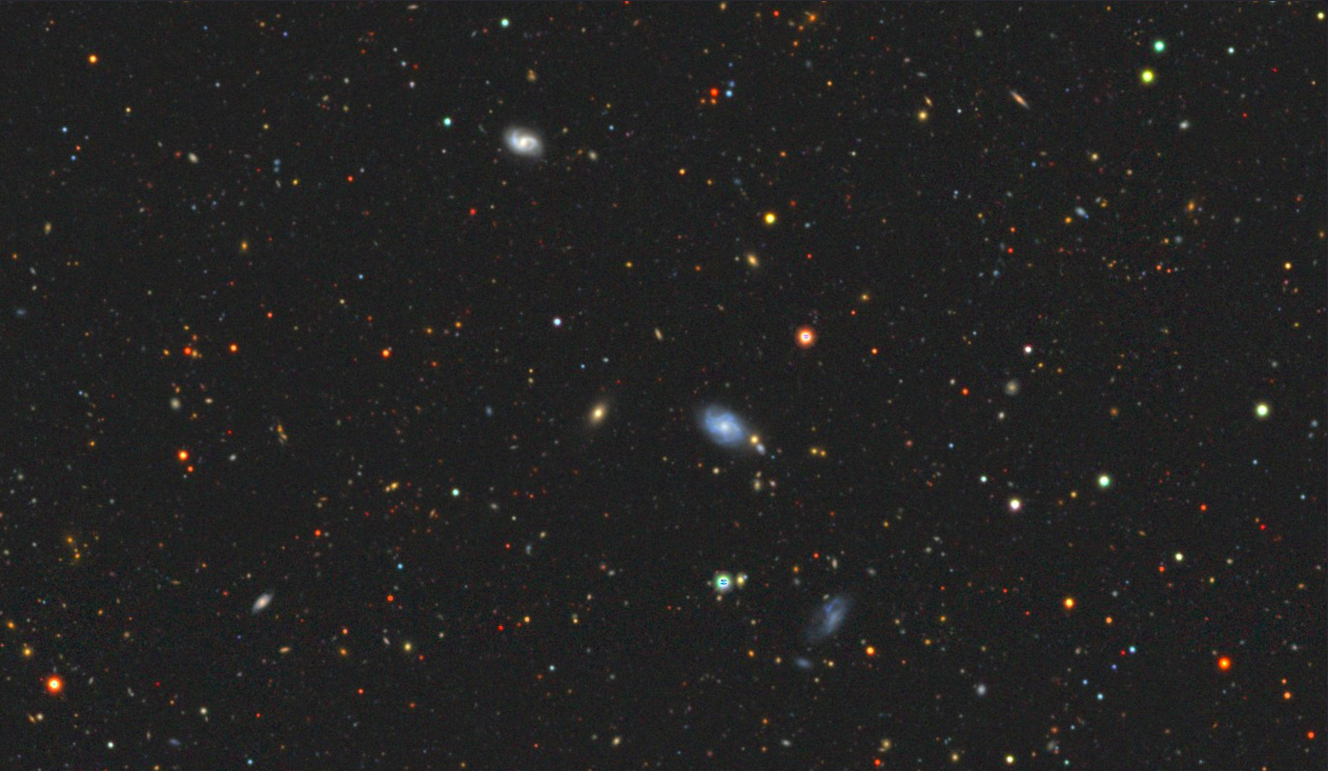
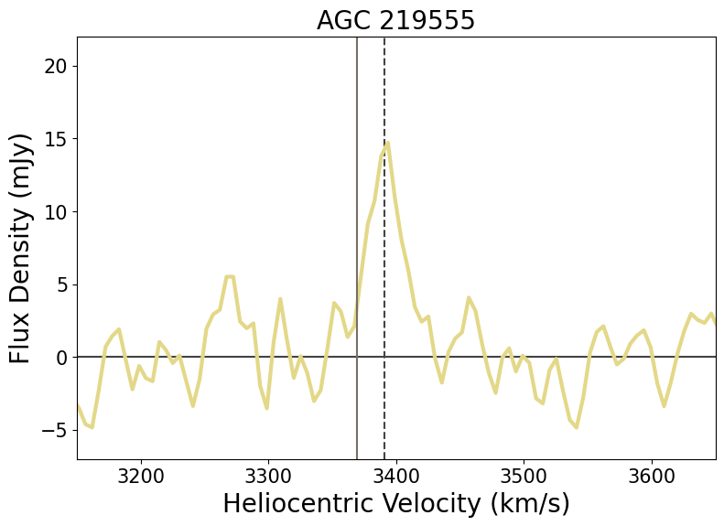
DESI Image of AGC 219555 (V_{hel} = 3391 km/s)
10
LEDA 1532274: 13731 km/s
(Ahumada et al. 2020)
LEDA 1529933: 3369 km/s
(Ahumada et al. 2020)
LEDA 1531099: 6661 km/s
(Ahumada et al. 2020)
SDSS J114310.55+172009.7:
6709 km/s (Yu et al. 2022)
5 arcmin
© Legacy Surveys / D.Lang (Perimeter Institute)
Notes:
Next step here is to zoom out and give ourselves a couple more options to work with. These three galaxies on the left might be promising, but simbad says otherwise
One of our last options is this galaxy toward the bottom right, which, it turns out, has a close enough vhelio for it to be an optical counterpart
And this starts to make even more sense when we refer to agc219555’s spectrum
It’s a single-peak detection, and when we consider the optical counterpart’s vhelio, we see that’ it’s very likely that, since this galaxy is on the edge of Arecibo’s beam, we’ve only caught one end of its double horn profile. (which we’d see if we were centered on bro) Both the spectrum and the optical imaging tell the same story, AGC219555 probably isn’t a dark galaxy, but just a detection of the edge of this normal one: great news in terms of finding an optical counterpart, and bad news in terms of searcihing for dark galaxies
This OC checking was also done for all 101 galaxies, and we similarly assigned each detection a color for the likelihood of having an OC (green meant no, red yes)

Slide 13
Color
Distributions
11
Spectral Shape | Number of Detections
Green | 11
Yellow | 28
Orange | 31
Red | 21
OC Checking | Number of Detections
Green | 26
Yellow | 22
Orange | 24
Red | 19
Notes:
these are the final numbers of our color coding schemes
From here, when considering the definition of a dark galaxy, the biggest threat to our sample were galaxies that we confidentally believed had an OC, these 19 red.
So, for our finalfainl sample, we removed these and made a couple more cuts

Slide 14
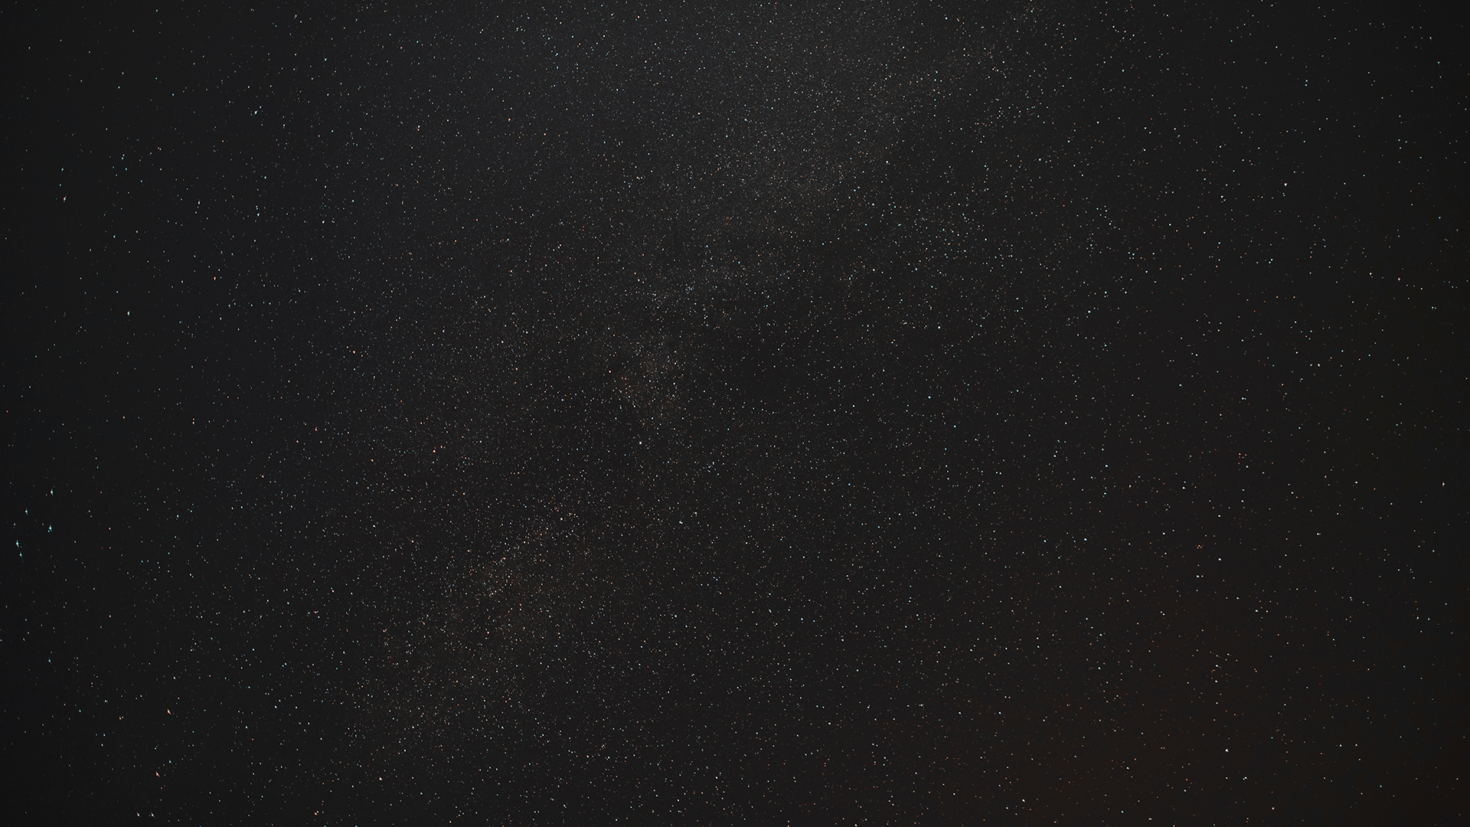
73
12
Dark galaxy candidates to (hopefully) be followed up by the Green Bank Telescope
Notes:
Giving us 73 dark galaxy candidates—some more confidently dark than others—that will hopefully be followed up by the GBT.
Qwin Goodwin, who lead this GBT proposal and helped me a lot this summer, will have more to say on thursday

Slide 15
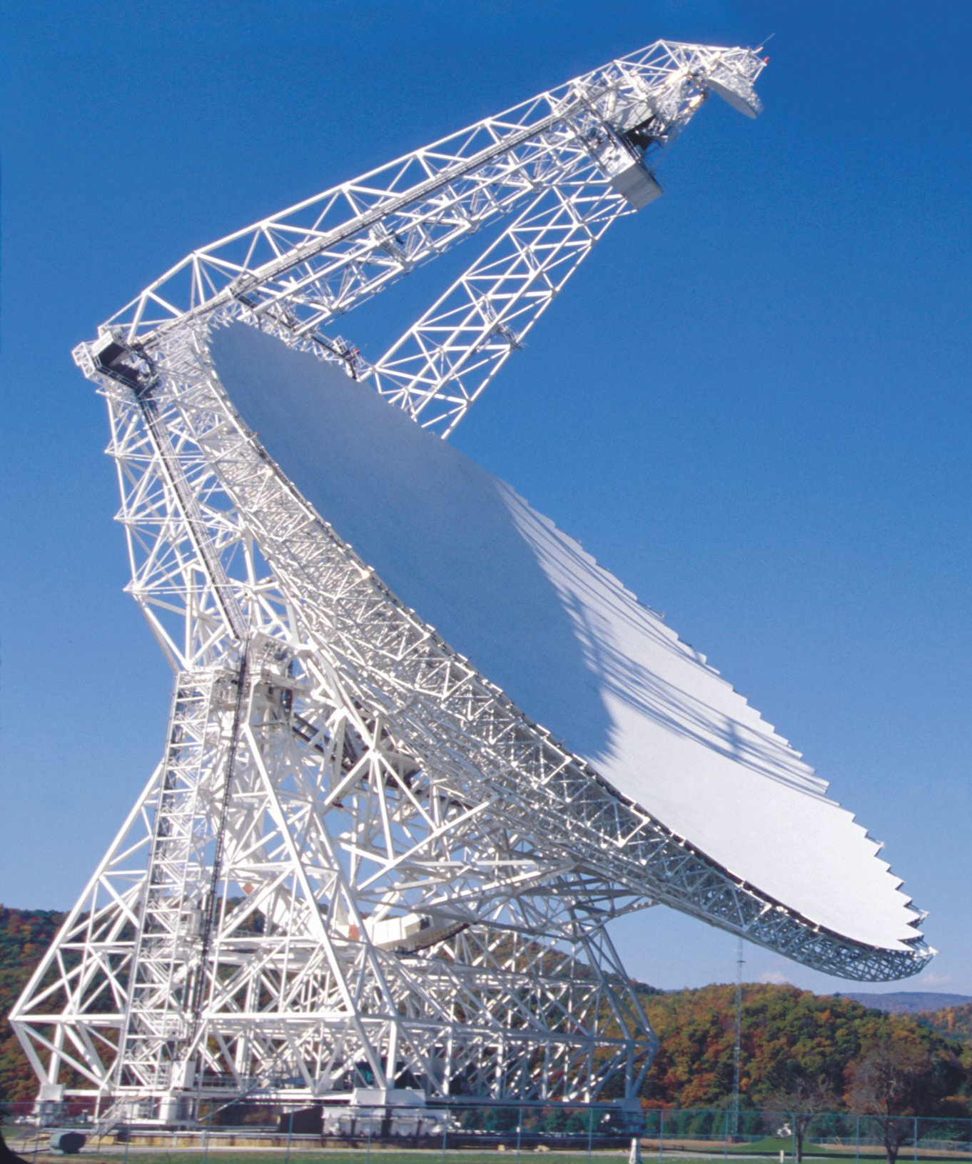


Thank you!
Do you have any questions?

Slide 16
