Slide 1

2026/08/12
Generation of Phonon Pulse Templates for SuperCDMS SNOLAB
Guneev Dhillon (He/Him)
Undergraduate Research Assistant
1
Notes:
Currently 11 mins 58 seconds
Can cut a bunch from slide 5 and 6 to shave it down to 10 min 13 seconds
---------------
Whats the maintenance for slide 3
Why are you taking so much data on slide 6 – why 1 hour
Slide 10: why is there a prompt signal
Slide 17: I didn’t notice any trend and I don’t see the triangles youre talking about
Define anisotropic

Slide 2
Overview
Introduction of SuperCDMS SNOLAB
Optimal Filter and Event Reconstruction
Event Selection
Template Generation
2
Notes:
17 seconds

Slide 3
SuperCDMS at SNOLAB
Notes:
3 seconds
Whole section: 3 min 30 seconds
Cut to 2:40

Slide 4
SuperCDMS SNOLAB Objectives
Adapted From: https://indico.cern.ch/event/1188759/contributions/5044015/
1 meV
1 eV
1 keV
1 MeV
1 GeV
1 TeV
“Wave-like DM”
“DM Absorption”
“DM Scattering”
“WIMPs”
Uses cryogenic detectors (O(mK)) to search for dark matter
Sensitive to multiple interaction mechanisms
  Nucleon coupling: 0.05 – 5 GeV/c²
    Nuclear recoil
4
Notes:
25 seconds
Opens me up to a lot of questions
The point of this slide is just that supercdms is <GeV, low mass

Slide 5
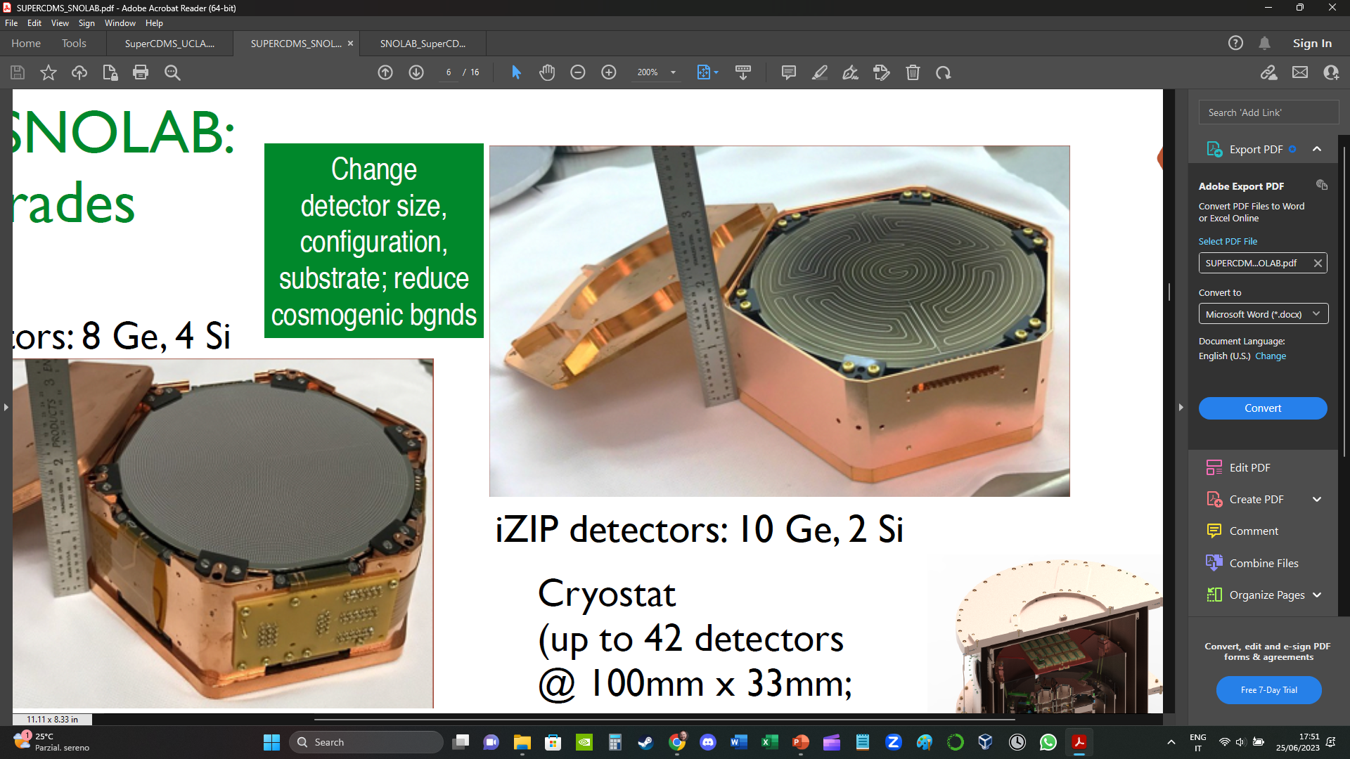
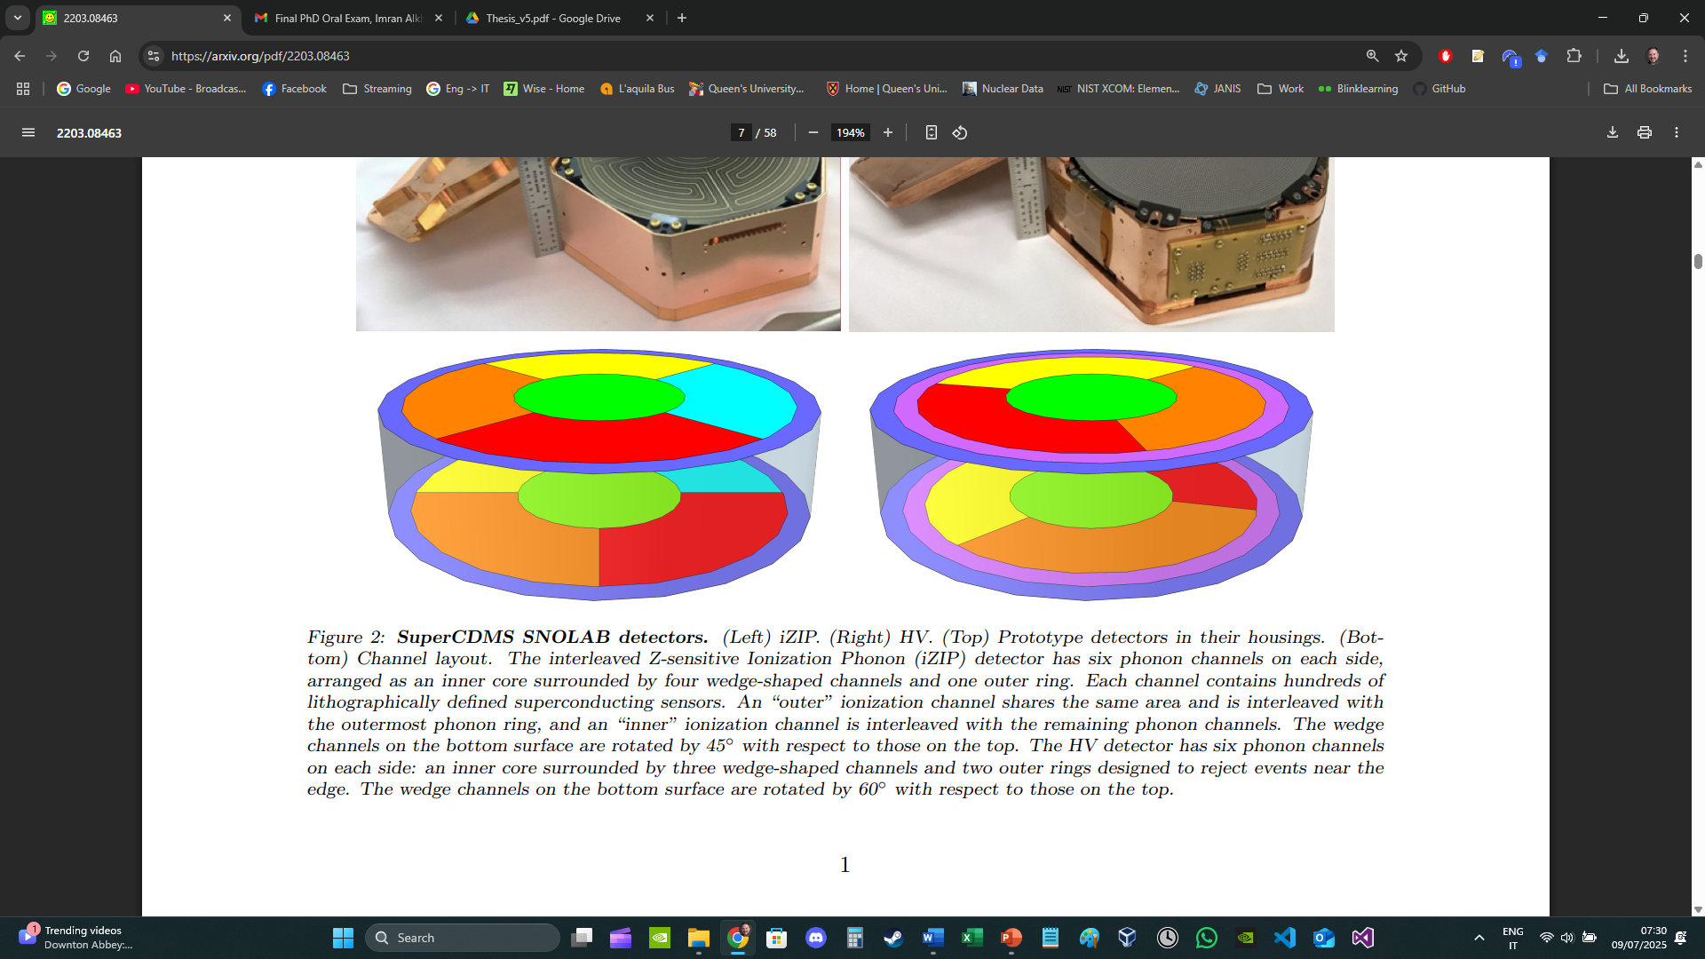
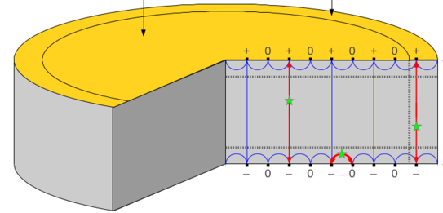
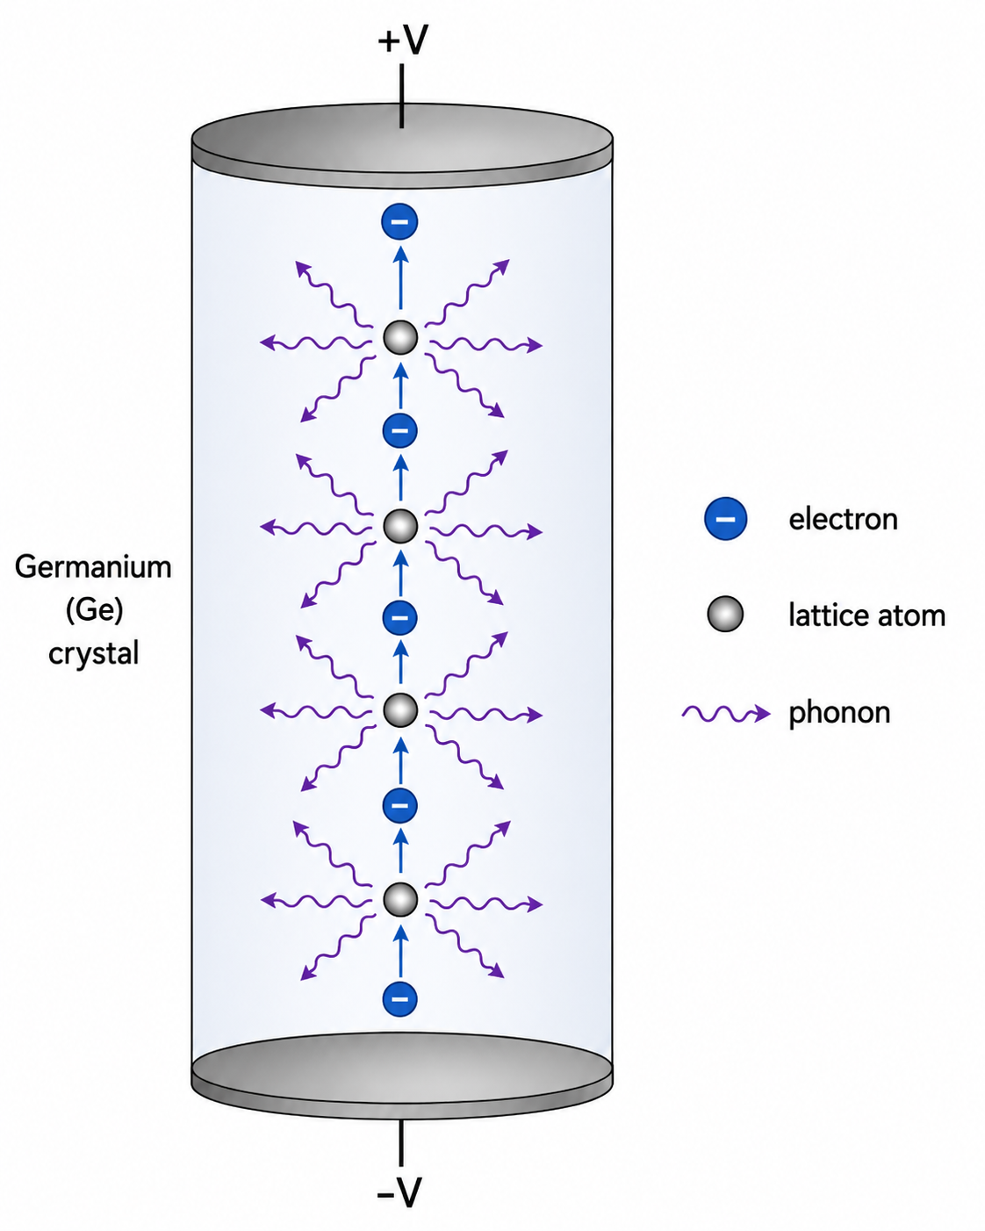

iZIP and HV SuperCDMS Detectors
$$Ε$$
HV (High Voltage detector)
12 phonon channels
100 V across the detector to exploit the Neganov-Trofimov-Luke (NTL) Effect
iZIP (interleaved Z-sensitive Ionization and Phonon detector)
12 phonon, 4 charge channels
Phonon and ionization channel allow for electron-recoil vs. nuclear-recoil discrimination
Notes:
Electron hole pair
Introduce channels here
iZIP: 45 seconds
HV: 45 seconds
45 seconds combined if rush thru it without explaining much

Slide 6
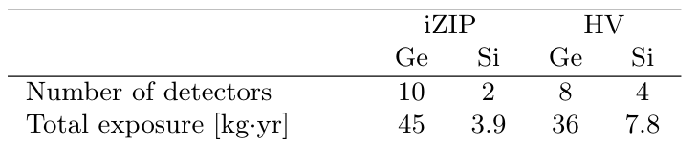
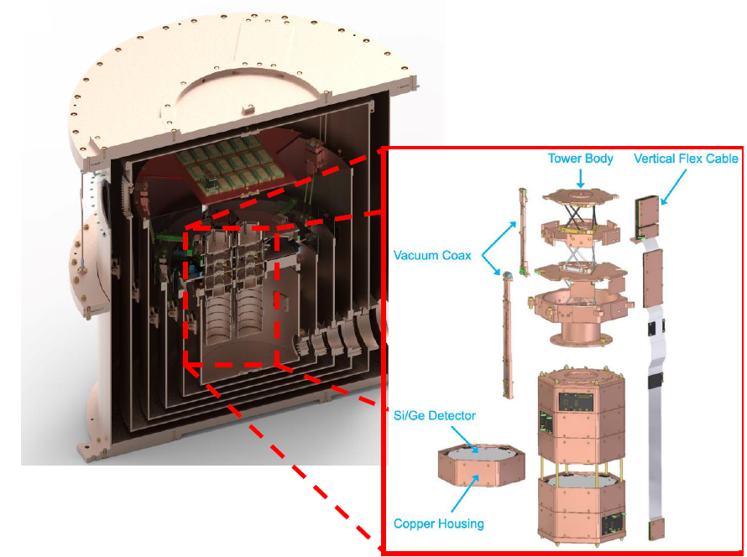
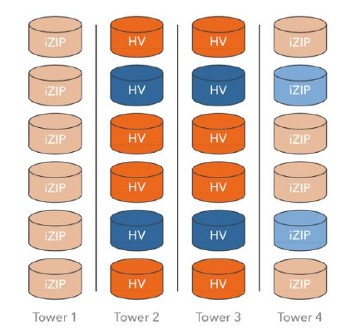
Detector Setup
Notes:
15 seconds
Copper chamber
More coloured ones are HV
24 total detectors arranged in 4 towers of 6, operating at mK temps

Slide 7
Reconstruction of Events using Optimal Filter
Notes:
5 seconds
1 min 55 seconds whole section
Explain why changing the bounds changes the resolution slide 10
Slide 12: does that insinuate you used the same settings every run
Slide 12 after: does not have a slide number

Slide 8
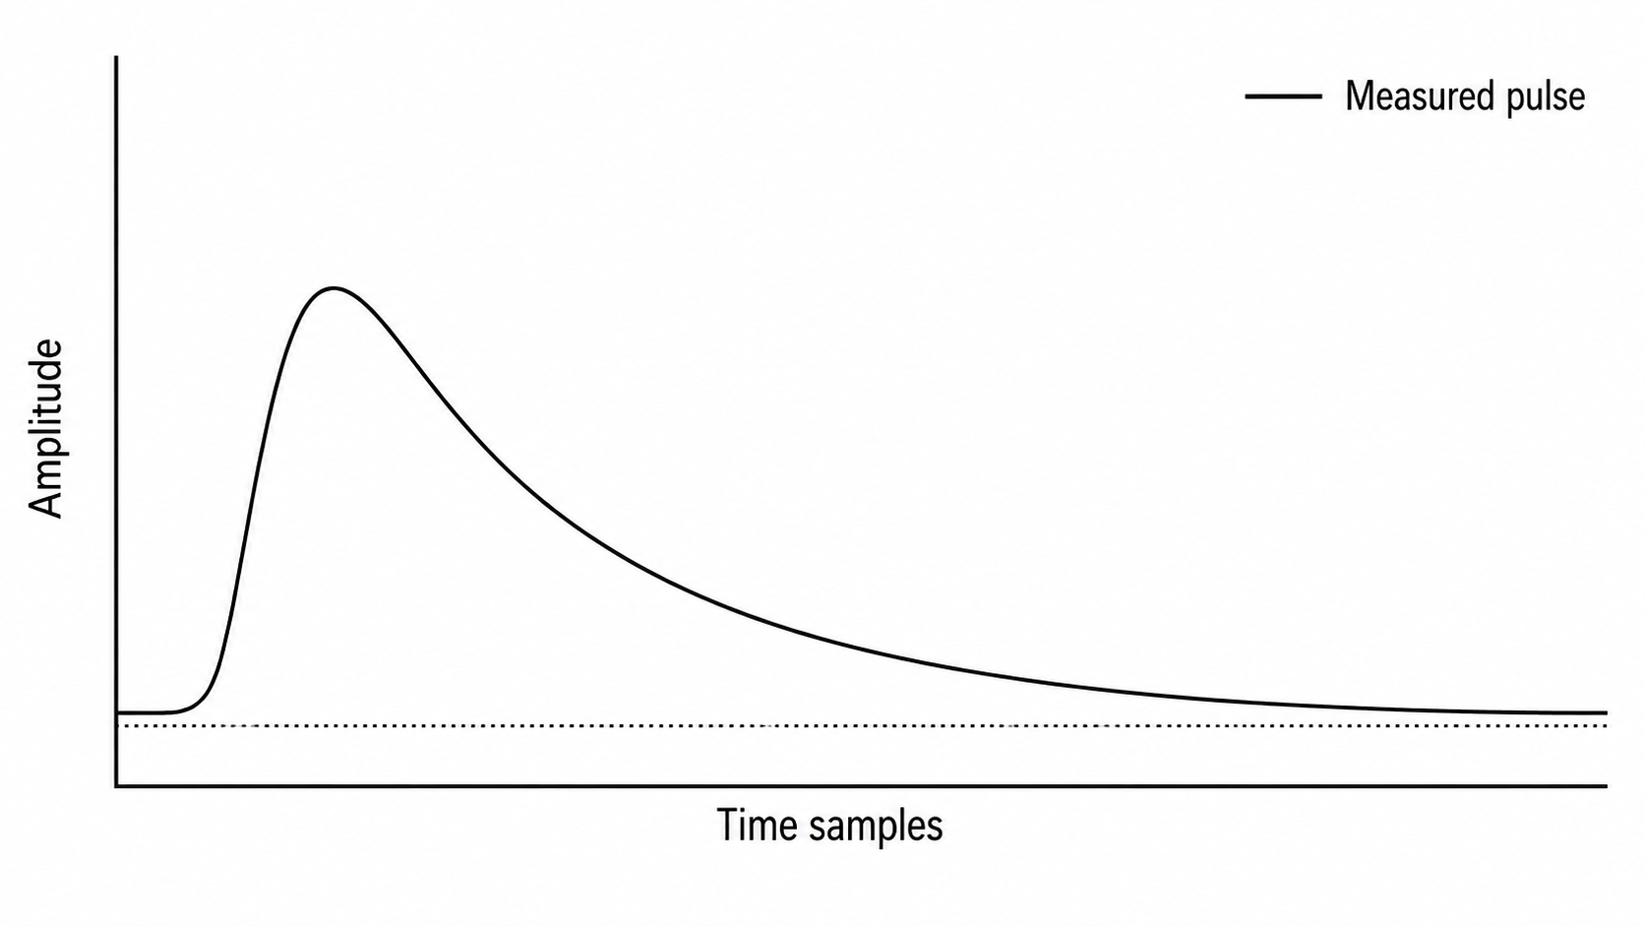
Reconstruction of Events with
Optimal Filter
Events are stored as signal amplitude as a function of time
We want to reconstruct quantities:
  Pulse amplitude
  Pulse start time
  Fit quality (χ²)
  Position information from relative channel responses
The Optimal Filter uses a template to help reconstruct these quantities
8
Notes:
10 seconds

Slide 9
Reconstruction of Events with
Optimal Filter
Events are stored as signal amplitude as a function of time
We want to reconstruct quantities:
  Estimate of deposited energy
    Location of interaction in detector
  Pulse start time
  Fit quality (χ²)
The Optimal Filter uses a template to help reconstruct these quantities
9
Notes:
20 seconds

Slide 10
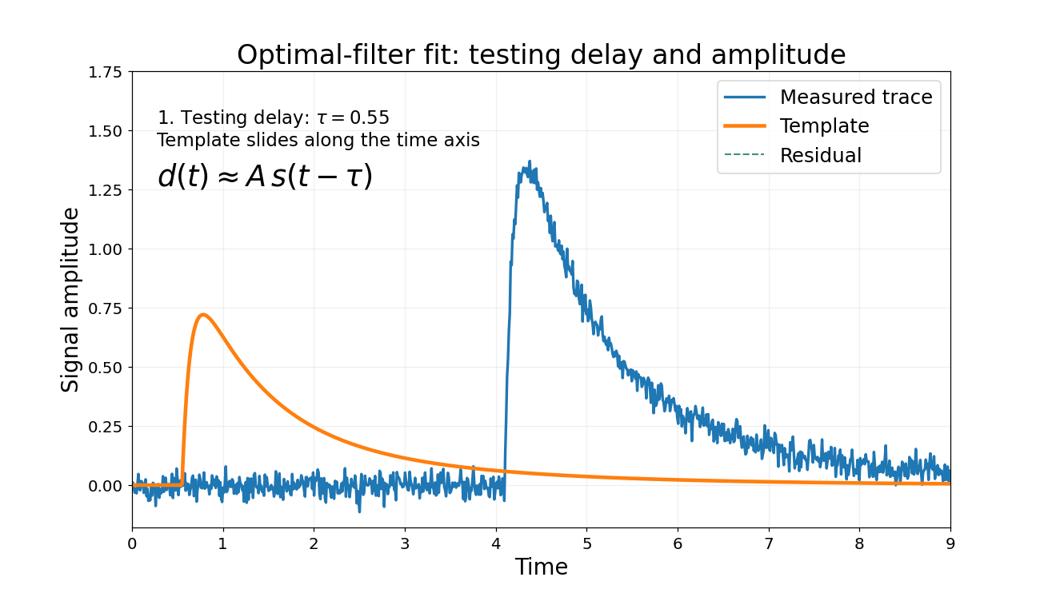
Optimal Filter
Conceptually shifts and scales template to fit event pulse
Finds a best-fit delay and amplitude to reduce χ²
Actual fit is performed in the frequency domain
  Noisy frequencies are down weighted
$$d\left(t\right)=A s\left(t−τ\right)+n(t)$$
Measured
Pulse
Time Delay
Noise
Template
Amplitude
10
Notes:
1 min 20 seconds but might be able to cut down if explained better
Explain chisq is a fit statistic that tells us how different our expected pulse is to the actual pulse
Include a back up slide about how it is derived more
Explain what a PMT is briefly
Q; what classifies silver to gold rankings of event
Slide 11 is so tuff
Slide 13 – the titles mean nthn to me but idk how you would fix that
I like the story you paint through the slides – don’t change that
Do the run selection processes discard the events all together or just mark the run as silver
2026-6-12 85% failure, why not 100%? Slide 19
Maybe make one slide where the scintillator is working and the next where is broken down for slide 21
Make more eye contact with crowd
Slide 14, what do you think caused that breakdown and why do neighboring crates see the breakdown from crates 1 and 2
What solution is there to overriding memory cards
What happened on the day where 3/5 non seismeic failed runs happened
Howd

Slide 11
Event Selection for Template Generation
Commissioning data
Notes:
15 seconds
I used SuperCDMS commissioning data, so I’ll take you through my process of filtering events and generating a template for it
2 min 15 seconds whole section

Slide 12
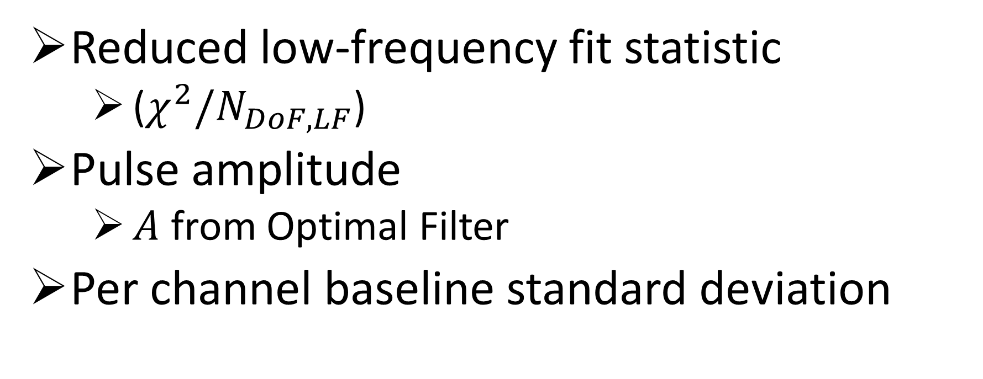
Event-Selection Cuts
Reduced low-frequency fit statistic
  ($χ^{2}/N_{DoF,LF}$)
Pulse amplitude
  $A$ from Optimal Filter
Per channel baseline standard deviation
12
Notes:
30 seconds
Gotta explain what baseline std is (what is the baseline – honestly might not be important to explain that)

Slide 13
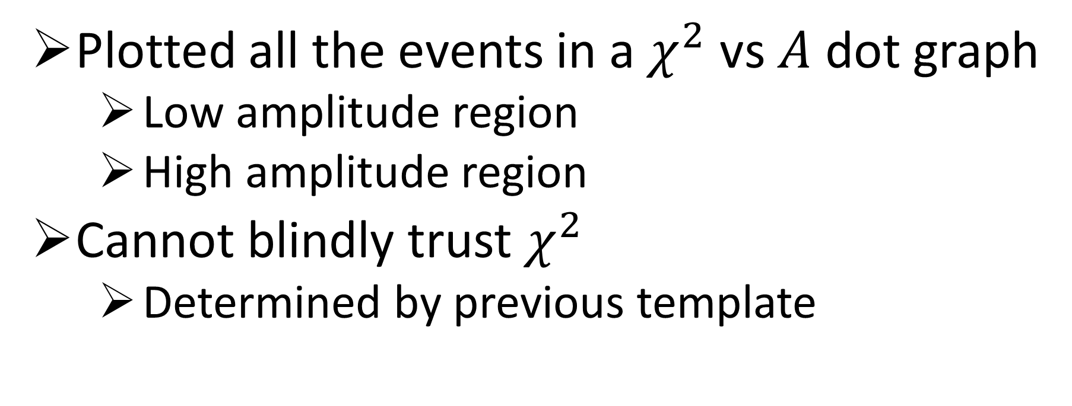
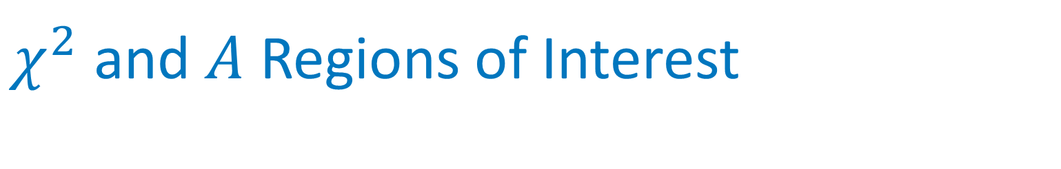
$χ^{2}$ and $A$ Regions of Interest
Plotted all the events in a $χ^{2}$ vs $A$ dot graph
  Low amplitude region
  High amplitude region
Cannot blindly trust $χ^{2}$
  Determined by previous template
13

Slide 14
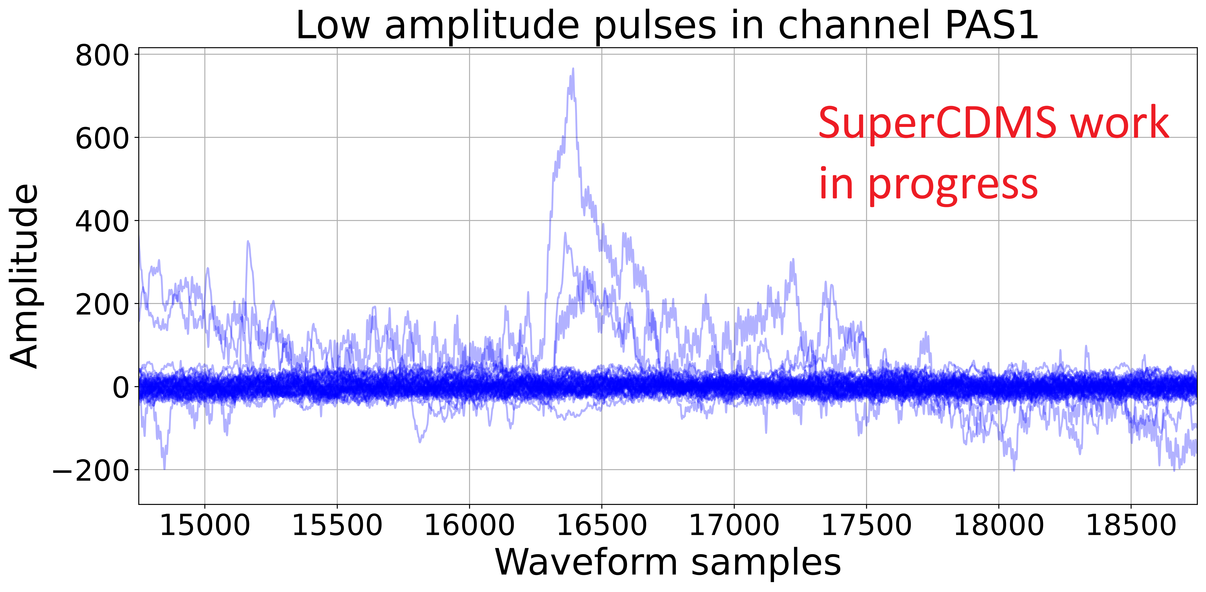
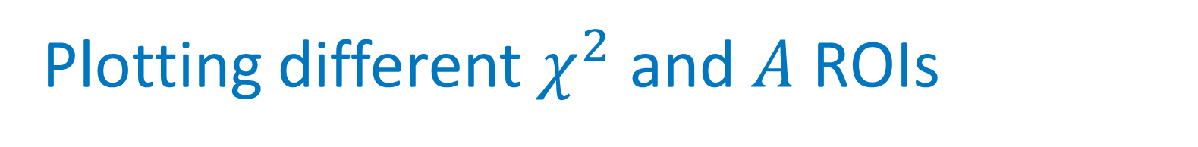
Plotting different $χ^{2}$ and $A$ ROIs
14
Notes:
1 min 30 seconds (maybe could be cut down)
Explain that you cant blindly trust the chisq and amplitude because it biases towards the old template
Why is there clear feature discrimination
Remove the stuff in legend (remove from plot to)
Plot, y axis, x axis, mo

Slide 15
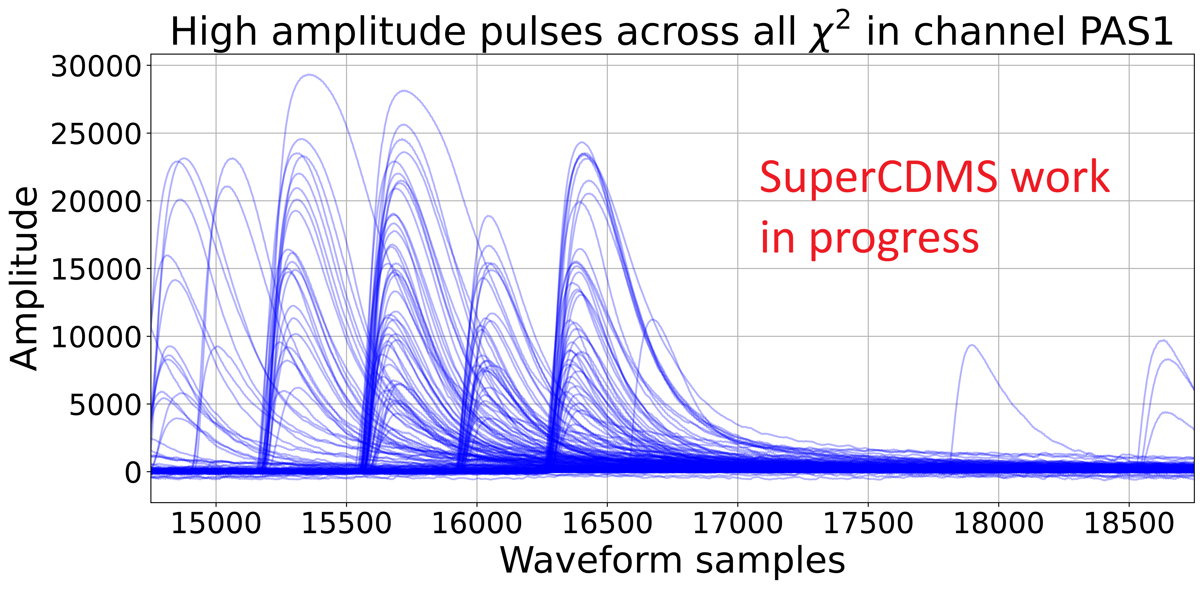
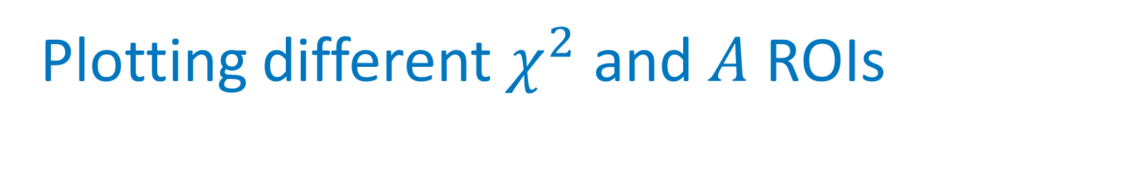
Plotting different $χ^{2}$ and $A$ ROIs
15
Notes:
1 min 30 seconds (maybe could be cut down)
Explain that you cant blindly trust the chisq and amplitude because it biases towards the old template
Why is there clear feature discrimination
Remove the stuff in legend (remove from plot to)

Slide 16
Generation of Template Using Selected Events
Notes:
5 seconds

Slide 17
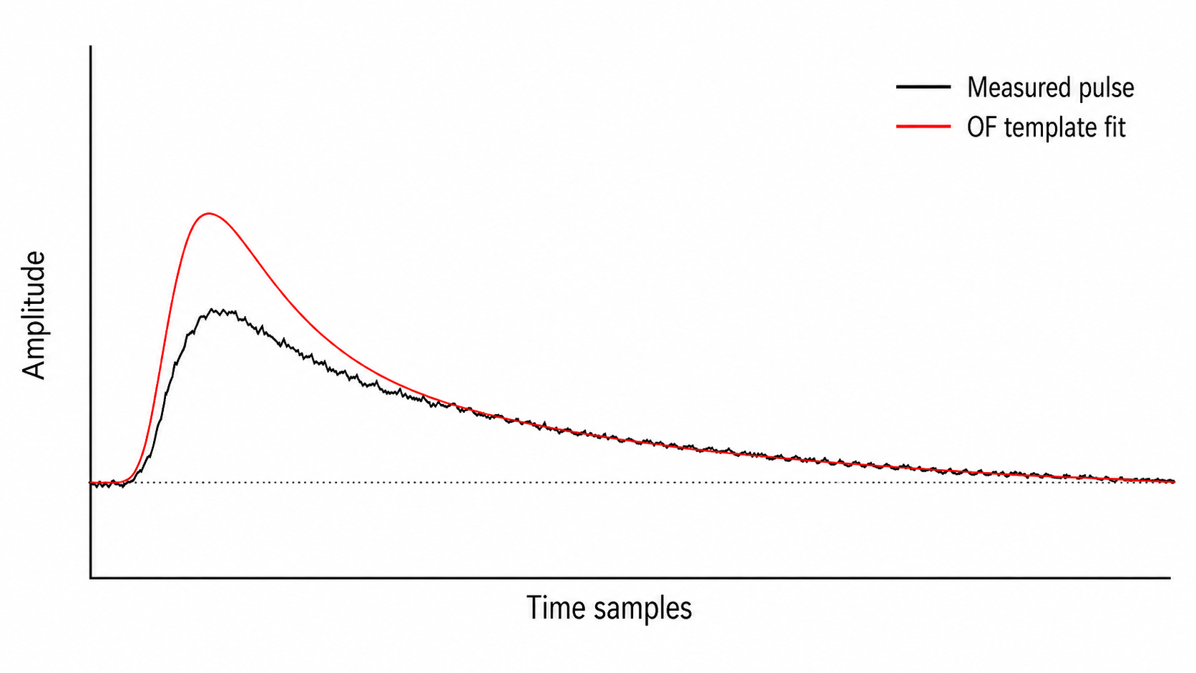
Filtering Bad Events
Remove events with low peaks
Remove events with saturation
Remove events with pileup
17
Notes:
50 seconds

Slide 18
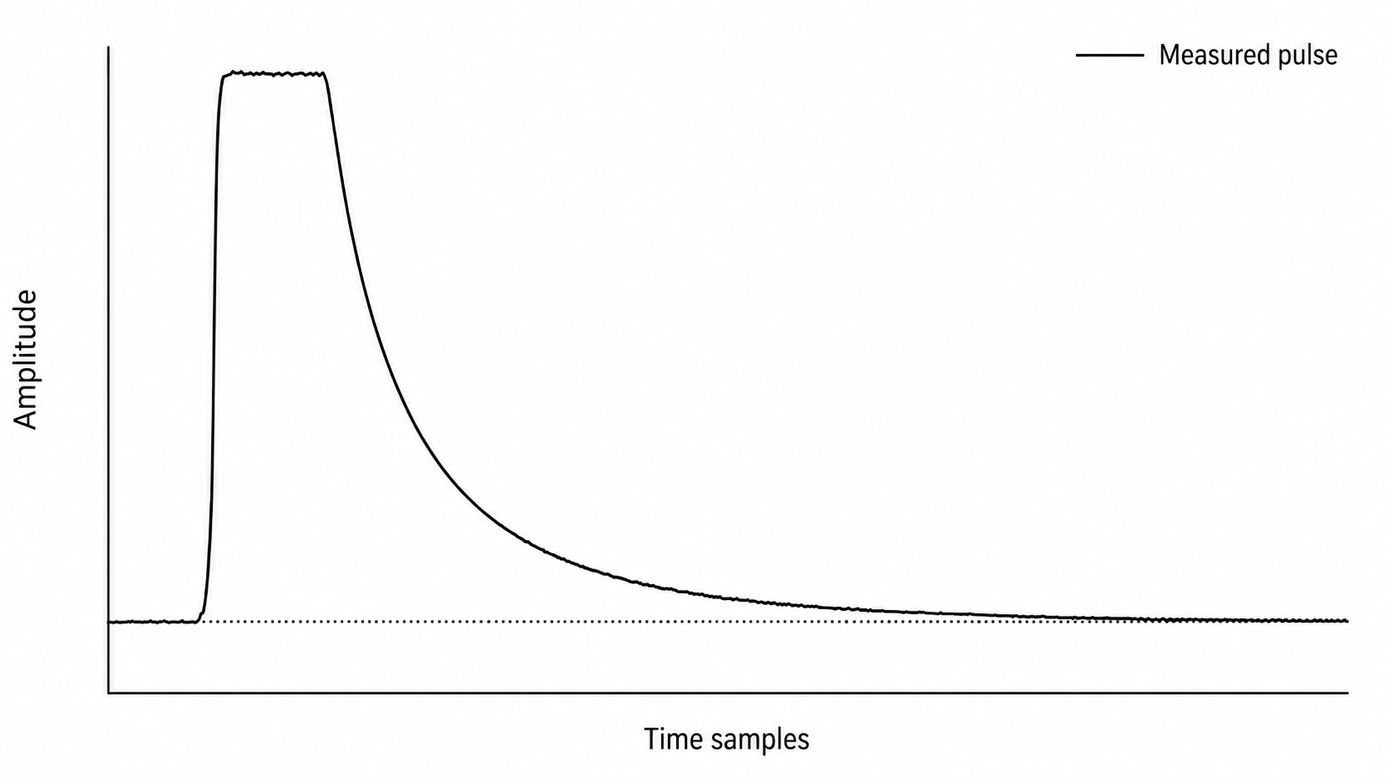
Filtering Bad Events
Remove events with low peaks
Remove events with saturation
Remove events with pileup
18
Notes:
15 seconds

Slide 19
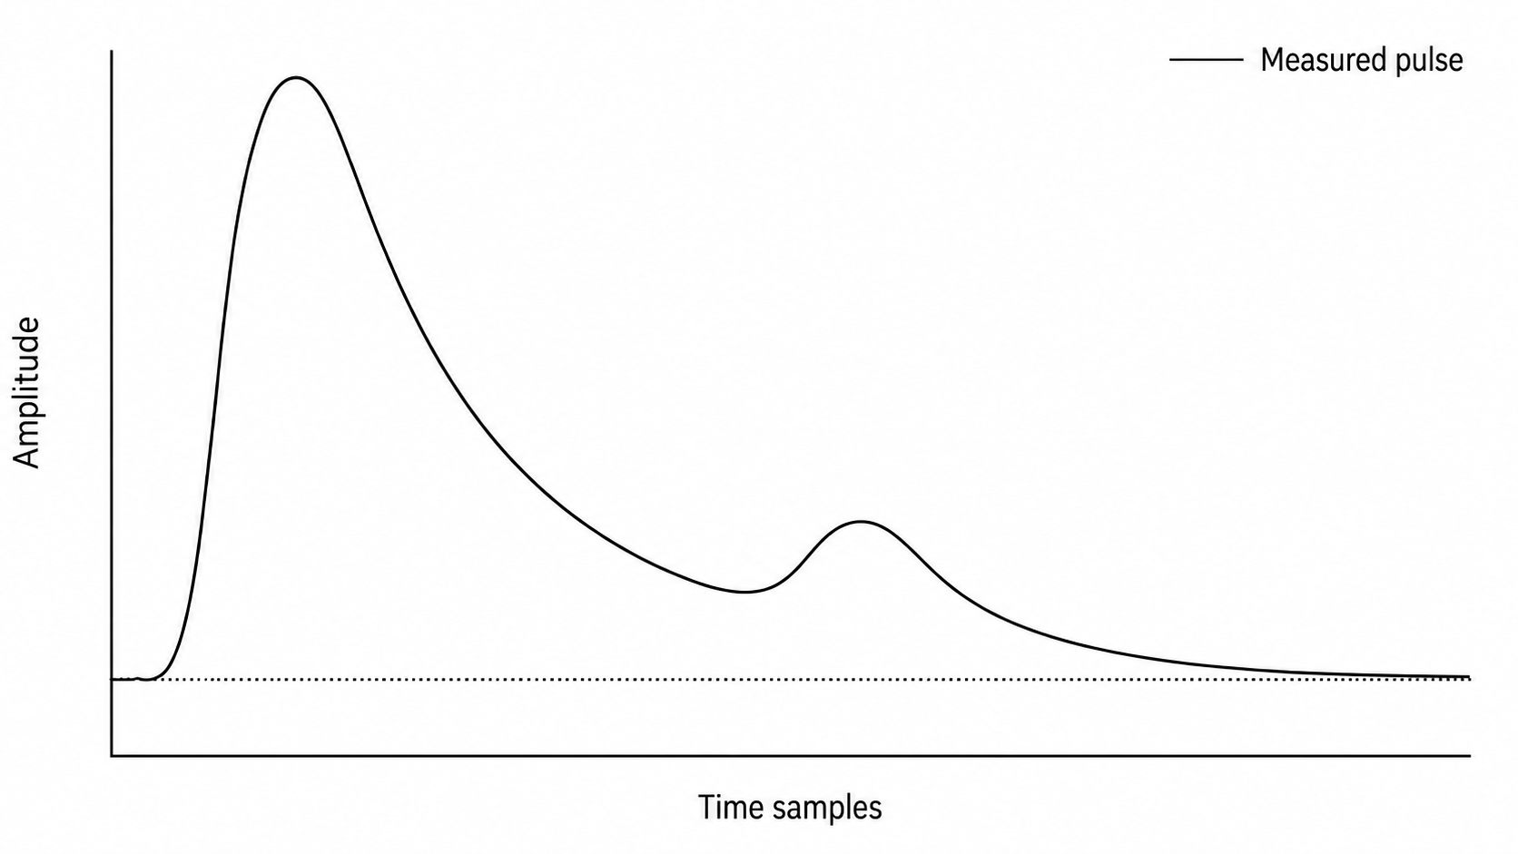
Filtering Bad Events
Remove events with low peaks
Remove events with saturation
Remove events with pileup
19
Notes:
25 seconds
What is actually cooling down?

Slide 20
Filtering
DC removal
  Base-line subtracting
10 kHz low-pass
Align the pulses
Average the pulses
20
Notes:
13 seconds
Now we have what our pulse template looks like visually, but we need a way to characterize it

Slide 21
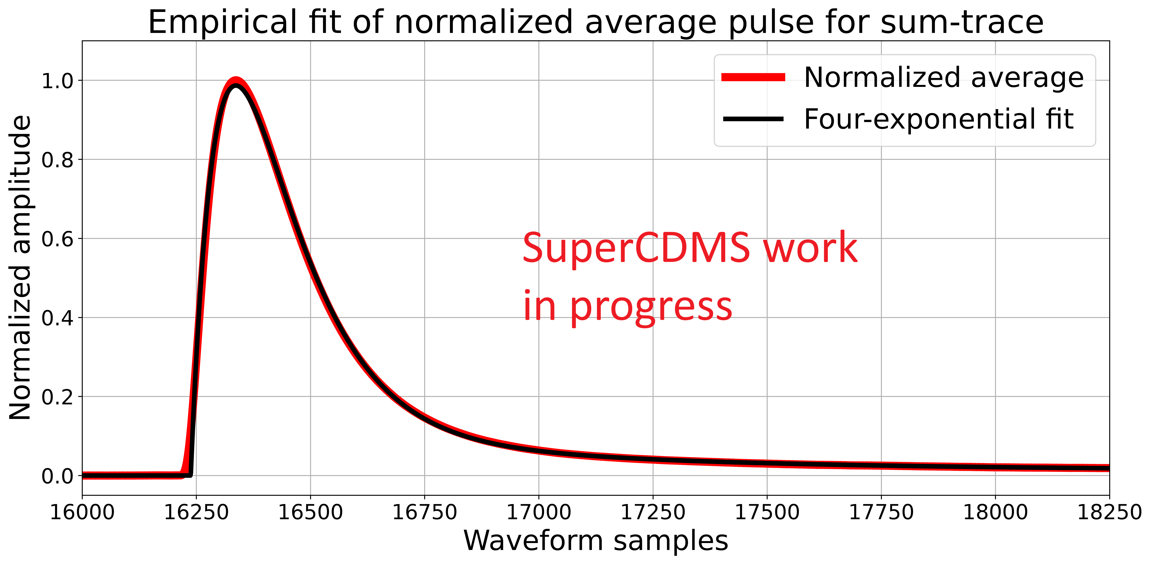
Fitting an Empirical Function
Fit an empirical function to a normalized average of the total phonon pulse events in all channels
$$−\left(a_{1}+a_{2}+a_{3}\right)exp\left(\frac{−\left(x−pt\right)}{srt t_{1}}\right)+a_{1}exp\left(\frac{−\left(x−pt\right)}{srt t_{2}}\right)+a_{2}exp\left(\frac{−\left(x−pt\right)}{srt t_{3}}\right)+a_{3}exp\left(\frac{−\left(x−pt\right)}{srt t_{4}}\right)$$
21
Notes:
40 seconds
Explain where function comes from and what it characterizes
Explain how the fit is done (whats the cost function? Least squares)
So now we have out empirical function, and if we expand it to fit all 32000 waveform samples, we are left with… (next slide)

Slide 22
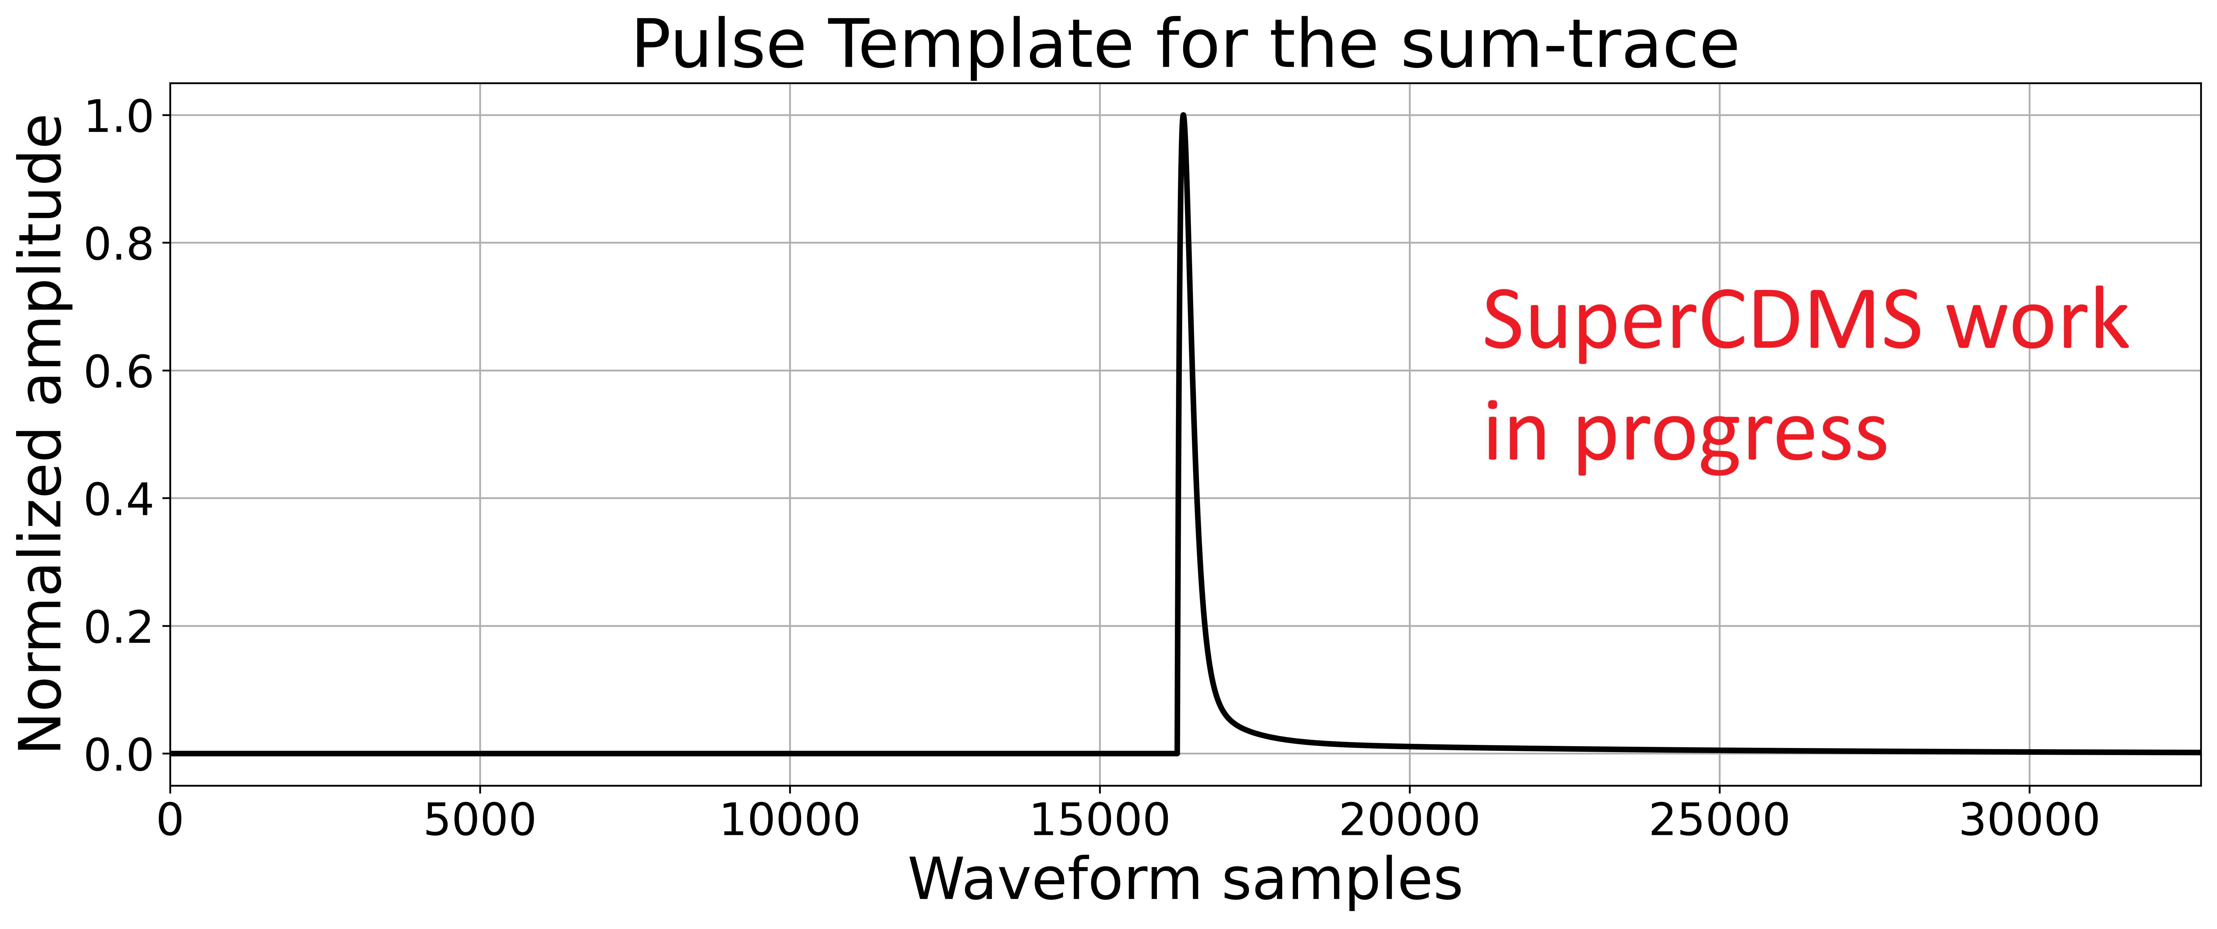
Final Total-Phonon Template
22
Notes:
30 seconds
From this you can get your estimated energy deposition, and from the per channel traces, you can get the location where the interaction occurred within the detector, along with many other quantities

Slide 23
Consequences
Use the sum-trace template with the Optimal Filter to estimate the energy deposition per event
Build an event spectrum of counts vs deposited energy
  Use a profile likelihood ratio to compare dark-matter signal + background models with the observed spectrum
    Can point to evidence of dark matter!
Use the individual-channel templates with the Optimal Filter to extract position-sensitive information about the interaction
23

Slide 24
Next Steps
Validate templates
  Test fit against independent events
  Compare new template against previous template
  Repeat using different run periods and event subsets
Use larger event subset to generate template
Iterate template generation until they converge
Generate templates for other detectors
24
Notes:
55 seconds

Slide 25
Acknowledgements
Matt Stukel
Andy Kubik
Max Hughes
Aditi Pradeep
Vijay Iyer
Madeleine Zurowski
Raymond Bunker
Stephen Sekula
Sukeerthi Dharani
Miriam Diamond
All the students
25
Notes:
10 seconds

Slide 26
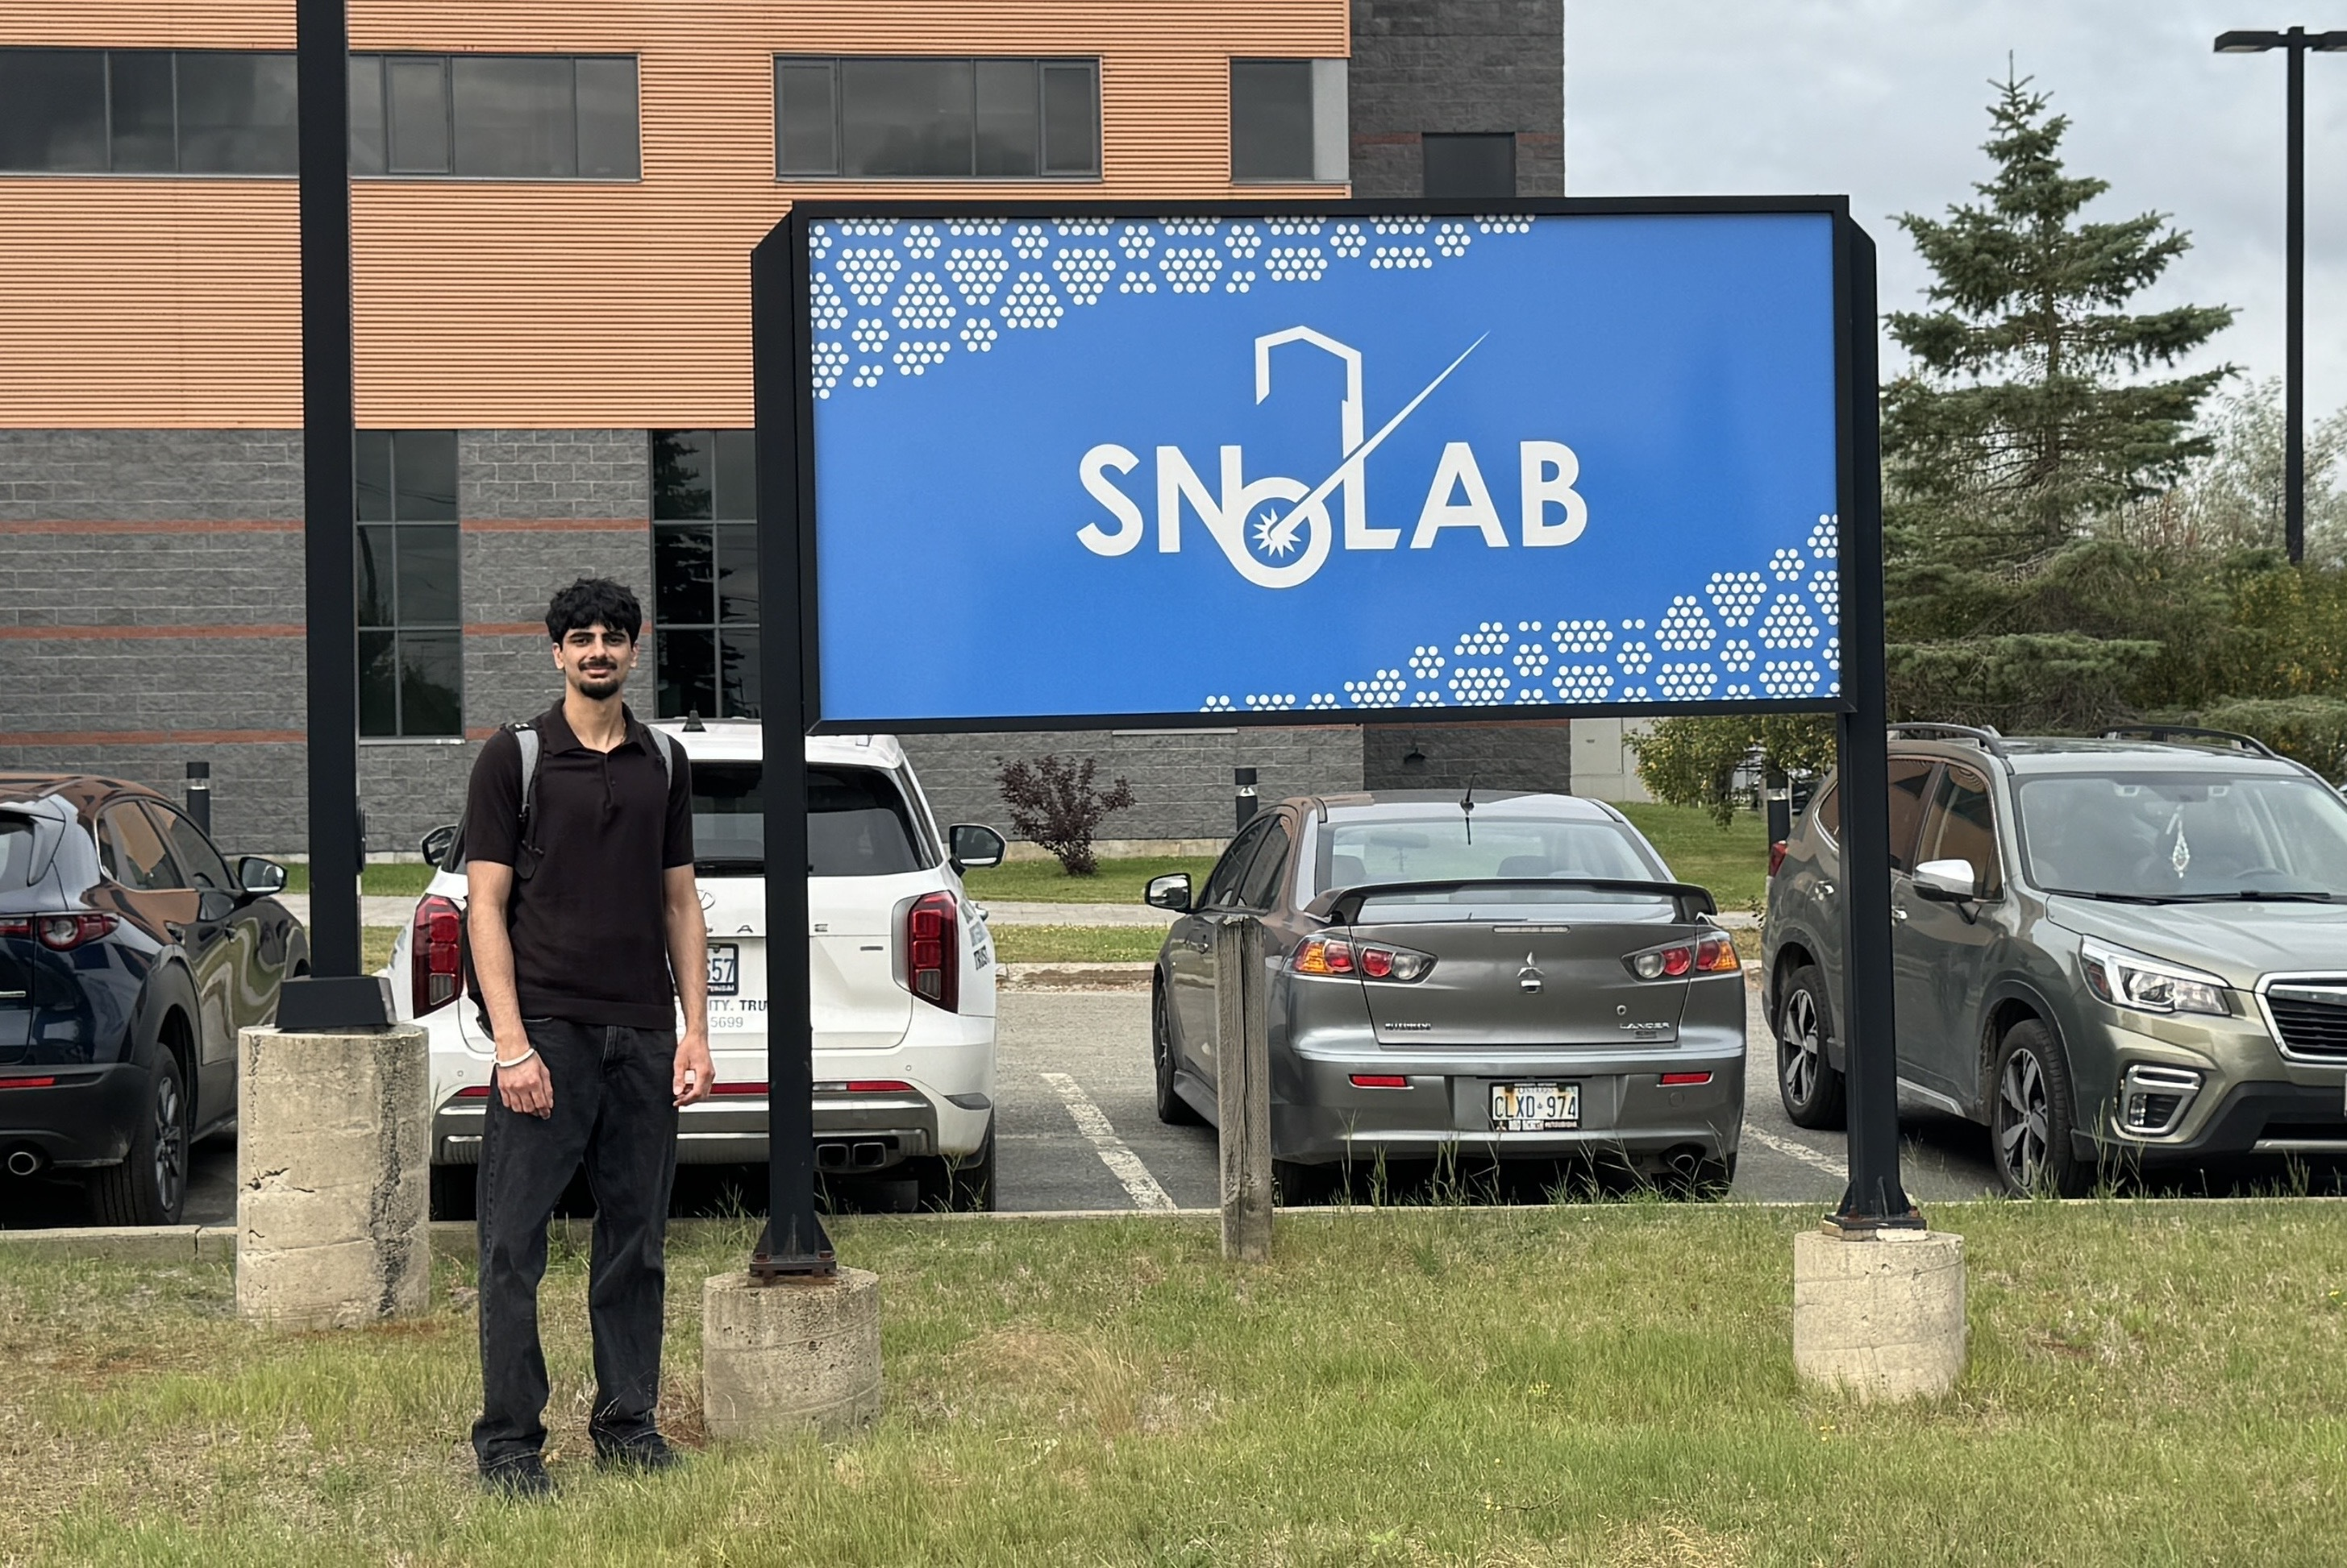
Questions?
Photo credit: Sanjit Patil

Slide 27
Extra Slides

Slide 28
Dark Matter
Properties:
Interacts gravitationally
Electromagnetically dark
Stable on cosmological timescale
Hoping it interacts weakly with ordinary matter
28
Notes:
Interacts gravitationally
Electromagnetically dark: its coupling is very weak as we have not seen it emit, absorb, or scatter photons
Mostly non-baryonic
Stable/long-lived: was needed for early formation of structure and it remains abundant today
Non-relativistic:
Interacts weakly with ordinary matter

Slide 29

Questions to Answer
What is it?
  A new particle?
  A field?
What is its mass?
How does it interact with ordinary matter?
  Nuclei coupling?
  Dark photon absorption?
Does it interact with itself?
How was it produced?
Is all dark matter the same substance?
29

Slide 30
SuperCDMS SNOLAB Objectives
Adapted From: https://indico.cern.ch/event/1188759/contributions/5044015/
1 meV
1 eV
1 keV
1 MeV
1 GeV
1 TeV
“Wave-like DM”
“DM Absorption”
“DM Scattering”
“WIMPs”
Uses cryogenic detectors (O(mK)) to search for particle dark matter
Nucleon coupling: 0.05 – 5 GeV/c²
Also sensitive to:
  Dark photon-coupled light dark matter: 1 – 100 MeV/c²
  Dark photon absorption : 1 – 100 eV/ c²
  Axion-like particles absorption: 1 – 100 eV/ c²
30
Notes:
Opens me up to a lot of questions
The point of this slide is just that supercdms is <GeV, low mass

Slide 31
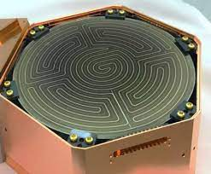
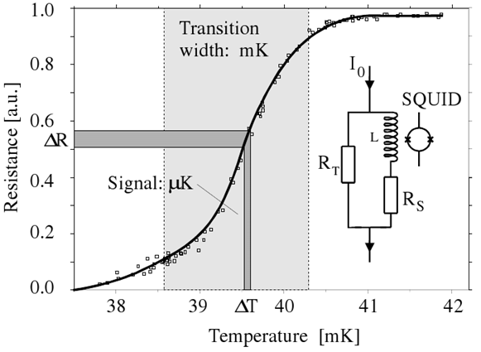
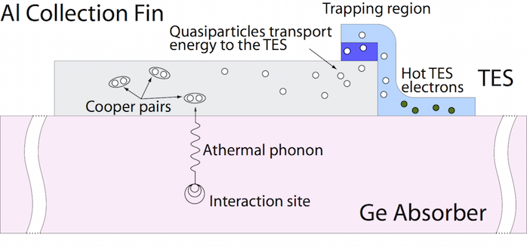
SuperCDMS SNOLAB Detectors
Si(0.6 kg)/Ge (1.4 kg) cryogenic detectors
Measure phonons (vibrations) and ionization
  Phonons are measured through Quasiparticle trap assisted ElectroThermal (QET) feedback Transition Edge sensors (TES)
100 mm
33.3 mm
Notes:
1 min 15 seconds
15 seconds if just stay on the surface and say someone else answered these already but you can ask me at the end if you want
Si/Ge cryogenic detectors
Measure heat and ionization
How is ionization measured?
Interaction creates an electron-hole pair which is guided by an applied electric field
Ionization is read using electrodes
How are phonons measured?
Particle hits nucleus inside detector, producing athermal phonons
Phonons are read out using Aluminum Collection Fins which are connected to Transition Edge Detectors

Slide 32
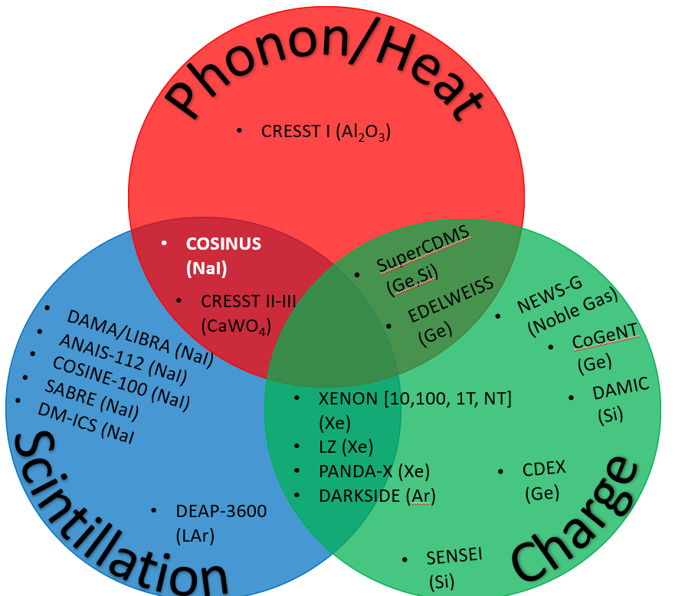
Landscape of Dark Matter searches
Bubbles:
PICO-40
PICO-500
Notes:
Remove this if going over time in practice

Slide 33
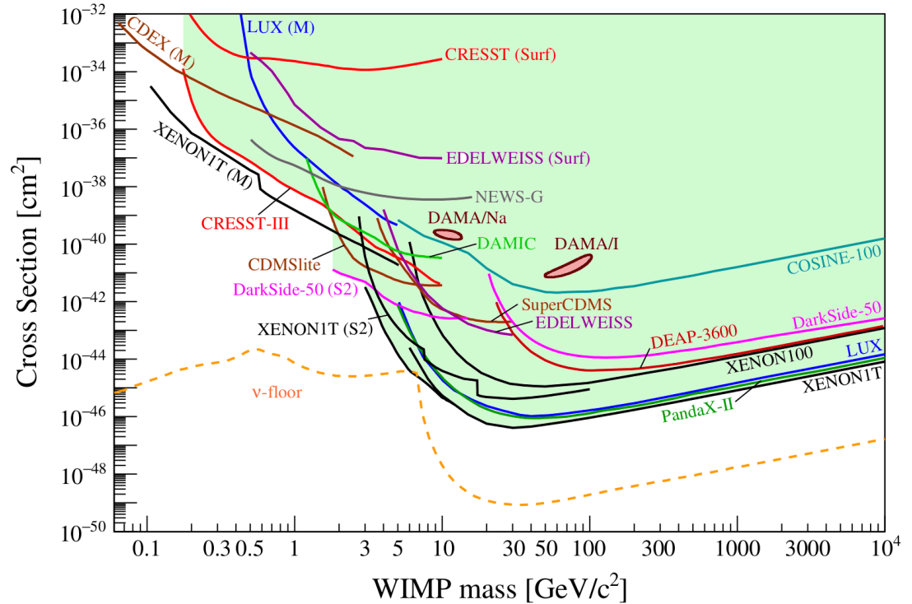

Dark Matter: The Current Search
Notes:
Lots of assumptions made for these limits
Just remove this
Get the report from the plot and cite it
Add a thank you to matt, andy, ray, max at the end

Slide 34
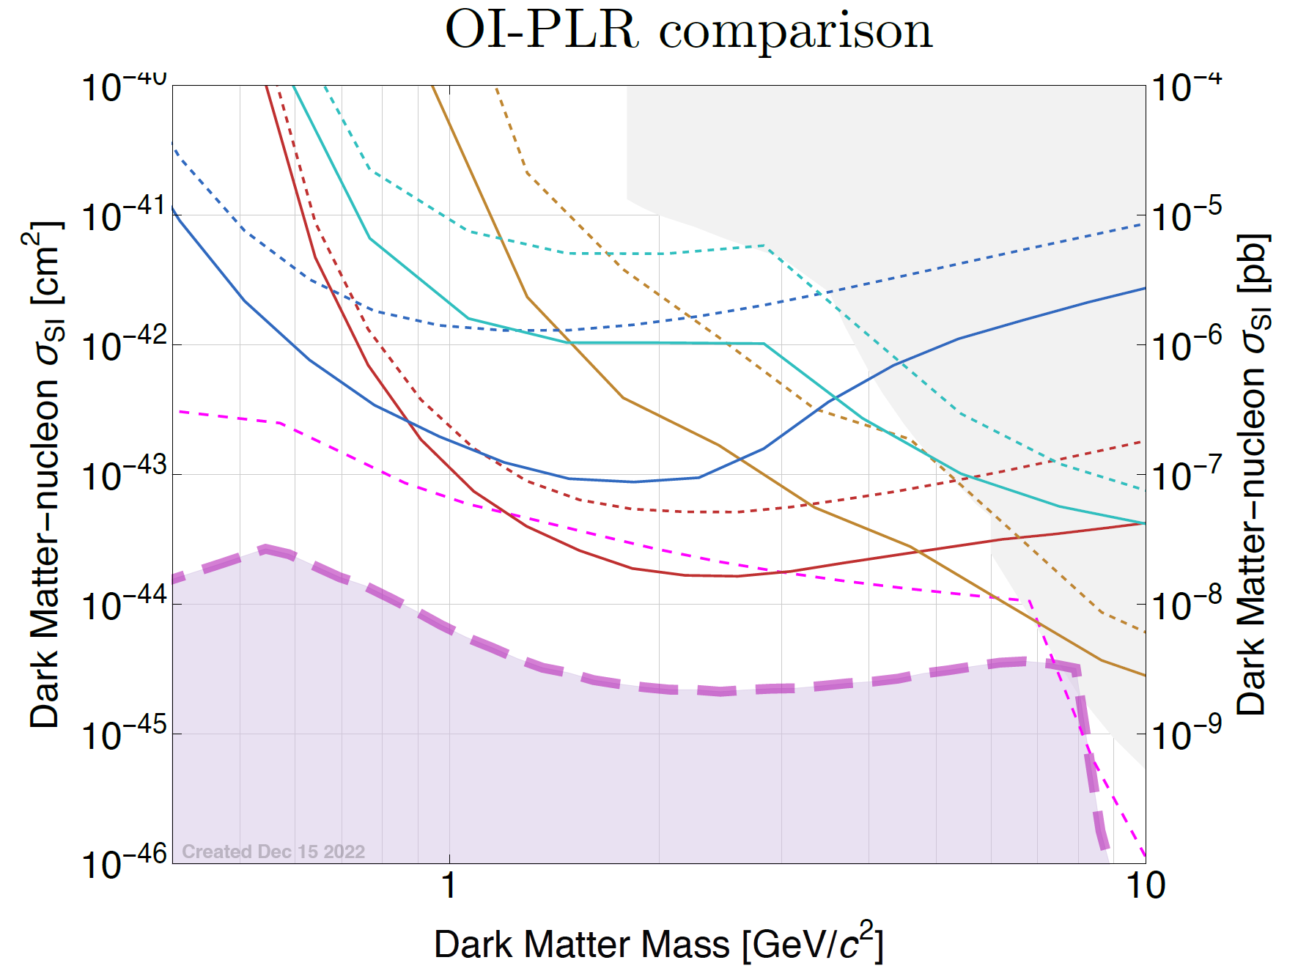
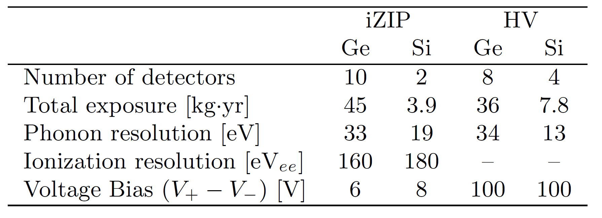
SuperCDMS NRDM Sensitivity
90% C.L. exclusion sensitivity using the optimal interval (dashed) and profile likelihood ratio (solid)
Uses current estimate for detector performance and backgrounds
  4-year exposure
Si HV
Si iZIP
Ge iZIP
Ge HV
Neutrino Fog
https://doi.org/10.48550/arXiv.2203.08463
Notes:
Ask Matt:
Should I go into Optimum Interval vs PLR?
Put this in the backup slides

Slide 35
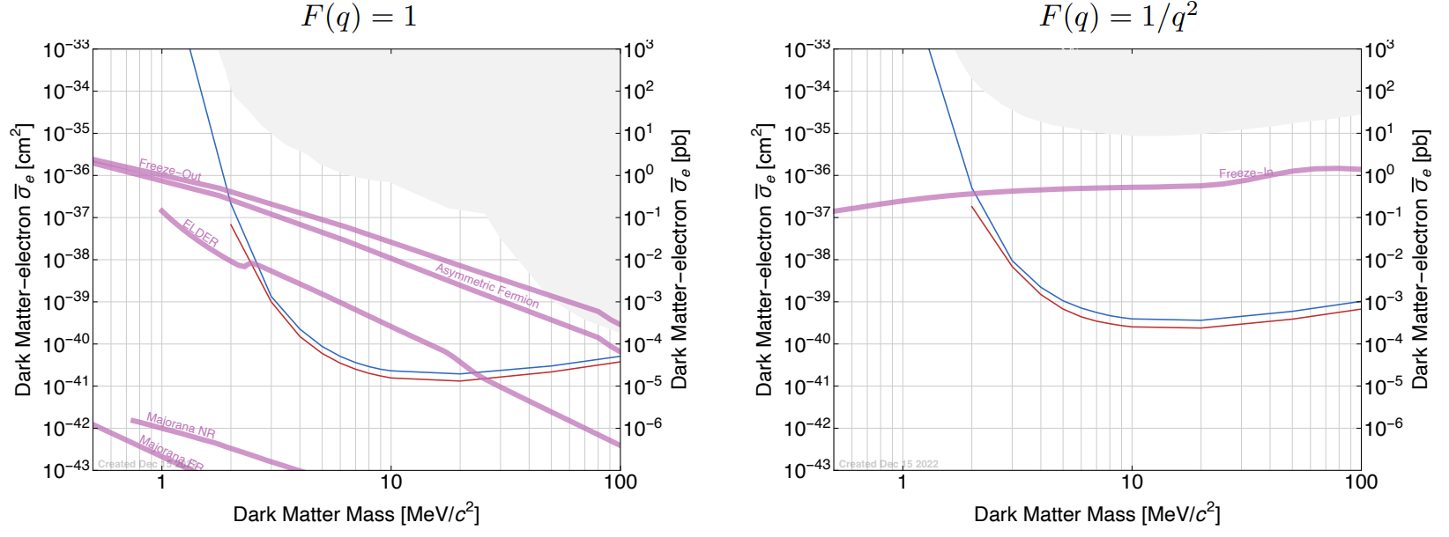
DM-electron scattering sensitivity
SuperCDMS can probe electron scattering from photon coupled light DM (O(MeV)). Si = blue, Ge = Red
https://doi.org/10.48550/arXiv.2203.08463

Slide 36
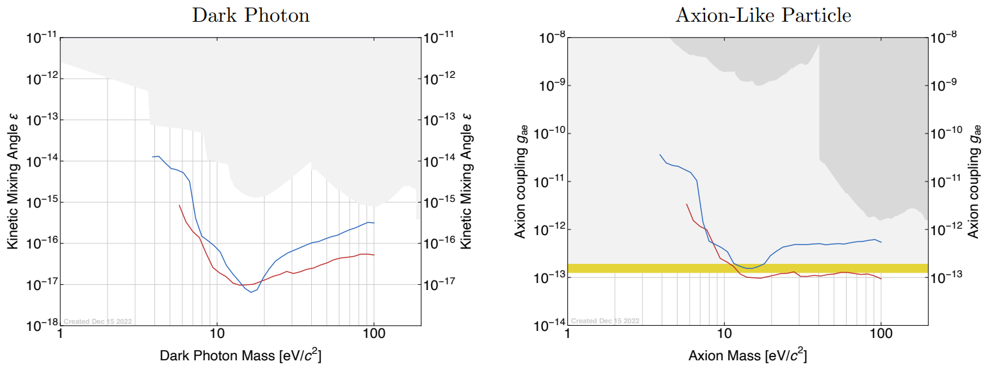
Absorption Sensitivity
SuperCDMS can probe even further by looking for dark photon (O(eV)) absorption (peak) or axion-like particle absorption (O(eV)). Si = blue Ge = Red
https://doi.org/10.48550/arXiv.2203.08463

Slide 37
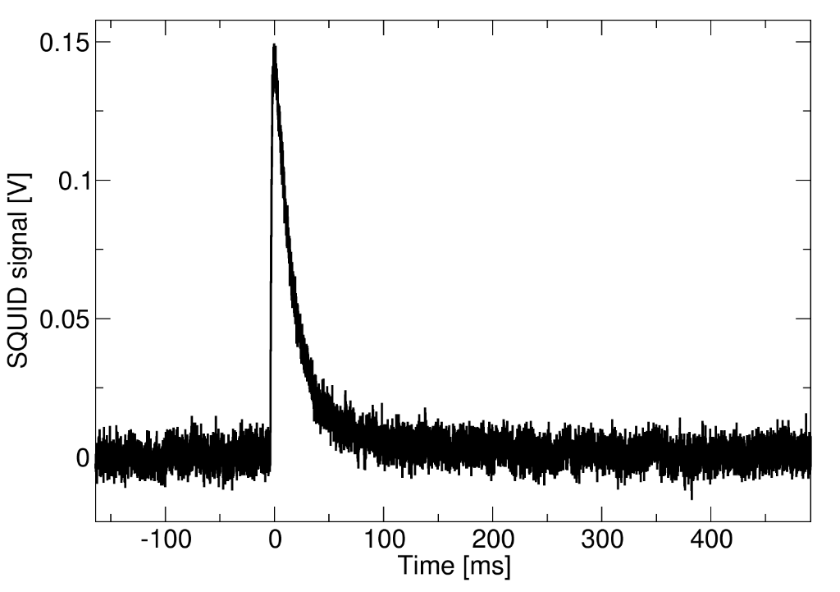
Transition Edge Sensors (TES)
Deposition of energy → Lattice vibrations (Phonons) → Change of temperature → Change in resistance → Signal
Critical temperature reduced from 90 mk (Soudan) to 40 mk.
TES are widely used in the field of rare event searches

Slide 38

iZIP Detectors
iZIP (interleaved Z-sensitive Ionization and Phonon detector)
12 phonon channels, 4 charge channels
Phonon and ionization channel allow for particle discrimination ER vs. NR
Allow for rejection of surface events
$$Ε$$
Notes:
iZIP: upon interaction with a nuclei, an electron will be excited into the conductance band and an electron-hole pair will move to either side of the detector. That is for nonsurface events.
However, we need to distinguish surface events as most events on the surface are noise
Interleaving electrodes that alternate between in voltage bias between charged and ground
Makes it easy to distinguish surface events as the conducting electron will be collected by an electrode and the hole will also be seen by an electrode on the same side, with little to no ionization on the opposite side
Also excellent for Electron vs Nuclear recoil. Dark matter is far more likely to couple with nucleis, so rejecting all electron recoils is a reasonable decision. When a particle interacts directly with an electron, more of the energy transfer goes to knocking out the electron, compared to nuclear recoils, where a lot of the energy goes to vibrating the nucleus. So, the ionization yield, a ratio of the ionization to phonon values, is much greater for electron recoils, making it possible to distinguish the different events.

Slide 39



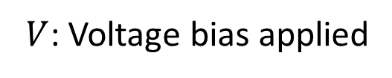
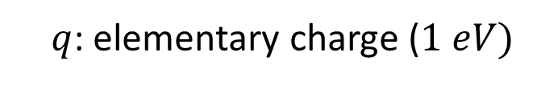
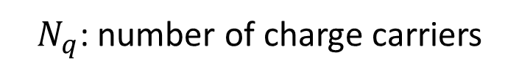
HV Detectors
HV (High Voltage detector)
12 phonon channels
100 V across the detector to exploit the Neganov-Trofimov-Luke (NTL) Effect
$$Ε$$
NTL Effect
$$E_{phonon}=E_{recoil}+E_{NTL}$$
$$E_{NTL}=N_{q}×q×V$$
$N_{q}$: number of charge carriers
$q$: elementary charge ($1 eV)$
$V$: Voltage bias applied
Notes:
HV: the main frontier pushing detector. It applies a 100 V voltage bias across the detector, which results in a strong electric field to exploit the NTL effect.
For discrimination, fiducial cuts, and then discriminate ER and NR populations statistically from the entire spectrum, rather than individual events
Say its an amplification process we take advantage of and leave it at that

Slide 40
iZIP and HV SuperCDMS Detectors
iZIP (interleaved Z-sensitive Ionization and Phonon detector)
12 phonon, 4 charge channels
Phonon and ionization channel allow for particle discrimination ER vs. NR
HV (High Voltage detector)
12 phonon channels
100 V across the detector to exploit the Neganov-Trofimov-Luke (NTL) Effect

Slide 41
Empirical Function
$$−\left(a_{1}+a_{2}+a_{3}\right)exp\left(\frac{−\left(x−pt\right)}{srt t_{1}}\right)+a_{1}exp\left(\frac{−\left(x−pt\right)}{srt t_{2}}\right)+a_{2}exp\left(\frac{−\left(x−pt\right)}{srt t_{3}}\right)+a_{3}exp\left(\frac{−\left(x−pt\right)}{srt t_{4}}\right)$$
x: waveform sample number
pt: fitted pulse onset, or pretrigger
srt: the sampling rate
t1​: the rise timescale
t2​: the fast decay timescale
t3​: the intermediate decay timescale.
t4​: the slow decay timescale
a1​: weight/amplitude of the t2​ decay component
a2​: weight/amplitude of the t3​ decay component
a3​: weight/amplitude of the t4​ decay component
41
Notes:
40 seconds
Explain where function comes from and what it characterizes
Explain how the fit is done (whats the cost function? Least squares)
So now we have out empirical function, and if we expand it to fit all 32000 waveform samples, we are left with… (next slide)

Slide 42
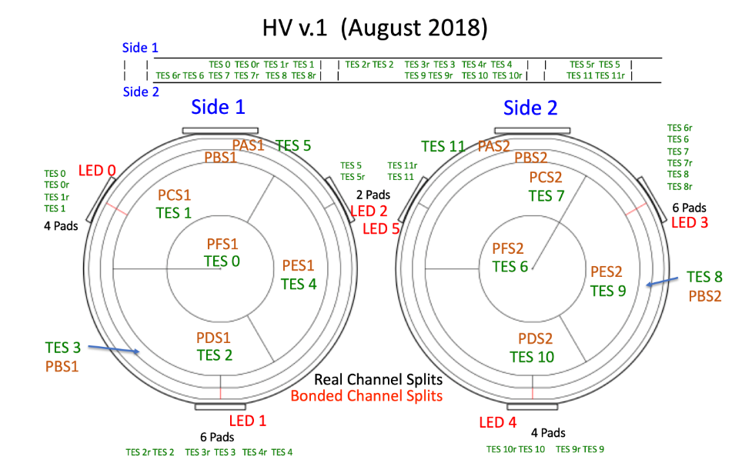
Detector Setup
Notes:
Copper chamber
More coloured ones are HV
24 total detectors arranged in 4 towers of 6, operating at mK temps

Slide 43
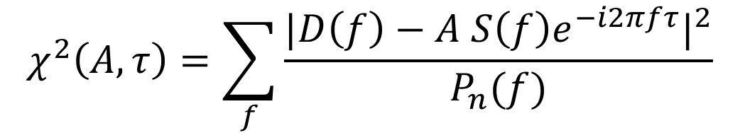
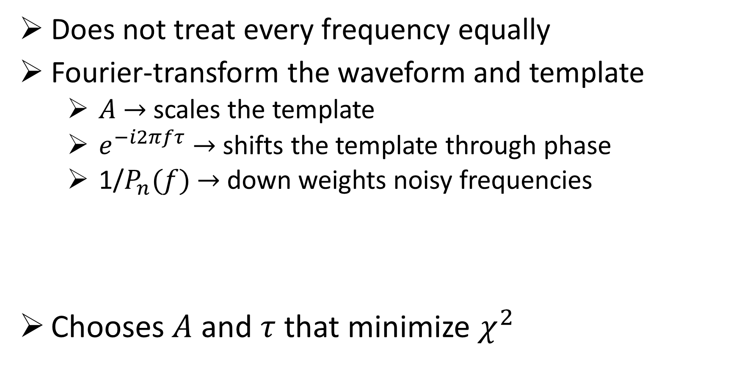
Optimal Filter in the Frequency Domain
Does not treat every frequency equally
Fourier-transform the waveform and template
  $A$ $→$scales the template
  $e^{−i2πfτ}$ $→$ shifts the template through phase
  1/$P_{n}(f)$ $→$down weights noisy frequencies
Chooses $A$ and $τ$ that minimize $χ^{2}$
$$χ^{2}\left(A,τ\right)=\sum_{f}{\frac{|D\left(f\right)−A S{\left(f\right)e^{−i2πfτ}|}^{2}}{P_{n}(f)}}$$
43

Slide 44
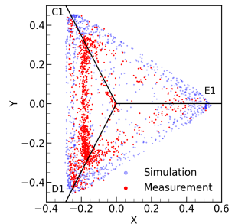
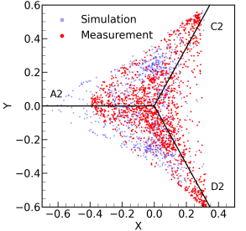

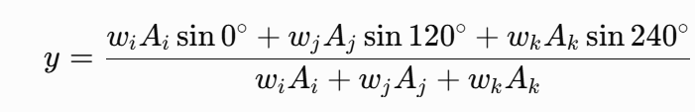
Calibrating channel weights
Normalized Y Projection
Normalized Y Projection
Normalized X Projection
Normalized X Projection
44

