Slide 1
Testing a Pulse-IV Multiplexer for Large SiPM Array Characterization
Will Gray, McGill University
Supervisor: Dr. Thomas Brunner
August 12th
CASST 2026

Slide 2
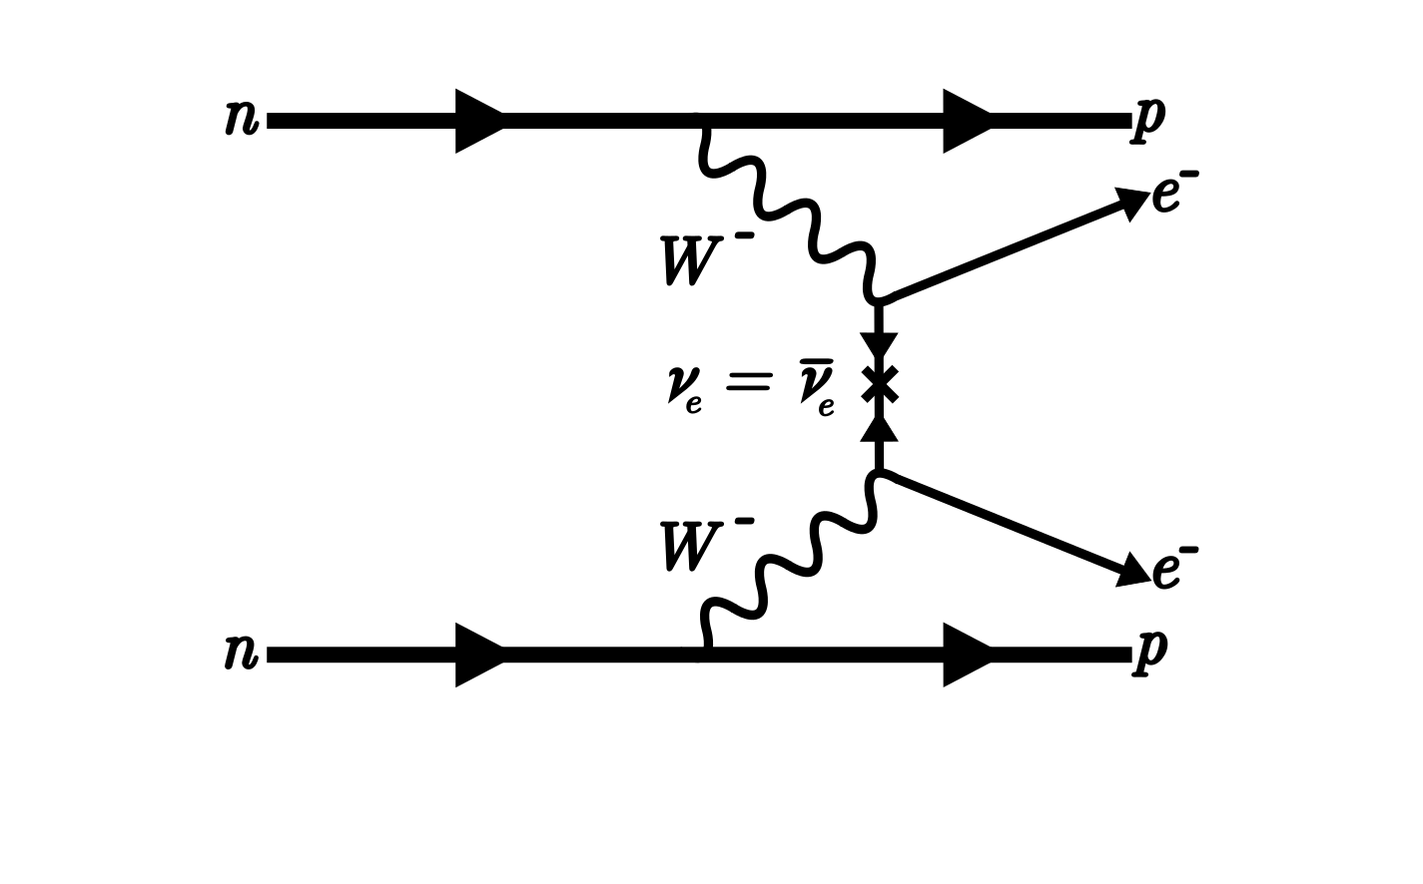
Neutrinoless double beta decay (0νββ)
0νββ is a hypothetical decay where two electrons are emitted without neutrinos
0νββ is only possible if neutrinos are Majorana particles
Would violate lepton number conservation
Observation would provide evidence for physics beyond the Standard Model
Feynman diagram for 0νββ
Diagram credit: Simon Lavoie
Notes:
Explain ovbb…. Physics beyond S.M. would be so cool… but how can we observe this process??

Slide 3
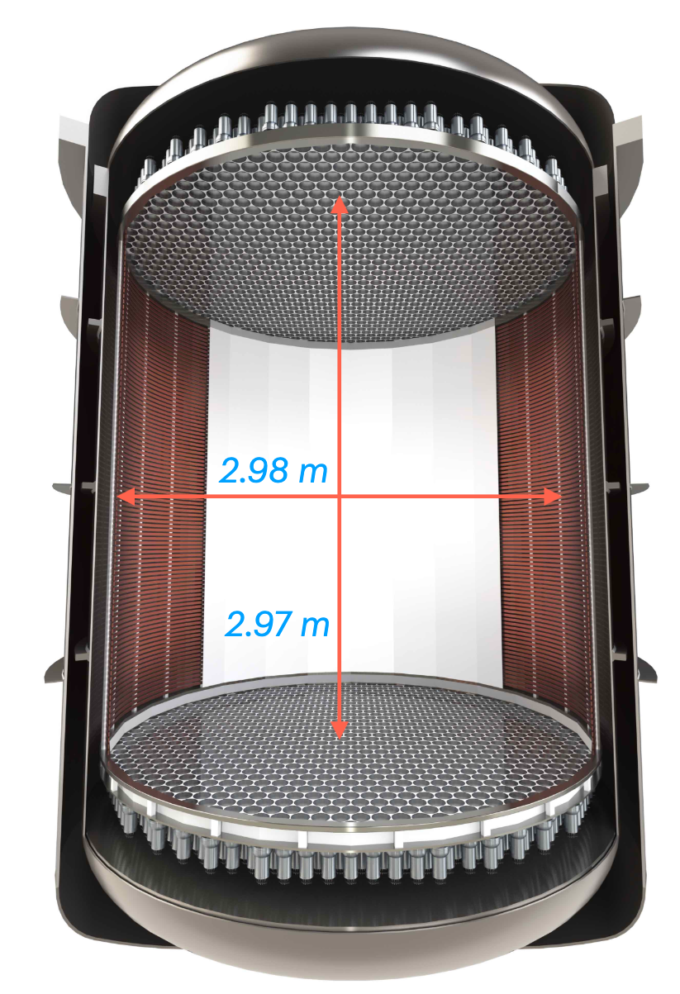
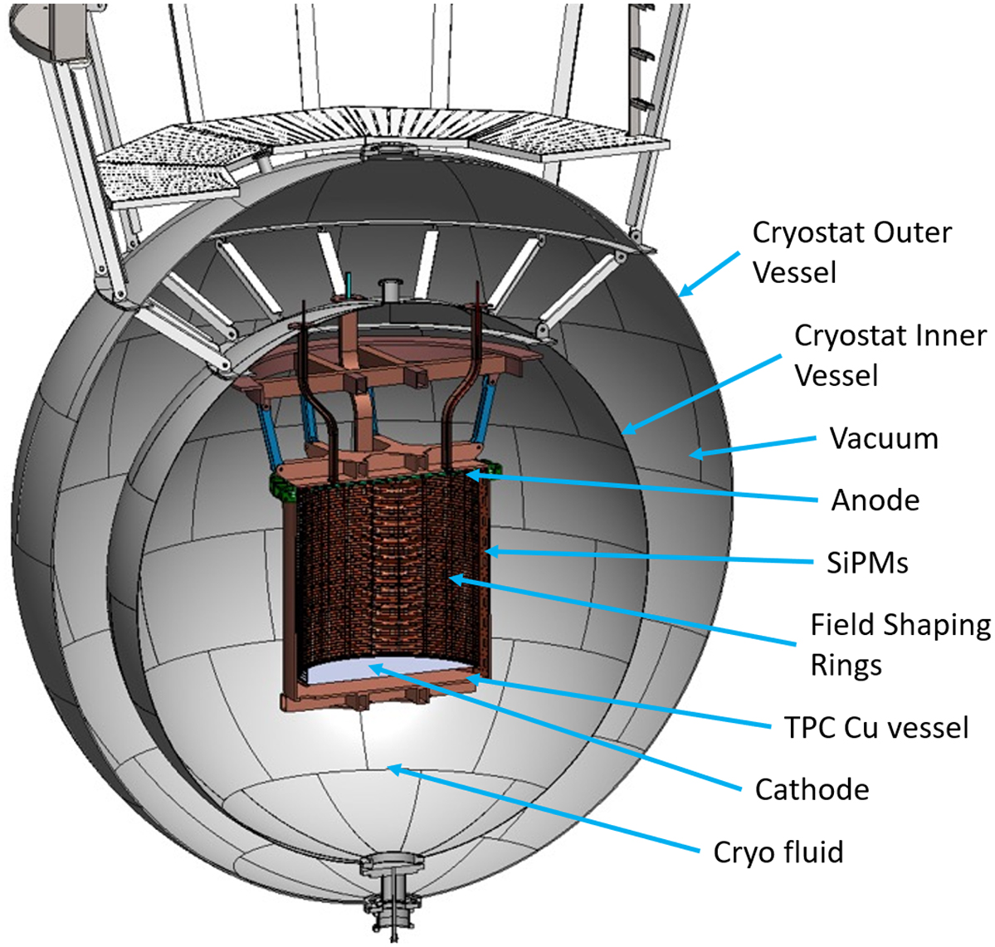
How could we detect 0νββ?
Lower limit for the 0νββ decay half-life of T_{1/2} > 3.8x10²⁶ yr [1]
Extremely rare decay
Requires large detectors with ultra low backgrounds
nEXO and XLZD are possible liquid Xenon time projection chamber-based detectors that could search for 0νββ
nEXO
XLZD
[1] Abe, S., et al. "Search for Majorana Neutrinos with the Complete KamLAND-Zen Dataset." Physical Review Letters 135.26 (2025): 262501.
Notes:
Requires large detectors because the more of the isotope that we have the more likely it is to observe the decay
nEXO. Detector = TPC, Isotope = Xe-136
LEGEND-1000. Detector = HPGe, Isotope = Ge-76?
CUPID: Li₂MoO₄ scintillating crystals enriched in ¹⁰⁰Mo
Really want to explain what this lower limit is and what it means…
I think you then want to say “nEXO uses a liquid xenon time projection chamber…”
-> transfer into slide about LXe TPCs.

Slide 4
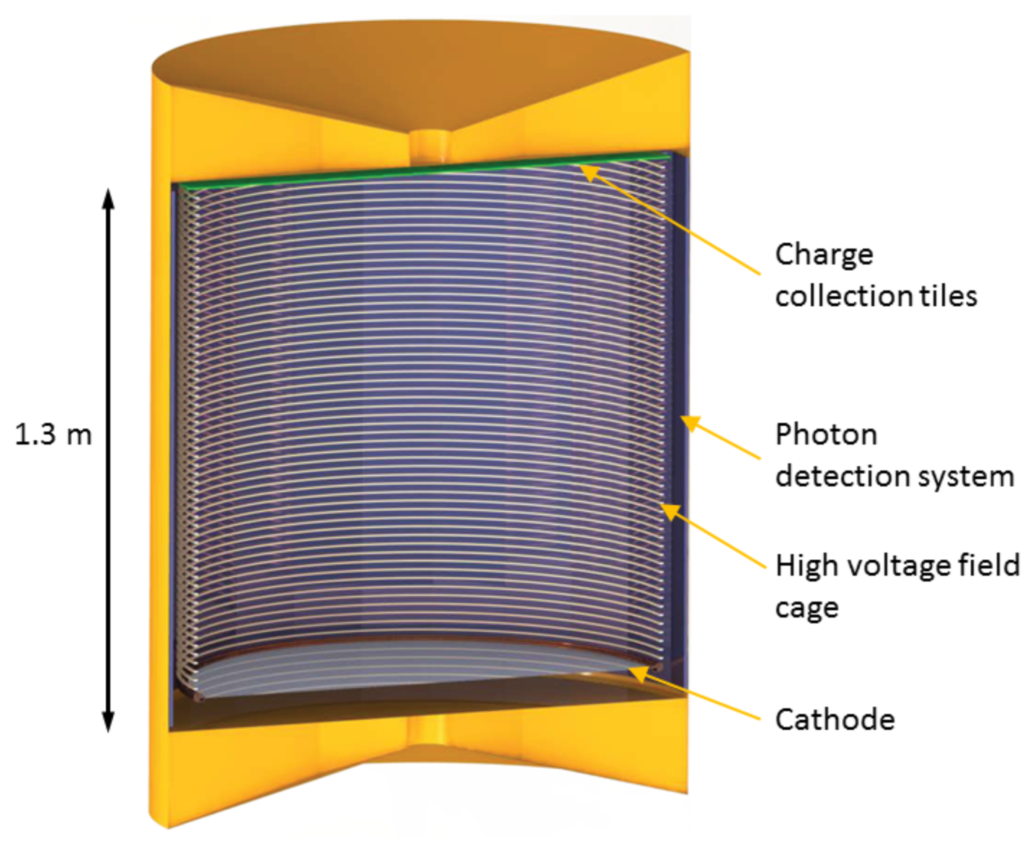
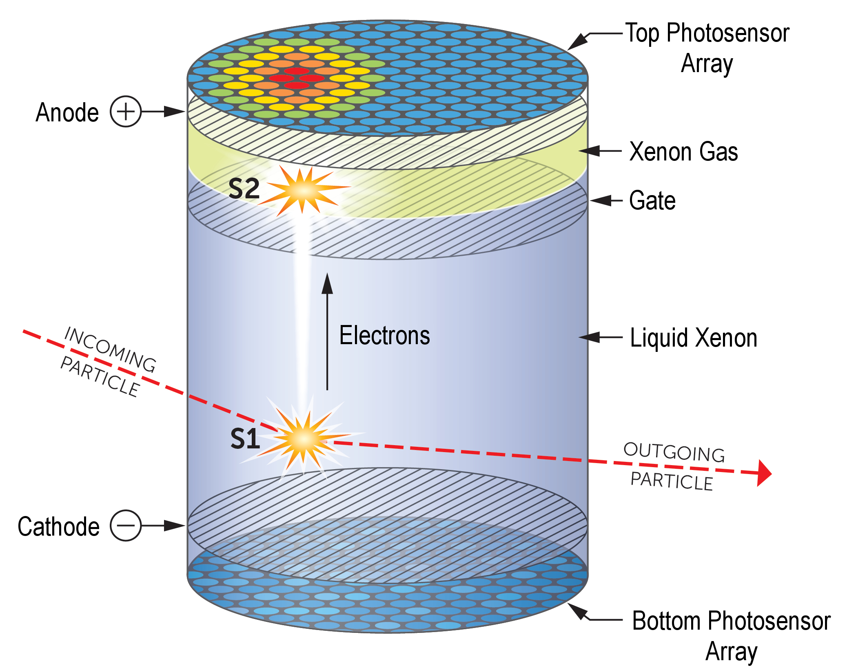
Liquid xenon time projection chambers
nEXO: Single phase
XLZD: Dual phase
Both require photosensors to detect initial scintillation light
Key difference is in the charge readout
Notes:
How could they they detect the initial scintillation light?... Show example of nEXO’s photon detection system…

Slide 5
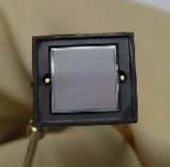
Example of photon detection system for LXe TPC: nEXO
1 cm² Silicon PhotoMultiplier (SiPM)

Slide 6
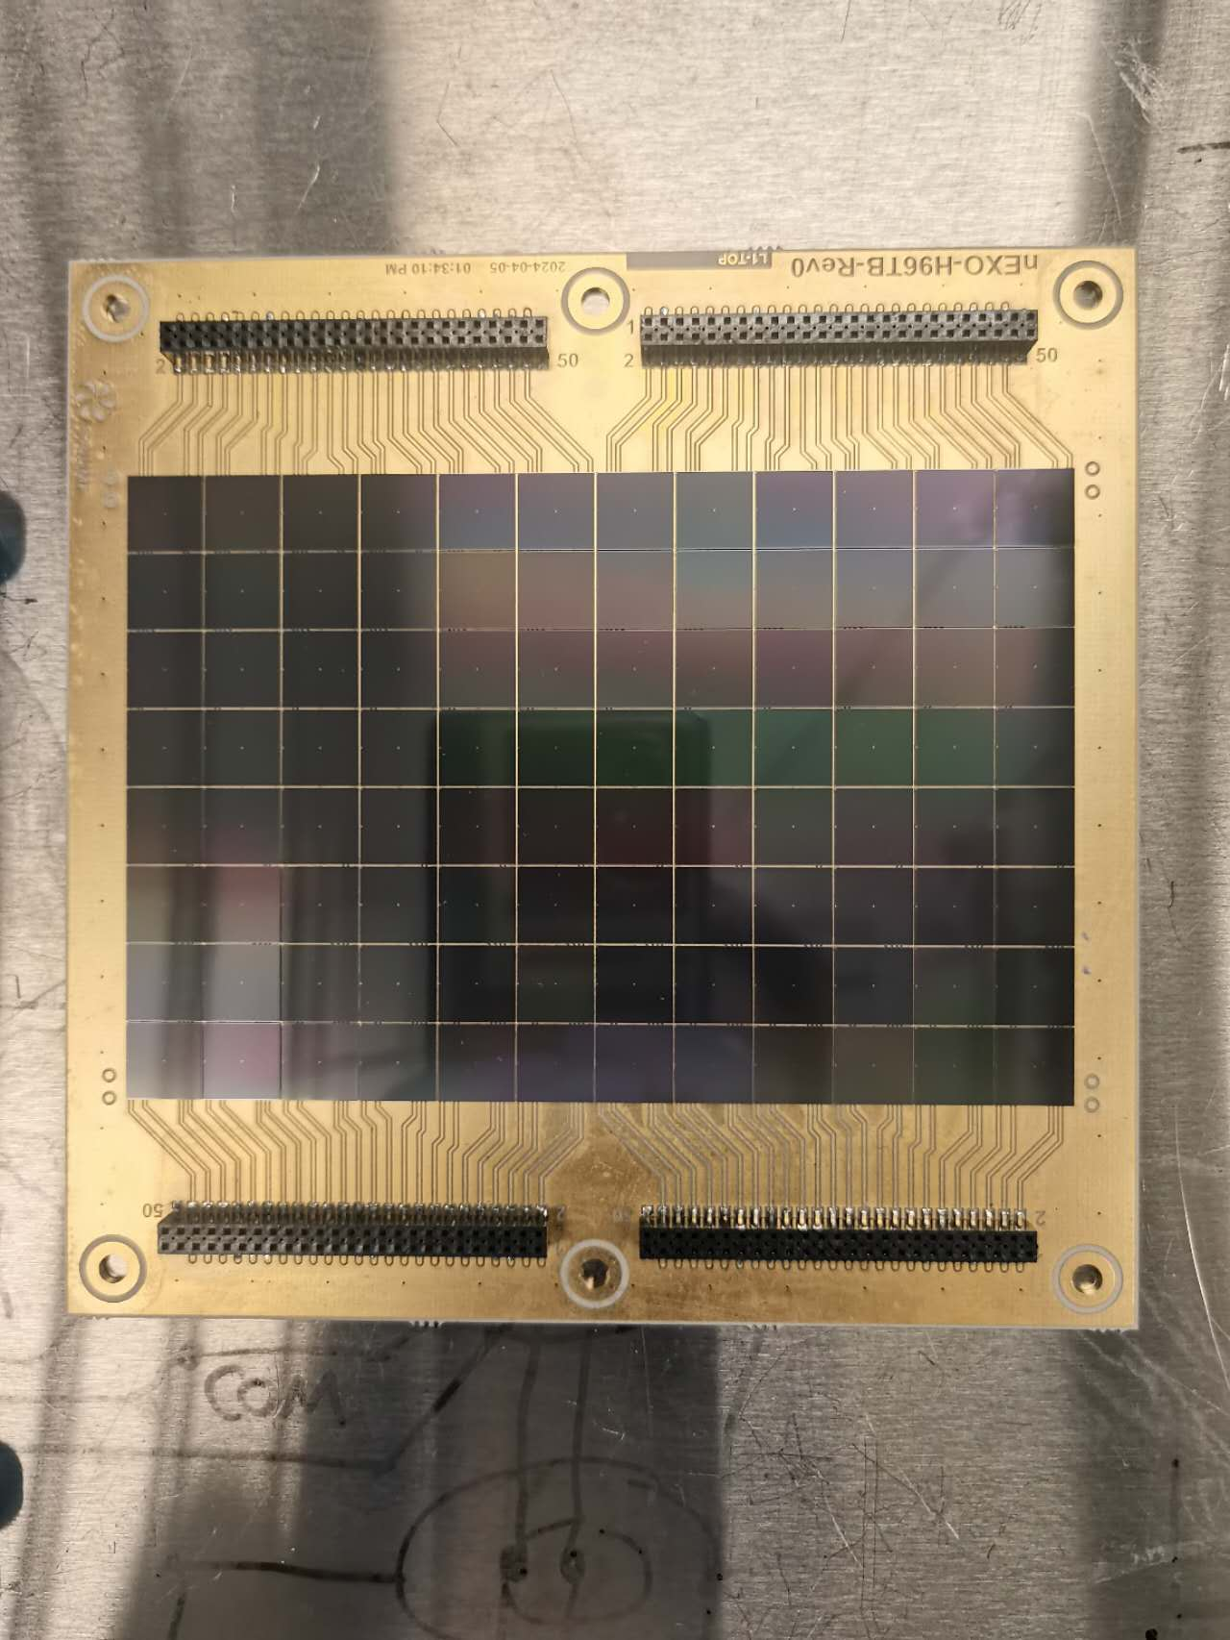
Example of photon detection system for LXe TPC: nEXO
1 cm² Silicon PhotoMultiplier (SiPM)
96-SiPM “tile”
Notes:
remove x and maybe change font for the numebrs?
Blue and black contrast

Slide 7
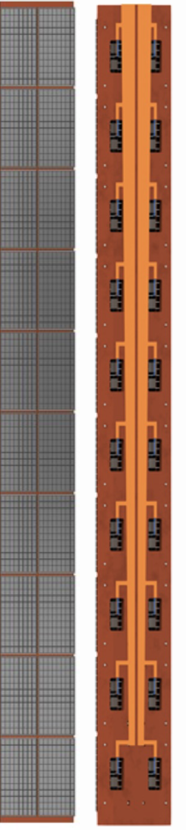
Example of photon detection system for LXe TPC: nEXO
1 cm² Silicon PhotoMultiplier (SiPM)
96-SiPM “tile”
Front and back of a single stave consisting of 20 SiPM tiles
Front
Back
Notes:
arrow in the wrong direction

Slide 8
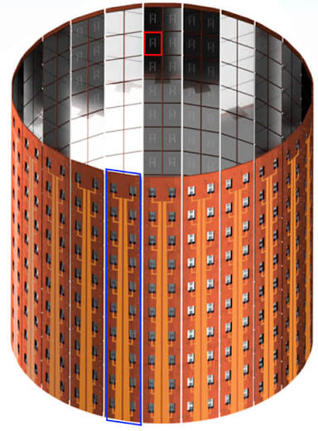
Example of photon detection system for LXe TPC: nEXO
1 cm² Silicon PhotoMultiplier (SiPM)
96-SiPM “tile”
Front and back of a single stave consisting of 20 SiPM tiles
Complete detector configuration, 24 staves surround the cylindrical LXe TPC
46 080 SiPMs!
Notes:
Example for possible detection for LXe
Don't know how many SiPMs will be used for XLZD

Slide 9
How a SiPM works
n-type
SiPMs consist of many avalanche photodiodes (APDs), or microcells
Microcells are reverse-biased above their breakdown voltage
A photon generates an electron-hole pair which drifts due to electric field
High electric field triggers avalanche multiplication
e -
E
h +
p-type
Reverse Bias
-
+
V
Simplified diagram of electron-hole pair generation due to a photon in a semiconductor

Slide 10
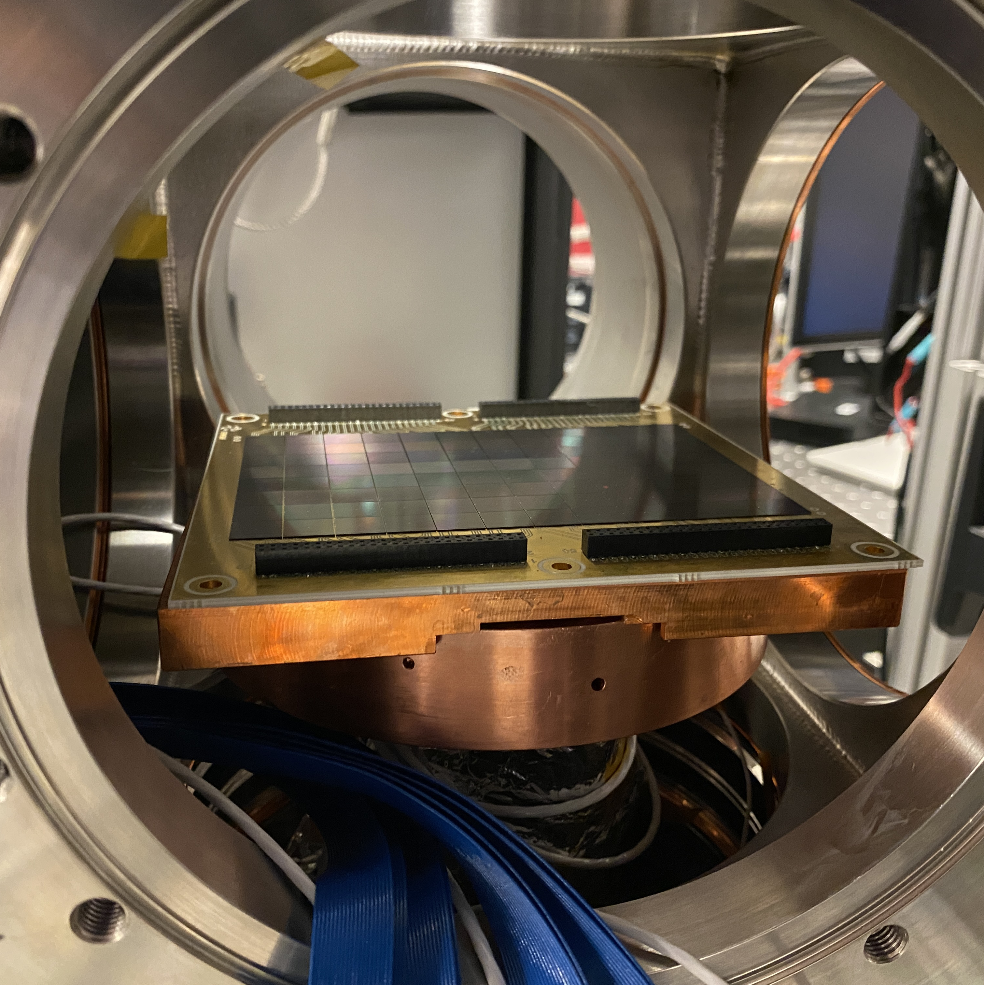
SiPM testing
Possible large LXe TPCs with many SiPMs motivates characterization of large SiPM arrays
Tile and stave characterization happening at McGill
Large cost per channel due to air-to-vacuum feedthroughs
Image taken by Lucas Darroch: 05/28/26
96-SiPM tile inside cryostat
Notes:
No Underscore

Slide 11
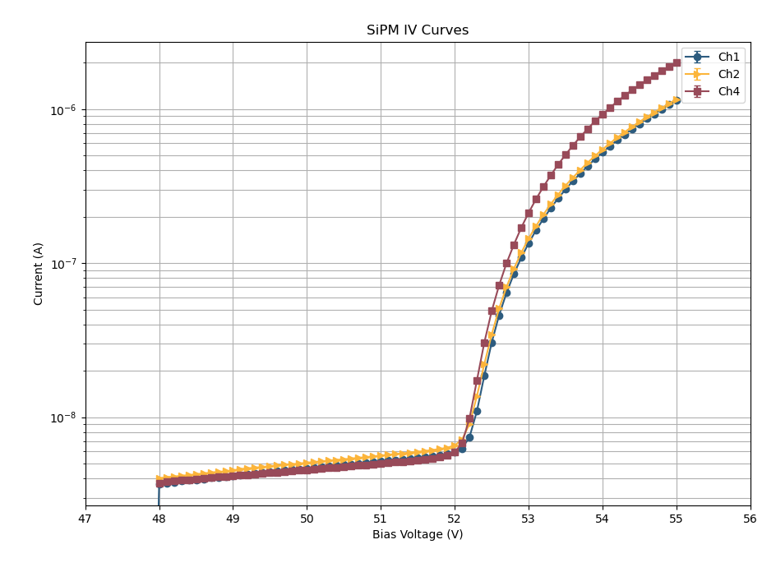
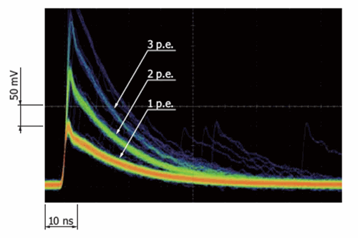
SiPM characterization
IV-Mode
Pulse-Mode
Current is measured as a function of voltage
Characterizes breakdown voltage and dark current
Counts individual pulses
Characterizes SPE resolution, gain and noise

Slide 12
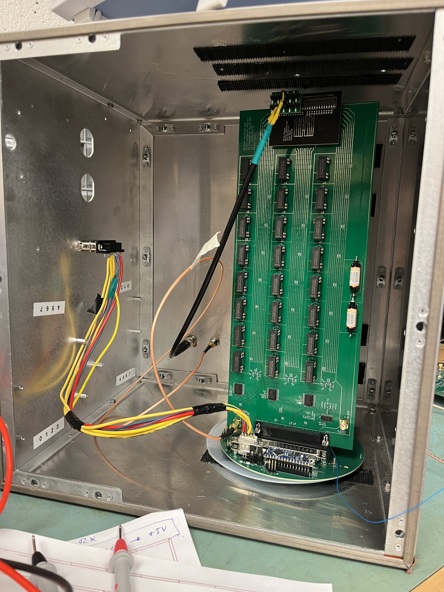
Pulse-IV Multiplexer
Can measure both RF pulse signals (Pulse) and DC current (IV)
Allows us to perform pulse counting and IV-curve tests on individual SiPMs
Minimizes cryostat feedthroughs with automatic switching
The test setup for the pulse-IV multiplexer
Notes:
That’s cool… but how does it accomplish this?

Slide 13
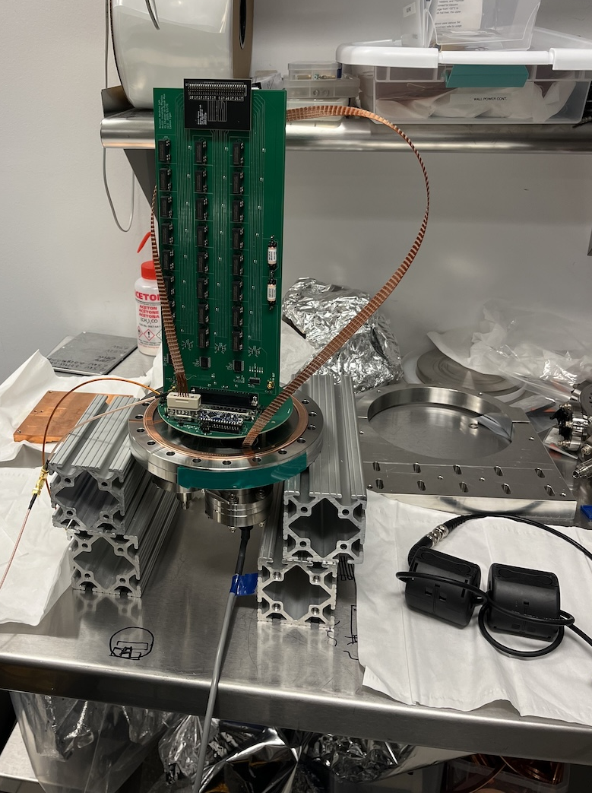
Where do I come in?
Get the multiplexer working
Stress test
Characterize the noise to see if the multiplexer is suitable for tile testing
Pulse-IV multiplexer

Slide 14
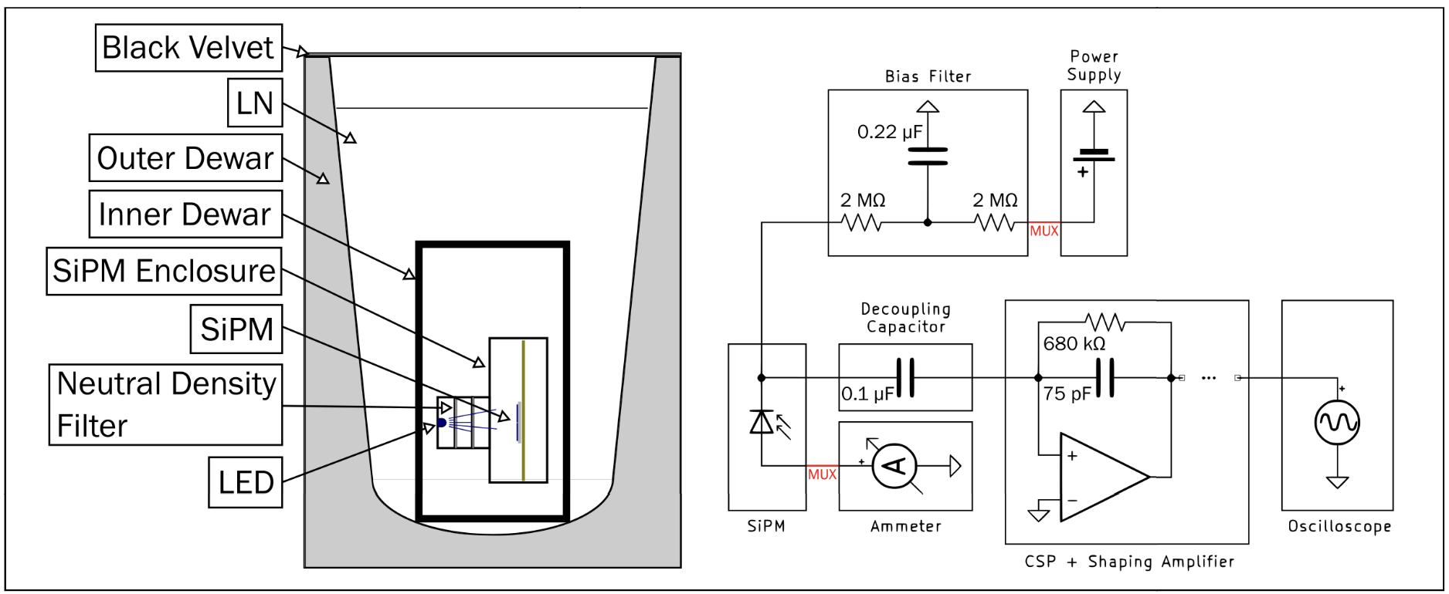
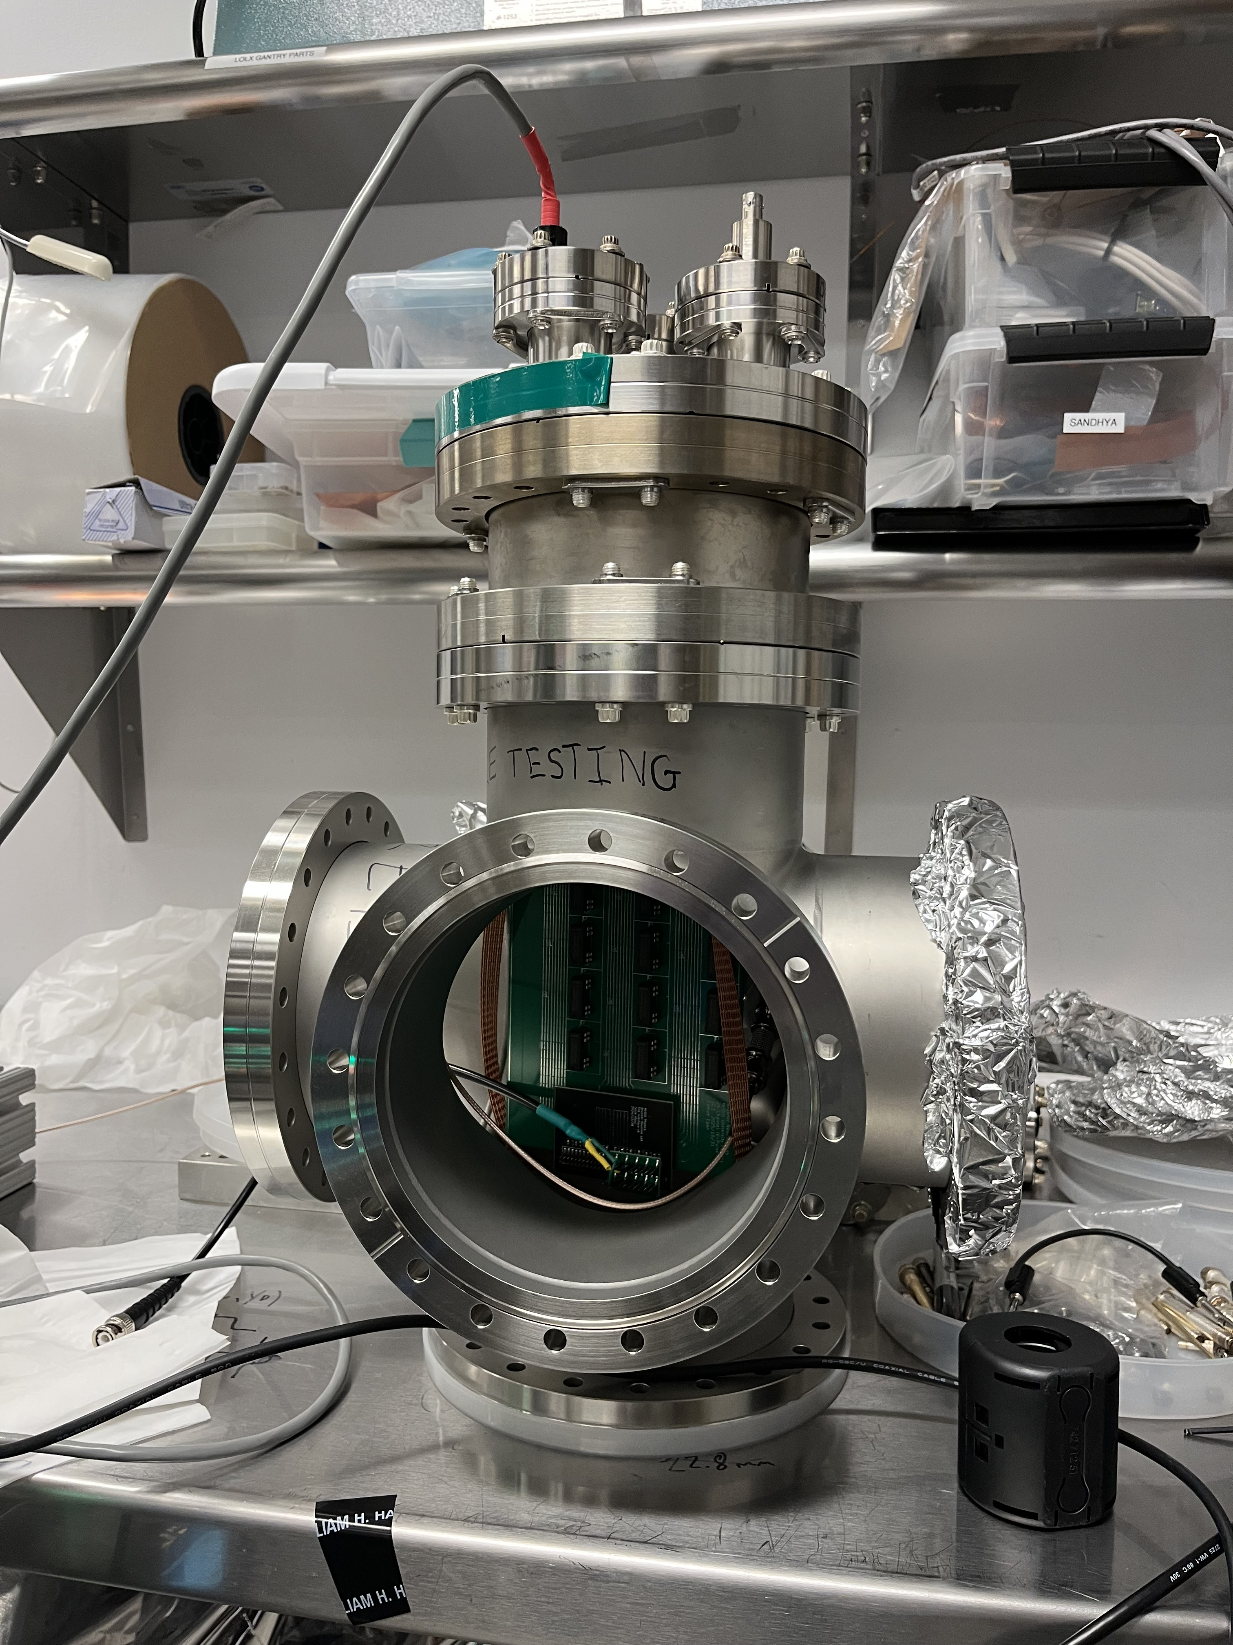
SiPM bucket test
Recreate this experiment using the Pulse-IV multiplexer
Compare SNR of going through the multiplexer with the SNR of bypassing the multiplexer
Diagram source: Darroch et al. (2025)
Pulse-IV multiplexer inside
of an open cryostat cross

Slide 15
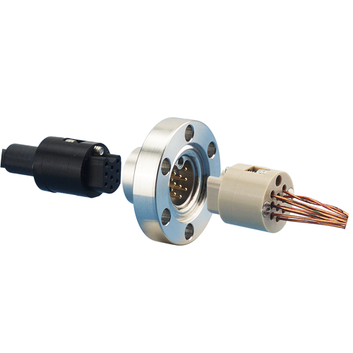
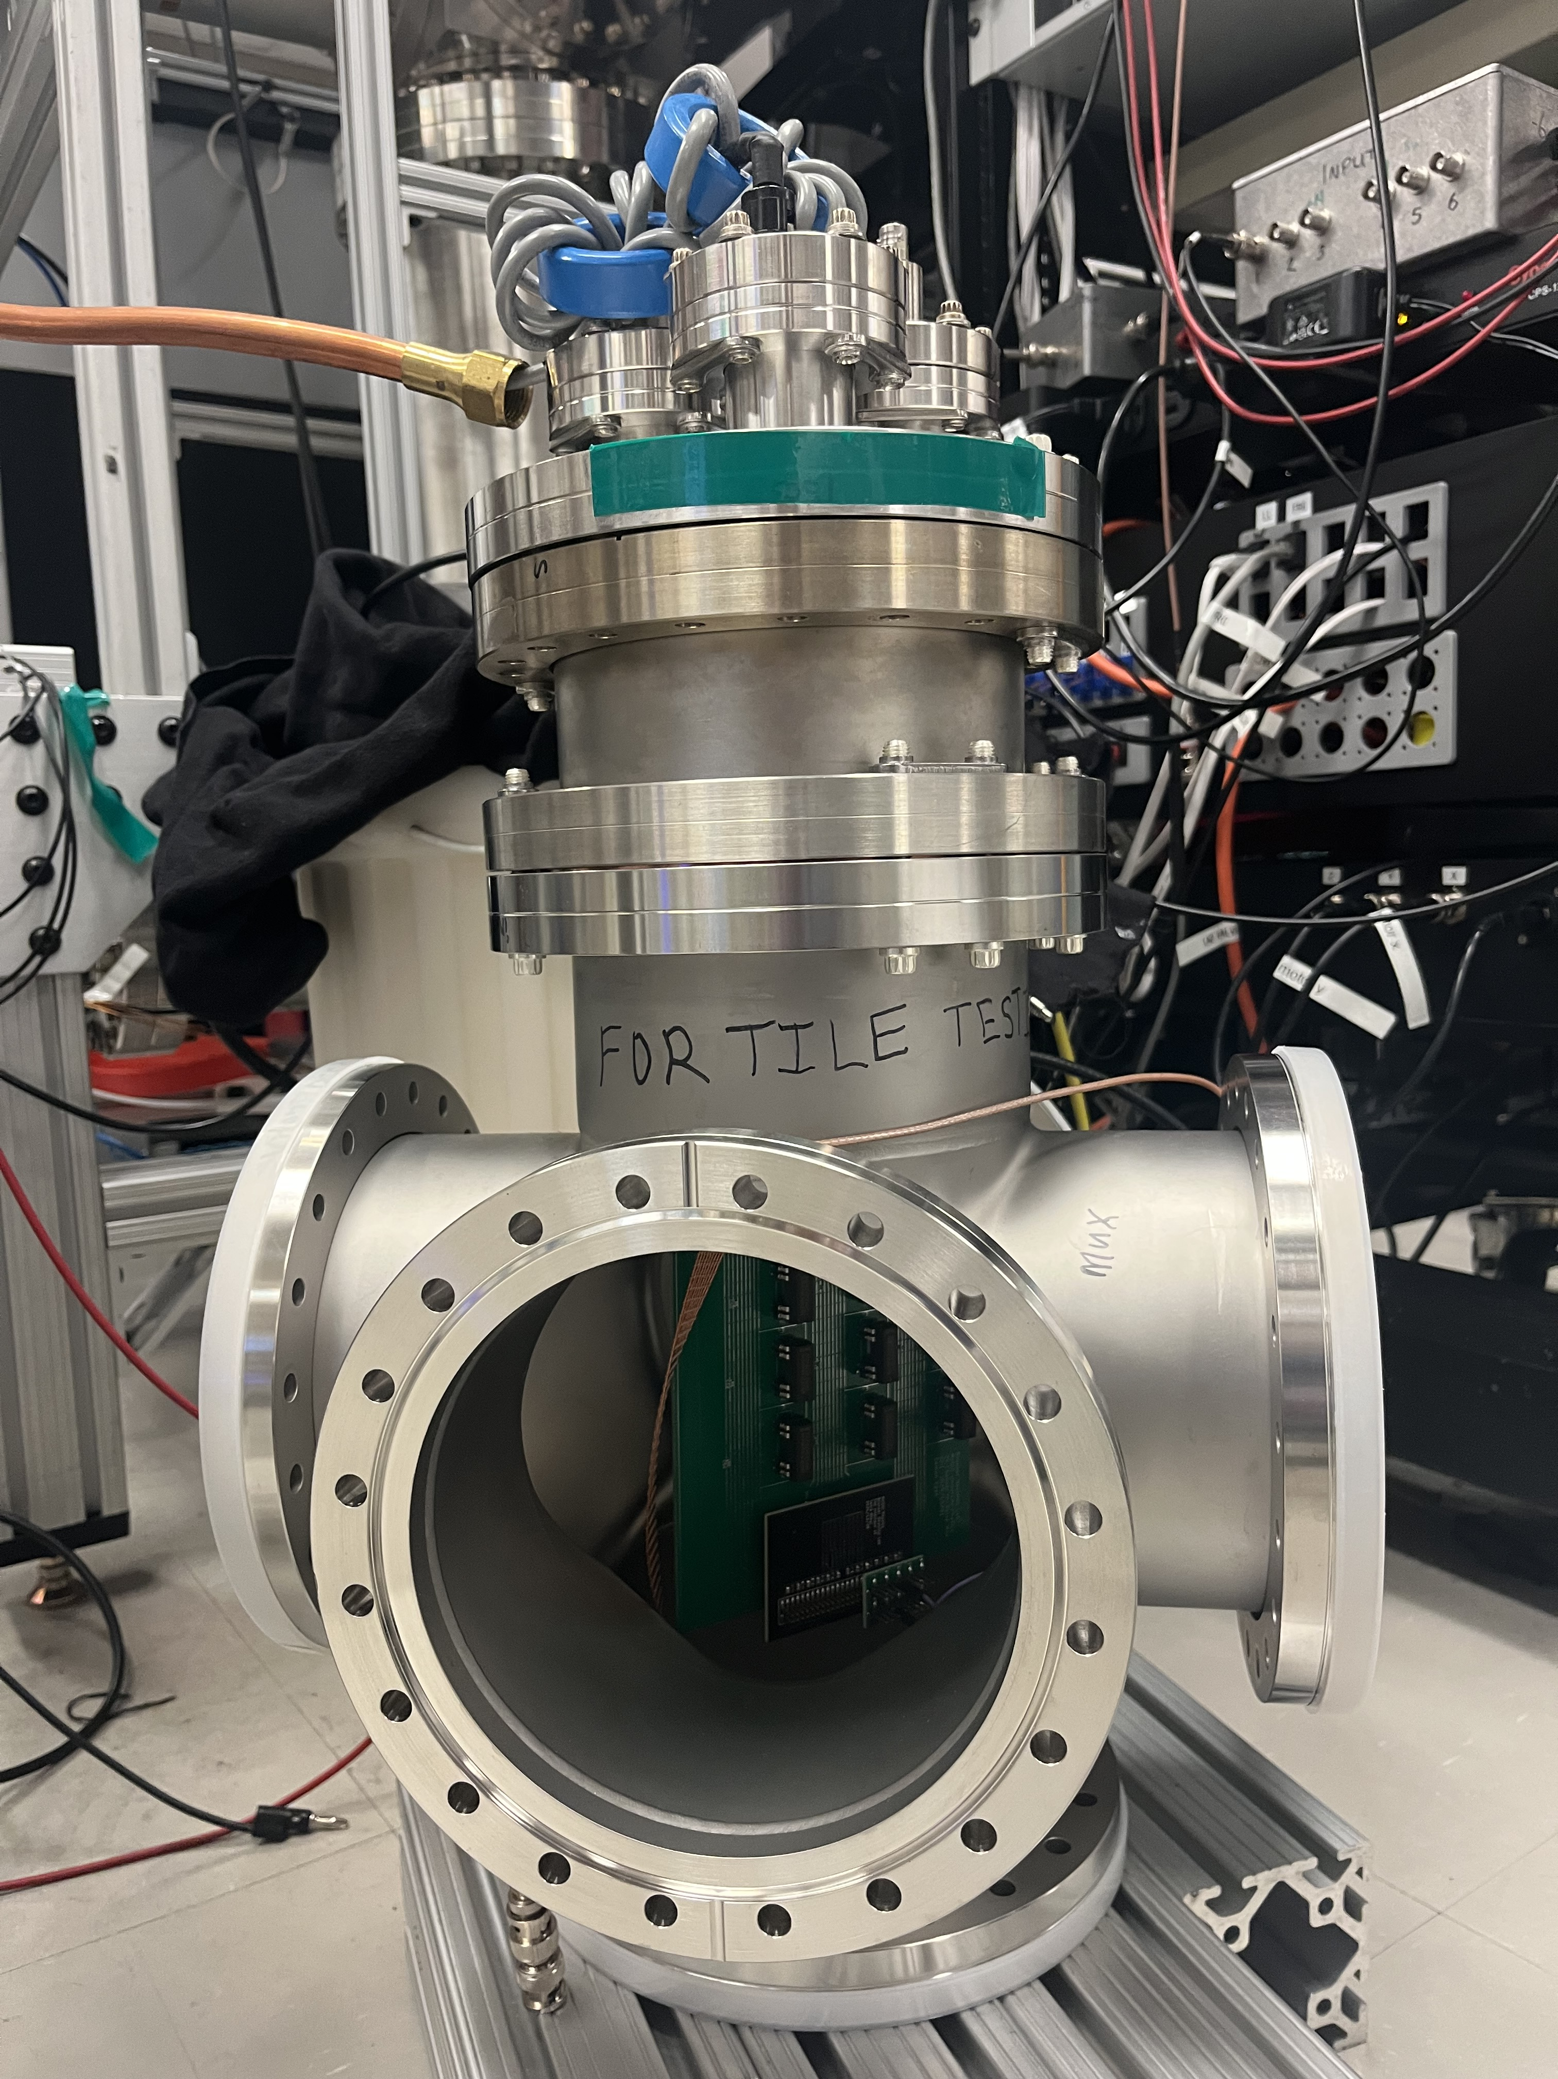
Electrometer
VB
Laptop
Power
Opto Board

Slide 16
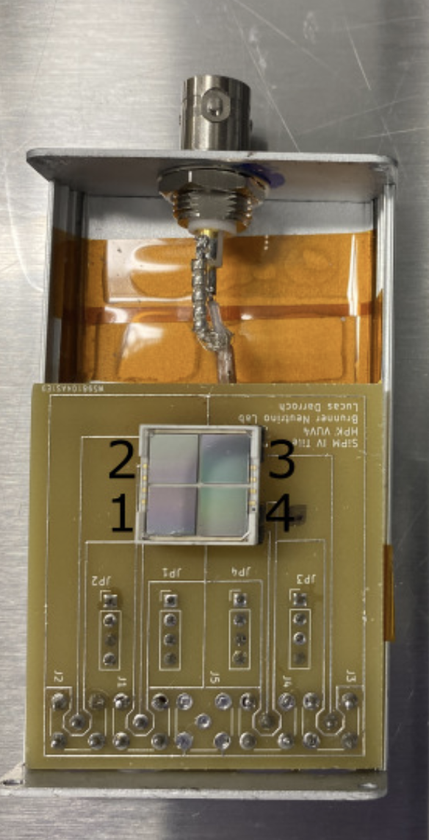
Electrometer
VB
Laptop
WFM Gen
Freq = 50kHz
Amp = 3Vpp
Duty Cycle = 3%
Power
Opto Board
SiPM Box
LN2
BNC
Blinking
LED
Interface board
Samtec

Slide 17
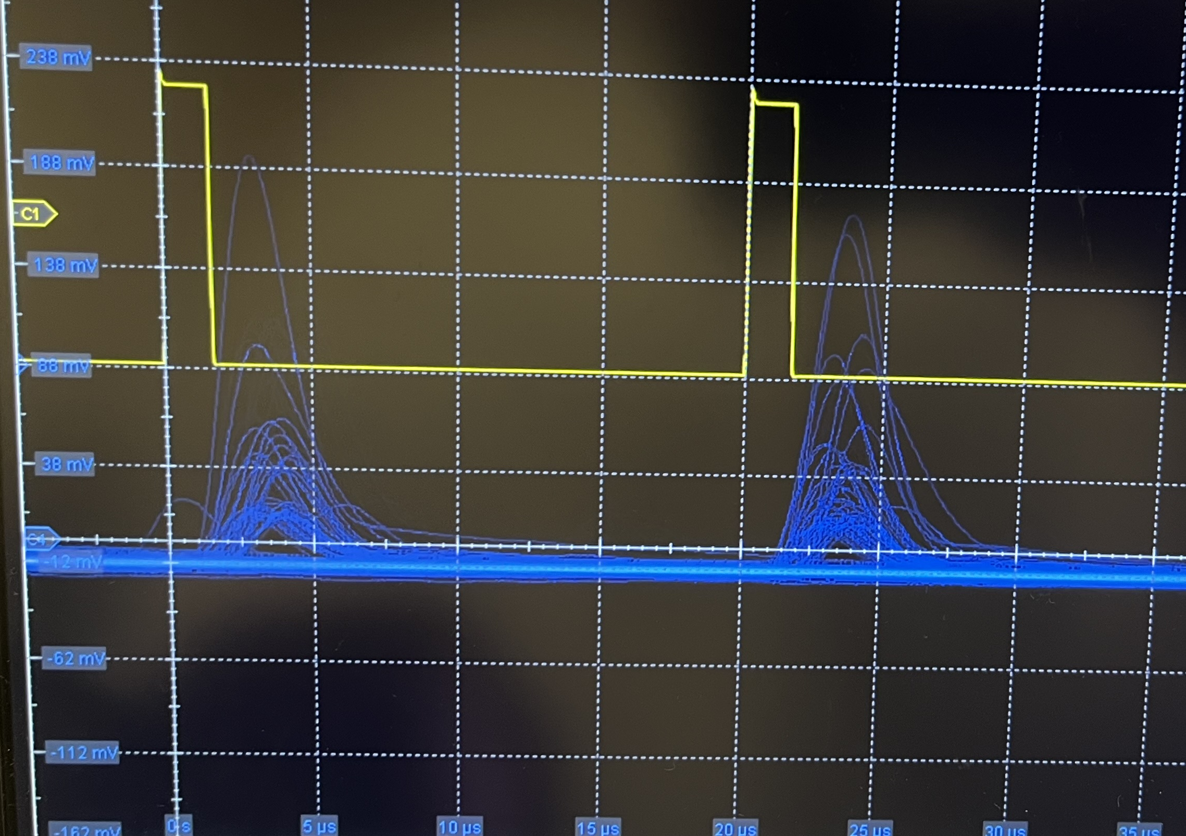
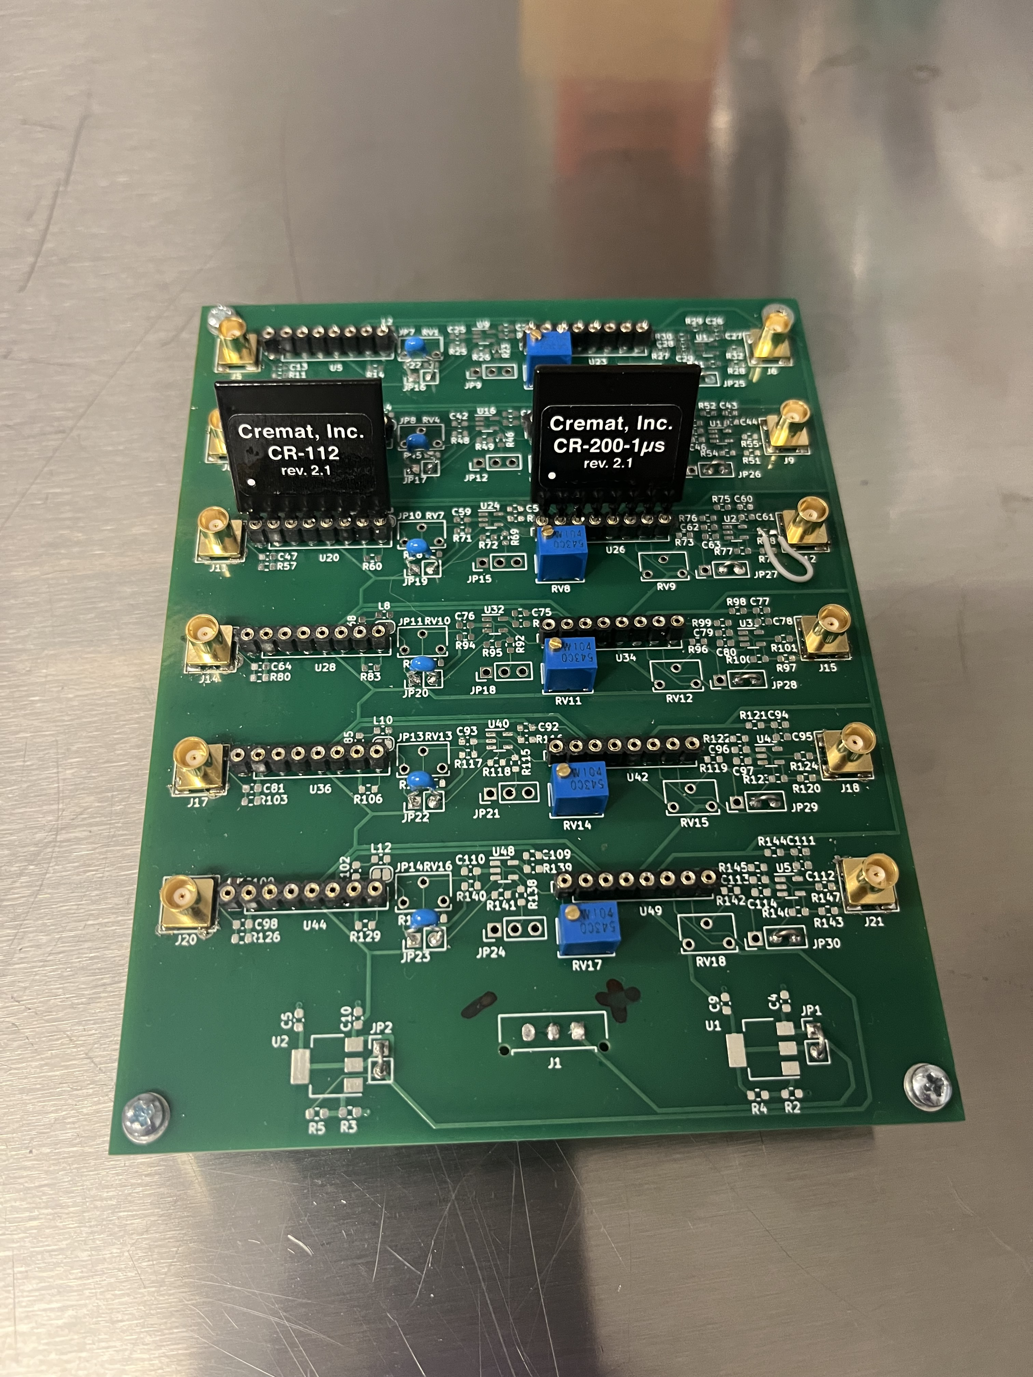
Electrometer
VB
Scope
Laptop
WFM Gen
Freq = 50kHz
Amp = 3Vpp
Duty Cycle = 3%
Power
Opto Board
q
SiPM Box
LN2
Cremat Board
BNC
Blinking
LED
Interface board
Samtec
CSP + Shaper
Notes:
Not clear that the MUX is inside of the cryostat

Slide 18
SiPM preliminary tests (no multiplexer)
Tests performed at room temperature (~300 K)
Confirmed SiPMs worked in both IV mode and pulse mode
Found the breakdown voltages for SiPMs through IV-curve
IV-Curves for three of the SiPMs at room temperature

Slide 19
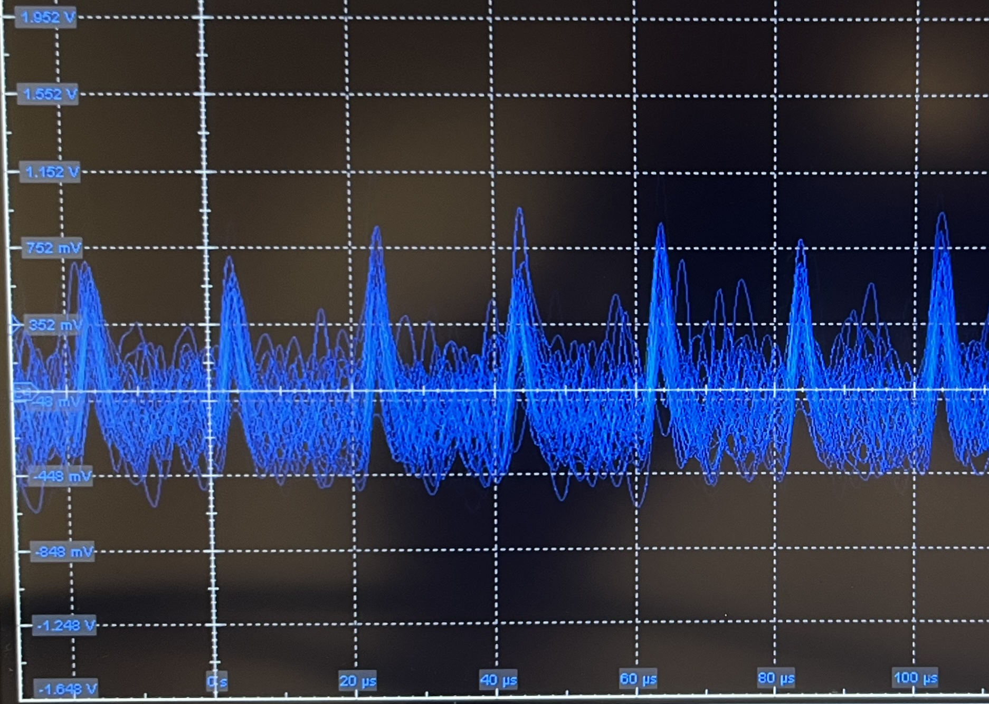
SiPM preliminary tests (no multiplexer)
Tests performed at room temperature (~300 K)
Confirmed SiPMs worked in both IV mode and pulse mode
Found the breakdown voltages for SiPMs through IV-curve
Traces of the Cremat output from a SiPM at room temperature, with 5 volts of overvoltage.

Slide 20
SiPM preliminary tests (no multiplexer)
Tests performed at room temperature (~300 K)
Confirmed SiPMs worked in both IV mode and pulse
Found the breakdown voltages for the SiPMs through IV-curves
SiPMs work!
Traces of the Cremat output from a SiPM at room temperature, with 5 volts of overvoltage.

Slide 21
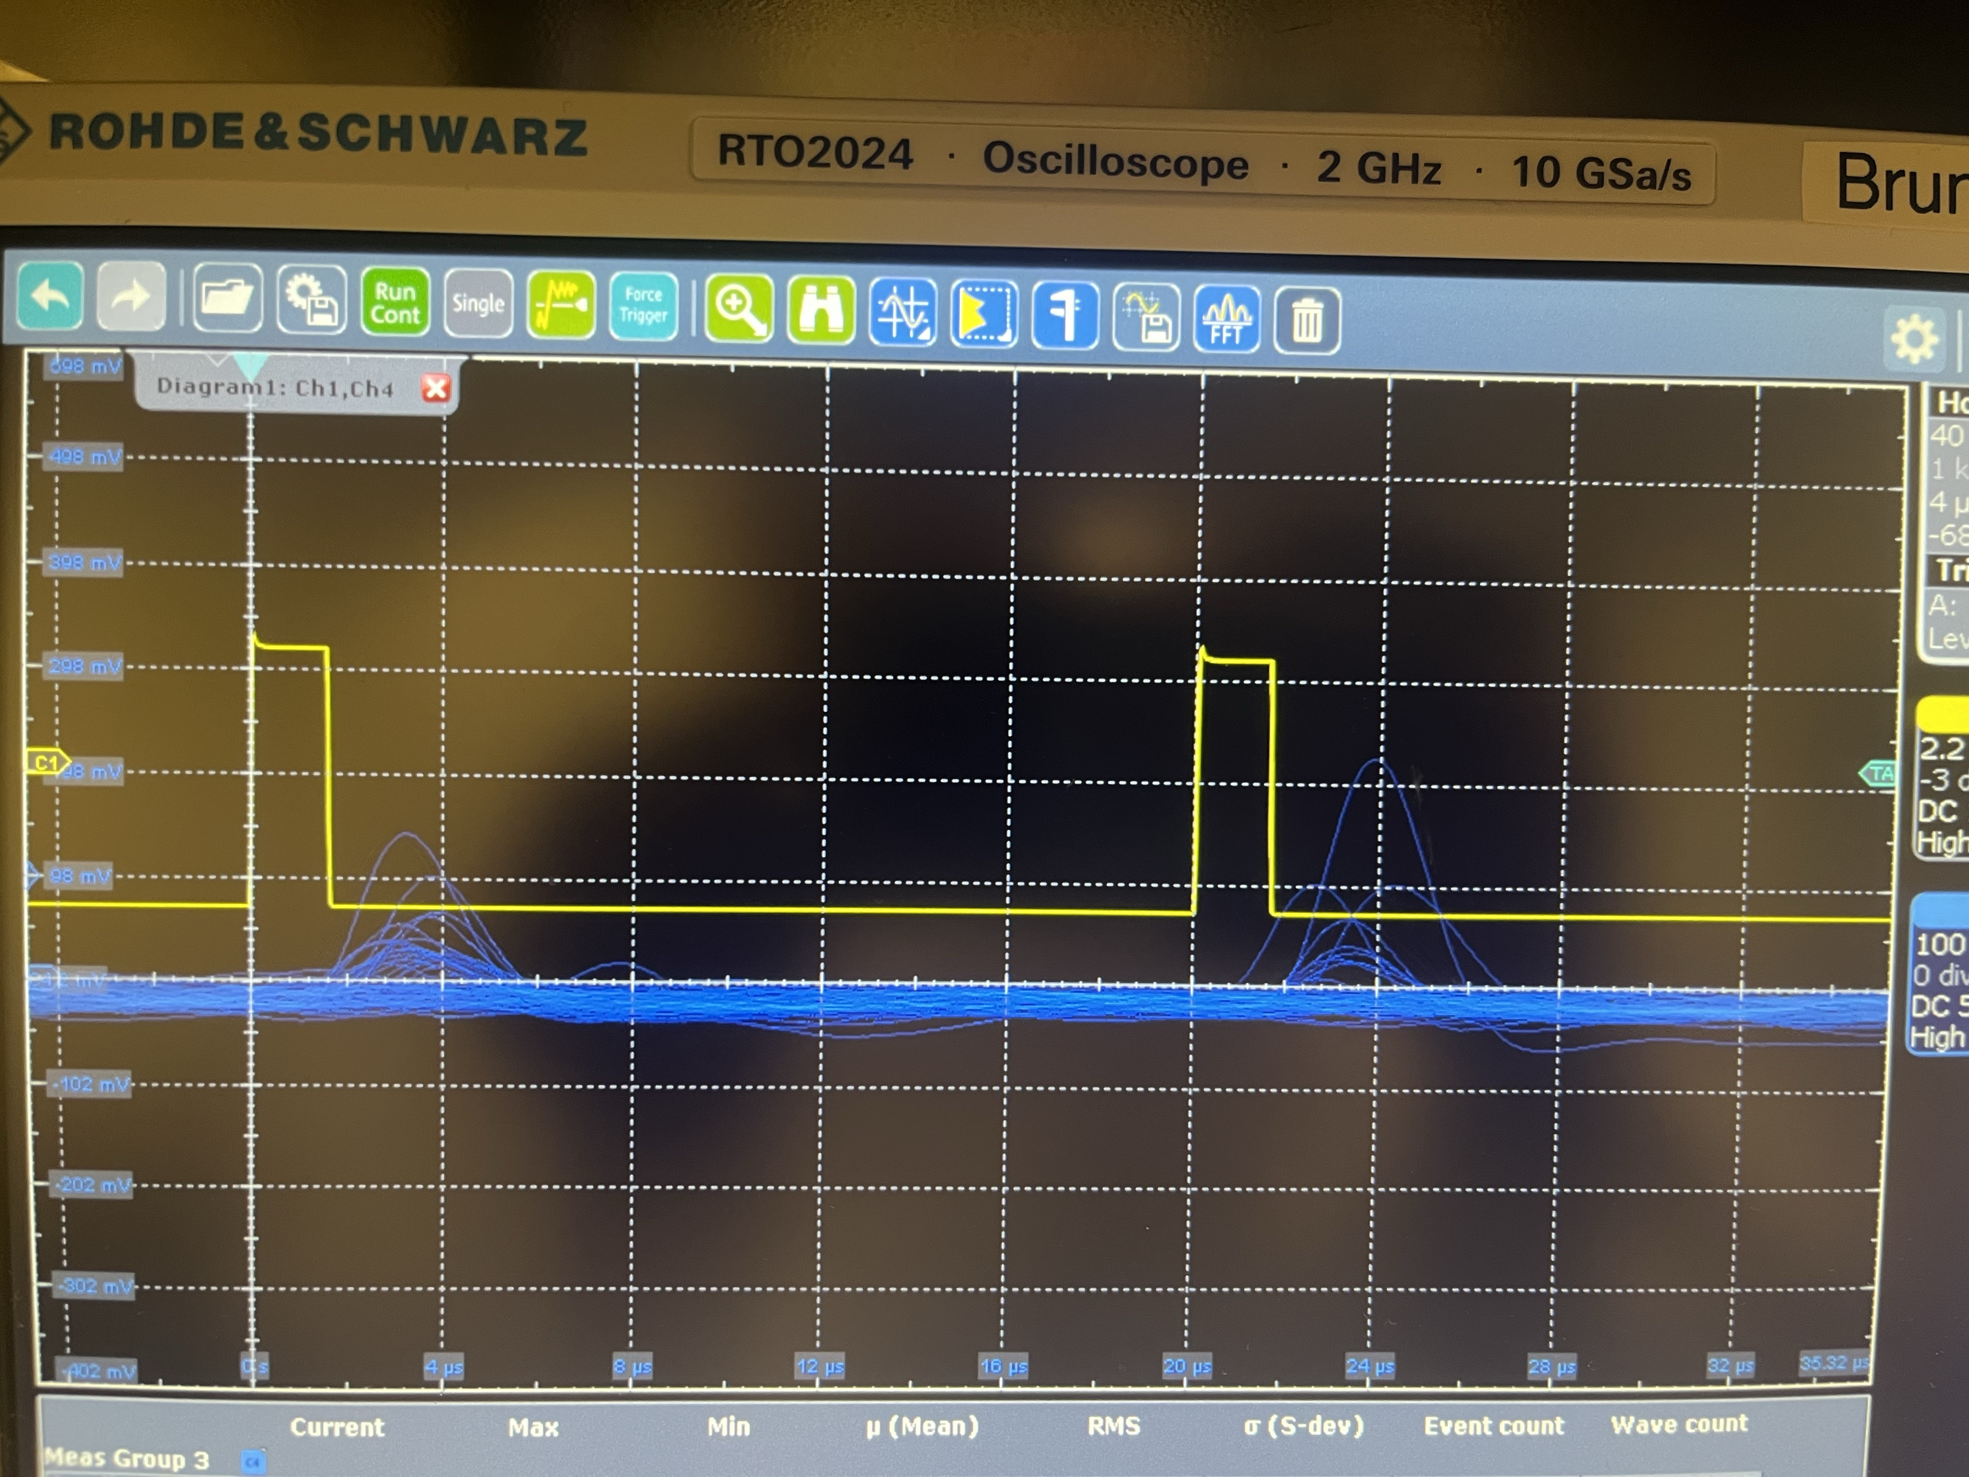
SiPM pulse through the multiplexer
Blue: Traces of the Cremat output from a SiPM with 5-V overvoltage (50V) at 77 k
Yellow: Signal injected into LED (on/off)
Notes:
add yellow trace to the caption
add axis labels in power point

Slide 22
SiPM pulse through the multiplexer
How noisy is this?
Notes:
Mention why the noise is important instead of just saying

Slide 23
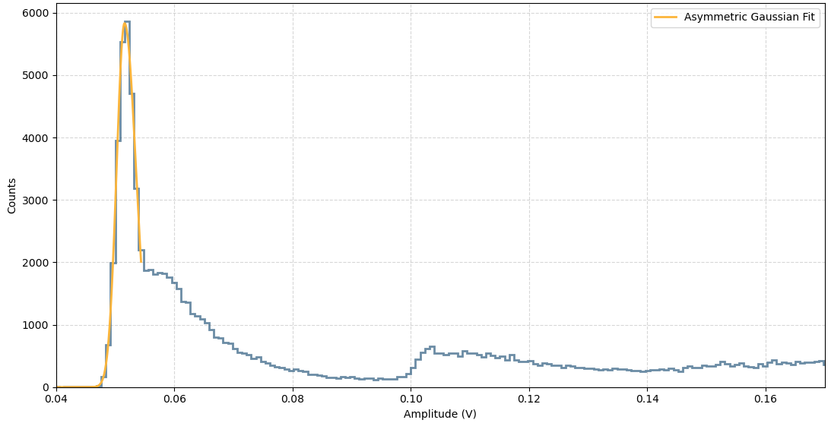
Charge spectrum: bypassing multiplexer
From fit:
FWHM = 3.83 mV
μ = 51.55 mV
Notes:
Talk to Lucas again
Does FWHM use the cut leg or the full leg??

Slide 24
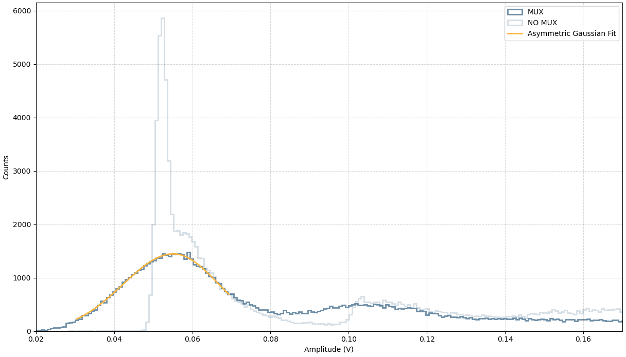
Charge spectrum: through multiplexer
From fit:
FWHM = 28.85 mV
μ = 55.17 mV
Notes:
could have the bypassing spectrum on the same plot

Slide 25
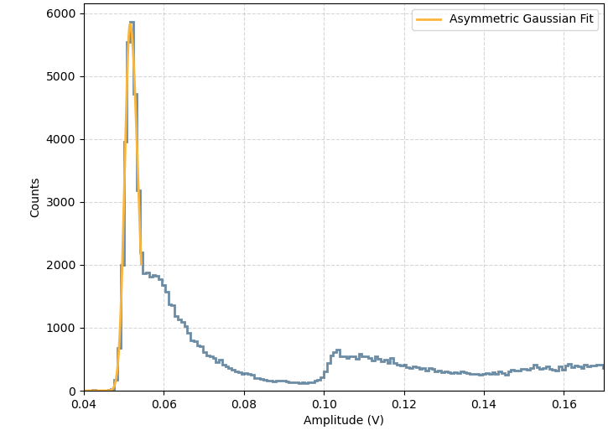
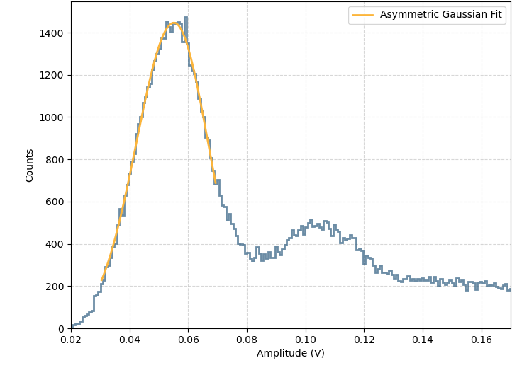
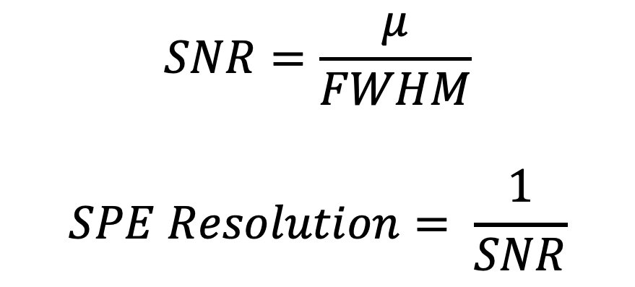
Single photoelectron (SPE) resolution analysis
$$SNR=\frac{μ}{FWHM}$$
$$SPE Resolution= \frac{1}{SNR}$$
No
multiplexer
 | SNR | SPE Resolution
Bypassing multiplexer | 13.46 | 0.07
Through multiplexer | 1.91 | 0.52
Through
multiplexer
Notes:
Must define FWHM, SNR and SPE resolution
FWHM – how thick is your peak? Really good for analyzing the resolution of something. If something is very thick it will be hard to see events close to it.
SNR – Signal-to-noise ratio… not sure I have to explain this guy
SPE – Single photoelectron (one photon)
SPE resolution – How well can we detect a single photon? How well can we determine 1 from 2 …. Etc.

Slide 26


Will the pulse-IV multiplexer be used for tile testing this fall?
Bypassing the multiplexer:
$$SPE Resolution= \frac{1}{SNR}=0.07$$
nEXO requires an SPE resolution <= 0.1 [2], multiplexer currently does not meet this requirement
Limited access to tile (going to Carleton soon)
Through the multiplexer:
$$SPE Resolution= \frac{1}{SNR}=0.52$$
[2] Al Kharusi, S., et al. "nEXO pre-conceptual design report." arXiv preprint arXiv:1805.11142 (2018).
Notes:
put the box to the back so the black text is bolder so one can see - again a contrast issue

Slide 27
Conclusion
The pulse-IV multiplexer will not be used for tile testing this fall
There are plans to make a new version of the pulse-IV multiplexer
This work serves as a guide for noise analysis for future pulse-IV multiplexers
Bypassing the multiplexer:
$$SPE Resolution= \frac{1}{SNR}=0.07$$
Through the multiplexer:
$$SPE Resolution= \frac{1}{SNR}=0.52$$
Notes:
put the box to the back so the black text is bolder so one can see - again a contrast issue

Slide 28
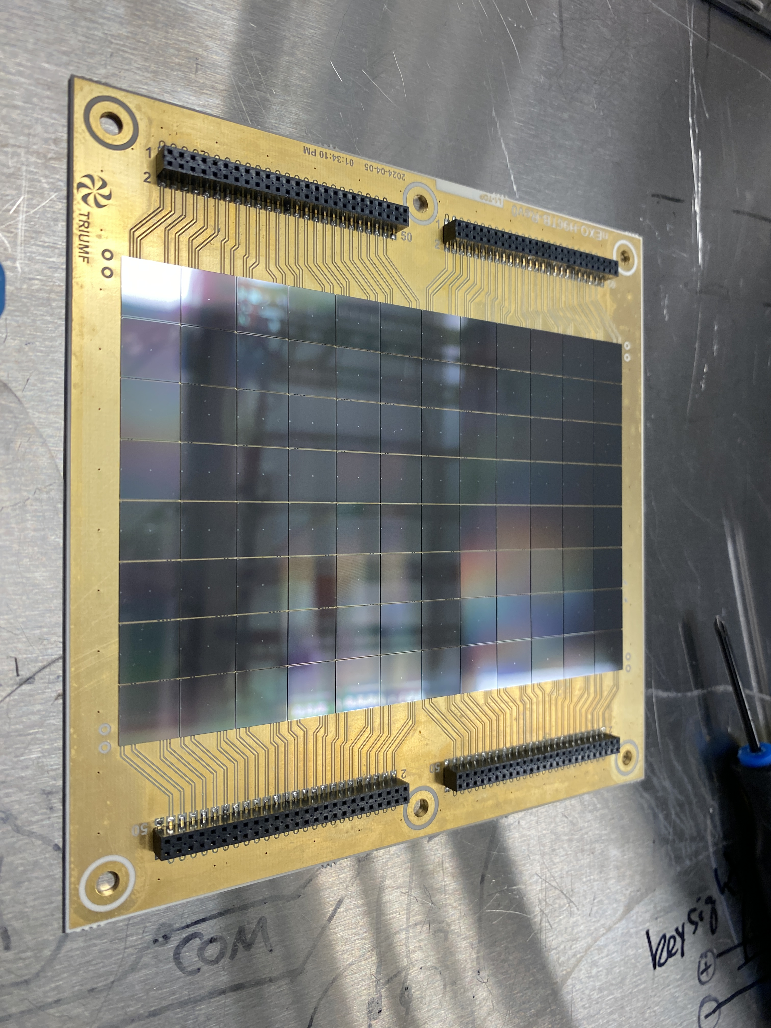




Acknowledgments:
Thank you to Lucas, Eamon, Riya and Thomas for their support, guidance and patience throughout the summer.
Thank you!
Image taken by: Lucas Darroch 05/28/26
Notes:
NSERC image, CFI, McDonanld instatuit... FUNDING, TRIUMF...

Slide 29
Backup Slides

Slide 30
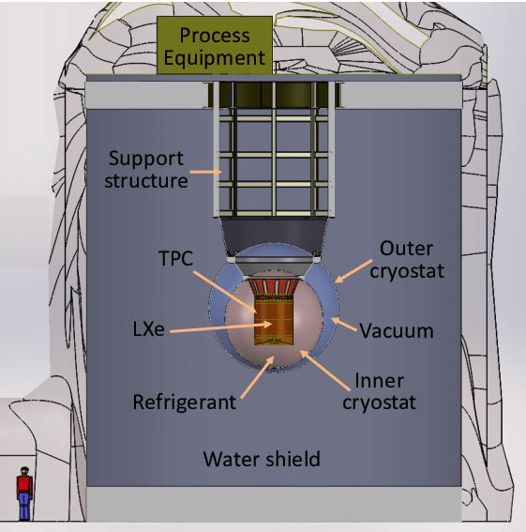
nEXO
Proposed next-generation 5-tonne liquid Xenon time projection chamber (TPC), enriched in Xe-136
Proposed to be located at SNOLAB!
TPC allows for two ways to detect 0νββ
  Scintillation light
  Ionization charge
Will be sensitive to a half-life to 10²⁸ yr [2]
Conceptual sketch of the nEXO detector
Image source: Al Kharusi, S. et al. (2018).
[2] Adhikari, G., et al. "nEXO: neutrinoless double beta decay search
beyond 1028 year half-life sensitivity." Journal of Physics G: Nuclear and
Particle Physics 49.1 (2021): 015104.

Slide 31
SiPM in a bucket test – Testing IV-MUX
Diagram source: Darroch et al. (2025)

Slide 32
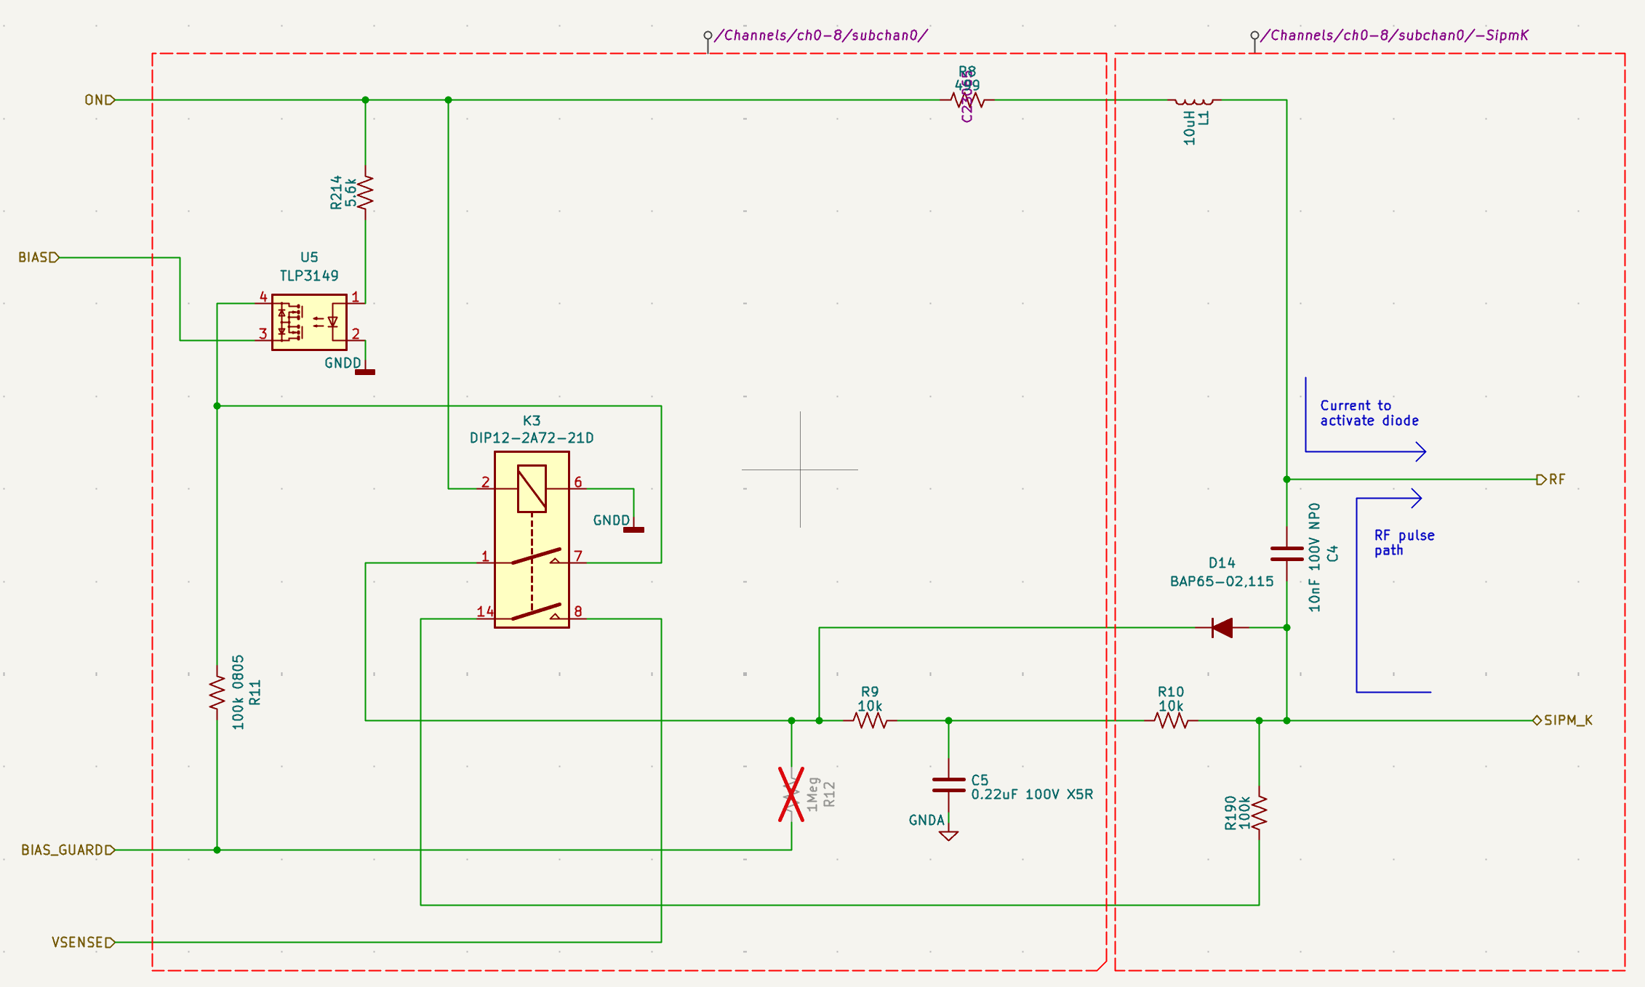
How the multiplexer works
Each SiPM has its own bias relay circuit
When the channel is activated, system connects the bias voltage to SiPM
When the channel is deactivated, system fully isolates the SiPM, minimizing leakage
Notes:
ON: High – SiPM Ch is activated – Biases SiPM
ON: Low – SiPM Ch is deactivated – SiPM is fully isolated
This is done using the U5 which is a photoMOS optical relay and a reed relay
WHY photoMOS relay isolates the SiPM – this is to reduce leakage (reduced leakage is important since we are measuring small current ~pA). photoMOS relays provides low leakage (no mechanical contacts)

Slide 33
off
off
Notes:
ON (low) – GND
Both U5 and K3 are off
SiPM_K is not biased

Slide 34
*click
*click
Notes:
ON (low) – GND
Both U5 and K3 are off
SiPM_K is not biased

Slide 35
on
on
Biased SiPM!
Notes:
ON (low) – GND
Both U5 and K3 are off
SiPM_K is not biased

Slide 36
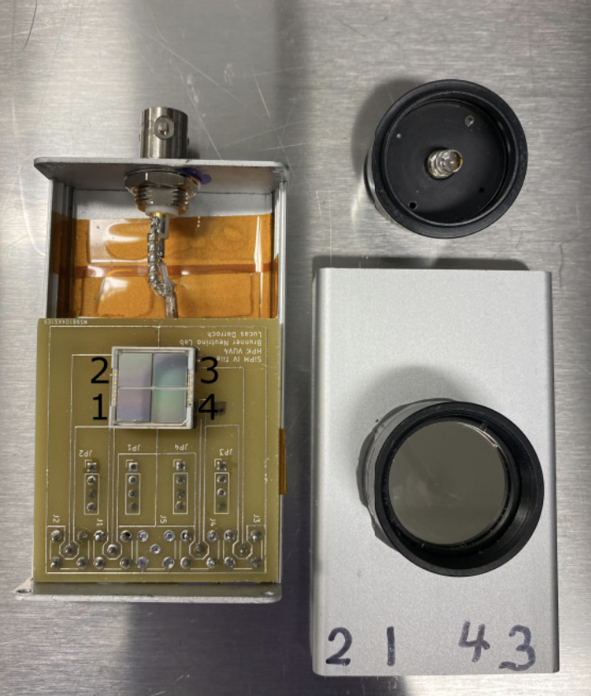
SiPM box
A
B
A: Triax that connects to ammeter
B: Fibre optics cable connector to transfer light from LED to SiPM
C: 4 SiPMs, each with individual channels
D: Thorlabs reflective nd filter
C
D
Image source: Darroch et al. (2025)

Slide 37
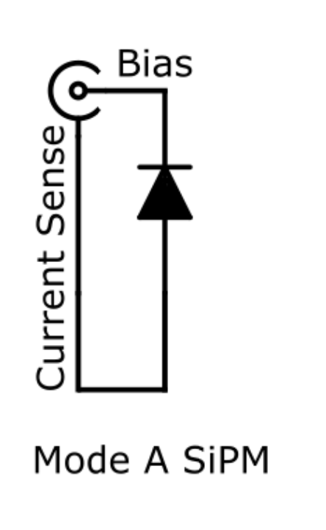
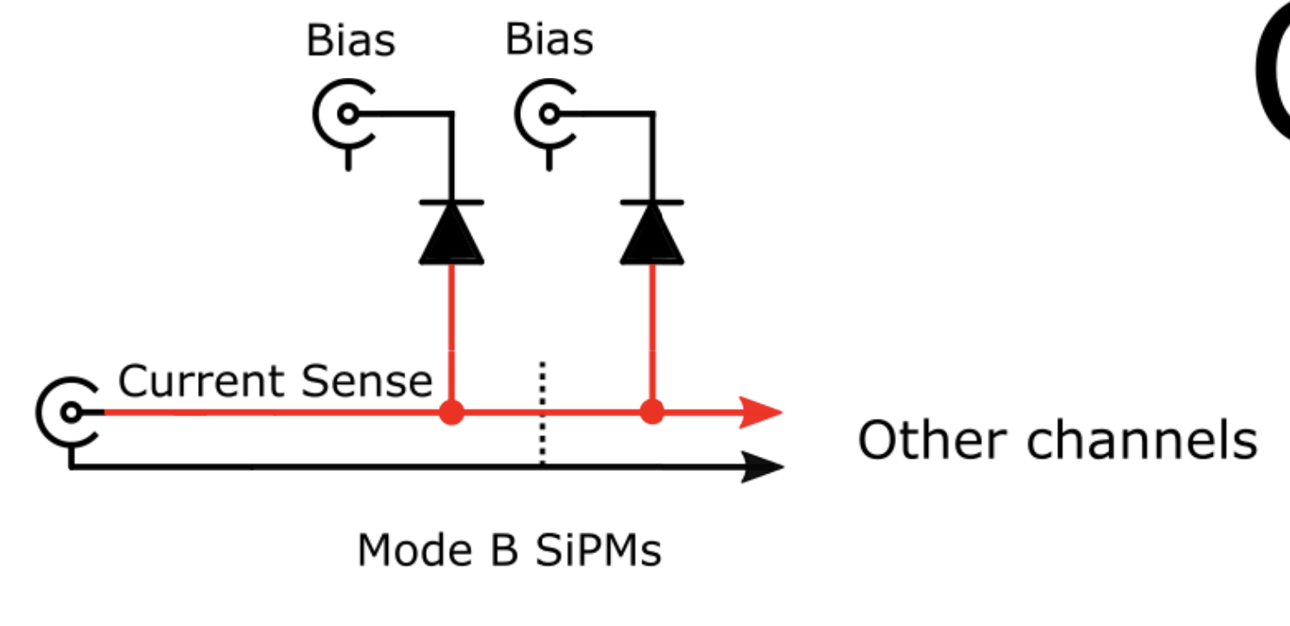
Mode B
Mode A
Image source: Darroch et al. (2025)
Image source: Darroch et al. (2025)

