Slide 1
Engineering World-Class
Collaboration
Modernization of the Fraser Duncan Auditorium Control System
Ahmed Abdel-Dayem
IT Student (SNOLAB)
2nd year Computer Science at Laurentian University
aabdeldayem1@laurentian.ca
August 13, 2026
CASST 2026
1
Notes:
Add a brief overview of the room

Slide 2
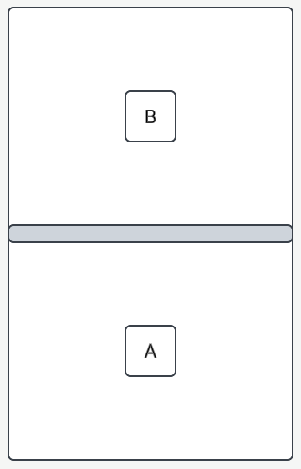
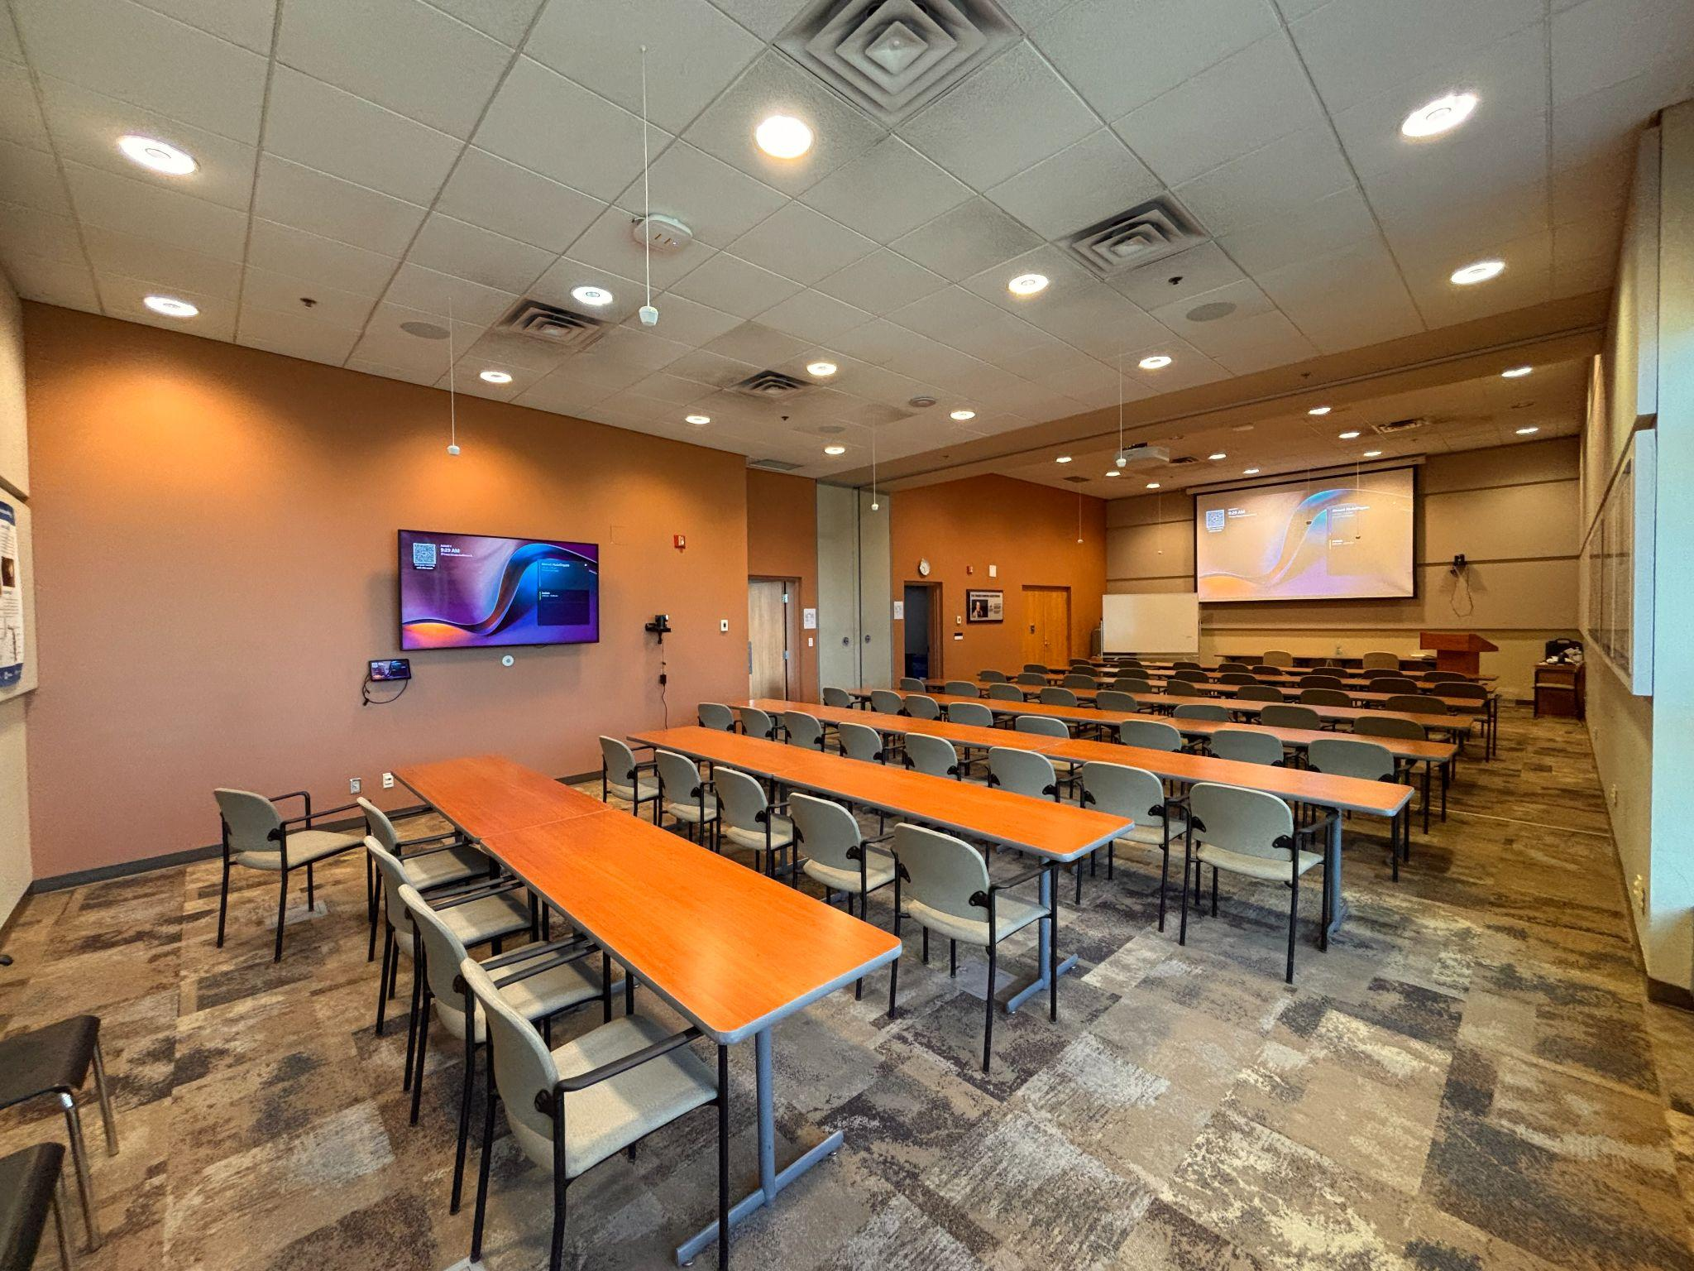
What is the Fraser Duncan Auditorium?
CASST 2026 | Ahmed Abdel-Dayem
2

Slide 3
Why this room matters?
Scientific Seminars
International Collaborations
Collaboration Infrastructure
SNOLAB-wide Staff Events
Student Orientations
CASST 2026 | Ahmed Abdel-Dayem
3
1

Slide 4
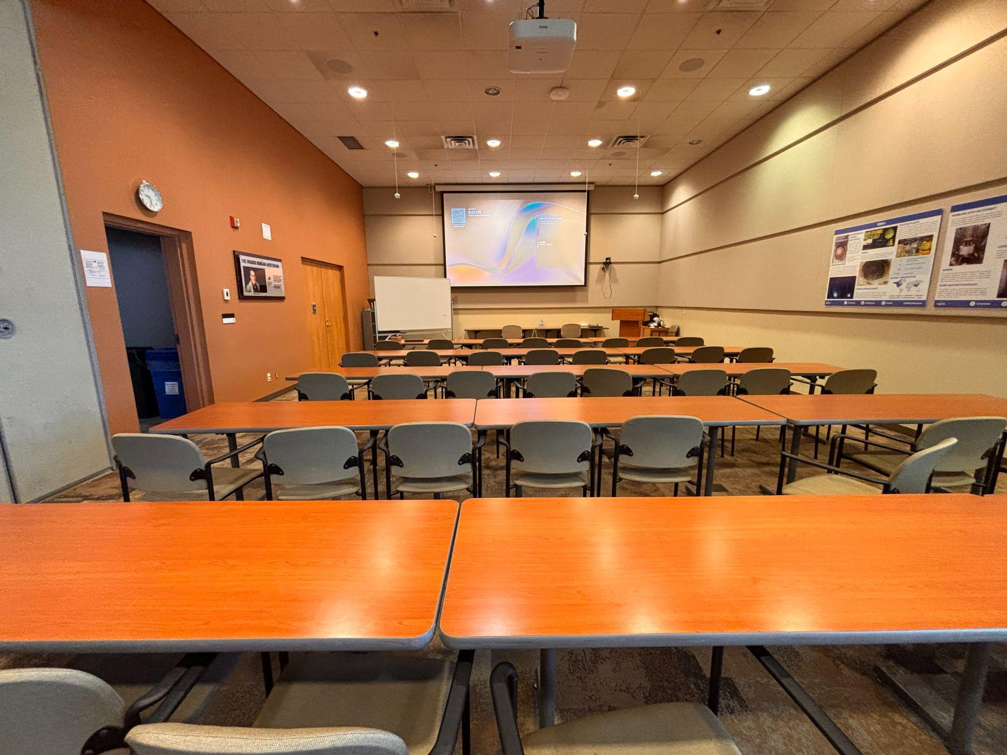
Challenges
Audio system was non functional
Poor user interface
Cameras system was not operational
Screen casting system would consistently fail
Only functional unit was the projector and projector screen
CASST 2026 | Ahmed Abdel-Dayem
4
1

Slide 5
SNOLAB’s Proposed Solution
An external vendor offered to replace the whole system for $100, 000
The project budget was approved
$100, 000
CASST 2026 | Ahmed Abdel-Dayem
5

Slide 6

My Proposed Solution
Fix the existing system
Integrate Microsoft Teams
Design a UI
$20, 000
$80, 000
CASST 2026 | Ahmed Abdel-Dayem
6

Slide 7
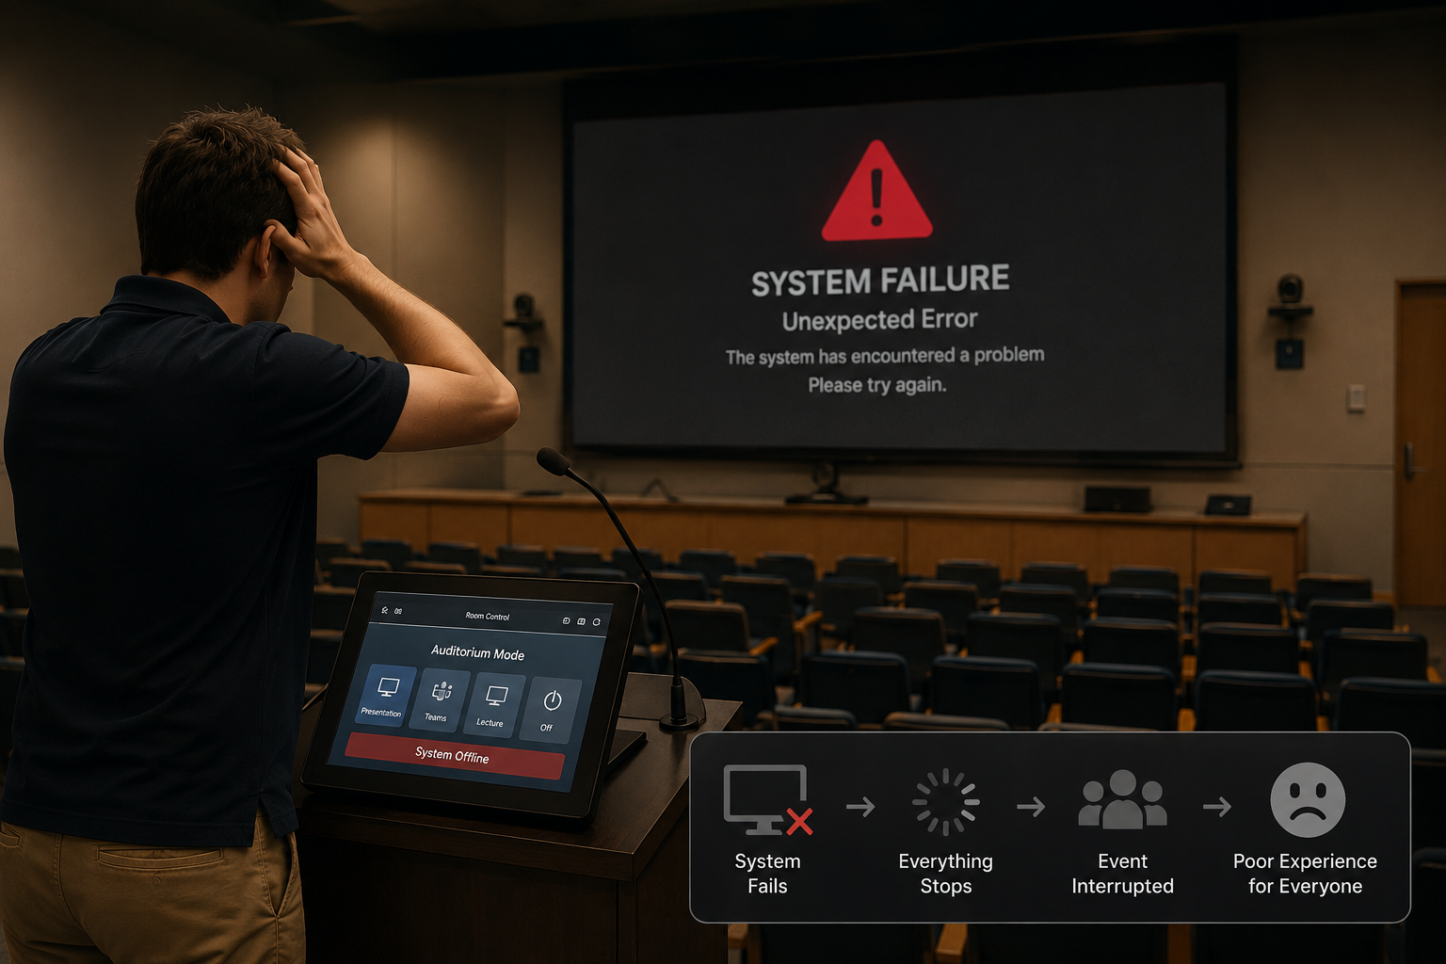
Each Issue Became a Design Requirement
Unexpected sound system failure
CASST 2026 | Ahmed Abdel-Dayem
7
Notes:
Add images

Slide 8
Each Issue Became a Design Requirement
Unexpected sound system failure
Isolate the system
Isolate each component
Reset and reconfigure
CASST 2026 | Ahmed Abdel-Dayem
8
Notes:
Add images

Slide 9
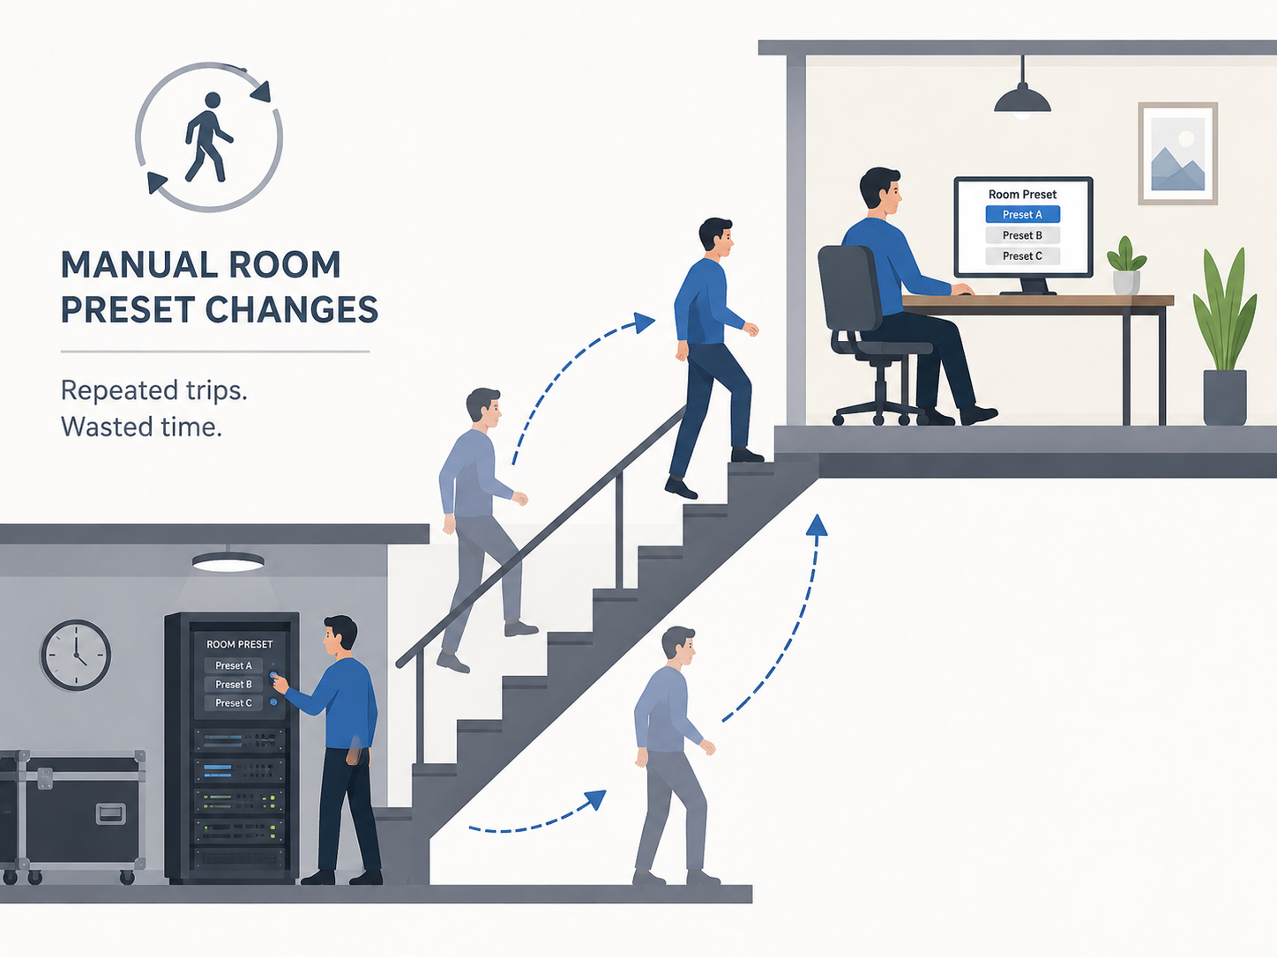
Each Issue Became a Design Requirement
User Control UI
Event Scheduler
Remote Access
CASST 2026 | Ahmed Abdel-Dayem
9
Notes:
Add images

Slide 10
Control Interface and Automation
Designed around 4 main goals
1
Simplicity for users
2
Diagnostic visibility
3
Remote access for IT
4
Reliable room automation
CASST 2026 | Ahmed Abdel-Dayem
10

Slide 11
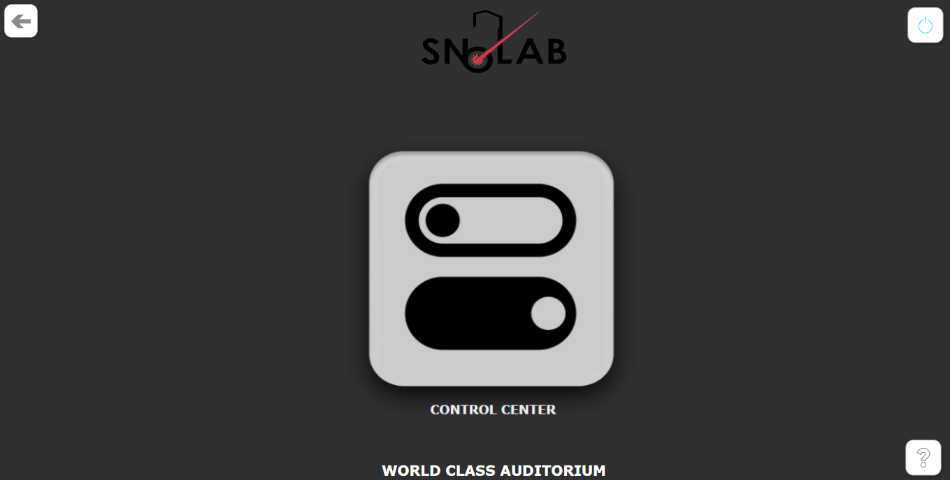
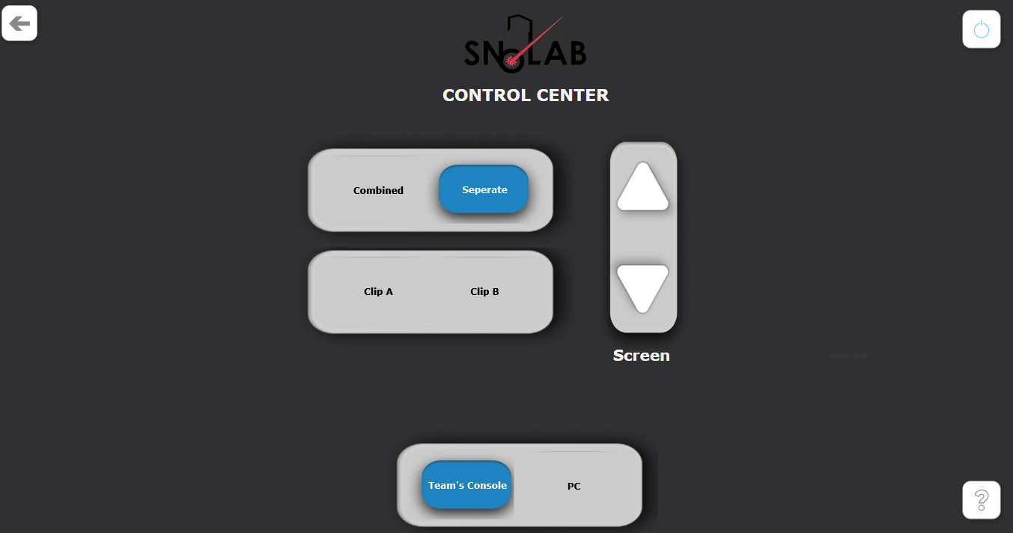
Goal 1: Simple for Users
CASST 2026 | Ahmed Abdel-Dayem
11
Notes:
Mac and easy UI

Slide 12
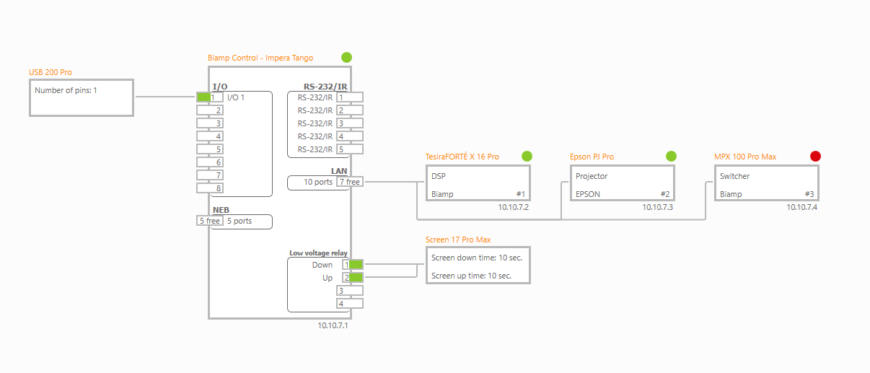
Goal 2: Built-in Diagnostics
CASST 2026 | Ahmed Abdel-Dayem
12

Slide 13
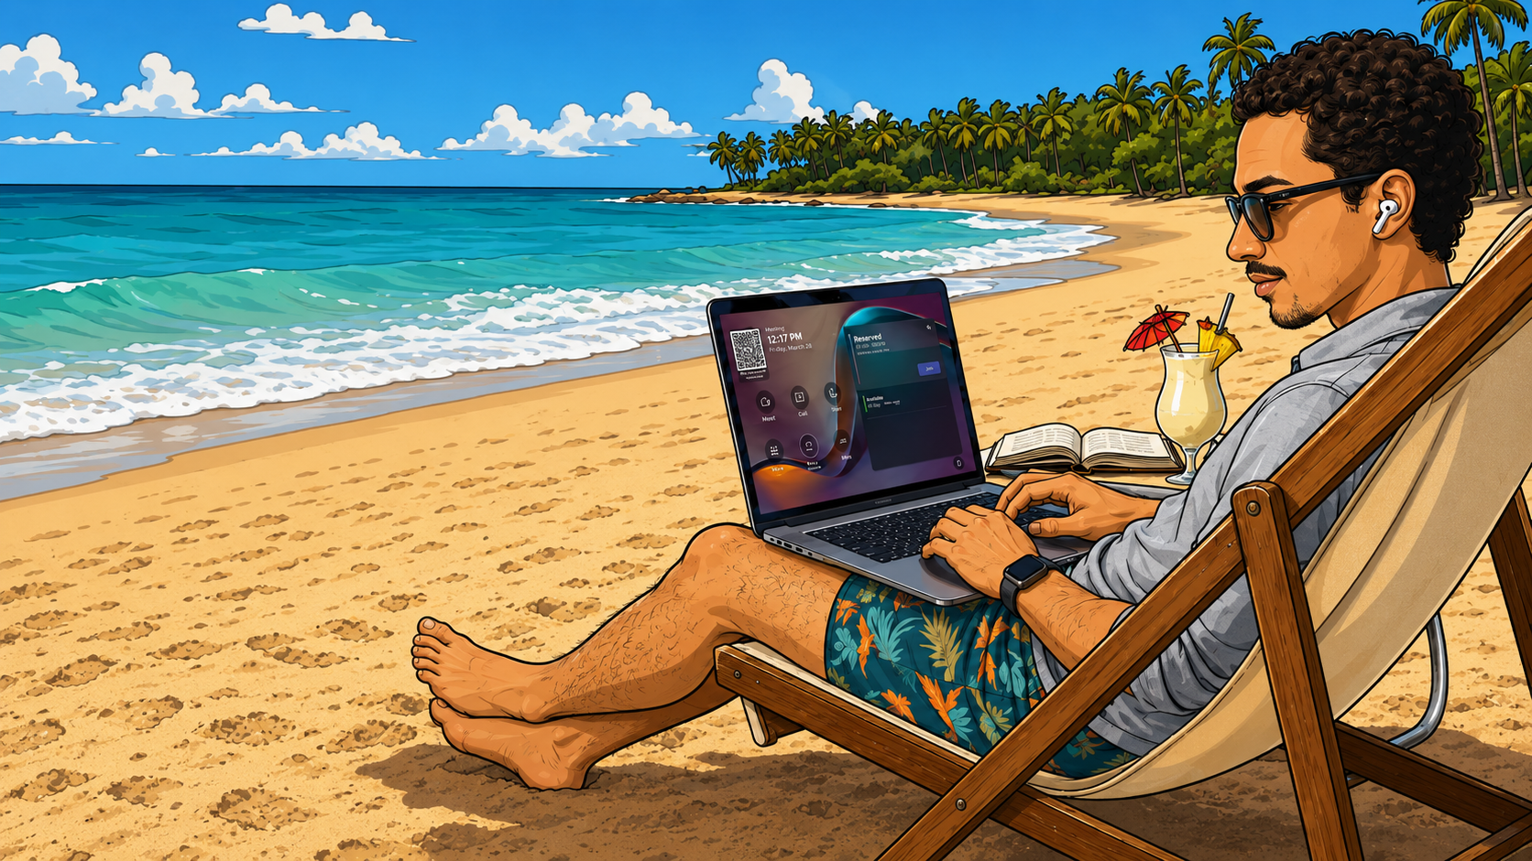
Goal 3: Remote IT Support
CASST 2026 | Ahmed Abdel-Dayem
13
Notes:
Add florida dude

Slide 14
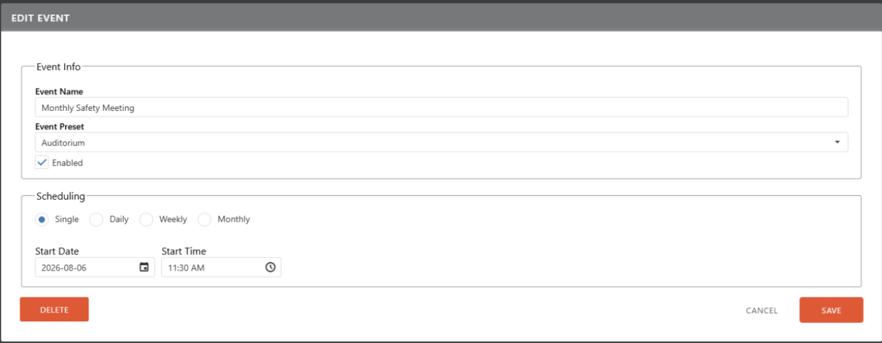
Goal 4: Reliable Room Automation
CASST 2026 | Ahmed Abdel-Dayem
14
Notes:
Fix image.

Slide 15
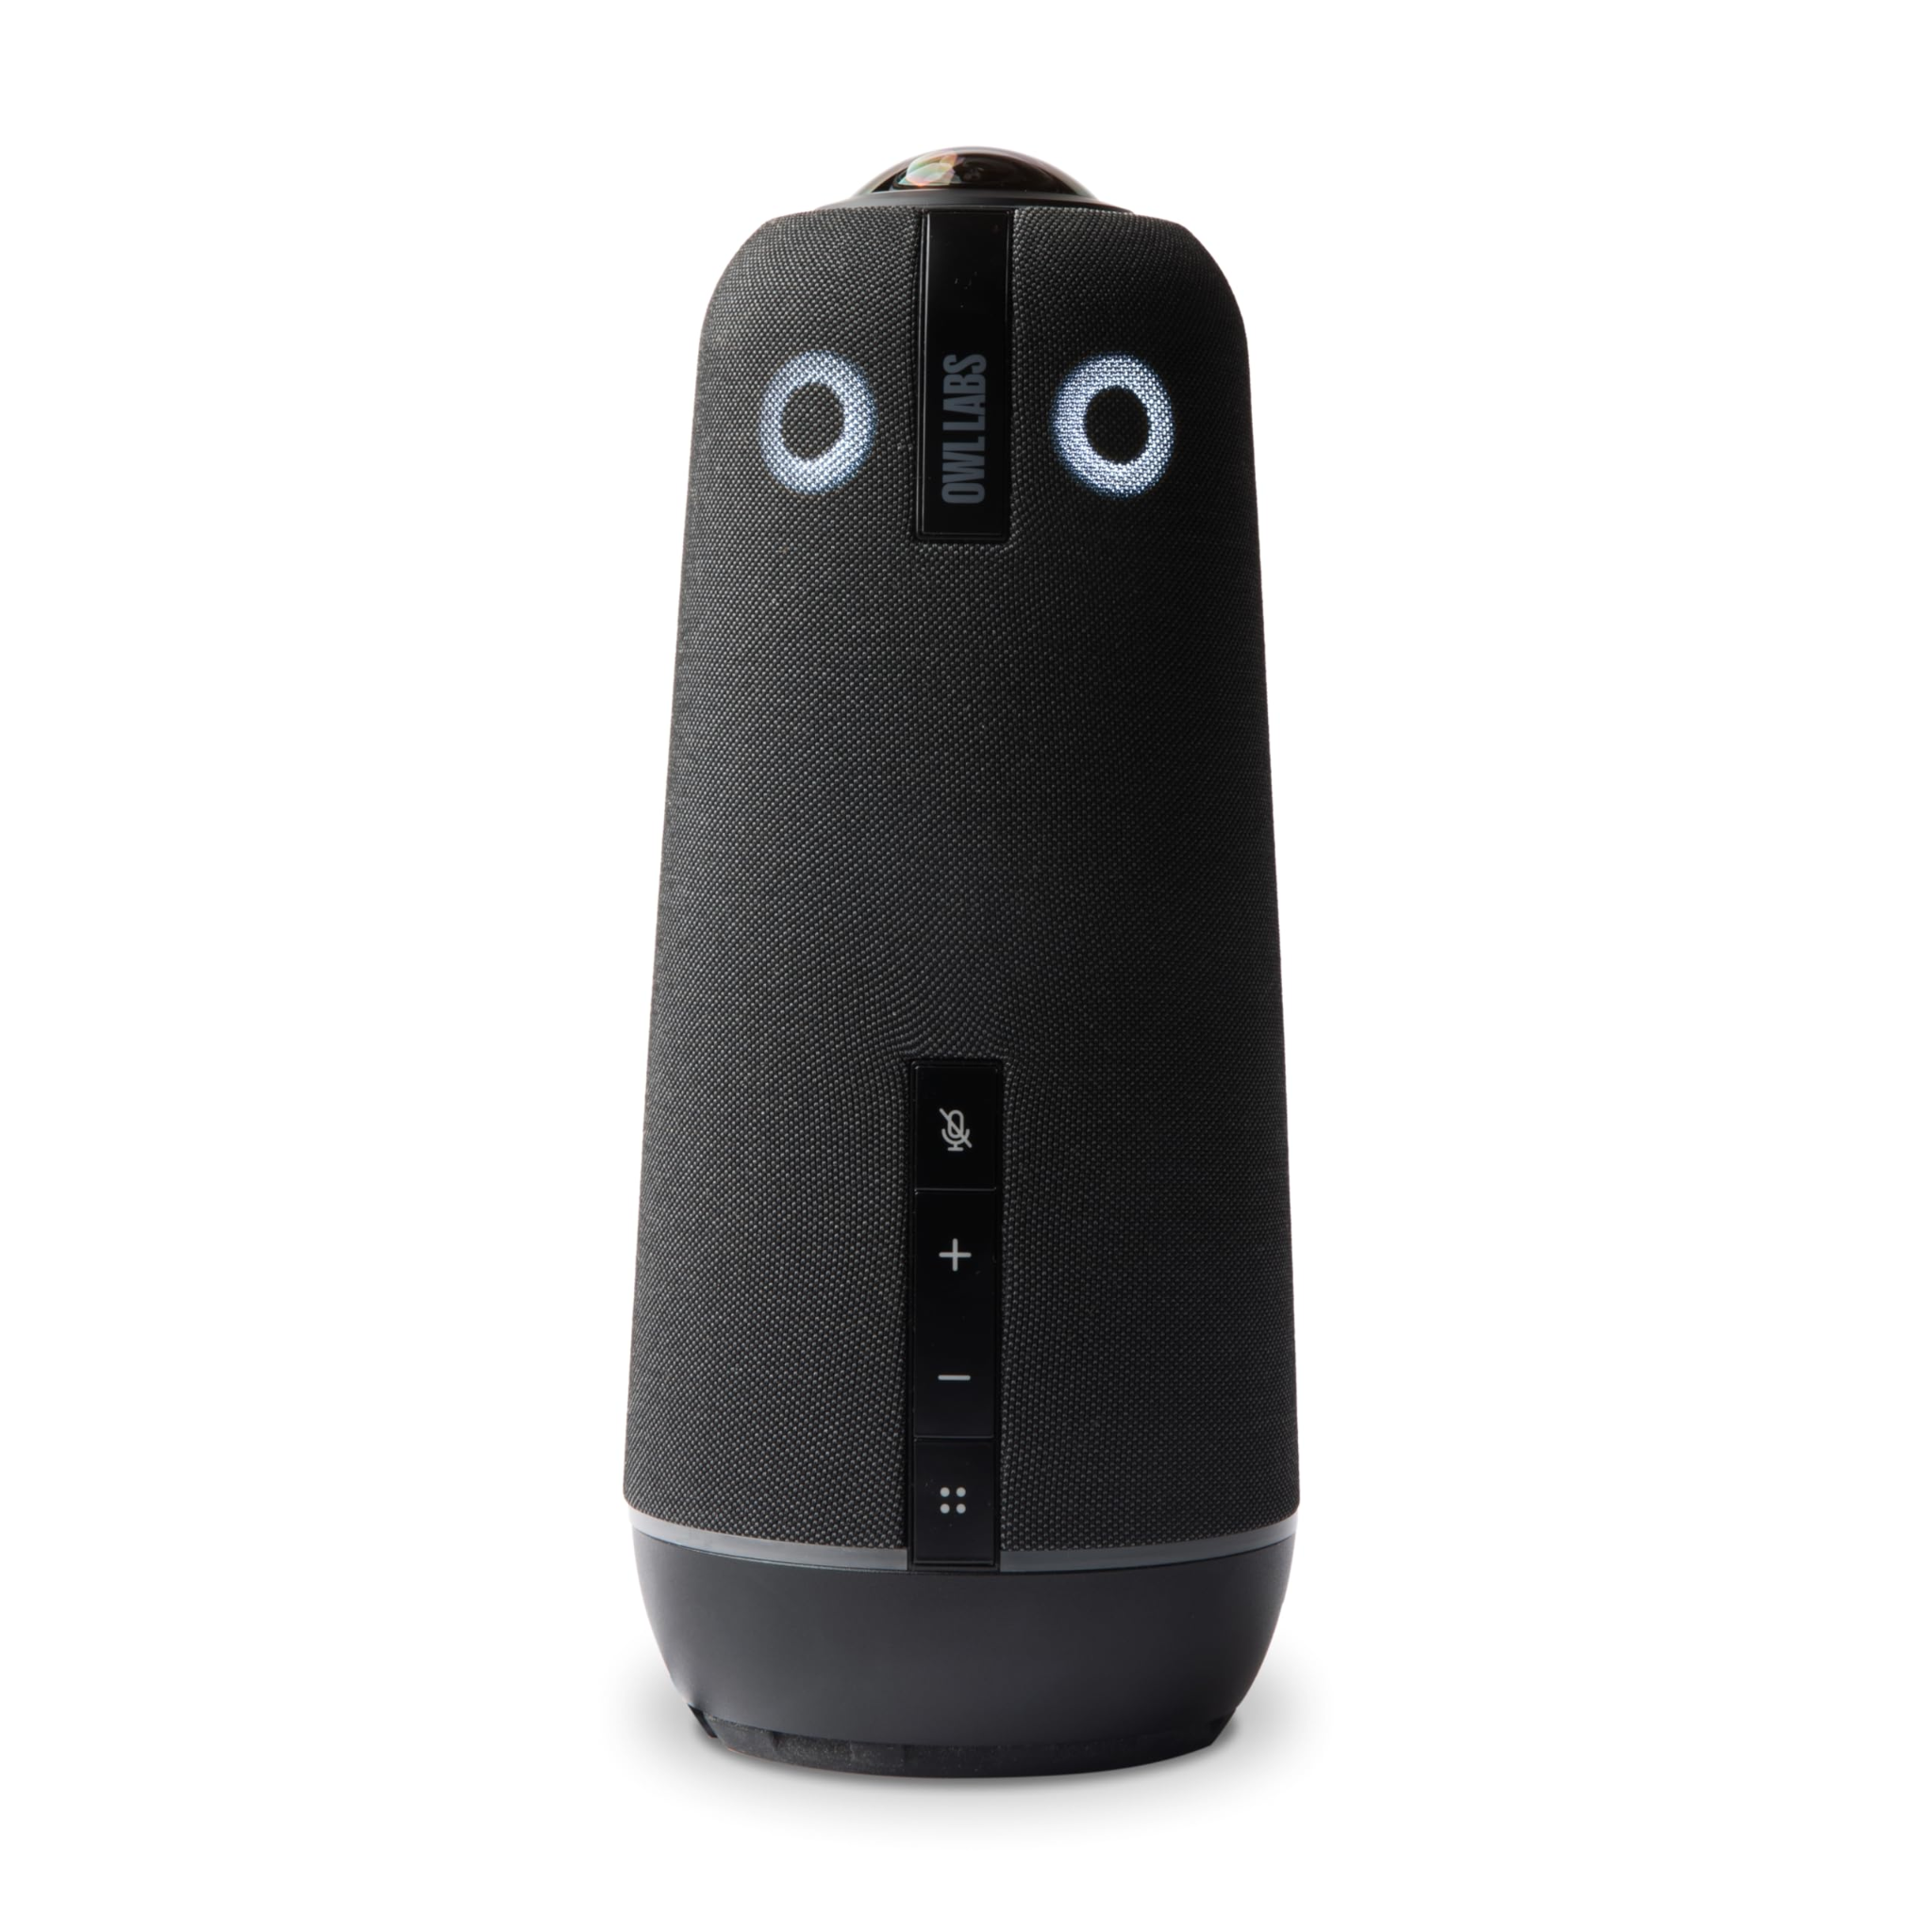
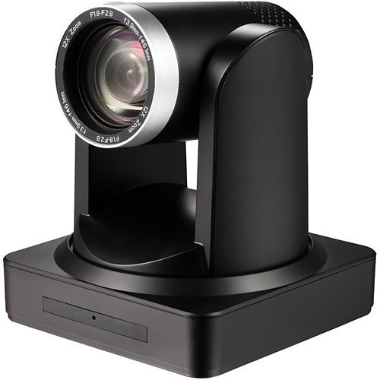
Upgrades
Meeting Owls
CASST 2026 | Ahmed Abdel-Dayem
15
Notes:
Add images

Slide 16

Upgrades
Meeting Owls
CASST 2026 | Ahmed Abdel-Dayem
15
Notes:
Add images

Slide 17
Upgrades
Meeting Owls
Four 4K 360° cameras and backup speakers/mics
CASST 2026 | Ahmed Abdel-Dayem
15
Notes:
Add images

Slide 18
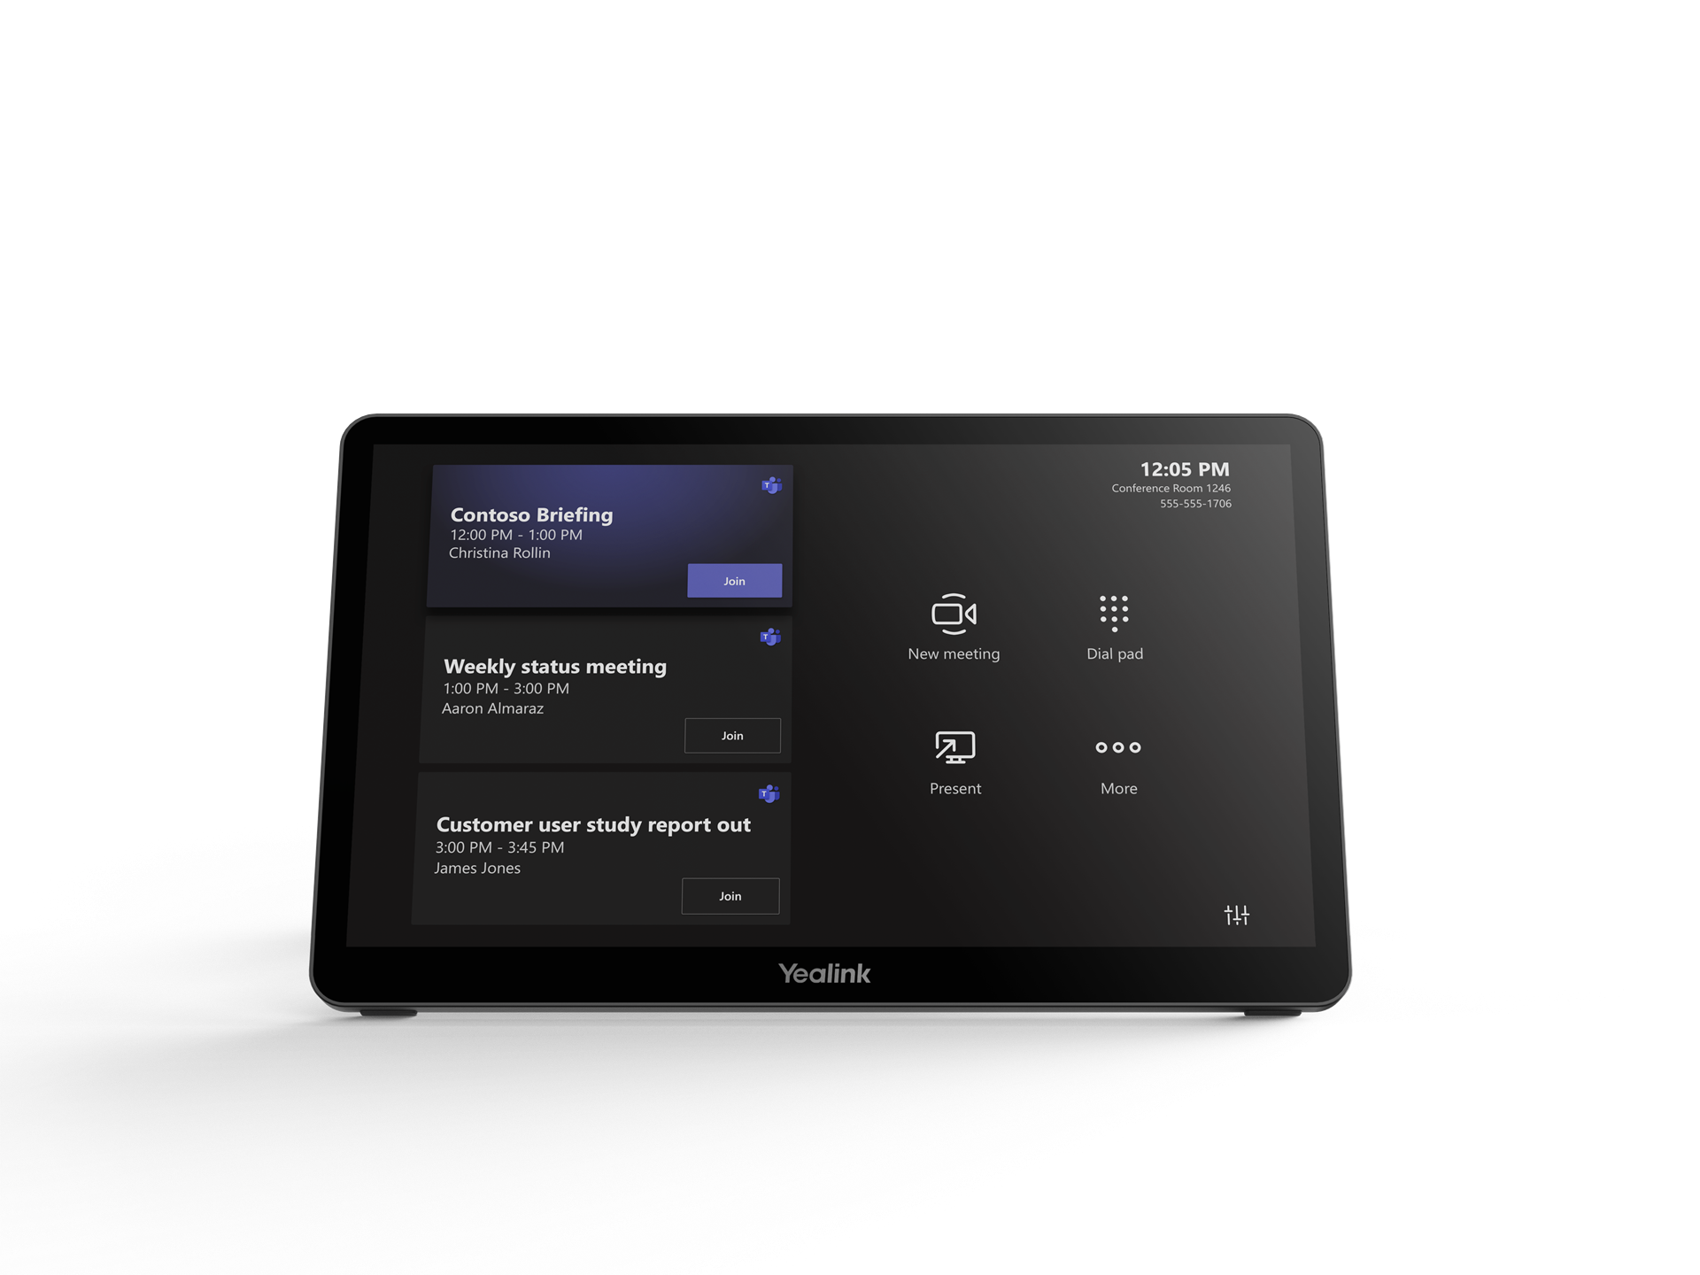
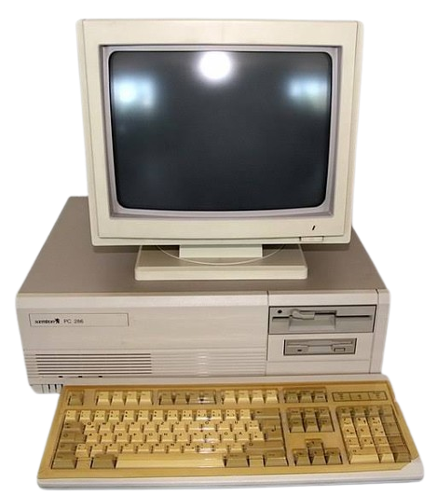
Upgrades
New Teams Consoles
CASST 2026 | Ahmed Abdel-Dayem
16
Notes:
Add images

Slide 19
Upgrades
New Teams Consoles
CASST 2026 | Ahmed Abdel-Dayem
16
Notes:
Add images

Slide 20
Upgrades
New Teams Consoles
One touch controls and offline casting options
CASST 2026 | Ahmed Abdel-Dayem
16
Notes:
Add images

Slide 21



Where are we now?
Simple UI
Remote access to every component
Most stable AV system ever
Microsoft Teams integration
$20, 000
$80, 000
CASST 2026 | Ahmed Abdel-Dayem
17
Notes:
Explain teams integration

Slide 22
Acknowledgments
Kipp Grose
James Hawkins
Paul Grylls
Dr. Stephen Sekula
IT Colleagues
CASST 2026 | Ahmed Abdel-Dayem
CASST 2026 | Ahmed Abdel-Dayem
18

Slide 23
Thank You!
Questions?
CASST 2026 | Ahmed Abdel-Dayem
CASST 2026 | Ahmed Abdel-Dayem
19

