Slide 1

Neutron Scattering Experiment For Quenching Factor Measurements at NEWS-G
Riley Breen
August 13th, 2026

Slide 2
Outline
Goal: The neutron scattering experiment is an experiment currently taking place within NEWS-G to measure the quenching factor in Neon + 2% Methane
Contents:
NEWS-G
What is a quenching factor?
The Neutron scattering experiment
My role this summer
  SPCs
  DAQ
  Preliminary Analysis
1

Slide 3

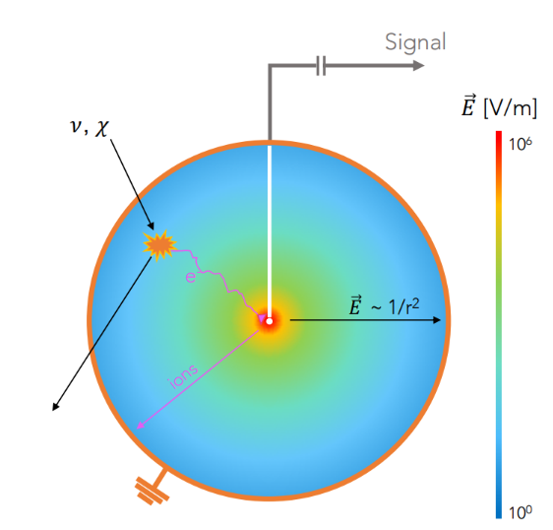
New Experiments With Spheres-Gas (NEWS-G)
NEWS-G is an experiment that uses spherical gas detectors or SPCs (spherical proportional counters) for low mass dark matter search.
SPC’s are detectors which contain a target gas and an anode. When an interaction takes place in the target gas, electrons drift towards the anode in the sphere. As they drift towards the center, the electric field increases which triggers an avalanche process that amplifies the signal detected by the sensor.
2

Slide 4
What is the Quenching Factor?
Many detectors are calibrated and tested using energy sources that produce electron recoils​
Low energy neutrons cannot rely on this calibration as they are detected through nuclear recoils​
This produces an issue as the number of ionized atoms induced by electronic recoils and nuclear recoils of the same energy are not the same, the nuclear recoil will appear to be "quenched"​
This introduces a need to measure this factor difference to be able to measure the energy ​
NEWS-G's Role​
NEWS-G uses SPCs to search for dark matter in the low mass range, called weakly interacting massive particles (WIMPs). WIMPs will theoretically produce a nuclear recoil when being measured, which provides motivation to measure the quenching factor of the gas used in our detectors. ​
3

Slide 5
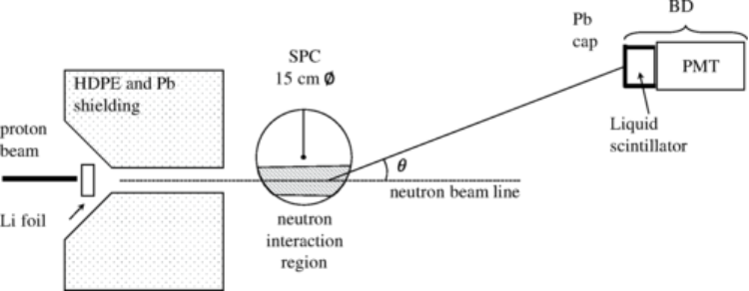
The Neutron Scattering Experiment
To measure the quenching factor, we must perform a neutron scattering experiment
The goal is to measure the recorded energy in a detector (SPC) while also knowing the true energy deposited from the neutron
The goal is to look for events where there is a pulse in the SPCs and the backing detector, which we call coincidence events
Takes place at the University of Montreal, using their low energy neutron beam (<10 keV), SPCs and a backing detector
Image Credit: Balogh et al., Phys. Rev. D 105, 052004 (2022), Fig. 1
4

Slide 6
My Role This Summer
Before this experiment can be performed at the University of Montreal, we need a
thorough understanding and characterization of our SPCs, our backing detector
and our DAQ.
5

Slide 7
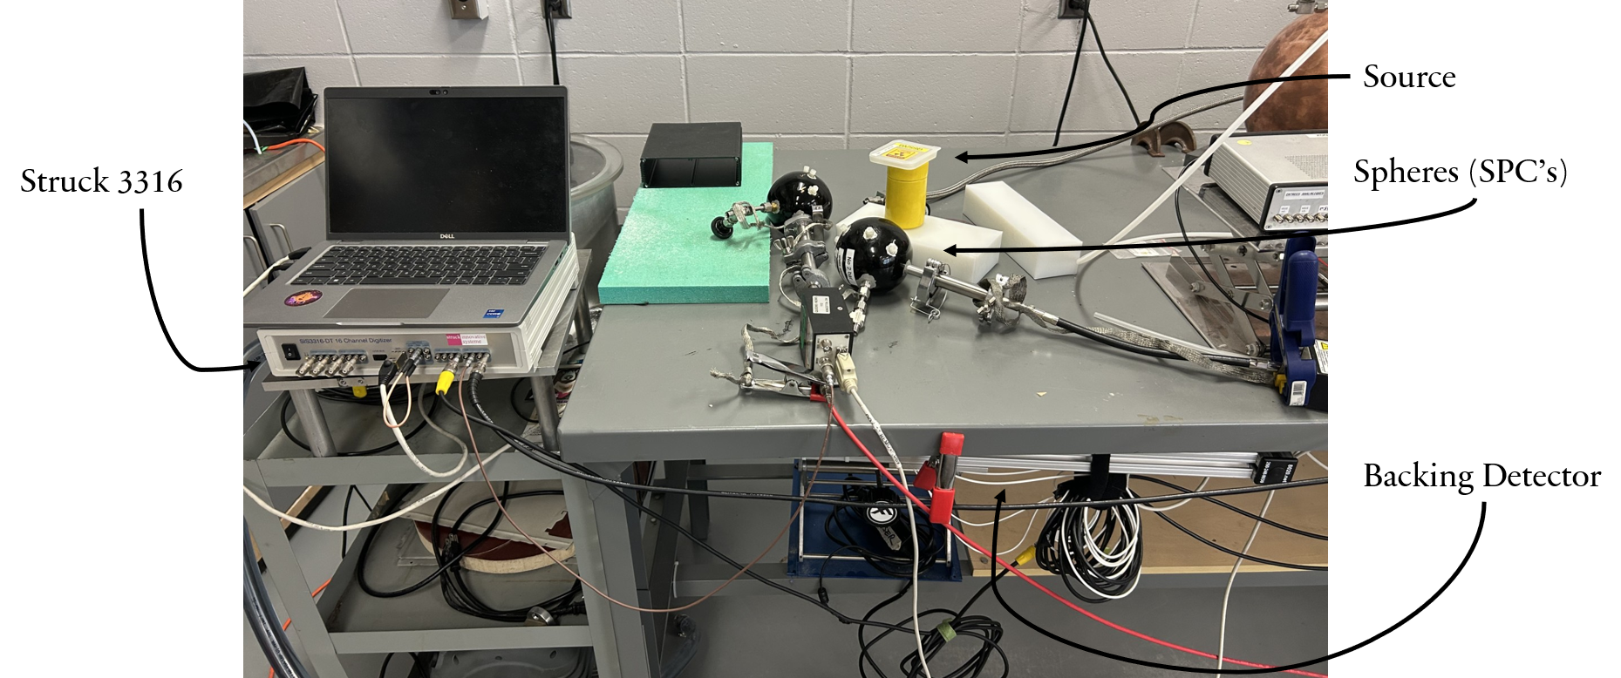
Testing at Queen's University
6

Slide 8
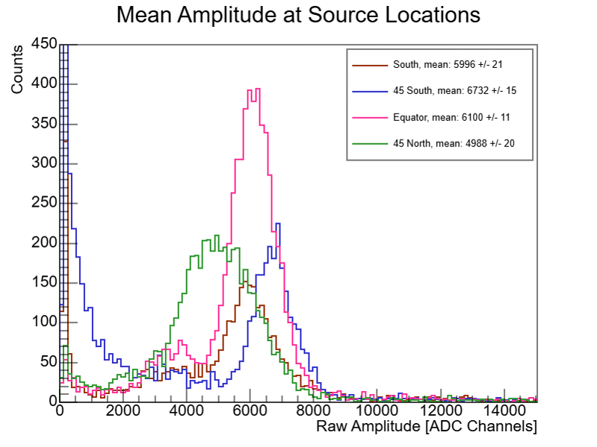
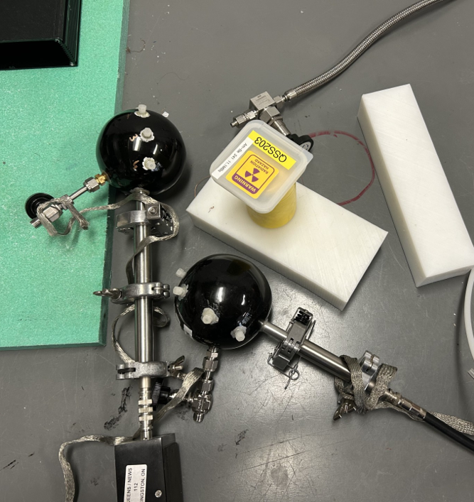
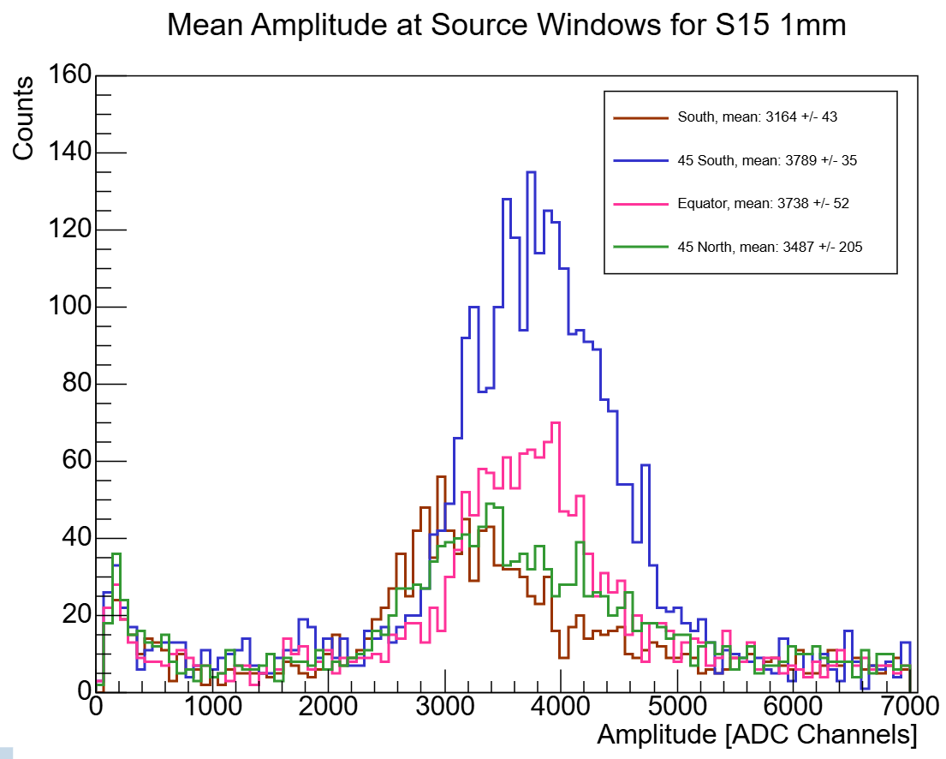
Sphere Detectors
I spent some time looking at a few key characteristics of the spheres
Their long-term stability
Uniformity across source windows
How gain changes with voltage
Rise time and amplitude
We had many issues with a lack of uniformity in spheres and spent much time trying to resolve this. Most recently, we opened the spheres and fixed the spacing in the sensor to varying degrees of success.
7

Slide 9
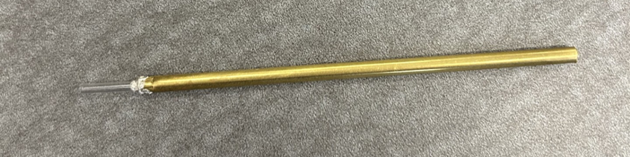
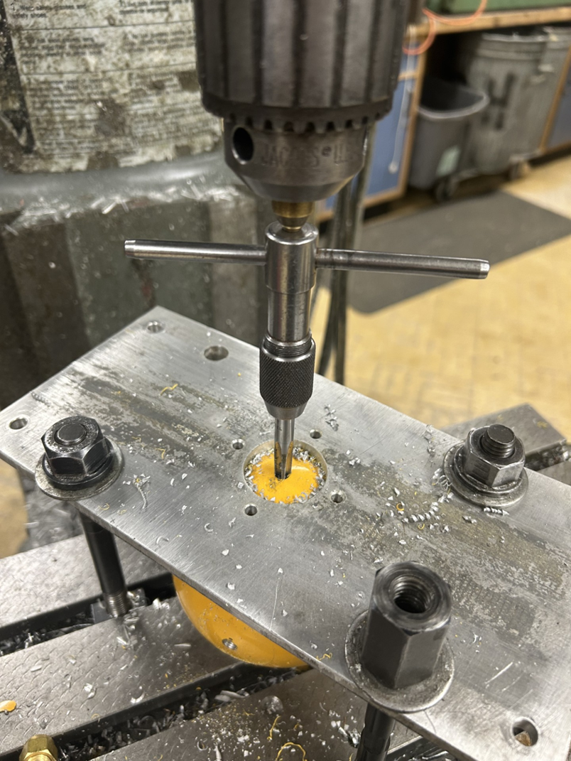
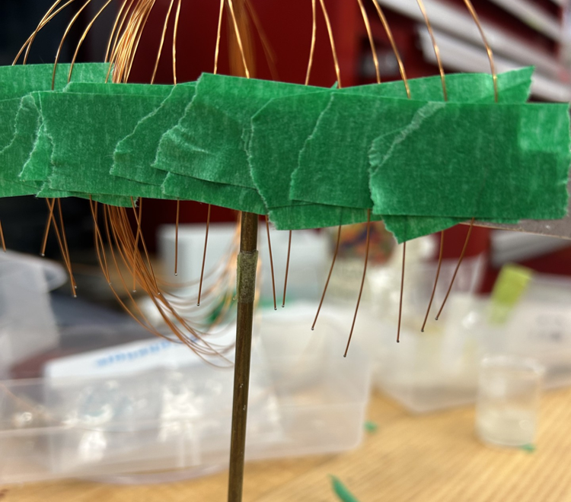
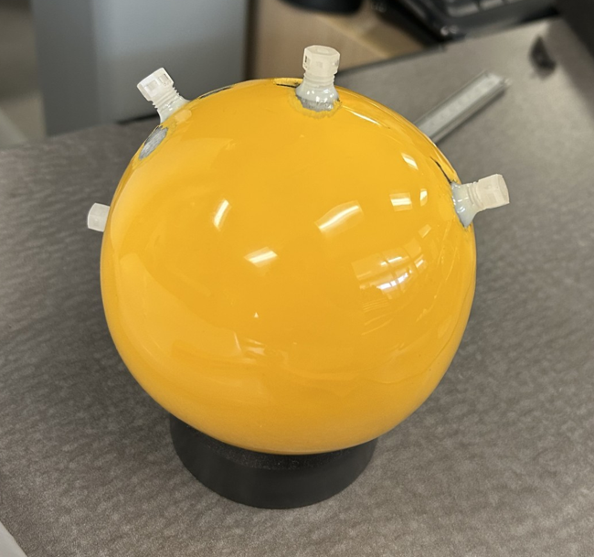
New Sphere
I got the chance to make my own sphere with a slightly simplified sensor design
This should also fix the issue of movement within the sensor in the sphere
8

Slide 10
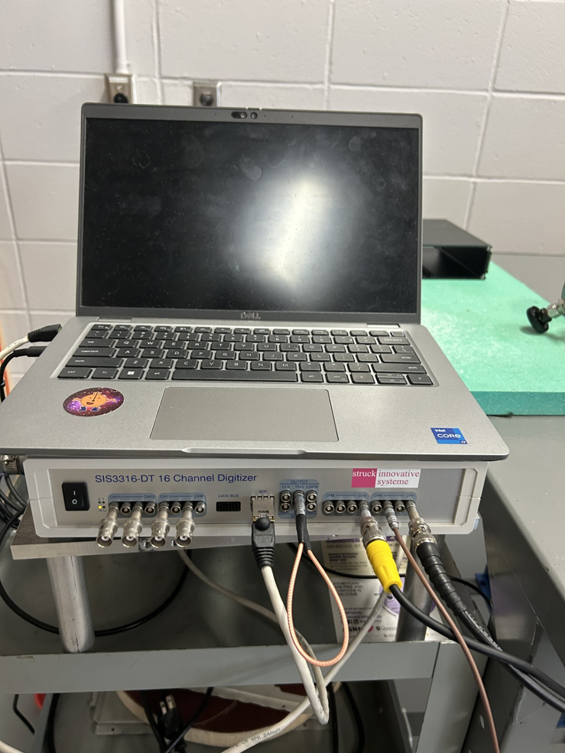
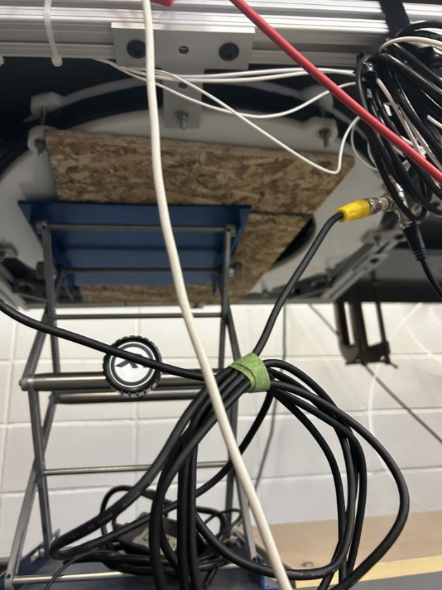
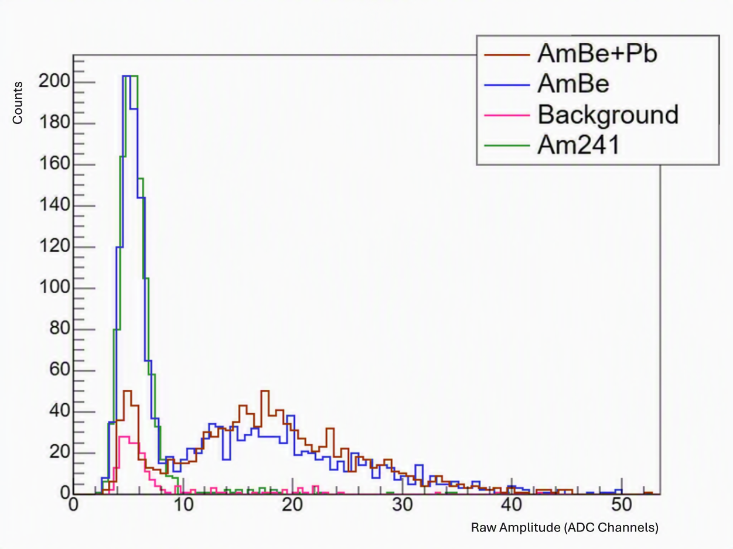
Data Acquisition
We got a new DAQ system, the Struck 3316 digitizer
It was set up by my supervisor at the beginning of the summer
When this was set up we were able to start testing the backing detector with an AmBe source (4.4 MeV gammas and ~4.5 Mev neutrons)
9

Slide 11
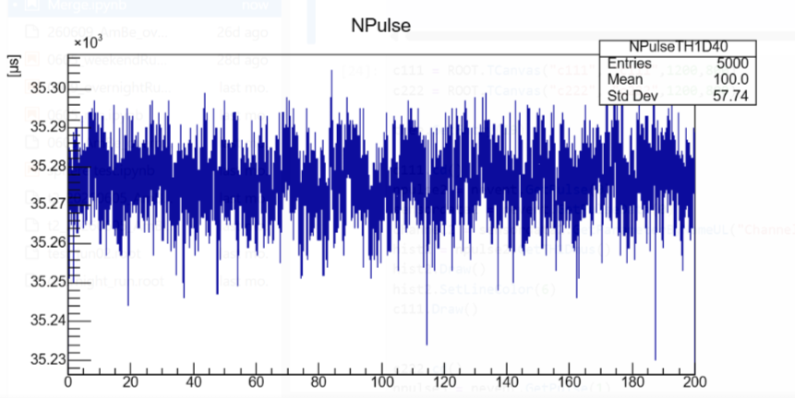
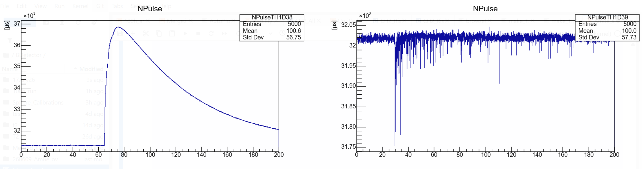
Preliminary Analysis
Once everything started working the way we expected, the next step was to see if we detect neutron coincidence events
We spent time creating standard cuts to answer 3 important questions
  Is the triggered event a neutron?
  Is there a pulse in the sphere?
  Is that sphere pulse a neutron?
10

Slide 12
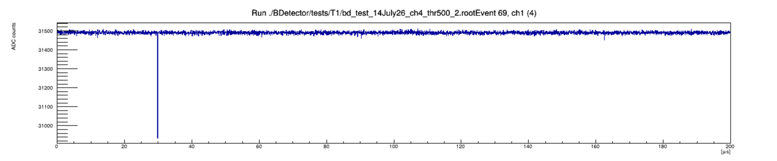
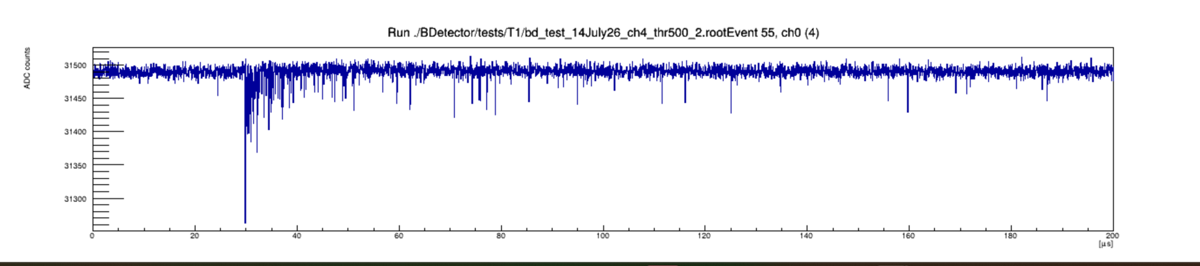
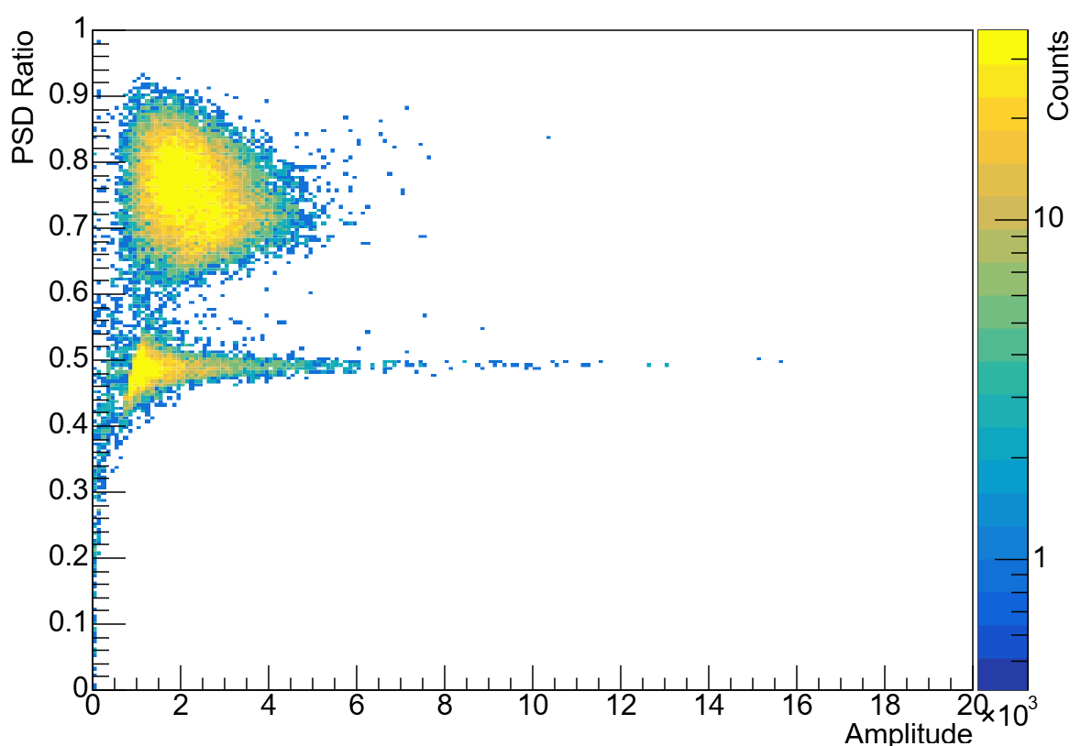
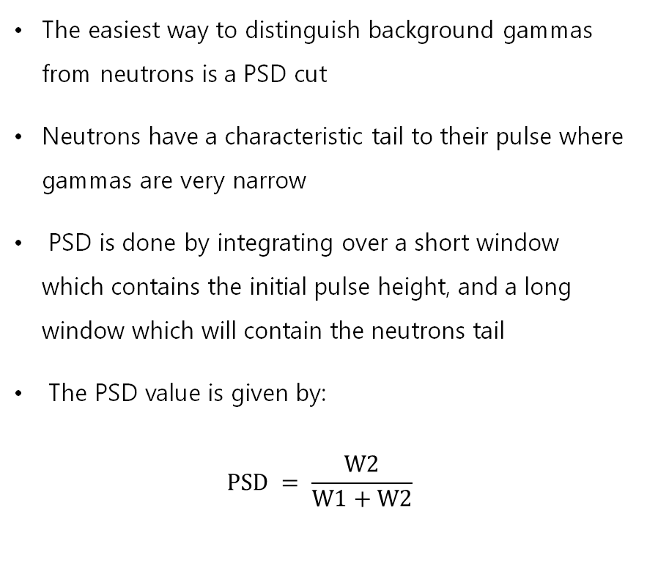
PSD
The easiest way to distinguish background gammas from neutrons is a PSD cut
Neutrons have a characteristic tail to their pulse where gammas are very narrow
PSD is done by integrating over a short window which contains the initial pulse height, and a long window which will contain the neutrons tail
The PSD value is given by:
$$PSD = \frac{W2}{W1+W2}$$
11

Slide 13
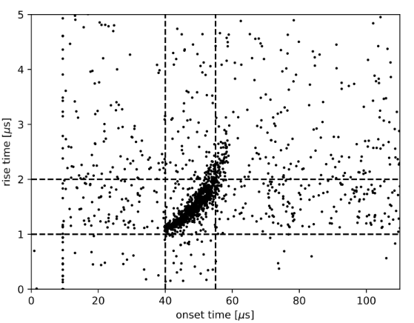
Sphere Pulses
The area that has given us the most difficulty, is distinguishing the pulses from a neutron and all the other pulses we could see in the SPC
Theoretically, we should be able to look at rise time pulses start time and see a trend
Experimentally we have been unable to recreate this trend and are still looking into exactly why
Image Credit: Balogh et al., Phys. Rev. D 105, 052004 (2022), Fig. 13
12

Slide 14
Thank you!
Questions?

