Slide 1
Development and Characterization of a New Sensor for NEWS-G
CASST 2026
Connor Bennett
1

Slide 2
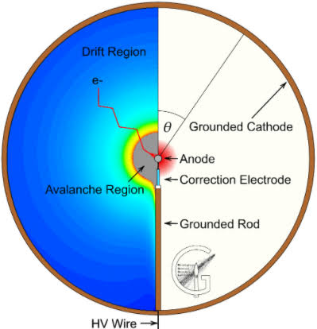
SPC Intro
Primary ionization:
  Nuclear recoils, point-like
Drift:
  E ∝ V/r²
  R is calculated "globally"
Avalanche:
  E ∝ V/r²
  R is calculated "locally"
Signal from positive ion drift
  Time response related to field
Signal readout:
  Charge amplifier
  Digitizer
2
Notes:
Before getting into the sensor itself, I just want to give a quick overview of how a spherical proportional counter works. When a particle interacts with the gas inside the detector, it produces primary ionization. Those electrons then drift toward the central sensor because of the electric field, which increases strongly as you get closer to the anode, approximately as one over r squared.
Once the electrons get close enough to the anode, the field becomes strong enough to produce an avalanche, which amplifies that initial ionization into a measurable signal. The resulting signal is then read out through a charge amplifier and digitizer.
So because essentially all of the amplification happens very close to this central sensor, the geometry and electrical properties of the sensor itself can have a pretty significant effect on the detector performance.

Slide 3
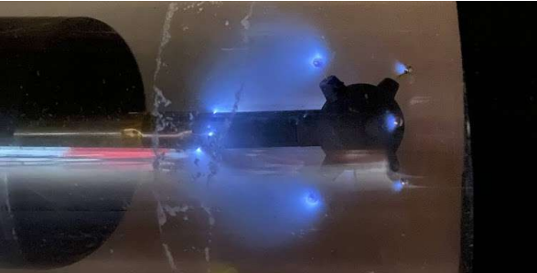
Why sparks/discharges are a problem
3
Notes:
One of the challenges with operating these detectors is that electrical discharges can still occur, even when the detector is running in proportional mode. These can be triggered by things like highly ionizing events, local field fluctuations, or operating conditions.
These discharges are unwanted because over time they can contribute to detector aging or even damage materials, and they can also temporarily disrupt the detector gain while the system recovers. So for a stable detector, we want some way of suppressing these discharges before they develop into full sparks.
That leads directly into the use of resistive materials in the sensor.

Slide 4
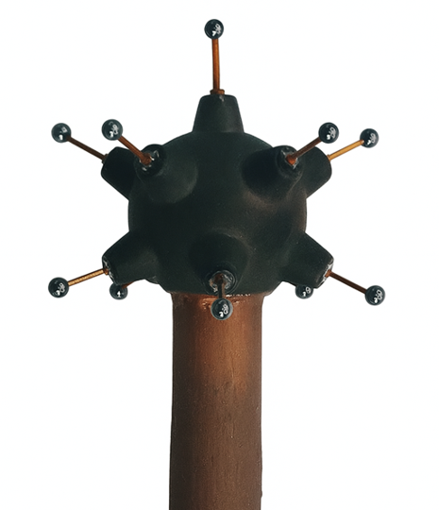
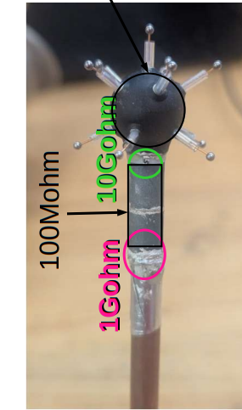
Choosing the Right Resistive Material
Achinos Sensor in use at SNOLAB
DLC (Diamond-Like Carbon)
3D Printed Resin
4
Notes:
One way to suppress these discharges is by using resistive materials around the sensor. When a large avalanche begins to develop, it induces charge on the nearby material. If that material is highly conductive, the charge is removed immediately, so the amplification field remains high and the discharge can continue.
With a resistive material, the charge remains locally for a short time and creates an opposing electric field. That reduces the amplification field enough to quench the streamer before it develops into a full spark.
But we also don’t want the material to be a perfect insulator, because then that charge would remain and permanently distort the field. So the goal is really to find a resistance that holds charge long enough to suppress the discharge, but allows it to drain away before the next event.
The difficulty is that getting exactly the resistivity we want is not very straightforward. Resistivity is a material property, so once the material is chosen, there’s only so much control we have over it. In practice, the conductivity can also be dominated by the surface, which means simply changing the thickness doesn’t necessarily give us the resistance we want.
Some materials, like diamond-like carbon coatings, can have good properties, but they’re difficult to apply to custom sensor geometries. Conductive 3D-printing resins are much easier to manufacture into complicated shapes, but the material we’re using is actually more conductive than ideal.
So instead of relying only on the material resistivity, one option is to add a controlled resistance between the sensor body and ground.

Slide 5
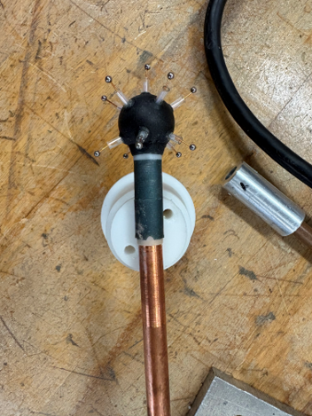
Current Sensor Iteration
Anodes
Umbrella
Ground Rod
Head
Stem
5
Notes:
And that brings us to the sensor that I’ve been working on. This is our current sensor iteration, which uses a tetrahedral geometry. The sensor head and body are made from a highly resistive 3D-printed resin, which gives us the ability to manufacture these relatively complicated geometries while still incorporating resistive material for spark protection.
The resistive glass tubes protruding through the anode holes are used to help shape the electric field around the anodes. So once we had this sensor design, my work was mainly focused on characterizing how it actually performs inside the detector.
I’ve been looking at that in two main ways: first, its stability over time, and second, how uniform the gain is depending on where an event occurs within the detector

Slide 6
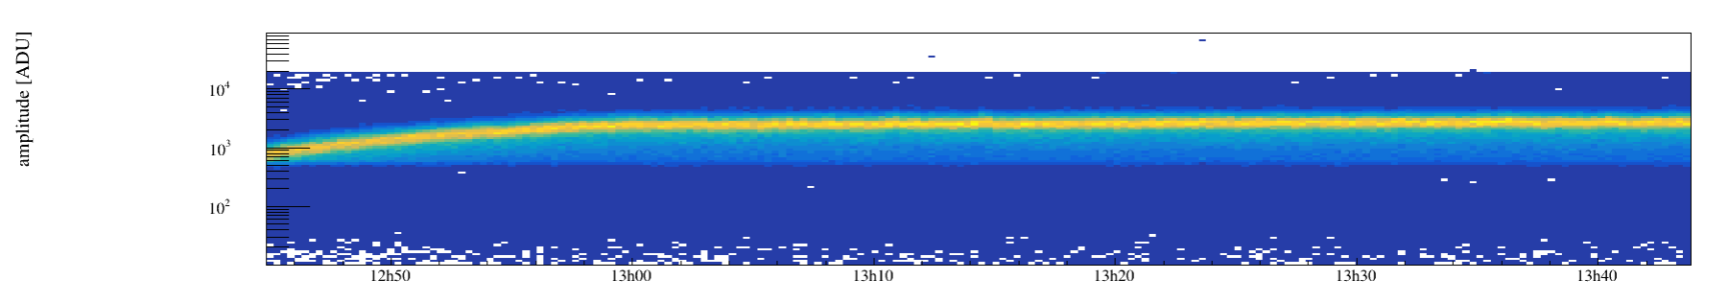
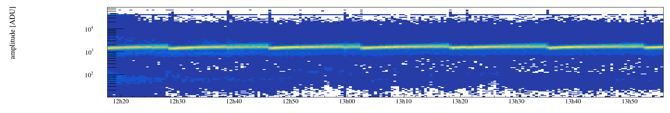
Stability Test
Detector filled with Argon and sensor brought to operating voltage
Iron-55 pulse amplitude shifts during the initial stabilizing period
Amplitude eventually reaches a stable plateau
Stability likely related to charge accumulation
If sensor-body resistance is too low, excessive current can cause electrical discharges
Expected Stabilization
Discharges
6
Notes:
The first thing I looked at was the stability of the sensor over time. For this test, the detector was filled with argon and the sensor was brought up to its operating voltage. We then continuously monitored the amplitude of the iron-55 peak.
What we typically see is an initial stabilization period, where the measured pulse amplitude gradually shifts before eventually reaching a relatively stable plateau. We believe this behaviour is related to charge accumulating on the resistive components of the sensor and changing the local electric field until an equilibrium is reached.
So for a good sensor, we want to see this initial stabilization followed by a consistent gain over time. On the other hand, if the resistance of the sensor body is too low, too much current can flow and we can begin to see electrical discharges rather than stable operation.
Once we established that the sensor could operate stably, the next question was whether that gain was uniform throughout the detector.

Slide 7
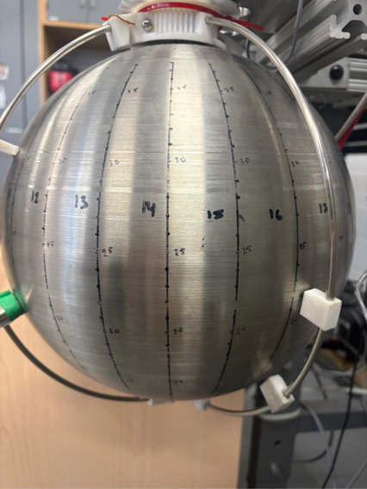
Spatial Gain Mapping
⁵⁵Fe source positioned using an external magnet
Measurements taken on a grid of 24 longitude (1-24) and 8 latitudes (40-5 in steps of 5)
A 15s calibration run collected at each measurement position
Mean ⁵⁵Fe gain taken from each run to map sensor uniformity
Detector operates at 300 mbar Ar, giving ⁵⁵Fe an attenuation length of ~4 cm, roughly the spacing between each longitude line
7
Notes:
The second part of the characterization was looking at how uniform the detector gain is spatially around the sphere. To do this, we positioned an iron-55 source on the outside of the detector using a magnet, which allowed us to move the source to different locations on the sphere.
We measured on a grid of 24 longitude positions and eight latitudes, going from 40 degrees down to 5 degrees in 5-degree steps. At each position, we collected a 15-second calibration run and used the mean iron-55 gain from that run as our measurement for that location.
The detector was operated at 300 millibar of argon. Under those conditions, the iron-55 attenuation length is about 4 centimetres, which is roughly comparable to the spacing between neighbouring longitude positions. That gives us reasonably localized measurements of how the gain changes around the detector.
Once all of those measurements are combined, we can build a spatial map of the sensor response and identify regions where the gain is less uniform

Slide 8
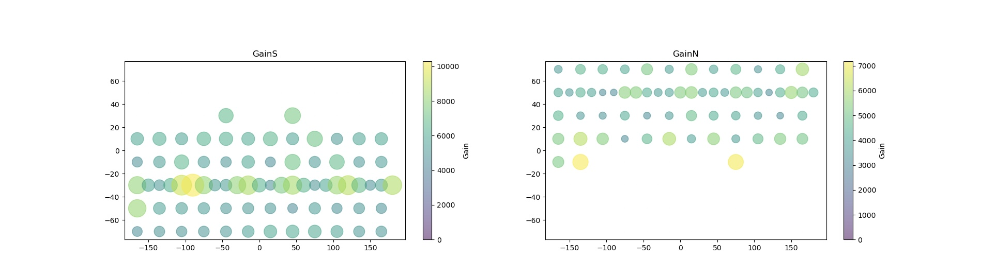
Current results
Bubble size and colour represent the measured gain
Gain is not uniform across the detector surface
Fluctuating gain pattern observed on 15 S and 35 N latitudes
These regions were focused for different sensor configurations
8
Notes:
Once we combine all of those measurements, we can visualize how the gain changes across the detector surface. In this map, both the bubble size and the colour represent the measured gain at each source position.
What stands out is that the gain is clearly not uniform across the sphere. In particular, we see a repeating gain pattern around the 15-degree south and 35-degree north latitudes.
Those two regions became the main focus for the next set of measurements, because they showed the strongest variation with longitude and gave us a good way to compare different sensor configurations.
So rather than remapping the entire detector every time, we could focus on those latitudes and look at how changing the sensor geometry affected the size of that gain modulation.

Slide 9
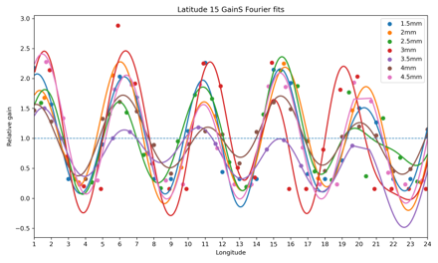
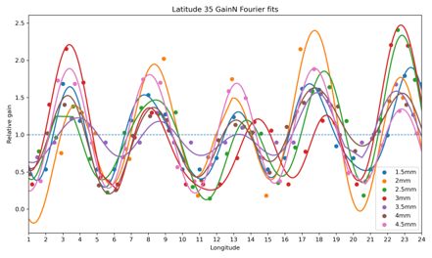
Comparison of Sensor Spacing
9
Notes:
The sensor parameter we varied was the spacing between the anodes and the glass tubes. Here I’m showing the relative gain as a function of longitude at 35 and 15 degrees latitude for several different spacings, ranging from 1.5 to 4.5 millimetres.
At the smaller spacings, you can see a strong periodic modulation in the gain. There are about five maxima around the detector, which corresponds well with the five-anode geometry of the sensor. The gain tends to be highest when the iron-55 source is aligned more directly with one of the anodes.
As we increase the spacing between the anodes and the sensor head, that modulation becomes smaller. In particular, the 3.5 to 4 millimetre configurations give the flattest response out of the spacings we tested.
So this suggests that increasing the spacing helps reduce the dependence of the gain on the source position and improves the overall gain uniformity.

Slide 10
Questions?
10

