Slide 1

Characterizing the Long-Term Behaviour of IceCube Supernova Scaler Rates
Tayler East¹, Dr. Nahee Park¹
¹Department of Physics, Engineering Physics and Astronomy, Queen's University, Canada
Notes:
Hi everyone. I'm Tayler East from Queen's University, and today I'll be talking about work I did characterizing the long-term behaviour of IceCube's supernova scaler rates.

Slide 2
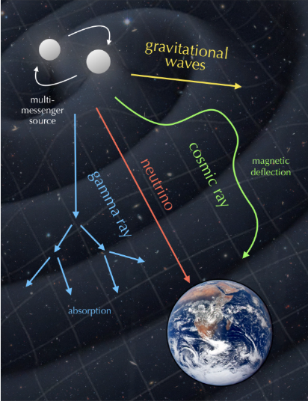
Multimessenger Astronomy
Electromagnetic radiation (light) : reveals the visible and energetic processes occurring around cosmic sources.
Cosmic rays : high-energy charged particles that provide information about extreme acceleration processes.
Gravitational waves : ripples in spacetime produced by massive accelerating objects.
Neutrinos : rarely interacting particles that can escape dense environments and provide information about the cores of energetic events.
They are a group of signals collected from deep-space events that act as messengers from the universe.
https://nbi.ku.dk/english/research/experimental-particle-physics/icecube/astroparticle-physics/
Notes:
Before I get into the detector specifics, I want to to first talk briefly about multimessenger particles. Over the last couple of decades we've built up what's called multimessenger astronomy, where we combine several very different types of signals in order to study extreme cosmic events.
There's electromagnetic radiation, which is what we're used to, when telescopes collect photons across the spectrum. There are cosmic rays, which are high-energy charged particles that tell us about extreme particle acceleration, though they get bent by magnetic fields on the way here, so they don't point straight back at their source. There are gravitational waves, which are ripples in spacetime from massive accelerating objects. And then there are neutrinos — extremely weakly interacting particles.
That weak interaction is actually what makes neutrinos extremely useful for this kind of science. Because they barely interact with anything, they can escape incredibly dense environments such as the core of a star in the middle of collapsing, that light and even gravitational waves can't easily get out of, at least not with the same information. So if you want to know what's happening in the actual core of an exploding star, in real time, neutrinos are what you need. And those are what we will focus on in this presentation.

Slide 3
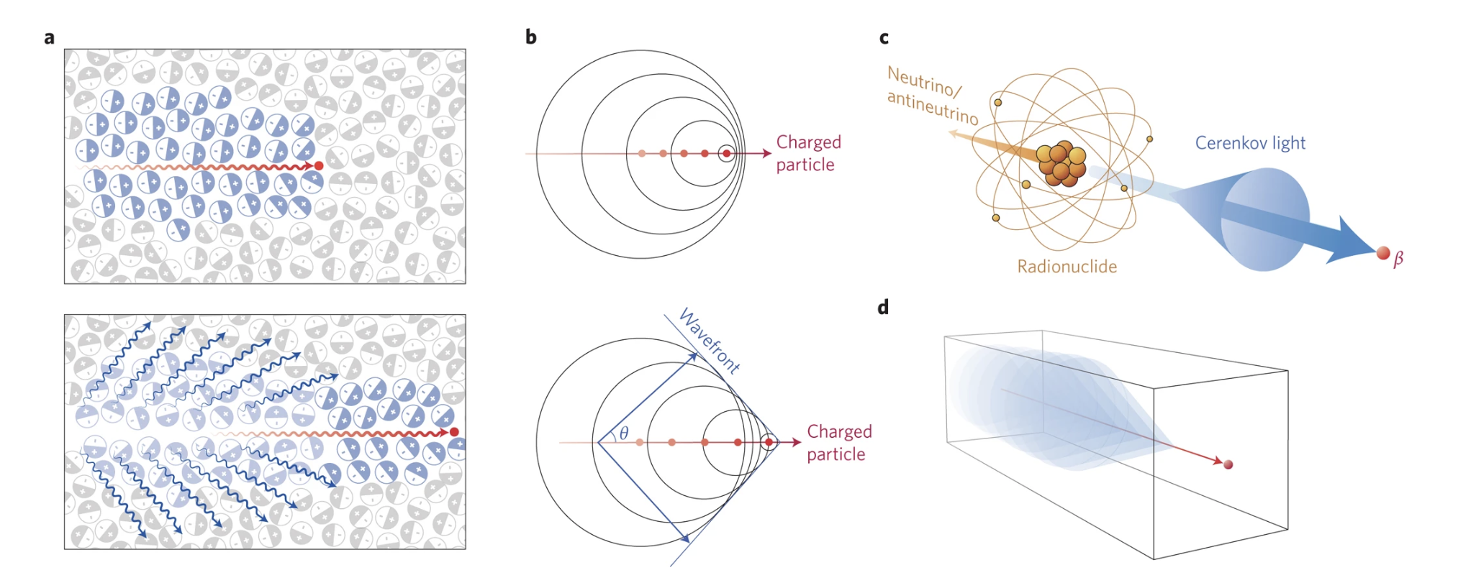
Seeing neutrinos
https://www.nature.com/articles/nnano.2016.301
Neutrinos rarely interact, but occasionally collide with an atom in the detector medium (water or ice for neutrino astronomy).
This interaction produces a fast-moving charged particle (typically an electron or muon).
If the particle travels faster than light travels in that medium (not faster than light in a vacuum), it emits Cherenkov radiation—a cone of blue light, similar to the optical equivalent of a sonic boom.
Photomultiplier Tubes (PMTs) inside the detector measure the arrival time and intensity of this light.
Using the timing, charge, and positions of the detected photons, the neutrino's direction, energy, and interaction point can be reconstructed.
Notes:
So, if neutrinos barely interact with anything, how do we detect them at all?
The trick is we don't wait for a neutrino to interact with the detector directly in the way you'd detect, say, a photon. Instead, you build an enormous volume of transparent material such as water or ice and then you wait for the rare occasion when a neutrino happens to hit an atomic nucleus in that medium. When it does, that interaction produces a fast-moving charged particle, typically an electron or a muon, carrying off a lot of the neutrino's energy.
If that charged particle is moving faster than the local speed of light in that medium it emits a cone of blue light called Cherenkov radiation. It's the optical equivalent of a sonic boom. You get a shockwave of light instead of sound.
Photomultiplier tubes surrounding the medium pick up the arrival time and intensity of that light. And because you know the geometry of your sensor array precisely, you can use the timing pattern, the amount of light, and which sensors lit up to reconstruct the neutrino's direction, its energy, and roughly where in the detector it interacted. That's the fundamental detection principle behind every large-scale neutrino telescope, including the one I'm about to describe.

Slide 4
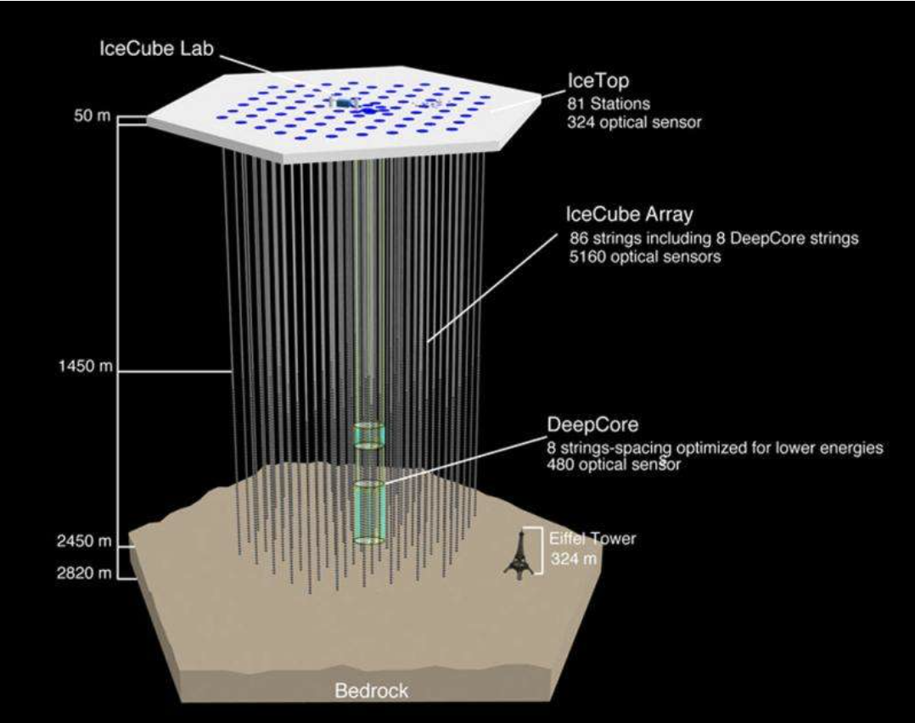
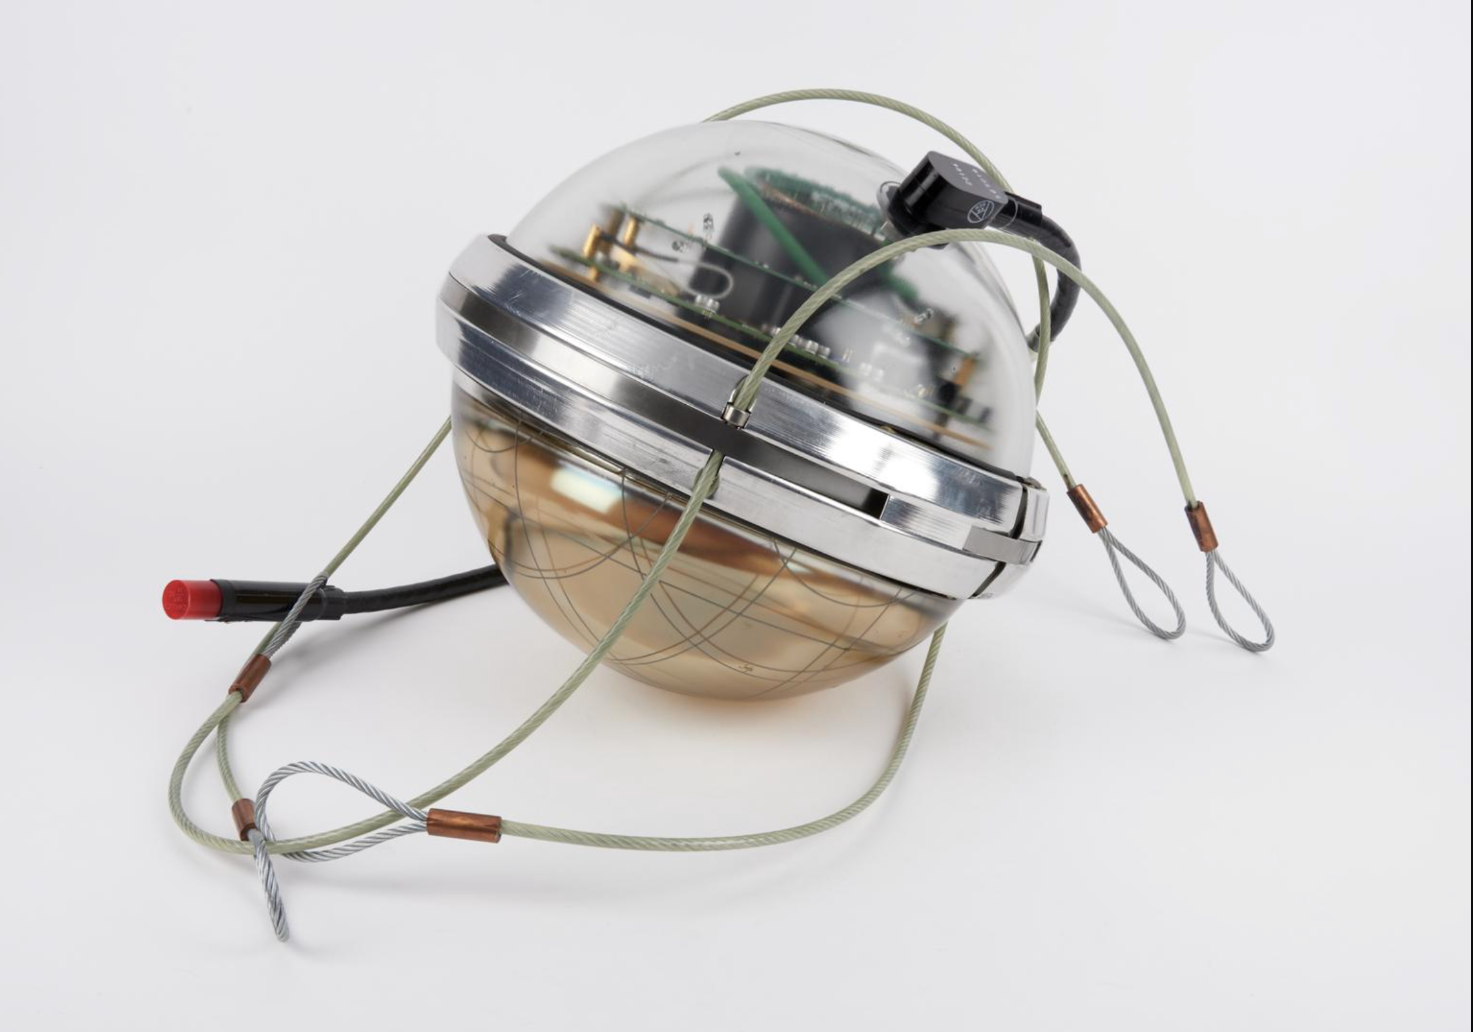
Icecube Neutrino Observatory
Cubic-kilometer neutrino detector located in ice at the South Pole
Was finished being built in 2011
Consists of 5160 DOMs (digital optical modules), 86 strings.
South Pole: clear and stable medium (good for faint Cherenkov detection)
Detects high energy neutrinos (optimized for TeV-PeV)
https://phys.org/news/2015-04-detector-south-pole-explores-mysterious.html
https://collection.sciencemuseumgroup.org.uk/objects/co8234420/digital-optical-module-dom-from-the-icecube-neutrino-detector
Notes:
IceCube Neutrino Observatory is a cubic-kilometer neutrino observatory buried deep in the ice at the South Pole. Construction finished in 2011, and the completed array consists of 5,160 digital optical sensors, called DOMs (digital optical modules), strung along 86 vertical cables lowered into holes drilled up to about 2.5 kilometers into the ice.
The reason they chose the South Pole ice sheet specifically is that it's an incredibly clear, stable, radioactively quiet medium which is ideal for letting that faint Cherenkov light travel far enough to be detected. IceCube is optimized for high-energy neutrinos, in the TeV to PeV range, which is the regime relevant for astrophysical sources like blazars and other extreme accelerators.

Slide 5
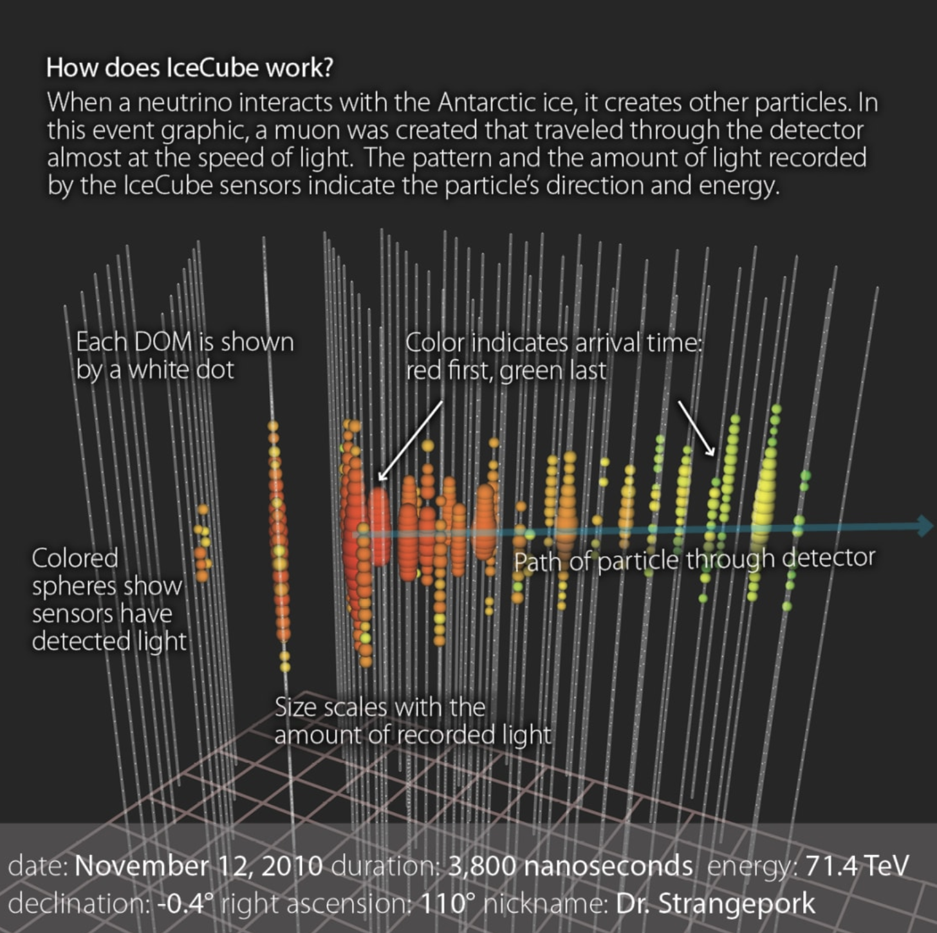
Icecube detecting neutrinos
Each basketball-sized DOM has a large 10-inch PMT facing downward to capture the Cherenkov photons
Neutrino interacts in the ice.
Produces a charged particle.
Charged particle emits Cherenkov light.
PMTs detect the light.
Event reconstruction (for high-energy neutrinos).
https://icecube.wisc.edu/science/icecube/
Notes:
Each Digital Optical Modules is about the size of a basketball, and it houses a large, ten-inch photomultiplier tube pointed downward, since most of the useful light in these events travels in a fairly predictable direction relative to the particle's path.
The full detection chain looks like this: a neutrino interacts somewhere in the ice, that interaction produces a charged particle, the charged particle emits Cherenkov light as it travels, the surrounding DOMs pick up that light, and from the pattern of hits across many sensors — you can see an example event on the right, where colour indicates arrival time and size indicates how much light was recorded — you reconstruct the underlying neutrino event. This works well for the high-energy astrophysical neutrinos IceCube was built for. It turns out supernovae break this model completely, and that's where my work comes into place.

Slide 6
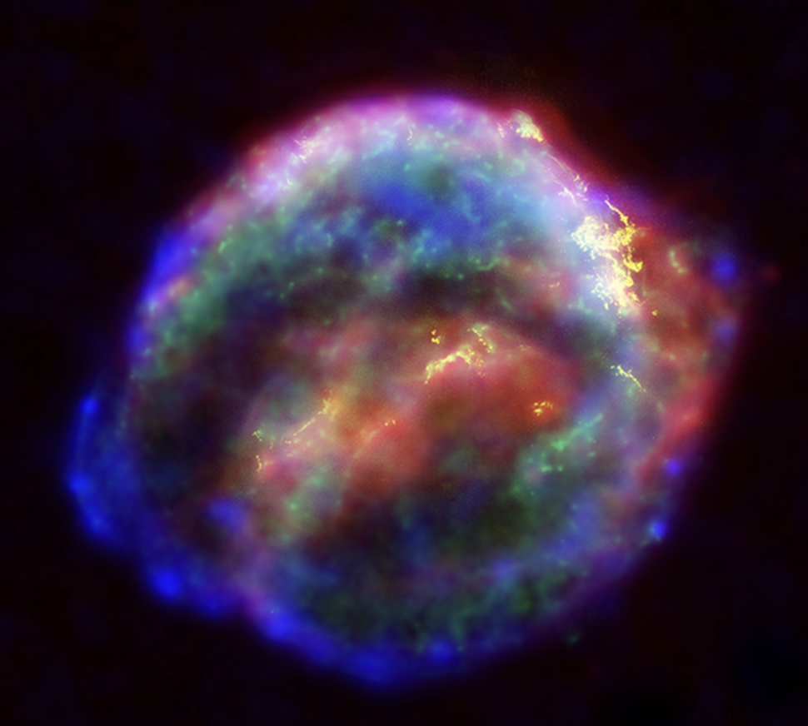
Motivation for Supernova (SN) scalers
Core-collapse supernovae release ~99% of their energy as low-energy (~10 MeV) neutrinos.
Individual supernova neutrino interactions in IceCube are too weak to reconstruct as events.
Instead, IceCube monitors the SN scaler rate—the number of PMT hits recorded by each DOM in 500 ms intervals.
A nearby supernova produces a small, simultaneous increase in the scaler rate across thousands of DOMs.
Reliable supernova detection therefore requires understanding the background scaler rate and how it changes over time. (No false alarms).
https://en.wikipedia.org/wiki/Kepler%27s_Supernova
Notes:
Core-collapse supernovae are a fundamentally different regime. About 99% of the total energy released in a core-collapse event comes out as neutrinos — but they're extremely low energy, only around 10 MeV, compared to the TeV-to-PeV neutrinos IceCube normally looks for.
At that energy, an individual supernova neutrino interaction in the ice is too faint to reconstruct as a distinct event as there isn't enough Cherenkov light from any single interaction to pick out a clean track or cascade. So IceCube uses a completely different detection strategy for supernovae: instead of looking for individual events, it monitors something called the SN scaler rate — which counts of how many times each DOM's PMT fires, binned into 500-millisecond intervals, for every single sensor in the array.
The physical idea is that a nearby supernova would flood the entire ice sheet with low-energy neutrinos over a period of seconds, which would produce a small but simultaneous uptick in the count rate across thousands of DOMs at once. But to actually pick that signal out with confidence, you first need a very solid understanding of what the background scaler rate looks like on its own, and how it drifts over time, so that you're not chasing false alarms caused by the detector itself. That idea is the main motivation for this talk.

Slide 7
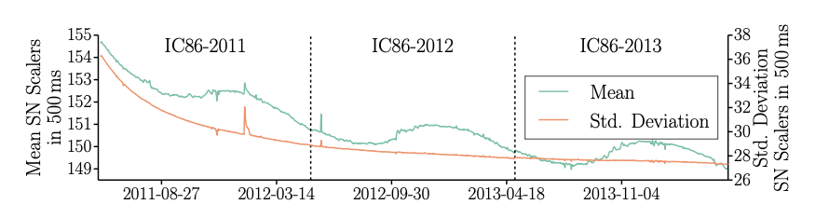
Prior work done
Previous IceCube analysis:
Observed a long-term decrease in average DOM dark noise rates (~3.5% over three years).
The reduced background noise increased sensitivity to atmospheric muons, leading to a ~50% increase in false positive supernova alerts.
The decrease was correlated with DOM deployment date and depth, suggesting detector-dependent effects.
Proposed explanation: possible faint light produced from ice deformation during freeze-in.
→ Motivated the need to understand long-term evolution of SN scaler rates.
(V. Baum et al. , 2015)
Notes:
Slide 7 — Prior Work Done Previous IceCube analyses already looked at this and found a long-term decrease in the average DOM dark noise rate, on the order of 3.5% over a three-year span.
That might sound small, but it has real consequences. As the background noise drops, the detector effectively becomes more sensitive to things like atmospheric muons passing through because the threshold for what counts as an unusual spike in the scaler rate stays fixed while the baseline noise floor drops underneath it. That increased sensitivity led to roughly a 50% increase in false-positive supernova alerts, which is an operational problem if you're trying to run a live alert system that other observatories act on.
To be precise about what "dark noise rate" means here, the mean scaler rate they track only has one processing step applied which is a 250-microsecond artificial dead time that suppresses correlated afterpulse noise within a single DOM. Instead of removing muon-triggered hits, they see two distinct effects layered together in the raw mean rate: an overall decay, which they attribute to the dark rate, and a seasonally varying influence from atmospheric muons on top of it. They also found that the size of the decay correlated with each DOM's deployment date and depth, which points to it being a genuine detector-dependent effect rather than some external or astrophysical cause. One proposed physical explanation was light that was produced by mechanical stress or deformation in the ice as it slowly refreezed and settled around each sensor after deployment.
This three-year trend had been observed, but nobody had characterized how it evolves over much longer timescales. That's what my work looked at.

Slide 8
Motivation for my work
Prior studies observed a long-term decrease in IceCube DOM dark noise rates.
These changes affected the detector's sensitivity and increased false supernova trigger rates.
This work extends the analysis using a longer dataset and models the observed long-term trend.
Understanding how SN scaler rates evolve over longer timescales is essential for detector calibration and reliable supernova searches.
Notes:
Slide 8 — Motivation for My Work This project extends that earlier analysis using a longer dataset, and both observing that a trend exists, and looking at a model for it. Understanding how the supernova scaler rate evolves over these longer timescales is essential for detector calibration and for keeping supernova search sensitivity well understood and stable over the full lifetime of the experiment.

Slide 9
Data and Method
IceCube SN scaler data (2011–2017... for now)
Good Run List (GRL) selection (quality cut for clean validated runs)
Average scaler rates calculated
Timeline constructed from run start times then converted to proper time units
Notes:
Slide 9 — Data and Method For my analysis I'm using IceCube's supernova scaler data from 2011 through 2017 for this stage of the analysis, but I will add more years as I extend the work. From there, I apply a Good Run List selection which is a quality cut that keeps only the periods of clean, validated detector operation and throws out runs affected by calibration issues, downtime, or known problems. From the clean runs, I calculated average scaler rates, and I constructed a timeline from the individual run start times, which then gets converted into proper time units so the whole dataset can be treated as one smooth accurate timeline.

Slide 10
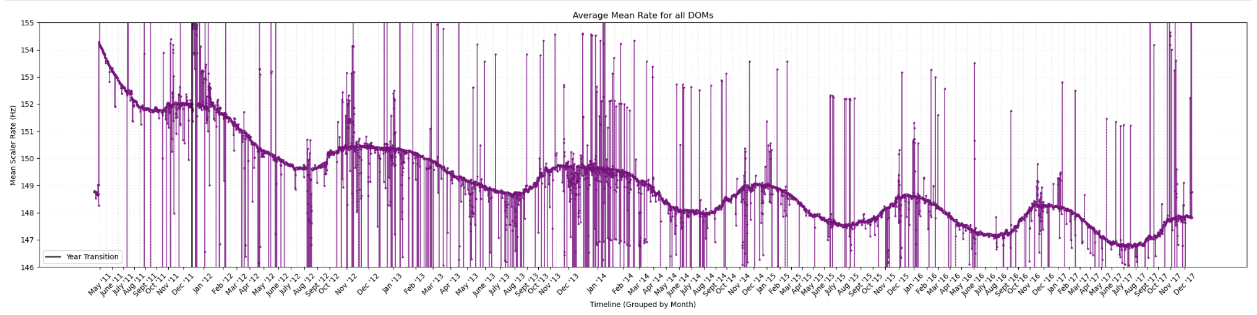
Data Processing
Removed bad runs using the GRL
Converted run times to a continuous timeline
Combined runs into a single dataset
Removed missing/corrupted entries
Prior to processing the data
Notes:
Slide 10 — Data Processing Before I could start any fitting, the raw data needed to be cleaned up. I removed bad runs flagged by the Good Run List, converted the individual run start and stop times into one continuous timeline, combined everything across all runs into a single unified dataset, and removed missing or corrupted entries that would otherwise throw off the averaging.
The graph you're looking at at the bottom is the result of the mean scaler rate averaged across all DOMs, plotted month by month from May 2011 through the end of 2017. Even in this raw, unprocessed form, you can already see two things: first the overall downward drift across the full six years, and an oscillation factor on top of that. We can see the characterization of both of those features in the upcoming fitting.

Slide 11
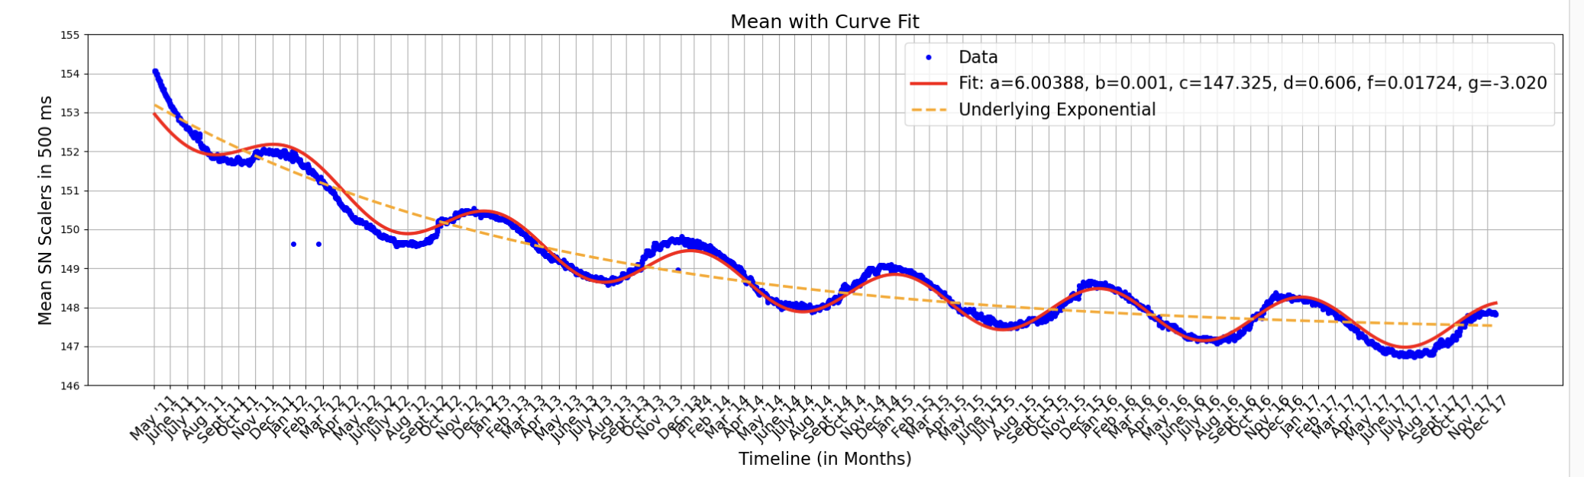
Results
Fit Equation: a*e^{(-b * x)} + c + d * sin(f * x + g)
Notes:
Slide 11 — Results To explain what we're seeing, I fit the data to a model with two components: an exponential decay, and a sinusoidal term. You can see the fit equation with the parameters written below the graph.
Physically, the exponential piece which is the dashed orange line on the graph, shows the overall long-term decline in the scaler rate. The a parameter is roughly the initial amplitude of that decay, b is the decay rate, and c is the long-term baseline the rate is settling toward. The sinusoidal term on top of that captures the oscillation: d is its amplitude, f sets how fast it repeats, and g is a phase offset. The solid red line is the full fit, including both the exponential and sinusoidal terms together. You can see it follows the blue data points closely across the full six-year timeline, including through each of those bumps.

Slide 12
Interpretation of Results
Long-term decrease is observed.
Exponential decay model captures the trend.
Findings are consistent with previous IceCube observations (extended dataset confirms trend over long timescales).
Stronger evidence of a genuine detector effect.
Identified and modeled seasonal periodic component.
Notes:
Slide 12 — Interpretation of Results So, pulling this all together, the long-term decrease that motivated this work is clearly present in this extended dataset, and a simple exponential decay does a good job of capturing that overall trend on its own.
This agrees with what the earlier IceCube analysis found over its original three-year window, so in that sense, this work is a confirmation. But more importantly, by fitting the same kind of decline over a dataset roughly twice as long, we get stronger evidence that this is a genuine, persistent, long-timescale detector effect, instead of something that happened to show up in the shorter data set and then leveled off. On top of confirming the decline, we've now also identified and modeled that periodic component that sits on top of it, which the earlier work didn't characterize.

Slide 13
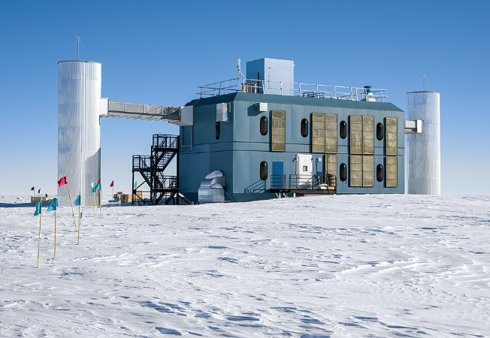
Conclusions & future
Conclusions
Extended previous IceCube analysis.
Characterized long-term SN scaler evolution.
Combination of exponential decay and periodic oscillation provides a good description of the behaviour.
Future work
Seasonal effects (separate plots per season of deployment)
Depth dependence (suggested by earlier work)
Continuous timeline mapping (see if it flattens)
Comparisons with IceCube's Upgrade (effects of the newer sensor technology long term)
https://en.wikipedia.org/wiki/IceCube_Neutrino_Observatory
Notes:
Slide 13 — Conclusions & Future Work To wrap up, this project extended the previous IceCube supernova scaler analysis using a much longer dataset, we characterized the long-term evolution of the supernova scaler rate across that extended timeline, and showed that a combination of exponential decay and a periodic oscillation component gives a good quantitative description of the observed behaviour.
Looking ahead, there are several next steps. First, would be to look into seasonal effects specifically, by having separate plots for the different seasons of deployment. Second, we want to look at depth dependence, since the earlier work suggested the decline correlates with how deep each DOM is in the ice, we would plot the DOMs at each given depth to see how they behave differently. Third, continuing to build out the continuous timeline mapping as more years of data become available, to see whether the exponential decay eventually flattens out entirely or continues indefinitely. And finally, comparing these results against data from IceCube's upcoming Upgrade, which will let us see whether newer sensor technology shows the same long-term behaviour and allow us to have better calibration and oscillation measurements.

Slide 14
Thanks for listening!
References:
V. Baum et al. Recent Improvements in the Detection of Supernovae with the IceCube Observatory. Proceeding of Science. 2015.
Naoko Kurahashi. Highlights from the IceCube Neutrino Observatory. Proceeding of Science. 2023.
Notes:
Thank you so much for listening.

Slide 15
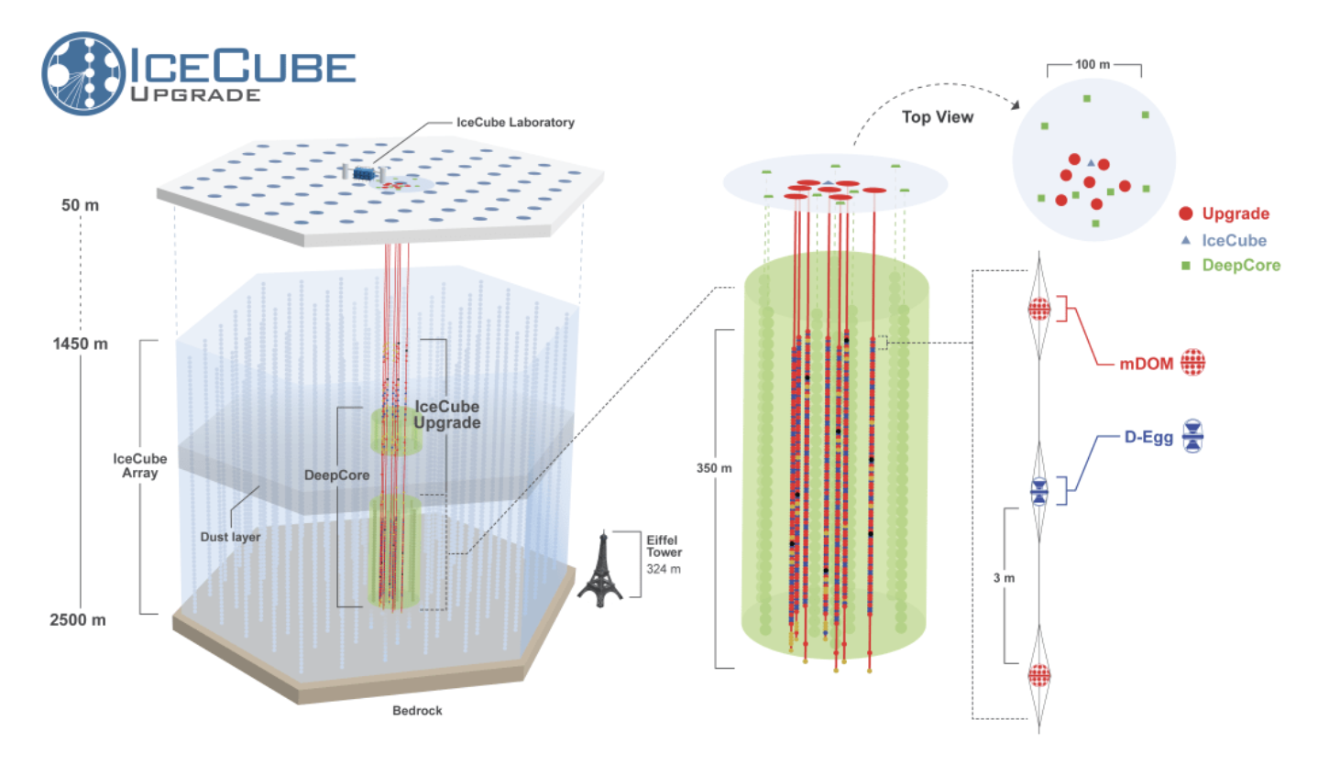
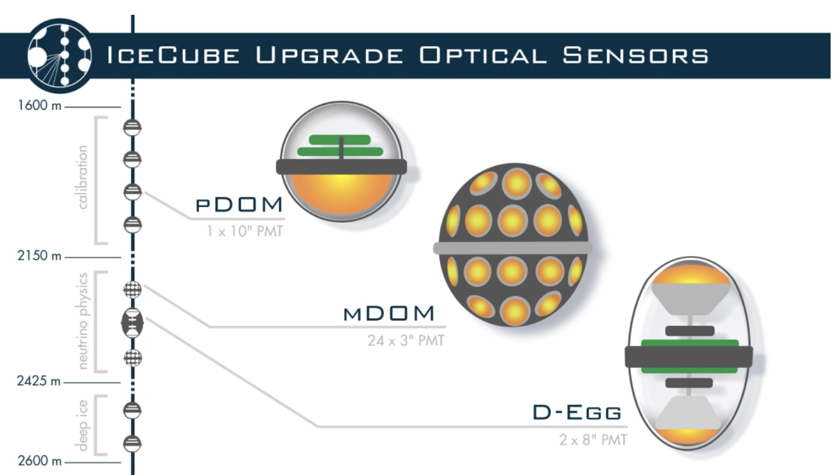
Icecube Upgrade
Goal:
Long-term study of module behaviour in a stable environment
        Better calibration, oscillations measurements, low energy transients
Compare to in-ice modules as the strings freeze
https://icecube.wisc.edu/news/research/2025/09/quantifying-the-estimated-sensitivity-of-the-icecube-upgrade-to-atmospheric-neutrino-oscillations/
5665 DOMs (Digital Optical Modules) on 91strings (extra 505 DOMs on 5 new strings)
Improved sensitivity for 1-10 GeV
https://icecube.wisc.edu/news/press-releases/2019/07/nsf-mid-scale-award-sets-off-first-extension-of-icecube/

Slide 16
Dark Noise Rate
The mean scaler rate they track only has one processing step applied which is a 250-microsecond artificial dead time that suppresses correlated afterpulse noise within a single DOM.
Instead of removing muon-triggered hits, they see two distinct effects layered together in the raw mean rate: an overall decay, which they attribute to the dark rate, and a seasonally varying influence from atmospheric muons on top of it.

