Slide 1
Comparing the Milky Way to Simulated Galaxies
CASST symposium 2026
Nicole Muchos, Nikhil Arora
August 12, 2026
Notes:
Third-year Astrophysics undergraduate student at Queen's University
This summer, I worked as a Summer Research and Outreach Fellow with Dr. Nik Arora at the McDonald Institute on comparing the Milky Way to simulated galaxies

Slide 2
Outline
Background
Disk structure, cosmological simulations
Milky Way Simulations
Stellar density, stellar population distributions
Next steps
Resolution comparison, metallicity check
Notes:
Background information and motivation for working with galaxy simulations
Galaxy disk structure, cosmological simulations and their uses
Simulations I used to analyze stellar populations, as well as stellar density distributions in the Milky Way
Next steps, including a resolution comparison and a metallicity check

Slide 3
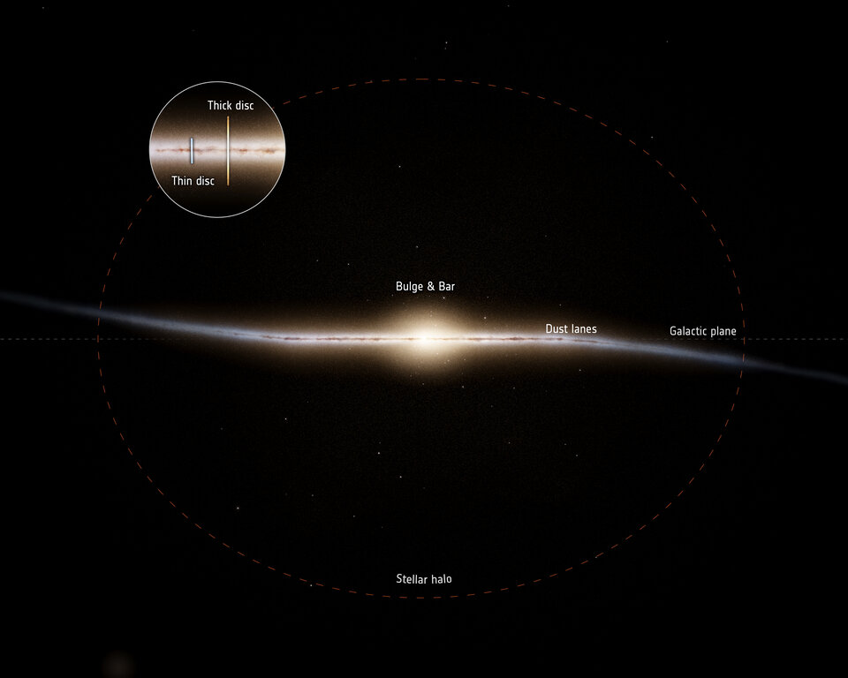
Milky Way: Disk Structure and Stellar Populations
Barred spiral galaxy
Thick outer disk: older, metal-poor stars
Thin inner disk: younger, metal-rich stars
Two populations - continuous population distribution or distinct?
Motivation: understand galaxy formation and evolution
https://www.esa.int/Science_Exploration/Space_Science/Gaia/Gaia_finds_parts_of_the_Milky_Way_much_older_than_expected
Notes:
Barred spiral galaxy: contains a flat and bar-shaped disk which is surrounded by spiralling arms
This knowledge can then be applied to other spiral galaxies much further away, whose stars we cannot so easily study

Slide 4
Cosmological Hydrodynamical Simulations
Computer models that recreate how the universe evolves over billions of years
Hydrodynamical: models fluid dynamics by solving the equations that govern fluid motion along with various astrophysical processes (star formation, supernovae, black hole evolution, etc.)
Zoom-in: small number of galaxies at a much higher resolution
Performed with a cosmological model and begins with smooth initial conditions
Gravity, dark matter and other physics evolve the system
https://www.esa.int/Science_Exploration/Space_Science/Gaia/Gaia_finds_parts_of_the_Milky_Way_much_older_than_expected

Slide 5

Cosmological Hydrodynamical Simulations
https://www.esa.int/Science_Exploration/Space_Science/Gaia/Gaia_finds_parts_of_the_Milky_Way_much_older_than_expected
Notes:
Simulation from the HELLO suite (cosmological hydrodynamical zoom-in), evolution (starting at formation)
In dark blue, showing dark matter falling into each other
Once light blue, switching to regular matter
The red points are supernovae and black hole formation

Slide 6
NIHAO: Numerical Investigation of a Hundred Astrophysical Objects
100 cosmological zoom-in hydrodynamical simulations
Haloes range from dwarf to Milky Way masses
NIHAO-AGN: includes active galactic nuclei (AGN) feedback
NIHAO-UHD: higher-resolution versions of 6 NIHAO simulations
NIHAO-LG: Milky Way, Andromeda analogues and numerous dwarf galaxies, constrained to form the Local Group environment
https://www.esa.int/Science_Exploration/Space_Science/Gaia/Gaia_finds_parts_of_the_Milky_Way_much_older_than_expected
Notes:
Range of masses: allowing for a wide range of comparisons
Active galactic nuclei feedback: drives massive and fast outflows of gas, playing a key role in galaxy evolution

Slide 7
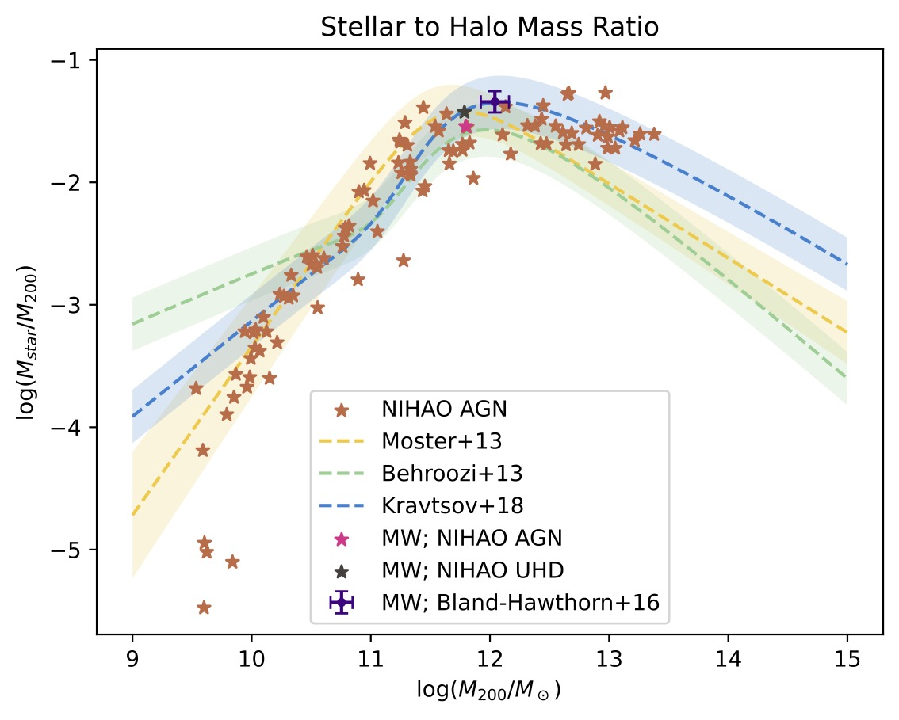
Preliminary Plot: SHMR
https://www.esa.int/Science_Exploration/Space_Science/Gaia/Gaia_finds_parts_of_the_Milky_Way_much_older_than_expected
Notes:
Stellar to Halo Mass Ratio
Considered a measure of efficiency and accuracy of cosmological simulations
Stellar mass (normalized by the halo mass) as a function of halo mass
For all NIHAO AGN galaxies (in light brown)
Dashed lines are popular abundance matching relations
Pink and grey stars are the Milky Way analogues from NIHAO AGN and UHD respectively
Purple point is observed Milky Way data
NIHAO AGN and UHD follow very nicely with observed data and matching relations

Slide 8
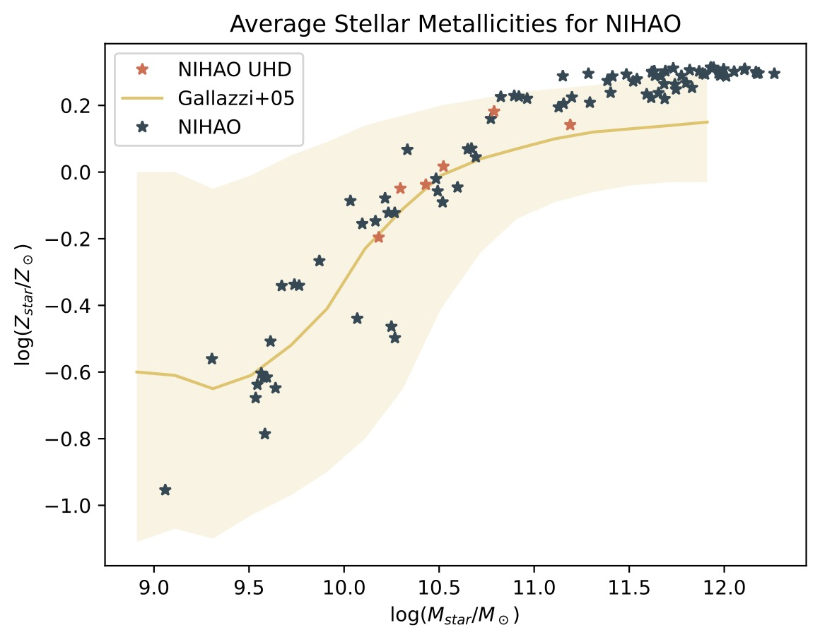
Preliminary Plot: Stellar Metallicities
https://www.esa.int/Science_Exploration/Space_Science/Gaia/Gaia_finds_parts_of_the_Milky_Way_much_older_than_expected
Notes:
Average stellar metallicities for all the NIHAO (in blue) and NIHAO UHD (in coral) galaxies as a function of stellar mass
Yellow line shows observed relation
NIHAO and NIHAO UHD for the most part match quite well within the observed relation
However, for higher stellar masses, the metallicity is higher than expected
This emphasizes the importance of including AGN feedback
Z = fraction of mass made of elements heavier than helium
Z/Zdot = how metal-rich relative to the sun

Slide 9
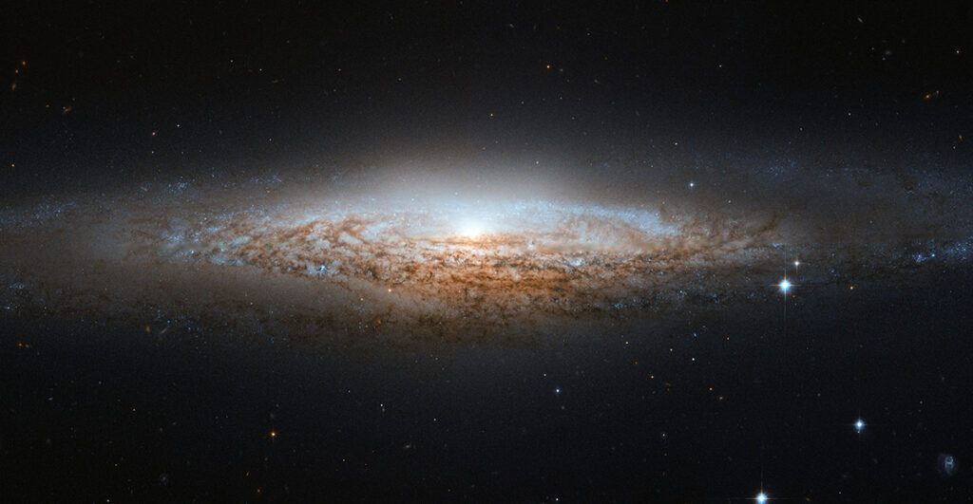
Modelling Stellar Populations: Radial Bins
1. Create radial bins of width 2 kpc
https://www.esa.int/Science_Exploration/Space_Science/Gaia/Gaia_finds_parts_of_the_Milky_Way_much_older_than_expected
2 kpc (not to scale)
Notes:
Model stellar density throughout the disk
Galaxy in edge-on view
Created radial bins of width 2 kpc

Slide 10
Modelling Stellar Populations: Height Bins
2. Create height bins along the z-axis from –5 kpc to 5 kpc
https://www.esa.int/Science_Exploration/Space_Science/Gaia/Gaia_finds_parts_of_the_Milky_Way_much_older_than_expected
2 kpc (not to scale)
Notes:
Within each radial bin, create vertical bins along the z-axis from –5 kpc to 5 kpc
Calculate the stellar density in each bin, filtering the stars by age
Vertical bins are much smaller than shown

Slide 11
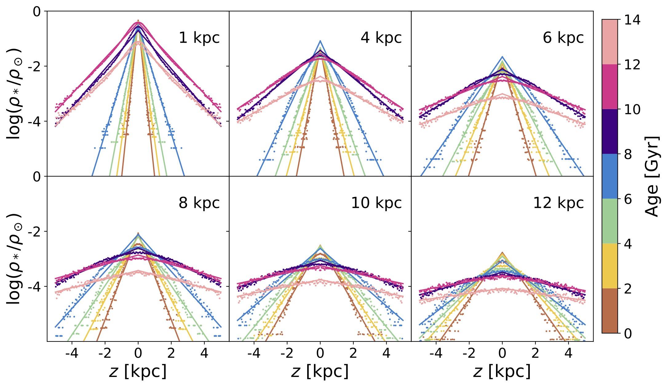
NIHAO-UHD: Stellar Density
https://www.esa.int/Science_Exploration/Space_Science/Gaia/Gaia_finds_parts_of_the_Milky_Way_much_older_than_expected
Notes:
Stellar data from the Milky Way analogue in NIHAO-UHD
Stellar density as a function of z, the height above the disk
Each panel shows the densities at different radii from the centre, and each color shows the stellar ages, as shown by the colour bar on the right
For the first three panels, you can see a clear distinction between the older stars lying far above and below the plane of the disk, with younger stars concentrating on the plane
As you go further out from the centre, these populations begin to merge and become less distinct

Slide 12
Next Steps
Test this result out with the other NIHAO suites
  Is this a result of science or resolution?
Look at the stellar and gas metallicities above and below the disk
  Does this result translate for metallicities as well?
https://www.esa.int/Science_Exploration/Space_Science/Gaia/Gaia_finds_parts_of_the_Milky_Way_much_older_than_expected

