Slide 1
Primordial Black Hole-Induced Radiative
Suppression of H₂ for Direct Collapse Supermassive Black Hole Formation
2026 Canadian Astroparticle Summer Student Talk Symposium
Kayla Payne, Aaron Vincent
August 13, 2026

Slide 2
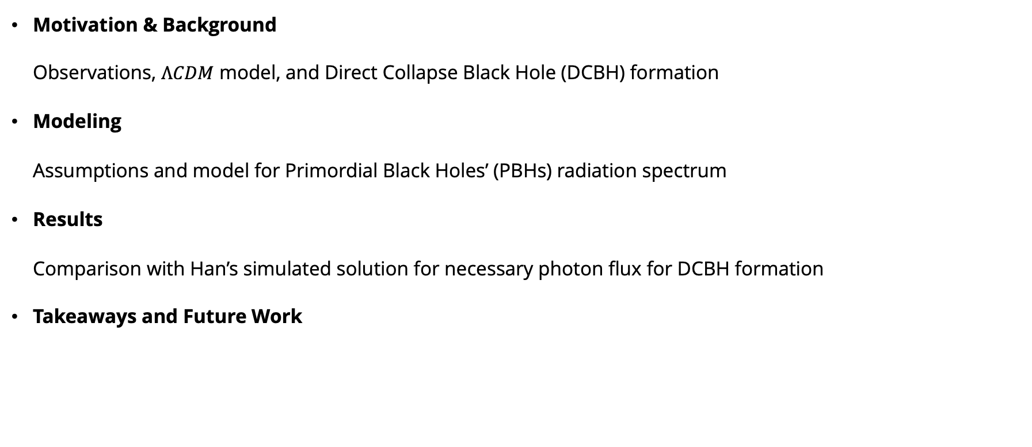
Outline
Motivation & Background
  Observations, $ΛCDM$ model, and Direct Collapse Black Hole (DCBH) formation
Modeling
  Assumptions and model for Primordial Black Holes’ (PBHs) radiation spectrum
Results
  Comparison with Han’s simulated solution for necessary photon flux for DCBH formation
Takeaways and Future Work

Slide 3
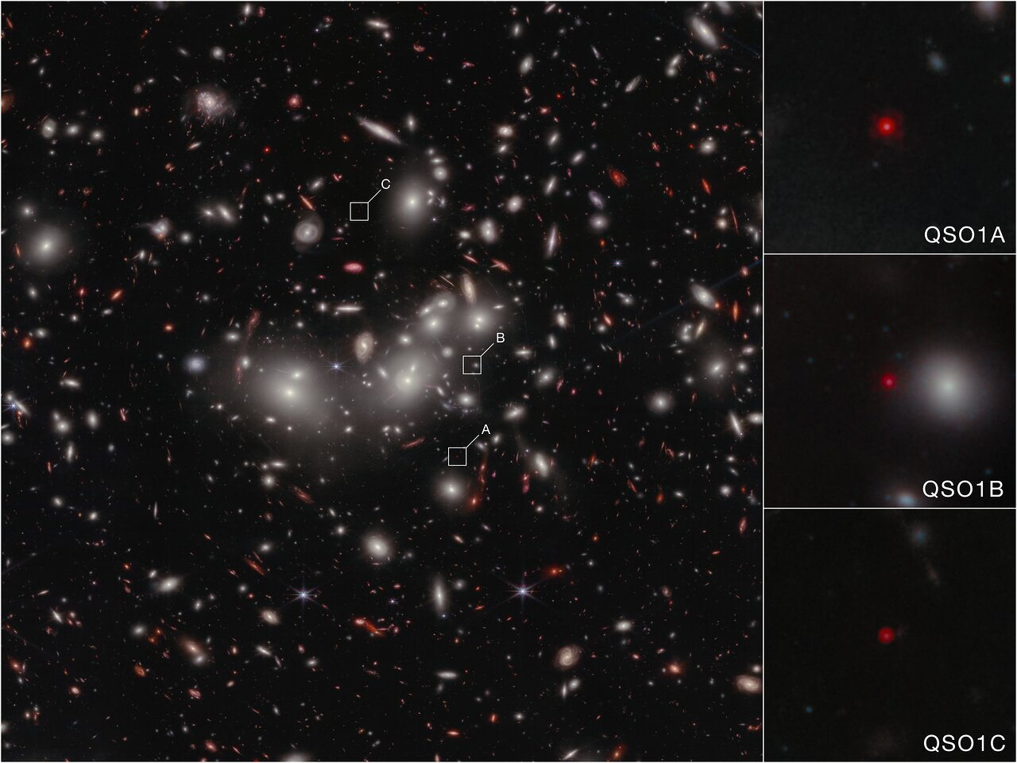
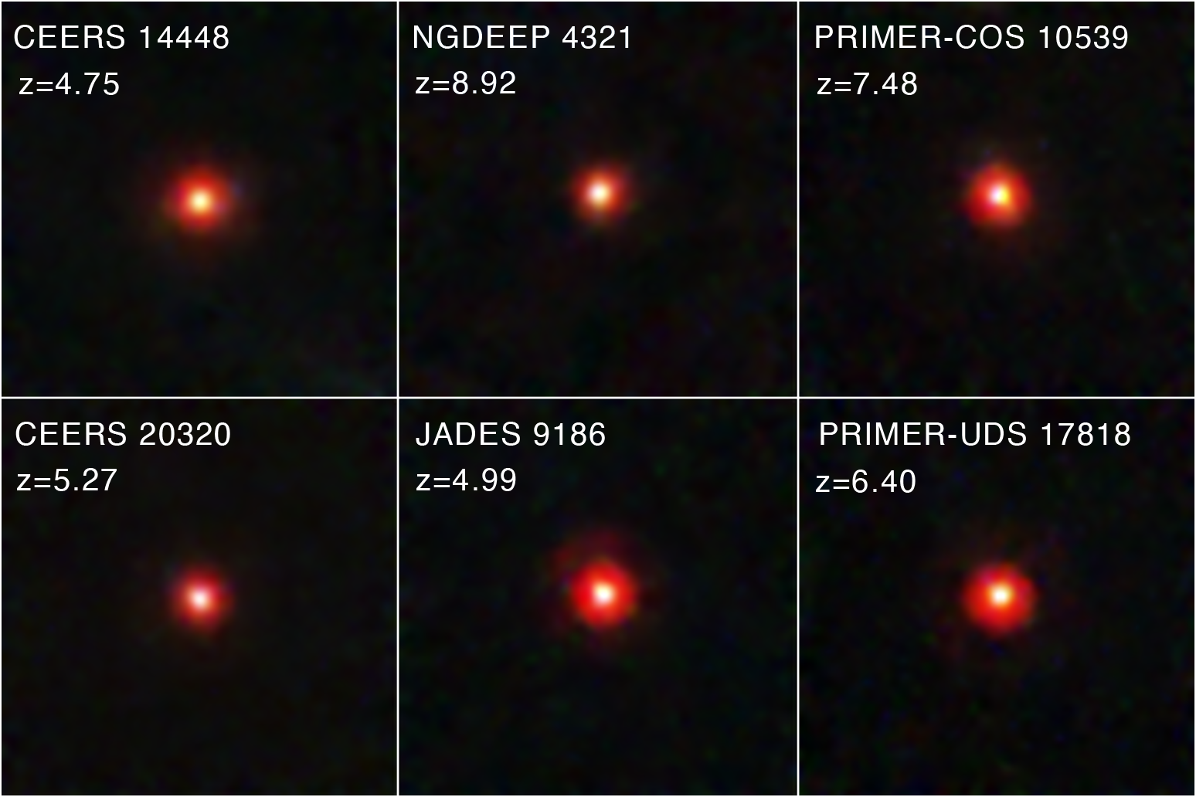
Motivation
Little Red Dots (LRDs)
NASA, ESA, CSA, L. Furtak (Ben-Gurion University), R. Maiolino (Cambridge), F. D'Eugenio (Cambridge), I. Juodžbalis (Cambridge), H. Übler (MPE), C. Marconcini (University of Florence). Image processing: A. Pagan
NASA, ESA, CSA, STScI, D. Kocevski (Colby College)
Page 1 of 14

Slide 4


Direct Collapse SMBHs
Rapid cooling → fragmentation → star formation
Moderate cooling → direct collapse → SMBH seed formation
Page 2 of 14

Slide 5
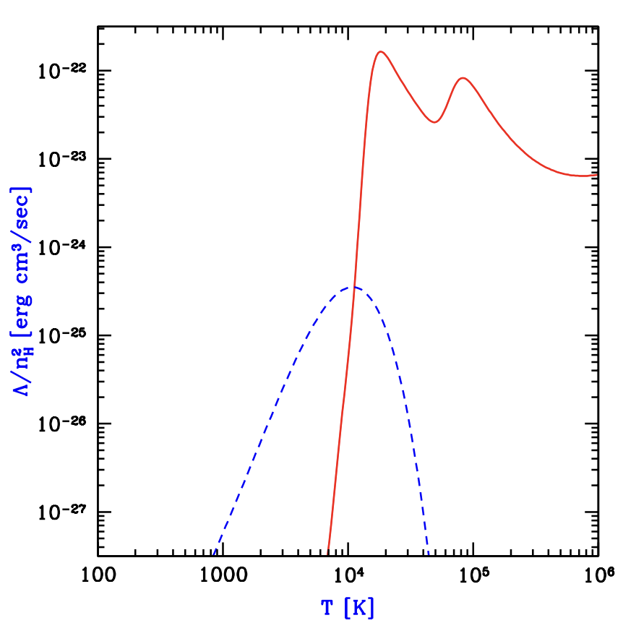
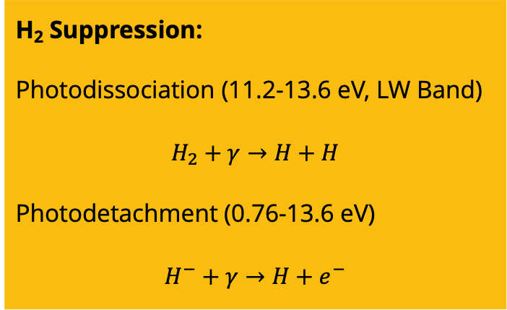
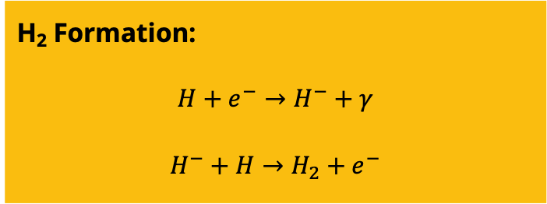
Cooling Mechanisms
Below 10⁴ K
H₂ Formation:
$$H+e^{−}→H^{−}+γ$$
$$H^{−}+H→H_{2}+e^{−}$$
Atomic H, He
H₂
H₂ Suppression:
Photodissociation (11.2-13.6 eV, LW Band)
$$H_{2}+γ→H+H$$
Photodetachment (0.76-13.6 eV)
$$H^{−}+γ→H+e^{−}$$
https://arxiv.org/pdf/astro-ph/0010468
We want to slow cooling by suppressing the formation of H₂.
Page 3 of 14

Slide 6
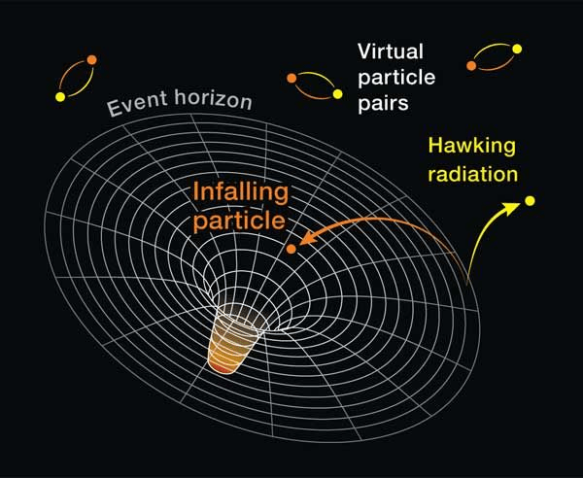


Proposed Solution Method
Can Primordial Black Holes (PBHs) around 10¹⁴g provide the required photon flux to suppress H₂ cooling in gas clouds?
At redshift $z≈100$
Where PBHs are some fraction, $f_{PBH}$, of dark matter.
https://lifespaceandthelot.com/2023/06/06/hawking-radiation-could-lead-to-the-end-of-the-universe/
Page 4 of 14

Slide 7
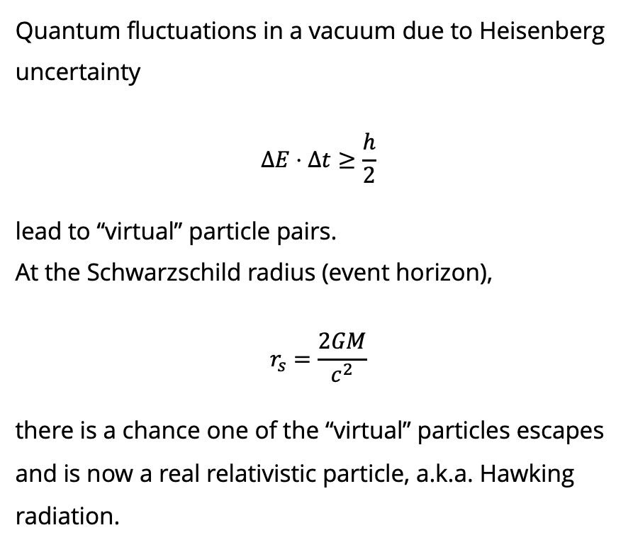
Hawking Radiation
Quantum fluctuations in a vacuum due to Heisenberg uncertainty
$$ΔE⋅Δt≥\frac{h}{2}$$
lead to “virtual” particle pairs.
At the Schwarzschild radius (event horizon),
$$r_{s}=\frac{2GM}{c^{2}}$$
there is a chance one of the “virtual” particles escapes and is now a real relativistic particle, a.k.a. Hawking radiation.
https://lifespaceandthelot.com/2023/06/06/hawking-radiation-could-lead-to-the-end-of-the-universe/
Page 5 of 14

Slide 8
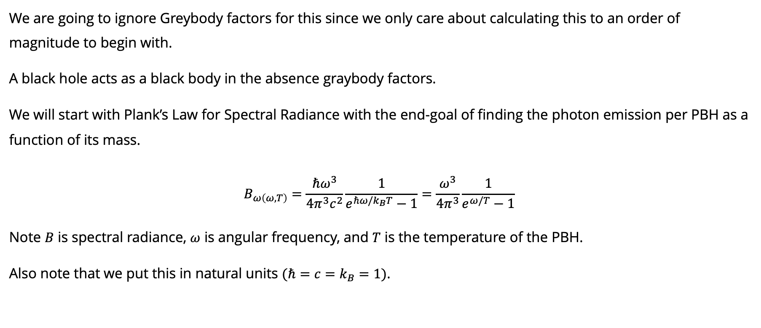
Black Body Approximation
We are going to ignore Greybody factors for this since we only care about calculating this to an order of magnitude to begin with.
A black hole acts as a black body in the absence graybody factors.
We will start with Plank’s Law for Spectral Radiance with the end-goal of finding the photon emission per PBH as a function of its mass.
$$B_{ω\left(ω,T\right)}=\frac{ℏω^{3}}{4π^{3}c^{2}}\frac{1}{e^{ℏω/k_{B}T}−1}=\frac{ω^{3}}{4π^{3}}\frac{1}{e^{ω/T}−1}$$
Note $B$ is spectral radiance, $ω$ is angular frequency, and $T$ is the temperature of the PBH.
Also note that we put this in natural units $(ℏ=c=k_{B}=1)$.
Page 6 of 14

Slide 9
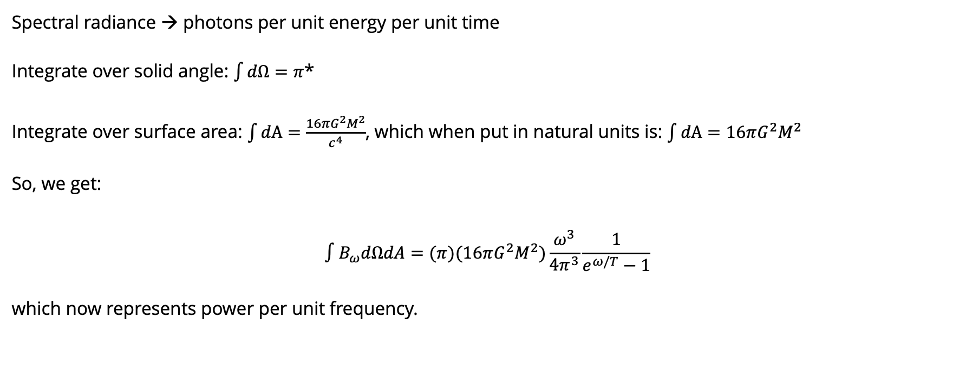
Black Body Approximation
Spectral radiance → photons per unit energy per unit time
Integrate over solid angle: $\int{dΩ}=π$*
Integrate over surface area: $\int{dA}=\frac{16πG^{2}M^{2}}{c^{4}}$, which when put in natural units is: $\int{dA}=16πG^{2}M^{2}$
So, we get:
$$∫B_{ω}dΩdA=(π)(16πG^{2}M^{2})\frac{ω^{3}}{4π^{3}}\frac{1}{e^{ω/T}−1}$$
which now represents power per unit frequency.
*Typically, the integral over the full solid angle would give you $4π$, however, we only want to integrate over the outward hemisphere and weight each direction by $cosθ$ (the Lambertian projection factor). However, for an order of magnitude calculation this distinction isn’t overly important.
Page 7 of 14

Slide 10
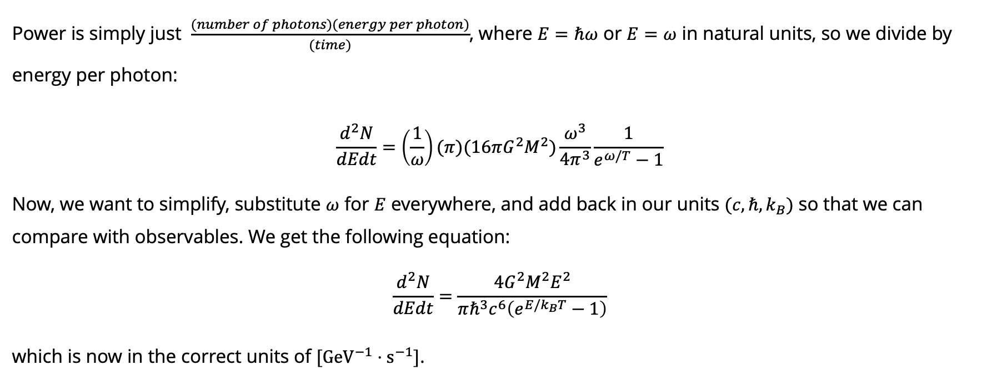
Black Body Approximation
Power is simply just $\frac{(number of photons)(energy per photon)}{(time)}$, where $E=ℏω$ or $E=ω$ in natural units, so we divide by energy per photon:
$$\frac{d^{2}N}{dEdt}=\left(\frac{1}{ω}\right)(π)(16πG^{2}M^{2})\frac{ω^{3}}{4π^{3}}\frac{1}{e^{ω/T}−1}$$
Now, we want to simplify, substitute $ω$ for $E$ everywhere, and add back in our units $(c, ℏ, k_{B})$ so that we can compare with observables. We get the following equation:
$$\frac{d^{2}N}{dEdt}=\frac{4G^{2}M^{2}E^{2}}{πℏ^{3}c^{6}\left(e^{E/k_{B}T}−1\right)}$$
which is now in the correct units of $[{GeV}^{−1}⋅s^{−1}]$.
Page 8 of 14

Slide 11
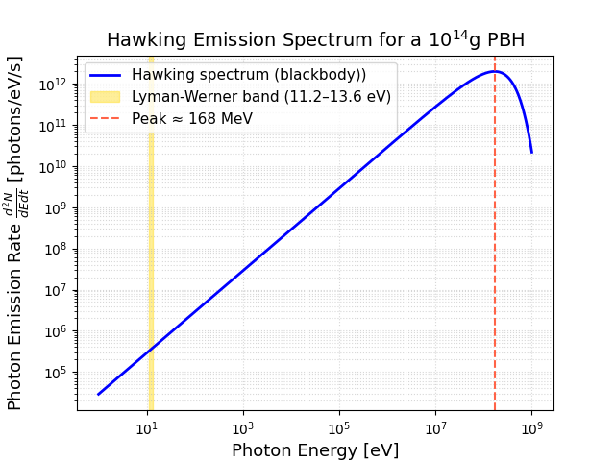
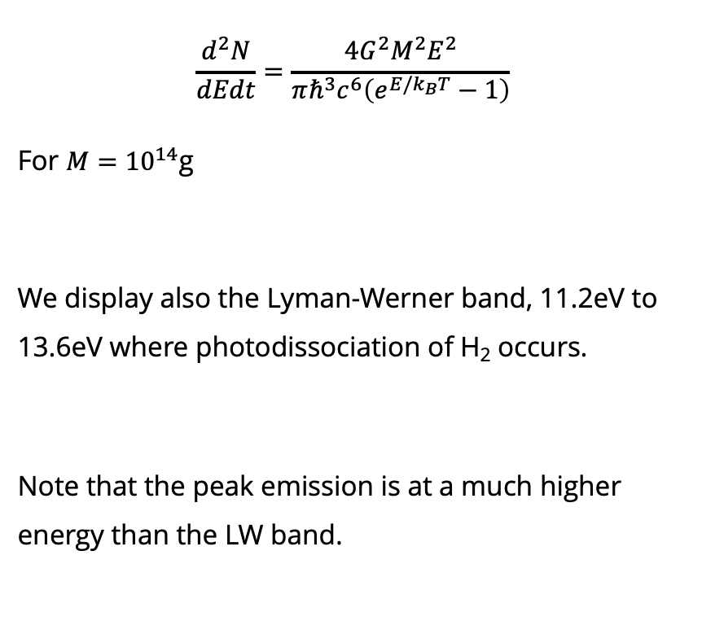
Black Body Spectrum for 1 PBH
$$\frac{d^{2}N}{dEdt}=\frac{4G^{2}M^{2}E^{2}}{πℏ^{3}c^{6}\left(e^{E/k_{B}T}−1\right)}$$
For $M={10}^{14}$g
We display also the Lyman-Werner band, 11.2eV to 13.6eV where photodissociation of H₂ occurs.
Note that the peak emission is at a much higher energy than the LW band.
Page 9 of 14

Slide 12
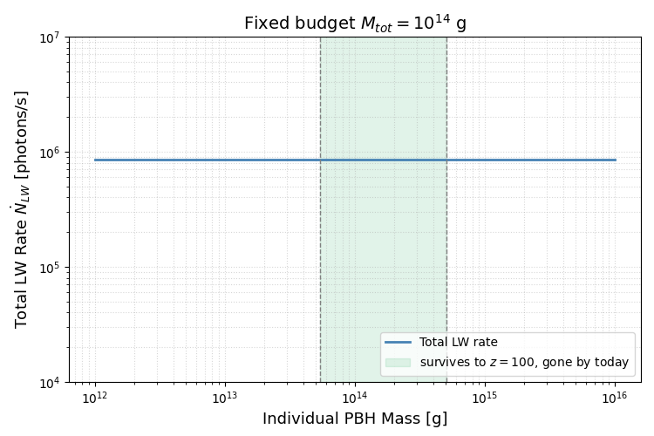
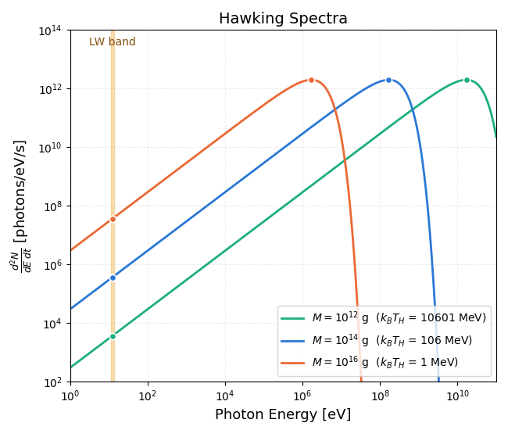
Why M = 10¹⁴ g?
Page 10 of 14

Slide 13
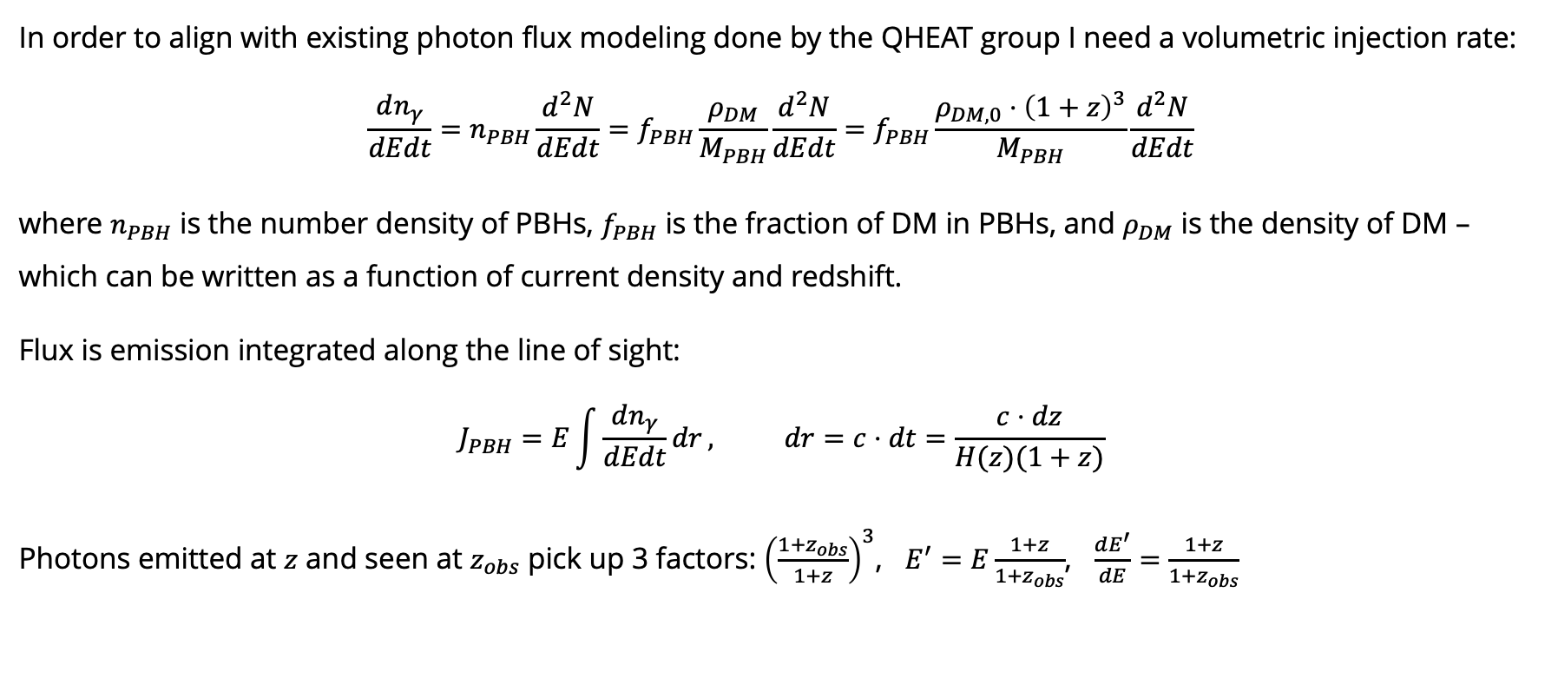
Volumetric Injection Rate
In order to align with existing photon flux modeling done by the QHEAT group I need a volumetric injection rate:
$$\frac{dn_{γ}}{dEdt}=n_{PBH}\frac{d^{2}N}{dEdt}=f_{PBH}\frac{ρ_{DM}}{M_{PBH}}\frac{d^{2}N}{dEdt}=f_{PBH}\frac{ρ_{DM,0}⋅{\left(1+z\right)}^{3}}{M_{PBH}}\frac{d^{2}N}{dEdt}$$
where $n_{PBH}$ is the number density of PBHs, $f_{PBH}$ is the fraction of DM in PBHs, and $ρ_{DM}$ is the density of DM – which can be written as a function of current density and redshift.
Flux is emission integrated along the line of sight:
$$J_{PBH}=E\int{\frac{dn_{γ}}{dEdt}dr}, dr=c⋅dt=\frac{c⋅dz}{H(z)(1+z)}$$
Photons emitted at $z$ and seen at $z_{obs}$ pick up 3 factors: ${\left(\frac{1+z_{obs}}{1+z}\right)}^{3}$, $E^{′}=E\frac{1+z}{1+z_{obs}}$, $\frac{dE^{′}}{dE}=\frac{1+z}{1+z_{obs}}$
dilution
redshifted energy
bin stretches
Page 11 of 14

Slide 14
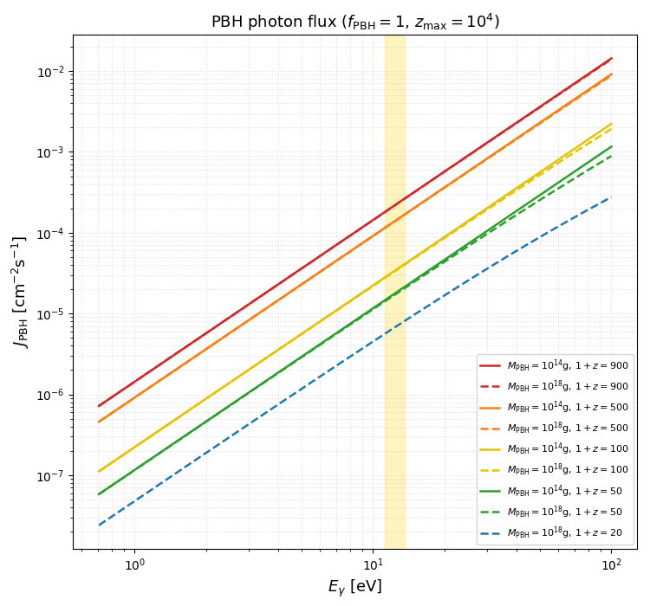
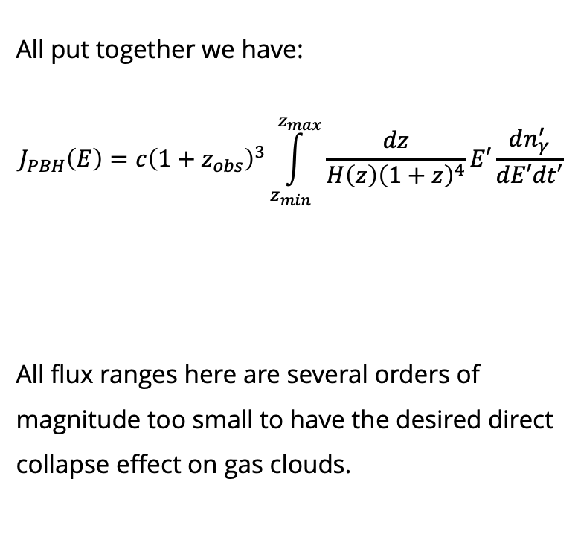
PBH Photon Flux
All put together we have:
$$J_{PBH}\left(E\right)=c{\left(1+z_{obs}\right)}^{3}\int_{z_{min}}^{z_{max}}{\frac{dz}{H\left(z\right){\left(1+z\right)}^{4}}}E′\frac{dn_{γ}^{′}}{dE′dt′}$$
All flux ranges here are several orders of magnitude too small to have the desired direct collapse effect on gas clouds.
LW
Page 12 of 14

Slide 15
Ongoing Work
Composites thermalizing in the plasma of the early universe and later on releasing blackbody radiation.
  What kind of composite DM could achieve this?
Could the observed LRDs simply be super-heated gas clouds?
Page 13 of 14

Slide 16
Takeaways
Photon flux in early universe gas clouds can disrupt chemical reactions.
Suppression of H₂ slows cooling of a gas cloud and therefore affects star formation or rather allows for direct collapse SMBHs to form.
PBHs release Hawking radiation which could contribute to the photon flux needed, but at a DM fraction of 1 it was found to only produce a flux many orders of magnitude too small.
Page 14 of 14

Slide 17
Thank You!

