Slide 1
Machine Learning Model for the Milky Way's Galactic Disk
CASST Symposium 2026
Isabella Botelho, Lawrence Widrow
AUGUST 12, 2026

Slide 2
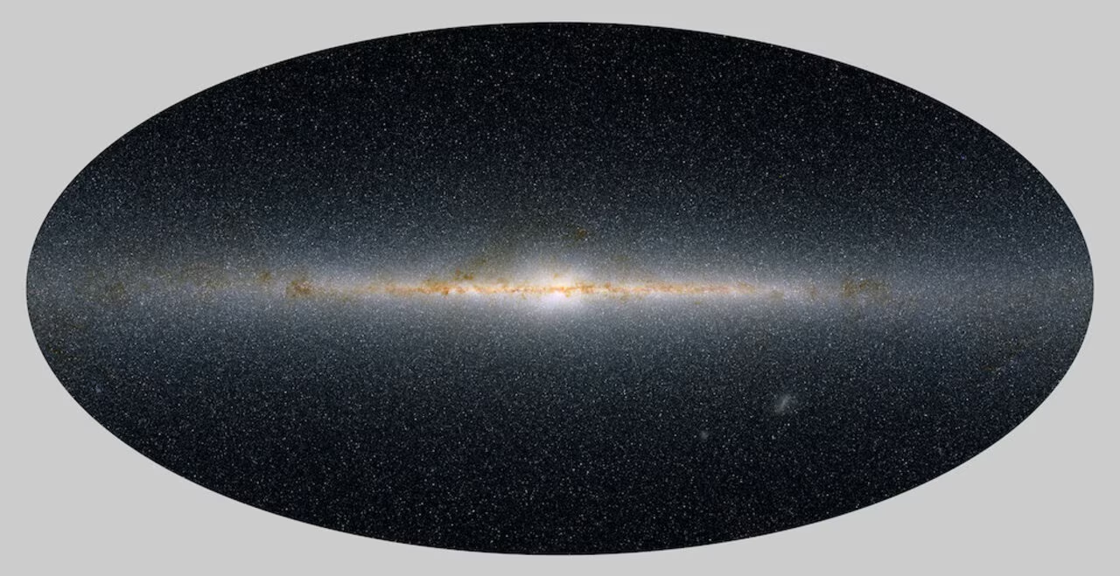
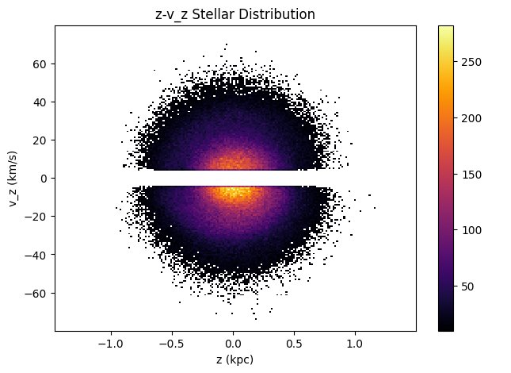
Galactic Dynamics Background
Stellar density in the disk can be expressed using a phase space distribution function (DF).
By determining the DF, one can determine the gravitational potential, and subsequently the dark matter content in the disk.
This DF is reliant on the motion of stars in the z direction and the vertical velocity dispersion.
CASST Symposium 2026
2
Notes:
Stellar density in the disk can be expressedusing a phase space distribution function (DF).
By determining the DF, one can determine thegravitational potential, and subsequently thedark matter content in the disk.
In the 1930s, Oort, with the knwoledge that stellar density within the solar neighbourhood is approximately constant, realises thatgravitaitonal potential could be determined using the vertical motion of stars in the disk.
This DF is reliant on the motion of stars in thez direction and the vertical velocity dispersion.

Slide 3
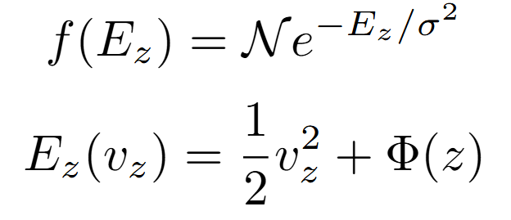
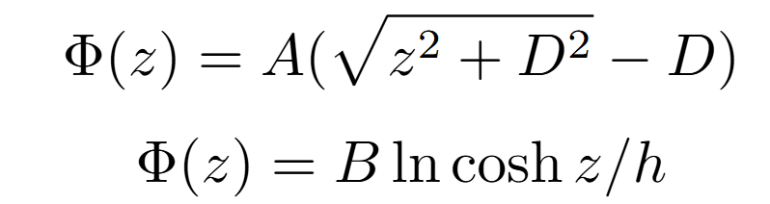
Phase Space DF
CASST Symposium 2026
3

Slide 4
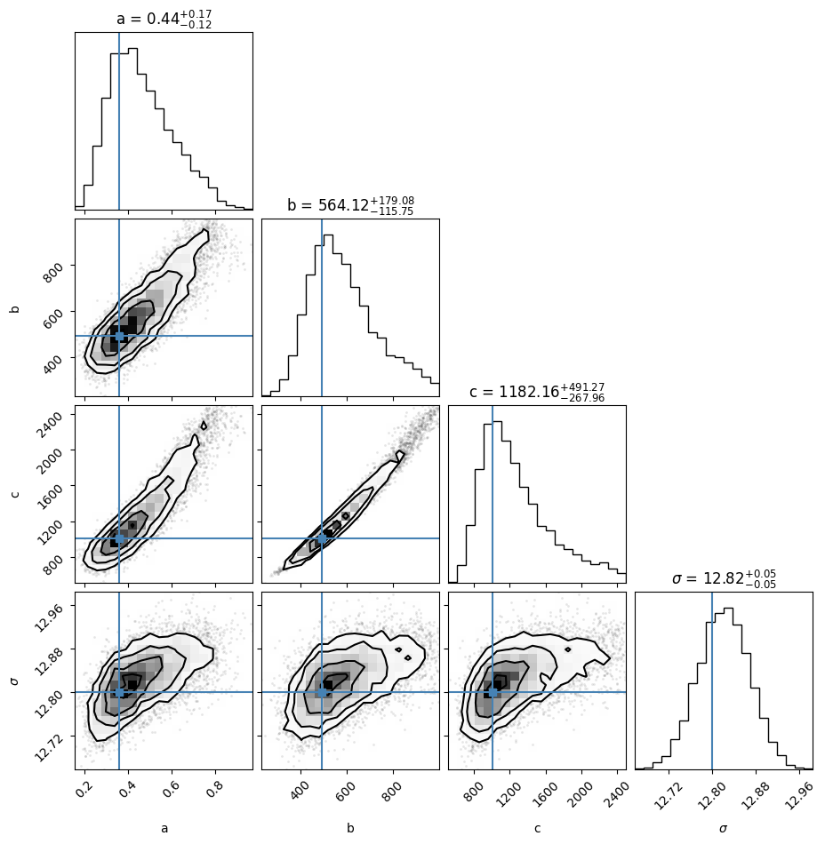
Part I: Fitting using Simulated Data and EMCEE
Using simulated particles and data from Gaia DR2, the DF can be fitted, and its parameters recovered.
EMCEE is a Python implementation of a multi-chain Monte Carlo (MCMC) sampler.
  https://emcee.readthedocs.io/en/stable/
Uses a standard log-likelihood with a posterior probability distribution to fit data and recover parameters.
From fitting, the relationships between parameters can also be seen.
CASST Symposium 2026
4
Notes:
EMCEE is a Python implementation of a multi-chain Monte Carlo (MCMC) sampler.
https://emcee.readthedocs.io/en/stable/
Uses a standard log-likelihood with a posterior probability distribution to fit data and recover parameters.
From fitting, the relationships between parameters can also be seen.

Slide 5
Problem: What if the model is wrong?
There are different functional models of the distribution function. ​
These models are generally similar in shape, but the goodness of fit for both the gravitational potential and the DF depend on each other. ​
Standard MLE often fails when dealing with a mismatched model.
So, what method can we use that accommodates a wrong model?
CASST Symposium 2026
5
Notes:
There are different functional models of the distribution function.
These models are generally similar in shape, but the goodness of fit for both the gravitationalpotential and the DF depend on each other.
Standard MLE often fails when dealing with a mismatched model.
So, what method can we use that accommodates a wrong model?

Slide 6
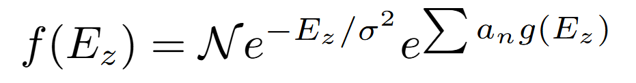
Part II: Machine Learning for Fitting
Using a Log-Gaussian Cox Process to fit an incorrect model.
A mixture model piece in fitting a model provides an uncertainty blanket for wrongness in the model.
A Log-Gaussian Cox Process (LGCP) is a mixture model algorithm that adds weighted radial basis functions to the pre-existing model being fitted.
CASST Symposium 2026
6
Notes:
A mixture model piece in fitting a model provides an uncertainty blanket for wrongness inthe model.
A Log-Gaussian Cox Process (LGCP) is a mixture model algorithm that adds weightedradial basis functions to the pre-existing model being fitted.
LGCP uses a combination of statistics and gaussian processing to fit spatial point data.

Slide 7
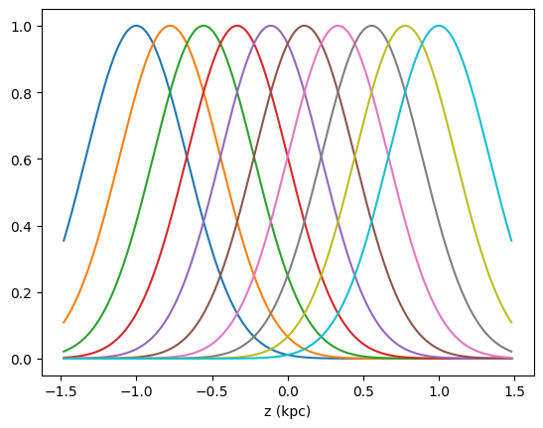
CASST Symposium 2026
7
Notes:
Explaining how radial basis functions work

Slide 8
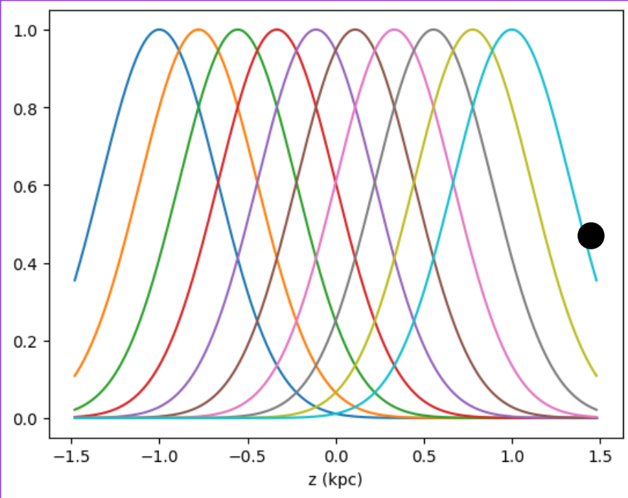
CASST Symposium 2026
8

Slide 9
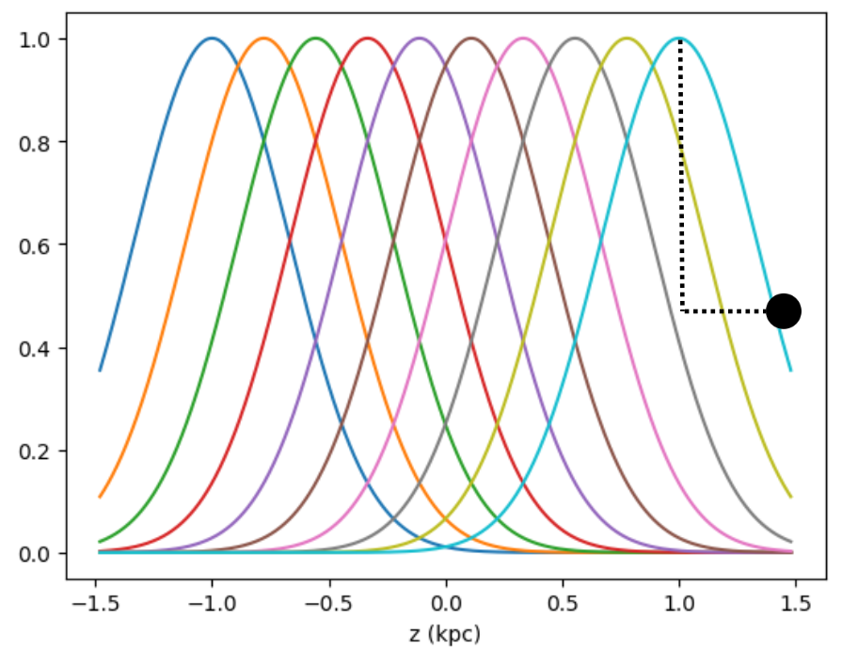
CASST Symposium 2026
9
Notes:
If the distance between the point and the center is small, the weight associated with that specific gaussian increases.
If the distance between the point and the center is large, the weight associated with the gaussian decreases. Since it's inside of an exponential, it will approach 0, multiplying the DF by 1 leaving it unchanged.

Slide 10
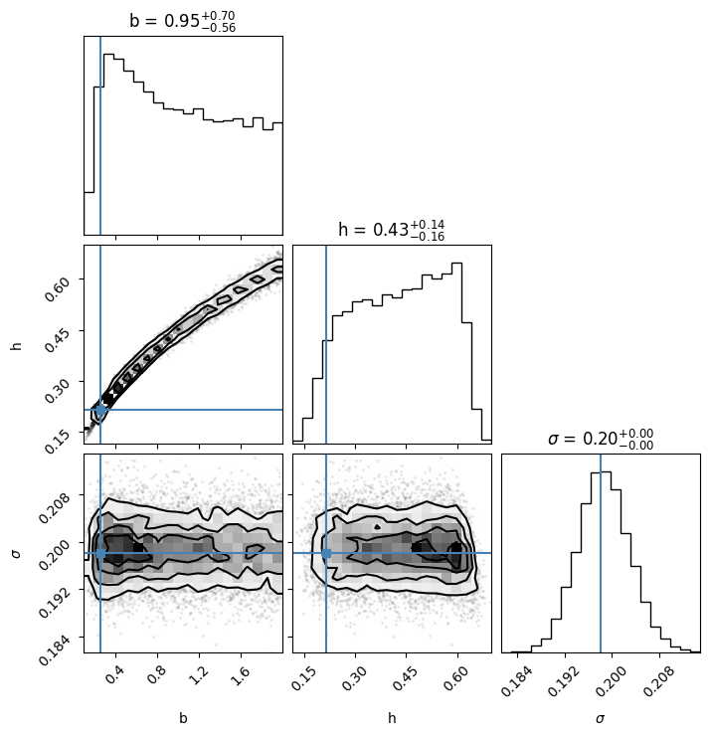
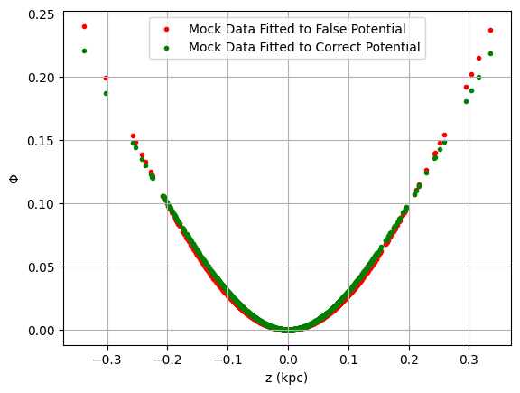
Comparison to Other Fitting Methods
To compare the effectiveness to this process, I generated mock data using one gravitational potential and fitted it with another.
CASST Symposium 2026
10
Notes:
Describe my process to test the effectiveness of LGCP
Plot on the left:
corner plot of the EMCEE fit for the mock data to the incorrect potential
Sigma is recovered well (parameter of the DF, which remained the same)
B and h are recovered poorly
Plot on the right:
Fit parameters recovered from the LGCP fit
Parameters are different than ones recovered by EMCEE
Potential is fitted closely but not completely correctly to the true potential

Slide 11
Conclusion
Bayesian statistical methods provide poor parametric recovery when fitting data to an incorrect model.
Using a machine learning algorithm for fitting provides room for wrongness in the model.
In a fit using 1000 simulated particles, LGCP recovered the correct parameters while a Bayesian statistical method couldn't.
CASST Symposium 2026
11
Notes:
Bayesian statistical methods provide poor parametric recovery when fitting data to anincorrect model.
Using a machine learning algorithm for fitting provides room for wrongness in the model.
In a fit using 1000 simulated particles, LGCP recovered the correct parameters while aBayesian statistical method couldn't.

Slide 12
Next Steps
Adding an additional mixture model in f
Moving on from the 1D simplification to a full 3D, multi-component disk
Using data from Gaia DR3 and the soon to be released Gaia DR4 for fitting
CASST Symposium 2026
12
Notes:
Adding an additional mixture model in f
Moving on from the 1D simplification to a full 3D, multi-component disk
Using data from Gaia DR3 and the soon to be released Gaia DR4 for fitting

Slide 13
Thank you, any questions?
CASST Symposium 2026

