Slide 1
Characterizing Noise in SuperCDMS HVeV Detectors
Hussein David & Rhea Zhu
1/17

Slide 2
01
Background
2/17

Slide 3
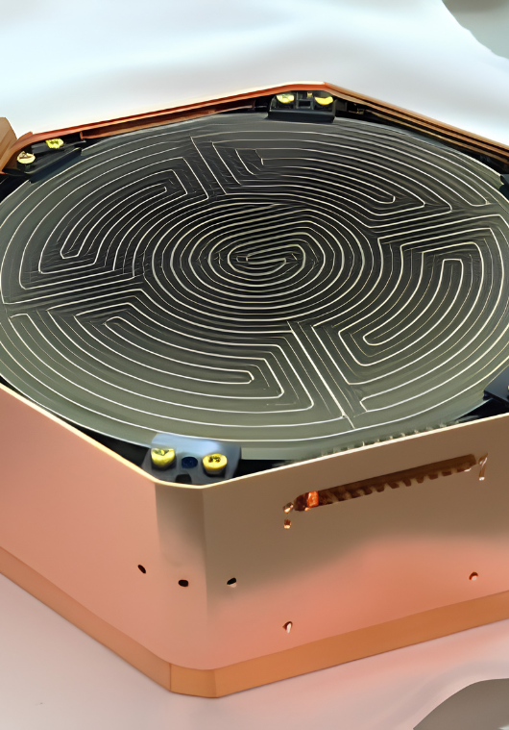
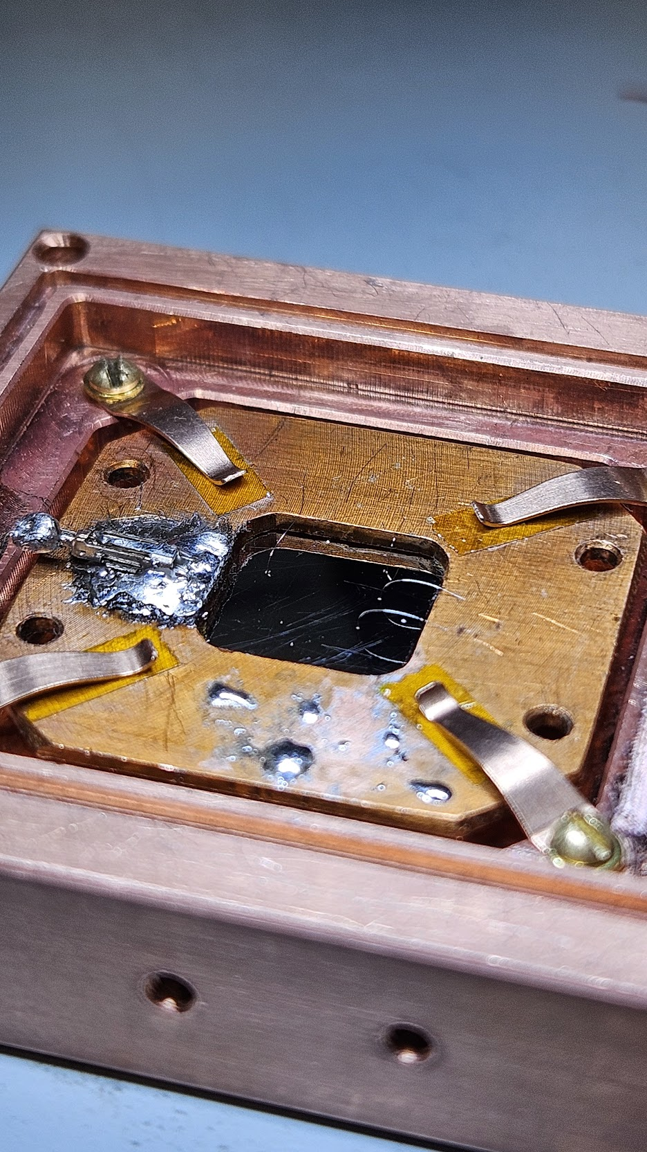
SuperCDMS and HVeV
The energy deposition of light-DM is small, in the order of eV scale.
SuperCDMS employs Ge and Si crystals at SNOLAB to measure this.
HVeV detectors: 1 gram version that has reached sub-eV resolution.
10cm
1cm
3/17

Slide 4
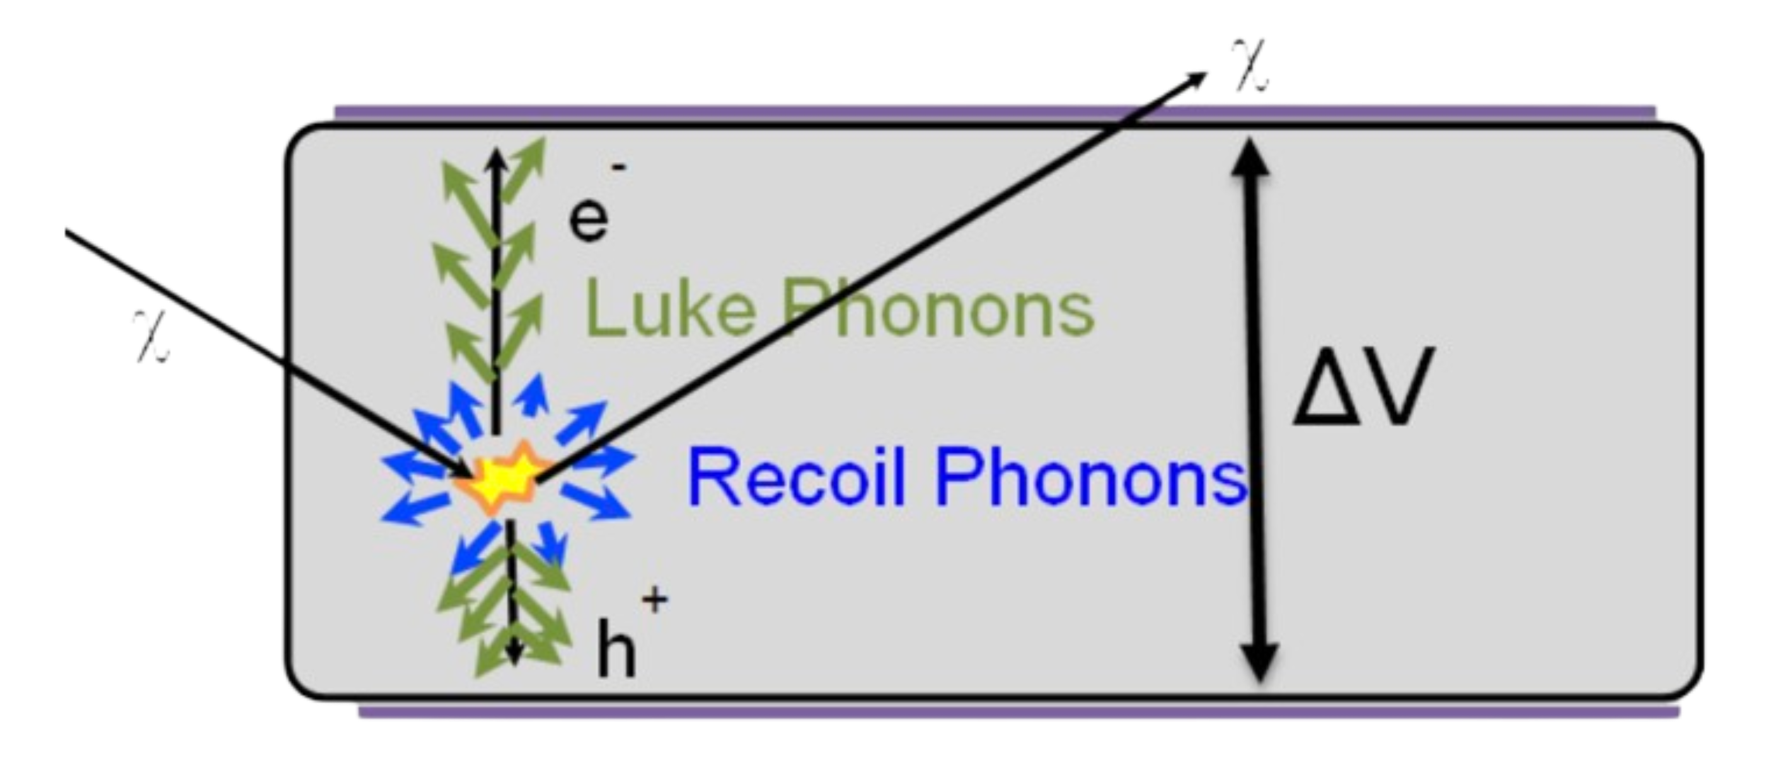



HV Detector Technology
Particles scatter in crystal and deposit energy $E_{recoil}$ as recoil phonons and $n_{eh}$ electron-hole pairs
Bias voltage $V_{bias}$ drifts the electrons and holes to opposite faces of the detector
NTL effect: as one charge crosses $V_{bias}$, it gains $eV_{bias}$ of energy, adding $eV_{bias}$ of Luke phonons
Total phonon (heat) energy is then:
$$E_{phonon}=E_{recoil}+n_{eh}eV_{bias}$$
$$χ$$
$$χ$$
bias
4/19

Slide 5

HV Detector Technology
$$∆V_{bias}$$
= Nucleus
= Particle
4/17

Slide 6
HV Detector Technology
$$∆V_{bias}$$
= Nucleus
= Particle
4/17

Slide 7


HV Detector Technology
$$∆V_{bias}$$
= Nucleus
= Particle
= $h^{+}$
= $e^{−}$
= Recoil phonons
4/17

Slide 8
HV Detector Technology
$$∆V_{bias}$$
= Nucleus
= Particle
= $h^{+}$
= $e^{−}$
= Recoil phonons
4/17

Slide 9
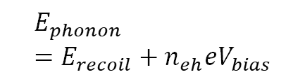
HV Detector Technology
$$E_{phonon}=E_{recoil}+n_{eh}eV_{bias}$$
$$∆V_{bias}$$
= Nucleus
= Particle
= $h^{+}$
= $e^{−}$
= Recoil phonons
= Luke phonons
4/17

Slide 10
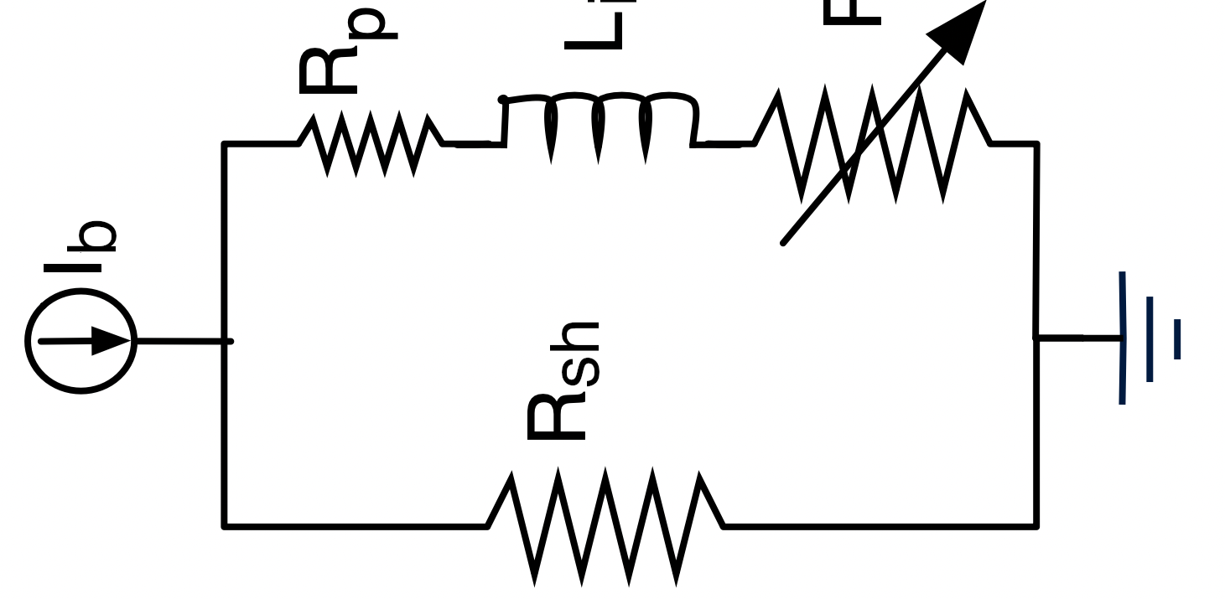
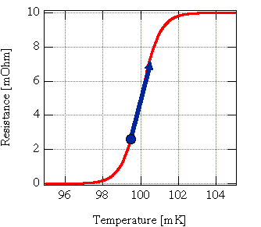
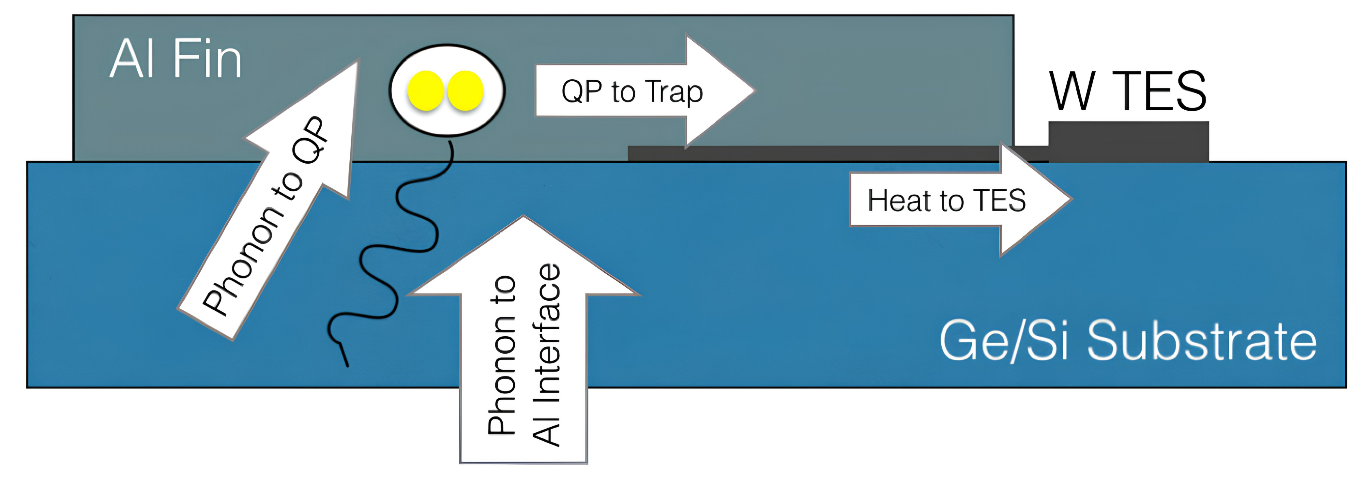
What is a Transition-Edge Sensor (TES)?
Cryogenic sensor cooled to transition
I
s
Phonons in substrate absorbed into Al
Additional energy break Cooper pairs
Quasiparticles converted to heat in TES:
Rₚ
Lᵢ
TES
I
Rₛₕ
b
I
sh
Sensitive
resistance measurement
Resistance read out by SQUID
5/17
Notes:
Phonon – quasiparticle of quantized vibrational energy

Slide 11
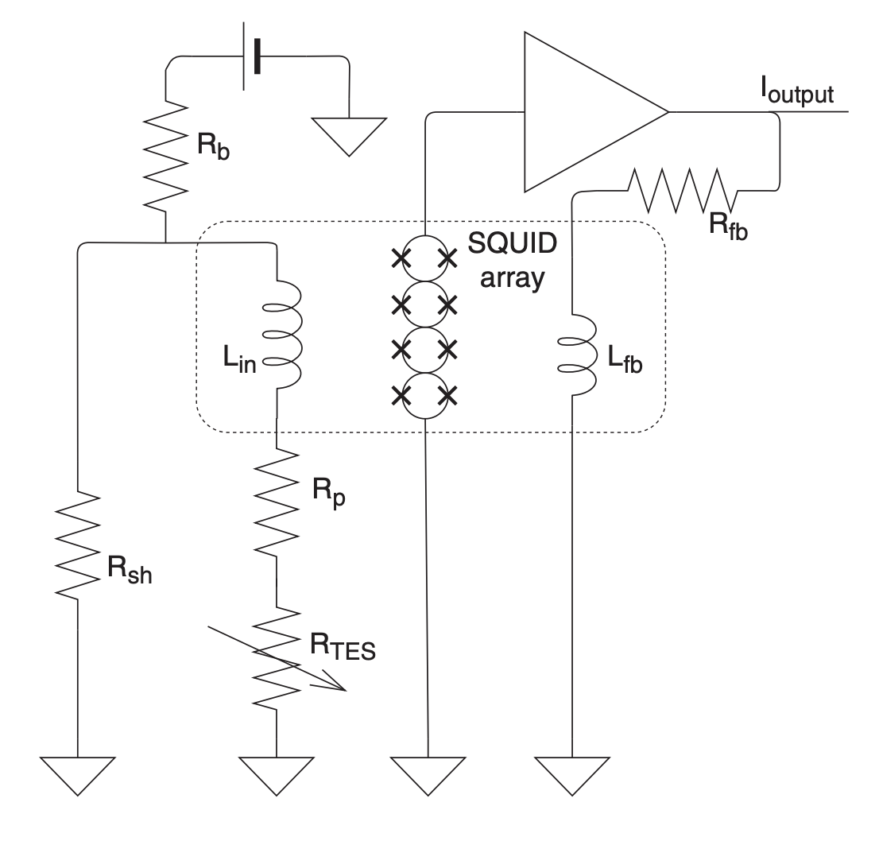
What is a Transition-Edge Sensor (TES)?
Cryogenic sensor cooled to transition
Phonons in substrate absorbed into Al
Additional energy break Cooper pairs
Quasiparticles converted to heat in TES:
Sensitive
resistance measurement
Resistance read out by SQUID
5/17
Notes:
Phonon – quasiparticle of quantized vibrational energy

Slide 12
02
Overview of Noise Modelling Methods
6/17

Slide 13

General Procedures
IV curve
sweep
Superconducting
noise, PJN
Normal noise,
SQUID
Complex
admittance
Rₚ, Rₙ @ 40% transition
Inductance, L
DC, f , n
$τ_{a,}$ $τ_{b,} β$, LG, K
sq
sq
Interpreting Parameters
Use extracted parameters in the context of potential thermal models to calculate expected noise
7/17

Slide 14

General Procedures
I
s
IV curve
sweep
Normal noise,
SQUID
Complex
admittance
Superconducting
noise, PJN
Rₚ
Lᵢ
TES
Rₚ, Rₙ @ 40% transition
Inductance, L
DC, f , n
$τ_{a,}$ $τ_{b,} β$, LG, K
sq
sq
Rₛₕ
I
I
b
sh
Interpreting Parameters
Use extracted parameters in the context of potential thermal models to calculate expected noise
7/17

Slide 15

General Procedures
IV curve
sweep
Superconducting
noise, PJN
Normal noise,
SQUID
Complex
admittance
Rₚ, Rₙ @ 40% transition
Inductance, L
DC, f , n
$τ_{a,}$ $τ_{b,} β$, LG, K
sq
sq
Interpreting Parameters
Use extracted parameters in the context of potential thermal models to calculate expected noise
7/17

Slide 16
General Procedures
IV curve
sweep
Superconducting
noise, PJN
Normal noise,
SQUID
Complex
admittance
Rₚ, Rₙ @ 40% transition
Inductance, L
DC, f , n
$τ_{a,}$ $τ_{b,} β$, LG, K
sq
sq
Interpreting Parameters
Use extracted parameters in the context of potential thermal models to calculate expected noise
7/17

Slide 17
General Procedures
IV curve
sweep
Superconducting
noise, PJN
Normal noise,
SQUID
Complex
admittance
Rₚ, Rₙ @ 40% transition
Inductance, L
DC, f , n
$τ_{a,}$ $τ_{b,} β$, LG, K
sq
sq
Interpreting Parameters
Use extracted parameters in the context of potential thermal models for
our setup to calculate expected noise
7/17
Notes:
* Change to complex admittance

Slide 18


Complex Admittance (dIdV)
Complex Admittance: Function of of $R_{TES},L$, $β,ℒ, { τ}_{a},τ_{b},k$
$$A= \frac{I}{V} \left| β=\frac{∂\log{R}}{∂\log{I}} \right| ℒ∝\frac{∂\log{R}}{∂\log{T}}$$
(frequency dependent)
Method
Apply square voltage, convert raw transition data by taking Fourier transform of raw current
8/17
Notes:
* step-bystep process of didv
Leave out dIdV, pick impedance/admittance

Slide 19
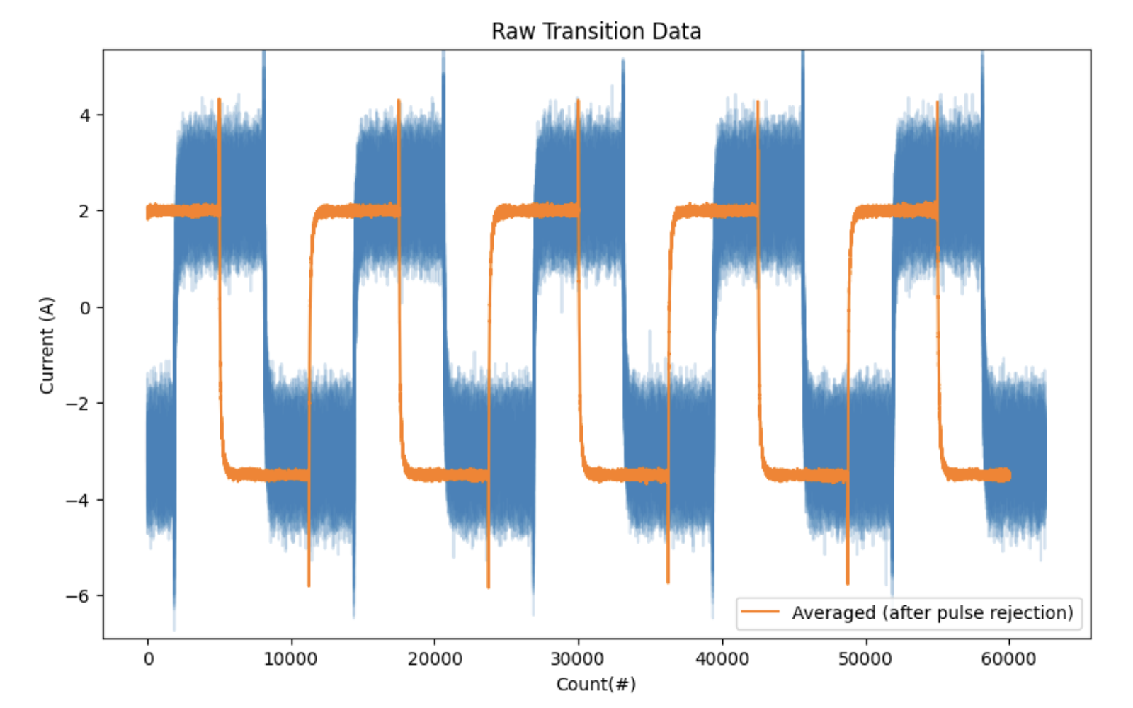
Complex Admittance (dIdV)
9/17
Notes:
* step-bystep process of didv
Leave out dIdV, pick impedance/admittance

Slide 20
Complex Admittance (dIdV)
Square wave
9/17
Notes:
* step-bystep process of didv
Leave out dIdV, pick impedance/admittance

Slide 21
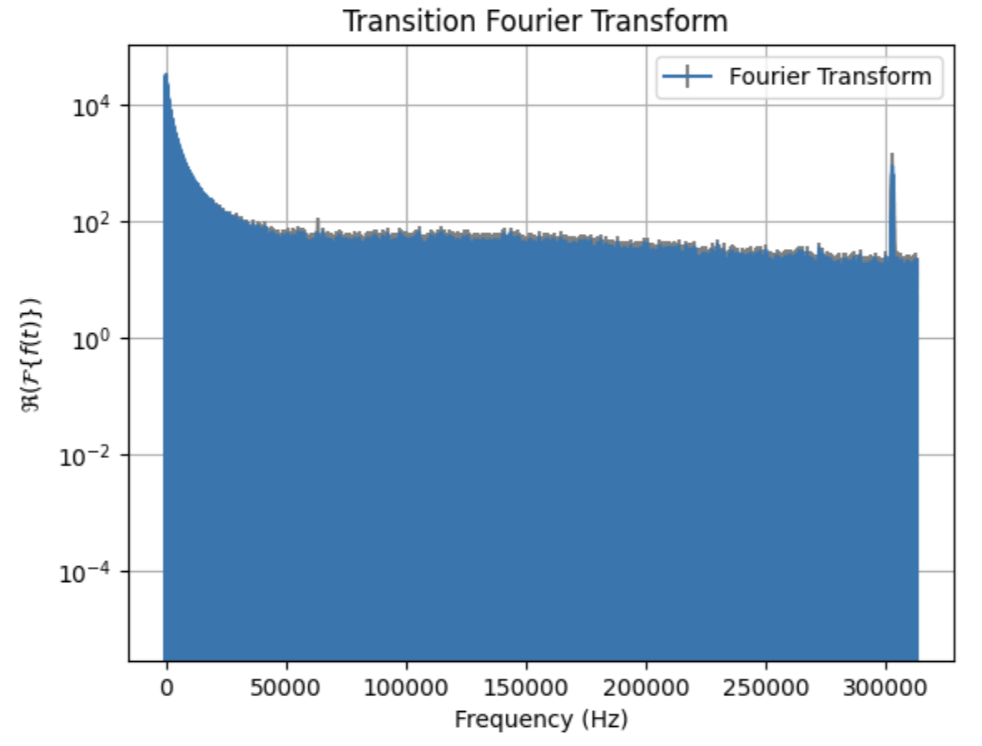
Complex Admittance (dIdV)
9/17
Notes:
* step-bystep process of didv
Leave out dIdV, pick impedance/admittance

Slide 22
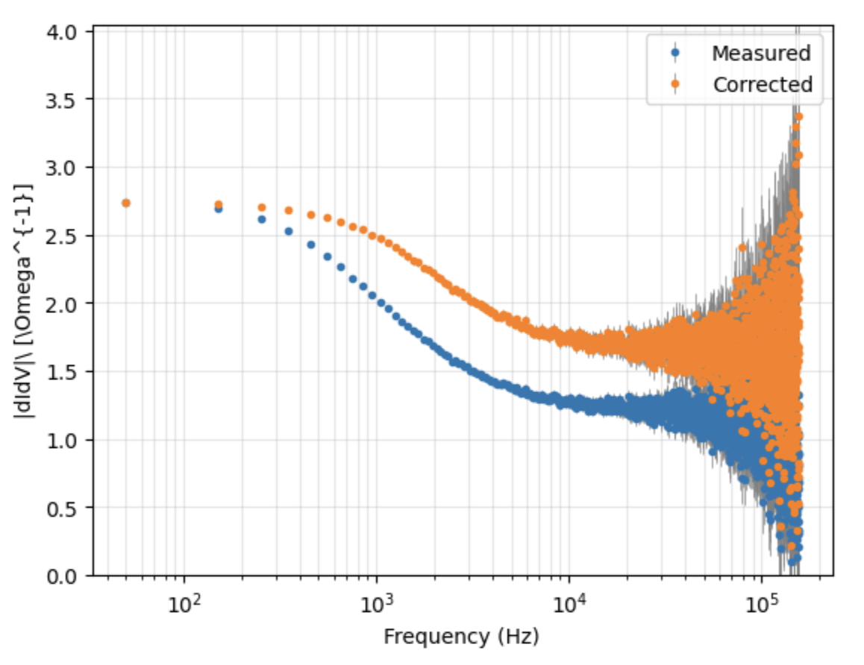
Complex Admittance (dIdV)
9/17
Notes:
* step-bystep process of didv
Leave out dIdV, pick impedance/admittance

Slide 23
Complex Admittance (dIdV)
9/17
Notes:
* step-bystep process of didv
Leave out dIdV, pick impedance/admittance

Slide 24
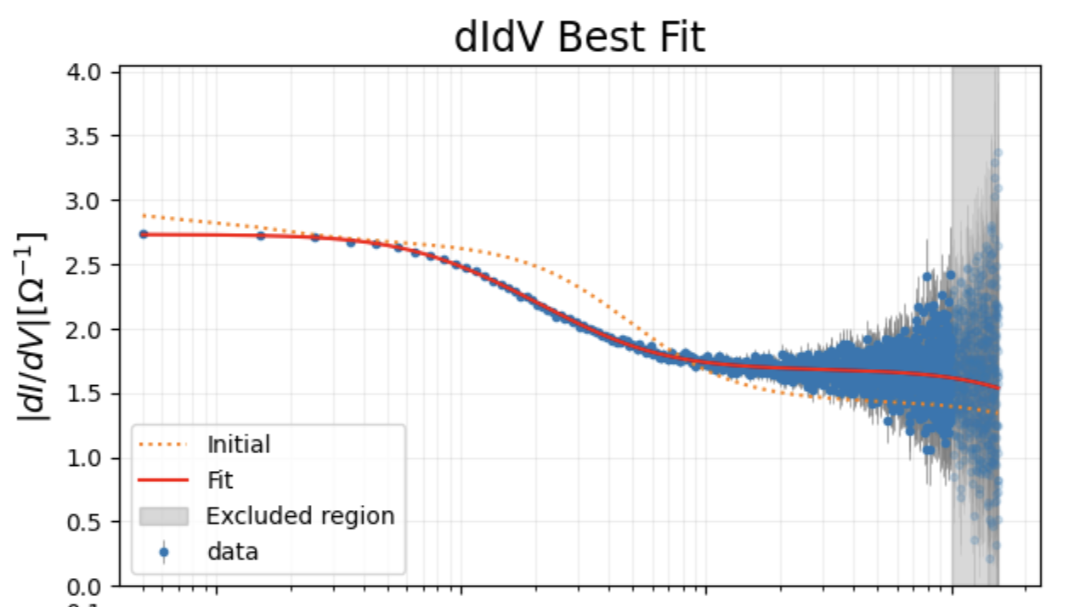
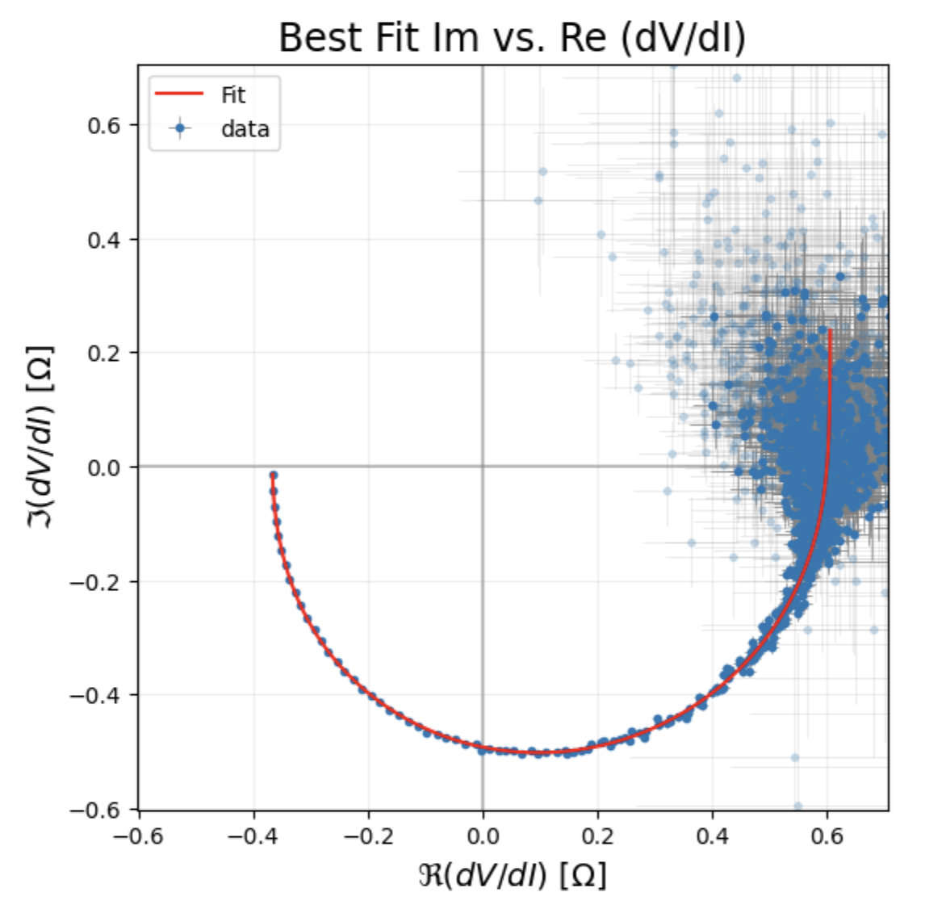
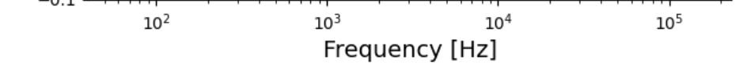





Complex Admittance
$$β: (0.03 | 1 ) ± (0.4 | 2)\%$$
$$τ_{b}= (3e−5 | 5e−4) ± (1 | 17) \% s$$
$$τ_{a}= (8e−5 | 2e−3) ± (0.7 | 5) \% s$$
$$k: (0.4 | 1) ± (0.4 | 7)\%$$
$$ℒ= (2 | 25) ± (0.7 | 5) \%$$
10/17
Notes:
units

Slide 25
Complex Admittance
$$β: (0.03 | 1 ) ± (0.4 | 2)\%$$
$$τ_{b}= (3e−5 | 5e−4) ± (1 | 17) \% s$$
$$τ_{a}= (8e−5 | 2e−3) ± (0.7 | 5) \% s$$
$$k: (0.4 | 1) ± (0.4 | 7)\%$$
$$ℒ= (2 | 25) ± (0.7 | 5) \%$$
10/17
Notes:
What does fall off region physically mean

Slide 26
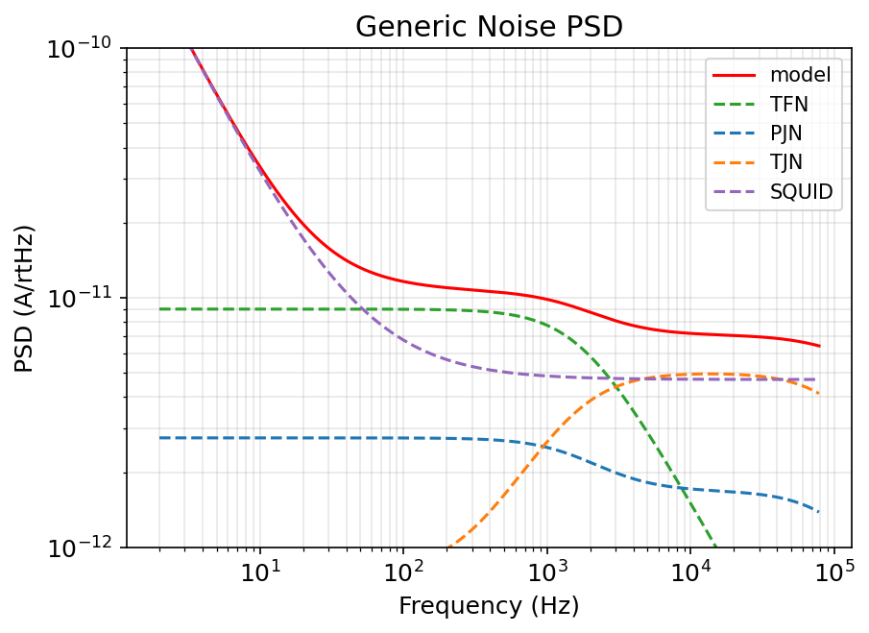


Sources of Noise
Johnson noise
SQUID noise
Thermal agitation of charge carriers in any resistor produce a fluctuating voltage.
The SQUID readout adds its own floor, roughly white with a 1/f rise at low frequency.
$$S_{PJN/TJN}=4k_{B}TR$$
Thermal fluctuation noise
Because the TES is a thermometer, random heat exchanges across thermal links look like fake power signals.
$$S_{TFN}=4k_{B}T^{2}G$$
11/17

Slide 27
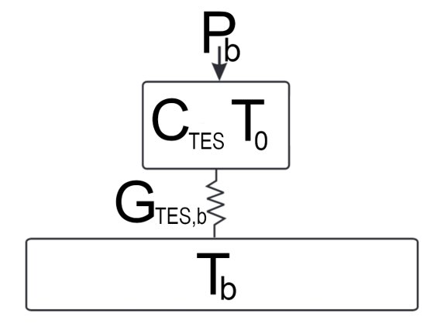
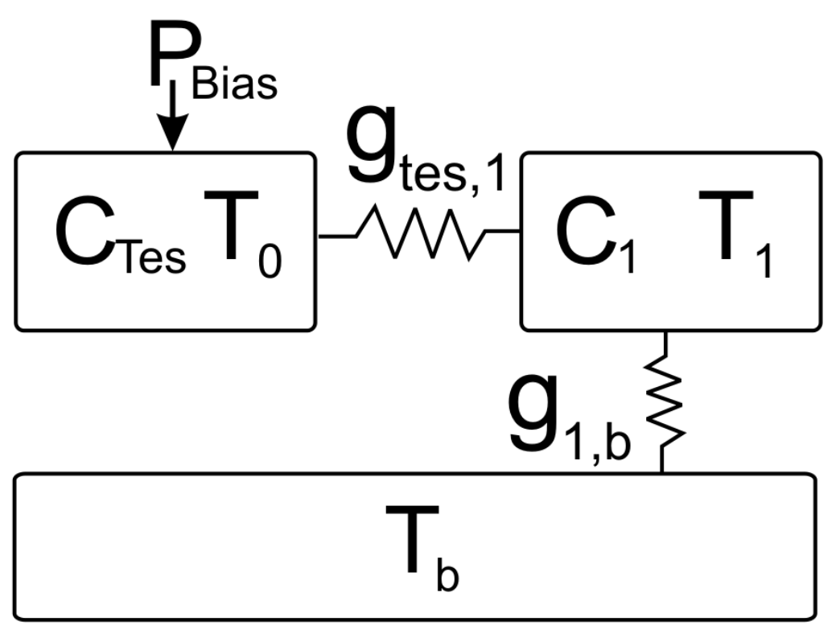
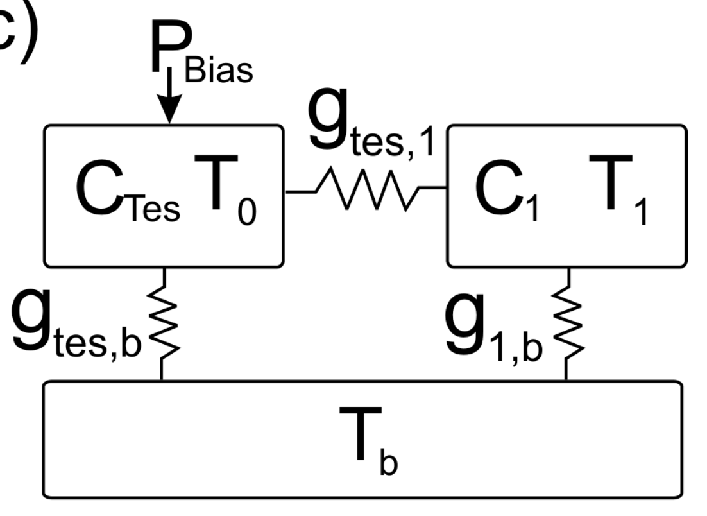







Thermal Block Models
One-block
Intermediate
Parallel
$$C_{TES}\frac{∂T_{TES}}{∂t}=P_{bias} − A\left(T_{TES}^{n}–T_{1}^{n}\right)$$
$$C_{TES}\frac{∂T_{TES}}{∂t} =P_{bias}−$$
$$A\left(T_{TES}^{n}–T_{1}^{n}\right)−D\left(T_{TES}^{z}–T_{b}^{z}\right)$$
$$C_{TES}\frac{∂T_{TES}}{∂t}=A\left(T_{TES}^{n}–T_{b}^{n}\right)$$
$$C_{1}\frac{∂T_{1}}{∂t}=A\left(T_{TES}^{n}–T_{1}^{n}\right) –B\left(T_{1}^{m}−T_{b}^{m}\right)$$
$$T_{b}=\text{copper housing}$$
$$T_{1}=\text{crystal}$$
$$T_{b}=\text{copper housing}$$
$$T_{1}=\text{W overlap / Al fins }$$
$$T_{b}=\text{c}\text{rystal}\text{ + copper}$$
12/17
Notes:
Add arrows here

Slide 28

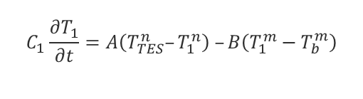

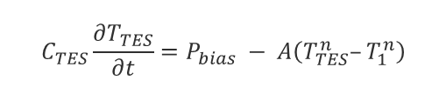

Thermal Block Models
One-block
Intermediate
Parallel
Copper Housing
copper housing
$$C_{TES}\frac{∂T_{TES}}{∂t}=P_{bias} − A\left(T_{TES}^{n}–T_{1}^{n}\right)$$
$$C_{TES}\frac{∂T_{TES}}{∂t} =P_{bias}−$$
$$A\left(T_{TES}^{n}–T_{1}^{n}\right)−D\left(T_{TES}^{z}–T_{b}^{z}\right)$$
$$C_{TES}\frac{∂T_{TES}}{∂t}=A\left(T_{TES}^{n}–T_{b}^{n}\right)$$
$$C_{1}\frac{∂T_{1}}{∂t}=A\left(T_{TES}^{n}–T_{1}^{n}\right) –B\left(T_{1}^{m}−T_{b}^{m}\right)$$
$$T_{b}=\text{copper housing}$$
$$T_{1}=\text{crystal}$$
$$T_{b}=\text{copper housing}$$
$$T_{1}=\text{W overlap / Al fins }$$
$$T_{b}=\text{c}\text{rystal}$$
12/17
Notes:
Power exponential

Slide 29




Thermal Block Models
One-block
Intermediate
Parallel
Copper Housing
crystal
copper housing
$$C_{TES}\frac{∂T_{TES}}{∂t} =P_{bias}−$$
$$A\left(T_{TES}^{n}–T_{1}^{n}\right)−D\left(T_{TES}^{z}–T_{b}^{z}\right)$$
$$C_{TES}\frac{∂T_{TES}}{∂t}=A\left(T_{TES}^{n}–T_{b}^{n}\right)$$
$$C_{TES}\frac{∂T_{TES}}{∂t}=P_{bias} − A\left(T_{TES}^{n}–T_{1}^{n}\right)$$
$$C_{1}\frac{∂T_{1}}{∂t}=A\left(T_{TES}^{n}–T_{1}^{n}\right) –B\left(T_{1}^{m}−T_{b}^{m}\right)$$
$$T_{b}=\text{copper housing}$$
$$T_{1}=\text{crystal}$$
$$T_{b}=\text{copper housing}$$
$$T_{1}=\text{W overlap / Al fins }$$
$$T_{b}=\text{c}\text{rystal}$$
12/17
Notes:
Add labels here

Slide 30

Thermal Block Models
One-block
Intermediate
Parallel
Copper Housing
W/Al
crystal/copper
$$C_{TES}\frac{∂T_{TES}}{∂t}=P_{bias} − A\left(T_{TES}^{n}–T_{1}^{n}\right)$$
$$C_{TES}\frac{∂T_{TES}}{∂t} =P_{bias}−$$
$$A\left(T_{TES}^{n}–T_{1}^{n}\right)−D\left(T_{TES}^{z}–T_{b}^{z}\right)$$
$$C_{TES}\frac{∂T_{TES}}{∂t}=A\left(T_{TES}^{n}–T_{b}^{n}\right)$$
$$C_{1}\frac{∂T_{1}}{∂t}=A\left(T_{TES}^{n}–T_{1}^{n}\right) –B\left(T_{1}^{m}−T_{b}^{m}\right)$$
$$T_{b}=\text{copper housing}$$
$$T_{1}=\text{crystal}$$
$$T_{b}=\text{copper housing}$$
$$T_{1}=\text{W overlap / Al fins }$$
$$T_{b}=\text{c}\text{rystal}\text{ + copper}$$
12/17

Slide 31
03
Results
13/17

Slide 32
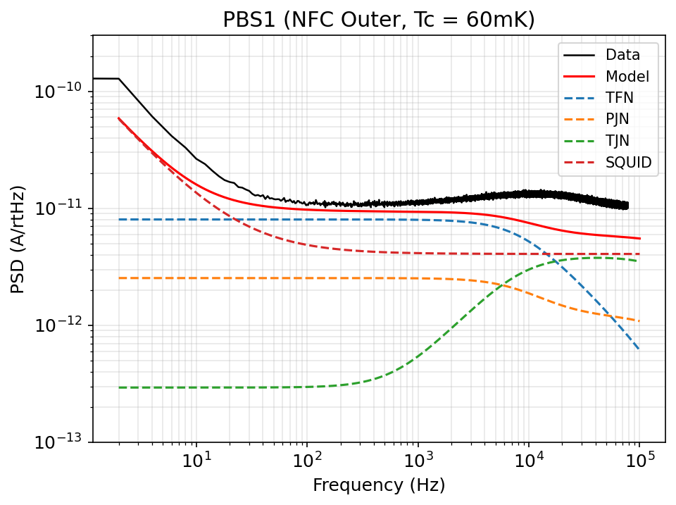
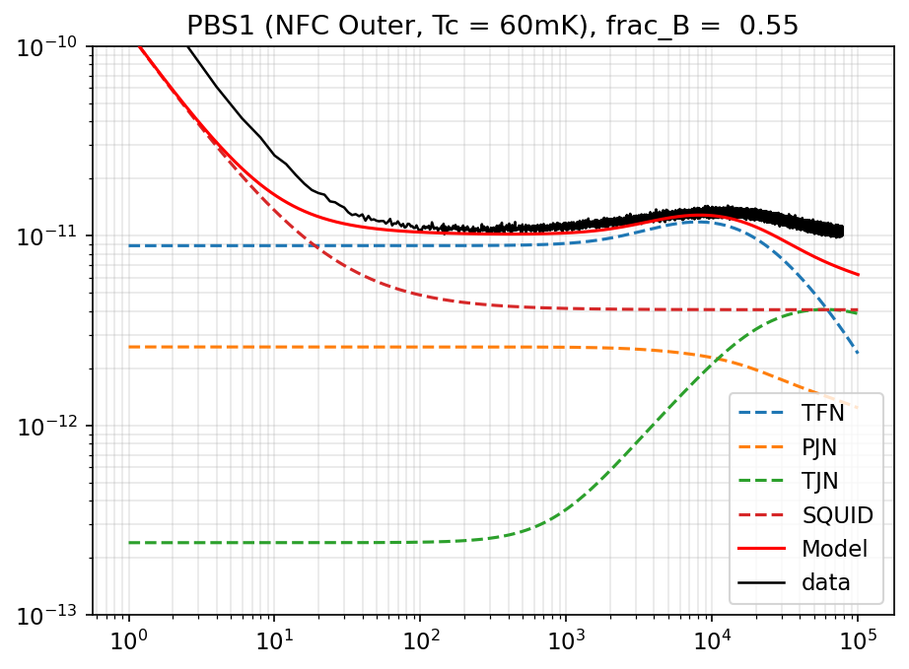
Results – High Tc
One-block
Parallel
14/17

Slide 33
Results – High Tc
One-block
Parallel
14/17

Slide 34
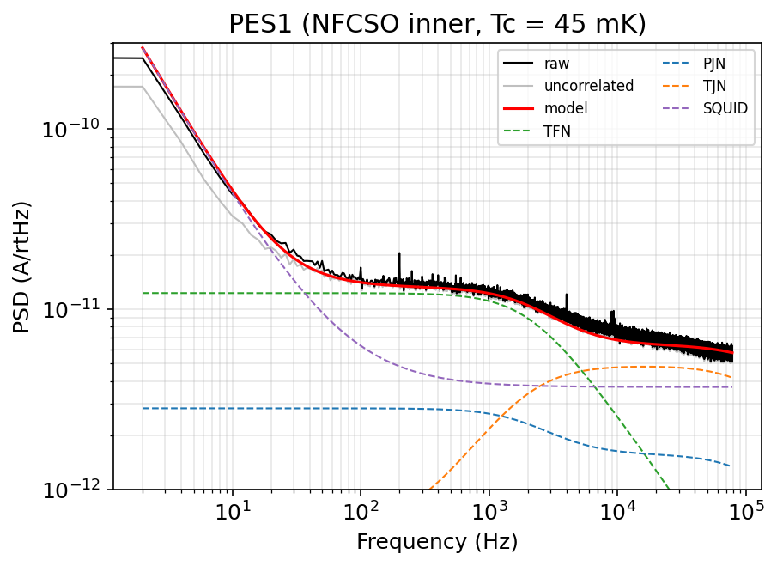
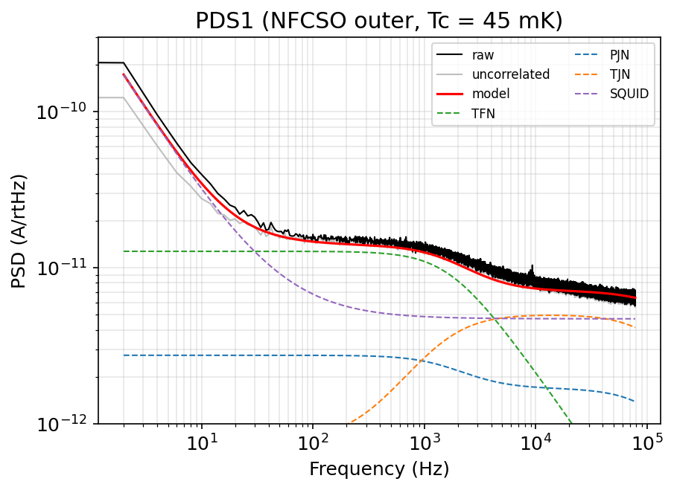
Results – Mid Tc
One-block Inner
One-block Outer
15/17

Slide 35
Results – Mid Tc
One-block Inner
One-block Outer
15/17

Slide 36
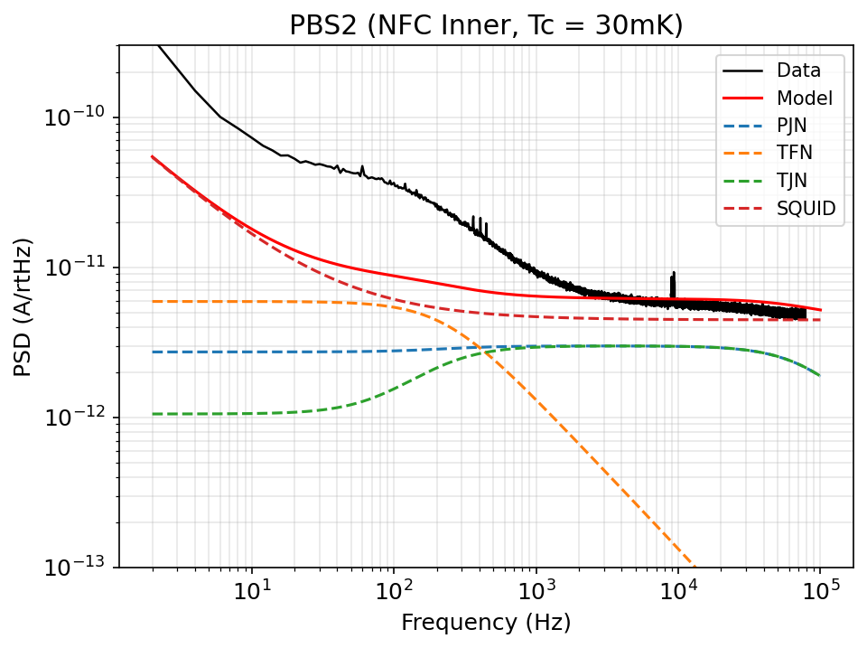
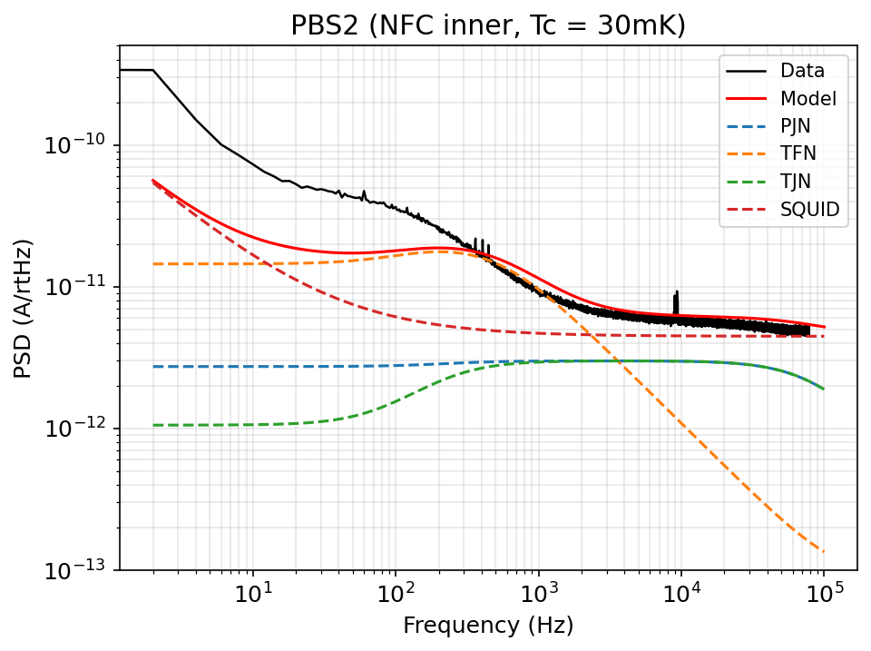
Results – Low Tc
One-block
Intermediate
16/17
Notes:
Talk about summary
Resolutions (0.5ev low tc)

Slide 37
Conclusion
Project-Specific
Expected vs. actual noise different
Looking Forward: Detector optimization
High/mid Tc: TFN
Improvements
  Understanding low Tc noise model
  Discrepancies
Low Tc: SQUID
17/17

Slide 38
Conclusion
Baseline resolution:
  High Tc = 86 meV
  Mid Tc = 130 meV
  Low Tc = 146 meV
In practice, the resolution is higher → phonon collection efficiency
High/Mid Tc noise floor dominated by TFN
Low Tc noise floor dominated by SQUID
How to improve/make better detectors
16/19

Slide 39



Acknowledgements
Principal Investigators:
Prof. Ziqing Hong, UofT
Prof. Miriam Diamond, UofT
Postdoctoral Fellows:
Runze (Tom) Ren, UofT
Graduate Students:
Antoine Rehberg, UofT
Ry Pressman-Cyna, UofT
Weigeng Peng, UofT
Funding:
NSERC USRA

Slide 40
References
Clarke, J., & Braginski, A. I. (2004). The SQUID handbook. Wiley-VCH.
Kurinsky, N., Cabrera, B., Partridge, R., Graham, P., & Gratta, G. (n.d.). The low-mass limit : dark matter
  detectors with eV-scale energy resolution. Stanford Digital Repository. https://purl.stanford.edu/xh271zf3698
Maasilta, I. J. (2012, October 2). Complex impedance, responsivity and noise of transition-edge sensors: Analytical
  solutions for two- and three-block thermal models. arXiv.org. https://arxiv.org/abs/1205.5693
Pyle, M. C. (2012). (thesis). Optimizing the design and analysis of cryogenic semiconductor dark matter detectors for
  maximum sensitivity.
Simon, R. W., Burns, M. J., Colclough, M. S., Zaharchuk, G., Cantor, R., & STAR Cryoelectronics, LLC. (2012).
  Mr. SQUID User’s Guide. STAR Cryoelectronics, LLC. https://starcryo.com/wp-content/themes/education-pro/manuals/MrSQm66.pdf
Wikipedia contributors. (2026, April 29). SQUID. Wikipedia. https://en.wikipedia.org/wiki/SQUID

Slide 41
Thank you!
Questions?

Slide 42
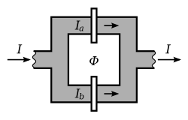



What is a SQUID?
(Superconducting QUantum Interference Device)
Josephson Junction (JJ): 2 superconductors + insulator
DC effect: supercurrent through Josephson junction
Flux quantization in superconductor
$$φ_{0}=\frac{ℏ}{2ℰ}$$
SQUIDs biased above $I_{c}$: resistive current in junction
Magnetic flux change induces screening current
Flux-Locked Loop (FLL) to prevent SQUID jumps
$I_{fb}$read out
Iₛ

Slide 43
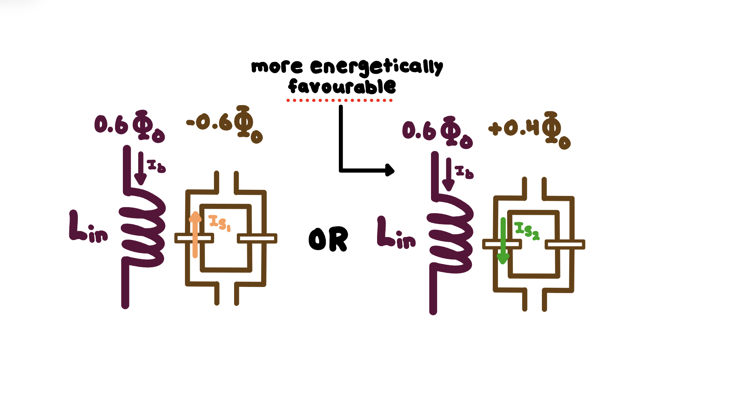
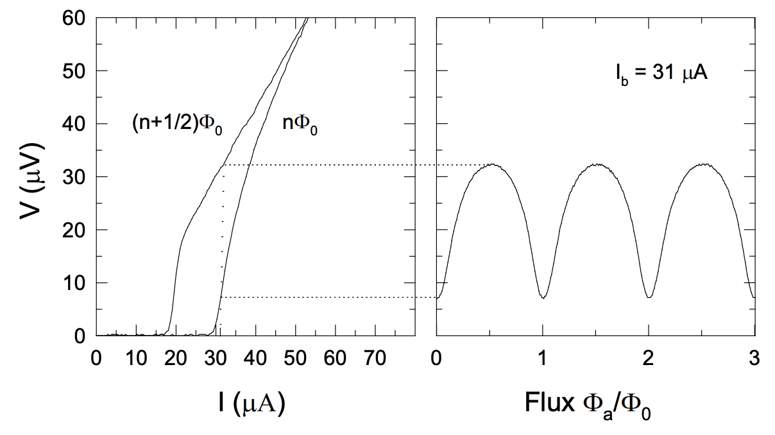
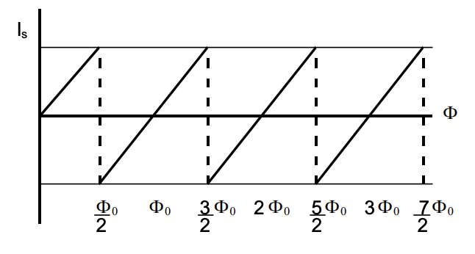

FLLs and SQUID Jumps
The amplitude of the voltage is affected by bias current. We therefore bias the SQUIDs to maximize $\frac{∂V}{∂φ}$, and we use the flux-locked loop (FLL) to stay at that operating point of peak sensitivity. We also produce some background magnetic flux of magnitude $\frac{\left(2n+1\right)φ}{4},n∈\left(ℤ\right).$
SQUID JUMPS

