Slide 1
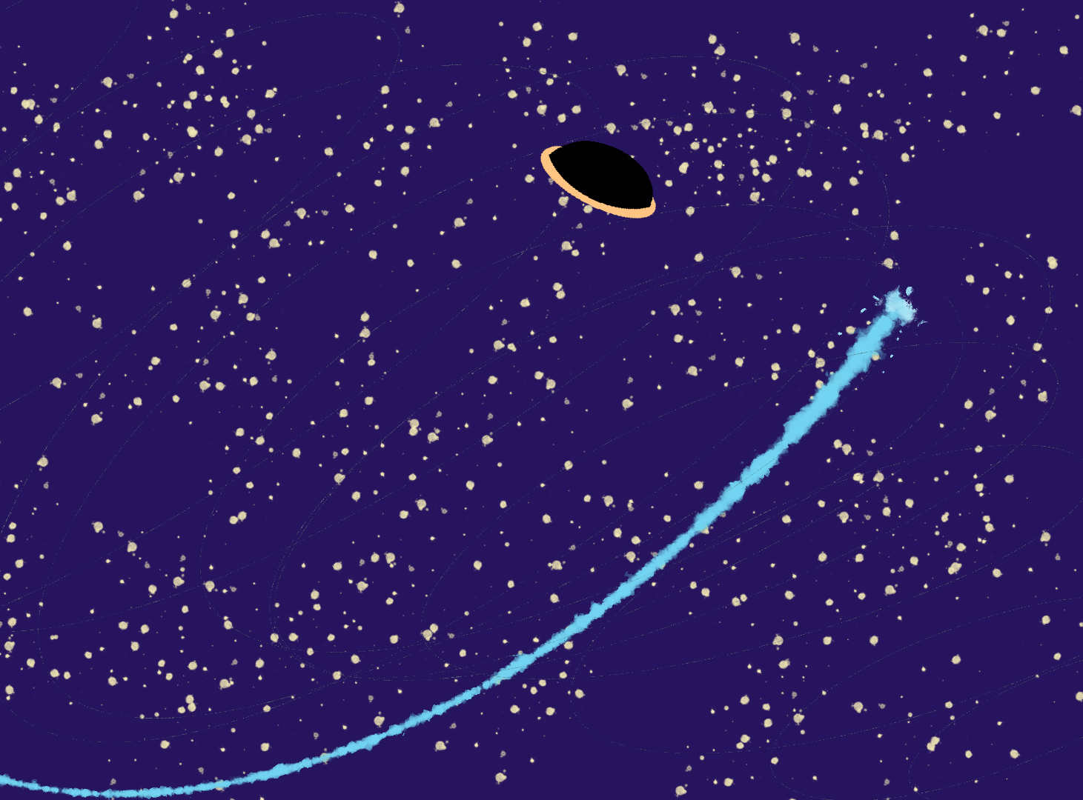

How to escape things in space and the things you can’t
An SPH4U Resource
Sebastian Blaha

Slide 2

A Little Bit About Me:
I’m going into my 4th
year at Queen’s
I’m very interested in Astrophysics and Astroparticle physics
I’m very passionate about teaching
This summer, I made a teacher resource about BH and aerospace

Slide 3
What is a Teacher Resource?

Slide 4
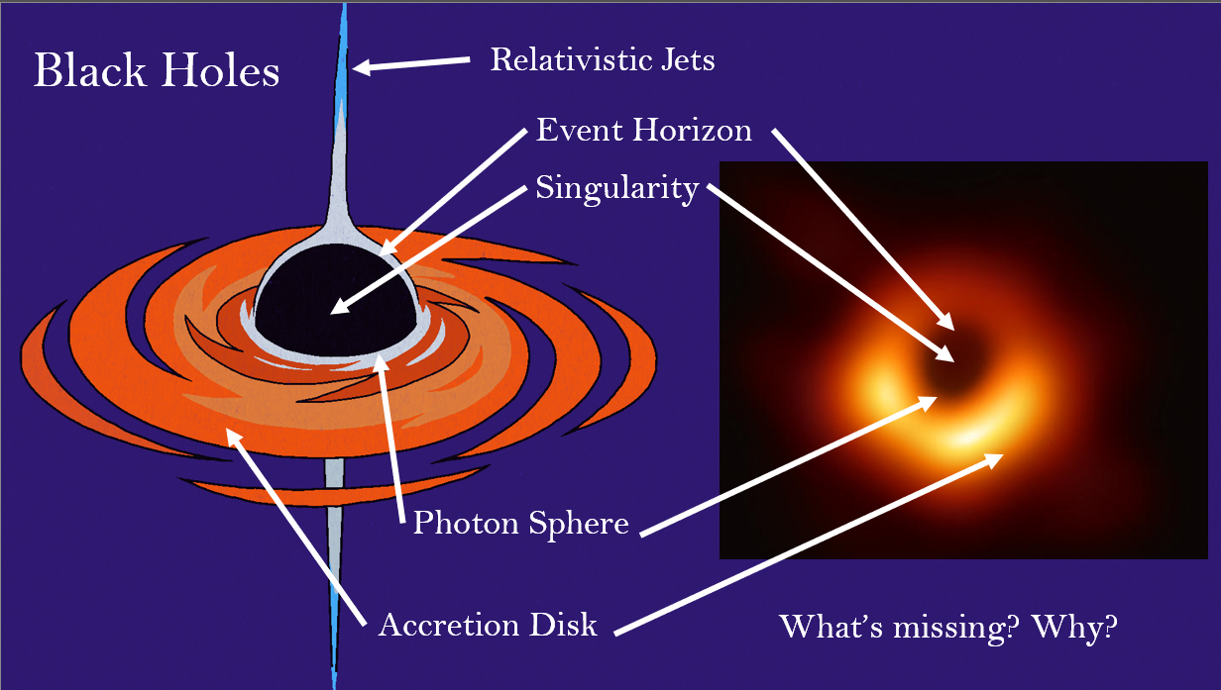
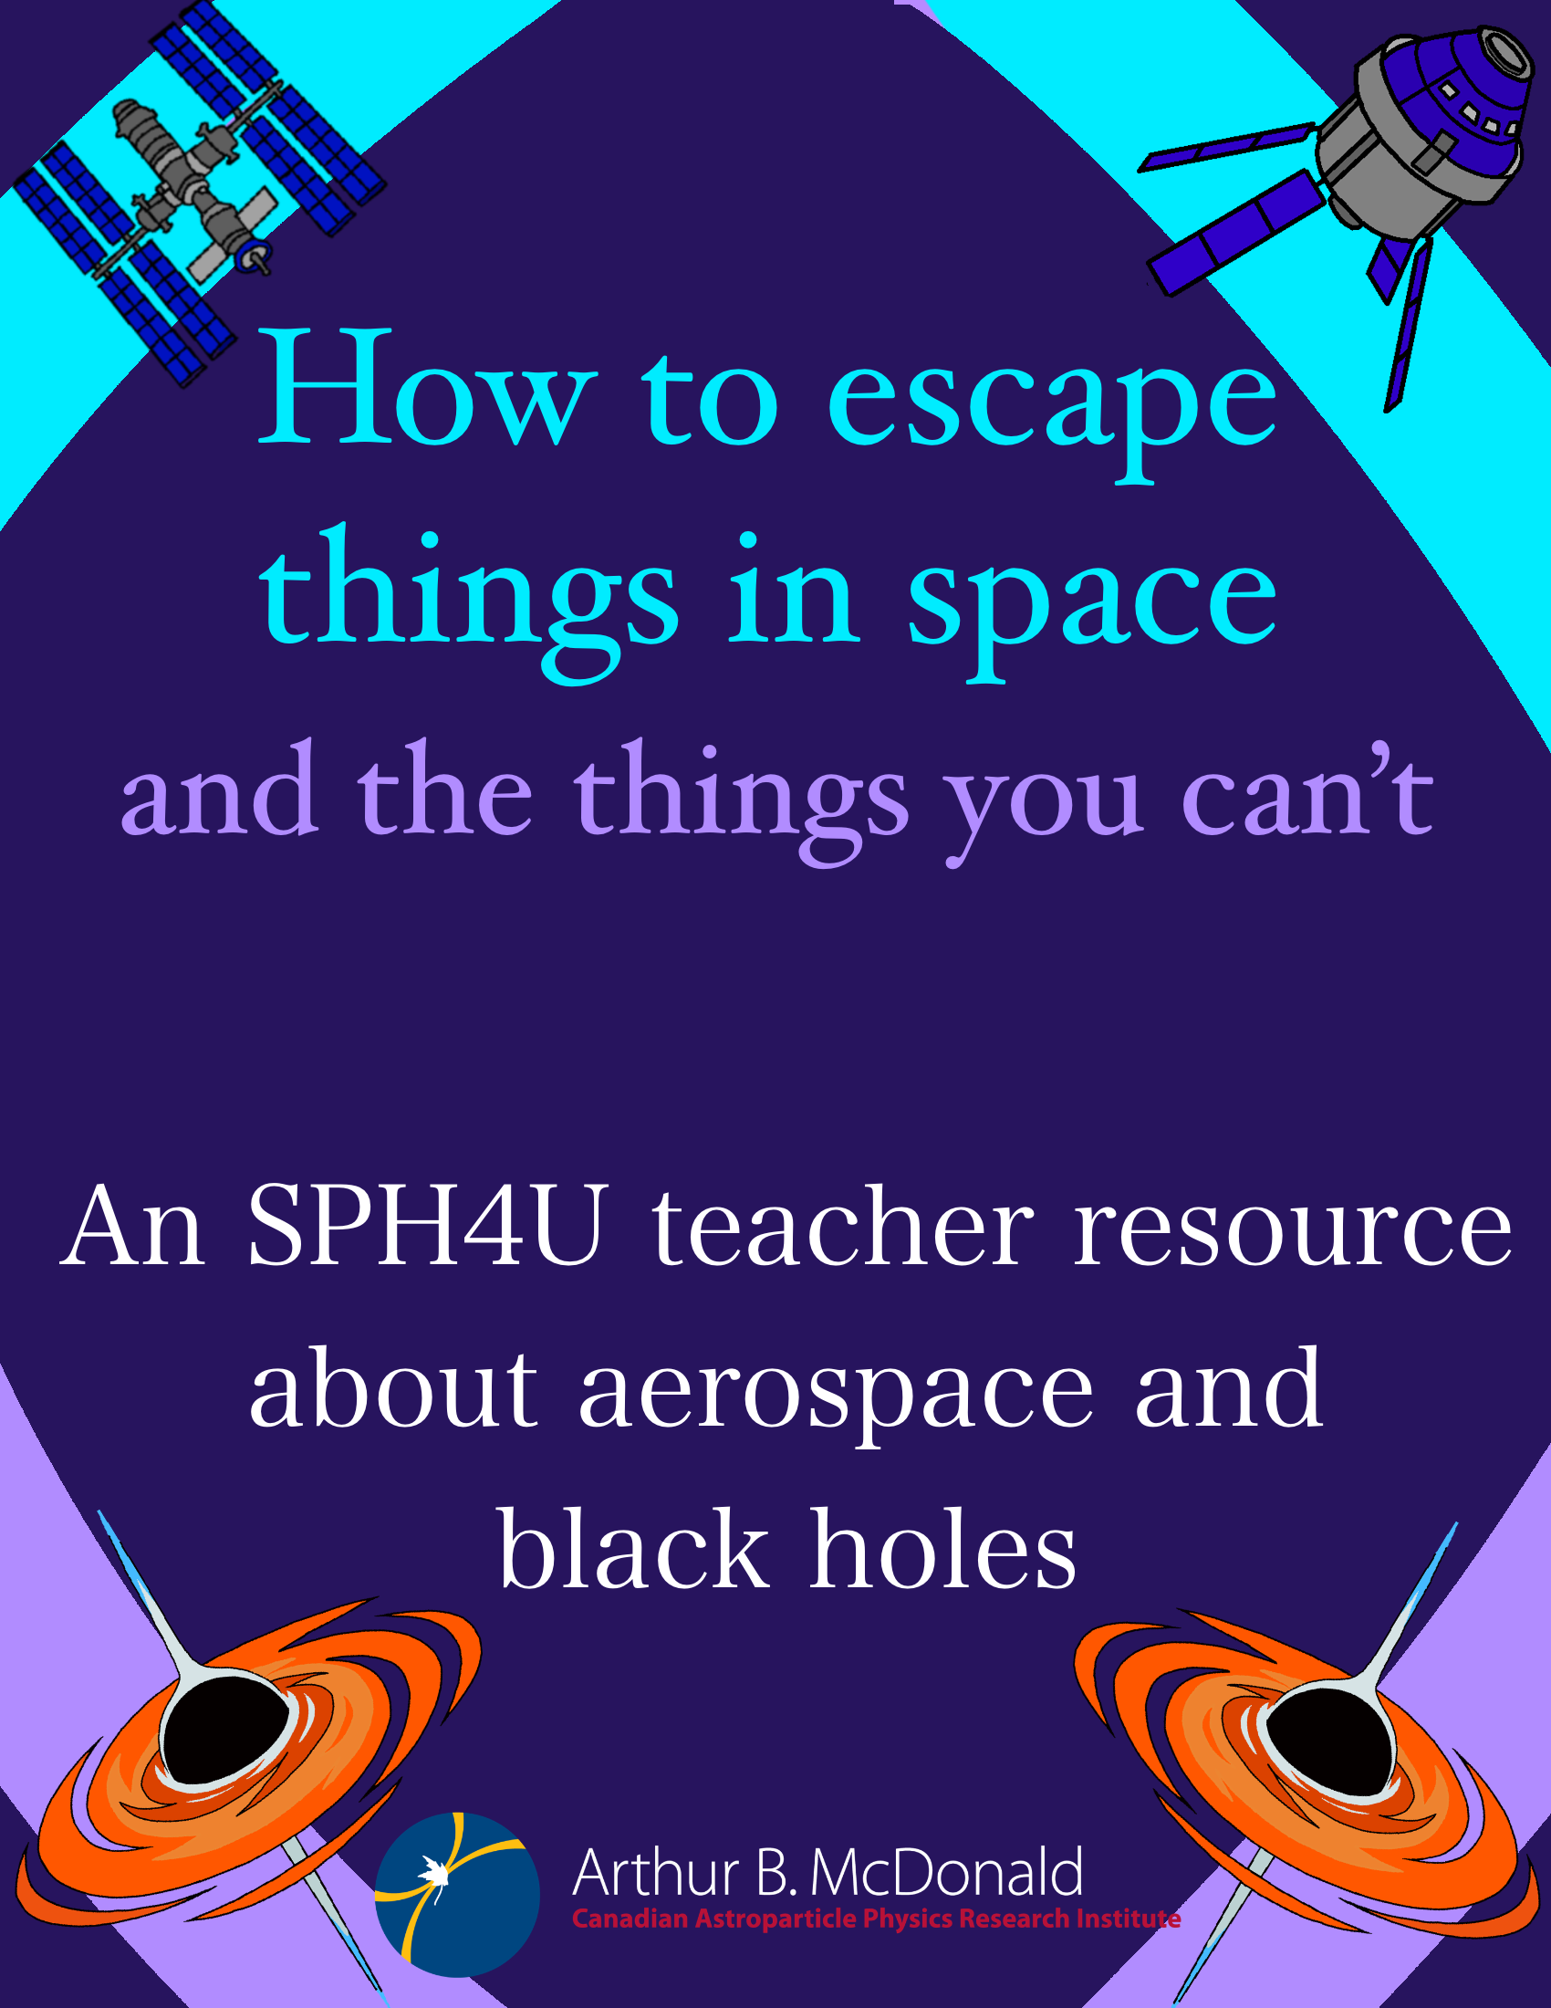
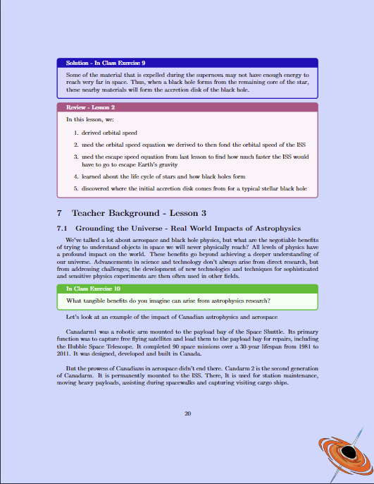
What is a Teacher Resource?
A collection of documents made for a teacher to guide a lesson(s) to their students.
It may include a teacher background, slides, activities, experiments, etc…

Slide 5
Why create a resource?
physics is cool
personal story about going to uni for chem
get students inspired to pursue the field and make the next great discoveries
talk more philosophy rather than the content
Why Create a Resource?

Slide 6
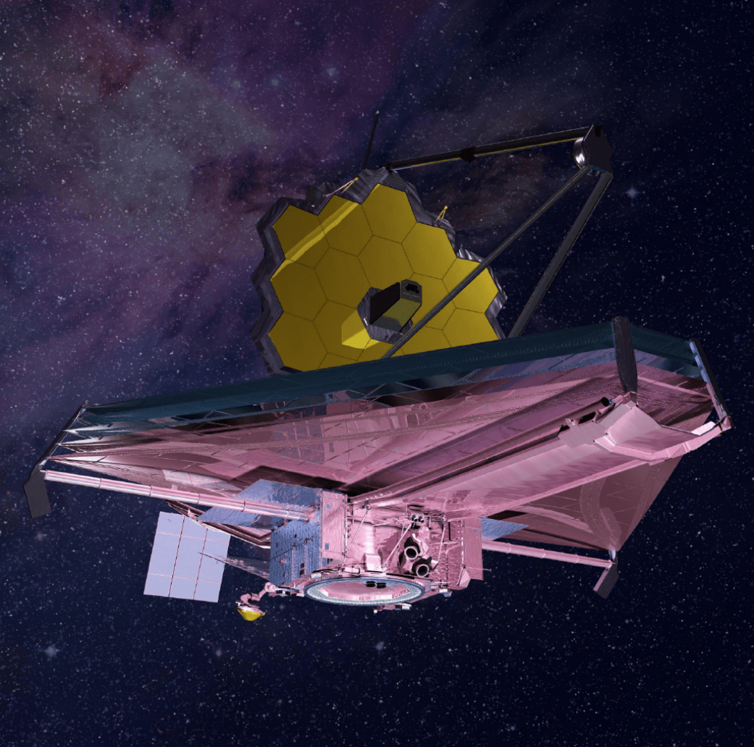
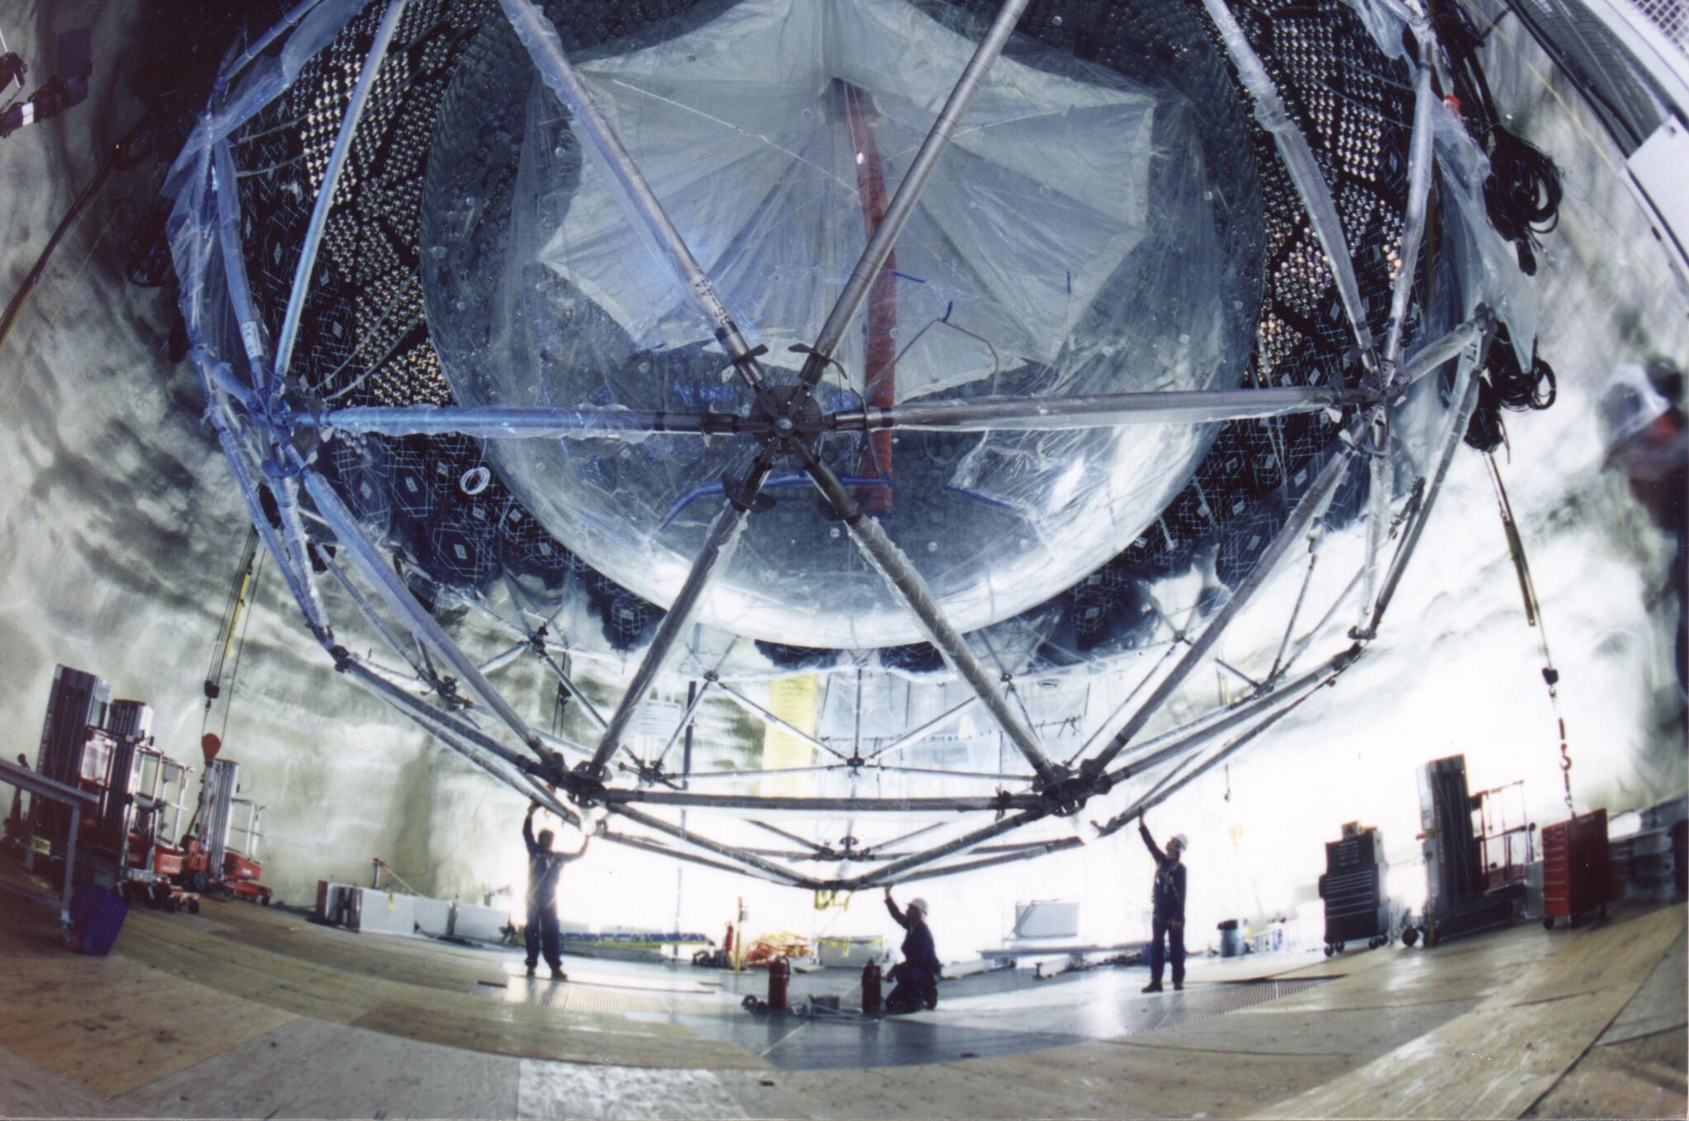
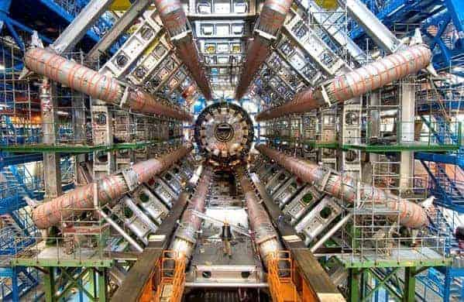
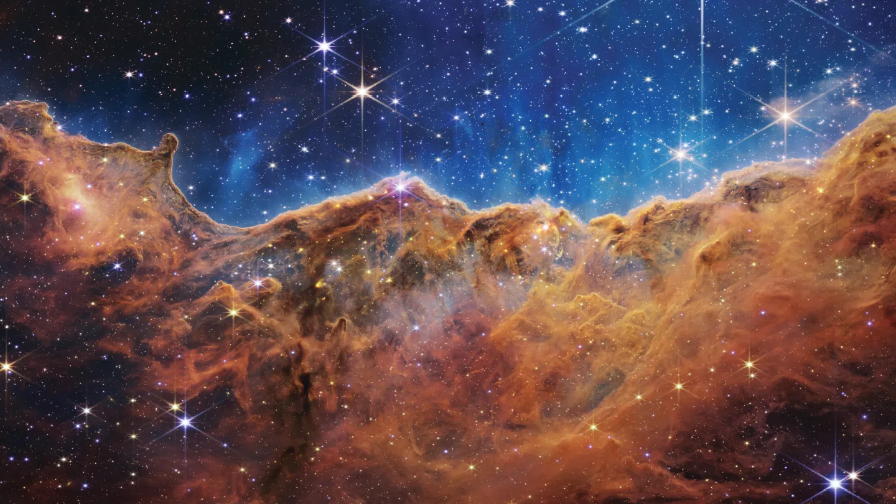
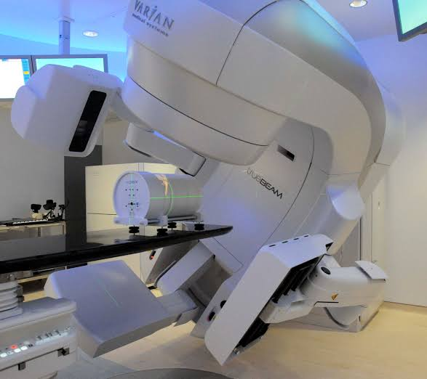
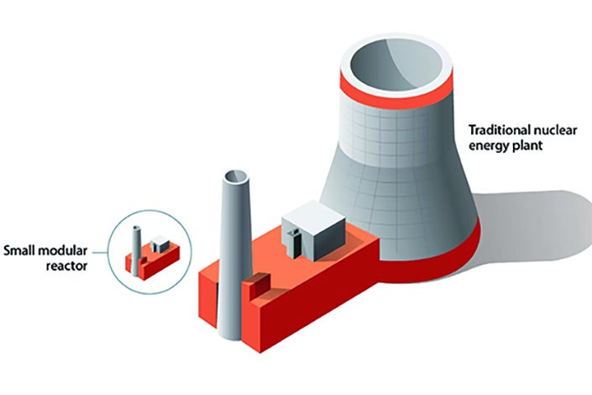
Why create a resource?
physics is cool
personal story about going to uni for chem
get students inspired to pursue the field and make the next great discoveries
talk more philosophy rather than the content
Why Create a Resource?
Physics is Cool!

Slide 7
Why create a resource?
We want to inspire students to pursue physics and make tomorrow’s great discoveries.
While also showing them that they can.

Slide 8
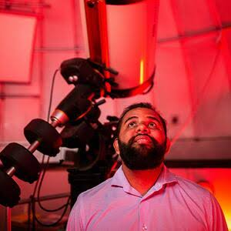
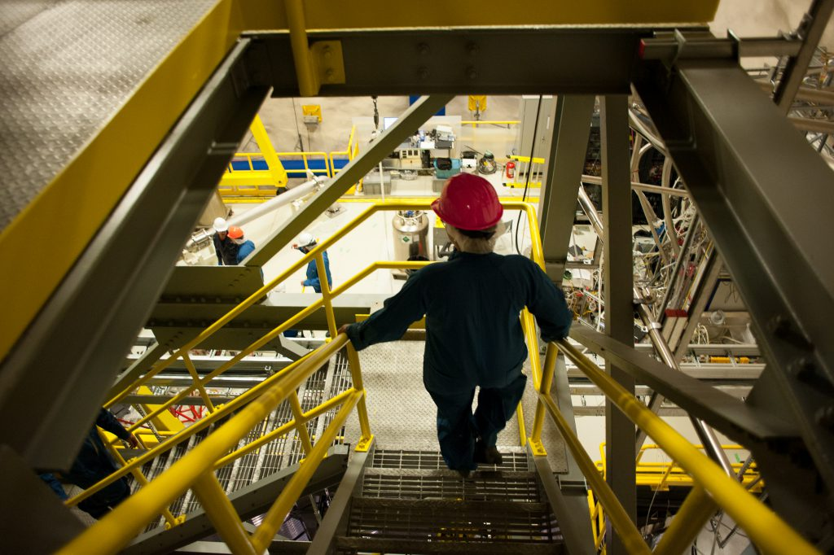
Why create a resource?
We are uniquely advantaged in being surrounded by so much physics and so many physicists.
Gives us a chance to bring our expertise into a classroom that the teacher may not have.

Slide 9
Why create a resource?
physics is cool
personal story about going to uni for chem
get students inspired to pursue the field and make the next great discoveries
talk more philosophy rather than the content
What Do You Make a Resource About?

Slide 10
Question:
What is a physics question you often get from people not in physics?

Slide 11

Personally, I often find myself getting asked “what is a black hole?”
This is a very loaded question.
However, grade 12 physics students already have the tools to start picking at it.

Slide 12
I wanted to make a resource that:

Slide 13
I wanted to make a resource that:
Would inspire students to pursue physics

Slide 14
I wanted to make a resource that:
Would inspire students to pursue physics
Uses physics students already know

Slide 15
I wanted to make a resource that:
Would inspire students to pursue physics
Uses physics students already know
Shows the impacts of physics research, emphasizing Canadian research

Slide 16
This brought about a challenge:
How can I tie in physics about objects that are thousands of LY away, to real world impacts felt by students.

Slide 17
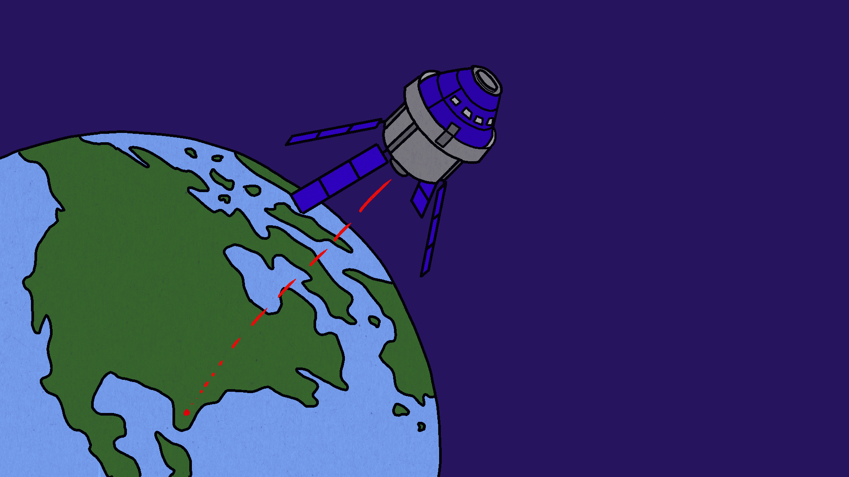
Artemis 2

Slide 18
Artemis 2
Why Artemis 2?
Recent
It involved Canadians
Big event

Slide 19
Artemis 2
How does Artemis 2 tie into black holes?

Slide 20

Artemis 2
How does Artemis 2 tie into black holes?
Escape speed.
$$v=\sqrt{\frac{2GM}{R}}$$

Slide 21

Artemis 2
How does Artemis 2 tie into black holes?
Escape speed.
$$v=\sqrt{\frac{2GM}{R}}$$
Is it possible to have something so dense nothing can escape?

Slide 22
Black Holes

Slide 23
Black Holes
Students:
Learn about black hole structure
Derive the Swarzschild radius to find the size of the Earth if it was a BH
Learn about the life cycle of a star

Slide 24
Black Holes
Challenge #2:
How can I ground these ideas in tangible benefits?

Slide 25
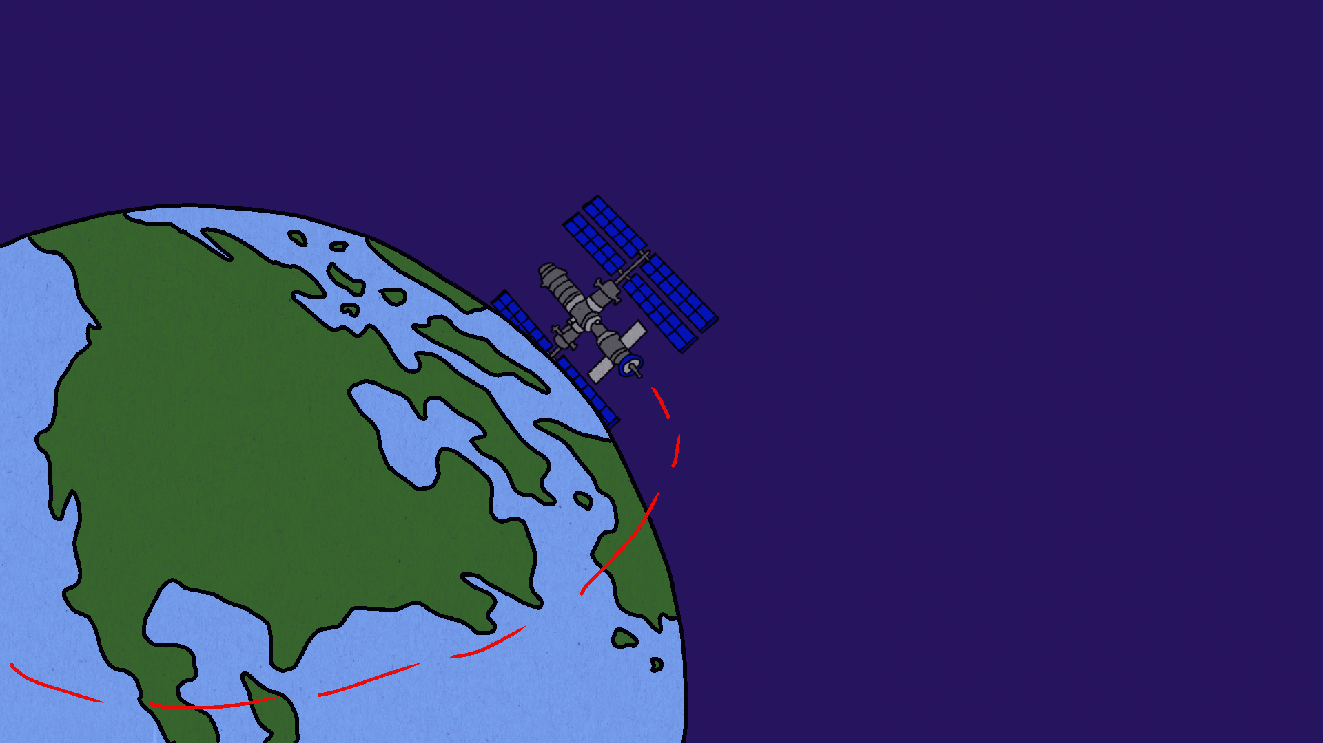
Applications
Students learn about:
The advancements in Canadian medical physics thanks to the Canadarm projects.
Early earthquake warning technology developed thanks to the LIGO experiment
SNEWS

Slide 26
Black Holes
What makes black holes so important?
Everyone from children to career physicists are fascinated by black holes.
To many it appears to be the pinnacle of physics.
If students can learn about BH, they can learn about anything.

Slide 27
Conclusion
Making a resource is important for the future generations of physicists.
It allows us to bring our unique expertise to schools and inspire students.
They will also expand the field and empower students to follow their passion.
Thank you.

Slide 28
Questions?
Questions?

