Slide 1
Toward Sensing Ultralight Dark Matter with Superfluid-Filled Optical Cavities
McHeLIOS
Alex Semeraro
Supervisors: Brigitte Vachon, Jack Sankey, Minh Au
Mcgill University

Slide 2
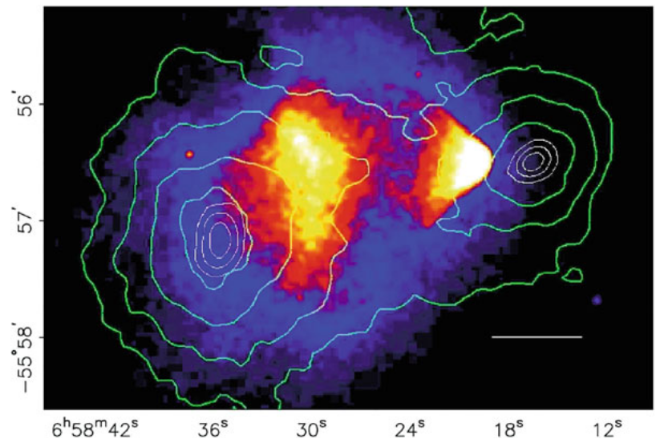
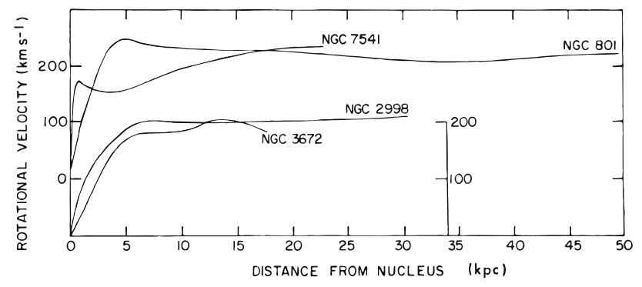
Dark matter?
Gravitational lensing
Invisible. 6 times more mass than we can account for
Supported by observational evidence through gravitational effects
Clowe, et al Astrophys. J. Lett. 648, L109 (2006)
Rotation curves of galaxies
Rubin, Ford, Thonnard, Astrophys. J. 225, L107 (1978)
Notes:
TALKING POINTS:
WHAT IS DARK MATTER? INVISIBLE FORM OF MATTER, CONSTITUTES ~27% OF UNIVERSE’S TOTAL ENERGY CONTENT
RATHER THAN REACTING WITH LIGHT, OPTICALLY, IT REACTS (OBSERVABLY) WITH MASSIVE OBJECTS GRAVITATIONALLY
SUPPORTED BY OBSERVATIONAL EVIDENCE SUCH AS GRAVITATIONAL LENSING, THE ROTATION CURVES OF GALAXIES, AND TEMPERATURE ANISOTROPIES IN THE COSMIC MICROWAVE BACKGROUND

Slide 3
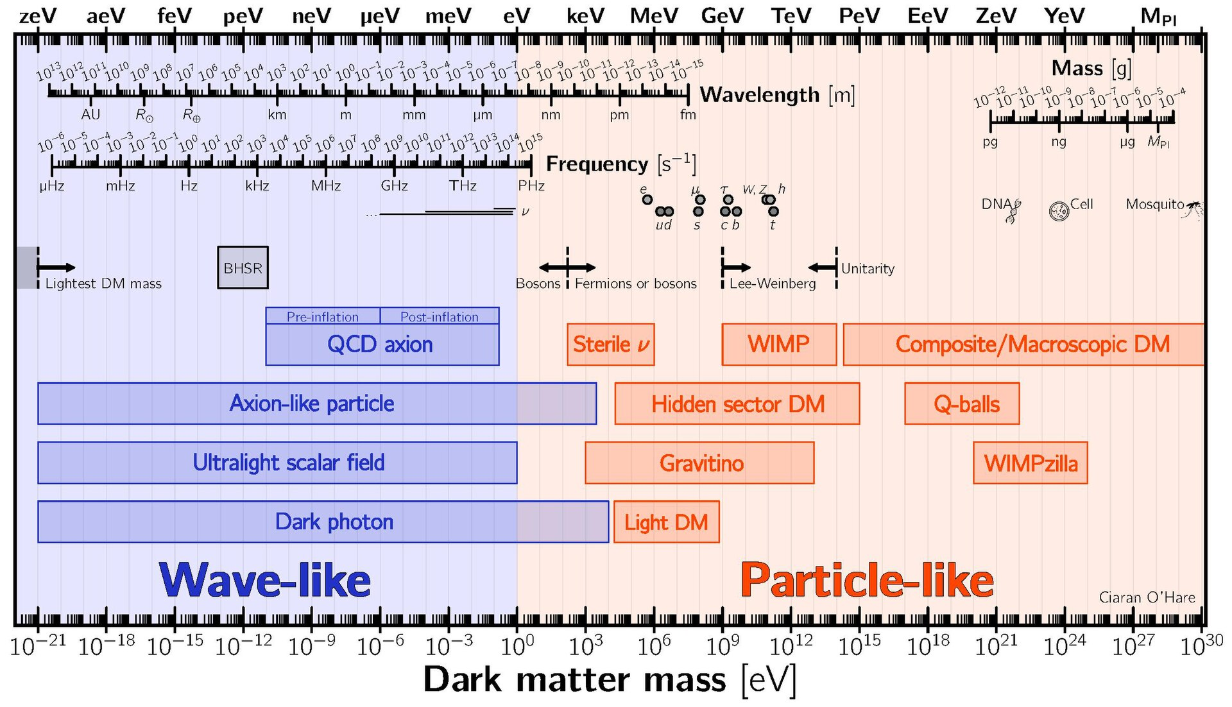
Ultralight Dark matter?
Interested in ultralight field.
Wave-like: Act together to create strain fields
Lot to learn from this field→ Large parameter space
Credit: Wikipedia
Notes:
WHAT IS ULTRALIGHT DARK MATTER?
DARK MATTER, DEPENDING ON THE MASS, CAN ACT EITHER AS PARTICLE-LIKE, LIKE ANY BILLIARD BALL WITH ITS OWN MASS, OR AS A MATTER WAVE, WITH ITS OWN COMPTON FREQUENCY. WE’RE INTERESTED IN ULTRALIGHT FIELD SINCE IT’S RELATIVELY LITTLE EXPLORED COMPARED TO OTHER CATEGORIES.
ACT TOGETHER AND FORM “STRAIN FIELDS”, AFFECTING PHYSICAL CONSTANTS OR OBSERVABLE QUANTITIES.

Slide 4
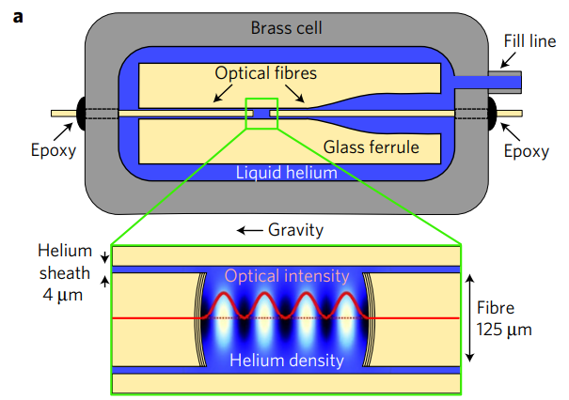
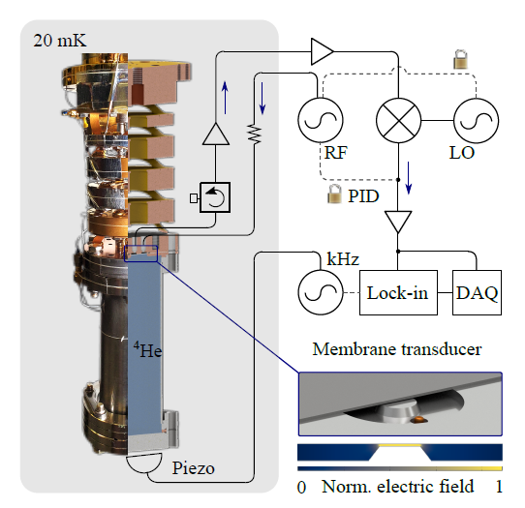
What We’re Doing (McHeLIOS)
Use superfluid He as acoustic medium to measure pressure oscillations.
HeLIOS 1 (UofA):
Microwave transducer as a sensor
Inherent electronic noise
Kashkanova, A., Shkarin, A., Brown, C. et al. Superfluid Brillouin optomechanics. Nature Phys 13, 74–79 (2017).
McHeLIOS:
Goal: Better Pressure Measurements
Use of IR laser, fiber optic cavity
Reads out 300 MHz acoustic mode of He.
M. Hirschel et al. Physical Review D, 109(9):095011, 2024.
Notes:
TALKING POINTS:
HELIOS: BRASS CAN OF SUPERFLUID HELIUM. SHOOT LASER: LASER INTERACTS WITH HELIUM, COUPLES WITH HELIUM PRESSURE OSCILLATIONS→ SOUND WAVES
PRESSURE OSCILLATIONS ARE PERIODIC IN NATURE, WITH WELL-DEFINED FREQUENCY. OUR JOB IS TO MEASURE ANY DEVIATION IN THAT PERIODICITY WHICH MAY BE CAUSED BY A DARK MATTER STRAIN FIELD.
FIRST PROTOTYPE: MICROWAVE TRANSDUCER CAVITY. ISSUE: INHERENT READOUT NOISE FROM ELECTRONICS

Slide 5
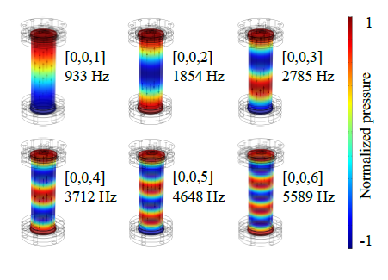
Our Central Problem
Thermal Noise
  Thermal noise ⇒ fundamental noise limit.
  Small pressure sensor ⇒ sensitivity to many acoustic modes (~200,000 modes)
Solution: Bigger Optical Cavity
  Averages out thermal noise from higher order modes
  Want a cavity comparable in size to the can (sensitive to a couple modes instead of 200,000)
Acoustic Helium Modes
M. Hirschel et al. Physical Review D, 109(9):095011, 2024.
Notes:
TALKING POINTS:
MAJOR PROBLEM: THERMAL NOISE OF THE SUPERFLUID HELIUM GIVES TOO HIGH OF A NOISE FLOOR, MASKS ANY POTENTIAL DARK MATTER SIGNAL
SOLUTION: IMPLEMENT FREE SPACE OPTICAL CAVITY, FILTERS OUT A LOT OF THERMAL NOISE FROM THE SENSOR. DRIVES DOWN SENSITIVITY TO UNWANTED THERMAL NOISE
FIBER OPTIC CAVITY IS A REALLY TINY SENSOR → SENSITIVE TO A LOT OF OTHER NOISE. SOLUTION: MAKE A HUGE SENSOR (MACRO-CAVITY)

Slide 6
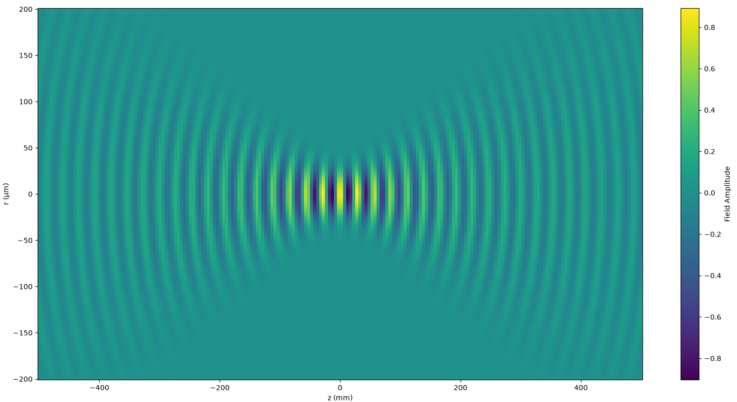
A bit about Gaussian Beams
Paraxial Gaussian Beams:
Waves with gaussian amplitudes & intensities
Amplitude mostly in the transverse direction, doesn’t change much over the wavelength scale
Radius of Curvature
Mirror
Mirror
Beam width
Laser beams AND Helium acoustic modes can be described as Gaussian beams!
Notes:
TALKING POINTS:
BEFORE DIVING INTO CAVITIES, LET’S TALK ABOUT A BIT OF LASER THEORY
LASER IS SINGLE-WAVELENGTH COHERENT EM WAVE WITH WELL-DEFINED AXIS OF PROPAGATION, MATHEMATICALLY CALLED “GAUSSIAN BEAMS”
ELECTRIC FIELD LOOKS LIKE THIS: DONT WORRY ABOUT ALL THE MATH, JUST REMEMBER THESE THREE CHARACTERISTICS
WIDTH: THE BEAM SPOT SIZE. WAIST: MINIMUM WIDTH OF THE BEAM (FOCUS POINT). RADIUS OF CURVATURE: CURVATURE OF THE WAVEFRONTS
WIDTH ESPECIALLY IMPORTANT IN SENSING: THE LARGER THE SPOT SIZE, THE LOWER THE NOISE
LASER BEAMS ACT IN SAME WAY AS HELIUM ACOUSTIC WAVES
REITERATE: WE WANT TO TRAP AN OPTICAL MODE OF LIGHT AND A SINGLE HELIUM ACOUSTIC MODE

Slide 7
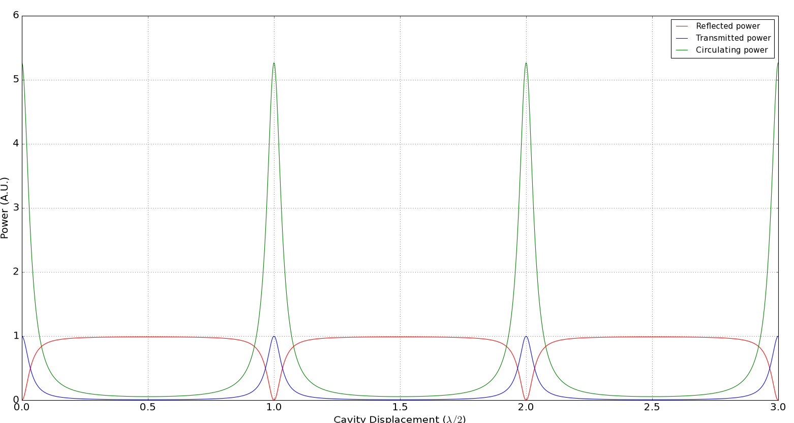
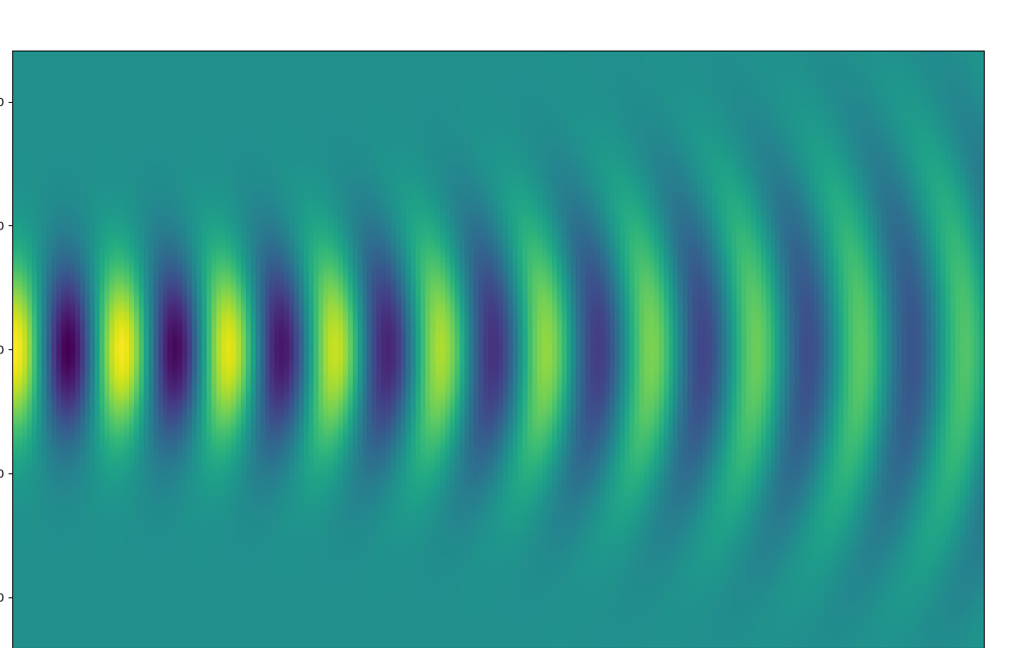
Fabry-Perot Optical Cavity
λ/2
λ/2
λ/2
Cavity resonant conditions:
Cavity length = mode number * λ/2
Beam curvature = mirror curvature
Possible consequences:
Bad alignment ⇒ higher-order modes excited
Plano-Concave cavity
Notes:
TALKING POINTS:
OPTICAL CAVITY “TRAPS” LIGHT
LIGHT BOUNCES AROUND, TRAVELING IN BOTH DIRECTIONS, CREATING STANDING WAVES
RESONANT CONDITIONS: RADIUS OF CURVATURE OF THE BEAM MATCHES RADII OF CURVATURE OF THE MIRRORS, CAVITY LENGTH MUST BE AN INTEGER NUMBER OF HALF-WAVELENGTHS
SIMPLE DESIGN IS THE PLANO-CONCAVE CAVITY, WHERE WAIST OCCURS AT PLANE MIRROR.
WE WANT TO OPTIMIZE BEAM WIDTH: MAKE CAVITY LENGTH HALF OF RADIUS OF CURVATURE OF THE BACK MIRROR.
IMPORTANT CHARACTERISTIC OF CAVITY: FINESSE, PROPORTIONAL TO REFLECTIVITY OF THE TWO MIRRORS. RELATED TO HOW MANY TIMES A PHOTON BOUNCES BACK AND FORTH. Q-FACTOR: LOSS PARAMETER OF THE SYSTEM. LOWER THE LOSS → HIGHER THE Q-FACTOR. THE HIGHER THE Q-FACTOR → LARGER THE SIGNAL

Slide 8
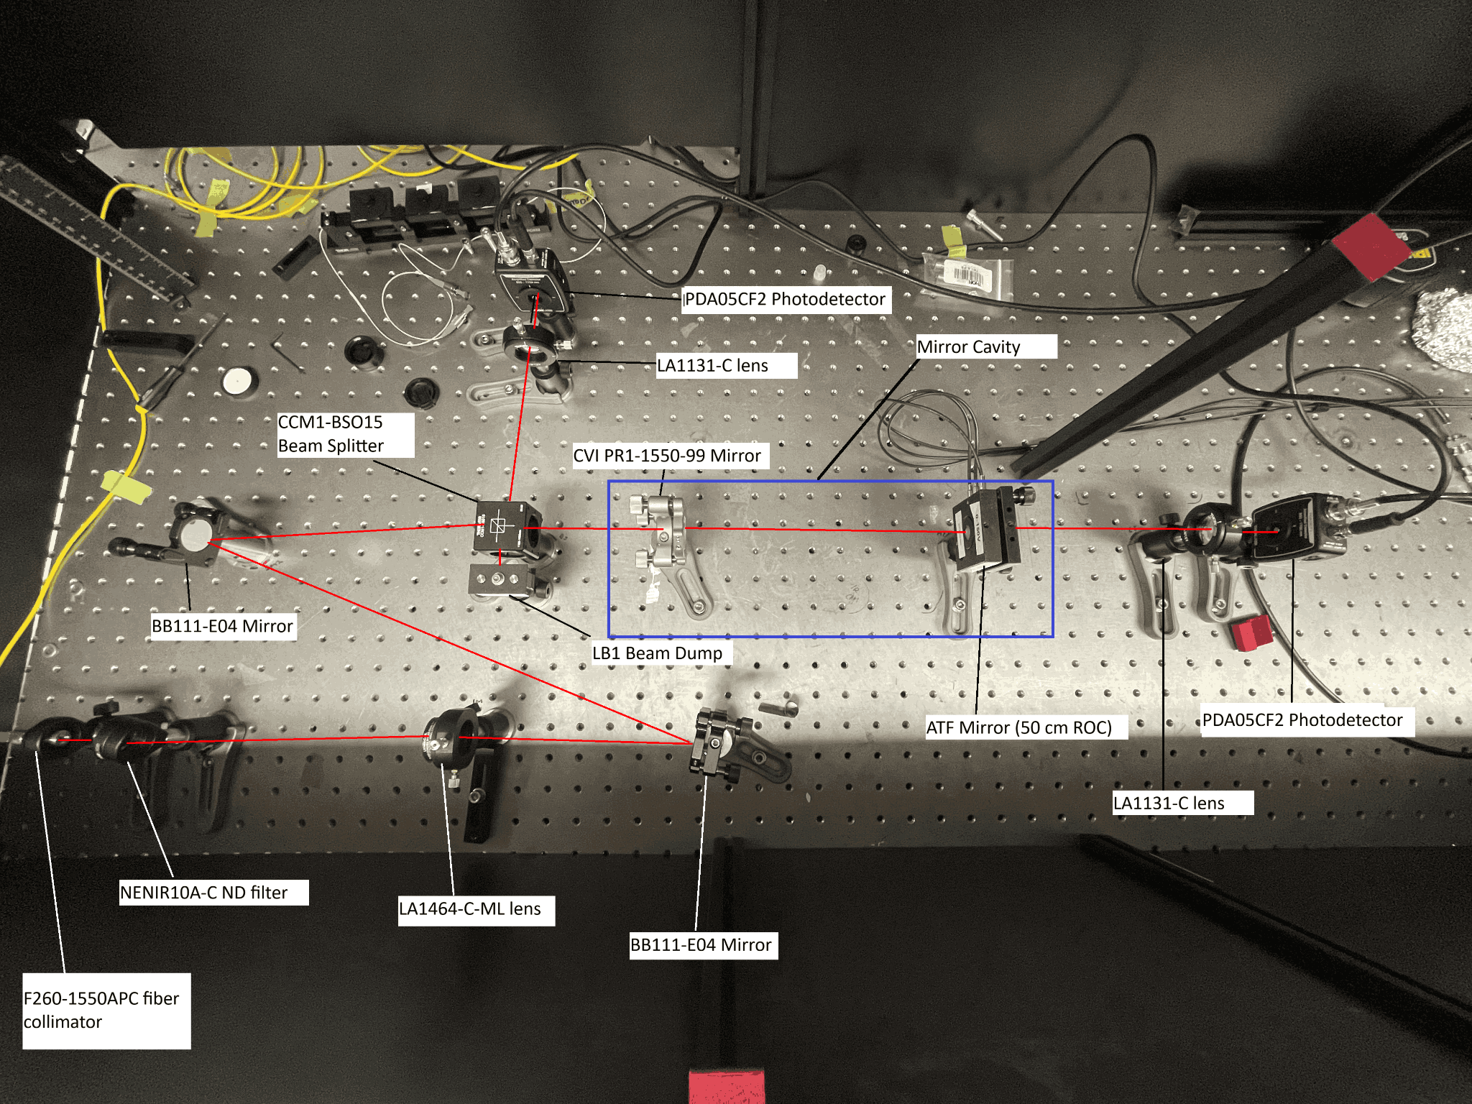
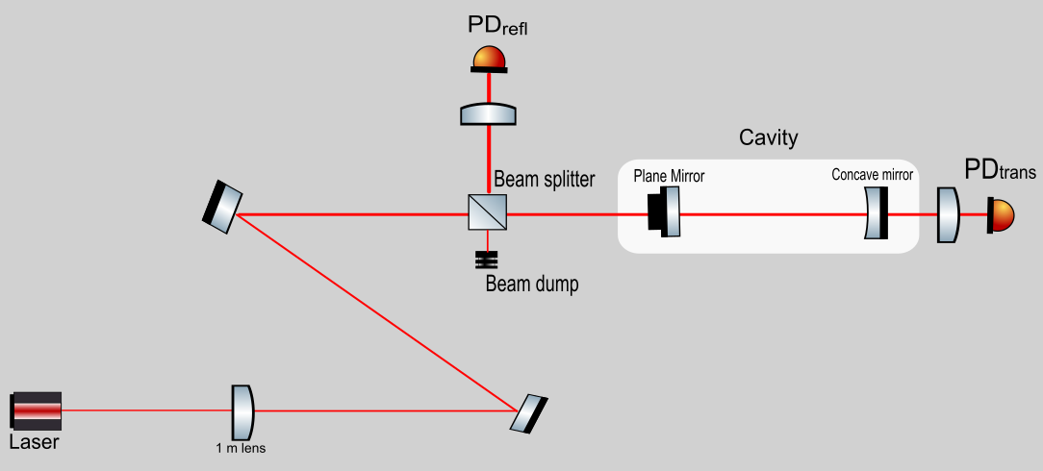
Fabry-Perot Cavity Setup
25 cm
d
Piezo-mounted
Notes:
DESCRIBE SETUP, PATH, STEERING MIRRORS. PIEZO → VOLTAGE SIGNAL SENT TO PIEZO MIRROR MOUNT, PIEZO EXPANDS/CONTRACTS ON MICROMETER SCALE, ALLOWING FOR RESONANCE SWEEPS CAPTURED BY THE OSCILLOSCOPE.

Slide 9
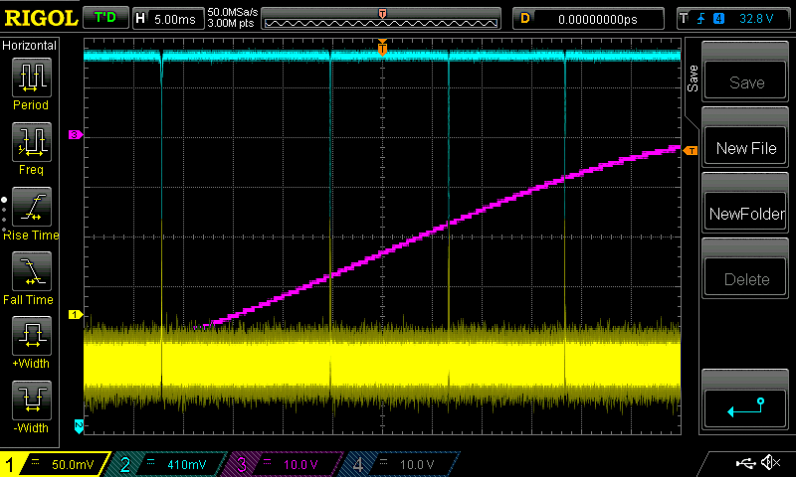
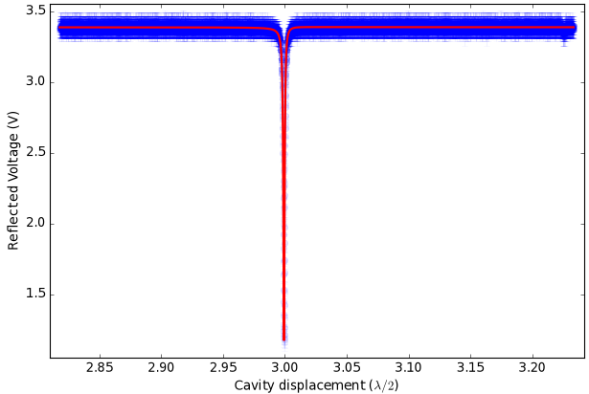
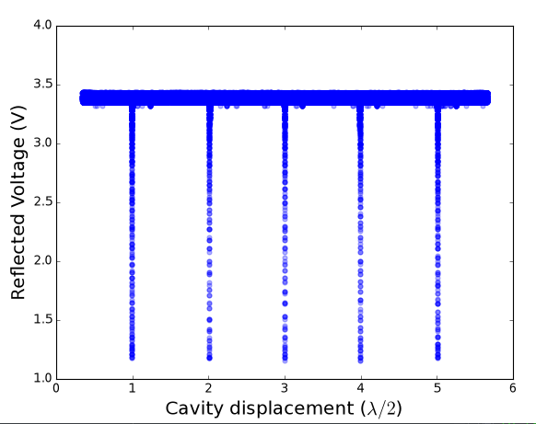
Fabry-Perot Results
Full waist: 0.7 mm
Sensitivity decrease:
200,000 modes → ~200 modes
Good alignment → ~one excited mode
Notes:
DESCRIBE OFF-RESONANCE, ON-RESONANCE
ONE PEAK PER HALF-WAVELENGTH (FSR UNIT):BAD ALIGNMENT EXCITES TRANSVERSE MODES → NO HIGHER ORDER TMODES = NEAR-PERFECT ALIGNMENT.
DESCRIBE RESULTS: IN BLUE IS REFLECTION, IN YELLOW IS TRANSMISSION. IN PURPLE IS THE VOLTAGE SIGNAL SENT TO THE PIEZO. OVERCOUPLED CAVITY LEADS TO LOWER TRANSMISSION CONTRAST.
THEORETICAL PROBLEM: NORMAL INCIDENCE OF HELIUM WAVES ON MIRRORS → CAUSES POWER LEAKING. LOSS FACTOR DRIVES THE Q-FACTOR OF THE SYSTEM DOWN BY SEVERAL ORDERS OF MAGNITUDE.

Slide 10

Mechanical energy leaks!
Notes:
REINTRODUCE FABRY-PEROT CAVITY, POWER LEAKAGE FROM NORMAL INCIDENCE

Slide 11
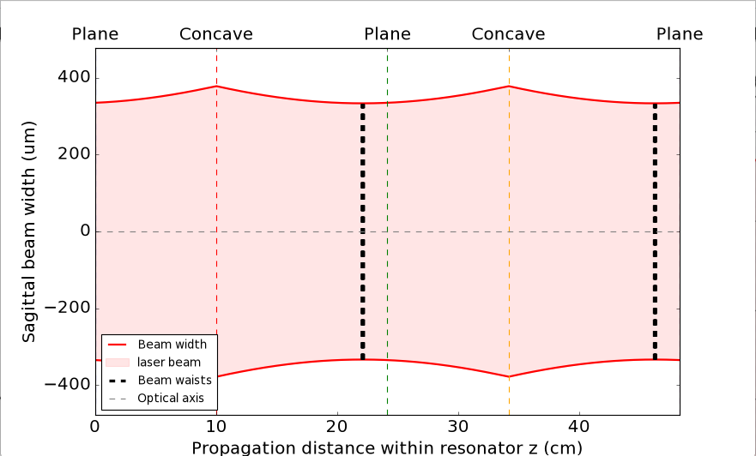
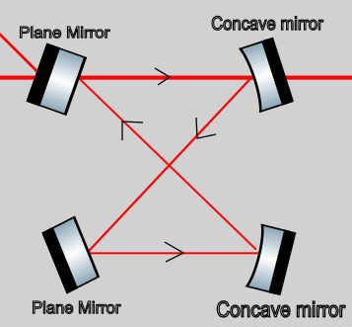
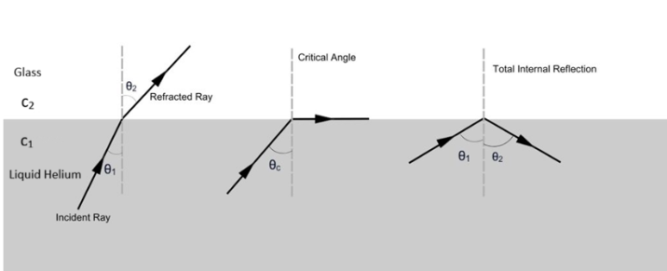
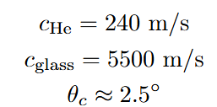
Bowtie Ring Resonator
Advantages:
Longer path length in shorter area
Total internal reflection of acoustic waves!
Notes:
SOLUTION TO MECHANICAL LEAKAGE: TOTAL INTERNAL REFLECTION OF ACOUSTIC HELIUM. HOW? OBLIQUE INCIDENCE ON MIRROR. INTRODUCE BOW-TIE RING RESONATOR. LIGHT HAS

Slide 12
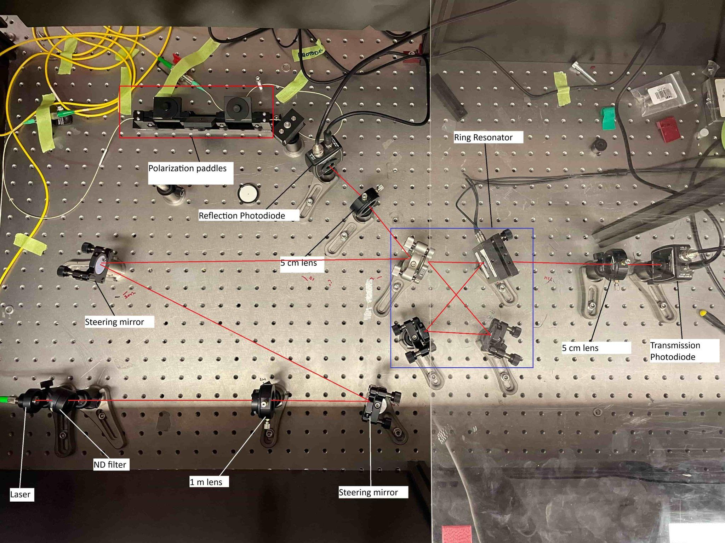
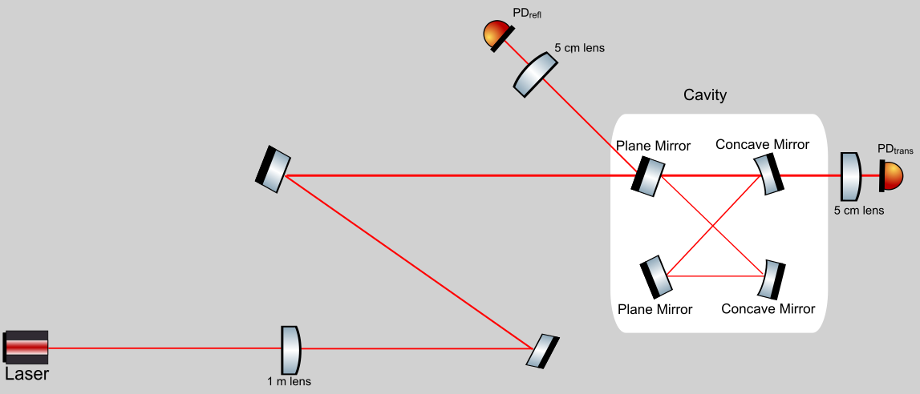
Ring Resonator Setup
Piezo-mounted

Slide 13
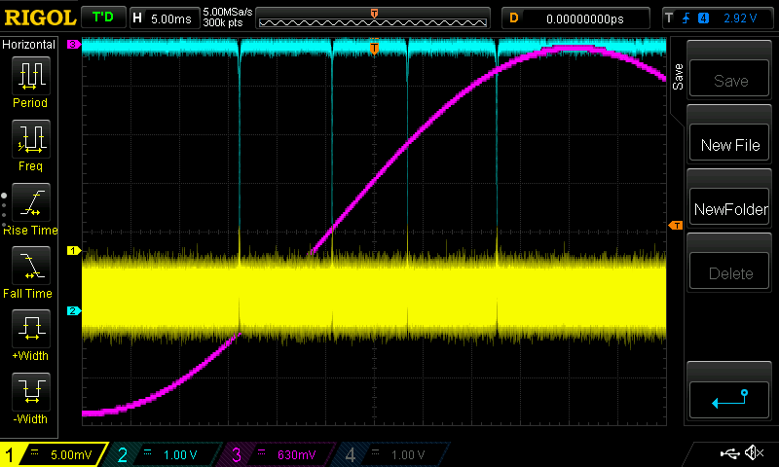
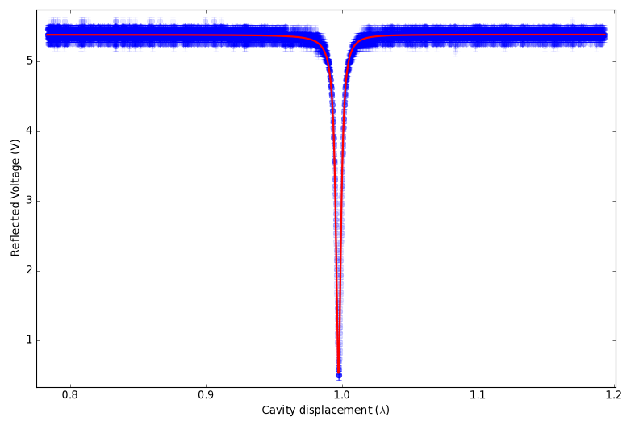
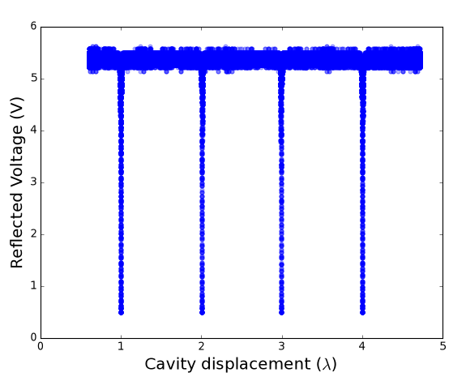
Bowtie Ring Resonator
Full waist : ~0.7 mm(similar to Fabry-Perot)
Near-perfect alignment
New territory
λ

Slide 14
Takeaway
Improving pressure readout for HeLIOS
Macro-cavity optics:
  Larger beam width⇒ low thermal noise
Ring Resonators:
  Helium total internal reflection ⇒ better resonator quality
Notes:
TALKING POINTS:
SUMMARY – WANT TO PLACE A FREE SPACE OPTICAL CAVITY INSIDE A SUPERFLUID HE CAN, TO IMPROVE THERMAL NOISE ON READOUT
DIFFERENT POSSIBILITIES: EITHER A FABRY PEROT DESIGN (TWO-MIRROR), OR A RING RESONATOR (4-MIRROR).
OUTLOOK – NEXT STEPS IS TO INCREASE WAIST BY USING DIFFERENT MIRRORS SUCH AS CONVEX MIRRORS.

Slide 15
Thanks For Listening!
Special thanks to:
VERY special thanks to:
McGill Quantum Optics & Sensing Lab
Minh Au
Jiaxing Ma
Fernanda Rodrigues Machado
Michael Caouette-Mansour
Kate Szabo
Kenny Moc
Pr. Brigitte Vachon
Pr. Jack Sankey
McHeLIOS

