Slide 1
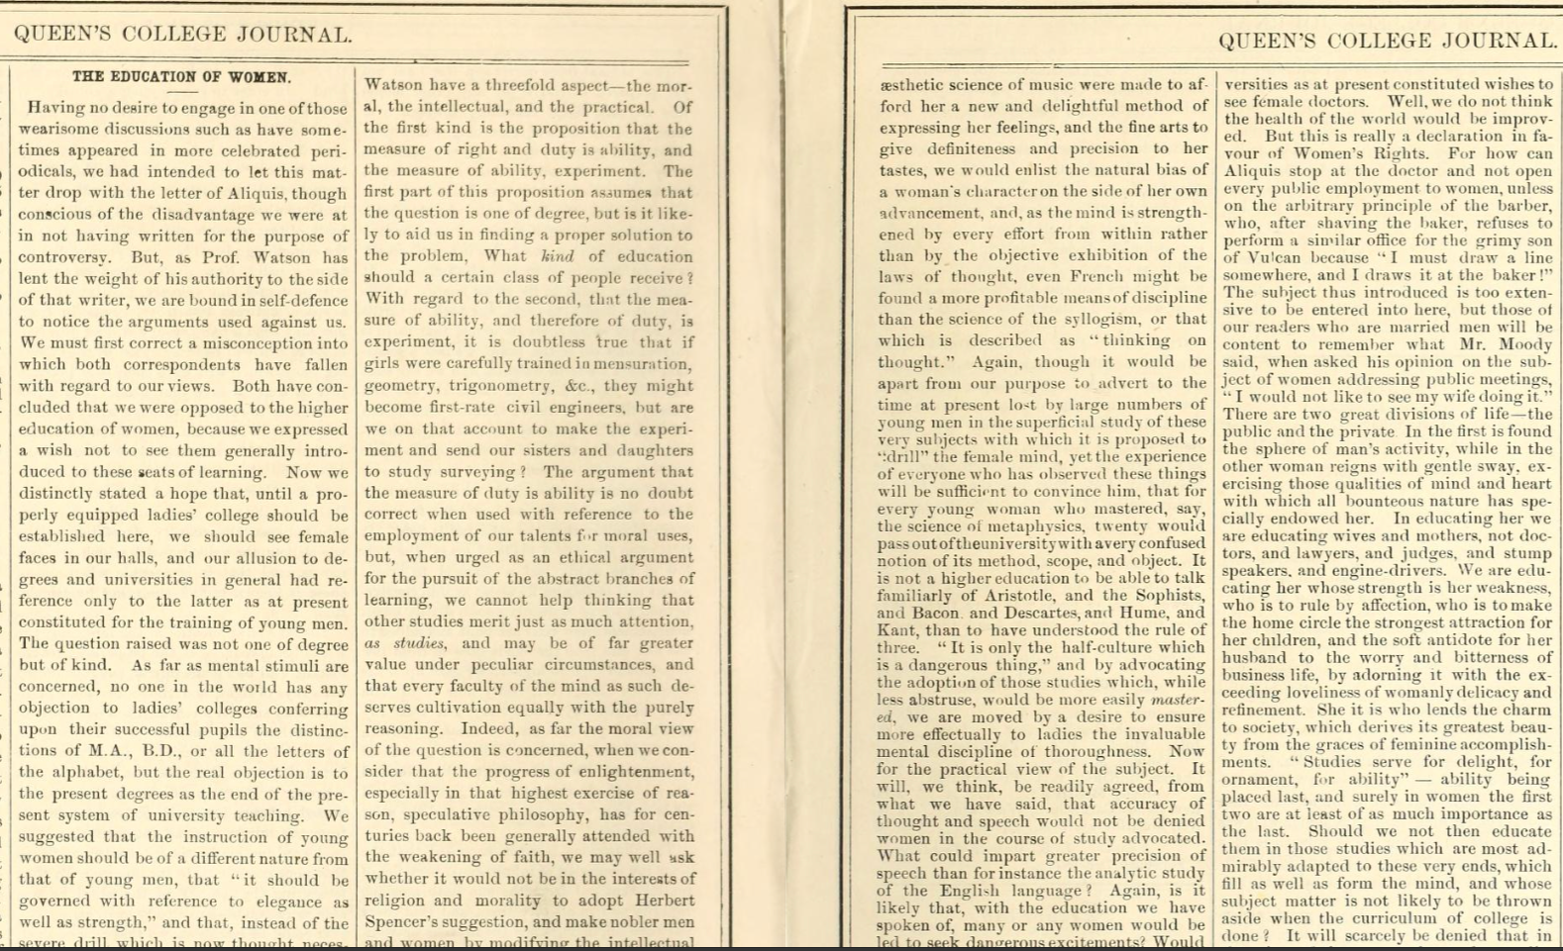
CASST 08/13/2026
A Brief History of the Physics Department at Queen’s and the Place of Women Within It
Alexandra Butler
Supervisor: Dr. Aaron Vincent
Queen’s University

Slide 2
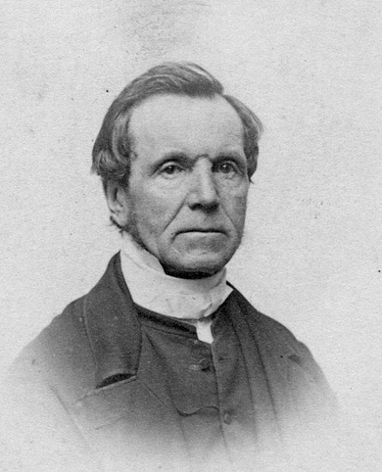
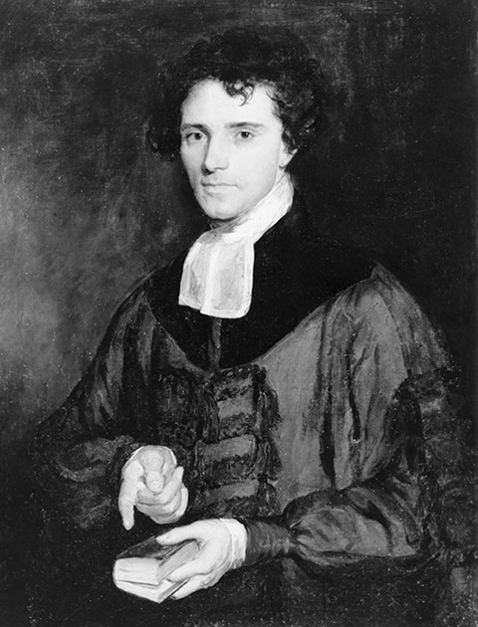
A Quick Background of Physics at Queen’s
Queen's College was established in October 1841 and opened for classes in March 1842 as a small Scottish Presbyterian institution.
Natural Philosophy (Physics) was one of the original nine subjects offered and one of only two subjects that would today be considered STEM.
The student body consisted of only 15 students, and Natural Philosophy was initially taught by founding principal Rev. Thomas Liddell.
In Queen's second year, Rev. James Williamson became both the university's first full-time professor and its first dedicated professor of Natural Philosophy.
Williamson taught at Queen's for 53 years until his death in 1896.
A 1901 Queen's Journal article claimed that replacing him required four professors and two tutors.
Williamson was instrumental in the development of physics at Queen's and was widely considered a modernizing force through his expansion of the science curriculum.
First Full-Time Physics Professor (1806-1895), Reverend James Williamson
Founding Principal (1841-1846), Reverend Thomas Liddell

Slide 3
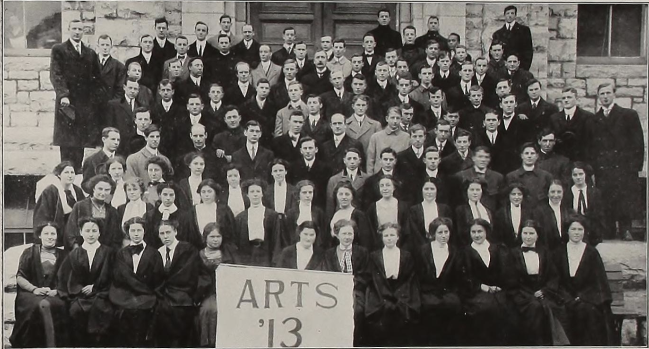
Throughout the nineteenth century, women's access to higher education was constrained by the Victorian ideology of "separate spheres," which held that women belonged in the domestic sphere while men were suited to public and professional life.
Reflecting these assumptions, Queen's initially excluded women from university education.
In 1870, Professor Clark Murray offered an English class for women that attracted 22 students.
Following its success, the Senate opened courses in English, rhetoric, and natural history, though mathematics and the sciences remained excluded.
In 1878, Queen's opened all Arts and Science courses to women and allowed them to pursue degrees.
Supporters argued that denying women higher education violated their natural rights as human beings.
Opposition remained strong. A Queen's Journal article titled Sweet Girl Graduates insisted that a woman's "proper sphere of action is in the domestic circle."
Women's inclusion at Queen's, particularly in science, therefore remained controversial and debated.
The Place of Women at Queen’s
Arts Graduating Class of 1913, Pictured are 31 women & 85 men

Slide 4
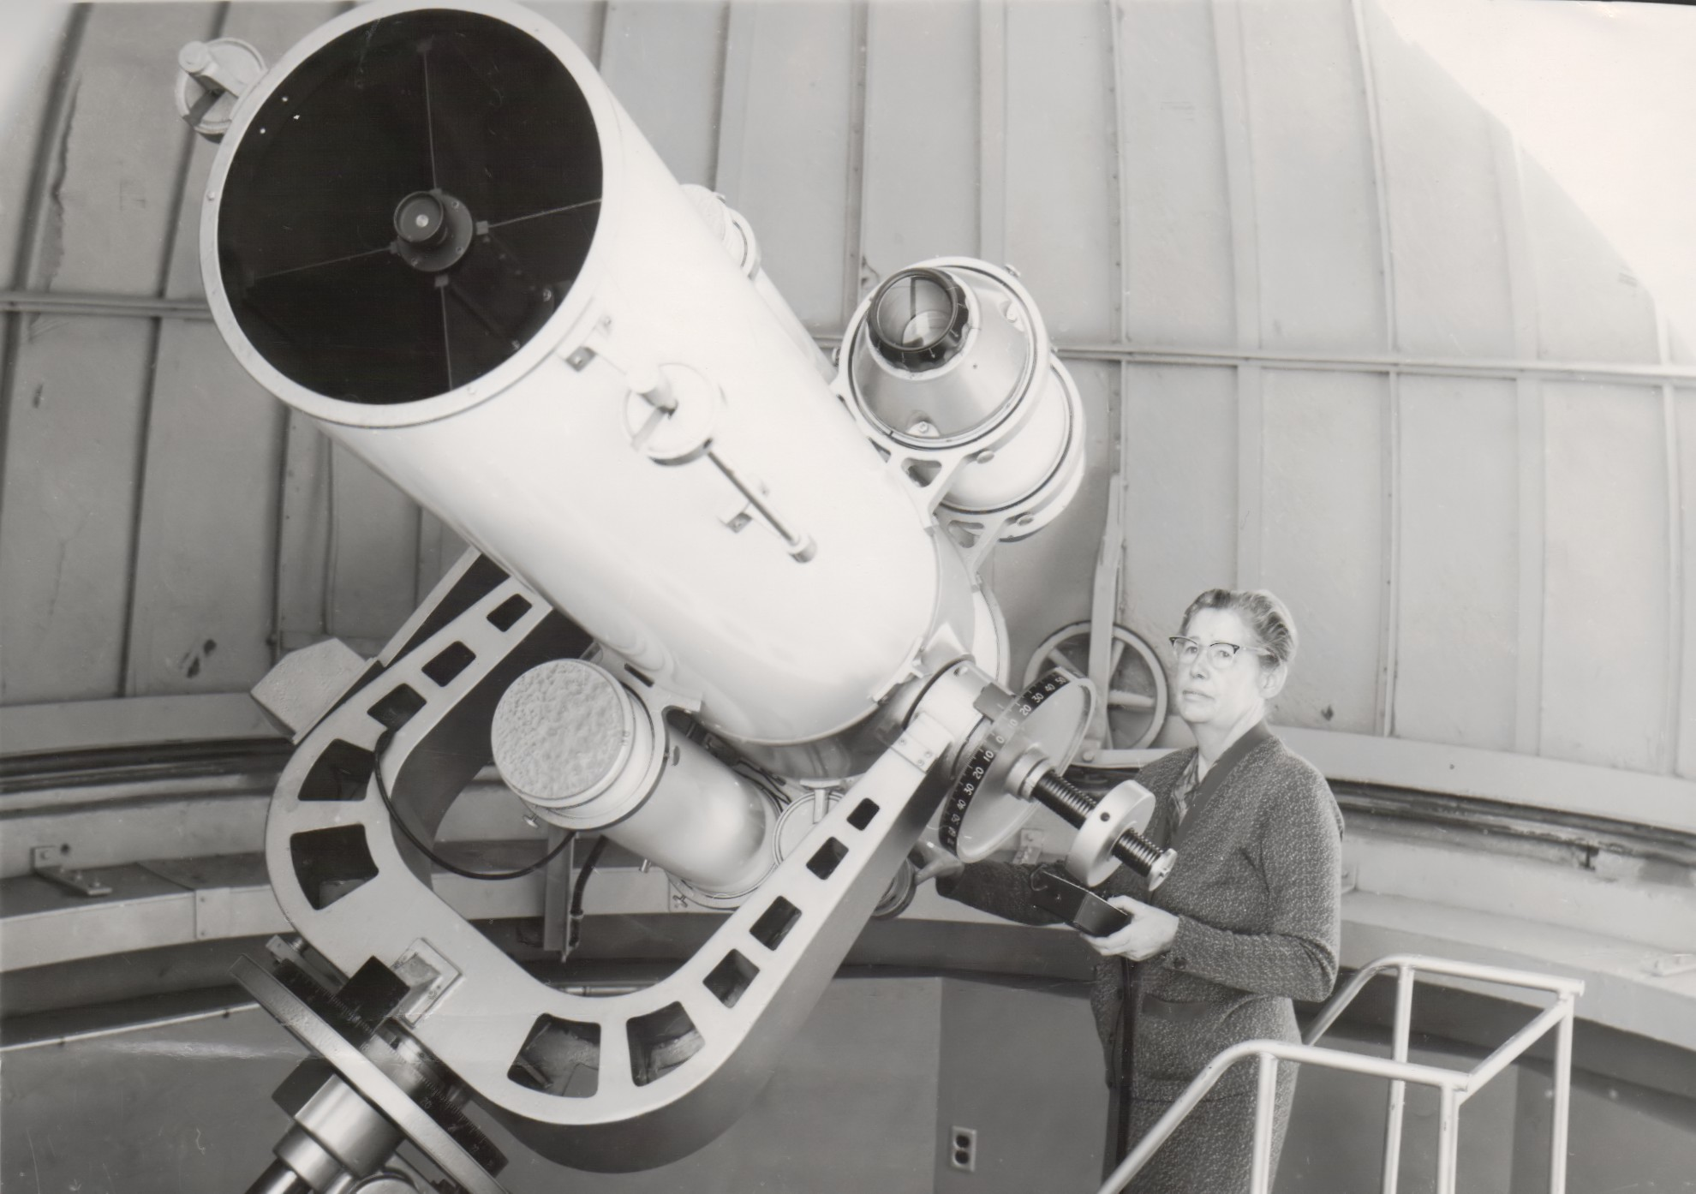
Who was Allie Vibert Douglas?
Alice "Allie" Vibert Douglas (1894-1988) was one of Canada's most influential astronomers and science educators.
Studied Mathematics and Physics at McGill University, graduating in 1920.
Served as a statistician for the British War Office during the First World War and was appointed a Member of the Order of the British Empire (MBE).
Earned an MSc in Physics in 1921 and continued advanced studies at Cambridge University.
Worked under leading physicists Ernest Rutherford and Arthur Eddington.
Completed doctoral requirements at Cambridge but could not receive a Cambridge degree because women were not yet eligible.
Returned to Canada and earned a PhD from McGill University in 1926.
Joined Queen's University in 1939 as Dean of Women while also teaching physics.
Her career linked the history of women in higher education with the history of physics in Canada.
Dr. Alice ‘Allie’ Vibert Douglas with the new telescope at the Queen’s University Observatory, 1963

Slide 5
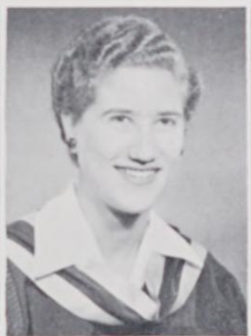
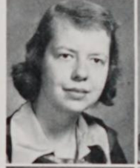
Douglas spent 25 years at Queen's, supporting women pursuing higher education and scientific careers.
She actively mentored female students in fields where women remained severely underrepresented.
In the Applied Science class of 1957, only two women graduated; Douglas successfully advocated for residence accommodations to support them.
Former students described her as living proof that women could become scientists and academics.
Her mentorship encouraged many women to pursue careers in physics, astronomy, engineering, and research.
Beyond Queen's, she achieved international recognition as an astronomer.
Accomplishments included:
  Writing a major biography of Arthur Eddington
  Conducting an interview with Albert Einstein
  Becoming the first female president of the Royal Astronomical Society of Canada
Douglas helped open pathways for future generations of women in science.
Douglas’ Impact for Women in Science at Queen’s
Lynne Vidal, Graduated Applied Science with a Degree in Engineering Physics in 1957
Llewellya Hillis, Graduated from Arts with a Degree in Chemistry and Biology in 1952

Slide 6
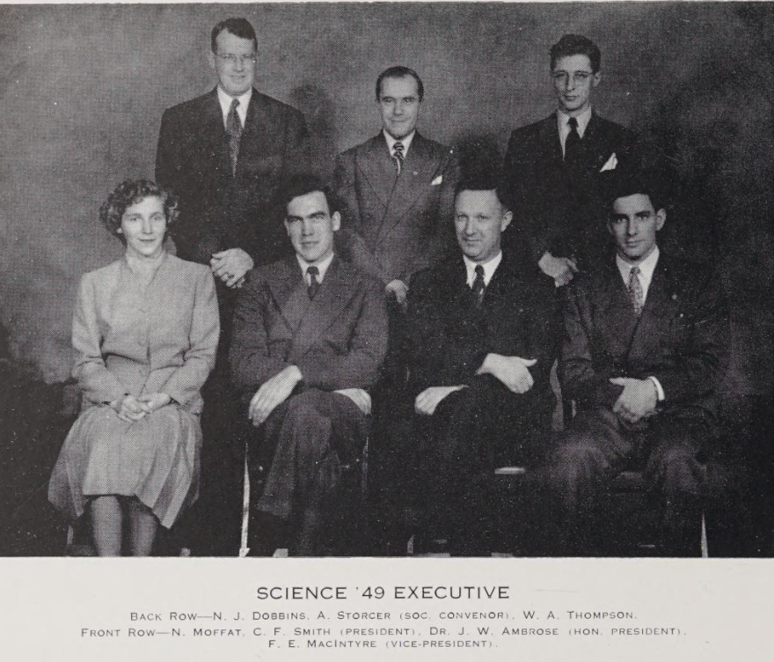
Gender and Physics: A Complicated Relationship
In the 19th century, both Natural Philosophy (Physics) and women occupied a liminal space at Queen's: they were present within the institution, but neither was fully integrated into its traditional Presbyterian liberal arts identity.
Physics was included from the beginning, but as a minority discipline its place had to be justified through theological and humanistic language rather than accepted on its own terms.
Women's presence followed a similar pattern. Even after gaining access to higher education, they remained subject to debate, supervision, and separate institutional structures.
As both became more established, these debates increasingly converged, though inclusion meant neither equality nor acceptance.
Physics challenged the university's traditional intellectual foundations, while women challenged assumptions about who could participate in higher education and scientific study itself.
Allie Vibert Douglas encapsulated this tension. Despite her international stature as an astrophysicist, much of her professional life was shaped by the gendered expectations attached to her role as Dean of Women.
Pictured is Nancy (Moffat) Scarth, First Woman to Complete a 4-Year Engineering Degree at Queen’s. Her Specialization was Engineering Physics.

Slide 7
Final Remarks
Despite the fact that both the study of physics and women were on the periphery at Queen’s, they both became the centre of salient cultural and intellectual challenges and changes at Queen’s.
Physics was secularized and its presence no longer needed religious arguments to justify its inclusion. It persisted despite undermining the liberal arts and divinity-focussed reputation at Queen’s.
Women were the forces of challenge and change, physics was the site of it. Broadly speaking, women challenged and changed the intellectual culture of Queen’s, which was based on a masculine and humanist ethos.
Women also challenged long held social paradigms that extended beyond Queen’s, namely the Victorian paradigm of separate social spheres. Women were no longer confined to the domestic sphere after they established themselves at this university.
More research is needed to determine how this process unfolded at other Ontario universities, including Toronto, Guelph, McMaster, and Western.
“In a world where professional women were rare, [Allie Vibert Douglas] provided splendid and much needed evidence that women could be scientists…Almost fifty years on [in 1997], it is perhaps difficult for the current undergraduate, and graduate to appreciate the importance to our intellectual development in the pre-feminist era provided by a dean such as Dr. Douglas.”
- Llewellya Hillis, BAH, PhD, DSc

Slide 8
Presentation Bibliography
Primary Sources
Douglas, Allie Vibert, Pilgrims Were We All. Unpublished memoirs of Allie Vibert Douglas. Queen’s University Archives, c. 1970s-1980s.
Douglas, Allie Vibert. Personal Correspondence. Unpublished correspondence of Allie Vibert Douglas. Queen’s University Archives, 1937-1972.
Issues from The Queen’s Journal
Issues from The Queen’s Principal Reports
Issues from The Tricolour Yearbooks
Scholarship
Garvie, Maureen, Jennifer J. Johnson, and Queen’s University . Alumni Association. Committee on Women’s Affairs. Their Leaven of Influence : Deans of Women at Queen’s University, 1916-1996. Queen’s University Alumni Association, Committee on Women’s Affairs, 1999.
Neatby, Hilda, Frederick W. Gibson, and Roger Graham. To Strive, to Seek, to Find and Not to Yield, 1841-1917. 1st ed. McGill-Queen’s University Press, 1978. https://doi.org/10.1515/9780773560741.
Neatby, Hilda. To Serve and yet Be Free, 1917-1961. 1st ed. McGill-Queen’s University Press, 1983. https://doi.org/10.1515/9780773560802.

