Slide 1
Corporate Services Division
SEF/EAC– July 2024
Samantha Kuula
Director

Slide 2
Site Access
EHS STMS
Cyber Event
EDI support

Slide 3
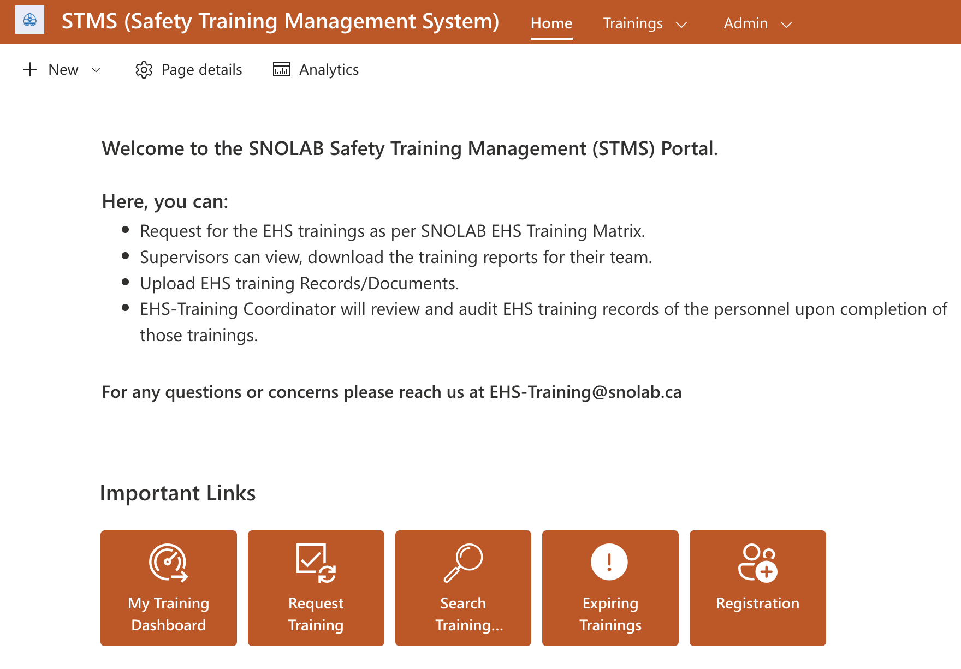

Slide 4
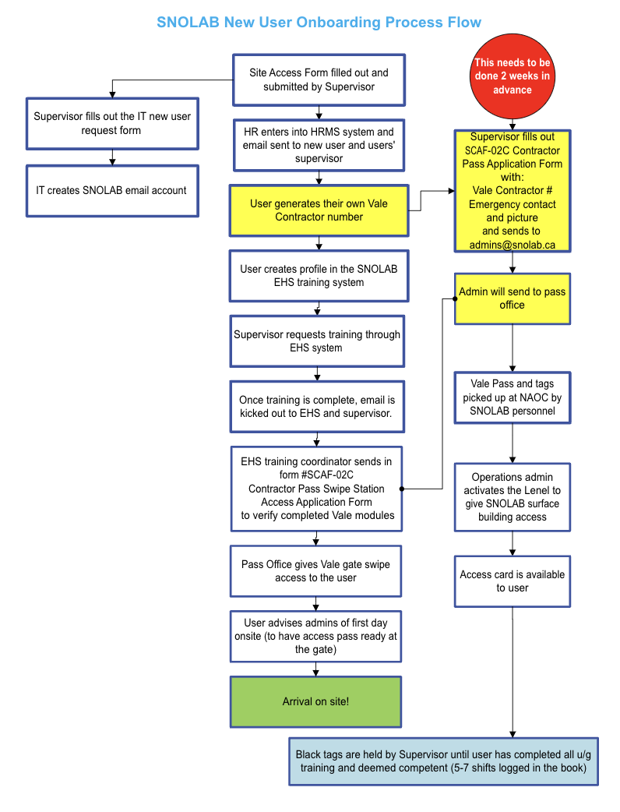
Highlights
Paperwork must be submitted 2 weeks prior to arrival on site
Vale is enforcing “No pass, No access”
There are new training requirements to access site (CAR, Environmental)
All vehicles driven through the gate to the SNOLAB building must have a Vehicles Contractor Pass.

Slide 5
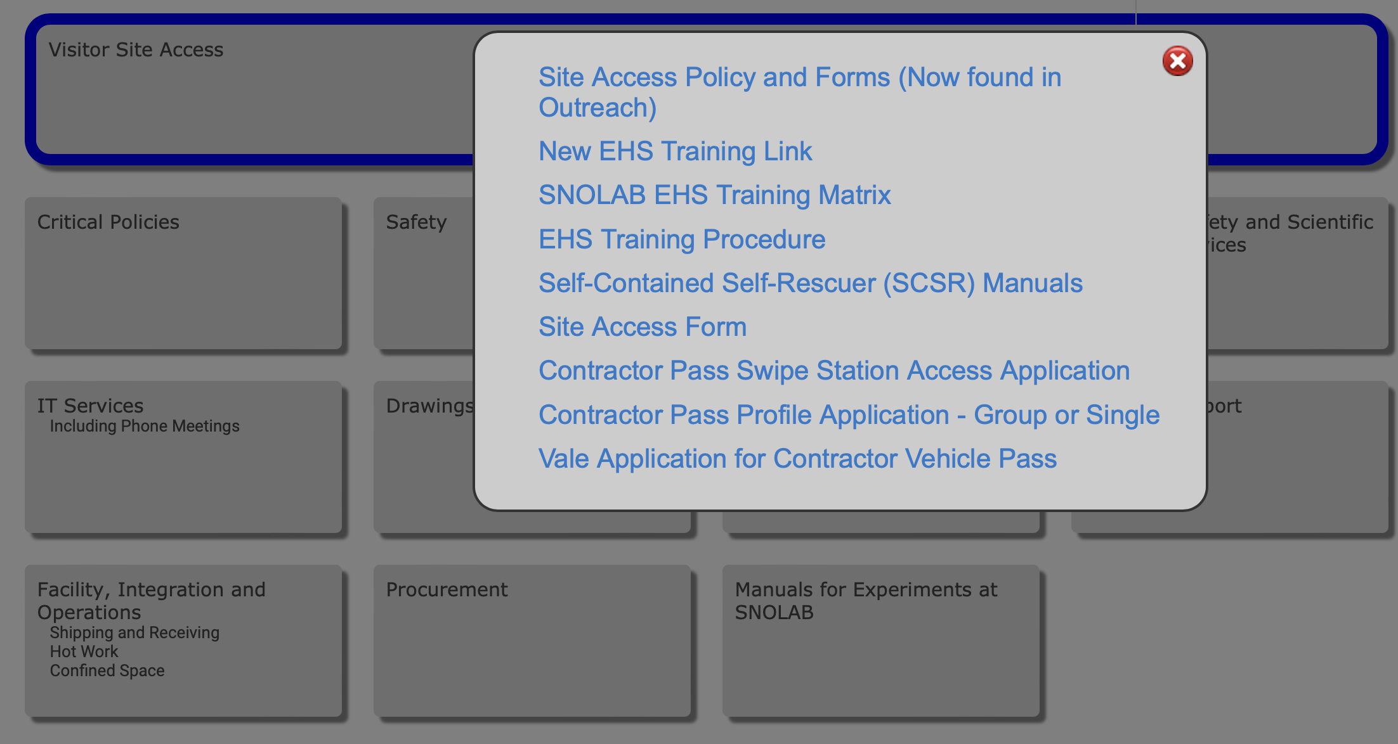
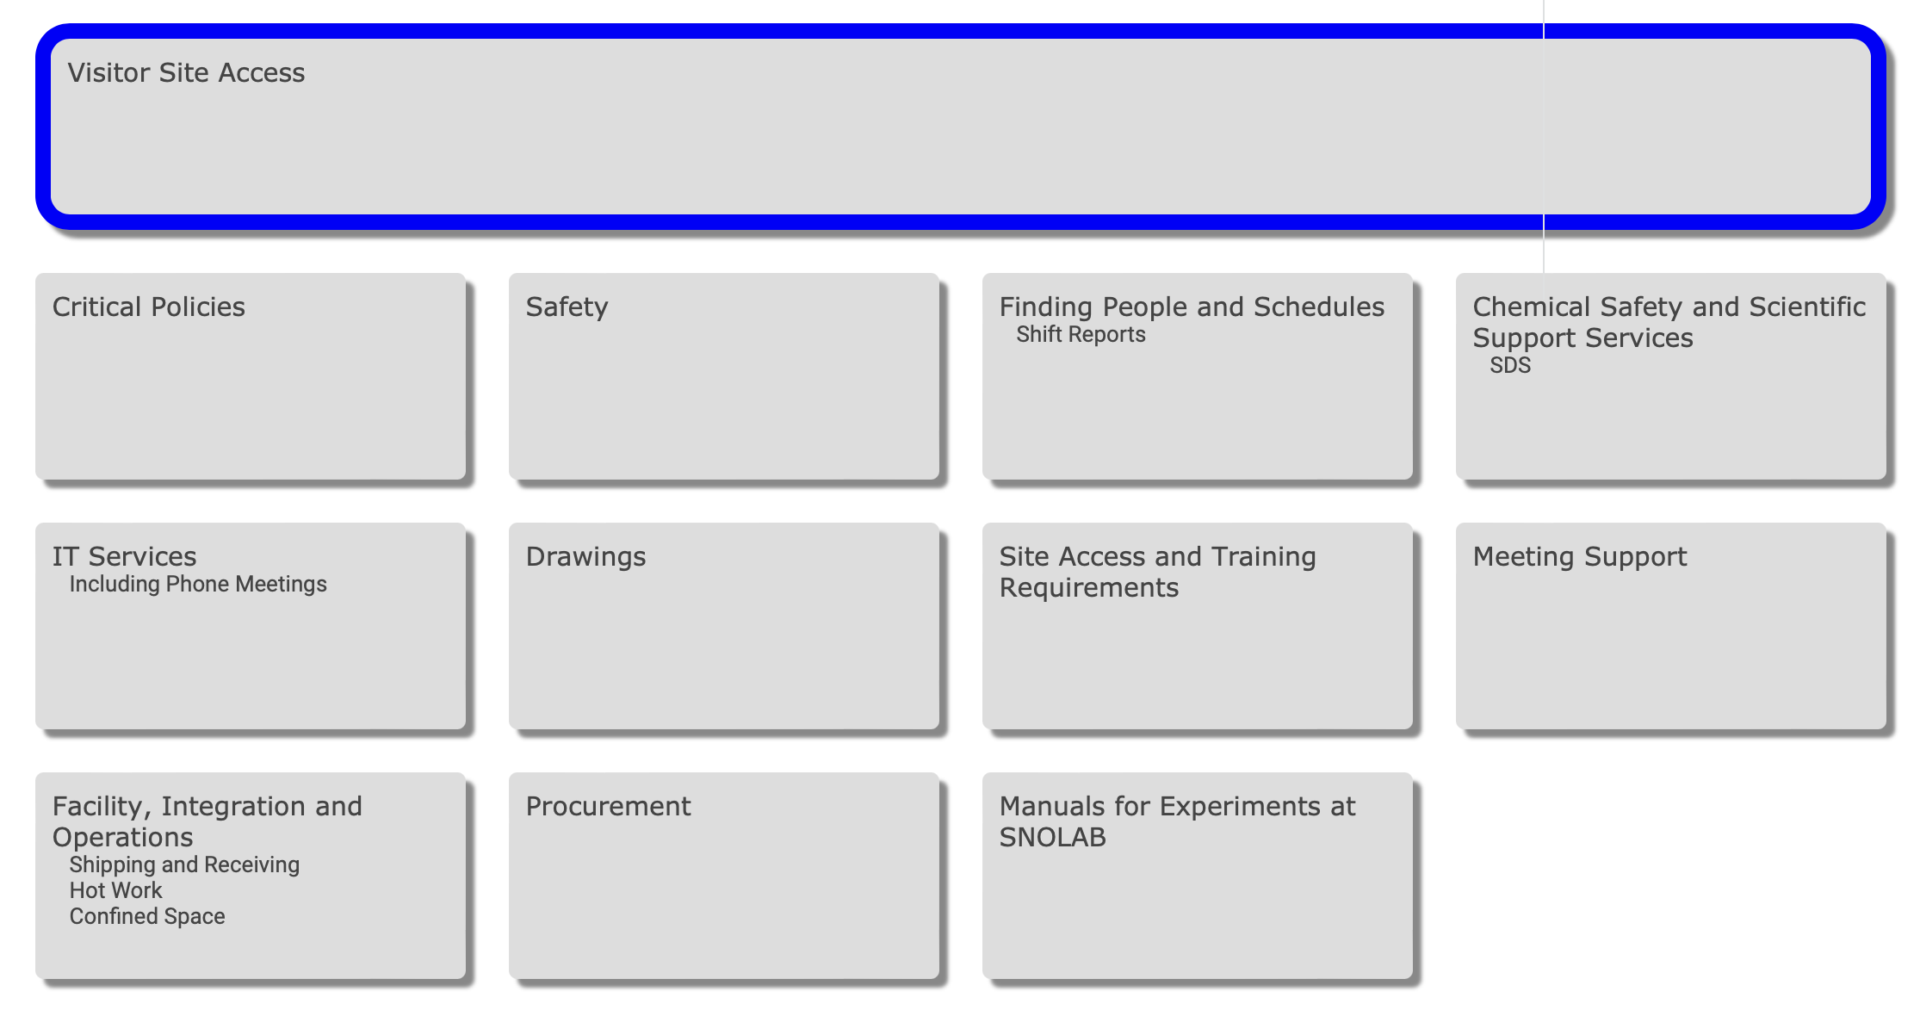
Docushare

Slide 6
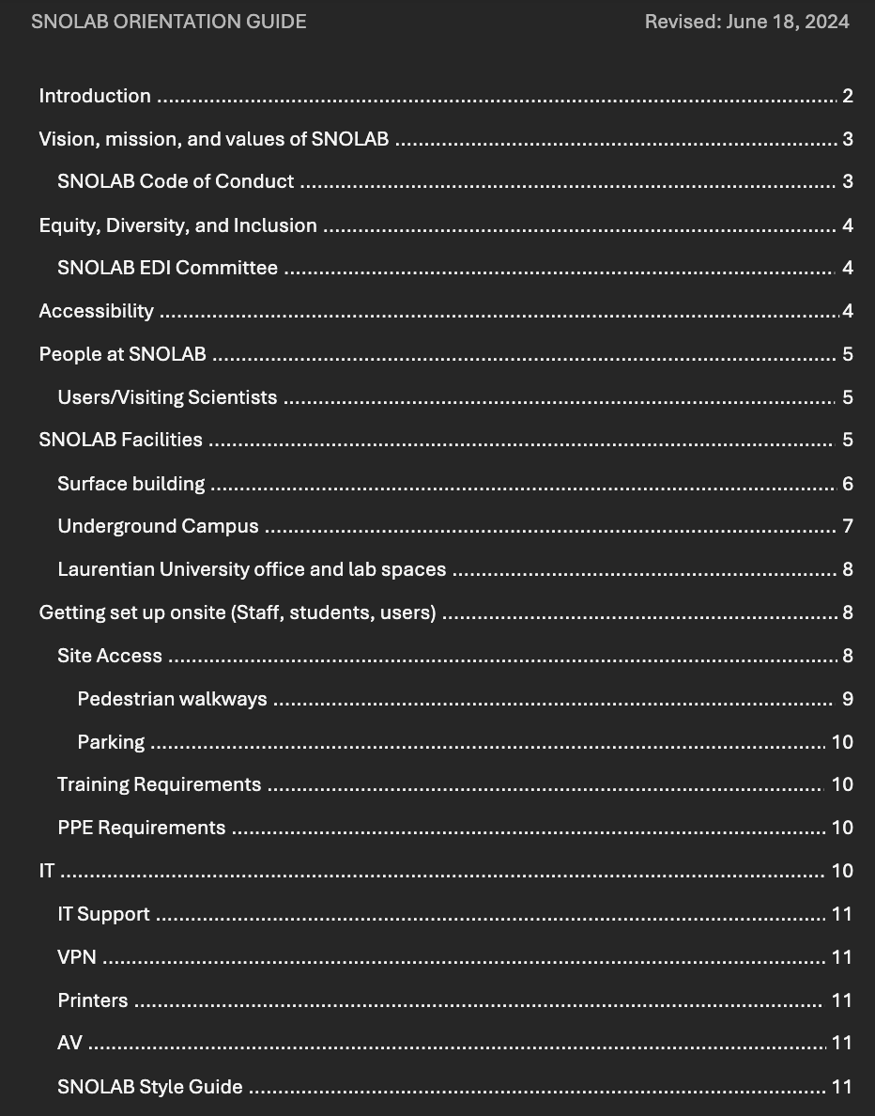
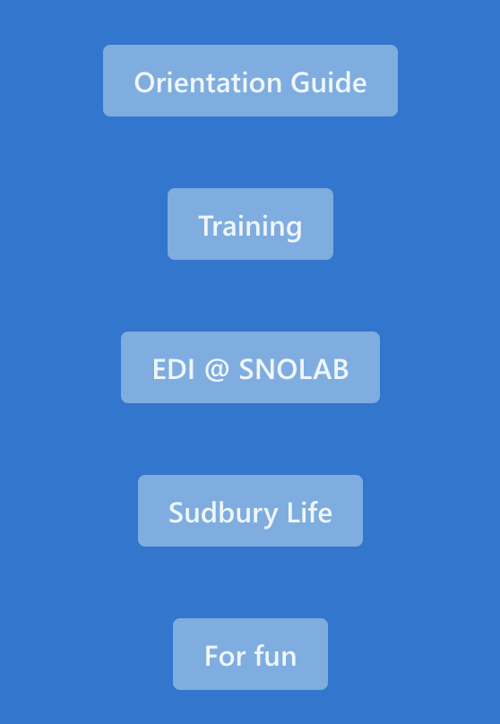
SNOLAB Users Sharepoint

Slide 7
Why this Change ?
Our previous system limitations
HRMS-Not a safety training management system, challenges with record keeping and tracking the trainings.
Limited visibility to Supervisors- depending on whose name is captured in system in HRMS as Supervisor.
Safety training compliance & Audit – EHS or Supervisors couldn’t perform spot audit to check the individuals training status. Ineffective system to monitor compliance
Manual data update- EHS training coordinator had to update training data manually.
Communication- EHS training coordinator wasn't getting the feedback about training completion
Records Management- If proof of completion not provided to EHS training coordinator, they won’t update the training.
Tracking of training status
Lots of concerns raised about visibility and transparency
HRMS and our previous SharePoint based system (developed in rush when COVID started) were not integrated.

Slide 8
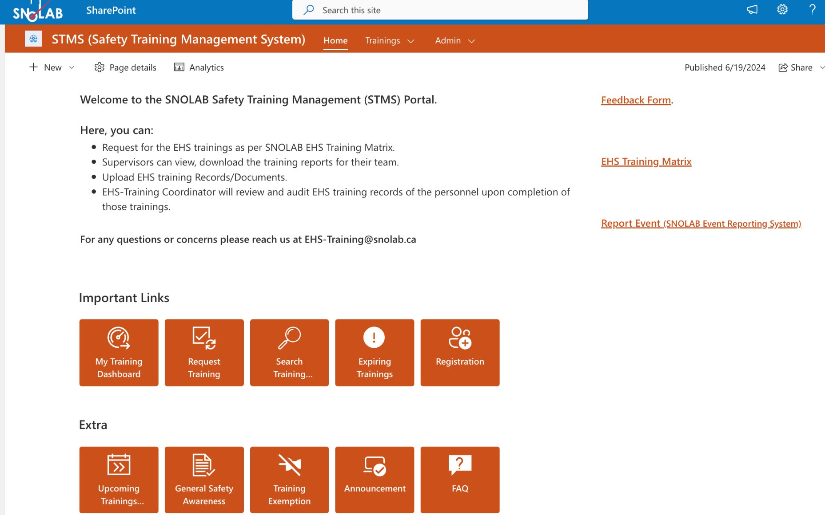
Features of STMS
SharePoint based system
Designed and Developed with Internal resources
Centralized system
Accessing the new system:
https://snolab.sharepoint.com/sites/EHSTraining/
Link provided on the Docushare as well.
You need SNOLAB account to access this system.
You will have access to : Registration, My Training dashboard, Request training, Search training, Expiring Training, General safety, upcoming training, FAQs
System admins will have access to few other apps-Training approval/rejection, Edit Profile, Edit Training apps.
System generated notifications to individual, supervisor, site contact per training status.

Slide 9
Cyberincidents
Cyber Security Incident Report:
DDoS Attack on March 13th 2024
Executive Summary
Date of the beginning of the incident: March 13th 2024
Date the incident was resolved: March 15th 2024
Systems Affected: Network Connectivity
Type of Attack: Outbound Network Traffic was more than our Firewall could manage.
Immediate Response: Worked with our Partner’s ORION and HAXXESS to make changes to our Firewall and VPN configurations and blocked a very large amount of destination IPS as per ORION’s direction.
Cyber Security Incident Report:
DDoS Attack on April 4th 2024
Executive Summary
Date of Incident: April 4th
Systems Affected: SNOLAB Site Internet Traffic, ability to VPN into SNOLAB
Type of Attack: Distributed Denial of Service (DDOS) facilitated through Command and Control (C&C) Server
Immediate Response: Isolation of affected system, blocking of IP ranges, initiation of forensic analysis

Slide 10
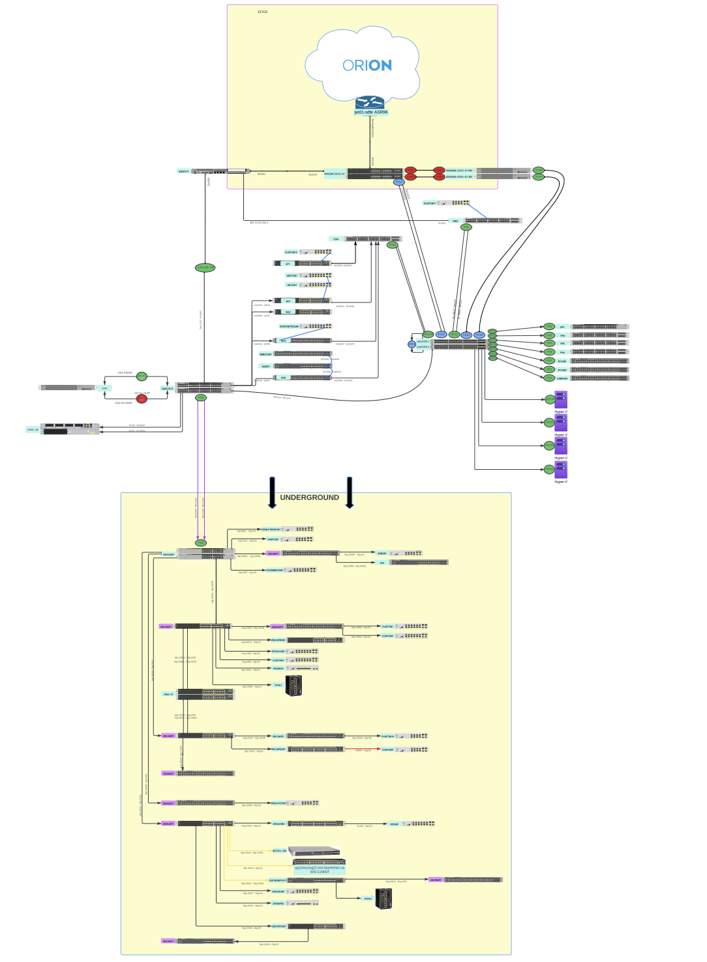
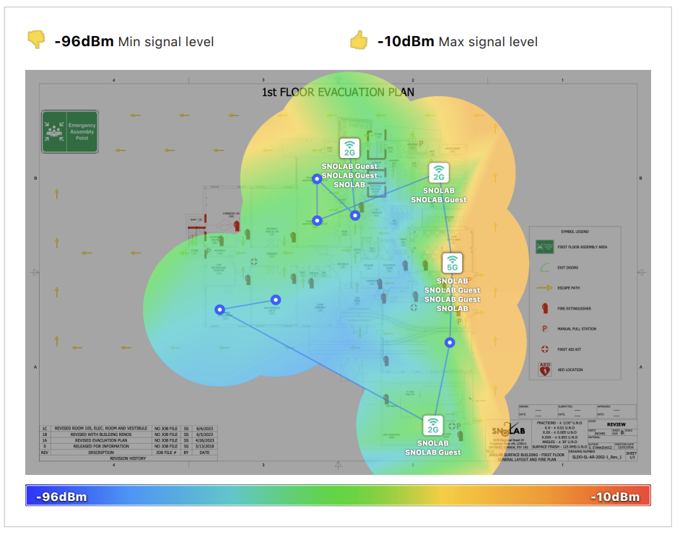
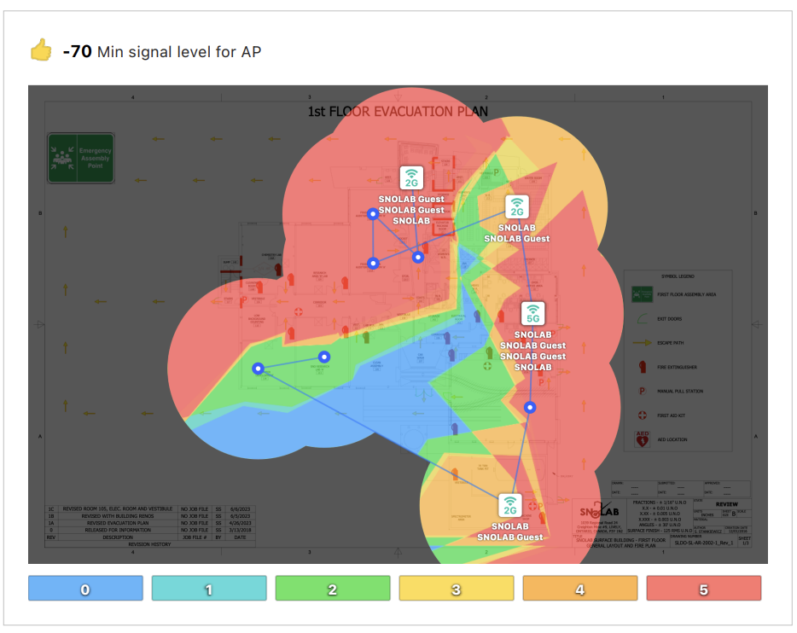

Slide 11
EDI Support
Qualtrics survey support
Project Lifecycle support
Knowledge keeper in house
LinkedIn Learning
EDI Committee

