Slide 1
REPAIR
2024/07/31
Michel R. Lapointe, Ph.D.
Postdoctoral Fellow

Slide 2
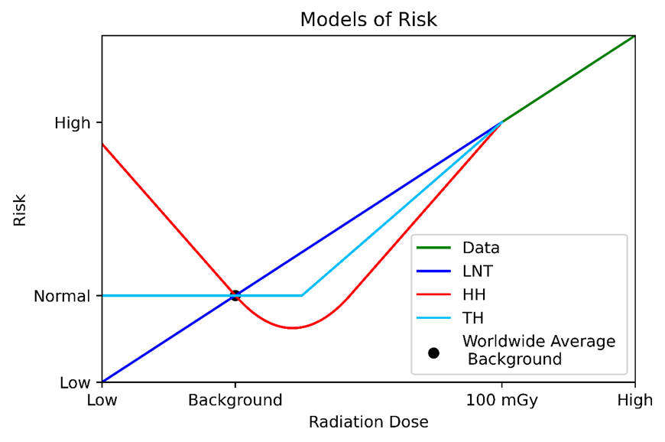
Experiment Overview
REPAIR:
Researching the Effects of the Presence and Absence of Ionizing Radiation
Notes:
Only active life sciences experiment at SNOLAB

Slide 3
Experiment Overview
Creating a sub-NBR environment:
Cosmic: SNOLAB
Terrestrial (Gamma): Lead
Inhalation (Radon): Air filtration
Endogenous radioisotopes: Nutritional restriction*

Slide 4
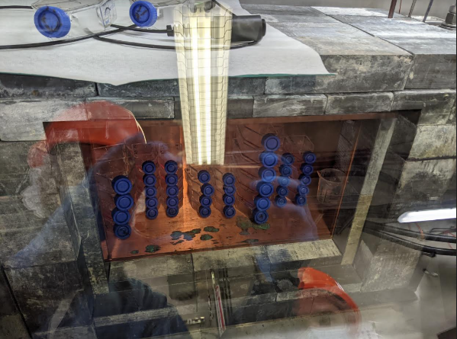
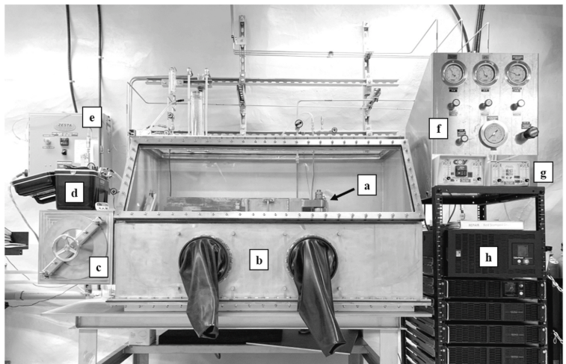
Experiment Overview
Creating a sub-NBR environment:
Cosmic: SNOLAB
Terrestrial (Gamma): Lead
Inhalation (Radon): Air filtration
Endogenous radioisotopes: Nutritional restriction*

Slide 5
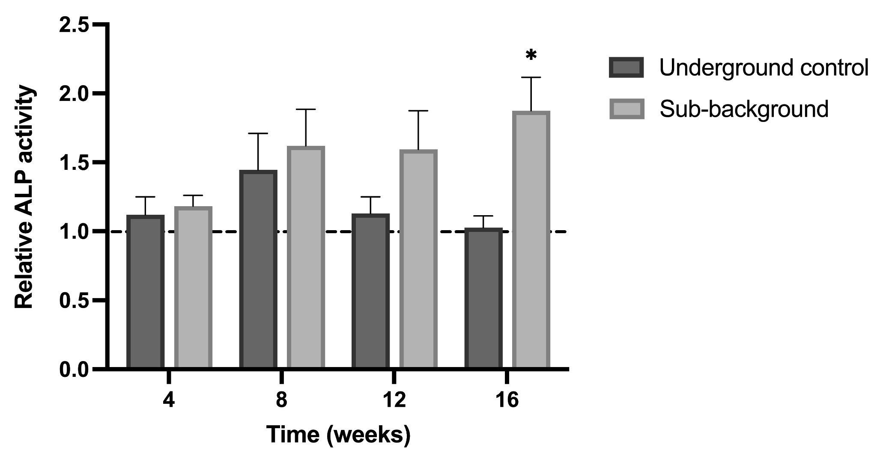
New science developments
Recently accepted for publication in
the journal: Radiation Research
5

Slide 6
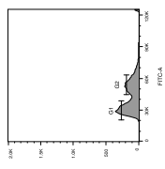
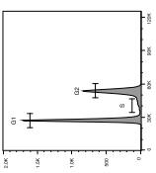
New science developments
Development of a flow-based assay for cellular ALPi activity
Comparison with conventional transformation assay for validation
Detect baseline transformation (~28/1,000,000)

Slide 7
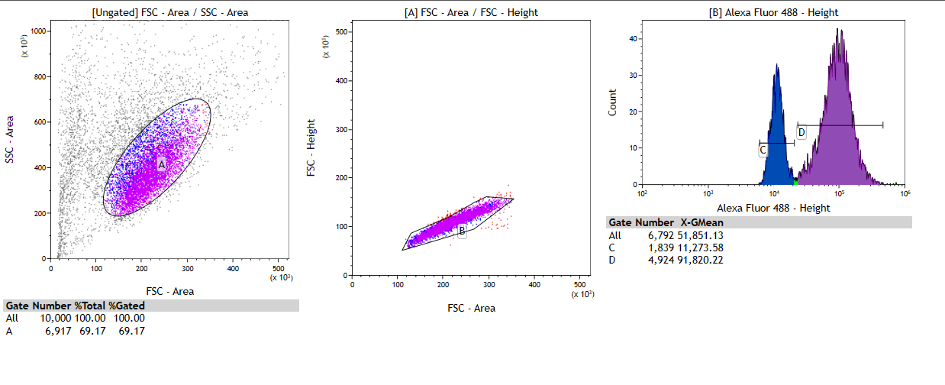
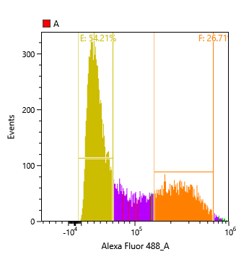
New science developments
Development of a flow-based assay for cellular ALPi activity:
Comparison with conventional transformation assay for validation
Detect baseline transformation (~28/1,000,000)
7

Slide 8
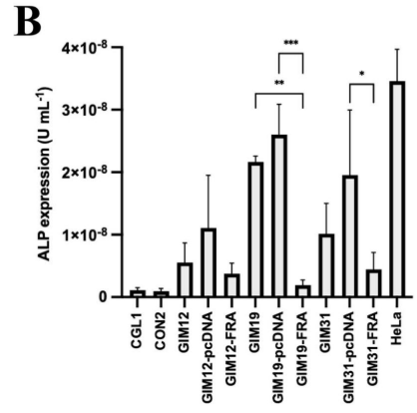
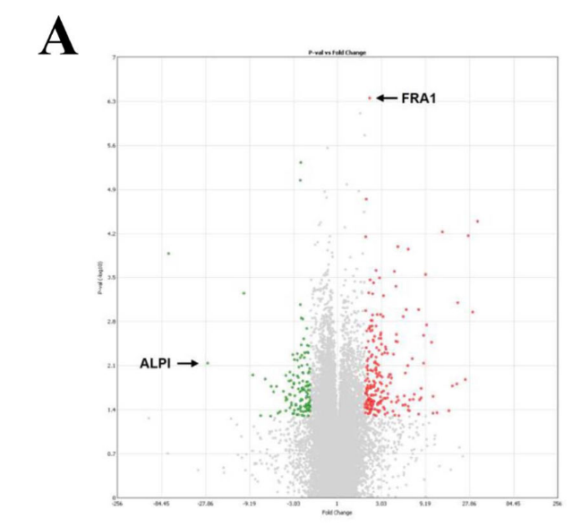
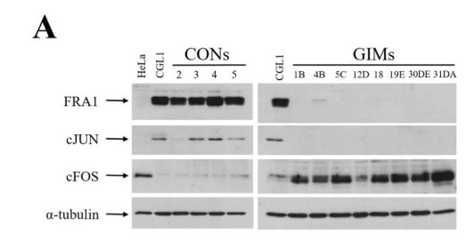
New science developments
Alternative markers:
Available upon request
cFos

Slide 9
Collaboration Health
Two new graduate and undergraduate students starting in the fall.
Three summer student working through August.

Slide 10
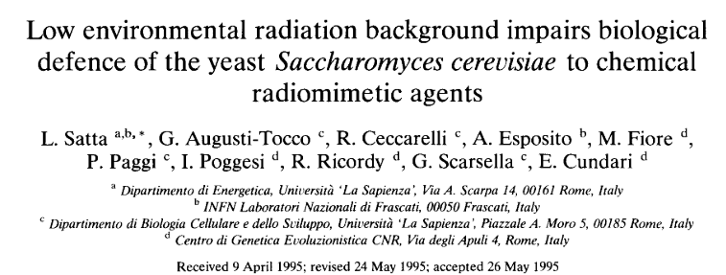
Experiment Status
Researching the Effects of the Presence and Absence of Ionizing Radiation
The Yeast Culturing Experiment
Two yeast strains:
Normal wild type
Radiation-sensitive rad51KO
Validating results from L. Satta et al. (1995) with modern assays and greater background reduction

Slide 11
Schedule impacts & milestones
August 7 - 9: Yeast pilot experiment setup
August 12 – 30: Yeast pilot experiment run
September – December: CGL1 experimental run with novel assay for neoplastic transformation

Slide 12
Challenges
Commissioning STCI for yeast work: risk of contamination, balancing gases
Recommissioning for cell work, same risks
Parental leave, training new students
Smooth operation (shutdowns, equipment failures)

Slide 13
Conclusion – any other pertinent business
Many new lab members
Novel yeast experiment in late summer
Novel cells biology experiment in fall
FLAME Update: low 40K yeast – fed flies

