Slide 1
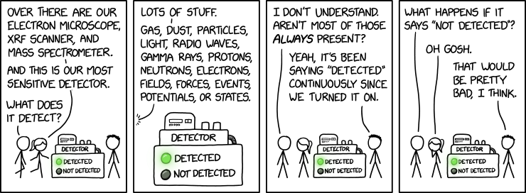
Interaction between particles and matter
Dr. Pierre Gorel
Students Orientation Session
Sept 10, 2026
With figures from William R. Leo, Techniques for Nuclear and Particle Physics Experiments
https://xkcd.com/3254/

Slide 2
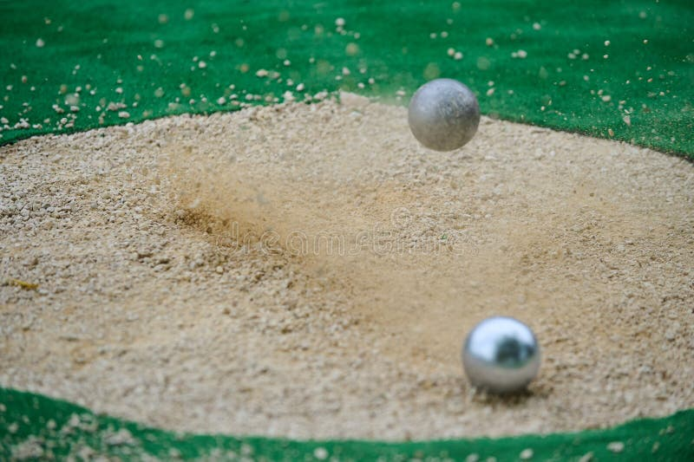
How are “particles” interacting with “matter” ?
Dreamstime.com

Slide 3
Why ?

Slide 4
We need to know the interactions because it is critical to design/understand our detectors
What is the signal I am looking?
What kind of background should I expect?
How can I shield the detector?

Slide 5
“Matter” can be…
Molecules
Crystals
Atoms
…
A large sphere of liquified noble gas 2km underground…

Slide 6
A non-exhaustive list of particles
Photons
Neutrinos
Electrons/positrons
Nuclei (Proton, α, recoil nuclei…)
Ions
Muons
WIMPs
…

Slide 7
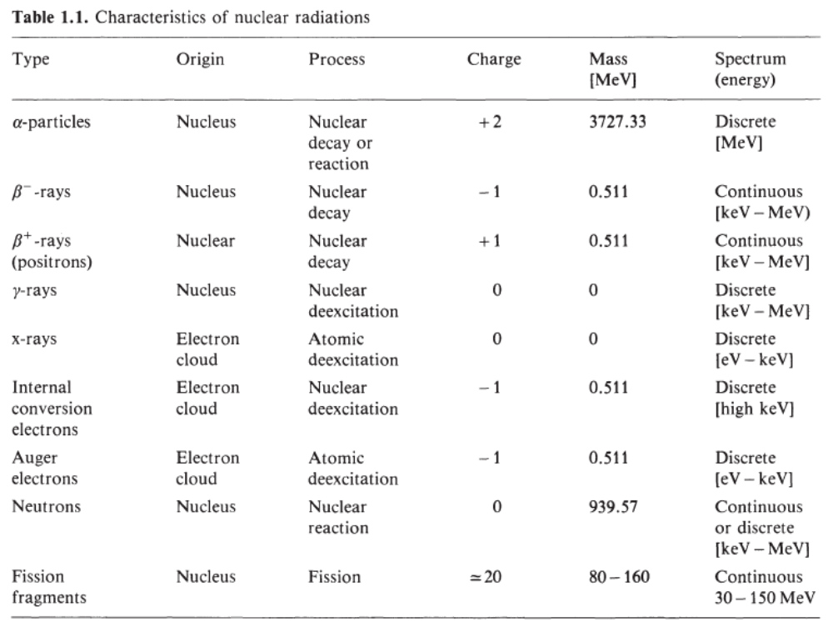
Natural radioactivity: broad source of particles
Electromagnetic: X-rays and γ-rays
Corpuscular: Electrons/Positrons, α-particles, neutrons, protons, fission fragments, muons, neutrinos…

Slide 8
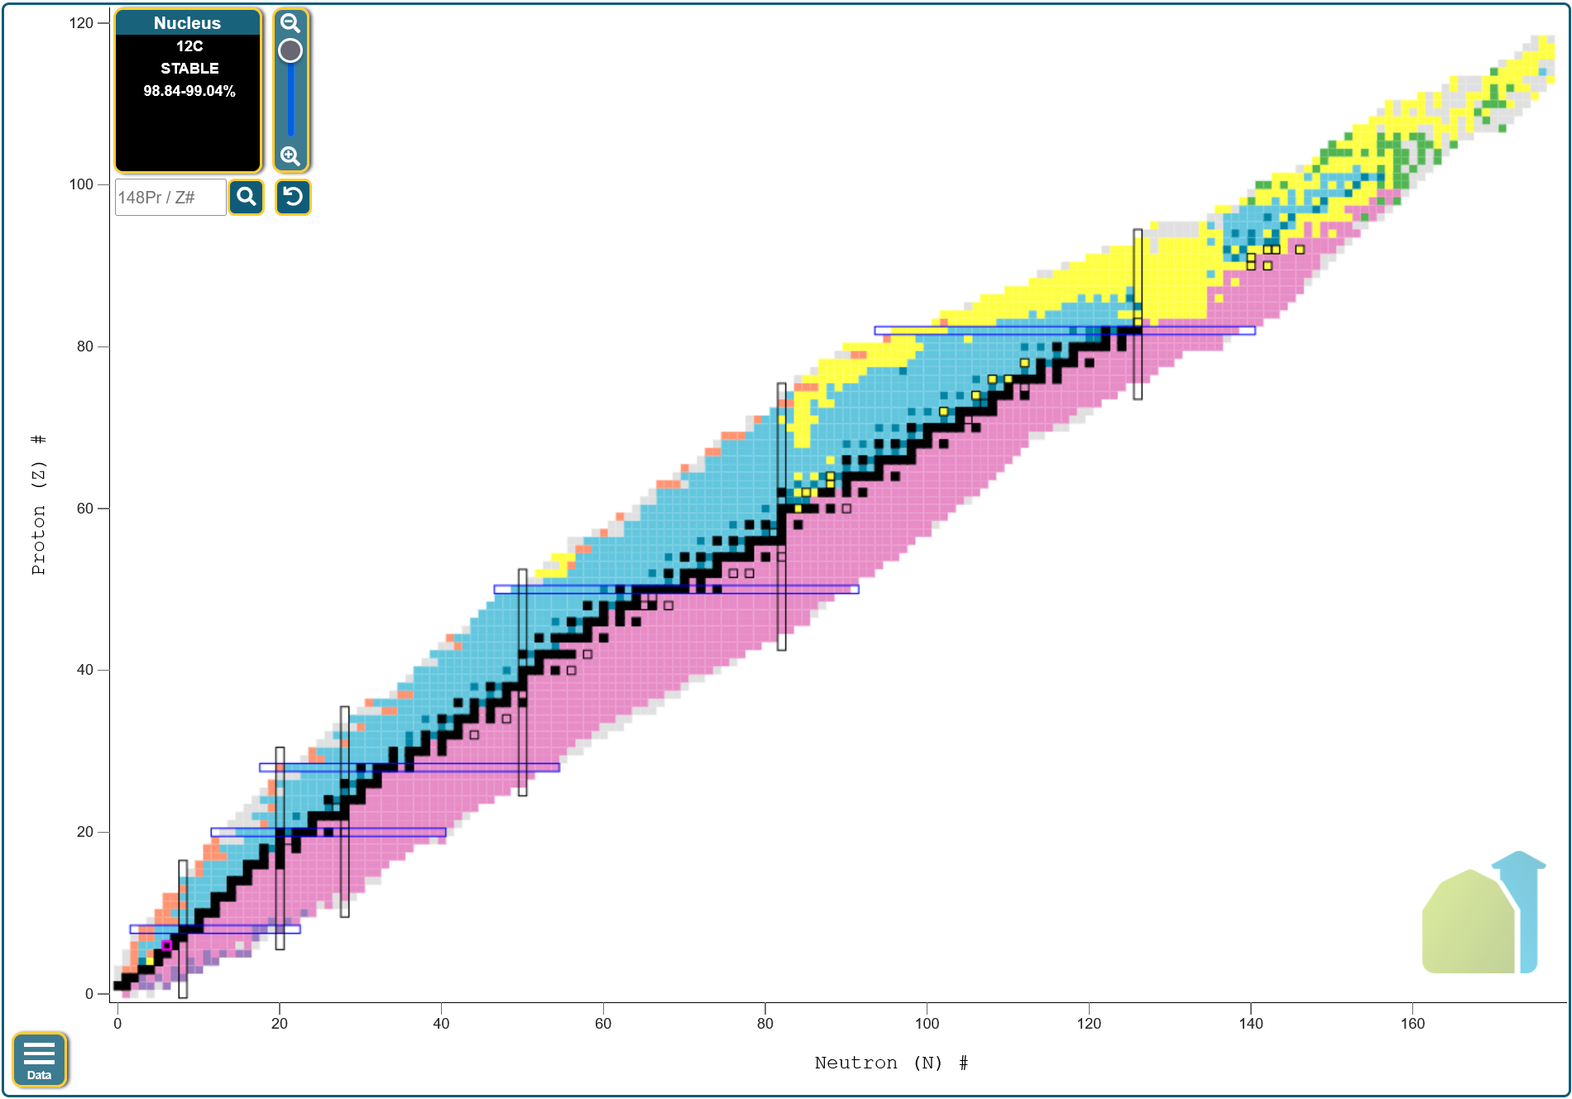
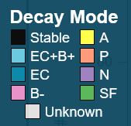
Chart of Nucleides
EC: electron capture
A: α-emission
B: β-emission
N: Neutron
P: Proton
SF: Spontaneous Fission
https://www.nndc.bnl.gov/nudat3/

Slide 9
Rutherford experiment: alpha on gold foil

Slide 10
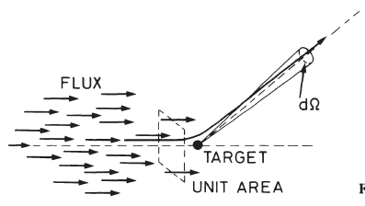




Cross section
Probability for scattering in a solid angle dΩ:
dσ has dimension of area, referred as
Cross section
Total cross section:
Large beam, homogeneous on target, with flux F : number of incident particle per unit of area, per unit of time
For a real material (many scattering centers):
Target area
Thickness
Density centers
For all angles:
If single particle on large target of thickness $δx$: $P_{int}=Nσδx$

Slide 11
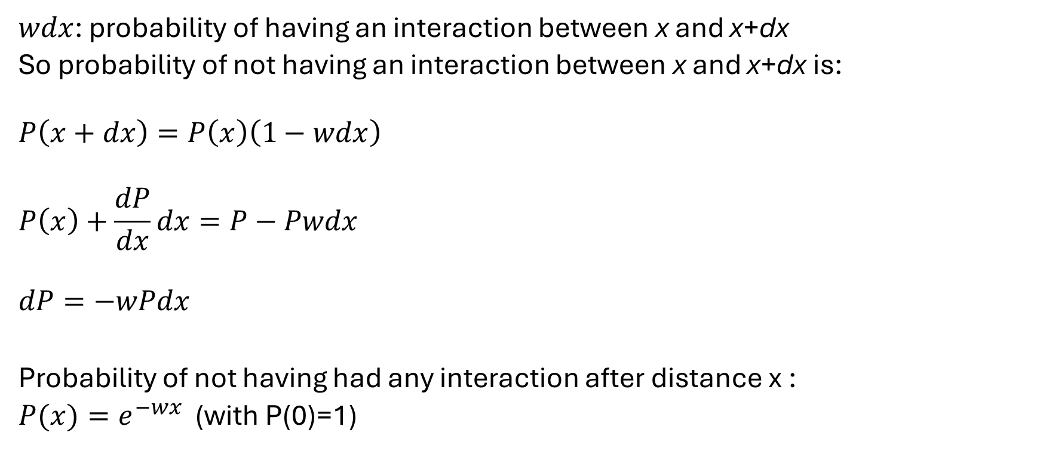
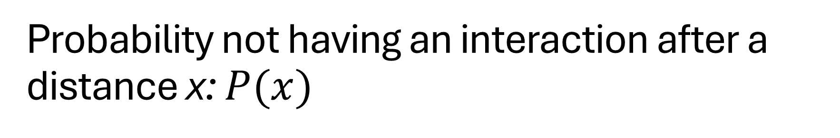
Probability not having an interaction after a distance x: $P(x)$
$wdx$: probability of having an interaction between x and x+dx
So probability of not having an interaction between x and x+dx is:
$$P\left(x+dx\right)=P\left(x\right)\left(1−wdx\right)$$
$$P\left(x\right)+\frac{dP}{dx}dx=P−Pwdx$$
$$dP=−wPdx$$
Probability of not having had any interaction after distance x :
$P(x)=e^{−wx}$ (with P(0)=1)

Slide 12
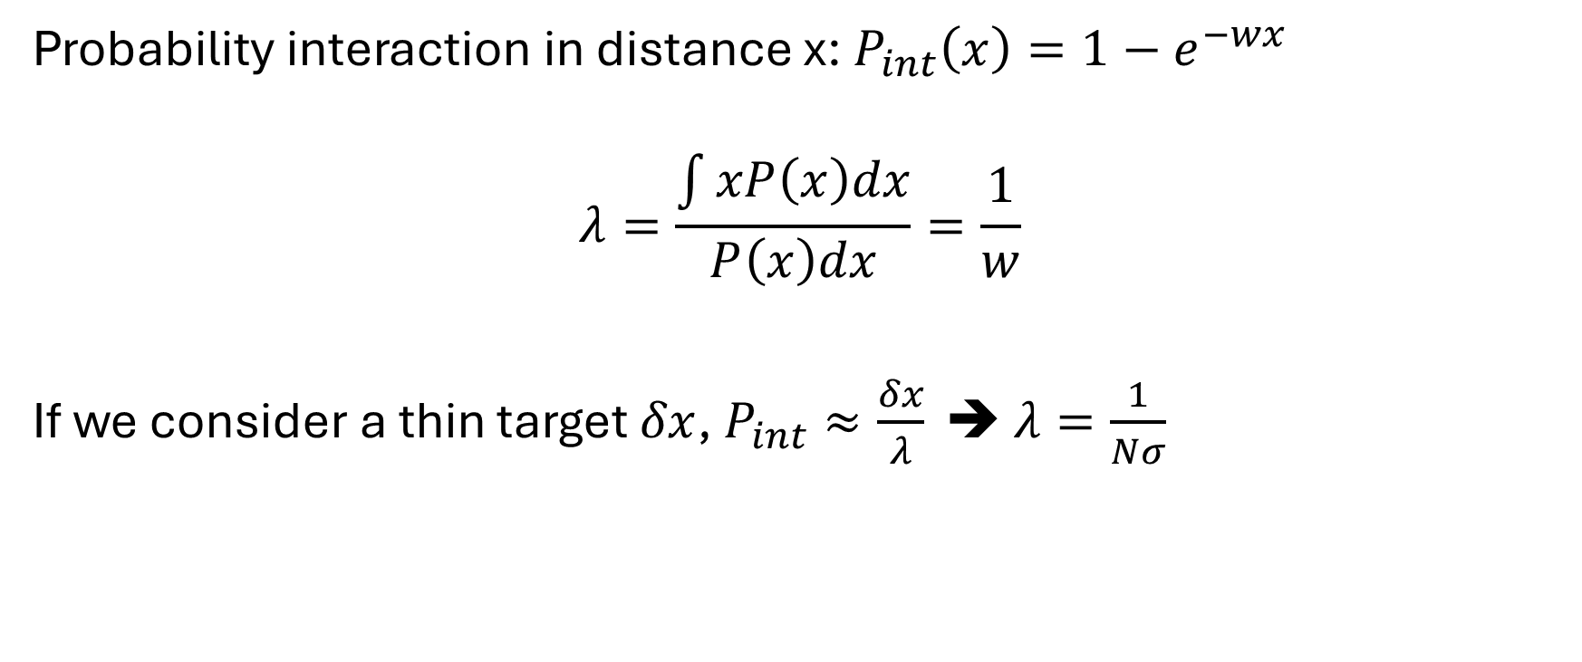
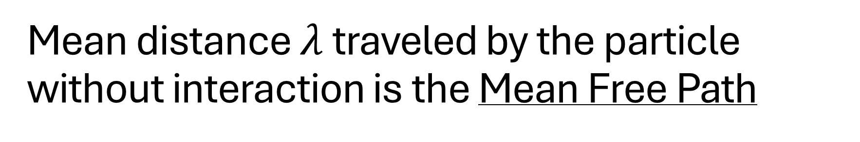
Mean distance $λ$ traveled by the particle without interaction is the Mean Free Path
Probability interaction in distance x: $P_{int}\left(x\right)=1−e^{−wx}$
$$λ=\frac{\int{xP\left(x\right)dx}}{P\left(x\right)dx}=\frac{1}{w}$$
If we consider a thin target $δx$, $P_{int}≈\frac{δx}{λ}$ ➔ $λ=\frac{1}{Nσ}$

Slide 13
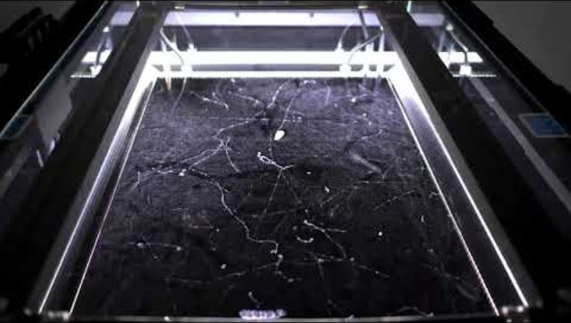
Cloud chamber

Slide 14
Charged particles through material (not e-)
Loss of energy
Change of trajectory
Also :
Cherenkov radiation
Nuclear reactions
Bremsstrahlung
Mainly due to :
Inelastic collisions with atomic e⁻
Elastic scattering from nuclei

Slide 15
Inelastic collisions responsible for most of the energy losses
Energy transferred from particles to atom ➔ excitation or ionization
Small transfer for each collision, but number of collisions large

Slide 16
Elastic collisions are less frequent
Large mass of the nucleus usually means that little energy is transferred

Slide 17
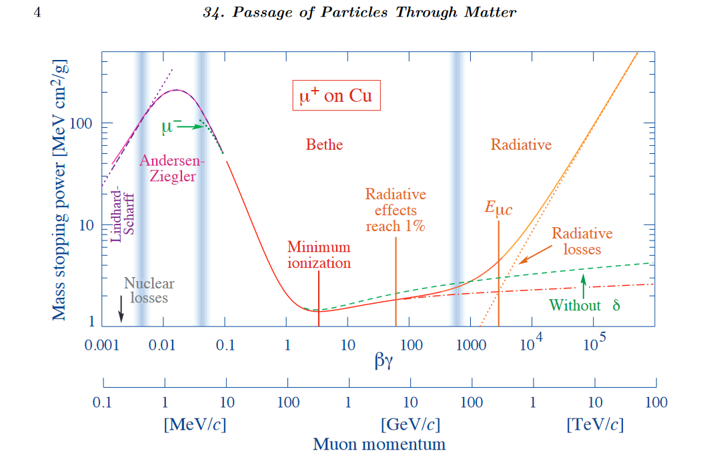

Stopping power or ${dE}/{dx}$
Large number of collision
fluctuation in the energy losses are small
Easier to work with the average energy loss per unit path length
Bethe-Bloch Formula:

Slide 18
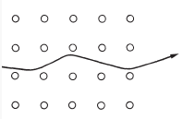
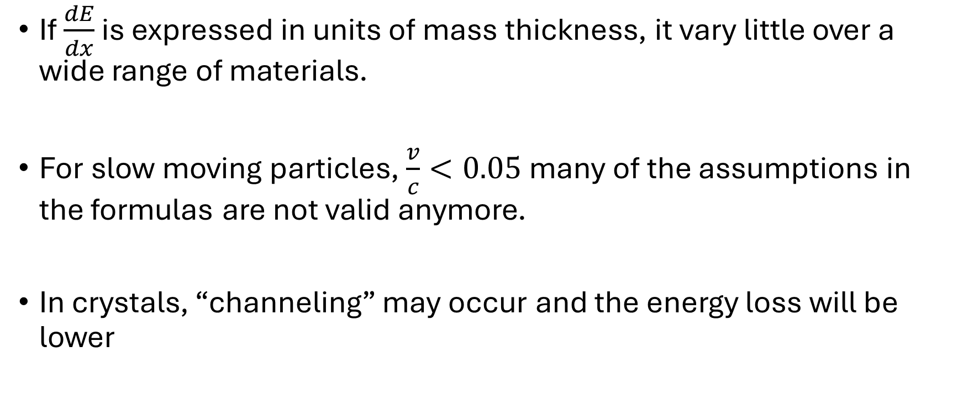
Remarks on the Bethe-Bloch formula
If $\frac{dE}{dx}$ is expressed in units of mass thickness, it vary little over a wide range of materials.
For slow moving particles, $\frac{v}{c}<0.05$ many of the assumptions in the formulas are not valid anymore.
In crystals, “channeling” may occur and the energy loss will be lower

Slide 19
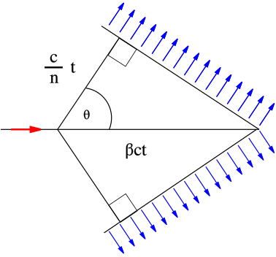
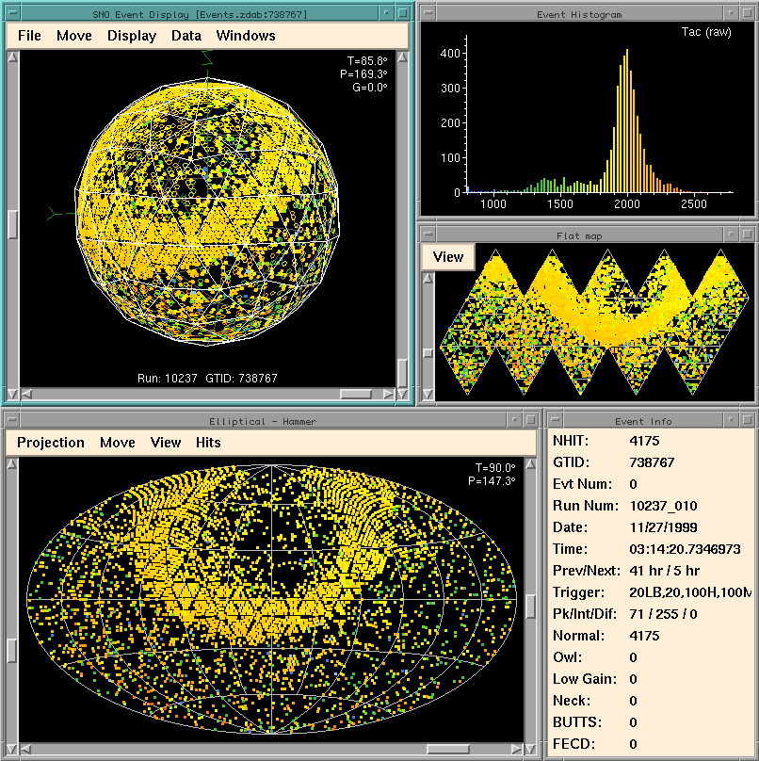
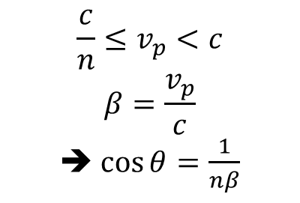
Cherenkov Radiation
$$\frac{c}{n}≤v_{p}<c$$
$$β=\frac{v_{p}}{c}$$
➔ $\cos{θ=\frac{1}{nβ}}$
“Sonic Boom” of light
Particle must be traveling faster than the speed of light in the medium
Light is emitted only at angle θ
An upward-going contained event in SNO

Slide 20
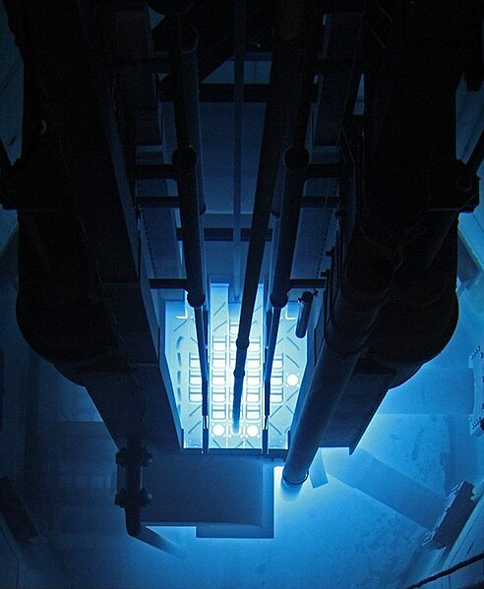
Cherenkov Radiation
“Sonic Boom” of light
Particle must be traveling faster than the speed of light in the medium
Light is emitted only at angle θ_{c}
Extremely weak source of light

Slide 21
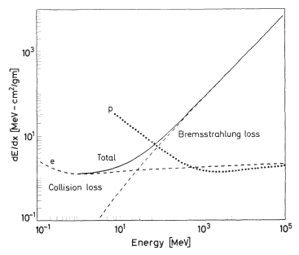
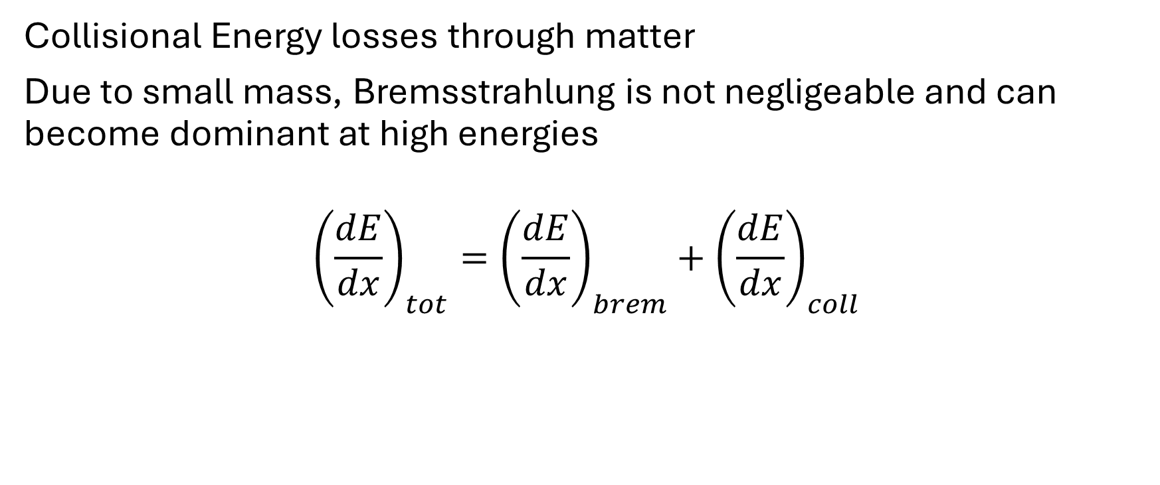
Electrons and Positrons
Collisional Energy losses through matter
Due to small mass, Bremsstrahlung is not negligeable and can become dominant at high energies
$${\left(\frac{dE}{dx}\right)}_{tot}={\left(\frac{dE}{dx}\right)}_{brem}+{\left(\frac{dE}{dx}\right)}_{coll}$$
Modified Bethe-Block formula

Slide 22
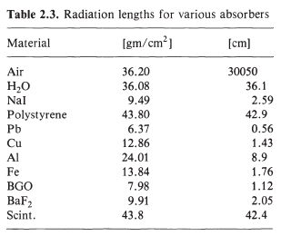
Radiation length: distance at which e- energy is divided by 2

Slide 23
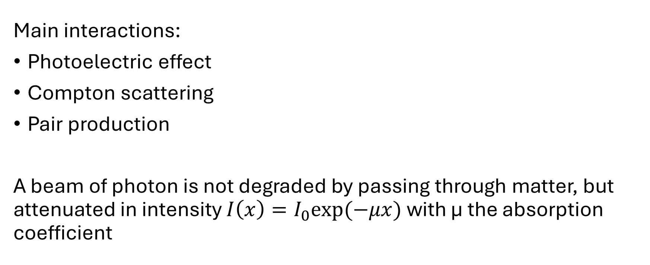
Photons (X-rays and ϒ-rays)
Main interactions:
Photoelectric effect
Compton scattering
Pair production
A beam of photon is not degraded by passing through matter, but attenuated in intensity $I\left(x\right)=I_{0}exp⁡(−μx)$ with μ the absorption coefficient

Slide 24
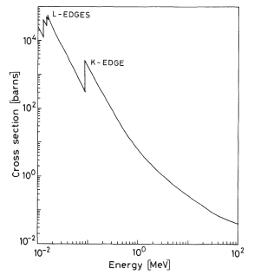
Photoelectric Effect
Photon is absorbed by atom, electron is released
Electron has energy equal to photon energy – atomic binding energy

Slide 25
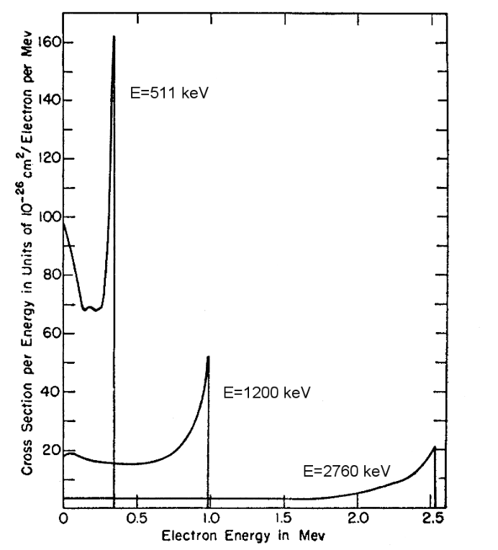
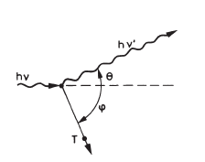
Compton Scattering
Photon bounces off an electron like billiard balls
Exit direction of photon determines energy of photon and electron.
Electron Energy

Slide 26
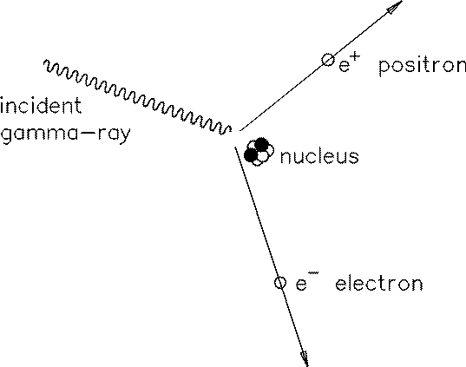
Pair Production
Incident photon converts into an electron-positron pair
Only possible in the presence of matter to conserve momentum
Only possible if gamma ray energy is > 1 MeV
Positron will quickly annihilate with an electron, producing 2 gamma rays with 511 keV each

Slide 27
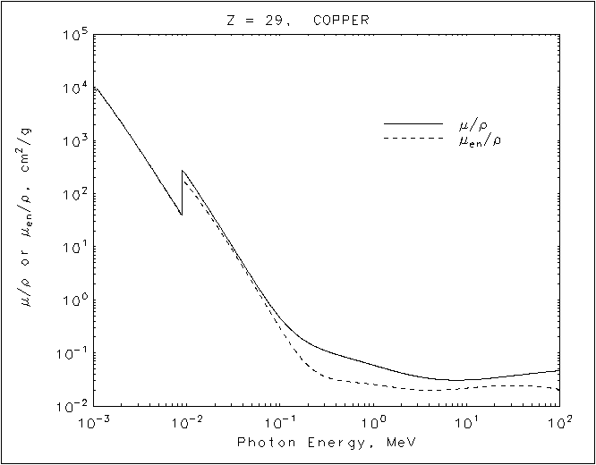
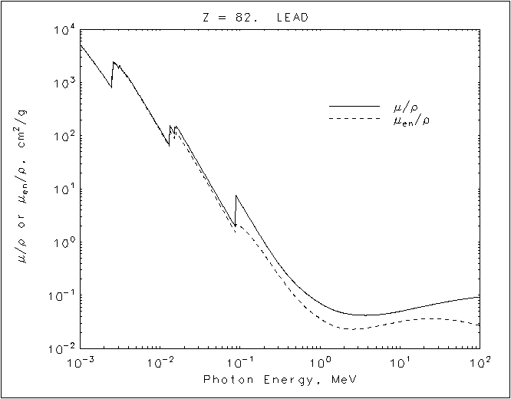
Photon Attenuation
At 1 MeV, gamma rays are attenuated by 1/e at 1.9 cm in copper.
At 1 MeV, gamma rays are attenuated by 1/e at 1.2 cm in lead.

Slide 28
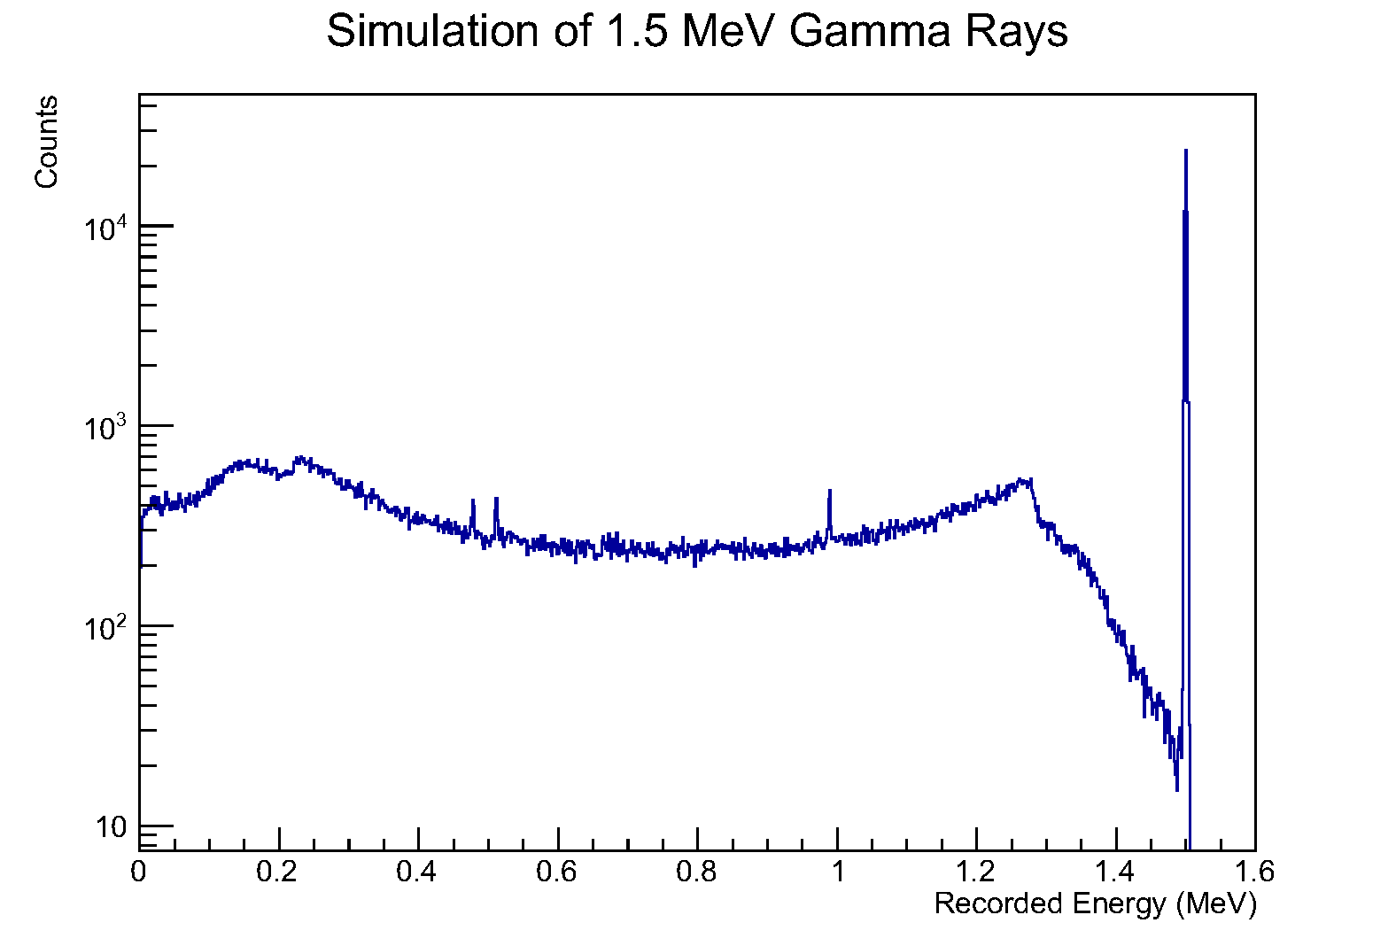
Photoelectric Peak (E)
Annihilation Peak (0.511)
Double Escape Peak (E – 1.022)
Escape Peak (E – 0.511)
Compton Scattering
Multiple Compton Scattering
Line widths are usually set by the resolution of the detector.
Germanium detectors have resolutions of 1 to 3 keV.

Slide 29
Muons (and anti-muon)
Same charge as electron, 206 times more massive
Unstable: half-life ~1.5μs
Deeply penetrating (hence the depth of SNOLAB)
Created in accelerator or when high energy particles interact with atmosphere (“shower”)
Nuclear reactions will create radioactive elements and neutrons

Slide 30
Neutrons
No charge!
Energy transfer through atomic collisions
Max energy transfer to with light nuclei
Best shielding with H-rich material
Decays or get absorbs, producing ϒ-rays

Slide 31
Common Interactions at SNOLAB
Comic Ray muons
  Produced in the atmosphere by cosmic rays (extremely energetic protons)
  Travel through the detectors
  Deposit tons of energy
  Can break up nuclei (spallation) which releases neutrons, and can activate other materials
Alpha Decays
  Nuclear decay that releases a helium-4 nucleus
  Very energetic
  Very short-ranged (mm in material)
Beta Decays
  Nuclear decay that releases an electron or positron (and neutrino)
  Range of around 10 mm
Gamma Decays
  De-excitation of a nucleus after another decay
  Highly penetrating
Neutrons
  Very rarely released
    fission decays
    spallation
    alpha particle interactions
  Highly penetrating
  Detected as either nuclear recoil or capture on another nucleus

Slide 32
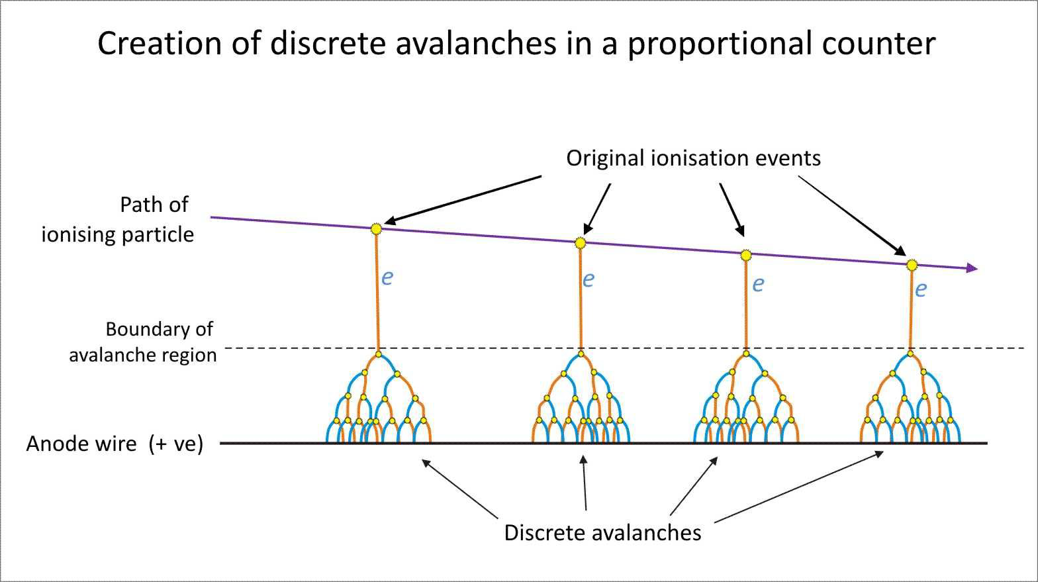
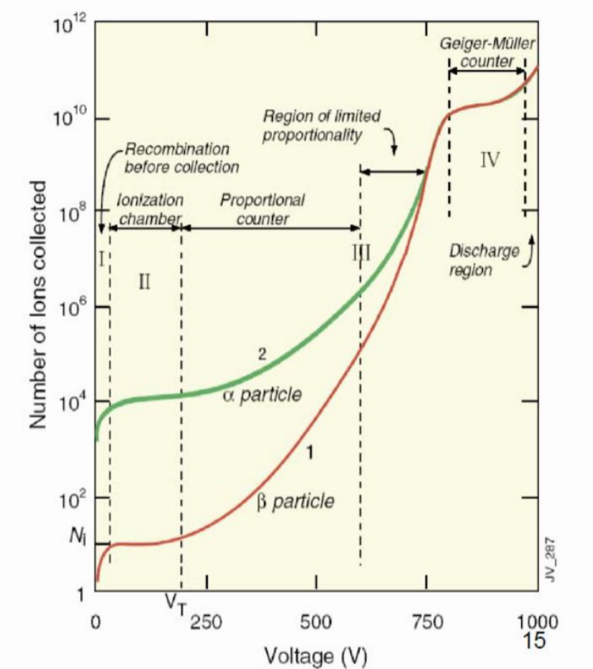

Gas detectors
$$E\sim 1/r$$
+V
Charge amplification by avalanche, readout on the wire
Proportional Mode: signal proportional to ionization,
Limited Proportional Mode: strong photoemission,
Geiger-Muller Mode: massive photoemission, discharge

Slide 33
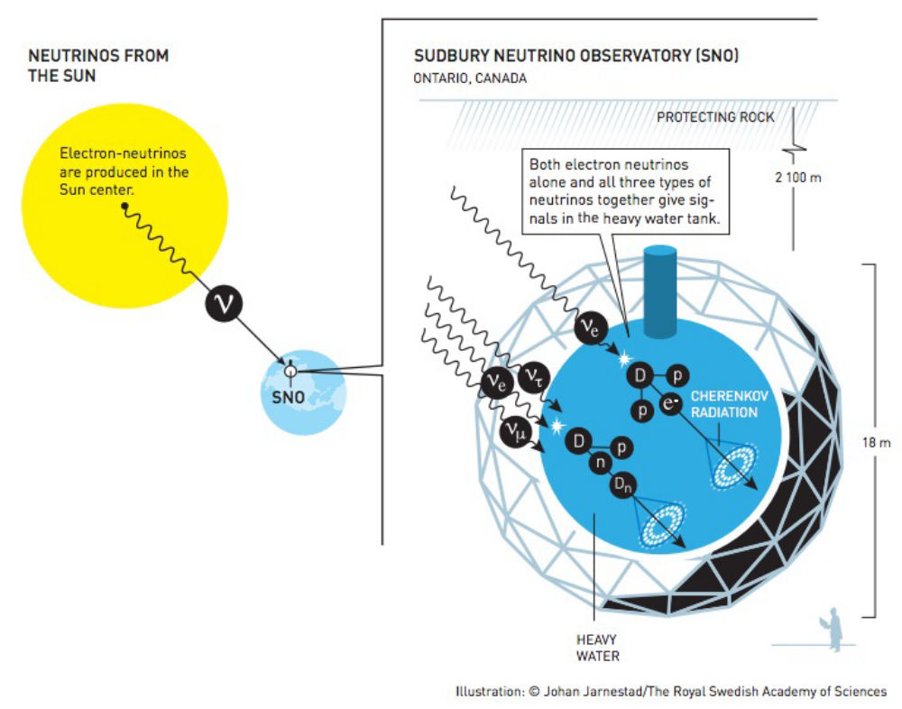
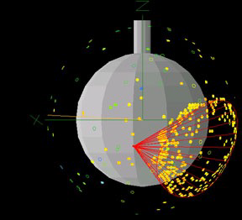
Photo detectors: Cherenkov
Light emitted by particles travelling at a speed higher than the speed of light in the material.

Slide 34
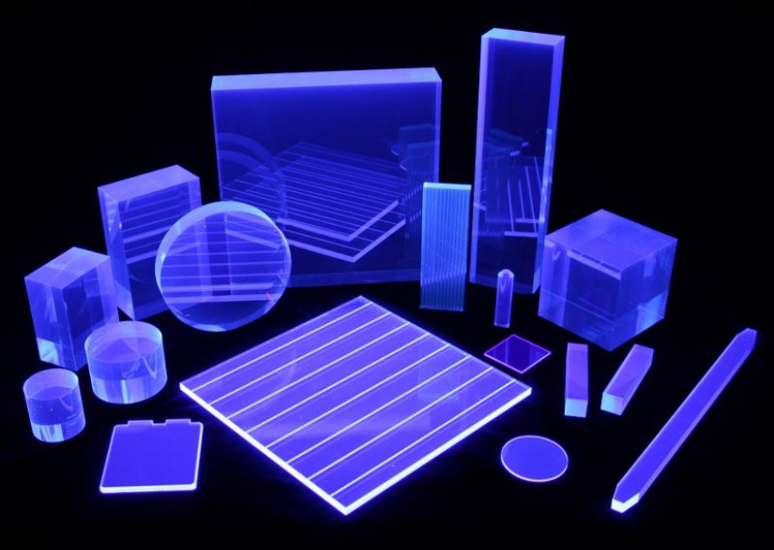
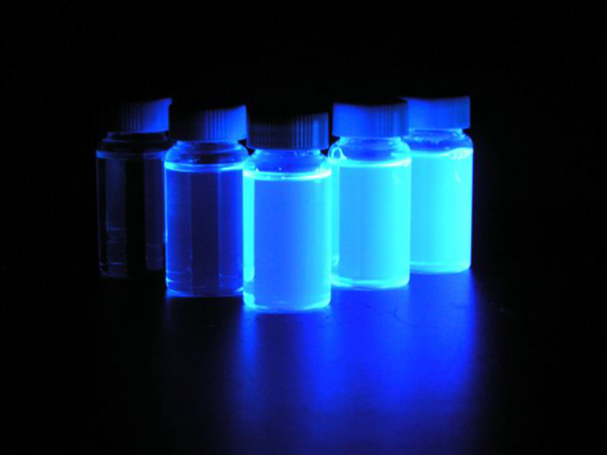
Photo detectors: scintillators
Inorganics scintillators: Usually crystals
Better energy resolution
Can have higher density (better stopping power)
Organic scintillators: plastic/liquid
Better timing information
Can be made large

Slide 35
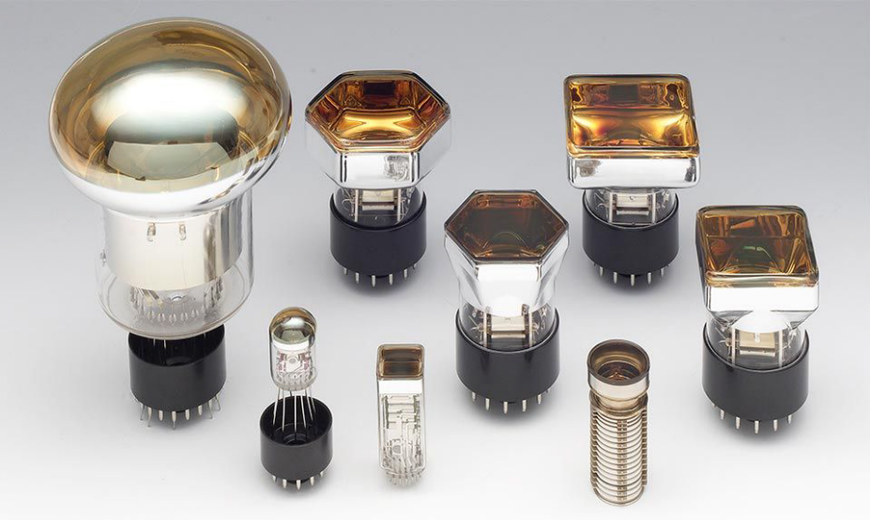
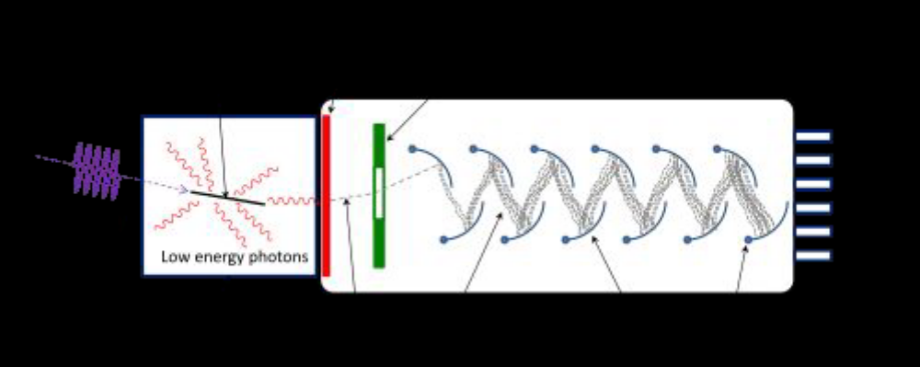
Photo detectors: light detection
Photomultiplier tubes (PMTs)
Photon converted to electron by photocathode
Electron(s) accelerated, striking dynodes => amplification
Voltage typically 1000-2000V
Gain 10⁵-10⁷
Sensitive to magnetic field !

Slide 36
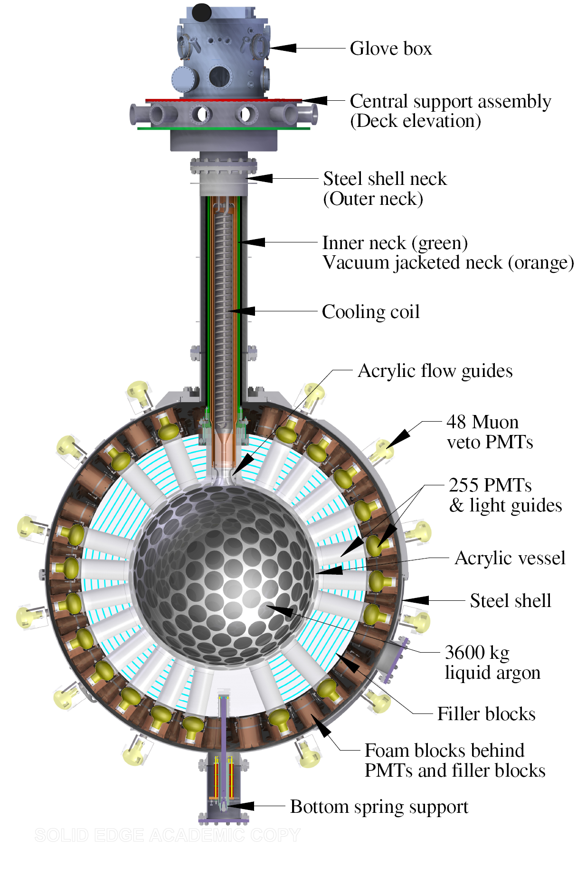
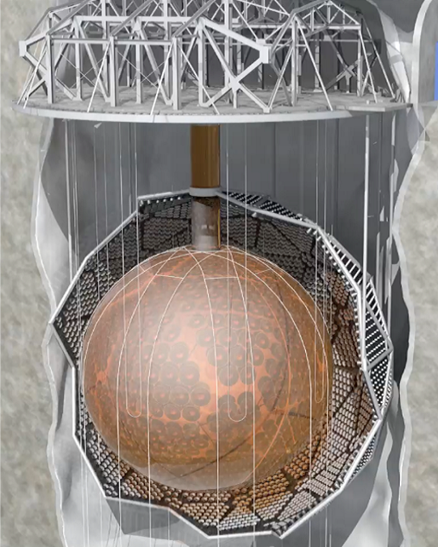
SNO+ and DEAP 3600
Water-filled cavity
780t of liquid scintillator
(LAB)
~10000 PMTs
Ø12m acrylic vessel
Credit: SNO+
Credit: DEAP-3600

Slide 37
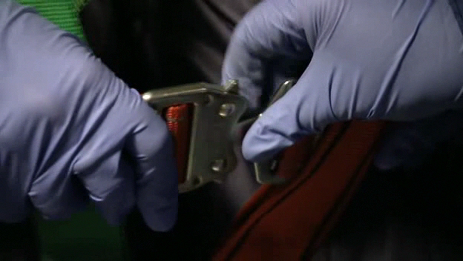
Quick peak into the SNO/SNO+ vessel

Slide 38
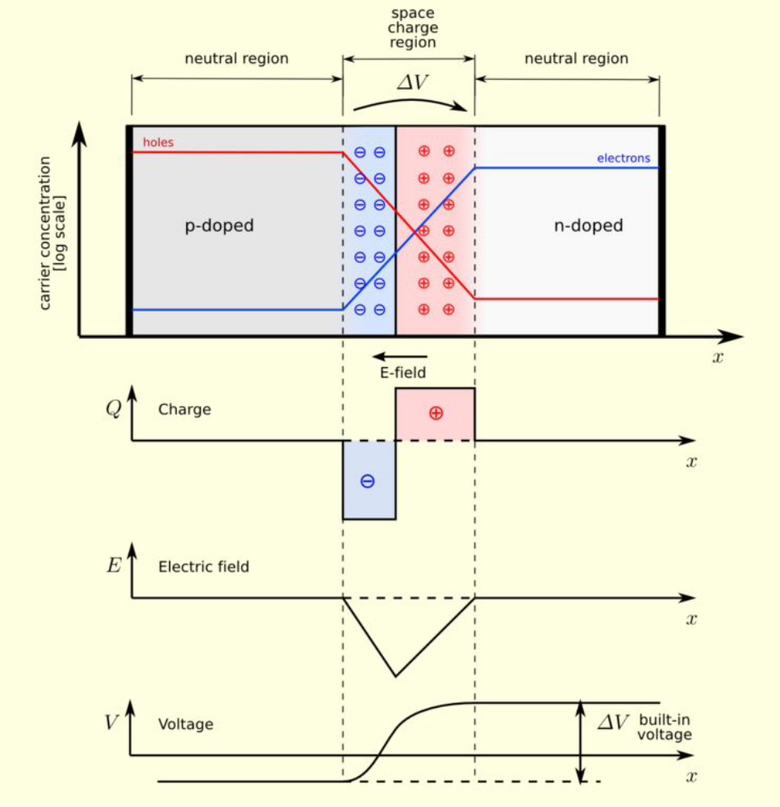
Junction diode
Ge and Si detectors forms crystals with 4 co-valence bound with neighbors
N-type semiconductor: doping with valence 5 atoms => extra electrons available
P-type semiconductor : doping with valence 3 atoms => extra holes.
P- and N- type semiconductors put together => junction diode
Credit: wikipedia

Slide 39
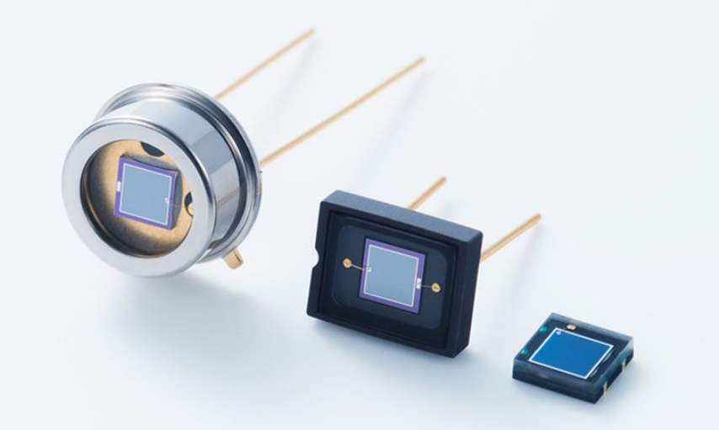
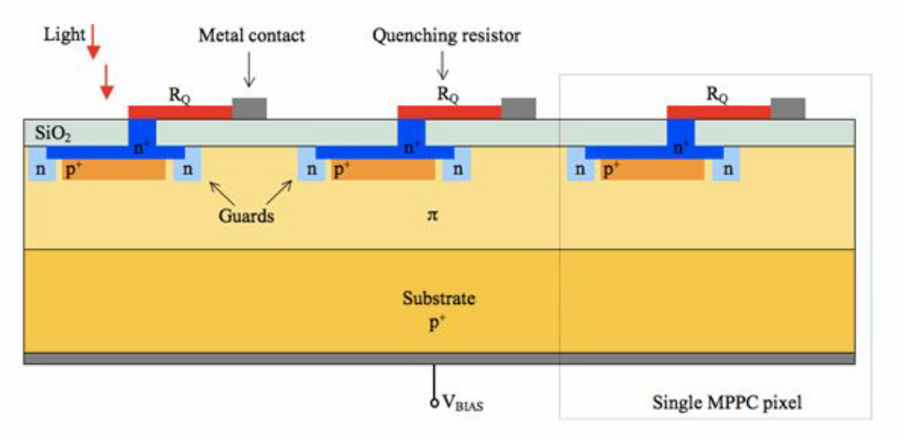
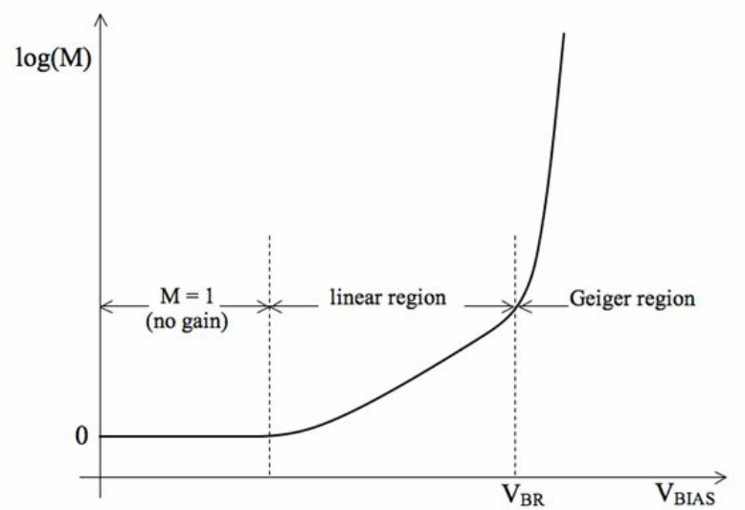
Photo detectors: light detection
Silicon Photomultipliers (SiPM)
Electron/pair production
Voltage typically 50V
Gain 10⁵-10⁷
Insensitive to magnetic field

Slide 40
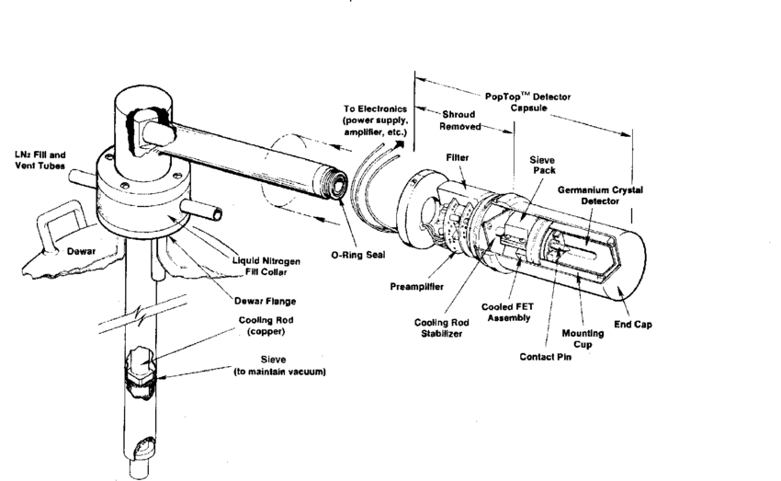
Ionization: solid states detectors, in LN2
Prevents migration of dopants
Decreases dark currents
High-purity crystal:
large sensitive volume
~1%
~10%
From: Radiation detections and measurements, G.F. Knoll

Slide 41
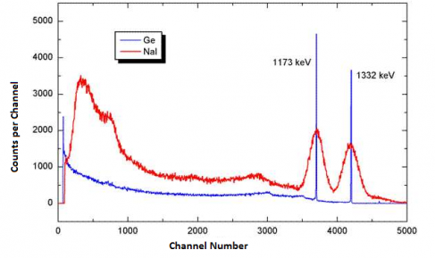
Ionization: solid states detectors, in LN2
Prevents migration of dopants
Decreases dark currents
High-purity crystal: large sensitive volume
Improve resolution:
=> precision spectroscopy
~1%
~10%
Cobalt 60 spectroscopy

Slide 42
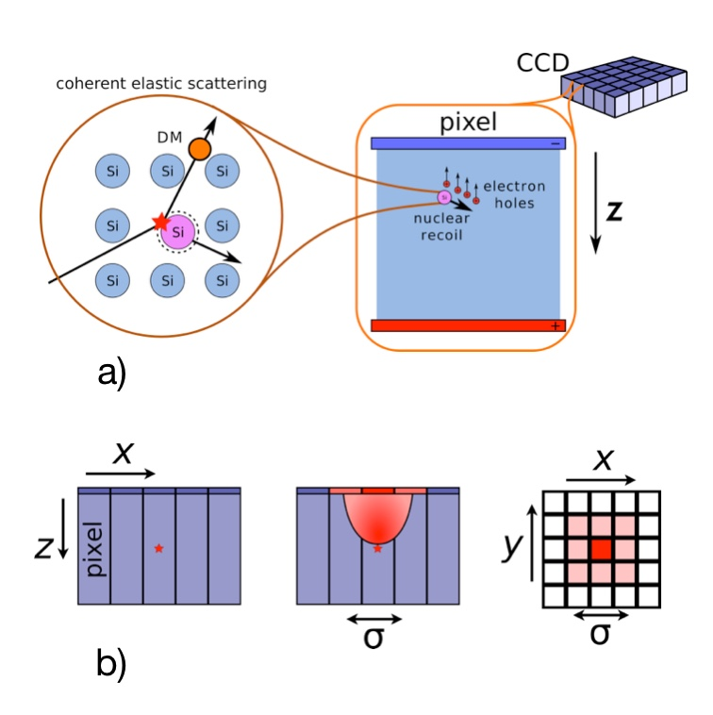
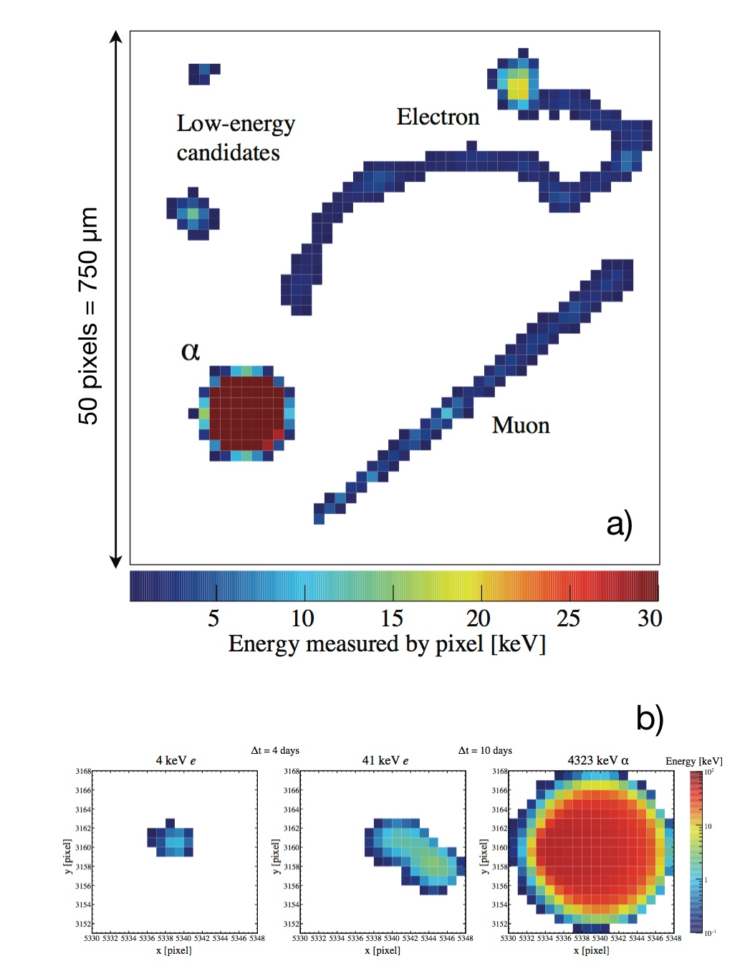
Ionization: solid states (CCDs)
Credit: DAMIC
Credit: DAMIC

Slide 43
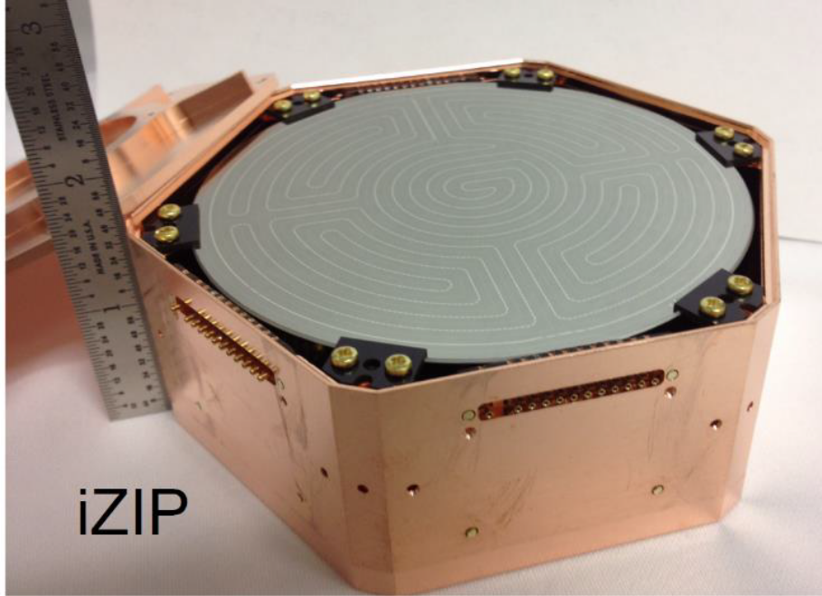
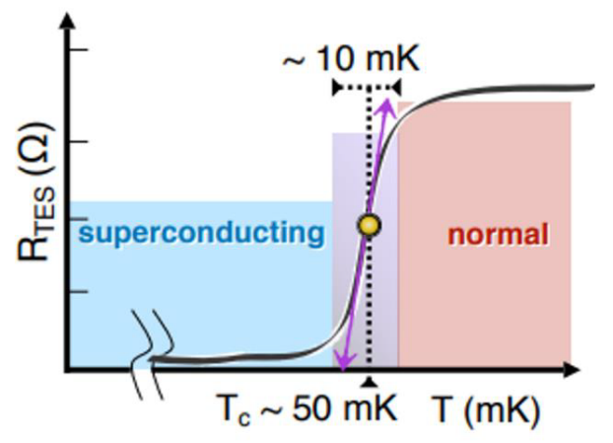
Thermal detector: solid states
Requires temperatures ~10mK
Detecting phonons (heat quasi-particles)
Readout through Transition Edge sensors
=> superconductor becoming conductors when receiving phonons
Best possible energy resolution/sensitivity
Credit: SuperCDMS

Slide 44


Thermal detector: bubble chambers
Superheated fluid: geyser
Detection:
high speed cameras
Piezo transducers (sound)
Credit: PICO

