Slide 1
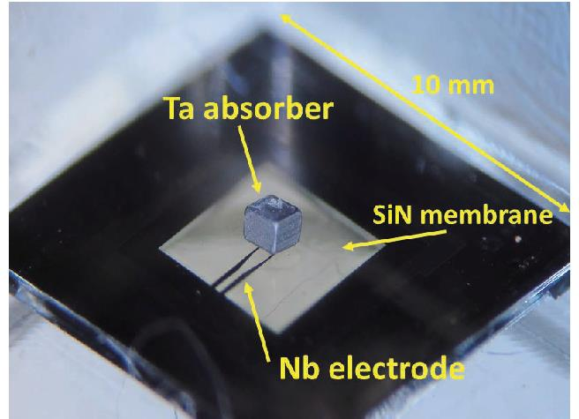
Establishing Transition-Edge Sensor (TES) Technology for Advanced Nuclear
Detection at CNL
TES Coupled with Tantalum Absorber for γ-ray spectroscopy
Zahra Yamani
Canadian Nuclear Laboratories
Wednesday, June 26, 2024
SNOLAB User Meeting 2024
June 26-27, 2024
Superconducting Ir/Au bilayer film is deposited on the silicon nitride membrane.
https://www.jstage.jst.go.jp/article/transele/E100.C/3/E100.C_283/_article

Slide 2
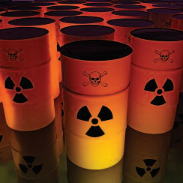
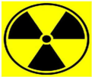
Presentation outline
Introduction
    Canadian Nuclear Laboratories
    Nuclear detection
    Current technologies
TES detectors
    Nuclear applications of TES detectors (γ-ray, α-particles, neutrons, neutrinos…)
    Principles and operation (advantages and challenges)
    Our work so far
Collaborative opportunities
Conclusions
Nuclear Detection

Slide 3
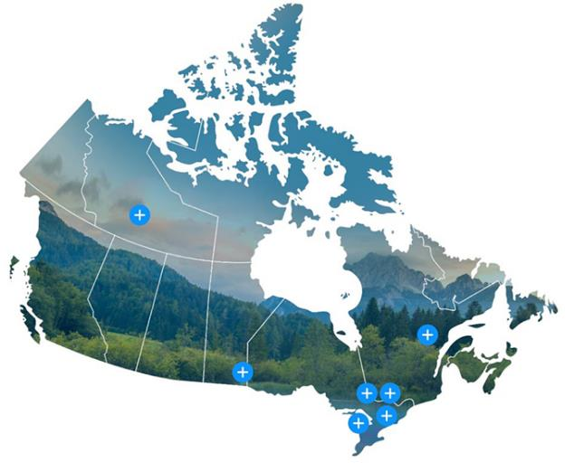

CNL Laboratories and Project Sites across Canada
Chalk River Laboratories, Ontario
Whiteshell Laboratories, Manitoba
Historic Waste Program, Port Hope, Ontario
National Innovation Centre for Cybersecurity, New Brunswick
Prototype reactors and legacy facilities
Chalk River Laboratories is the single largest science and technology laboratory in Canada:
  ~ 9,000 acre site (~200 acre lab complex) with 17 nuclear facilities, 70 major buildings.
  ~3,100 employees including 1,600 scientific, engineering, and technical staff (expertise in physics, metallurgy, chemistry, biology and engineering, etc.).
https://www.cnl.ca/
DOCUMENT SECURITY IDENTIFIER

Slide 4
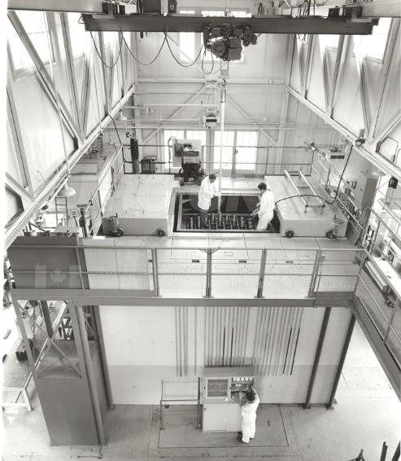
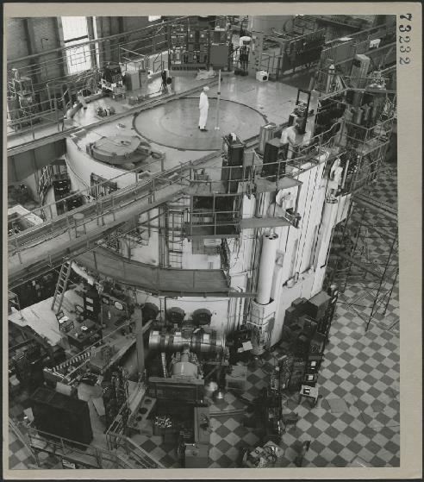
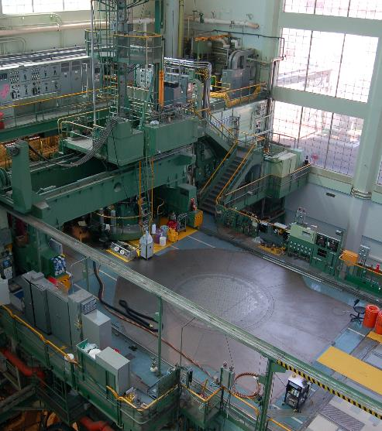
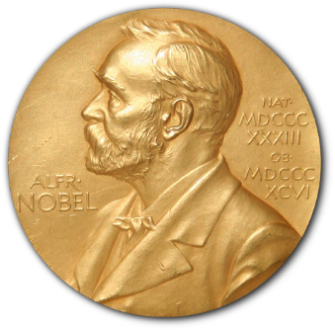
CNL origins go back to early 1940s
ZEEP: 1st reactor outside USA (first critical in 1945 with final shutdown in 1970)
NRX: a research reactor started at 10 MW in 1947 and reached 42 MW by 1954 before permanent shutdown in 1993.
NRU: a major research reactor at 135 MW was first critical in 1957 and permanently shut down in 2018.
Major accomplishments:
  Medical isotopes: more than 500 million treatments
  CANDU Industries
  Materials research with neutron beams
DOCUMENT SECURITY IDENTIFIER

Slide 5
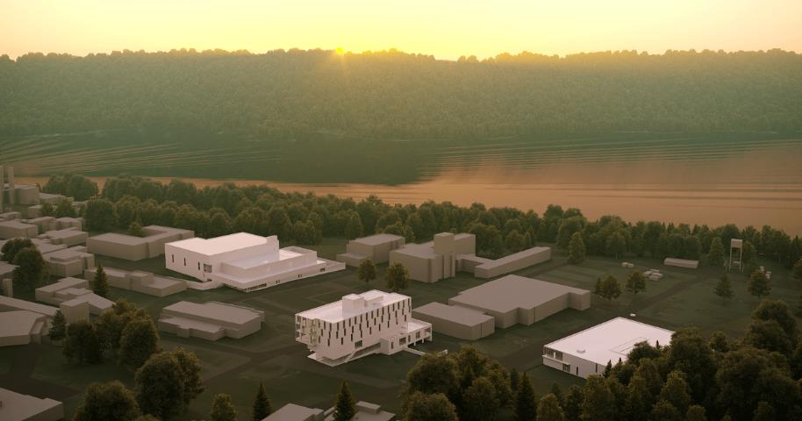
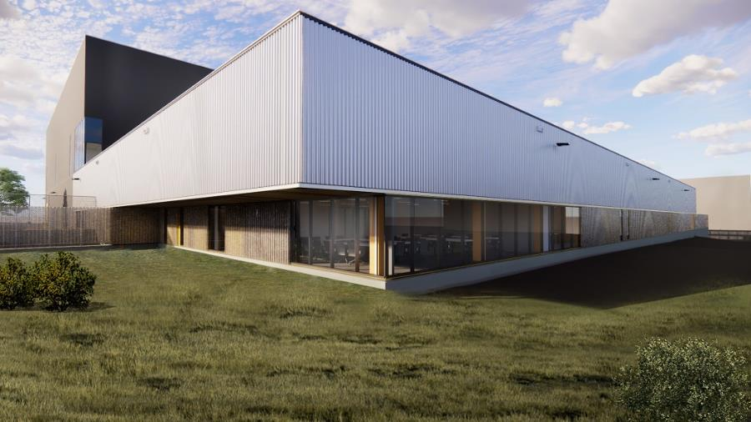
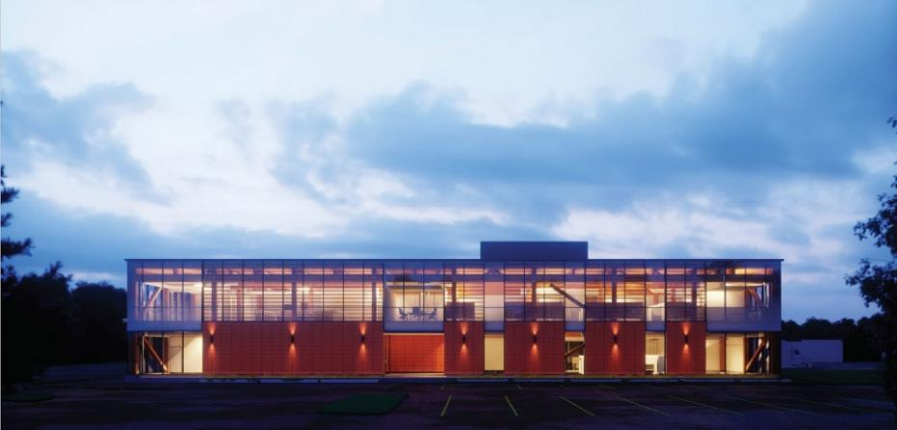
CNL is revitalizing the Chalk River Laboratories campus
The ANMRC will be Canada's largest nuclear research facility. It will hold 23 laboratories, 160 personnel, and essential skills from decommissioning facilities at the site. Construction is expected to finish in April 2028.
https://www.cnl.ca/about-cnl/revitalization-of-the-chalk-river-laboratories/

Slide 6
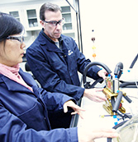
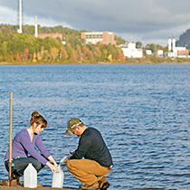
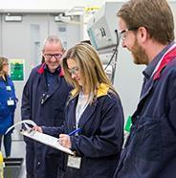




CNL Strategic Priorities: Vision 2030
Restore and protect Canada's environment
Conducting the largest and most complex environmental remediation in Canada, spanning three provinces
Clean energy for today and tomorrow
Support CANDU and LWR industry; SMR/vSMR demonstration; advanced fuel and materials; and hydrogen sciences
Contributing to the health of Canadians
Ac-225 radioisotope program and radiobiology

Slide 7
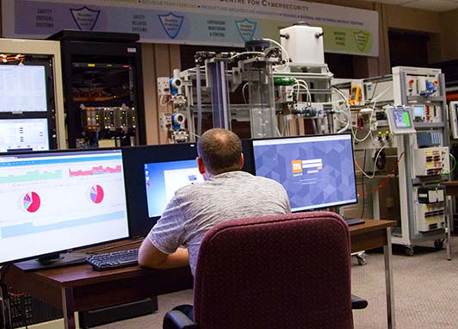







Overview: Science & Technology at CNL
S&T Directorates
Reactor Fleet Sustainability
Advanced Reactors
Hydrogen and Tritium Technologies
PROJECT OFFICES
Isotopes, Radiobiology & Environment
Small Modular Reactor Project Office
Safety & Security
Isotopes Production Project Office

Slide 8
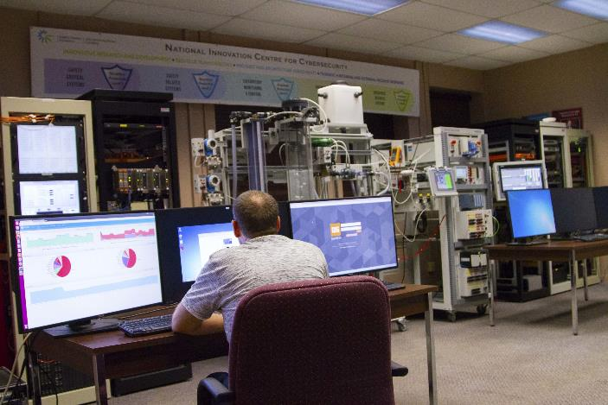
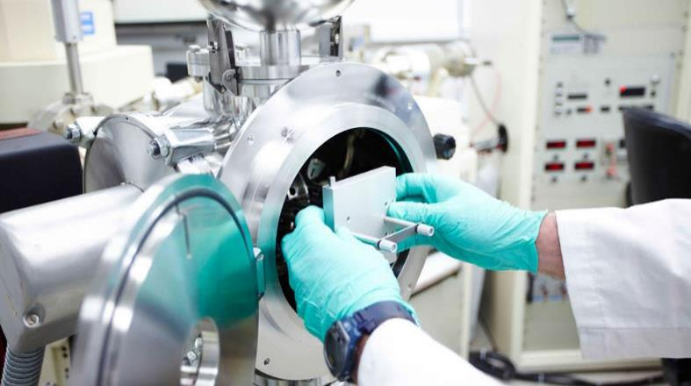
CNL’s Safety & Security
Cyber Security
Nuclear Detection, Forensics and Response
Cyber security of industrial control systems for nuclear and non-nuclear critical infrastructure.
A multimillion-dollar cyber security research facility in New Brunswick, including a safe plant display.
Partnerships with U of New Brunswick, and Canadian Institute for Cybersecurity.
Created a real-time process control distributed control systems testing platform.
Used cyber security to examine process environments in real time.
Detection and interception of special nuclear materials in transit.
Advanced CBRNE threat detection techniques.
Innovation in safeguards and security required for the deployment of advanced reactors.
Nuclear forensics signatures and analysis methods.
Methodologies and support for international nuclear treaties.
Emerging technologies including quantum (e.g., TES detectors).

Slide 9
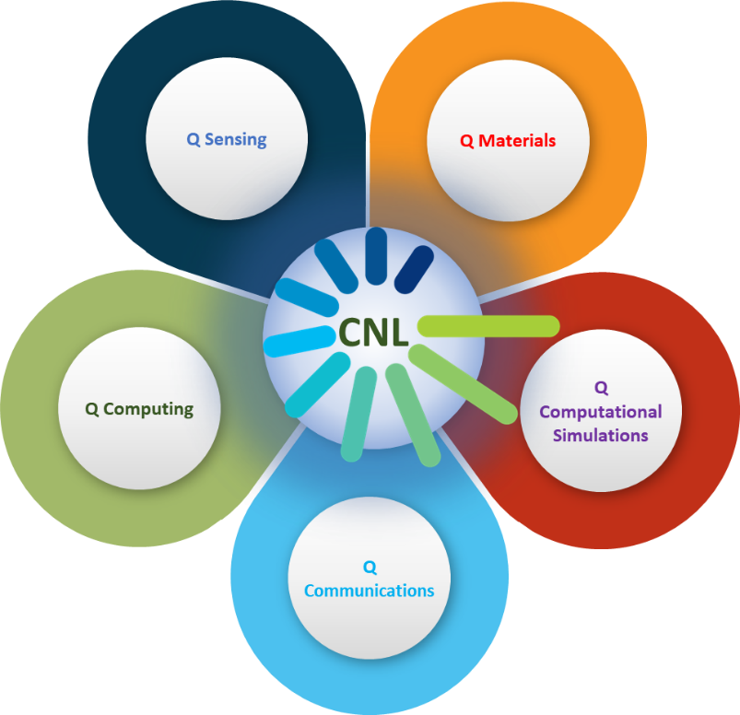
Recent Quantum Technology Developments at CNL
A cross-directorate effort (S&SD and ARD).
Team building (and growing).
Literature review and idea generation.
Engagements with key stakeholders (e.g., understanding defence’s needs and priorities).
Exploring and establishing collaborations (e.g., CNL-Waterloo Quantum Horizon Workshop Oct 30 – Nov 1, 2023).
Funding from FNST, CSSP, and CNL’s LDST streams.
Developed a CNL road-map for quantum technology development for defence.
Expanding to quantum technology development to space sector.
An initiative spanning multiple Directorates!
Created by Zahra Yamani (CNL) using the Pin Radial with 5 Levels Design by PRESENTATIONGO (Free PowerPoint Templates and Google Slides Themes).

Slide 10
Superconducting Transition Edge Sensors (TES)

Slide 11
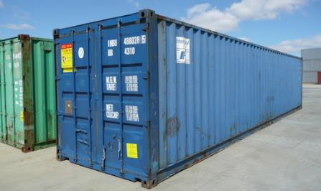

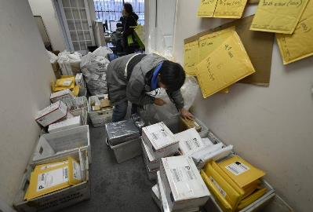
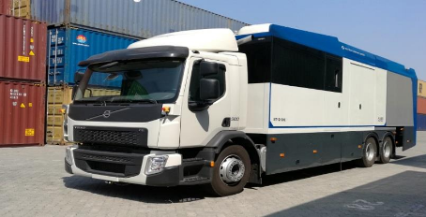
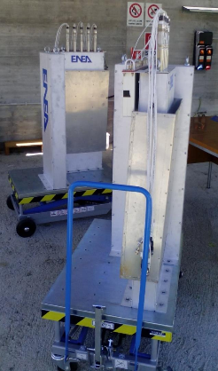
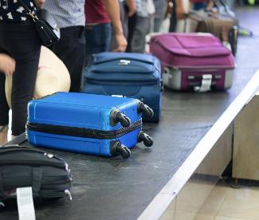
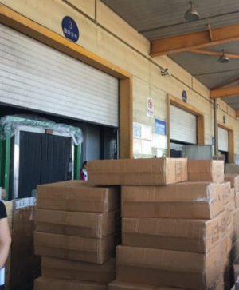

Nuclear detection for safety and security
C-Container
Areas of importance for nuclear detection:
  Defence,
  National security,
  Nuclear proliferation.
In a variety of settings:
  Cargo, trucks, cars, boxes, mail/letters, …,
  Emergencies / incidents and conflict situations (i.e., theatres of war).
Palletized Cargo
Mail
Trucks
Cars
Large boxes
Luggage
Field/portable

Slide 12
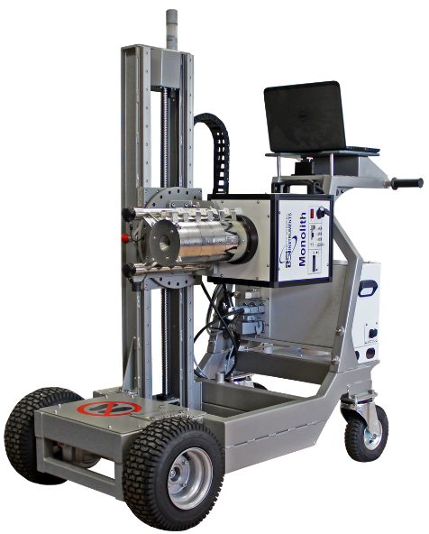
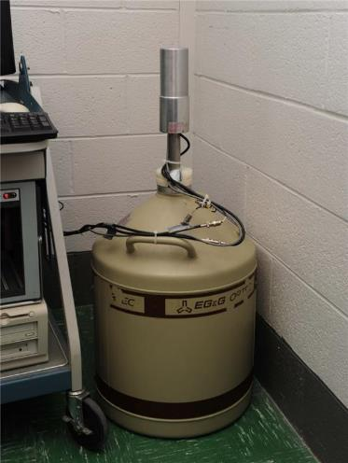
Nuclear detection: current technologies
HPGe Mobile Spectrometer (electric cooling)
Radiation relevant to nuclear safety and security:
  Charged particles: α-, β-particles,
  Photons: γ-rays, X-rays,
  Neutrons: uncharged (not directly ionizing, scattering, nuclear interactions and activation).
Detection technologies:
  Physical/chemical change in materials: track recording, cloud/bubble chambers, and imaging,
  Charge collection: gas filled detectors, ion chamber, proportional counters, semiconductor solid state, Si-based for charged particles, high purity germanium (HPGe) detectors for photons,
  Collection of scintillation light: inorganic scintillators (NaI(Tl)), organic scintillators (anthracene, C14H10).
LN2-cooled HPGe
http://www.nuclearphysicslab.com/npl/npl-home/spectroscopy/gamma-ray-spectroscopy/gamma-ray-spectroscopy-education/
https://bsi.lv/en/products/hpge-detectors-spectrometers/hpge-mobile-spectrometer/
Goals of nuclear detection:
Rapid and effective detection,
Precise identification, characterization, and imaging of nuclear materials and devices,
Detection of distant, shielded, or weak nuclear signatures,
In a variety of operational conditions (temperature, ruggedness, power limitation, etc.).

Slide 13
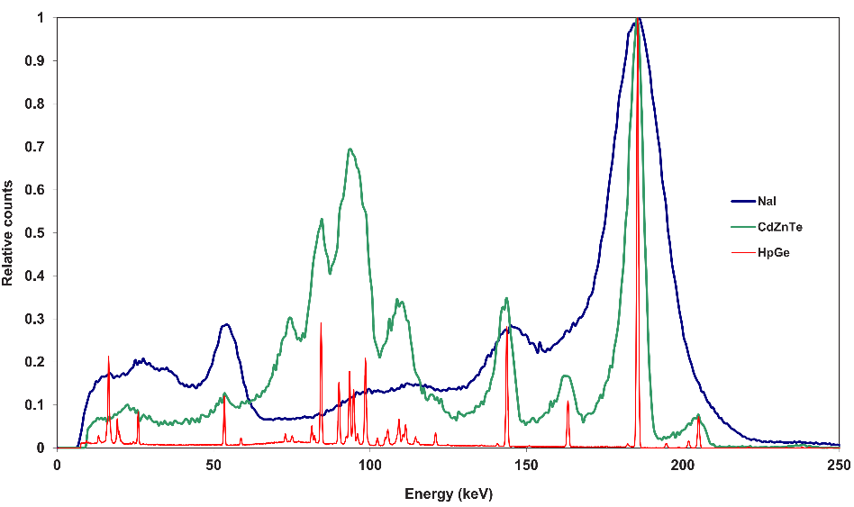
Nuclear isotope detection: γ-spectroscopy
Analysis of nuclear materials:
  Example: Uranium samples generally contain U-238, U-235, U-239 (& decay products),
  Current non-destructive techniques to determine isotopic composition:
      γ-ray spectroscopy,
      α-particle spectroscopy.
Various γ-ray spectrometers for verifying uranium enrichment
U-235 γ-ray at 186 keV
https://www-pub.iaea.org/MTCD/Publications/PDF/nvs1_web.pdf
Superconducting transition-edge sensor (TES) with Superconducting Quantum Interferometer Device (SQUID) readout outperforms the best scintillator-based detectors and High Purity Germanium (HPGe) detectors.

Slide 14
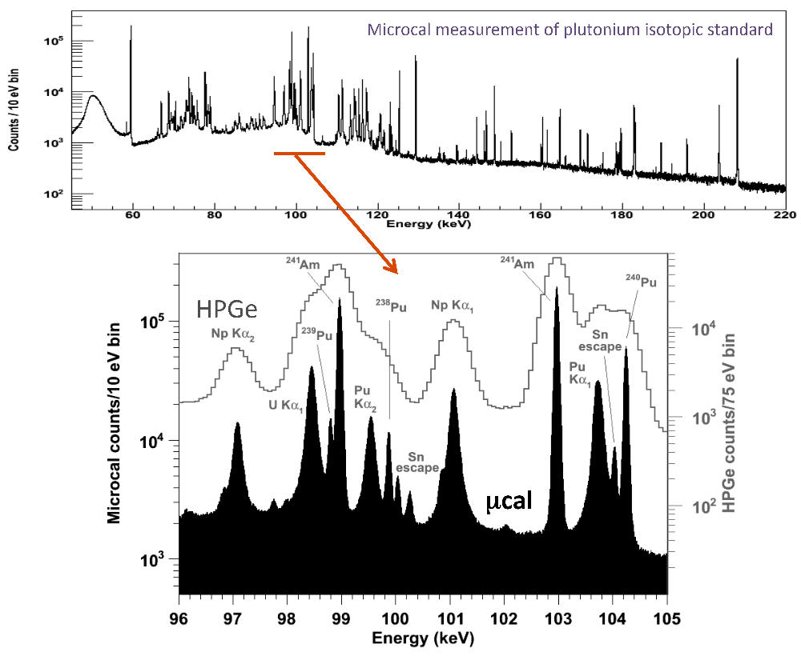
Nuclear isotope detection: γ-spectroscopy
Analysis of nuclear materials:
TES detector offers superior resolution compared to conventional semiconductor technology,
This is advantageous when assessing samples with a high peak density and overlap.
Low noise (very low operating temperatures).
Similarly, Si-based α-detectors with 10 keV resolution cannot resolve 240Pu:239Pu, 238Pu:241Am peaks, also 10 times better resolution for TES-based detectors.
Plutonium samples generally contain Pu-238, Pu-239, Pu-240, Pu-241 (& decay products).
TES-based detectors have 10 times greater energy resolution than HPGe detectors!
TES
https://www.phenix.bnl.gov/WWW/publish/mxliu/talks/LANL-V/P-25-Hoover.pdf

Slide 15
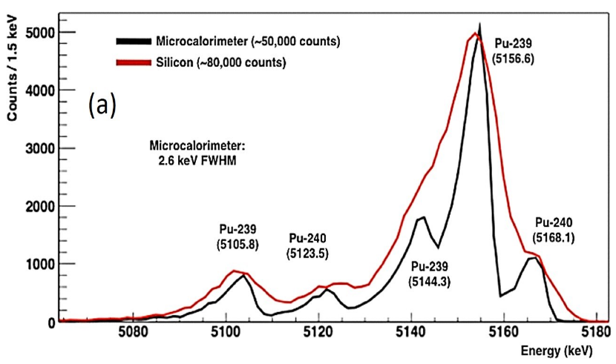
Nuclear applications of TES detectors
TES-based γ-ray, α-particle spectroscopy, Coherent-Elastic Neutrino-Nucleus Scattering, (& neutron detectors?):
  Isotopic analysis,
  Elemental analysis,
  Characterizing spent nuclear fuel (treaty verification),
  Distinguishing nuclear materials from natural backgrounds (border security),
  Nuclear forensics,
  Spent fuel and reactor monitoring (antineutrino detection).
α-spectroscopy
TES (blue)
Pure Si (red)
IEEE Trans. on Applied Superconductivity, vol. 21, p. 207, 2011.

Slide 16
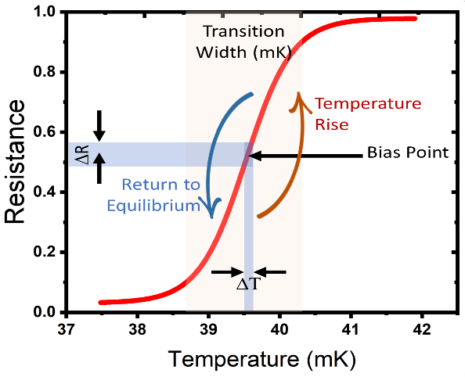
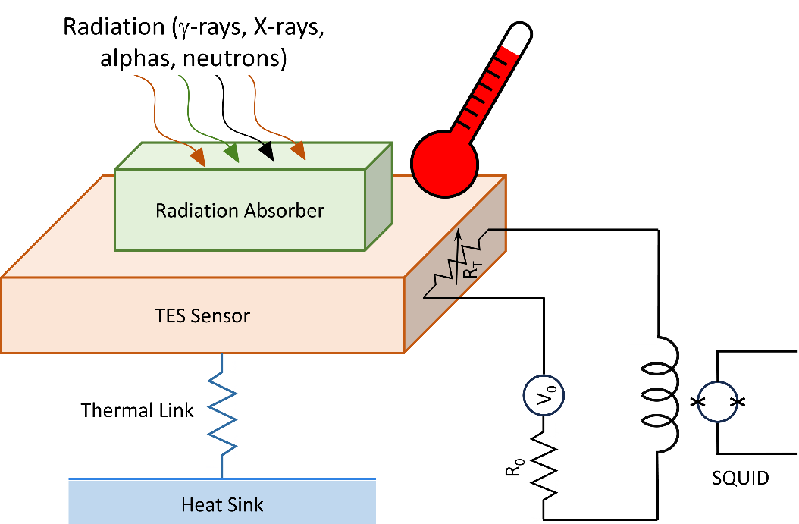
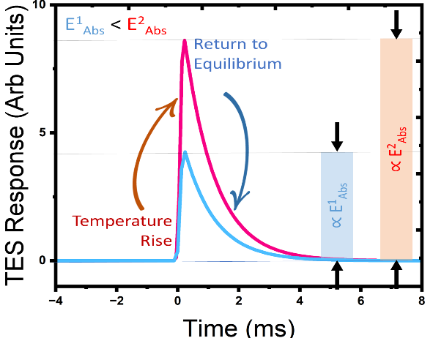
TES detectors: principles and operation
Temperature change determines energy (power) absorption!
Sharpness of ρ(T) of the superconductor close to Tc
Energy (E) deposit leads to ΔT~ E/C

Slide 17
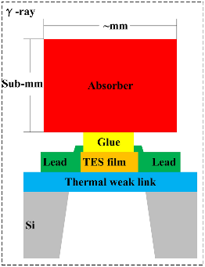
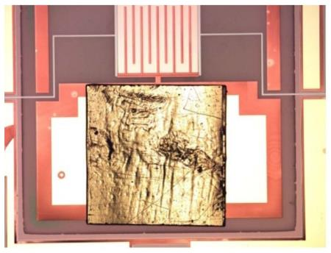
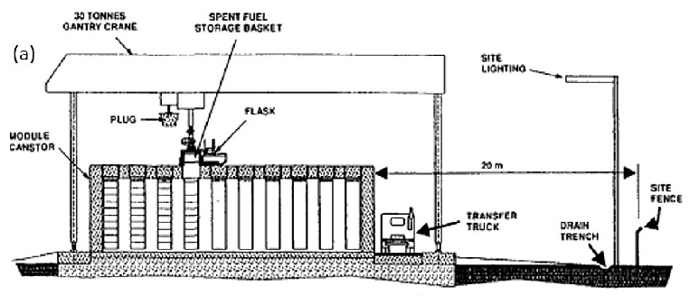
TES applications we are considering
γ-ray spectroscopy
https://link.springer.com/article/10.1007/s41365-022-01071-5
Q-spectroscopy
https://www.sciencedirect.com/science/article/pii/S0168900214015149
γ-ray spectroscopy: measure several γ− energies for a given isotope (favourable for high peak density and overlap samples),
Q-spectroscopy: embed sample in absorber to measure combined energy of all decay products (α, recoil nucleus, X-rays, γ-rays, e⁻) a single energy peak at Q-value (total energy release) for each isotope,
α-particle spectroscopy: measure several α− energies for a given isotope (sample preparation is a challenge),
Neutrons: neutron detection/spectroscopy?
TES
Absorber embedded with Pu-241 and Am-241
Spent Fuel Dry Storage at GENTILLY 2 NGS
https://inis.iaea.org/collection/NCLCollectionStore/_Public/31/006/31006110.pdf
Nuclear spent fuel and reactor monitoring: detect coherent-elastic neutrino-nucleus scattering (nuclear recoil).
M. Stringer, A. Erlandson, V. Anghel, and Z. Yamani
Phys. Rev. D 109, 096038 – Published 28 May 2024

Slide 18
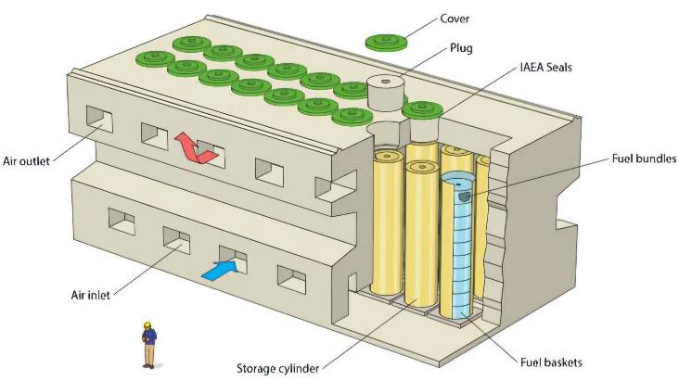
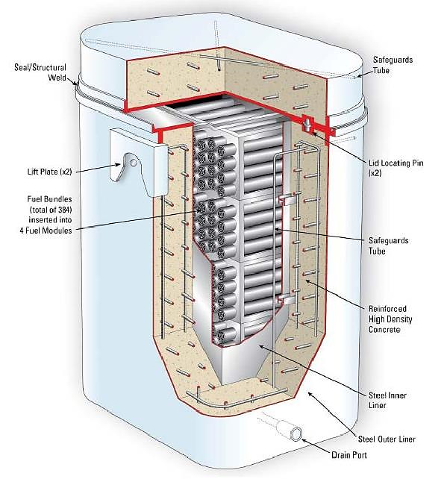
Monitoring CANDU spent fuel using TES: a GEANT4 simulation study
Monitoring spent nuclear fuel: crucial to prevent unauthorized spread of nuclear materials.
Feasibility of using TES-based detectors for monitoring spent CANDU fuel for two scenarios:
Scenario A: CANSTOR – Fuel Stored in Baskets inside Tubes (Spent Fuel Dry Storage at GENTILLY 2 NGS): One basket holds 1.2 tonnes of spent fuel while one tube 12 tonnes.
Scenario B: A Dry Storage Container (DSC) contains approximately 7.4 tonnes of spent fuel
https://archive.opg.com/
https://unene.ca/
Neutrino-based safeguards of CANDU spent fuel using superconducting detectors and the CEνNS interaction
M. Stringer, A. Erlandson, V. Anghel , and Z. Yamani, Phys. Rev. D 109, 096038 (2024); https://journals.aps.org/prd/pdf/10.1103/PhysRevD.109.096038

Slide 19
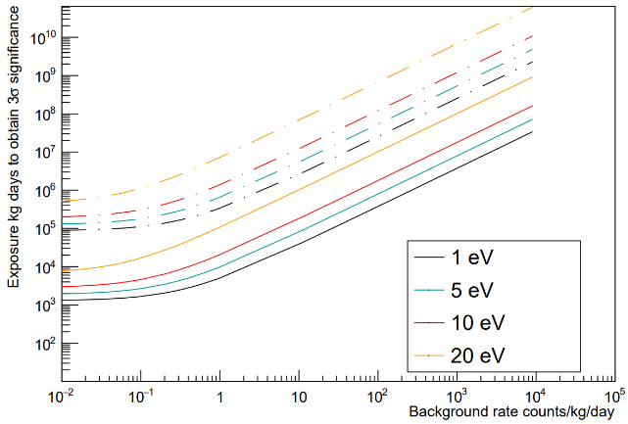
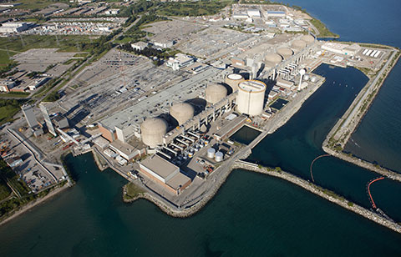
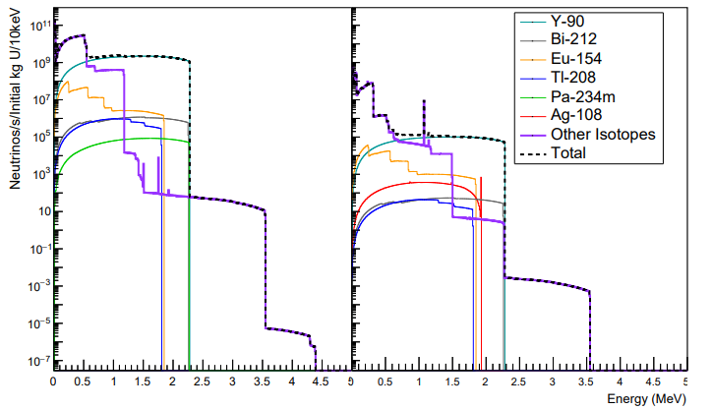
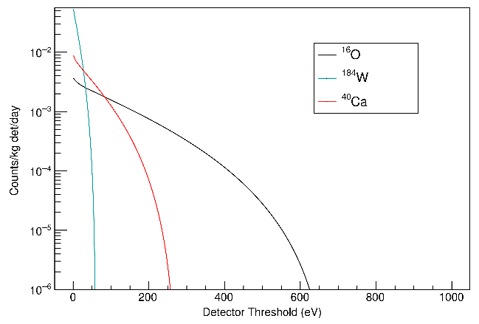
Monitoring CANDU spent fuel using TES: a GEANT4 simulation study
Spent fuel isotopic composition is coupled with isotope neutrino spectra to calculate neutrino emission rates.
High activity and energy allow CEvNS signal detection for Y-90 isotope.
TES-based detectors show potential for monitoring spent fuel in large containers (like CANSTOR) but impractical for smaller DSCs due to high background.
Multiple or large array detectors to reduce measurement time and improve feasibility.
Next: investigate SMR reactor monitoring.
Pure tungsten detector
1 kg
Scenario A – CANSTOR: Measurement time for removal of a tube is ~3.6 years (~150 years for a single basket).
Spent fuel is stored in DSCs near the reactors
Neutrino emissions from 30-y-old spent CANDU fuel
Neutrino Rate from a DSC
2 m away from detector
Scenario B –DSCs: Monitoring DSCs at Pickering site is difficult due to the irreducible background from reactor neutrinos.
nuclearsafety.gc.ca
Additional neutrino background due to the running reactors at the site
https://journals.aps.org/prd/pdf/10.1103/PhysRevD.109.096038

Slide 20
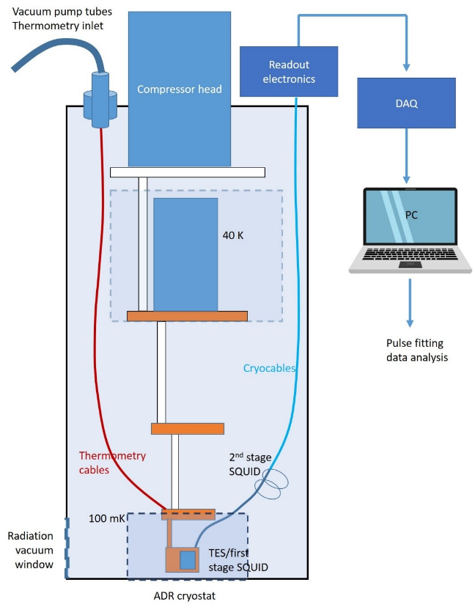
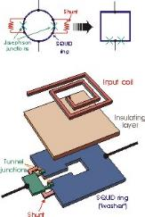
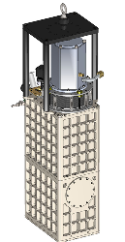

Establishing TES detector technology at CNL
Low temperature infrastructure and SQUID read-out for TES detector.
Activities conducted thus far encompass:
  Setting up low temperature infrastructure and SQUID signal read-out,
  Funding acknowledgment: CNL, AECL, FNST, DRDC-CSS.
SQUID, Electronics, Adiabatic Demagnetization Refrigerators (ADR), mK
Simulations: TES design optimization and other TES applications
A complete infrastructure required for TES detector development is installed and ready
FY22-23
FY23-24
FY24-25
Completion of acquisition, delivery
System installation, commissioning and testing
Acquisition initiation
Z. Yamani et al., 153-120000-REPT-000016 (CNL).

Slide 21
Establishing TES detector technology at CNL
Activities conducted thus far encompass (continued):
  Performing simulations to gain insight and optimize detector parameters (transition temperature, superconductor and absorber materials),
  Performing simulations to explore other types of applications (SMR reactor monitoring).
Opportunities for collaborations:
  Microfabrication of TES sensors,
  Simulations, tests, other applications (imaging?),
  Optimization,
  Development of field-able prototype.
Tc=100 mK
Ic(0)=55 mA
Tc=100 mK

Slide 22
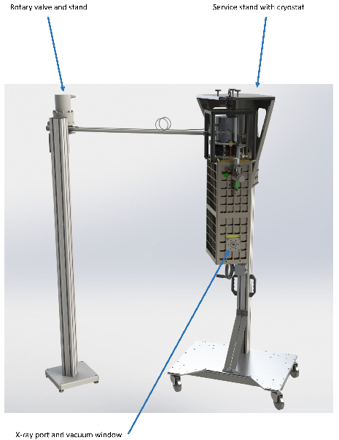
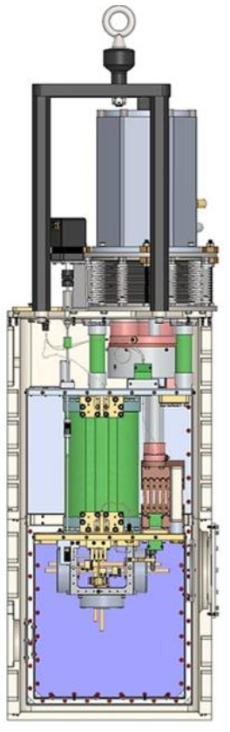
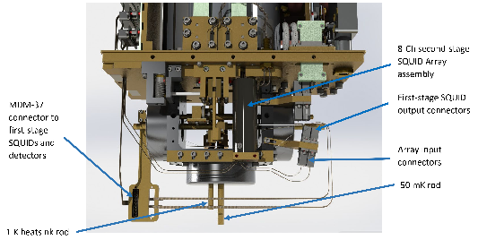
Challenges in utilization of TES-based detectors in real-world applications:
TES-based spectrometer
More R&D to make TES-sensors, that
  Outperform the existing technologies,
  Field-deployable (i.e., border, defence).
Challenges include
  Very low temperatures are required,
  Continuous operation must be maintained,
  Size, weight, and power,
  Fairly complicated setup and operations,
  Cost!

Slide 23
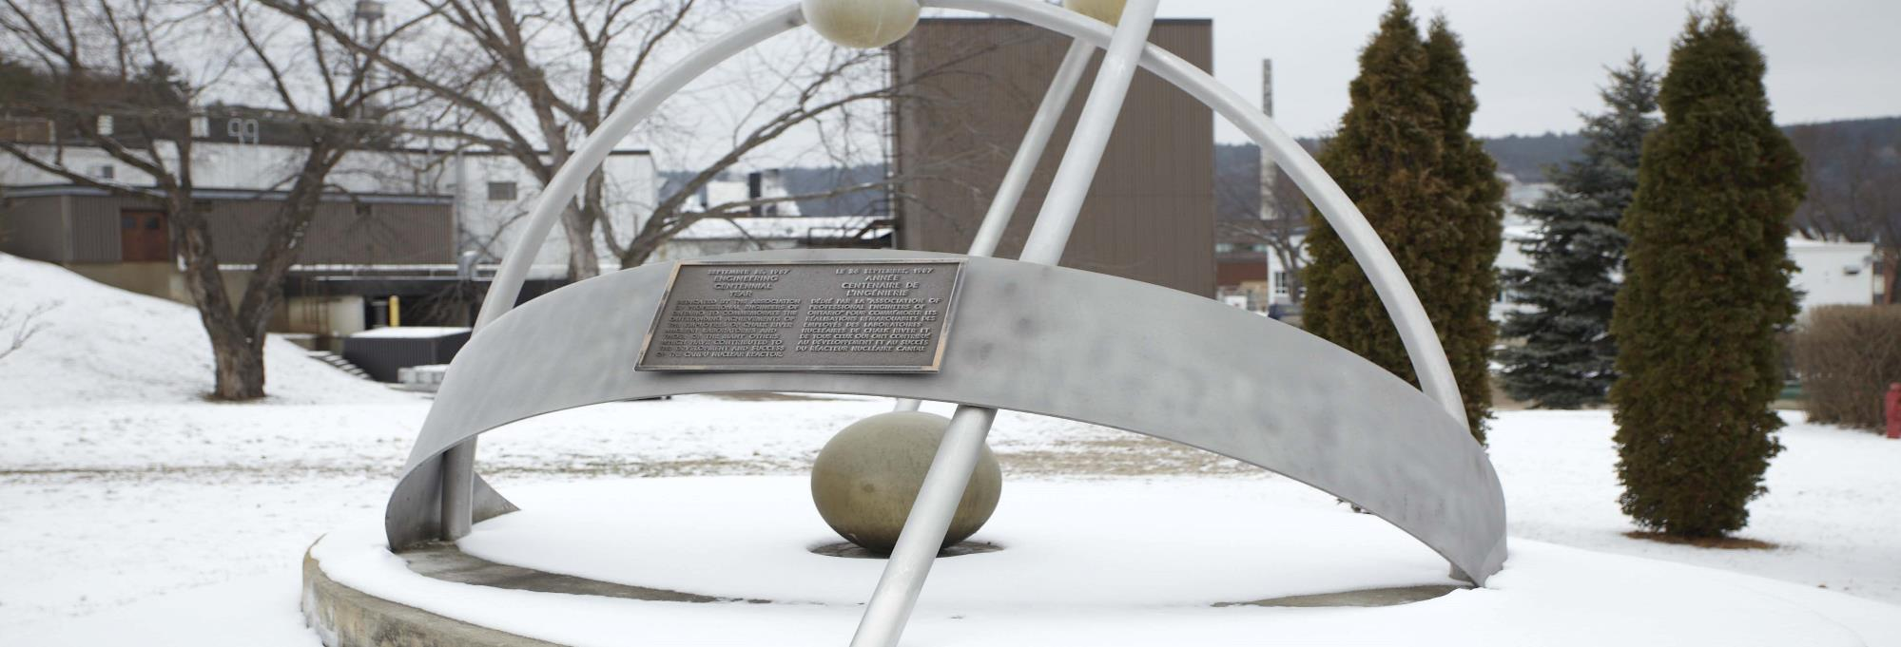
Thank you! ☺ Merci! ☺
zahra.yamani@cnl.ca
Questions?
Acknowledgements:
M. Stringer, R. Sammon, D. Dean, E. Erlandson, V. Anghel
CNL, AECL, FNST, DRDC-CSS
OFFICIAL USE ONLY / À USAGE EXCLUSIF

