Slide 2
SNOLAB User Meeting:
NSERC updates
Sarah Overington
Director, Research Grants and Scholarships
June 2024

Slide 3
Budget 2024

Slide 4
Investing in research talent
Increases to annual value of scholarships and fellowships
Increased award values take effect as of September 1, 2024
Additional details will be communicated to award holders in July 2024
 | New value
Master’s | $27,000
Doctoral | $40,000
Post-doctoral | $70,000
Approximately 1720 additional scholarships/fellowships
Enhanced suite of scholarships and fellowship programs will be streamlined into one talent program
Notes:
This enhancement reflects the Government of Canada’s steadfast dedication to supporting the next generation of researchers, giving them equal opportunity to succeed and providing them with the resources they need to tackle complex challenges and drive innovation.
$825 million over five years, starting in 2024-25, with $199.8 million per year ongoing, to increase the annual value of master’s and doctoral student scholarships to $27,000 and $40,000, respectively, and post-doctoral fellowships to $70,000.
Increased award values take effect as of September 1, 2024.
Additional details will be communicated to award holders in July 2024.
This will also increase the number of research scholarships and fellowships provided, building to approximately 1720 more graduate students or fellows benefiting each year.
To make it easier for students and fellows to access support, the enhanced suite of scholarships and fellowship programs will be streamlined into one talent program.
There will be no changes to the value or duration of the Vanier Canada Graduate Scholarships or the Banting Postdoctoral Fellowships. The Vanier and Banting programs will continue under their current parameters, $50,000 and $70,000 per year respectively, until they are replaced by the new, streamlined talent program proposed in Budget 2024.

Slide 5
Enhancing research support (investments)
Increased core funding
$1.8 billion over five years, starting in 2024-25, with $748.3 million per year ongoing to SSHRC, NSERC, and CIHR
Harmonized grant management system
$26.9 million over five years, starting in 2024-25, with $26.6 million in remaining amortization and $6.6 million ongoing
Indigenous participation in research
$30 million over three years, starting in 2024-25, with $10 million each for First Nation, Métis, and Inuit partners
Notes:
To increase core research grant funding and support Canadian researchers, Budget 2024 proposes to provide $1.8 billion over five years, starting in 2024-25, with $748.3 million per year ongoing to SSHRC, NSERC, and CIHR.
Budget 2024 also proposes to provide a further $26.9 million over five years, starting in 2024-25, with $26.6 million in remaining amortization and $6.6 million ongoing, to the granting councils to establish an improved and harmonized grant management system.
$30 million over three years, starting in 2024-25, to support Indigenous participation in research, with $10 million each for First Nation, Métis, and Inuit partners.

Slide 6
Enhancing Research Support (Research Infrastructure)
$45.5 million over five years, starting in 2024-25, to support the Arthur B. McDonald Canadian Astroparticle Physics Research Institute
$399.8 million over five years, starting in 2025-26, to support TRIUMF, Canada's sub-atomic physics research laboratory, located on the University of British Columbia's Vancouver campus.
$176 million over five years, starting in 2025‑26, to CANARIE, a national not-for-profit organization that manages Canada's ultra high-speed network to connect researchers, educators, and innovators, including through eduroam.

Slide 7
Enhancing research support (coordination)
New capstone research funding organization to be created
Granting councils will continue to exist
New organization and structure will also help to advance internationally collaborative, multi-disciplinary, and mission-driven research
Preliminary outline released by Ministers of ISED and Health in a statement and letter to federal research granting council Presidents June 17, 2024 (publicly available)
For those who would like to provide feedback, comments can be emailed to: Secretariat.CRCC-CCRC@sshrc-crsh.gc.ca by Wednesday, July 17, 2024.
Notes:
To provide better coordination across the federally funded research ecosystem, Budget 2024 announces the government will create a new capstone research funding organization. The granting councils will continue to exist within this new organization, and continue supporting excellence in investigator-driven research, including linkages with the Health portfolio. This new organization and structure will also help to advance internationally collaborative, multi-disciplinary, and mission-driven research.
The government will create an advisory Council on Science and Innovation. This Council will be made up of leaders from the academic, industry, and not-for-profit sectors, and be responsible for a national science and innovation strategy to guide priority setting and increase the impact of these significant federal investments.

Slide 8
NSERC news and updates

Slide 9
Training and talent updates
Tri-agency training strategy
Centred on five themes: 1. Equity, Diversity, Inclusion, & Accessibility
2. Evolving Career Paths
3. Harmonization & Streamlining Efforts
4. Indigenous Research & Training
5. International Mobility & Globalization
Tri-agency talent evaluation
Scope: Direct and Indirect funding of graduate student training by the three agencies
Areas: access to training opportunities, contribution to training environment, student career trajectory
Evaluation report and management response available on NSERC website
Notes:
TATS
The CRCC asked the three federal granting agencies to develop a Tri-agency Training Strategy in order to deliver an equitable, accessible, and effective suite of scholarships and fellowships that help support a diverse population of students and postdoctoral fellows for careers requiring strong research skills in all sectors of society.
Scope: direct scholarship and fellowship programs by the three agencies.
After an environmental scan, five themes were identified:
Equity, diversity, inclusion, and accessibility
Evolving career paths
Harmonization and streamlining efforts
Indigenous research and training
International mobility and globalization
Last year, an External Advisory Committee was formed to advise the agencies on the five themes of the TATS. It was composed of 17 members, half of whom were students, postdocs, or early career researchers. The group was diverse: representing varied disciplines, lived experiences, and geographical regions.
Five virtual meetings of the EAC were held where each of the five themes, and some potential actions, were discussed. The meetings were semi-structured, with discussion guided by a series of prepared questions.
We are now drafting the Strategy, which draws from recommendations made by the Naylor and Bouchard reports; the new Talent Evaluation, Banting evaluation, and previous program evaluations; the findings of the Parliamentary Standing Committee on Science and Research; and feedback from the EAC and external partners and communities.
We anticipate the Strategy will be published on the CRCC website in the coming months.
MRAP
As some of you may already know, the Tri-agency recently undertook a strategic-level program evaluation that looked across the Tri-agencies’ funding for graduate student training, including both direct support (i.e., via scholarships) and indirect support (i.e., through training grants and researchers’ grants).
The evaluation, referred to as Talent Evaluation, was undertaken to inform decisions about agency funding for research training and talent development.
It looked at how the agencies’ funding enables student access to training opportunities, contributes to a rich and inclusive training environment, and influences student career trajectory.
The evaluation began in Spring 2021 and today we are pleased to inform you that it was concluded in fall 2023. The three agencies have finalizing a response to the recommendations emanating from the evaluation. Both the Talent Evaluation report and the Tri-agency response will be posted on the three agencies’ websites in the coming weeks.

Slide 10
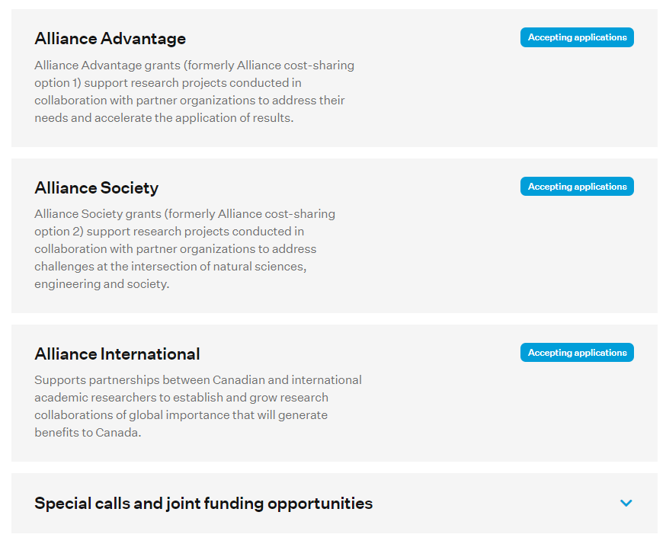
Changes to Alliance grants
Alliance Advantage grants: Support partner-driven projects. They fund projects focused on the partners’ goals, with at least one partner sharing in the costs of research.
Alliance Society grants: Support projects with societal impact as the main driver. They draw on the relevant perspectives and skill sets of active participants that help accelerate the translation and application of research results.
Alliance International grants: Help researchers establish and grow collaborations with academic research groups that have a high potential for impact in NSE disciplines.
https://www.nserc-crsng.gc.ca/Innovate-Innover/Alliance-Alliance_eng.asp
Notes:
The Alliance Program offers 4 distinct approaches for Collaborative Research, three of which are standing calls open to researchers nationwide, in addition to various special calls and joint funding opportunities.
The three standing calls are:
Alliance Advantage grants (formerly cost sharing option 1) which are grants for partner-driven projects. They fund projects focused on the partners’ goals, with at least one partner sharing in the costs of research.
- Alliance Society grants (formerly cost sharing option 2) fund projects with societal impact as the main driver. All relevant stakeholders are active participants, help disseminate results and help create concrete outcomes.
- Alliance International grants help researchers establish and grow research collaborations of global reach and importance with international colleagues.
In addition to those, Alliance includes various focused special calls that are generally advertised a few months prior to the deadline to submit applications.
If you want to learn more Alliance special calls, I invite you to visit NSERC's innovate webpage (by clicking on the link at the bottom of this slide). The layout of the page is illustrated on the right side of the slide and down here you will find a dropdown menu under Special Calls and joint funding opportunities, where those opportunities will be listed as links to the relevant literature.

Slide 11
Recent updates to Alliance grants
Interactions between trainees and partner organizations
Consolidation of Merit Indicators
More flexibility for Alliance Advantage applications to be reviewed internally
Conflict of Interest (COI) guidelines
National Security Guidelines for Research Partnerships
https://www.nserc-crsng.gc.ca/Media-Media/NewsDetail-DetailNouvelles_eng.asp?ID=1433
Notes:
Other important recent changes to the Alliance Grants in general which I wish to highlight are detailed on this slide.
As of Dec 2023, The training plan of any Alliance proposal must now include interactions between partner organizations and trainees. Those interactions enrich the training, provide mentoring opportunities, and provide the trainees with experiences that are relevant to both the academic and the non-academic research environments, and such interactions should therefore be explicitly detailed in the proposal. While they were expected for Alliance, the requirement to include details pertaining to those interactions in the proposal has been made more explicit in the program literature as well as in the assessment criteria.
Talking about Assessment Criteria, Alliance Advantage Merit indicators were also recently revised to consolidate the merit assessment and clarify important elements that are evaluated during the Merit review of the application. The number of merit indicators has thus been reduced from 11 to 8 criteria. The application template has consequently been revised to align with those new criteria. The new template provides a better guidance to the applicants on what information to provide. This should help applicants prepare better and more successful proposals.
More flexibility has also been introduced for Alliance Advantage applications to be reviewed internally. Alliance Advantage grants can now be reviewed internally when the average annual requested amount from NSERC is less than $75,000. In addition, ECR co-applicants no longer need to hold an Active NSERC peer reviewed grant for the Alliance application to be reviewed internally.
There were updates to the NSERC Online System: The Form 101 also been updated to include the attestation concerning conflicts of interest. : Institutions must manage COI and put mitigation plans in place according to their own policies. Applicants must now confirm on behalf of the entire research team that they are in compliance with the conflict-of-interest policies of ALL institutions represented in the application – not just their own. This will be a “yes” or “no” question. It must be answered YES before it can be submitted.
Finally, in the Partnership section of the online application system, you must select yes or no to indicate if your application includes a partner organization from the private sector. If you select “yes” in the Partnership section, you will be required to upload the Risk Assessment Form, in its new dedicated section. So you will no longer need to remember to combine the form with other attachments to add it to “Other documents”. And the system will not let the application be submitted without the form when it is required, helping you to ensure a complete application.

Slide 12
Tri-agency research data management policy (2021) requirements
88% compliance (as of March 2024)
Links compiled at science.gc.ca
Qualitative analysis underway
Institutional strategies
Data Management Plans (DMPs)
Piloted through select funding opportunities (see list posted on science.gc.ca)
Lessons to be compiled to inform ongoing approach
Engagements ongoing to inform options for implementation
Key issues : repository capacity; sensitive data; support, education and training; Indigenous RDM; compliance monitoring; international policy alignment
Data deposit
Notes:
Qualitative analysis will be available publicly by the fall of 2024 via the Tri-Agency RDM webpage on science.gc.ca.
Presenter: please refer to the slide and contact Dominique Roche if speaking notes are needed.
Institutional strategies
88% compliance (as of March 2024)
Links compiled at science.gc.ca
Qualitative analysis underway, with uOttawa and the Digital Research Alliance of Canada
Data management plans
Piloted through select CIHR, NSERC, SSHRC funding opportunities (see list posted on science.gc.ca)
Lessons to be compiled to inform ongoing approach
Data deposit
Engagements with service providers and other stakeholders ongoing since fall 2023, to inform options for implementation
Key issues being discussed: repository capacity; sensitive data; support, education and training; Indigenous RDM; compliance monitoring; international policy alignment
the requirements of the Tri-Agency Research Data Management (or RDM) Policy are being gradually implemented across all three agencies.
The adoption of the use of the DMP is part of our broader efforts to Open Science, specifically removing access barriers to research findings and ensuring the research ecosystem is more transparent and robust.
At NSERC, the Data Management Plan (or DMP) requirement was piloted in the 2024 competition of the Subatomic Physics Discovery Grants program. Applicants for the Individual and Project streams were required to submit a two-page data management plan with their applications. In their DMPs, applicants were asked to describe the types of data they planned to compiled or produce, their plans for data storage both during and after the active research phase, and who would have access to the research data. Applicants were also required to indicate if there were any legal, ethical or commercial considerations that might impact the use of their research data.
For this iteration of the pilot, the DMPs were not included in the adjudication score, but committee members did review the plans and were encouraged to provide written comments. Program staff also surveyed applicants about their thoughts on the new requirement and reviewed the DMPs submitted with the 38 project and individual SAP applications.
Applicants to the 2025 competition of the Subatomic Physics Discovery grants program will again be required to submit a DMP with their applications. The DMP requirement will be gradually introduced into other funding programs at NSERC, with broader implementation being informed by the lessons learned from the pilot and ongoing engagement with the research community and the other funding agencies. The introduction of the requirement into programs will be announced well in advanced, both in online materials and in communications with the research community.
----
Anticipated Q&A:
When will the requirement be extended to other funding opportunities?
The adjudication process for the SAP pilot concluded at the end of February – the lessons learned are being considered and discussed at the program, agency and tri-agency levels. The introduction of the requirement into any programs will be announced in advanced online and in communications, and applicants to programs with the DMP requirement will be directed to resources to support the creation of their DMPs.
Why DMPs?
Can help shape and improve research plans and methodologies
Can be useful for ethics approval
Can strengthen partnership agreements
Can address security concerns
The requirement will bring NSERC in line with international research funders in Europe and the United States, who also require DMPs
Concerns about additional burdens
DMPs prompt researchers to consider aspects of data management in advance, and can help avoid costly delays due to data-related problems later in the research process
Many institutions and partnerships are in the process of introducing data management protocols or DMP requirements; this is not necessarily a new or unique requirement.
The agencies are aware of concerns about administrative burdens for applicants and reviewers, and one of the issues being considered in the evaluation of the SAP pilot is how to maximize the usefulness of the DMPs without adding additional burdens
There are a number of existing resources at institutions and online to help streamline the creation of a DMP. For example, the DMP Assistant is a national, online, bilingual data management planning tool developed by the Digital Research Alliance of Canada (the Alliance) in collaboration with host institution University of Alberta to assist researchers in preparing data management plans (DMPs). This tool is freely available to all researchers and develops a DMP through a series of key data management questions, supported by best-practice guidance and examples. Researchers are also strongly encouraged to consult their institution’s data management strategies, which were another requirement under the Tri-Agency RDM policy. The strategies should contain information about resources available at each institution.
Other requirements of the RDM policy
Institutions eligible to receive tri-agency funding are required to develop an institutional RDM plan that will support a culture of open science and strong research data management practices. The deadline for institutions to publicly post their completed strategies was March 2023. The agencies have received links to over 200 strategies, which are now being analysed. The agencies are also working with the remaining institutions, including newly eligible institutions, to support the development of their strategies. Links to all the completed strategies can be found on the science.gc website.
The third requirement of the RDM policy is the data deposit requirement. This requirement has not yet been implemented – the agencies are in the process of reviewing the institutional strategies and are engaging with stakeholders to gauge the readiness of the research community to determine when to implement the requirement

Slide 13
Data management plan pilot in subatomic physics
Tri-Agency Research Data Management (RDM) policy requirements are being implemented using a gradual, phased-in approach:
Data Management Plan (DMP) requirement piloted in the Subatomic Physics Discovery Grants – Individual and Project for competition 2024 (launched in summer 2023).
Applicants were required to submit a 2-page DMP with their applications, which was reviewed by committee members but not included in adjudication score.
Pilot is being evaluated through an applicant survey, review of submitted DMPs, and consultations with committee members.
Broader implementation of the DMP requirement into other NSERC programs will be informed by pilot evaluation, as well as continued engagement with the research community, CIHR, SSHRC and the Digital Research Alliance of Canada.
Notes:
13
the requirements of the Tri-Agency Research Data Management (or RDM) Policy are being gradually implemented across all three agencies.
The adoption of the use of the DMP is part of our broader efforts to Open Science, specifically removing access barriers to research findings and ensuring the research ecosystem is more transparent and robust.
At NSERC, the Data Management Plan (or DMP) requirement was piloted in the 2024 competition of the Subatomic Physics Discovery Grants program. Applicants for the Individual and Project streams were required to submit a two-page data management plan with their applications. In their DMPs, applicants were asked to describe the types of data they planned to compiled or produce, their plans for data storage both during and after the active research phase, and who would have access to the research data. Applicants were also required to indicate if there were any legal, ethical or commercial considerations that might impact the use of their research data.
For this iteration of the pilot, the DMPs were not included in the adjudication score, but committee members did review the plans and were encouraged to provide written comments. Program staff also surveyed applicants about their thoughts on the new requirement and reviewed the DMPs submitted with the 38 project and individual SAP applications.
Applicants to the 2025 competition of the Subatomic Physics Discovery grants program will again be required to submit a DMP with their applications. The DMP requirement will be gradually introduced into other funding programs at NSERC, with broader implementation being informed by the lessons learned from the pilot and ongoing engagement with the research community and the other funding agencies. The introduction of the requirement into programs will be announced well in advanced, both in online materials and in communications with the research community.
----
Anticipated Q&A:
When will the requirement be extended to other funding opportunities?
The adjudication process for the SAP pilot concluded at the end of February – the lessons learned are being considered and discussed at the program, agency and tri-agency levels. The introduction of the requirement into any programs will be announced in advanced online and in communications, and applicants to programs with the DMP requirement will be directed to resources to support the creation of their DMPs.
Why DMPs?
Can help shape and improve research plans and methodologies
Can be useful for ethics approval
Can strengthen partnership agreements
Can address security concerns
The requirement will bring NSERC in line with international research funders in Europe and the United States, who also require DMPs
Concerns about additional burdens
DMPs prompt researchers to consider aspects of data management in advance, and can help avoid costly delays due to data-related problems later in the research process
Many institutions and partnerships are in the process of introducing data management protocols or DMP requirements; this is not necessarily a new or unique requirement.
The agencies are aware of concerns about administrative burdens for applicants and reviewers, and one of the issues being considered in the evaluation of the SAP pilot is how to maximize the usefulness of the DMPs without adding additional burdens
There are a number of existing resources at institutions and online to help streamline the creation of a DMP. For example, the DMP Assistant is a national, online, bilingual data management planning tool developed by the Digital Research Alliance of Canada (the Alliance) in collaboration with host institution University of Alberta to assist researchers in preparing data management plans (DMPs). This tool is freely available to all researchers and develops a DMP through a series of key data management questions, supported by best-practice guidance and examples. Researchers are also strongly encouraged to consult their institution’s data management strategies, which were another requirement under the Tri-Agency RDM policy. The strategies should contain information about resources available at each institution.
Other requirements of the RDM policy
Institutions eligible to receive tri-agency funding are required to develop an institutional RDM plan that will support a culture of open science and strong research data management practices. The deadline for institutions to publicly post their completed strategies was March 2023. The agencies have received links to over 200 strategies, which are now being analysed. The agencies are also working with the remaining institutions, including newly eligible institutions, to support the development of their strategies. Links to all the completed strategies can be found on the science.gc website.
The third requirement of the RDM policy is the data deposit requirement. This requirement has not yet been implemented – the agencies are in the process of reviewing the institutional strategies and are engaging with stakeholders to gauge the readiness of the research community to determine when to implement the requirement

Slide 14
Overview of the STRAC Policy:
The Policy on Sensitive Technology Research
and Affiliations of Concern (STRAC)
On January 16, 2024, the Government of Canada announced the Policy on Sensitive Technology Research and Affiliations of Concern (STRAC Policy).
The policy operates using two lists that must be used in conjunction — a list of Sensitive Technology Research Areas (STRA) and a list of Named Research Organizations (NRO).
The granting agencies and the CFI are implementing the policy in harmonized manner, starting with funding opportunities launching as of May 1st, 2024.
At the application stage, applicants will be asked to identify if the research supported by their grant will aim to advance a STRA. If it will not aim to advance a STRA, no action is required.
If the grant aims to advance a STRA, researchers with named roles (applicant, co-applicants, collaborators) on the application must complete attestation forms to certify their compliance. In addition, for the duration of the grant, no researchers involved in activities supported by the grant can be affiliated with, or in receipt of funding or in-kind support, from an NRO.
Notes:
We will now provide a brief overview of the STRAC Policy, which was announced earlier this year [Jan. 2024] by the Government of Canada.
Read second bullet and third bullet and then say:
The STRAC Policy does not apply retroactively to existing awards. It will only apply on a forward basis to funding opportunities launched as of May 1 and only considers current and ongoing affiliations. This timeline is intended to provide sufficient time for the research community to understand and align with the policy, before new requirements come into effect.
Read 4th bullet and 5th bullet and move on to the next slide.
For more details, including the relevant procedures and forms, we encourage all members of the research community to consult the new Tri-Agency Guidance on Research Security.
(More information if needed: only researchers with named role in the grant application need to submit attestation forms to certify their compliance. However, all researchers involved in research activities supported by a grant that advances a STRA must be compliant with the policy; this includes HQP and other researchers who do not have a named role in the grant application. It will be up to the applicant, co-applicants and collaborators – with support from their institutions – to ensure that their research teams are aware of their individual responsibilities with regards to the policy.)

Slide 15
2024 Discovery Grants results – overview

Slide 16
2024 Discovery research program competition results
Discovery Grants offered $84.3M in new awards
3186 applications; 2015 awards
The CY2024 cohort is the size of a typical pre-pandemic competition
Research Tools and Instruments awarded over $25M
666 applications; 199 awards, with a 30% success rate
Subatomic Physics Grants invested over $18.5M in new awards
52 applications across all categories; 38 awards
Success rates ranged from 36% to 88%
Discovery Horizons offered $5.5M in new awards
81 LOIs received, 33 full applications reviewed, and 15 grants awarded

Slide 17
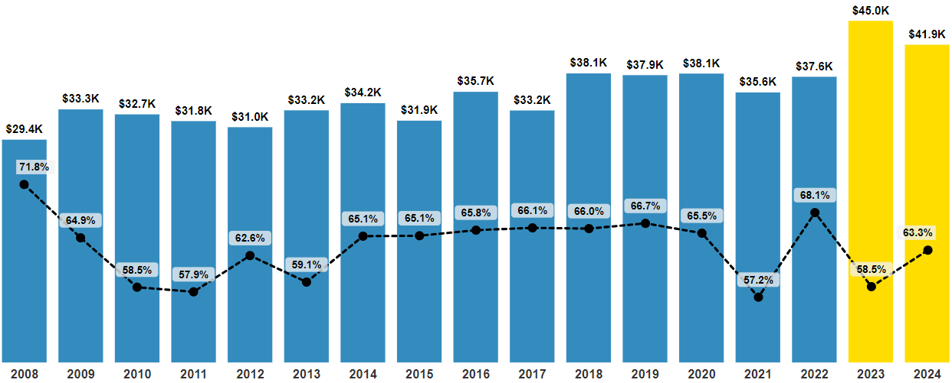
Discovery Grants over the last 17 years
2024 Discovery Grants Results - Overview
Average DG Grant Size 2008-2022: $34,232
Success Rate
Average Grant 2008 - 2002
Average Grant 2023 and 2024
*
*
*
Applications | 3,369 | 3,210 | 3,323 | 3,460 | 3,455 | 3,432 | 3,173 | 3,194 | 3,167 | 3,240 | 3,213 | 3,404 | 3,372 | 2,008 | 2,518 | 2,802 | 3,186
*Pools of applicants differ from a typical year, due to COVID-19 one-time extensions with funds provided to eligible DG holders
Results presented for CY2024 are not official
Notes:
Yellow bars: For Competition 2024, we maintained the funding threshold set in Competition 2023.
For Reference:
For Established Researchers (ER): One Very Strong (V) and two Strongs (S) on any selection criteria
For Early Career Researchers (ECR): Two Strongs (S) and one Moderate (M), with some EG specific exceptions to ensure balanced ECR support [One Strong (S) and two Moderates (M)]
From CY 2020 through CY 2022, inclusive, S-S-M, where the M was in HQP, was the minimum score threshold for ERs required for a fundable outcome.
Compared to last year, there is an increase in success rate and a corresponding decrease in average grant. However, average grant levels remain the highest they’ve been, except for 2023.
Importantly, there is continued strong support for early career researchers and for a broad base of excellence across disciplines, regions, and institutions through the Discovery Grants Program.
A 14% increase in the number of Discovery Grant applications was noted this year. More increases are expected in the coming two years as the COVID-19 one-time one-year extensions with funds come to an end. Other factors contributing to increased application pressure are lower success rates as well as continued growth in the number of researchers in Canadian Institutions.
The increase in the number of applications as well as the total number of active awards since COVID puts increasing pressure on a fixed amount of funding available. This drove the decision last year to not fully fund Bin J in order to stabilize the average grant value.
The average grant value has decreased slightly this year due to the following factors: an increase in the number of applications ranked in higher bins and an increase in the number of applications. A further increase in the number of applications received (as currently forecasted) could lead to a further decrease in average grant value unless additional measures are implemented.
Additional information:
Due to COVID-19, one-time extensions with funds were provided to eligible Discovery Grant holders. Consequently, the composition of the 2021, 2022 and 2023 pools of applicants differs from a typical year with pools of approximately 59%, 74%, 82% the size of a typical competition, respectively.
In Competition 2023 the VSS threshold did NOT apply to RF$. In Competition 2024 the VSS threshold did include RF$.

Slide 18
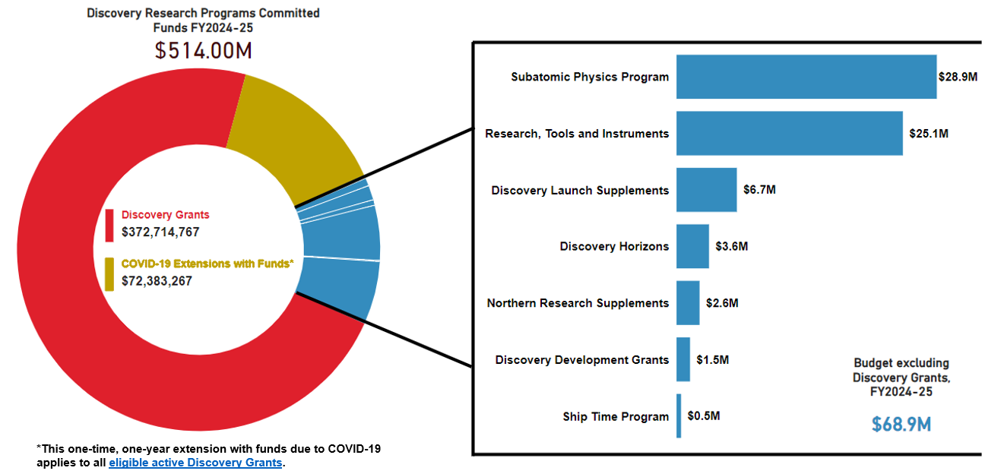
Discovery Grants and other research grants
2024 Discovery Grants Results - Overview
Notes:
The Discovery Research Program is delivered through a range of funding opportunities, including NSERC’s flagship program, Discovery Grants.
Discovery Grants (DG) provide a base of support for over 11,000 researchers in natural sciences and engineering annually. Over 60% of the funds support students, post-doctoral fellows, and other research personnel.

Slide 19
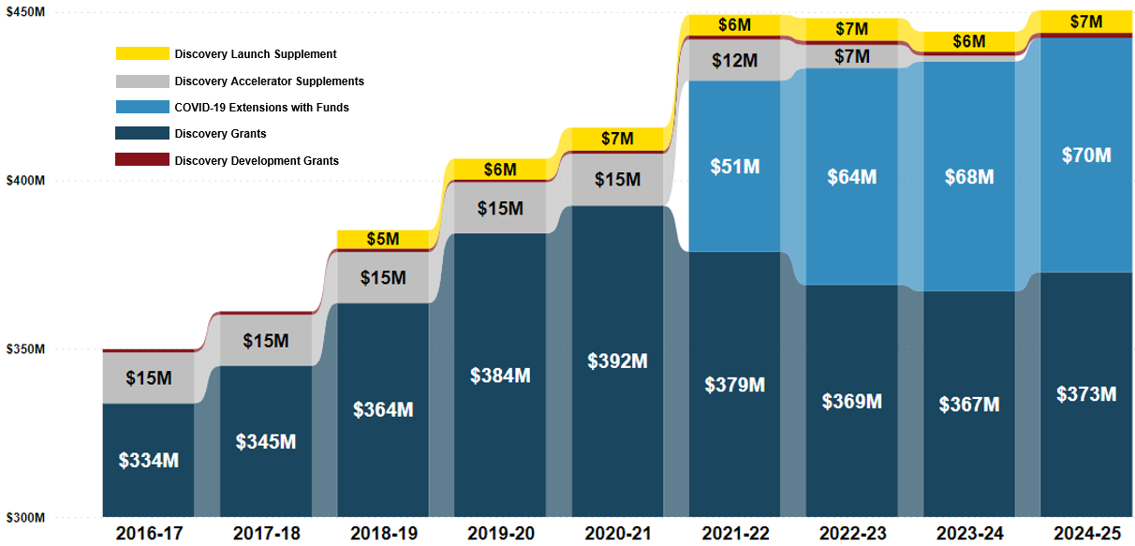
Total Investment in Discovery Grants
2024 Discovery Grants Results - Overview
Notes:
NSERC makes large investment in research: 84.3M in new awards in 2024
Additional information:
Graph from 1st page of dashboard
2016-17 and 2018-19 include additional funding resulting from Federal Budget 2016 & 2018.
As of CY2022, NSERC’s Discovery Accelerator Supplements (DAS) program was suspended in CY2022 and formally terminated this year. Although no new DAS awards were made, ongoing DAS awards continue to be honored.
Some of the funding for the COVID extensions comes from the termination of DAS ($15M/year) and funding received from RTP ($10M/Year) this source of funding is no longer available to the DG budget.

Slide 20
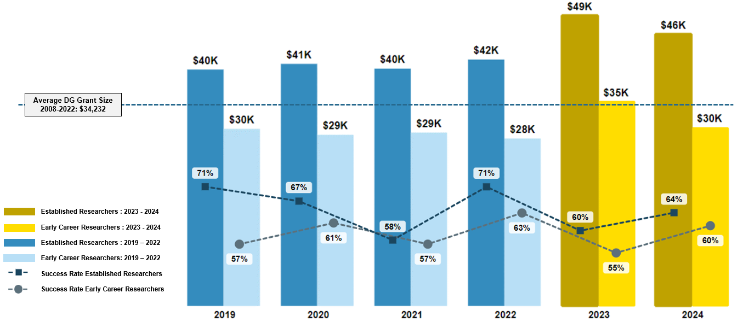
Discovery Grants over the last 5 years
2024 Discovery Grants Results - Overview
Notes:
Adding an ECR specific slide – possibly to include the RF$ to show early stage of career

Slide 21
Supporting Early Career Researchers
2024 Discovery Grants Results – Overview
Over 90% Early Career Researchers (ECRs) who apply within the 5-year eligibility window are funded
The window is adjusted for eligible delays (credited as twice the amount of time taken)
ECRs receive a one-time Discovery Launch Supplement ($12,500) and the option of a 6th year of funding
The success rate of applicants who reapply after their first grant is over 70%
Notes:
Notes on ECR funding: The $30.2K for ECRs is the CY2024 average grant (which includes the $5K top up). There are 6 boxes for these to account for the fact that most ECRs accept the ECR extension.
Additional Information:
What is an early career researcher?
Early career researchers (ECR) are applicants who have held their first independent academic position within the last five years. For example, to be classified as an ECR, a researcher submitting an NOI in August 2023 would have been hired on or after July 1, 2018. The five-year window for being considered an ECR is adjusted to take into account instances where a researcher has had an eligible delay in research. All eligible leaves (for example, maternity, parental, personal illness, leave taken by applicants for family-related illness, bereavement), as well as delays related to COVID-19 are credited as twice the amount of time taken. For example, a researcher submitting an NOI in August 2023 and who took a seven-month parental leave within the past five years, must have been hired on or after May 2017 to be considered an ECR. Professional leaves (for example, training, sabbatical, administrative) are not credited.
What is an established researcher?
Established researchers (ER) are applicants who have held an independent academic position with a start date before the last five years.
NSERC offers additional sources of support to those ECRs awarded a Discovery Grant. These include:
An annual $5,000 top-up on their Discovery Grant;
The Discovery Launch Supplement, introduced in 2018, a one-time award valued at $12,500; and
Since 2017, offering ECRs scheduled to apply for their second Discovery Grant the option of accepting an additional year of funding on their existing Discovery Grant at the same level.

Slide 22
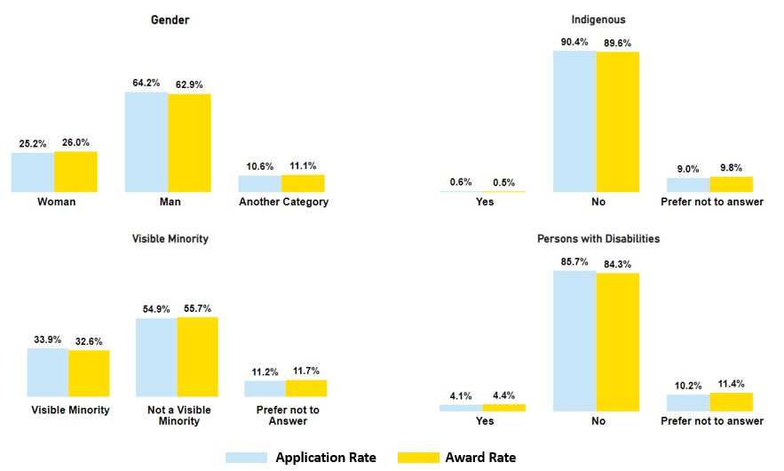
Overall DG – Equity, Diversity and Inclusion (EDI)
2024 Discovery Grants Results - Overview
Notes:
NSERC externally publishes competition statistics disaggregated by self-identification information for select groups and actively monitors the impacts of policy and program changes for all self-identification information collected through the Tri-agency self-identification questionnaire. This includes intersecting identities when numbers are large enough.

Slide 23
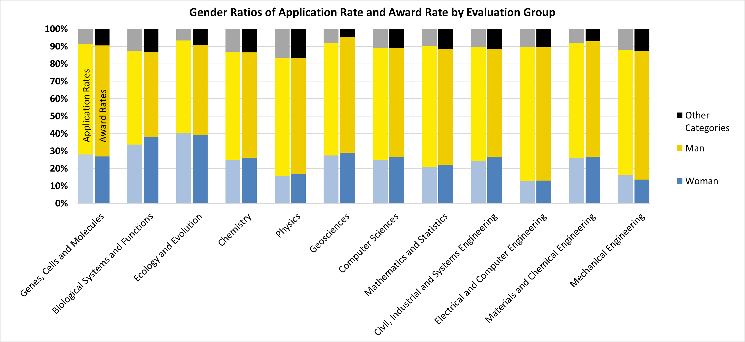
Overall DG – Equity, Diversity and Inclusion (EDI)
2024 Discovery Grants Results – Overview
Notes:
Figure shows % of applicants by gender (woman, man or other categories) for each EG
NSERC is committed to monitoring success rates and average grant amounts by gender.
Applicants may self-identify by gender or they may select “I prefer not to answer”. This information is used for statistical purposes only and is not shared with reviewers.
25% of CY2024 applicants are women
Notes on slides:
Data is from self-identification section of application
Other categories includes Gender-fluid, Binary and/or Two-spirit, as well as those who selected “I prefer not to answer”. For ATIP reasons, these groups were combined under the heading of “Other Categories”. These categories contain less than 5 applications when broken down by award status, which could make individuals within those categories identifiable.

Slide 24
Overall DG – Equity, Diversity and Inclusion (EDI)
2024 Discovery Grants Results – Overview
 |  | Women | Men | Gender-fluid, Binary and/or Two-spirit ,“I prefer not to answer”.
Early Career Researchers (ECR) | Number of Awards | 201 | 313 | 22
 | Success Rate | 60% | 60% | 67%
Established Researchers Returning (ER-R) | Number of Awards | 263 | 797 | 185
 | Success Rate | 79% | 75% | 79%
Established Researchers Not Holding a Grant (ER-NHG) | Number of Awards | 60 | 158 | 16
 | Success Rate | 45% | 34% | 23%
Notes:
NSERC is committed to monitoring success rates and average grant amounts by gender.
Notes on slides:
Data is from self-identification section of application
Other categories includes Gender-fluid, Binary and/or Two-spirit, as well as those who selected “I prefer not to answer”. For ATIP reasons, these groups were combined under the heading of “Other Categories”. These categories contain less than 5 applications when broken down by award status, which could make individuals within those categories identifiable.

Slide 25
The Subatomic Physics Evaluation Section
The Subatomic Physics Evaluation Section (SAPES) is a standing review committee that oversees various programs:
Individual and Project Discovery Grants
Research Tools and Instruments (RTI - Category 1, 2 or 3) Grants
Major Resources Support (MRS) Grants
Funded through a unique independent envelope mechanism at NSERC, since 1991
Notes:
This comprehensive approach is essential
Complexity and inter-dependency of many proposals
Country-wide collaborations among individuals, groups, universities, and national research organizations
Long-term and large-scale international projects and commitments
Possibility to exchange funds between the various programs as a function of the priorities of the community and the pressures it faces

Slide 26
Pre-Competition Details
52 applications
Total requested: $11.41M
Available funds: $6.03M
Projected average funding rate: 52%
Compare to past funding rates:
2019 | 2020 | 2021 | 2022 | 2023
64% | 56% | 40% | 64% | 60%
Notes:
Data found : http://enterprise/enterprise/llisapi.dll/app/nodes/81919145#

Slide 27
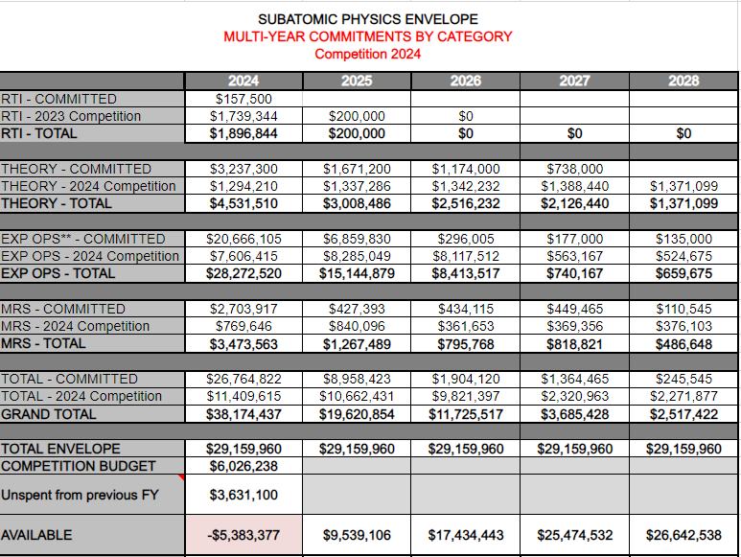
Competition Budget - Pre-competition
**EXP OPS = Experimental Operations – Includes Project grants and experimental Individual grants
Notes:
Requested amount for 2023 exceeded available funds by ~$7M, this is largely due to an increase in SAPPJ requests that coincide with the funding pressures of those project’s whose McDonald Institute funding has come to an end. The committee had the difficult task to determine how best to allocate available funds this year, given the unknown future of support for the McDonald Institute.
Note: The amount presented as “Unspent from previous FY” also includes the 2.43M in additional funds that was secured to cover the equivalent cost of funded COVID grant extensions.

Slide 28
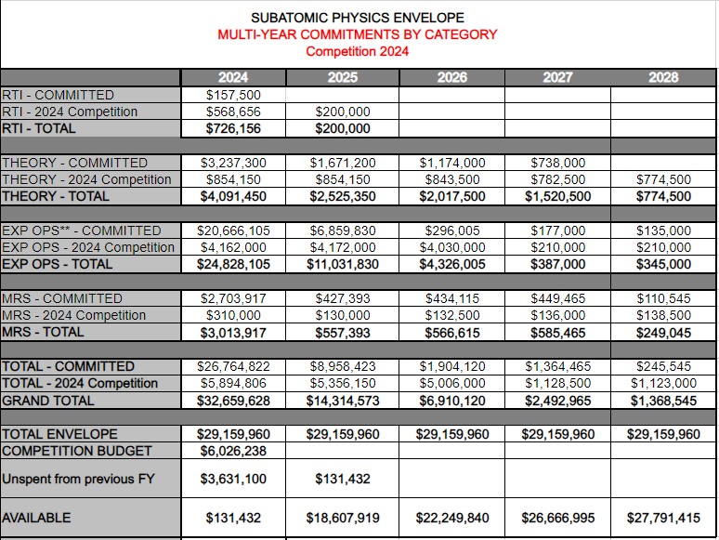
Multiyear Commitments - End of Competition
**EXP OPS = Experimental Operations – Includes Project grants and experimental Individual grants
All remaining funds will be added to the SAP envelope for CY2024.
Notes:
The “Grand Total” awarded this year is higher than what is available in the “Total Envelope” due balancing funding pressures from year-to-year and the addition of $2.43M to cover the equivalent costs of funded COVID grant extensions. This year, the Section awarded all but $131k of the total funding available. This $131k will be used next year to help alleviate funding pressures. This speaks to the Sections fiscal responsibility and budgetary planning.

Slide 29
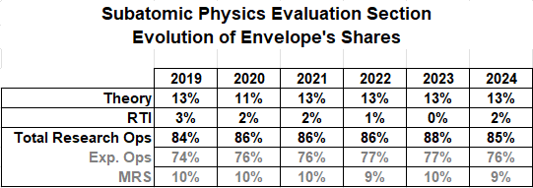
Share of Envelope at End of Competition Comparison to Past Years

Slide 30
Research excellence

Slide 31
Strengthening research excellence through EDI
NSERC is actively working to foster a more equitable, diverse and inclusive research ecosystem in Canada through measures like:
Unconscious bias training for peer reviewers
Ensuring a wide range of contributions to research, training and mentoring are considered and valued as part of the merit assessment (DORA principles)
Development of policy tools to better identify and support Indigenous Research and Indigenous researchers
Guidance on integrating equity, diversity and inclusion considerations in research
Use of self-identification information in select funding opportunities
Development of an accessibility plan and a progress report - feedback welcomed
Notes:
These efforts are guided by the Tri-agency EDI Action Plan for 2018–2025, which is the foundation for a concerted long-term commitment to enhancing equity, diversity and inclusion in the Canadian research landscape.
Additional information:
Funding opportunities that use self-identification in funding decisions ask applicants to provide consent for use of their self-identification information in funding decisions.

Slide 32
NSERC webpage for equity, diversity and inclusion (EDI)
True to its commitment to supporting research excellence, NSERC developed an Equity, diversity and inclusion webpage in 2023 to help the research community to easily access information on NSERC’s EDI-related actions, programs and policies.
The EDI webpage includes information on:
EDI policies related to the Review process and Career interruptions;
Grants and awards that address barriers and biases experienced by underrepresented groups;
concrete Actions NSERC is taking to support EDI;
Data collected and used by NSERC to support EDI goals; and
Resources to assist NSE researchers with integrating EDI considerations in their work.
New for summer 2024 - Additional information on how NSERC uses GBA Plus to analyze and improve its programs, policies and processes will be added.
Notes:
Slide updated: April 2024
Speaking notes updated: April 2024
True to its commitment to research excellence in the natural sciences and engineering, in 2023 NSERC developed a hub highlighting its actions, programs and policies related to equity, diversity and inclusion (EDI) as a tool for the research community, policymakers and other stakeholders to work with us on strengthening the research ecosystem.
NSERC’s EDI webpage helps the research community navigate NSERC policies relating to career interruptions and the review process as well as grants and awards that address barriers and biases experienced by underrepresented groups. The webpage also includes information on concrete actions NSERC is taking to increase EDI and on the data it collects to support this goal, as well as information on resources designed to assist the natural sciences and engineering researchers with integrating EDI considerations into their work. Finally, this year a new section including additional information on how NSERC uses GBA Plus to critically analyze and improve its programs, policies and processes will be added to the webpage.
Research excellence and equity, diversity and inclusion are intertwined. To achieve world-class research and be competitive on a global scale, an equitable, diverse, accessible and inclusive research culture is needed. While progress has been made over the years, sustained and concerted efforts are necessary. This engagement to take action is reaffirmed in NSERC’s newest strategic plan and reflected across the webpage.

Slide 33
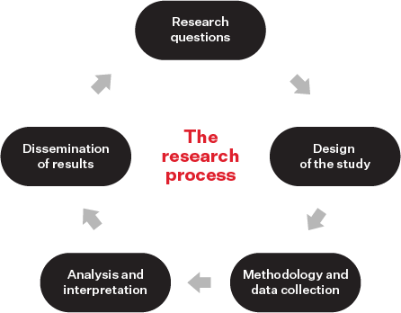
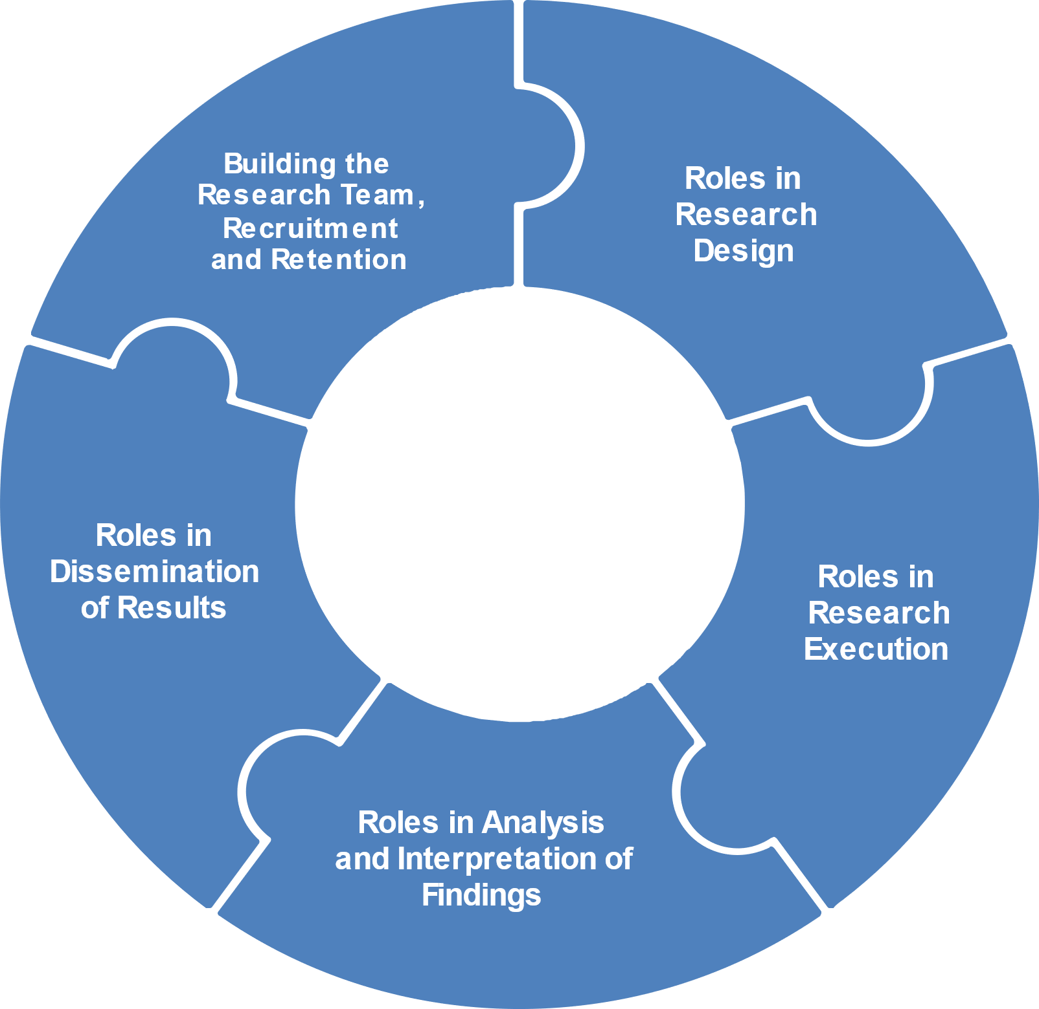
EDI considerations contribute to research excellence
NSERC is continuing to support research excellence by encouraging all applicants and awardees to take EDI considerations into account throughout the research process and for research teams.
NSERC guide on integrating equity, diversity and inclusion considerations in research
Figure 1. EDI considerations in the research process
Two primary sections:
EDI considerations at each stage of the research process
EDI considerations for research teams
The guide provides:
information on how EDI considerations in research promote research excellence;
detailed guidance and examples relevant to the natural sciences and engineering disciplines; and
links to key resources.
Figure 2. EDI considerations for research teams
Notes:
Slide updated: April 2024
Speaking notes updated: April 2024
NSERC’s ongoing commitment to support excellence in research through integration of EDI considerations in research
Considering equity, diversity and inclusion in the research process, where relevant, promotes research excellence by making it more relevant to society as a whole, ethically sound, rigorous, reproducible, and useful (Tannenbaum et al. 2019). It also fuels innovation through scientific discovery and by opening up new areas of research.
Considering EDI in the context of research teams and the research environment promotes research excellence by: Increasing teams’ effectiveness; Increasing performance and collaboration within diverse groups; Driving radical innovation; Promoting equity and inclusion through mentorship, enhancing recruitment and retention; Allowing collective input during problem solving; Creating an inclusive climate.
Available guidance
A document was developed by NSERC in 2022 to assist the research communities served by NSERC with the integration of EDI considerations in research.
Two sections:
EDI considerations at each stage of the research process:
Highlights how embedding EDI considerations to each or any stage of the research process, including research design, methodology and data collection, analysis and interpretation and dissemination of results, can help promote research excellence.
provides guidance on how to apply a critical EDI lens through the planning of research at each stage of the research process. It focuses on the research itself.
EDI considerations for research teams:
- Considering EDI in the context of research teams also supports research excellence. A research team is defined as group of researchers involved in a research program or project that share collective competence, expertise and/or goals.
- Highlights how EDI considerations are relevant to the the research environment including in building of teams, recruitment and retention, and to the roles of team members in research design, research execution, analysis and interpretation of findings, and dissemination of results.
More info for presenters:
Considering equity, diversity and inclusion in the research process, where relevant, promotes research excellence by making it more relevant to society as a whole, ethically sound, rigorous, reproducible, and useful (Tannenbaum et al. 2019). It also fuels innovation through scientific discovery and by opening up new areas of research.
Considering EDI in the context of research teams promotes research excellence by: Increasing teams’ effectiveness; Increasing performance and collaboration within diverse groups; Driving radical innovation; Promoting equity and inclusion through mentorship, enhancing recruitment and retention; Allowing collective input during problem solving; Creating an inclusive climate.
Definition of research teams:
In the context of this document, the research team is a group of researchers (including, but not limited to applicants, co-applicants, collaborators, partners and trainees and/or students ) involved in a research program or project that share collective competence, expertise and/or goals. Members within the research team have defined roles, leadership and other contributions related to research.
Note: Although trainees can be part of your research team, NSERC programs often consider Highly Qualified Personnel (HQP) and their training and mentorship separately in their program literature. Special considerations may need to be given to these specific members of your team.
Applicant: Principal investigator on an application (i.e., university faculty member). For applications to the College and Community Innovation (CCI) Program, the applicant is a designated institutional administrator.
Co-applicant: Member of a research group applying for a team grant (i.e., university faculty or college faculty).
Collaborator: A research scientist or engineer from any sector, e.g., government scientist, academic researcher, company staff member, can be formally associated with a research team that is applying for a team grant, but will not have access to grant funds. Collaborators may also include members of a community involved in a research team or project.
Partner: Private and/or public sector organizations that have a plan for exploiting the research results to provide economic, social or environmental benefits for Canada and Canadians.
Étudiants et étudiantes

Slide 34
Promotion of broader and fairer application assessments
Surrogate measures of quality and impact (e.g. JIF or h-index) must not be used as they introduce bias in the merit review process
Changes to program and reviewer documents are being made to reflect the Guidelines on the assessment of contributions to research, training and mentoring
Video: Broad, balanced and responsible: a practical guide for research evaluators
Hear the 6 practical tips for fostering a more holistic evaluation process!
Notes:
The San Francisco Declaration on Research Assessment (DORA) asks that surrogate measures of quality and impact not be used because they introduce bias in the merit review process.
Reference to the Guidelines on the assessment of contributions to research, training and mentoring has been added into most NSERC programs. Over the next few years, NSERC will adjust program and reviewer documentation, where relevant, to further support the implementation of DORA principles and ensure continued broad and fair assessments.
Applicants and reviewers are encouraged to view DORA and the Luxembourg National Research Foundation’s “Balanced, broad and responsible: a practical guide for research evaluators” video. The video contains 6 practical tips for fostering a more holistic evaluation process. NSERC has published a French translation and accessible English and French
As Canada’s largest funder of science and engineering, NSERC works with universities, colleges, and the private and not-for-profit sectors to remove barriers, develop opportunities and attract new expertise to make Canada’s natural sciences and engineering (NSE) research community thrive.
As described in NSERC’s 2030 strategic plan, NSERC is committed to integrating DORA principles into our programs and processes by considering and valuing a broad range of contributions to research, training and mentoring in the evaluation of research excellence and by further focusing on the quality and impact of each contribution.
It’s been over 4 years since NSERC signed the San Francisco Declaration on Research Excellence.
At that time, a number of NSERC’s initiatives and policies already aligned to the DORA recommendations for meaningful assessment of excellence in research funding.
Since then, NSERC has continued to improve and update its policies to ensure that a wide range of research results and outcomes are considered and valued as part of the assessment process.
For example (and I will go into more detail in the next few slides):
The Guidelines on the assessment of contributions to research and training – was published in May 2022 and used in this year’s Discovery Grants competition.
Pilot of a narrative CV in the most recent Discovery Horizons competition.
Ensured DORA video for evaluators, was available and accessible in both English and French.
Additional notes:
About signing DORA:
DORA signing date: November 13, 2019 (with CIHR, SSHRC, CFI and Genome Canada).
About preparing and publishing the Guidelines on the assessment of contributions to research, training and mentoring:
The development process began in late 2020 due to the COVID-19 pandemic and involved the literature review of policies and programs; Canadian research community engagement (through focus groups, conference presentations and written feedback); alignment of the new Guidelines with key NSERC and Tri-agency policies and NSERC’s 2020 and 2030 strategies; and having the NSE community validate the inclusive language of the Guidelines prior to publication in May 2022.
About the narrative CV pilot:
To expedite the development of a narrative CV, a working group was established at NSERC in March 2022 and the narrative CV was launched in July 2022. The Discovery Horizons program was used to pilot the narrative CV due to its specific program requirements (ex. tools used to apply allowed for experimentation, individual applicants could apply, small program size, interdisciplinary nature).
About the French DORA video:
It is available in the NSERC website with an English and French transcription and subtitles.
About adding hyperlinks:
Program teams (ex. Discovery Research Programs, Alliance, the Collaborative Research and Training Experience Program, the Arthur B. McDonald Fellowship, Postdoctoral Fellowships and the Postgraduate Scholarship – Doctoral program) have or are adding the hyperlink to the Guidelines in line with their competition cycles to familiarize the NSE community with the Guidelines. Other NSERC initiatives are discussing the inclusion of the Guidelines hyperlink in their program websites at this time.
versions online.

Slide 35
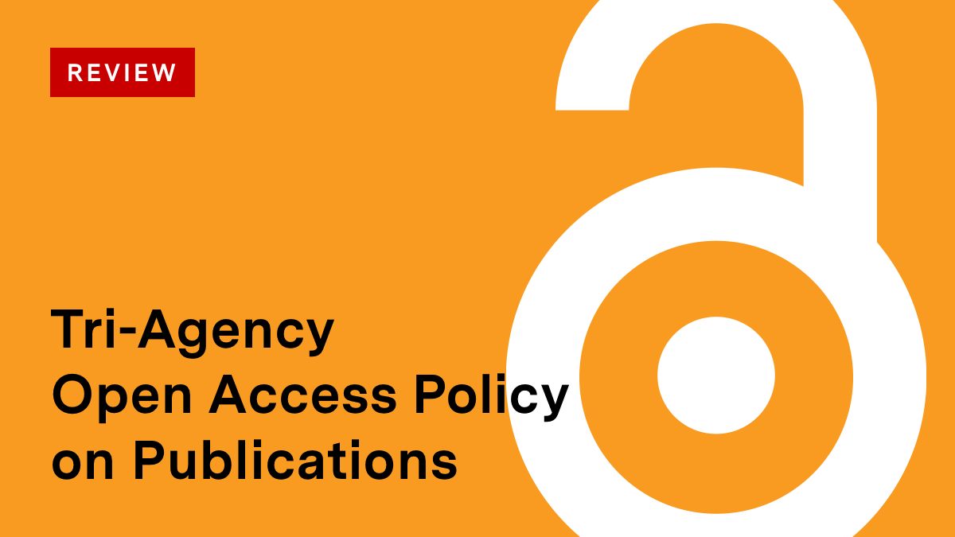
Review of Tri-agency open access (OA) policy
July 4 2023 announcement
The tri-agency Presidents announced the review of the Tri-Agency OA Policy on Publications (2015), with the goal of requiring immediate OA by the end of 2025. A survey to gauge initial community thoughts was also launched.
The agencies are committed to increasing the dissemination of research results and accelerating knowledge mobilization by ensuring peer-reviewed articles resulting from agency-funded research are freely and immediately available.
Notes:
Presenter: please refer to the slide, if more notes are needed contact Bryde Kelly OR Melanie McNeil, Hugh Thompson, Leigh-Ann Coffey Marc André Simard

Slide 36
Tri-agency CV pilot
Template sections
Personal information
Personal statement
Most significant contributions
Other contributions to knowledge
Supervisory and mentorship activities
Other relevant information
Appendix – Current research funding (Optional)
Tri-agency pilot programs
NSERC Discovery Horizons
CIHR Health Research Training Platform, Operating Grant : NWHRI: Innovation Fund, Catalyst Grant : Chief Public Health Officer (CPHO) Report
SSHRC Imagining Canada’s Future Ideas Lab
Notes:
Through workshop discussions with applicants on the desired usability of a CV management tool, the agencies had the opportunity to redesign a CV management tool in terms of usability, but the agencies also had an opportunity to revisit the purpose of the CV and reflect on what information they gather through the CV and what value in terms of research excellence and the metrics the agencies use to assess research.
Based on what we heard, the agencies have piloted in 2023 a redesigned CV template.
Next steps:
Analyze and incorporate feedback received (April – May 2024)
Finalize CV template and instructions (June – July 2024)
Define implementation plan (August 2024)

Slide 37
Upcoming Deadlines

Slide 38
NSERC and SSHRC data centre move
There will be a planned outage of our websites and several of our granting portals and systems from Friday, June 28, at 4 p.m. (ET) until Tuesday, July 2, 8 a.m. (ET).
Corporate email and phone lines will remain functional.
We anticipate a smooth transition but are preparing for potential scenarios (e.g. extended outages).
Should there be issues resuming service, check our social media accounts and dedicated web pages for updates.
As a best practice, remember to keep a copy of your documents and grant application information in your personal files.
Notes:
NSERC and SSHRC will move their data centre on the Canada Day long weekend. This will result in several of our granting portals, systems and websites being unavailable. The outage will take place from Friday, June 28. at 4 p.m. (ET) until Monday, July 2, at 8 a.m. (ET). We expect all systems to be operational again on July 2. Should there be issues resuming services, we will post updates on our dedicated webpages and social media channels. Email and phone lines will not be affected by the move.
Systems unavailable during the move:
NSERC websites
SSHRC websites (including CBRF, NFRF)
TIPS websites (CRC, CERC, C150, CFREF, RSF)
SharePoint sites for competitions or adjudication (Extranet, Influence, Ensemble, NSERC Collab, SSHRC Collab)
NSERC online, SSHRC online
the Financial Data Submission and Reconciliation System
Matrix
the Research Portal (RP1)
Systems not affected by the move:
corporate email and phone lines
Convergence funding portal
social media channels
Visit our dedicated web page for a list of systems and websites that will be unavailable, and a list of precautionary changes to programs and corporate activities:
https://info.nserc-crsng.gc.ca/move-demenagement
https://info.sshrc-crsh.gc.ca/move-demenagement
If you have questions, contact your program liaison or the Helpdesk:
Toll-free: 1-855-275-2861
Email: webapp@nserc-crsng.gc.ca / webgrants@sshrc-crsh.gc.ca

Slide 39
Upcoming program deadlines
Discovery Horizons LOI – June 14th
NOI Discovery Grants – August 1st
NOI Subatomic Physics: Project, Individual, MRS, Category 2&3 RTI – August 1st
Ship Time Program - September 3rd
PromoScience - September 16th
Subatomic Physics: Large Projects (> $500,000/yr), RTI Category 2&3, & MRS - October 2nd
Research Tools & Instruments (and Subatomic Physics Category 1) - October 25th
Northern Research Supplements Program - November 1st
Full Application Discovery Grants - November 1st
Full Application Subatomic Physics: Individual and Projects (< $500k/yr) – November 1st
Canada Graduate and Postgraduate Scholarships (Doctoral) – October 17th
Canada Graduate Scholarships (Masters) – December 2nd
NOI Chairs for Inclusion in Science and Engineering (Quebec) – December 2nd
Full Application Chairs for Inclusion in Science and Engineering (Quebec) – March 3rd
Notes:
**can remove certain applications from list if presentation occurs after deadlines**
Consult website and other media platforms to connect with NSERC – our deadlines webpage is typically updated by June 1st with the summer/fall deadlines.
SAP: note that SAP-RTI Category 1 applications do not require an NOI. All other SAP applications have an NOI deadline of August 1st.
SAP applications: Large Projects are those requesting > $500,000/year.
For Shiptime: this year the deadline is September 3, 2024, because Sept 1st falls on a Sunday this year and Monday Sept 2nd is a statutory holiday.
Note: NRS is part of the RPGIN and SAPIN applications
Not listed: several other programs including NSERC prizes (deadlines later) and several Partnerships programs that are open – no fixed deadlines.

Slide 40
Sarah Overington
Director, Research Grants and Scholarships
Sarah.Overington@nserc-crsng.gc.ca
Connect with us / Suivez-nous
@nserc_crsng / @crsng_nserc
facebook.com/nserccanada / facebook.com/crsngcanada

