Slide 1

Tales from the SNO+ Detector or: How I Learned to Stop Worrying and Love the DAQ
Matt Depatie – Queen’s University
SNOLAB Users Meeting – Wednesday June 26th 2024

Slide 2
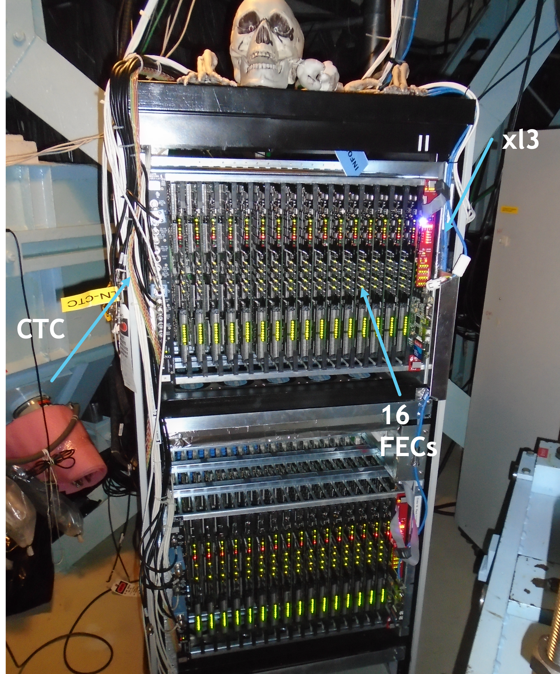

What is the SNO+ Detector?
12m diameter Acrylic Vessel (AV) filled with liquid scintillator Linear Alkylbenzene (LAB)
9362 Photo Multiplier Tubes (PMTs)
6738 currently active
On deck electronics:
  Timing Rack (includes MTC/D, MTC/A+s, TUBs, TUBii)
  11 Data Racks (holding 1 or 2 crates which include xl3s, FECs, CTCs)
Data readout is divided over 19 crates; each crate can read 512 PMTs
2

Slide 3
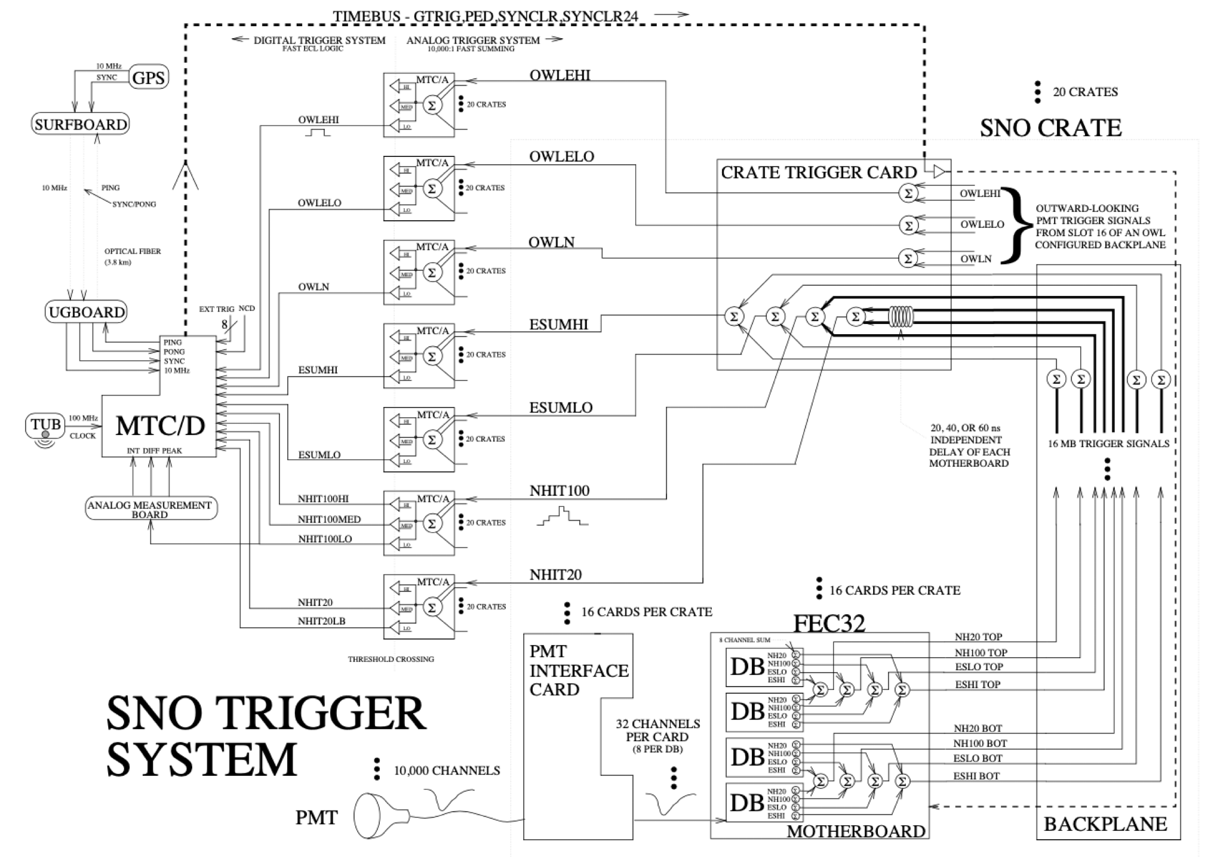
3

Slide 4
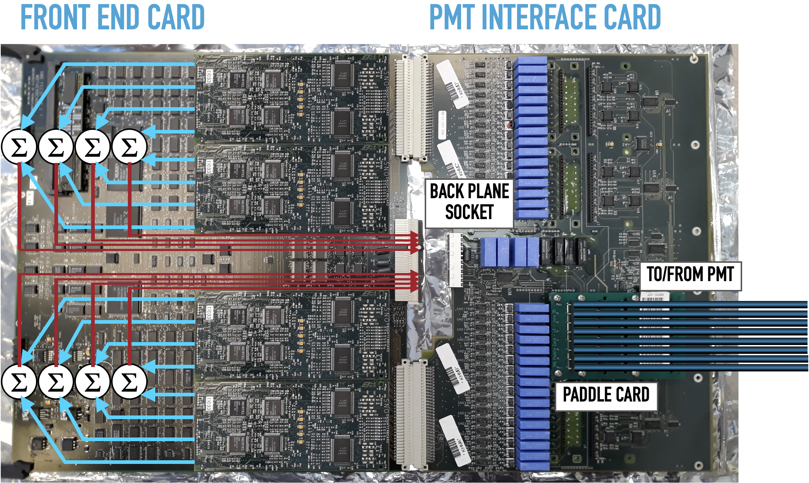
What makes up a slot?
Crates are divided into 16 slots
Slots hold both a FEC and a PMTIC
FEC has 4 Daughterboards, PMTIC 4 “paddle cards”. These connect to 8 PMTs
Each crate has one PMT HV supply
PMTICs decouple the PMT pulse from the HV path and sends it to the FEC
4

Slide 5
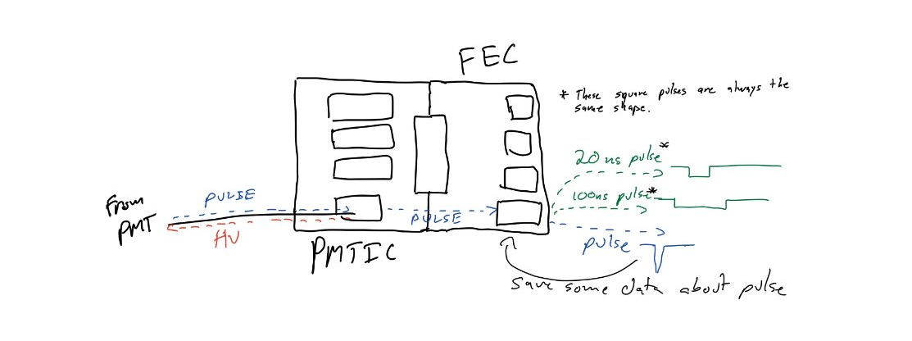
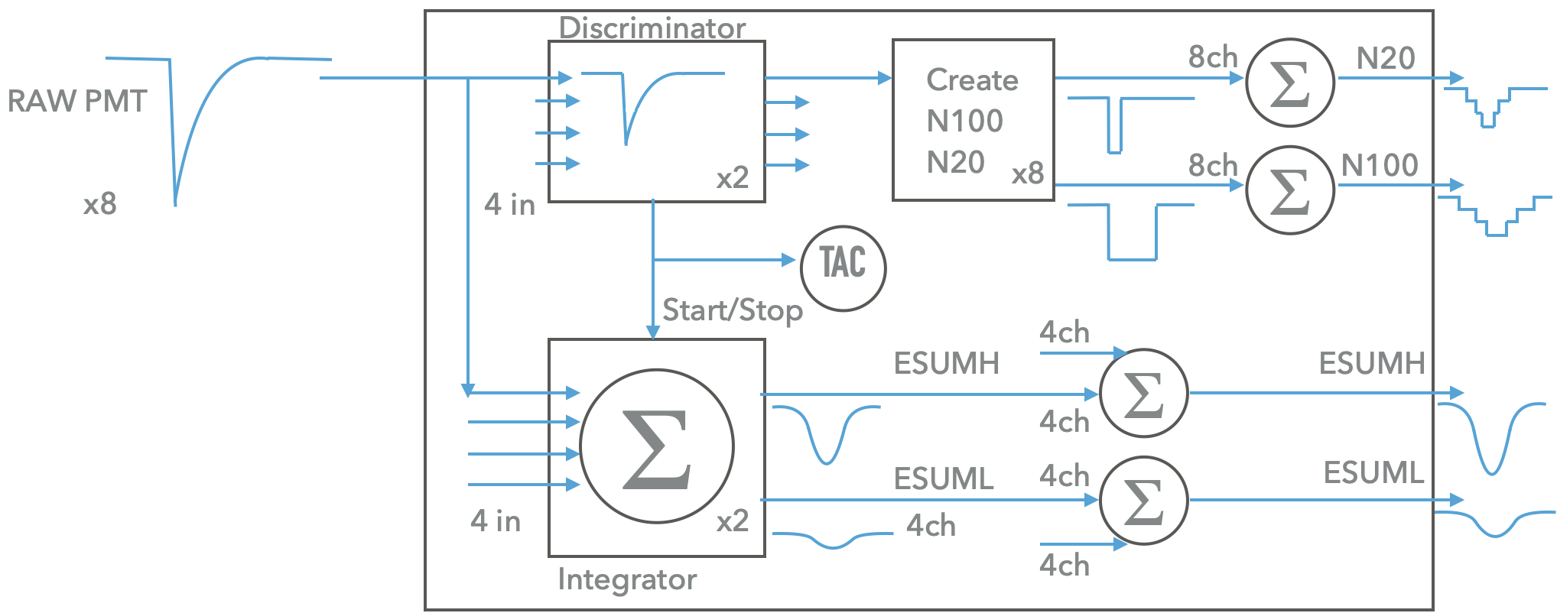
From PMT hit, what happens?
FEC records information about the PMT pulse:
3 charge integrations: High gain long window, high gain short window, low gain variable window
Time to Amplitude Conversion: a relative timing measurement from Global Trigger (GT)
PMT pulse leaves FEC to the “ESUM” trigger, FEC also produces 100ns and 20ns square pulse for every hit. These our Physics triggers: the N100 and N20 triggers
5

Slide 6
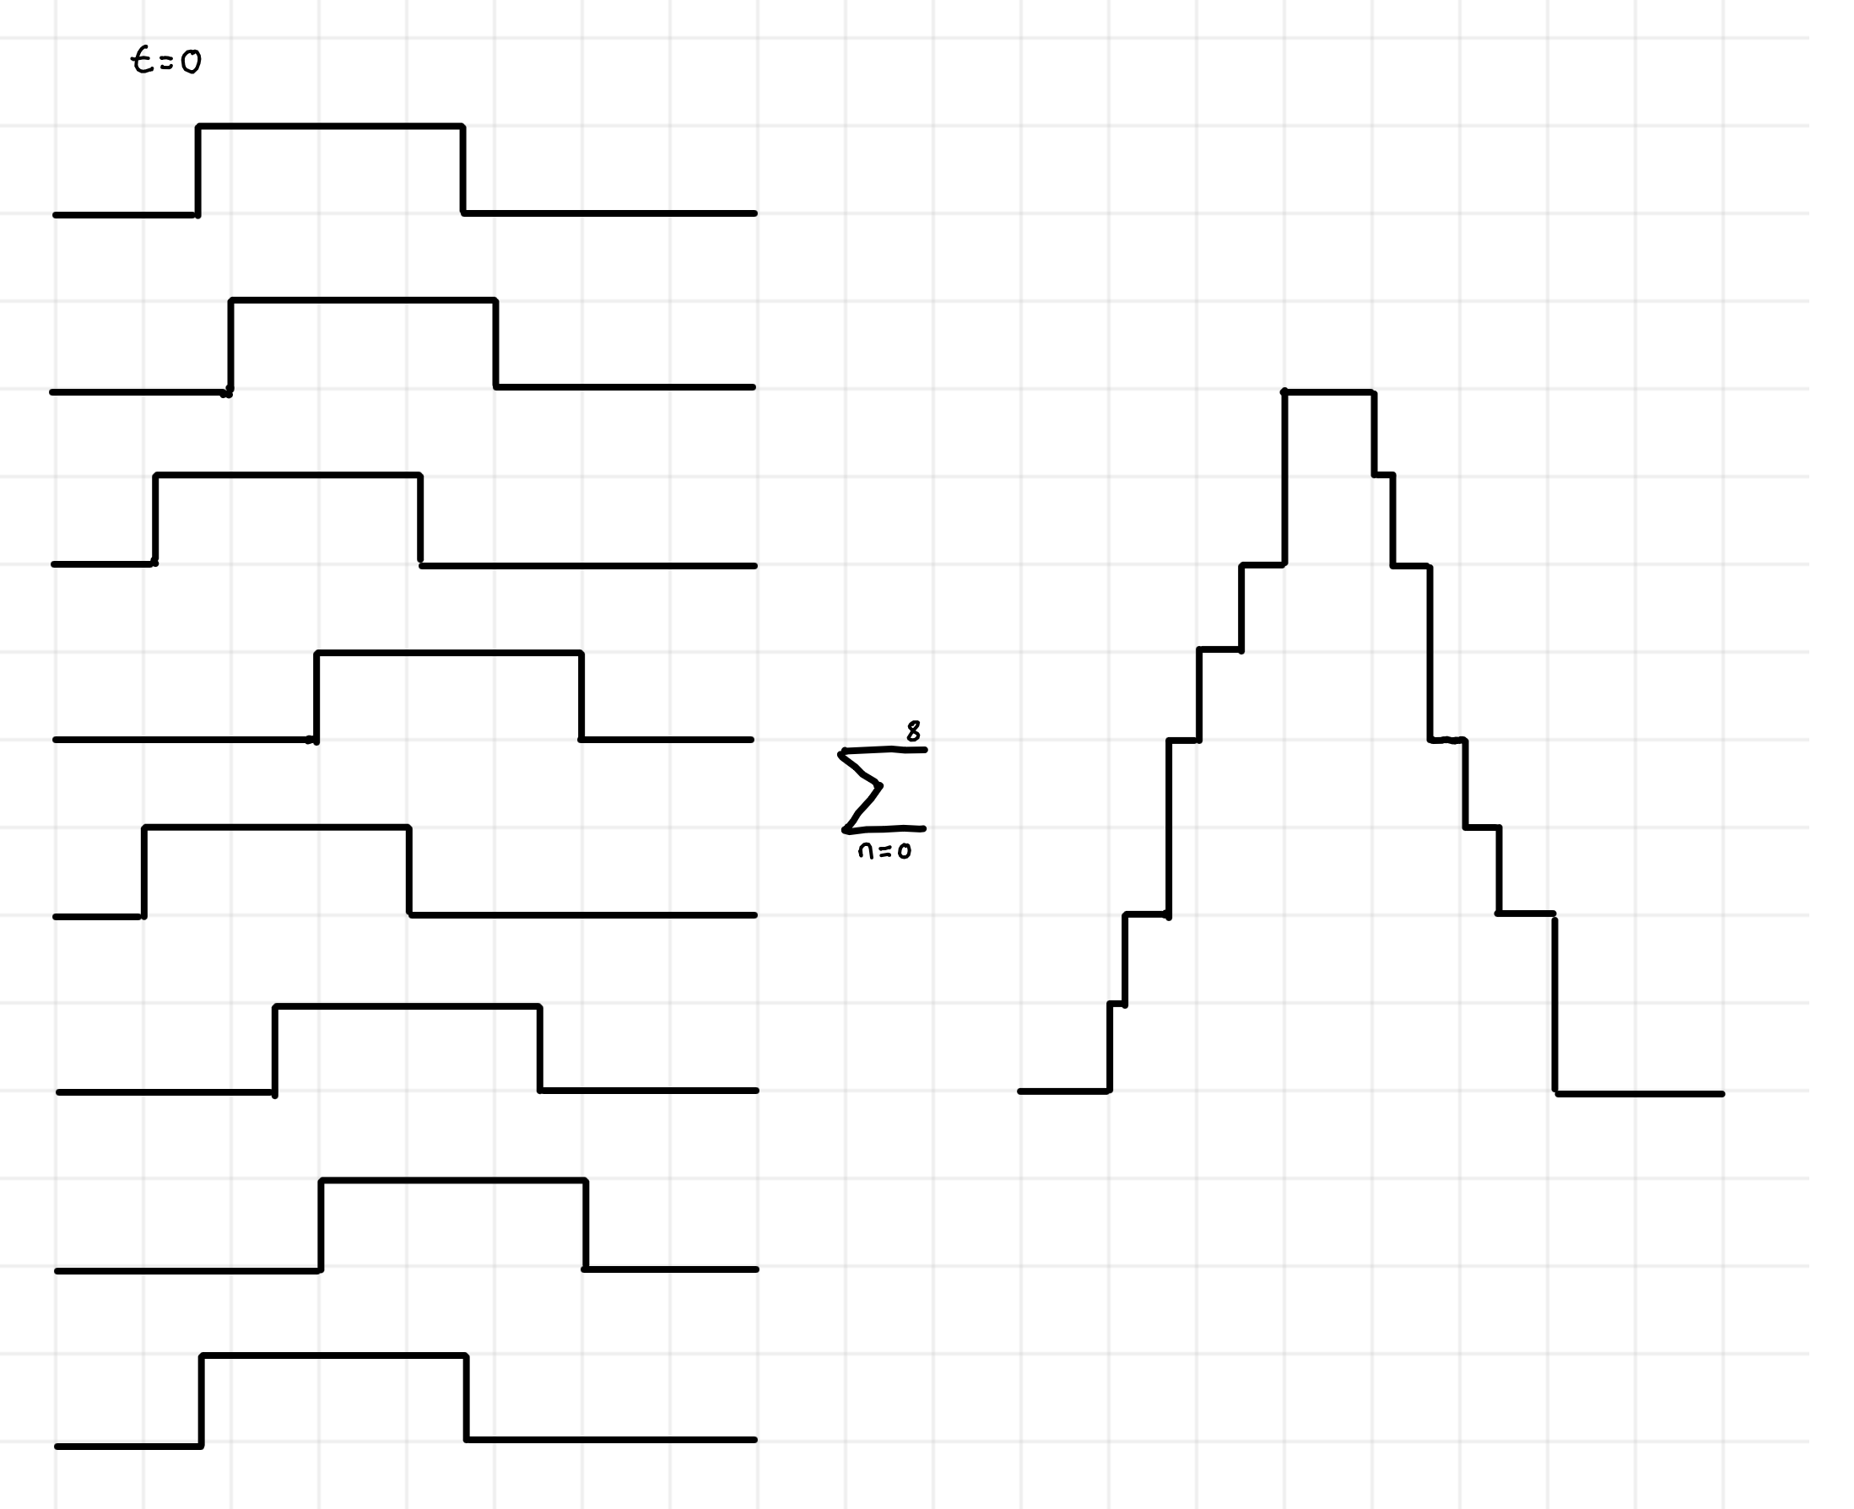
Summing pulses
The Crate Trigger Card (CTC) sums the trigger pulses for the crate and sends them to the Timing Rack
Timing Rack has a Master Trigger Card Analog (+, since SNO+, so MTC/A+) for each trigger. MTC/A+s sum every crate together
If the set threshold on an MTC/A+ is crossed, it sends a digital signal to the Master Trigger Card Digital (MTC/D) which then emits a global trigger pulse
Data is only recorded when a GT is sent, only by channels that have hit PMTs
example:
6 nHit threshold
6

Slide 7
Data!
The PMT output data is contained within 3 32-bit words
The Crate, Slot, Channel & Cell address identifies the PMT
  The maximum number for a slot or cell is 16, for channels it’s 32. There are 19 crates.
The GT is a 24-bit number, broken up in 3 chunks in the data
The charge integrations and TAC are recorded by 12-bit Analog-to-Digital converters (ADC)
The hit data also included 6 bits for error flags
31 | 30 | 29 |  |  |  | 25 |  |  |  |  | 20 |  |  |  |  | 15 |  |  |  |  |  |  |  |  |  |  |  |  |  |  | 0
SYNC CLEAR24 | SYNC CLEAR16 | Slot Address |  |  |  | Crate Address |  |  |  |  | Channel Address |  |  |  |  | GT ID Bits 15-0
31 | 30 | 29 | 28 | 27 |  |  |  |  |  |  |  |  |  |  |  | 15 |  |  |  | 11 |  |  |  |  |  |  |  |  |  |  | 0
CMOS ES16 | Gain Select | NC=1 CC=0 | Miss Count | Charge integration QHS (12-bit ADC) |  |  |  |  |  |  |  |  |  |  |  | Cell Address |  |  |  | Charge integration QLX (12-bit ADC)
31 | 30 | 29 | 28 | 27 |  |  |  |  |  |  |  |  |  |  |  | 15 |  |  |  | 11 |  |  |  |  |  |  |  |  |  |  | 0
GTID Bits 23-20 |  |  |  | TAC, Time-Amplitude Conversion (12-bit ADC) |  |  |  |  |  |  |  |  |  |  |  | GT ID Bits 19-16 |  |  |  | Charge integration QHL (12-bit ADC)
7

Slide 8
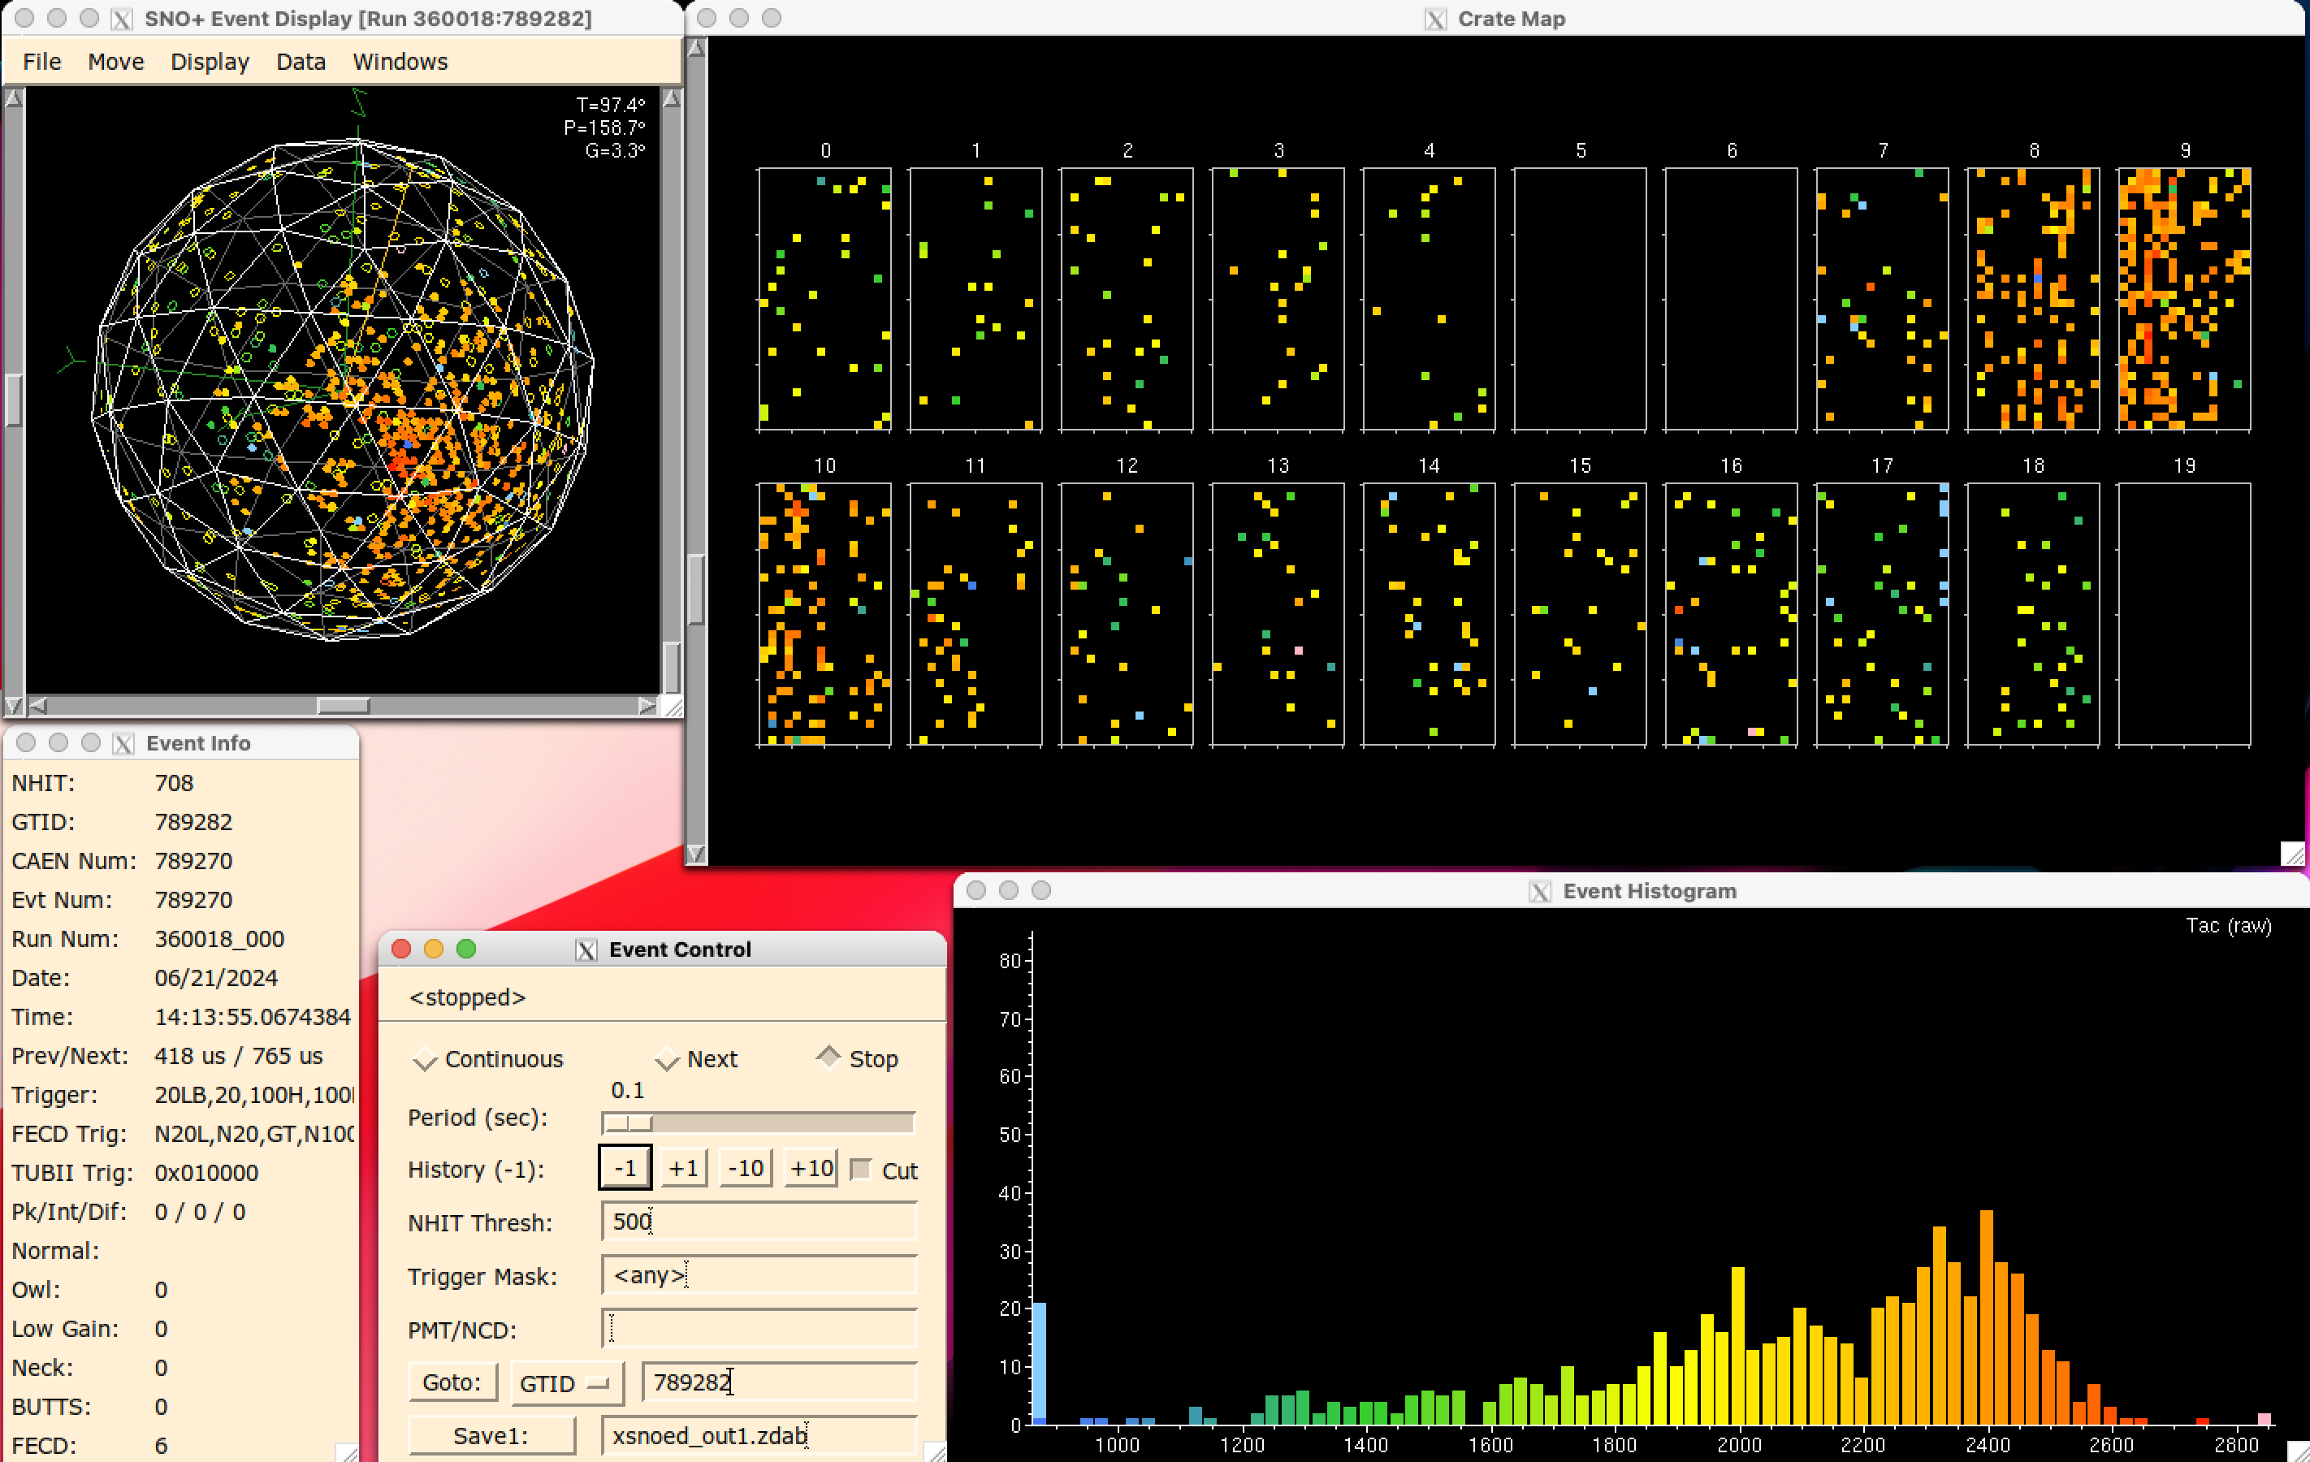
Event viewer displays all hit data per event
Missing crates impact data quality, priority to keep them all online
19 is the teststand, not UG
8

Slide 9
9

Slide 10
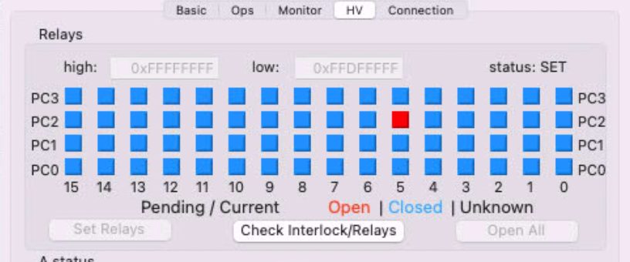
Debugging tales:
PMTIC relays / shift registers
PMTs breakdown over time, which can cause damage to resistors along the HV path on the PMTICs but can also damage specific integrated circuits.
Each PMTIC has 4 relays to isolate 8 PMTs each. The relays are controls by a shift register.
The crate is loaded with a 64-bit data stream containing the full relay mask (16 slots x 4 relays each). Broken shift registers impede or corrupt the loading of the relay mask.
Slot 0 is the first loaded in, from PC3 down to PC0.
Had one breakdown that damaged the relay control for several slots, needed to untangle several issues.
10

Slide 11
This shift register (HCT164) can be damaged by breakdowns
Controls these relays
11

Slide 12
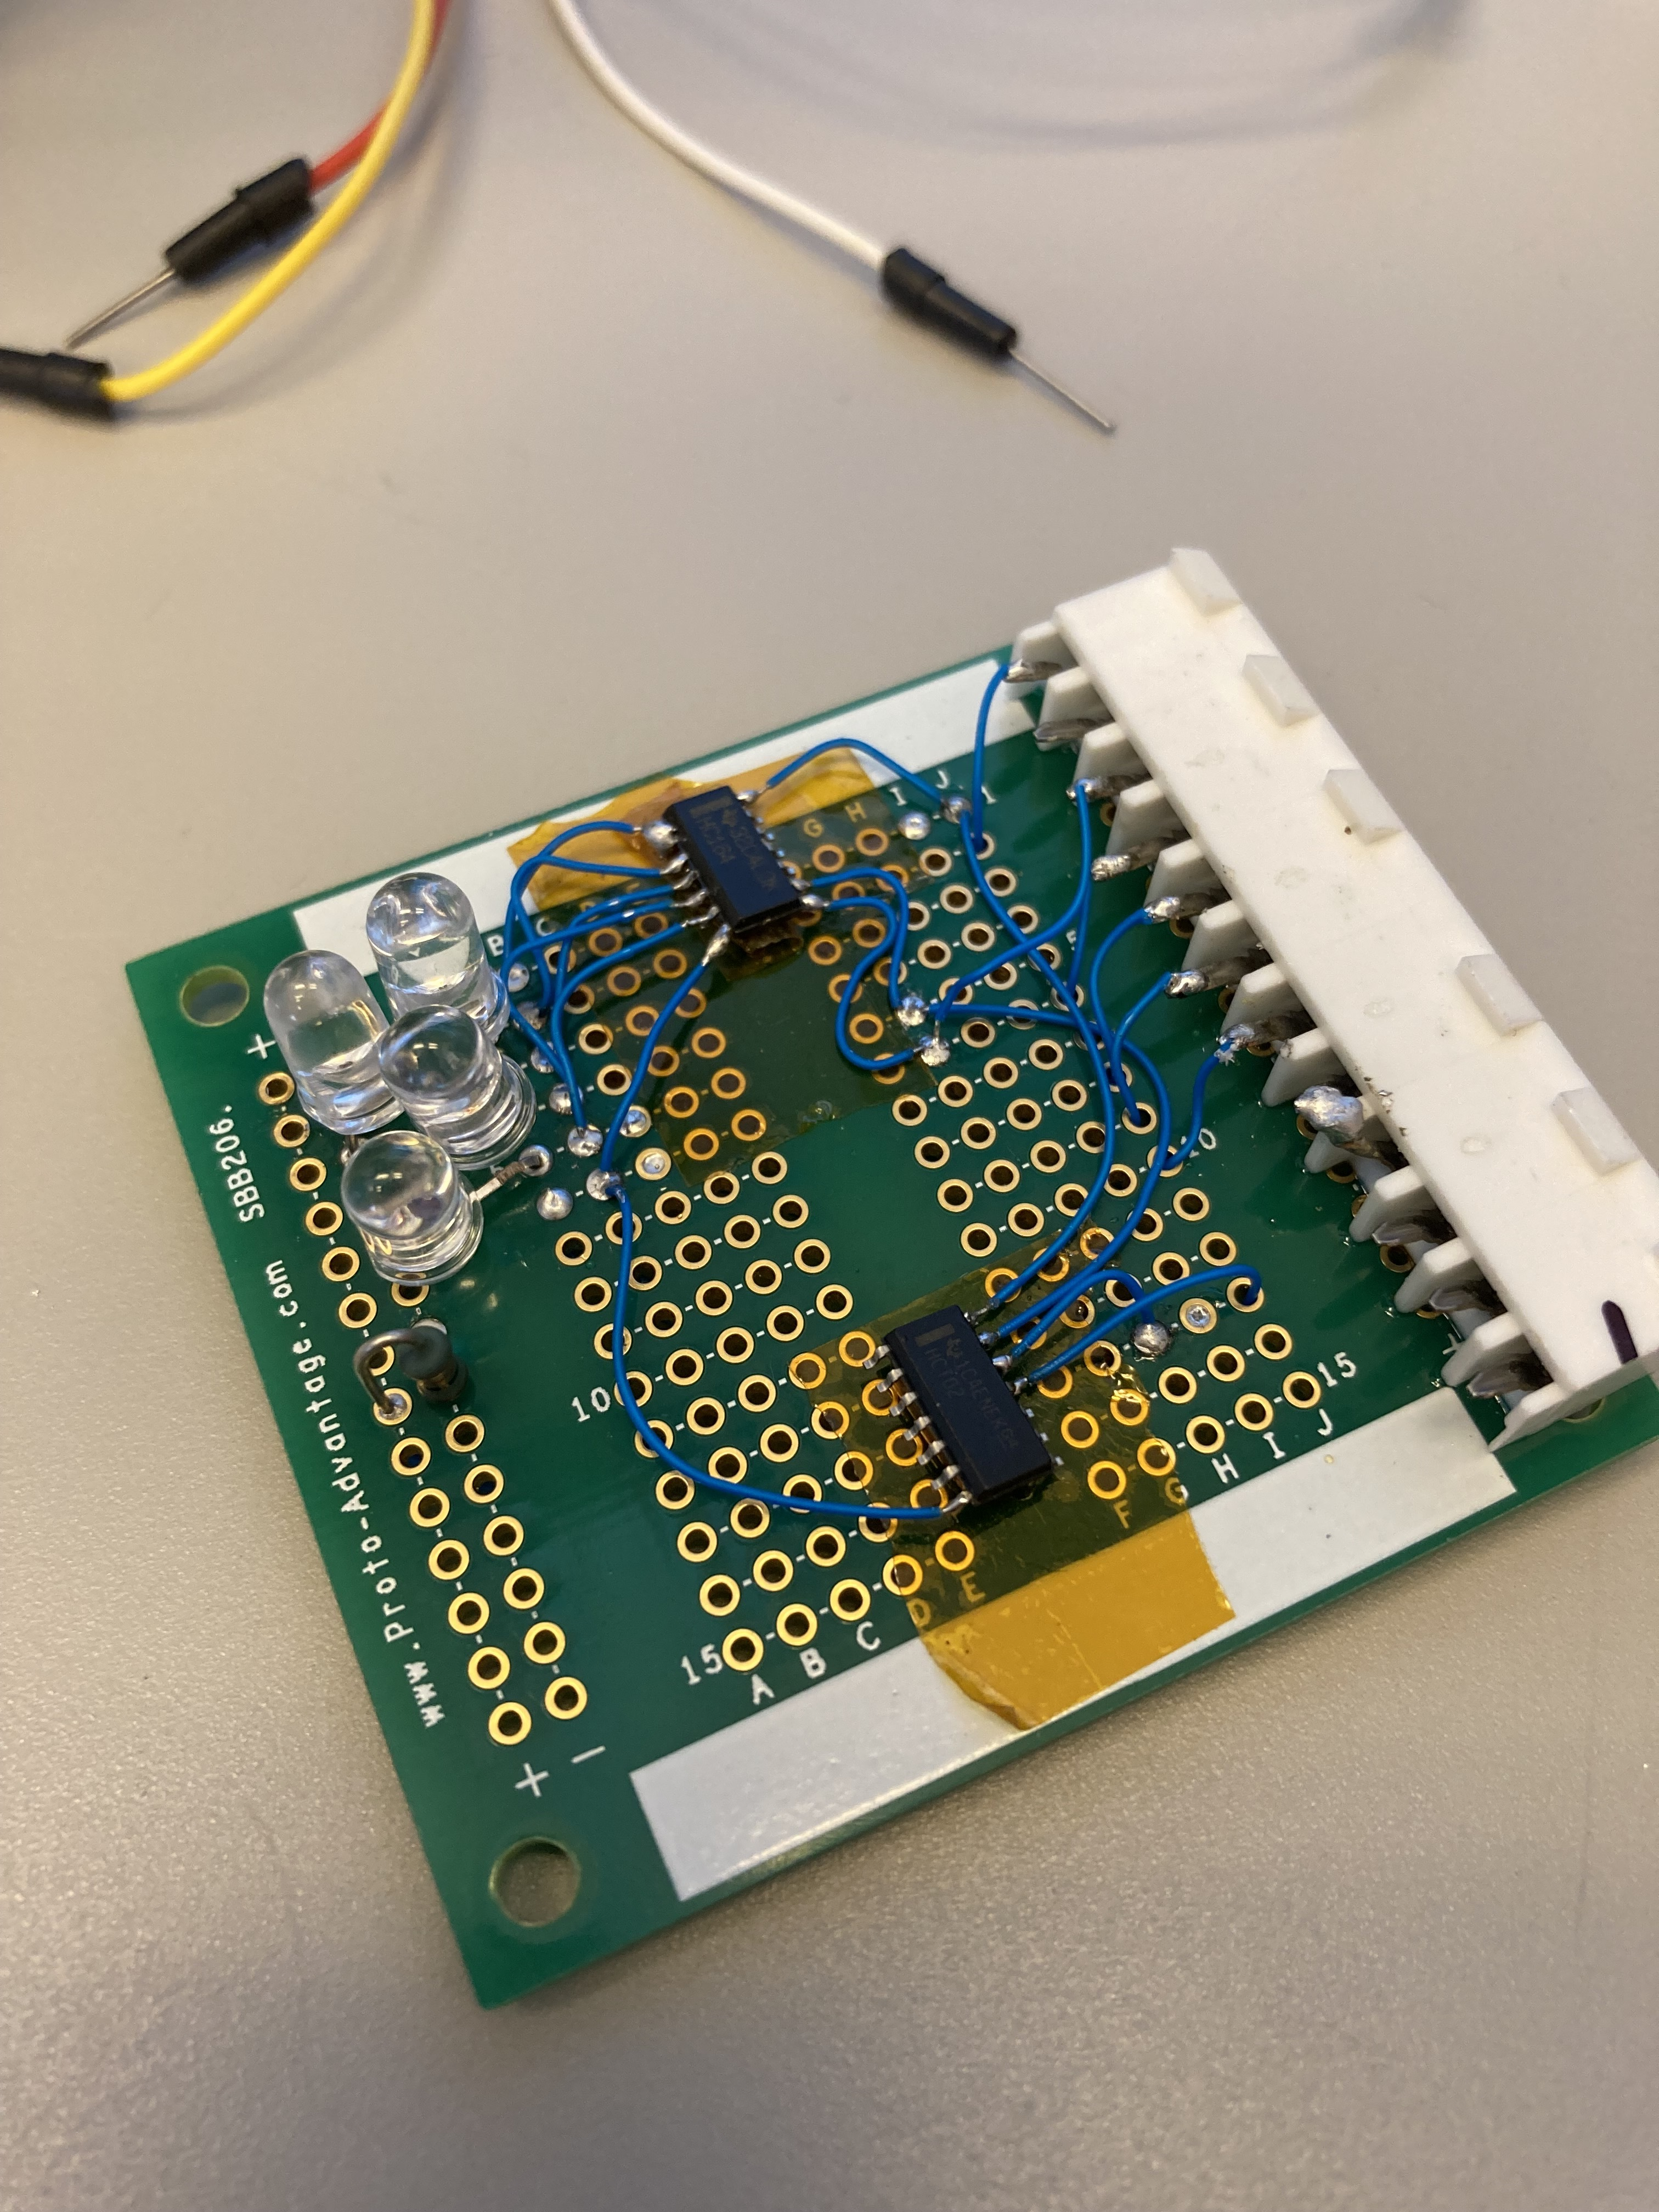
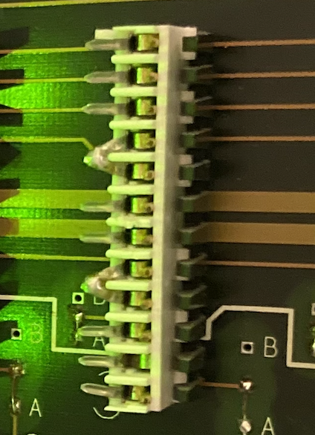
Debugging tales:
PMTIC relays / shift registers
We used jumper connecters that bridge the interlock pins and the relay data pins to debug relay mask issues or if a PMTIC needs to be repaired on surface
Can test the crate with these, but the relay mask will be shifted by 4 bits wherever this in installed
Prototyped a board that can be installed in place of a PMTIC
Needs to bridge the interlock and emulate the relay control circuit of a PMTIC.
Will not connect to HV (removed the HV pins on the connector)
12

Slide 13
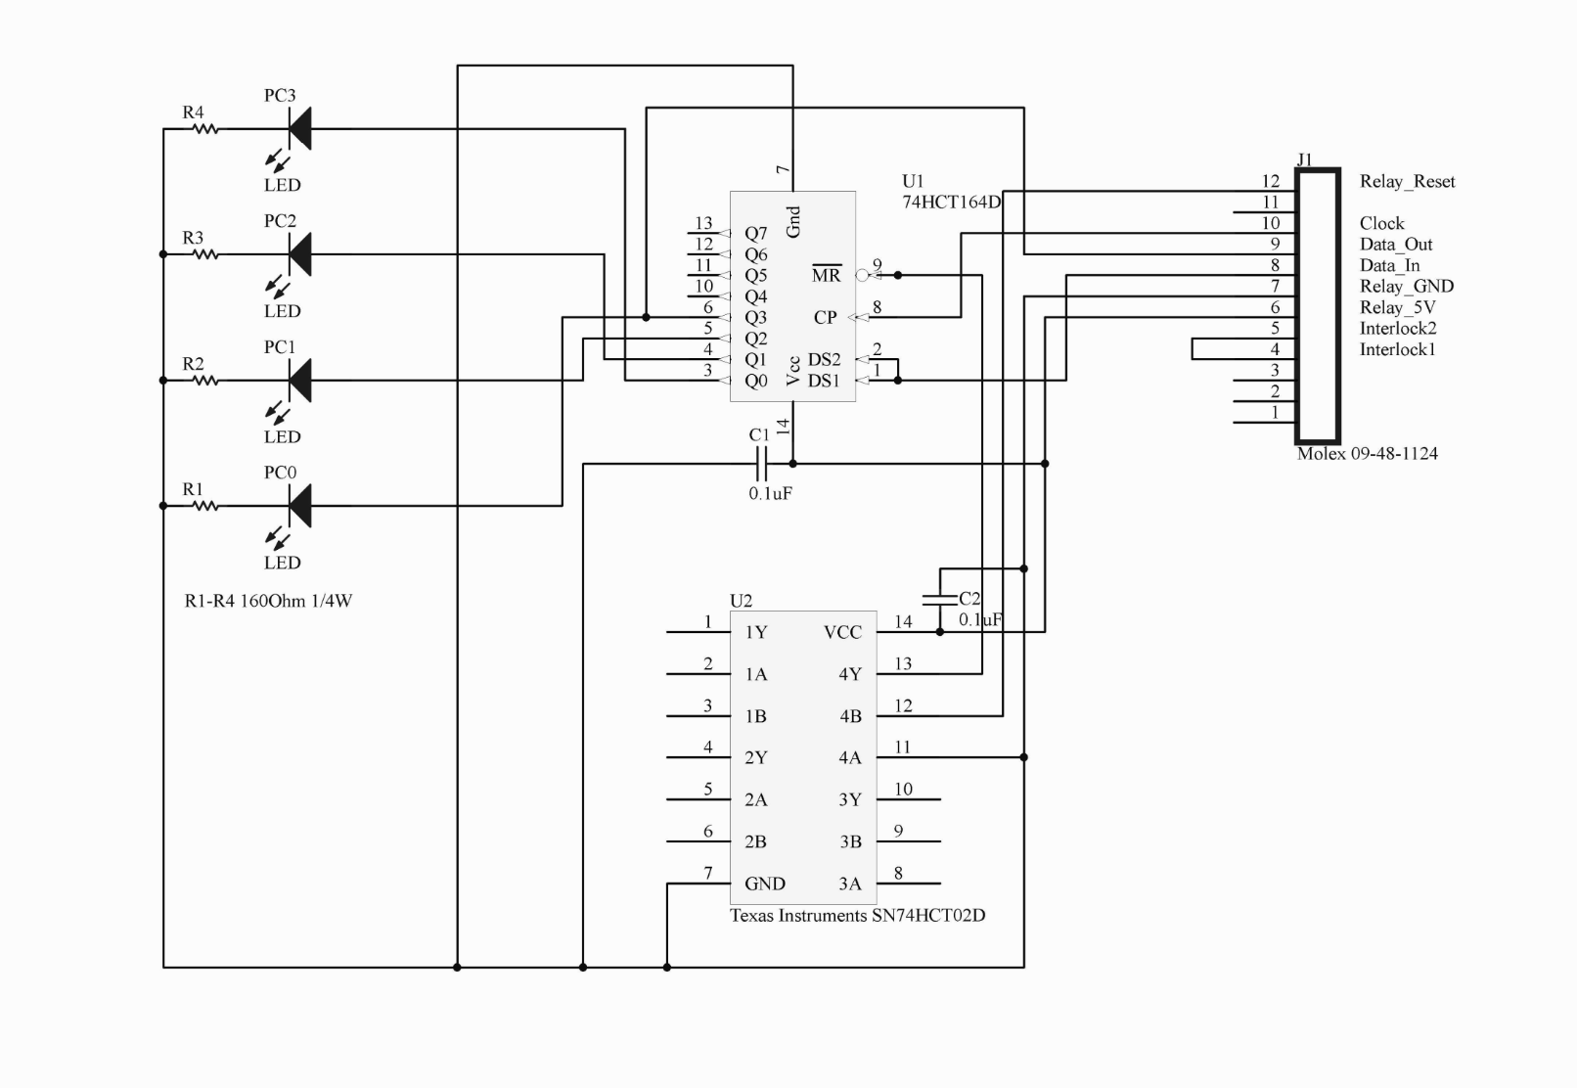
Debugging tales:
PMTIC relays / shift registers
Copy…
…Paste
13

Slide 14
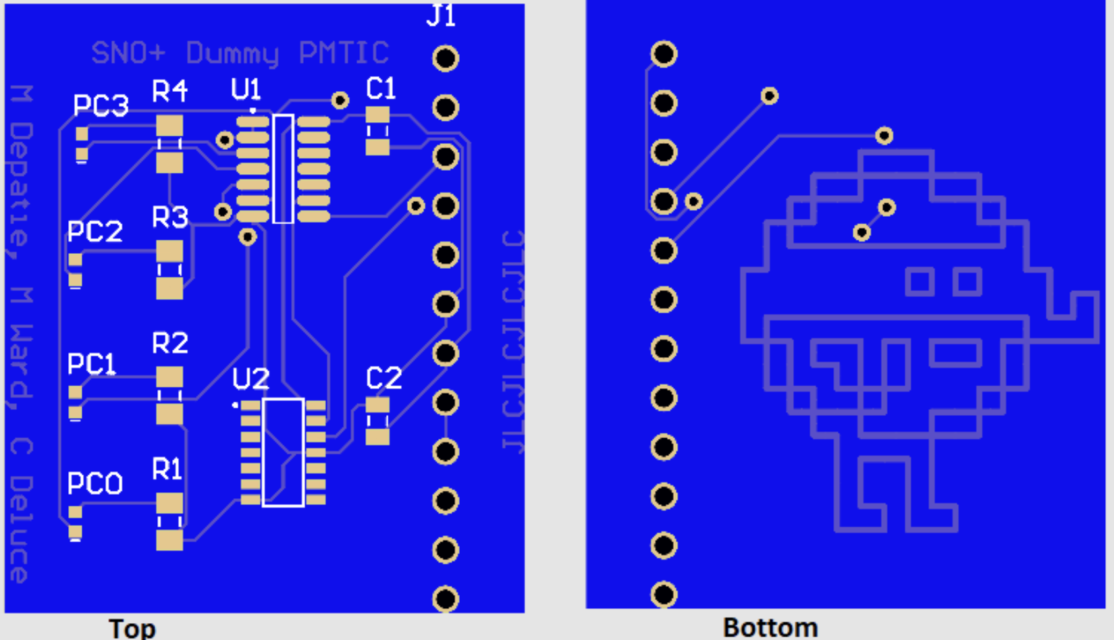
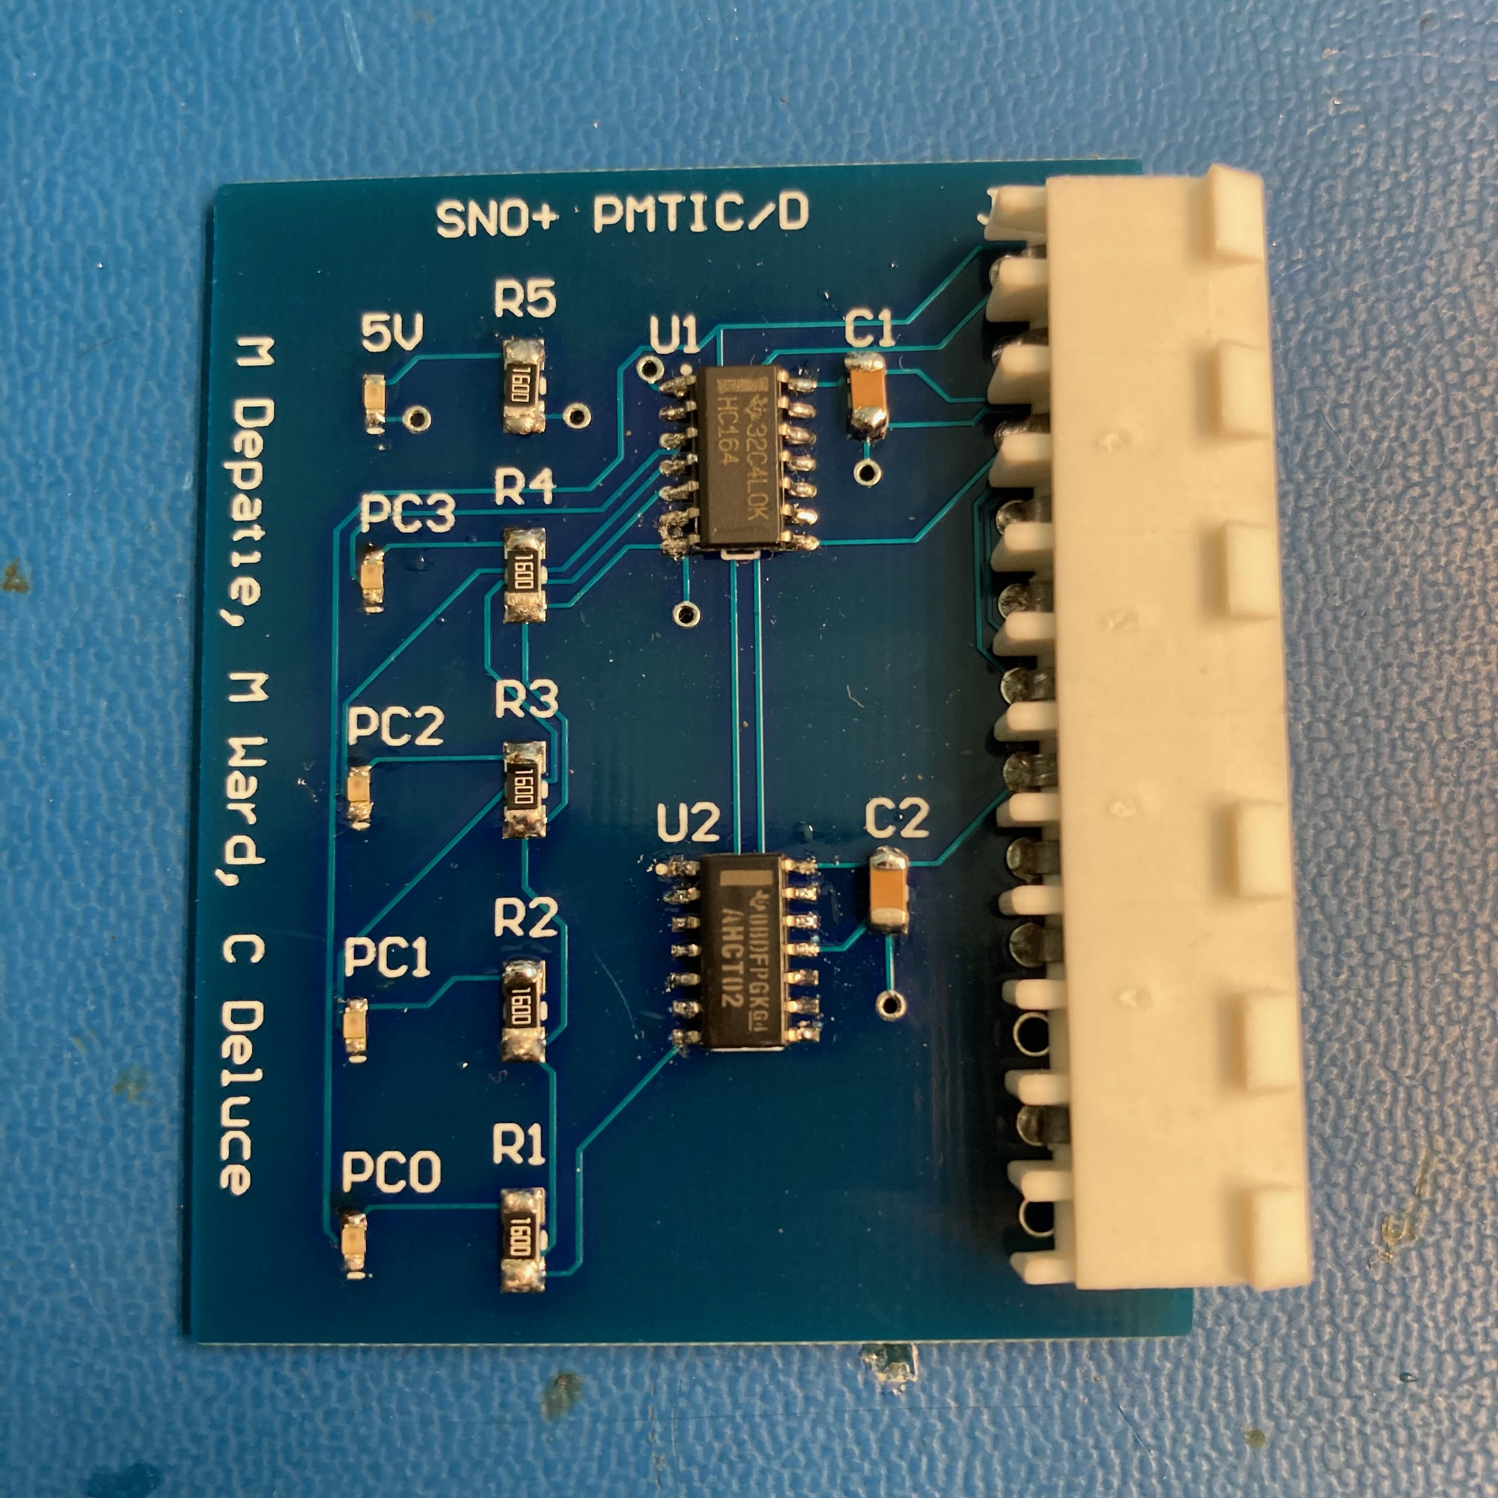
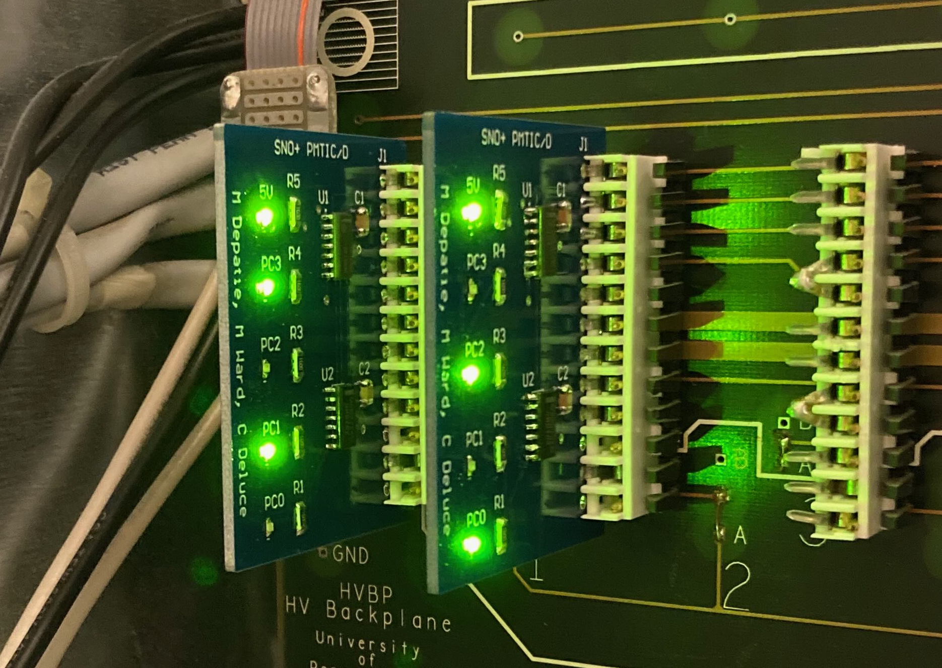
Debugging tales:
PMTIC relays / shift registers
Prototype worked, it helped understand all the issues caused by that bad breakdown
Instead of controlling relays, the shift registers on this board enable LEDs
We now have a tool to debug relay mask issues or to install in place of PMTICs
I name thee…. PMTIC/D! We now have ~20 of these PCBs
PCB render v1
Populated PCB
Works in the teststand!
14

Slide 15
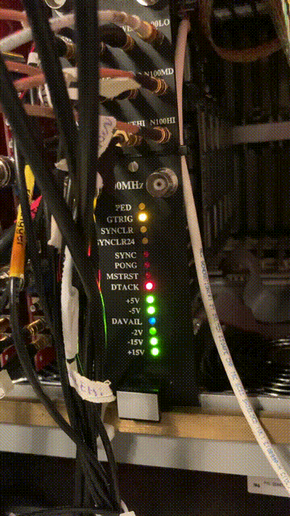
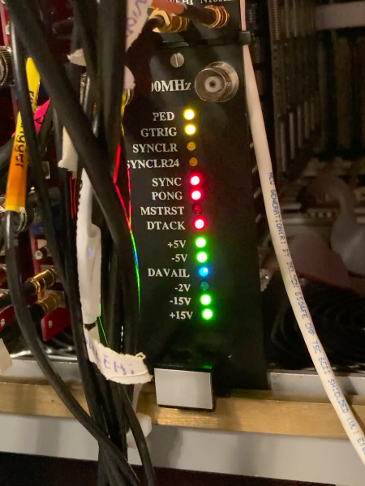
Debugging tales:
MTC/D stops counting or resets
The frame where it resets…
MTC/D stopped counting; it looks like to board reset itself.
Restarting a Physics run would load the needed settings into the MTC/D, but this issue impacts data quality.
Started investigating UG with the issue occurring frequently, managed to catch the random reset on video
Why are these
LEDs on?!?
Oh no where’s
the -2V?
15

Slide 16
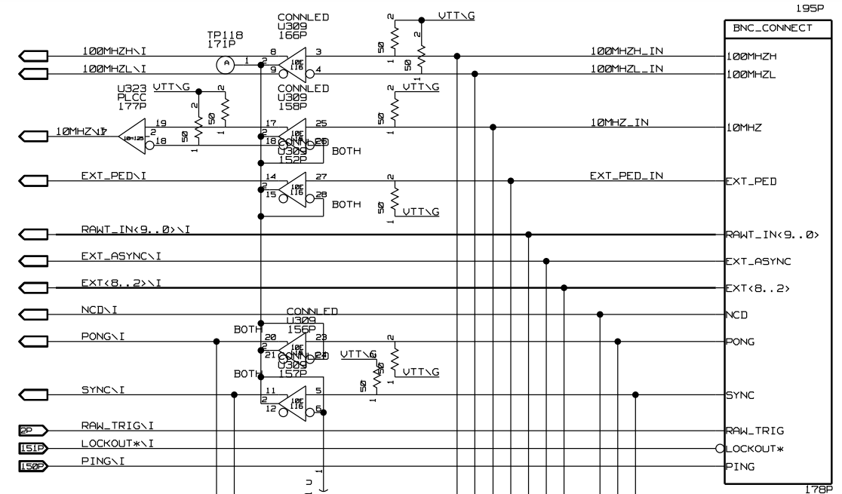
Debugging tales:
MTC/D stops counting or resets
Clues: LEDs that should have been on (PED, SYNC & PONG) flashed and the LED for the -2V went dim.
The line drivers for those the signals connected to the flashed LEDs use -2V (also labeled Vtt). Anything using ECL logic will produce an errant single pulse if the -2V drops.
Why are these
LEDs on?!?
Oh no where’s
the -2V?
16

Slide 17
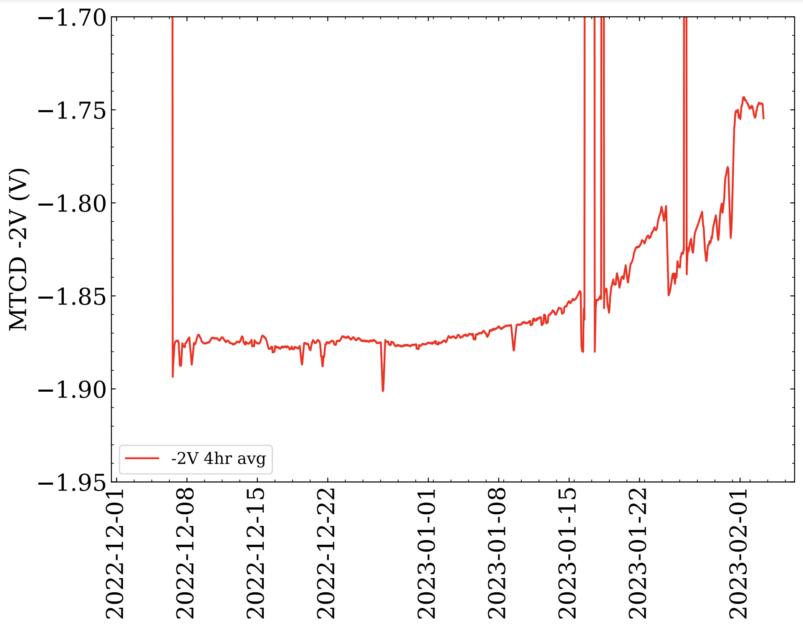
Debugging tales:
MTC/D stops counting or resets
The reset signal for the MTC/D is ECL, explain why the board resets.
Is the -2V regulator on the MTC/D going bad?
We monitor the low voltage supplies from every rack using our slow control system
Looking at the MTC/D -2V over the previous 6 months shows it lowering, likely now sitting at a borderline functional voltage for the circuits that need it for logic.
But…. why? Age? Gremlins?
17

Slide 18
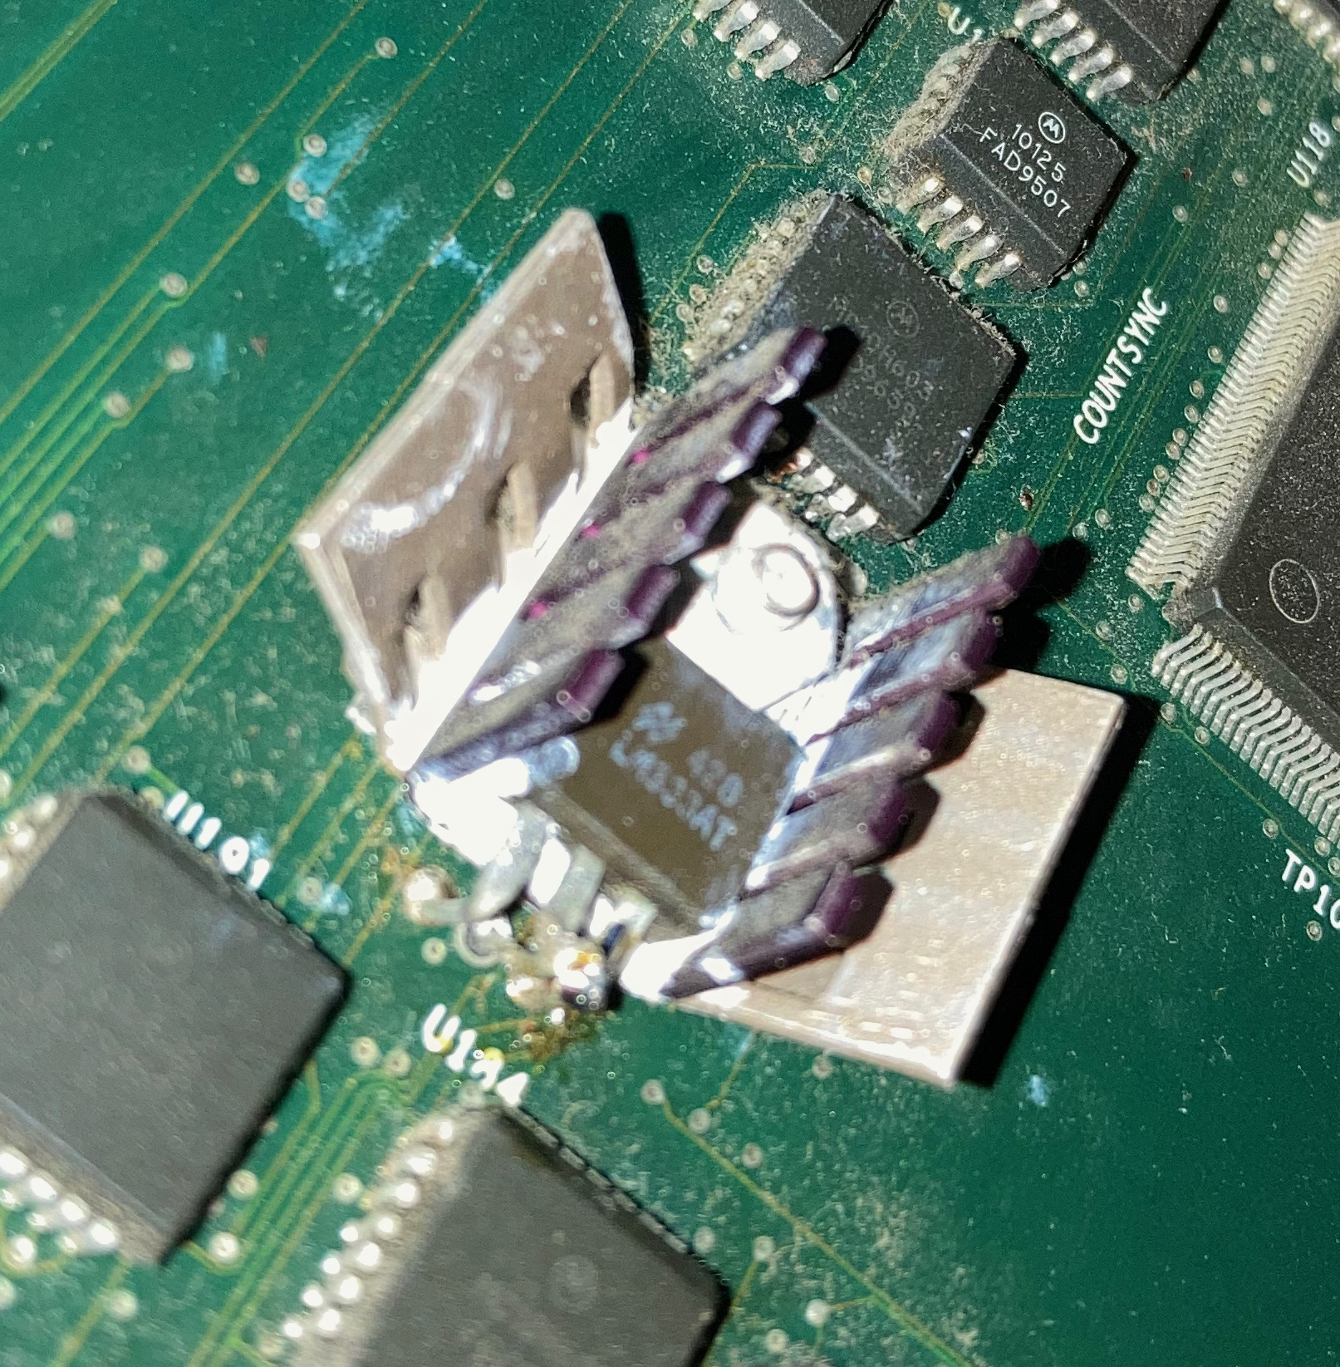
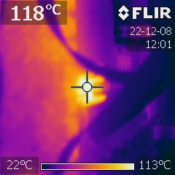
Debugging tales:
MTC/D stops counting or resets
The event rate for SNO+ was below 1kHz for Water phase
Now in Scintillator phase, the event rate has increased to around 2.5kHz
The MTC/D now performs twice as many ECL operations compared to water phase resulting in higher current draws from this regulator
The -2V regulator is rated for 3A output, that can generate a lot of heat, so it’s installed with heatsinks
18

Slide 19
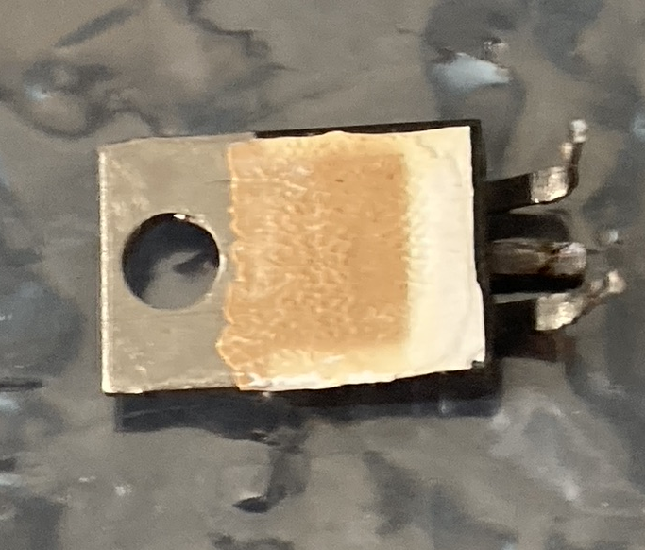
Debugging tales:
MTC/D stops counting or resets
Tried replacing the regulator, keeping the same heatsink configuration.
Burnt out another, needed to rethink the thermals for this component.
Even with heatsinks, the regulator is held against the board trapping heat in a small ~1cm² area
On the last attempt, I accidentally used worse thermal compound and really cooked the regulator
18

Slide 20
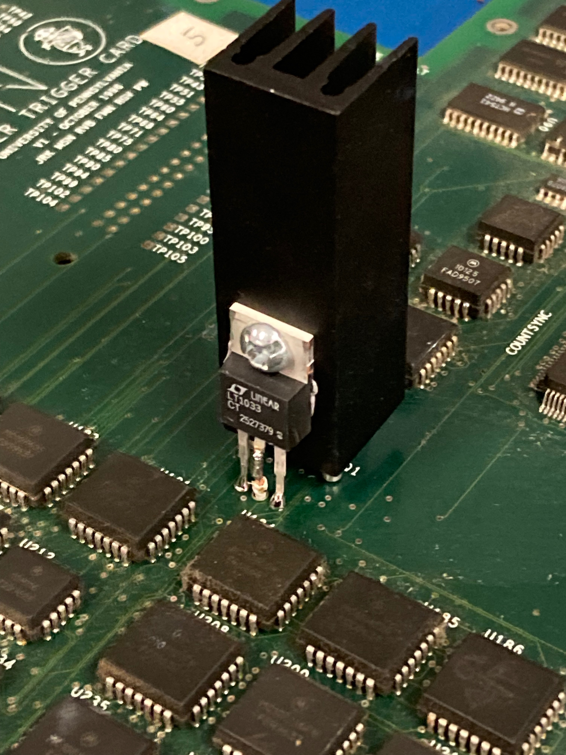
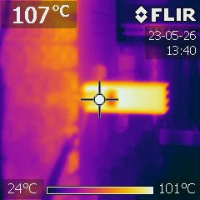
Debugging tales:
MTC/D stops counting or resets
Time for an upgrade!
Original regulator LM337 no longer made, moved to new LT1033 (still a 3A regulator)
Sourced the largest heatsink for a T0-220 component we could fit
Installed regulator on the heatsink with proper thermal compound…
And it’s running cooler!
51mm!!!
20

Slide 21
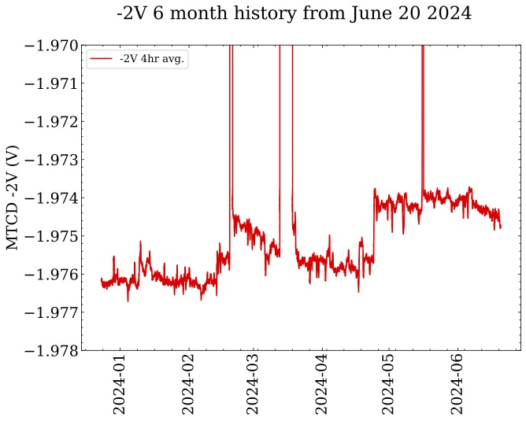
Debugging tales:
MTC/D stops counting or resets
The new heatsink allows the -2V to run cooler (and look cool)
Been installed and stable since March 2023
Plot shows the voltage history over the last 6 months
Baseline changing within 20mV, will continue to monitor and replace if needed
21

Slide 22
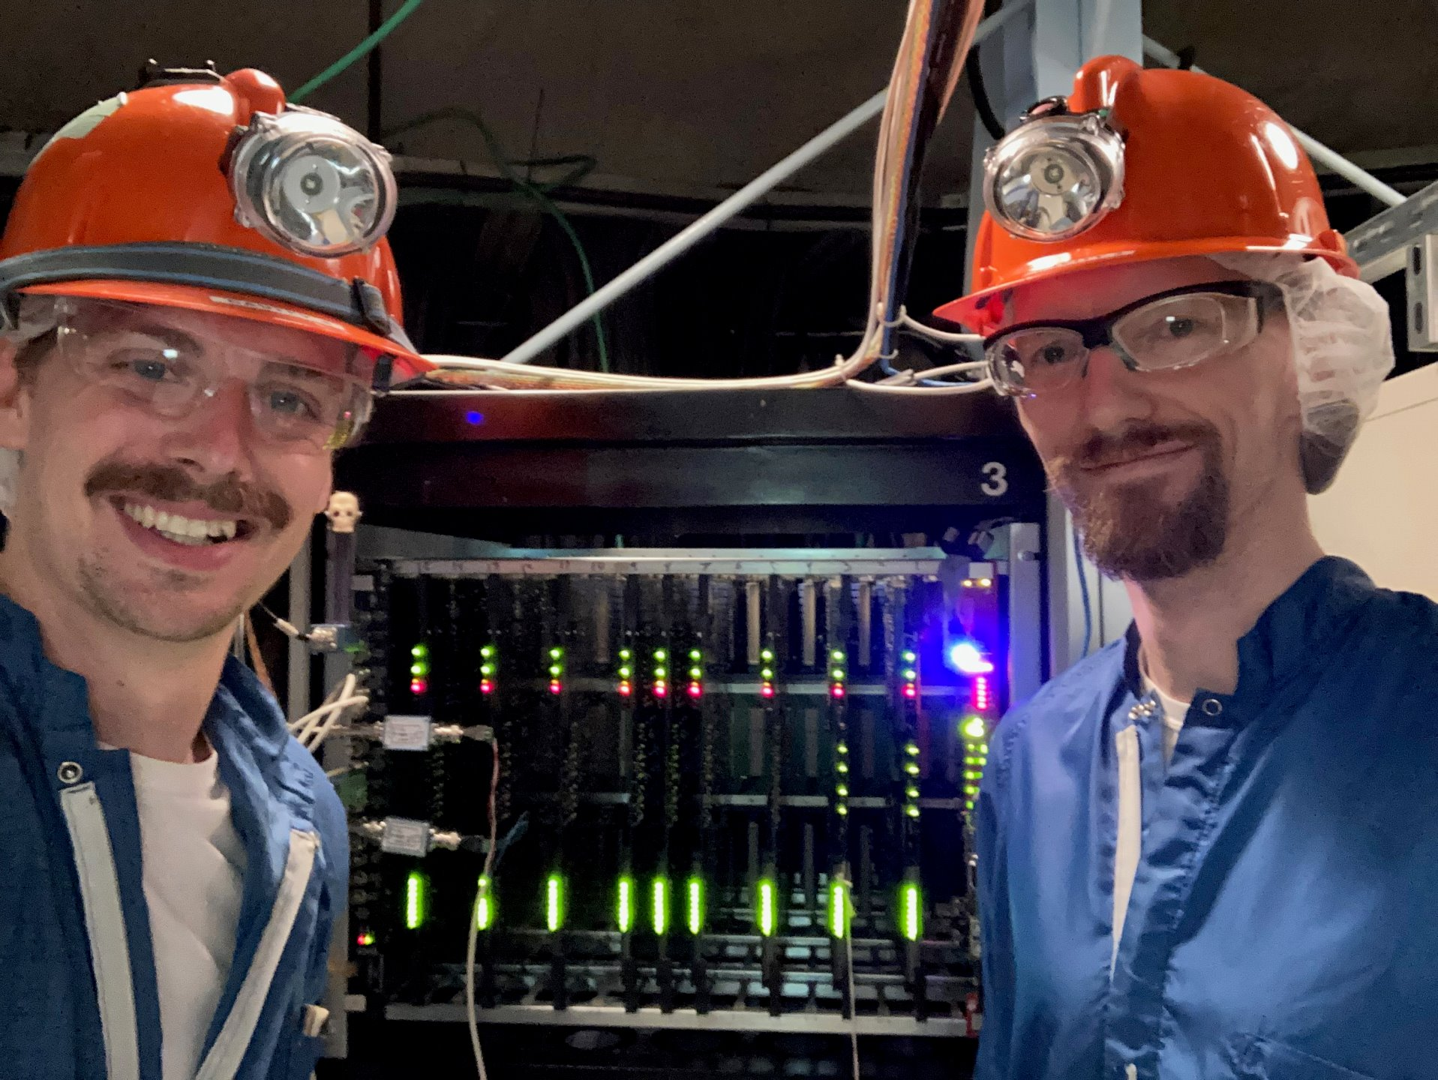
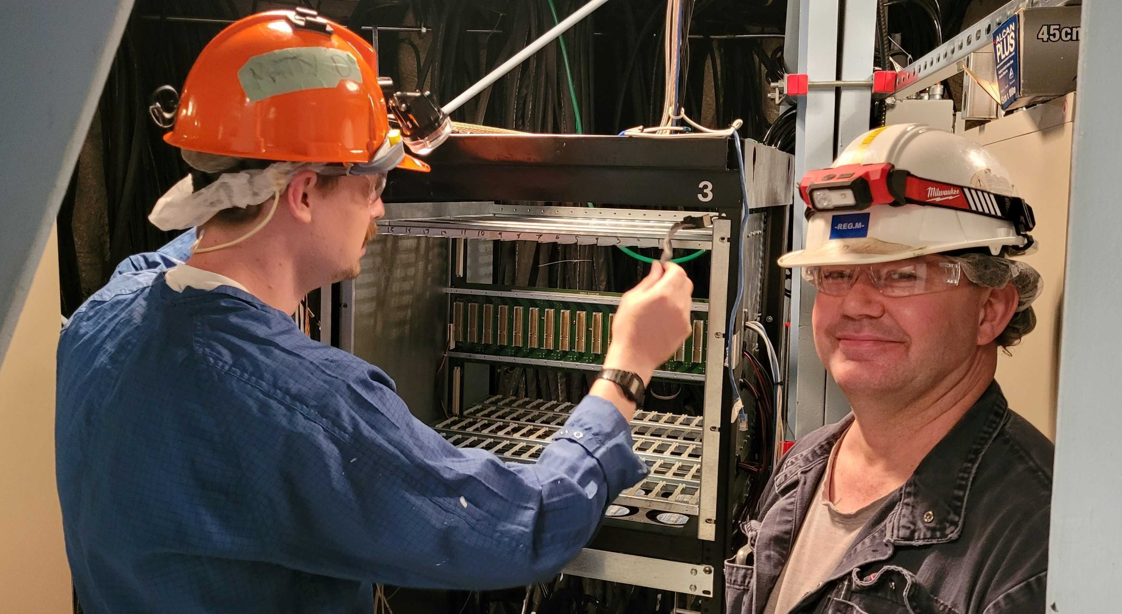
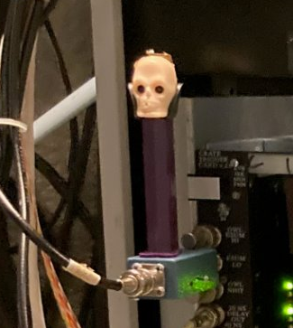
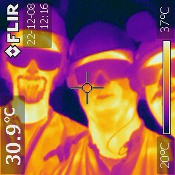
Final thoughts
SNO+ has a robust but aging detector, matched by a dedicated and creative team
Many common issues are understood and resolved quickly but new issues require novel approaches
23

Slide 23
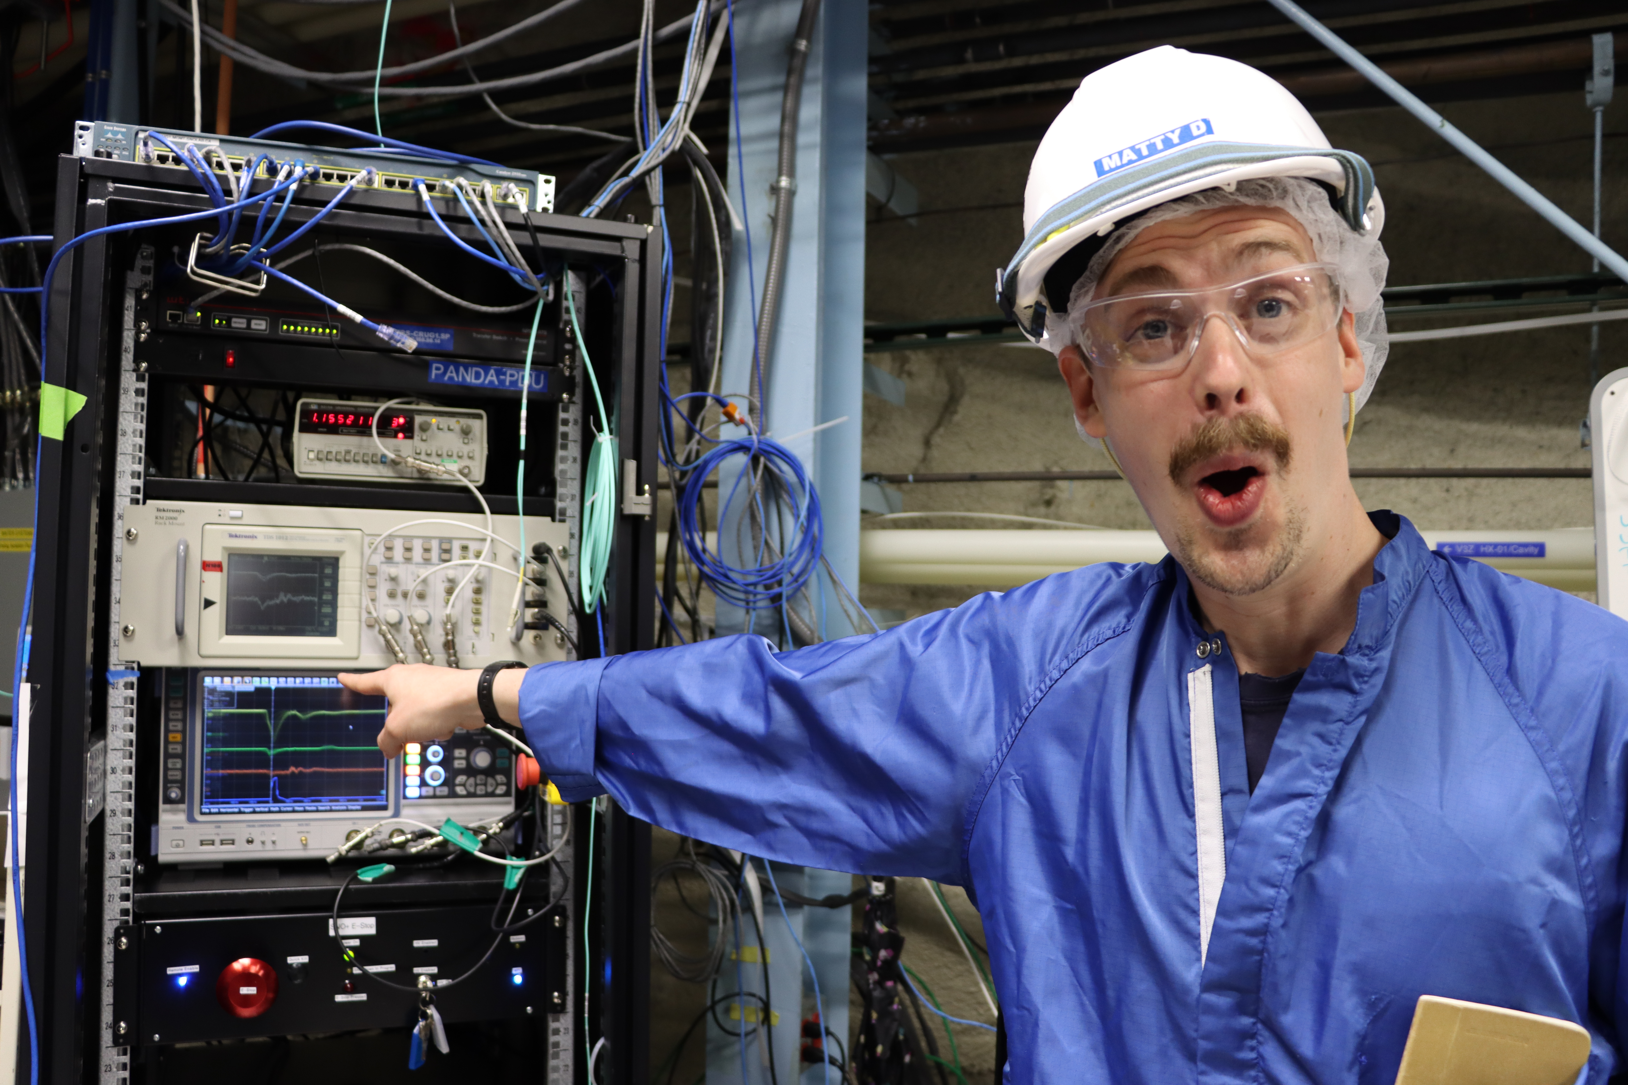
Questions?

