Slide 1



Digital SPAD array for many things
Fabrice Retiere (TRIUMF)

Slide 2
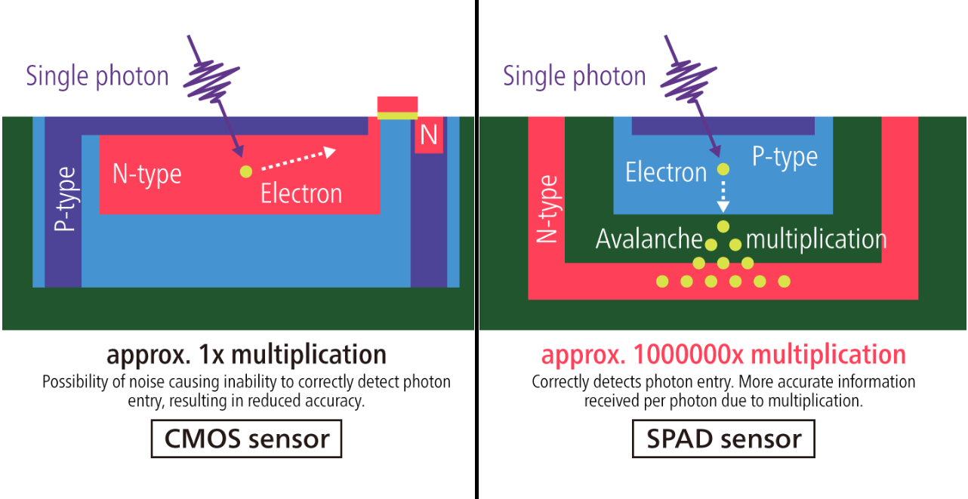
Single Photon Avalanche diode
https://www.canon.ca/en/Discover/Commercial-Imaging-Solutions/SPAD-Sensor-Long-Range-Night-Vision

Slide 3
SPAD in astro-particle physics
Used/foreseen by several experiments
  4.5 m² for nEXO in liquid Xenon
  30 m² for DarkSide-20k for Dark matter search in liquid Argon
    ARGO may need up to 200 m2
  Considered for XLZD and DARWIN for dark matter search in liquid Xenon
Pros
  Ultra-low radioactivity (1/1000 compare to PMTs)
  High efficiency
    25% at 175nm (vs 35% for PMT)
    >50% at 420nm (vs 35% for PMT)
  Fast timing (small size)
  Few issues
    Low dark noise (when cold)
    Low after-pulse
    Emit light, which could prove problematic
Cons: cumbersome to readout

Slide 4
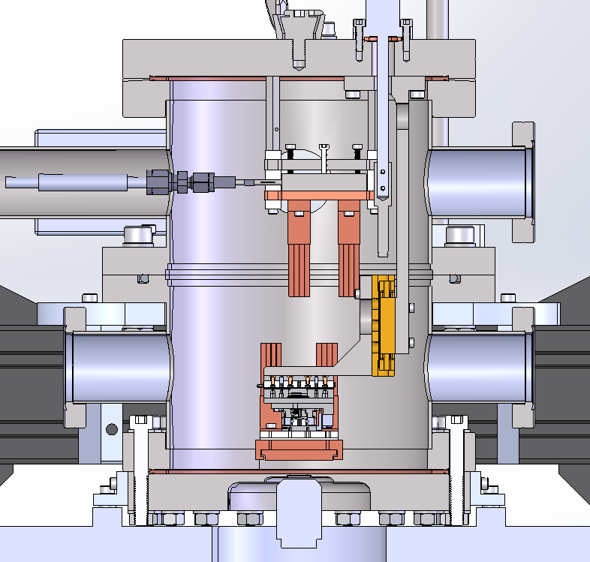
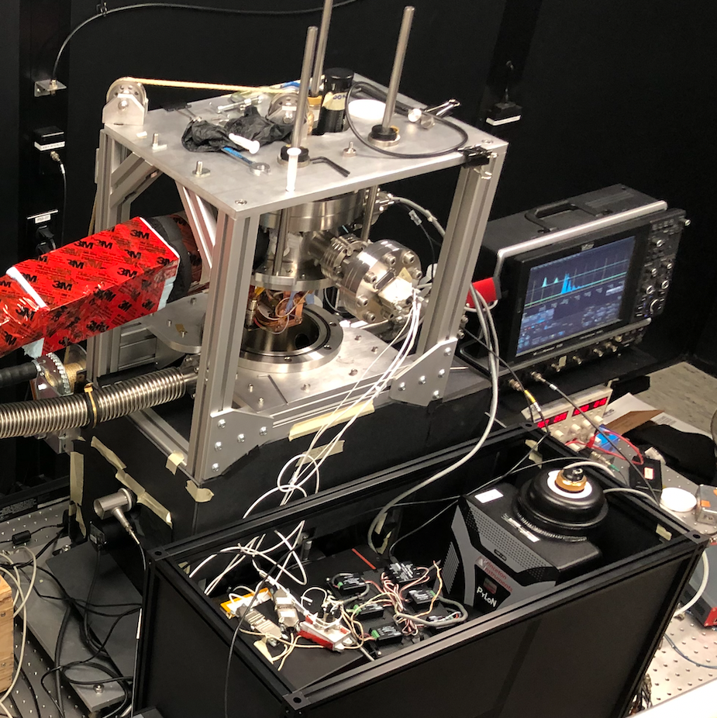
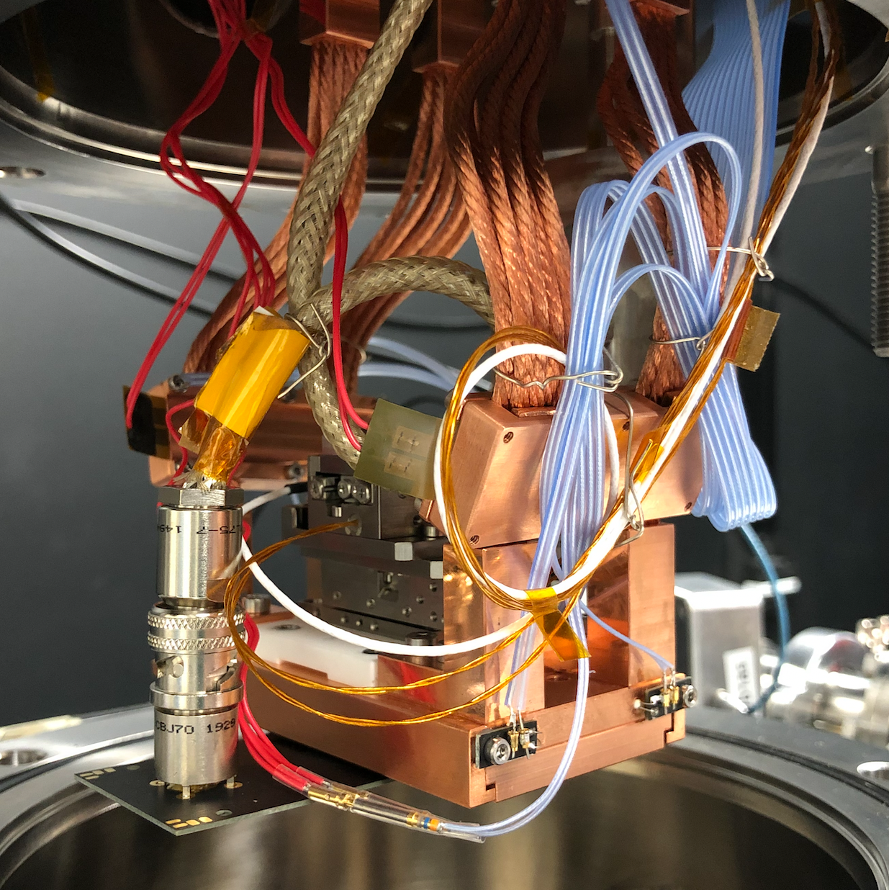
MIEL
Microscope for the Injection and Emission of Light
Cooled X-Y Stage
SPAD
DAQ
Vacuum Window
SiPM Surface
Upper Cold Stage
Vacuum Chamber
Objective
Copper Braided
Cold Fingers
Sync
Dichroic Mirror
X-Y Stage Motors
Laser
LASER
(405 nm)
SiPM Position
Microscope Objective
Emission Filter
Emitted Light
IX-83 Microscope
Diffraction Grating
B)
A)
Spectroscopy
Imaging
Spectrometer and Cryogenically Cooled Camera
The MIEL Experiment
Cryogenically Cooled X-Y Stage with SiPM Mounted

Slide 5
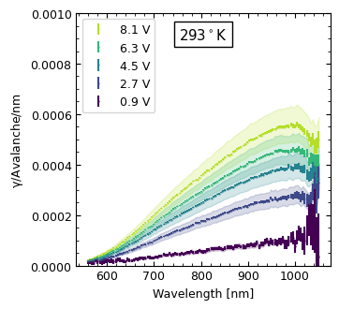
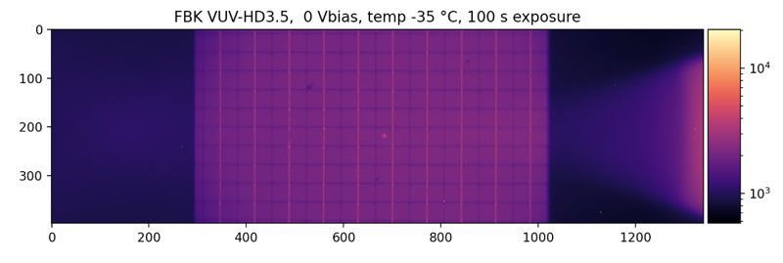
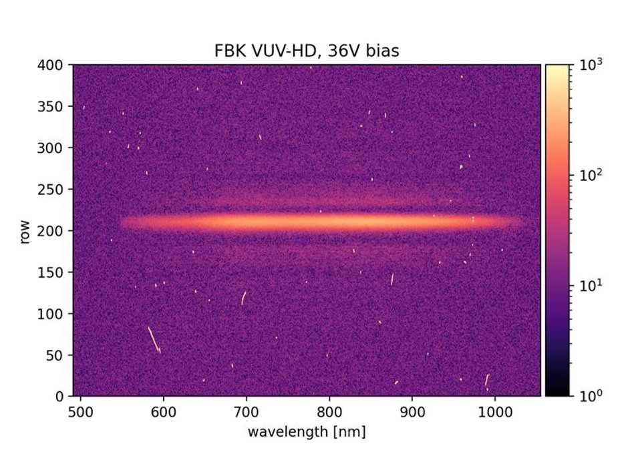
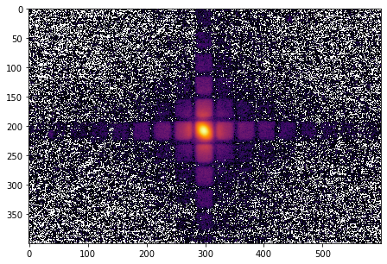
MIEL
Cooled X-Y Stage
Two basic modes
SPAD
SiPM Surface
B)
Vacuum Window
A)
Vacuum Chamber
Objective
FBK Reflected Light and Laser Spot
Dichroic Mirror
Laser
(405 nm)
Emission Filter
Emitted Light
IX-83 Microscope
Diffraction
Grating
B)
A)
Spectroscopy
Imaging
Spectrometer and Cryogenically Cooled Camera
2D Emission Map

Slide 6
Cross-talk. Light production and transport
FBK VUV-HD3 emitted photon within NA<0.45
Cross-talk is the dominant correlated nuisance
We estimate that every avalanche emits 1-3 photons back in the liquid
Fortunately the detection efficiency is low in IR (<10%)

Slide 7
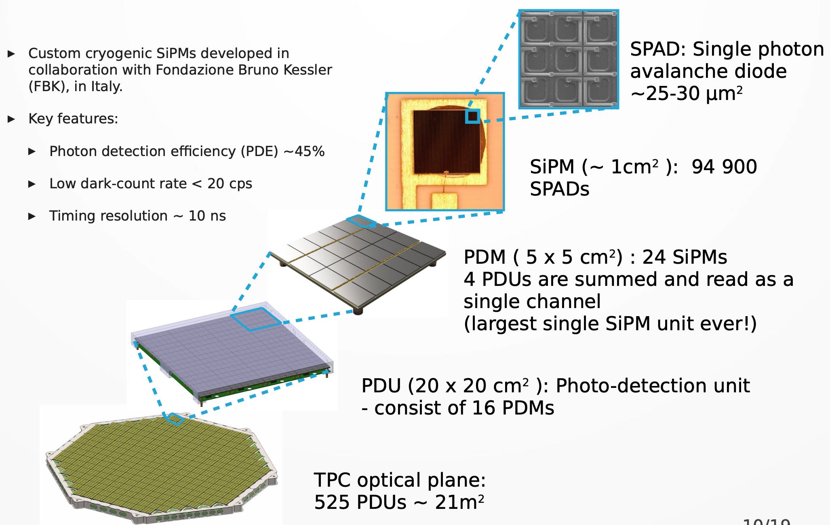
DarkSide-20k photon detection
Taken from Rafał Wojaczyński (Astrocent)

Slide 8
Moving away from DS analog scheme?
Bias
Photon
Amplifier
Need power
to buffer
capacitance
Analog to Digital
Conversion
Comparator (more power)
Waveform digitizer
Photon search engine
In software or firmware
Timing performance
Limited by size
Large pulse very messy
~0.1nF/mm²
Photon time stamp
Bias
Photon
AQ
Active
Quench
Photon time stamp
Tag for every photon
Or some simpler aggregate
Digital processing

Slide 9
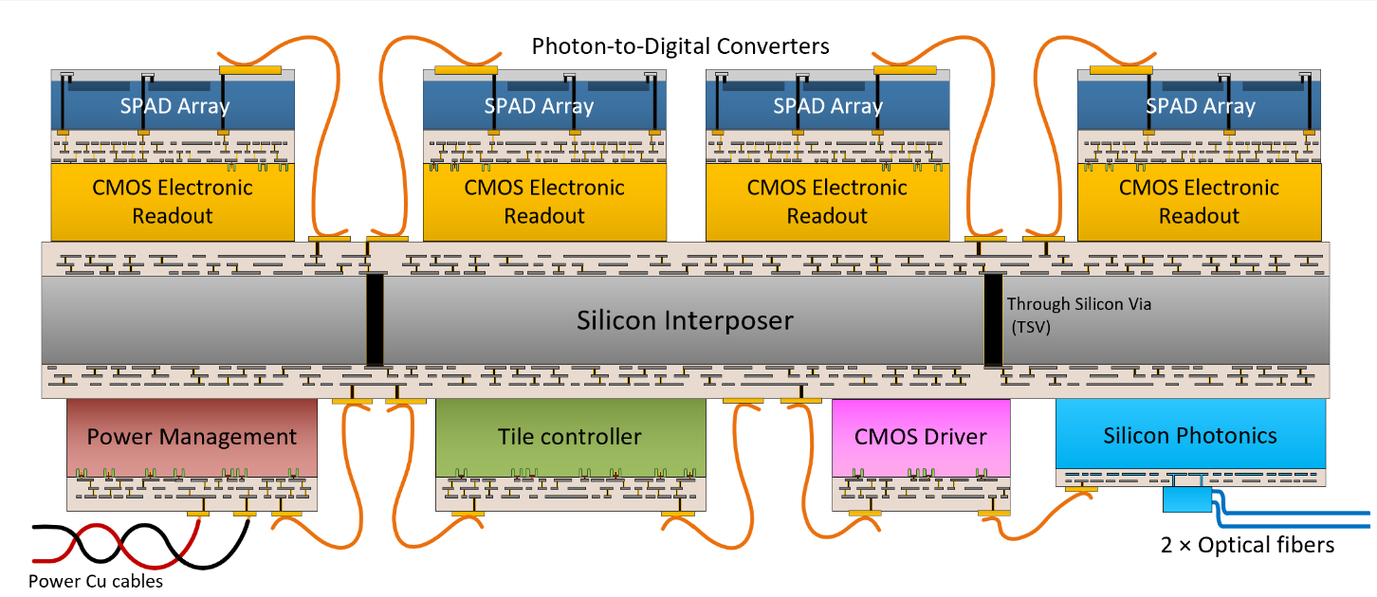


A simpler solution: Photon to Digital Converter

Slide 10
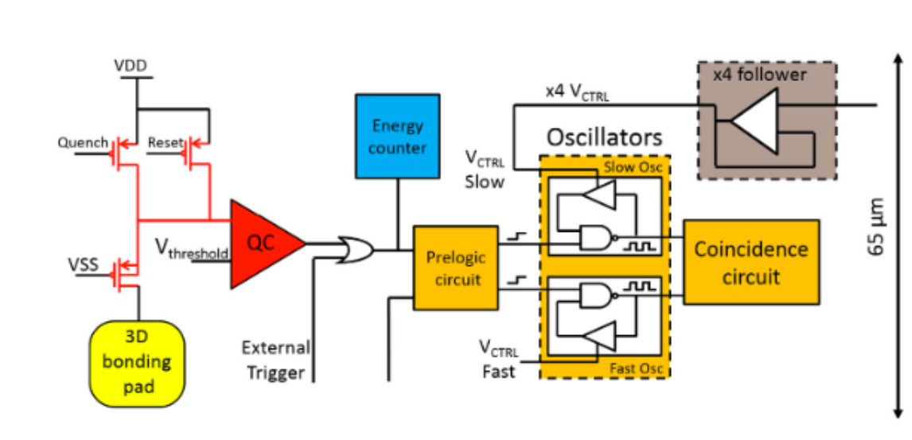
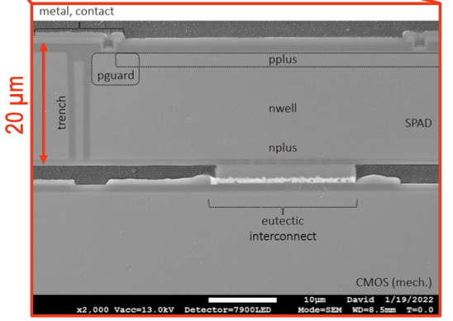
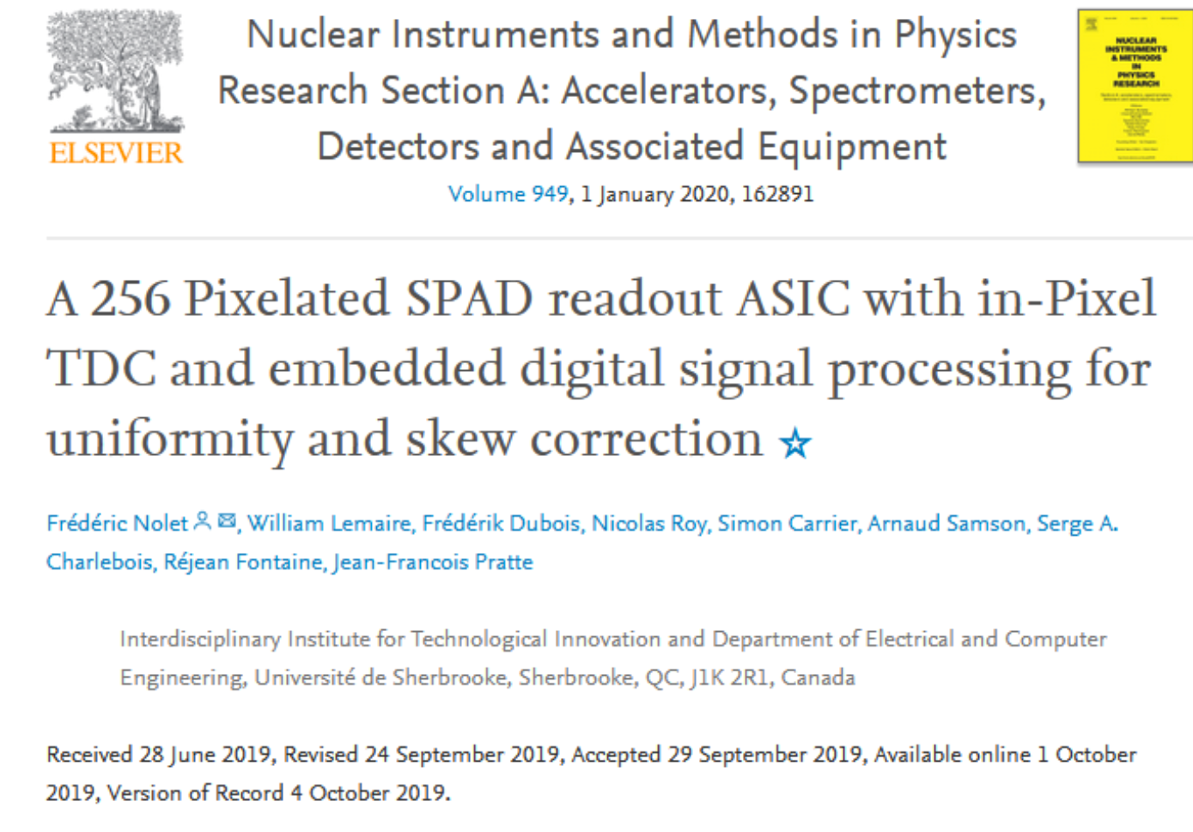
TDC integrated in each Single Photon Avalanche Diode (SPAD)

Slide 11
3D integration and FSI vs BSI configuration

Slide 12
BSI for other things than photon detection
p+
p
p-epi
p-epi
Even dark matter search
n+
n
Poly
SiO2
100-500 um
Electron trajectories
Geiger mode avalanche
Hole trajectories
Linear avalanche
VUV – Blue photon
Charged particle
Neutron or dark matter
5-50um
Un-depleted
depleted
80um
5-20um
CMOS
CMOS
CMOS
CMOS
Front side avalanche diode
Back side avalanche diode
Extended
Ultra-thick

Slide 13
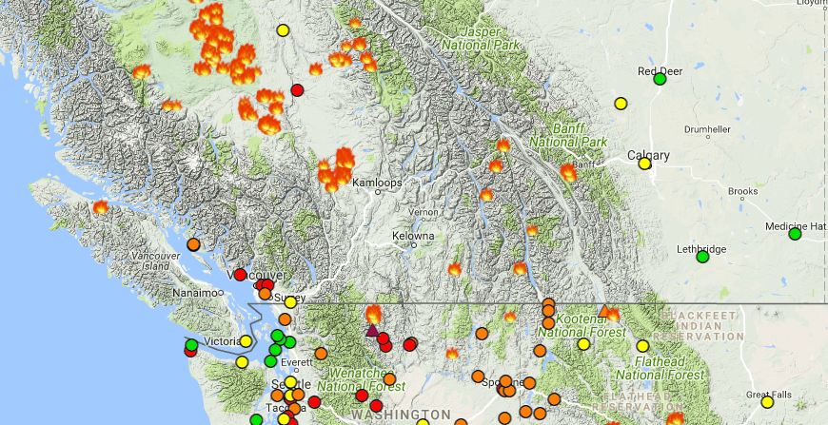

Beyond physics - Is it possible to prevent / control major fire with a sensor network?
It is certainly not obvious
But there may not be any other alternative
  Other solutions are not full-proof
  We have to keep an open eye
  Investigate all modalities
  Work with commercial parties
  And push the technology
SPAA + SENSENET

Slide 14
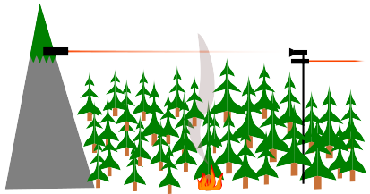
Single photon air analyser – open path
Fire laser in open air
  Backscattered light – smoke
    LIDAR for distance
  Fluorescence
    “LIDAR” for distance
  Attenuation
    For conventional attenuation SPAD not so good because high flux required
    Quantum scheme with entangled photons may reduce photon flux requirement

Slide 15
SPAA – enclosed sensor
Replace photo-diode by array of digital SPADs
  Measure scattering angle distribution – particulate size
  Measure fluorescence with filters
  Enhanced sensitivity requiring lower power
SPAD promise high performance and low power
  Cost should be competitive in large quantity
Existing Piera system
SPAA proposal

Slide 16
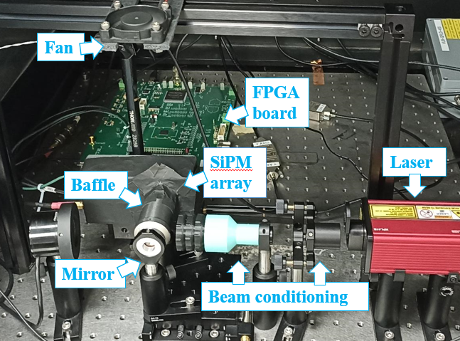
2nd generation based on analog SiPM
(Early data)
Notes:
Now, what we all want to know
does it work?​
Not to spoil things, but the short answer is, we don’t know yet.
We are still getting our experimental setup ready.
So here I have a picture of our setup,
and you can see we have a laser,
Some beam conditioning and a baffle just to make sure that the only light our sensor see is light that scattered from particulate
And of course our mirror and sensors.
We also have an FPGA, so for those who don’t know, that’s a Field-Programmable Gate Array.
It’s like a small computer, or a really low-level Arduino
So, one of the advantages is that it’s very fast,
and we use it to process the sensor signal and send nice-looking data to our computer
Alright, now the data!

Slide 17
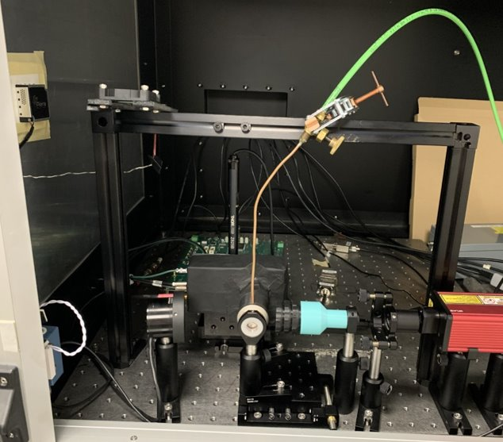
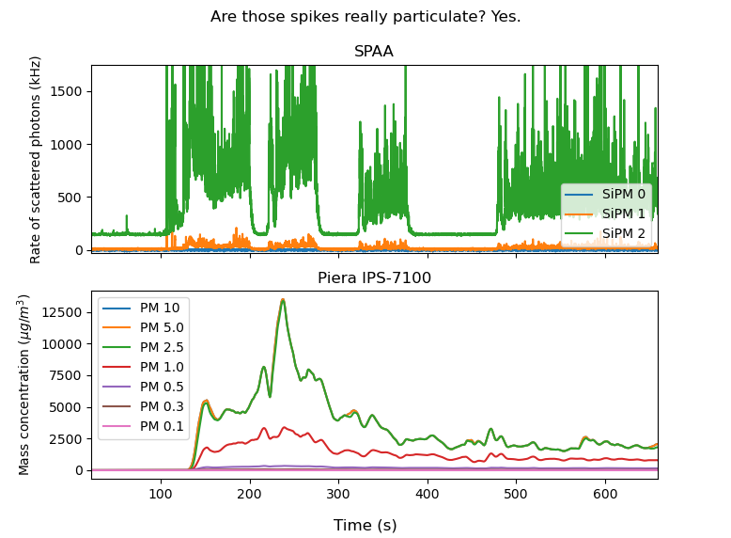
On-of smoke measurements
Inject smoke
Turn Helium gas line on
Helium injection
(Reference sensor saw no helium)

Slide 18
Summary and outlook – A bright future for digital SPADs
Environment monitoring (forest fire, health care, water purity,…)
  SPAD make sense when the detected photon flux is low: scattering, fluorescence, … entangled photon attenuation?
  Low cost / low power photon counting – SPAD addressing, MHz counting
  Possible LIDAR-like for open path monitoring – ns-scale timing resolution
Radiation monitoring
  High rate neutron counting for Fusion ”reactors”
Physics research
  Dark matter search and neutrino properties require scalable large area
  Quantum entanglement studies with near unity efficiency. Need carefully tuned BSI with very effective AR coating for specific wavelength (green)
  Collider – Now participating to CERN DRD4

Slide 19
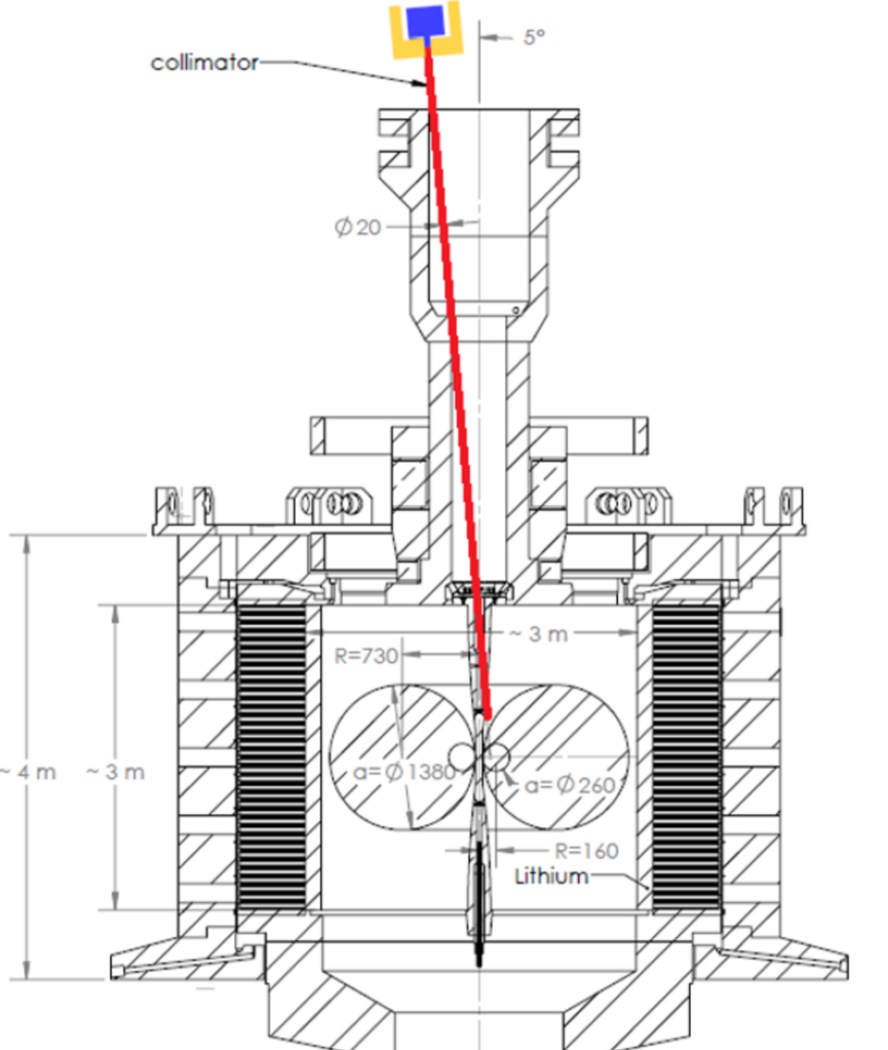
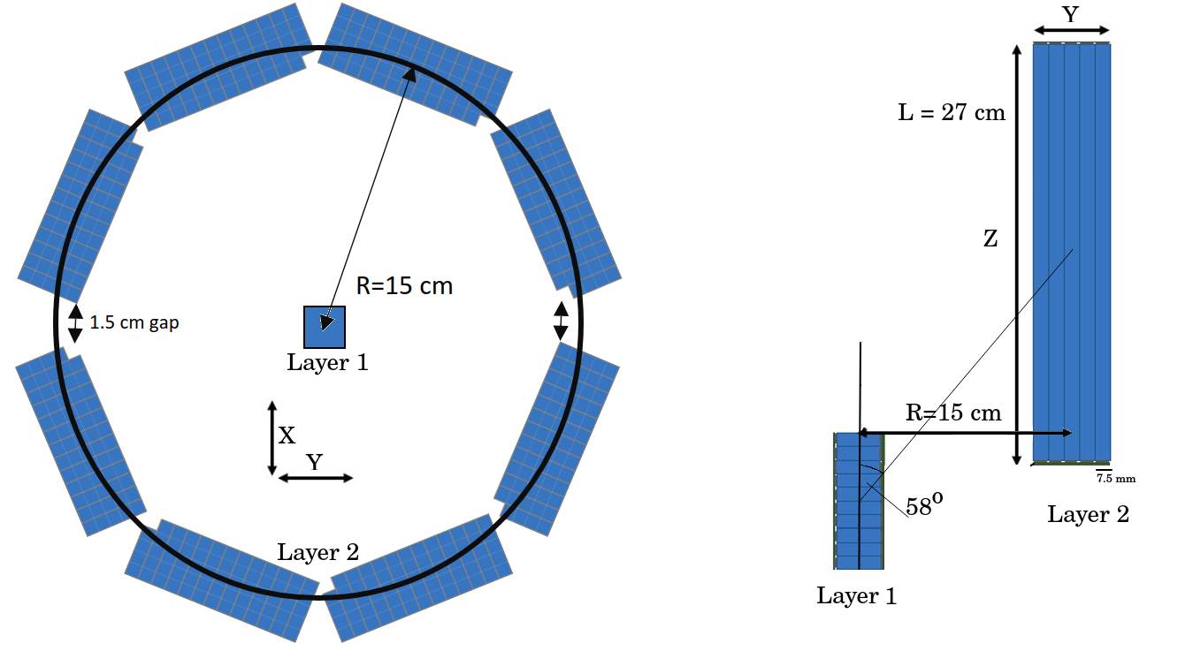
Supporting General Fusion
General Fusion is a company headquarter in Richmond BC (suburb of Vancouver)
Expected to produce 1GHz of neutrons (in pipe) during 10us
Extremely high rate that is very hard to deal with with analog SiPM
Fusion zone
Neutrons

Slide 20
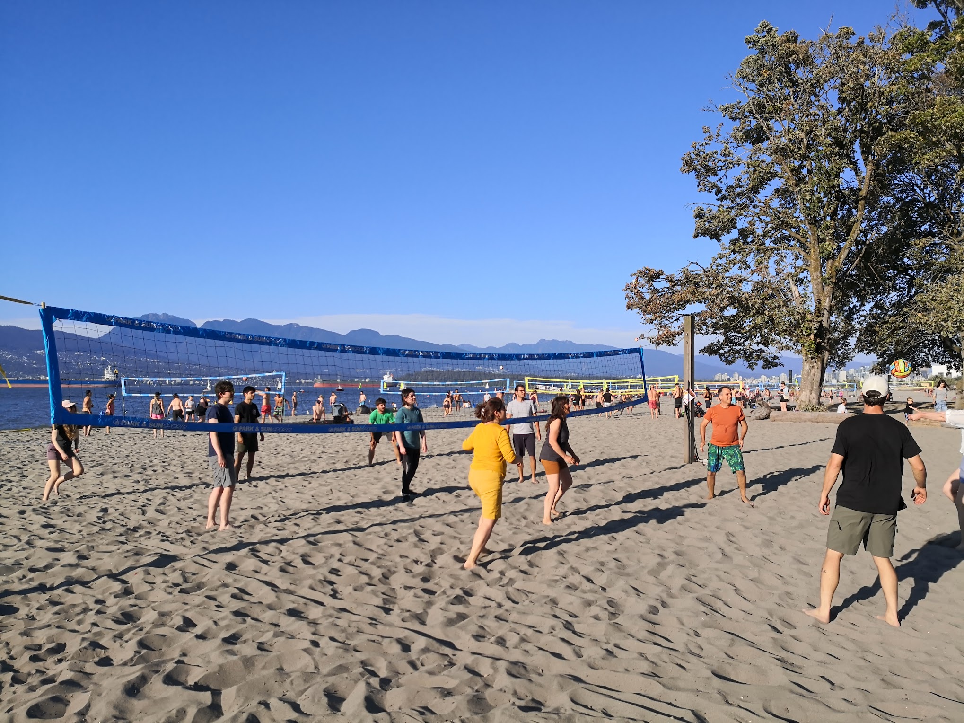
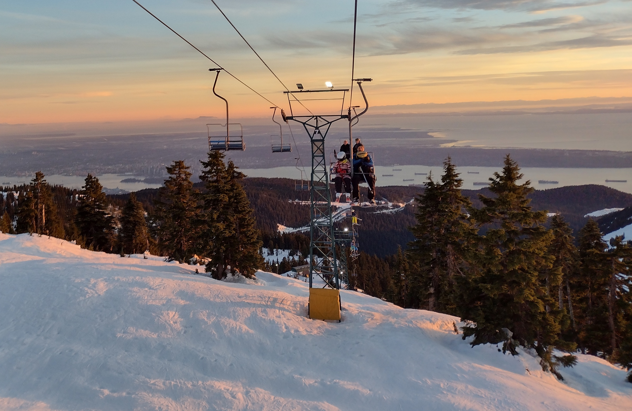
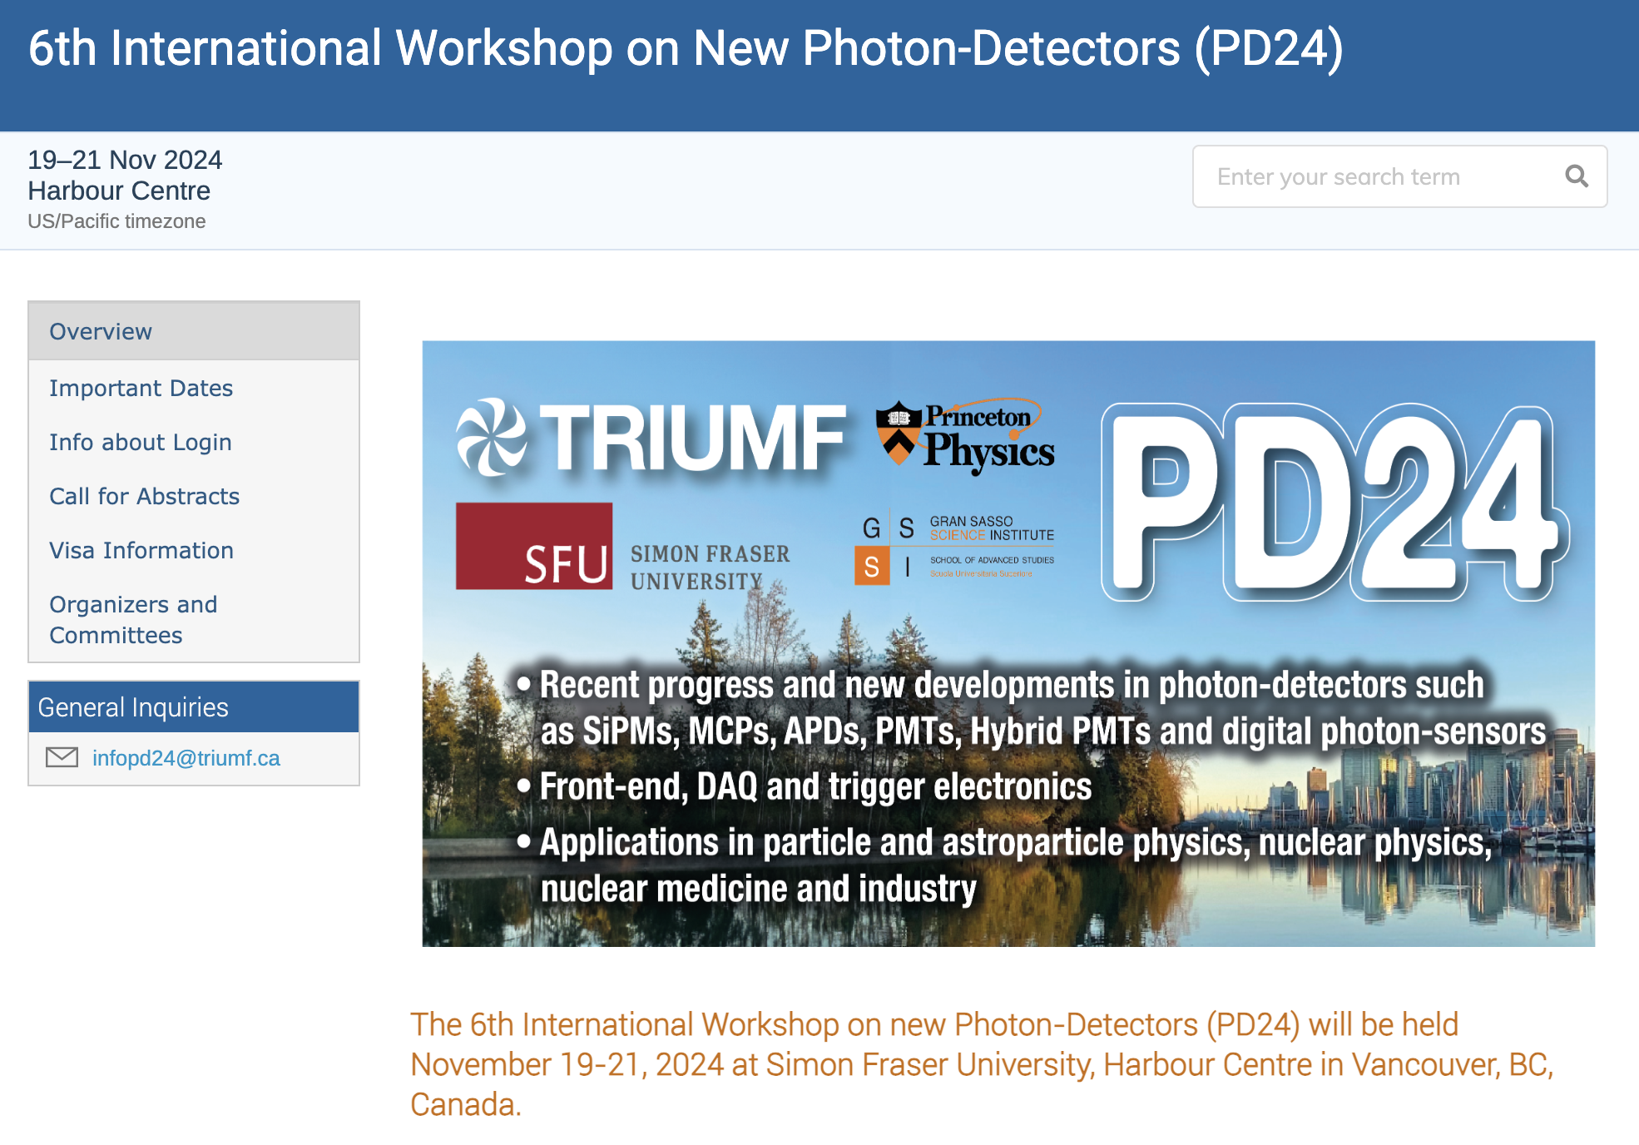
The end
https://indico.cern.ch/event/1404192/

Slide 21
Dark noise
Have we reached the minimum possible?
  It may depend on temperature
Field enhanced can dominate
  Trade-off between probability of triggering avalanche and dark noise
300K
Sherbrooke 2D SPAD
Sherbrooke 2D SPAD

Slide 22
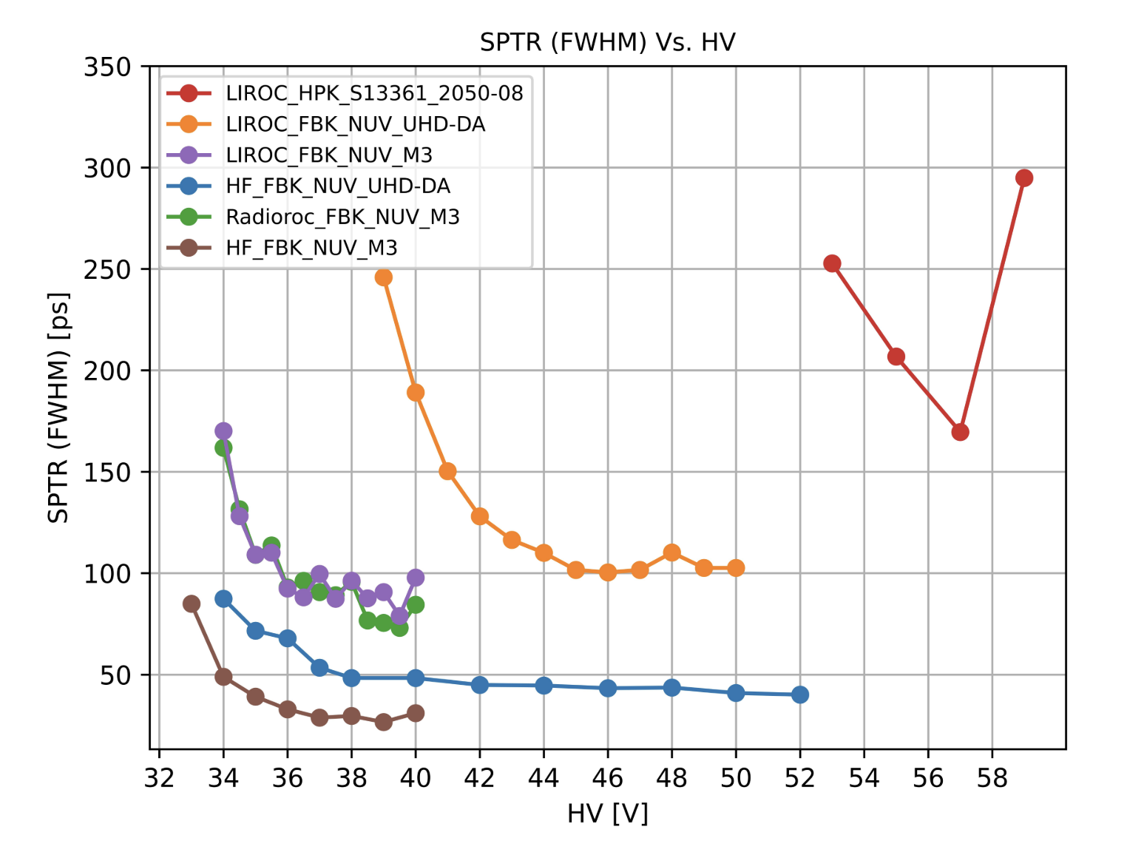
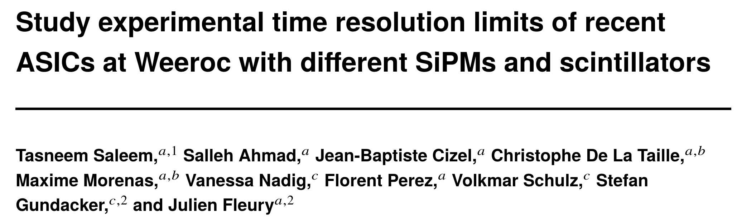
Single Photon Timing Resolution
The electronics matters a lot
Does 3D integration provide best results
  May be for the same power dissipation
What about the SPAD avalanche evolution time?
  Is it worth studying?
What about tails?
  Probe region of low field?
  Mask such regions?
In BSI the electron transit time may matter

